Slide 1
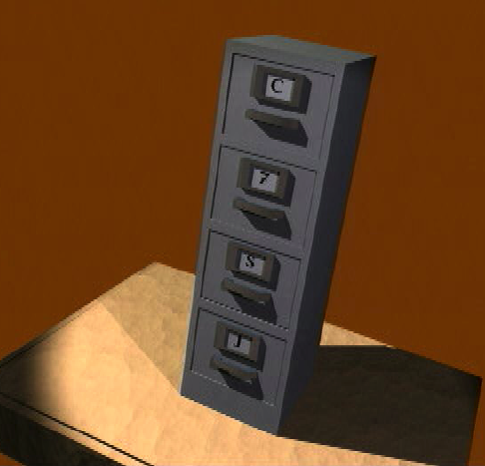
7
7
C
7
M
J
37

Slide 2

Bible…
Amolo Leino
Bible…Amolo Leino modo kocho
Ministries International Inc. Fort Worth, Texas
Designed by Dr. John Fryman, Texas, USA • BibleBasically.org
Taught by Dr. Rick Griffith, Singapore Bible College
All files in many languages for free download at BibleStudyDownloads.org
www.biblebasically.org
8.0.01.
©2004 TBBMI
04

Slide 3
Modo kocho chii, zomazhi-e mani makrii-o chakrii pili kralole. Nile zhii mobile khru ti-e mahio li zhiile. Kralo-e
01
1
9.6.01.

Slide 4
©
Bible…Amolo Leino Ministries Int’l
Committee of Reference
Dr. John Hannah
Distinguished Professor of Historical Theology
Research Professor, Historical Theology
Dallas Theological Seminary
Dallas, Texas
Dr. Rick Griffith
Lecturer in Biblical Studies
Director, ThM Programme
Singapore Bible College
Singapore, Republic of Singapore
Dr. Mark Bailey
President
Dallas Theological Seminary
Dallas, Texas
John Maisel Kurt Nelson
President Exec. Vice President
East/West Ministries
Dallas, Texas
Dr. William R. Bright
Late Founder
Campus Crusade for Christ
Orlando, Florida
Vasily Dimitrievski
Director for Russia
Global Missions Fellowship (e3)
Penza, Russia
Rev. Douglas Valenzuela
Senior Pastor, Conservative Baptist Missions
Chiesa Battista Evangelica di Casoria
Naples, Italy
Dr. Ted Kitchens
Senior Pastor
Christ Chapel Bible Church
Ft. Worth, Texas
Karyn Granger
Director of Bible Studies
Southwest Christian Schools
Ft. Worth, Texas
Dr. Kenneth Horton
Senior Pastor
McKinney Memorial Bible Church
Ft. Worth, Texas
02
©2006 TBBMI
9.6.01.

Slide 5
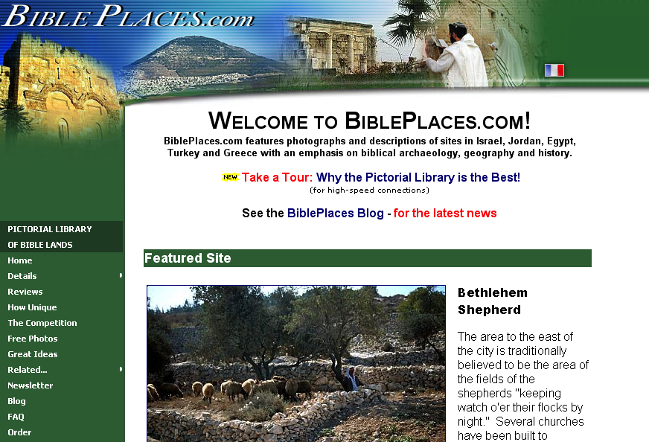
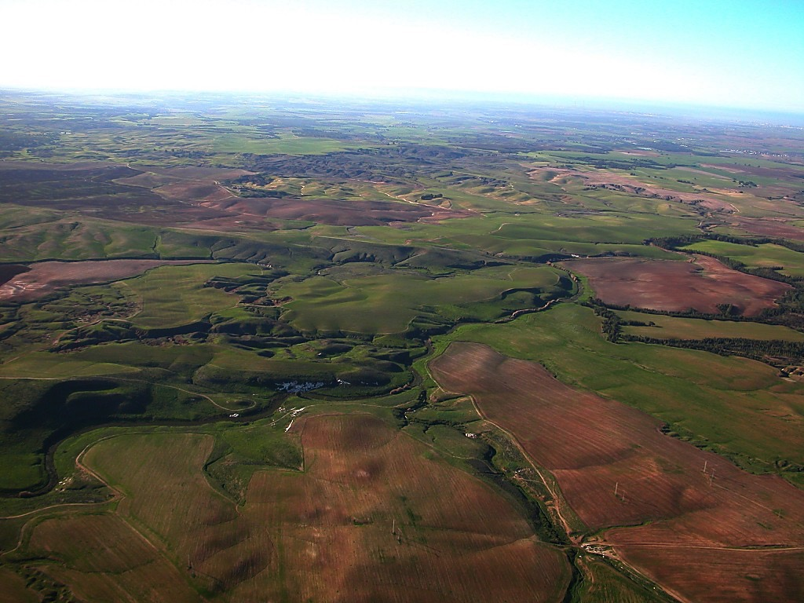
The Pictorial Library of Bible Lands
Our ministry is deeply indebted to Todd Bolen, creator of the Pictorial Library of Bible Lands, for his generous permission to use photo resources throughout THE BIBLE…BASICALLY®. TBB users are urged to visit BiblePlaces.com and explore the thousands of photo resources available: from the Holy Land, throughout the Aegean and Mediterranean Basin to Southern Europe where the Christian faith took root. BiblePlaces.com offers teachers and visual producers an incomparable array of high-resolution digital photographic resources. Please visit! Thanks, Todd!
04
9.65.01.
Notes:
This presentation has been granted use of almost 150 pictures from the BiblePlaces.com website. We thank Todd Bolen for his support!

Slide 6
The Bible…Amolo Leino zhi hi by John E. Fryman, Ph.D. no sophra-e.
Copyright © 2006 The Bible…Amolo Leino Ministries Intl. Inc., Ft. Worth, Texas
All rights reserved. This work is protected under the copyright laws of the United States of America. No part or section may be reproduced in any form without permission in writing from the author or copyright owner, except in the case of brief quotations embodied in critical articles or reviews.
Those sections for which permission is specifically provided in the text may be reproduced locally as student need requires.
The ministry is indebted to Dr. Todd Bolen, The Master’s College, Jerusalem, Israel, and Pictorial Library of Bible Lands (BiblePlaces.com) for permission
to use extensive photo resources throughout this production. Photography of Kadesh-Barnea is used with permission of Dr. Leen Ritmeyer, Hawthornedene, Australia. Should the copyrighted material of others be noted without our knowledge or proper attribution, the ministry requests an immediate notice. The specified content attribution will be properly adjusted. Every effort was used to avoid unauthorized use of text and graphics.
Teachers, media operators and/or other facilitators may not alter any PowerPoint slide, animation effect, or order of presentation in any way, in any language edition, or in any computerized application from any image storage facility, transmission, digital or Internet technique except by permission of the producers.
Produced in the United States of America. International Rights Reserved.
03
©2006 TBBMI
9.6.01.

Slide 7
Bible…
Amolo Leino
Bible…Amolo Leino modo kocho Ministries International Inc.
Fort Worth, Texas
www.biblebasically.org
8.0.01.
©2004 TBBMI
04

Slide 8


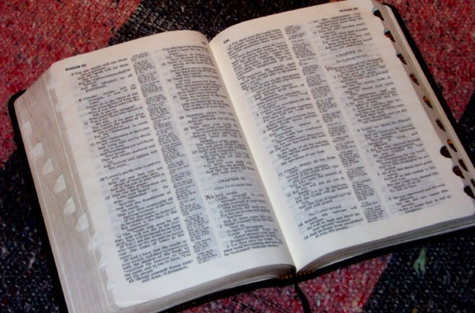
(Sokoru: Itsii leino Bible siikolo!)
BIBLE… AMOLO LEINO
®
OZHI KALI
“BIBLE FILE” HRUPRAKOCHO
05
©2006 TBBMI
9.6.01.

Slide 9
ADI CHIINO PRA-E…
?
Kristamei amodo
Itsii kajii kali mocho ttelowo ovo hinahi soleshe
Kristameino amole zhi
Bible ye kathe kocho lariibvii khru
Oramei ko amodo larii chii zhii larii kathe chii
Moso no larii kathe chii
Meina meizhii larii kathe chii
University le larii kathe chii
Chiijiiphe le inu thopfii
Ola thopfii le
YE
Bible ye kathe kocho istii
Chiijiiphe le mole kolomei ye mole komomei thopfii
06
15
©2006 TBBMI
9.6.01.

Slide 10
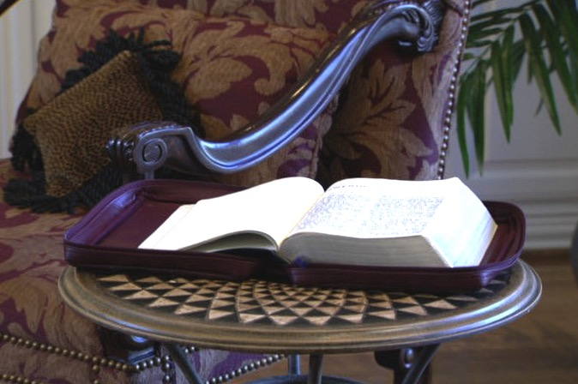
ILLE ZHII AMOLE ZHII BIKHRII OTTO NASII
Handbook pg. 6
2
07

Slide 11
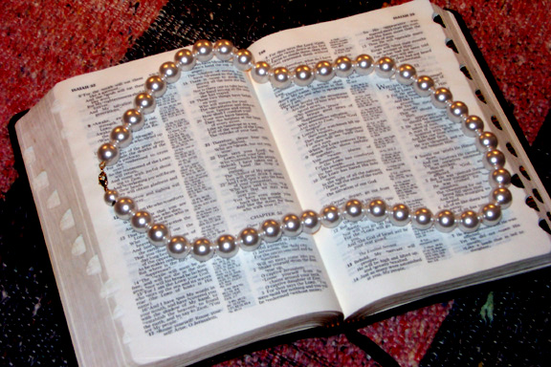
Hipei zhii lariibvii le “Bible hi Adivano Rii-e Tikocho!”
Dr. Henrietta Mears no korii…
Handbook pg. 6
08

Slide 12
Omei koproko zhii Bible kosii hi: otto zhuhi koto bviio bue.
Ana kopro mei leleiwoli…
Handbook pg. 6
09

Slide 13
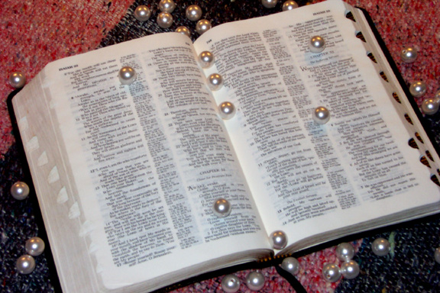
…otto tho adzii kotu bvii-o Bible li oko khru sii mari moro tie!
Handbook pg. 6
10

Slide 14
Handbook pg. 6
11

Slide 15
Oramei chiipe zhii kotho
Lathe ottali kobu
Raku Amothu no kotho leino sata kapi
12
2

Slide 16
?
?
?
Oramei no kolupi koru ovo
Abraham & de-ni Israel
Jisu Khrista no chane kocho
Church amono
?
?
?
?
?
?
13
5

Slide 17
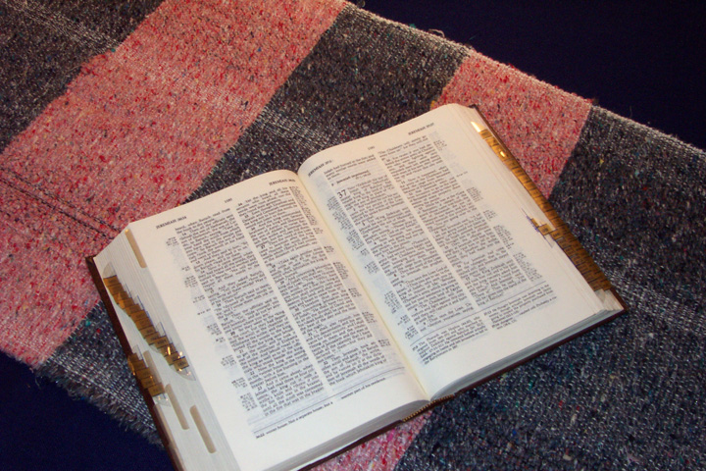
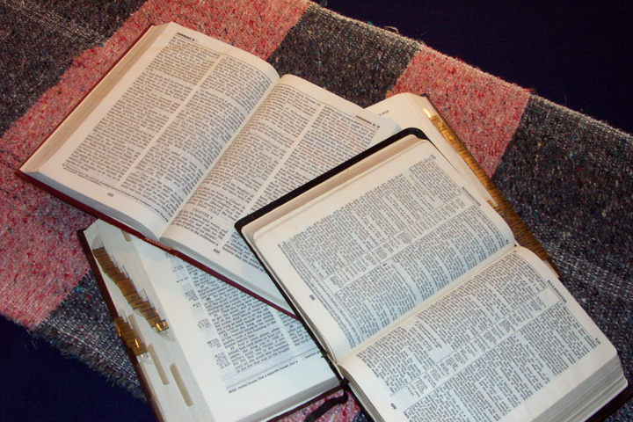
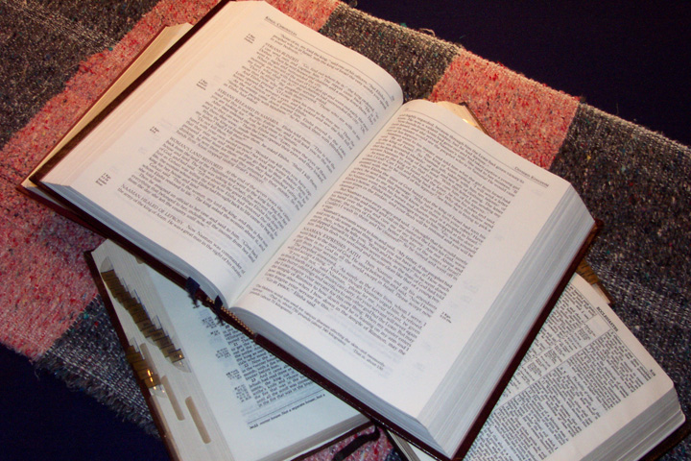
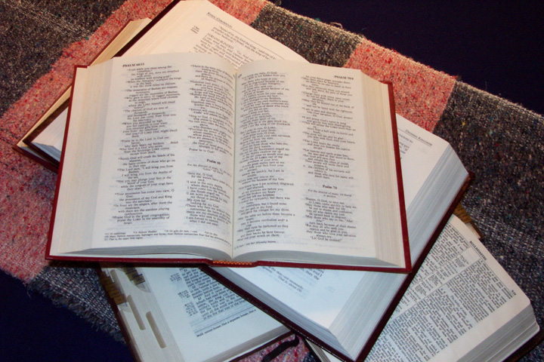
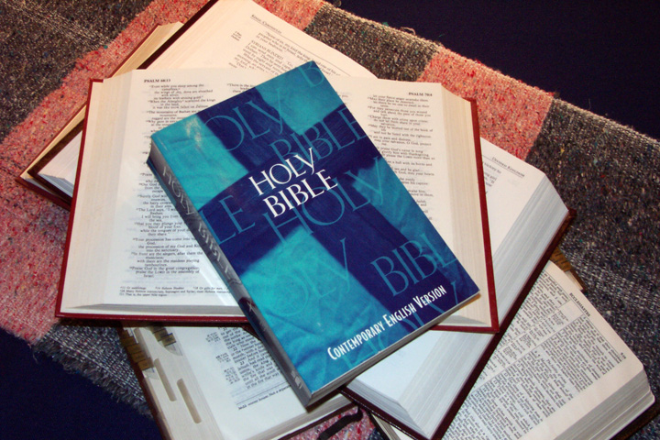
  BIBLE KHRIIHI KOLEIHIO!
14

Slide 18
Atachii sii siiheno pratiwe!
MOCHO PRALO KOHO KALI KOE!
• Siimoli kashii Thuthu
• Ocha Kreikrei
• 750,000 Ocha
• 1,200 Okomu
• 31,000 Azhi
• Phrohe koho Koda
hi Koto
15
7

Slide 19
ATHINO ADI SOE?
ATHINO ADI PE?
LARIIBVII
ADIVANO?
OMEI
TARI
KOHIBVII-O KALI NO KALI YI KATHEWE?
16
7

Slide 20
Sokhropio!
ATHINO ADI PE?
ATHINO ADI SOE?
LARIIBVII
ADIVANO?
OMEI
TARI
KOHIBVII-O KALI NO KALI YI KATHEWE?
17

Slide 21
SOKHROPIO!
Ai Solohrotie!!!
PASTOR YI
PENO SO-WO LE!
18

Slide 22
ATHENO
MOCHOLE?
19

Slide 23
SIILI
ADI SOE?
20

Slide 24
“Oto nasii no bikhru solo moli, siikhru sii idemei ko ye amocho kolikhrii bvii beile.”
Miles Stanford
Principles of Spiritual Growth
21
4

Slide 25
Telo kosii kophro…
“Kosii dziino mole pu lemoe ye ile, amole dziino hrii pu lemoe ,
Albert Mohler, President
The Southern Baptist Seminary Louisville, KY
22
3

Slide 26
Bible…
Amolo Leino
Bible…Amolo leino modo kocho Ministries International Inc. Fort Worth, Texas
www.biblebasically.org
8.0.01.
©2004 TBBMI
04

Slide 27
Bible…Amolo Leino
®
Amocho kali!
24
Notes:
CHANGED FROM THE ORIGINALS (TQC)

Slide 28
Bible…Amolo Leino
®
Nile no Bible hi
itsii leino siinile!
25
Notes:
CHANGED FROM THE ORIGINALS (TQC)

Slide 29
Bible…Amolo Leino
®
MOTSII SHU KOCHO KALI: Omei kakrii yi-e modo pilo koru!
C 7 M J
Omei he Oramei ko pepilo koru adei oke kazhii kali kosa!!!
26
1
Notes:
CHANGED FROM THE ORIGINALS (TQC)

Slide 30
Bible…Amolo Leino
®
“Bible File” hruprakocho
27
Notes:
CHANGED FROM THE ORIGINALS (TQC)

Slide 31
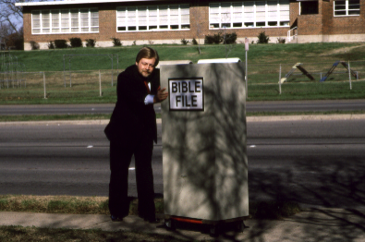
28

Slide 32
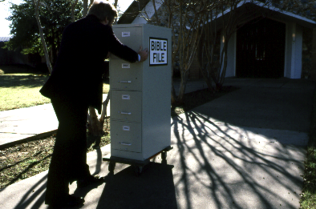
29

Slide 33
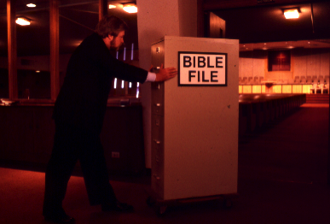
30

Slide 34
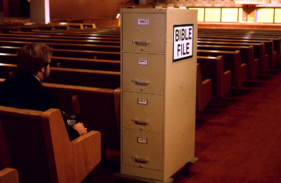
31

Slide 35
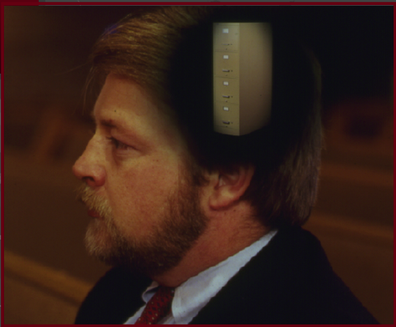
32

Slide 36
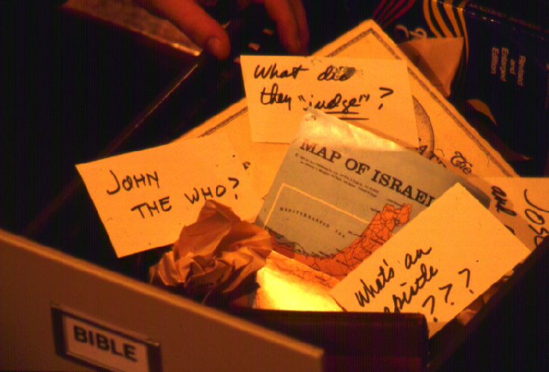
?
KOLEINO MOSIIKOCHO KHRU YE MOSIIMA… KOCHO KHRU HI SII MAKRII PRA LOLE?
?
?
?
33
5

Slide 37
Itsii kali ko-e mocholo MOTIE!
Koli no SOTHU lole?
34

Slide 38
7
Handbook pg. 8-14
35

Slide 39
7
7
Handbook pg. 8-14
1
36

Slide 40
7
NIZHII BIBLE FILE
Handbook pg. 8-14
37

Slide 41
7
NIZHII BIBLE FILE
HILIHI CINEMA HOE
Handbook pg. 8-14
38

Slide 42
7
1
2
3
4
5
6
7
8
9
10
Handbook pg. 8-14
39

Slide 43
7
“Nizhii Bible File” Hruprakocho
7
7
7
7
7
7
7
C
7
J
C
M
J
C
M
C
J
M
J
M
Handbook pg. 8-14
4
40

Slide 44
“Nizhii Bible File” Hruprakocho
7
7
= 4+3
Handbook pg. 8-14
2
41

Slide 45
7
“Nizhii Bible File” Hruprakocho
C 4 3 M J
C 4 3 M J
Handbook pg. 8-14
1
42

Slide 46
5 Motsii Chiipe:
7
C = CHIIJIIPHE KOSO
4 = OMEI
3 = SOCIETY
M = MAKRA KOBU
J = JISU
Handbook pg. 8-14
5
43

Slide 47
5 Motsii Chiipe:
7
C = Chiijiiphe koso
4 = Omei
3 = SOCIETY
M = Makra kobu
J = JISU
Handbook pg. 8-14
6
44

Slide 48
5 Motsii Chiipe:
7
C = Chiijiiphe koso
4 = Omei
3 = SOCIETY
M = MAKRA KOBU
J = JISU
Handbook pg. 8-14
45

Slide 49
OMEI 4 SII:
7
A BRAHAM
J OSEPH
M OSES
J OSHUA
Handbook pg. 8-14
5
46

Slide 50
7
AI
JISU
MOLI
JIIHOE!
Handbook pg. 8-14
47

Slide 51
OMEI 4 SII:
7
J OSEPH
A BRAHAM
Ai
M OSES
JISU
J OSHUA
MOLI
JIIHOE
Handbook pg. 8-14
8
48

Slide 52
7
CHIIJIIPHE KOSO
ABRAHAM
JOSEPH
MOSES
JOSHUA
Handbook pg. 8-14
5
49

Slide 53
5 Motsii Chiipe:
7
C = CHIIJIIPHE KOSO
4 = OMEI
3 = SOCIETY
S = MAKRA KOBU
J = JISU
Handbook pg. 8-14
50

Slide 54
7
A M C
Handbook pg. 8-14
2
51

Slide 55
3 SOCIETY KHRU SII:
7
A MAZHI CHILU
M OVU CHILU
C HIILI KOSO CHIILU
Handbook pg. 8-14
6
52

Slide 56
CHIIJIIPHE KOSO
ABRAHAM
JOSEPH
MOSES
JOSHUA
AMAZHI CHILU
MOVU CHILU
CHIILI KOSO CHIILU
7
Handbook pg. 8-14
53

Slide 57
7
7
KOLI IKRII KOCHO...
C 7 M J
C 4 3 M J
Handbook pg. 8-14
3
54

Slide 58
CHIIJIIPHE KOSO
4 OMEi
3 SOCIETY
MAKRA KOBU
JISU
7
Handbook pg. 8-14
55

Slide 59
7
CHIIJIIPHE KOSO
ABRAHAM
JOSEPH
MOSES
JOSHUA
AMAZHI CLIILU
MOVU CHILU
CHIILI KOSO CHILU
MAKRA KOBU
JISU
Handbook pg. 8-14
2
56

Slide 60
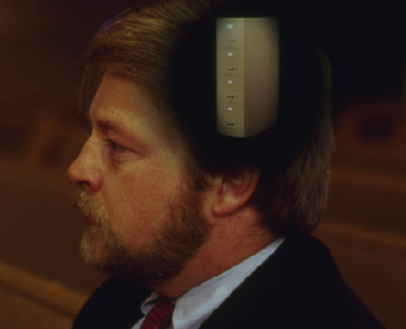
Nizhii Kothu “Bible File”
CHIIJIIPHE KOSO
CHIIJIIPHE KOSO
ABRAHAM
ABRAHAM
ABRAHAM
ABRAHAM
JOSEPH
ABRAHAM
MOSES
JOSEPH
JOSHUA
A MAZHI CHIILU
MOSES
MOVU CHILU
CHIILI KOSO CHIILU
JOSHUA
MAKRA KOBU
JISU
AMAZHI CHIILU
MOVU CHILU
CHIILI KOSO CHIILU
MAKRA KOBU
JISU
Handbook pg. 8-14
57
11

Slide 61
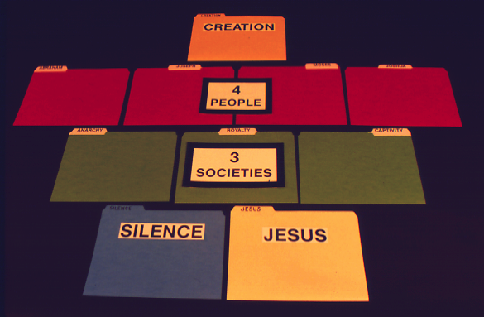
7
CHIIJIIPHE KOSO
Handbook pg. 8-14
58

Slide 62
7
CHIIJIIPHE KOSO
4
OMEI
Handbook pg. 8-14
59

Slide 63
7
CHIIJIIPHE KOSO
4
OMEI
3
SOCIETY
Handbook pg. 8-14
59

Slide 64
7
CHIIJIIPHE KOSO
4
OMEI
3
SOCIETY
MAKRA KOBU
JISU
Handbook pg. 8-14
59

Slide 65
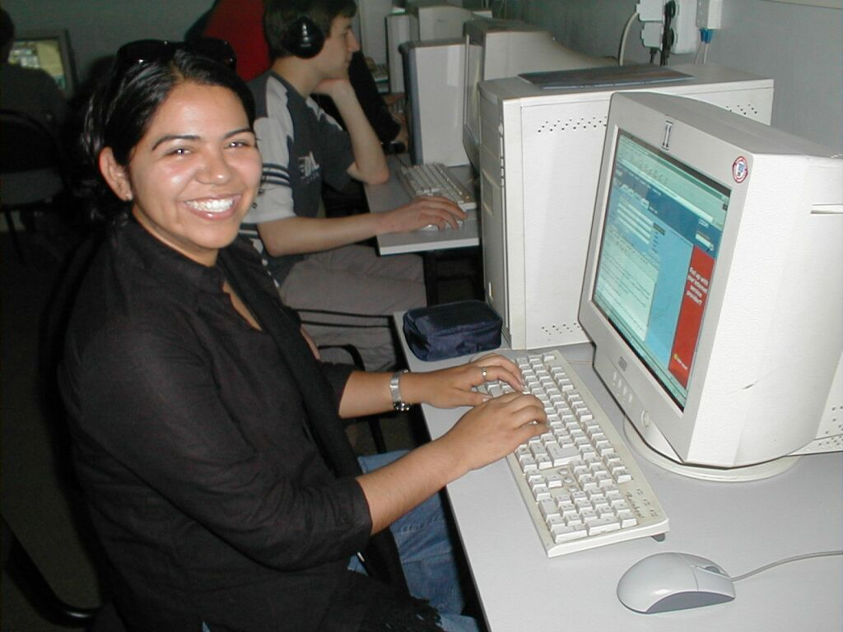
7
Ojiiphe hi ota krii shutie!
Handbook pg. 8-14
62

Slide 66
7
CHIIJIIPHE KOSO
CREATION
ABRAHAM
ABRAHAM
ABRAHAM
ABRAHAM
ABRAHAM
ABRAHAM
JOSEPH
JOSEPH
ABRAHAM
ABRAHAM
MOSES
MOSES
JOSHUA
JOSHUA
AMAZHI CHIILU
ANARCHY
MOVU CHILU
ROYALTY
CHIILI KOSO CHIILU
CAPTIVITY
MAKRA KOBU
SILENCE
JISU
JESUS
63

Slide 67
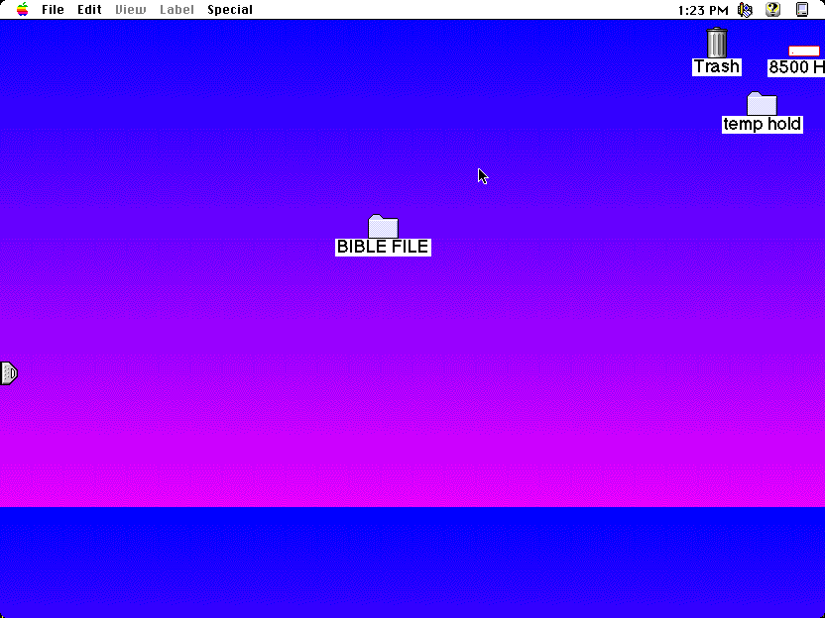
64

Slide 68
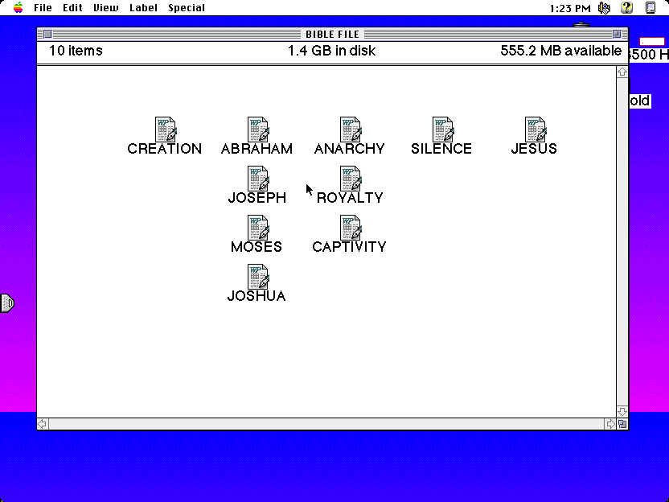
C
CHIIJIIPHE KOSO
ABRAHAM
AMAZHI CHIILU
MAKRA KOBU
JISU
JOSEPH
MOVU CHIILU
MOSES
CHIILI KOSO CHIILU
JOSHUA
10
65

Slide 69
C
{
}
CHIIJIIPHE KOSO
ABRAHAM
AMAZHI CHIILU
MAKRA KOBU
JISU
4
OMEI
JOSEPH
MOVU CHIILU
3
SOCIETY
MOSES
CHIILI KOSO CHIILU
JOSHUA
10
65

Slide 70
NIZHI BIBLE FILE ITSII LEINO!
CHIIJIIPHE KOSO
ABRAHAM
Koshu kocho
JOSEPH
MOSES
JOSHUA
AMAZHI CHIILU
Thopfii thole sii kolo
MOVU CHILU
CHIILI KOSO CHIILU
MAKRA KOBU
JISU
Machite kocho
67
4

Slide 71
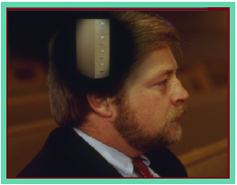
Bible..Amolo Leino tikocho, ichu woli nile amocho li bule …
• Itsii kali “Bible File” tikocho
• “Bible File”…C 7 MJ Hruprakocho Itsii nasii
1. ADI SOTIE!
ANO KOCHO KOSII KOLA PIKORU
2. ADI VANO PRATIE!
3. KOHRII CHIIPE ADI PEWO SA TIKOCHO SII MAZHIILO YE SIIPUKOLO
68
4

Slide 72
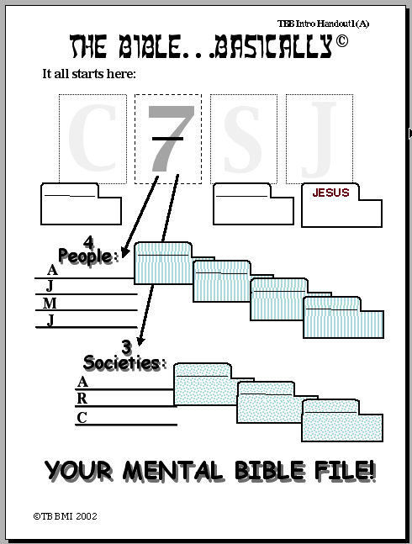
BIBLE… AMOLO LEINO
Hehino prakhri tie:
C
7
M
J
CHIIJIIPHE KOSO
MAKRA KOBU
JISU
JISU
{
4
Omei
ABRAHAM
BRAHAM
JOSEPH
OSEPH
MOSES
OSES
JOSHUA
OSHUA
SOKHRO PU PILO KORU #01
{
3
Society:
MAZHI CHILU
AMAZHI CHILU
M
MOVU CHILUY
OVU CHILU
CHIILI KOSO CHILU
IILI KOSO CHILU
ITSII LEINO BIBLE FILE AMOCHO!
©2006 TBBMI
69
20
9.6.01.

Slide 73
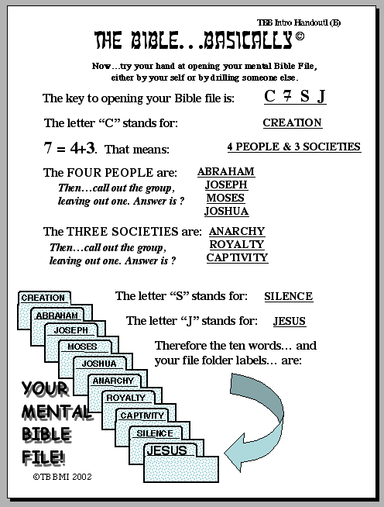
BIBLE… AMOLO LEINO
Echu-o…ni moe omei kakrii yi peno nizhi Bible File sii oba no hrupra kolihio.
Bible File hruprakocho chabi: C 7 M J
Ocha ‘C’ hino: Chiijiiphe koso
7 = 4 + 3 chosii: 4 OMEI + 3 SOCIETY
Omei padi sii: ABRAHAM
Siithisii…omei khruyi ko prahio, MOSES
kali yi komo. Answer sii? JOSEPH
JOSHUA
Kosii society khrusii: AMAZHI CHIILU
Siithisii…omei khruyi ko prahio, MOVU CHIILU
kali yi komo. Answer sii? CHIILI KOSO CHIILU
SOKHRO PU PILO KORU #02
CHIIJIIPHE KOSO
Ocha “M” hino MAKRA KOBU
Ocha “J” hino JISU
...
Siiduno ocha chiir khru ye…nizhi file zhii ozhii khru sii…:
ITSII LEINO BIBLE FILE AMOCHO!
AMAZHI CHILU
MOVO CHILU
CHIILI KOSO CHILU
MAKRA KOBU
JISU
©2006 TBBMI
9.6.01.
9
70

Slide 74
7
71

Slide 75
Bible…Amolo Leino
®
“Nizhii Bible File” Hrupralo koru chabi
72

Slide 76
Ech-o adi chii ta-e tikocko siilo thisii fii-o… hehi tale…
•Itsii kali “Bible File” tikocho
•“Bible File”…C 7 M J Hruprakocho Itsii Nasii
• Itsii leino Bible li Oko Kajii Khru hibviitei tikocho siikolo
•Bible zhii “DEMOKO” Kotholi: “The Quick Chronology”
•Abraham no Bikhrii sothohi kotono pfo Lipeo Jisu Christa no Ovo Koso chilu kotu
• “Demoko” thisii fii-o Bible leino zhihi koto, hibvii tile tikocho hrihi koto
• Old Testament ye New Testament li Lariibvii ye Ochii bi khru
 
8
73

Slide 77
Bible…
Amolo Leino
Bible…Amolo Leino modo kocho
Ministries International Inc. Fort Worth, Texas
www.biblebasically.org
8.0.01.
©2004 TBBMI
04

Slide 78


The Bible…Basically link at BibleStudyDownloads.org
Get this presentation for free!
Notes:
The Bible…Basically (bb)

Slide 79
75
©2006 TBBMI
9.6.01.

