Slide 1
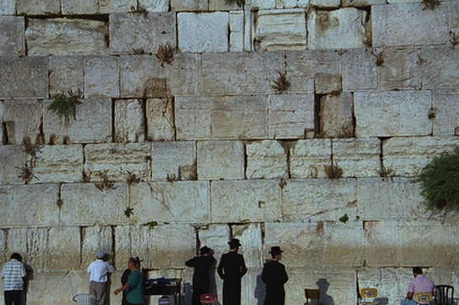
tpjyKonf.ae&m
orRmusrf;pm
ta_ccHtkwf_rpf
orRmusrf;pm
ta_ccHtkwf_rpf
Part 2
Dr ရက္ခ္ ဂရီဖိတ္၊ စကၤပူဓမၼေကာလိပ္ • BibleStudyDownloads.org
©2004 TBBMI
8.0.05a.
04
1

Slide 2
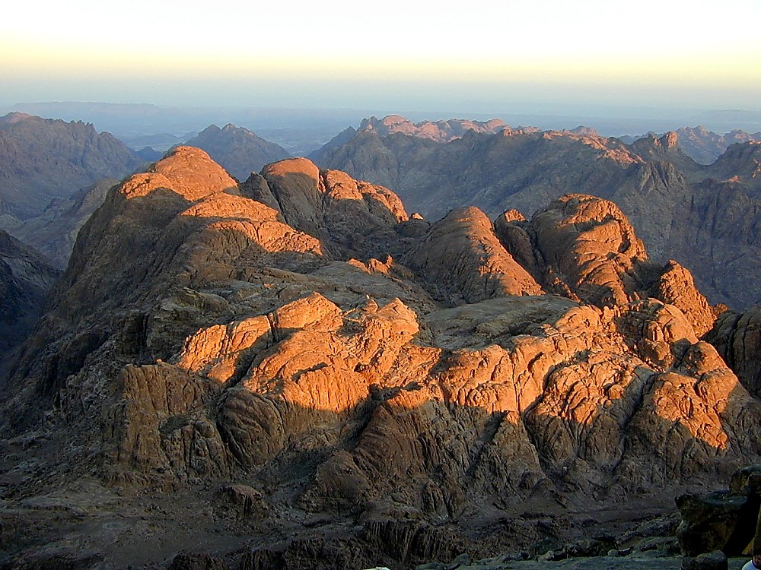
arma&StwGuf bk&m;ocif\ txl;pDrHcsuf
"r®a[mif;usrf;xJrS h h hh
xGufajrmuf&musrf;
I
II
III
IV
V
VI
VII
VIII
IX
X
“arma&Sy#dnmOf”
'DtpDtpOf b,fvkdvJqkd&if/ - - -
Texas jrdk.rS or®musrf;pm-tkwfjrpf (edkifiHwumtrSkawmfaqmifvkyfief;)
\ wifjycsuf
STUDY HELP #15
www.biblebasically.org
Dr ရက္ခ္ ဂရီဖိတ္၊ စကၤပူဓမၼေကာလိပ္ • BibleStudyDownloads.org
8.0.05B.
©2004 TBBMI
01

Slide 3
I
II
III
IV
V
VI
VII
VIII
IX
X
arma&S
xGufajrmuf&musrf;
odemawmif
M - C - C
“M-C-C”
ukd,fusifhw&m;
vlUtodkif;t0dkfif;ESifhqkdifaomw&m;
0wfjyKyJGvrf;obifESifhqkdifaomw&m;
KADESH BARNEA
40
5 SERMONS
02
1

Slide 4
rmwdumukdowd&yg? (qkdvkd&if;udkowd&yg?)
I
II
III
IV
V
VI
VII
VIII
IX
X
tD*spfjynfYusGefjzpfjcif; - ESpf 400
,Ofaus;rIESdrfhusjcif;eJhvlOD;a&wkd;wufrSk
bk&m;ESifhqkdifaom - - - vQdKU0Sufcsuf
xkdYajumifh
tpöa&;vlawGwkd;wufrSktwGuf
arma&S&JUy#dnmOf[m
t"duajcvSrf;jzpfvmw,f?
8.0.05B.
03
4
©2004 TBBMI

Slide 5
I
II
III
IV
V
VI
VII
VIII
IX
X
uGJjym;jcm;em;rSk - - -
arma&Sy#dnmOfonf
tptqHk;&Sdonf/
04
1
03

Slide 6
“arma&S ynwfcsuf”
I
II
III
IV
V
VI
VII
VIII
IX
X
“M”
xGufajrmuf&musrf;tcef;BuD; 20
ynwfawmfq,fyg;
“ynwfawmfq,fyg;”
ukd,fusifhw&m;
yxrjyÏ|ef;csuf - - -
bk&m;ociftwGufvkyfaqmif&rnfhwm0ef (tcef;i,f 1 - 12 )
oif.bk&m;ocifxm07bk&m;onf
wqlwnf;aombk&m;jzpf\
bk&m;ocif\&kyfwkqif;wkrjyK&?
wjcm;aombk&m;rukd;uG,f&?
bk&m;\emrtxGwftjrwfxm;jcif;?
Oyk'faeUukdoefh&Sif;apjcif;?
ajcmuf&uftvkyfvkyfjcif;?
OykofaehwGiftem;,ljcif;?
05
12

Slide 7
“arma&S ynwfcsuf”
xGufajrmuf&musrf;tcef;BuD; 20
ynwfawmfq,fyg;
I
II
III
IV
V
VI
VII
VIII
IX
X
“M”
“ynwfawmfq,fyg;”
ukd,fusifhw&m;
yxrjyÏ|mef;csuf - - -
bk&m;ociftwGufvkyfaqmif&rnfhwm0ef (tcef;i,f 1 - 12 )
'kwd,jyÏ|ef;csuf - - -
vlawGtwGufvkyfaqmif&rnfhwm0ef (tcef;i,f 13 - 17 )
rdbawGukd&dkao&rnf?
wm;jrpfxm;aomtcsufrsm; - - -
olUtoufowfjcif;?
azmufjyefjcif;?
ckd;jcif;/ olhUOpömckd;jcif;?
rkomajymjcif;?
&rufBuD;jcif; (avmbBuD;jcif;)?
06
7

Slide 8
“arma&S ynwfcsuf”
I
II
III
IV
V
VI
VII
VIII
IX
X
xGufajrmuf&musrf;tcef;BuD; 20
ynwfawmfq,fyg;
“ynwffawmfq,fyg;”
“M”
The Second
yxrjyÏ|mef;csuf - - -
bk&m;ociftwGufvkyfaqmif&rnfhwm0ef (tcef;i,f 1 - 12 )
'kwd,jyÏ|mef;csuf - - -
vlawGtwGufvkyfaqmif&rnfhwm0ef (tcef;i,f 13-17)
;”
(tcef;BuD; 21 - 24 )
vlrSla&;qkdif&mjyÏ|ef;csufrsm;
“C”
vlaerIb0
udk,fa&;ukd,fwmESif.qdkifaomjyKvkyfydkifcGif.?
Opömypnf;ESif.qdkifaomjyKvkyfydkifcGif.?
tusif.pm&dwÅjynfhpHkhjcif;? ajzmifhrwfjcif;twGufvkdtyfcsufrsm;/
07
4

Slide 9
“arma&S ynwfcsuf”
I
II
III
IV
V
VI
VII
VIII
IX
X
xGufajrmuf&musrf;tcef;BuD; 20
ynwfawmfq,fyg;
“ynwffawmfq,fyg;”
“M”
The Second
yxrjyÏ|mef;csuf - - -
bk&m;ociftwGufvkyfaqmif&rnfhwm0ef (tcef;i,f 1- 12 )
'kwd,jyÏXmef;csuf - - -
vlawGtwGufvkyfaqmif&rnfhwm0ef (tcef;i,f 13- 17 )
;”
(tcef;BuD; 21 - 24 )
vlrSla&;qkdif&mjyÏ|ef;csufrsm;
“C”
vlaerSkb0
udk,fa&;ukd,fwmESif.qdkifaomjyKvkyfykdifcGifh?
Opömypnf;ESif.qdkifaomjyKvkyfykdifcGifh?
tusif.pm&dwÅjynfhpHkhjcif;? ajzmifhrwfjcif;twGufvkdtyfcsufrsm;/
07
4

Slide 10
I
II
III
IV
V
VI
VII
VIII
IX
X
“arma&Sy#dnmOfaygif;csKyf”
“M”
tcef;BuD; 20 -
ynwfawmfq,fyg;
“C”
tcef;BuD; 21 - 24
vlrSka&;qkdif&mjyÏ|ef;csufrsm;
“C”
tcef;BuD; 25 - 31
bk&m;ocif\wJawmfjy|mef;csufrsm;
09
3

Slide 11
“arma&Sy#dnmOfü yg0ifaomtaBumif;t&mrsm;”
1 - ,m,DpDrHcsuf
2 – jcTif;csufpDrHcsuf
3 - t"duqdkvdk&if;onf a,&Skc&pfawmf\omoemwGif tqHk;owfoGm;onf?
þae&mwGiftqHk;owfonf)
4 - oefh&Sif;aom0dnmOfawmfqif;oufvmjyD;
aemufykdif;
ynwfawmfonf,HkBunfolwkdif;twGuf toufwmESif.ESvHk;om;\tpdwftydkif;wpfckjzpfvmonf?
8.0.05B.
10
4
©2004 TBBMI

Slide 12
&SifróJc&pf0if 5;17
“ynwÅdusrf;? tem*wÅdusrf;rsm;ukdzsufy,fjcif;iSg igvmonf[krxifBuESifh/
zsufy,fjcif;iSg igvmonfr[kwf? jynfhpHkapjcif;iSg igvmownf;/”
11
1

Slide 13
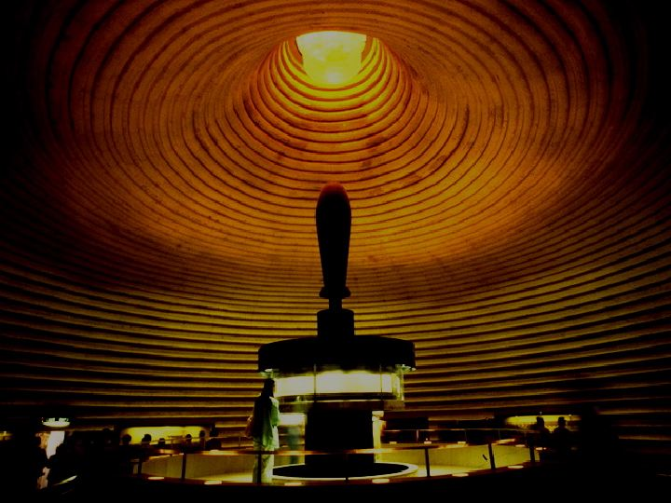
tmjA[Hukdbk&m;ac:jcif;
(urÇmOD;usrf;12;1-3)
y#dnmOf
(urÇmOD;;usrf; 15;9-18)
tmjA[H
y#dnmOf
“y#dnmOftpdwftydkif; cGJjcrf;pdwfjzmjcif;”
pmoiftaxmuftul trSwf-14
usrf;pm\t"duausmaxmufaemufcH Asm'dwfawmf
©2004 TBBMI
7.2.05B.
12

Slide 14
tmjAH[Hukdbk&m;ac:jcif;
(urÇmOD;usrf; 12; 1 - 3)
tmjA[H
y#dnmOf
y#dnmOf
(urÇmOD;usrf; 15; 9 -18)
xm0&
urÇm 13;15
vufawGh
urÇm 13; 14-16
jcGif;csufr&Sd
urÇm 15; 9-18
e,fajr
urÇm 12;1
trsKd;
urÇm 12;2
aumif;BuD;
urÇm 12;3
usrf;pm\t"duaBumaxmufaemufcH Asm'dwfawmf
©2004 TBBMI
7.2.05B.
13

Slide 15
tmjA[H
y#dnmOf
tmjA[Hukdbk&m;ac:jcif;
(urÇmOD;usrf; 12;1-3)
y#dnmOf
urÇmOD;usrf; 15;9-18
xm0&
urÇm 13;15
vufawGh
urÇm 13;15
jcGif;csufr&Sd
urÇm 15;9-18
e,fajr
urÇm 12;1
trsKdK;
urÇm 12;2
aumif;BuD;
urÇm 12;3
y#dnmOftpdwftykdif;tm; tus,fwyGif.zGif.jycsuf
e,fajr
w&m; 30;1-10
usrf;pm\t"duaBumaxmufaemufcH Asm'dwfawmf
©2004 TBBMI
7.2.05B.
14

Slide 16
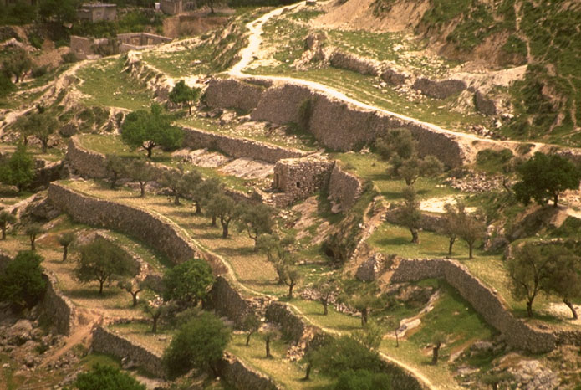
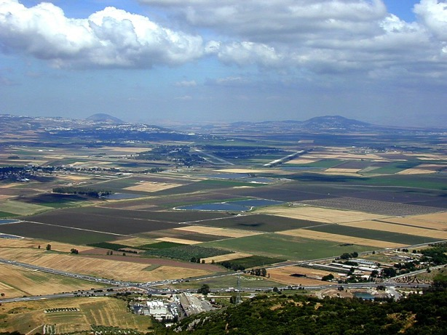
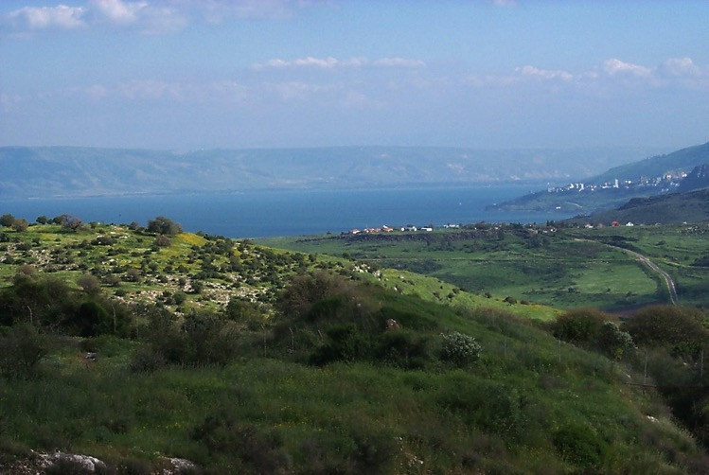
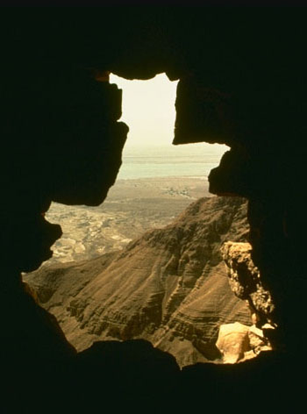
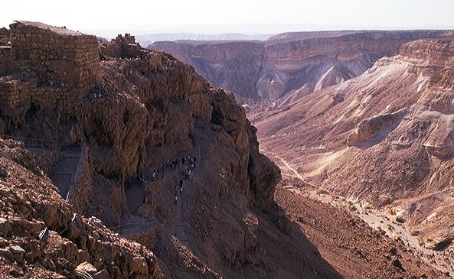
tmjA[H\e,fajrtarGtESpf
15

Slide 17
w &m; a[m &musrfffff;tcef;BuD; 30
“uwdxm;&mjynf”
5? bdk;ab;wkdh0ifpm;aomjynfokdhwzefaqmifcJhawmf
rlojzifh/oifonf0ifpm;&vdrfhrnf? xkdtcgaus;Zl;jyKawmfrljyefojzifh bkd;ab;rsm;wkdhxufoifhukd omírsm;jym;apawmfrlvdrfhrnf?
6? oifonftouf&SifrnftaBumif;/ oif\bk&m;ocif
xm0&bk&m;udkpdwfESvHk;tBuGif;rJhcspfapjcif;iSg/ oifhESvHk;ESifhoifhtrsKd;om;taygif;wdkU\
ESvHk;ta&;zsm;udkvSD;jzwfawmfrlvdrfhrnf?
16
2

Slide 18
vSy BuD;yGm;aomjynf
17

Slide 19
tmjAH[Hukdbk&m;ac:jcif;
urÇm 12; 1-3
tmjA[H
y#dnmOf
y#dnmOf
urÇm 15;9-18
xm0&
urÇm 13;15
vufawGh
urÇm 13;15
jcGif;csufr&Sd
urÇm 15;9-18
e,fajr
urÇm 12;1
trsdKK;
urÇm 12;2
aumif;BuD;
urÇm 12;3
y#dnmOftpdwftykdif;.tus,fwyGif.zGif.jycsuf
e,fajr
w&m; 30;1-10
'g0d'f
2&m &;4-16
or®musrf;pm\t"duaBumaxmufaemufcH Asm'dwfawmf
©2004 TBBMI
7.2.05B.
18

Slide 20
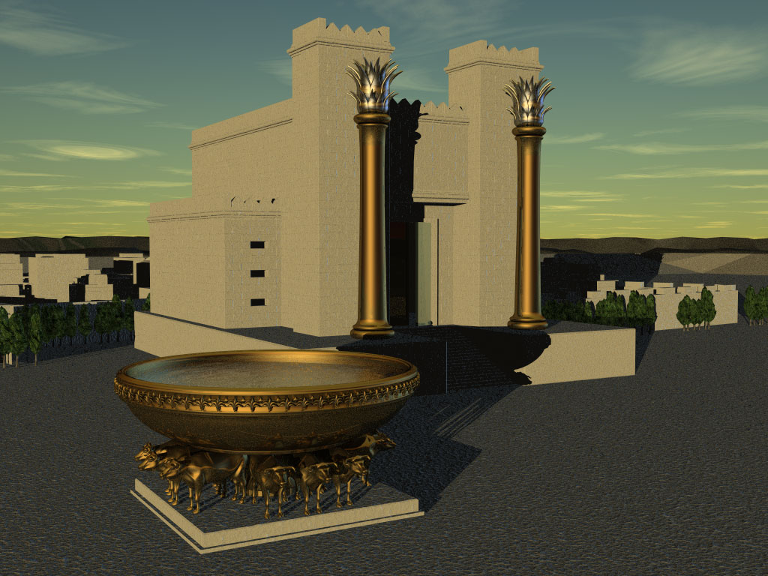
'g0d'fy#dnmOf
tmrcHcsufoHk;csuf
1&m 7 ; 16? oif.trsKd;tEG,fESifh/oif.EdkifiHonfigha&ShrSmtpO ftjrJ
wnfvdrfhrnf?oif.&mZyvifonfvnf;tpOftjrJwnfvdrfhrnf
[kighusGef'g0d'ftm;ajymavmh[krdefhawmfrl.?
8.0.05B.
19
6
©2004 TBBMI

Slide 21
xkdhaBumifh ar;oifhonfhar;cGef;rSm 'g0d'frif;\yv’ifawmfay:wGif tb,follxdkifrnfenf;/
20
©2004 TBBMI
8.0.05B.

Slide 22
'g0d'frif;quf
a,&Skc&pfawmf&Jhr[maqGpOfrsKD;qufqif;oufvmyHk
pmoifaxmuful trSwf-16
8.0.05B.
21
1
©2004 TBBMI

Slide 23
'g0d'f.om;pOfajr;qufpm&if; -
c&pfawmf&Jhr[maqGpOfrsKd;qufqif;oufvmyHk
tusOfcsKH;azmfjycsuf
22
1

Slide 24
'g0d'f.om;pOfajr;qufpm&if; -
a,&Skc&pfawmf&Jhr[maqGpOfrsKd;qufqif;oufvmyHk
tm'H - {0
usrf;csufrsm;
urÇmOD;usrf; 3;20
tusOfcsKH;azmfjycsuf
23

Slide 25
'g0d'f.om;pOfajr;qufpm&if; -
a,&Skc&pfawmf&Jhr[maqGpOfrsKd;qufqif;oufvmyHk
tm'H - {0
um£e tmaAv
usrf;csufrsm;
urÇmOD;usrf;4;1-2/4;8
tusOfcsKH;azmfjycsuf
24
1

Slide 26
'g0d'f.om;pOfajr;qufpm&if; - a,&Skc&pfawmf&Jhr[maqGpOfrsKd;qufqif;oufvmyHk
tm'H {0
usrf;csufrsm;
urÇmOD;usrf; 4;25
um£e tmaAv a&So
tusOfcsKH;azmfjycsuf
25

Slide 27
'g0d'f.om;pOfajr;qufpm&if; - a,&Skc&pfawmf&Jhr[maqGpOfrsKd;qufqif;oufvmyHk
tm'H {0
usrf;csufrsm;
urÇmOD;usrf; 5;29
um£e tmaAv a&So
aem{
tusOfcsKH;azmfjycsuf
26

Slide 28
'g0d'f.om;pOfajr;qufpm&if; - a,&Skc&pfawmf&Jhr[maqGpOfrsKd;qufqif;oufvmyHk
tm'H {0
usrf;csufrsm;
urÇmOD;usrf; 11;26
um£e tmaAv a&So
aem{
tmjA[H
tusOfcsKH;azmfjycsuf
27

Slide 29
'g0d'f.om;pOfajr;qufpm&if; - a,&Skc&pfawmf&Jhr[maqGpOfrsKd;qufqif;oufvmyHk
tm'H {0
usrf;csufrsm;
&ko 4;22
um£e tmaAv a&So
aem{
tmjA[H (pm&J)
tusOfcsKH;azmfjycsuf
'g0df'f
28

Slide 30
'g0d'f.om;pOfajr;qufpm&if; - a,&Skc&pfawmf&Jhr[maqGpOfrsKd;qufqif;oufvmyHk
tm'H {0
usrf;csufrsm;
2&m 12;24
um£e tmaAv a&So
aem{
tmjAH[H
tusOfcsKH;azmfjycsuf
'g0d'f - Amoa&Sb
29

Slide 31
'g0d'f.om;pOfajr;qufpm&if; - a,&Skc&pfawmf&Jhr[maqGpOfrsKd;qufqif;oufvmyHk
tm'H {0
usrf;csufrsm;
2&m 5;14
umÁe tmaAv a&So
aem{
tmjAH[H
tusOfcsKH;azmfjycsuf
'g0d'f Amoa&Sb
emoef a&Smvrkef
30

Slide 32
'g0d'f.om;pOfajr;qufpm&if; - a,&Skc&pfawmf&Jhr[maqGpOfrsKd;qufqif;oufvmyHk
tm'H {0
usrf;csufrsm;
um£e tmaAv a&So
vkkum 3;23 ESifhtjcm;usrf;rsm;
aem{
tusOfcsKH;azmfjycsuf
tmjAH[H
'g0d'f Amoa&Sb
vkum 3;23 (tjcm;usrf;rsm;ukdukd;um;rI)
emoef a&Smvrkef
rm&d
31

Slide 33
'g0d'f.om;pOfajr;qufpm&if; - a,&Skc&pfawmf&Jhr[maqGpOfrsKd;qufqif;oufvmyHk
vkum 3;23 (tjcm;usrf;rsm;udkudk;um;rI)
vkum 3;23 - xkdtcga,&SlonftESpfoHk;q,fcefhrsS&Sdawmfrl.\/vlrsm;
txifjrif,lqcsufrSmukd,fawmf\tbum;a,moyfwnf;?
&Sifvkumonfrm&d\aemufaBumif;&mZ0ifukdazmfjyjcif;tm;jzifh c&pfawmfonfvnf;'g0d'f\om;pOfajr;qufjzpfonf/ xkdhaBumifha,&Slonfu,fwif&Sifar&Sd,jzpfzkdhtqifhrSDonf/ a,moyfwpfOD;wnf;aBumifhomr[kwf [kqkdvdkjcif;jzpfonf/ [kusrf;wwfyk*¾dKvftrsm;uqkdBuonf?
0000
32
1

Slide 34
'g0d'f.om;pOfajr;qufpm&if; - a,&Skc&pfawmf&Jhr[maqGpOfrsKd;qufqif;oufvmyHk
tm'H {0
usrf;csufrsm;
(romJ 1;16)
um£e tmaAv a&So
aem{
tmjAH[H
tusOfcsKH;azmfjycsuf
'g0d'f Amoa&Sb
emoef a&Smvrkef
rm&d a,moyf
33

Slide 35
'g0d'f.om;pOfajr;qufpm&if; - a,&Skc&pfawmf&Jhr[maqGpOfrsKd;qufqif;oufvmyHk
tm'H {0
usrf;csufrsm;
(roJ 1;16)
um£e tmaAv a&So
aem{
tmjAH[H
tusOfcsKH;azmfjycsuf
'g0d'f Amoa&Sb
emoef a&Smvrkef
rm&d a,moyf
a,&Slc&pfawmf
34

Slide 36
'g0d'f.om;pOfajr;qufpm&if; - a,&Skc&pfawmf&Jhr[maqGpOfrsKd;qufqif;oufvmyHk
tm'H {0
um£e tmaAv a&So
aem{
tmjA[H
'g0d'f Amoa&Sb
emoef a&Smvrkef
aoG;om;tarGqufcHjcif;
Oya'tarGqufcHjcif;
rdom;pkrSefuefrSk
vkum 3;23-28
Oya't&rSefuefrSkkkkk
vkum 1;1-17
rm&d a,moyf
a,&Slc&pfawmf
35
3

Slide 37
'g0d'f.om;pOfajr;qufpm&if; - a,&Skc&pfawmf&Jhr[maqGpOfrsKd;qufqif;oufvmyHk
tm'H {0
um£e tmaAv a&So
aem{
tmjA[H
'g0d'f Amoa&Sb
emoef a&Smvrkef
rdom;pkrSefuefrSk
vkum 3;23-28
Oya't&rSefuefrSkkkkk
vkum 1;1-17
aoG;om;
rSefuefrI
rm&d a,moyf
a,&Slc&pfawmf
36

Slide 38
'g0d'f.om;pOfajr;qufpm&if; - a,&Skc&pfawmf&Jhr[maqGpOfrsKd;qufqif;oufvmyHk
tm'H {0
ume tmaAv a&So
aem{
tmjA[H
'g0d'f Amoa&Sb
emoef a&Smvrkef
rdom;pkrSefuefrSk
vkum 3;23-28
Oya't&rSefuefrSkkkkk
vkum 1;1-17
aoG;om;
rSefuefrI
rm&d a,moyf
Oya'rSefuefrSk
a,&Slc&pfawmf
37

Slide 39
Criswell, W. A.
Danker, Frederick
Ellis, E. Earle
Fitzmeyer, Joseph
Godet, F. A.
Hendricksen, William
Hoehner, Harold
Ironside, F. A.
Marshall, I. Howard
McGee, J. Vernon
Morgan, G. Campbell
MacArtuhur, John
Scofield, C. I
Swindoll, Charles
Unger, Merrill
Walvoord, John
Zuck, Roy
c&pfawmf&JhrsKd;qufqif;oufvmyHkudk a&;aom pma&;q&mwpfcsdKhU
©2004 TBBMI
8.0.05B.
38

Slide 40
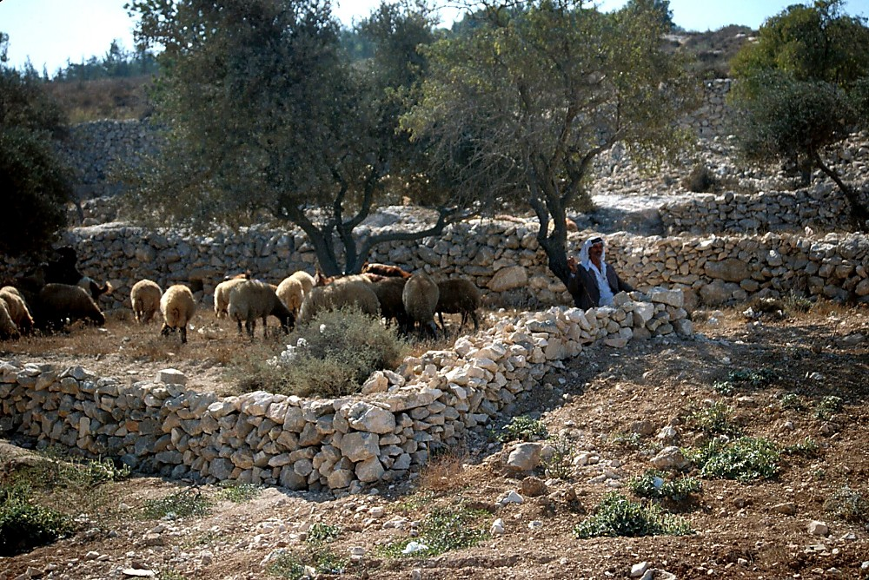
c&pfawmf\arG;zGm;jcif;eSif. toufwmukdr,HkEdkifzG,f&mjzpf&yf[k oifpOf;pm;zl;ygovm;?
r,HkEdkifzG,f&m arG;zGm;jcif;jzpfw,f?
pmoiftaxmuftul trSwf- 17
8.0.05B.
39
2
©2004 TBBMI

Slide 41
c&pfawmf\arG;zGm;jcif;eJhtoufwmukdr,HkEdkifzG,f&mjzpf&yf[koifpOf;pm;zl;ygovm;?
"r®a[mif;usrf;xJwGif c&pfawmf\arG;zGm;jcif;toufwmeSif. taocHawmfjcif;onfar&Sd,BuGvmawmfrljcif;tm; udk;um;aomusrf;csuf
300 ausmfukdjynfhpHkapcJ.onf xkdkhtwl - - -
r,HkEdkifzG,f&marG;zGm;jcif;jzpfw,f?
pmoiftaxmuftul trSwf- 17
*Source: Josh MacDowell, Evidence That Demands A Verdict, 1972, page 175; Peter Stoner, Science Speaks, Moody Press, 1963.
40

Slide 42
rawmfwqarG;zGm;jcif;omjzpfw,f?
a[mcsuf 8csuf wpfOD;wpfa,muf&JhtoufwmrSmjyD;jynfhpHkzdkUtcGifh tvrf;[mb,favmufvJ
₁₇
_{tajz - - -(10)}
_{1; 100 000 000 000 000 000}
*Source: Josh MacDowell, Evidence That Demands A Verdict, 1972, page 175; Peter Stoner, Science Speaks, Moody Press, 1963.
2
41

Slide 43
rawmfwqarG;zGm;jcif;omjzpfw,f?
'gqkd&if 48 eJhqkd&if (300 xJrS) wpfOD;wpf
a,muf&JhtoufwmrSma[mcsufjynfhpHkzkdh
tcGifhta&;wpfcktwGufb,favmufvJ/
₁₅₇
_{tajz - - - (10)}
1;100 000 000 000 000 000 000 000 000 000 000 000 000 000 000 000 000 000 000 000 000 000 000 000 000 000 000 000 000 000 000 000 000 000 000 000 000 000 000 000 000 000 000 000 000 000 000 000 000 000 000 000 000 000 000 000 000 000
*Source: Josh MacDowell, Evidence That Demands A Verdict, 1972, page 175; Peter Stoner, Science Speaks, Moody Press, 1963.
3
42

Slide 44
'g0d'f.om;pOfajr;qufpm&if; - c&pfawmf&Jhr[maqGpOfrsKd;qufqif;oufvmyHk
pmoifaxmuful trSwf- 16 wGif/ /
rm&d
a,moyf
vkum 3;23-38
romJ 1;1-17
aoG;om;rsKd;qufqif;oufvmykH
tm'HtrsdK;udkjyefBunfhjcif;
….rm&dtm;jzifhwdkuf&dkufqufcHaom
trsdK;tEG,f
ukd,fykdifaqGpOfrsKd;quf
rm&dtm;jzifh 'g0d'frsKd;quf
(2&m 7;12-13/ a&mr 1;3)
•
• r[maqGpOfrsKd;qufqif;oufvmyHk
tmjA[HrSpwifí
'g0d'f\om;awmfa,moyftm;jzifh
tpDtpOfusaomaqGpOfrsKd;quf
,k'trsdK;tEG,fudkazmfjyjcif;
c&pfawmf\r[marG;zGm;jcif;
43
16

Slide 45
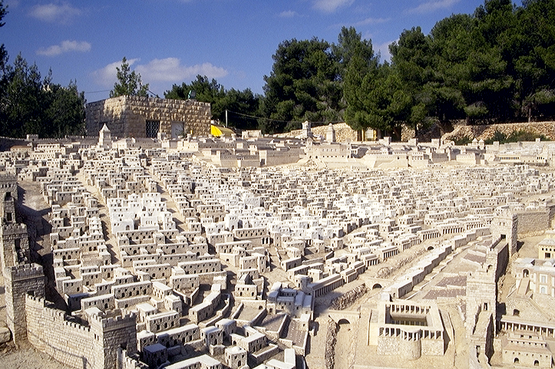
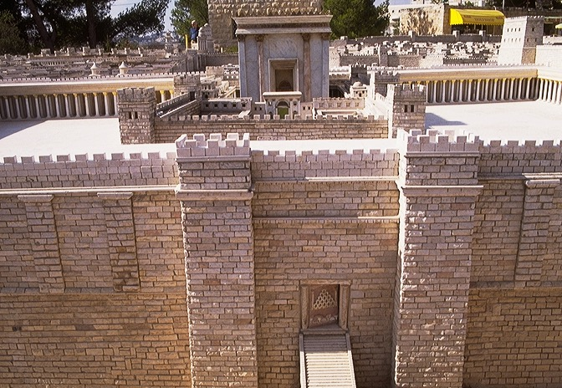
“c&pfawmfoufawmfpOf umvua,&k&Svif”
“c&pfawmfoufawmfpOfumvu a[&k'fausmif;awmfBuD;\ ta&SU0ifayguf”
44
1

Slide 46
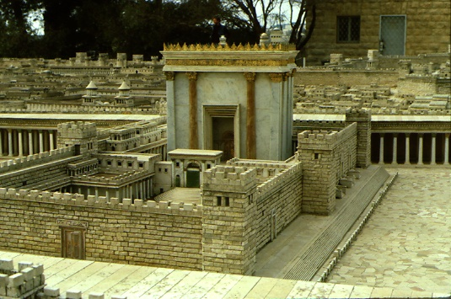
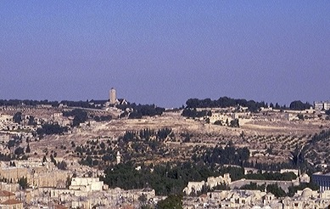
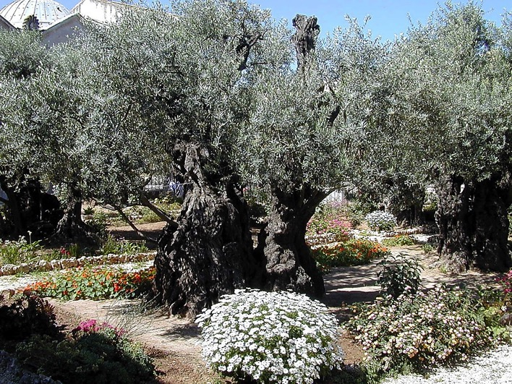
r[ma[&k'frif;BuD;\ 'kwd,ausmif;awmfBuD; (Adrmefawmf? eef;awmf)
oHvGifawmif
a*oa&SrefO,smOf&Sd a&S;oHvGifyif
45
2

Slide 47
tmjA[H y#dnmOf
y#dnmOf urÇm 15;9-18
tmjA[Hukdbk&m;ocifac: jcif; urÇm 12;1-3
xm0& urÇm 13;15
vufawGU urÇm 13;14-16
jcGif;csufr&Sd urÇm 15;9-18
e,fajr urÇm 12;1
trsKd; urÇm 12;2
aumif;BuD; urÇm 12;3
y#dnmOftpdwftykdif;\tzGifh
topf a,&rd 31;31-34
e,fajc awmvnf 30; 1-10
'g0d'f 2&m7;14-16
usrf;pm\t"duaBumaxmufaemufcH Asm'dwfawmf
46
1
©2004 TBBMI
8.0.05B.

Slide 48
a,&rd 31
y#dnmOftopf
a,&rdtay:wGifjzpfysufcJh aomtaBumif;t&m rsm;onftvGefjyif; xefcJ.onf?
xD;eef;pHjref;rI
(1000 B.C.)
S - D - S
••• uGJjym;jcif;•••
ajrmuf awmif
,k'
uKoa&v
10 2
Yya&mzufrsm;
20 J 20 R
200 350
“usyfwnf;aomtajctaewGif&SdcJ.aom ,k'”
tqD;&D;,m; AmAkvkef
47
2

Slide 49
a,&rd 31
y#dnmOftopf
31 -32 xm0&bk&m;rdefhawmfrlonfum;/igonfþ vlrsKd;.bkd;ab;wkdhukdxkwfaqmifítJ*kwÅKjynfrS aqmifoGm;pOftcgu olwkdhYtm;igay;cJ.aomy#dnmOfw&m;ESifh jcm;em;aomy#dnmOfw&m;opfudk
£oa&vtrdsK;om;? ,k'trdsK;om; wkdhYtm;ay;&aomtcsdefumv a&mufvdrfhrnf?
(NIV)
48
4

Slide 50
a,&rd 31
y#dnmOftopf
32? t&ifigay;zl;aomy#dnmOfw&m;udkol wkdhonfy,fzsufí igonfvnf;olwkdhudk&HGh&Sm\/
49

Slide 51
a,&rd 31
y#dnmOftopf
33? “aemifumvtcg£Koa&vtrsKd;om;wkdhYtm; igay;vwHhaomy#dnmOfw&m;[lrlum;? igxm0&bk&m;onf ig.ynwfw&m;wdkUukdolwkdhtwGif;okdU udk,fwdkifoGif;rnf/ olwkdUESvHk;ay:rSma&;xm;rnf?
igonfvnf;olwdkUbk&m;jzpfrnf? olwkdUonfvnf;ig\vl jzpfBuvdrfhrnf?”
(NIV)
50
1

Slide 52
“"r®opfusrf;aBumfjimcsuf”
vkum 22;19-20
19? “xkdtcgrkefhukd,líaus;Zl;awmfukdcsD;rGrf;jyD;rSrkefhukdzJhí/ þrkefhum;oifwkdhtzkdhtvkd iSgpGefhaomig.ukd,fjzpf\/ ig.udkatmufarhbkdh&mþokdh jyKBuavmh[krdefhawmfrl\/”
20? “xkdenf;wlnpmpm;jyD;rScGufukdvnf;,lIí
þcGufum;oifwdkhtbkdh tvkdhiSgoGef;aomig\taoG;Ywnfaomy#dnmOfw&m;opfjzpf\/”
51
4

Slide 53
“"r®opfusrf;aBumfjimcsuf”
romJ 26; 26-28
26? “xkdtcgpm;vsufaeBupOfwGif/ a,&Slonfrkefhukd,líaus;Zl;awmfukdcsD;rGrf; jyD;rSrkefhukdzJ.í þrkefhum;ig.udk,fjzpf\/,lípm;Buavmh[krdefhawmfrlvsuf/ wynfhawmfwkdhtm;ay;awmfrl.\/
27? cGufudkvnf;,líIaus;Zl;awmfukdcsD;rGrf;jyD;rSolwkdhtm;ay;awmfrlí? aomufBuavmh?
28? þcGufum;y#dnmOfw&m;opfESifhqkdifívlrsm;wkdh.tjypfudkvGwfapjcif;iSg oGef;aomig\taoG;jzpf\
52
4

Slide 54
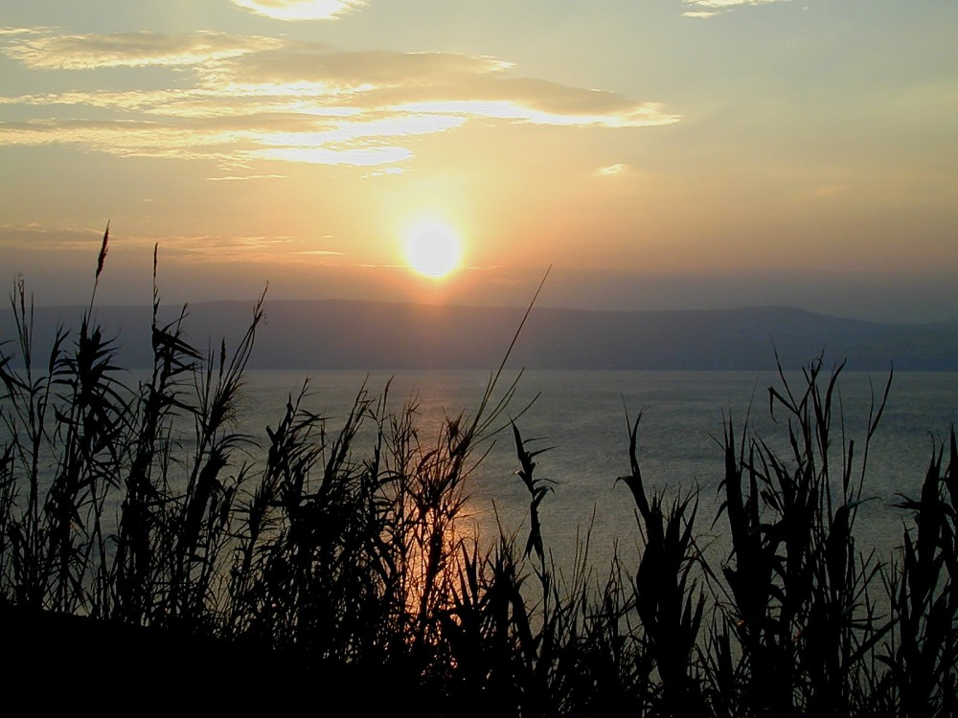
Sunset from Kursi
'DrSmb,fvdkjzpfoGm;ovJ?
WHAT IS HAPPENING HERE?
tajz ---
zefqif;&SifESif. olzefqif;xm;aomvlwkdh.\ qufqHa&;vHk;0ajymif;vJoGm;onf?
53
1
©2004 TBBMI
8.0.05B.

Slide 55
"r®a[mif;usrf;\“jzpf&rnf”
qkdonfhtawG;tac:onf - --
54
©2004 TBBMI
8.0.05B.

Slide 56
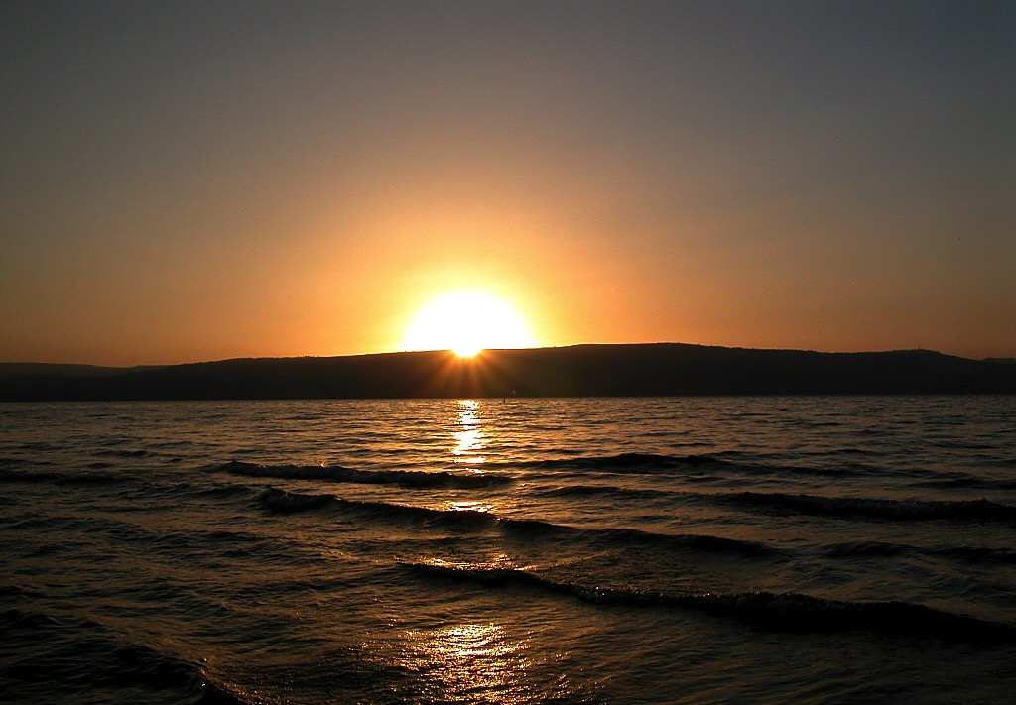
Sunset over Sea of Galilee
"r®a[mif;usrf;\ “jzpf&rnf” qkdonfhtawG;tac:onf - --
"r®opfusrf;\“jzpfrnf” qkdonfhtawGtac:udkvrf;aBumif;ay;jzpfapcJhonf?
tb,fuJhodkUenf;[lrlum; - - - oefY&Sif;aom0dnmOfawmf\ twGif;ESdk;aqmfrIonf,HkBunfolwkdif;udk ar&Sd,owif;aumif;\oufaojzpfaponf?
©2004 TBBMI
55
2

Slide 57
Sunset over Sea of Galilee
ynwf
aus;Zl;awmfukdvrf; aBumif;zGifhay;onf?
qkdonfht&monf
56
©2004 TBBMI
8.0.05B.

Slide 58
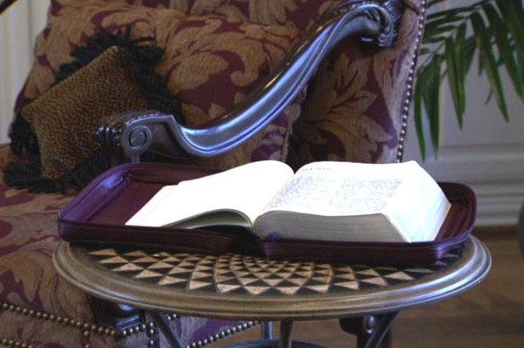
tckusGEkfyfwkdhonfusrf;pmyHkjyifvrf;aBumif;\ ta&;BuD;yHkudk trdt&qkyfukdifEdkifjyDjzpfonf?
CREATION
ABRAHAM
JOSEPH
MOSES
“a&G;EIwfu,fwifawmfrljcif;\ cef;em; aomjrifuGif;”
JOSHUA
ANARCHY
ROYALTY
CAPTIVITY
SILENCE
JESUS
57

Slide 59
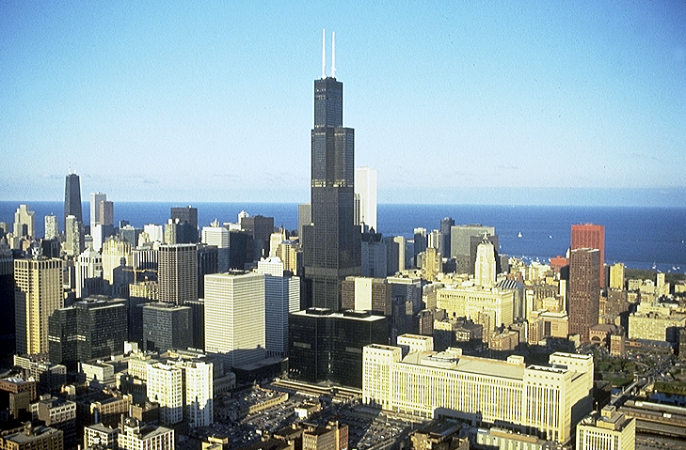

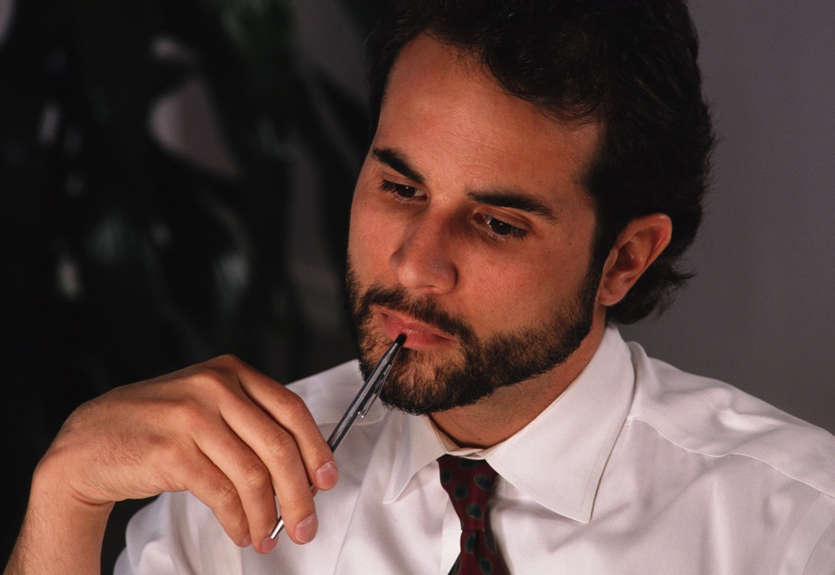
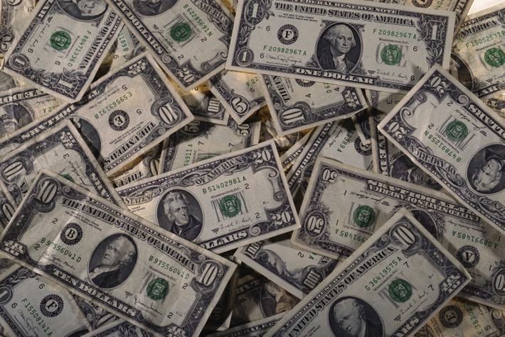

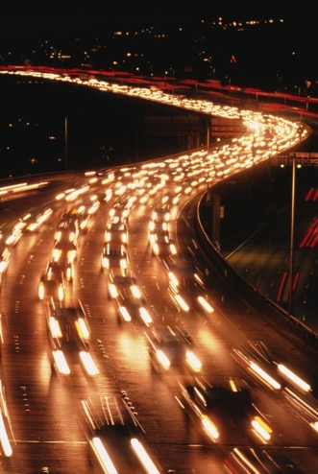
ar;cGef; -
wkd;wufajymif;vJacwfrSD aeaomþumvwGif a,&Sl\taoG;awmfoGef;? u,fwifjcif;ukd tb,fodkUoabm& rnfenf;/
58

Slide 60
“taoG;”awmf&Jht"dyÜ,f - - -
a[jAJ 9;15-22
15? xkdaBumifhy|ry#dnmOfw&m;vufxufü jypfrSm;aomtjypfukdvnf;vGwfapjcif;iSg/ c&pfawmfonf taocHawmfrlonfjzpfí? ac:awmfrlaom olwkdhonf *wdawmfESifh,SOfaomxm0&t arGukd cH&rnftaBumif;/xkdocifonf y#dnmOfw&m;opf\ tmrcHjzpfawmfrl\/
59
2

Slide 61
“taoG;awmf \t"dyÜ,f - - -
a[jAJ 9;15-22
16? tarGcHapjcif;iSgtcGifhay;ípmcsKyfon.ftrIrSm? pmcsKyfwnfvSsifpmcsKyfcsKyfaomolonf{ueftrSefao&rnfjzpfonf/
17? tu,fíraovSsif/ xkdpmcsKyfonfrwnf/ aorSomwnf\/
60
1

Slide 62
“taoG;awmf \t"dyÜ,f - - -
a[jAJ 9;15-22
18? xkdaBumifhy|ry#dnmOfw&m;udkpD&ifaomtcg/ taoG;ESifhuif;í rpD&ifcJ./
61

Slide 63
“taoG;awmf \t"dyÜ,f - - -
a[jAJ 9;15-22
19? w&m;awmfüygorSsaomynwfwkdhukdarma&Sonf vltaygif;wkdhtm; a[majymjyD;rS/ a&ESifha&maESmaomEGm;? qdwf\taoG;ü
okd;arG;wyfaom[kokyfyifnGefhtm;eSpfí
usrf;pmudk4if;?‚vltaygif;wdkUtm;4if; jzef;vsuf - --
62

Slide 64
“taoG;awmf \t"dyÜ,f- - -
a[jAJ 9;15-22
20? þtaoG;um;/ oif\bk&m;ocif0efcHawmfrlaom y#dnmOf\taoG;jzpfonf[kajymqkd\/
63
1

Slide 65
“taoG;awmf \t"dyÜ,f - - -
a[jAJ 9;15-22
21? wJawmfESifh0wfjyKaomwefqmrsm;ukdvnf;xkd enf;wltaoG;ESifhjzef;&\/
64

Slide 66
“taoG;” awmf\t"dyÜg,f - - -
a[jAJ 9;15-22
22? ynwfw&m;twkdif;cyfodrf;aomt&mwkdhudk ukefrwwftaoG;tm;jzifhpifBu,fap&\/ taoG;roGef;avmif;bJtjypfvTwfjcif;r&Sd/
65

Slide 67
“taoG;” awmf\t"dyÜ,f - - -
a[jAJ 9;15-22
22? ynwfw&m;twkdif;cyfodrf;aomt&mwkdhudk ukefrwwftaoG;tm;jzifhpifBu,fap&\/ taoG;roGef;avmif;bJtjypfvTwfjcif;r&Sd?
66
1

Slide 68
“taoG;” awmf&Jht"dyÜg,f -
a[jAJ 9;15-22
taoG;oGef;jcif;r&SdvQif tjypfvTwfjcif;vnf;r&Sd? c&pfawmfonf u&meDü taoG;awmfoGef;í
taocHjyD;jyefvnf&Sifjyefxajrmufjcif;tm;jzifh vlom;rsm;\tjypfudk cGifhvTwfapcJhonf?
67

Slide 69
pmoiftaxmuftul trSwf-14 ESif. 32
tmjA[H y#dnmOf
tmjA[Htm;bk&m;ocif ac: jcif;
urÇm 12;1-3
y#dnmOf urÇm15;9-18
xm0& urÇm 13;15
vufawGh urÇm 13;14-16
jcGif;csufr&Sd urÇm 13;9-18
e,fajr urÇm 12;1
trsdK; urÇm 12;2
aumif;BuD; urÇm 12;3
“y#dnmOftpdwftykdif;\tzGifh”
'g0d'f 2&m 7;4-16
topf a,&rd31;31-34
e,fajr w&m; 30;1-10
usrf;pm\t"duaBumaxmufaemufcH Asm'dwfawmf
68
5
©2004 TBBMI
8.0.05B.

Slide 70



csnfrQifuJhokdUao;i,faomtykdif;tprsm;&Sdonf ukdowd&yg?
usrf;pm\zGJUpnf;yHktajccH Z,m;
oifaxmuful trSwf- 08
69
© 2004 TBBMI
8.0.05B.

Slide 71
csnfrQifuJhokdhao;i,faomtykdif;tprsm;&Sdonfukdowd&yg?
usrf;pm\zGJUpnf;yHktajccH Z,m;
70
© 2004 TBBMI
8.0.05B.

Slide 72
usrf;pmordkif;csnfrQif
7
c&pfawmf\urmajrNuD;ay:pdk;pHjcif;
4P
3S
aumif;uifopfESif.ajrBuD;opf
odl;olc,fr*vmaqmifyGJ
'kwd,tBudrfBuGvmjcif;
J
yv’ifjzLw&m;pD&ifjcif;
C
A
J
M
J
A
R
C
S
71
© 2004 TBBMI
8.0.05B.

Slide 73
or®musrf;pmordkif;csnfrQif
7
toif;awmf
EARTHLY REIGN OF CHRIST
4P
3S
MARRIAGE SUPPER OF
THE LAMB
NEW HEAVEN, NEW EARTH
GREAT WHITE THRONE
JUDGMENT
J
THE SECOND COMING
C
A
J
M
J
A
R
C
S
tmjA[Hy#dnmOf
jynfawmfy#dnmOf
'g0d'fy#dnmOf
y#dnmOftopf
72
6
© 2004 TBBMI
8.0.05B.

Slide 74
or®musrf;pmordkif;csnfrQif
7
toif;awmf
EARTHLY REIGN OF CHRIST
4P
3S
MARRIAGE SUPPER OF
THE LAMB
NEW HEAVEN, NEW EARTH
GREAT WHITE THRONE
JUDGMENT
J
THE SECOND COMING
C
A
J
M
J
A
R
C
S
tmjA[Hy#dnmOf
c&pfawmfajrBuD;ay:Y
bk&ifcHtkyfpkd;jcif;
odk;oli,fyJGawmf
yv’ifjzLw&m;pD&ifjcif;
aumif;uifopf
ajrBuD;opf
'kwd,tBudrfBuGvmawmfrljcif;
jynfawmfy#dnmOf
'g0d'fy#dnmOf
y#dnmOftopf
72
6
© 2004 TBBMI
8.0.05B.

Slide 75
'g0d'fy#dnmOf
usrf;pmordkif;csnfrQif
7
EARTHLY REIGN OF CHRIST
4P
3S
MARRIAGE SUPPER OF
THE LAMB
NEW HEAVEN, NEW EARTH
GREAT WHITE THRONE
JUDGMENT
J
THE SECOND COMING
C
A
J
M
J
A
R
C
S
tmjA[Hy#dnmOf
jynfawmfy#dnmOf
y#dnmOftopf
74
© 2004 TBBMI
8.0.05B.

Slide 76
'gqkd&ifar;cGef;[m'DrSm - - -
ESpfaygif; 4000 ausmfubk&m;ocifeJhtmjA[HBum;xm;cJhaomuwdawmfudk þ21 &mpk wkd;wufajymif;vJaomacwfumvwGif cH,ltoHk;csoif.ygtHk;rvm;/ (urÇm 12/15)
þcH,lcsufudkurÇmwpfvGrf;&Sdusrf;pm bmomjyefjcif;? yHkESdyfxkwfa0jcif; wdkUwGifawGU&onfukd owd&yg?
tjynf.t0cH,ltoHk;csoifhon/f tb,faBumif.enf;[lrlum;---
urÇmOD;usrf; 26 wGiftmjA[H\om;Zuftay:ü
uwdawmfqufvufwnfjrJwnfcJ.onf/ xdkUaemuf,mukyftay:wGif (urÇm 35) xdkUaemufa,moyftay:wGif (urÇm 48)? xdkUaemuf arma&S (xGufajrmuf 6) ESifha,m&Sltay: (a,m&Sl 1) wdkUwGifawGh&onf?
aemufqHk;üta&;BuD;qHk;jzpfaom ar&Sd,BuGvmawmfrljcif;jzifh þuwdawmfonfjynfhpHkcJ.onf/
75
8
©2004 TBBMI
8.0.05B.

Slide 77
xkdhaBumifh - - - þodkUqdkBuonf/
jcTif;csufr&Sdwdusaomuwdawmfrsm;onf oifh\or®musrf;pmtkyfxJwGif&Sdonf/ usGEkfyfwkdhzwf&Slavhvmoifhonf/ wpfenf;tm;jzifh - - -
76
1

Slide 78
uREkfyfwkdh\,HkBunfjcif;onf jzpf&yfrSefay:wGifwnfaqmufxm;jcif;r&SdvSsif taBumif;w&m;aygif;pHkESif.qef.usifbufjzpfjcif;? t,loD;jcif;ESifhxifjrif,lqjcif;rQom jzpfygvdrf.rnf?
77
4

Slide 79
þwGifa&G;cs,fp&mtcsufrsm;&Sdonf ---
1? tqufpyfr&Sdbl;[kqkdvQufvspfvsL&Skedkifonf/
2? "r®a[mif;usrf;[kqkdvQuf Oayu©mjyKedkifonf/
3/ t"dyÜg,fESif.zGifhqkdcsufrsm;onf þurÇmBuD;\ tem*wfESif.oufqdkifpGm ynmom;ygatmifzGifhqkdxm;onf [kqdkEdkifonf/
78
3

Slide 80
þwGifa&G;cs,fp&mtcsufrsm;&Sdonf ---
1? tqufpyfr&Sdbl;[kqkdvQufvspfvsL&Skedkifonf/
2? "r®a[mif;usrf;[kqkdvQuf Oayu©mjyKedkifonf/
3/ t"dyÜg,fESif.zGifhqkdcsufrsm;onf þurÇmBuD;\ tem*wfESif.oufqdkifpGm ynmom;ygatmifzGifhqkdxm;onf [kqdkEdkifonf/
eHygwf 3 udka&G;r,fqkdvQif---
4? oifh&Jhtem*wfESifh ocifa,&Sltay:wGifxm;&Sdaom oif\oabmxm;onftb,fodkU&Sdonf qdkonfudkqHk;jzwfEdkifonf/
78
3

Slide 81
ta&;BuD;aomudk,fhukd,fudkar;&rnfh ar;cGef;
EIwfuywfawmfonfrSefygovm;/ rSm;ygovm;?
oifh\tajzonf tb,fuJ.odkUyifjzpfapumrl- ,kwÅd&Sdaomtajzopfwpfckonf ay:xGufvmygawm.onf/
80
2

Slide 82
“a,&SlonfuREkfyfwkdhtwGuf tb,fodkUjzpfoenf;/
81

Slide 83
uRefawmfonfa,&Sltay:wGifvlawGxm;aomt,ltqrSm;wpfckukdumuG,fzkdhtoifhjzpfonf? xdkt&mrSm wpfcsKdUhaomolawGonfa,&Sludk q&maumif;wpfa,muftaejzif.omvufcHjyD;?olhwdkU\ bk&m;jzpfjcif;udk jiif;y,fBuonf/ þuJ.odkUrjzpfoif.yg/
tb,faBumif.enf;[lrlum;? omrefvlwpfa,mufonfc&pfawmfoGefoifuJ.odkUajymvkduf&HkESif.q&maumif;wpfa,mufjzpfrvmEdkifyg/
82
7

Slide 84
“xkdhaBumifhaemufwpfBudrf þar;cGef;udkar;&vQif a,&Slonfoif\twGuf tb,folenf;/”
83

Slide 85
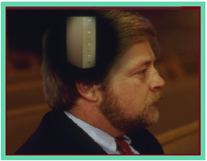
,cktcsdefavmufqkdvQifoifh\pdwful;xJwGif usrf;pm\tajccHonf - - -
aomhcsuf - - - usrf;pmtkyfwGJrS
•or®musrf;pmtkyfwGJzGifh&ef pdwful;OmPfaomh - - - ?
•usrf;pmxJü&Sdaom tjzpftysufrsm;jzpfyGm;&mae&mrsm;\pdwful;jyajryHk?
•usrf;pmyHkjyift&if;tjrpf - ouú&pftpOftvkdufa&;rSwfxm;jcif;?
•c&pfawmf\omoemonftmjA[HtaBumif;t&ma&;om;xm;aomusrf;ESif. wkduf&dkufqufEG,faeonf?
84
1

Slide 86

Burmese
or®musrf;pm
tkwfNrpf
Texas jrdk.rS or®musrf;pm-tkwfjrpf (edkifiHwumtrSkawmfaqmifvkyfief;)\ wifjycsuf

Slide 87


တရားေဟာျခင္းအ တတ္ပညာ • BibleStudyDownloads.org
အခမဲ့အဘို့ဤတင်ပြချက်
Notes:
Preaching (pr)
Homiletics

Slide 88
Black

