Slide 1
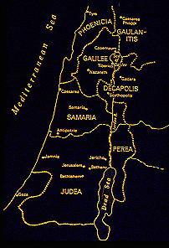
roJ 4;25/ rmuk 7;31
3
a,&I
a,&I
oufawmfpOf/
2
Dr ရက္ခ္ ဂရီဖိတ္၊ စကၤပူဓမၼေကာလိပ္ • BibleStudyDownloads.org
39

Slide 2

Burmese
or®musrf;pm
tkwfNrpf
Texas jrdk.rS or®musrf;pm-tkwfjrpf (edkifiHwumtrSkawmfaqmifvkyfief;)
\ wifjycsuf
biblebasically.org

Slide 3
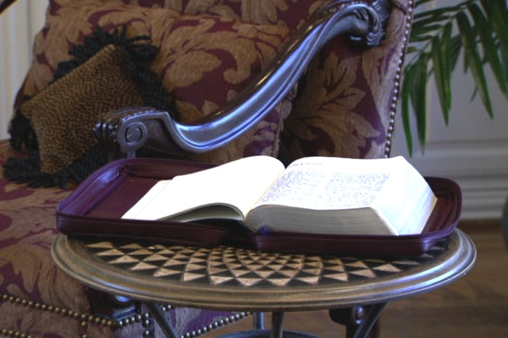
tcsdefumv
aphaom
tcg
touftdkaomtmNAH[HtwGufbk&m;*wdawmf ESpfaygif; 2000 a&mufaomcg = *vmwd 4;4
zefqif;jcif;/
ABRAHAM
tmNA[H/
ABRAHAM
a,moyf/
a,&I
ABRAHAM
arma&S/
a,m&Sk
bk&m;ocif\
topfaomtpDtpOf
rif;rJh/
rif;pH/
zrf;qD;/
a,&SI
qdwfNidrf/
a,&Sk
Handbook pg. 39-41
6
01

Slide 4
romJ/ rmuk/ vkum/ a,m[ef/
7
a,&I
oufawmfpOf/
um;wdkif/
toif;awmf/
tmNA[HtwGuftajcae
ay:wGifrrlwnfaom*wdawmf/
a,&I
tjrifhrSBunfhjcif;/ tao;pdwfraz:jyjcif;/
Handbook pg. 39-41
5
02

Slide 5
romJ/ rmuk/ vkum/ a,m[ef/
7
a,&I
oufawmfpOf/
uav;b0/ *gvdvJom;/
tOD;qHk; a,&k&Svif trIawmf/
xdkaemuf *gvdvJ/
xdkaemuf ay&aemif XmecsKyf/
yg&D,ef trIawmf/
aemufqHk; a,&k&Svif trIawmf
a,&I
oufawmfpOf/
Handbook pg. 39-41
6
03

Slide 6
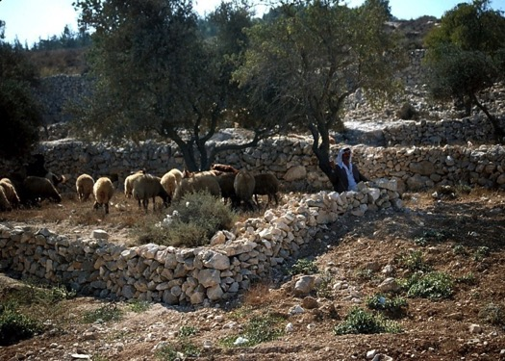
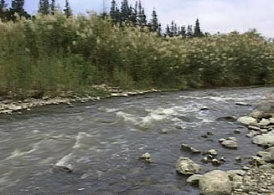
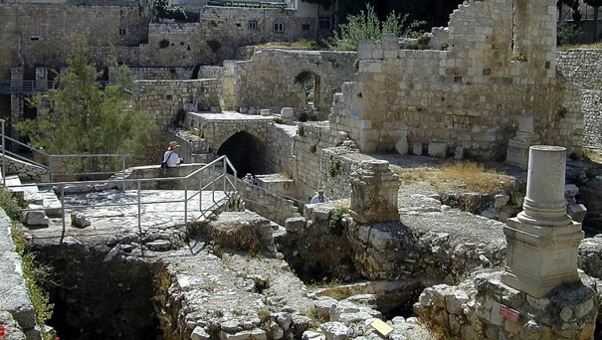
romJJ 4;11=16/
AufvifteD;&Sdodk;ausmif;om;rsm;/
uay&aemifteD;&Sdukef;jrifhav;rsm;/
a,&I+
oufawmfpOf/
a,mf'efjrpftxufydkif;/
aAo'uefrsm;/
ocifa,&Ic&pfawmf\aemufcHyefcsDum;/
a,&Ic&pfawmf\vlUrsufpdjzifhjrifcJ.&aomjrifuGif;/
Handbook pg. 39-41
04

Slide 7
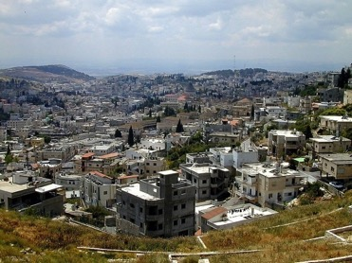
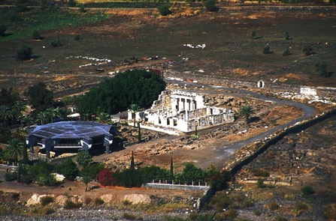
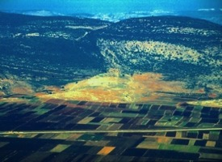
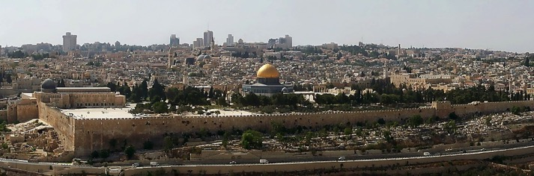
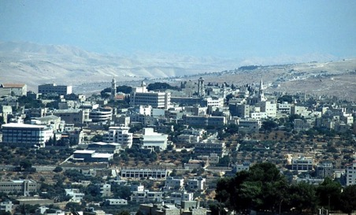
7
uay&aemif
emZ&uf/
*gvdvJ
a,&Ic&pfawmf\ toufwmESifhtrIawmf\t"du 6ae&m/
ume
a,&I
oufawmfpOf/
a,&k&Svif
Aufvif
Handbook pg. 39-41
05
6

Slide 8
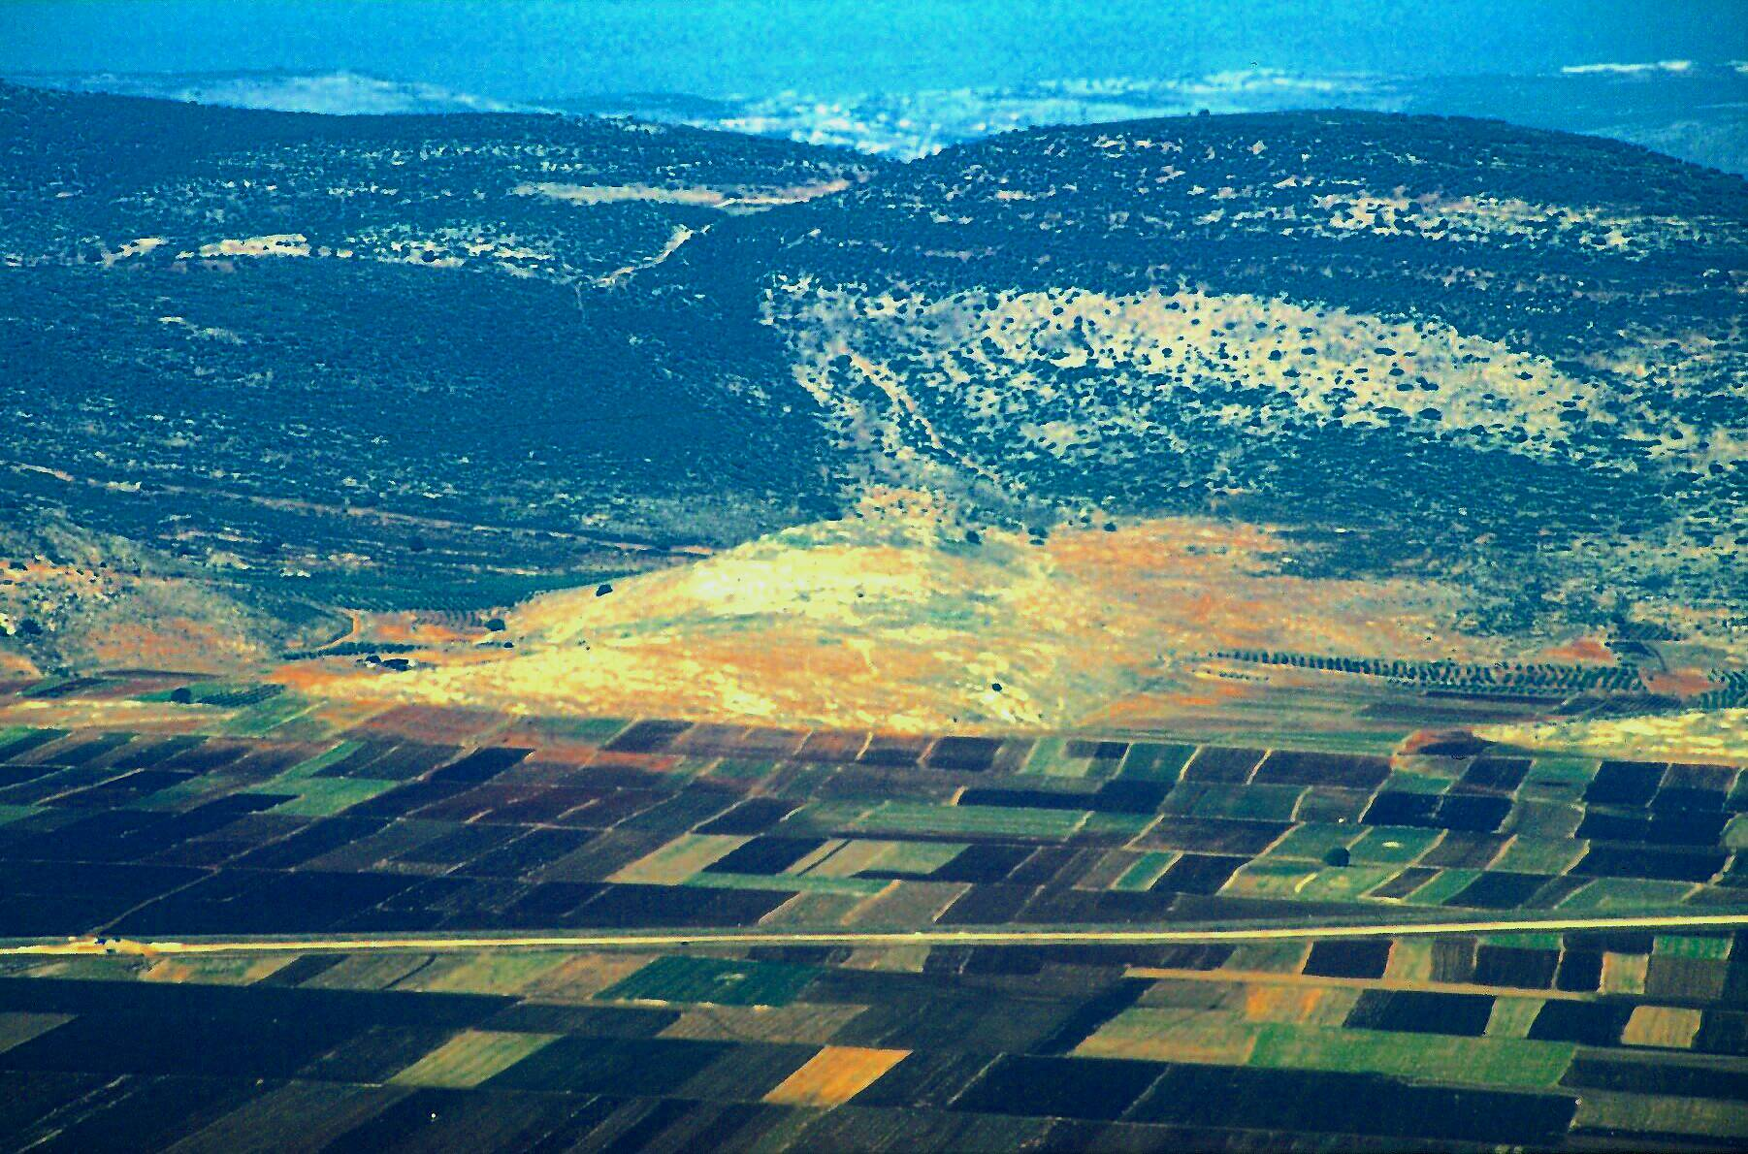
a,m[ef 2;1=11/
JESUS
a,&I
oufawmfpOf/
Jesus Traveled His Land:
umeNrdKU/ a,&Ic&pfawmftOD;qHk;erdwfvu©Pmjyaomae&m
06

Slide 9
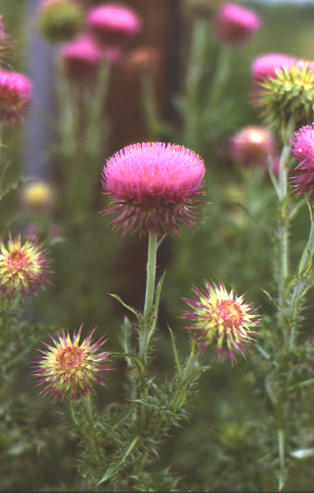
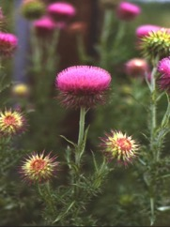


7
a,&I
oufawmfpOf/
ql;avyiftaBumif;pOf;pm;Bunfhyg?
Handbook pg. 39-41
07
1

Slide 10
7
wref 17;16-34
a,&I
oufawmfpOf/
ql;avyef;yHk&Sdaoma,&Ic&pfawmf\c&D;pOf/
Handbook pg. 39-41
08
1

Slide 11
a,m[ef 2;13=2;25/
7
avhvmrItaxmuftul (07)
1/ a,&Ic&pfawm\ftOD;qHk;aom
a,&k&Svif
omoem
a,&I
oufawmfpOf/
ql;avyef;yHk&Sdaoma,&Ic&pfawmfc&D;pOf/
Handbook pg. 39-41
09
1

Slide 12
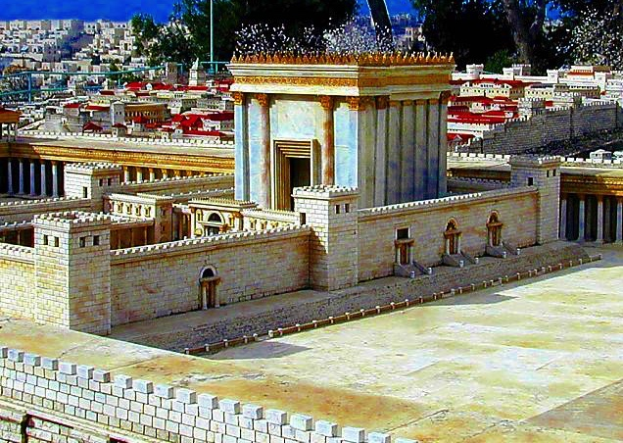
a,m[ef 2;13=2;25/
7
a,&I
oufawmfpOf/
a[&k'frif;BuD;\a,&k&SvifNrdKUeef;awmf
Handbook pg. 39-41
10

Slide 13
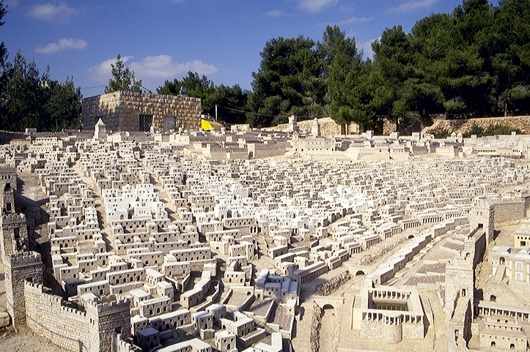
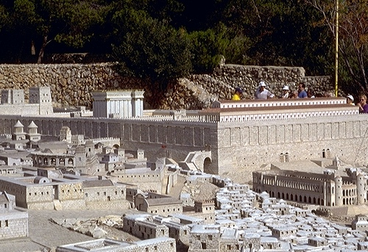
a,m[ef 2;13=2;25/
a,&IumvwGif&Sdaom
a,&k&Svif
a,&I
oufawmfpOf/
ywf0ef;usif&SdaomNrdKU/
Adrmefawmf/ tefwdkeDtdk cHwyf/
Location Credit: Holyland Hotel, Jerusalem
Handbook pg. 39-41
11

Slide 14
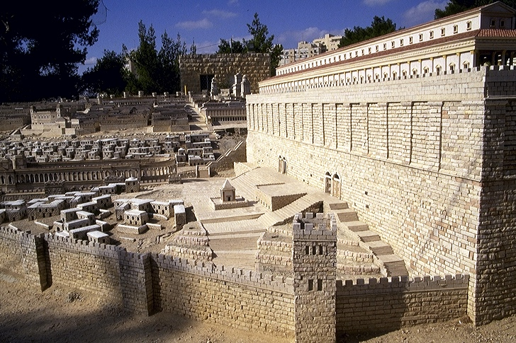
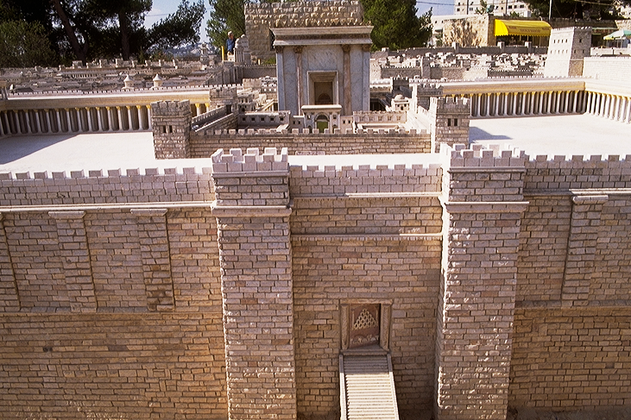
rmuk 11;27/
a,&Itouf&SifpOfumvwGif&Sd aoma,&k&Svif/
a,&I
oufawmfpOf/
Adrmefawmf\awmif
ydkif;t0if0/
ta&SUydkif;t0if0
Location Credit: Holyland Hotel, Jerusalem
Handbook pg. 39-41
12

Slide 15
a,m[ef 4;1=6/
7
tajymif;tvJtjzpf&Srm&dom; vkyf&
a,&I
oufawmfpOf/
a,&I\tOD;qHk;
omoem/
&SdvHk/ wJawmf/
ql;avyef;yHk&Sdaoma,&Ic&pfawmfc&D;pOf/
Handbook pg. 39-41
3
13

Slide 16
rmuk 4;13=16/ 9;1
*gvdvJjynf&Sdaom
uay&aemifomoem/
Bum;cH&Srm&d
vlrsm;/
JESUS
a,&I
oufawmfpOf/
a,&I\tOD;qHk;aoma,&k&SviftrIawmf/
ql;avyef;yHk&Sdaoma,&Ic&pfawmfc&D;pOf/
Handbook pg. 39-41
14

Slide 17
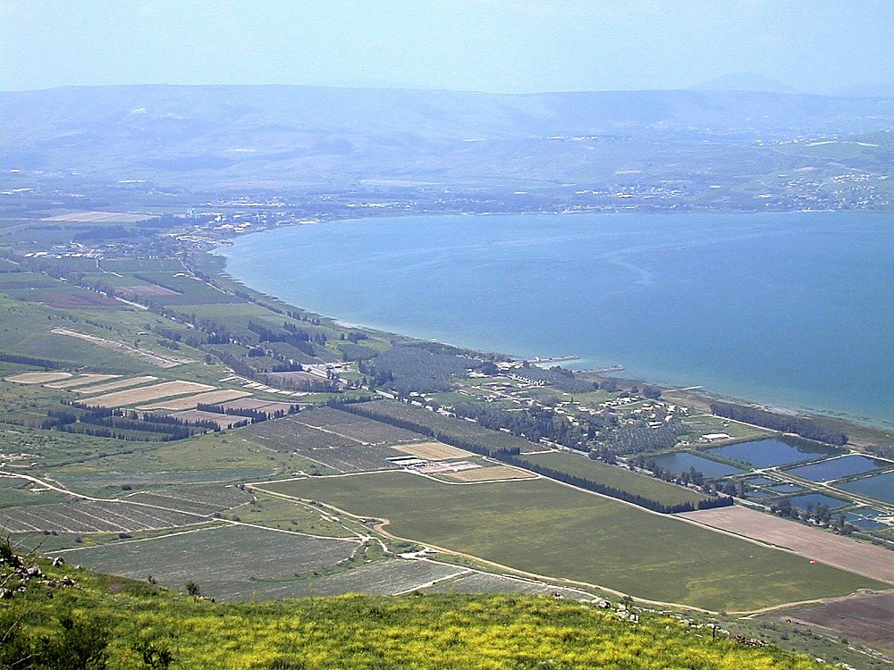
uay&aemifjrdKU omoem XmecsKyf/
JESUS
a,&I
oufawmfpOf/
a,&Iomoeme,fajrc&D;pOf/
*gvdvJyifv,ftaemufawmif urf;&dk;wef;wavQmuf
15

Slide 18
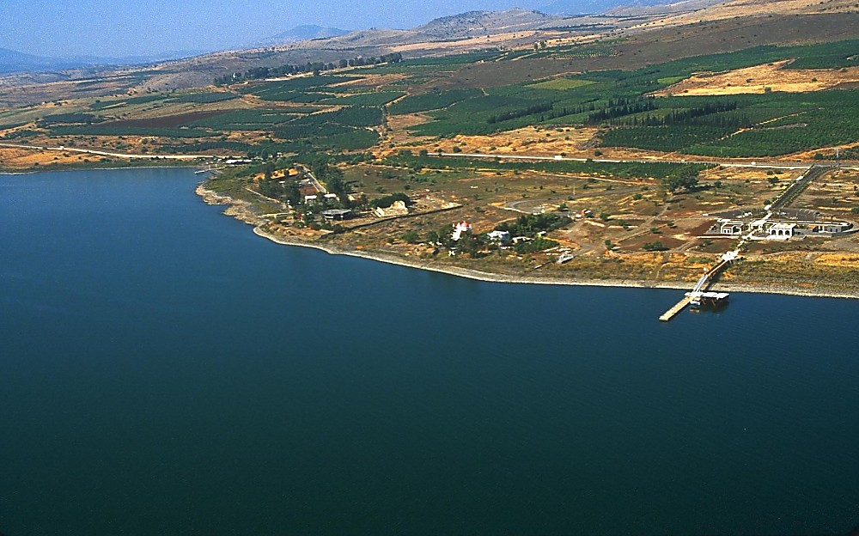
JESUS
a,&I
oufawmfpOf/
a,&I\omoeme,fajrc&D;pOf/
uay&aemif tm; av,mOfay:rSvSrf;jrif&yHk/
16

Slide 19
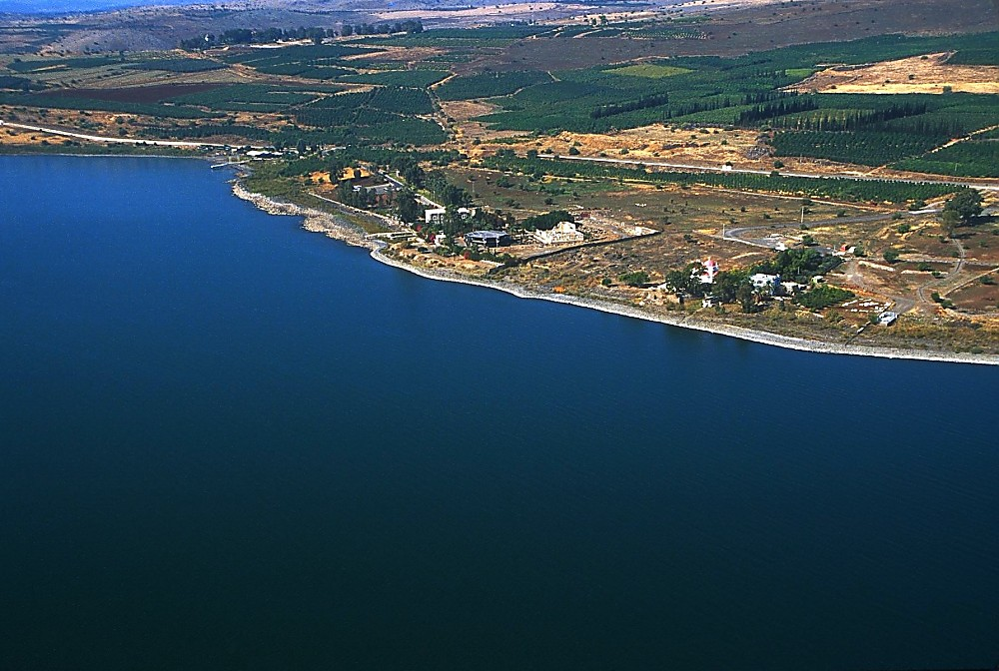
JESUS
a,&I
oufawmfpOf/
a,&I\omoeme,fajrc&D;pOf/
uay&aemif tm; av,mOfay:rSvSrf;jrif&yHk/
17

Slide 20
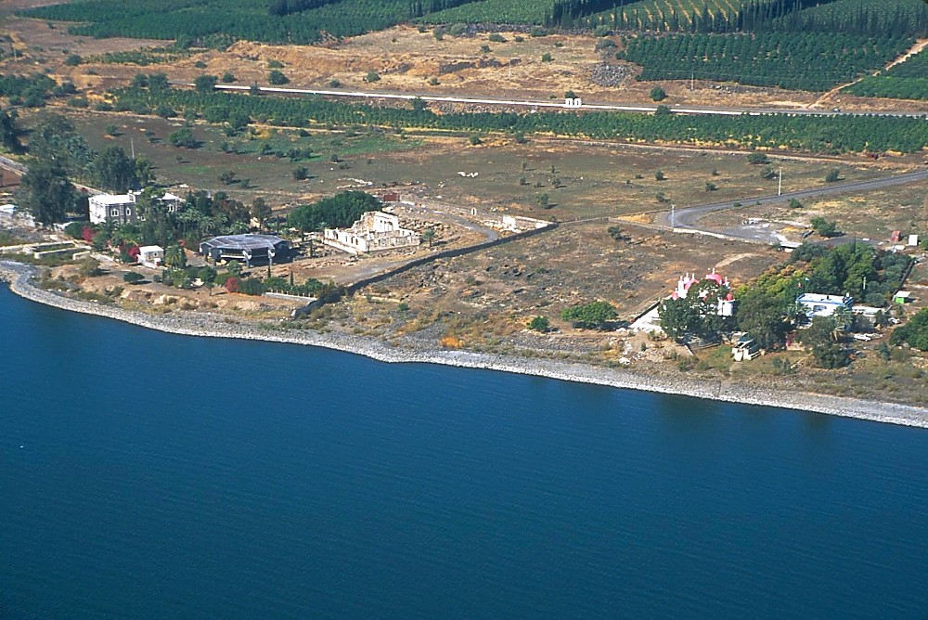
JESUS
a,&I+
oufawmfpOf/
a,&I\omoeme,fajrc&D;pOf/
uay&aemif tm; av,mOfay:rSvSrf;jrif&yHk/
18

Slide 21
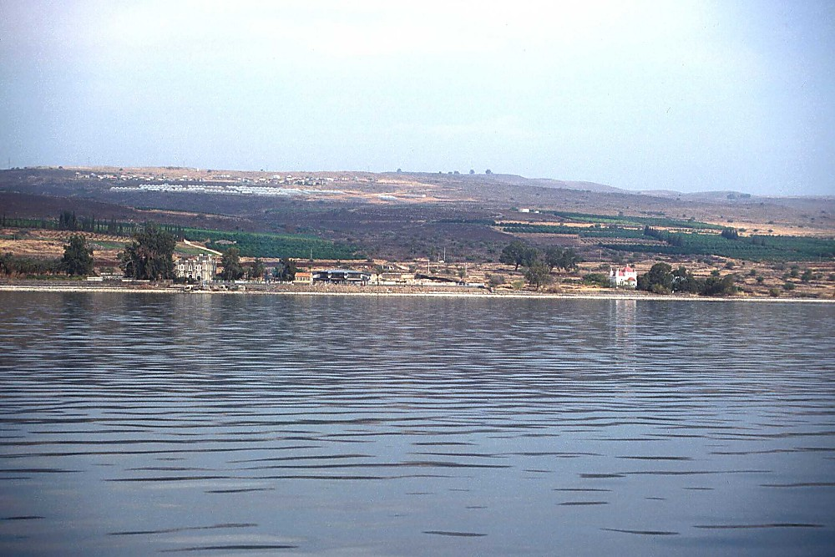
JESUS
a,&I
oufawmfpOf/
a,&I\omoeme,fajrc&D;pOf/
uay&aemif tm; avSay:rSvSrf;jrif&yHk
19

Slide 22
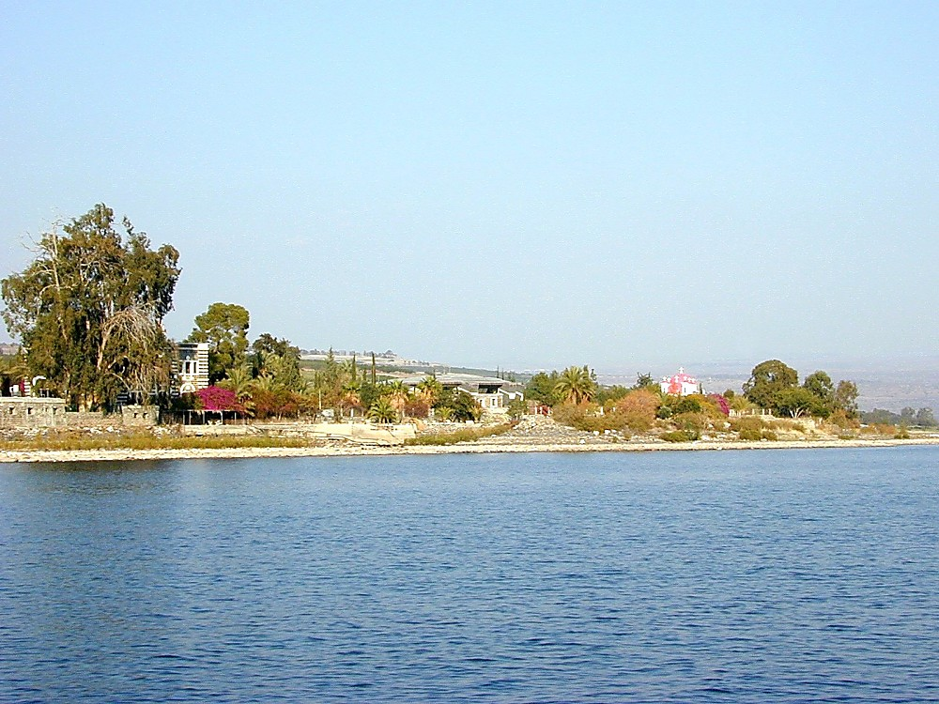
JESUS
a,&I
oufawmfpOf/
a,&I\omoeme,fajrc&D;pOf/
uay&aemif tm; avSay:rSvSrf;jrif&yHk
20

Slide 23
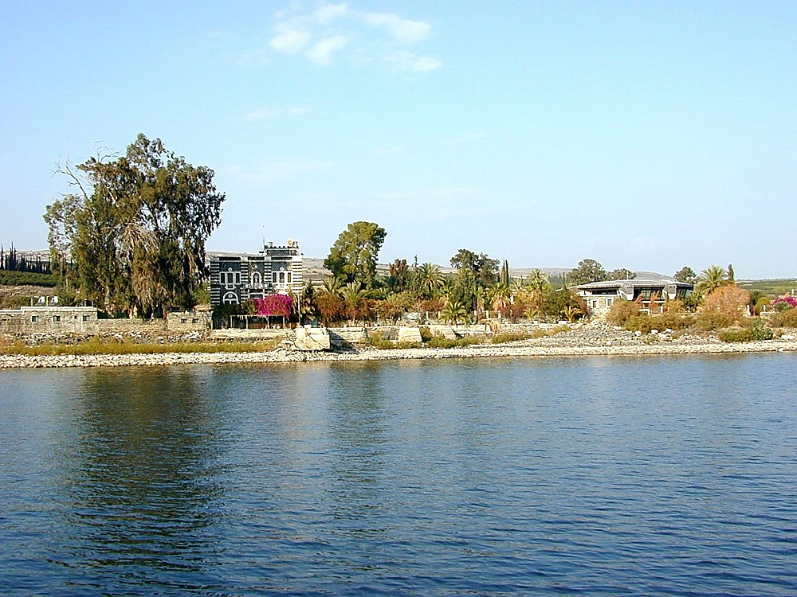
a,&I
JESUS
oufawmfpOf/
a,&I\omoeme,fajrc&D;pOf/
uay&aemif tm; avSay:rSvSrf;jrif&yHk
21

Slide 24
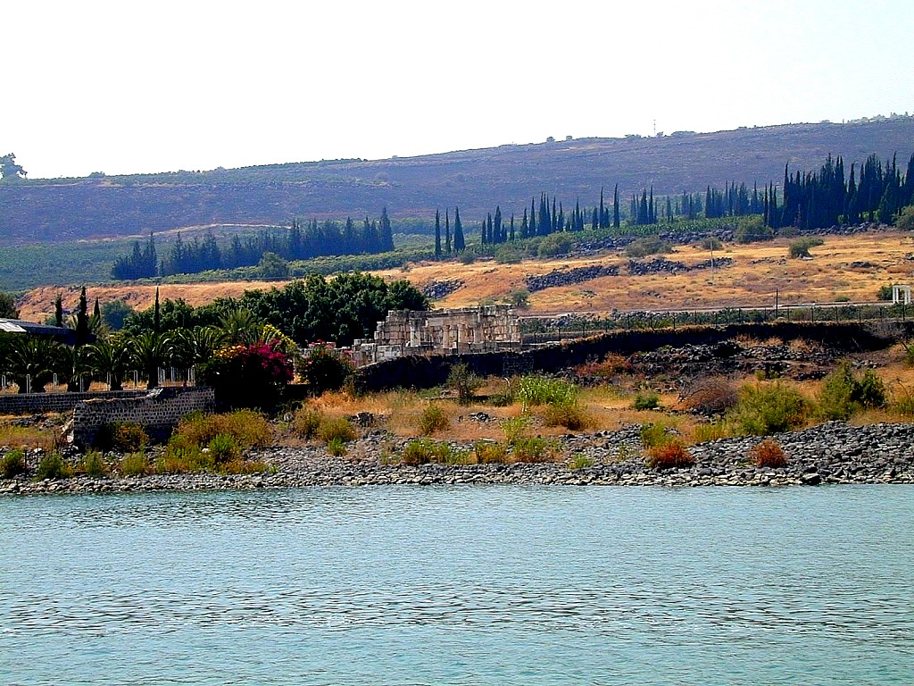
JESUS
a,&I
oufawmfpOf/
a,&I\omoeme,fajrc&D;pOf/
uay&aemif w&m;Z&yf
22

Slide 25
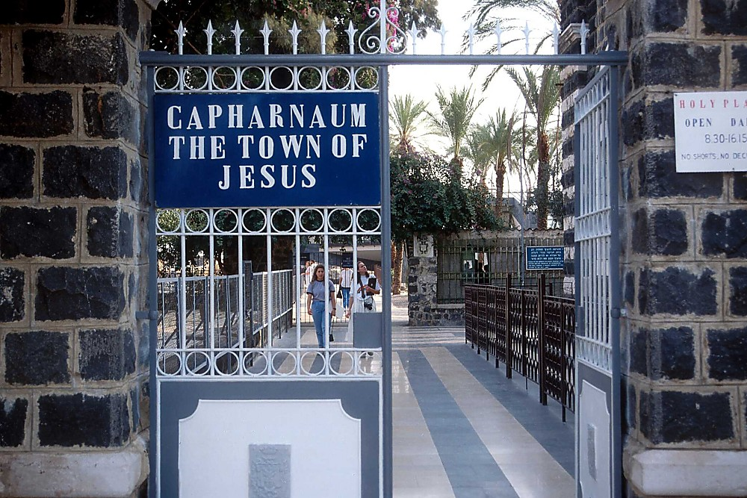
JESUS
a,&I
oufawmfpOf/
a,&I\omoeme,fajrc&D;pOf/
uay&aemifjrdKUt0if0
23

Slide 26
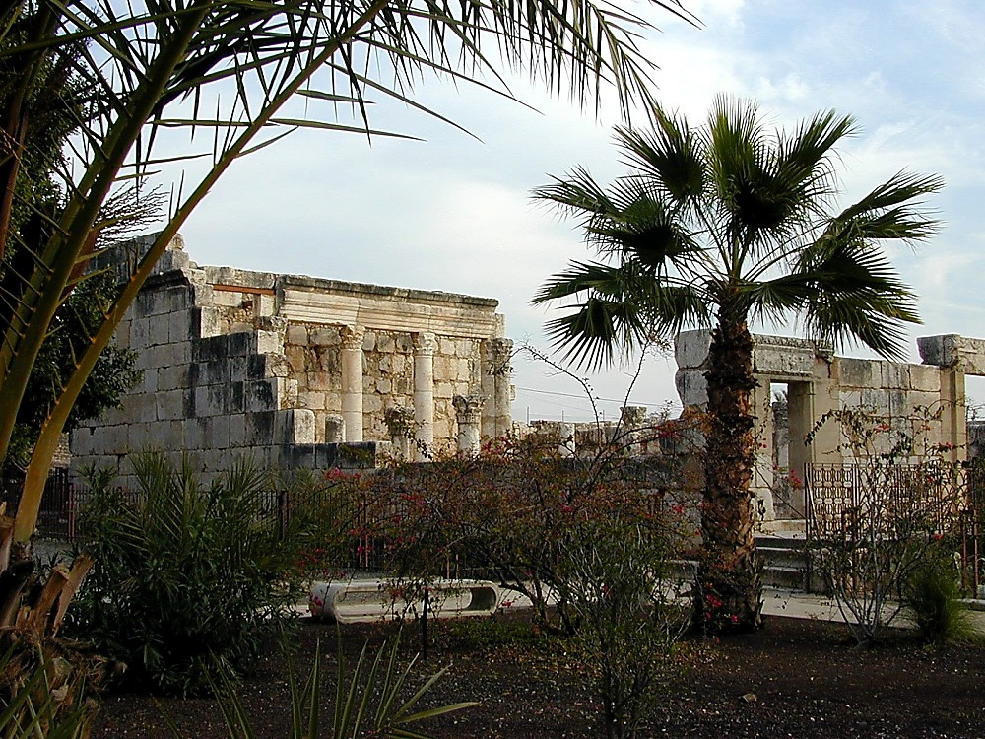
JESUS
a,&I
oufawmfpOf/
a,&I\omoeme,fajrc&D;pOf/
a&S;usaomuay&aemifw&m;Z&yf
24

Slide 27
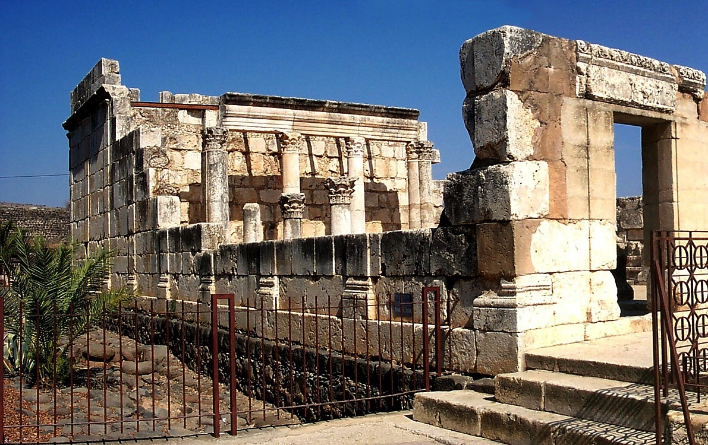
JESUS
a,&I
oufawmfpOf/
a,&I\omoeme,fajrc&D;pOf/
a&S;usaomuay&aemifw&m;Z&yf
25

Slide 28
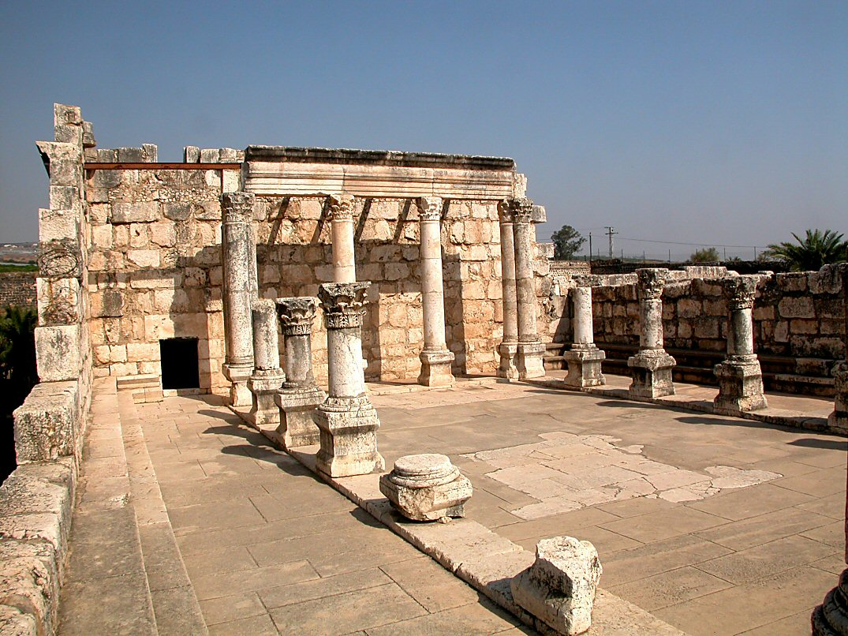
rmuk 1;21/ a,m[ef 6;59
a,&I
oufawmfpOf/
a,&I\omoeme,fajrc&D;pOf/
a&S;usaomuay&aemifw&m;Z&yf
26

Slide 29
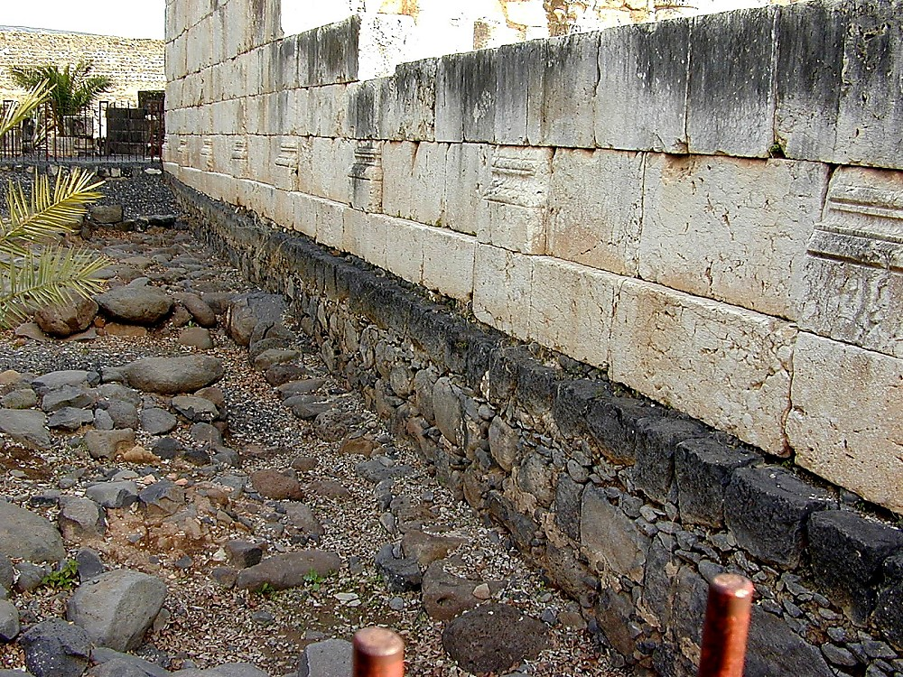
JESUS
a,&I
oufawmfpOf/
a,&I\omoeme,fajrc&D;pOf/
uay&aemifbmaqmhvrf;rsm;
27

Slide 30
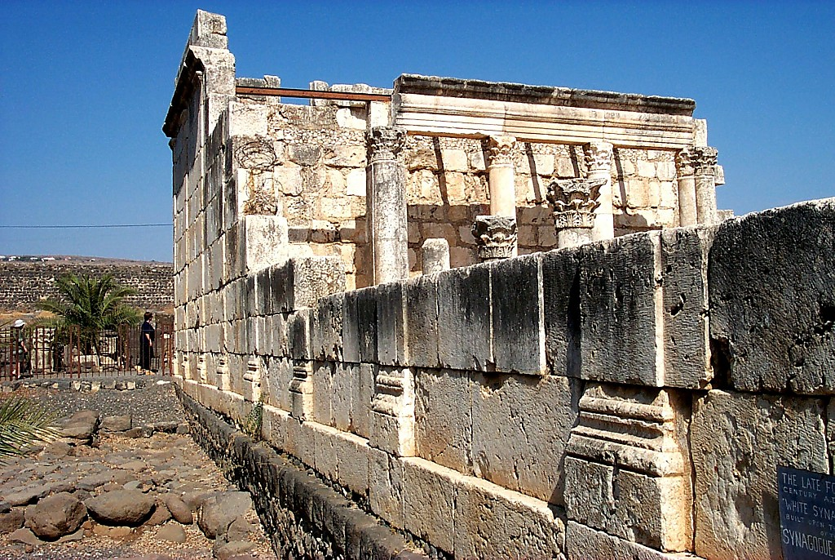
JESUS
a,&I
oufawmfpOf/
a,&I\omoeme,fajrc&D;pOf
uay&aemifbmaqmhvrf;rsm;
28

Slide 31
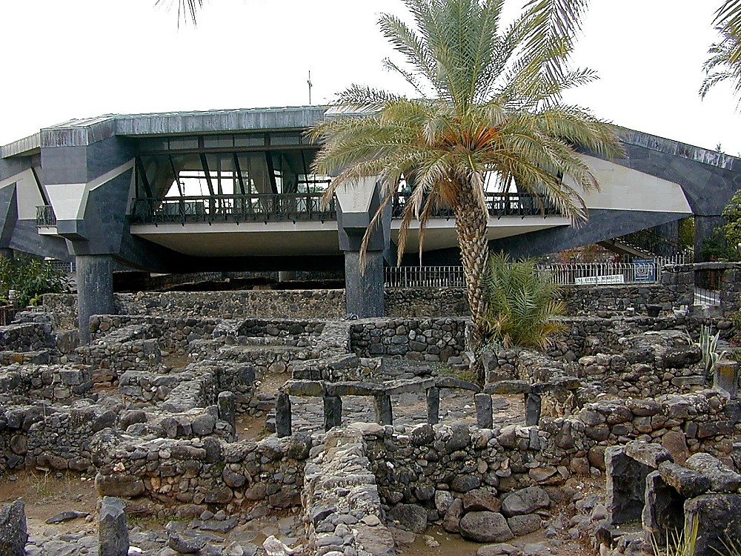
JESUS
a,&I
oufawmfpOf/
a,&I\omoeme,fajrc&D;pOf/
uay&aemifü&Sdaomayw&k.tdrftm; apmifha&Smufxm;yHk
29

Slide 32
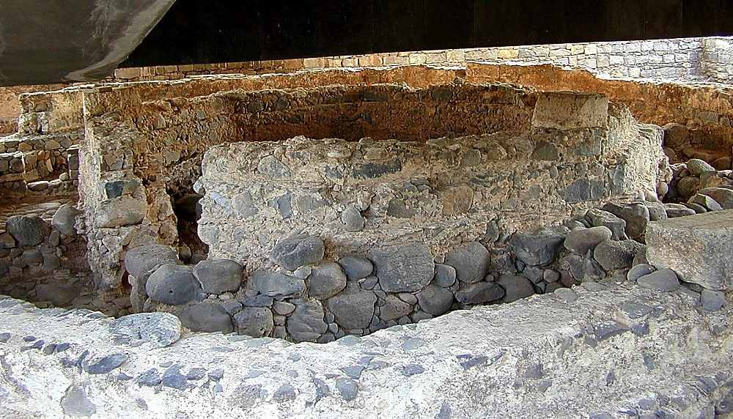
JESUS
a,&I
oufawmfpOf/
a,&I\omoeme,fajrc&D;pOf/
uay&aemifü&Idaomayw&k.tdrftm; apmifha&Smufxm;yHk
30

Slide 33
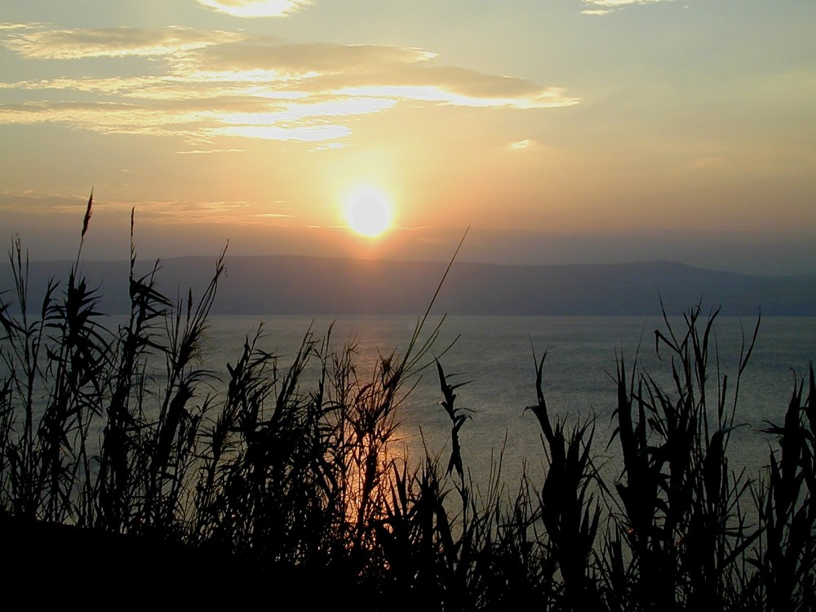
JESUS
a,&I
oufawmfpOf/
a,&I\omoeme,fajrc&D;pOf/
*gvdvJjynfae0ifqnf;qm
31

Slide 34
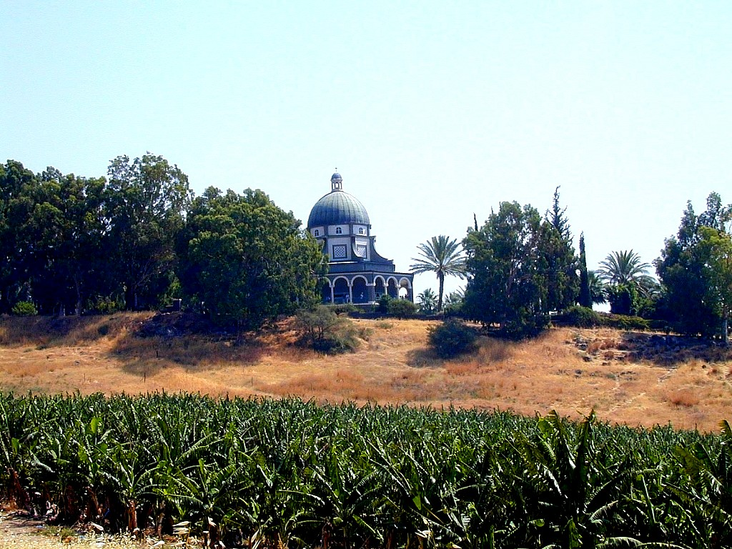
JESUS
a,&I
oufawmfpOf/
a,&I\omoeme,fajrc&D;pOf/
vSyaomawmif
32

Slide 35
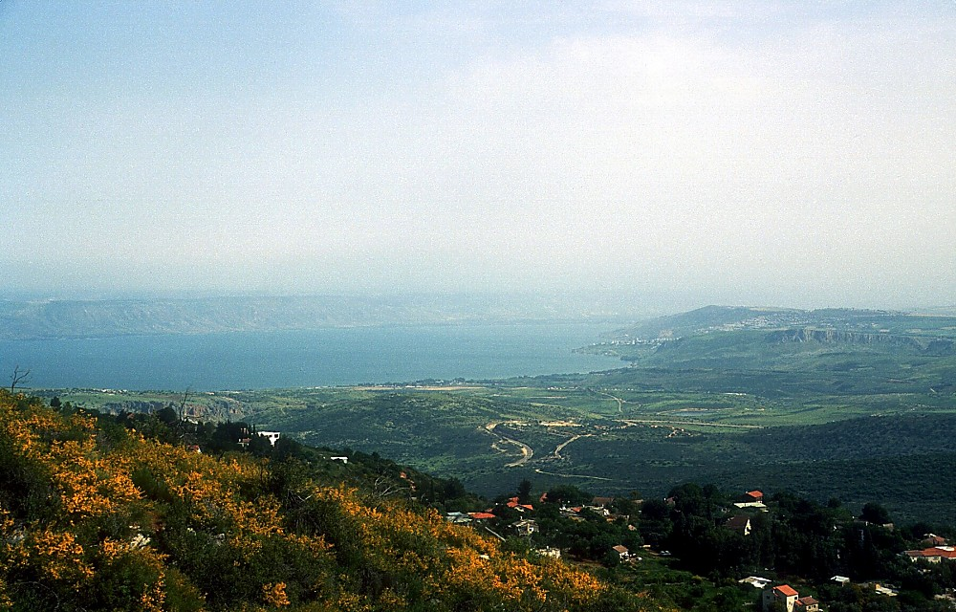
JESUS
a,&I
oufawmfpOf/
a,&I\omoeme,fajrc&D;pOf/
*gvdvJjynftm;tjrifhrSjrif&yHk
33

Slide 36
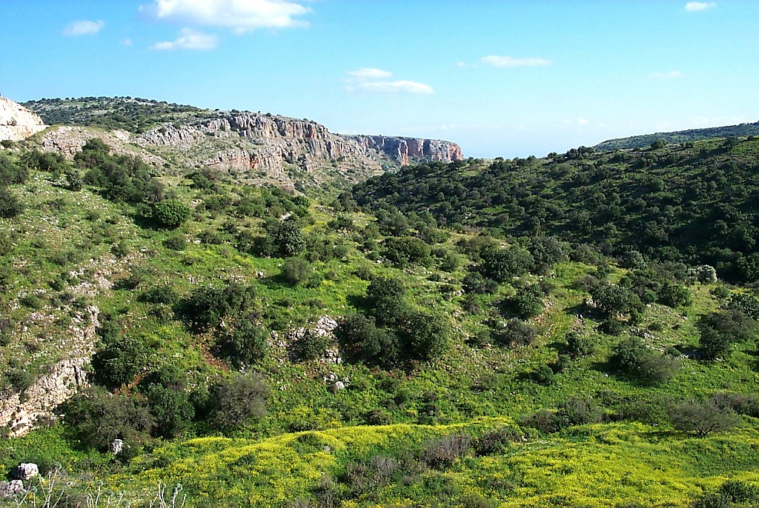
JESUS
a,&I
oufawmfpOf/
a,&I\omoeme,fajrc&D;pOf/
*gvdvJjynf\jrifhaomt&yf
34

Slide 37
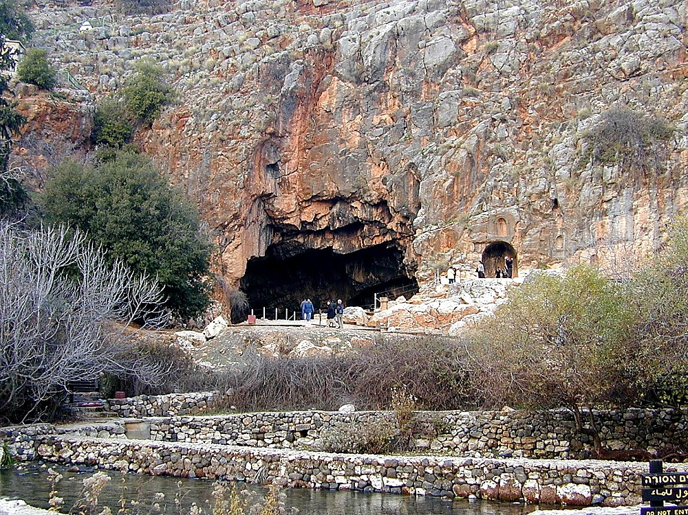
r\J 16;13=28
JESUS
a,&I
oufawmfpOf/
a,&I\omoeme,fajrc&D;pOf/
uJom&D;,m;? zdvdydÜe,f/ ayw&k\ausmuf[ktrnfwGifaomae&m
35

Slide 38
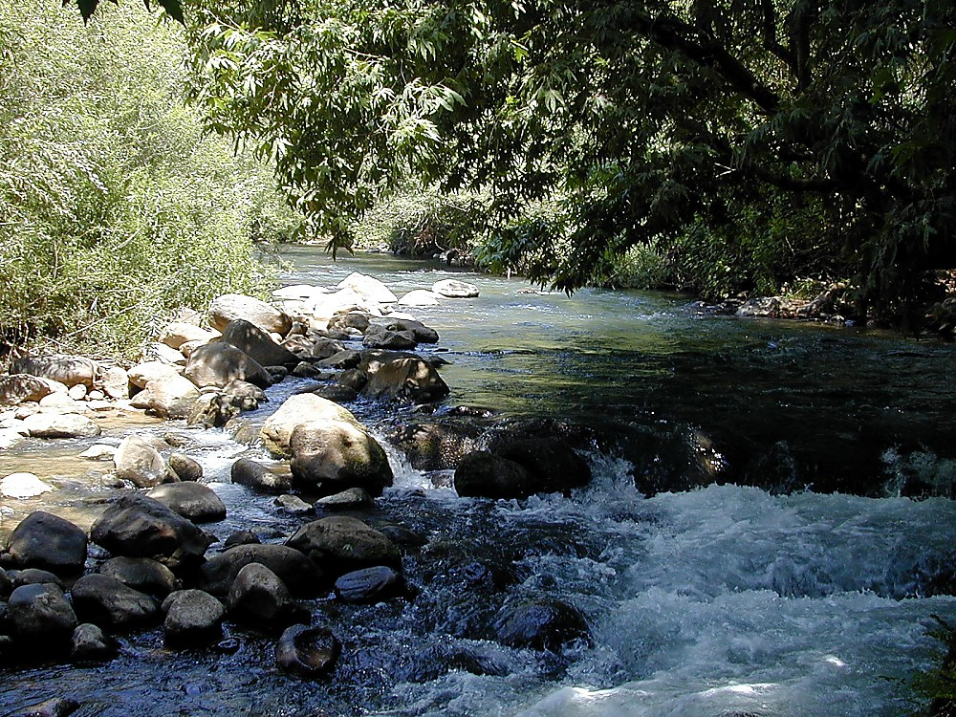
JESUS
a,&I
oufawmfpOf/
a,&I\omoeme,fajrc&D;pOf/
a,m'efjrpftxufydkif;
36

Slide 39
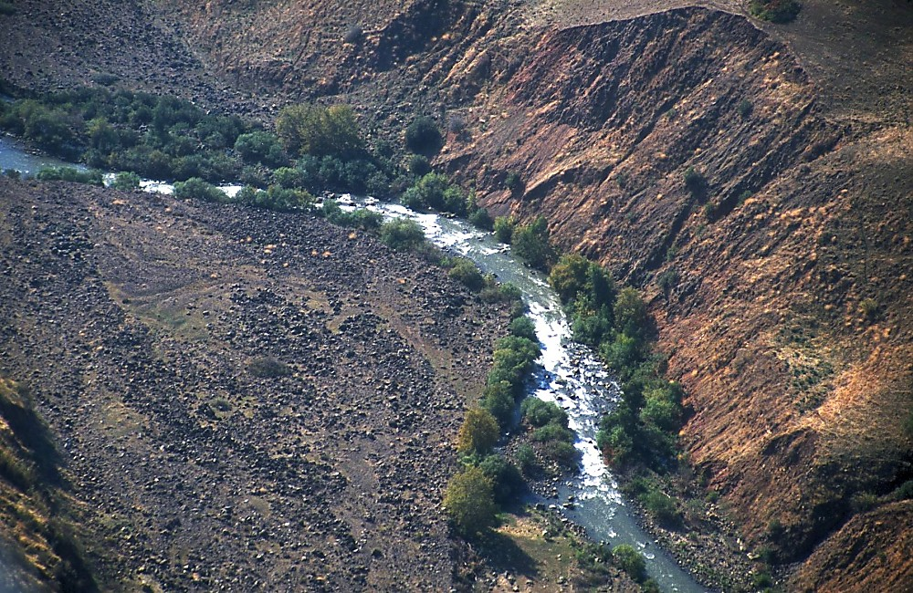
JESUS
a,&I
oufawmfpOf/
a,&I\omoeme,fajrc&D;pOf/
awmifydkif;odkUpD;qif;aeaoma,mf'efjrpf
37

Slide 40
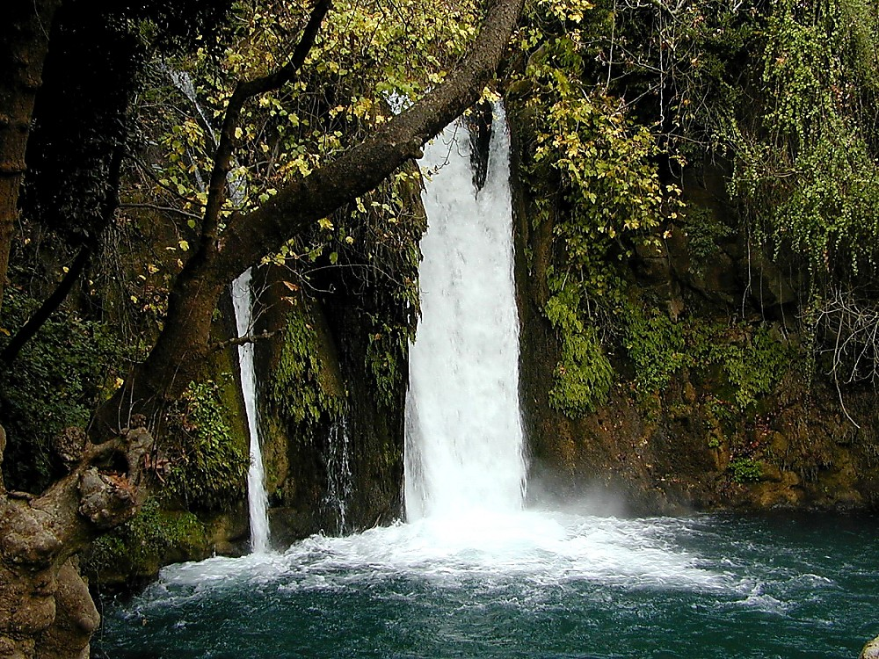
JESUS
a,&I
oufawmfpOf/
a,&I\omoeme,fajrc&D;pOf/
*gvdvJjynf&SdtvQHty,fa&rsm;
38

Slide 41
roJ 4;25/ rmuk 7;31
3
*gvdvJjynf&Sd uay&aemifomoem/
Bum;cH&Srm&d
vlrsm;/
a,&I
oufawmfpOf/
a,&I\a,&k&SviftOD;qHk;trIawmf/
ql;avyef;yHk&Sdaoma,&Ic&pfawmf\c&D;pOf/
39
2

Slide 42
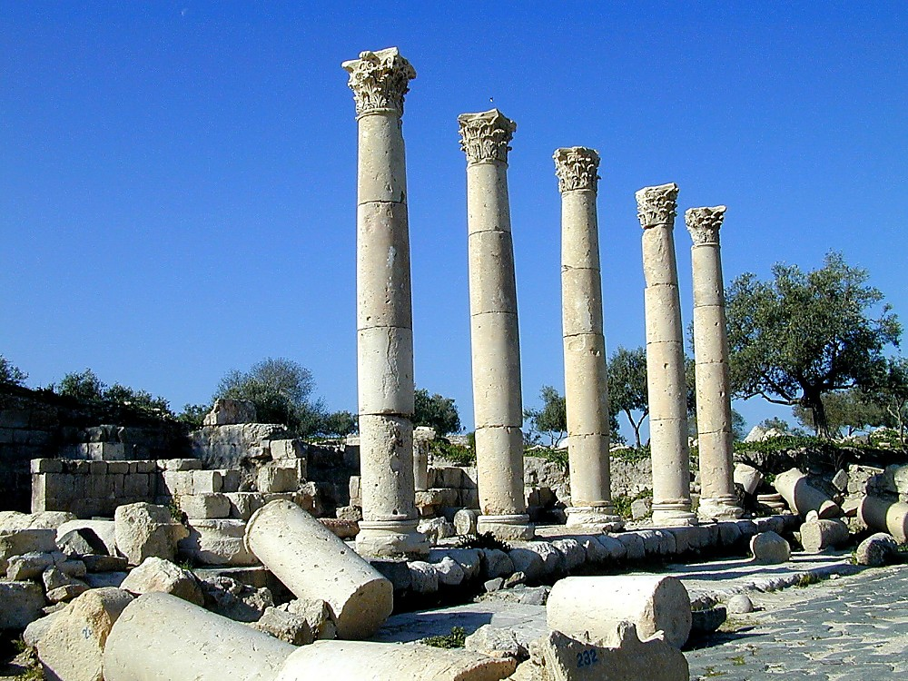
r\J 8;28/ rmuk 5;1 vkum 8;26=37
JESUS
a,&I
oufawmfpOf/
a,&I\omoeme,fajrc&D;pOf/
*g'&S *&dyHkpH NrdKUawmf
40

Slide 43
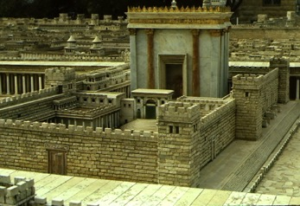
a,m[ef 2;23/ 4;45/ 5;1/ 10/ 22/ 12;12/
3
*gvdvJjynf&Sd uay&aemifomoem/
ysufpD;oGm;aom uay&aemif
Bum;cH&Srm&d
vlrsm;/
a,&I
a,&I\ a,&k&Svif tOD;qHk; trIawmf/
oufawmfpOf/
a,&k&Svif
ql;avyef;yHk&Sdaoma,&Ic&pfawmf.c&D;pOf/
41
2

Slide 44
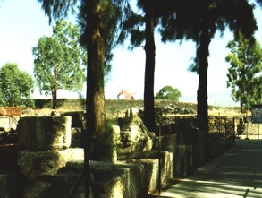

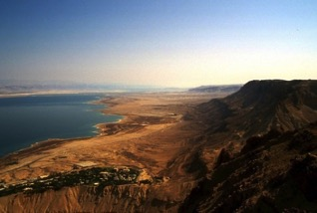
a,m[ef 2;23/ 4;45/ 5;1/ 10/ 22/ 12;12/
uay&aemifESifha,&k&Svifrdkif 80 uGma0;jcif;/
CAPERNAUM TO JERUSALEM: 80 MILES
*gvdvJtdkifrSwqif.a,mf'efjrpf? a,mf'efjrpfrSwqifh yifv,faoxJodkU rdkifaygif; 75 rdkifuGma0;
SEA OF GALILEE, JORDAN RIVER TO DEAD SEA: 75 MILES
JESUS
a,&I
oufawmfpOf/
Handbook pg. 39-41
2
42

Slide 45
vkum 19;2=10
*gvdvJjynf&Sduay&aemifomoem/
Bum;cH&Srm&d
vlrsm;/
yg&d,efjynfomoem
a,&I
a,&I\ a,&k&Svif tOD;qHk; trIawmf/
oufawmfpOf/
ql;avyef;yHk&Sdaoma,&Ic&pfawmf\c&D;pOf/
43

Slide 46
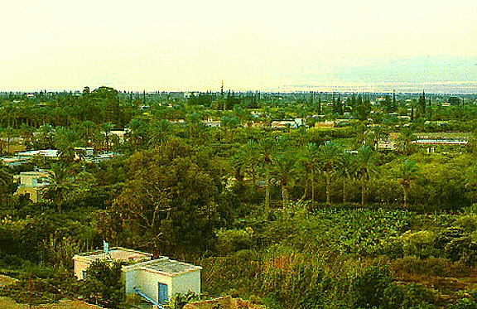
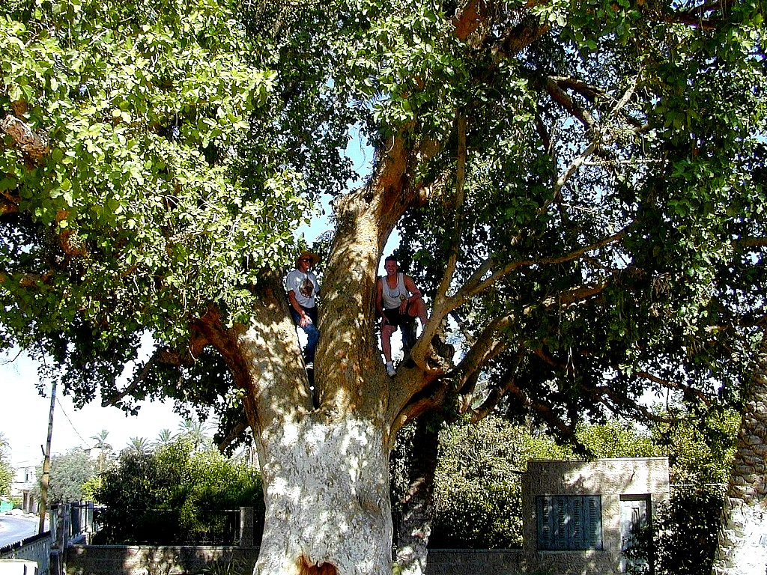
vkum 19;2-10
a,&I
oufawmfpOf/
Jesus Traveled His Land:
Zacheus In The Sycamore Tree
Handbook pg. 39-41
1
44

Slide 47
romJ21;10=14/ a,m[ef 12;13/
*gvdvJjynfY&Sdaomu ay&aemifomoem/
Bum;cH&Srm&d
vlrsm;/
4/ yg&djrdKUomoem
a,&I
a,&I\ a,&k&SviftOD;qHk; trIawmf/
oufawmfpOf/
5/
a,&k&Svif
aemufqHk;omoem
ql;avyef;yHk&Sdaoma,&Ic&pfawmf\c&D;pOf/
43

Slide 48
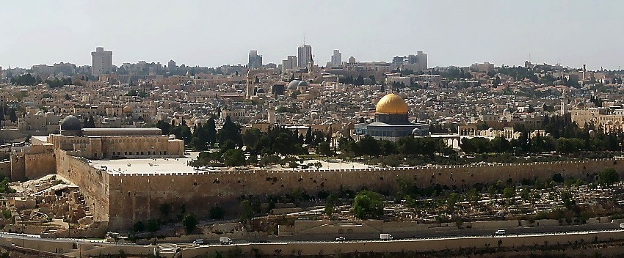
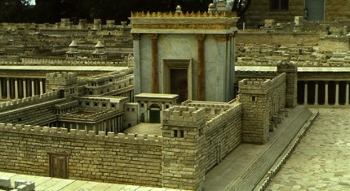

ro 21;12/
a,&k&SvifAdrmefawmftm; ,aeUawGU&yHk/
a,&I
oufawmfpOf/
Adrmefawmfta&SYawmifydkif; t0if0/
tmNA[H\arm&d,awmifonf*sL;vlrsdK;wdkYAdrmefawmfjzpfonf
Handbook pg. 39-41
46
2

Slide 49

roJ21;12/
tu,fíocifa,&Itcsdefumv\Adrmefawmftm;,aeY awGU&vQif
a,&I
oufawmfpOf/
Handbook pg. 39-41
47

Slide 50
romJ26;28/ rmuk 14;24/ vkum 22;20
7
a,&I
oufawmfpOf/
um;wdkif/
y#dnmOfopf
a,&I
oufawmfpOf/
um;wdkif/
Handbook pg. 39-41
48

Slide 51

vkum 22;42/
7
tdktz/ tvdkawmf&SdvQifþcGufudktuREkfyfrSvGJapawmfrlyg?
a,&I
oufawmfpOf/
um;wdkif/
oHvGifawmifwGif&Sdaom a*oa&Sref O,smOf/
Handbook pg. 39-41
1
49

Slide 52
romJ26=28/ rmuk 14=16/ vkum 23=24/ a,m[ef 19=20/
7
a,&I
oufawmfpOf/
um;wdkif/
y#dnmOfopf/
a,&I
trINyD;NyD/
oufawmfpOf/
um;wdkif/
a,&ItaocHjcif;/
a,&I\Zmye/
a,&I&Sifjyefxajrmufjcif;
Handbook pg. 39-41
4
50

Slide 53
r\J 16;18/ 28;19/
7
a,&I
oufawmfpOf/
um;wdkif/
toif;awmf
toif;awmfodkh ac:xkwfjcif;cH&olrsm;/
a,&I
oufawmfpOf/
um;wdkif/
toif;awmf/
a,&k&SvifjrdKUrSpíurÇmBuD;tESHU
Handbook pg. 39-41
4
51

Slide 54

toif;awmf/
vIdif;vHk;txGwftxdwf
a,&I
oufawmfpOf/
um;wdkif/
toif;awmf/
Handbook pg. 39-41
2
52

Slide 55
a,&k&SvifNrdKUrSpaom ,k'jynf? &Srm&djynf? &Srm&djynf? ajrBuD;pGef;wdkifatmifig\oufao jzpfBuvdrfhrnf/ wref 1;8
)
The Church:
What are we doing / about it?
a,&I
oufawmfpOf/
um;wdkif
toif;awmf/
Handbook pg. 39-41
1
53

Slide 56
romJ/ rmuk/ vkum/ a,m[ef/ {0H*vd/
7
trSefw&m;ESif. tawG;ac:
a,&I
oufawmfpOf
um;wdkif
toif;awmf
{0Ha*vd
a,&I
oufawmfpOf/
um;wdkif/
toif;awmf/
{0Ha*vd
Handbook pg. 39-41
54

Slide 57
wynfhawmfwdkU.trIawmf/
7
trSefw&m;ESif. tawG;ac:
a,&I
oufawmfpOf/
um;wdkif/
toif;awmf ordkif;/
toif;awmf/
{0Ha*vd
a,&I
wrefawmf0w¦K/
oufawmfpOf/
um;wdkif/
toif;awmf/
{0Ha*vd
wrefawmf0wˆK/
Handbook pg. 39-41
55

Slide 58
a&mrBo0g'wapmifrS ,k'‘Bo0g'pmapmifxd
7
trSefw&m;ESif.tawG;tac:
a,&I
oufawmfpOf/
um;wdkif/
toif;awm fordkif;/
toif;awmf/
{0Ha*vd
a,&+
wrefawmf0w¦K/
toif;awmfudpö/
oufawmfpOf/
um;wdkif/
toif;awmf/
Bo0g'pm
{0Ha*vd
wrefawmf0wˆK/
-o0g'pm
Handbook pg. 39-41
56

Slide 59
Asm'dwfusrf;/
7
trSefw&m;ESifhtawG;ac:
a,&I
oufawmfpOf/
um;wdkif/
toif;awmfordkif;/
toif;awmf/
{0Ha*vd
a,&I
wrefawmf0w¦K/
toif;awmfudpö/
oufawmfpOf/
um;wdkif/
toif;awmf/
Bo0g'pm
{0Ha*vd
wrefawmf0wˆK/
-o0g'pm
Asm'dwfusrf;/
Asm'dwfusrf;/
xm0&tem*gwf
Handbook pg. 39-41
57

Slide 60

usrf;Zmwfodrf;ydkif;? bkef;awmfESifhjynfhpHkaom aemufqHk;aomumvtm;Asm'dwfusrf;wifawGU&jcif;jzpfonf/ *wdawmfrsm;jynfhpHkjyD/
ESpfaygif; 1000 umvwGif tajctaetay:rrlwnfaom bk&m;ocif\0dnmOfawmf BuG,f0jynfhpHkjcif;&Sdrnf?
a,&I
oufawmfpOf/
um;wdkif/
toif;awmf/
{0Ha*vd
wrefawmf0wˆK/
Bo0g'pm
bk&m;ocifESifhtmNA[HESpfudk,fBum; oli,fcsif;uJhodkU rdwfaqGzGJUrI y#dOmOfonfatmif jrifcJhNyD/
Asm'dwfusrf;/
John Walvoord
Handbook pg. 39-41
3
8.0.03f.
© 2004 TBBMI
PHOTO ©NASA
58

Slide 61

tmNA[Hy#dOmOf/
ac:xkwfjcif;
urÇmOD; 12;1=3
a,&I
oufawmfpOf/
um;wdkif/
e,fajr/
rsdK;EG,f/
aumif;csD;/
toif;awmf/
{0Ha*vd
wrefawmf0wˆK/
Bo0g'pm
Asm'dwfusrf;/
e,fajr/
'g0d'f/
topf/
w&m; 30;1-10/
2"r® 7;4-16/
a,&rd31;31-33/
Handbook pg. 39-41
59

Slide 62
tmNA[HyÉdOmOf/
ac:xkwfjcif;/
urÇmOD; 12;1-3
a,&I
oufawmfpOf/
e,fajr/
rsdK;EG,f/
aumif;csD;/
um;wdkif/
toif;awmf/
{0Ha*vd
wrefawmf0wˆK/
Bo0g'pm
e,fajr/
'g0d'f/
topf/
Asm'dwfusrf;/
w&m; 30;1-10/
2"r®7;4-16/
a,&rd 31;31-33/
Handbook pg. 39-41
59

Slide 63
tmNA[Hy#dOmOf/
ac:xkwfjcif;/
urÇmOD; 12;1=3
a,&I
oufawmfpOf/
e,fajr/
rsdK;EG,f/
aumif;csD;/
um;wdkif/
toif;awmf/
{0Ha*vd
wrefawmf0wˆK/
Bo0g'pm
e,fajr/
'g0d'f/
topf/
Asm'dwfusrf;/
w&m; 30;1-10/
2"r® 7;4-16/
a,&rd31;31-33/
Handbook pg. 39-41
59

Slide 64
tmNA[Hy#dOmOf/
ac:xkwfjcif;/
urÇm 12;1=3
a,&+
oufawmfpOf/
e,fajr/
rsdK;EG,f/
aumif;csD;/
um;wdkif/
toif;awmf/
{0Ha*vd
wrefawmf0wˆK/
e,fajr/
topf/
Bo0g'pm
'g0d'f/
Asm'dwfusrf;/
w&m; 30;1-10/
2"r®7;4-16/
a,&rd 31;31-33/
Handbook pg. 39-41
59

Slide 65
tmNAS[Hy#dOmOf/
ac:xkwfjcif;/
zefqif;jcif;/
ABRAHAM
tmNA[H/
urÇm 12;1=3
ABRAHAM
/ a,moyf/
ABRAHAM
/ arma&S/
/ a,m&Sk
rif;rJh/
rif;pH/
a,&+
oufawmfpOf/
e,fajr/
rsdK;EG,f/
aumif;csD;/
um;wdkif/
/ zrf;qD;/
toif;awmf/
{0Ha*vd
qdwfNidrf/
wrefawmf0wˆK/
Bo0g'pm
e,fajr/
'g0d'f/
topf/
Asm'dwfusrf;/
a,&Sk
w&m; 30;1-10/
2"r® 7;4-16/
a,&rd 31;31-33/
Handbook pg. 39-41
59

Slide 66

xdkUaBumif.
a,&+
oufawmfpOf/
um;wdkif/
toif;awmf/
{0Ha*vd
wrefawmf0wˆK/
a,&k&Svif/ oHvGifawmifay:&Sd a*oa&SrmefO,smOf
Bo0g'pm
Asm'dwfusrf;/
64
1

Slide 67
a,&Iu/ aemifw&Buavmh/ aumif;uifEdkifiHawmf wnfvkeD;NyD/ [laomw&m;udka[mpjyKawmfrl\/ *gvdvJwavQmufBuGawmfrlí qHk;rBo0g'ay;vQuf EdkifiHawmfESifh,SOf aom{0Ha*vdw&m; udka[mvsuf--- roJ 4;17?23/
a,&I
oufawmfpOf/
um;wdkif/
toif;awmf/
{0Ha*vd
wrefawmf0wˆK/
Bo0g'pm
Asm'dwfusrf;/
65

Slide 68
roJ6;33 bk&m;ocifEdkifiHawmfESifhajzmifhrwfjcif;w&m;udka&S;OD;pGm&SmBuavmh/ aemufrSxdkt&mrsm;udkxyfí ay;awmfrlvwHh/
a,&+
oufawmfpOf/
um;wdkif/
toif;awmf/
{0Ha*vd
wrefawmf0wˆK/
Bo0g'pm
Asm'dwfusrf;/
66

Slide 69
aumavmoJ 1;13/ arSmifrdkufwefcdk;rSvnf;igwdkUudkEIwfí cspfawmfrlaom om;awmf\EdkifiH xJ odkYoGif;awmfrl\/
a,&I
oufawmfpOf/
um;wdkif/
toif;awmf/
{0Ha*vd
wrefawmf0wˆK/
Bo0g'pm
Asm'dwfusrf;/
67

Slide 70
usrf;pmwpftkkyfvHk;\ t"dutusqHk;aomtcsuf 2 ck
bk&m;ocifbkef;awmftm; csD;ajrSmufjcif;ESifh azmfjyjcif;
a,&I
oufawmfpOf/
um;wdkif/
toif;awmf/
{0Ha*vd
wrefawmf0wˆK/
bk&m;ocif\ EdkifiHawmf xJodYkac:
oGif;,laqmifjcif;
Bo0g'pm
Asm'dwfusrf;/
68
2

Slide 71
EdlifiHawmftrSefwnf&Sdjcif;/
a,&Ic&pfawmfonfaysmufqHk;aeaom olwdkUudku,fwif&efMuGqif;vmcJhonf? xdkxm0&toufudk&&Sd&ef/ ar&Sd,u,fwif&Sif\ {0Ha*vdowif;aumif;udk,HkBunf&rnf?
a,&+
oufawmfpOf/
um;wdkif/
toif;awmf/
{0Ha*vd
wrefawmf0wˆK/
Bo0g'pm
Asm'dwfusrf;/
xdYkaBumifh uRekfyfwdkYoGm;í ajymBum;&rnf?
69
1

Slide 72

7
urÇOD;usrf;-Asm'dwfusrf;/
zefqif;jcif;/ N
rif;rJh/
zefqif;jcif;
tOD;qHk;vlom;/
w&m;olBuD;/
tOD;qHk;tjypf
350
tOD;qkH;owif;aumif;/
350
tOD;qHk;rdom;pk/
DC
(1000 B.C.)
tOD;qHk;vlowfrI
rif;pH/
(1000 B.C.)
a&BuD;rI- oufwef@/
S - D - S
DC
arQmfpif/
ESpfjcrf;uJG/
jzpfpOf 3 &yf
awmif - ajrmu/f
qdwfNidrf
(2000 B.C.)
zefqif;jcif;/
tmNA[H/
(2000 B.C.)
/,k'/
Áoa&v
NC
a,±m
AC
10 2
C 7 S J
zdwfac:jcif;/
AC
ya&mzufrsm;/
NC
L - S - B
20-J 20-R
I - I
200 350
J - E
tm&+&d/ AmAkvkef/
12
zrf;qD;umv
7 = 4 + 3
a,moyf/
70 ESpf/
u|efb0/
vrf;aBumif; 3ck/
430
ESpf 100/ 50000 OD;/
lvl av; OD;
Z - E - N
(1500 B.C.)
arma&S/
(1500 B.C.)
(500 B.C.)
xGufajrmuf&m/
qdwfNidrf
qdwfNidrf
tvufZENm;
odeawmif/
a&mrpepf
M - C - C
uma'&S/
LC
a,m
40
40
LC
oufawmfpOf/
avhvmrItaxmuftul
(4) (31)
a'oemig;ck/
a,m
um;wdkif/
a,m&I
toif;awmf/
{0Ha*vd
a,&dacg/
wrefawmf0w¦K/
e,fajrcGJa0jcif;/
Bo0g'pm
Asm'dwfusrf;/
01
2

Slide 73



7
urÇmOD;/Asm'dwfusrf;/
zefqif;jcif;/
rif;rJh/
tOD;qHk;vlom;/
w&m;olBuD;/
tOD;qHk;tjypf
350
tOD;qkH;owif;aumif;/
350
tOD;qHk;rdom;pk/
DC
(1000 B.C.)
tOD;qHk;vlowfr+/
rif;pH/
(1000 B.C.)
a&BuD;rI/ oufwefY
S - D - S
DC
arQmfpif/
ESpfjcrf;uJG/
awmif ajrmu/f
(2000 B.C.)
tmNA[H/
(2000 B.C.)
/,k'/
Á£oa&v
NC
AC
10 2
zdwfac:jcif;/
AC
ya&mzufrsm;/
NC
L - S - B
20-J 20-R
I - I
200 350
J - E
tm&I&d/ AmAkvkef/
12
zrf;qD;umv
a,moyf/
70 ESpf/
uRefb0/
vrf;aBumif; 3ck/
430
ESpf 100/ 50000 OD;/
Z - E - N
(1500 B.C.)
arma&S/
(1500 B.C.)
(500 B.C.)
xGufajrmuf&m/
S
qdwfNidrf
tvufZENm;
odeawmif/
a&mrpepf
M - C - C
uma'&S/
LC
a,m
40
40
LC
oufawmfpOf/
a'oemig;ck/
um;wdkif/
a,m&I/
toif;awmf/
{0Ha*vd
a,&dacg/
wrefawmf0w¦K/
e,fajrcGJa0jcif;/
Bo0g'pm
Asm'dwfusrf;/
01
2

Slide 74


7
£Koa&vvlrsdK;. aygif;pyfpk pnfxm;aom ,ufxnf ubmvJ?
avhvmrItaxmuftul (8)
72
2

Slide 75


tHhBozG,faumif;vGef;aomþ,uf xnfESifhwlaom£Koa&vtaBumif; awG;Bunfhyg?
tazguf csnf?
twdkifcsnf?
tb,ft&monfvTuJhodkYwlnDatmif jyKvkyfxm;oenf;?
73
5
© 2004 TBBMI
8.0.03f.

Slide 76


oifonf,ufxnfwpfck,SufrnfqdkygpdkU/
usrf;ordkif;&mZ0if\ ,ufxnf
74
1
© 2004 TBBMI
8.0.03f.

Slide 77
oifonf,ufxnfwpfck,SufrnfqdkygpdkU
usrf;ordkif;&mZ0if. ,ufxnf
75
© 2004 TBBMI
8.0.03f.

Slide 78
oifonf,ufxnfwpfck,SufrnfqdkygpdkU/
10
5
76
© 2004 TBBMI
8.0.03f.

Slide 79
oifonf,ufxnfwpfck,SufrnfqdkygpdkU/
zefqif;jcif;/
tmNA[H/
a,moyf/
arma&S/
a,m&I/
rif;rJh/
rif;pH/
zrf;qD;/
qdwfNidrf?
a,&I/
tcsdefem&Dtm;vHk;\tqHk;
77
2
© 2004 TBBMI
8.0.03f.

Slide 80
usrf;ordkif;&mZ0if\ ,ufxnf
7
C 7 S J
4P
3S
J
C
A
J
M
J
A
R
C
S
zefqif;jcif;/
tmNA[H/
a,moyf/
arma&S/
a,m&+/
rif;rJh/
rif;pH/
zrf;qD;/
qdwfNidrf?
a,&I/
78
4
© 2004 TBBMI
8.0.03f.

Slide 81
usrf;ordkif;&mZ0if\ ,ufxnf
7
C 7 S J
4P
3S
J
C
A
J
M
J
A
R
C
S
79
© 2004 TBBMI
8.0.03f.

Slide 82
usrf;ordkif;&mZ0if\ ,ufxnf
7
C 7 S J
4P
3S
J
C
A
J
M
J
A
R
C
S
tmNAH[HESifhjyKaomy#dnmOf/
urÇmOD; 12/ 15
80
2
© 2004 TBBMI
8.0.03f.

Slide 83
usrf;ordkif;&mZ0if\ ,ufxnf
7
C 7 S J
4P
3S
J
C
A
J
M
J
A
R
C
S
tmNA[HESifhjyKaomy#dnmOf/
e,fajrqdkif&m y#dnmOf/
w&m; 30
81
2
© 2004 TBBMI
8.0.03f.

Slide 84
usrf;ordkif;&mZ0if\ ,ufxnf
7
C 7 S J
4P
3S
J
C
A
J
M
J
A
R
C
S
tmNA[HESifhjyKaomy#dnmOf/
e,fajrqdkif&m y#dnmOf/
'g0d'fESifhjyKaom y#dnmOf
2"r® 7
82
2
© 2004 TBBMI
8.0.03f.

Slide 85
usrf;ordkif;&mZ0if\ ,ufxnf
7
C 7 S J
4P
3S
J
C
A
J
M
J
A
R
C
S
tmNA[HESifhjyKaomy#dnmOf/
e,fajrqdkif&m y#dnmOf/
'g0d'fESifhjyKaom y#dnmOf
y#dnmOfopf/
a,&rd 31
83
3
© 2004 TBBMI
8.0.03f.

Slide 86
usrf;ordkif;&mZ0if\ ,ufxnf
7
C 7 S J
c&pfawmf\ajrBuD;ay:tkyfpdk;jcif;/
4P
3S
odk;oli,f.vufxyfnpmpm;yJG/
aumif;uifopf/ ajrBuD;opf
'kwd,tBudrfBuGvmjcif;/
yvifjzLw&m;pD&ifjcif;/
J
C
A
J
M
J
A
R
C
S
tmNA[HESifhjyKaomy#dnmOf/
tcsdefem&Dtm;vHk;\tqHk;
e,fajrqdkif&m y#dnmOf/
'g0d'fESifhjyKaom y#dnmOf
y#dnmOfopf/
84
5
© 2004 TBBMI
8.0.03f.

Slide 87
usrf;ordkif;&mZ0if\ ,ufxnf
7
C 7 S J
c&pfawmf.ajrBuD;ay:tkyfpdk;jcif;/
4P
3S
odk;oli,f.vufxyfnpmpm;yJG/
aumif;uifopf/ ajrBuD;opf
yv†ifjzLw&m;pD&ifjcif;/
'kwd,tBudrfBuGvmjcif;/
J
C
A
J
M
J
A
R
C
S
?
tmNA[HESifhjyKaomy#dnmOf/
e,fajrqdkif&m y#dnmOf/
'g0d'fESifhjyKaom y#dnmOf
wae&m&mwGifjzpf&rnf?
y#dnmOfopf/
85
3
© 2004 TBBMI
8.0.03f.

Slide 88
usrf;ordkif;&mZ0if. ,ufxnf
7
C 7 S J
c&pfawmf.ajrBuD;ay:tkyfpdk;jcif;/
4P
3S
odk;oli,f.vufxyfnpmpm;yJG/
aumif;uifopf/ ajrBuD;opf
yv†ifjzLw&m;pD&ifjcif;/
'kwd,tBudrfBuGvmjcif;/
J
C
A
J
M
J
A
R
C
S
tmNA[HESifhjyKaomy#dnmOf/
e,fajrqdkif&m y#dnmOf/
bmaBumifh/
'g0d'fESifhjyKaom y#dnmOf
y#dnmOfopf/
bmvJ
84
5
© 2004 TBBMI
8.0.03f.

Slide 89
usrf;ordkif;&mZ0if. ,ufxnf
7
C 7 S J
c&pfawmf.ajrBuD;ay:tkyfpdk;jcif;/
4P
3S
odk;oli,f.vufxyfnpmpm;yJG/
aumif;uifopf/ ajrBuD;opf
yv†ifjzLw&m;pD&ifjcif;/
'kwd,tBudrfBuGvmjcif;/
J
C
A
J
M
J
A
R
C
S
tmNA[HESifhjyKaomy#dnmOf/
twdkifcsnf?
e,fajrqdkif&m y#dnmOf/
'g0d'fESifhjyKaom y#dnmOf
y#dnmOfopf/
tazguf csnf?
84
5
© 2004 TBBMI
8.0.03f.

Slide 90
usrf;ordkif;&mZ0if\ ,ufxnf
7
C 7 S J
c&pfawmf.ajrBuD;ay:tkyfpdk;jcif;/
4P
3S
odk;oli,f.vufxyfnpmpm;yJG/
aumif;uifopf/ ajrBuD;opf
yv†ifjzLw&m;pD&ifjcif;/
'kwd,tBudrfBuGvmjcif;/
J
C
A
J
M
J
A
R
C
S
tmNA[HESifhjyKaomy#dnmOf/
twdkifcsnf?
e,fajrqdkif&m y#dnmOf/
'g0d'fESifhjyKaom y#dnmOf
y#dnmOfopf/
tazguf csnf?
85
3
© 2004 TBBMI
8.0.03f.

Slide 91
usrf;ordkif;&mZ0if\ ,ufxnf
7
C 7 S J
c&pfawmf.ajrBuD;ay:tkyfpdk;jcif;/
4P
3S
odk;oli,f.vufxyfnpmpm;yJG/
aumif;uifopf/ ajrBuD;opf
yv†ifjzLw&m;pD&ifjcif;/
'kwd,tBudrBuGvmjcif;/
J
C
A
J
M
J
A
R
C
S
tmNA[HESifhjyKaomy#dnmOf/
tmNA[HESifhjyKxm;aomy#dnmOf tpDpOfonf a&SUodkUqufvufoGm;aeonf?
e,fajrqdkif&m y#dnmOf/
twdkifcsnf?
'g0d'fESifhjyKaom y#dnmOf
y#dnmOfopf/
tazguf csnf?
85
3
© 2004 TBBMI
8.0.03f.

Slide 92


,HkBunfjcif;\tajccH usaomtaxmufxm;?
ocifa,&IBuGvmawmfrlyg
90
1

Slide 93


avhvmrItaxmufuljyK (09)/
0ufrSifbD;csyf&mZ0iftm;vsyfwjyufBunfhjcif;?
91

Slide 94

,ckawmhusrf;pmxJut&mudkoif.tawG;xJütajccHususawG;aeedkifjyD/
- usrf;pm.rSwfwrf;zdkifwJG[kac:aomtBuH
- pdwfydkif;qdkif&maomhjzifhusrf;pm\zdkifwJG/ tm;zGifh&ef
- pdwfydkif;qdkif&majryHk/ nGefjyxm;aom usrf;ordkif;tjzpfysufrsm;/ or®musrf;pm\ ausm&kd;rSwfwrf;/ vQyfwjyuf&mZ0if/
t"dyÜg,f/
tBudK;aBumif;/
&nf&G,fcsuf/
pdwfcs,kHBunfrI/
92
4

Slide 95
Burmese
or®musrf;pm
tkwfNrpf
Texas jrdk.rS or®musrf;pm-tkwfjrpf (edkifiHwumtrSkawmfaqmifvkyfief;)\ wifjycsuf
www.biblebasically.org

Slide 96


တရားေဟာျခင္းအ တတ္ပညာ • BibleStudyDownloads.org
အခမဲ့အဘို့ဤတင်ပြချက်
Notes:
Preaching (pr)
Homiletics

Slide 97
Black

