Slide 1
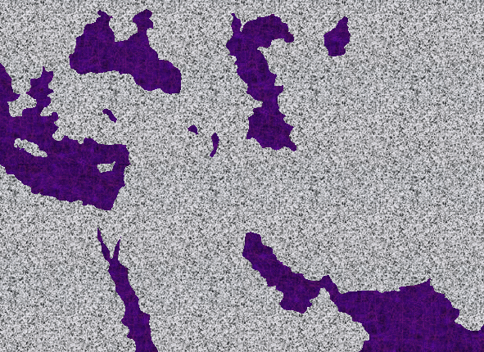
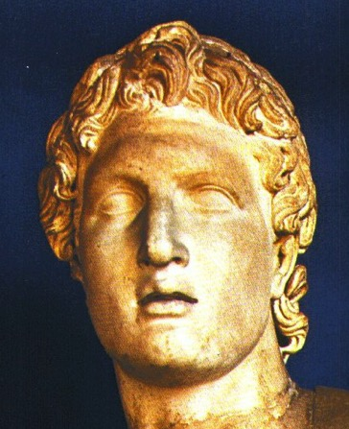
avhvmrItaxmuftul (05)
SILENCE
ca. 500 B.C.
qdwfNidrf/
"r®opfESifh "r®a[mif; pyfBum;umv tydkif;tjcm;/
tvufZef;'g;
tifyg,m?
OT S NT
tm&S
MEDITERRANEAN SEA
qdwfNidrf/
tvufZef;'g;
tma&;bD;,m;/
tmz&du
Handbook pg. 38-39
1
13

Slide 2

Burmese
or®musrf;pm tkwfNrpf
or®musrf;pm
tkwfNrpf
Texas jrdk.rS or®musrf;pm-tkwfjrpf (edkifiHwumtrSkawmfaqmifvkyfief;)
\ wifjycsuf
©2004 TBBMI
01
8.0.01.

Slide 3

7
urÇmOD;/ {owm/
zefqif;jcif;/ N
rif;rJh/
zefqif;jcif;
tOD;qHk;vlom;/
w&m;ol}uD;/
tOD;qHk;tjypf
350
tOD;qkH;owif;aumif;/
350
tOD;qHk;rdom;pk/
(1000 B.C.)
tOD;qHk;vlowfr+/
rif;pH/
(1000 B.C.)
DC
a&}uD;r+/ oufwef@/
S - D - S
DC
ar#mfpif/
ESpfjcrf;uJG/
jzpfpOf 3 &yf
(2000 B.C.)
Awmif ajrmu/f
zefqif;jcif;/
qdwfNidrf
a,m&I
tmNAH[H/
(2000 B.C.)
/,k'/
Áoa&v
10 2
NC
AC
NC
C 7 S J
zdwfac:jcif;/
AC
ya&mzufrsm;/
L - S - B
20-J 20-R
I - I
200 350
J - E
tm&+&d/ AmAkvkef/
12
zrf;qD;umv
7 = 4 + 3
a,moyf/
70 ESpf/
uRefb0
vrf;a-umif; 3ck/
430
vl av; OD;
ESpf 100/ 50000 OD;/
(1500 B.C.)
Z - E - N
arma&S/
(1500 B.C.)
qdwfNidrf
(500 B.C.)
S
xGufajrmuf&m/
qdwfjidrf
odeawmif/
M - C - C
uma'&S/
a,7I
40
40
LC
a'oemig;ck/
LC
a,7I
a,m&I
a,&dacg/
e,fajrcGJa0jcif;/
01
2

Slide 4
cefYrSef;aeYpJG/
tmNA[H = a,moyf/ 2000 B.C.
arma&S = a,m&I 1500 B.C.
rif;rJh = rif;pH/ 1000 B.C.
zrf;qD; = qdwfNidrf? 500 B.C.
02

Slide 5
7
qdwfNidrf/
S
zefqif;jcif;/
a,&I
C 7 J
"r®a[mif; = "r®opf
ESpfaygif; 400 cefUrSef;
Handbook pg. 38-39
2
03

Slide 6
"r®a[mif;/
7
zefqif;jcif;/
tmNAH[H/
/ a,moyf/
/ arma&S/
/ a,m&Sk
rif;rJh/
rif;pH/
/ zrf;qD;/
qdwfNidrf/
a,&Sk
"r®opf
07

Slide 7
7
qdwfNidrf/
ca. 500 B.C.
tvufZef;'g; (*&d)
qdwfNidrf
"r®opf
"r®a[mif;
OT S NT
qdwfNidrf/
tvufZef;'g;
Handbook pg. 38-39
05
1

Slide 8

7
tvufZENm;
tvufZef;'g;
tvufZef;'g; (rif;BuD;)
Handbook pg. 38-39
06

Slide 9
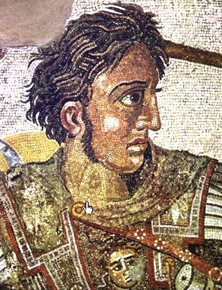
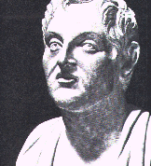
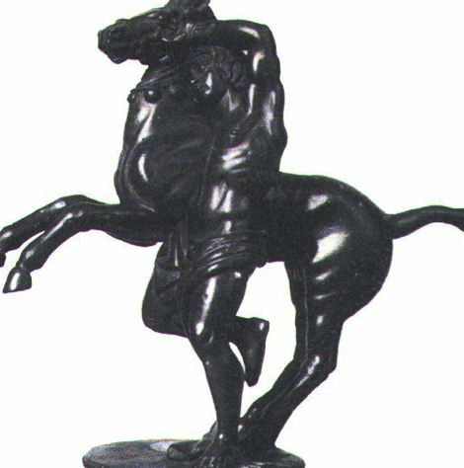
7
tvufZef;'g; (rif;BuD;)
ol\wynf
hjALqDzmvuf
qdwfNidrf/
tvufZef;'g;
ol\q&m t&pf(pf)wdkw,f/
Handbook pg. 38-39
07

Slide 10
ca. 500 B.C.
rufqD'dk;eD;,m;/ tvufZef;'g;\arG;&yfZmwd/
SILENCE
OT S NT
tm&S
ajrxJyifv,f/
£Koa&v (tpöa&;)/
qdwfNidrf/
tvufZef;'g;
*&dxHk;wrf;pOfvmESifh*&d[,fvefeDqrf (Hellenism)
ueOD;zdvdyÜdjrdKU
tma&;bD;,m;/
tmz&du/
Handbook pg. 38-39
08
5

Slide 11
7
wref 17;16=34)
qdwfNidrf/
ca. 500 B.C.
tvufZef;'g;
xl;csm;rIarmfuGef;wif*&drsm;rarh
Edkifaomyk*¾dKvf
qdwfNidrf/
tvufZef;'g;
&Sifaygvkvnf;rarhcJhyg
Handbook pg. 38-39
09
1

Slide 12
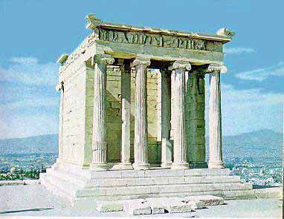
7
wref 17;16=34/ wref 18
qdwfNidrf/
ca. 500 B.C.
tvufZENm;
aum&defokNrdKY
qdwfNidrf/
tvufZENm;
atoif­NrdKY/ tufc&dkydkvpf(pf)ESifh toDemEdkufewfbk&m;yv’if?
Handbook pg. 38-39
10

Slide 13
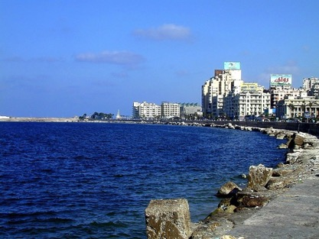
SILENCE
ca. 500 B.C.
tvufZE´m;.
tifyg,m?
OT S NT
tm&S
ajrxJyifv,f/
qdwfNidrf/
tvufZef;'g;
tvufZef;'&D;,m;&SdtD
*spfedkifiH
tma&;bD;,m;/
tmz&du/
Handbook pg. 38-39
11
2

Slide 14
qdwfNidrf/
tvufZef;'g;
tvufZef;'&D;,m;&Sd BuD;rm;onfhpmBunfhwdkuf?
Handbook pg. 38-39
12

Slide 15
avhvmrItaxmuftul (05)
SILENCE
ca. 500 B.C.
"r®opfESifh "r®a[mif; pyfBum;umv tydkif;tjcm;/
tvufZef;'g;
tifyg,m?
OT S NT
tm&S
MEDITERRANEAN SEA
qdwfNidrf/
tvufZef;'g;
tma&;bD;,m;/
tmz&du
Handbook pg. 38-39
1
13

Slide 16
7
touf 33ESpf BC 300 ütvufZef;'g;aoqHk;onf?
xdkYaemufAdkvfcsKyf (4)OD;cJGa0onf?
*&d/
tm&S rdkifem/
cgqef'&m/
vpfqDrmuyf(pf)/
qD;&D;,m;/
qufav;cyf/
qdwfNidrf/
tvufZef;'g;
ajrxJyifv,f/
avhvmrItaxmuftul (05)
tD*spf/
wdkvrD?
Handbook pg. 38-39
14
9

Slide 17
7
touf 33ESpf BC 300 ütvufZef;'g;aoqHk;onf
xdkYaemufAdkvfcsKyf (4)OD;cJGa0onf?
*&d/
tm&S rdkifem/
cgqef'&m/
vpfqDrmuyf(pf)/
qufvl;qpf. tifyg,mrif;rsm;
qD;&D;,m;/
urÇmUa&wyf tiftm;/
qufav;cyf/
qdwfNidrf/
tvufZef;'g;
ajrxJyifv,f/
£Koa&v (tpöa&;)/
tD*spf/
wdkvrpfzga&mrsm;
wdkvrD?
Handbook pg. 38-39
15
2

Slide 18
7
usrf;y,f 15 usrf;/
cJGxGufqefYusifolrsm;/
bk&m;rIwfoGif;xm;jcif;r[kwf?
a&mruufovpfwdkYonf (7)tkyfrQom 1546 ckESpf uvufcHcJhBuonf?
1546
1546
1546
"r®a[mif; ESpf 400 cefY "r®opf
Handbook pg. 38-39
3
16

Slide 19
7
yxr tuf(pf)'&m(pf)
'kwd, tuf(pf)'&m(pf)
wdkbpf/
*sL'pf/
{owm0w¦KtydkwJG/
a&Smvrkef.\ynm/
qD&uf.om;/ a,m7IOmPfawmf (0g) a'oem/
bm&k/
a,&rday;pm/
tZm&d,yXem/
vli,foHk;OD;oDcsif;/
qlqem/
acgif;avmif;ESifhe*g;/
rema&S.yXem/
yXr rubD;/
'kwd, rubD;?
usrf;y,f 15 tkyf
qdwfNidrf/
tvufZef;'g;
Handbook pg. 38-39
1
17

Slide 20
7
yxr tuf(pf)'&m(pf)
'kwd, tuf(pf)'&m(pf)
wdkbpf/
*sL'pf/
{owm0w¦KtydkwJG/
a&Smvrkef.Om%fynm/
qD&uf.om;/ a,m&IOmP%fawmf (0g) a'oem/
bm&k/
a,&rd.ay;pm/
tZm&d,.yXem/
vli,foHk;OD;.oDcsif;/
qlqem/
acgif;avmif;ESifhe*g;/
rema&S.yXem/
yXr rubD;/
'kwd, rubD;?
usrf;y,f 15 tkyf
4if;umv\&dk;&mordkif;taxmuftxm;/
qdwfNidrf/
yXr rubD;
tvufZef;'g;
*sdKqD;zyfa&;om;jcif;?
Handbook pg. 38-39
18

Slide 21
7
avhvmrItaxmuftul (05)
tvufZef;'g;umv
t&pfwdkw,f? tvufZE´,m;\q&m/ *DwoDtdk&D? w&kwfNrdK&dk;/
w&kwfjynf\oHowÅKtoHk;jyKjcif;/ tvufZef;'&D;,m;ü *&dbmompum;oifBum;jcif;/ ,luvpf/*Joarx&D\tqifhtwef;/ tOD;qHk;aoma&mrtaBuGaph/ aum&defokjrdKU\pD;yGm;a&;tcsuftcsmusvmjcif;/ *sL;wdkU\pD;yGm;a&;tcsuftcsm? tD*spfjynf/ [JveDqifESifh*&dBrdKrsm;/ *&dyHkpHjzifhaexdkifrI
*&dbmom&yfpum;?
qdwfNidrf/
tvufZef;'g;
a&mrpepf?
Handbook pg. 38-39
12
19

Slide 22
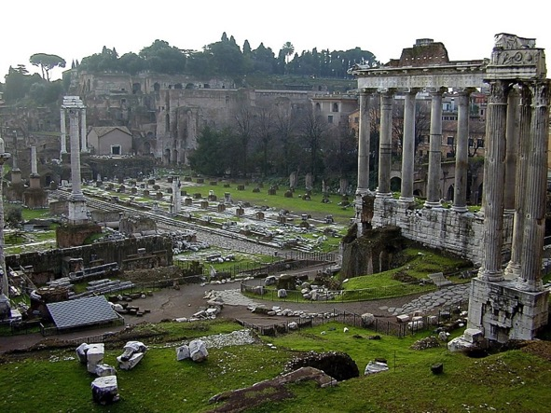
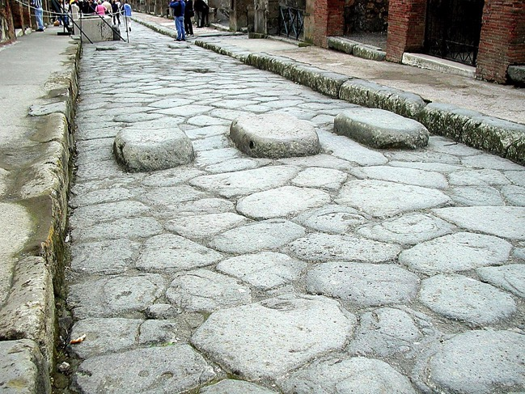
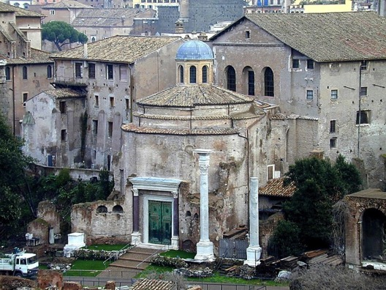
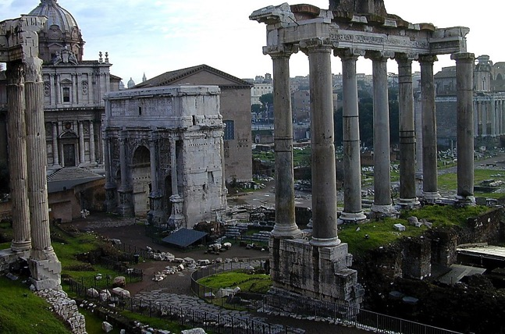
wref28
qdwfNidrf/
ca. 500 B.C.
tvufZef;'g; (*&d)
a&mrpepf?
ppftkyfcsKyfa&;Oya'/
vrf;yef;qufoG,fa&;/
pDrHcefUcGJa&;/
a&mrtcGefaumufcHjcif;/
qdwfNidrf/
tvufZef;'g;
a&mrpepf?
Handbook pg. 38-39
6
20

Slide 23
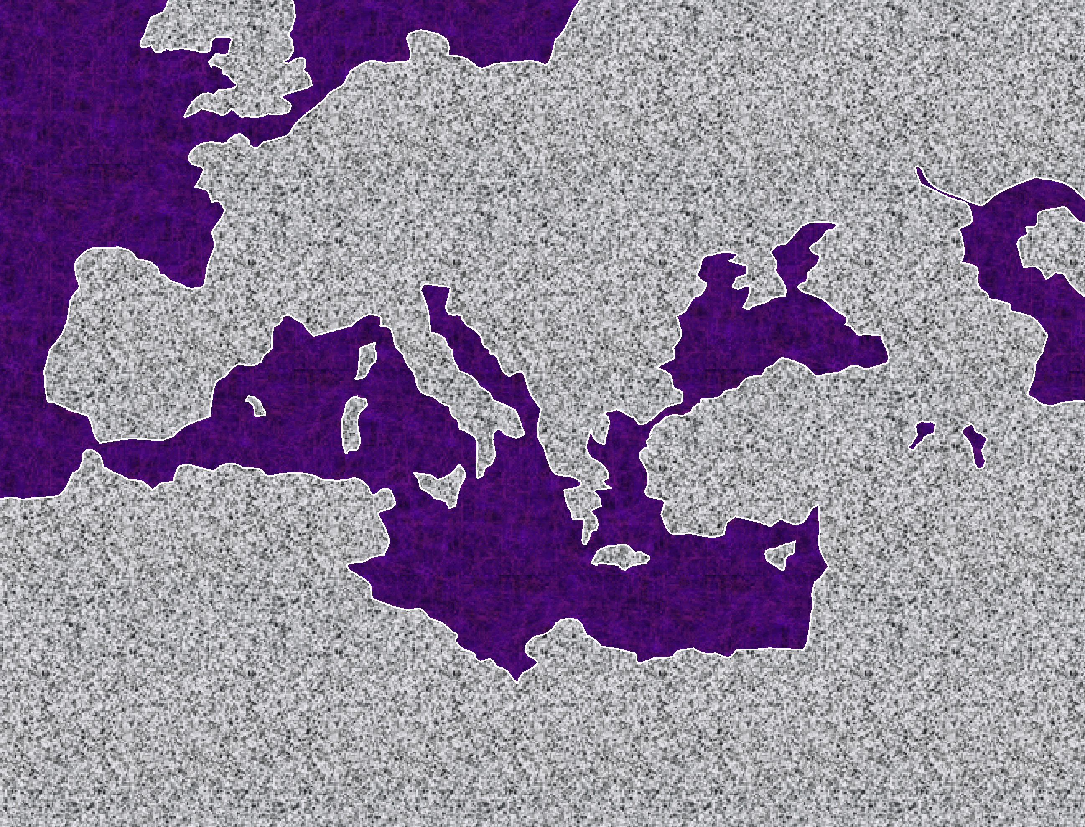

twÅvEÅdwfork'´&m/
Oa&my/
tm&S/
a&mrtifyg,m/
qdwfNidrf/
tvufZef;'g;
a&mrpepf?
ajrxJyifv,f/
tpöa&; (£Koa&v)
tma&;bD;,m;
tmz&du/
Handbook pg. 38-39
2
21

Slide 24
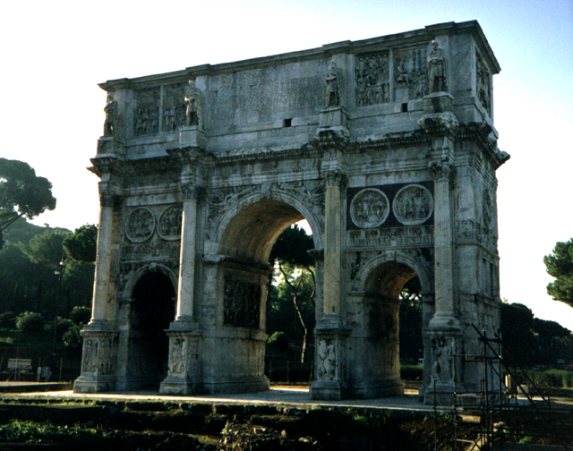
qdwfNidrf/
tvufZef;'g;
a&mrpepf?
a&mr/ uGefpwufuif; rkcf0
Handbook pg. 38-39
22

Slide 25
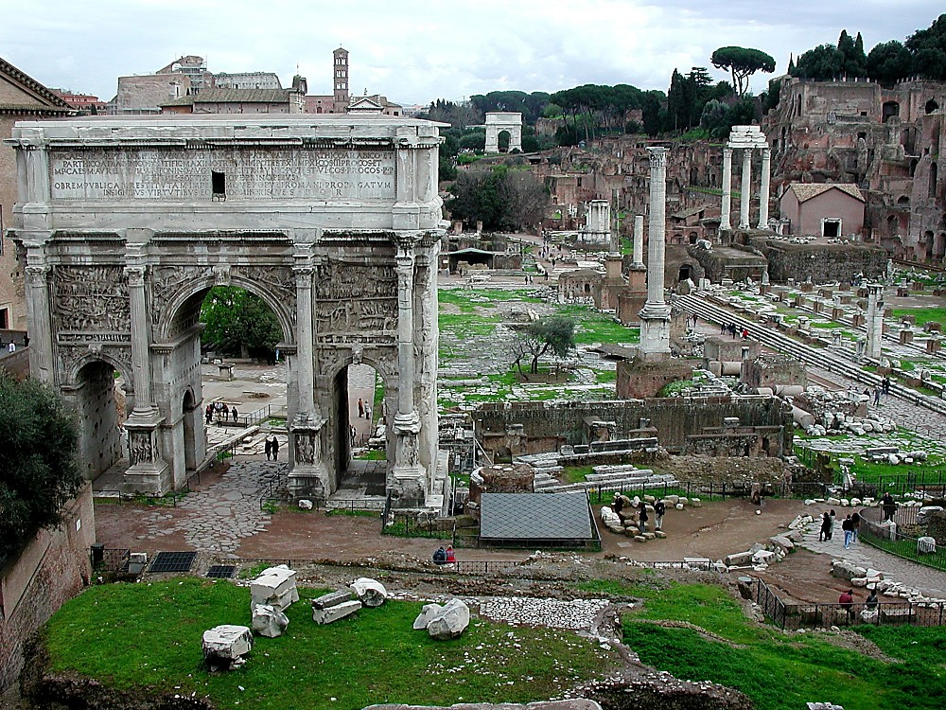
uJomtowfcH&jcif;/
qdwf+idrf/
tvufZENm;
a&mrpepf?
a&mr/ jynfolY[pfwdkifvrf;oG,frsm;
Handbook pg. 38-39
1
23

Slide 26
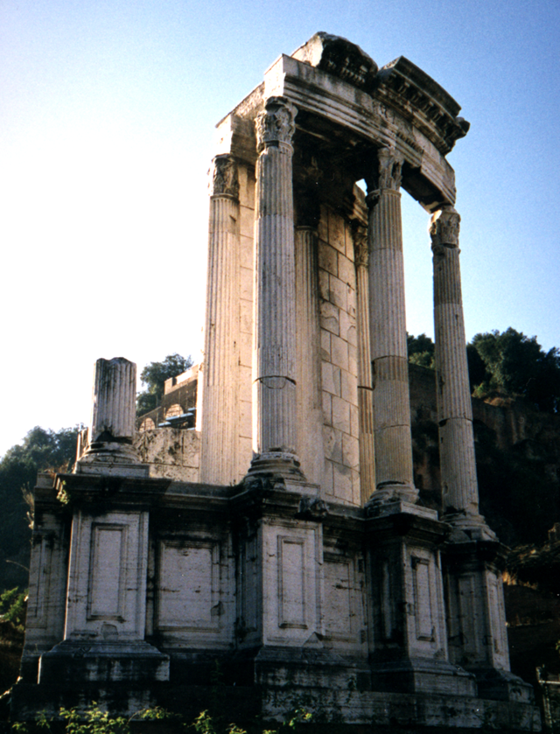
7
qdwfNidrf/
tvufZef;'g;
a&mrpepf?
a&mr/ wifhw,fcef;em;aomjynfolY[pfwdkifwnfaqmufyHk
Handbook pg. 38-39
24

Slide 27
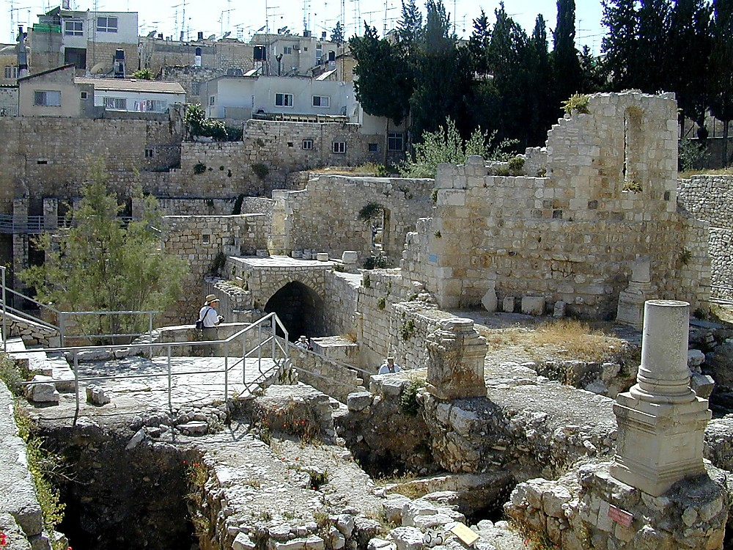
a,m[ef 5;2
qdwfNidrf/
tvufZENm;
a&mrpepf?
a,&k&Svif/ aAaooeduefrsm;/
Handbook pg. 38-39
25

Slide 28
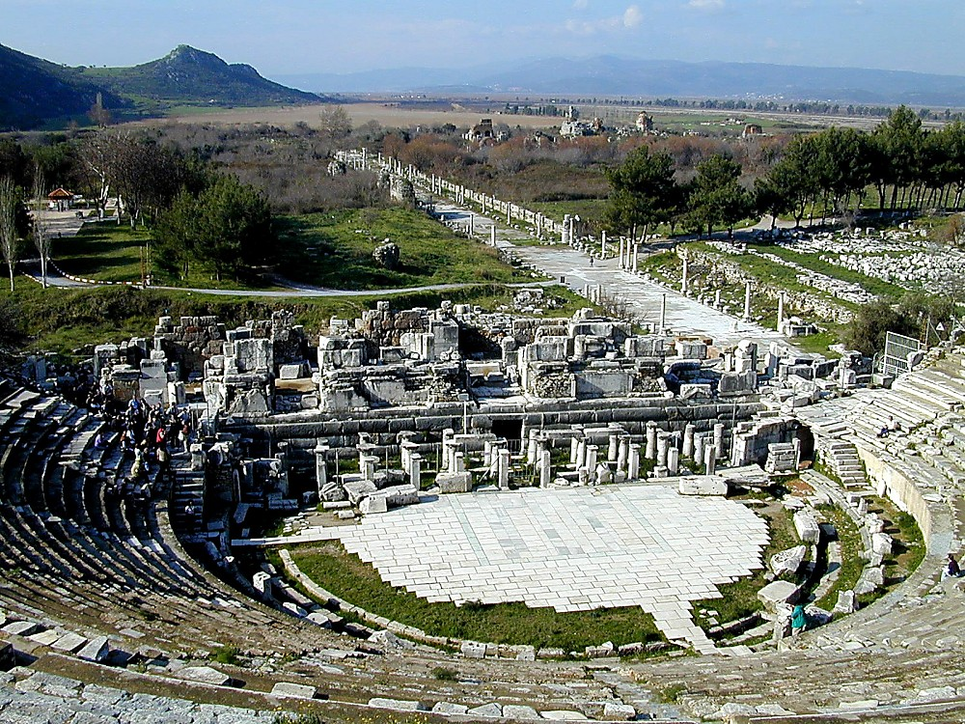
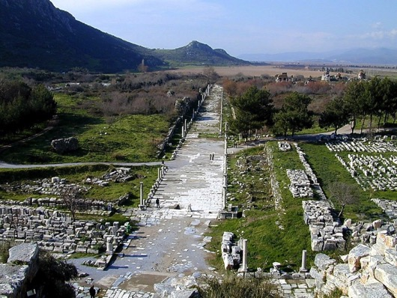
wref 19;29
qdwfNidrf/
tvufZENm;
a&mrpepf?
{zuf/ &SifaygvkESifhpuf0dkif;jcrf;yHk&SdyGJBunfhpif
Handbook pg. 38-39
1
26

Slide 29
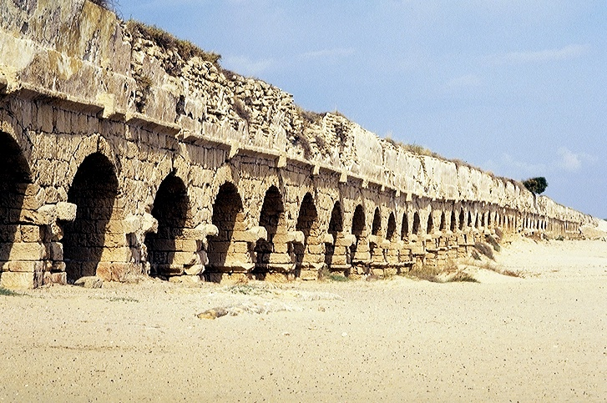
wref 18;22/
qdwfNidrf/
tvufZef;'g;
a&mrpepf?
uJom&de,fom;rm&dwDw/ tpöa&;/ a&mra&oG,facsmif;/
Handbook pg. 38-39
27

Slide 30
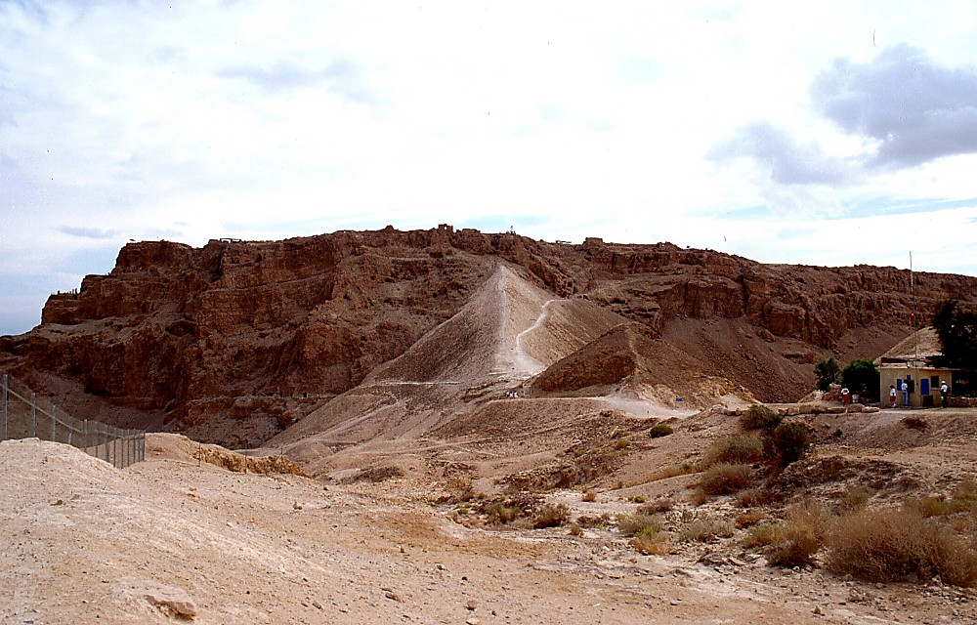
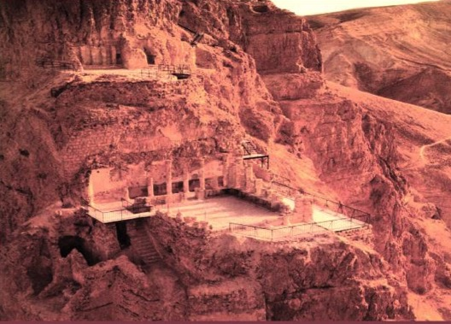
romJ2;1/
a&mrwdkU olykefudkzrf; aomae&m/
qdwfNidrf/
tvufZef;'g;
a&mrpepf?
Photo Credit: Massada Ltd. Publishers Givatayim, Israel
a[&k'frif;BuD;\eef;awmf rmp'g &Jwdkuf/ tpöa&;
28

Slide 31
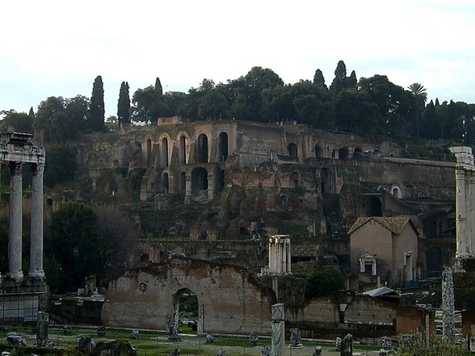
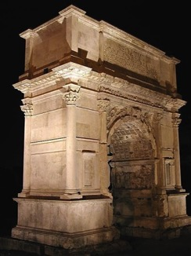
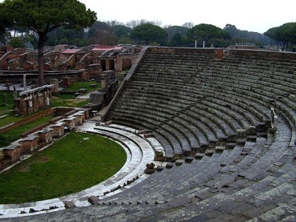
avhvmrItaxmuftul (05)
7
a&mrtkyfcsKyfumv/
THE ERA OF ALEXANDER THE GREAT:
tpdk;&.pDrHtkyfcskKyfa&;/ a&tm;*D,mtoHk;jyKjcif;/ Bwd*Ha'gifhtem;ocFsmynmwdk;wufrI/ a&tcsdefjyem&D/ &dkpDwmac:ausmufpm/ tvufZef;'&D;,m;/ enf;ynmtwwf/ a&mrbk7ifpepf/ qef;opfaomaqmufvkyfa&;enf;vrf;/ a&ESifhrdv’majymif;pepf/ cdkifcefYaomaps;uGuf/ ta0;ajy;vrf;rBuD;rsm;pepf/ 53/ 365&uf&Sdaomjyu©'defusifhoHk;jcif;/ jynfvHk;qdkif&m vufwif (latin) pum;/ ppfa&;enf;ynmBuG,f0jcif;/ a&mr\tpöa&;tay: (ygvufpwdkif;) atmifEdkifjcif;/
Handbook pg. 38-39
29
16

Slide 32
7
tvufZef;'g;\tkyfcsKyfa&;umv
xdkUaemuf-a&mrtkyfcsKyfa&;umv/
tvufZef;'g;\q&m?t&pfwdkw,f/ *DwoDtdk&D/ w&kwfNrdKY&dk;/ w&kwfjynf\oHowÅKtoHk;jyKjcif;/ tvufZef;'&D;,m;/ *&dbmompum;oifBum;jcif;/ ,luvpf/ *Joarx&D\tqifhtwef;/ tOD;qHk;aoma&mrtaBuGaph/ aum&defok\pD;yGm;a&; tcsuftcsmusvmjcif;/ *sL;wdkY\pD;yGm;a&;tcsuftcsm tD*spf/ [JveDqifESifh*&dNrdKYrsm;/ *&dyHkpHjzifhaexdkifrI/
*&dbmom&yfpum;/
tpdk;&.pDrHtkyfcskKyfa&;/ a&tm;*D,mtoHk;jyKjcif;/ }wd*Ha'gifhtem;ocFsmynmwdk;wufrI a&tcsdefjyem&D/ &dkpDwmac:ausmufpm/ tvufZE´&D;,m;/ enf;twwfynm/ a&mrbkHpepf/ qef;opfaomaqmufvkyfa&;enf;vrf;/ a&ESifhrdvmajymif;pepf/ cdkifcefYaomaps;uGuf/ ta0;ajy;vrf;r}uD;rsm;pepf/ 53/ 365 &uf&Sdaomjyu©'defusifhoHk;jcif;/ jynfvHk;qdkif&m vufwif(latin)pum;/ ppfa&;ynmBuG,f0jcif;/ a&mr\tpöa&;tay: (ygvufpwdkif;) atmifEdkifjcif;/
Handbook pg. 38-39
30

Slide 33
tvGefBuD;rm;
aomajymif;vJrI
Handbook pg. 38-39
31

Slide 34
7
avhvmrItaxmuftul (06)
rmvcdtem*wÅdusrf;ESifh&SifróJc&pf0ifusrf; Bum;umv
wdk;wufrIBuD;av;&yf/
usrf;ydkif;qdkif&m/
ordkif;aBumif;qdkif&m/
tvufZE´m;rif;BuD;onf olatmif&mae&mwdkif;ü *&d,Ofaus;rI jzefUa0cJ.jcif;/
ppfrSefaom"r®a[mif;usrf;ay: aygufvmjcif;/
qdwfNidrf/
tvufZENm;
a&mrpepf?
"r®a[mif;usrf;tm; *&dbmomodkYjyefqdkNyD;pD;jcif;/
qdwfNidrfaomumv/ tpöa&;/ a&mr\Nidrf;csrf;a&;umv/
tmNA[Htm;ay;xm;aombk&m;ocif\*wdawmf
tjrifhqHk;tqifhodkUa&muf&Sdjcif;
ar&Sd, = a,&Ic&pfawmf
32
5

Slide 35
7
urÇmOD;/ {owm/
zefqif;jcif;/ N
rif;rJh/
tOD;qHk;vlom;/
w&m;ol}uD;/
zefqif;jcif;
tOD;qHk;tjypf
350
tOD;qkH;owif;aumif;/
350
tOD;qHk;rdom;pk/
(1000 B.C.)
tOD;qHk;vlowfr+/
rif;pH/
(1000 B.C.)
S - D - S
DC
a&}uD;r+/ oufwef@/
ESpfjcrf;uJG/
DC
ar#mfpif/
Awmif ajrmu/f
(2000 B.C.)
/,k'/
Áoa&v
zefqif;jcif;/
qdwfNidrf
a,7I
tmNAH[H/
(2000 B.C.)
10 2
zdwfac:jcif;/
NC
AC
ya&mzufrsm;/
NC
C 7 S J
L - S - B
AC
I - I
20-J 20-R
J - E
vltzJG@tpnf; 3 &yf
200 350
tm&+&d/ AmAkvkef/
12
zrf;qD;umv
7 = 4 + 3
a,moyf/
70 ESpf/
u|efb0/
vrf;a-umif; 3ck/
430
ESpf 100/ 50000 OD;/
vl av; OD;
Z - E - N
(1500 B.C.)
arma&S/
(1500 B.C.)
(500 B.C.)
xGufajrmuf&m/
S
qdwf_idrf
odeawmif/
qdwf_idrf
tvufZENm;
M - C - C
a&mrpepf
uma'&S/
a,±7I
40
40
a'oemig;ck/
LC
LC
a,±&I
a,m&+/
a,&dacg/
e,fajrcGJa0jcif;/
01
2

Slide 36
34
©2004 TBBMI
7.2.03e.

