Slide 1
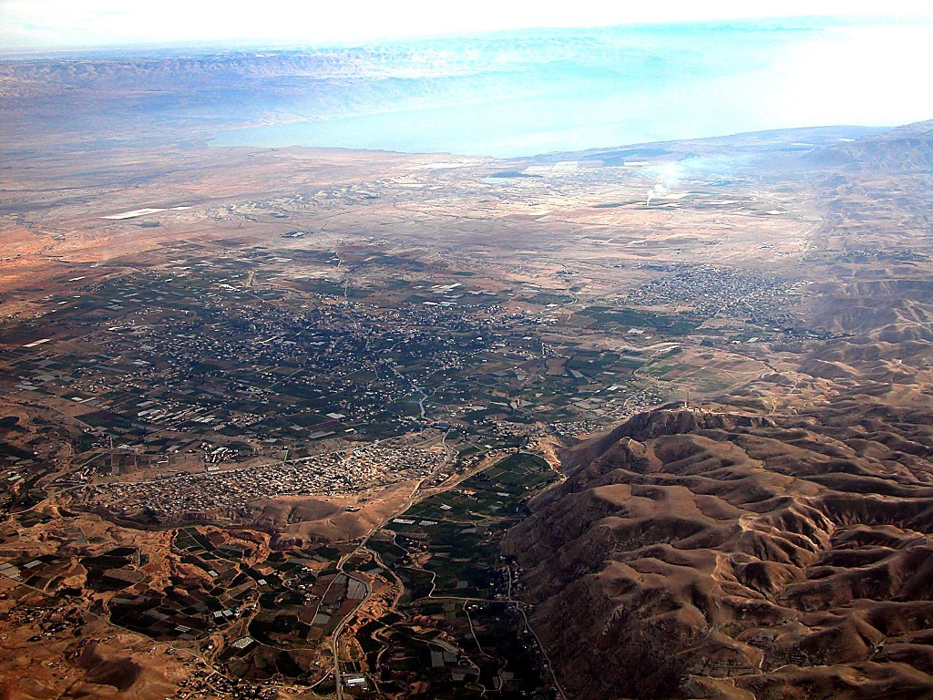
DEAD SEA
JORDAN RIVER
MODERN JERICHO
JOSHUA
Jericho/Ai
ANCIENT JERICHO
From Jericho...
Looking East Across the Jordan River
Dr ရက္ခ္ ဂရီဖိတ္၊ စကၤပူဓမၼေကာလိပ္ • BibleStudyDownloads.org
42
Notes:
Here is Jericho today. You can easily imagine Joshua's forces crossing the distant river to the east with his thousands upon thousands of armed men ready for the seven years of battle that lay ahead.

Slide 2

Burmese
or®musrf;pm tkwfNrpf
or®musrf;pm
tkwfNrpf
Texas jrdk.rS or®musrf;pm-tkwfjrpf (edkifiHwumtrSkawmfaqmifvkyfief;)
\ wifjycsuf
www.biblebasically.org
©2004 TBBMI
01
8.0.01.

Slide 3
usrf;ordkif;{/f ckeSpf oufwrf;rsm;
tm+AH[HrS a,moyf/ 2000 B.C.
arma&S rS a,m±_/ 1500 B.C.
01

Slide 4
7
xGufajrmuf&musrf; 2 ; 10
w&m;ol}uD;wpfOD;tkyfcsLyf&rnf?
zefqif;jcif;/
ABRAHAM
tm+AH[
ABRAHAM
a,moyf
ABRAHAM
arma&S
a,m±_
rif;rJhumv
rif;pHumv
zrf;qD; umv/
qdwf+idrfumv
a,±_
Handbook pg. 26-29
02

Slide 5

xGufajrmuf&m 7 ; 8
7
arma&S
ca. 1500 B.C.
ig. vlrsdK;udk oGm;cGifhjyK&rnf
vlav;OD;xJrS
wwd,yk*~dKvf
tm+AH[H a,moyf
arma&S a,m±_
arma&S
40
Handbook pg. 26-29
1
03

Slide 6
xGufajrmuf&musrf; 12 ; 31
7
arma&S
ca. 1500 B.C.
xGufajrmuf&m
ig.vlrsdK;udk oGm;cGifhjyK&rnf
vlav;OD;xJrS
wwd,yk*~dKvf
tm+AH[H a,moyf
arma&S a,m±_
arma&S
xGufajrmuf&m
40
Handbook pg. 26-29
04

Slide 7
xGufajrmuf&musrf; 12 ; 31-18 ;27
tqifhqifhydkif;
jcm;avhvmjcif;/
ajrxJyifv,f
edea0+rdK@
tmqD;&D;,m;
cg&ef+rdK@
? ,lza&;wD;/
*gvdvJtdkif
*aeFo&uf
AmAkvkef+rdK@
a,&dacg +rdK@
aeaAmawmif
arma&S
yifv,fao/
xGufajrmuf&m
ig. vlrsdK;udk oGm;cGifhjyK&rnf
tJ*kwWKjynf
uma'&S
40
O±k/
odemawmif
yifv,feD
yg;&Sm;yifv,fauG@
Handbook pg. 26-29
05

Slide 8
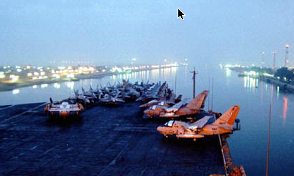
a,m±_ 13;18
tqifhqifhydkif;jcm; avhvmjcif;
ajrxJyifv,f
edea0+rdK@
tmqD;&D;,m;
cg&ef+rdK@
*gvdvJtdkif
*aeFo&uf
ER
aeaAmawmif
AmAkvkef+rdK@
a,&dacg +rdK@
arma&S
yifv,fao/
xGufajrmuf&m
pl;tufa&a=umif;qufoG,fa&;
tJ*kwWKjynf
uma'&S
usLyifv,f
“YAM SUPH”
O&k
40
odemawmif
yg;&Sm;yifv,fauG@
yifv,feD
Handbook pg. 26-29
2
06

Slide 9
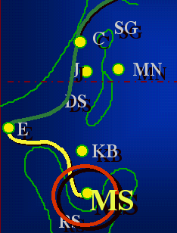
7
xGufajrmuf&m 19
arma&S
ca. 1500 B.C.
xGufajrmuf&m
odemawmif
tmjA[H a,moyf
arma&S
a,m±&Sk
arma&S
xGufajrmuf&m
odemawmif
40
Handbook pg. 26-29
1
07

Slide 10
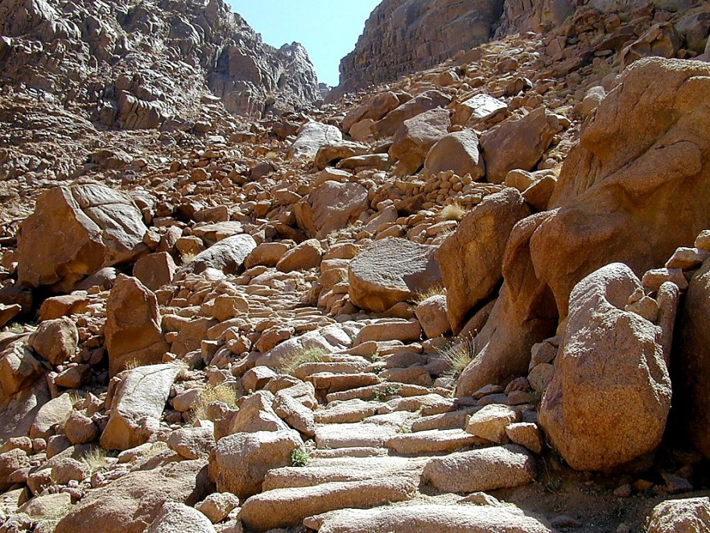
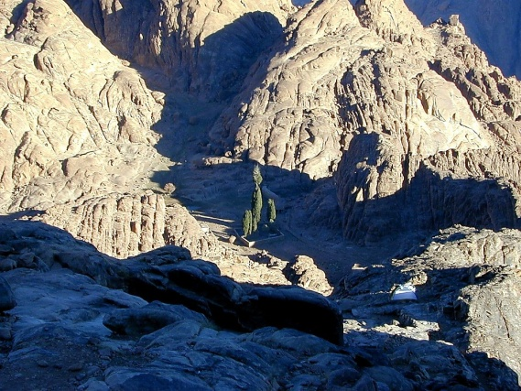
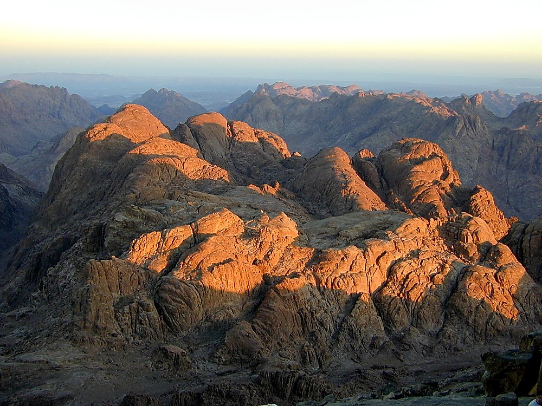
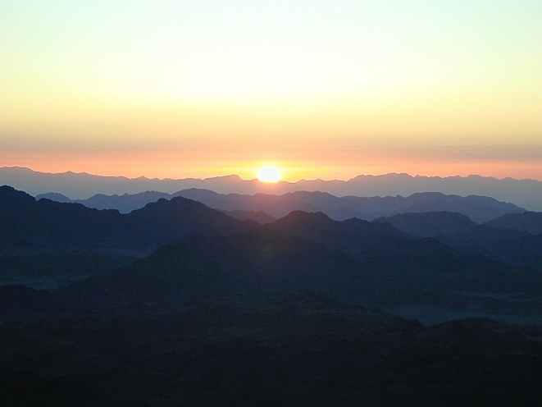
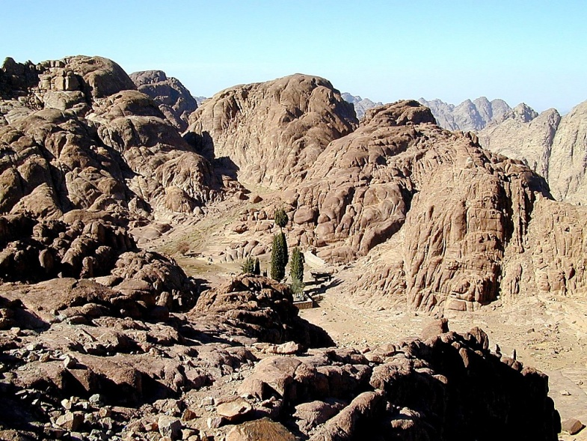
xGufajrmuf&musrf ; 19;2
arma& S
xGufajrmu
odemawmif
40
odemawmif
ynwfawmf 10 yg; &&Sdaom odemawmif
Handbook pg. 26-29
08

Slide 11
xGufajrmuf&musrf ; 20 - 31
7
arma&S
ca. 1500 B.C.
xGufajrmuf&m
odemawmif
tm+AH[H a,moyf
arma&S a,m±_
M - C - C
armaa&S
xGufajrmuf&m
odemawmif
M - C - C
40
usifh0wfw&m;
vlrlla&;/
udk;uG,f0wfjyKjcif;/
Handbook pg. 26-29
3
09

Slide 12
xGufajrmuf&musrf ; 20 - 31
7
arma&S ynwf
bk&m;ay;aomw&m;enf;vrf; 3 &yf
arma&S
xGufajrmuf&m
odemawmif
M - C - C
40
Handbook pg. 26-29
10

Slide 13
xGufajrmuf&musrf ; 20; 1-17
7
arma&S ynwf
bk&m;ay;aomw&m;enf;vrf; 3 &yf usifh0wfw&m;
ynwfawmf 10 yg; /
udk,fusif.w&m;ESif.qdkifaom pnf;rsOf;Oya' tajccHenf;vrf;/
arma&S
xGufajrmuf&m
odemawmif
M - C - C
40
Handbook pg. 26-29
11

Slide 14
xGufajrmuf&musrf ; 21 - 24
7
arma&S ynwf bk&m;ay;aomenf;vrf; 3 &yf
usifh0wfw&m; ynwfawmf 10 yg; udk,fusif.w&m;ESif.qdkifaom pnf;rsOf;Oya' tajccHenf;vrf;/
vlrIa&;
vlrIa&;zGJUpnf;yHkopf aexdkifqufqH&rnfhenf;vrf;
arma&S
xGufajrmuf&m
odemawmif
M - C - C
40
Handbook pg. 26-29
12

Slide 15
xGufajrmuf&musrf 25 -31
7
arma&S ynwf
bk&m;ay;aomenf;vrf; 3 &yf
usifh0wfw&m;
udk,fusif.w&m;ESif.qdkifaompnf;rsOf;Oya'tajccHenf;vrf;/
vlrIa&;
vlrIa&;zGJUpnf;yHkopfaexdkifqufqH&rnfhenf;vrf;/
udk;uG,f0wfjyKjcif;
udk;uG,frIenf;vrf;pOf/
arma&S
xGufajrmuf&m
odemawmif
M - C - C
40
Handbook pg. 26-29
13

Slide 16
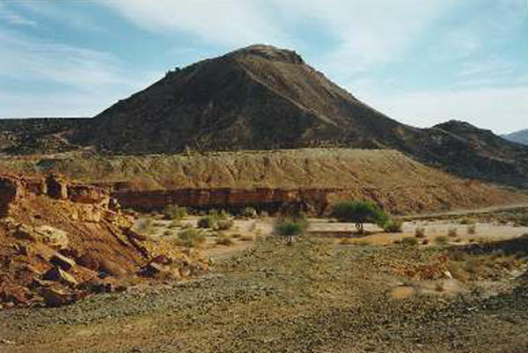
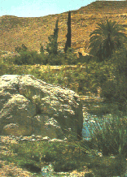
a
tqifhqifhydkif;
jcm;avhvmjcif;/
ajrxJyifv,f
edea0+rdK@
tmqD;&D;,m;
cg&ef+rdK@
*aeFo&uf
*gvdvJtdkif
,ae@ ,k'jynf uEWm&/
,lza&;wD;/
AmAkvkef+rdK@
arma&S
a,&dacg +rdK@ J
aeaAmawmif
xGufajrmuf&m
odemawmif
yifv,fao/
M - C - C
tdkatppf prf;acsmif;
tJ*kwWKjynf
uma'&S
40
O±k/
odemawmif
yg;&Sm;yifv,fauG
yifv,feD
Handbook pg. 26-29
2
14

Slide 17
awmvnf&m 20;13/ w&m;a[m&musrf; 1;19
7
arma&S
ca. 1500 B.C.
xGufajrmuf&m
odemawmif
tm+AH[H a,moyf
arma&S a,m±_
M - C - C
uma'&S
arma&S
xGufajrmuf&m
odemawmif
M - C - C
uma'&S
40
Handbook pg. 26-29
15

Slide 18
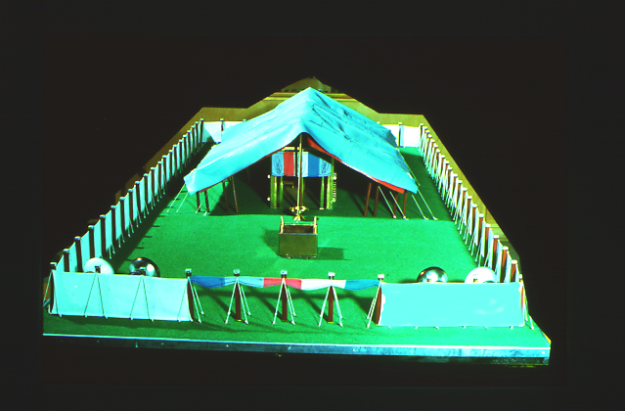
awmvnf&m 13
7
arma&SrodcJ.aomtcsuftvufrsm;
Áoa&v trsdK;EG,fpkwdkif;. udk,fpm;vS,frsm;
arma&S
xGufajrmuf&m
odemawmif
M - C - C
uma'&S
40
awmuEWm& Y &SdpOf wJawmf
Handbook pg. 26-29
2
16

Slide 19
7
awmvnf&m 13
arma&S. ar;cGef;rsm;/
uwdawmf.wdkif;jynfonf tb,fodk@en;f?
tb,fuJhodkhaomvlrsdK;rsm;jzpfrnf enf;?
yx0Da&
pm;0wf
arma&S
ajrtaetxm;
xGufajrmuf&m
odemawmif
M - C - C
uma'&S
40
aea&;
Handbook pg. 26-29
6
17

Slide 20
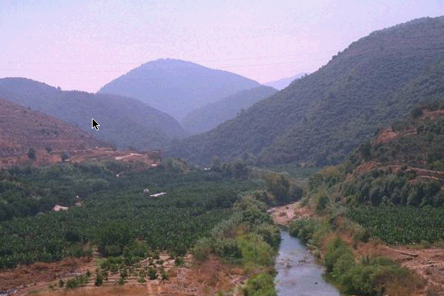
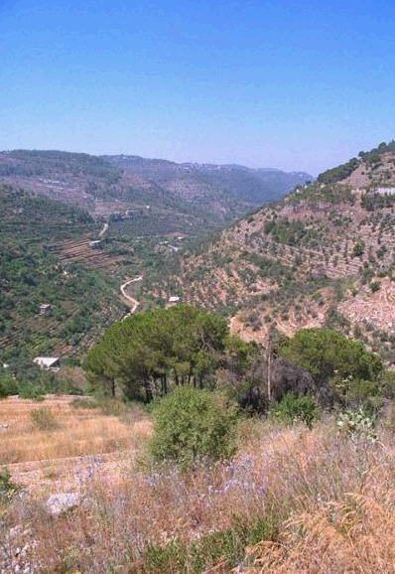
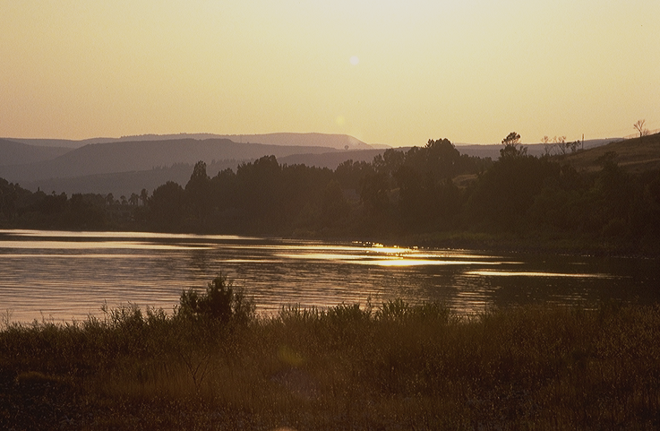
awmvnf&m 13
tqifhqifhydkif;jcm;
avhvmjcif;/
ajrxJyifv,f
edea0+rdK@
tmqD;&D;,m;
olvSsdKrsm;\
vrf;aBumif;
cg&ef+rdK@
*gvdvJtdkif
*aeFo&uf
ajrmuft&yf&Sd avAEkef.awmifydkif;;/
ER
AmAkvkef+rdK@
a,&dacg +rdK@ J
aeaAmawmif
MOSES
yifv,fao/
Exodus
Sinai
tJ*kwWKjynf
M - C - C
Kadesh Barnea
uma'&S
O±k/
40
odemawmif
yg;&Sm;yifv,fauG
yifv,feD
Handbook pg. 26-29
18

Slide 21
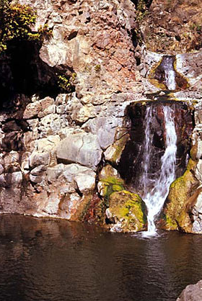
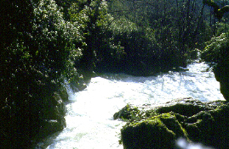
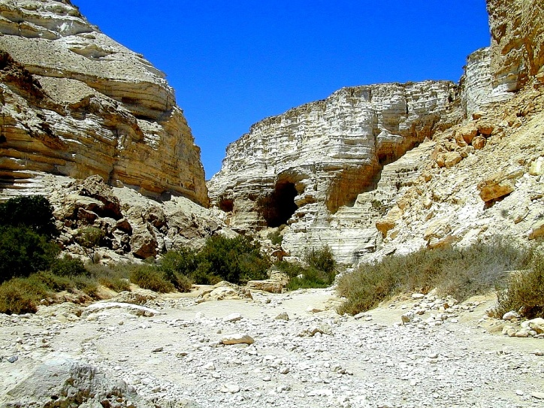
awmvnf&m 13
tqifhqifhydkif;
jcm;avhvmjcif;
ajrxJyifv,f
edea0+rdK@
tmqD;&D;,m;)
H
olv#dKrsm;. vrf;a=umif;
*gvdvJtdkif
C
ER
awmift&yf&Sduma'&Sodk@tjyefvrf;
aeaAmawmif
B
J
arma&S
yifv,fao
xGufajrmuf&m
odemawmif
tJ*kwWKjynf
M - C - C
uma'&S
uma'&S
O±k/
40
odemawmif
yifv,feD
Handbook pg. 26-29
19

Slide 22
awmvnf&m 13; 26-14;9/
tqifhqifhydkif;
jcm;avhvmjcif
tajctae.oifcef;pm
MS
olv#dK 12 OD;wkd@. uGJjym;aomjyefqdkcsufrsm; 10 OD;? ? trsm;pk . xifjrif,lqcsuf? Edk@ESifh ysm;&nfpD;aomjyn/f vl@bDvl;}uD;rsm;/ (tJ*kwWKjynfyJjyef=u&atmif)
2 OD;? ? vlenf;pk. xifjrifcH,lcsuf?
Edk@ESifhysm;&nfpD;aomjynf/ vl@bDvl;}uD;rsm;/ (bk&m;ocif igwdkheJhtwl&Sdw,f)
N(A)
H
SG
C
ER
B
J
MN
arma&S
DS
xGufajrmuf&m
odemawmif
E
M - C - C
uJ @ @ @ a&S@udkyJquf oGm;=ur,f
uma'&S
KB
U
40
MS
PG
RS
Handbook pg. 26-29
12
20

Slide 23
awmvnf&m 13; 26-14;9/
tqifhqifhydkif;
jcm;avhvmjcif
tajctae.oifcef;pm
c&D;pOfzsufodrf;jcif;
MS
olv#dK 12 OD;wkd@. uGJjym;aomjyef=um;csuf 10 OD;/ : trsm;pk . xifjrifcH,lcsuf Edk@ESifh ysm;&nfpD;aomjynf vl@bDvl;}uD;rsm;/ tJukwWKodk@jyef=u&atmif olv#dKESpfOD;/ vlenf;pk. xifjrifcH,lcsu
Edk@ESifhysm;&nfpD;aomjynf vl@bDvl;}uD;rsm; bk&m;ocif igwdk@ESifhtwl&Sdw,f
N(A)
H
SG
C
ER
B
J
MN
arma&S
DS
xGufajrmuf&m
odemawmif
E
M - C - C
uJ @ @ @ a&S@udkyJquf oGm;=ur,f
uma'&S
KB
U
40
MS
PG
RS
Handbook pg. 26-29
12
20

Slide 24
awmvnf&m 32; 13
7
arma&S
ca. 1500 B.C.
xGufajrmuf&m
odemawmif
AJMJ
M - C - C
uma'&S
ESpfaygif; 40
arma&S
xGufajrmuf&m
odemawmif
M - C - C
uma'&S
40
40
Handbook pg. 26-29
22

Slide 25
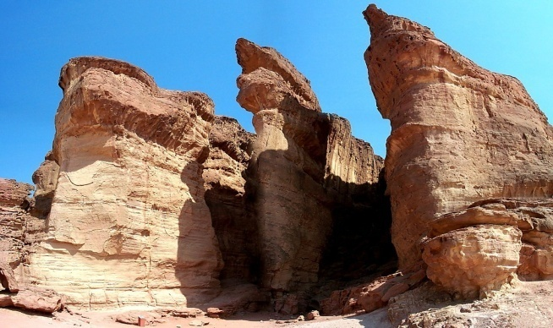
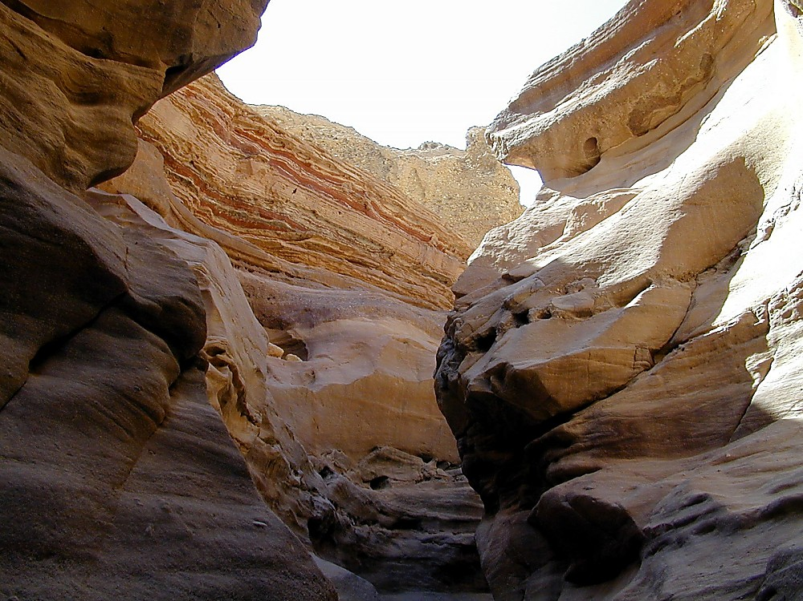
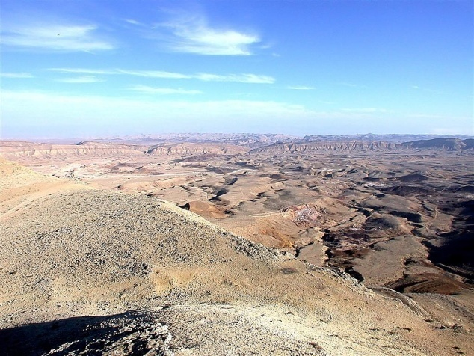
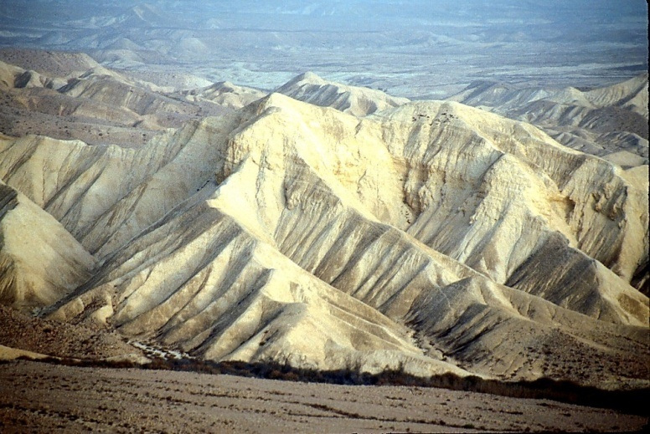
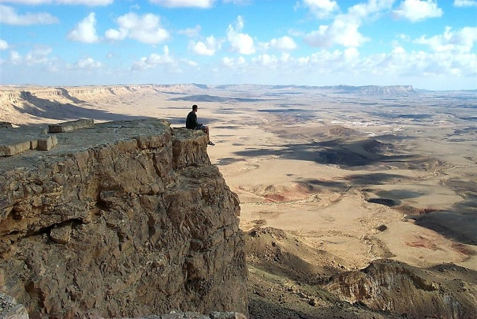
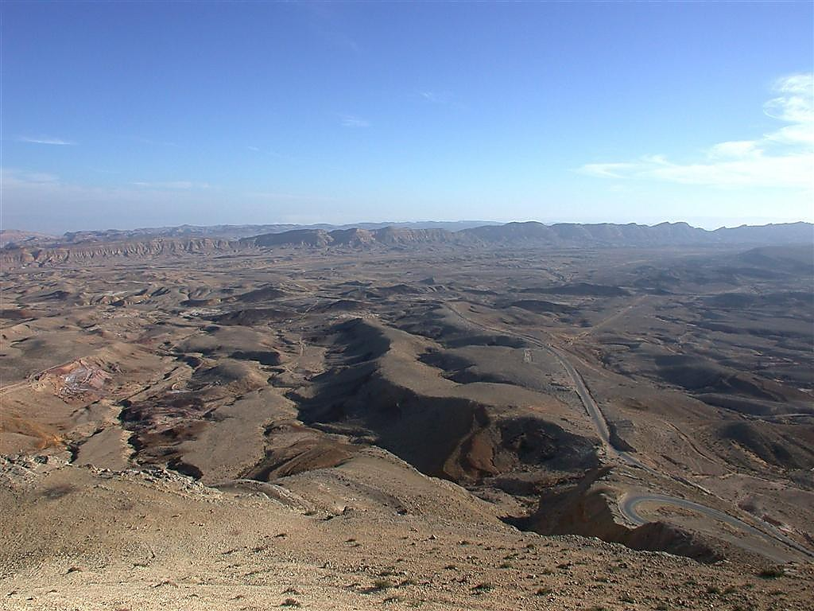
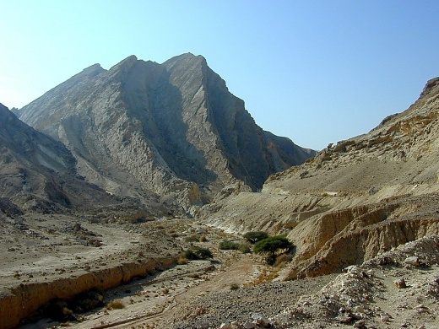
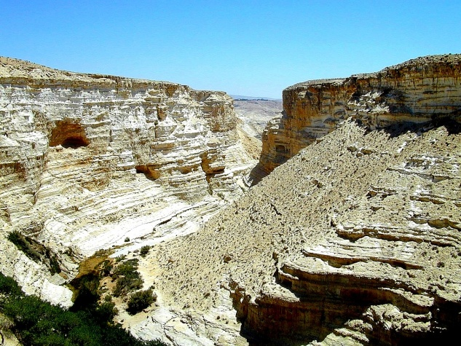
tqifhqifhydkif;jcm;avhvmjcif;/
awmvnf&m 32; 49/ 34; 1
tJ'Dvdkae&mrsdK;/ ESpfaygif; 40 awmif/ atmifrav;As
tJ'Dvdkae&mrsdK;/ ESpfaygif; 40 awmif/ atmifrav;As
tJ'Dvdkae&mrsdK;/ ESpfaygif; 40 awmif/ atmifrav;As
arma&S
xGufajrmuf&m
odemawmif
M - C - C
uma'&S/
40
40
Handbook pg. 26-29
1
23

Slide 26
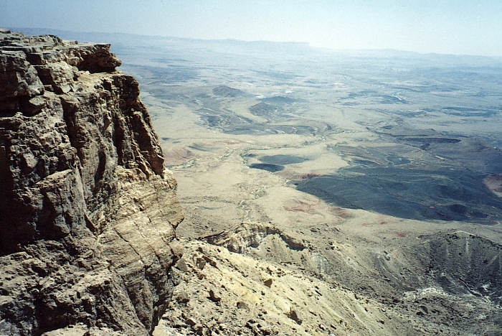
awmvnf&m 32; 49/ 34; 1
tqifhqifhydkif;
jcm;avhvmjcif
bma=umifhrsm;ygvdrfh
remcHjcif;
r,Hk=unfjcif;
arma&S
xGufajrmuf&m
odemawmif
M - C - C
uma'&S
40
40
oJuEWm&Y vnfywfaejcif;
Handbook pg. 26-29
3
24

Slide 27
awmvnf&m 32; 49/ 34; 1
tqifhqifhydkif;
jcm;avhvmjcif
ajrxJyifv,f
edea0+rdK@
tmqD;&D;,m;
cg&ef+rdK
gvdvJtdkif
*aeFo&uf
,lza&;wD;/
aeaAmawmif
B
a,&dacg +rdK@ J
aeaAmawmif
yifv,fao
arma&S
xGufajrmuf&m
odemawmif
tJ*kwWKjynf
M - C - C
uma'&S
O±k/
uma'&S
40
40
odemawmif
yg;&Sm;yifv,fauG
yifv,feD
Handbook pg. 26-29
25

Slide 28
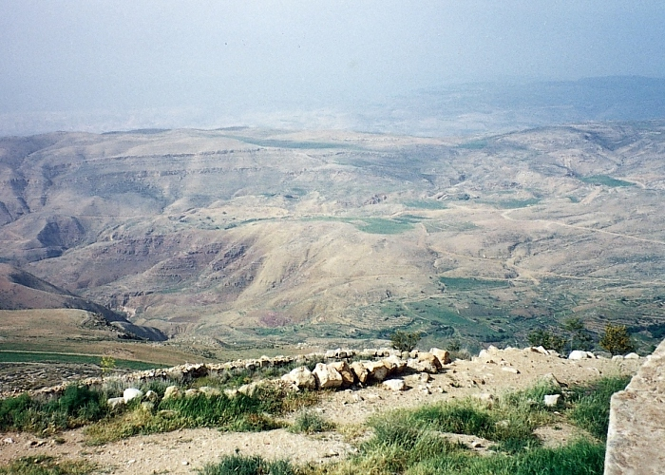
arma&S
xGufajrmuf&m
odemawmif
M - C - C
uma'&S
40
40
aeaAmawmifxdyfrS uwdawmfjynfodk@
vSrf;I=unfhjrif&yHk
Handbook pg. 26-29
26

Slide 29
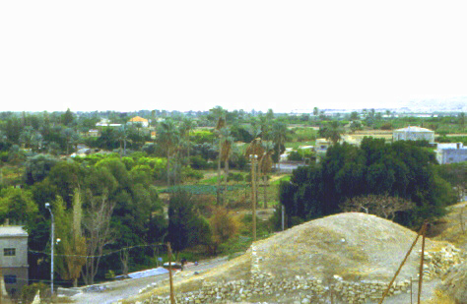
aeaAmawmif
arma&S
xGufajrmuf&m
odemawmif
M - C - C
uma'&S
40
40
a,&dacg rS a,mf'efjrpfwzuf&Sd aeaAmawmifodk@ vSrf;jrif&yHk
Handbook pg. 26-29
27

Slide 30
7
arma&S
ca. 1500 B.C.
xGufajrmuf&m
odemawmif
tm+AH[H a,moyf
arma&S a,m±_
M - C - C
uma'&S
ESpfaygif; 40
arma&S
LC
xGufajrmuf&m
a'oem 5 &yf/
odemawmif
M - C - C
uma'&S
40
40
w&m;a[m&musrf; --- 'kwd,ajrmuf ynwfw&m;/ !
jynfawmfESifhqdkifaom uwdpmcsKyf/
5 Sermons
/ w&m;a[m&musrf; 30;1-10
tb,folwdkhenf;?
tb,folonfxdkolwdkU\bk&m;enf;/
om;pOfajr;qufumvtwGuf/
xl;jcm;aomtarGtESpf/
taetxdkifudk,fusifhw&m;
Handbook pg. 26-29
8
28

Slide 31
7
w&m;a[m&musrf; 30
uwdawmfjynf (ygvufpwdkif;)
5 bdk;ab;wkd@0ifpm;aomjynfodk@ wzefaqmifcJhawmfrlojzifh/ oifonf 0ifpm;&vdrfhrnf? xdktcgaus;Zl;jyKawmfrljyefojzifh/ bkd;ab;rsm;wdk@xufoifhudkomI rsm;apawmfrlvdrfhrnf? 6 oifonftouf&Sif rnfta=umif;/ oif.bk&m;ocifxm0&bk&m;udk pdwfESvHk;tºuif;rJhcspfapjcif;iSm/ oifhESvHk;ESifh oifhtrsdK;.ESvHk; ta&zsm;udk vSD; jzwfawmfrlvdrfhrnf?
arma&S
xGufajrmuf&m
odemawmif
M - C - C
uma'&S
40
40
5 Sermons
Handbook pg. 26-29
1
29

Slide 32
7
tm+AH[HESifh qdkifaomuwdawmf/
urBmOD;usrf; 12; 1-3
wdkif;jynf trsdK;tEG,f aumif;csD;r*Fvm
arma&S
xGufajrmuf&m
odemawmif
wdkif;jynf
M - C - C
uma'&S
40
40
5 Sermons
w&m;a[m&musrf;
30;1-10
Handbook pg. 26-29
30

Slide 33
7
urBmOD;usrf; 1/ w&m;a[m&musrf; 34/
zefqif;jcif;/
rif;rJh/
zefqif;jcif
vlom;/
tjypf
owif;aumif;/
1st Family
rif;pH/
(1000 B.C.)
vlowfr_
oufwef@
&Jwdkuf}uD;/
tm+AH[H/
C 7 S J
a&G;ac:awmfrljcif;/
AC
L - S - B
jzpfpOf 3 &yf
I - I
J - E
12
zrf;qD;/
7 = 4 + 3
a,moyf
arma&S
yk*~dKvf av;OD;
u|efb0
xGufajrmuf&m
430
odemawmif
M - C - C
/ arma&S/
(500 B.C.)
uma'&S
qdwf+idrf
40
xGufajrmuf
S
S
40
odemawmi
5 Sermons
M - C - C
uma'&S
a,±_/
40
40
LC
a,±_
5 Sermons
JOSHUA
31

Slide 34
7
tm+AH[H a,moyf arma&S
a,m±_
yk*~dKvf av;OD;teuf pwkwÎajrmuf yk*~dKvf
?
32

Slide 35
7
tm+AH[H a,moyf arma&S
a,m±_
yk*~dKvf av;OD;t
euf pwkwÎ
ajrmuf yk*~dKvf
“a,m±_ ”
33

Slide 36
usrf;ordkif;{/f ckeSpf oufwrf;rsm;
tm+AH[HrS a,moyf/ 2000 B.C.
arma&S rS a,m±_/ 1500 B.C.
34

Slide 37
7
xGufajrmuf&musrf; 2 ; 10
w&m;ol}uD;wpfOD;tkyfcsLyf&rnf?
zefqif;jcif;/
ABRAHAM
tm+AH[
ABRAHAM
a,moyf
ABRAHAM
arma&S
a,m±_
rif;rJhumv
rif;pHumv
zrf;qD; umv/
qdwf+idrfumv
a,±_
Handbook pg. 26-29
02

Slide 38
7
? a,m±_ 1 ; 1
a,m±_
tm+AH[H a,moyf arma&S
a,m±_
a,m±_
Handbook pg. 29-31
36

Slide 39
a,m±_rSwfpm 1 ; 11
tqifhqifhydkif;
jcm;avhvmjcif;/
a,m±_twGuf bk&m;ocifjyKawmfrlaom uwdawmf
ajrxJyifv,f/
oJuEWm&rS avAEkef
edea0+rdK@/
cg&ef+rdK
*gvdvJtdkif/
*aeFo&uf
,lza&;wD;
AmAkvkef+rdK@/
aeaAmawmif
/ a,&dacg +rdK@/
a,m±_
Oz&wfjrpfrS ajrxJyifv,f
yifv,fao
tJ*kwWKjynf
uma'&S
O±k/
odemawmif/
yg;&Sm;yifv,fauG
yifv,feD
Handbook pg. 29-31
2
37

Slide 40
a,m±_rSwfpm 1 ; 1 1
tqifhqifhydkif;jcm;
avhvmjcif;/
ajrxJyifv,f/
edea0+rdK@/
cg&ef+rdK
wdkif; edkifiH
*gvdvJtdkif/
*aeFo&uf
,lza&;wD;
AmAkvkef+rdK@/
aeaAmawmi
/ a,&dacg +rdK@/
a,m±_
yifv,fao
xdkjynfodk@ 0ifpm;avmh
tJ*kwWKjynf
uma'&S
O±k/
odemawmif/
yg;&Sm;yifv,fauG
yifv,feD
Handbook pg. 29-31
38

Slide 41
a,m±_rSwfpm 1 ; 1 1
tqifhqifhydkif;jcm;
avhvmjcif;/
ajrxJyifv,f/
edea0+rdK@/
wdkif; edkifiH
cg&ef+rdK
aeaAmawmifrS xGuf+yD;
v#if a,m±_tzGJ@
onf a,m'efjrpf
udk jzwf&onf
*gvdvJtdkif/
,lza&;wD;
*aeFo&uf
AmAkvkef+rdK@/
/ a,&dacg +rdK@/
aeaAmawmi
a,m±_
yifv,fao
Jericho/Ai
tJ*kwWKjynf
uma'&S
O±k/
odemawmif/
yg;&Sm;yifv,fauG
yifv,feD
Handbook pg. 29-31
39

Slide 42
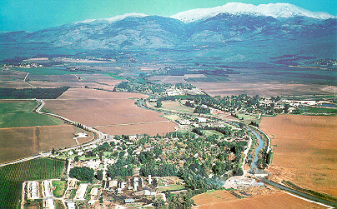
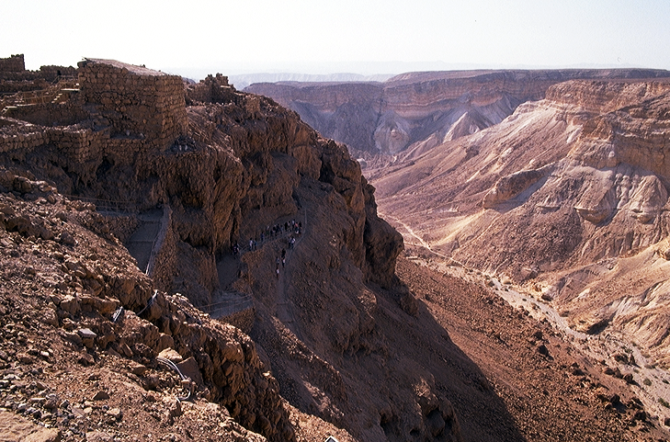
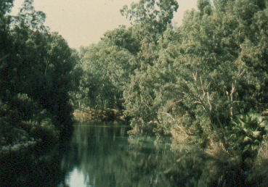
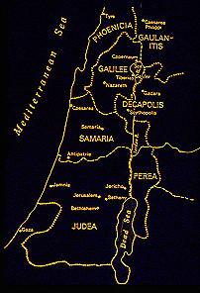
7
a,m±_ 1; 16
pGef@pm;Edkif&ef v_H@aqmfcsufrsm;
a,m±_
a,&dacg
Handbook pg. 29-31
4
40

Slide 43
7
? a,m±_ 6; 2/ 8; 26
a,m±_/
a,&dacg
tm+AH[H a,moyf arma&S
a,m±_
a,m±_
a,&dacg
Handbook pg. 29-31
41

Slide 44
DEAD SEA
JORDAN RIVER
MODERN JERICHO
JOSHUA
Jericho/Ai
ANCIENT JERICHO
From Jericho...
Looking East Across the Jordan River
Handbook pg. 26-29
42
Notes:
Here is Jericho today. You can easily imagine Joshua's forces crossing the distant river to the east with his thousands upon thousands of armed men ready for the seven years of battle that lay ahead.

Slide 45
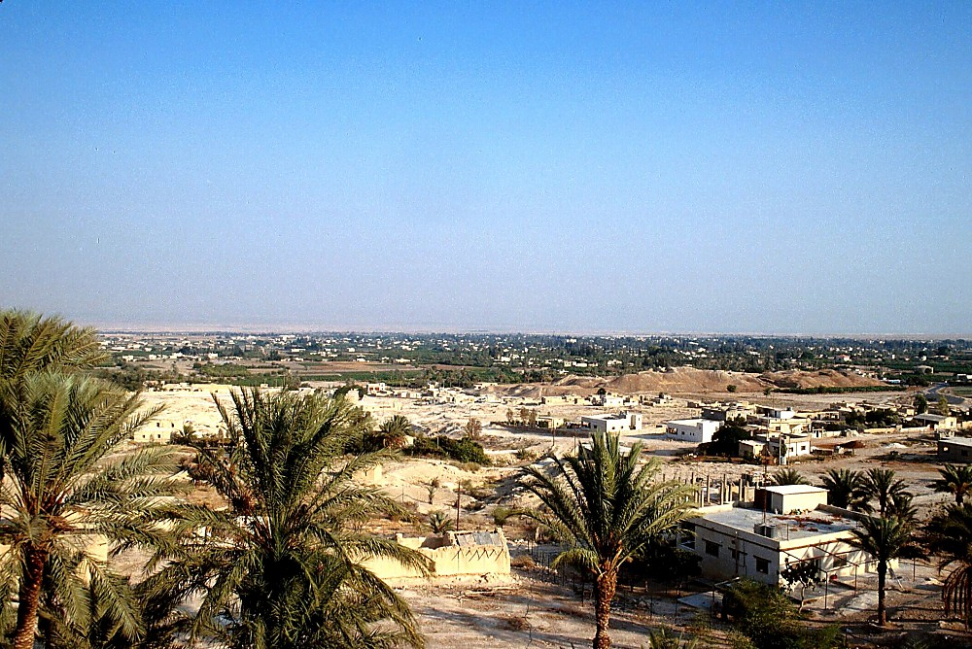
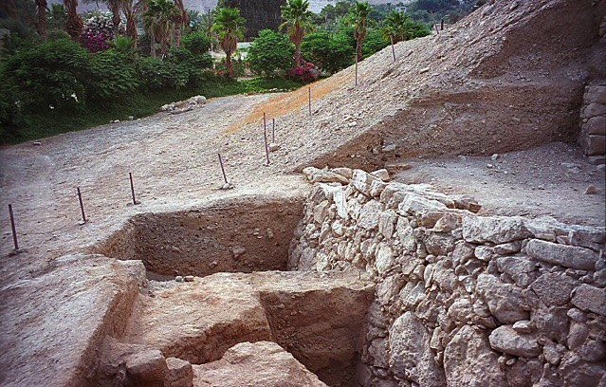
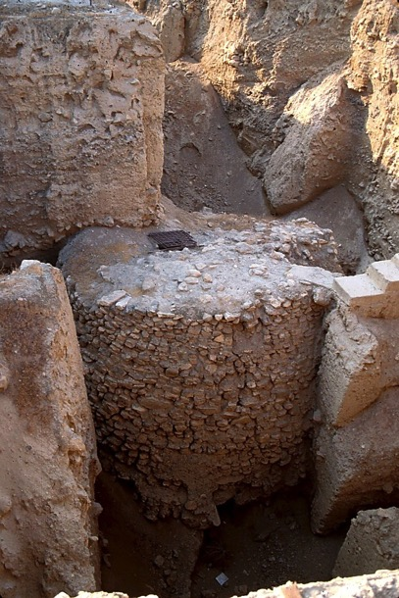
JOSHUA
Jericho/Ai
Jericho: Its Ancient Remains
Handbook pg. 29-31
43
Notes:
The sandy hills in the middle of this picture show the remains of the ancient city of Jericho -- as they stand today. It's possible that some ancient watchmen observed Joshua's forces from this Neolithic watchtower as they neared the city, eventually to bring down these actual walls of Jericho…uncovered here in past excavations…

Slide 46
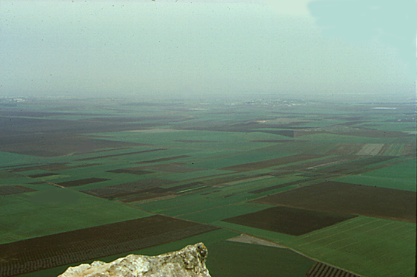
7
a,m±_ 17; 16
a,Za&v csdKifh0Srf;tm; aeaAmawmif
rS vSrf;Ijrif&yHk
a,m±_
a,&dacg
Edk@ESifh ysm;&nfpD;qif;&mae&m
Handbook pg. 29-31
44

Slide 47
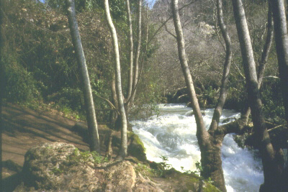
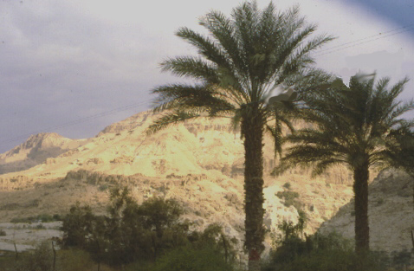
a,m±_ 3; 1 -12 ; 24
ajrmufydkif; 'ef rS
a,m±_
a,&dacg
e,fajra0cGJjcif;
awmifydkif; aA&a&Sb+rdK@wdkifatmif
Handbook pg. 29-31
3
45

Slide 48
7
? a,m±_ 14;5
a,m±_/
a,&dacg
e,fajra0cGJjcif;
a,m±_
tm+AH[H a,moyf arma&S
a,m±_
a,&dacg
e,fajra0cGJjcif;
Handbook pg. 29-31
46

Slide 49
/ a,m±_ 13; 1 -21; 43/ 13;14 (av0d)/
7
ajrxJyifv,f
e\vd
/ tm&Sm
cgeefe,fajrtm;ydkif;jcm;jcif;/
ZmAkvkef
*gvdvJtdkif/
wmaAmfawmif/
u&arvawmif
Áocg
a,m o yf . om; rsm;
*dvaAmawmif
vlrsdK;EG,fpkwdkif;onf
tmjA[Htm;
uwdxm;awmfrl
aome,fajrü
tajccsavhvmaexdkifBu
onf?
r em a&S
r em a&S
{ z &drf
a,m±_
a,&dacg
'ef
e,fajra0cGJjcif;
A,Fmrdef
*'f
wJawmfwnf&m
+rdK@ wdkif; Y
aexdkif&rnf?
,k'
/ a[jAKef+rdK@/
±kAif
yifv,fao
&Sdarmif/
Handbook pg. 29-31
13
47

Slide 50
/ a,m±_ 13; 1 -21; 43/ 13;14 (av0d)/
7
ajrxJyifv,f
e\vd
/ tm&Sm
ZmAkvkef
*gvdvJtdkif/
rdrdrSefonf[kxif onf.t&mudk jyKvkyfaecJh Buonf/
a,moyf\om;rsm;
wmaAmfawmif/
u&arvawmif
a,m o yf om; rsm;
*dvaAmawmif
r em a&S
r em a&S
a,m±_
{ z &drf
a,&dacg
'ef
e,fajra0cGJjcif;
A,Fmrdef
*'f
wJawmfwnf
&m+rdK@ wdkif; Y
aexdkif&rnf?
,k'
/ a[jAKef+rdK@/
±kAif
yifv,fao
&Sdarmif/
Handbook pg. 29-31
13
47

Slide 51
usrf;ordkif;{/f ckeSpf oufwrf;rsm;
tm+AH[HrS a,moyf/ 2000 B.C.
arma&S rS a,m±_/ 1500 B.C.
01

Slide 52
7
urBmOD;usrf; 1/ a,m±_rSwfpm 24/
zefqif;jcif;/
rif;rJh/
zefqif;jcif
vlom;/
tjypf
owif;aumif
rdom;pk
rif;pH
(1000 B.C.)
vlowfr_
oufwef@
&Jwdkuf}uD;/
tm+AH[H
(2000 B.C.)
a&G;ac:awmfrljcif;/
AC
C 7 S J
L - S - B
jzpf pOf 3 &yf
I - I
J - E
12
zrf;qD;/
7 = 4 + 3
a,moyf
yk*~dKvf av;OD;
u|efb0
a,m±_
430
(1500 B.C.)
qdwf+idrf
a,&dacg
arma&S
qdwf+idrf
(500 B.C.)
e,fajrydkif;jcm;a0jcif;?
xGufajrmuf
S
odemawmi
M - C - C
uma'&S
a,±_
40
40
LC
a'oem 5 &yf
a,±_
a,m±_
a,&dacg
e,fajra0cGJjcif
50
2

Slide 53


or®musrf;pm tkwfNrpf • BibleStudyDownloads.org
အခမဲ့အဘို့ဤတင်ပြချက်
Notes:
The Bible…Basically (bb)

Slide 54
51
©2003 TBBMI
7.2.03c.

