Slide 1
cef@rSef;ae@pGJ
tm+AH[H rS a,moyf 2000 bDpD
oufwrf;Espfaygif; 500 ESpf [kowfrSwfonf?
Handbook pg. 19-24
01
1

Slide 2
? urBm 37;2 - urBm 50;26
7
w&m;ol}uD;wpfOD;tkyfcsLyf&rnf?
zefqif;jcif;/
ABRAHAM
tm+AH[
ABRAHAM
a,moyf
ABRAHAM
arma&S
a,m±_
rif;rJhumv
rif;pHumv
zrf;qD; umv/
yk*~dKvf av;OD;rS yxr yk*~dKvf
qdwf+idrfumv
a,±_
Handbook pg. 19-24
02

Slide 3
tqifhqifhydkif;jcm;avhvmjcif;/
urBm 15;18
ajrxJyifv,f
6
edea0+rdK@tmqD;&D;,m;
cg&ef+rdK@
pdkajypdrf;vef;aom vjcrf;t&yfa'o
Fertile Crescent
*gvdvJtdkif
*aeFo&uf
? ,lza&;wD;/
B
J
aeaAmawmif
yifv,fao/
tpjyK&mt&yf/
tJ*kwWKjynf
O±k/
uma'&S
odemawmif
yifv,feD
yg;&Sm;yifv,fauG@
Handbook pg. 19-24
03
1

Slide 4
tqifhqifhydkif;jcm;avhvmjcif;/
urBm 15;11
a'o 10 &yf
tD&wf
tD&ef/
ul0dwf/ aqmf'Dtma&;bD;,m;/ qD;&D;,m;/
tpPa&;/
wl&uD /
tD*spf
ajrxJyifv,f
6
4
edea0+rdK@tmqD;&D;,m;
cg&ef+rdK@
*gvdvJtdkif
cgeef/
*gvdvJtdkif
*aeFo&uf
? ,lza&;wD;/
AmAkvkef+rdK@
a,&dacg +rdK@
aeaAmawmif
qm;yifv,f (yifv,fao)
yifv,fao/
Edkif;vfjrpf/
tJ*kwWKjynf
tD*spf
O±k/
uma'&S
odemawmif
wdeu|ef;qG,f/
yg;&Sm;yifv,fauG@
yifv,feD
Handbook pg. 19-24
03
1

Slide 5
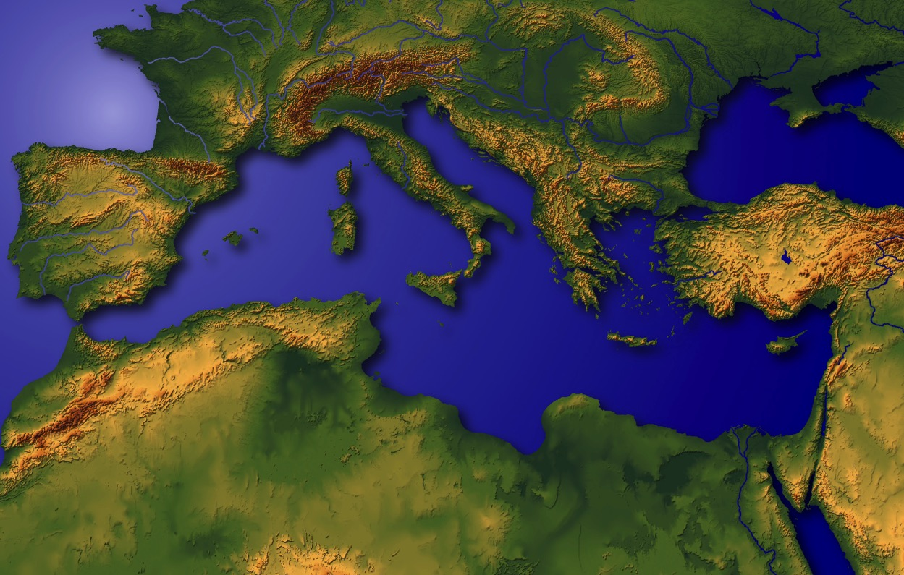
urBmajr}uD;. a&a=umif;taexm;
Handbook pg. 19-24
05

Slide 6
urBm 11;21
tqifhqifhydkif;
jcm;avhvmjcif;
ajrxJyifv,f
edea0+rdK@
tmqD;&D;,m;
cg&ef+rdK@
*gvdvJtdkif
*aeFo&uf
? ,lza&;wD;/
AmAkvkef+rdK@
a,&dacg +rdK@
aeaAmawmif
yifv,fao/
cgv'JY&Sdaom O±k/ rDqdkydkaw;rD;,m;csdKifh0Srf;Y&Sdaom a&S;acwf ±dk;&mxHk;"avh. A[dktcsufcsm/ tm+AH[H.aetdrf
tJ*kwWKjynf
uma'&S
O±k/
odemawmif
yg;&Sm;yifv,fauG@
yifv,feD
Handbook pg. 19-24
06
1

Slide 7
7
AmAkvkef
tD&wf
rSwfrdvm; / yifv,fauG@ppfyGJ tD&wfY/
Handbook pg. 19-24
07
6

Slide 8
7
The Mesopotamian Basin
SUMERIAN INVENTIONS…
WRITING AND THE WHEEL
BEGINNINGS…
LAW
MEDICINE
ASTRONOMY
ARCHITECTURE
EARLIEST URBAN CENTERS
Handbook pg. 19-24
07a
4
Notes:
Here in this Middle Eastern land – bordering the Persian Gulf --
were some of the earliest beginnings of mankind’s discovery of an intellectual life.
//// In this triangular shaped valley,
//// called the Mesopotamian Basin,
//// the ancient Sumerians presented us the gifts of writing and the wheel. And here we see
//// the beginnings of basic concepts of civilization…of law…of medicine… of astronomy and architecture.
//// Archaeologists have also found evidence of some of the very earliest urban centers…
the communities and the cities that, through time, have led directly to the civilization and cultures we know today.

Slide 9
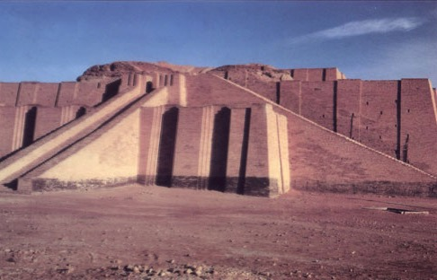
? urBm 10;10 / 11;28 / 31/
7
pHerlemjzpfaom ZD*l&wf/ a&S;acwf O±k/
+rdK@/ cgv'Je,f tm; ,ae@awG@&yHk?
Handbook pg. 19-24
08

Slide 10
urBm 11;31
7
tm+AH[H.rdom;pk
aw& (taz)/
tm+AH[H (t+AH)/
pm&m (r,m; pm&J)/
avmw (wlawmfarmif)
Handbook pg. 19-24
09
5

Slide 11

7
tm+AH[H/
ABRAHAM
ca. 2000 B.C.
yk*~dKvf av;OD; rS yxryk*~dKvf
onf
tm+AH[H/
tm+AH[H
AJMJ
urBmOD;usrf; 12 rS aemufydkif;
Handbook pg. 19-24
10
3

Slide 12
urBm 12;1-3
7
tm+AH[H/
ABRAHAM
ca. 2000 B.C.
a&G;aumufjcif;
yk*~dKvf av;OD; rS yxryk*~dKvf
onf
tm+AH[H/
a&G;aumufjcif;
tm+AH[H
AJMJ
urBmOD;usrf; 12 rS aemufydkif;
Handbook pg. 19-24
11

Slide 13
7
tm+AH[H/
ABRAHAM
ca. 2000 B.C.
tm+AH[H
a&G;aumufjcif;
AC
a,moyf/
a,m±_/
urBmOD;usrf; 12;1-3
arma&S/
AJMJ
ABRAHAM
The CALL
tm+AH[HtwGuf tajcaeay: rrlwnfaom uwdawmf/
Handbook pg. 19-24
12

Slide 14
7
tm+AH[H/
ABRAHAM
ca. 2000 B.C.
tm+AH[H
a&G;aumufjcif;
AC
a,m±_/
arma&S/
L - S - B
a,moyf/
AJMJ
urBmOD;usrf; 12;1-3
e,fajr/
rsdK;EG,f/
ABRAHAM
The CALL
L - S - B
aumif;csD;/
tajcaeay:rlrwnfaom uwdawmfonf aemufydkif;Y w&m;0if yËdOmOfw&m;jzpfvm.?
Handbook pg. 19-24
13

Slide 15
urBmOD;usrf; 12
7
1 xm0&bk&m;onfvnf; tm+AHudkac:awmfrlI/ oif.jynfESifhwuG trsdK;om;csif;aygufabmf rsm;xJuxGuf+yD;v#if/ igjyvwHhaomjynfodk@oGm;avmh?
1
2 igonfoifhudk vlrsdK;}uD;jzpfaprnf? igaumif; }uD;ay;I oif.emrudk}uD;jrwfaprnf? oifonf aumif;}uD;cH&aomoljzpfvdrfhrnf
tm+AH[H/
a&G;aumufjcif;
L - S - B
3oifhudkaumif;}uD;ay;aomoludkigaumif;}uD;ay;rnf?oifhudkusdefqJaomoludk igusdefqJrnf? oifhtm;jzifh vnf; vlrsdK;taygif;wdk@onf aumif;}uD;r*Fvmudk cH&=uvdrfhrnf [k rdef@awmfrl.?
Handbook pg. 19-24
14
2

Slide 16
urBmOD;usrf; 12
7
1 xm0&bk&m;onfvnf; tm+AHudkac:awmfrlI/ oif.jynfESifhwuG trsdK;om;csif;aygufabmf rsm;xJuxGuf+yD;v#if/ igjyvwHhaomjynfodk@oGm;avmh?
1
jynf
vlrsdK;}uD;
2 igonfoifhudk vlrsdK;}uD;jzpfaprnf? igaumif; }uD;ay;I oif.emrudk}uD;jrwfaprnf? oifonf aumif;}uD;cH&aomoljzpfvdrfhrnf
tm+AH[H/
a&G;aumufjcif;
L - S - B
3oifhudkaumif;}uD;ay;aomoludkigaumif;}uD;ay;rnf?oifhudkusdefqJaomoludk igusdefqJrnf? oifhtm;jzifh vnf; vlrsdK;taygif;wdk@onf aumif;}uD;r*Fvmudk cH&=uvdrfhrnf [k rdef@awmfrl.?
aumif;}uD;r*Fvm
Handbook pg. 19-24
14
2

Slide 17
7
tm+AH[HESifhqdkifaom uwdawmf/
urBm 12;1-3
e,fajr/ rsdK;EG,f/ aumif;csD;/
tm+AH[H/
a&G;aumufjcif;
L - S - B
12;1
12;2
12;3
“L-S-B”
Handbook pg. 19-24
16
3

Slide 18
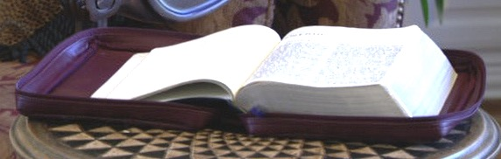
urBm 13;15 urBm 15
7
tm+AH[H ESifhqdkifaom uwdawmf/
urBm 12;1-3
e,fajr/ rsdK;EG,f/ aumif;csD;/
tm+AH[H
a&G;aumufjcif;
L - S - B
tuQ&mESifhqdkifaom
xm0&jzpfaom
tajctaeay: rrlwnfaom
Handbook pg. 19-24
17
3

Slide 19
,kH}unfjcif; c &D;
urBm 12;4/
tqifhqifhydkif;jcm;
avhvmjcif;/
ajrxJyifv,f
edea0+rdK@
tmqD;&D;,m;
cg&ef+rdK@
*gvdvJtdkif
*aeFo&uf
? ,lza&;wD;/
AmAkvkef+rdK@
a,&dacg +rdK@
aeaAmawmif
tm+AH[H/
yifv,fao/
a&G;aumufjcif;
tJ*kwWKjynf
uma'&S
O±k/
odemawmif
yg;&Sm;yifv,fauG@
yifv,feD
Handbook pg. 19-24
18
2

Slide 20
urBm 11;31
tqifhfqifhydkif;jcm;
avhvmjcif;/
ajrxJyifv,f
edea0+rdK@
tmqD;&D;,m;
cg&ef+rdK@
*gvdvJtdkif
*aeFo&uf
? ,lza&;wD;/
AmAkvkef+rdK@
a,&dacg +rdK@
aeaAmawmif
tm+AH[H/
yifv,fao/
a&G;aumufjcif;
tJ*kwWKjynf
uma'&S
O±k
AmAkvkef. }uD;rm;aom +rdK@awmf
odemawmif
yg;&Sm;yifv,fauG@
yifv,feD
Handbook pg. 19-24
19

Slide 21
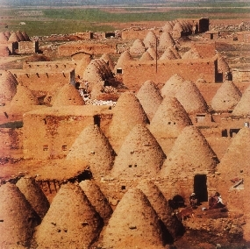
tqifhfqifhydkif;jcm;
avhvmjcif;/
urBm 11;31-32
ajrxJyifv,f
edea0+rdK@
tmqD;&D;,m;
cg&ef+rdK@
*gvdvJtdkif
touf}uD;aom tazaw&onf cg&efY
aoqHk;onf?
*aeFo&uf
,lza&;wD;
a,&dacg +rdK@
aeaAmawmif
AmAkvkef+rdK@
tm+AH[H/
yifv,fao/
a&G;aumufjcif;
tJ*kwWKjynf
uma'&S
O±k/
odemawmif
,ae@cg&ef+rdK@Y&Sdaom ysm;tHktdrfyHkpH+rdK@awmf
yg;&Sm;yifv,fauG@
yifv,feD
Handbook pg. 19-24
20
2

Slide 22
urBm 12;5
tqifhfqifhydkif;jcm;
avhvmjcif;/
ajrxJyifv,f
edea0+rdK@
tmqD;&D;,m;
cg&ef+rdK@
*aeFo&uf
SG
? ,lza&;wD;/
AmAkvkef+rdK@
a,&dacg +rdK@
aeaAmawmif
tm+AH[H/
yifv,fao/
a&G;aumufjcif;
tJ*kwWKjynf
uma'&S
O±k/
odemawmif
yg;&Sm;yifv,fauG@
yifv,feD
Handbook pg. 19-24
21

Slide 23

7
tm+AH[Huwdawmfe,fajr pwiftajccspOf touf 75ESpf&Sd.?…
ol.r,m; pm&monf touf 65ESpf&Sd.? odk@aomf uav;ay;rnf[k bk&m;uwd&Sdao;.?!
tm+AH[H/
a&G;aumufjcif;
L - S - B
Handbook pg. 19-24
22
4

Slide 24
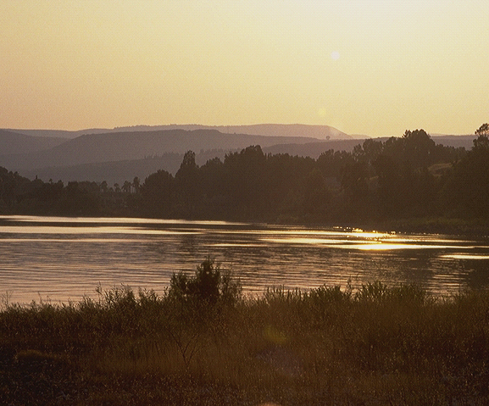
urBm 15;6
7
bk&m;.uwdawmfudk tm+AH[H ,Hk=unfonf? e,fajr/ rsdK;EG,f/ aumif;csD;/
urBm 15;6
,Hk=unfjcif;onf ajzmifhrwfjcif;jzpf.? &dl;pif;aom ,Hk=unfjcif;
tm+AH[H/
a&G;aumufjcif;
L - S - B
Handbook pg. 19-24
23
3

Slide 25
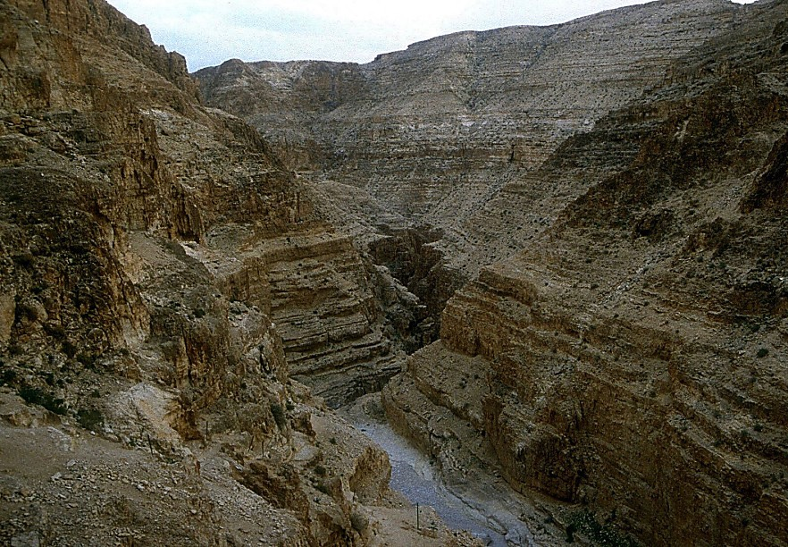
urBm 16;1-4
7
tm+AH[H bk&m;udk,Hk./ !
tm+AH[HESifh pm&m onf;cHjcif;tm;enf;vm onf? pm&m.uGsefr [m*&xH tm+AH[H0ifa&mufjcif;
tm+AH[H/
a&G;aumufjcif;
L - S - B
Handbook pg. 19-24
24
3

Slide 26
urBm16;11-12-17;20-21
7
tm+AH[Honf[m*&ESifh &aomom;.zcifjzpfvmonf? xdkom;emrnfrSm Á&SarvS jzpf.? Á&SarvSonfbk&m;uwdxm;aom om;r[kwfacs?
tm+AH[H/
a&G;aumufjcif;
L - S - B
Handbook pg. 19-24
25
3

Slide 27
urBm 17;19
7
,cktm+AH[Htouf 85ESpf/ pm&mtouf 75ESpf/ xdk@aemufESpfaygif; 15ESpf =umaomf ÁZufonf tm+AH[H ESifh pm&mwdk@rS arG;zGm;vmonf?
tm+AH[H/
a&G;aumufjcif;
L - S - B
Handbook pg. 19-24
26
4

Slide 28
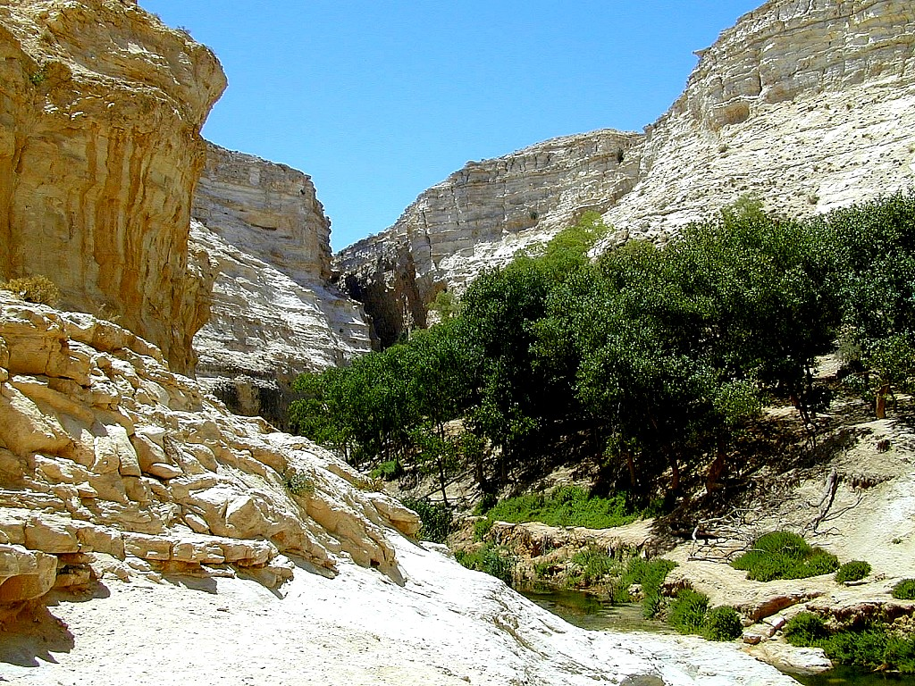
urBm 17;21
7
ÁZufonf apmifhpm;ar#mfvifhae&aom om;tppftrSefjzpf.?
xdkom;tm;jzifhtm+AH[Htm;bk&m;ay;
aomuwdawmfjynfhpHkvm.?
tm+AH[H/
a&G;aumufjcif;
L - S - B
xdkom;.rdom;pk rsdK;qufrS wqifhjzpf.?
Handbook pg. 19-24
27
2

Slide 29
urBm 17
7
tm+AH[H/
ABRAHAM
ca. 2000 B.C.
a&G;aumufjcif;
AC
arma&S/
L - S - B
a,moyf/
a,m&_
AJMJ
Á&Sarv ESifh ÁZuf/
urBm 12;1-3
tm+AH[H/
a&G;aumufjcif;
tm+AH[H
L - S - B
I - I
Á&Sarv ESifh ÁZuf/
Handbook pg. 19-24
28

Slide 30
7
tm+AH[H/
ABRAHAM
ca. 2000 B.C.
The CALL
AC
a,moyf/
arma&S/
a,m&_
L - S - B
AJMJ
urBm 12;1-3
Á&Sarv ESifh ÁZuf/
tm+AH[H
tm+AH[H/
a&G;aumufjcif;
L - S - B
I - I
Á&Sarv tm;jzifh tm&yfvlrsdK;/
ÁZuftm;jzifh ,k'vlrsdK;/
Handbook pg. 19-24
29
2

Slide 31
7
tm+AH[H/
ABRAHAM
ca. 2000 B.C.
The CALL
AC
a,moyf/
arma&S/
a,m&_
L - S - B
AJMJ
urBm 12;1-3
Á&Sarv ESifh ÁZuf/
tm+AH[H
tm+AH[H/
a&G;aumufjcif;
L - S - B
I - I
Á&Sarv tm;jzifh tm&yfvlrsdK;/
ÁZuftm;jzifh ,k'vlrsdK;/
Handbook pg. 19-24
29
2

Slide 32
7
tb,fwpfa,mufenf; ?
oifonf tvGefcspfaom wa,mufwnf;aom om; ÁZufudk,lI/ arm&djynfodk@oGm; avmh? igjyvwHhaom awmifay:rSm ol@udk rD;±d_@&m ,ZfjyKI ylaZmfavmh [krdef@awmfrl.?
tm+AH[H/
a&G;aumufjcif;
L - S - B
I - I
NIV Version t& a[+AJbmom ÁZuf [kqdk&mwGif ‘oifcspfaom’/ [k t"dy`g,f&Sdonf? ‘oif.om;’/ ‘oif.wpfOD;wnf;aomom;’/ ‘oifcspfaomom;’ [kt"dy`g,fxGuf.? ÁZufonf bk&m;uwdawmfom;jzpf.?
2&m 3;1 Y &Sdaom ÁZuftm; ylaZmf&mt&yfonf ,ae@ tpPa&;Y&Sd aom rlqvifausmif;awmf t&yfESifh wpfxyfwnf;us.?
Handbook pg. 19-24
31
3

Slide 33
7
tb,fwpfa,mufenf;?
Á&Sarvtr_Yum;/ oif.pum;udk igem;axmif.? ol@udkigaumif;}uD;ay;.? ol@tEG,fudk wdk;yGm;apI ol@udk tvGefrsm;jym;aprnf? olonf rif;om;q,fyg;wdk@. tbjzpfvdrfhrnf? }uD;aomvlrsdK;jzpfapjcif;iSmvnf; igjyKrnf? odk@aomfvnf;/ aemifESpf/ csdef;csufaomtcsdefwGif/ pm&m onf oifhtm;bGm;vwhHaom om; ÁZufY / ig.yËdOmOfudk igwnfaprnf [krdef@awmfrl+yD;v#if-
urBm 17;20-21 (NKJV)
tm+AH[H/
a&G;aumufjcif;
L - S - B
ig.yËdOmOfudk
I - I
igwnfaprnf
Handbook pg. 19-24
32
2

Slide 34
7
,ae@vufaqmifrsm;udk ESdkif;,SOf=unfhv#if/
ÁZuf/
tm+AH[H/
a&G;aumufjcif;
tb,fa=umifh }uD;}uD;rm;rm; jcm;em;r_&Sd&oenf;?
L - S - B
I - I
Á&Sarv
Handbook pg. 19-24
33
3

Slide 35
7
yx0Dajrtaexm; Ed_if;,SOfr
? Áoa&vESifh
tm+AH[H/
a&G;aumufjcif;
L - S - B
I - I
tm&yfurBm
Handbook pg. 19-24
34

Slide 36
7
yx0Dajrtaexm; Ed_if;,SOfr_/
tm+AH[H/
a&G;aumufjcif;
L - S - B
I - I
rdk[mrufESifh ÁZuf
Handbook pg. 19-24
35

Slide 37
7
yx0Dajrtaexm; Ed_if;,SOfr_/
Áoa&vESifh
? Áoa&vESifh
=opa=w;vs/
jyifopf
? Áoa&vESifh
? Áoa&vESifh
tm+AH[H/
a&G;aumufjcif;
u,fvDzdk;eD;,m;/
L - S - B
I - I
rdef;/
Handbook pg. 19-24
36
3

Slide 38
Áoa&vESifh tar&duefEdkifiH/
7
tm+AH[H/
a&G;aumufjcif;
L - S - B
I - I
w&m;r_&Sdovm;?
Handbook pg. 19-24
37

Slide 39
7
“…Á&SarvtrsdK;onf Áoa&vrdsK;EG,fxuf e,fajrESifh pnf;pdrf csrf;omr_ aumif;csD;ydkIcHpm;& onf? 0dOmOfa&;&mu,fwifjcif;Y vnf;aumif;/ Á&SarvtrsdK;omI cHpm;&onf?
tm+AH[H/
a&G;aumufjcif;
L - S - B
I - I
Hal Lindsey, “The Everlasting Hatred: The Roots of Jihad,” 2002, Pg 65
Handbook pg. 19-24
38

Slide 40
7
“…Á&SarvtrsdK;onf Áoa&vrdsK;EG,fxuf e,fajrESifh pnf;pdrf csrf;omr_ aumif;csD;ydkIcHpm;& onf? 0dOmOfa&;&mu,fwifjcif;Y vnf;aumif;/ Á&SarvtrsdK;omI cHpm;&onf?
odk@aomfjim;vnf; bk&m;ocif. yËdOmOfonf ÁZufESifh ol.rsdK;pOfrsdK;quftwGufomjzpf onf?avmuDESifhqdkifaomÁoa&v.csrf;omr_onf 0dOmOfa&;csrf;omr_Y bk&m;ac:aomtcg taxmuftuljyK&efjzpf.? [Emphasis added]
tm+AH[H/
a&G;aumufjcif;
L - S - B
I - I
Hal Lindsey, “The Everlasting Hatred: The Roots of Jihad,” 2002, Pg 65
Handbook pg. 19-24
39

Slide 41
7
vufbEGef/
ÁZuf.trsdK;tEG,f/
? ajrxJyifv,f/
qD;&D;,m;/
*gvdvJyifv,f/
tD&wf/
[dkifzm/
emZ&uf/
eDwm,m/
a*smf'ef/
xJtmApf*smzg
tmref/
a,&k&Svif/
a,&dacg/
*gqm/
a[jAKef/
yifv,fao/
tm+AH[H/
bD,ma&Sb/
a&G;aumufjcif;
;/ tpPa&;/
L - S - B
I - I
Á&Sarv. trsdK;tEG,f/
tD*spf/
aqmf'Dtma&;bD;,m;/
/ tdkifvwf/
/ tJcGgbm/
/ tJcGgbm/
Á&Sarv ESifh ÁZuf wdk@,ae@
Handbook pg. 19-24
2
40

Slide 42
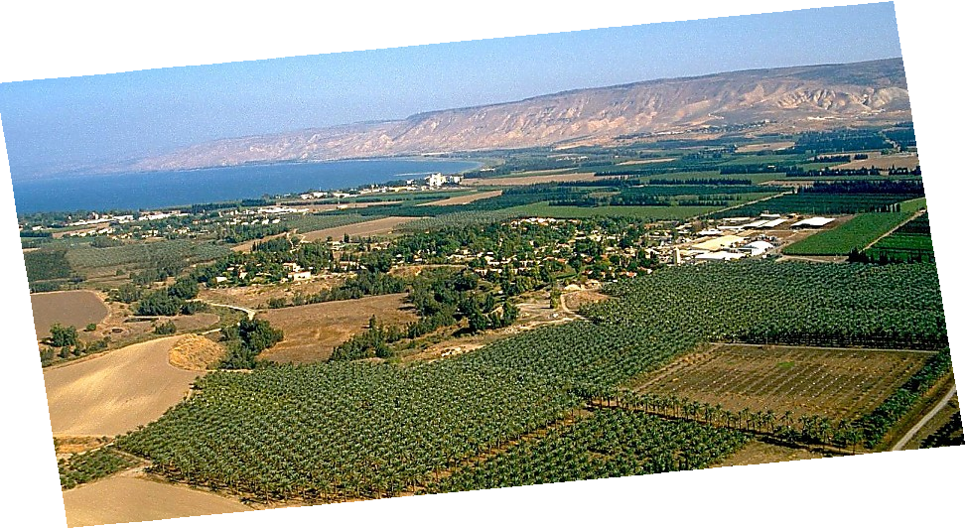
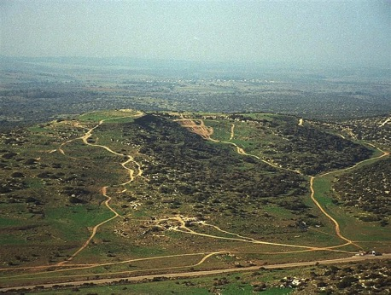
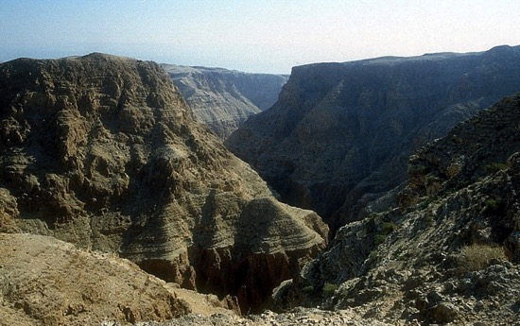
urÇmOD;usrf; 13;10-11/ a,m&SIrSwfpm 17;16/
7
tmjA[H\uwdawmf? aumif;BuD;wpfpdwfwpfydkif;? tvGefom,mvSyaomcgeef? bk&m;uwdawmftarGtESpfrsm;/
tmNAH[H/
a&G;aumufjcif;
L - S - B
The Jordan River in Central Israel
Handbook pg. 19-24
41

Slide 43
7
xGuf 2;24
tmNAH[H/
ABRAHAM
ca. 2000 B.C.
a&G;aumufjcif;
AC
L - S - B
arma&S/
a,moyf/
a,m&I
I - I
urÇm 12;1-3
AJMJ
J - E
12
tmNAH[H/
a&G;aumufjcif;
L - S - B
tmNAH[H
I - I
J - E
,mukyfonf uwdawmf\fom;jzpfonf/
12
uwdawmf\aqGpOfrsdK;quf
Handbook pg. 19-24
42
7

Slide 44
urÇm 35;23-26/ urÇm 34;1
7
tmNAH[H/
ABRAHAM
ca. 2000 B.C.
tmNAH[H
a&G;aumufjcif;
AC
a,moyf/
arma&S/
a,m&I
L - S - B
AJMJ
I - I
urÇm 12;1-3
J - E
12
12
10
tmNAH[H/
1
a&G;aumufjcif;
L - S - B
I - I
6
8
J - E
5
12
4
13
7
11
3
9
2
Handbook pg. 19-24
43

Slide 45
urÇm 35;23-26/ urÇm 34;1
7
tmNAH[H/
ABRAHAM
ca. 2000 B.C.
tmNAH[H
a&G;aumufjcif;
AC
a,moyf/
arma&S/
a,m&I
L - S - B
AJMJ
I - I
urÇm 12;1-3
J - E
12
12
10
tmNAH[H/
1
a&G;aumufjcif;
L - S - B
I - I
6
8
J - E
5
12
4
13
7
11
3
9
2
Handbook pg. 19-24
43

Slide 46
urÇm 35;24
7
tmNAH[H/
ABRAHAM
ca. 2000 B.C.
a&G;aumufjcif;
AC
a,moyf/
arma&S/
a,m&I
L - S - B
AJMJ
I - I
urÇm 12;1-3
J - E
12
tmNAH[H/
tmNAH[H
a&G;aumufjcif;
L - S - B
I - I
a,moyf
J - E
12
11
Handbook pg. 19-24
42
7

Slide 47
urÇm 1-35
7
zefqif;jcif;/
rif;rJh/
vlom;/
tjypf
zefqif;jcif
owif;aumif;/
rdom;pk
vlowform;
rif;pH/
(1000 B.C.)
oufwefha&mif
jzpfpOf 3 &yf
DC
&JwdkufBuD;/
zefqif;jcif
4 + 3
qdwfNidrf
a,&SI±
tmNAH[H/
(2000 B.C.)
(2000 B.C.)
a&G;ac:awmfrljcif;/
AC
NC
C 7 S J
L - S - B
I - I
J - E
12
zrf;qD;/
7 = 4 + 3
a,moyf
tmNAH[H/
a&G;aumufjcif;
yk*¾dKvf av;OD;
L - S - B
I - I
/ arma&S/
(1500 B.C.)
J - E
qdwfNidrf
qdwfNidrf
(500 B.C.)
12
S
LC
a,±&I/
a,m±&SI
a,&SI
46

Slide 48
7
a,moyf/
AJMJ
yk*¾dKvf av;OD; rS 'kwd, yk*¾dKvf
tmNAH[H
a,m&I/
arma&S/
?
47

Slide 49
7
a,moyf/
AJMJ
yk*¾dKvf av;OD; rS 'kwd, yk*¾dKvf
tmNAH[H
a,m&I/
arma&S/
?
“a,moyf”
47

Slide 50
7
ceYfrSef;aeYpGJ/
/ tmNAH[H rS a,moyf 2000 bDpD
49

Slide 51
ur®m 37;2 - ur®m 50;26/
7
w&m;ol BuD;wpfOD;tkyfcsLyf&rnf?
zefqif;jcif;/
ABRAHAM
tmNAH[
ABRAHAM
a,moyf
ABRAHAM
arma&S
a,m±7I
rif;rJh
rif;pH
zrf;qD;
qdwfNidrf
a,±7I
Handbook pg. 19-24
02

Slide 52
7
a,moyf
ABRAHAM
yk*¾dKvf av;OD; rS 'kwd, yk*¾dKvf
a,moyf/
a,moyf
tmNAH[H
a,m&I/
arma&S/
AJMJ
Handbook pg. 24-25
51

Slide 53
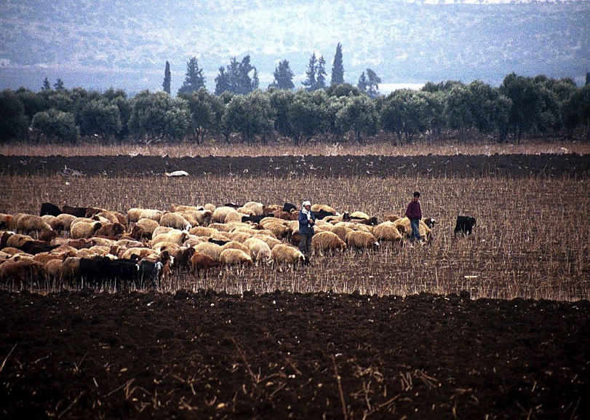
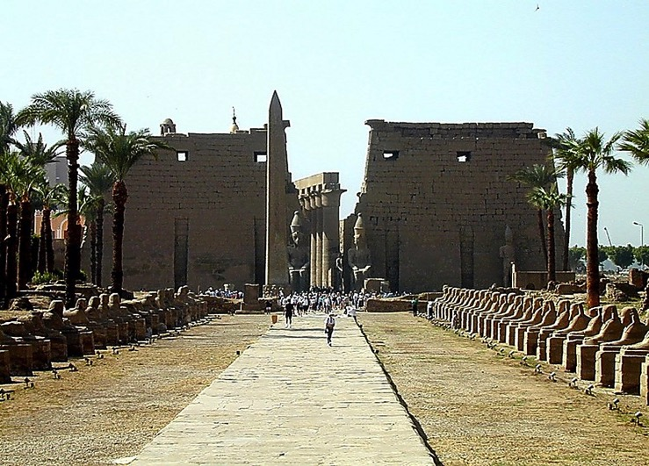
urÇm 37-41
tD*spf(tJ*kwÅK)Y&Sd
aomvkZm0wf ausmif; t0if0
a,moyf
a'goefY&Sd odk;ausmif;om; rsm;/
Handbook pg. 24-25
1
52

Slide 54
urÇm 37;41
a,moyf
Handbook pg. 24-25
53

Slide 55
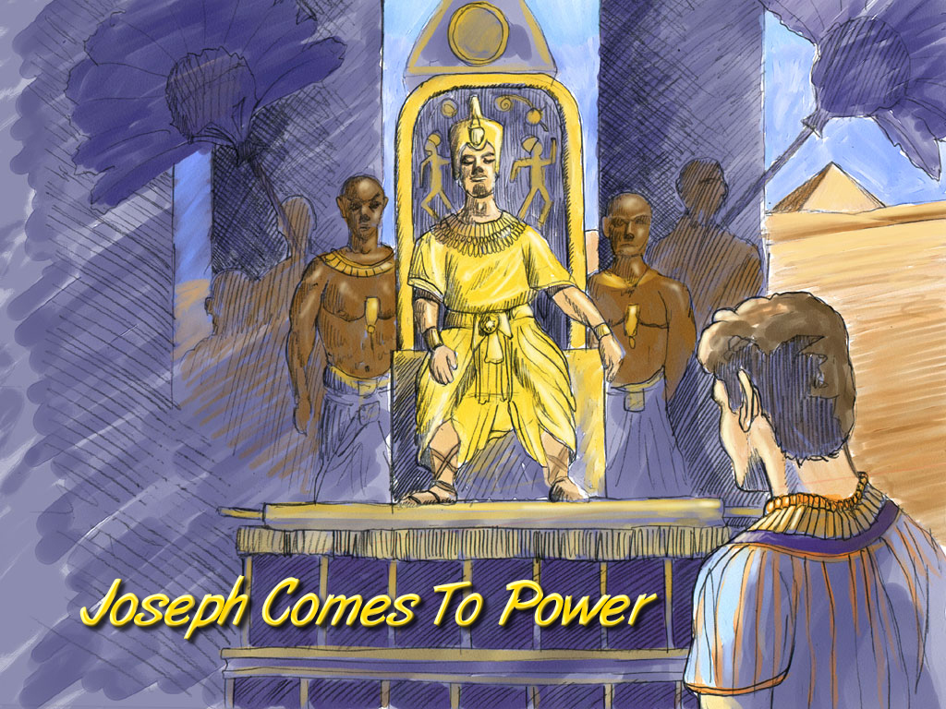
urÇm 41;41-44
a,moyf
a,moyftmPm&Sdcsdef
Joseph Comes To Power
Handbook pg. 24-25
54

Slide 56
urÇm 42;2/
tqifhqifhydkif;
jcm;avhvmjcif;
ajrxJyifv,f
tpma&acgif;ygjcif;/
edea0NrdKU
tmqD;&D;,m;
cg&efjrdKU
*gvdvJtdkif
*aeFo&uf
,lza&;wD;/
aeaAmawmif
AmAkvkefNrdKY
a,&dacgNrdKY
a,moyf
a,moyf
yifv,fao/
tJ*kwÅKjynf
O&
uma'&S
tpma&pmaygBu,f0jcif;/
odemawmif
yg;&Sm;yifv,fauGY
yifv,feD
Handbook pg. 19-24
06
1

Slide 57
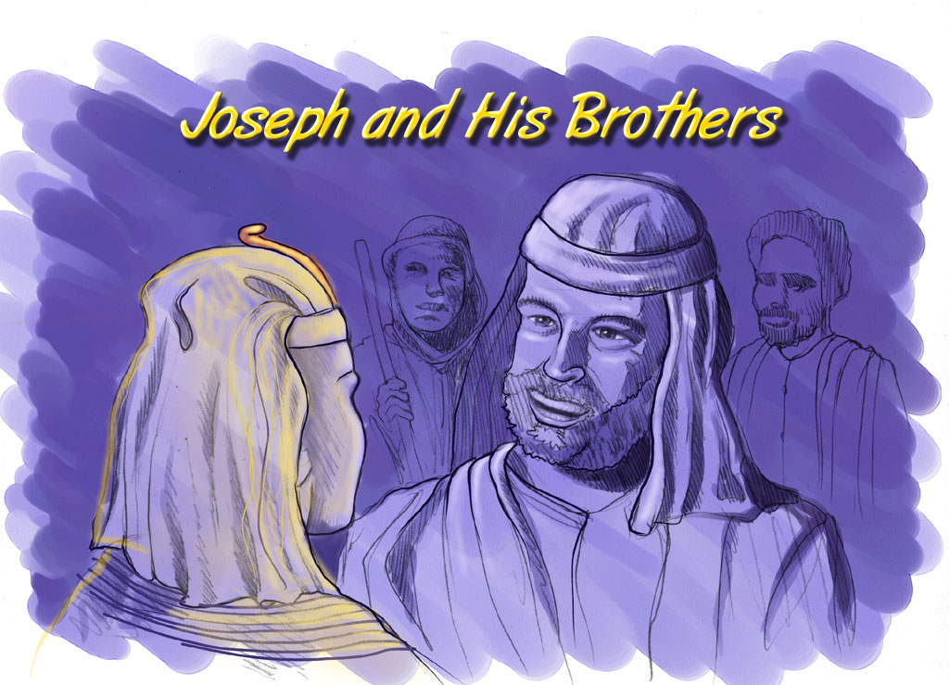
urÇm 37;41
a,moyfESifh ol.nDtpfudkrsm;/
a,moyf
Joseph and His Brothers
Handbook pg. 24-25
56

Slide 58
tqifhqifhydkif;
jcm;avhvmjcif;
urÇm 46;3-7
ajrxJyifv,f
edea0NrdKU
tmqD;&D;,m;
cg&ef NrdKY
*gvdvJtdkif
*aeFo&uf
? ,lza&;wD;/
aeaAmawmif
AmAkvkefNrdKY
a,&dacg NrdKY
rdom;pk rS vlrsdK;pkodkY qif;oufjcif;/
a,moyf
a,moyf
yifv,fao/
tJ*kwÅKjynf
uma'&S
O±k7k
odemawmif
yg;&Sm;yifv,fauGU
yifv,feD
Handbook pg. 19-24
06
1

Slide 59
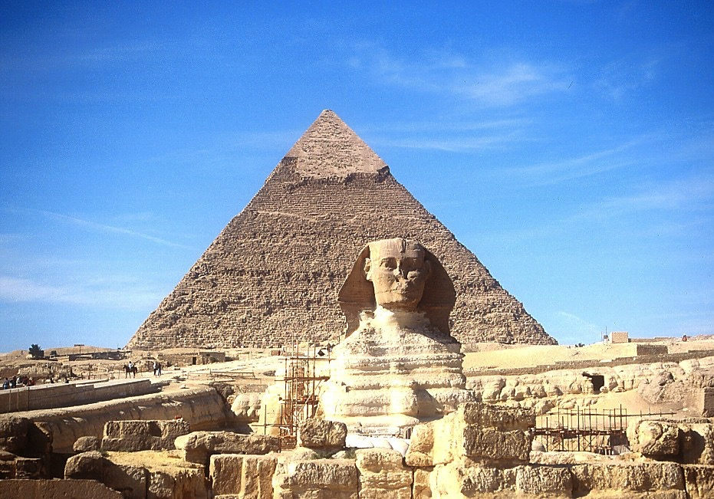
7
a,moyf
reKoD[ESifh BuD;rm;aom yd&rpf
Handbook pg. 24-25
58

Slide 60
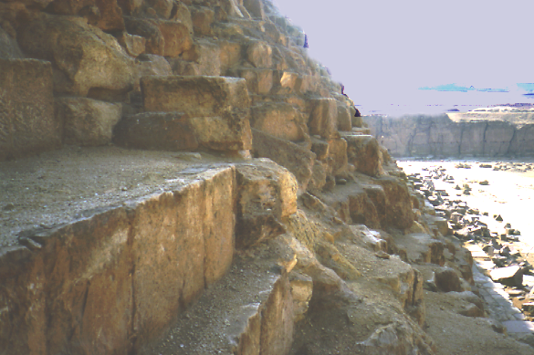
7
a,moyf
yd&rpfBuD;&Id ausmufusif;rsm;
Handbook pg. 24-25
59

Slide 61
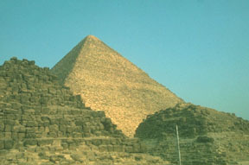
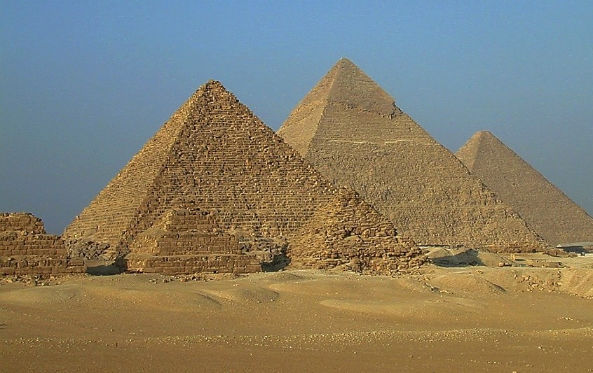
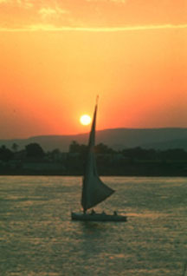
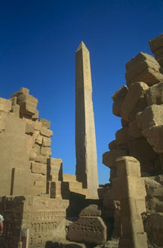
7
£Koa&v\ t&nftcsif;/
a,moyf
a&S;acwf tJ*kwÅK (tD*spf)\ tHhrcrf;7Icif;rsm;
Handbook pg. 24-25
60

Slide 62
7
xGuf 12;40-41/ *vmwd 3;17/
a,moyf
ABRAHAM
uGsefb0
vlav;OD;rS'kwd,ajrmufvl=
AJMJ

Slide 63
urÇm 1;1 - xGuf 1;6
7
zefqif;jcif;/
vlom;/
rif;rJh/
tjypf
zefqif;jcif
owif;aumif;/
rdom;pk
vlowfr_
rif;pH/
(1000 B.C.)
oufwef@
DC
&Jwdkuf}uD;/
zefqif;jcif
4 + 3
qdwfNidrf
tmNAH[H/
(2000 B.C.)
(2000 B.C.)
a,7I
a&G;ac:awmfrljcif;/
jzpfpOf 3 &yf
NC
C 7 S J
L - S - B
AC
I - I
J - E
12
a,moyf
zrf;qD;/
7 = 4 + 3
uRefb0
a,moyf
430
Slavery
yk*¾dKvf av;OD;
430
/ arma&S/
(1500 B.C.)
(500 B.C.)
qdwfNidrf
qdwfNidrf
S
LC
a,±7I/
a,m±7I
a,7I
Handbook pg. 24-25
62

Slide 64
7
arma&S/
a,moyf/
AJMJ
yk*¾dKvf av;OD; rS wwd, yk*¾dKvf
tmNAH[H
a,m&I/
?
47

Slide 65
7
arma&S/
a,moyf/
AJMJ
yk*¾dKvf av;OD; rS wwd, yk*¾dKvf
tmNAH[H
a,m&I/
?
“arma&S”
47

Slide 66


တရားေဟာျခင္းအ တတ္ပညာ • BibleStudyDownloads.org
အခမဲ့အဘို့ဤတင်ပြချက်
Notes:
Preaching (pr)
Homiletics

Slide 67
Black

