Slide 1

Burmese
or®musrf;pm
tkwfNrpf
Texas jrdk.rS or®musrf;pm-tkwfjrpf (edkifiHwumtrSkawmfaqmifvkyfief;)
\ wifjycsuf
www.biblebasically.org
Dr ရက္ခ္ ဂရီဖိတ္၊ စကၤပူဓမၼေကာလိပ္ • www.BibleStudyDownloads.org

Slide 2


jzpfysufcJh aomt&m
tajccHusus
or®musrf;pmavhvmjcif;/
®
tydkif; 3/
&mZ0if tusOf;csKyf
02
©2003 TBBMI
7.5.03a.

Slide 3

7
vl4OD;.../ jzpfpOf3&yf/
zefqif;jcif;/
qdwfNidrfumv
-
C
7
S
J
a,&Sk
03
1

Slide 4
7
jyefvnfav.vmjcif;
zefqif;jcif;/
C 7 S J
a,&Sk
=
4 3
qdwfNidrfumv
vl4OD;/ jzpfpOf3&y/f
04
1

Slide 5
7
jyefvnfav.vmjcif;
C 7 S J
C 4 3 S J
vl4OD;
a,&Sk
zefqif;jcif;
jzpfpOf3&yf
qdwfNidrfumv
05

Slide 6
7
today;jcif;
C 7 S J
C 4 3 S J
zefqif;jcif;
vl 4 OD;
jzpfpOf 3 &yf
qdwfNidrfumv
a,&Sk
06

Slide 7
7
zefqif;jcif;/
tmNA[H/
a,moyf/
arma&S/
a,m&Sl
rif;rJh/
rif;pH/
zrf;qD;/
qdwfNidrf/
a,&Sk
07

Slide 8
tqifhqifhydkif;
jcm;avhvmjcif;/
6 4
ae&m 10 ck/
zefqif;jcif;/
tmNA[H/
ajrxJyifv,f
edea0jrdKU
tmqD;&D;,m;
/ a,moyf/
/ arma&S/
cg&efjrdKU
/ a,m&Sk
*gvdvJtdkif
*aeFo&uf
e,fajr/
rif;rJh/
? ,lza&;wD;/
AmAkvkefNrdKU
a,&dacgNrdKU
rif;pH/
aeaAmawmif
/ zrf;qD;/
yifv,fao/
jzpfysufyHktqifhqifh
tJ*kwWKjynf
qdwfNidrf/
uma'&S
a,&Sk
O&
odemawmif
yifv,feD
yg;&Sm;yifv,fauGh
08

Slide 9
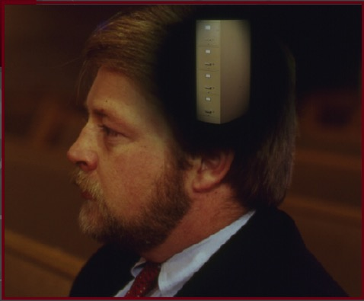
7
zefqif;jcif;/
ABRAHAM
tmjAH[H/
ABRAHAM
a,moyf
ABRAHAM
arma&S
a,m&Sk
rif;rJh
rif;pH
zrf;qD;
qdwfjidrf
a,&I
-pdwfjzif.ajryHk wnfaqmufjcif;
-tao;pdwf avhvmjcif;r[kwf
-NcKHikHítBurf;zsif; avhvmjcif;
-or®musrf;pm\ a,bk,susaom
t"dutcsufrsm;
09
4

Slide 10
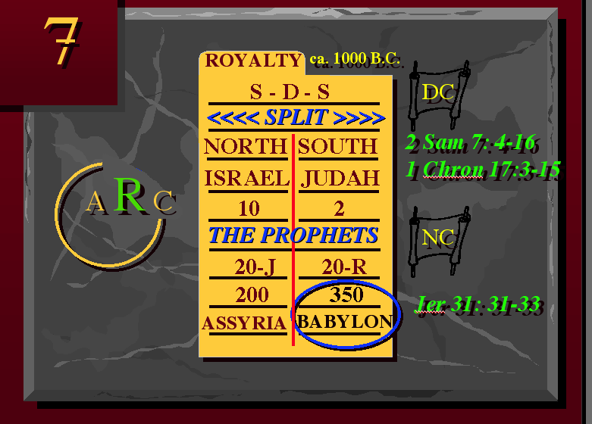
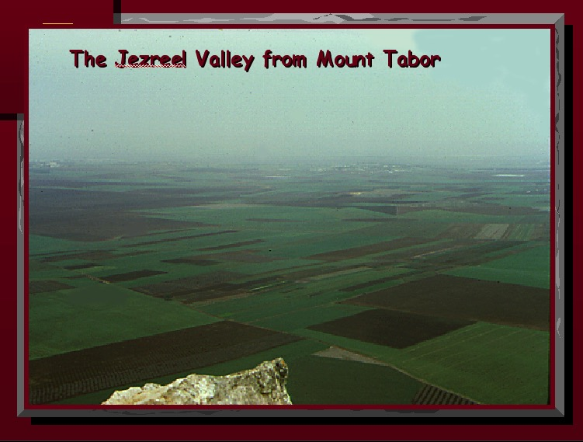
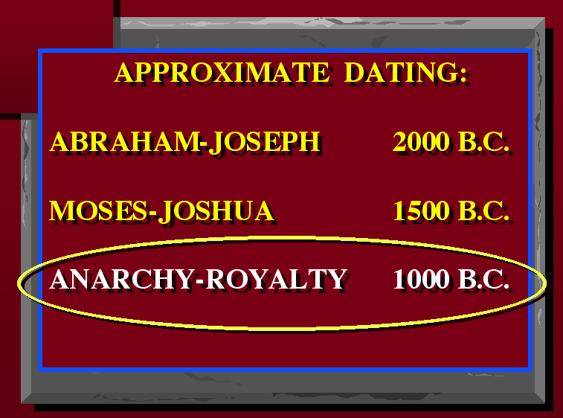
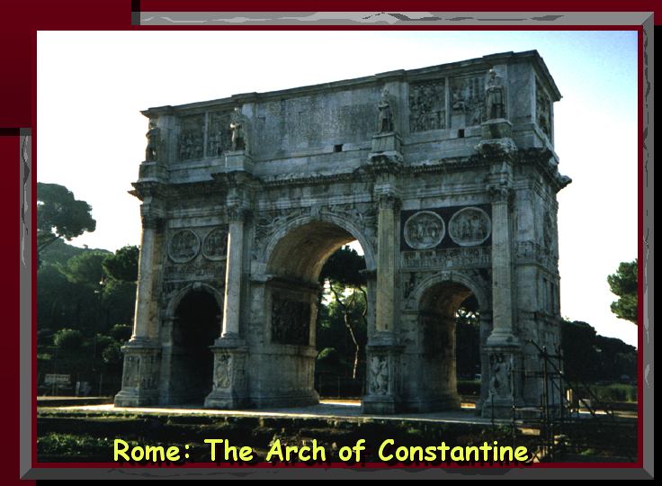
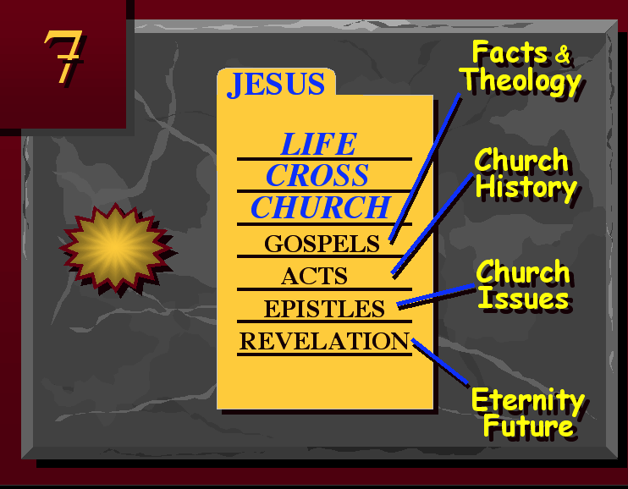
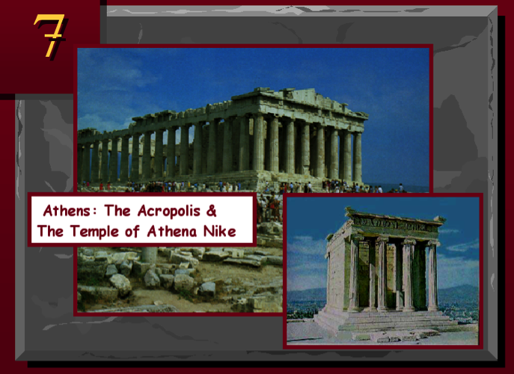
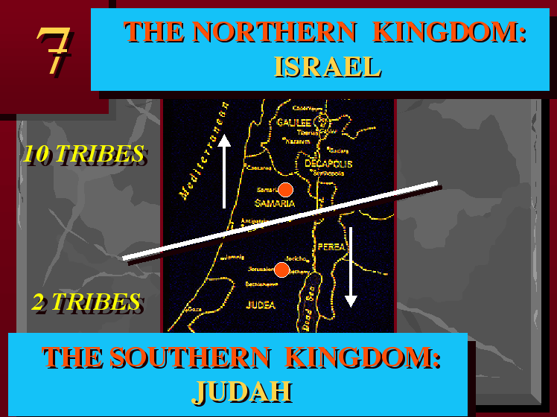
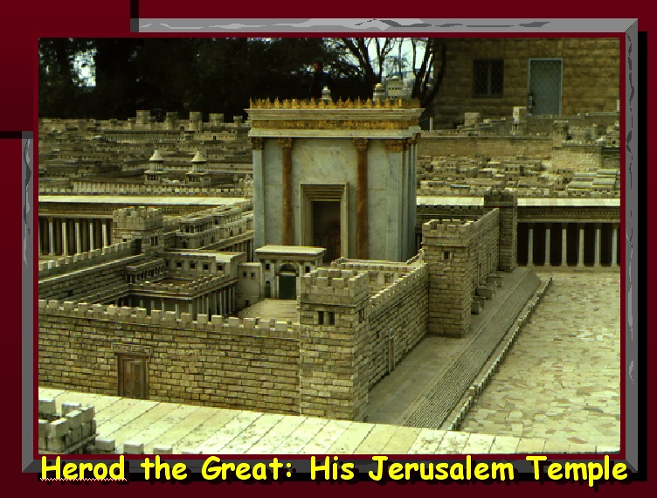
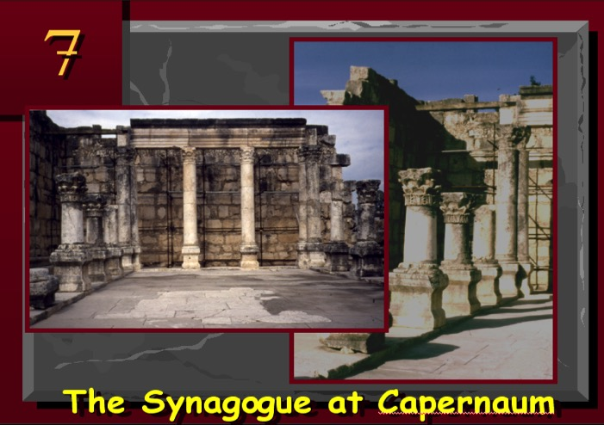
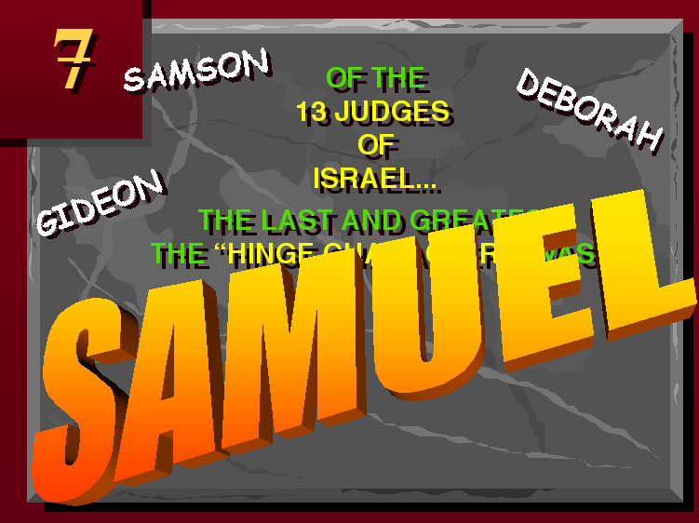
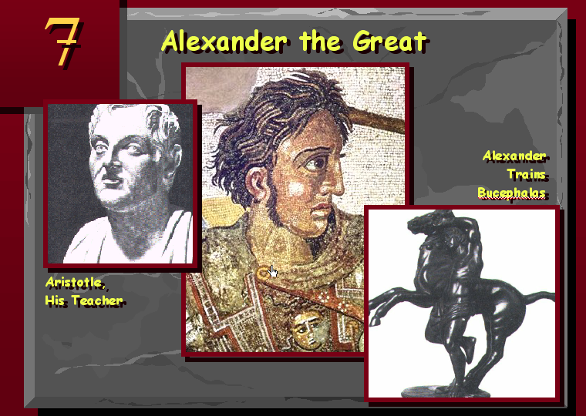
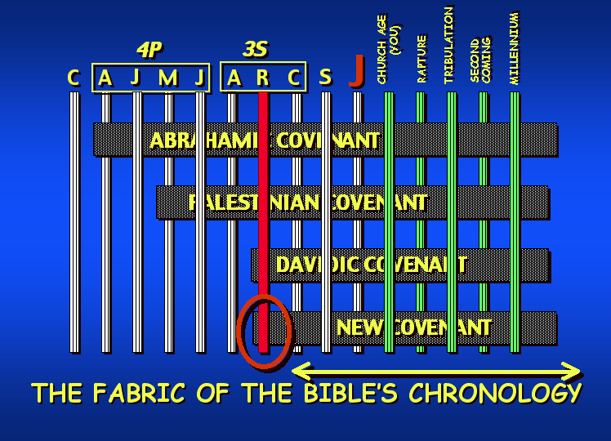
7
10

Slide 11
7
zefqif;jcif;/
ABRAHAM
tmNA[H/
ABRAHAM
/ a,moyf/
ABRAHAM
/ arma&S/
/ a,m&Sk
rif;rJh/
rif;pH/
/ zrf;qD;/
qdwfNidrf/
a,&Sk
11

Slide 12
7
zefqif;jcif;/
tmNA[H/
/ a,moyf/
/ arma&S/
/ a,m&Sk
rif;rJh/
rif;pH/
/ zrf;qD;/
qdwfNidrf/
a,&Sk
12

Slide 13
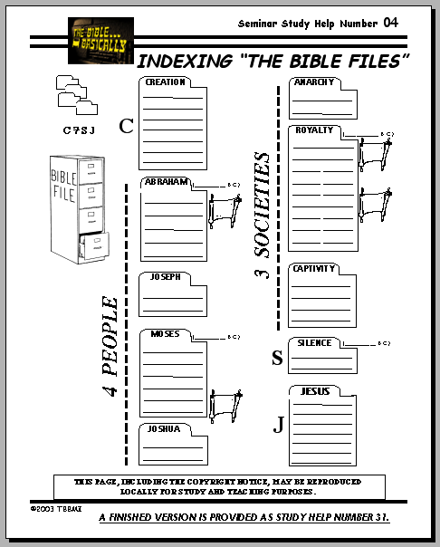
urÇmOD;usrf; 11
7
CREATION
ABRAHAM
ABRAHAM
zefqif;jcif;/
ABRAHAM
JOSEPH
ABRAHAM
MOSES
JOSHUA
ANARCHY
ROYALTY
CAPTIVITY
SILENCE
JESUS
zwfpmtkyfpmrsufESm 04
13
1

Slide 14
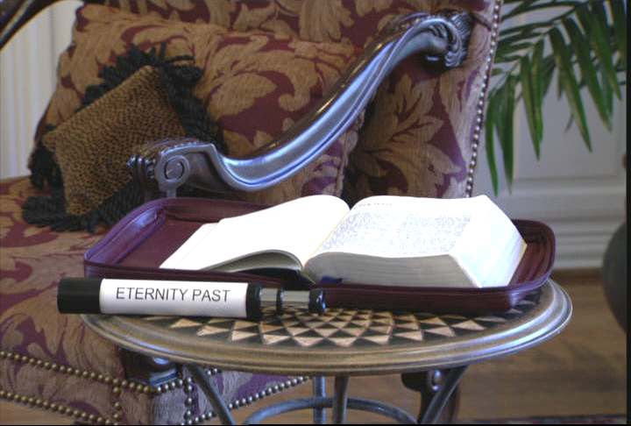
7
urÇmOD;usrf; 1-11/ t e EÅ t wd wf
Eternity past
Handbook pg. 17-19
14

Slide 15
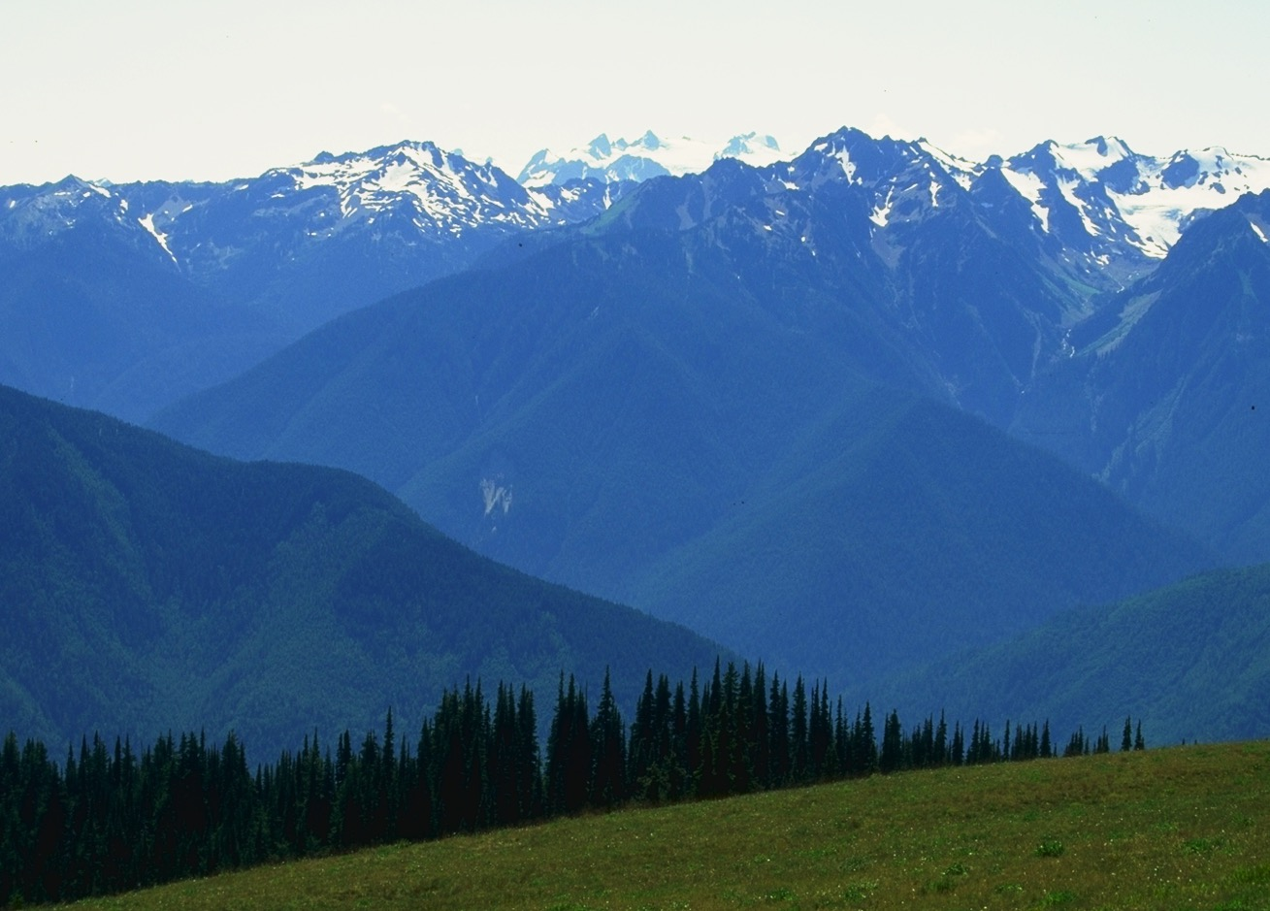
teEÅ twdwfumvudk vSrf;Bunfhjcif;
Handbook pg. 17-19
15

Slide 16
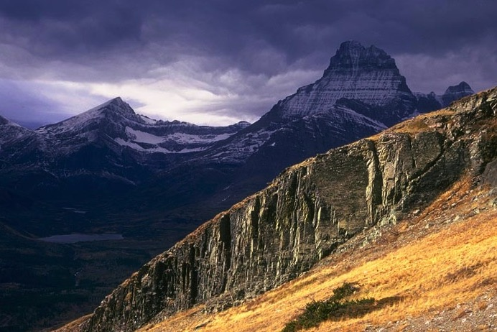
teEÅ twdwfumvudk vSrf;Bunfhjcif;
Handbook pg. 17-19
16
1

Slide 17
urÇmOD;usrf; 1;1/
tptOD;ü
17
1
©2003 TBBMI
7.5.03a.

Slide 18
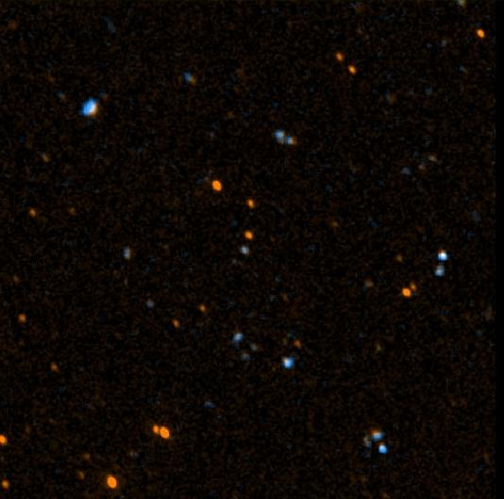
18
©2003 TBBMI
7.5.03a.

Slide 19

19
©2003 TBBMI
7.5.03a.

Slide 20
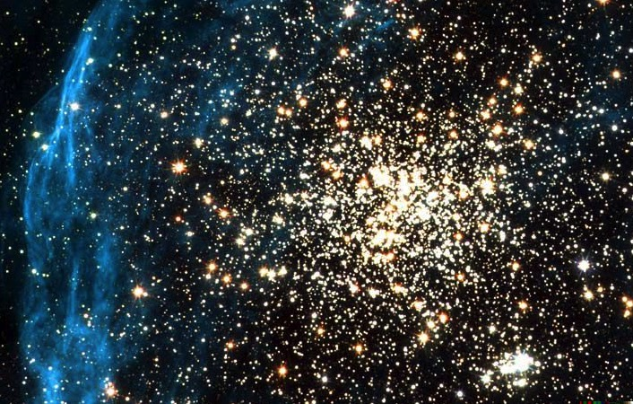
20
©2003 TBBMI
7.5.03a.

Slide 21

21
©2003 TBBMI
7.5.03a.

Slide 22
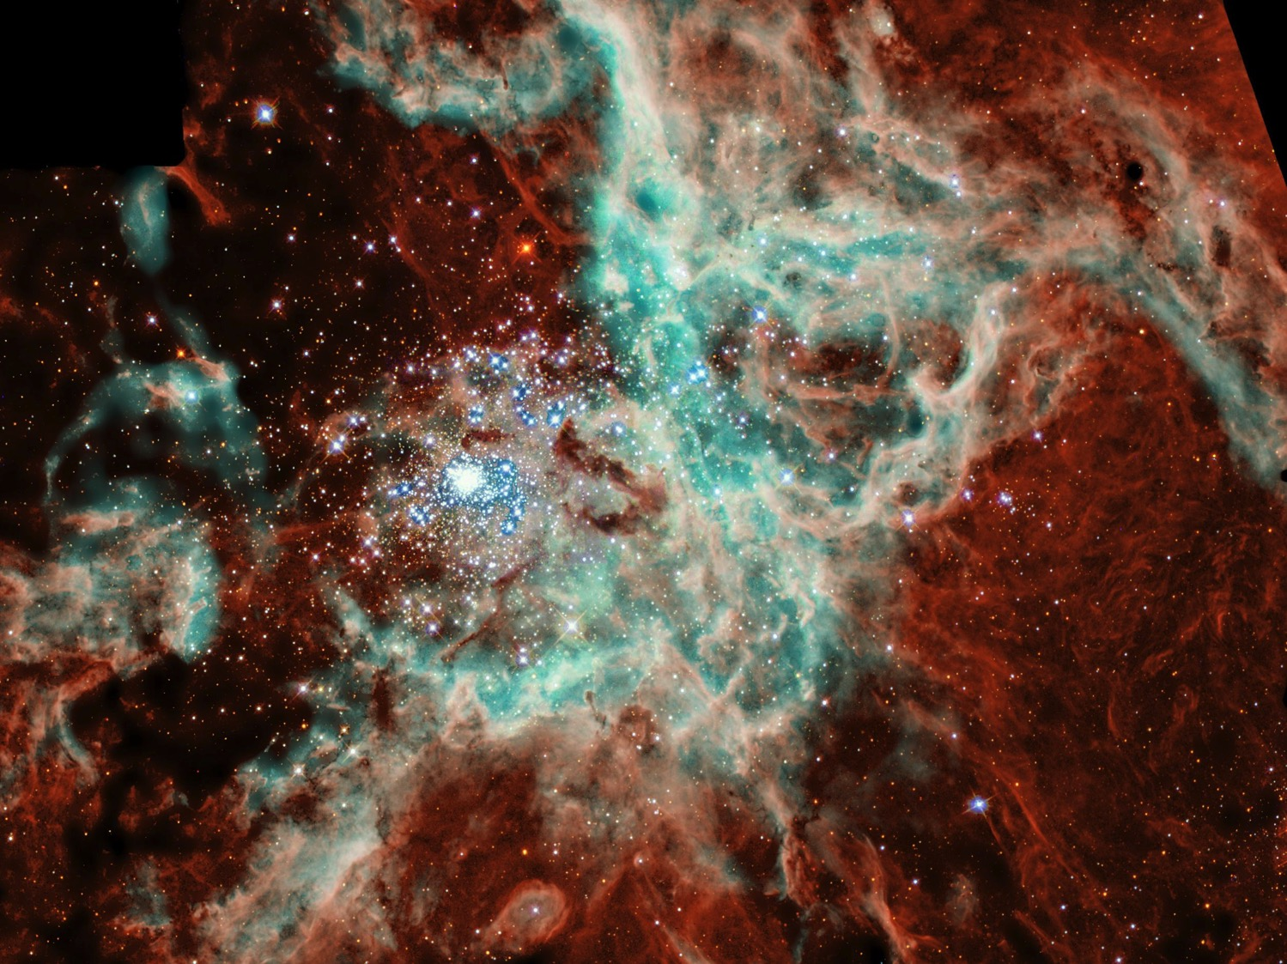
22
©2003 TBBMI
7.5.03a.

Slide 23
a,mb 38;4-18
CREATION
urÇmajrBuD; zefqif;csdefu oifb,frSmvJ/
23
1
©2003 TBBMI
7.5.03a.

Slide 24
urÇmOD;usrf; 1 -11
urÇOD;usrf; 3;15
oifESifh rdef;rudk‚4if;/ oif\trsdL;tEG,fESifh rdef;rtrsdK;tEG,fudk4if;/ igonf &efNidK;zGJYaprnf? olonf oif. acgif;udkBudwfvdrfhrnf? oifonf ol.zaemifhudk Budwfvdrfhrnf [k rdefYawmfrl.\?
a&mr 16;20 (rSwfpk) rdef;rrsKd;EG,fonfpmwef\
acgif;udktrSefwu,fBudwf
fvdrfYrnf/ xdk*wdawmfonfa,&Ic&pf
awmf\vuf0g;uyfwdkiftm;
Nzif.NynfYpHkcJhygonf/
tpjyKjcif;
(ordkif;aMumif;rprSDu)
CREATION
tOD;qHk;vl
(jyD;jynf.pHkjcif;)
tpjyKjcif;
tOD;qHk;tjypf
(bk&m;\pHrSusqif;jcif;)
ABRAHAM
7 rsdK;
tOD;qHk; owif;aumif;
(u,fwif&Sif)
tOD;qHk;rdom;pk
(pdwfaeoabmxm;uGmjcm;rSI)
tOD;qHk; vlowform;
(tjypf\aus;uRef)
a&vTrf;rdk;jcif;?oufwHh
(tjzpftysuf 1; aem{)
&Jwdkuf
(tjzpftysuf 2; AmAkvkef)
Handbook pg. 42-45
24
10

Slide 25
urBmOD;usrf; 1-11
7
tusOf;csKyf zefqif;jcif;rSwfwrf;onf vludkzefqif;jcif;ESifh. tNypf\aemufqufwGJ tusdK;qufrsm;udkrSwfwrf;wifxm;ygonf/ xdkrSwfwrf;xJwGif tzbk&m;\a7G;EIwfNcif;tBuHtpnf? rlvtaNct aNctaerSefNzpfaom bk&m;ocifESif.Nyefvnf rdo[m,zGJUNcif; vnf;yg0ifygonf/ bk7m;ocifxHjyefvmNcif;onfor®musrf;\ t"du yifwdkiftaBumif7if;Nzpfygonf/
Handbook pg. 17-19
25

Slide 26

urÇOD;usrf; - 1-11
7
zefqif;jcif;
rif;rJh
zefqif;jcif
vlom;
tjypf
rdom;pk
(1000 B.C.)
owif;aumif;
rif;pH
vlowfrI
DC
oufwefU
jzpfpOf 3 &yf
tmjA[H/
(2000 B.C.)
&Jwdkuf}uD;/
NC
C 7 S J
AC
zrf;qD;/
7 = 4 + 3
a,moyf
yk*¾dKvf av;OD;
arma&S
(1500 B.C.)
qdwfNidrf
(500 B.C.)
S
qdwf+idrf
LC
a,&SI
a,&SI
a,m&SI
Handbook pg. 17-19
26

Slide 27


တရားေဟာျခင္းအ တတ္ပညာ • BibleStudyDownloads.org
အခမဲ့အဘို့ဤတင်ပြချက်
Notes:
Preaching (pr)
Homiletics

Slide 28
Black

