Slide 1
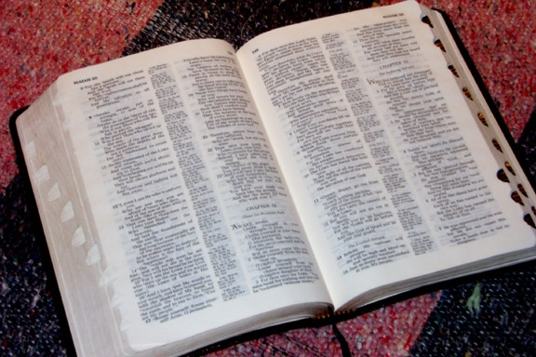
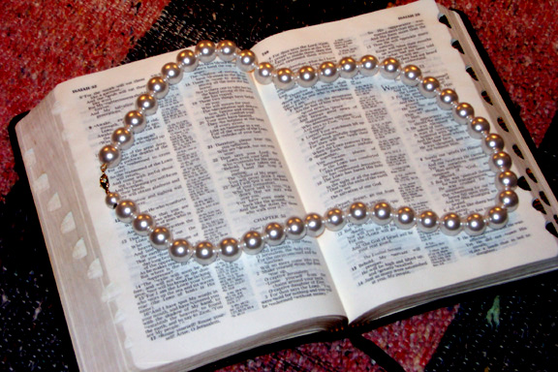
þykvJqGJBudK;udkoDukef;Ncif;wGif tcsdefrsm;pGmtokH;NyKcJhNyD..
End
04

Slide 2

Burmese
or®musrf;pm
tkwfNrpf
Texas jrdk.rS or®musrf;pm-tkwfjrpf (edkifiHwumtrSkawmfaqmifvkyfief;)
\ wifjycsuf

Slide 3
,ck
BuD;rm;aom
ar;p&mar;cGef;&SdvmNyD !
01
1

Slide 4
taNccHtusqHk;aom t&mrsm;udkzGifhNycJhNyD;NyD..
02

Slide 5
“oifh,kHBunfNcif;udk or®mw&m;ay:wGifrwnfaqmuf ygu oifh,kHBunfcsufonf cefYrSef;aNc? t,lonf;rIESifhxifNrifcsufrsm;om Nzpfygvdrfhrnf/”
Miles Stanford
Principles of Spiritual Growth
03
4

Slide 6
þykvJqGJBudK;udkoDukef;Ncif;wGif tcsdefrsm;pGmtokH;NyKcJhNyD..
,kHBunfNcif;twGuft"du taNccHtcsuf
04

Slide 7
  ,ckpkpnf;a&muf&SdvmNyD..
tvGefta&;ygaomar;cGef;ESpfck
&Sdao;onf .
05

Slide 8
ar;cGef; 1
or®musrf;pmudkavhvmNyD;onhfaemufydkif;
ocifa,&IESifhrdó[m,zGJUrI
rnfonfhtaNctaewGif&SdygovJ/
06
2
©2004 TBBMI
8.0.09.

Slide 9
bk&m;ocif\vuf&Hk;awmfxJwGif oifhtoufwmvkHNcHKNyD;Nzpfaumif; Nzpfaeygvdrfhrnf
odkYr[kwfbJ pdwfcsrIr&SdcJhvQif..
07
1
©2004 TBBMI
8.0.09.

Slide 10
aemifwESifhqdkifaom&dk;pif;aom qkawmif;csufonf oifhtwGufxm0&touf&bdkYvrf;p NzpfEdkifygonf/
08
©2004 TBBMI
8.0.09.

Slide 11
“ocifa,&I? uRefKyftwGufudk,fawmfvkyfaqmifay;cJhaomt&mrsm;tm;
em;vnfEdkifap&ef? þor®musrf;pmudkay;awmfrlaomaBumifh aus;Zl;txl;wifvSyg\/
09
©2004 TBBMI
8.0.09.

Slide 12
“ocifa,&I?, uRefKyftwGufudk,fawmfvkyfaqmifay;cJhaomt&mrsm;tm;
em;vnfedKifap&ef? þor®musrf;pmudkay;awmfrlaomaBumifh aus;Zl;txl;wifvSyg\/ usL;vGefcJhaomtNypfrsm;tm;vkH;udk 0efcHvsuf ,ckyif udk,fawmfhxHodkYwdk;0ifcsOf;uyfyg\/
10
©2004 TBBMI
8.0.09.

Slide 13
“ocifa,&I? uRefKyftwGufudk,fawmfvkyfaqmifay;cJhaomt&mrsm;tm;
em;vnfedKifap&ef? þor®musrf;pmudkay;awmfrlaomaBumifh aus;Zl;txl;wifvSyg\/ usL;vGefcJhaomtNypfrsm;tm;vkH;udk 0efcHvsuf ,ckyif udk,fawmhxHodkYwdk;0ifcsOf;uyfyg\/
uRefKyfonf rpkHvifaomolNzpfyg\/
11
©2004 TBBMI
8.0.09.

Slide 14
“ocifa,&I?uRefKyftwGufudk,fawmfvkyfaqmifay;cJhaomt&mrsm;tm;
em;vnfedKifap&ef? þor®musrf;pmudkay;awmfrlaomaBumif. aus;Zl;txl;wifvSyg\/ usL;vGefcJhaomtNypfrsm;tm;vkH;udk 0efcHvQuf ,ckyif udk,fawmhfxHodkYwdk;0ifcsOf;uyfyg\/
udk,fawmfhtvdkawmfESifha0;uGmaomolNzpfyg\/
12
©2004 TBBMI
8.0.09.

Slide 15
“ocifa,&I? uRefKyftwGufudk,fawmfvkyfaqmifay;cJhaomt&mrsm;tm;
em;vnfedKifap&ef? þor®musrf;pmudkay;awmfrlaomaBumifh aus;Zl;txl;wifvSyg\/ usL;vGefcJhaomtNypfrsm;tm;vkH;udk 0efcHvsuf ,ckyif udk,fawmfhxHodkYwdk;0ifcsOf;uyfyg\/
udk,fawmfhtvdkawmfESifha0;uGmaomolNzpfyg\/
udk,fawmf\cGifhvTwfNcif;? vrf;nTefcsufESifh xm0&toufudkawmif;cHyg\/
13
©2004 TBBMI
8.0.09.

Slide 16
“ocifa,&I? uRefKyftwGufudk,fawmfvkyfaqmifay;cJhaomt&mrsm;tm;
em;vnfedKifap&ef? þor®musrf;pmudkay;awmfrlaomaBumif. aus;Zl;txl;wifvSyg\/ usL;vGefcJhaomtNypfrsm;tm;vkH;udk 0efcHvsuf ,ckyif udk,fawmhfxHodkYwdk;0ifcsOf;uyfyg\/
udk,fawmfhtvdkawmfESifha0;uGmaomolNzpfyg\/
udk,fawmf\cGif.vTwfNcif;? vrf;nTefcsufESifh xm0&toufudkawmif;cHyg\/
,ckyif udk,fawmfhxHodkYcsOf;uyfvsuf xm0&toufudkt&,lyg\/
14
©2004 TBBMI
8.0.09.

Slide 17
“ocifa,&I? uRefKyftwGufudk,fawmfvkyfaqmifay;cJhaomt&mrsm;tm;
em;vnfedKifap&ef? þor®musrf;pmudkay;awmfrlaomaBumif. aus;Zl;txl;wifvSyg\/ usL;vGefcJhaomtNypfrsm;tm;vkH;udk 0efcHvsuf ,ckyif udk,fawmhfxHodkYwdk;0ifcsOf;uyfyg\/
udk,fawmfhtvdkawmfESifha0;uGmaomolNzpfyg\/
udk,fawmf\cGif.vTwfNcif;? vrf;nTefcsufESifh xm0&toufudkawmif;cHyg\/
,ckyif udk,fawmfhxHodkYcsOf;uyfvsuf xm0&toufudkt&,lyg\/
uRefKyfpdwfxJwGif0ifa&mufusdef;0yfNyD; tkyfpdk;vrf;Nyawmfrlyg/
15
©2004 TBBMI
8.0.09.

Slide 18
“ocifa,&I? uRefKyftwGufudk,fawmfvkyfaqmifay;cJhaomt&mrsm;tm;
em;vnfedKifap&ef? þor®musrf;pmudkay;awmfrlaomaBumif. aus;Zl;txl;wifvSyg\/ usL;vGefcJhaomtNypfrsm;tm;vkH;udk 0efcHvsuf ,ckyif udk,fawmhfxHodkYwdk;0ifcsOf;uyfyg\/
udk,fawmfhtvdkawmfESifha0;uGmaomolNzpfyg\/
udk,fawmf\cGif.vTwfNcif;? vrf;nTefcsufESifh xm0&toufudkawmif;cHyg\/
,ckyif udk,fawmfhxHodkYcsOf;uyfvsuf xm0&toufudkt&,lyg\/
uRefKyfpdwfxJwGif0ifa&mufusdef;0yfNyD; tkyfpdk;vrf;Nyawmfrlyg/
tvdkawmfESifhtnD touf&SifwwfygrnfhtaBumif; oGefoifvrf;Nyawmfrlyg/
16
©2004 TBBMI
8.0.09.

Slide 19
“ocifa,&I? uRefKyftwGufudk,fawmfvkyfaqmifay;cJhaomt&mrsm;tm;
em;vnfedKifap&ef? þor®musrf;pmudkay;awmfrlaomaBumif. aus;Zl;txl;wifvSyg\/ usL;vGefcJhaomtNypfrsm;tm;vkH;udk 0efcHvsuf ,ckyif udk,fawmhfxHodkYwdk;0ifcsOf;uyfyg\/
udk,fawmfhtvdkawmfESifha0;uGmaomolNzpfyg\/
udk,fawmf\cGif.vTwfNcif;? vrf;nTefcsufESifh xm0&toufudkawmif;cHyg\/
,ckyif udk,fawmfhxHodkYcsOf;uyfvsuf xm0&toufudkt&,lyg\/
uRefKyfpdwfxJwGif0ifa&mufusdef;0yfNyD; tkyfpdk;vrf;Nyawmfrlyg/
tvdkawmfESifhtnD touf&SifwwfygrnfhtaBumif; oGefoifvrf;Nyawmfrlyg/
tdrfawmfodkYydkYaqmifawmfrlyg/
17
©2004 TBBMI
8.0.09.

Slide 20
“ocifa,&I? uRefKyftwGufudk,fawmfvkyfaqmifay;cJhaomt&mrsm;tm;
em;vnfedKifap&ef? þor®musrf;pmudkay;awmfrlaomaBumif. aus;Zl;txl;wifvSyg\/ usL;vGefcJhaomtNypfrsm;tm;vkH;udk 0efcHvsuf ,ckyif udk,fawmhfxHodkYwdk;0ifcsOf;uyfyg\/
udk,fawmfhtvdkawmfESifha0;uGmaomolNzpfyg\/
udk,fawmf\cGif.vTwfNcif;? vrf;nTefcsufESifh xm0&toufudkawmif;cHyg\/
,ckyif udk,fawmfhxHodkYcsOf;uyfvsuf xm0&toufudkt&,lyg\/
uRefKyfpdwfxJwGif0ifa&mufusdef;0yfNyD; tkyfpdk;vrf;Nyawmfrlyg/
tvdkawmfESifhtnD touf&SifwwfygrnfhtaBumif; oGefoifvrf;Nyawmfrlyg/
tdrfawmfodkYydkYaqmifawmfrlyg/
emrawmfNrwfüqkawmif;yg\/
18
©2004 TBBMI
8.0.09.

Slide 21
“ocifa,&I? uRefKyftwGufudk,fawmfvkyfaqmifay;cJhaomt&mrsm;tm;
em;vnfedKifap&ef? þor®musrf;pmudkay;awmfrlaomaBumif. aus;Zl;txl;wifvSyg\/ usL;vGefcJhaomtNypfrsm;tm;vkH;udk 0efcHvsuf ,ckyif udk,fawmhfxHodkYwdk;0ifcsOf;uyfyg\/
udk,fawmfhtvdkawmfESifha0;uGmaomolNzpfyg\/
udk,fawmf\cGif.vTwfNcif;? vrf;nTefcsufESifh xm0&toufudkawmif;cHyg\/
,ckyif udk,fawmfhxHodkYcsOf;uyfvsuf xm0&toufudkt&,lyg\/
uRefKyfpdwfxJwGif0ifa&mufusdef;0yfNyD; tkyfpdk;vrf;Nyawmfrlyg/
tvdkawmfESifhtnD touf&SifwwfygrnfhtaBumif; oGefoifvrf;Nyawmfrlyg/
tdrfawmfodkYydkYaqmifawmfrlyg/
emrawmfNrwfüqkawmif;yg\/
uRefKyftwGufNyKawmfrlcJhaomtrIrsm;twGufaus;Zl;awmfudkcsD;rGrf;yg\/
19
©2004 TBBMI
8.0.09.

Slide 22
“ocifa,&I? uRefKyftwGufudk,fawmfvkyfaqmifay;cJhaomt&mrsm;tm;
em;vnfedKifap&ef? þor®musrf;pmudkay;awmfrlaomaBumif. aus;Zl;txl;wifvSyg\/ usL;vGefcJhaomtNypfrsm;tm;vkH;udk 0efcHvsuf ,ckyif udk,fawmhfxHodkYwdk;0ifcsOf;uyfyg\/
udk,fawmfhtvdkawmfESifha0;uGmaomolNzpfyg\/
udk,fawmf\cGif.vTwfNcif;? vrf;nTefcsufESifh xm0&toufudkawmif;cHyg\/
,ckyif udk,fawmfhxHodkYcsOf;uyfvsuf xm0&toufudkt&,lyg\/
uRefKyfpdwfxJwGif0ifa&mufusdef;0yfNyD; tkyfpdk;vrf;Nyawmfrlyg/
tvdkawmfESifhtnD touf&SifwwfygrnfhtaBumif; oGefoifvrf;Nyawmfrlyg/
tdrfawmfodkYydkYaqmifawmfrlyg/
emrawmfNrwfüqkawmif;yg\/
uRefKyftwGufNyKawmfrlcJhaomtrIrsm;twGufaus;Zl;awmfudkcsD;rGrf;yg\/ tmrif
20
©2004 TBBMI
8.0.09.

Slide 23
þqkawmif;csufrsm;udk &dk;om;pGm? pdwfESvHk;t<uif;rJh ESifh vdkcsif awmifhwaompdwfESifhtrSefwu,fawmif;cHvQif u,fwifNcif;pdwfcsrIonf oifhtwGufyifNzpfygonf/
,ckwGifyifoefY&Sif;aom0dnmOfawmfonf oifhpdwfESvkH;xJwGifusdef;0yfNyDNzpfoNzifh oif&&Sdaomxm0&toufonf tvGefpdwfcs&NyDygonf/
aNzmifhrwfNcif;&&SdNyD;Nzpfygonf/
,ckyif- oif.0dnmOfwdk;wufNcif;? oefY&Sif;Ncif; onf a,&Ic&pfawmftm;Nzifh
tpNyKcJhNyDNzpfygonf/
21
3
©2004 TBBMI
8.0.09.

Slide 24
ar;cGef; 2
þusrf;pmoifcef;pmudkavhvmNyD;aemuf..
þoifcef;pmESif. oifcef;pmygtaBumif;t&m rsm;ESifhqufpyfrI rnfonfhtwdkif;twmxd a&muf&Sdaeygoenf;/
22
2

Slide 25
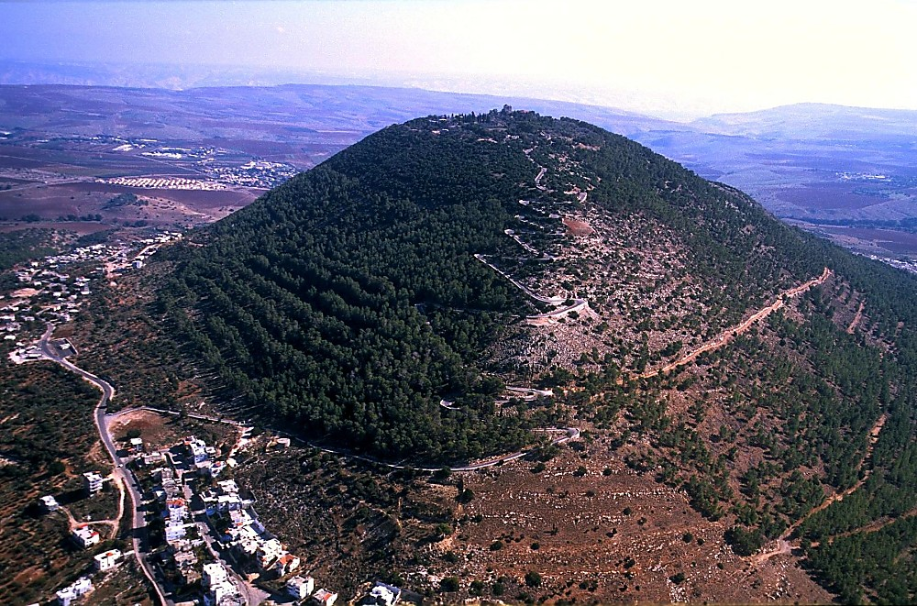
Mt Tabor aerial from northwest
“wusdyfwyg;aomwynf.awmfwdkYonf *gvdvJNynfodkYoGm;ía,&IrSmxm;awmfrlaom awmifay:odkYwufBuvQif? udk,fawmfudkawGYNrifí Nyyf0yfudk;uG,fBu\/”
róJ 28;16
a,&Ic&pfawmf\ r[mapcdkif;csuf
“aumif;uifbkHü¤if;? aNrBuD;ay:ü¤if;? pD&ifydkifaomtcGif.wefckd;&SdorQwdkYudkigcH&NyD/ oifwdkYoGm;ívlrsKd;wumwdkYudk ig.wynfYNzpfapvQuf? crnf;awmf? om;awmf? oefY&Sif;aom0dnmOfawmf\emrawmfNrwfü AwÅdZHudkay;Buavm./ igonfoifwdkYtm;ay;orQaom ydnmwfwdkYudkapmif.a&SmufapNcif;iSg qkH;rBo0g'‘ay;Buavm./ igonfvnf;uyfurÇmukefonfYwdkifatmif oifwdkYESif.twltpOfrNywf&Sdonf[kwynfYawmfwdkYtm;rdefYawmfrl\/”
róJ 28;18-20
23
5
©2004 TBBMI
8.0.09.

Slide 26
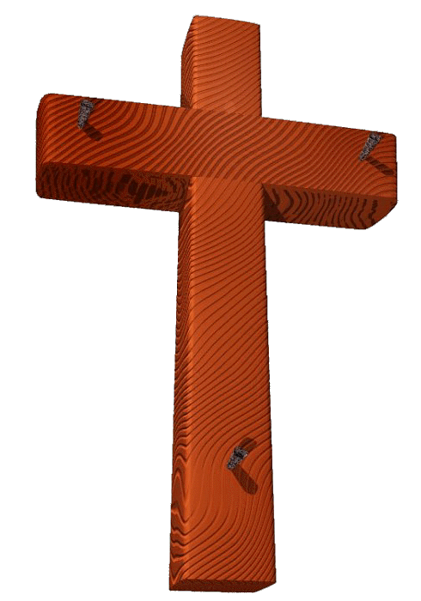
oifonf ,kHBunfolNzpfvQif..
&Sifay&ku 1ay 1;3-15 xJwGif
vkyfaqmif&rnfYt&m?enf;vrf; rsm;az:Nyay;xm;ygonf
24
1
©2004 TBBMI
8.0.09.

Slide 27
1ay 3;15
“pdwfESvHk;xJüxm07t7Sifbk&m;ocifudk &kdaoNcif;7SdBuavmh/ oifwdkYaNrSmfvif.Ncif;\taBumif;udk ar;Nref;aomol&dSorQwdkYtm;? El;nYHaomoabm? aBumuf&GUHaomoabmESif. NyefaNymNcif;iSg umvtpOfrNywf toifh&dSaeBuavm./”
25
©2004 TBBMI
8.0.09.

Slide 28
1ay 3;15
“pdwfESvHk;xJüxm07t&Sifbk7m;ocifudk &kdaoNcif;&SdBuavmh/ oifwdkYaNrSmfvif.Ncif;\taBumif;udk ar;Nref;aomol&SdorQwdkYtm;? El;nYHaomoabm? aBumuf&GUHaomoabmESifh NyefaNymNcif;iSg umvtpOfrNywf toif.&SdaeBuavmh/.”
26
©2004 TBBMI
8.0.09.

Slide 29
1ay 3;15
“pdwfESvHk;xJüxm07t7Sifbk7m;ocifudk 7kdaoNcif;7SdBuavm./ oifwdkYaNrSmfvif.Ncif;\taBumif;udk ar;Nref;aomol7SdorQwdkYtm;? El;nYHaomoabm? aBumuf&GUHaomoabmESif. NyefaNymNcif;iSg umvtpOfrNywf toif.7SdaeBuavm./.”
27
©2004 TBBMI
8.0.09.

Slide 30
1ay 3;15
“pdwfESvHk;xJüxm07t&Sifbk&m;ocifudk &kdaoNcif;&SdBuavm./ oifwdkYaNrSmfvif.Ncif;\taBumif;udk ar;Nref;aomol&SdorQwdkYtm;? El;nYHaomoabm? aBumuf&GUHaomoabmESifh NyefaNymNcif;iSg umvtpOfrNywf toifh&SdaeBuavmh/.”
28
©2004 TBBMI
8.0.09.

Slide 31
1ay 3;15
“pdwfESvHk;xJüxm0&t&Sifbk7m;ocifudk &kdaoNcif;7SdBuavm./ oifwdkYaNrSmfvif.Ncif;\taBumif;udk ar;Nref;aomol&SdorQwdkYtm;? El;nYHaomoabm? aBumuf&GUHaomoabmESifh NyefaNymNcif;iSg umvtpOfrNywf toifh&SdaeBuavmh/ ”
29
©2004 TBBMI
8.0.09.

Slide 32
1ay 3;15
“pdwfESvHk;xJüxm0&t&Sifbk&m;ocifudk &kdaoNcif;&SdBuavm./ oifwdkYaNrSmfvif.Ncif;\taBumif;udk ar;Nref;aomol&SdorQwdkYtm;? El;nYHaomoabm? aBumuf&GUHaomoabmESifh NyefaNymNcif;iSg umvtpOfrNywf toifh&SdaeBuavmh/ ”
30
©2004 TBBMI
8.0.09.

Slide 33
1ay 3;15
“pdwfESvHk;xJüxm0&t&Sifbk&m;ocifudk &kdaoNcif;&SdBuavmh/ oifwdkYaNrSmfvifh Ncif;\taBumif;udk ar;Nref;aomol&SdorQwdkYtm;? El;nYHaomoabm? aBumuf&GUHaomoabmESifh NyefaNymNcif;iSg umvtpOfrNywf toifh&SdaeBuavmh/”
31
©2004 TBBMI
8.0.09.

Slide 34
1ay 3;15
“pdwfESvHk;xJüxm0&t&Sifbk&m;ocifudk &kdaoNcif;&SdBuavm./ oifwdkYaNrSmfvif.Ncif;\taBumif;udk ar;Nref;aomol&SdorQwdkYtm;? El;nYHaomoabm? aBumuf&GUHaomoabmESif. NyefaNymNcif;iSg umvtpOfrNywf toif.&SdaeBuavm./ ”
32
©2004 TBBMI
8.0.09.

Slide 35
1ay 3;15
“pdwfESvHk;xJüxm0&t&Sifbk&m;ocifudk &kdaoNcif;&SdBuavm./ oifwdkYaNrSmfvif.Ncif;\taBumif;udk ar;Nref;aomol&SdorQwdkYtm;? El;nYHaomoabm? aBumuf&GUHaomoabmESif. NyefaNymNcif;iSg umvtpOfrNywf toif.&SdaeBuavm./ ”
33
©2004 TBBMI
8.0.09.

Slide 36
1ay 3;15
“pdwfESvHk;xJüxm0&t&Sifbk&m;ocifudk &kdaoNcif;&SdBuavm./ oifwdkYaNrSmfvif.Ncif;\taBumif;udk ar;Nref;aomol&SdorQwdkYtm;? El;nYHaomoabm? aBumuf&GUHaomoabmESif. NyefaNymNcif;iSg umvtpOfrNywf toifh&SdaeBuavmh/ ”
34
©2004 TBBMI
8.0.09.

Slide 37
1ay 3;15
“pdwfESvHk;xJüxm0&t&Sifbk&m;ocifudk &kdaoNcif;&SdBuavm./ oifwdkYaNrSmfvif.Ncif;\taBumif;udk ar;Nref;aomol&SdorQwdkYtm;? El;nYHaomoabm? aBumuf&GUHaomoabmESif. NyefaNymNcif;iSg umvtpOfrNywf toifh&SdaeBuavmh/ ”
35
©2004 TBBMI
8.0.09.

Slide 38
1ay 3;15
“pdwfESvHk;xJüxm0&t&Sifbk&m;ocifudk &kdaoNcif;&SdBuavm./ oifwdkYaNrSmfvif.Ncif;\taBumif;udk ar;Nref;aomol&SdorQwdkYtm;? El;nYHaomoabm? aBumuf&GUHaomoabmESif. NyefaNymNcif;iSg umvtpOfrNywf toifh&SdaeBuavmh/ ”
36
©2004 TBBMI
8.0.09.

Slide 39
urÇmBuD;onf oifhtm; apmifharQmfaeygonf/
37
©2004 TBBMI
8.0.09.

Slide 40
Thanks for your kind attention!
The Bible…Basically Ministries International Inc. Fort Worth, Texas
Conceived and Produced by John E. Fryman, Ph.D.
Photo Credit Thanks to Todd Bolen, Jerusalem, Israel; BiblePlaces.Com; Holyland Hotel, Jerusalem, Israel; and Dr. Leen Ritmeyer, Hawthornedene, Australia
www.biblebasically.com
©2004 TBBMI
39

Slide 41

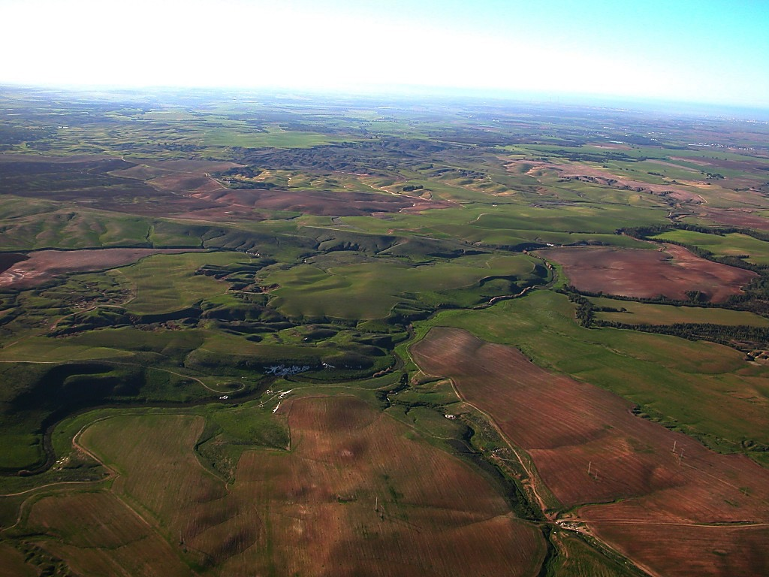
The Pictorial Library of Bible Lands
Our ministry is deeply indebted to Todd Bolen, creator of the Pictorial Library of Bible Lands, for his generous permission to use photo resources throughout THE BIBLE…BASICALLY®. TBB users are urged to visit BiblePlaces.com and explore the thousands of photo resources available: from the Holy Land, throughout the Aegean and Mediterranean Basin to Southern Europe where the Christian faith took root. BiblePlaces.com offers teachers and visual producers an incomparable array of high-resolution digital photographic resources. Please visit! Thanks, Todd!
Notes:
This presentation has been granted use of almost 150 pictures from the BiblePlaces.com website. We thank Todd Bolen for his support!

Slide 42
Burmese
or®musrf;pm
tkwfNrpf
Texas jrdk.rS or®musrf;pm-tkwfjrpf (edkifiHwumtrSkawmfaqmifvkyfief;)
\ wifjycsuf
www.biblebasically.org
Dr ရက္ခ္ ဂရီဖိတ္၊ စကၤပူဓမၼေကာလိပ္ • www.BibleStudyDownloads.org

Slide 43


တရားေဟာျခင္းအ တတ္ပညာ • BibleStudyDownloads.org
အခမဲ့အဘို့ဤတင်ပြချက်
Notes:
Preaching (pr)
Homiletics

Slide 44
Black

