Slide 1


usrf;pmusrf;ordkif;yHkjyif\ zGJ.pnf;yHkonf t"dutawG;tac:jzpfae
®
tydkif;(8)
ttkyfvdkufydkif;jcm;jcif;
"r®opfusrf;avhvmNcif;
Dr ရက္ခ္ ဂရီဖိတ္၊ စကၤပူဓမၼေကာလိပ္ • BibleStudyDownloads.org
©2004 TBBMI
8.0.08.
02
©2004 TBBMI

Slide 2

Burmese
or®musrf;pm
tkwfNrpf
Texas jrdk.rS or®musrf;pm-tkwfjrpf (edkifiHwumtrSkawmfaqmifvkyfief;)
\ wifjycsuf

Slide 3
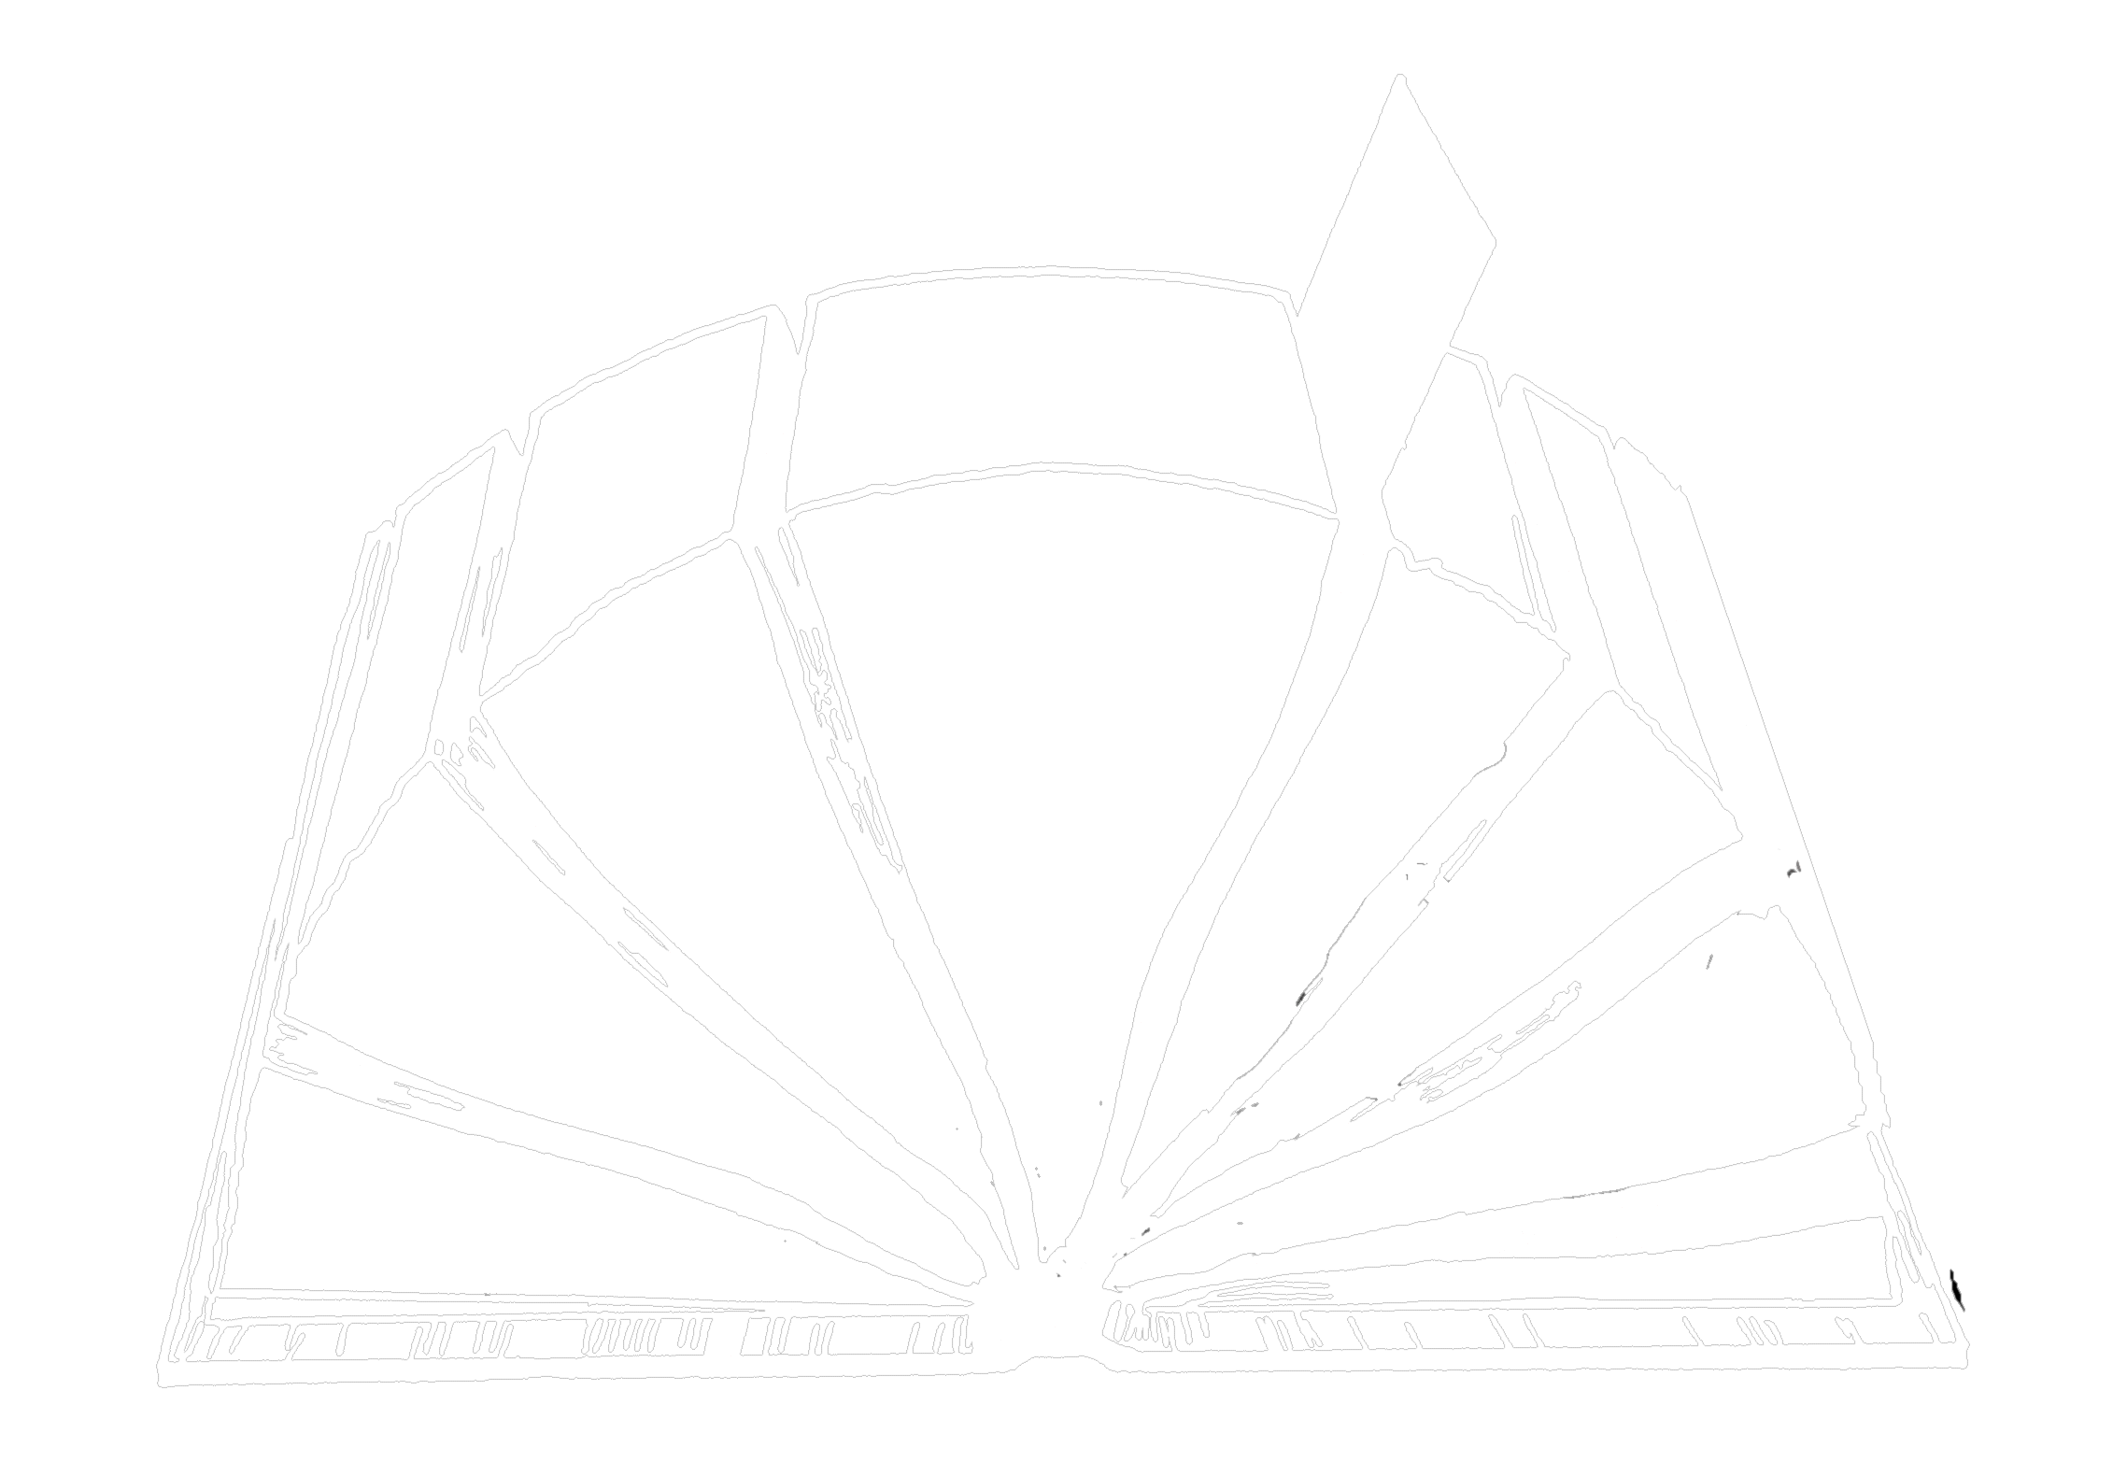
“ "r®opfusrf;tm;avhvmNcif; ^ "r®opfusrf;”
waygif;wnf;&Sdaom‘"r®opfusrf;pm
4
5
6
za&mzufrsm;
3
c&pf0ifusrf;rsm;
7
2
wrefawmf0w¬L
ta&; tom;rsm;
pmaqmifrsm;
ordkif;
1
8
ynwfw&m;
Asm'dwfawmf
“zGifhxm;aom” usrf;pm
03

Slide 4
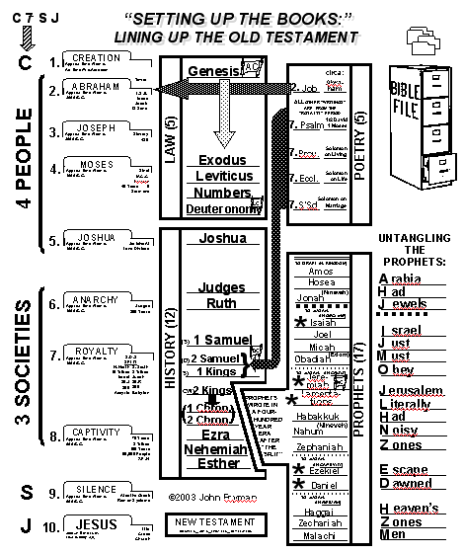
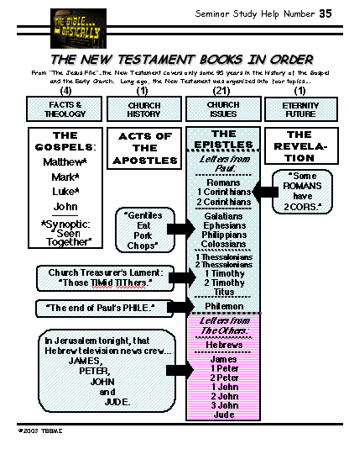
waygif;wnf;&Sdaom "r®opfusrf;pm
ttkyfvdkufydkif;jcm;jcif;
taxmuftul
tydkif; (27) &Sdaom
"r®opfusrf;rsm; ESifh
tydkif;(39) &Sdaom
"r®a[miff;usrf;rsm;
Nahum
(Niveveh)
Zephaniah
04
1

Slide 5
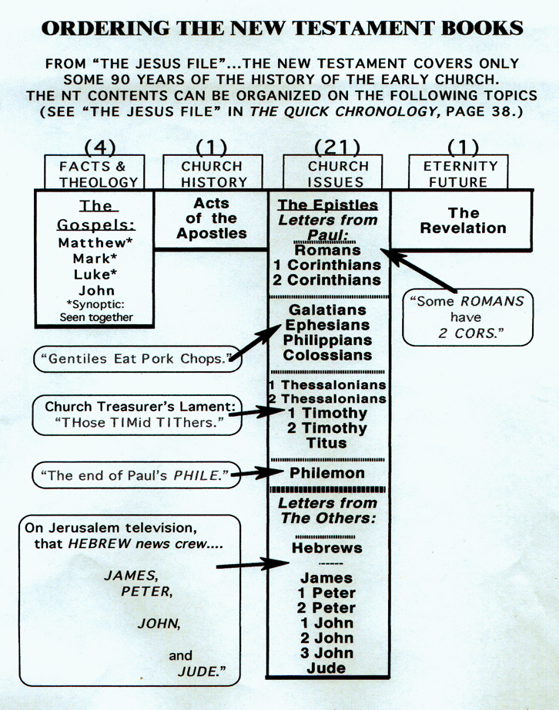
waygif;wnf;&Sdaom
"r®opfusrf;pm
oifaxmuful(20)
c&pf0ifusrf;rsm; (tjzpftysufrsm;eSif.tawG;tac:)
wrefawmf0w¬L
Bo0g'pm
Asm'dwfusrf;
05

Slide 6
waygif;wnf;&Sdaom
"r®opfusrf;pm
c&pf0ifusrf;rsm;
wrefawmf0w¬L (toif;awmfordkif;)
Bo0g'pm
Asm'dwfusrf;
06

Slide 7
waygif;wnf;&Sdaom
"r®opfusrf;pm
c&pf0ifusrf;rsm;
wrefawmf0w¬L
wrefawmf0w¬L
Bo0g'pm (toif;awmfeSif.yufoufaom taBumif;t&mrsm;)
Asm'dwfusrf;
07

Slide 8
waygif;wnf;&Sdaom
"r®opfusrf;pm
c&pf0ifusrf;rsm;
wrefawmf0w¬L
Bo0g'pm
Asm'dwfusrf; (xm0&umv)
08

Slide 9
waygif;wnf;&Sdaom
"r®opfusrf;pm
c&pf0ifusrf;rsm;
wrefawmf0w¬L
{zufBo0g'pm
Asm'dwfusrf;
09

Slide 10
waygif;wnf;&Sdaom
"r®opfusrf;pm
ESpfaygif;(1500)
"r®opf ESpfaygif;(40)rS(50)
4
3
5
c&pf0ifusrf;
2
6
ya&mzufrsm;
wrefawmf0w¦L
7
ta&; tom;rsm;
ordkif;rsm;
Mo0g'pm
1
ynwfw&m;
8
Asm'dwfusrf;
usrf;pmwpfckvHk; NyD;ajrmufatmifa&;om;&onf.tcsdef
10
1

Slide 11
waygif;wnf;&Sdaom
"r®opfusrf;pm
"r®opftydkif;(4)ydkif;
at'D40 aemufydkif;ESifh 90 aemufydkif;Bum; a&;om;xm;onf
4 tkyf
1 tkyf
21 tkyf
1 tkyf
tjzpftysufrsm; ESifh
oDtdk&D
toif;awmf\
ordkif;
toif;awmfeSif. yufoufaom taBumif;t&mrsm;
xm0&umv
(tem*wf)
c&pf0ifusrf;rsm;
wrefawmf0w¬L
Bo0g'pm
Asm'dwfusrf;
11
6

Slide 12
waygif;wnf;&Sdaom
"r®opfusrf;pm
4 tkyf
tjzpftysufrsm; ESifh
oDtdk&D
c&pf0ifusrf;rsm;
4 tkyf
tjzpftysufrsm; ESifh
oDtdk&D
&SifroJc&pf0ifÄ
&Sifrmukc&pf0ifÄ
&Sifvkumc&pf0ifÄ
&Sifa,m[efc&pf0if
tusOf;csKyfudk
aygif;pnf;avhvmjcif;
c&pf0ifusrf;rsm;
12
3

Slide 13

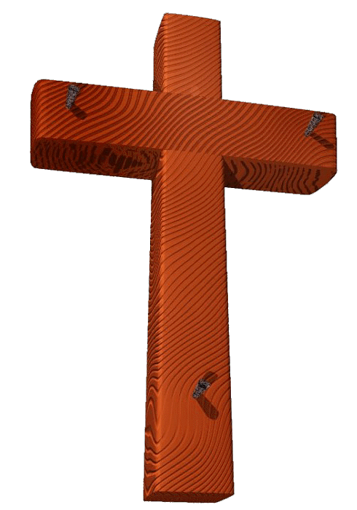

a,&lc&pfawmf\ vkyfaqmifcsuf udk
pmjzifhazmfjy NyD;aemufydkif;
&laxmifhav;rsdL;jzifh awGUjrif&onf
oifaxmuful trSwf -21
13
2

Slide 14
c&pf0ifusrf; usrf;a&;q&mrsm;rS
&nfnTef;olrsm;h\ t"dutcsuftvufrsm;
a,&lc&pfawmf\ toufwmtay: usrf;a&;q&m wpfOD;pD\ xl;jcm;aomwifjycsufrsm;
c&pf0ifusrf; wpfckpDwdkif;\ t"du&nf&G,fcsufrsm;
a&;om;xm;onfh ae.pGJrsm;udkcef.rSef;csufrsm;
14
4

Slide 15
usrf;wpfusrf;pDwdkif;tm; twdtusazmfjyjcif;
1
2
3
4
15

Slide 16
c&pf0ifusrf;rsm;udk abmifcwfavhvmjcif; ...
1
2
&SifroJc&pf0if
&Sifrmukc&pf0if
3
4
&Sifvkumc&pf0if
&Sifa,m[efc&pf0if
16
3

Slide 17
&nfnTef;olwdk.\t"du tcsuftvufrsm;
&SifroJc&pf0if
2
1
&Sifrmukc&pf0if
*sL;vlrsdK;rsm;qDodkU
a&mrvlrsdK;rsm;qDodkU
3
4
&Sifvkumc&pf0if
&Sifa,m[efc&pf0if
*&dvlrsdK;rsm;qDodkU
toif;awmfwdkif;odkU
17
4

Slide 18
... a,&Iudk ,ckuJhodk. yHkazmfxm;onf
1
&SifroJc&pf0if
2
&Sifrmukc&pf0if
*sL;vlrsdK;rsm;qDodkU
a&mrvlrsdK;rsm;qDodkU
bk&if
tapcH
4
3
4
JOHN
&Sifvkumc&pf0if
&Sifa,m[efc&pf0if
TO:
CHURCH
TO:
*&dvlrsdK;rsm;qDodkU
toif;awmfwdkif;odkU
vlom;pifppf
bk&m;pifppf
18
4

Slide 19
owif;udk twdkcsKyftm;jzif.av.vmjcif;
1
&SifroJc&pf0if
2
&Sifrmukc&pf0if
*sL;vlrsdK;rsm;qDodk.
a&mrvlrsdK;rsm;qDodk.
bk&if
tapcH
a,&IbmajymovJ
a,&IbmvkyfcJ.ovJ
3
&Sifvkumc&pf0if
4
&Sifa,m[efc&pf0if
*&dvlrsdK;rsm;qDodk.
toif;awmfwdkif;odk.
vlom;pifppf
bk&m;pifppf
a,&Ib,fvdkcHpm;ovJ
a,&IbmudkqdkvdkovJ
19
4

Slide 20
xl;jcm; qef;jym;aompum;vHk; ...
tusOf;csKyfudk aygif;pnf;avhvmjcif;
1
2
&Sifrmukc&pf0if
&SifroJc&pf0if
,k'vlrsdK;rsm;qDodkU
a&mrvlrsdK;rsm;qDodkU
bk&if
tapcHuGsefuJ.odkU
tusOf;csKyfudk aygif;pnf;avhvmjcif;
a,&IbmajymovJ
a,&IbmvkyfcJ.ovJ
tusOf;csKyfudk aygif;pnf;avhvmjcif;
tusOf;csKyfudk aygif;pnf;avhvmjcif;
tusOf;csKyfudk twlwuG avhvmjcif;
3
&Sifvkumc&pf0if
4
&Sifa,m[efc&pf0if
tusOf;csKyfudk aygif;pnf;avhvmjcif;
*&dvlrsdK;rsm;qDodkU
toif;awmfwdkif;odkU
bk&m;pifppf
vlom;pifppf
a,&Ib,fvdkcHpm;ovJ
a,&IbmudkqdkvdkovJ
20
3

Slide 21
owif; twdkcsKyftm;jzif.av.vmjcif;
1
&SifroJc&pf0if
2
&Sifrmukc&pf0if
*sL;vlrsdK;rsm;qDodk.
a&mrvlrsdK;rsm;qDodk.
bk&if
tapcH
a,&IbmajymovJ
a,&IbmvkyfcJ.ovJ
3
&Sifvkumc&pf0if
4
&Sifa,m[efc&pf0if
∑
*&dvlrsdK;rsm;qDodk.
toif;awmfwdkif;odk.
vlom;pifppf
bk&m;pifppf
a,&IbmudkqdkvdkovJ
a,&Ib,fvdkcHpm;ovJ
19
4

Slide 22
&Sifa,m[ef ; taMumif;t&m jcHKiHkwifjyjcif; ...
1
&SifroJc&pf0if
2
&Sifrmukc&pf0if
*sL;vlrsdK;rsm;qDodk.
a&mrvlrsdK;rsm;qDodk.
bk&if a,&IbmajymovJ
tapcH a,&IbmvkyfcJ.ovJ
∑
3
&Sifvkumc&pf0if
4
&Sifa,m[efc&pf0if
*&dvlrsdK;rsm;qDodk.
toif;awmfwdkif;odk.
vlom;pifppf a,&Ib,fvdkcHpm;ovJ
bk&m;pifppf
a,&IbmudkqdkvdkovJ
19
4

Slide 23
&Sifa,m[ef ; taMumif;t&m jcHKiHkwifjyjcif; ...
tcef;BuD;(1) ; a,&Ic&pfawmf\ r[mppfrSef onfh t&nfaoG;(6) csuf
tcef;i,f(1)
tptOD;üwnfawmfrljcif;
xif&Sm;aomvljzpfjcif; ^ xl;jcm;jcif;
bk&m;jzpfcJhjcif; ESifh jzpfaejcif;
a,&Ibk&m;
tptOD;uwnf;u EIwfuywfawmf&SdcJhonf/xdkEIwfuywfawmfonf bk&m;ESifh,cktcsdeftxd &Sdonf/
oifaxmuful 22
23
3

Slide 24
&Sifa,m[ef \ taMumif;t&m jcHKiHkwifjyjcif; ...
tcef;BuD;(1) ; a,&Ic&pfawm f\ r[mppfrSef onfh t&nfaoG;(6) csuf
tcef;i,f(1)
tptOD;üwnfawmfrljcif;
xif&Sm;aomvljzpfjcif; ^ xl;jcm;jcif;
bk&m;jzpfcJhjcif; ESifh jzpfaejcif;
a,&Ibk&m;
tcef;i,f(2)
tpOftjrJwnf&Sdjcif;
tptOD; ü bk&m;ESifhtwl &Sd\/
24
1

Slide 25
&Sifa,m[ef ; taMumif;t&m jcHKiHkwifjyjcif; ...
tcef;BuD;(1) ; a,&Ic&pfawm f\ r[mppfrSef onfh t&nfaoG;(6) csuf
tcef;i,f(1)
tptOD;üwnfawmfrljcif;
xif&Sm;aomvljzpfjcif; ^ xl;jcm;jcif;
bk&m;jzpfcJhjcif; ESifh jzpfaejcif;
a,&Ibk&m;
tcef;i,f(2)
tpOftjrJwnf&Sdjcif;
zefqif;awmfrljcif; ESifh uif;vGwfvsuf jzpfaomt&mwpfpHk wpfckrQr&Sd
tcef;i,f(3)
pMum0|m udk zefqif;&Sif
25
1

Slide 26
&Sifa,m[ef ; taMumif;t&m jcHKiHkwifjyjcif;
tcef;BuD;(1) ; a,&Ic&pfawmf\ r[mppfrSef onfh t&nfaoG;(6) csuf
tcef;i,f(1)
tptOD;üwnfawmfrljcif;
xif&Sm;aomvljzpfjcif; ^ xl;jcm;jcif;
bk&m;jzpfcJhjcif; ESifh jzpfaejcif;
a,&Ibk&m;
tcef;i,f(2)
tpOftjrJwnf&Sdjcif;
cyfodrf;aom vltaygif;wdkhtm;t vif;udkay; aomol jzpf\/
tcef;i,f(3)
pMum0|m udk zefqif;&Sif
tcef;i,f(4^5^9)
touf ESifhtvif; \ t&Sif
26
1

Slide 27
a&;om;xm;aom aeUpGJrsm;
1
&SifroJ
2
&Sifrmuk
at'D 40 aemufydkif;
at‘'D 64 - 68 Mum;
TO:
JEWS
TO:
ROMANS
AS:
KING
AS:
SERVANT
WHAT
HE:
WHAT
HE:
SAID
DID
3
&Sifvkum
4
&Sifa,m[ef
at'D 57- 59 Mum;
at'D69 tusOf;av.vmrI aemufydkif;
TO:
GREEKS
TO:
CHURCH
AS:
GOD/MAN
AS:
GOD
WHAT
HE:
WHAT
HE:
FELT
MEANT
27
4

Slide 28
wifjyrINyD;ajrmufjcif;twGuf
12/ xdkodkYigESifYpum;aNymí toHjrnfaomol udk jrifjcif; iSm igonf vSnfYMunfY vQifa&TrD;cGuf 7 vHk;udk 4if;
13/ 7vHk;tv,fü vlom;awmf ESifh wlaom vl wOD;udk 4if;
jrif\ xdkolonf ajcokdh wdkifatmif 0wfNcHK vQuf&ifawmfü a&Tcg;yef;udk pnf; vQuf jzpf\
c&pfawmf wrefawmf &Sifa,m[ef xH
udk,fa,mifjyjcif;
MATTHEW
MARK
14/ acgif;awmf ESifh qHyifawmf onf jzlaomodk;arT; uJhodkY 4if; rdk;yGifh uJhodkY 4if; jzl\ rsufpdawmf onf vnf; rD;vQH uJhodkY jzpf\
15/ ajcawmfonf vnf; rD;ücsGwfNyD;aom aMu;0gppf ESifh wl\ toHawmfonf vnf; ork&m oH uJhodkh jzpf\
^{Ffffffffffffffffffffffffffff}16/ vuf,mbufawmfonf vnff; Mu,f 7 vHk; udk udkif\ cHwGif;awmfxJuvnf; xufaom oefvQuf xGuf\ rsufESmawmfonf t&Sdefwefcdk; ESifh xGef;awmufaom ae uJhodkYjzpf\
LUKE
JOHN
17/ xdkoludk igjrifaomtcg aorwufjzpfí ajcawmf&if;üvJvQufae\ xdkolonfvuf,mvufawmfudk ightay:odkYwifvQuf aMumuf&THjcif;r&SdESifh igonftOD;qHk;aom ol aemufqHk;aomoljzpf\
18/ touf&Sifaomolvnf; jzpf\ igonf t&ifaoonfjzpfíurÇmtqufquf toufESifh jynfYpHk\ r&PmESifhr&PmEdkifiHudkvnf; igtpdk;&\
28
10

Slide 29
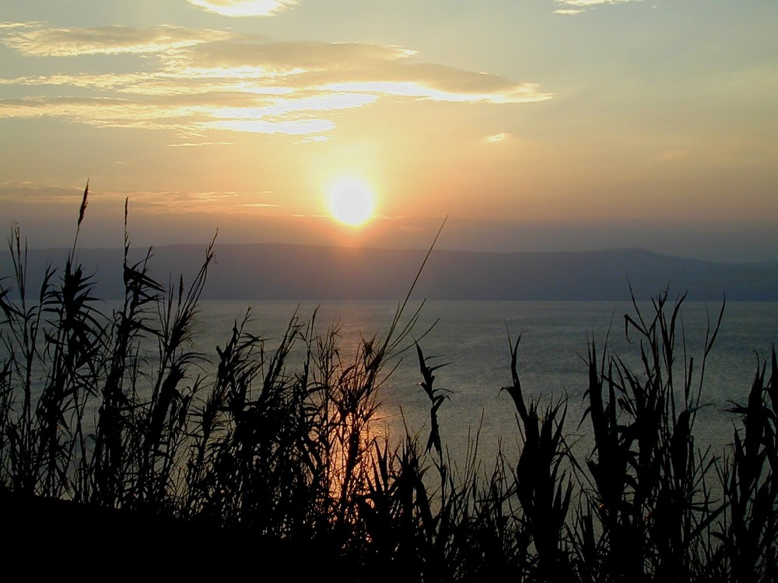
a,&I c&pfawmf \ toufwmudkazmfjy NyD;ajrSmufonf/
vlrsdK;taygif;wdk honf aumif;BuD; r*Fvm udk cH&Muvdrf. rnf...
urÇmOD;usrf; 12;3
29
1
28

Slide 30
waygif;wnf;&Sdaom‘"r®opfusrf;pm
"r¨opftydkif; (4) ydkif;
at'D50 ESif h 90 Mum; a&;om;csuf rsm;
(4 tkyf )
(1 tkyf )
(21 tkyf )
(1 tkyf )
tjzpftysufrsm; ESifh
oDtdk&D
toif;awmf\
ordkif;
toif;awmf
jyoemrsm;
xm0&
tem*wf
c&pf0ifusrf; rsm;
wref fawmf0w¬L
Asm 'dwfusrf;
{zufBo0g'pm
30

Slide 31
waygif;wnf;&Sdaom‘"r®opfusrf;pm
xGufvmaom tjzpftysufrsm; \ ordkif;
t"duvlrsm;
(1 tkyf)
aygvk
ayw&k
AmvA
wdarmao
vkum (usrf;a&; q&m)
a,m[efrmuk
zdvdyÜK
a'gufwm ^ q&m0ef ]vkum} rS at 'D50 aemufydkif;wGif a&;om;xm; onf/
toif;awmf ordkif;
wrefawmf 0w¬K
31
8

Slide 32
“... a,&I&SvifNrdkY rSpaom ,kjynf? &Srm&djynf? ajrBuD;pGef;wdkifatmif ig\oufao jzpfMuvdrfhrnf[k rdefYawmfrl\” wrefawmf 1;8
1/ a,&I \ r,mappm;csuf ESif h <uawmfrljcif;
2/ yifw£Kyf ; toif;awmf\ arG;ae h
3/ ajcrpGrf;ol usef;rmjciff;
4/ yxrtBudrf nSif;qJcH&jcif;
5/ tmeed ESif h &Izda&
6/ yxr toif;awmfvlBuD; pwDAif ESif h ol\ toufay;jcif;
7/
a,&I&Svif
ü
tcef;BuD; (1-7)
aumif;uifwref rygaom tjzpfysufoHk;ck/
toif;awmf arG;zGm;cJ.jyD/--
xdkUaBumif.uGsefkyfwdkUþae&mwGif&Sdae Buonf/
STUDY HELP #23
ygvifpwdkif; ESifh qD;&D;,m;
tcef;BuD; (8-12)
8/ zdvdyÜK ESif h tJoa,mtrwf
9/ aqmvktoufwm ajymif;vJjcif;
10/ Ayw&k ESif h aumffaevd
11/ ayw7k a[vw ómoem c7Dl
12/ a[&k c&pf,mefrsm; udk nSif;qJol
13/ yxromoem c&D;
14/ /
15/ /
16/ a,&k&Ivif aumifpD
17/ wd, oóemc&D;
18/ /
19/ /
20/ wwd, omoem c&D;l
21/ /
22/ /
23/ aygvk ; a,&I&Svifü
24/ aygvk ; vltkyfBuD;a&ShwGiftjypfr&SdaMumif; 0efcHjcif;
25/ aygvk ; a,&I&Svif cHk&Hk;la&ShwGif tjypfr&SdaMumif;0efcHjcif;
26/ aygvk ; azvZfa&Sh ü
27/ aygvk ; azwÅKa&Sh ü
28/ aygvk ; tN*dyÜ rif;BuD;a&Sh ü
a&mrodkYa&vrf;c&D;jzifh ; oabFmysufpD;jcif;
AN INDEX TO THE ACTS OF THE APOSTLES
13
14
15
16
17
18
19
20
21
22
23
24
25
26
27
28
urÇmw0Srf;vHk;odkY
tcef;BuD; (13-28)
©2004 TBBMI
32
5

Slide 33
waygif;wnf;&Sdaom‘"r®opfusrf;pm
"r®opftydkif; (4) ydkif;
at3D 50 ESif h 90 Mum; a&;om;csuf rsm;
(4 tkyf )
(1 tkyf )
(21 tkyf )
(1 tkyf )
tjzpftysufrsm; ESifh
oDtdk&D
toif;awmf\
ordkif;
xm0&
tem*wf
toif;awmf
jyoemrsm;
c&pf0ifusrf; rsm;
wref awmf0w¬L
{zufBo0g3pm
Asm'dwfusrf;
33

Slide 34
waygif;wnf;&Sdaom‘"r®opfusrf;pm
aygvk\ c&D;pOfudk ajzmifhwef;atmifwifjyjcif;
oifh&J h or®musrf; taemufbufjcrf; &Sd trSwftom;
trsdkK;rsdK;? ta&miftrsdK;rsdK; wck ESif h wck tay:trSwftom; 0dkif;cwfxm; onf h ajryHkudk owdxm;rdygovm;/
34
1

Slide 35
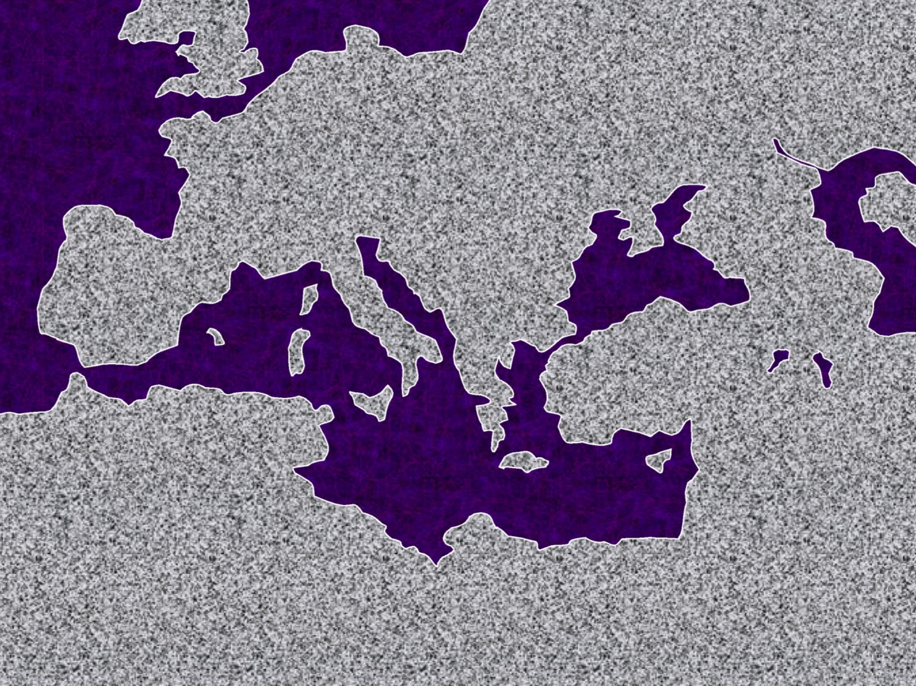
aygvkonf wu,f hc&D;onf rDQawa&; eD;,rf; jrpf0Srf;wavQmuf c&D;vGefaeoljzpfonf/
twÅvEÅdwf
ork'´&m
Oa&my
tm&S
rwuf<u aom
*&D
rD”aw a&;eD;,rf; yifv,f
a&mrenf;pepf
tma&As
tmz&du
35

Slide 36
bmjzpfvdkUþt&mwifjy&ovJ
qdk&ifawm h...
wrefawmf 0w¦K[m urÇm homoem\ tpueOD; jzpfaomaMumif.wifjy&jcif;jzpfygonf/
©2004 TBBMI
8.0.08.
36
1

Slide 37
?
?
?
?
?
oifb,fvdk þc&D;pOf(4)ckudkpDpOfrvJ
©2004 TBBMI
8.0.08.
37

Slide 38
?
?
'kwd, c&D;pOf
?
&S&djynftEÅdtkwf
wma&m
a3a&aA
vkwÅ&
tdkufudkeD,rf
ydod3djynf tEÅdtkwfNrdKY
jzK* djynf
*vmwdjynf
rkod
wma&m
omarmo&uf
emaygvd
zdvdyÜK
tHzdaygvd
oufoavmedwf
aA&d
tmoif
aum&dEÅK
pc&D;,m;
{zuf
uJo&d
a,&I &Svif
uJo&d
&Sdrm&djynf tEÅdtkwfNrdKY
yxr c&D;pOf
?
?
wwd, c&D;pOf
&S&djynftEÅdtkwf
aovkud
&Smvrd
ygzk
ao&a*
ydod'djynf tEÅdtkwfNrdKY
£aumed
vkwÅ&
a3a&aA
vkwÅ&
£aumed
ydod'djynf tEÅdtkwfNrd ao&a*
&Smvrd
ygzk
&S&djynftEÅdtkwf
&Sdrm&djynf tEÅdtkwfNrdKY
*vmw
jzK*djynf
tpOfwdkif;
{zuf
rmauaumed
wma&m
tók
rdvuf
aumouRef;
a&m3kuRef;
aygw&
wk&k
yawmvif
uJo&d
a,&I &Svif
pwkw¦c&D;pOf (a&mrodkY)
a,&I&Svif aumifpD
(toif;awmfudk xm0&ajymif; apaom tjrefc&D;)
uJo&d
Zd'kef
uky&kuRef; eD;w0dkuf
rk&
ua&aw
umvkvd
rJvdom
ok&ukwf
a&*sLef
aygwa,mvd
tyÜdaps;
oHk;p&yf
a&mr
&S&djynftEÅdwf
zdedwf
&Srm&d
a,&I&Svif
&Srm&d
zdedwf
&S&djynftEÅd tkwf
©2004 TBBMI
8.0.08.
38
4

Slide 39
yxr c&D;pOf
?
?
'kwd, c&D;pOf
?
&S&djynftEÅdtkwf
wma&m
a3a&aA
vkwÅ&
tdkufudkeD,rf
ydod3djynf tEÅdtkwfNrdKY
jzK* djynf
*vmwdjynf
rkod
wma&m
omarmo&uf
emaygvd
zdvdyÜK
tHzdaygvd
oufoavmedwf
aA&d
tmoif
aum&dEÅK
pc&D;,m;
{zuf
uJo&d
a,&I &Svif
uJo&d
ydod3djynf tEÅdtkwfNrdKY
wwd, c&D;pOf
&S&djynftEÅdtkwf
aovkud
&Smvrd
ygzk
ao&a*
ydod3djynf tEÅdtkwfNrdKY
£aumed
vkwÅ&
a3a&aA
vkwÅ&
£aumed
ydod3djynf tEÅdtkwfNrd ao&a*
&Smvrd
ygzk
&S&djynftEÅdtkwf
?
?
ydod3djynf tEÅdtkwfNrdKY
*vmw
jzK*djynf
tpOfwdkif;
{zuf
rmauaumed
wma&m
tók
rdvuf
aumouRef;
a&mruRef;
aygw&
wk&k
yawmvif
uJo&d
a,&I &Svif
pwkw¦ c&D;pOf
(a&mr odkY)
a,&I&SvifaumifpD
(toif;awmfudkxm0&ajymifapaom tjrefc&D;)
uJo&d
Zd'kef
uky&kuRef; eD;w0dkuf
rk&
ua&aw
umvkvd
rJvdom
ok&ukwf
a&*sLef
aygwa,mvd
tyÜdaps;
oHk;p&yf
a&mr
&S&djynftEÅdtkwf
zdedwf
&Srm&d
a,&I&Svif
&Srm&d
zdedwf
&S&djynftEÅdtkwf
prf;oyfjcif;
Oa&myom;
wGef;tm;zdtm;
tm&Som; wGef;tm;jznfYtm;
a&mrudk atmifjrif&ef
©2004 TBBMI
8.0.08.
39
8

Slide 40
twÅvEÅdwf
ork3´&m
Oa&my
tm&S
ygvufpwdkif;
rD” awa&;eD;,rf;
yifv,f
tma&As
tmz&du
40

Slide 41
twÅvEÅdwf
ork3´&m
Oa&my
tm&S
a&mr tifyg,m
a&mr
•
tmz&du
rDawa&; eD;,rf;
yifv,f
ygvufpwdkif;
tma&As
41

Slide 42
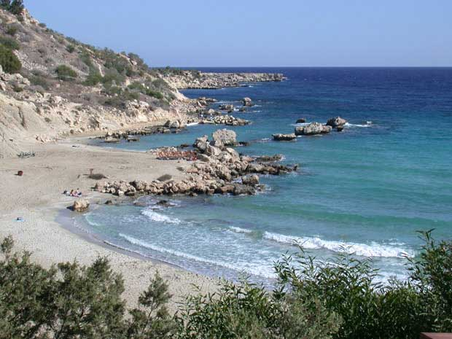
oifaxmuful 24
aygvkk\c&D;pOf &klwfw&uf Munfhjcif;
twÅvdEÅdwf
ork3´&m
at'D46 rS 48
Oa&my
tm&S
a&mr•
. rufpfpdeD;,m;
. yDpDwef tifefawtkyf
•
uky&k urf;ajc
tifwifpf
{zuf
tmz&du
wrefawmf 13 - 14
r,fwDwm
yifv,f
pdkif7mrftifefawtkyf
1/ csdwf"gwfcGJcef;
a,&I&Svif
xl;jcm;rIjyKaombk&m;tjzpf udk;uG,fcJ.onf/ erdwfvu©Pm
jycJ.onf/ aygvkcJESif haygufcH&onf/
tma&As
42
14

Slide 43
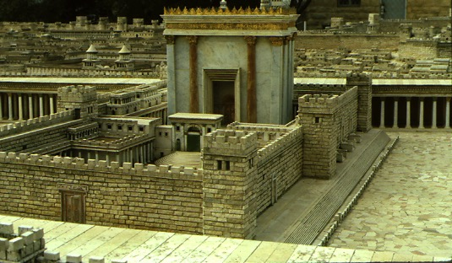
at'D49
twÅvdEÅdwf
ork3´&m
wrefawmf 15;1
.ta&jym;vSD;jcif;udkrcHvQif u,fwifawmfrljcif; odk hra&muf--
aygvkc&D;pOf Munf hjcif;
Oa&my
aus;Zl; awmf
oufouf
tm&S
a&mr
rufpfpDwdk;eD;,m;
wrefawmf (15)
. rufpfpdeD; ,m;
•
tmz&du
rufwrfpf
{zuf
. yDpDwef tifefawtkyf
r,fwDwm
yifv,f
1(--)2; a,&I&Svif aumifpD
a,&I&Svif
jyóemudkcdkifrmpGmajz&Sif;cJhonf/ ynwfawmfr[kwf aus;Zl;awmf
tma& AD;,m;
©2004 TBBMI
43
4

Slide 44
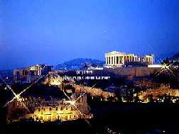
at'D 49-52
twÅvdEÅdwf
ork3´&m
Oa&my
tm&S
a&mr
rufpfpDwdk; eD;,m;
yDpDwef tifefawtkyf
wrefawmf 15 - 18
•
{zuf
tmz&du
rufwrfpf
pD&mrf tefawtkuf
r,fwDwm
yifv,f
2 Oa&myom;wGef;tm; ^ zdtm;
a,&I&Svif
xl;jcm;rI ; toif;awmf wdk;yGm;jcif;
rmauawmed ac:oH
tmoifNrdl hodk h trnfrodbk&m; rmpf;awmifukef;
aum&dEåKom;rsm;Mum&SnfpGmaexdkifrI
tma&AD;,m;
©2004 TBBMI
8.0.08.
44
5

Slide 45
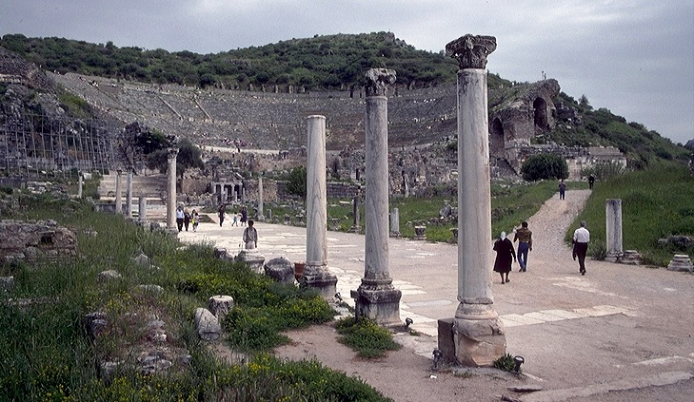
at” 53-57
twÅvdEÅdwf
ork3´&m
Oa&my
tm&S
a&S;a[mif; {zufNrdK h
a&mr
rufpfpDwdk;eD;,m;
wrefawmf 18-21
. yDpDwef tifefawtkyf
•
{zuf
tmz&du
tifwifpf
3 tm&SwGef;tm;
•pdkif7mrftifefawtkyf
r,fwDwm
yifv,f
a,&I&Svif
xl;jcm;rI ; {zuftoif;awmfwGif tcsdefwdk;jrif h aexdkifonf
aoaomvli,f jyefvnf touf&Sif
t a&;BuD; aom pmapmifrsm; a&;om; cJ.onf/
{zufom;vufrIq&m ESif.tm;upm;&HlwGif txdu&lPf; jzpfcJ.onf/
tma&As
©2004 TBBMI
8.0.08.
45
4

Slide 46
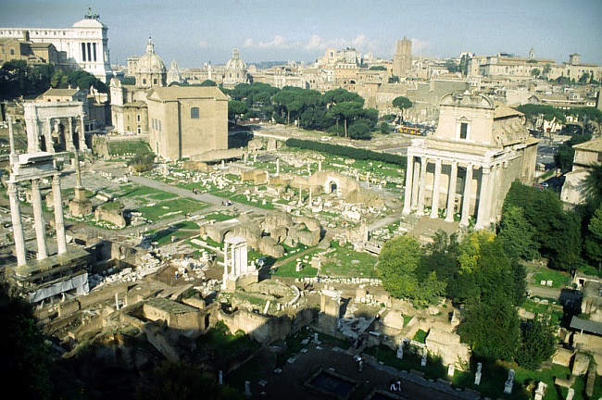
oifaxmuful 36
at'D 59-62
twÅvdEÅdwf
ork3´&m
Oa&my
tm&S
a&mr•
. rufpfpdeD;,m;
a&S;a&mracwf wpfwdkif
. yDpDwef tifefawtkyf
•
{zuf
tmz&du
tifwifpf
wrefawmf 21-28
pdkif7mrftifefawtkyf
r,fwDwm
yifv,f
4 a&mr odk h
a,&I&Svif
Tjzpftysuf ; tusOf;om;tae ESif h a&mr odk h ydk hjcif;cH&
tusOf;axmif ESif h uJom bk&if\ aetdrfwGif c&pf,mefvTrf;rdk;rI
aemufuspGm a&;aom ta&;BuD; pmapmifrsm;
tma&As
©2004 TBBMI
8.0.08.
46
3

Slide 47
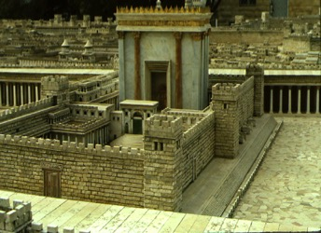

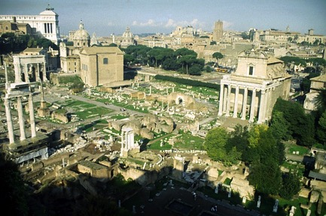
oifaxmuful 36
aygvk\c&D;pOfudk tMurf;tm;jzifhMunfhjcif;
ATLANTIC OCEAN
csdwf-1; QwfcGJjcif;
(21 tkyf)
Oa&my
toif;awmf jyótem
tm&S
Mum;umv: a,&l &SvifaumifpD
•rufpfpDwdk; eD;,m;
{zuf
csdwf-2; Oa&mywGef;tm;zdtm;
•yDpDwef tifefawtkyf
•
•{zuf
tmz&du
rufwrfpf
pD&mrf tefawtkuf
csdwf-3; tm&Som;wGef;tm;zdtm;
r,fwDwm
yifv,f
•a,&I&Svif
csdwf-4; a&mrudkatmifEdkif&ef
tma&AD;,m;
©2004 TBBMI
47
7

Slide 48
waygif;wnf;&Sdaom‘"r®opfusrf;pm
(21 tkyf)
toif;awmf
jyóem
usrf; a&;om;csdfef
at” 50 rS 90
pmapmifrsm;
tzGJhtpnf;opf\ta&;BuD;aom vrf;nGefzGJUpnf;rIESif.azmfxkwf rawGU&SdcJU& onfh jyóemtrsm;pkESif.yufoufí
toif;awmf
aygvkxHrSpmapmiftrsm;pk wjcm;pmapmiftenf;pk ueOD;toif;awmf ysHESHrI
aygvk xHrS
pmapmifrsm;
Letters from
The Others
tjcm;olrsm;rS
pmapmifrsm;
48
3

Slide 49
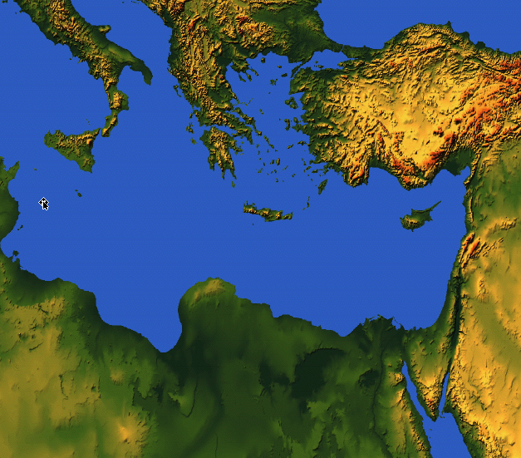
ueOD;toif;awmf ysHESHrI
owfrSwfí&aomae&ma”o wpfcsdK hwnf;om
9.65.08.
©2006 TBBMI
49
Notes:
[ON MED MAP: AUTO INSERTION OF 31 DOTS INDICATING NEWLY PLANTED CHURCHES –– REPRESENTATIVE ONLY]
As a means of wide communication, these circular letters were written to the new churches all across the Mediterranean Basin-- from Palestine to today's Italy, Greece, Turkey and Crete. They dealt –– then and now ––with all matters imaginable of life and living among members of the many churches springing up throughout the region.

Slide 50
(21 Books)
CHURCH
ISSUES
ueOD;toif;awmf twGuf ta&;BuD;aom tajccHpnf;rsOf;udk ay;pmrS azmfjycJ honf/
THE EPISTLES: Letters from Paul
Dates of Writing:
A.D. 50s - 90s
THE EPISTLES
Concerning generally unexplored issues requiring new and crucial instruction in leadership of the new organism...
the ECCLESIA,
the CHURCH.
Most letters from Paul …some fewer from “The Others.”
tzGJ htpnf; vSKyf&Sm;rI ESif hjyef hum;jcif; toif;awmfzGJ hpnf;&mwGif rdom;pktoufwm
toif;om;rsm;Mum;xJwGif aexdkifaom toufwm
rdom;pkrsm; toufwm
wpfa,muf ESif hwpfa,muf qufqHrI
Letters from
The Others
Letters from
The Others
0dnmOf toufwm
r[mappm;csufudkjznf hqnf;jcif;
©2004 TBBMI
8.0.08.
50
6

Slide 51
(21 tkyf)
waygif;wnf;&Sdaom‘"r®opfusrf;pm
toif;awmf
jyóem
aygvk xHrS
pmamifrsm;
xdk haMumif hta&;BuD;aom ar;cGef;wpfcku
b,f[mb,frSm&SdvJ¿
tjcm;olrsm;rS
pmapmifrsm;
oifaxmuful 20
51

Slide 52
(21 tkyf)
waygif;wnf;&Sdaom‘"r®opfusrf;pm
aygvk \ pmaqmifrsm;
toif; awmf
jyóem
aygvk xHrS
pmapmifrsm;
a&mrpmaqmif wcsdKUwGif
(aumEåK'kwd,pmaqmif) 2aum yg0ifonf
}
a&mr
1 aumavmoJ
2 aumavmoJ
ueOD;toif;awmf twGuf ol\ta&;BuD;aom oGefoifrI
a&mr
1 aumavmoJ
2 aumavmoJ
52
4

Slide 53
aygvk \ pmaqmifrsm;
(21 tkyf)
waygif;wnf;&Sdaom‘"r®opfusrf;pm
toif;awmf
jyóem
aygvk xHrS
pmamifrsm;
a&mrpmaqmif wcsdK hwGif
(aumEåK'kwd,pmaqmif) 2 aumyg0ifonf
a&mr
1 aumavmoJ
2 aumavmoJ
*vmwd
{zuf
zdvdyd
aumavmoJ
}
ueOD;toif;awmf twGuf ol\ta&;BuD;aom oGefoifrI
0ufom;pm; a[vorsm;
*vmwd
{zuf
zdvdyÜK
aumavmoJ
53
5

Slide 54
aygvk \ pmaqmifrsm;
(21 tkyf)
waygif;wnf;&Sdaom‘"r®opfusrf;pm
toif;awmf
jyóem
aygvk xHrS
pmamifrsm
a&mrpmaqmif wcsdK hwGif
(aumEåK'kwd,pmaqmif) 2 aumyg0ifonf
a&mr
1 aumavmoJ
2 aumavmoJ
*vmwd
{zuf
zdvdyd
aumavmoJ
ueOD;toif;awmf twGuf ol\ta&;BuD;aom oGefoifrI
0ufom;pm; a[vorsm;
1 oufomavmedwd
2 oufomavmedwf
1 wdarmao
2 wdarmao
wdwl
}
toif;awmfb@m xdef; jrnfwrf;
1 oufomavmeddwf
2 oufomavmedwf
1 wdarmao
2 wdarmao
wdwk
54
6

Slide 55
aygvk \ pmaqmifrsm;
(21 tkyf)
waygif;wnf;&Sdaom‘"r®opfusrf;pm
toif;awmf
jyóem
aygvk xHrS
pmamifrsm
a&mrpmaqmif wcsdK hwGif
(aumEåK'kwd,pmaqmif) 2 aumyg0ifonf
a&mr
1 aumavmoJ
2 aumavmoJ
*vmwd
{zuf
zdvdyd
aumavmoJ
ueOD;toif;awmf twGuf ol\ta&;BuD;aom oGefoifrI
0ufom;pm; a[vorsm;
1 oufomavmedwd
2 oufomavmedwf
1 wdarmao
2 wdarmao
wdwl
toif;awmfb@m xdef; jrnfwrf;
}
apwempdwfrygbJq,fydkU hwpfydkUay;aomolrsm;
zdavrkef
aygvk\ aemufqHk;
zdavrkef
55
2

Slide 56
aygvk \ pmaqmifrsm;
(21 tkyf)
waygif;wnf;&Sdaom‘"r®opfusrf;pm
zdavrkef
toif; awmf
jyóem
aygvk xHrS
pmamifrsm
aygvk\pm apmif rsm; jynfhpHkoGm;onf
a&mr
1 aumavmoJ
2 aumavmoJ
*vmwd
{zuf
zdvdyd
aumavmoJ
ueOD;toif;awmf twGuf ol\ta&;BuD;aom oGefoifrI
1 oufomavmedwd
2 oufomavmedwf
1 wdarmao
2 wdarmao
wdwl
zdavrkef
56

Slide 57
waygif;wnf;&Sdaom‘"r®opfusrf;pm
oifaxmuful 25
aygvk\ rSefuefaooyfaom oDtdk&D2ck\ aom hcsuf
c&pf,meftMuHtpnfESif.vkyfudkifrIh\ tajccHtkwfjrpf
ajzmif hrwfjcif;...rvHkrvJtjypfrSvGwfajrmufjcif;ESif hajzmifhrwf&modk ha&mufjcif;
tjzpftysufwpfckwnf;jzif.csufjcif;
urÇmOD;usrf; 15;6 ol\ ,HkMunfjcif; udk aNzmif.rwfNcif;
oef.&Sif;jcif; oef h&Sif;&mtrItwGuf toHk;jyl&efowfrSwfz,fxm;jcif;
&ifhusufjcif;odk havQmufvSrf;jcif;
1aum 1;2 cyfodrf;aomt&yfüy|memjyKaomoltaygif;wdkhudkMum;vdkufyg\
2
2aum 5;17 ESif h a&mr 5;1-4
57
8

Slide 58
(21 tkyf)
waygif;wnf;&Sdaom‘"r®opfusrf;pm
toif;awmf
jyóem
aygvk xHrS
pmamifrsm
tjcm;olrsm;rS pmaqmifrsm;
a[jAJ
&Sif,mukyf
1 &Sifayw&k
2 &Sifayw&k
1 &sifa,m[ef
2 &Sifa,m[ef
3 &Sifa,m[ef
&Sif,k'”
a&mr
1 aumavmoJ
2 aumavmoJ
*vmwd
{zuf
zdvdyd
aumavmoJ
(aygvkra&;c.Jhaom)
taxGaxG pmapmifrsm;
1 oufomavmedwd
2 oufomavmedwf
1 wdarmao
2 wdarmao
wdwl
zdavrkef
tjcm;olrsm;rS
pmaqmifrsm;
a[jAJ
&Sif,mukyf
1 &Sifayw&k
2 &Sifayw&k
1 &sifa,m[ef
2 &Sifa,m[ef
3 &Sifa,m[ef
&Sif,k”
a,&k&Svif &kyfjrifoHMum;ay:wGif a[jAJowif;twlwuG
&Sif,mukyf
&Sifayw&k
&Sifa,m[ef
&Sif,k”
©2004 TBBMI
58
3

Slide 59
(21 tkyf)
waygif;wnf;&Sdaom‘"r®opfusrf;pm
toif; awmf
jyóem
aygvk xHrS
pmamifrsm
a&mrpmaqmif wcsdK hwGif
(aumEåK'kwd,pmaqmif) 2 aumyg0ifonf
a&mr
1 aumavmoJ
2 aumavmoJ
ueOD;toif;awmfodk h
vSnf hywfay;pmrsm;
*vmwd
{zuf
zdvdyd
aumavmoJ
0ufom;pm; a[vorsm;
1 oufomavmedwd
2 oufomavmedwf
1 wdarmao
2 wdarmao
wdwl
toif;awmfb@m xdef; jrnfwrf;
rvdkvm;pGmq,fyfk hwydk hay;ammolrsm;
zdavrkef
aygvk\ aemufqHk
tjcm;olrsm;rS
pmaqmifrsm;
a,&k&Svif &kyfjrifoHMum;ay:wGif a[jAJowif;twlwuG
&Sif,mukyf
&Sifayw&k
&Sifa,m[ef
&Sif,k'
a[jAJ
&Sif,mukyf
1 &Sifayw&k
2 &Sifayw&k
1 &sifa,m[ef
2 &Sifa,m[ef
3 &Sifa,m[ef
&Sif,k3
©2004 TBBMI
59
5

Slide 60
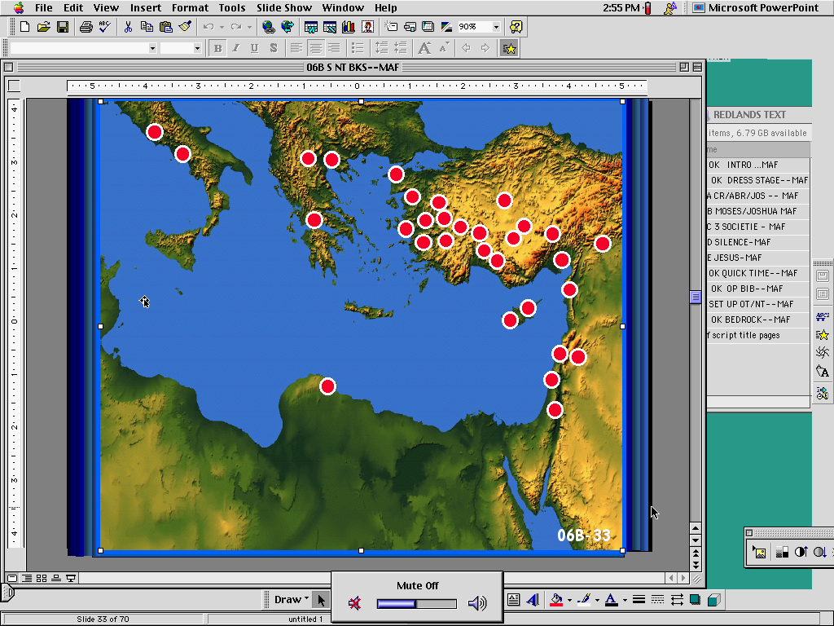
(21 tkyf)
waygif;wnf;&Sdaom‘"r®opfusrf;pm
toif;awmf
jyóem
aygvk xHrS
pmamifrsm
a&mr
1 aumavmoJ
2 aumavmoJ
"r®opfusrf;ay;pmrsm; tjynf htpHk pkaqmif;jcif;
*vmwd
{zuf
zdvdyd
aumavmoJ
1 oufomavmedwd
2 oufomavmedwf
1 wdarmao
2 wdarmao
wdwl
ueOD;toif; awmfokd.vSnf.ywf ay;pmrsm;
zdavrkef
tjcm;olrsm;rS
pmaqmifrsm;
a[jAJ
&Sif,mukyf
1 &Sifayw&k
2 &Sifayw&k
1 &sifa,m[ef
2 &Sifa,m[ef
3 &Sifa,m[ef
&Sif,k”
60

Slide 61
waygif;wnf;&Sdaom‘"r®opfusrf;pm
pmapmifrsm;\ t"du&nf&G,fcsufubmvJ¿
61
1

Slide 62
waygif;wnf;&Sdaom‘"r®opfusrf;pm
oifaxmuful 26
pmapmifrsm; [m pmaqmifrsm;taejzifh
tcef; ESpfck cGJxm;onf/
aygvk a&;xm;aompmaqmifrsm;
aygvkay;pm
tjcm;olrsm;xHrS vmaompmapmifrsm;
taxGaxGay;pm
62
6

Slide 63
waygif;wnf;&Sdaom‘"r®opfusrf;pm
yxr ; aygvkxHrSpmapmifrsm;
a&mr
,HlMunfjcif;jcif h
ajzmif hrwf&modk
1aum
toif;awmfwGif c&pf,meftjyK trl
2aum
*vmwd
{zuf
zdvdydÜ
aumavmoJ
,HkMunfol\toufwm ESif havQmufvSrf;jcif;
a,&Ic&pfawmf
vHk;0 vHkavmufjynfhpHkjcif;
aygvk\ ppfrSefaom wrefawmf jzpfjcif;
aus;Zl;awmf
cGeftm;
a,&Ic&pfawmf
uRefawmfwdk h\ 0rf;ajrmufjcif;
1;17
1;2
12;9
3;2
1;3
4;4
2;10
{zuf 1;3
igwdkYonf bk&m;ocifha&Shawmfü arwÅmtm;jzifhoefY&Sif; vsuftjypfuif;vGwfvsufjzpfrnftaMumif;
2 aum 12;9
ihgaus;Zl;onfoifhtbdkYavmufay\ ihgwefcdk;onf tm;enf;jcif;tjzpfüpHkvifwwfonf[k rdefYawmfrl\ xdkUaMumifh c&pfawmf\wefcdk;onfihgtay:ü usdrf;rnftaMumif;ihgudk,fü tm;enf;jcif;tjzpfudk0rf;ajrmufaompdwfESifh 0g<um;jcif; iSm omíigtvdk&Sd\
1 aum 1;2
a,&Ic&pftm;jzifhtjypfESifhuif;piffí oefY&Sif;ol t&mücefYxm;aomolwnf;[laom aum&dEÅK NrdlYü &Sdaom bk&m;ocif\ toif;awmfrSpíf cyfodrf;aomt&yfü igwdkYocif a,&Ic&pfudk yxeXmjylaomoltaygif; wdkYudk Mum;vdkufyg\
a&mr 1;17
ajzmifhrwfaomolonf,HkMunfjcif; tm;jzifhtouf&Sifvdrfhr,f [k usrf;pmvmonfESifhtnD ,HkMunfjcif;ü wnfaombk&m;ocif\ ajzmifhrwfjcif;w&m;onf ,HkMunfjcif;tbdkYtvdkYiSm {0Ha*vdw&m; tm;jzifhxif&Sm;vQuf&Sd\
*vmwd 3;2
ynwfw&m;\ tusifYtm;jzifY 0dnmOfawmf udk cH&Muoavm/ odkYr[kwf ,HkMunfjcif;w&m;udk Mum;emjcif;tm;jzifh cH&Muoavm [laomt&mwck udkomoifodkYü igodvdk\
*vmwd 3;2
ajrMuD;ay:rSm&Sdaomt&mwdkhudkpJGvrf;aompdwf r&SdMuESifh/ txuft&mwdkY udkompGJvrf;jcif; &SdMuavmY
zdvdydÜ 4;4
ocifbk&m;ütpOfrysuf0rf;ajrmufjcif; &SdMuavmY

Slide 64
waygif;wnf;&Sdaom‘"r®opfusrf;pm
yxr ; aygvkxHrSpmaqmifrsm;
{zuf
a&mr
,HlMunfjcif;jcif h
ajzmif hrwf&modk
1aum
toif;awmfwGif c&pf,meftjyK trl
2aum
*vmwd
{zuf
,HkMunfol\toufwmESif havQmufvSrf; jcif;
zdvdydÜ
aumavmoJ
aygvk\ppfrSefaom wrefawmfjzpfjcif;
1;3
a,&Ic&pfawmf
uRefawmfwdk h\0rf;ajrmufjcif;
a,&Ic&pfawmf
vHk;0 vHkavmufjynfhpHkjcif;
aus;Zl;awmf
cGeftm;
1;17
1;2
12;9
3;2
4;4
2;10
1 ouf
2 ouf
1 wd
2 wd
wdwk
zdavrkef
owif;aumif;apmif ha&Smufjcif;
toif;awmfvlBuD;rsm;\&dxdkufaom t&nftaoG;
aemufqHk; aomumvtjzpftysufrsm;
c&pfawmfjyefvnf<ua&mufvmrnf hae h
toif;awmfwGifoif havQmfaomtpDpOf
wyg;oludkc&pfawmfemrjzif hvufcHjcif;
1;10
1;6
2;8
1;13
2;1-2
vv. 17-18
2 ouf 1;6
tb,fodkYenf; [lrlum; ocifa,&I onf wefcdk;&Sdaom aumif;uifwrefESifhtwl aumif;uifbHkuay:xGef;awmfrlí bk&m;ocifudk,frodaomol? {0Ha*vdw&m;udk em;raxmifaomolwdkYudk rD;vQHtm;jzifhtjypfay;awmfrlaomtcg qif;&Japbl;aom olwdkYü qif;&Jjcif;udk 4if; qif;&JcH&bl;aomoifwdkYü igwdkYESifhtwl csrf;omjcif;udk 4if; bk&;ocifqyfay; í w&m;ojzifh pD&ifawmfrlvdrfrnf/
wdwk 2;1-2
oifrlum; pifMu,faomw&m;ESifhxdkufweforQwdkYudka[majymavmh/toufBuD&ifhaom a,mufusm;wdkYonf or®mowd &Sdaomol ? wnfMunfaomol ? £aNEéapmifhaomol ? ,HkMunfjcif; ? cspfjcif; ? onf;cHjcif;üpdwfoefaomoljzpf&Murnf taMumif;/
zdvdrkef 17-18
odkYjzpfí oifonf ighudk,ftaygif;tabmfuJhodkY rSwfvQif olYudkiguJhodkyifvufcHavmh/
olonfoifü jypfrSm;jcif; a<u;wifjcif; wpHkwck&SdvQif
1 ouf 1;10
a&mufvwHhaomab;rS igwdkYudku,fEIwfaom ocifa,&Iwnf;[laom aojcif;rSbk&m;ocifxajrmufapaom om;awmfonf aumifuifbkHrS <uvmawmfrlrnft&mudk iHhvifhjcif;iSm 4if; &kyfwkqif;wkwdkYudkypfy,fí bk&m;ocifhtxHawmfodkY ajymif;vJMuonf taMumif;t&mudkvnf;ajymMu\
1 wD 2;8
odkYjzpfí t&yf&yfwdkYü a,mufusm;wdkY onf trsufxGufjcif;r&SdbJ oefY&Sif;aomvufudkcsDí qkawmif;apjcif; iSm igtvdk&Sd\
2 wd 1;13
igwdkYonfr,HkMunfaomvnf; xdkocifonf opömwnfojzifh udk,fudkjiif;y,fawmfrrlEkdif/
©2004 TBBMI
8.0.08.
64
5

Slide 65
FIRST:THE LETTERS FROM PAUL
1 ay 2;7
odkYjzpfí ,HkMunfjcif;&SdaomoifwdkYüum; bkef;toa& &Sd\/ em;raxmifaomolwdkYüum;? wdkufudkwnfaqmufaomolrsm; y,fxm;aomausmufonf aemufwzef wdkufaxmifYtxG#fzsm;odkYa&mufjyef\/ em;raxmifbJ EIwfuywfw&m;awmfudk xdrdívJaomolwdkYonf xdrdívJp&mausmuf? rSm;,Gif;p&mausmufvJjzpf\/ xdktrIESifhawGYapjcif;iSm xdkolwdkYudk cefYxm;awmfrlownf;/
1 a,m 5;13
bk&m;ocif\om;awmfudk ,HkMunfaomoifwdkYonf xm0&toufudk udk,fwdkif&onf[k odapjcif; iSm? uSsft&mrsm;udk oifwdkYtm;iga&;í ay;vdkuf\/
,mukyf 2;16
oifwdkYwGifwpHkwa,mufolu? Nidrf0yfpGmoGm;Muavmh/ aEG;Muavmh/ 0Muavmh[k ajymvQuf? olwdkYudk,fESifh awmfavsmfaomtoHk;taqmifudk ray;bJaevQif tb,ftusdL;&Sdoenf;/
2 ay 2;1
odkYaomfvnf;? ,k3vlwdkwGifrdpäm ya&mzuf&SdMu\/ xdkenf;wl zsufqD;wufaom rdpäm 3dXdt,lrsm;udk y&d,m,ftm;jzifh oGif;írddrdwdkudk0,fawmfrlaom t&Sifjiif;y,f vsuf? rdrdwdkYtay:odkY vQifpGmaomzsufqD;jcif;udka&mufapaom rdpämq&mwdkYonf oifwdkYwGif &SdMuvdrfhrnf/
2 a,m 3
crnf;awmf bk&m;xHawmfu 4if;? crnf;awmfom;awmf a,&I c&pfxHu 4if;? or®mw&m;? arwÅmw&m;ESifhwuG? aus;Zl; ? u&kPm? Nidrfoufjcif;onf oifwdkYü &Sdygapaom/
a[jAJ 1;4
aumif;uifwrefodkY&aom bGJYemrxufxl;jrwfaom bGJYemrawmfudk cH&onfESifhtnD? aumif;uifwrefwdkYxufBuDjrwfaomoljzpfawmfrl\/
3 a,m 4?11
ig\om;orD;wdkYudk or®mw&m;ü usifvnfonfudkigMum;í 0rfajrmufjcif;xuf omí0rfajrmufjcif;r&Sd/ tcsif;cspfol? raumif;aomenf;udkrvdkufESifh? aumif;aomenf;udkomvdkufavmh/ aumif;tusifhudkusifhaomolonf bk&m;ocifESifhpyfqdkif\/ raumif;aomtusifhudkusifhaomolrlum;? bk&m;ocifudk rodrjrif&NyD/
,k 20-21
cspfolwdkY? oifwdkYonf rdrdwdkYtvGefoefY&Sif;aom ,HkMunfjcif;tay:rSm rdrdwdkYudk wnfaqmufvQuf? oefY&Sif;aom 0dnmOfawftm;jzifY qkaxmif;yXmemjyKvQuf? bk&m;ocifudkcspfjcif;arwÅmü udk,fudkudk,fapmifha&Smufí? xm0&touftvdkiSm? igwdkY ocifa,&I c&pf\u&kPmawmfudk ajrmfvifhíaeMuavmh/
ROMANS
1 COR
2 COR
GALATIANS
EPHESIANS
PHILIPPIANS
COLOSSIANS
JUSTIFI- CATION BY FAITH
CHRISTIAN CONDUCT IN THE CHURCH
PAUL’S AUTHENTIC APOSTLE-SHIP
THE POWER OF GRACE
POSITION AND WALK OF THE BELIEVER
JESUS CHRIST OUR JOY
JESUS CHRIST: TOTALLY ADEQUATE
1:17
1:2
7:6; 12:9
3:2
1:3
3:7; 4:4
2:10
1 THESS
2 THESS
1 TIMOTHY
2 TIMOTHY
TITUS
PHILEMON
a[jAJ
THE COMING DAY OF THE LORD
PROPER ORDER IN THE CHURCH
GUARD THE GOSPEL; PREACH ON
QUALIFI-CATIONS OF ELDERS
ACCEPT- ANCE OF OTHERS IN CHRIST
a,&I c&pfawmftPmukefNyD;qHk;
jcif;
EVENTS OF THE LAST DAYS
0
3:5
3:9
1:13
2:1-2
v.17
1;4
,muk
1 ay
2 ay
1 a,m
2 a,m
3 a,m
,k'
,HkMunfjcif;\toD;t yGif h
wm0ef
oGefoifol rsm;
rSm;,Gif;ol rsm;
oGefoifcsuffvdkufavQmufjcid;
auseyfjcif;
tmPm
2;26
2;7
2;1
5;13
;3
;4ç11
;20-21
tjcm;olrsm;rS “wwd,pmaqmif
65
8

Slide 66
waygif;wnf;&Sdaom‘"r®opfusrf;pm
yxr ; aygvkxHrSpmaqmifrsm;
a&mr
,HlMunfjcif;jcif
ajzmif. hrwf&modk
1aum
toif;awmf wGifc&pf,mef tjyK trl
2aum
*vmwd
{zuf
zdvdydÜ
aumavmoJ
{zuf
,HkMunfol\toufwm ESif havQmuf vSrf; jcif;
a,&Ic&pfawmf
vHk;0vHkavmuf jynfhpHkjcif;
aygvk\ppf rSefaom wrefawmf jzpfjcif;
aus;Zl;awmf
cGeftm;
a,&I c&pfawmf
uRefawmfwdk h\0rf;ajrmuf jcif;
1;17
1;2
12;9
3;2
1;3
4;4
2;10
1 ouf
2 ouf
1 wd
2 wd
wdwk
zdavrkef
a[jAJ
toif;awmfwGifoif. hawmfaomtpDpOf
owif;auif; apmif. ha&Smufjcif;
toif;awmfvlBuD;rsm;\&dxdkufaom t&nftaoG;
aemufqHk; aomumvtjzpftysufrsm;
c&pfawmf jyefvnf <ua&muf vmrnf hae h
wyg;oludkc&pfawmf emrjzif hvufcHjcif;
a,&I c&pfawmf tPmukef NyD;qHk;jcif;
1;10
1;6
2;8
1;13
2;1-2
vv. 17-18
1;4
,muk
1 ay
2 ay
1 a,m
2 a,m
3 a,m
,k'
,HkMunfjcif;\toD; tyGif h
wm0ef
oGefoifol rsm;
rSm;,Gif;ol rsm;
oGefoifcsuffvdkuf avQmufjcid;
tmPm
auseyfjcif;
2;26
2;7
2;1
5;13
;3
;4ç11
;20-21
tjcm;rSwwd,pmrsm;
66

Slide 67
a&mr
{zuf
aumavmoJ
zdvdrkef
zdvdydÜ
1 ay
2 ay
2 aw
rmqDvdk;eD;,rf;
2 aum
1 wd
{zuf
a[jAJ
aumvif;
1 aum
wdwk
1 a,m
2 a,m
3 a,m
qdkif;vif htefwdtkyf
a&mr
1 ouf
2 ouf
*vmwd
b,frSma&; ovJ
a,&k&Svif
,mukyf
,k'
©2004 TBBMI
8.0.08.
67
27

Slide 68
a&mr
{zuf
aumavmoJ
zdvdrkef
zdvdydÜ
1 ay
2 ay
2 aw
rmqDvdk;eD;,rf;
2 aum
1 wd
{zuf
a[jAJ
aumvif;
1 aum
wdwk
1 a,m
2 a,m
3 a,m
qdkif;vif htefwdtkyf
a&mr
1 ouf
2 ouf
*vmwd
a,&k&Svif
tb,faBumif.toif;awmfwdkif;qDodkUtjrJ jzefa0cJ.oenf;/
,mukyf
,k'
©2004 TBBMI
8.0.08.
68

Slide 69
waygif;wnf;&Sdaom‘"r®opfusrf;pm
"r®opftydkif;”(4) ydkif;
at'D” 50 ESif h 90 Mum; a&;om;csuf rsm;
(4 tkyf )
(1 tkyf )
(21 tkyf )
(1 tkyf )
tjzpftysuf rsm; ESifh
oDtdk&D
toif;awmf\
ordkif;
toif;awmf
jyoemrsm;
xm0&
tem*wf
c&pf0ifusrf; rsm;
wref awmf0w¬L
{zufBo0g'
pm
Asm'dwfusrf;
oifaxmuful 27
©2004 TBBMI
69

Slide 70
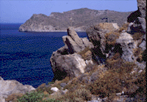
waygif;wnf;&Sdaom‘"r®opfusrf;pm
Asm'dwf
ywfrk uRef;wGif
at'D90 cef hwGif a&;onf /
xm0& tem*wf taMumif;udk 6 ae&mü wifjyjcif;
toif;awmf 7 ckay;pm
wHqdyfcwfpD&ifcsufrsm;
toHvTif hpD&ifcsufrsm;
a&TrD;cGuf pD&ifcsufrsm;
opömrJ haomtoif;awmf
c&pfawmf <uvmjcif;
(1 tkyf)
xm0&
tem*wf
Asm'dwf
70
9

Slide 71



tma&As usrf;pm pum;vHk; a&;om; rSwfxm;aom pm&if;
7
c&pfawmfajrBuD;ay:pdk;pHjcif;
odk;oli,fawmf vufxyfyGJ
aumif;uifopfajrBuD;opf
yv’ifjzKw&m;pD&ifjcif;
'kkwd,tBudrf <uvmjcif
4 yD
3 tufpf
J
C
J
A
M
J
A
R
S
C
tmjA[H y#dnmOf
c&pfawmfajrBuD;ay:pdk;pHjcif;
aumif;uifopfajrBuD;opf
odk;oli,fawmfvufxyfyGJ
yv’ifjzKw&m;pD&ifjcif;
“'kwd,tBudrf <uvmjcif;
ajrBuD;y#dnmOf
'g0d'f y#dnmOf
y#dnmOftopf
©2004 TBBMI
8.0.08.
71
5

Slide 72
waygif;wnf;&Sdaom‘"r®opfusrf;pm
Asm'dwf
ywfrk uRef;wGif
at'D 90 cef hwGifa&;onf/
xm0& tem*wftaMumif;udk 6 ae&mü wifjyjcif;
aMumufql; 5 ck
tcef;BuD; 19?20?21
(1 tkyf)
xm0&
tem*wf
Asm'dwf
72

Slide 73
waygif;wnf;&Sdaom‘"r®opfusrf;pm
odk;oli,fawmf vyfxyfyGJ
Asm'dwf 19;1-10
Asm'dwf
xm0& tem*wftaMumif;udk 6 ae&mü wifjyjcif;
Asm'dwf
19;9
aumif;uifwrefuvnf; ? odk;oli,f\ r*FvvmaqmifyGJodkYac:zdwfjcif;udk cH&aomolwdkYonf r*Fvm&SdMu \ a&;om;xm; avmh[lí 4if;? uSsfpum;onfbk&m;ocif\ EIwfawmfxGufpifppf jzpf\ [lí 4if; ightm;ajymqdk\/
73

Slide 74
waygif;wnf;&Sdaom‘"r®opfusrf;pm
odk;oli,fawmf vyfxyfyGJ
Asm'dwf
xm0& tem*wftaMumif;udk 6 ae&mü wifjyjcif;
'kwd,tBudrf <uvmjcif;
Asm'dwf 19;11-16
xdktcgaumif;uifbHkzGifhvSpfvQuf&Sdonfudk igjrifvQif? jrif;jzl&Sd\/ jrif;pD;aomolonf opöm[laomtrnf? or®m[laomtrnf&Sdownf;/ xdkolonf w&m;ojzifhpD&ifwuf\/ w&m;ojzifhppfwdkufwuf\/ rsufpdawmfonf rD;vQHuJhodkYjzpf\/ acgif;awmfüo&zlrsm;udk aqmif;\/ udk,fwdkifrS\wyg; tb,folrSsrodaom emrnfawmf a&;xm;avh&Sd\/ taoG;üESpfNyD;aomt0wfudk0wf\/ bk&m; ocif\ EIwfuywfawmf[laom trnf&Sd\/ aumif;uifAdkvfajcwdkYonfjrif;jzLudkpD;vQuf pifMu,faomydwfacsmjzLudk0wfvQuf? aemufawmfodkYvdkufMu\/ vlrsdK;wdkYudk 3Pfcwfp&m bdkY ? xufaomoefvsufonf cHwGif;awmfxJu xGuf\/ olwdkudkoHvSHwH ESifh tkyfpdk;awmfrlrnf/ tem*wfwef;cdk;ESifh jynfhpHkawmfrlaom bk&m;ocif\ trsufawmf\ pyspfoD;ES,f&m wefqmudk zdeif;awmfrlrnf/ bk&m;wdkY\bk&if? ocifwdkY\ocif[k bGJYemrawmfonf t0wfawmfü 4if;? aygifawmfü 4if;a&;xm;vsuf&Sd\/
74

Slide 75
waygif;wnf;&Sdaom‘"r®opfusrf;pm
odk;oli,fawmf vufxyfyGJ
Asm'dwd
xm0& tem*wftaMumif;udk 6 ae&mü wifjyjcif;
'kwd,tBudrf <uvmjcif;
Asm'dwf 20;6
yxrxajrmufjcif;udk 0ifpm;aomolonf r*Fvm &Sdaom ol? oefh&Sif;aomol? 3kwd,aojcif;ESifhuif;vGwfvsuf bk&m;ocif\,Zfyka&m[dwf? c&pfawmf\,Zfyka&m[dwfjzpfí? tESpfwaxmifywfvHk; c&pfawmfESifhtwl pDk;pHMuvdrhfrnf/
yv’ifjzKw&m;pD&ifjcif;
75

Slide 76
odk;oli,fawmf vufxyfyGJ
Asm'dwf
xm0& tem*wftaMumif;udk 6 ae&mü wifjyjcif;
'kwd,tBudrf <uvmjcif;
Asm'dwf 20;11-12
wzefwkH?jzLaom yv’ifudk4if;?yv’ifay:rSmxdkifawmfrlaomoludk4if; igjrif\/ aumif;uifESifhajrMuD;onf rsufESmawmfa&ShrSajy;vGifhí olwdkYaep&mt&yfr&Sd/aovGefaomoltBuDti,folwdkYonf yv’ifawmfa&ShrSm &yfaeMuonfudkigjrif\/ pmapmifzGifhxm;\/ toufpmapmif wnf;[laom tjcm;wyg;aompmapmifrsm;udkvnf; zGifhav\/ aovGefaomolwdkYonf \/ aovGefaomolwdkonf rdrdtusifhtwdkif; pmapmifwdkYüa&;om;csufESifhtnD w&m;pD&ifjcif;udkcH&Mu\/
c&pfawmfajrBuD;ay:pdk;pHjcif;
yv’ifjzKw&m;pD&ifjcif;
76

Slide 77
waygif;wnf;&Sdaom‘"r®opfusrf;pm
odk;oli,fawmf vufxyfyGJ
Asm'dwf
xm0& tem*wftaMumif;udk 6 ae&mü wifjyjcif;
'kwd,tBudrf <uvmjcif;
Asm'dwf
21;1-2
aumifuifopfESifhajrBuD;opfudkvnf; igjrif\/
a&S;aumif;uifESifhajrBuD;onf a&GoGm;MujyD/ ork'´&mr&Sd/ oefY&Sif;aomNrdKY a,&k&Svif NrdKYopfonf rdrdcifyGef;bdkY wefqmqifaom r*FvmowdkYorD;uJhodkY jyifqifvQuf? bk&m;ocifhtxHawmf? aumif;uifbHkrSqifoufonf udkigjrif\/
c&pfawmfajrBuD;ay:pdk;pHjcif;
yv’ifjzKw&m;pD&ifjcif;
aumif;uifopfajrBuD;opf
8.0.08.
77

Slide 78
odk;oli,fawmf vufxyfyGJ
Asm'dwf
xm0& tem*wftaMumif;udk 6 ae&mü wifjyjcif;
'kwd,tBudrf <uvmjcif;
aMumufql; 5 ck
tcef;BuD; 19?20?21
c&pfawmfajrBuD;ay:pdk;pHjcif;
yv’ifjzKw&m;pD&ifjcif;
aumif;uifopfajrBuD;opf
©2004 TBBMI
8.0.08.
78

Slide 79
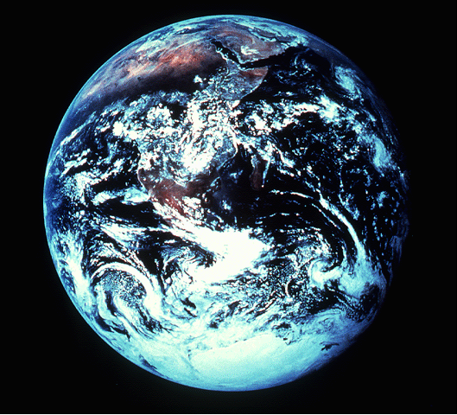
igonf tvQiftjrefvmrnf
Asm”wf 22;20
©2004 TBBMI
8.0.08.
79

Slide 80
8.0.08.
©2004 TBBMI
80

Slide 81

oifaxmuful 26
©2004 TBBMI
8.0.08.
81

Slide 82
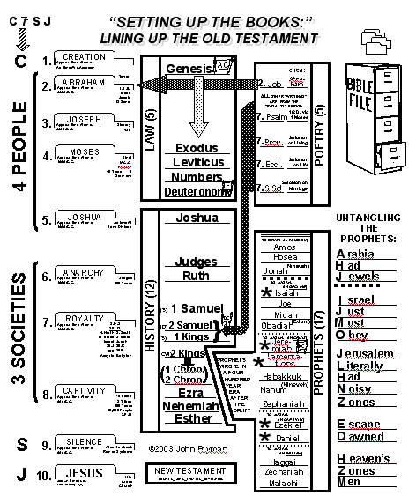

usrf;pmtajccHusus
®
“66 tkyfaom usrf;pmudk jyifqifjcif;
a[mif;
opf
oifaxmuful 34 ESifh 35
©2004 TBBMI
8.0.08.
82

Slide 83
“kwd,tBudrf <uvmjcif
tma&As usrf;pm pum;vHk; a&;om;rSwfxm;aom pm&if;
7
c&pfawmfajrBuD;ay:pdk;pHjcif;
odk;oli,fawmf vyfxyfyGJ
aumif;uifopfajrBuD;opf
yv’ifjzKw&m;pD&ifjcif;
'kkwd,tBudrf <uvmjcif
4 yD
3 tufpf
J
C
J
A
M
J
A
R
S
C
tmjA[H y#dnmOf
'kkwd,tBudrf <uvmjcif
ajrBuD;y#dnmOf
'g0d'fy#dnmOf
y#dnmOftopf
oifaxmuful 28 ; twdtuspkaygif;jcif;
© 2004 TBBMI
8.0.08.
83

Slide 84
tma&As usrf;pm pum;vHk; a&;om;rSwfxm;aom pm&if;
7
c&pfawmfajrBuD;ay:pdk;pHjcif;
odk;oli,fawmf vyfxyfyGJ
aumif;uifopfajrBuD;opf
yv’ifjzKw&m;pD&ifjcif;
'kkwd,tBudrf <uvmjcif
4 yD
3 tufpf
J
a,&Ic&pfawmf
C
J
A
M
J
A
R
S
C
tmjA[H y#dnmOf
ajrBuD;y#dnmOf
'g0d'f y#dnmOf
y#dnmOftopf
© 2004 TBBMI
8.0.08.
84

Slide 85
[kwfNyD uRefawmfwdk h usrf;pmtqHk;ydkif;udka&muf&SdvmNyDjzpfonf/
tajccHusaomoGefoifjcif; onftb,frSmenf;/
©2004 TBBMI
8.0.08.
85

Slide 86
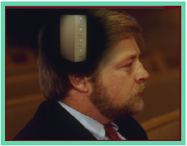
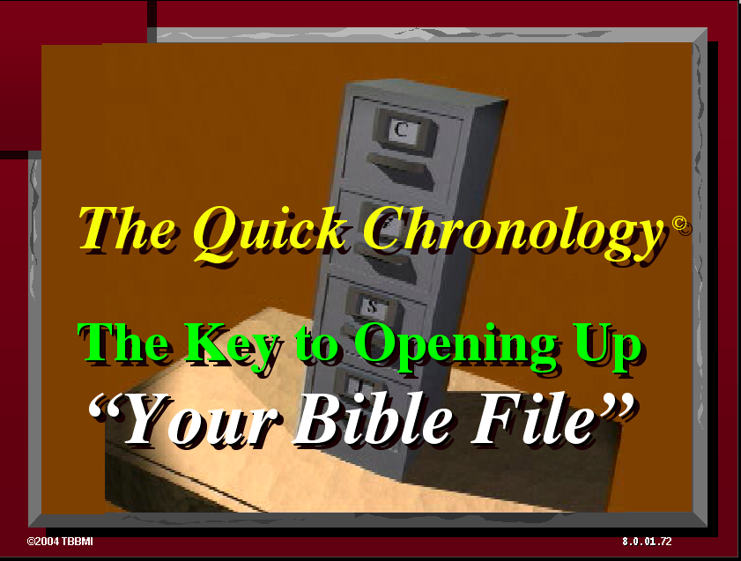
usrf;pmtajccHuspGm NyD;qHk;jyD/ tckoif hpdwful;xJrSm bm&SdovJ/
®
usrf;pmqdkonf h tawG;tac:
©2004 TBBMI
8.0.08.
86

Slide 87
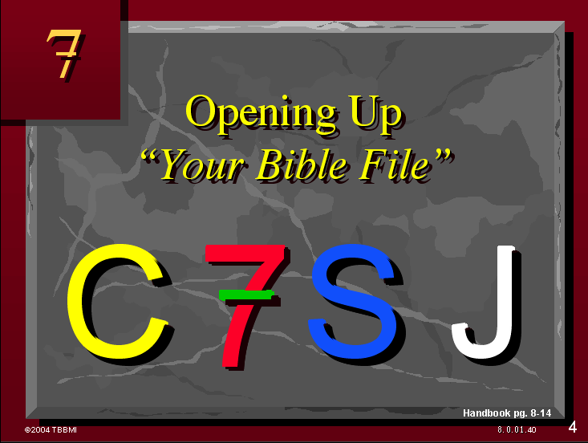
usrf;pGm tajccHus pGm NyD;qHk;jyD/ tckoif hpdwful;xJrSm bmvJ
®
usrf;pmqdkonf h tawG;tac:
usrf;pmudk zGif.zdk hpdwful;aomhcsuf
©2004 TBBMI
8.0.08.
87

Slide 88
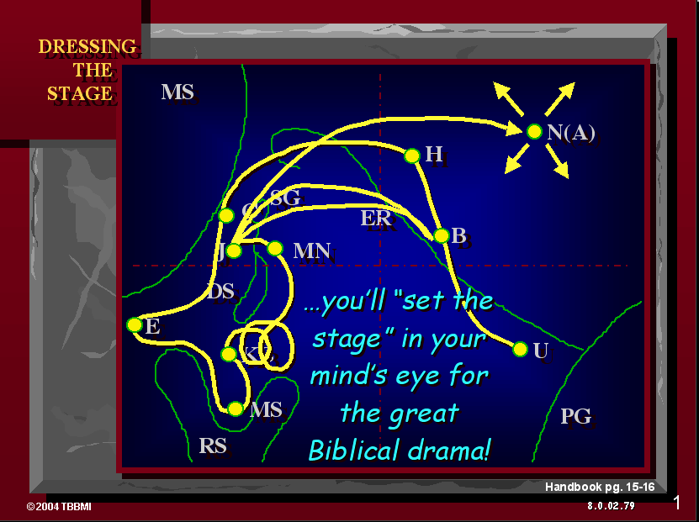
usrf;pmtajccHuspGm NyD;qHk;jyD/ tckoif hpdwful;xJrSm bmvJ
®
usrf;pmqdkonf h tawG;tac:
usrf;pmudk zGif.zdk hpdwful;aom.csuf
usrf;pmygtjzpftysufrsm;\ wnf&Sd&mjyaom pdwful;ajryHk
©2004 TBBMI
8.0.08.
88

Slide 89
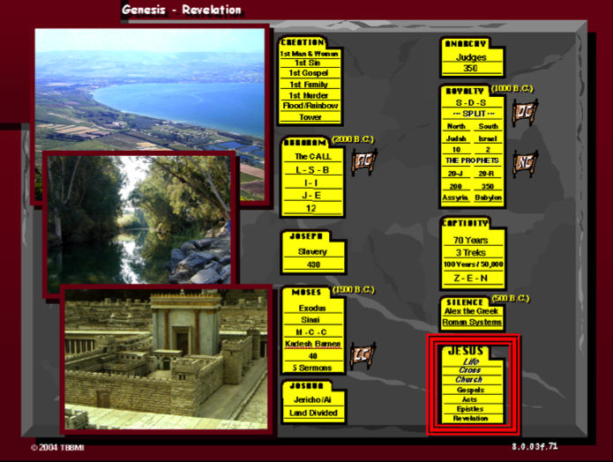
usrf;pGm tajccHus pGm NyD;qHk;jyD/ tckoif hpdwful;xJrSm bmvJ
®
usrf;pmqdkonfhtawG;tac:? usrf;pmudk zGif.zdk hpdwful;aom.csuf? husrf;pmygtjzpftysufrsm;\ wnf&Sd&mjyaom pdwful;ajryHk? usrf;pmyHkjyif\ ta&;BuD;qHk;ydkif; vQifjrefaomjzpfpOf.?
©2004 TBBMI
8.0.08.
89

Slide 90
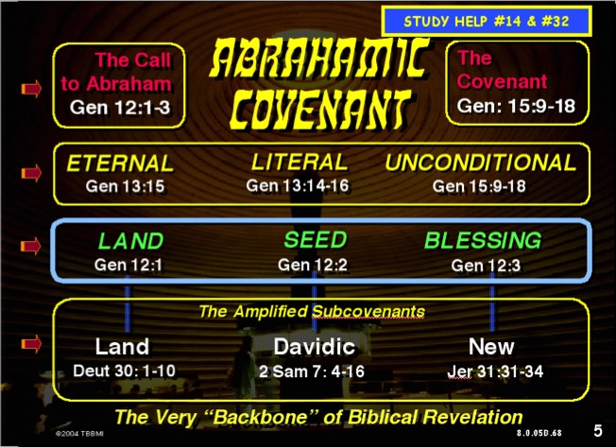
usrf;pGm tajccHus pGm NyD;qHk;jyD/ tckoif hpdwful;xJrSm bmvJ
®
usrf;pmydkuf qdkonf h tawG;tac:
usrf;pmydkufudk zGif h zdk hpdwful;aom hcsuf
usrf;pmtjzpftysufrsm; \ wnf&Sd&mjyaom pdwful;ajryHk
usrf;pmyHkjyif \ ta&;BuD; qHk;ydkif? vQifjrefaom jzpfpOf
c&pfawmf \ óoem udk tmjAJ[H ‘or®musrf;pmu wdkuf&dkuf qufEG,fonf
‘or®musrf;pm\ zGJUpnf;yHkonf yg0ifaom tjzpftysufrsm;ay: rlwnfonf
ta[mif;ESif.topf usrf;tkyfrsm;\ acgif;pOfrsm;
©2004 TBBMI
8.0.08.
90

Slide 91
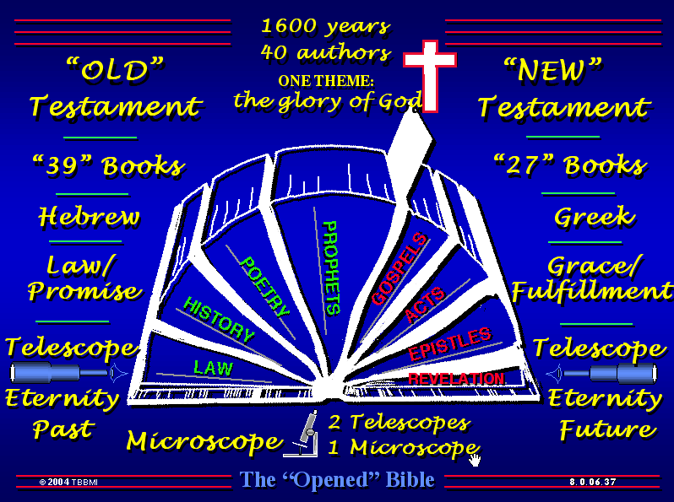
usrf;pGm tajccHus pGm NyD;qHk;jyD/ tckoif hpdwful;xJrSm bmvJ
…
®
•usrf;pmydkuf qdkonf h tawG;tac:
usrf;pmydkufudk zGif h zdk hpdwful;aom hcsuf
usrf;pmtjzpftysufrsm; \ wnf&Sd&mjyaom pdwful;ajryHk
usrf;pmyHkjyif \ ta&;BuD;qHk;ydkif? vQifjrefaomjzpfpOf
c&pfawmf \ óoem udk tmjAJ[H ‘or®musrf;pmu wdkuf&dkuf qufEG,fonf
‘or®musrf;pm\ zGJUpnf;yHk onf yg0ifaom tjzpf tysufrsm;ay:rlwnfonf
ta[mif;ESif.topf usrf;tkyfrsm;ESif. acgif;pOfrsm;
©2004 TBBMI
8.0.08.
91

Slide 92
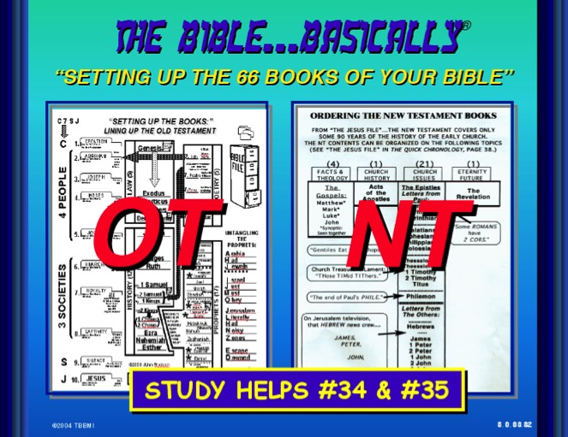
usrf;pGm tajccHus pGm NyD;qHk;jyD/ tckoif hpdwful;xJrSm bmvJ
®
usrf;pmydkuf qdkonf h tawG;tac:
usrf;pmydkufudk zGif h zdk hpdwful;aom hcsuf
usrf;pmtjzpftysufrsm; \ wnf&Sd&mjyaom pdwful;ajryHk
usrf;pmyHkjyif \ ta&;BuD;qHk;ydkif? vQifjrefaomjzpfpOf
c&pfawmf \ óoem udk tmjAJ[H ‘or®musrf;pmu wdkuf&dkuf qufEG,fonf
‘or®musrf;pm\ zGJ h pnf;yHk onf yg0ifaom tjzpf tysufrsm;ay:rlwnfonf
ta[mif;ESif.topf usrf;tkyfrsm;ESif. acgif;pOfrsm;
©2004 TBBMI
8.0.08.
92

Slide 93
usrf;pGm tajccHus pGm NyD;qHk;jyD/ tckoif hpdwful;xJrSm bmvJ
usrf;pmydkuf qdkonf h tawG;tac:
usrf;pmydkufudk zGif h zdk hpdwful;aom hcsuf
usrf;pmtjzpftysufrsm; \ wnf&Sd&mjyaom pdwful;ajryHk
usrf;pmyHkjyif \ ta&;BuD;qHk;ydkif? vQifjrefaomjzpfpOf
c&pfawmf \ óoem udk tmjAJ[H ‘or®musrf;pmu wdkuf&dkuf qufEG,fonf
or®musrf;pm \ zGJ h pnf;yHk onf yg0ifaom tjzpf tysufrsm;ay:rlwnfonf
ta[mif;ESif.topf usrf;tkyfrsm;ESif. acgif;pOfrsm;
©2004 TBBMI
8.0.08.
93

Slide 94
The Bible…Basically is ending. Now you have in your thinking…
®
oif.\udk,fydkifvufpGJopf
(pdwfwGufjzif husrf;pmydkdif;jcm;jcif;)
•An Idea Called “The Bible File”
•The Mental Key to Open “The Bible File”…C 7 S J
•A Mental Map locating The Major Biblical Events
•The Bible’s “STORY” Core: “The Quick Chronology”
•Abrahamic Foundations of Scripture leading directly to The Ministry of The Lord Jesus Christ
•The Bible’s “Architecture” Based on The Story
•The Old and New Testament Books and Themes
©2004 TBBMI
8.0.08.
94

Slide 95
The Bible…Basically is ending. Now you have in your thinking…
®
•An Idea Called “The Bible File”
•The Mental Key to Open “The Bible File”…C 7 S J
•A Mental Map locating The Major Biblical Events
•The Bible’s “STORY” Core: “The Quick Chronology”
•Abrahamic Foundations of Scripture leading directly to The Ministry of The Lord Jesus Christ
•The Bible’s “Architecture” Based on The Story
•The Old and New Testament Books and Themes
,ckxkyfydk;zdkYtcsdef a&mufNyD/
©2004 TBBMI
8.0.08.
95

Slide 96
Burmese
or®musrf;pm
tkwfNrpf
Texas jrdk.rS or®musrf;pm-tkwfjrpf (edkifiHwumtrSkawmfaqmifvkyfief;)\ wifjycsuf
www.biblebasically.com

Slide 97


တရားေဟာျခင္းအ တတ္ပညာ • BibleStudyDownloads.org
အခမဲ့အဘို့ဤတင်ပြချက်
Notes:
Preaching (pr)
Homiletics

Slide 98
8.0.08.
©2004 TBBMI
97

