Slide 1
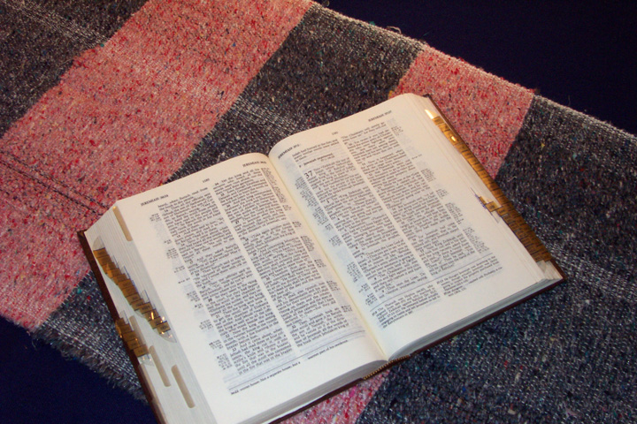
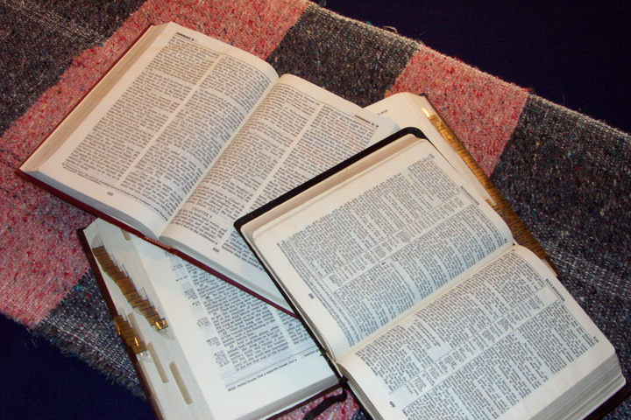
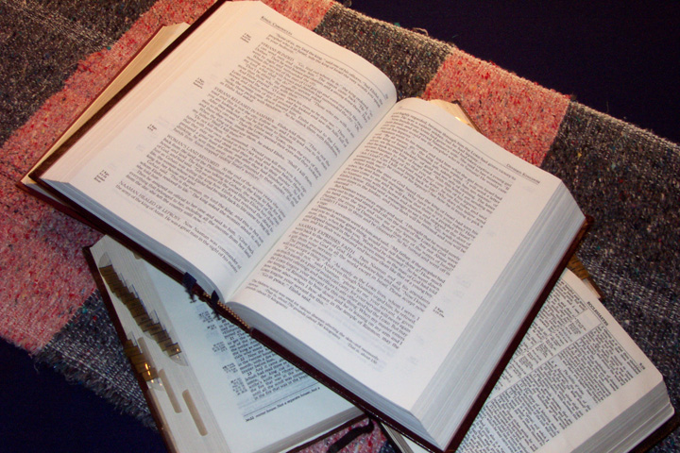
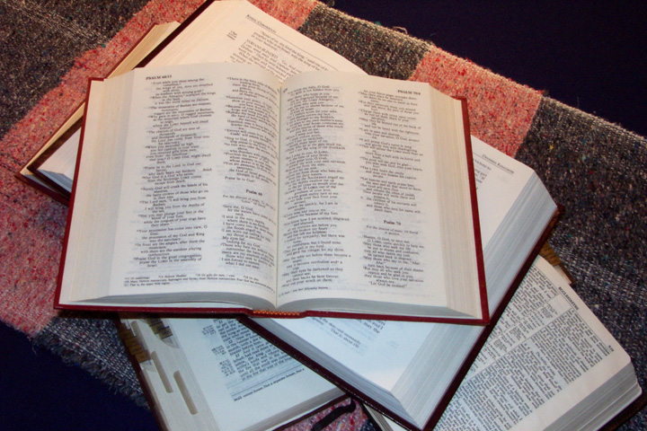
zefqif;jcif;
tmjA[H
C 7 S J
a,moyf
arma&S
Quick Time
a,m&k
rif;rJhpepf
rif;pHumv
odrf;oGm;csdef
wdwfqdwfumv
a,&k
 
Dr ရက္ခ္ ဂရီဖိတ္၊ စကၤပူဓမၼေကာလိပ္ • BibleStudyDownloads.org
16
2

Slide 2

Burmese
or®musrf;pm
tkwfNrpf
Texas jrdk.rS or®musrf;pm-tkwfjrpf (edkifiHwumtrSkawmfaqmifvkyfief;)
\ wifjycsuf

Slide 3


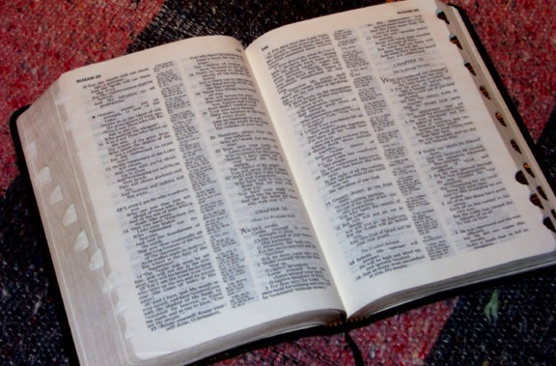
(yg0ifaomtajumif;t&mrsm;)
ormusrf;pm tajccHususavhvmjcif;
®
tydkif; 4
orRmusrf;pmrSwfwrf;uddk
tusOf;csKH;avhvmjcif;
PowerPoint Slide Version
©2004 TBBMI
8.0.04SL.
02

Slide 4
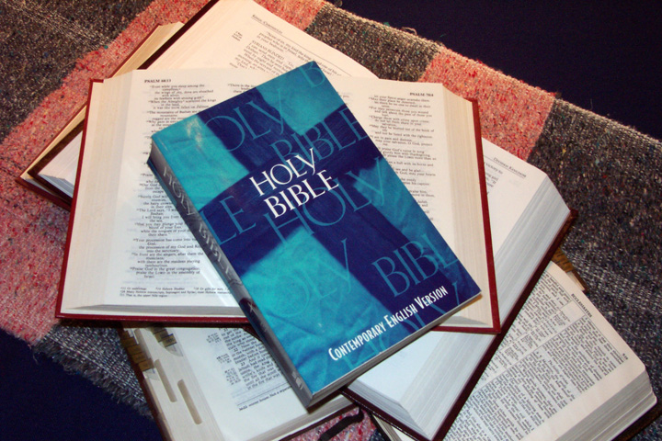
ormusrf;pmrSwfwrf;udk tusOf;csKH;ajymjy&eftoifh
jyifxm;yg
03
1

Slide 5
12
rdepftwGif;
oifajymekdifrvm;?
04

Slide 6
toifhjzpfjyDvm;?
(rSwfpktwdkif; vdkufemyg)
uJpr,f
taxmuftuljyKpmtkyf 04 0g 31
05

Slide 7
urmOD;usrf; 1-11
5-2
zefqif;jcif;
tmjA[H rwdkifrDumv
CREATION
( jynfh pHk jcif; )
yxrvla,mufsm;eSifhvlrdef;r
(jypfrSwfvGJjcif;)
yxrqHk;tjypf
zefqif;jcif;
(a&G;eSkwfydkifol)
ABRAHAM
yxrqHk;aomowif;aumif;
(vdk&if;tcsuf)
yxrqHk;aomrdom;pk
(xif&Sm;aomtjypf)
yxrvlowform;
a&juD;jcif;/oufwefh
(Pgm #1: aem{ )
arsSmfpif
(Pgm #2: bmabv )
Handbook pg. 42-45
06
9

Slide 8

urmOH;usrf; 12-36
7
tmjA[H
ca. 2000 bDpD
ac:zdwfjcif;
AC
zefqif;jcif;
L - S - B
ABRAHAM
tmjA[H
ABRAHAM
I - I
J - E
12
Handbook pg. 42-45
07
6

Slide 9
urBmVD;usrf; 37-50
a,moyf
ca. 2000 bDpD
usGefcHjcif;
430
zefqif;jcif;
ABRAHAM
tmjA[H
ABRAHAM
a,moyf
ABRAHAM
Handbook pg. 42-45
08
2

Slide 10
urBmOD;usrf;/ xGufajrmuf&musrf;/ 0wfjyK&musrf;/ awmvnf&musrf;/ w&m;a[m&musrf;
arma&S
ca. 1500 bDpD.
xGufajrmuf&musrf;
odeawmif
zefqif;jcif;
ABRAHAM
tmjA[H
M - C - C
ABRAHAM
a,moyf
ABRAHAM
arma&S
cgv'J bmem
LC
40
5 w&m;a[mcsuf
Handbook pg. 42-45
09
7

Slide 11
a,m&k
a,moyf
ca. 1500 bDpD
a,&dacg / tmPm
eSpfjcrf;uGJjcif;
zefqif;jcif;
ABRAHAM
tmjA[H
ABRAHAM
a,moyf
ABRAHAM
arma&S
a,m&k
Handbook pg. 42-45
10
2

Slide 12
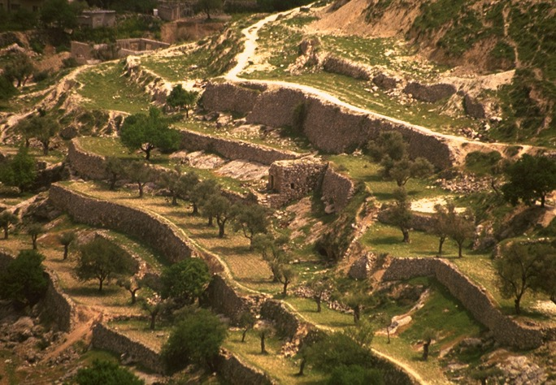
w&m;oljuD;rSwfpm/ &ko0wWK
rif;rJhumv
ca. 1000bDpD
w&m;oljuD;rsm;
350
zefqif;jcif;
ABRAHAM
tmjA[H
ABRAHAM
a,moyf
ABRAHAM
armaa7S
a,m&Sk
rif;rJhumv
Handbook pg. 42-45
11
2

Slide 13
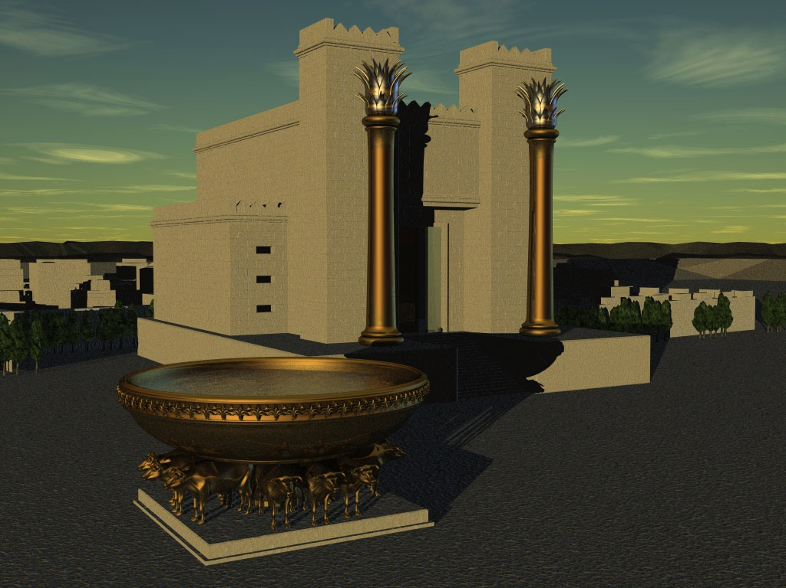
1 &m/ 2 &mcsKyf
bk&ifacmwf
ca. 1000 bDpD
DC
S - D - S
<<<< eSpfjcrf;uGJ >>>>
zefqif;jcif;
ABRAHAM
ajrmuf awmif
tmjA[H
ABRAHAM
a,moyf
ABRAHAM
WQQSDJUD uUKoa&v ,k'
arma&S
a,m&Sh
rif;rJhumv
10 2
rif;pHumv
NC
ya&mzufrsm;
20-J 20-R
200
350
tm&Sk&d
AmAkvkef
Handbook pg. 42-45
12
9

Slide 14
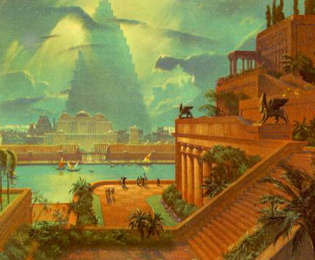
{Z&m// {owm
odrf;oGm;_cif;
ca. 500 bDpD
eSpfaygif; 70
c&D;&Snf 3 judrf
zefqif;jcif;
ABRAHAM
tmjA[H
eSpf100/500
ABRAHAM
a,moyf
ABRAHAM
arma&S
Z - E - N
a,m&Sk
rif;rJhumv
rif;pHumv
odrf;oGm;jcif;
Handbook pg. 42-45
13
4

Slide 15
rmvcdeSifh &SifroJ (“rRa[mif; eSifh rRopf”)
qdwfjidrfumv
ca. 500 bDpD
r[mtvufZef;'g; *&d
a&mrenf;pepf
zefqif;jcif;
ABRAHAM
tmjA[H
ABRAHAM
a,moyf
ABRAHAM
arma&S
a,m&k
rif;rJh
rif;pHumv
odrf;oGm;&mumv
qdwfkidrf&mumv
Handbook pg. 42-45
14
2

Slide 16
&Sifr\J-Asm'Ìwf
yxr&mpkeSpf
tcsuftvufeSifh
bk&m;ocif
a,7I
touf
zefqif;jcif;
ABRAHAM
um;wdkif
toif;awmf
ordkif;
ABRAHAM
tmjA[H
a,moyf
ABRAHAM
arma&S
toif;awmf
a,m&Sk
rif;rJhumv
rif;pHumv
owif;aumif;
odrf;oGm;jcif;
qdwfjidrfumv
wrefawmf 0w¬K
toif;awmf_y
oemrsm;
a,&k
J Bo0g'pmrsm;
Asm'dwfusrf;
xm0&
tem*wf
Handbook pg. 42-45
15
7

Slide 17
zefqif;jcif;
tmjA[H
C 7 S J
a,moyf
arma&S
a,m&k
rif;rJhpepf
rif;pHumv
odrf;oGm;csdef
wdwfqdwfumv
a,&k
 
16
2

Slide 18
þt&mrsm;onf oif\ or®musrf; tusOf;csKH;yifjzpfonf?
“oifwdkhoGm;IvlrsKd;wumwdkhtm;ighwynfh_zpf apjuavmh”
 
17
1

Slide 19
Burmese
or®musrf;pm
tkwfNrpf
Texas jrdk.rS or®musrf;pm-tkwfjrpf (edkifiHwumtrSkawmfaqmifvkyfief;)\ wifjycsuf
www.biblebasically.org
©2004 TBBMI
8.0.01.

Slide 20


တရားေဟာျခင္းအ တတ္ပညာ • BibleStudyDownloads.org
အခမဲ့အဘို့ဤတင်ပြချက်
Notes:
Preaching (pr)
Homiletics

Slide 21
Black

