Slide 1
Engtin nge Testimoni I sawi ang?
Dr. Rick Griffith, Singapore Bible College
BibleStudyDownloads.org

Slide 2
Testimoni kalhmang
vii
Thuhmahruai (minute 1)
Mimal/ mahni Testimoni (minute 2-3)
Mite hmin tura thusawi (minute 2)
Lehkha thawn anga Thusawi (minute 15)
Thawnthu anga Thusawi (minute 15)
Notes:
Same slide for presentation 01.54 and 02.07 so translators may copy from one to the other

Slide 3
Eng Vang Nge testimoni i sawi?
16
Nangma chanchin awlsam takin I sawi thei
Nangmah I thiam ber
I thil zir sawina rem chang a ni
I chanchin miten hriat an duh
Pathian i hriat na a ti tha deuh deuh ang
Pathian in enge a tih sak che I hre chiang ang
Chhanchintha hrilhna hun rem chang a ni
Mi dang nena I in lei chin naah a tan pui ang che
Mi dang in i chanchin an hnial thla thei lo
Notes:
Same slide for presentation 01.49 and 02.03 so translators may copy from one to the other except that 02.03 expands the 01.49 slide

Slide 4
Testimoni Kalhmang
16
Piangthar hnu:
I ngeihtuah na
Chiang takah anglam
Chiang takin le!
Piangtharna:
Thu awmzia hril rawh
I thurin
Chiang takin le!
Piangthar hma:
I ngeihtuah na
I chiatzia
Chiang takin le!
A tawp thlengin
A thupui
thlak suh!
Notes:
Same slide for presentation 01.50 and 02.04 so translators may copy from one to the other

Slide 5
Ka Testimoni
19
Piangthar hnu:
Inremna
Himna
Mi dangte hmangeih na
Piangthar na:
Thalaite Pungho na
Isua hi pathian thilpek
“Hlawh ka dawng tawh lo'"
Piangthar hma:
hna tha
“inring takin"
Inrin tawkna neihlo, zakzum
A tawp thlengin
A thupui
thlak suh!

Slide 6
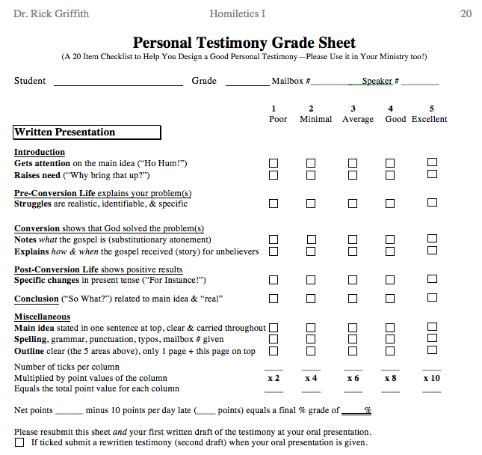
Testimony Grade Sheet
20
Thuhmahruai
Pian tharhma
Piang tharna
Piangthar hnu
A tawpa
A dangte

Slide 7
Black

Slide 8
Thusawi dan (Homiletics) link at BibleStudyDownloads.org
He thu leh hla hi a thlawng in I hmang thei!
Notes:
Preaching (pr)
Homiletics

