Slide 1


VERSION 9.6 BETA
BAIBUL…
THU TLANGPUI
Baibul… A Tlangpui Rawngbawlna Lantirna, International Inc. Fort Worth, Texas
Designed by Dr. John Fryman, Texas, USA • BibleBasically.org
Taught by Dr. Rick Griffith, Singapore Bible College
All files in many languages for free download at BibleStudyDownloads.org
www.biblebasically.org
©2006 TBBMI

Slide 2
Gen. 11:26 atang 25:8
HUN-BI CHHINCHHIAH DAN:
ABRAHAMA-JOSEFA 2000 B.C.
HUN ZAWNG ZAWNG
KUM 500-DAN BI
ANGA CHHINCHHIAH
Handbook pg. 19-24
01
1
Notes:
Now…let's begin a biblical timeline. Abraham's date on the timeline: about 2000 B.C. By the way, throughout our study…
//// …most dates will be presented in large, rounded groupings in 500 -year increments.
More precise dating is not needed in this particular study. All dates can be sharpened as your own interests direct.
2135-1960 BC Abraham's lifespan

Slide 3
7
"A
Roreltu
In
Ro a rel tur a ni"
SIAMNA
ABRAHAM
ABRAHAMA
ABRAHAM
JOSEFA
ABRAHAM
MOSIA
JOSUA
BUAINA
CHHIAH
SALTANNA
Mi HMASABER
zinga
MI CHI 4
NGAWIHNA
ISUA
Handbook pg. 19-24
02
Notes:
The memory tool, A JUDGE MUST JUDGE, brings to mind ABRAHAM…the FIRST OF THE FOUR GREAT PEOPLE...right after the CREATION file folder. Here is ABRAHAM'S folder in the Bible File line up.

Slide 4
Gen. 12:4
STAGE
DUAN LAWK
NA
MT
6
N(A)
H
Fertile Crescent
GD
K
EL
B
J
NT
TT
Thil Bul Tanna...
A
U
KB
ST
PTS
TS
Handbook pg. 19-24
03
1
Notes:
In Chapter 12 of Genesis, this "Quick Chronology" of Abraham's life] begins – at ancient Ur of the Chaldees – the "U" on your map of the Ancient Near East. That's the place in Scripture where the Author comes to a quick narrowing of the earlier Biblical perspective.
//// And its setting is in the rich Fertile Crescent of the Middle East,
The stage of this great drama stretches from the Euphrates Valley all the way over to the Mediterranean Sea…
and in between we find some very familiar place names.

Slide 5
STAGE
DUAN LAWK
NA
HMUN 10
MT
6
4
N(A)
IRAQ
IRAN
KUWAIT
SAUDI ARABIA
SYRIA
ISRAEL
TURKEY
EGYPT
H
GD
GALILEE DIL
K
EL
B
KANAN
J
NT
TT
NILE LUI
TUIPUI THI
A
AIGUPTA
U
KB
SINAI HUALVEL RAM..
ST
PTS
TS
Handbook pg. 19-24
04
14
Notes:
You've already identified some of them on your map that we called "Dressing the Stage."
There lie
//// Canaan…today's state of Israel, and the West Bank, Palestine,
//// the Sea of Galilee,
//// and the Dead or Salt Sea…as Scriptures calls it.
//// Also there is Egypt and
//// the great Nile River.
//// The Sinai Peninsula appears, a region in the headlines of recent world events.
But in our world, our own time, we also find
//// Iraq
//// Iran
//// Kuwait
//// Saudi Arabia
//// Syria
//// Modern Israel and the West Bank
//// Turkey and
//// Today's Egypt

Slide 6
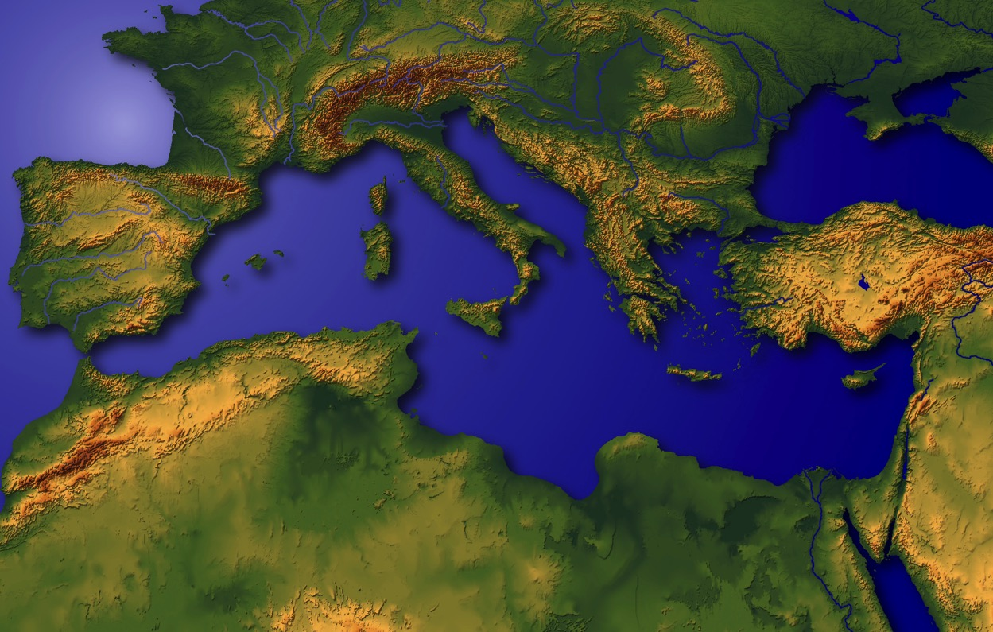
”Khawvel Lawng Hmunpui"
Handbook pg. 19-24
05
1
Notes:
This region has been called the very NAVEL OF THE EARTH.
Through this great hinge of history, time and again, great world powers of the past -- time and again -- have marched in conquest,
//// with Canaan/Palestine/Israel being pulled and stretched by enormous international and internal pressures.

Slide 7
Gen. 11:28
STAGE
DUAN LAWK NA
MT
N(A)
H
GD
K
EL
B
J
NT
TT
A
KB
U
ST
KALDAI-HO KHAWPUI UR: HMANLAI NUNPHUNG INNGHAHNA MESOPOTAMIAN TUIPUI KUANG;
ABRAHAMA AWMNA
PTS
TS
Handbook pg. 19-24
06
1
Notes:
So the story of ABRAHAM begins at the head of the Persian Gulf, in that ancient city -- Ur of the Chaldees.
//// Abraham and his family lived in this early cultural center in the Mesopotamian Basin.
This is the "U" on map we named "Dressing the Stage."
Follow along by tracing on your own map as the story begins to unfold.

Slide 8
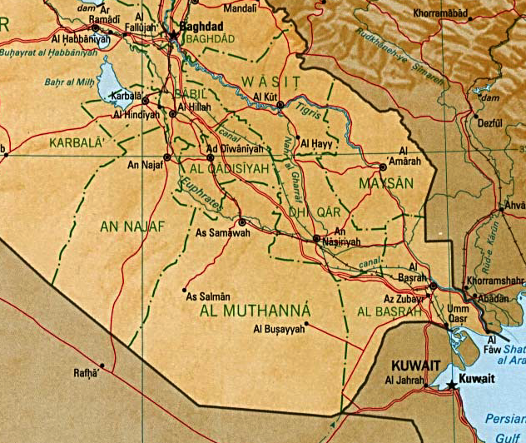
7
BABULON
UR
HRIA ANG CHE! Persian Gulf Indona Iraq-a Indona
Handbook pg. 19-24
07
6
Notes:
Here is the map of this region in today's world. Remember that this was the stage of the earlier Persian Gulf War of the 1990s…
and more recently the War in Iraq that toppled Saddam Hussein.
//// There is the familiar Tigris River…
//// …and the Euphrates…
//// …today's city of Baghdad…
//// …Kuwait stands at the head of the Persian Gulf…
//// …to the north…the location of ancient Babylon…
//// …and the beginning point of our story…the ancient city of UR.

Slide 9
7
Mesopotamian Tuipui Kuang
SUMERI THIL SIAM CHHUAH…
LEHKHA ZIAH LEH TAWLAILIR
BUL INTANNA…
DAN
DAMDAWI
VAN SANG CHANCHIN ZIRNA
IN SAK THIAMNA
KHAWPUI HMASA DINNA
Handbook pg. 19-24
07a
4
Notes:
Here in this Middle Eastern land – bordering the Persian Gulf --
were some of the earliest beginnings of mankind's discovery of an intellectual life.
//// In this triangular shaped valley,
//// called the Mesopotamian Basin,
//// the ancient Sumerians presented us the gifts of writing and the wheel. And here we see
//// the beginnings of basic concepts of civilization…of law…of medicine… of astronomy and architecture.
//// Archaeologists have also found evidence of some of the very earliest urban centers…
the communities and the cities that, through time, have led directly to the civilization and cultures we know today.

Slide 10
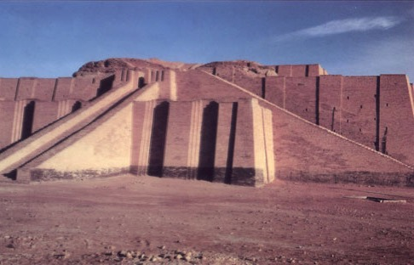
Gen 10:10; 11:28
"Ziggurat" In sak dan
Kaldai khawpui hlui Ur khua ami Tunlai Iraq-a awm
Handbook pg. 19-24
08
Notes:
This kind of temple tower, or ziggurat, was common in that region in Abraham's day in Ur of the Chaldees. In 2000 B.C., Ur was a great city, an international center of learning, culture, commerce and idolatrous spiritual darkness. But think about this: what kind of technology -- literally, brain power -- was required to construct a building of such size and complexity of design? Those thoughts hint at the kind of life, times and talent of those ancient civilizations!

Slide 11
Gen. 11:31
ABRAHAMA CHHUNGKUA:
• TERA (CHHUNGKUA PA)
•ABRAHAMA (ABRAMA)
• SARAII (A FAPAA NUPUI, SARAII)
• LOTA (ABRAHAMA TUPA)
Handbook pg. 19-24
09
5
Notes:
//// The Biblical narrative tells us about a man named ABRAHAM, living with his family in ancient Ur of the Chaldees.
//// In the family was his aging father…Terah.
//// Terah's son named Abram, later to be renamed by God, ABRAHAM, as his future place in history is made clear.
//// ABRAHAM'S wife's name was Sarah (originally named Sarai)...
//// Also in the family group was ABRAHAM's nephew, Lot

Slide 12

7
ABRAHAMA
ABRAHAM
ca. 2000 B.C.
Mi
HMASABER
zinga
MI CHI 4
te:
ABRAHAMA
AJMJ
Genesis 12 leh A Hnulam
Handbook pg. 19-24
10
3
Notes:
So we begin with ABRAHAM's file folder.
Note also a special feature about the visuals you are watching...
//// From this point and on through the chronology there will be a small file folder image floating in most slide frames. They will help guide your thinking as the great story line unfolds. You'll always know where we are as the BILE FILE folders build out and fill up.
//// Abraham's story opens in Genesis 12 and forward...
//// Time frame: about 2000 B.C...the first of the four Great People.
It is through this one man, ABRAHAM, that God begins a new program
to provide for His creation the way back to that original intimate relationship that existed in the beginning. Through ABRAHAM unfolds all the rest of the Bible, until we see in the book of Revelation, once again, the broad view of the world and the universe.

Slide 13
7
Gen. 12: 1-3
ABRAHAMA
ABRAHAM
ca. 2000 B.C.
Mi
HMASABER
zinga
MI CHI 4
te:
KOH CHHUAHNA
ABRAHAMA
The CALL
AJMJ
Genesis 12 leh A Hnulam
Handbook pg. 19-24
11
Notes:
The great story begins in the 12th Chapter of Genesis where ABRAHAM receives God's CALL, telling him to leave Ur and go toward a land that will be shown to him in due time.

Slide 14
7
Gen. 12: 1-3
ABRAHAMA
ABRAHAM
ca. 2000 B.C.
KOH CHHUAHNA
AC
AJMJ
Gen. 12:1-3
ABRAHAM
Koh ChhuahnaL
ABRAHAMA HNENA
AMAH, PATHIAN THUTIAM!
Handbook pg. 19-24
12
Notes:
This is the most crucial Biblical event in the life of the old patriarch and also the beginning point in the revelation of God's new Program with Man. On your work sheet, it's represented by the letters AC inside the image of a scroll. AC is to remind us of the great ABRAHAMIC COVENANT -- provided for us in our own Bibles at Genesis 12...verses 1-3. It is an UNCONDITIONAL covenant promise!

Slide 15
Chin Nei Lo Mizia
7
ABRAHAM
ABRAHAM
ca. 2000 B.C.
KOH CHHUAHNA
AC
R - C - M
AJMJ
Gen. 12:1-3
RAM PEK
CHI THLAH
ABRAHAMA
Koh Chhuahna
R - C - M
MALSAWMNA
CHIN NEI LO THATNA HMANGA THUTIAM CHU NAKIN AH DANA THUTHLUN A NI LEH!
Handbook pg. 19-24
13
Notes:
Now…on ABRAHAM'S file folder, add the letters...L...S...B...standing for the words: LAND...SEED...AND BLESSING. Here is the significance of those words. Right there in the book of Genesis, 12th Chapter, verses 1-3, God makes THAT UNCONDITIONAL COVENANT PROMISE to Abraham…later to become an actual legal contract in the culture of that day!

Slide 16
7
Genesis 12
Tin, Lalpan Abrama hnenah chuan,
“I khaw lam ata leh I laichinteho zing ata leh
I pa in ata chhuak la, ram ka entir tur che lamah kal rawh.
1
"Tichuan, chi ropui takah ka siam ang chia; mal pawh ka sawm ang chia,
I hming ka ti ropui bawk ang;
tin, nang malsawna ni ang che.
2
ABRAHAMA
Koh Chhuahna
R - c - M
Tin, malsawmsaktu apiang che chu mal ka sawm ang a, anchhe lawhtu che chu anchhia ka lawh ang; nangmahah chuan leia hnam tin an la thawveng ang. "
3
Handbook pg. 19-24
14
3
Notes:
In Genesis 12, verses 1-3 present God's three-part promise to Abraham. Here it is:
//// The Lord had said to Abram,
"Leave your country, your people and your father's household, and go to THE LAND I will show you.
//// "I will make you into A GREAT NATION
and I will bless you;
I will make your name great,
and you will be a blessing.
//// I will bless those who bless you,
and whoever curses you I will curse;
and ALL PEOPLES ON EARTH
WILL BE BLESSED THROUGH YOU.”
Tichuan, chi ropui takah ka siam ang chia; mal pawh ka sâwm ang chia, i hming ka tiropui bawk ang; tin, nang malsâwmna ni ang che. 3Tin, malsâwmsaktu apiang che chu mal ka sâwm ang a, ânchhe lawhtu che chu ânchhia ka lawh ang; nangmahah chuan leia hnam tin an la thawveng ang,” a ti a.

Slide 17
7
Genesis 12
Tin, Lalpan Abrama hnenah chuan,
“I khaw lam ata leh I laichinteho zing ata leh
I pa in ata chhuak la, ram ka entir tur che lamah kal rawh.
1
RAM PEK
Tichuan, chi ropui takah ka siam ang chia; mal pawh ka sawm ang chia,
I hming ka ti ropui bawk ang;
tin, nang malsawna ni ang che.
CHI THLAH
2
ABRAHAMA
Koh Chhuahna
R- C - M
Tin, malsawmsaktu apiang che chu mal ka sawm ang a, anchhe lawhtu che chu anchhia ka lawh ang; nangmahah chuan leia hnam tin an la thawveng ang. "
3
MALSAWMNA
Handbook pg. 19-24
15
3
Notes:
The order of those covenant promises is an important key to Biblical order itself:
//// First is the promise of a LAND…then…
//// a SEED
//// followed by a BLESSING, represented by "L-S-B" on the ABRAHAM file folder.

Slide 18

Abrahama Thuthlung
(”Koh Chhuahna")
Genesis 12:1-3
ABRAHAMA
RAM
CHI THLAH
MALSAWMNA
Koh Chhuahna
R - C - M
12:1
12:2
12:3
”R-C-M"
Handbook pg. 19-24
16
3
Notes:
Now study this plan of organization…the down-to-earth meaning of those three promises…the L-S-B on ABRAHAM's folder…
//// First…PROMISE #1: GENESIS 12:1...A LAND — real estate, a geographic inheritance that most Jewish people respect politically to this present day.
//// PROMISE #2: GENESIS 12:2...A SEED — a long line of descendants...especially interesting because at the time the Promise is given, ABRAHAM and SARAH are approaching old age and yet they have never had children.
//// The final PROMISE, Number 3: GENESIS 12:3...A BLESSING promised to Abraham personally and to his descendants. Furthermore, God promises that, through His blessing to ABRAHAM, all the families of the earth will be blessed…NOT JUST ABRAHAM'S descendants! Notice that wording! It's important to an understanding of GRACE!

Slide 19
Abrahama Thuthlung
(”Koh Chhuahna")
Genesis 12:1-3
Ze Pawimawh Pathum!
ABRAHAMA
RAM
CHI THLAH
MALSAWMNA
Koh Chhuahna
R - C - M
• A NGIAL A NGAN IN
• KUMKHAW TLAITLUAN
• PHUTLET TEL LO
17
3
Notes:
Now...to the basic outline of the promise...L-S-B-...for LAND, SEED, and BLESSING...we can also add these basic concepts...three additional ideas that describe the characteristics of that Abrahamic Promise...
//// First…that great promise was -- and is -- LITERAL in that the words mean exactly what they say.
//// It is also ETERNAL, an unending arrangement, guaranteed by the maker of the contract, God Himself. And finally...
//// It is UNCONDITIONAL...indicating that no matter what Abraham or his descendants might do in the future, God would, in time…REPEAT: IN TIME…fulfill every element of His promises.
As we move farther through this story, we'll come to see how the entire Bible is built on that set of unconditional and foundational promises.... soon to become a legal contract between God and his friend, Abraham.

Slide 20
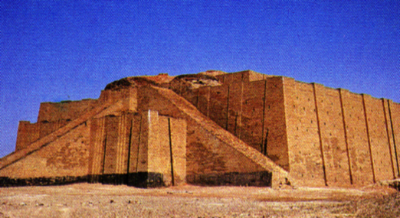
Gen. 11:31
STAGE
DUAN LAWK
NA
RINNA
NEN
AN KAL!
MT
N(A)
H
GD
K
EL
B
J
NT
ABRAHAMA
TT
Koh Chhuahna
The CALL
L - S - B
R - C - M
A
KB
U
MS
PTS
TS
Handbook pg. 19-24
18
2
Notes:
After Abraham receives God's Promises…the entire family leaves Ur of the Chaldees to follow the Lord's direction.
//// They move toward the northwest with all their flocks and their possessions -- probably a large congregation of people, animals and tents. Biblical evidence shows ABRAHAM's family was probably wealthy. Again, if you have the map, add to it the map tracing that you see here in bright yellow. The main point here is this:
//// ABRAHAM and his family LEFT IN FAITH! They are moving toward a land that God will show them in due time. But as they leave Ur of the Chaldees they DO NOT know their destination. Their obedience is a profound demonstration of their faith in God's provision and His total protection as they head out into the unknown under Abraham's leadership.

Slide 21

Gen. 11:31-32
STAGE
DUAN LAWK
NA
MT
N(A)
H
GD
K
EL
B
J
NT
ABRAHAMA
TT
Koh Chhuahna
The CALL
L - S - B
R - C - M
A
KB
U
Babulon Khaw Ropui
ST
PTS
TS
Handbook pg. 19-24
19
Notes:
It is entirely possible that they passed through the region of ancient Babylon, upriver from Ur...that city to which you'll learn that Abraham's descendants – the Jews -- would be held as prisoners in the centuries to follow.

Slide 22
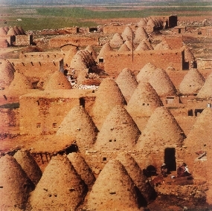
Gen. 11:31-32
STAGE
DUAN LAWK
NA
MT
N(A)
H
CHHUNGKUA PA, TERA, HARAN AH A THI.
GD
K
El
B
J
NT
ABRAHAM
ABRAHAMA
TT
Koh Chhuahna
The CALL
L - S - B
R - C - M
A
KB
U
”Sawntlung Pawng" Haran Khawpui (Turkey)
ST
PTS
TS
Handbook pg. 19-24
20
1
Notes:
They continue northwestward, finally arriving at ancient Haran…
… still in existence today in modern Turkey.
//// While settled temporarily in Haran, ABRAHAM's father, Terah, dies.

Slide 23
Gen. 12:5
STAGE
DUAN LAWK
NA
MT
N(A)
H
GD
K
EL
B
J
MN
ABRAHAMA
TT
Koh Chhuahna
The CALL
L - S - B
R - C - M
A
KB
U
ST
PG
TS
Handbook pg. 19-24
21
Notes:
Once again, God speaks to ABRAHAM, instructing him to now leave Haran and to move onward toward The Land He had promised to show him. That land is to be Canaan, or the land we call Israel today.

Slide 24

7
Abrahama’n Ram tiam a lut…
Kum 75 upa ani tawh…
A nupui, Saraii, kum 65.
Nimahse… chithlah tura
thutiam pek an ni!
ABRAHAM
ABRAHAMA
Koh Chhuahna
The CALL
L - S - B
R - C - M
Handbook pg. 19-24
22
4
Notes:
Now the great stage is set!
//// When he enters The Land,
//// ABRAHAM is already 75 years old and
//// his wife, Sarah, is 65.
//// And yet, God has promised them children? What?
Was God teasing the old couple? Children promised at that age?

Slide 25
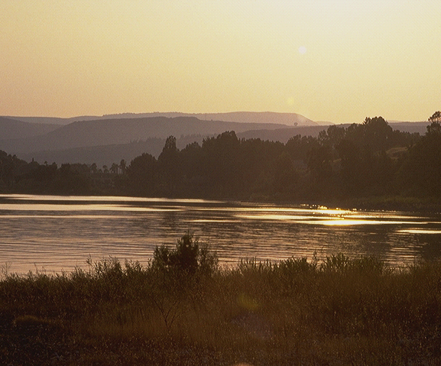
7
Gen. 15:6
ABRAHAMA’N PATHIAN THUTIAM A RING: RAM, CHI THLAH, LEH MALSAWMNA!
_{RAM}
_{CHI THLAH,}
_{MALSAWMNA}
Genesis 15:6!
Lalpa’n a rinna chu amah Abrahama felnaa
a ruat sak!
Rinna kan tih hi chutia awlsam a ni!
ABRAHAM
ABRAHAMA
Koh Chhuahna
The CALL
L - S - B
R - C - M
Handbook pg. 19-24
23
3
Notes:
Yes…ABRAHAM continues to believe God's promise of a LAND, a SEED, and a BLESSING!
//// His simple unquestioning belief is told to us in Genesis 15:6...
//// …where God counts that BELIEF as righteousness on ABRAHAM's part.
//// Just simple belief! This is the first step in the new program of redemption God will introduce to the earth through His old friend.

Slide 26
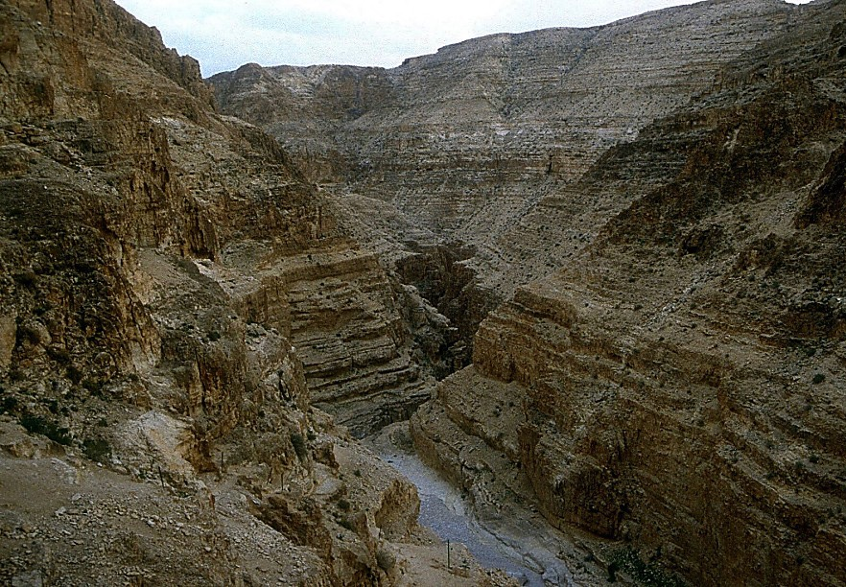
7
Gen. 16:1-4
ABRAHAMA’N PATHIAN A RING!
Nimahsela: Abrahama leh Saraii ten dawhtheihna an nei lo.
"Abrahama’n… Hagari a pawl!"
(Saraii bawihnu)
ABRAHAMA
Koh Chhuahna
The CALL
L - S - B
R - C - M
Handbook pg. 19-24
24
3
Notes:
//// Abraham truly believes that God will accomplish what He has promised. And the years pass.
//// In spite of God's clear promise…ABRAHAM and Sarah become impatient as they wait for the children God had promised would be coming. In her impatience,
//// Sarah suggests that ABRAHAM go in to her Egyptian servant girl, Hagar, hoping that through that union the promised child might be born. That was not unusual in the culture of their day.

Slide 27
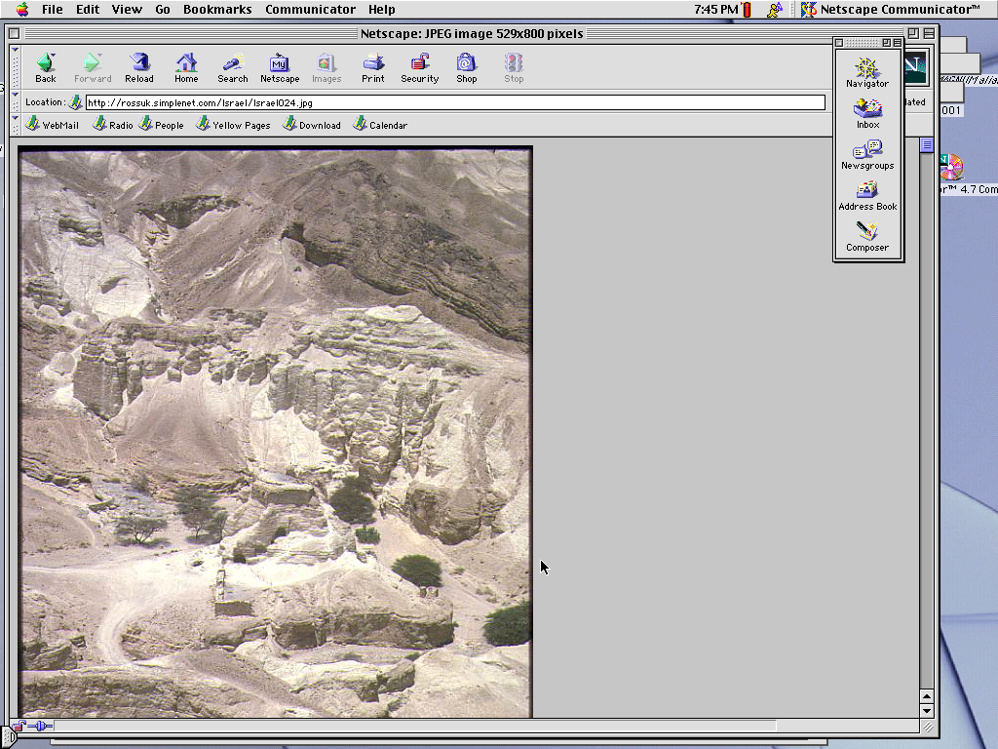
7
Gen. 16:11-12; 17:20-21
Hun a liama…Abrahama’n Hagari lak atangin fapa a nei ta a.
A Hming: ISMAELA.
(ISMAELA ERAWH THUTIAM FA A NI LO).
ABRAHAM
ABRAHAMA
Koh Chhuahna
The CALL
L - S - B
R - C - M
Handbook pg. 19-24
25
3
Notes:
//// Indeed, in time...ABRAHAM does father a son through Hagar.
//// The boy is named ISHMAEL.
//// But, God says, the infant is not the intended son of His covenant Promise to Abraham's descendants.

Slide 28
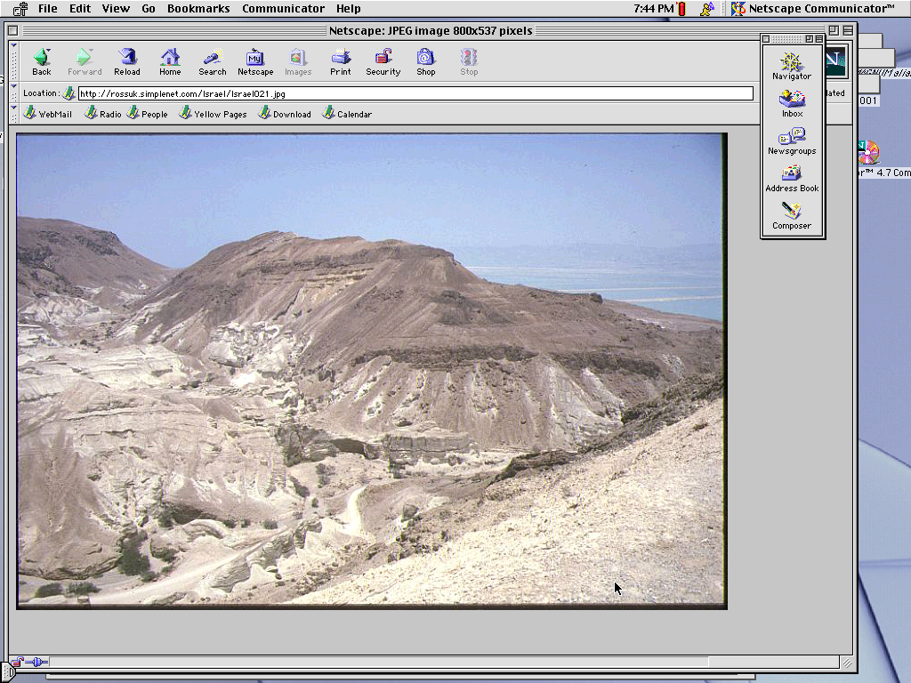
7
Gen. 17:19
Tunah chuan… Abrahama kum 85 upa ani ta…
Saraii pawh kum 75.
Kum 15 dang a ral hnu ah…
ABRAHAMA’n fapa a nei ta, SARAII lak atang.
A Hming: "ISAAKA"
ABRAHAMA
Koh Chhuahna
The CALL
L - S - B
R - C - M
Handbook pg. 19-24
26
4
Notes:
//// By now, ABRAHAM is 85; Sarah, 75.
//// After another 15 years...
//// …the son of God's promise to ABRAHAM is finally born...through Sarah.
//// He is named ISAAC, a word that traces its meaning to the Hebrew root term indicating laughter. Yes, ABRAHAM thinks it hilarious that he and Sarah are to become parents at such advanced ages.

Slide 29
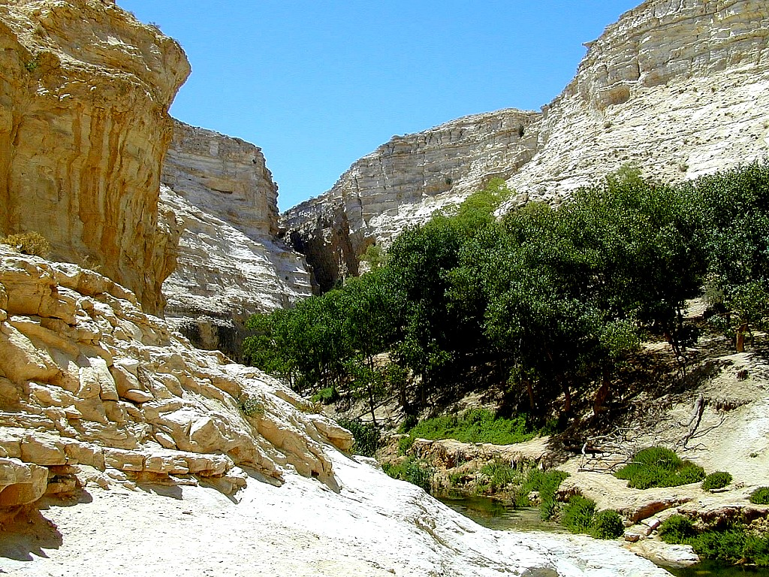
7
Gen. 17:21
Isaaka ngei chu a lo ni, beisei taka an nghah fapa chu…
… amaha kaltlangin Abrahama hnena Pathian thutiam thlen famkimna tur chu…
ABRAHAM
ABRAHAMA
Koh Chhuahna
The CALL
L - S - B
R - C - M
…ISAAKA THLAH KAL ZEL ATANGIN!
Handbook pg. 19-24
27
2
Notes:
ISAAC is indeed the long-awaited son…
//// …through whom God's promise to ABRAHAM is to be passed down…
//// …through HIS family line.

Slide 30
7
Gen. 17
ABRAHAMA
ABRAHAM
ca. 2000 B.C.
Koh Chhuahna
AC
R - C - M
AJMJ
I - I
Gen. 12:1-3
ABRAHAMA
Koh Chhuahna
R - C - B
I - I
ISMAELA & ISAAKA
Handbook pg. 19-24
28
Notes:
So…the letters I and I appear on ABRAHAM's file folder. From these two sons of Abraham….ISHMAEL and ISAAC...
right here at this crucial historic point…the terrible Jewish-Arab conflict of our own time begins some 4,000 years ago...around 2000 B.C.

Slide 31
7
ABRAHAMA
ABRAHAM
ca. 2000 B.C.
The CALL
AC
L - S - B
AJMJ
Gen. 12:1-3
I - I
ABRAHAMA
Koh Chhuahna
R - C - B
I - I
ARABIC HNAMTE
THLAHTU ISMAELA
JUDA HNAMTE
THLAHTU ISAAKA
Handbook pg. 19-24
29
2
Notes:
Because...
//// …ISHMAEL is recognized today as the father of the Arab nations…through ABRAHAM…
//// while ISAAC, of course, is revered as one of the founding patriarchs of the Jews…also through ABRAHAM!

Slide 32
7
ABRAHAMA
ABRAHAM
ca. 2000 B.C.
The CALL
AC
L - S - B
AJMJ
Gen. 12:1-3
I - I
ABRAHAMA
Koh Chhuahna
R - C - B
I - I
ARABIC HNAMTE
THLAHTU ISMAELA
JUDA HNAMTE
THLAHTU ISAAKA
Handbook pg. 19-24
30
Notes:
There is enormous conflict between the two half-brothers and their mothers. And as we watch or read today's news, we see that that age-old turmoil begun in ABRAHAM's tent 4,000 years ago continues today! Both the Jews and the Arabs claim ABRAHAM as the beginning point of their respective peoples!

Slide 33
7
Gen. 22:2; 2 Chr. 3:1
KHAWI FAPA ZAWK NGE?
TIN, ANI CHUAN, “I FAPA NEIH CHHUN, I HMANGAIH TAK, ISAAKA NGEI KHA HRUAI LA, MORIA RAMAH CHUAN KAL LA, CHUTAH CHUAN KA HRILH TUR CHE TLANG PAKHATAH CHUAN HALRAL THILHLANAH HLAN RAWH” A TI A. Genesis 22:2
ABRAHAM
ABRAHAMA
Koh Chhuahna
R - C - B
I - I
NIV study note: Hebrai lehkha ziak ah chuan, ‘Isaaka’ tih tawngkam a hman rual chiah in, ‘I hmangaih tak’ tih thu hlawm in a rawn zui a, hemi awmzia chu, ’Isaaka kha ani, Lalpa’n a duh, Abrahama fapa neih chhun tak tak chu.’
2 Chr 3:1 Ziaktu hian Lalpa In tih leh Moria Tlang hi hmun thuhmun anni tih a finfiah tawh. [Tunlaia ‘Dome of the Rock’].
Handbook pg. 19-24
31
3
Notes:
The question then arises: how do we know WHICH SON was REALLY the inheritor of the Abrahamic promises? Look at Genesis 22:2…
//// "The God said, "Take your son, your only son, Isaac, whom you love, and go to the region of Moriah. Sacrifice him there as a burnt offering, on one of the mountains I will tell you about."
//// Look at this study note from the NIV translation: "In the Hebrew text, "Isaac" follows the clause "whom you love," in order to heighten the effect: "your son, your only son, whom you love – Isaac." Isaac was the only "son of the Promise."
//// Here also, you'll find in Second Chronicles 3:1 that God identifies Moriah with the Temple mount, which, today, is the site of the Moslem Dome of the Rock." Much more on that location a little later.
Tin, ani chuan, “I fapa, i fapa neih chhun, i hmangaih tak, Isaaka ngei kha hruai la, Moria ramah chuan kal la, chutah chuan ka hrilh tûr che tlâng pakhatah chuan hâlral thilhlanah hlân rawh,” a ti a

Slide 34
7
Gen. 17:20-21
KHAWI FAPA ZAWK NGE?
"Ismaela chung thu pawh ka ngaihthlaksak che a ni; ngai teh, amah chu mal ka sawm tawh a, chi tam tak ka thlahtir ang a, nasa takin ka tipung bawk ang; ani chuan lal sawm leh pahnih a hring ang a, amah chu chi ropui takah ka la siam ang. Ka thuthlung erawh chu Isaaka, Sarin nakum hetih hun taka a hrinsak tur che hnenah chuan a ni ka tihngheh zawk dawn ni,” a ti a.
Gen. 17:20-21 (NKJV)
ABRAHAM
ABRAHAMA
Koh Chhuahna
Ka thuthlung erawh chu
R - C - B
Isaaka
I - I
Handbook pg. 19-24
32
2
Notes:
But Ishmael was not forgotten…not at all!
//// Genesis 17: 20-21…"And as for Ishmael, I have heard you. Behold I have blessed him, and will make him fruitful, and will multiply him exceedingly. He shall beget twelve princes, and I will make him a great nation.
//// But My covenant I will establish with Isaac, whom Sarah shall bear to you at this set time next year.”
Ismaela chung thu pawh hi ka ngaihthlâksak che a ni; ngai teh, amah chu mal ka sâwm tawh a, chi tam tak ka thlahtîr ang a, nasa takin ka tipung bawk ang; ani chuan lal sâwm leh pahnih a hring ang a, amah chu chi ropui takah ka la siam ang. 21Ka thuthlung erawh chu Isaaka, Sarin nakkum hetih hun taka a hrinsak tûr che hnênah chuan a ni ka tihngheh zâwk dâwn ni,” a ti a.

Slide 35
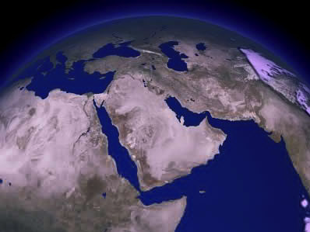
TUNLAI AN DINHMUN KHAIKHIN CHHIN RAWH…
ISAAKA
ABRAHAMA
ISMAELA
Koh Chhuahna
R - C - B
I - I
AN INTHLAUHNA A VA NASA VE?
Handbook pg. 19-24
33
3
Notes:
It's interesting to compare those gifts today…
//// Generally speaking…here are the lands populated today by the descendants of Ishmael…the lands of the Middle East.
//// But then…compare that with the descendants of Isaac in the Middle East…right there in tiny Israel.
//// Why the enormous difference?

Slide 36
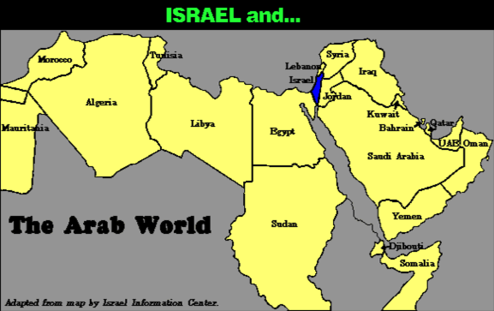
7
AN RAM LUAH KHAIKHIN CHHIN RAWH…
Israel leh…
ABRAHAMA
The CALL
Koh Chhuahna
L - S - B
R - C - B
Arab Khawvel
I - I
I - I
Handbook pg. 19-24
34
Notes:
Practically speaking…just compare the geography…today's Israel versus the rest of the Arab world!

Slide 37
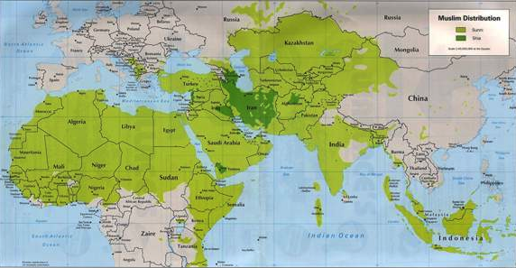
7
AN RAM LUAH KHAIKHIN CHHIN RAWH…
ABRAHAM
ABRAHAMA
Koh Chhuahna
L - S - B
R - C - B
I - I
I - I
MOHAMMED LEH ISAAKA!
Handbook pg. 19-24
35
Notes:
But there is something else at work here. Compare the Middle Eastern influence of Ishmael's descendant, Mohammed, founder of Islam…with that of Isaac, the great Israelite patriarch, and the brother of Ishmael!

Slide 38
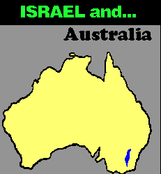
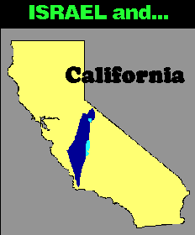
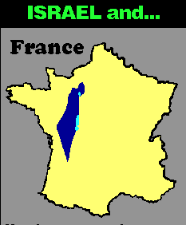
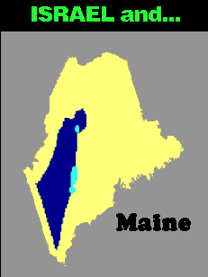


7
AN RAM LUAH KHAIKHIN CHHIN RAWH…
ISRAEL leh…
ISRAEL leh…
Australia
ISRAEL leh…
France
California
ISRAEL leh…
ISRAEL leh…
Singapore
ABRAHAMA
Koh Chhuahna
R - C - B
I - I
Maine
Maps drawn to same scale with Israel in blue
Handbook, pages 19-24
4
36
9.65.03b.
Notes:
In today's geopolitical world…compare the size of tiny Israel with
Australia…
//// Israel with France…
//// Israel and the United States' state of Maine…or
//// Israel and California.
//// The width of Singapore and Israel are about the same.

Slide 39
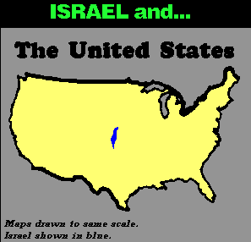
7
ISRAEL leh…
THE UNITED STATES
ABRAHAMA
Koh Chhuahna
The CALL
L - S - B
R - C - B
I - I
I - I
A DIK KAN TI EM?
Handbook pg. 19-24
37
Notes:
And finally…even when Israel is compared to the entire United States…from the north to the south…from east to west: when it comes to size alone, there is enormous disparity between Isaac and Ishmael! Why is this so? How can we explain it?

Slide 40
7
"… Ismaela thlahte hnenah ram rochan tur zau zawk leh hauhsakna nasa tak pek an ni a, Israe-te ai deih in an hausa reng a ni. He nihlawhna an chan hi an chanchin kal tawh atang mai bak ah, tunlai an khawnvar tui khur neih zo zai atang pawn a hriattheih. An thlarau chhandamna tur kawngka, Ismaela thlahte tan zau tak in a in hawng reng.
ABRAHAMA
The CALL
Koh Chhuahna
L - S - B
R - C - B
I - I
I - I
Hal Lindsey, The Everlasting Hatred: The Roots of Jihad (2002), 65
Handbook pg. 19-24
38
Notes:
Look at this passage from Hal Lindsay's 2002 book, The Everlasting Hatred: The Roots of Jihad:
"…the Ishmaelites were given more land and ultimately more wealth than Israelites. This was true in their past history, not to mention the vast oil wealth of modern times. And spiritual salvation has always been open to the Ishmaelites."
[Continue to the next part of the passage below.]

Slide 41
7
"… Ismaela thlahte hnenah ram rochan tur zau zawk leh hauhsakna nasa tak pek an ni a, Israe-te ai deih in an hausa reng a ni. He nihlawhna an chan hi an chanchin kal tawh atang mai bak ah, tunlai an khawnvar tui khur neih zo zai atang pawn a hriattheih. An thlarau chhandamna tur kawngka, Ismaela thlahte tan zau tak in a in hawng reng.
Amaherawh chu, Pathian thuthlung, Ama thlarau chanpual, erawh Isaaka leh a thlahte tan bika tih a ni. Lei malsawmna Isaaka fate pek tura tiam sa kha chu Pathian thlarau hnathawn tanpuitu nih theih nan a ni e.." [Thu tih uarna belh ani e]
ABRAHAMA
The CALL
Koh Chhuahna
L - S - B
R - C - B
I - I
I - I
Hal Lindsey, The Everlasting Hatred: The Roots of Jihad, 2002, p. 65
Handbook pg. 19-24
39
Notes:
"But God's covenant, which concerned His spiritual purposes, was only for Isaac and his descendants. The physical blessings promised to Isaac were to facilitate God's spiritual call for the nation that would come from him."

Slide 42
7
LEBANON
Mediterranean Tuipui
ISAAKA THLAHTE
SYRIA
Sea of Galilee
IRAQ
Haifa
Nazareth
Netanya
JORDAN
Tel Aviv-Jaffa
AMMAN
JERUSALEM
Jericho
Gaza
Hebron
Dead Sea
ABRAHAMA
Beersheba
Koh Chhuahna
ISRAEL
R - C - M
1 -1
ISHMAELA THLAHTE
EGYPT
SAUDI ARABIA
Eilat
Al' Aqaba
Gulf of Aqaba
TUNLAI ISRAEL RAMA ISMAELA & ISAAKA THLAHTE
Handbook pg. 19-24
40
2
Notes:
And inside the ancient Land right now…
//// Here, the descendants of Isaac
//// and the descendants of Ishmael continue today -- that endless conflict begun in Abraham's tent in ancient Palestine or Canaan – or Israel -- so long ago. Jewish Israel is engulfed by the descendants of Ishmael in surrounding countries on all sides! The implications of that circumstance in our own day are enormous.

Slide 43
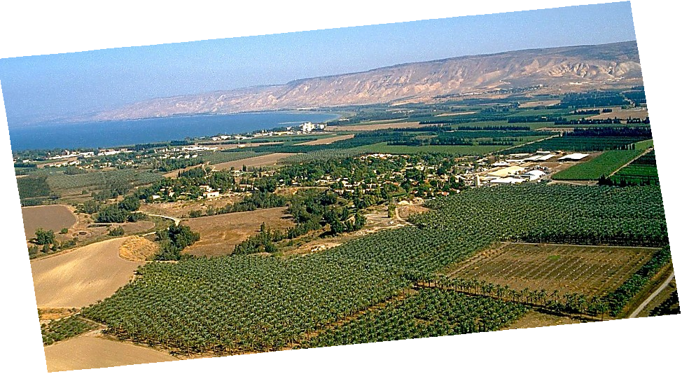
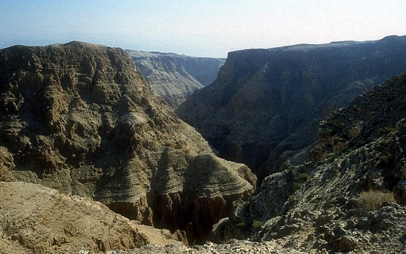
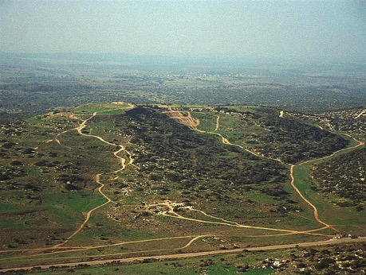
Gen. 13:10-11; Ex 3:8
A PORTION OF ABRAHAM'S PROMISE,,,
ABRAHAM
The CALL
L - S - B
I - I
THE MARVELOUS BEAUTY OF CANAAN…
THE LAND OF HIS ANCIENT INHERITANCE!
Jordan Lui, Central Israel
Handbook pg. 19-24
41
1
© 2006 TBBMI
9.65.03b.
Notes:
And here is that Land today…but only a portion of God's promise to Abraham…this lush location along Israel's Jordan River.
//// the Land of his promised inheritance! From the fertile north to the desolate south…"milk and honey" are only the start of the blessings of this special piece of earth's real estate.

Slide 44
7
Ex. 2:24
ABRAHAMA
ABRAHAM
ca. 2000 B.C.
Koh Chhuahna
AC
R - C - M
AJMJ
I - I
Gen. 12:1-3
J - E
12
ABRAHAMA
Koh Chuahna
R - C - B
I - I
J - E
Jakoba ani thutiam
Fapa tur chu!
12
THUTIAN DAWNG THLAH TE!
Handbook pg. 19-24
42
7
Notes:
The story now begins to move much faster. ISAAC, ABRAHAM's son through Sarah, IS the Son of God's promise.
//// ISAAC then has two sons: JACOB and ESAU (J and E on the ABRAHAM File Folder). JACOB is the son through whom the unconditional Promise now passes on.
//// Jacob, in turn has 12 sons (the number 12 on the Abraham folder).
//// So, then...the Line of the Promise...is
//// Abraham
//// Isaac
//// Jacob and
//// the 12 sons of Jacob.

Slide 45
7
Gen. 35:23-26; Gen. 34:1
ABRAHAMA
ABRAHAM
ca. 2000 B.C.
Koh Chhuahna
AC
R - C - M
AJMJ
I - I
Gen. 12:1-3
J - E
12
12
ABRAHAMA
1
10
Koh Chhuahna
R - C - M
I - I
6
J - E
8
12
4
5
13
7
11
3
9
2
Handbook pg. 19-24
43
Notes:
Here is a graphic representation of those 12 sons of JACOB, born to him and his four wives across the long years of his life. You'll see there was also a 13th child… one daughter. From those 12 sons of old Jacob emerge the 12 tribes of Israel.

Slide 46
7
Gen. 35:24
ABRAHAMA
ABRAHAM
ca. 2000 B.C.
Koh Chhuahna
AC
R - C - M
AJMJ
I - I
Gen. 12:1-3
J - E
12
ABRAHAMA
Koh Chhuahna
R - C - M
I - I
J - E
12
11
Handbook pg. 19-24
44
Notes:
But notice one particular son of Jacob – number eleven, one of his youngest -- and probably the most remembered of all his children. This son's story is familiar to almost everyone:

Slide 47
7
Gen. 35:24
ABRAHAM
ABRAHAM
ca. 2000 B.C.
Koh Chhuahna
AC
R - C - M
AJMJ
I - I
Gen. 12:1-3
J - E
12
ABRAHAMA
Koh Chhuahna
R - C - M
I - I
J - E
12
JOSEFA!
11
Handbook pg. 19-24
45
Notes:
His name is JOSEPH. This great man of legendary character –– his name known throughout the ages -- bridges us over to the next of the four biblical personalities in this mental map of the biblical storyline:

Slide 48
7
Gen. 1 atang 25
SIAMNA
CHIMBUAITU
1na Mipa & Hmeichhia
1na Sualna
S
1na Chanchintha
1na Chhungkua
LALNA
(1000 B.C.)
1na Tualthah
Tuilet/Chhimbal
Inchhawng Sang
(2000 B.C.)
ABRAHAMA
(2000 B.C.)
3 KHAWTLANG
S 7 N I
Koh Chhuahna
AC
R - C - M
I - I
J - E
12
SALTANNA
7 = 4 + 3
JOSEFA
ABRAHAMA
4 MIHRING
Koh ChhahnaL
R - C - M
I - I
MOSIA
(1500 B.C.)
(500 B.C.)
J - E
N
S
NGAWIHNA
12
ISUA
I
JOSUA
46
2
Notes:
Now we've completed the second folder in the Bible File collection:
//// first is CREATION,
//// followed by ABRAHAM, the first of the four great names.

Slide 49
7
AJMJ
Mi
PAHNIHNA
MI CHI 4
Zing ami:
?
47
Notes:
Time now to move forward to the second in the group of four great Old Testament characters…the Bible File Folder Number 3.
From "A Judge Must Judge" we know that his name begins with the letter J. Which is…

Slide 50
7
Gen 30:24
AJMJ
Mi PAHNIHNA
MI CHI 4
Zing ami:
"JOSEFA"
48
Notes:
Joseph. Probably no Biblical character is more famous, more legendary than this one man who -- through his character and his integrity before God -- changed all of human history.

Slide 51
7
Gen 30:24
HUN-BI CHHINCHHIAH DAN:
ABRAHAMA-JOSEFA 2000 B.C.
49
Notes:
And the timeline…let's keep it generally in that early 2000 B.C. range. It's unnecessary to be more specific at this point. So don't feel burdened to remember a long lists of ancient dates. The dates presented in THE BIBLE…BASICALLY are only broad anchor points to help keep events in correct order. You can sharpen them later.

Slide 52
7
SIAMNA
ABRAHAM
"A
Roreltu
In
Ro a rel tur a ni"
ABRAHAMA
ABRAHAM
JOSEFA
ABRAHAM
MOSIA
JOSUA
BUAINA
CHHIAH
SALTANNA
NGAWIHNA
ISUA
Handbook pg. 19-24
02
Notes:
The memory tool, A JUDGE MUST JUDGE, brings to mind ABRAHAM…the FIRST OF THE FOUR GREAT PEOPLE...right after the CREATION file folder. Here is ABRAHAM'S folder in the Bible File line up.

Slide 53
7
JOSEFA
ABRAHAM
Mi PAHNIHNA
MI CHI 4
Zing ami:
JOSEFA
AJMJ
Handbook pg. 24-25
51
Notes:
JOSEPH's folder appears ready for two significant events to be filled in. The young man is well loved by his father, JACOB — so deeply and obviously, in fact…

Slide 54
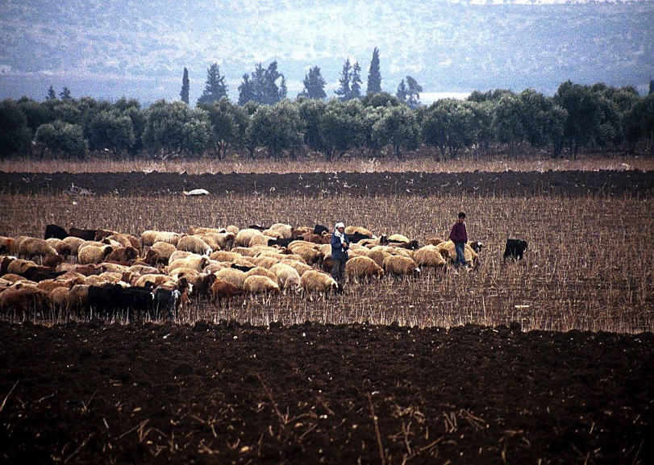
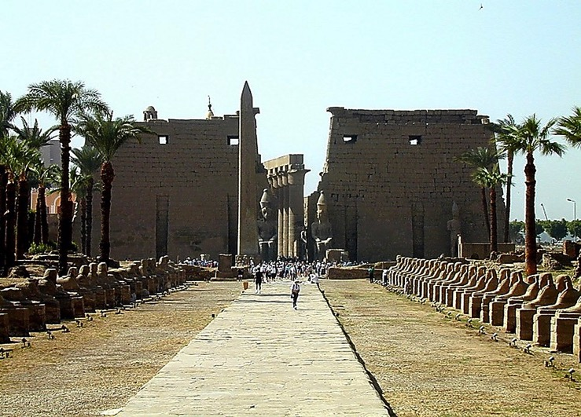
Gen. 37:16-18
Façade of Luxor Temple, Egypt
JOSEFA
Dothan hmuna Berampu ho, Israel
Handbook pg. 24-25
52
1
Notes:
…that it arouses the envy of most of his shepherd brothers. Tending flocks at that time in the fields near today's Dothan in northern Israel…
//// the brothers plot against JOSEPH, selling him into slavery to a passing caravan on its way to Egypt.

Slide 55
Gen. 37:28
JOSEFA
Handbook pg. 24-25
53
Notes:
Once in Egypt…among the fabulous wealth and wonders of that advanced civilization…and after several difficult personal trials…JOSEPH is soon discovered to be a brilliant young man with enormous administrative ability. He learns quickly while remaining faithful and obedient to God's authority and leading in his life.

Slide 56
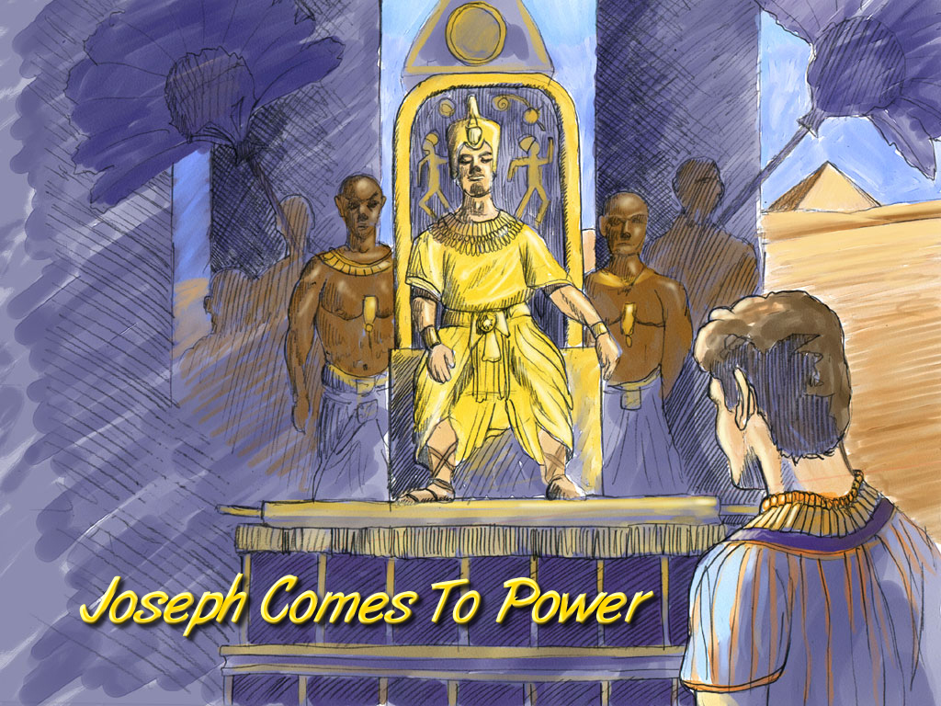
Gen. 41:41-46
JOSEFA
Joseph Comes To Power
Josefa A Rawn Lal
Handbook pg. 24-25
54
Notes:
In time JOSEPH rises in Egyptian civil authority. He becomes governor of all of Egypt, second only to the Pharaoh himself.

Slide 57
STAGE
DUAN LAWK
NA
Gen. 42:2
MT
N(A)
TAM-PUI!
H
GD
K
EL
B
J
NT
JOSEFA
TT
A
KB
U
TAM TAK!
ST
PG
TS
Handbook pg. 24-25
55
1
Notes:
At this same time, back in Canaan, famine strikes The Land.
//// In order to survive the crisis, JOSEPH's father, old JACOB (now called Israel), sends some of the brothers to Egypt to buy grain. FAMINE IN THE NORTH…PLENTY TO THE SOUTH. (On your map, add the tracing line from Canaan down to Egypt.)

Slide 58
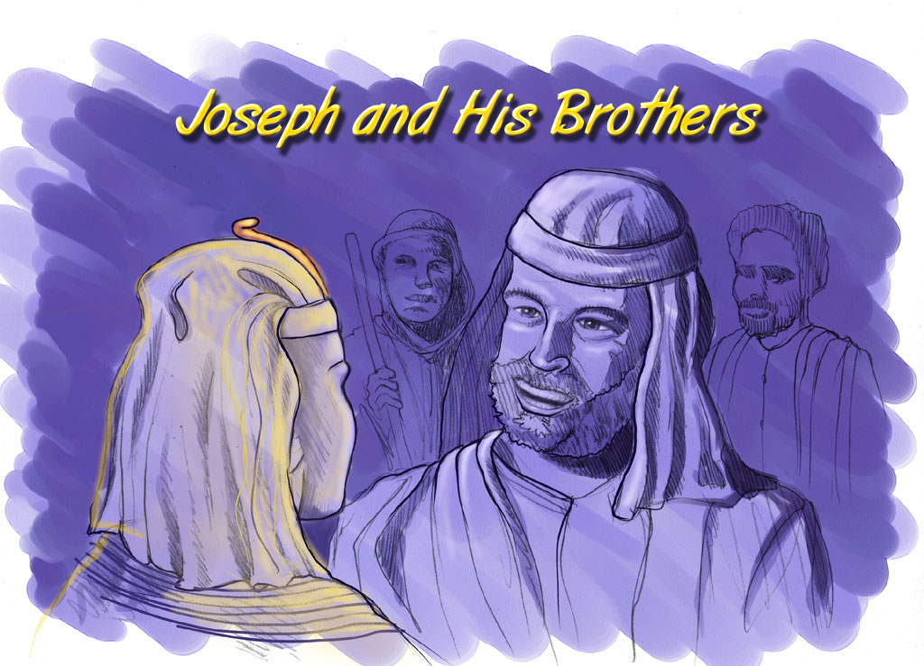
Gen. 42:7
Josefa leh A Unau-te
JOSEFA
Joseph and His Brothers
Handbook pg. 24-25
56
Notes:
Through a series of dramatic events -- told about in great detail in the latter chapters of Genesis – the brothers learn that their sibling, JOSEPH, is now the governor of Egypt

Slide 59
STAGE
DUAN LAWK
NA
Gen. 46:3-7
MT
N(A)
H
GD
K
EL
A CHHUNG TEN AN ZUI…
CHHUNGKUA ATANG HNAM AH AN LO DING !
B
J
MN
JOSEFA
TT
A
KB
U
ST
PTS
TS
Handbook pg. 24-25
57
Notes:
The family follows and decides to settle in Egypt permanently. And there...as a family of Hebrews…they begin to multiply into a nation, to be known through later history as the Israelites.

Slide 60
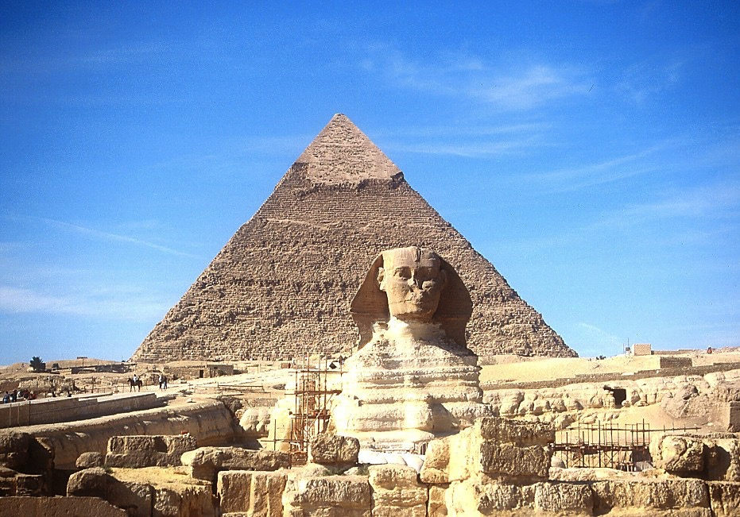
7
JOSEFA
The Sphinx leh the Great Pyramid
Handbook pg. 24-25
58
Notes:
For a while, they remain in good favor with the Egyptian people and the government administration. After all, they are the family of their respected Governor! Perhaps they even saw the great structures of the Sphinx and the pyramids of Egypt even as they remain for us to marvel at today.

Slide 61
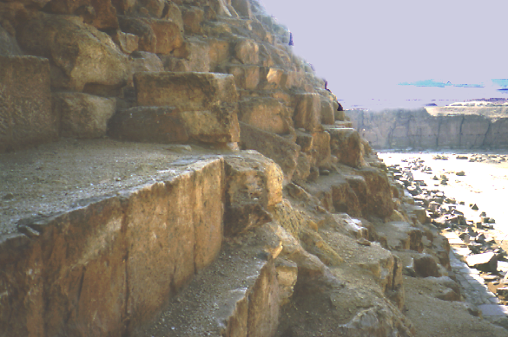
7
JOSEPH
Great Pyramid hmuna Quarries ho
Handbook pg. 24-25
59
Notes:
We can climb the side of the Great Pyramid today and wonder: are these the quarries where Joseph's family later slaved through the centuries? Maybe so. Some evidence points in that direction.

Slide 62
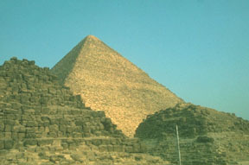
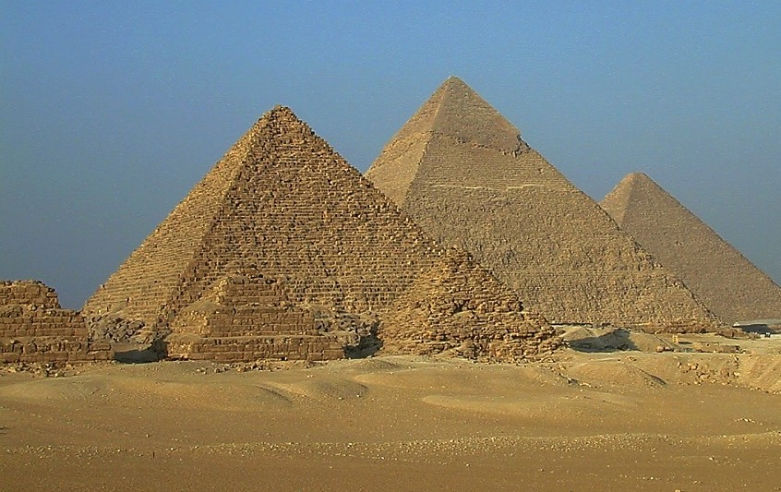
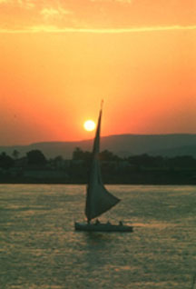
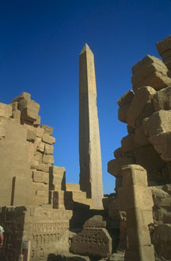
7
ISRAELTE’N AN HMU…
JOSEFA
… HMANLAI AIGUPTA ROPUINATE.
Handbook pg. 24-25
60
Notes:
As time passed and Joseph died, these ancient wonders would have seen the throne of Egypt undergo changes of attitude and a loss of respect for the alien Hebrews -- or the Israelites, the old family of Joseph.

Slide 63
Ex. 8:8-10
JOSEFA
ABRAHAM
SALTANNA
Mi
PAHNIHNA
MI CHI 4
Zing ami
AJMJ
Notes:
After his death, Joseph's long service to Egypt is soon forgotten.
//// While at the same time, as a population, the Israelites are multiplying rapidly – lots and lots of children –
[NOTE: SEVEN SETS OF "CHILDREN-DOTS" APPEAR]
– soon becoming an enormous social problem and a serious national threat to their Egyptian overlords. So…to take care of that problem…
//// the Israelites, Joseph's national descendants, become SLAVES to the Egyptians.
//// Israelites are in Egypt for some 430 years. Much of that time is lived out under the terrible bondage of Egyptian slave masters.

Slide 64
7
Gen. 1:1 atang Ex. 1:6
CREATION
CHIMBUAITU
1na Mipa leh Hmeichhia
1na Sualna
S
1na Chanchintha
1na Chhungkua
LALNA
(1000 B.C.)
1na Tualthah
Tuilet/Chhimbal
Inchhawng Sang
(2000 B.C.)
ABRAHAMA
(2000 B.C.)
3 KHAWTLANG
S 7 N I
Koh Chhuahna
AC
R - C - M
I - I
J - E
12
TANNA
7 = 4 + 3
JOSEFA
JOSEFA
Saltanna
Saltanna
430
430
4 MIHRING
MOSIA
(1500 B.C.)
(500 B.C.)
N
S
NGAWIHNA
ISUA
I
JOSUA
Handbook pg. 24-25
62
Notes:
Now…THE BIBLE FILE...is filled in to include
CREATION, ABRAHAM, and JOSEPH…

Slide 65
7
AJMJ
Mi
PATHUMNA
MI CHI 4
Zing ami:
?
63
Notes:
…which brings us now to the third person in the Group of Four great Biblical personalities.
This great person – THE LARGE CAPITAL M – will be…

Slide 66
7
Ex 2:10
AJMJ
Mi
PATHUMNA
MI CHI 4
Zing ami:
"MOSIA"
64
Notes:
...MOSES.
In His time, God raises up the most famous of all the Old Testament characters, MOSES, known as The Great Deliverer…
to take the people out of their Egyptian bondage and on toward the land of Abraham's promised inheritance.

Slide 67


Baibul… A Tlangpui • BibleStudyDownloads.org
A Thlawnin Hetah Rawn La Rawh Le!
Notes:
The Bible…Basically (bb) Mizo

Slide 68
65
©2006 TBBMI
9.65.03b.

