Slide 1


VERSION 9.6 BETA
BAIBUL…
A TLANGPUI
Baibul… A Tlangpui Rawngbawlna Lantirna, International Inc.
Fort Worth, Texas
Baibul… A Tlangpui Rawngbawlna Lantirna, International Inc. Fort Worth, Texas
Designed by Dr. John Fryman, Texas, USA • BibleBasically.org
Taught by Dr. Rick Griffith, Singapore Bible College
All files in many languages for free download at BibleStudyDownloads.org
www.biblebasically.org
©2006 TBBMI

Slide 2
HRIATTUR PAWIMAWH THENKHATTE… KHAWNGAIHIN ZIRLAI ZIR CHHUNGIN CELL PHONES, BEEPERS LEH RI THEI THILDANG RENG RENG TIHRIK BENCHHEN LOH HRAM NI SE. IN THIANTEN LAWMTHU KAN SAWI E !
01
1
9.6.01.

Slide 3
©
Baibul…A Tlangpui Rawngbawlna Int’l
Hruaitute
Dr. John Hannah
Distinguished Professor of Historical Theology
Research Professor, Historical Theology
Dallas Theological Seminary
Dallas, Texas
Dr. Rick Griffith
Lecturer in Biblical Studies
NT Department Coordinator
Singapore Bible College
Singapore, Republic of Singapore
Dr. Mark Bailey
President
Dallas Theological Seminary
Dallas, Texas
John Maisel Kurt Nelson
President Exec. Vice President
East/West Ministries
Dallas, Texas
Dr. William R. Bright
Late Founder
Campus Crusade for Christ
Orlando, Florida
Vasily Dimitrievski
Director for Russia
Global Missions Fellowship (e3)
Penza, Russia
Rev. Douglas Valenzuela
Senior Pastor, Conservative Baptist Missions
Chiesa Battista Evangelica di Casoria
Naples, Italy
Dr. Ted Kitchens
Senior Pastor
Christ Chapel Bible Church
Ft. Worth, Texas
Karyn Granger
Director of Bible Studies
Southwest Christian Schools
Ft. Worth, Texas
Dr. Kenneth Horton
Senior Pastor
McKinney Memorial Bible Church
Ft. Worth, Texas
9.6.01.
©2006 TBBMI
02

Slide 4


Baibul Ram Milem Dahkhawmna
BAIBUL…A TLANGPUI ® hman atana phal taka thlalak leh milem chi hrang hrang min hawhtirtu Todd Bolen-a lakah hian keini pawl hian bat nasa tak kan nei a ni. Ani hi Pictorial Library of Bible Lands dintu a ni.TBB hmangtute zawng zawng chu BiblePlaces.com tlawh thin tur leh a theih anga hmang tangkai turin kan sawm a ni: Ram thianghlim atanga Aegean leh Mediterranean tuipui hrul zawng zawng, Europe hmar lam, Kristiante lo thanzelna bulpui chu. BiblePlaces.com hian hmanraw changkang leh tha ber ber-in zirtirtute leh thlalak-milem buaipuitute a chawm reng a ni. BiblePlaces.Com in nangpawh kan sawm a che. Kan lawm e, Todd!

Slide 5
The Bible…Basically Project was conceived, developed and produced by John E. Fryman, Ph.D.
Copyright © 2006 The Bible…Basically Ministries Intl. Inc., Ft. Worth, Texas
All rights reserved. This work is protected under the copyright laws of the United States of America. No part or section may be reproduced in any form without permission in writing from the author or copyright owner, except in the case of brief quotations embodied in critical articles or reviews.
Those sections for which permission is specifically provided in the text may be reproduced locally as student need requires.
The ministry is indebted to Dr. Todd Bolen, The Master’s College, Jerusalem, Israel, and Pictorial Library of Bible Lands (BiblePlaces.com) for permission
to use extensive photo resources throughout this production. Photography of Kadesh-Barnea is used with permission of Dr. Leen Ritmeyer, Hawthornedene, Australia. Should the copyrighted material of others be noted without our knowledge or proper attribution, the ministry requests an immediate notice. The specified content attribution will be properly adjusted. Every effort was used to avoid unauthorized use of text and graphics.
Teachers, media operators and/or other facilitators may not alter any PowerPoint slide, animation effect, or order of presentation in any way, in any language edition, or in any computerized application from any image storage facility, transmission, digital or Internet technique except by permission of the producers.
Produced in the United States of America. International Rights Reserved.
03
©2006 TBBMI
9.6.01.

Slide 6
VERSION 9.6 BETA
BAIBUL…
A TLANGPUI
Baibul… A Tlangpui Rawngbawlna Lantirna, International Inc.
Fort Worth, Texas
Baibul…A Tlangpui Rawngbawlna Lantirna, International Inc. Fort Worth, Texas
Baibul… A Tlangpui Rawngbawlna Lantirna, International Inc. Fort Worth, Texas
www.biblebasically.com
www.biblebasically.org
04
©2006 TBBMI
9.6.01.
©2006 TBBMI

Slide 7


(A Tum: Rilru-a Baibul Hriat leh Vawn reng)
BAIBUL… A TLANGPUI
®
BUNG KHATNA
KEU RAWH LE “BAIBUL CHHUNG THU”
05
©2006 TBBMI
9.6.01.

Slide 8
?
Let’s launch this project with one massive thought!
WHAT IS THE SOURCE OF…
Every Christian Doctrine
Every Christian Belief System
Every Biblically Based Book:
In Every Seminary Library
In Every Public Library
In Every Personal Library
In Every University Library
In Every Country in the World
In Almost Every Language
AND
The Biblically Based Thoughts of
Every Believer and Nonbeliever Across the Planet
06
15
©2006 TBBMI
9.6.01.

Slide 9

KAN RINNA ZIAKNA BUPUI
Handbook pg. 6
2
07

Slide 10

A lehkhabu ah chuan “Baibul hi eng lam hawi chiah nge a nih reng !”
Dr. Henrietta Mears chuan a ziak a…
Handbook pg. 6
08

Slide 11
Mi tam tak Baibul hriatna chu: Tuikeplung tha-mi ang mai. Mahse chhiartu tamtak rilru ah chuan…
Handbook pg. 6
09

Slide 12

…thi-hrui ang maiin a chat a… Baibul chhungthu inlaichin chhoh dan chu a buaiin a mumal lo nuai thin a ni !
Handbook pg. 6
10

Slide 13
Handbook pg. 6
11

Slide 14
Pathian Lehkhabu Rilna
A awmzia leh pawimawhna
Thlarau thianghlim hruaina thuk zawk
12
2

Slide 15
?
?
?
Tlanna atana Pathian thiltum
Abrahama & hmanlai Israel
Lal Isua Krista lo lanna
Kohhran lo pianchhuahna
?
?
?
?
?
?
13
5

Slide 16





  HENG BAIBUL-TE HI HAN ENKUAL VEL TEH!
14

Slide 17
Tichuan, a buaithlak lai chu le !
HRIATTHIAM HARSA TAK A NI !
• Thu chi hrang tam lutuk
• Mi chi hrang tam lutuk
• Thumal 750,000
• Bung 1,200
• Chang 31,000
• Tawng danga chhut
leh lehlin tam lutuk
15
7

Slide 18
TU TIH NGE ?
ENGE A TIH ?
TUNGE SAWI ? ENGE
A SAWI ?
LEHKHABU
ENGATINGE ?
MIPUI
A HUN
AN INLAICHIN KUAL DAN
16
7

Slide 19
MIN PUI RU !
TU TIH NGE ?
ENGE A TIH ?
TU SAWI NGE ?
ENGE A SAWI ?
LEHKHABU
ENGATI-NGE ?
MIPUI
A HUN
AN INLAICHIN KUAL DAN
17

Slide 20
MIN PUI RU !
A HARSA KA TI
EM MAI !!!
KAN PASTOR-TE
KUTAH KA
DAH MAI DAWN !
18
Notes:
E

Slide 21
TUNGE
BENGKHAWN ?
19

Slide 22
ANIH
ENGTINNGE?
20

Slide 23
“Kan rinna hi thutaka tihngheh anih loh chuan, mihring ngaihdan leh riruatna mai, puithuna thil ang chauh mai a ni.”
Miles Stanford
Principles of Spiritual Growth
21
4

Slide 24
THU KHAIKHAWMNA…
“Kan hriat bak chu kan ring lovang a ,
Rinna kan neih ang zelin kan nung bawk ang.”
Albert Mohler, President
The Southern Baptist Seminary Louisville, KY
22
3

Slide 25

So… here we go!
(And don’t miss a single session. Each builds toward the next!)
BAIBUL…
A TLANGPUI
23
1
©2006 TBBMI
9.6.01.

Slide 26
Baibul…A Tlangpui
®
hi ngaihtuahna min siamtu a ni !
24
Notes:
CHANGED FROM THE ORIGINALS (TQC)

Slide 27
Baibul…A Tlangpui
®
Baibul hriatna nghet a neihtir ang che !
25
Notes:
CHANGED FROM THE ORIGINALS (TQC)

Slide 28
Baibul…A Tlangpui
®
THU PAWIMAWH PAKHAT: Hetah hian midang i zirtir theih tur thil a awm !
S 7 N I
Hriatna tinghettu a va ni em !!!
26
1
Notes:
CHANGED FROM THE ORIGINALS (TQC)

Slide 29
Baibul…A Tlangpui
®
Keu Rawh Le
“I Baibul Chhungthu”
27
Notes:
CHANGED FROM THE ORIGINALS (TQC)

Slide 30
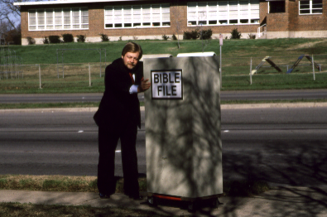
28

Slide 31
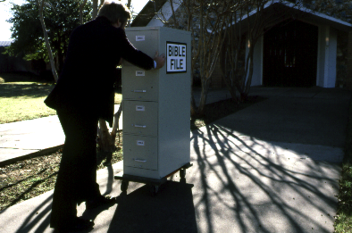
29

Slide 32
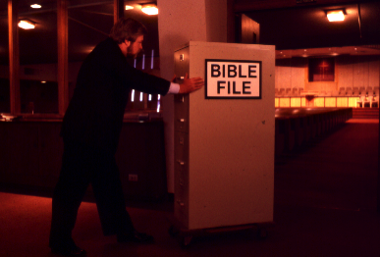
30

Slide 33
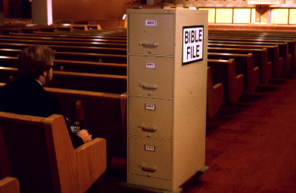
31

Slide 34
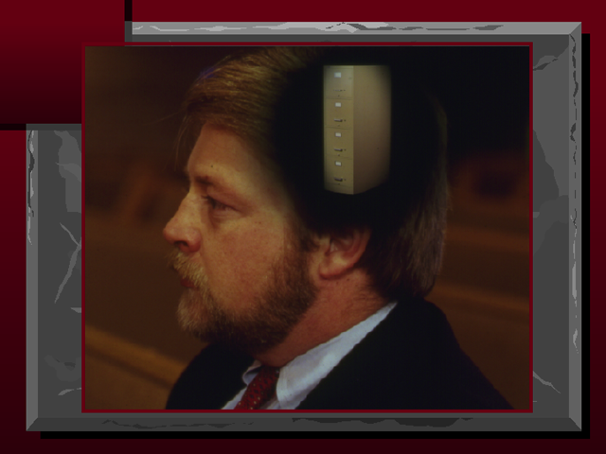
32

Slide 35
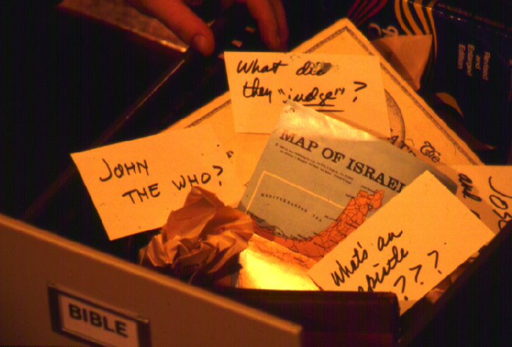
?
CHUAN…HRIATTIRNA DIK LEH DIK LO TE PAWH HI ENGTINNGE I HRIATCHIAN THEIH ANG ?
?
?
?
33
5

Slide 36
Ngaihdan ka nei lo takzet e !
Khawiah nge bul ka tan ang?
34

Slide 37
7
Handbook pg. 8-14
35

Slide 38
7
7
Handbook pg. 8-14
1
36

Slide 39
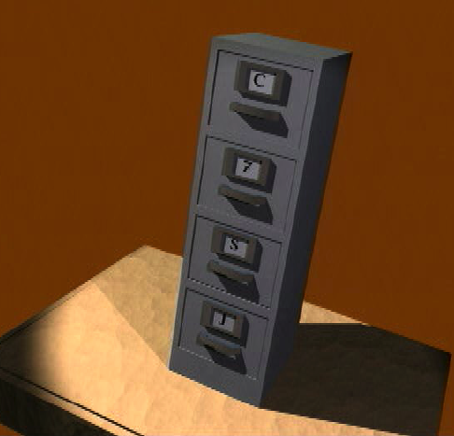
7
I BAIBUL CHHUNGTHU
Handbook pg. 8-14
37

Slide 40
7
I BAIBUL CHHUNGTHU
HEMI AH HIAN VIDEO LAM CHI EN
TUR A AWM LO
Handbook pg. 8-14
38

Slide 41
7
1
2
3
4
5
6
7
8
9
10
Handbook pg. 8-14
39

Slide 42
7
Keu rawh le
“I Baibul Chhung Thu”
7
7
7
7
7
7
7
S
7
N
I
S
N
I
S
I
S
N
I
N
Handbook pg. 8-14
4
40

Slide 43
Keu rawh le
“I Baibul Chhung Thu”
7
7
= 4+3
Handbook pg. 8-14
2
41

Slide 44
7
Keu rawh le
“I Baibul Chhung Thu”
S 4 3 N I
S 4 3 N I
Handbook pg. 8-14
1
42

Slide 45
THUMAL AWMZE NEI 5 :
7
S = SIAMNA
4 = MI
3 = KHAWTLANG
N = NGAWIHNA
I = ISUA
Handbook pg. 8-14
5
43

Slide 46
THUMAL AWMZE NEI 5:
7
S = SIAMNA
4 = MI
3 = KHAWTLANG
N = NGAWIHNA
I = ISUA
Handbook pg. 8-14
6
44

Slide 47
THUMAL AWMZE NEI 5:
7
S = SIAMNA
4 = MI
3 = KHAWTLANG
N = NGAWIHNA
I = ISUA
Handbook pg. 8-14
45

Slide 48
MI 4-TE :
7
A BRAHAMA
J OSEFA
M OSIA
J OSUA
Handbook pg. 8-14
5
46

Slide 49
7
A
J
M
J
Handbook pg. 8-14
47

Slide 50
MI 4-TE :
7
J OSEFA
A BRAHAMA
A
M OSIA
J
J OSUA
M
J
Handbook pg. 8-14
8
48

Slide 51
7
SIAMNA
ABRAHAMA
JOSEFA
MOSIA
JOSUA
Handbook pg. 8-14
5
49

Slide 52
THUMAL AWMZE NEI 5 :
7
S = SIAMNA
4 = MI
3 = KHAWTLANG
N = NGAWIHNA
I = ISUA
Handbook pg. 8-14
50

Slide 54
KHAWTLANG 3-TE :
7
B UAINA
C HHIAH
S ALTANNA
Handbook pg. 8-14
6
52

Slide 55
SIAMNA
ABRAHAMA
JOSEFA
MOSIA
JOSUA
BUAINA
CHHIAH
SALTANNA
7
Handbook pg. 8-14
53

Slide 56
7
7
THLIRLETNA...
S 7 N I
S 4 3 N I
Handbook pg. 8-14
3
54

Slide 57
SIAMNA
MI 4-TE
KHAWTLANG 3-TE
NGAWIHNA
ISUA
7
Handbook pg. 8-14
55

Slide 58
7
SIAMNA
ABRAHAMA
JOSEFA
MOSIA
JOSUA
BUAINA
CHHIAH
SALTANNA
NGAWIHNA
ISUA
Handbook pg. 8-14
2
56

Slide 59
I Rilru a Nghet Tawh Baibul Thu
SIAMNA
SIAMNA
ABRAHAM
ABRAHAMA
ABRAHAMA
ABRAHAM
JOSEFA
ABRAHAM
MOSIA
JOSEFA
JOSUA
BUAINA
MOSIA
CHHIAH
SAL TANNA
JOSUA
NGAWIHNA
ISUA
BUAINA
CHHIAH
SALTANNA
NGAWIHNA
ISUA
Handbook pg. 8-14
57
11

Slide 60
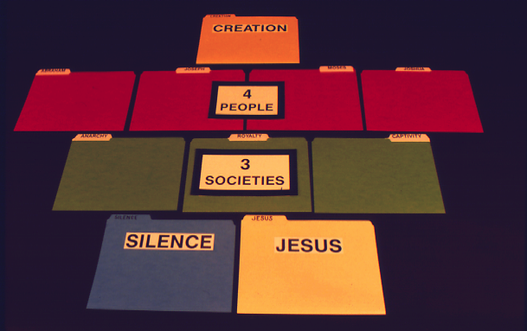
7
Handbook pg. 8-14
58

Slide 61
7
Handbook pg. 8-14
59

Slide 62
7
Handbook pg. 8-14
60

Slide 63
7
Handbook pg. 8-14
61

Slide 64

7
Khawvel danglam chakzia hi !
Handbook pg. 8-14
62

Slide 65
7
SIAMNA
CREATION
ABRAHAM
ABRAHAM
ABRAHAMA
ABRAHAM
ABRAHAM
ABRAHAM
JOSEFA
JOSEPH
ABRAHAM
ABRAHAM
MOSES
MOSES
JOSHUA
JOSHUA
ANARCHY
ANARCHY
ROYALTY
ROYALTY
CAPTIVITY
CAPTIVITY
NGAWIHNA
SILENCE
ISUA
JESUS
63

Slide 66

64

Slide 67

C
65
10

Slide 68
S 7 N I
C
{
}
Mi 4-te
Khawtlang
3-te
66

Slide 69
I RILRU A BAIBUL I HRIATNGHEH TAWH !
SIAMNA
ABRAHAMA
JOSEFA
NGHET
MOSIA
JOSUA
BUAINA
HRETHIAM
CHHIAH
SALTANNA
NGAWIHNA
BELHBAWM
ISUA
67
4

Slide 70

Tunah chuan The Bible..Basically chungchangah, ngaihtuahna i nei ang a…
• “Baibul chhungthu” kan tihte
• “Baibul chhungthu” kan hriatna kawngte…S 7 N I
1. ENG THIL NGE THLENG !
ZAWHNA PATHUM CHHAN TUR
2. ENGATINGE A THLEN !
3. ENGTINNGE PATHIAN THU
AH NGHAWNG A NEIH
68
4

Slide 71
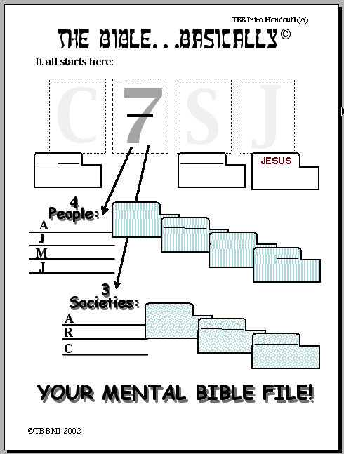
S
7
N
I
SIAMNA
NGAWIHNA
{
ABRAHAMA
BRAHAM
JOSEFA
OSEPH
MOSIA
OSES
JOSUA
OSHUA
{
ZIRNA PUITU #01
NARCHY
BUAINA
OYALTY
CHHIAH
APTIVITY
SALTANNA
©2006 TBBMI
69
20
9.6.01.

Slide 72
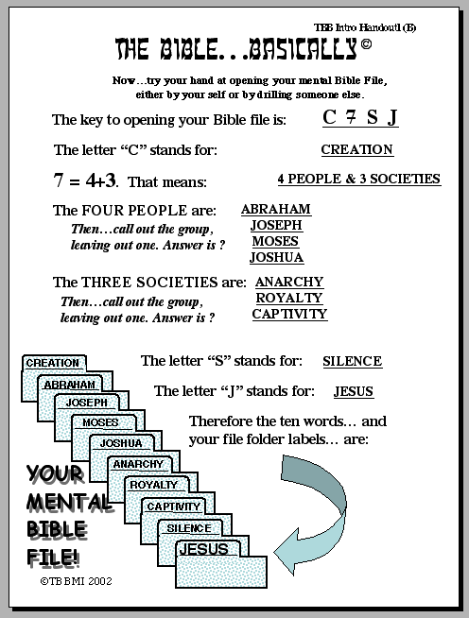
ZIRNA PUITU #02
...
©2006 TBBMI
9.6.01.
9
70

Slide 73
7
71

Slide 74
Baibul…A Tlangpui
®
“I BAIBUL CHHUNGTHU”
Hriatchianna
72

Slide 75
Tunah a kalphung I hre ta… hei, kan kal zeldan tur…
•”Baibul chhungthu” kan tihte
•”Baibul Chhungthu” kan hriatna kawngte…S 7 N I
•Baibul a thilthleng rilru a vawnngheh tawhte
•Baibul thawnthu laipui ber: ”a indawtdan awlsam”
•Abrahama bulpui atanga Lal Isua Krista rawngbawlna
•Baibul ruangam, thawnthu a innghat
•Thuthlung hlui leh Thuthlung thar Bu leh a Thupuite
 
8
73

Slide 76
VERSION 9.6 BETA
BAIBUL…
A TLANGPUI
Baibul… A Tlangpui Rawngbawlna Lantirna, International Inc.
Fort Worth, Texas
Baibul… A Tlangpui Rawngbawlna Lantirna, International Inc. Fort Worth, Texas
Baibul…A Tlangpui Rawngbawlna Lantirna, International Inc. Fort Worth, Texas
Baibul… A Tlangpui Rawngbawlna Lantirna, International Inc. Fort Worth, Texas
www.biblebasically.com
www.biblebasically.com
www.biblebasically.org
04
74
9.6.01.
©2006 TBBMI
9.6.01.
©2006 TBBMI
©2006 TBBMI

Slide 77
75
©2006 TBBMI
9.6.01.

Slide 78


Baibul… A Tlangpui • BibleStudyDownloads.org
A Thlawnin Hetah Rawn La Rawh Le!
Notes:
The Bible…Basically (bb) Mizo

