Slide 1

성경은
기본적으로
©2006 TBBMI
Designed by Dr. John Fryman, Texas, USA • BibleBasically.org
Taught by Dr. Rick Griffith, Singapore Bible College
All files in many languages for free download at BibleStudyDownloads.org

Slide 2



(이야기의 흐름에 의해 구성된다.)
성경은
기본적으로
®
일곱 번째
성경책 구성하기:
구약성경 줄 세우기
©2006 TBBMI
9.6.07.
02
Notes:
Now we move on to what we call SETTING UP THE BOOKS. This is Part 7 of THE BIBLE...BASICALLY. Since we are dealing with filing systems and file folders, we'll remain with that same idea. Because, we are going to discover how the Bible's shape and structure IS organized by the story line of Scripture… extending across thousands and thousands of years. A subtitle might be “Lining Up the Books.”

Slide 3
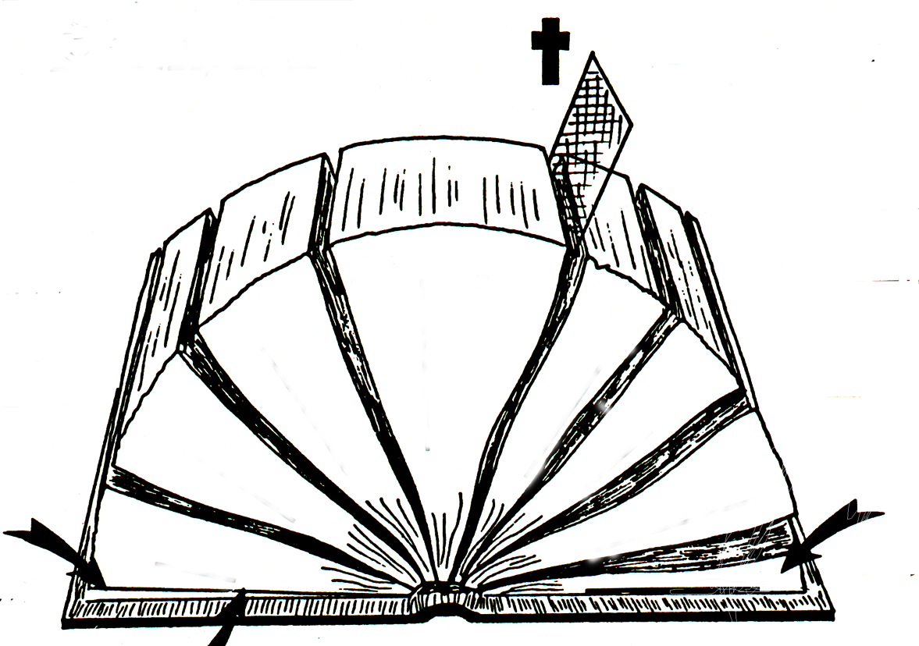
1600 년
A
B
40명의 저자들
“ ”
“ ”
D(OT)
“옛” 언약(구약)
D(NT)
“새” 언약
C
한 가지 주제:
하나님의 영광
“ ”
“ ”
27 권의 책
E(OT)
39 권의 책
E(NT)
F(OT)
히브리어
F(NT)
그리스어
4
3
5
/
복음서
/
G(OT)
율법 약속
G(NT)
은혜 성취
선지서
6
2
시가서
사도행전
7
역사서
서신서
1
율법서
8
계시록
H(OT)
망원경
H(NT)
망원경
영원과 과거
현미경
J
2 망원경
1 현미경
I(OT)
영원과 미래
©2006 TBBMI
“열린” 성경
9.6.07.
03
Notes:
Here is the familiar “OPENED BIBLE,” we just explored…some of the basic facts about the overall structure, languages and objectives of the Scriptures.

Slide 4
4
3
5
6
2
선지서
시가서
7
역사서
1
율법서
8
“열린” 성경
©2006 TBBMI
9.6.07.
04
Notes:
Of that “OPENED BIBLE”…we'll now call out its Old Testament section, the first 39 books of Scripture…Law, History, Poetry, and Prophets.

Slide 5
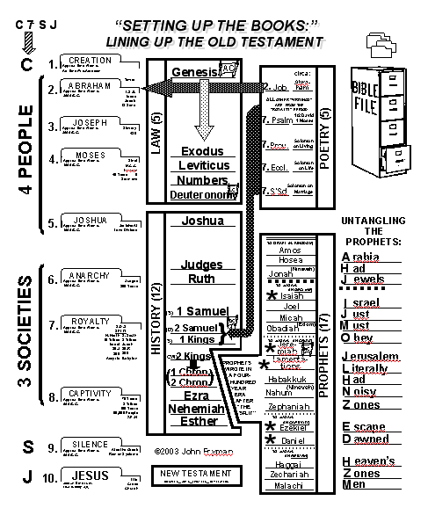
공부 가이드
성경책
구성하기
구약 성서 줄세우기
공부 가이드 #19
05
Notes:
Study Help #19 will be useful to you now. You'll notice that it's organized in four columns. Looking at each column.
_________
Note to Translators: Please find the English version of this graphic in the Student Workbook Study Helps PPT file called “Study_Helps_Answered_10_ed-45.pptx” at slide 41. Translate it there and then take a screen shot of it to put here and in the subsequent slides.

Slide 6
연대기
율법과 역사
시와 예언
암기해 보기
06
Notes:
Beginning with the one on the far left…is THE BIBLE FILE briefly arranged in its proper ten-file order. There you see the C7SJ…the four people and three societies…together with small file folder images and the basic items we learned for each file folder. This is THE QUICK CHRONOLOGY from THE BIBLE…BASICALLY.

Slide 7
연대기
율법과 역사
시와 예언
암기해 보기
06
Notes:
Beginning with the one on the far left…is THE BIBLE FILE briefly arranged in its proper ten-file order. There you see the C7SJ…the four people and three societies…together with small file folder images and the basic items we learned for each file folder. This is THE QUICK CHRONOLOGY from THE BIBLE…BASICALLY.

Slide 8
연대기
율법과 역사
시와 예언
암기해 보기
08
Notes:
Now the remaining two sections of the Old Testament, the third column: in the top box: POETRY, and below that, THE PROPHETS. So the complete Old Testament is presented in its traditional four sections…although, through the centuries, others have divided it in somewhat different ways…depending on their own religious traditions. However, these divisions are widely held around the world.

Slide 9
연대기
율법과 역사
저작과 예언
암기해 보기
09
Notes:
Finally, the outer box on the right side presents a special memory tool for working with the prophets. We'll explain it shortly. It's a tool specifically designed to help you "straighten out all those prophets."

Slide 10
왼쪽 방향으로 수평적으로 생각하기
연대기
율법과 역사
시와 예언
암기해 보기
10
Notes:
The design of this worksheet is based on this one idea: every item in the two center columns is arranged horizontally…so think horizontally in relation to the biblical storyline of THE QUICK CHRONOLOGY on the far left column. SO THINK HORIZONTALLY TO THE LEFT.

Slide 11
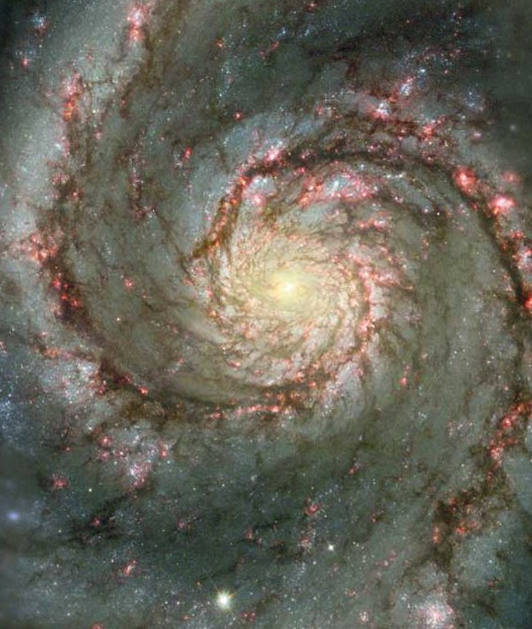
하나님의 영광
연대기
연대기
율법과 역사
율법과 역사
(구약)을 작성하는 데에
1500년의 시간이 소요되었다.
시와 예언
시와 예언
암기해 보기
암기해 보기
11
2
Notes:
As we work through this correlation of books alongside the time-frame of the Biblical chronology and the four Old Testament sections...keep in mind one basic historical fact about this Old Testament book:
//// about 1,500 years were required to write the complete collection. And we discovered in "The Opened Bible"…
//// …it's written with one theme...one message...from Genesis all the way to Revelation...that one theme: The Glory of God! Paul teaches this in 1 Cor. 10:31.

Slide 12

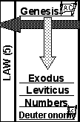
공부 가이드 #19
아
언
율법서 (5)
땅
언
12
1
Notes:
First, look at the box that includes the first five books of the Old Testament,
//// the first traditional grouping of the Biblical books greatly enlarged on the left of the graphic

Slide 13

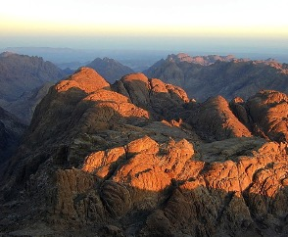
아
언
성경책 구성하기:
구약성경 줄 세우기
5권의
“율법서”
또는
“모세오경”
율법서 (5)
대략적인 성경적 시간대 :
아브라함 이전부터 주전 1400년
땅
언
13
1
Notes:
They are called the books of THE LAW. As we add each book to the list, you'll see that it will line up chronologically with the events of THE BIBLE FILE printed on the far-left column of the work sheet. So...here we go. The block arrows will guide you as you move through the first block, especially the one pointing down.
//// The one pointing to the left will be used later.

Slide 14
아
언
성경책 구성하기:
구약성경 줄 세우기
5권의
“율법서”
또는
“모세오경”
율법서 (5)
대략적인 성경적 시간대 :
아브라함 이전부터 주전 1400년
땅
언
14
Notes:
These five books…called the Torah in the Jewish Scripture…recount events that occurred roughly between 2000 B.C. and 1400 B.C. Remember that these numbers are highly rounded for ease of memory.

Slide 15
아
언
성경책 구성하기:
구약성경 줄 세우기
창세기
5권의
“율법서”
또는
“모세오경”
율법서 (5)
대략적인 성경적 시간대 :
아브라함 이전부터 주전 1400년
땅
언
14
Notes:
These five books…called the Torah in the Jewish Scripture…recount events that occurred roughly between 2000 B.C. and 1400 B.C. Remember that these numbers are highly rounded for ease of memory.

Slide 16
아
언
성경책 구성하기:
구약성경 줄 세우기
창세기
5권의
“율법서”
또는
“모세오경”
율법서 (5)
출애굽기
대략적인 성경적 시간대 :
아브라함 이전부터 주전 1400년
땅
언
14
Notes:
These five books…called the Torah in the Jewish Scripture…recount events that occurred roughly between 2000 B.C. and 1400 B.C. Remember that these numbers are highly rounded for ease of memory.

Slide 17
아
언
성경책 구성하기:
구약성경 줄 세우기
창세기
5권의
“율법서”
또는
“모세오경”
율법서 (5)
출애굽기
레위기
대략적인 성경적 시간대 :
아브라함 이전부터 주전 1400년
땅
언
14
Notes:
These five books…called the Torah in the Jewish Scripture…recount events that occurred roughly between 2000 B.C. and 1400 B.C. Remember that these numbers are highly rounded for ease of memory.

Slide 18
아
언
성경책 구성하기:
구약성경 줄 세우기
창세기
5권의
“율법서”
또는
“모세오경”
율법서 (5)
출애굽기
레위기
민수기
대략적인 성경적 시간대 :
아브라함 이전부터 주전 1400년
땅
언
14
Notes:
These five books…called the Torah in the Jewish Scripture…recount events that occurred roughly between 2000 B.C. and 1400 B.C. Remember that these numbers are highly rounded for ease of memory.

Slide 19
아
언
성경책 구성하기:
구약성경 줄 세우기
창세기
5권의
“율법서”
또는
“모세오경”
율법서 (5)
출애굽기
레위기
민수기
대략적인 성경적 시간대 :
아브라함 이전부터 주전 1400년
신명기
땅
언
14
Notes:
These five books…called the Torah in the Jewish Scripture…recount events that occurred roughly between 2000 B.C. and 1400 B.C. Remember that these numbers are highly rounded for ease of memory.

Slide 20
아
언
성경책 구성하기:
구약성경 줄 세우기
창세기
5권의
“율법서”
또는
“모세오경”
율법서 (5)
출애굽기
레위기
민수기
대략적인 성경적 시간대 :
아브라함 이전부터 주전 1400년
신명기
땅
언
14
Notes:
These five books…called the Torah in the Jewish Scripture…recount events that occurred roughly between 2000 B.C. and 1400 B.C. Remember that these numbers are highly rounded for ease of memory.

Slide 21
아
언
성경책 구성하기:
구약성경 줄 세우기
창세기
아브라함
언약
Gen. 12:1-3
율법서 (5)
출애굽기
땅에 대한
언약
Deut. 30:1-10
레위기
민수기
신명기
땅
언
14
Notes:
These five books…called the Torah in the Jewish Scripture…recount events that occurred roughly between 2000 B.C. and 1400 B.C. Remember that these numbers are highly rounded for ease of memory.

Slide 22
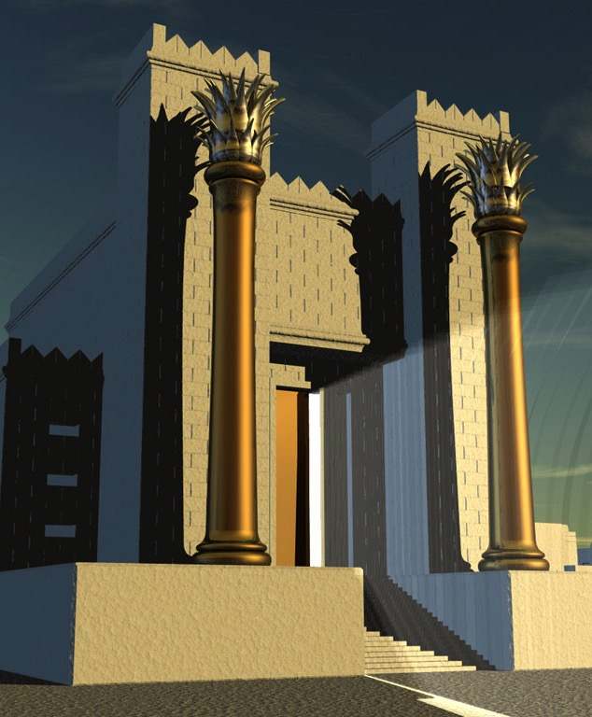
성경책 구성하기:
구약성경 줄 세우기
성경책
구성하기
(사)
역사서 (12)
다
언
열두 권의
(다)
}
(솔)
“역사서”
(내전)
(
)
끼워 넣은 것
기억하기
22
2
Notes:
Now let's move to the next set of books, traditionally organized in the
//// group of 12 books called HISTORY.
//// Pay close attention to the wedge shaped piece cut out of the HISTORY block. We'll explain its use shortly because it is extremely important in organizing your thinking about the Old Testament. Once again the books listed here will line up horizontally with the file folders of the chronology in THE BIBLE FILE. The time line for the HISTORY extends from around 1400 B.C. to 500 B.C.

Slide 23
여호수아
성경책 구성하기:
구약성경 줄 세우기
성경책
구성하기
(사)
역사서 (12)
다
언
열두 권의
(다)
}
(솔
“역사서”
(내전)
(
)
대략적인 성경 시간대 :
주전 1400년부터 1350년
22
2
Notes:
Now let's move to the next set of books, traditionally organized in the
//// group of 12 books called HISTORY.
//// Pay close attention to the wedge shaped piece cut out of the HISTORY block. We'll explain its use shortly because it is extremely important in organizing your thinking about the Old Testament. Once again the books listed here will line up horizontally with the file folders of the chronology in THE BIBLE FILE. The time line for the HISTORY extends from around 1400 B.C. to 500 B.C.

Slide 24
여호수아
성경책 구성하기:
구약성경 줄 세우기
사사기
성경책
구성하기
(사)
역사서 (12)
다
언
열두 권의
(다)
}
(솔)
“역사서”
(내전)
(
)
대략적인 성경 시간대 :
주전 1400년부터 1050년
22
2
Notes:
Now let's move to the next set of books, traditionally organized in the
//// group of 12 books called HISTORY.
//// Pay close attention to the wedge shaped piece cut out of the HISTORY block. We'll explain its use shortly because it is extremely important in organizing your thinking about the Old Testament. Once again the books listed here will line up horizontally with the file folders of the chronology in THE BIBLE FILE. The time line for the HISTORY extends from around 1400 B.C. to 500 B.C.

Slide 25
여호수아
성경책 구성하기:
구약성경 줄 세우기
사사기
룻기
성경책
구성하기
(사)
역사서 (12)
다
언
열두 권의
(다)
}
(솔)
“역사서”
(내전)
(
)
대략적인 성경 시간대 :
주전 1100년
22
2
Notes:
Now let's move to the next set of books, traditionally organized in the
//// group of 12 books called HISTORY.
//// Pay close attention to the wedge shaped piece cut out of the HISTORY block. We'll explain its use shortly because it is extremely important in organizing your thinking about the Old Testament. Once again the books listed here will line up horizontally with the file folders of the chronology in THE BIBLE FILE. The time line for the HISTORY extends from around 1400 B.C. to 500 B.C.

Slide 26
여호수아
성경책 구성하기:
구약성경 줄 세우기
사울
사사기
룻기
성경책
구성하기
다윗
(사)
역사서 (12)
다
언
열두 권의
솔로몬
(다)
}
(솔)
“역사서”
(내전)
국내전쟁
(
)
대략적인 성경 시간대 :
주전 1050년부터 600년
22
2
Notes:
Now let's move to the next set of books, traditionally organized in the
//// group of 12 books called HISTORY.
//// Pay close attention to the wedge shaped piece cut out of the HISTORY block. We'll explain its use shortly because it is extremely important in organizing your thinking about the Old Testament. Once again the books listed here will line up horizontally with the file folders of the chronology in THE BIBLE FILE. The time line for the HISTORY extends from around 1400 B.C. to 500 B.C.

Slide 27
여호수아
성경책 구성하기:
구약성경 줄 세우기
사사기
룻기
성경책
구성하기
사무엘상
(사)
역사서 (12)
삼하
다
언
열두 권의
(다)
}
(솔)
“역사서”
(내전)
(
)
대략적인 성경 시간대 :
주전 1050년부터 970년
22
2
Notes:
Now let's move to the next set of books, traditionally organized in the
//// group of 12 books called HISTORY.
//// Pay close attention to the wedge shaped piece cut out of the HISTORY block. We'll explain its use shortly because it is extremely important in organizing your thinking about the Old Testament. Once again the books listed here will line up horizontally with the file folders of the chronology in THE BIBLE FILE. The time line for the HISTORY extends from around 1400 B.C. to 500 B.C.

Slide 28
여호수아
성경책 구성하기:
구약성경 줄 세우기
사사기
룻기
성경책
구성하기
사무엘상
(사)
역사서 (12)
삼하
다
언
열두 권의
(다)
}
열왕기상
(솔)
왕하
“역사서”
(내전)
(
)
대략적인 성경 시간대 :
주전 970년부터 600년
22
2
Notes:
Now let's move to the next set of books, traditionally organized in the
//// group of 12 books called HISTORY.
//// Pay close attention to the wedge shaped piece cut out of the HISTORY block. We'll explain its use shortly because it is extremely important in organizing your thinking about the Old Testament. Once again the books listed here will line up horizontally with the file folders of the chronology in THE BIBLE FILE. The time line for the HISTORY extends from around 1400 B.C. to 500 B.C.

Slide 29
여호수아
성경책 구성하기:
구약성경 줄 세우기
사사기
룻기
성경책
구성하기
사무엘상
(사)
역사서 (12)
삼하
다
언
열두 권의
(다)
}
열왕기상
(솔)
왕하
“역사서”
(내전)
(
)
대략적인 성경 시간대 :
주전 1050년부터 600년
22
2
Notes:
Now let's move to the next set of books, traditionally organized in the
//// group of 12 books called HISTORY.
//// Pay close attention to the wedge shaped piece cut out of the HISTORY block. We'll explain its use shortly because it is extremely important in organizing your thinking about the Old Testament. Once again the books listed here will line up horizontally with the file folders of the chronology in THE BIBLE FILE. The time line for the HISTORY extends from around 1400 B.C. to 500 B.C.

Slide 30
여호수아
(사)
(다)
(솔)
(내전)
성경책 구성하기:
구약성경 줄 세우기
사울
사사기
룻기
성경책
구성하기
다윗
사무엘상
(사)
역사서 (12)
삼하
다
언
열두 권의
(다)
}
열왕기상
(솔)
솔로몬
왕하
“역사서”
(내전)
(
)
국내전쟁
대략적인 성경 시간대 :
주전 1050년부터 600년
22
2
Notes:
Now let's move to the next set of books, traditionally organized in the
//// group of 12 books called HISTORY.
//// Pay close attention to the wedge shaped piece cut out of the HISTORY block. We'll explain its use shortly because it is extremely important in organizing your thinking about the Old Testament. Once again the books listed here will line up horizontally with the file folders of the chronology in THE BIBLE FILE. The time line for the HISTORY extends from around 1400 B.C. to 500 B.C.

Slide 31
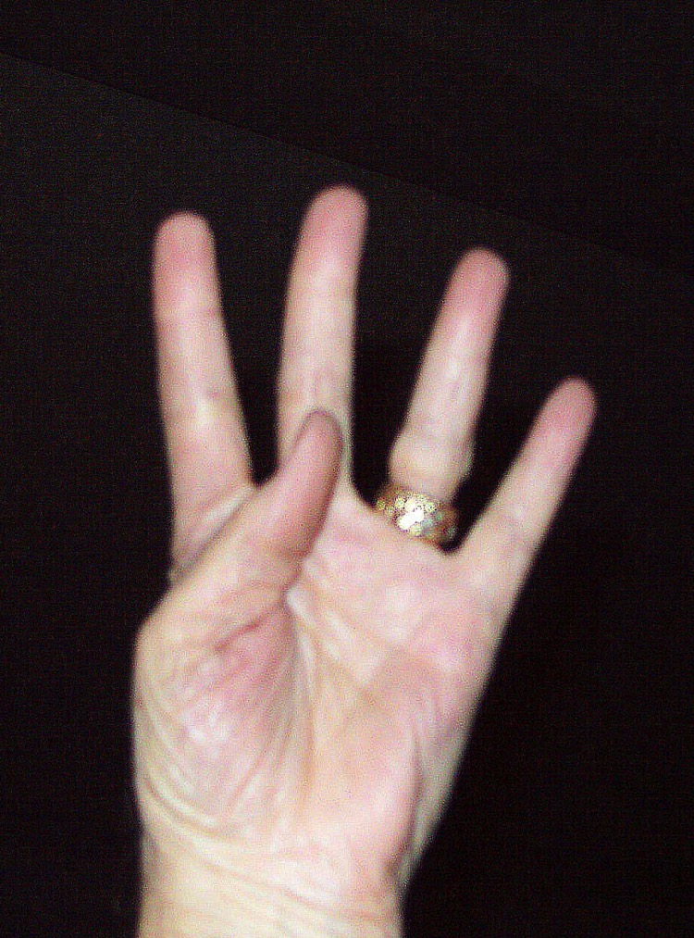
성경책 구성하기:
구약성경 줄 세우기
사무엘하
사무엘상
다윗
사울
다
열왕기상
사
솔로몬
성경책
구성하기
솔
열왕기하
국내전쟁
내전
열두 권의
“역사서”
대략적인 성경 시간대 :
주전 1050년부터 600년
22
2
Notes:
Now let's move to the next set of books, traditionally organized in the
//// group of 12 books called HISTORY.
//// Pay close attention to the wedge shaped piece cut out of the HISTORY block. We'll explain its use shortly because it is extremely important in organizing your thinking about the Old Testament. Once again the books listed here will line up horizontally with the file folders of the chronology in THE BIBLE FILE. The time line for the HISTORY extends from around 1400 B.C. to 500 B.C.

Slide 32
성경책 구성하기:
구약성경 줄 세우기
사무엘하
사무엘상
다윗
사울
다
열왕기상
사
솔로몬
성경책
구성하기
솔
열왕기하
국내전쟁
내전
열두 권의
“역사서”
대략적인 성경 시간대 :
주전 1050년부터 600년
22
2
Notes:
Now let's move to the next set of books, traditionally organized in the
//// group of 12 books called HISTORY.
//// Pay close attention to the wedge shaped piece cut out of the HISTORY block. We'll explain its use shortly because it is extremely important in organizing your thinking about the Old Testament. Once again the books listed here will line up horizontally with the file folders of the chronology in THE BIBLE FILE. The time line for the HISTORY extends from around 1400 B.C. to 500 B.C.

Slide 33
여호수아
성경책 구성하기:
구약성경 줄 세우기
사사기
룻기
성경책
구성하기
사무엘상
(사)
역사서 (12)
다윗의
언약
삼하7:16
삼하
다
언
열두 권의
(다)
}
열왕기상
(솔)
왕하
“역사서”
(내전)
(
)
대략적인 성경 시간대 :
주전 1000년
22
2
Notes:
Now let's move to the next set of books, traditionally organized in the
//// group of 12 books called HISTORY.
//// Pay close attention to the wedge shaped piece cut out of the HISTORY block. We'll explain its use shortly because it is extremely important in organizing your thinking about the Old Testament. Once again the books listed here will line up horizontally with the file folders of the chronology in THE BIBLE FILE. The time line for the HISTORY extends from around 1400 B.C. to 500 B.C.

Slide 34
여호수아
성경책 구성하기:
구약성경 줄 세우기
사사기
룻기
성경책
구성하기
사무엘상
(사)
역사서 (12)
삼하
다
언
열두 권의
(다)
}
열왕기상
(솔)
왕하
“역사서”
(내전)
(
)
대략적인 성경 시간대 :
주전 970년부터 550년
22
2
Notes:
Now let's move to the next set of books, traditionally organized in the
//// group of 12 books called HISTORY.
//// Pay close attention to the wedge shaped piece cut out of the HISTORY block. We'll explain its use shortly because it is extremely important in organizing your thinking about the Old Testament. Once again the books listed here will line up horizontally with the file folders of the chronology in THE BIBLE FILE. The time line for the HISTORY extends from around 1400 B.C. to 500 B.C.

Slide 35
여호수아
성경책 구성하기:
구약성경 줄 세우기
사사기
룻기
성경책
구성하기
사무엘상
(사)
역사서 (12)
다
언
}
사무엘하 열왕기하
삼하
(다)
}
열왕기상
(솔)
왕하
(내전)
역대기 역사서:
(
역대상
)
일반적으로: 같은 자료...
역대하
대략적인 성경 시간대 :
주전 970년부터 550년
22
2
Notes:
Now let's move to the next set of books, traditionally organized in the
//// group of 12 books called HISTORY.
//// Pay close attention to the wedge shaped piece cut out of the HISTORY block. We'll explain its use shortly because it is extremely important in organizing your thinking about the Old Testament. Once again the books listed here will line up horizontally with the file folders of the chronology in THE BIBLE FILE. The time line for the HISTORY extends from around 1400 B.C. to 500 B.C.

Slide 36
여호수아
성경책 구성하기:
구약성경 줄 세우기
사사기
룻기
성경책
구성하기
선지자적
관점
사무엘상
(사)
역사서 (12)
삼하
다
언
흥미로운 병렬 배치:
(다)
}
열왕기상
(솔)
동일한 시간 틀
왕하
다수의 동일한 사건들
(내전)
(
역대상
)
다량의 동일한 기록들
역대하
제사장적
관점
대략적인 성경 시간대 :
주전 970년부터 550년
22
2
Notes:
Now let's move to the next set of books, traditionally organized in the
//// group of 12 books called HISTORY.
//// Pay close attention to the wedge shaped piece cut out of the HISTORY block. We'll explain its use shortly because it is extremely important in organizing your thinking about the Old Testament. Once again the books listed here will line up horizontally with the file folders of the chronology in THE BIBLE FILE. The time line for the HISTORY extends from around 1400 B.C. to 500 B.C.

Slide 37
여호수아
성경책 구성하기:
구약성경 줄 세우기
사사기
룻기
성경책
구성하기
위대한
왕국의 분열:
한 개의
통일 왕국이
두 개의 분열
왕국이 됨
사무엘상
(사)
역사서 (12)
삼하
다
언
흥미로운 병렬 배치:
(다)
}
열왕기상
(솔)
동일한 시간 틀
왕하
다수의 동일한 사건들
(내전)
(
역대상
)
다량의 동일한 기록들
역대하
대략적인 성경 시간대 :
주전 1400년부터 1350년
22
2
Notes:
Now let's move to the next set of books, traditionally organized in the
//// group of 12 books called HISTORY.
//// Pay close attention to the wedge shaped piece cut out of the HISTORY block. We'll explain its use shortly because it is extremely important in organizing your thinking about the Old Testament. Once again the books listed here will line up horizontally with the file folders of the chronology in THE BIBLE FILE. The time line for the HISTORY extends from around 1400 B.C. to 500 B.C.

Slide 38
여호수아
성경책 구성하기:
구약성경 줄 세우기
사사기
룻기
성경책
구성하기
사무엘상
(사)
역사서 (12)
삼하
다
언
열두 권의
(다)
}
열왕기상
(솔)
왕하
“역사서”
(내전)
(
역대상
)
역대하
에스라
대략적인 성경 시간대 :
주전 550년부터 450년
22
2
Notes:
Now let's move to the next set of books, traditionally organized in the
//// group of 12 books called HISTORY.
//// Pay close attention to the wedge shaped piece cut out of the HISTORY block. We'll explain its use shortly because it is extremely important in organizing your thinking about the Old Testament. Once again the books listed here will line up horizontally with the file folders of the chronology in THE BIBLE FILE. The time line for the HISTORY extends from around 1400 B.C. to 500 B.C.

Slide 39
여호수아
성경책 구성하기:
구약성경 줄 세우기
사사기
룻기
성경책
구성하기
사무엘상
(사)
역사서 (12)
삼하
다
언
열두 권의
(다)
}
열왕기상
(솔)
왕하
“역사서”
(내전)
(
역대상
)
역대하
에스라
대략적인 성경 시간대 :
주전 450년
느헤미야
22
2
Notes:
Now let's move to the next set of books, traditionally organized in the
//// group of 12 books called HISTORY.
//// Pay close attention to the wedge shaped piece cut out of the HISTORY block. We'll explain its use shortly because it is extremely important in organizing your thinking about the Old Testament. Once again the books listed here will line up horizontally with the file folders of the chronology in THE BIBLE FILE. The time line for the HISTORY extends from around 1400 B.C. to 500 B.C.

Slide 40
여호수아
성경책 구성하기:
구약성경 줄 세우기
사사기
룻기
성경책
구성하기
사무엘상
(사)
역사서 (12)
삼하
다
언
열두 권의
(다)
}
열왕기상
(솔)
왕하
“역사서”
(내전)
(
역대상
)
역대하
에스라
대략적인 성경 시간대 :
주전 480년
느헤미야
에스더
22
2
Notes:
Now let's move to the next set of books, traditionally organized in the
//// group of 12 books called HISTORY.
//// Pay close attention to the wedge shaped piece cut out of the HISTORY block. We'll explain its use shortly because it is extremely important in organizing your thinking about the Old Testament. Once again the books listed here will line up horizontally with the file folders of the chronology in THE BIBLE FILE. The time line for the HISTORY extends from around 1400 B.C. to 500 B.C.

Slide 41
여호수아
성경책 구성하기:
구약성경 줄 세우기
사사기
룻기
성경책
구성하기
사무엘상
(사)
역사서 (12)
삼하
다
언
열두 권의
(다)
}
열왕기상
(솔)
왕하
“역사서”
(내전)
(
역대상
)
역대하
에스라
대략적인 성경 시간대 :
주전 1400년부터 440년
느헤미야
에스더
22
2
Notes:
Now let's move to the next set of books, traditionally organized in the
//// group of 12 books called HISTORY.
//// Pay close attention to the wedge shaped piece cut out of the HISTORY block. We'll explain its use shortly because it is extremely important in organizing your thinking about the Old Testament. Once again the books listed here will line up horizontally with the file folders of the chronology in THE BIBLE FILE. The time line for the HISTORY extends from around 1400 B.C. to 500 B.C.

Slide 42
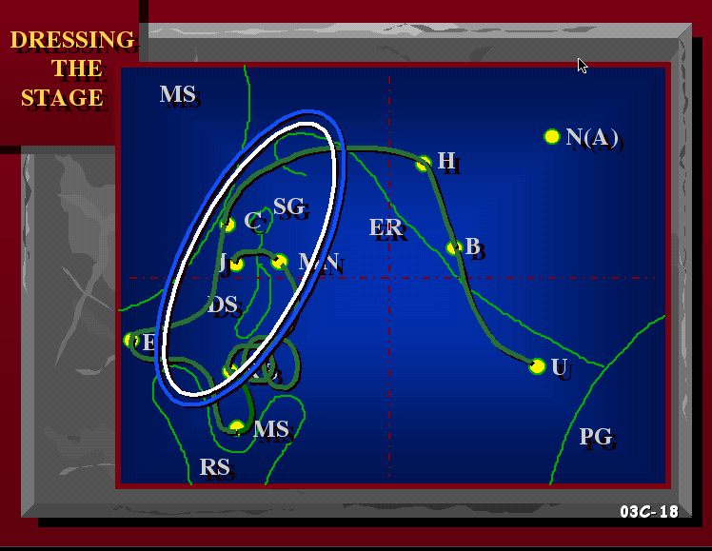
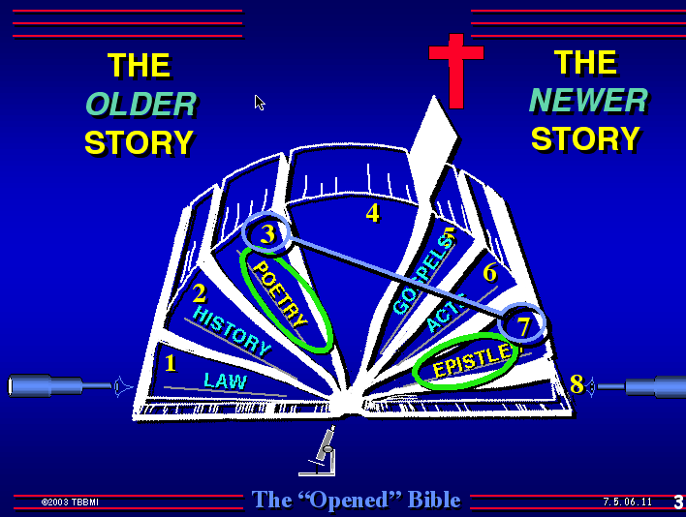
THE CHRONOLOGY
LAW & HISTORIES
시가서 & 예언서
기억하기 위한 방법
42
4
Notes:
Now we move to the third column of the worksheet for “Setting Up The Books” ...containing the book collections known as POETRY and THE PROPHETS.
//// Beginning with the collection of works known as THE 5 BOOKS OF POETRY. As to their place in the order of things....think of it this way...
//// …just as we did back in THE OPENED BIBLE section of THE BIBLE…BASICALLY. This thought: only after a culture has become rather settled can an atmosphere of intellectuality and introspection begin to settle in. In other words, there is time for thinkers to think.
That is the circumstance with books of POETRY.
Except for the Book of Job!
//// Each of the remaining five books in this group were penned when Israel was at the height of her international prestige and political power. So, to begin with the books of POETRY…

Slide 43
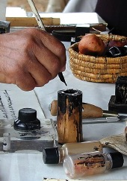
성경책 구성하기:
구약성경 줄 세우기
2.
욥
아브라함
다른 모든 “시가서들”은 “왕정” 시대에 쓰여졌다.
“시가서”
요지:
아브라함
욥기
7.
“욥기”는
왕정시대 이전에
쓰여졌다.
POETRY (5)
7.
7.
7.
43
4
Notes:
Here is the POETRY box greatly enlarged. Each entry has two short lines...
//// one for the name of the book, and to the side, a line for a short identification phrase about it. You'll also see thick arrows and some numbers. You'll learn about each of those as we get to them.
To begin....the top line...with the number 2....the 2 referring to file folder number 2 ... which is the first of THE FOUR GREAT PEOPLE on the left side of the sheet…ABRAHAM. The thick arrow crosses the page to direct your attention to that folder.
So…In THE POETRY BOX, first line,
//// write in JOB...and next to it, you see the word "circa" meaning "around the time of..." then… add ABRAHAM.
//// Next to these words, you'll also see that the lines and the fill-ins have been enlarged for clarity. Even here, please abbreviate the information to fit it all in.
//// Many scholars tell us that the book of JOB was written far earlier than the other POETRY BOOKS. In fact, from certain linguistic clues in the text, they are quite sure that JOB was living in the same general time period as ABRAHAM. (Thus…the arrow pointing straight across to THE BIBLE FILE folders on the left.) Which only means, then, that GOD was also carrying on His work in other places for which we have little knowledge. But He HAS told us about his work with old and faithful JOB. That's the other arrow we mentioned earlier.

Slide 44
성경책 구성하기:
구약성경 줄 세우기
2.
욥
아브라함
“시가서”
다른 모든 “시가서들”은 “왕정” 시대에 쓰여졌다.
아브라함
요지:
욥기
7.
시가서 (5)
7.
다른 모든
“시가서들”은
“왕정” 시대에
쓰여졌다
7.
7.
.
44
Notes:
Next...except for JOB, all of the other books of POETRY come from the time of DAVID, SOLOMON and the ROYALTY period. Now follow the thick arrow down from the POETRY box...

Slide 45

성경책 구성하기:
구약성경 줄 세우기
여호수아
(북왕국) 이스라엘로
(북)
아모스
“시가서”
사사기
호세아
(니느웨)
룻기
요나
(남)
아브라함
*
요지:
유다를 향해 (쇠망행 가는)
욥기
역사서 (12)
이사야
사무엘상
요엘
(사)
}
미가
사무엘 하
다언
(에돔)
(다)
오바댜
열왕기상
*
(남)
(솔)
위기의 유다로
신약
열왕기하
예레미야
(내전)
선지자들은
“분열” 이후
400년이 넘는
기간 동안
기록했다.
예레미야애가
( )
역대상
하박국
역대하
(니느웨)
에스라
나훔
다른 모든
“시가서들”은
“왕정” 시대에
쓰여졌다
느헤미야
스바냐
*
에스더
유대를 향하여 (포로생활 중)
(남)
에스겔
*
다니엘
귀환한 유대를 향하여
(남)
학개
스가랴
.
말라기
44
Notes:
Next...except for JOB, all of the other books of POETRY come from the time of DAVID, SOLOMON and the ROYALTY period. Now follow the thick arrow down from the POETRY box...

Slide 46
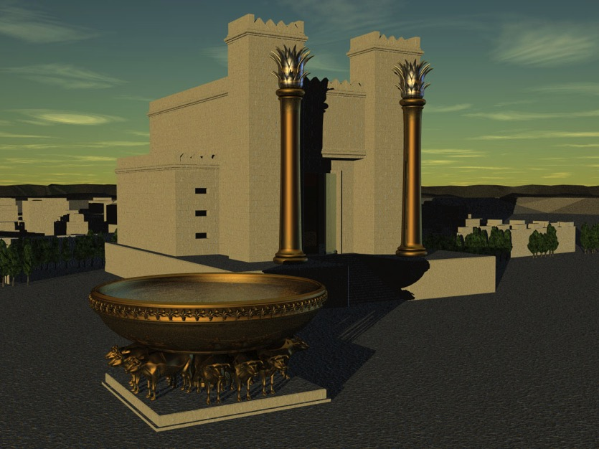
성경책 구성하기:
구약성경 줄 세우기
2.
욥
아브라함
“시가서”
다른 모든
“시가서들”은
“왕정”시대에
쓰여졌다.
아브라함
요지:
욥기
7.
시편
찬양
시가서 (5)
시편
찬양
7.
7.
7.
46
1
Notes:
Next in the POETRY collection comes the book of PSALMS. The number 7 identifies it with the ROYALTY folder on the left.
Magnified off to the side…its identifying phrase...PRAISE...because half of the PSALMS are specifically designed as praise psalms. Also, most are written by KING DAVID. The remainder of the PSALMS are the work of various persons associated with the worship services of the Temple. Remember that the main purpose of a Psalm is for a musical experience in the worship of God. In the Psalms also, reference is made again to the Davidic promises from God to David, assuring him that there would always be a king of his line to sit on that Davidic throne.

Slide 47
성경책 구성하기:
구약성경 줄 세우기
2.
욥
아브라함
“시가서”
다른 모든
“시가서들”은
“왕정”시대에
쓰여졌다.
아브라함
요지:
욥기
7.
시편
찬양
시가서 (5)
시편
찬양
7.
잠언
지혜로운
솔로몬
잠언
지혜로운
솔로몬
7.
7.
46
1
Notes:
Next in the POETRY collection comes the book of PSALMS. The number 7 identifies it with the ROYALTY folder on the left.
Magnified off to the side…its identifying phrase...PRAISE...because half of the PSALMS are specifically designed as praise psalms. Also, most are written by KING DAVID. The remainder of the PSALMS are the work of various persons associated with the worship services of the Temple. Remember that the main purpose of a Psalm is for a musical experience in the worship of God. In the Psalms also, reference is made again to the Davidic promises from God to David, assuring him that there would always be a king of his line to sit on that Davidic throne.

Slide 48

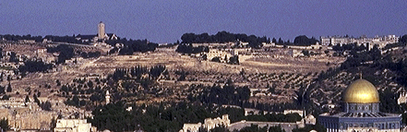
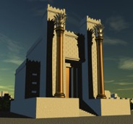
성경책 구성하기:
구약성경 줄 세우기
2.
욥
아브라함
“시가서”
다른 모든
“시가서들”은
“왕정”시대에
쓰여졌다.
아브라함
요지:
감란산
욥기
7.
시편
찬양
시가서 (5)
시편
찬양
잠언
지혜로운
솔로몬
성산
7.
잠언
지혜로운
솔로몬
전도서
솔로몬의
삶
7.
전도서
솔로몬의
삶
7.
46
1
Notes:
Next in the POETRY collection comes the book of PSALMS. The number 7 identifies it with the ROYALTY folder on the left.
Magnified off to the side…its identifying phrase...PRAISE...because half of the PSALMS are specifically designed as praise psalms. Also, most are written by KING DAVID. The remainder of the PSALMS are the work of various persons associated with the worship services of the Temple. Remember that the main purpose of a Psalm is for a musical experience in the worship of God. In the Psalms also, reference is made again to the Davidic promises from God to David, assuring him that there would always be a king of his line to sit on that Davidic throne.

Slide 49
성경책 구성하기:
구약성경 줄 세우기
2.
욥
아브라함
“시가서”
다른 모든
“시가서들”은
“왕정”시대에
쓰여졌다.
아브라함
요지:
감란산
욥기
7.
시편
찬양
시가서 (5)
시편
찬양
7.
잠언
지혜로운
솔로몬
잠언
지혜로운
솔로몬
전도서
솔로몬의
삶
7.
전도서
솔로몬의
삶
7.
아가
솔로몬의
결혼
아가
솔로몬의
결혼
46
1
Notes:
Next in the POETRY collection comes the book of PSALMS. The number 7 identifies it with the ROYALTY folder on the left.
Magnified off to the side…its identifying phrase...PRAISE...because half of the PSALMS are specifically designed as praise psalms. Also, most are written by KING DAVID. The remainder of the PSALMS are the work of various persons associated with the worship services of the Temple. Remember that the main purpose of a Psalm is for a musical experience in the worship of God. In the Psalms also, reference is made again to the Davidic promises from God to David, assuring him that there would always be a king of his line to sit on that Davidic throne.

Slide 50
성경책 구성하기:
구약성경 줄 세우기
2.
욥
아브라함
“시가서”
다른 모든
“시가서들”은
“왕정”시대에
쓰여졌다.
아브라함
요지:
감란산
욥기
7.
시편
찬양
시가서 (5)
시편
찬양
7.
잠언
지혜로운
솔로몬
잠언
지혜로운
솔로몬
전도서
솔로몬의
삶
7.
전도서
솔로몬의
삶
7.
아가
솔로몬의
결혼
아가
솔로몬의
결혼
46
1
Notes:
Next in the POETRY collection comes the book of PSALMS. The number 7 identifies it with the ROYALTY folder on the left.
Magnified off to the side…its identifying phrase...PRAISE...because half of the PSALMS are specifically designed as praise psalms. Also, most are written by KING DAVID. The remainder of the PSALMS are the work of various persons associated with the worship services of the Temple. Remember that the main purpose of a Psalm is for a musical experience in the worship of God. In the Psalms also, reference is made again to the Davidic promises from God to David, assuring him that there would always be a king of his line to sit on that Davidic throne.

Slide 51
성경책 구성하기:
구약성경 줄 세우기
욥기
2.
욥
아브라함
“시가서”
다른 모든
“시가서들”은
“왕정”시대에
쓰여졌다.
시편
아브라함
요지:
감란산
욥기
7.
시편
절반은 다윗
모세 1편
시가서 (5)
시편
찬양
잠언
7.
잠언
지혜로운
솔로몬
잠언
지혜로운
솔로몬
전도서
솔로몬의
삶
7.
전도서
전도서
솔로몬의
삶
7.
아가
솔로몬의
결혼
아가
아가
솔로몬의
결혼
46
1
Notes:
Next in the POETRY collection comes the book of PSALMS. The number 7 identifies it with the ROYALTY folder on the left.
Magnified off to the side…its identifying phrase...PRAISE...because half of the PSALMS are specifically designed as praise psalms. Also, most are written by KING DAVID. The remainder of the PSALMS are the work of various persons associated with the worship services of the Temple. Remember that the main purpose of a Psalm is for a musical experience in the worship of God. In the Psalms also, reference is made again to the Davidic promises from God to David, assuring him that there would always be a king of his line to sit on that Davidic throne.

Slide 52
대단히
감사합니다!
이제
제가
이 모든
선지서에 대하여
무엇을 할까요?
그러나...
저는 그것을
저의 목사님이
하게 하려고요.
52
1
©2006 TBBMI
9.6.07.
Notes:
Now we come to that part of the Old Testament that, quite frankly, causes many people to simply close the Bible. And that's THE 17 BOOKS OF THE PROPHETS. What to do with all those prophets?
//// As we said much earlier in this study...many people just say... "THANK YOU VERY MUCH...BUT I'LL JUST LET THE PASTOR DO IT."
Well, if you fall in that category of Bible readers, let's help you through that problem…

Slide 53
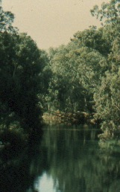
성경책 구성하기:
구약성경 줄 세우기
(북)
재배열 하기
열 일곱 권의
“선지서들"
(남)
*
사무엘상
(사)
(다)
사무엘하
}
(솔)
열왕기상
선지서 (17)
열왕기하
(남)
(내전)
*
신
약
(
역대상
)
*
역대하
선지자들은
“분열왕국” 이후
400년에 걸쳐
기록했다.
에스라
끼워 넣기에
주목할 것
느헤미야
에스더
.
(남)
*
*
(남)
대략적인 시간 대:
주전 840년에서 430년
9.6.07.
1
© 2006 TBBMI
53
Notes:
… right here. On the Study Help worksheet,…
//// …you have probably noticed that wedge shape cut into the HISTORY block. It has been mentioned before. Now notice that in THE PROPHETS block -- with its 17 lines for the book titles -- there is a protruding shape that fits exactly into the wedge shape cut out of THE HISTORY block on its left.

Slide 54
성경책 구성하기:
구약성경 줄 세우기
(북)
재배열 하기
열 일곱 권의
“선지서들"
(남)
*
사무엘상
(사)
사무엘하
}
THE PROPHETS WROTE IN A 400-YEAR PERIOD AFTER THE NATIONAL “SPLIT.”
(다)
열왕기상
(솔)
선지서 (17)
열왕기하
(남)
(내전)
*
신
약
(
역대상
)
*
역대하
선지자들은
“분열왕국” 이후
400년에 걸쳐
기록했다.
에스라
끼워 넣기에
주목할 것
느헤미야
에스더
.
(남)
*
*
(남)
대략적인 시간 대:
주전 840년에서 430년
9.6.07.
1
© 2006 TBBMI
53
Notes:
… right here. On the Study Help worksheet,…
//// …you have probably noticed that wedge shape cut into the HISTORY block. It has been mentioned before. Now notice that in THE PROPHETS block -- with its 17 lines for the book titles -- there is a protruding shape that fits exactly into the wedge shape cut out of THE HISTORY block on its left.

Slide 55
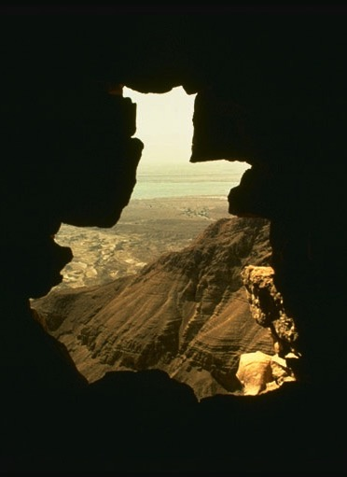
성경책 구성하기:
구약성경 줄 세우기
(북)
(남)
첫 페이지부터
마지막까지...
선지서는
성경 전체를 단지
떠돌지는 않다.
*
사무엘상
(사)
(다)
사무엘하
}
(솔)
열왕기상
선지서 (17)
열왕기하
(남)
(내전)
*
신
약
(
역대상
)
*
역대하
선지자들은
“분열왕국” 이후
400년에 걸쳐
기록했다.
에스라
느헤미야
에스더
.
(남)
*
*
(남)
대략적인 시간 대:
주전 840년부터 430년
9.6.07.
1
© 2006 TBBMI
53
Notes:
… right here. On the Study Help worksheet,…
//// …you have probably noticed that wedge shape cut into the HISTORY block. It has been mentioned before. Now notice that in THE PROPHETS block -- with its 17 lines for the book titles -- there is a protruding shape that fits exactly into the wedge shape cut out of THE HISTORY block on its left.

Slide 56
성경책 구성하기:
구약성경 줄 세우기
(북)
두 가지 문제는...
(남)
*
사무엘상
문제 #1: 명확한 순서가 없다.
(사)
(다)
사무엘하
}
(솔)
열왕기상
선지서 (17)
열왕기하
(남)
(내전)
*
신
약
(
역대상
)
*
역대하
선지자들은
“분열왕국” 이후
400년에 걸쳐
기록했다.
단지,
대선지서와
소선지서로
모아놓았을 뿐이다.
에스라
느헤미야
에스더
.
(남)
*
*
(남)
9.6.07.
1
© 2006 TBBMI
53
Notes:
… right here. On the Study Help worksheet,…
//// …you have probably noticed that wedge shape cut into the HISTORY block. It has been mentioned before. Now notice that in THE PROPHETS block -- with its 17 lines for the book titles -- there is a protruding shape that fits exactly into the wedge shape cut out of THE HISTORY block on its left.

Slide 57
성경책 구성하기:
구약성경 줄 세우기
(북)
(예, 이사야)
(남)
대선지서:
매우 긴
저작
*
사무엘상
(사)
(다)
사무엘하
}
(솔)
열왕기상
선지서 (17)
(남)
(예, 요나)
(내전)
열왕기하
신
약
*
(
역대상
)
*
소선지서:
보다 짧은
저작
역대하
선지자들은
“분열왕국” 이후
400년에 걸쳐
기록했다.
에스라
느헤미야
에스더
.
(남)
*
*
(남)
9.6.07.
1
© 2006 TBBMI
53
Notes:
… right here. On the Study Help worksheet,…
//// …you have probably noticed that wedge shape cut into the HISTORY block. It has been mentioned before. Now notice that in THE PROPHETS block -- with its 17 lines for the book titles -- there is a protruding shape that fits exactly into the wedge shape cut out of THE HISTORY block on its left.

Slide 58
성경책 구성하기:
구약성경 줄 세우기
(북)
두 가지 문제는...
(남)
*
사무엘상
문제 #2: 명확한 순서가 없다.
(사)
(다)
사무엘하
}
(솔)
열왕기상
선지서 (17)
열왕기하
(남)
(내전)
*
신
약
(
역대상
)
*
역대하
선지자들은
“분열왕국” 이후
400년에 걸쳐
기록했다.
이스라엘 역사의 진행이 선지서의 순서와 들어맞지 않는다.
에스라
느헤미야
에스더
.
(남)
*
*
(남)
9.6.07.
1
© 2006 TBBMI
53
Notes:
… right here. On the Study Help worksheet,…
//// …you have probably noticed that wedge shape cut into the HISTORY block. It has been mentioned before. Now notice that in THE PROPHETS block -- with its 17 lines for the book titles -- there is a protruding shape that fits exactly into the wedge shape cut out of THE HISTORY block on its left.

Slide 59
성경책 구성하기:
구약성경 줄 세우기
(북)
그래서...
(남)
*
사무엘상
(사)
사무엘하
}
성서적인 기록(그리고 다른 역사)이 우리에게 말하는 대로, 선지서들을 사건들의 역사적 순서와 들어맞게 배치하는 것이 어떠한가?
(다)
열왕기상
(솔)
선지서 (17)
열왕기하
(남)
(내전)
*
신
약
(
역대상
)
*
역대하
선지자들은
“분열왕국” 이후
400년에 걸쳐
기록했다.
에스라
느헤미야
에스더
.
(남)
*
*
(남)
9.6.07.
1
© 2006 TBBMI
53
Notes:
… right here. On the Study Help worksheet,…
//// …you have probably noticed that wedge shape cut into the HISTORY block. It has been mentioned before. Now notice that in THE PROPHETS block -- with its 17 lines for the book titles -- there is a protruding shape that fits exactly into the wedge shape cut out of THE HISTORY block on its left.

Slide 60
성경책 구성하기:
구약성경 줄 세우기
(북)
재배열 하기
열 일곱 권의
“선지서들"
(남)
*
사무엘상
(사)
(다)
사무엘하
}
(솔)
열왕기상
선지서 (17)
열왕기하
(남)
(내전)
*
신
약
(
역대상
)
*
역대하
선지자들은
“분열왕국” 이후
400년에 걸쳐
기록했다.
연대기적인 순서로
그것들을 보라!
에스라
느헤미야
에스더
.
(남)
*
*
(남)
대략적인 시간 대:
주전 760년부터 430년
9.6.07.
1
© 2006 TBBMI
53
Notes:
… right here. On the Study Help worksheet,…
//// …you have probably noticed that wedge shape cut into the HISTORY block. It has been mentioned before. Now notice that in THE PROPHETS block -- with its 17 lines for the book titles -- there is a protruding shape that fits exactly into the wedge shape cut out of THE HISTORY block on its left.

Slide 61
성경책 구성하기:
구약성경 줄 세우기
(북)
재배열 하기
열 일곱 권의
“선지서들"
(남)
*
사무엘상
(사)
(다)
사무엘하
}
(솔)
열왕기상
선지서 (17)
열왕기하
(남)
(내전)
*
신
약
(
역대상
)
*
역대하
선지자들은
“분열왕국” 이후
400년에 걸쳐
기록했다.
연대기적인 순서로
그것들을 보라!
에스라
느헤미야
에스더
.
(남)
*
*
(남)
대략적인 시간 대:
주전 760년부터 430년
9.6.07.
1
© 2006 TBBMI
53
Notes:
… right here. On the Study Help worksheet,…
//// …you have probably noticed that wedge shape cut into the HISTORY block. It has been mentioned before. Now notice that in THE PROPHETS block -- with its 17 lines for the book titles -- there is a protruding shape that fits exactly into the wedge shape cut out of THE HISTORY block on its left.

Slide 62
성경책 구성하기:
구약성경 줄 세우기
(북왕국)
이스라엘을 향하여
(북)
재배열 하기
열 일곱 권의
“선지서들"
(남)
*
사무엘상
(사)
(다)
사무엘하
}
(솔)
열왕기상
선지서 (17)
열왕기하
(남)
(내전)
*
신
약
(
역대상
)
*
선지자들은
“분열왕국” 이후
400년에 걸쳐
기록했다.
연대기적인 순서로
그것들을 보라!
역대하
에스라
느헤미야
에스더
.
(남)
*
우선…
이스라엘로 향한 자들
(북왕국)
*
(남)
9.6.07.
1
© 2006 TBBMI
53
Notes:
… right here. On the Study Help worksheet,…
//// …you have probably noticed that wedge shape cut into the HISTORY block. It has been mentioned before. Now notice that in THE PROPHETS block -- with its 17 lines for the book titles -- there is a protruding shape that fits exactly into the wedge shape cut out of THE HISTORY block on its left.

Slide 63
성경책 구성하기:
구약성경 줄 세우기
(북왕국)
이스라엘을 향하여
(북)
재배열 하기
열 일곱 권의
“선지서들"
쇠락하는
유다를 향하여
(남)
*
사무엘상
(사)
(다)
사무엘하
}
(솔)
열왕기상
선지서 (17)
열왕기하
(남)
(내전)
*
신
약
(
역대상
)
*
선지자들은
“분열왕국” 이후
400년에 걸쳐
기록했다.
연대기적인 순서로
그것들을 보라!
역대하
에스라
느헤미야
에스더
.
(남)
*
그 다음…
유다로 향한 자들
(남왕국)
*
(남)
9.6.07.
1
© 2006 TBBMI
53
Notes:
… right here. On the Study Help worksheet,…
//// …you have probably noticed that wedge shape cut into the HISTORY block. It has been mentioned before. Now notice that in THE PROPHETS block -- with its 17 lines for the book titles -- there is a protruding shape that fits exactly into the wedge shape cut out of THE HISTORY block on its left.

Slide 64
성경책 구성하기:
구약성경 줄 세우기
(북왕국)
이스라엘을 향하여
(북)
재배열 하기
열 일곱 권의
“선지서들"
쇠락하는
유다를 향하여
(남)
*
사무엘상
(사)
(다)
사무엘하
}
(솔)
열왕기상
선지서 (17)
열왕기하
위기의
유다를 향하여
(남)
(내전)
*
신
약
(
역대상
)
*
선지자들은
“분열왕국” 이후
400년에 걸쳐
기록했다.
연대기적인 순서로
그것들을 보라!
역대하
에스라
느헤미야
에스더
.
(남)
*
그 다음…
유다로 향한 자들
(남왕국)
*
(남)
9.6.07.
1
© 2006 TBBMI
53
Notes:
… right here. On the Study Help worksheet,…
//// …you have probably noticed that wedge shape cut into the HISTORY block. It has been mentioned before. Now notice that in THE PROPHETS block -- with its 17 lines for the book titles -- there is a protruding shape that fits exactly into the wedge shape cut out of THE HISTORY block on its left.

Slide 65
성경책 구성하기:
구약성경 줄 세우기
(북왕국)
이스라엘을 향하여
(북)
재배열 하기
열 일곱 권의
“선지서들"
쇠락하는
유다를 향하여
(남)
*
사무엘상
(사)
(다)
사무엘하
}
(솔)
열왕기상
선지서 (17)
열왕기하
위기의
유다를 향하여
(남)
(내전)
*
신
약
(
역대상
)
*
선지자들은
“분열왕국” 이후
400년에 걸쳐
기록했다.
연대기적인 순서로
그것들을 보라!
역대하
에스라
느헤미야
에스더
.
포로 생활 중의
유다를 향하여
(남)
*
그 다음…
유다로 향한 자들
(남왕국)
*
(남)
9.6.07.
1
© 2006 TBBMI
53
Notes:
… right here. On the Study Help worksheet,…
//// …you have probably noticed that wedge shape cut into the HISTORY block. It has been mentioned before. Now notice that in THE PROPHETS block -- with its 17 lines for the book titles -- there is a protruding shape that fits exactly into the wedge shape cut out of THE HISTORY block on its left.

Slide 66
성경책 구성하기:
구약성경 줄 세우기
(북왕국)
이스라엘을 향하여
(북)
재배열 하기
열 일곱 권의
“선지서들"
쇠락하는
유다를 향하여
(남)
*
사무엘상
(사)
(다)
사무엘하
}
(솔)
열왕기상
선지서 (17)
열왕기하
위기의
유다를 향하여
(남)
(내전)
*
신
약
(
역대상
)
*
선지자들은
“분열왕국” 이후
400년에 걸쳐
기록했다.
연대기적인 순서로
그것들을 보라!
역대하
에스라
느헤미야
에스더
.
포로 생활 중의
유다를 향하여
(남)
*
그 다음…
유다로 향한 자들
(남왕국)
*
귀환한
유다를 향하여
(남)
9.6.07.
1
© 2006 TBBMI
53
Notes:
… right here. On the Study Help worksheet,…
//// …you have probably noticed that wedge shape cut into the HISTORY block. It has been mentioned before. Now notice that in THE PROPHETS block -- with its 17 lines for the book titles -- there is a protruding shape that fits exactly into the wedge shape cut out of THE HISTORY block on its left.

Slide 67
성경책 구성하기:
구약성경 줄 세우기
(북왕국)
이스라엘을 향하여
(북)
쇠락하는
유다를 향하여
(남)
성경책
구성하기
*
사무엘상
(사)
(다)
사무엘하
}
열 일곱 권의
“선지서들"
(솔)
열왕기상
선지서 (17)
열왕기하
위기의
유다를 향하여
(남)
(내전)
*
신
약
(
역대상
)
*
역대하
선지자들은
“분열왕국” 이후
400년에 걸쳐
기록했다.
비-기록 선지자의
예:
에스라
느헤미야
에스더
.
포로 생활 중의
유다를 향하여
(남)
*
엘리야
엘리사
(그 외)
*
귀환한
유다를 향하여
(남)
9.6.07.
1
© 2006 TBBMI
53
Notes:
… right here. On the Study Help worksheet,…
//// …you have probably noticed that wedge shape cut into the HISTORY block. It has been mentioned before. Now notice that in THE PROPHETS block -- with its 17 lines for the book titles -- there is a protruding shape that fits exactly into the wedge shape cut out of THE HISTORY block on its left.

Slide 68
성경책 구성하기:
구약성경 줄 세우기
(북왕국)
이스라엘을 향하여
(북)
재배열 하기
열 일곱 권의
“선지서들"
쇠락하는
유다를 향하여
(남)
*
사무엘상
(사)
(다)
사무엘하
}
(솔)
열왕기상
선지서 (17)
열왕기하
위기의
유다를 향하여
(남)
(내전)
*
신
약
(
역대상
)
*
역대하
선지자들은
“분열왕국” 이후
400년에 걸쳐
기록했다.
별표들:
대선지서들
에스라
느헤미야
에스더
.
포로 생활 중의
유다를 향하여
(남)
*
*
귀환한
유다를 향하여
(남)
9.6.07.
1
© 2006 TBBMI
53
Notes:
… right here. On the Study Help worksheet,…
//// …you have probably noticed that wedge shape cut into the HISTORY block. It has been mentioned before. Now notice that in THE PROPHETS block -- with its 17 lines for the book titles -- there is a protruding shape that fits exactly into the wedge shape cut out of THE HISTORY block on its left.

Slide 69
성경책 구성하기:
구약성경 줄 세우기
(북왕국)
이스라엘을 향하여
아모스
호세아
(니느웨)
(북)
재배열 하기
열 일곱 권의
“선지서들"
요나
쇠락하는
유다를 향하여
(남)
*
사무엘상
(사)
(다)
사무엘하
}
(솔)
열왕기상
선지서 (17)
열왕기하
위기의
유다를 향하여
(남)
(내전)
*
신
약
“북쪽” 왕국으로
…이스라엘: 디아스포라…
(
역대상
)
*
역대하
선지자들은
“분열왕국” 이후
400년에 걸쳐
기록했다.
에스라
아모스
호세아
요나 (니느웨로)
느헤미야
에스더
.
포로 생활 중의
유다를 향하여
(남)
*
*
귀환한
유다를 향하여
(남)
대략적인 시간 대:
주전 760년부터 730년
9.6.07.
1
© 2006 TBBMI
53
Notes:
… right here. On the Study Help worksheet,…
//// …you have probably noticed that wedge shape cut into the HISTORY block. It has been mentioned before. Now notice that in THE PROPHETS block -- with its 17 lines for the book titles -- there is a protruding shape that fits exactly into the wedge shape cut out of THE HISTORY block on its left.

Slide 70
성경책 구성하기:
구약성경 줄 세우기
(북왕국)
이스라엘을 향하여
아모스
호세아
(니느웨)
(북)
재배열 하기
열 일곱 권의
“선지서들"
요나
쇠락하는
유다를 향하여
(남)
*
이사야
사무엘상
요엘
(사)
(다)
사무엘하
}
미가
열왕기상
(에돔)
(솔)
오바댜
선지서 (17)
열왕기하
위기의
유다를 향하여
(남)
(내전)
*
신
약
“남쪽” 왕국으로
…쇠망하는 유다…
(
역대상
)
*
역대하
선지자들은
“분열왕국” 이후
400년에 걸쳐
기록했다.
에스라
이사야
요엘
오바댜 (에돔으로)
느헤미야
에스더
.
포로 생활 중의
유다를 향하여
(남)
*
*
귀환한
유다를 향하여
(남)
대략적인 시간 대:
주전 830년부터 590년
9.6.07.
1
© 2006 TBBMI
53
Notes:
… right here. On the Study Help worksheet,…
//// …you have probably noticed that wedge shape cut into the HISTORY block. It has been mentioned before. Now notice that in THE PROPHETS block -- with its 17 lines for the book titles -- there is a protruding shape that fits exactly into the wedge shape cut out of THE HISTORY block on its left.

Slide 71
성경책 구성하기:
구약성경 줄 세우기
(북왕국)
이스라엘을 향하여
아모스
호세아
(니느웨)
(북)
재배열 하기
열 일곱 권의
“선지서들"
요나
쇠락하는
유다를 향하여
(남)
*
이사야
사무엘상
요엘
(사)
(다)
사무엘하
}
미가
열왕기상
(에돔)
(솔)
오바댜
선지서 (17)
열왕기하
위기의
유다를 향하여
(남)
(내전)
*
신
약
“남쪽” 왕국으로
…위기 속에 있는 유다…
(
)
예레미야
역대상
*
선지자들은
“분열왕국” 이후
400년에 걸쳐
기록했다.
예레미야애가
역대하
하박국
예레미야
예레미야애가
하박국
나훔(니느웨로)
스바냐
에스라
(니느웨)
나훔
느헤미야
스바냐
에스더
.
포로 생활 중의
유다를 향하여
(남)
*
*
귀환한
유다를 향하여
(남)
대략적인 시간 대:
주전 630년부터 600년
9.6.07.
1
© 2006 TBBMI
53
Notes:
… right here. On the Study Help worksheet,…
//// …you have probably noticed that wedge shape cut into the HISTORY block. It has been mentioned before. Now notice that in THE PROPHETS block -- with its 17 lines for the book titles -- there is a protruding shape that fits exactly into the wedge shape cut out of THE HISTORY block on its left.

Slide 72
성경책 구성하기:
구약성경 줄 세우기
(북왕국)
이스라엘을 향하여
아모스
호세아
(니느웨)
(북)
재배열 하기
열 일곱 권의
“선지서들"
요나
쇠락하는
유다를 향하여
(남)
*
이사야
NC
사무엘상
요엘
(사)
(다)
사무엘하
}
미가
열왕기상
(에돔)
(솔)
오바댜
선지서 (17)
열왕기하
위기의
유다를 향하여
(남)
(내전)
*
신
약
“남쪽” 왕국으로
(
)
예레미야
역대상
*
선지자들은
“분열왕국” 이후
400년에 걸쳐
기록했다.
예레미야애가
역대하
하박국
새 언약(신약)은
예레미야 31장 31절에
언급된다.
에스라
(니느웨)
나훔
느헤미야
스바냐
에스더
.
포로 생활 중의
유다를 향하여
(남)
*
*
귀환한
유다를 향하여
(남)
대략적인 시간 대:
대략 주전 595년
9.6.07.
1
© 2006 TBBMI
53
Notes:
… right here. On the Study Help worksheet,…
//// …you have probably noticed that wedge shape cut into the HISTORY block. It has been mentioned before. Now notice that in THE PROPHETS block -- with its 17 lines for the book titles -- there is a protruding shape that fits exactly into the wedge shape cut out of THE HISTORY block on its left.

Slide 73
성경책 구성하기:
구약성경 줄 세우기
(북왕국)
이스라엘을 향하여
아모스
호세아
(니느웨)
(북)
재배열 하기
열 일곱 권의
“선지서들"
요나
쇠락하는
유다를 향하여
(남)
*
이사야
사무엘상
요엘
(사)
(다)
사무엘하
}
미가
열왕기상
(에돔)
(솔)
오바댜
선지서 (17)
열왕기하
위기의
유다를 향하여
(남)
“남쪽” 왕국으로
...포로로 잡혀 간 유다...
(내전)
*
신
약
(
)
예레미야
역대상
*
선지자들은
“분열왕국” 이후
400년에 걸쳐
기록했다.
예레미야애가
역대하
하박국
에스라
(니느웨)
나훔
에스겔
다니엘
느헤미야
스바냐
에스더
.
포로 생활 중의
유다를 향하여
(남)
*
에스겔
*
다니엘
귀환한
유다를 향하여
(남)
대략적인 시간 대:
약 주전 600년
9.6.07.
1
© 2006 TBBMI
53
Notes:
… right here. On the Study Help worksheet,…
//// …you have probably noticed that wedge shape cut into the HISTORY block. It has been mentioned before. Now notice that in THE PROPHETS block -- with its 17 lines for the book titles -- there is a protruding shape that fits exactly into the wedge shape cut out of THE HISTORY block on its left.

Slide 74
성경책 구성하기:
구약성경 줄 세우기
(북왕국)
이스라엘을 향하여
아모스
호세아
(니느웨)
(북)
재배열 하기
열 일곱 권의
“선지서들"
요나
쇠락하는
유다를 향하여
(남)
*
이사야
사무엘상
요엘
(사)
(다)
사무엘하
}
미가
열왕기상
(에돔)
(솔)
오바댜
선지서 (17)
열왕기하
위기의
유다를 향하여
(남)
“남쪽” 왕국으로
...포로에서 귀환한 유다...
(내전)
*
신
약
(
)
예레미야
역대상
*
선지자들은
“분열왕국” 이후
400년에 걸쳐
기록했다.
예레미야애가
역대하
하박국
에스라
(니느웨)
나훔
학개
스가랴
말라기
느헤미야
스바냐
에스더
.
포로 생활 중의
유다를 향하여
(남)
*
에스겔
*
다니엘
귀환한
유다를 향하여
(남)
대략적인 시간 대:
주전 520년부터 430년.
학개
스가랴
말라기
9.6.07.
1
© 2006 TBBMI
53
Notes:
… right here. On the Study Help worksheet,…
//// …you have probably noticed that wedge shape cut into the HISTORY block. It has been mentioned before. Now notice that in THE PROPHETS block -- with its 17 lines for the book titles -- there is a protruding shape that fits exactly into the wedge shape cut out of THE HISTORY block on its left.

Slide 75
성경책 구성하기:
구약성경 줄 세우기
(북왕국)
이스라엘을 향하여
아모스
호세아
(니느웨)
(북)
재배열 하기
열 일곱 권의
“선지서들"
요나
쇠락하는
유다를 향하여
(남)
*
이사야
사무엘상
요엘
(사)
(다)
사무엘하
}
미가
열왕기상
(에돔)
(솔)
오바댜
선지서 (17)
열왕기하
위기의
유다를 향하여
(남)
(내전)
*
신
약
북왕국으로
3권의 책
(
)
예레미야
역대상
*
선지자들은
“분열왕국” 이후
400년에 걸쳐
기록했다.
예레미야애가
역대하
하박국
에스라
(니느웨)
나훔
느헤미야
스바냐
에스더
.
포로 생활 중의
유다를 향하여
(남)
*
남왕국으로
14권의 책
에스겔
*
다니엘
귀환한
유다를 향하여
(남)
학개
스가랴
말라기
9.6.07.
1
© 2006 TBBMI
53
Notes:
… right here. On the Study Help worksheet,…
//// …you have probably noticed that wedge shape cut into the HISTORY block. It has been mentioned before. Now notice that in THE PROPHETS block -- with its 17 lines for the book titles -- there is a protruding shape that fits exactly into the wedge shape cut out of THE HISTORY block on its left.

Slide 76
선지서
풀어보기
북왕국 이스라엘로
아
아모스
성경책 구성하기:
구약성경 줄 세우기
이스라엘:
(북)왕국만
호세아
호
요나
요
(니느웨)
*
쇠망하는 유다로
이
이사야
풀어보기
유대:
쇠망
요엘
요
미가
미
오바댜
열 일곱 권의
“선지서"
(에돔)
오
위기의 유다로
*
:
예
신약
예레미야
NC
선지서 (17)
*
예레미야애가
예
하박국
하
유다:
위기
나훔
(니느웨)
나
유용한
기억법
스바냐
스
포로로 잡혀간
유다로
유다:
포로 생활
*
에스겔
에
이 모든 선지서를
풀어보기
*
다니엘
다
포로에서 귀환한
유다로
학개
학
유다:
포로 귀환
스가랴
스
말라기
말
9.6.07.
1
76
Notes:
Now another tool…helpful in keeping in mind the order of all these strange and exotic names. We call this
//// UNTANGLING ALL THOSE PROPHETS.

Slide 77
북왕국 이스라엘로
암
아모스
성경책 구성하기:
구약성경 줄 세우기
이스라엘:
(북)왕국만
호세아
호
요나
욘
(니느웨)
*
쇠망하는 유다로
이사야
풀어보기
유대:
쇠망
요엘
미가
열 일곱 권의
“선지서"
오바댜
(에돔)
위기의 유다로
*
:
신약
예레미야
NC
선지서 (17)
*
예레미야애가
유다:
위기
하박국
나훔
(니느웨)
기억 방법:
스바냐
포로로 잡혀간
유다로
유다:
포로 생활
*
에스겔
암호 여나?
*
다니엘
포로에서 귀환한
유다로
유다:
포로 귀환
학개
스가랴
말라기
9.6.07.
1
76
Notes:
Now another tool…helpful in keeping in mind the order of all these strange and exotic names. We call this
//// UNTANGLING ALL THOSE PROPHETS.

Slide 78
선지서
풀어보기
북왕국 이스라엘로
암
아모스
성경책 구성하기:
구약성경 줄 세우기
이스라엘:
(북)왕국만
호세아
호
요나
욘
(니느웨)
쇠망하는 유다로
사
*
이사야
욜
풀어보기
유대:
쇠망
요엘
미
미가
옵
열 일곱 권의
“선지서"
오바댜
(에돔)
위기의 유다로
*
:
신약
예레미야
NC
선지서 (17)
*
예레미야애가
유다:
위기
하박국
나훔
(니느웨)
기억 방법:
스바냐
포로로 잡혀간
유다로
유다:
포로 생활
*
에스겔
사열 미흡(옵)
*
다니엘
포로에서 귀환한
유다로
유다:
포로 귀환
학개
스가랴
말라기
9.6.07.
1
76
Notes:
Now another tool…helpful in keeping in mind the order of all these strange and exotic names. We call this
//// UNTANGLING ALL THOSE PROPHETS.

Slide 79
선지서
풀어보기
북왕국 이스라엘로
암
아모스
성경책 구성하기:
구약성경 줄 세우기
이스라엘:
(북)왕국만
호세아
호
요나
욘
(니느웨)
쇠망하는 유다로
사
*
이사야
욜
풀어보기
유대:
쇠망
요엘
미
미가
옵
열 일곱 권의
“선지서"
오바댜
(에돔)
위기의 유다로
렘
*
:
신약
예레미야
NC
선지서 (17)
*
애
예레미야애가
합
유다:
위기
하박국
나훔
나
(니느웨)
습
기억 방법:
스바냐
포로로 잡혀간
유다로
유다:
포로 생활
*
에스겔
애(렘)매합니(나)습
*
다니엘
포로에서 귀환한
유다로
유다:
포로 귀환
학개
스가랴
말라기
9.6.07.
1
76
Notes:
Now another tool…helpful in keeping in mind the order of all these strange and exotic names. We call this
//// UNTANGLING ALL THOSE PROPHETS.

Slide 80
선지서
풀어보기
북왕국 이스라엘로
암
아모스
성경책 구성하기:
구약성경 줄 세우기
이스라엘:
(북)왕국만
호세아
호
요나
욘
(니느웨)
쇠망하는 유다로
사
*
이사야
욜
풀어보기
유대:
쇠망
요엘
미
미가
옵
열 일곱 권의
“선지서"
오바댜
(에돔)
위기의 유다로
렘
*
:
신약
예레미야
NC
선지서 (17)
*
애
예레미야애가
합
유다:
위기
하박국
나훔
나
(니느웨)
습
기억 방법:
스바냐
포로로 잡혀간
유다로
겔
유다:
포로 생활
*
에스겔
길(겔)다
*
다
다니엘
포로에서 귀환한
유다로
유다:
포로 귀환
학개
스가랴
말라기
9.6.07.
1
76
Notes:
Now another tool…helpful in keeping in mind the order of all these strange and exotic names. We call this
//// UNTANGLING ALL THOSE PROPHETS.

Slide 81
선지서
풀어보기
북왕국 이스라엘로
암
아모스
성경책 구성하기:
구약성경 줄 세우기
이스라엘:
(북)왕국만
호세아
호
요나
욘
(니느웨)
쇠망하는 유다로
사
*
이사야
욜
풀어보기
유대:
쇠망
요엘
미
미가
옵
열 일곱 권의
“선지서"
오바댜
(에돔)
위기의 유다로
렘
*
:
신약
예레미야
NC
선지서 (17)
*
애
예레미야애가
합
유다:
위기
하박국
나훔
나
(니느웨)
습
기억 방법:
스바냐
포로로 잡혀간
유다로
겔
유다:
포로 생활
*
에스겔
학습 말
*
다
다니엘
포로에서 귀환한
유다로
학
유다:
포로 귀환
학개
스가랴
슥
말라기
말
9.6.07.
1
76
Notes:
Now another tool…helpful in keeping in mind the order of all these strange and exotic names. We call this
//// UNTANGLING ALL THOSE PROPHETS.

Slide 82
선지서
풀어보기
북왕국 이스라엘로
암
아모스
성경책 구성하기:
구약성경 줄 세우기
이스라엘:
(북)왕국만
호세아
호
요나
욘
(니느웨)
쇠망하는 유다로
사
*
이사야
욜
풀어보기
유대:
쇠망
요엘
미
미가
오
열 일곱 권의
“선지서"
오바댜
(에돔)
위기의 유다로
렘
*
:
신약
예레미야
NC
선지서 (17)
*
애
예레미야애가
합
유다:
위기
하박국
나훔
나
(니느웨)
습
연대기적 순서에 따라 제시됨
스바냐
포로로 잡혀간
유다로
겔
유다:
포로 생활
*
에스겔
*
다
다니엘
포로에서 귀환한
유다로
학
유다:
포로 귀환
학개
스가랴
슥
말라기
말
9.6.07.
1
76
Notes:
Now another tool…helpful in keeping in mind the order of all these strange and exotic names. We call this
//// UNTANGLING ALL THOSE PROPHETS.

Slide 83
성경책 구성하기:
구약성경 줄 세우기
(북왕국)
이스라엘을 향하여
아모스
호세아
(니느웨)
(북)
풀어보기
요나
쇠락하는
유다를 향하여
(남)
*
열 일곱 권의
“선지서"
이사야
사무엘상
요엘
(사)
(다)
사무엘하
}
미가
열왕기상
(에돔)
(솔)
오바댜
선지서 (17)
열왕기하
위기의
유다를 향하여
(남)
(내전)
*
신
약
북왕국으로
3권의 책
(
)
예레미야
역대상
*
선지자들은
“분열왕국” 이후
400년에 걸쳐
기록했다.
예레미야애가
역대하
하박국
에스라
(니느웨)
나훔
느헤미야
스바냐
에스더
.
포로 생활 중의
유다를 향하여
(남)
*
남왕국으로
14권의 책
에스겔
*
다니엘
귀환한
유다를 향하여
(남)
학개
스가랴
말라기
9.6.07.
1
© 2006 TBBMI
53
Notes:
… right here. On the Study Help worksheet,…
//// …you have probably noticed that wedge shape cut into the HISTORY block. It has been mentioned before. Now notice that in THE PROPHETS block -- with its 17 lines for the book titles -- there is a protruding shape that fits exactly into the wedge shape cut out of THE HISTORY block on its left.

Slide 84
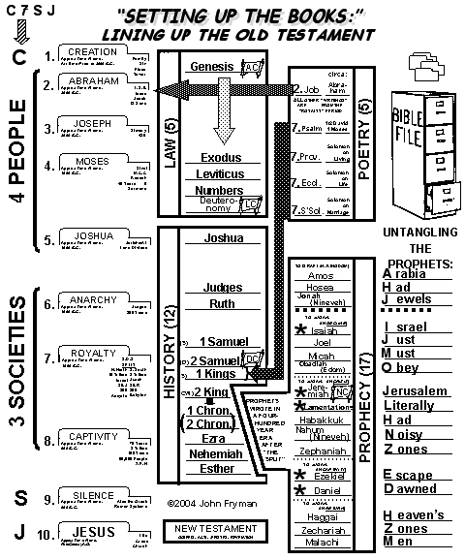
성경책
구성하기
조직화 된
연대기적인
구약의
39권
합리성
연계성
접근성
대략적인 성경적 시간대:
아브라함 이전부터 주전 430년
맥락
공부 가이드 #34
84
7
Notes:
So...there is our Old Testament, its 39 books, with a completed Study Help #34.
//// It's total timeline ranging from all time before Abraham up through 430 B.C.
//// ORGANIZED, rearranged somewhat, but presented in a
//// chronological manner that gives greater clarity to each one...
//// especially the reason for each book,
//// some connecting circumstances surrounding each writing, and perhaps most importantly,
//// making each one more mentally accessible to every Bible reader. And this foundational factor in Biblical understanding...
//// we have added a measure of CONTEXT to each book handed down to us.
NEXT…we'll turn to the New Testament…drawing around it a reasonable structure along with the dramatic story line of Scripture, the life of Our Lord, and the development of the Early Church…all leading directly to our own day and our commitment to the Great Commission.

Slide 85
성경은
기본적으로
©2006 TBBMI
A Presentation of The Bible…Basically Ministries International Inc.
Fort Worth, Texas
www.biblebasically.org

Slide 86


“성경은 기본적으로” 링크는 BibleStudyDownloads.org
이 프레젠테이션을 무료로!
Notes:
The Bible…Basically (bb)

Slide 87
00
9.6.07.
©2006 TBBMI
86

