Slide 1


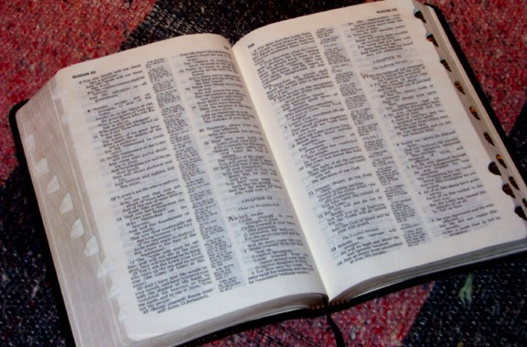
(では、全体は?)
バイブル
ベイシック
®
パート ４
聖書のストーリー：
クイックレビュー
パワーポイントスライド版
9.7.04SL.
©2006 TBBMI
02
Notes:
Now we’re going to do the entire Quick Chronology!

Slide 2

バイブル ベイシック
A Presentation of The Bible…Basically Ministries International Inc.
Fort Worth, Texas
Designed by Dr. John Fryman, Texas, USA • BibleBasically.org
Taught by Dr. Rick Griffith, Singapore Bible College
All files in many languages for free download at BibleStudyDownloads.org
9.65.01.
©2004 TBBMI
04
Notes:
Japanese title slide

Slide 3
(では、全体は?)
バイブル
ベイシック
®
パート ４
聖書のストーリー：
クイックレビュー
パワーポイントスライド版
9.7.04SL.
©2006 TBBMI
02
Notes:
Now we’re going to do the entire Quick Chronology!

Slide 4
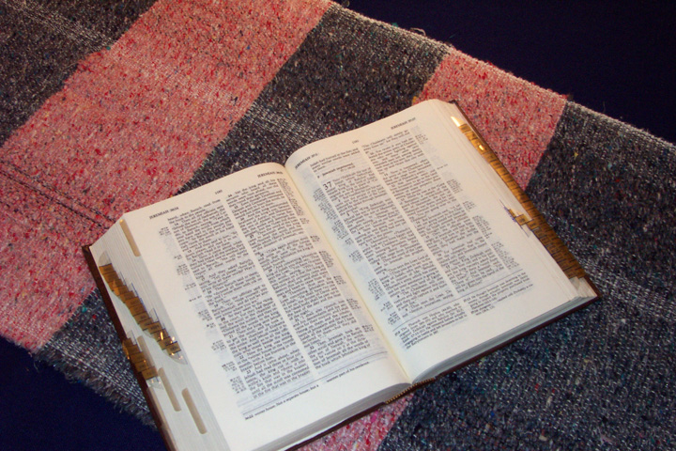
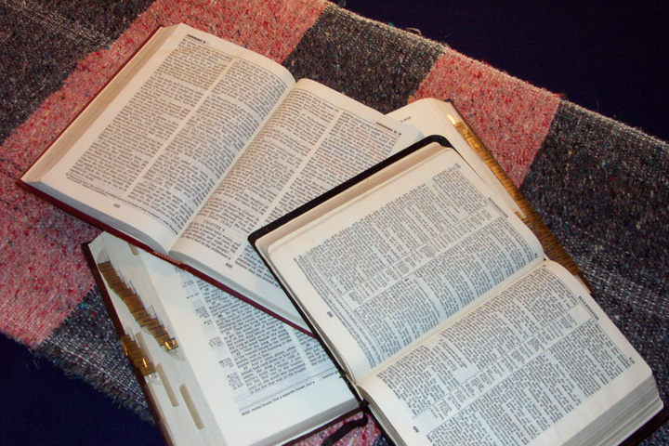
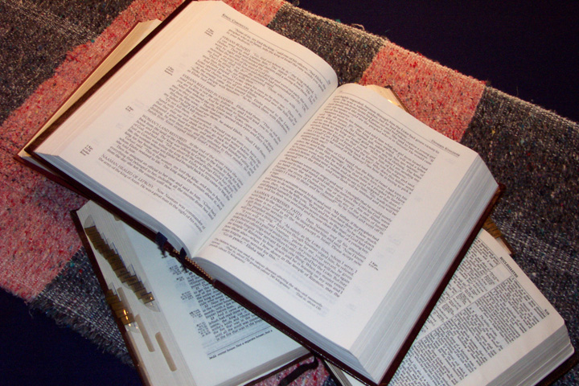
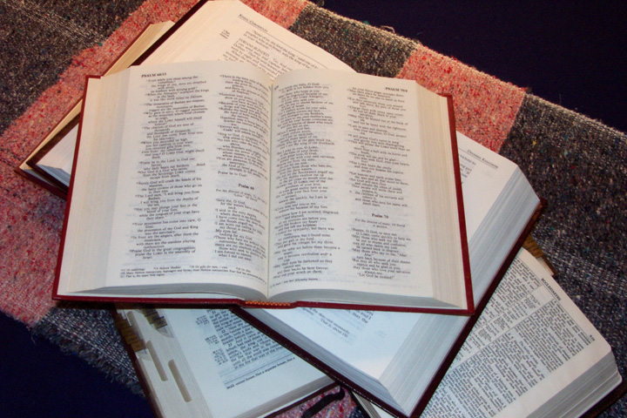
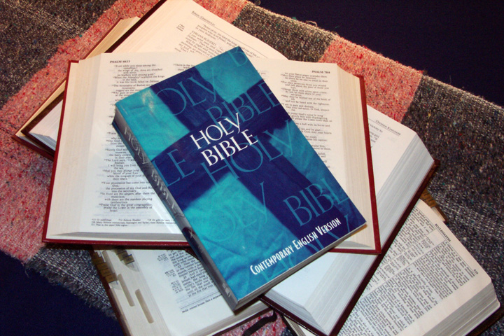
聖書のストーリーを
簡潔に話せますか？
03
1
Notes:
Now…after your trip through THE QUICK CHRONOLOGY…here’s a challenging question: how quickly could YOU tell that great Bible story -- in all of these books -- to somebody else? It’s a powerful witnessing tool, you know! Yes...the whole thing…and YOU can do it!
//// So…get ready to tell the Bible story in quick time!

Slide 5
12分以内で
お願いします
04
Notes:
And how about doing all this is just about twelve minutes? You can, you know! So, we’re going to make this final sprint through THE QUICK CHRONOLOGY in a lightning-fast run taking us across the entire Bible time line…once again: and remember, only an overview!

Slide 6
よろしいですか？
(あなたの聖書書庫を
活用してください)
それでは、
お願いします！
スタディヘルプ #04 または #31
05
Notes:
Ready? Follow along with your BIBLE FILE Study Helps 04 or 31. Here we go!

Slide 7
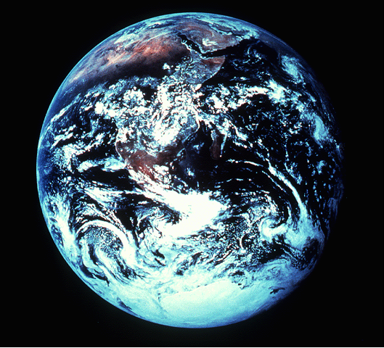
創世記 1～11章
5+2
創造
アブラハム以前の出来事
CREATION
最初の男女
(完全体)
最初の罪
(的を外す)
創造
ABRAHAM
最初の福音
(購い主)
最初の家族
(争い)
最初の殺人
(最低の罪)
洪水・虹
(物語#1:ノア)
塔
(物語#2:バベル)
Handbook pg. 42-45
06
9
Notes:
Beginning with the CREATION folder…
//// Five first things and two great programs are described here in the Creation folder.
//// God has always been eternal and without a beginning, so we can call time before creation of the earth “pre-history,” certainly before the time of Abraham.
//// .... However after the earth was created the FIRST MAN and WOMAN appear on earth in a perfect form and placed in the sinless environment of God’s created perfection.
//// .... The FIRST SIN is committed…where Man is given a test of his gift of free will. He is tempted by Satan and falls from his created state of perfection into a sinful condition, having “missed the mark” for which he was created.
//// .... The FIRST GOSPEL or good news is given to men…
The Creator provides the first announcement that He will send a Redeemer to provide for man a way back to that original state of created perfection, innocence and holiness.
//// .... The FIRST FAMILY appears…
Adam and Eve have children and provide the basis for future development of a race of men who must contend with Satanic efforts to keep them from a restored relationship with the loving Father and Creator.
//// .... The FIRST MURDER is committed…
Sin is committed in its most abusive and abject form, the destruction by man of God’s ultimate gift, life itself.
AND THEN…The first of two great God-ordained programs comes into view…
//// .... Program #1: The GREAT FLOOD and RAINBOW….
….where God determines to wipe out His creation and begin it again. All mankind perishes except eight people who, under the leadership of righteous Noah, have remained true to God, who provides His rainbow promise as the waters recede.
//// .... At a later time, Program #2, during the TOWER OF BABEL event…
Man attempts to climb to an elevation equal to God Himself. God intervenes with a confusion of languages in order to disperse the races.

Slide 8

創世記 12～36章
7
アブラハム
紀元前2000年ごろ
召命
AC
L - S - B
創造
ABRAHAM
I - I
アブラハム
ABRAHAM
J - E
12
Handbook pg. 42-45
07
6
Notes:
THE SECOND FILE FOLDER…presents the first of the four great people…ABRAHAM, JOSEPH, MOSES AND JOSHUA. First is.... ABRAHAM….TIME FRAME…about 2000 B.C.…remember that these few time frames are roughly in 500 year increments.
//// .... ABRAHAM is called by God out of Ur of the Chaldees when he proclaimed
//// .... his great promise of a LAND, a SEED, and a BLESSING,
//// .... to be later expanded in the unconditional ABRAHAMIC COVENANT. All future biblical events unfold from these single covenant promises! Abraham leaves UR of the Chaldees with his family, moving toward an unknown land. With him were wife SARAH, nephew Lot and father Terah. They journey to ancient Haran where old Terah, ABRAHAM’S father, dies. At a later time, under God’s continued beckoning, they move on to Canaan.
//// ....Eventually ABRAHAM has two sons: I and I…ISHMAEL through Sarah’s maidservant, Hagar; then years later ISAAC through his wife Sarah. ISAAC is the son through which God’s promise to Abraham will be passed.
//// ....ISAAC has two sons... J and E ...JACOB and ESAU. In this case, Jacob is the recognized son through which the promise will pass.
//// ....JACOB then has 12 SONS who become the patriarchs of the 12 TRIBES OF ANCIENT ISRAEL. One of those sons is…

Slide 9
創世記 37～50章
ヨセフ
紀元前2000年ごろ
奴隷
430
創造
ABRAHAM
アブラハム
ABRAHAM
ヨセフ
ABRAHAM
Handbook pg. 42-45
08
2
Notes:
THE THIRD FILE FOLDER .... JOSEPH…time frame remains about 2000 B.C.….the second of the four great people…
JOSEPH, is sold into Egyptian slavery by his jealous brothers. He arrives in Egypt and eventually rises to become Governor. The family of JACOB, with all JOSEPH’s brothers, is driven down to Egypt by famine.
//// .... Eventually slavery for the Hebrews follows because they multiplied rapidly! Through time, because of their increasing population, they become a threat to the Egyptian government. Thus, they become SLAVES of the Egyptians.
//// ....They remain in Egypt for 430 years.

Slide 10

創世記、出エジプト記、レビ記、民数記、申命記
モーセ
紀元前1500年ごろ
出エジプト
シナイ
創造
ABRAHAM
アブラハム
道徳・民事・儀式
ABRAHAM
ヨセフ
ABRAHAM
モーセ
カデシュ・バルネア
40
LC
５つの説教
Handbook pg. 42-45
09
7
Notes:
THE FOURTH FILE FOLDER.... Now in a time frame of about 1500 B.C.….the third of the four great people…MOSES….rises from among them, leading the Israelites out of Egypt in the great
//// ....EXODUS and into the desert of the Sinai Peninsula. At
//// ....MT. SINAI, MOSES is given the LAW, the Torah...
//// ....in 3 parts ...M-C-C... Moral, Civil and Ceremonial. MOSES
//// ....leads the Israelites on to the oasis of KADESH BARNEA ....where 12 spies are dispatched on a mission to the north to check out The Land of Canaan prior to the Israelites going in to take it as God had commanded.
A majority report comes back, saying they cannot take The Land: the people are too tall, too powerful; Israelites too small, too weak.
However, two spies, Joshua and Caleb, report that with obedience and faithfulness to God, they can enter The Land and victoriously subdue it.
The people rebel against God, having no faith in His provision. The faithless Israelites follow that majority report.
As a result of their disbelief God banishes them to wander in the wilderness until all those above the age of 20 who disobeyed Him have died out.
//// ....After 40 YEARS of wandering, just before entering The Promised Land,
MOSES
//// ....in a series of FIVE SERMONS…teaches the new generation who they are in God's sight, reminds them of all that God expects of them and defines the promises of the unconditional ....
//// ….LAND COVENANT. MOSES dies, never himself, having set foot in Israel’s Promised Land.

Slide 11
ヨシュア記
ヨシュア
紀元前1500年ごろ
エリコ／アイ
土地を分ける
創造
ABRAHAM
アブラハム
ABRAHAM
ヨセフ
ABRAHAM
モーセ
ヨシュア
Handbook pg. 42-45
10
2
Notes:
THE FIFTH FILE FOLDER….JOSHUA…the last of the four great people…still in the 1500 B.C. time frame…As MOSES' successor, Joshua takes command as a new generation prepares to go into The Land and to subdue it.
//// ....The Israelites enter Canaan, taking first the cities of Jericho and Ai and begin the long campaign to take possession under God’s direction.
//// After seven years the land is sufficiently subdued to begin dividing up the region among the Israelite tribes. They settle down to their new way of living in the Promised Land. Joshua dies, making way for the first of the three societies.

Slide 12
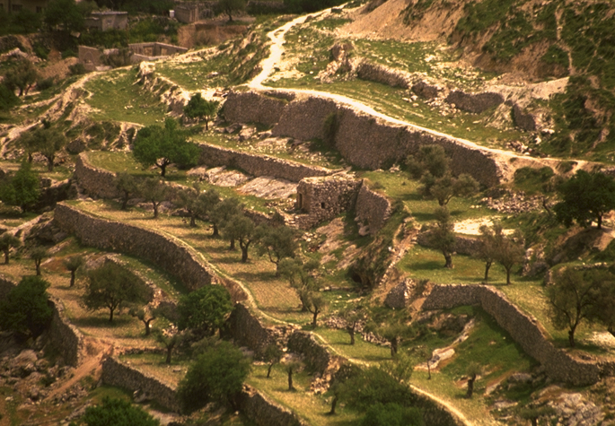
士師記、ルツ記
無政府
紀元前1000年ごろ
士師
350
創造
ABRAHAM
アブラハム
ABRAHAM
ヨセフ
ABRAHAM
モーセ
ヨシュア
無政府
Handbook pg. 42-45
11
2
Notes:
THE SIXTH FILE FOLDER…the period of ANARCHY in a time frame of about 1000 B.C.….
//// ....the JUDGES appear during a time of national apostasy or falling away from the God of the Hebrews, now called Israelites. The Judges repeatedly call the people back to God and His commandments for their lives.
//// ....Lasting some 350 years, the period ends with the emergence of SAMUEL, whom God commissions to appoint Israel's first king.

Slide 13
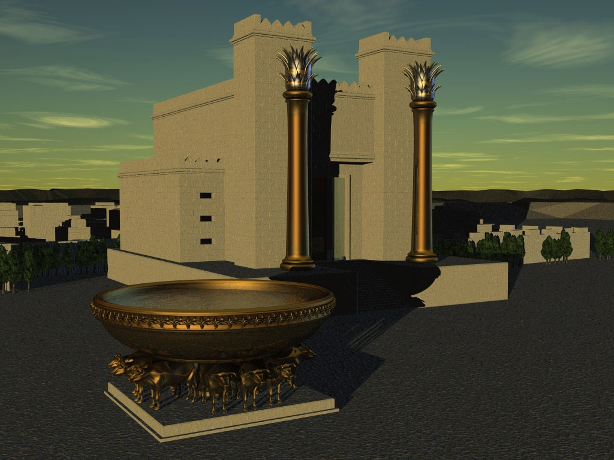
サムエル記第一～歴代誌第二
王制
紀元前1000年ごろ
DC
S - D - S
<<<< 分裂 >>>>
創造
ABRAHAM
アブラハム
北 南
ABRAHAM
ヨセフ
ABRAHAM
モーセ
イスラエル ユダ
ヨシュア
無政府
10 2
王制
NC
預言者たち
20-J 20-R
200
350
アッシリア
バビロン
Handbook pg. 42-45
12
9
Notes:
Leading to .... THE SEVENTH FILE FOLDER …THE ROYALTY period.....Time frame: 1000 B.C. A united Israel enters its period of ROYALTY under the direction of three kings…
//// ....S-D-S…SAUL, DAVID and SOLOMON…the three kings of a united Israel. SAUL is eventually deposed, replaced by DAVID, who is succeeded by his son SOLOMON.
//// ....Through David God pronounces the unconditional DAVIDIC COVENANT. After Solomon dies there is…
//// ....the great NATIONAL SPLIT…Israel’s tragic CIVIL WAR...
//// ....10 Tribes to the NORTH as a kingdom: calling itself ISRAEL...2 tribes to the SOUTH become the kingdom of JUDAH.
//// ....Now the great Old Testament prophets appear. Through their messages to the people, God begins to chastise both parts of His Chosen People, issuing
//// ....the unconditional NEW COVENANT in which God promises a new arrangement with his creation to appear at some future time. Here the Messiah is clearly prefigured.
//// ....There follow 20 kings in each nation, beginning with JEROBOAM in the NORTH and REHOBOAM in the SOUTH…J before R….North before South.
//// ....After some 200 years, the ASSYRIANS invade and carry off the NORTHERN KINGDOM, ISRAEL, never to be heard from again. It is dispersed.
//// ....Then, after another 150 years or so, the BABYLONIANS invade, destroying Jerusalem and carrying off the SOUTHERN KINGDOM, JUDAH, into the great Babylonian CAPTIVITY

Slide 14
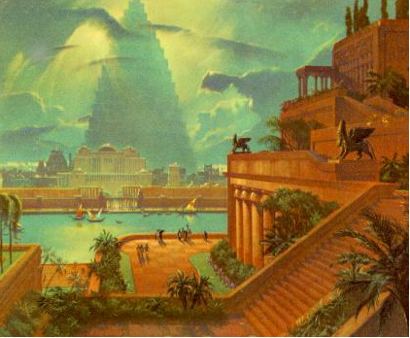
エズラ記 ～エステル記
捕囚
紀元前500年ごろ
70年
3つの長旅
創造
ABRAHAM
アブラハム
100 年/50,000
ABRAHAM
ヨセフ
ABRAHAM
モーセ
Z - E - N
ヨシュア
無政府
王制
捕囚
Handbook pg. 42-45
13
4
Notes:
THE EIGHTH FILE FOLDER ….The CAPTIVITY file....time frame: 500 B.C…
//// ....After 70 Years captivity in Babylon, the Jews are told that they can return to The Land to rebuild the Temple and the city of Jerusalem.
//// ....In 3 different treks back to Israel…
//// ....over a 100-year period, 3 diplomat-priests lead 50,000 people back into The Promised Land.
//// ....Those great leaders are: Z -E-N: ZERUBBABEL, EZRA and NEHEMIAH. And here the Old Testament closes.

Slide 15
マラキ書とマタイの福音書の間 (旧約と新約聖書)
沈黙
紀元前500年ごろ
アレキサンダー大王
ローマ様式
創造
ABRAHAM
アブラハム
ABRAHAM
ヨセフ
ABRAHAM
モーセ
ヨシュア
無政府
王制
捕囚
沈黙
Handbook pg. 42-45
14
2
Notes:
THE NINTH FILE FOLDER: SILENCE.... time frame still about 500 B.C., a period of about 400 years called Biblical SILENCE follows…events not recorded in Scripture.
//// ....ALEX THE GREEK -- ALEXANDER the Great –- appears on history’s stage, spreading the GREEK culture and language throughout all his conquered lands…
//// ....followed by ROME and its efficient but difficult SYSTEMS for maintaining civil order while expanding its enormous empire from the Middle East to Britain.

Slide 16
マタイの福音書～ヨハネの黙示録
紀元
一世紀
事実と
神学
イエス
人生
十字架
教会の
歴史
創造
ABRAHAM
教会
アブラハム
ABRAHAM
ヨセフ
ABRAHAM
モーセ
福音書
ヨシュア
無政府
使徒の働き
教会の
問題
王制
捕囚
書簡
沈黙
イエス
黙示
永遠
未来
Handbook pg. 42-45
15
7
Notes:
THE TENTH AND LAST FILE FOLDER....its time frame: the First Century. Finally…JESUS – the long-promised Messiah -- is introduced in the first chapter of Matthew. We are now into the New Testament where we experience JESUS’
//// ....LIFE, in its many locations in Israel and its infinite lessons of ministry and loving care and message of salvation…to all the world.
//// ....the CROSS — where we encounter the implications of his death, burial and resurrection —
//// ....and finally…the historic spread of His CHURCH, which includes every believer on Planet Earth.
//// ....The record is preserved for us in the facts and theology of the Gospels,
//// ....Jesus’ outworking in the early history of the Church, the Acts,
//// ....and the many letters of instruction and encouragement to the young churches, known as the Epistles.
//// ....Finally…in the great climax to the Biblical chronology…In the Revelation…God's Program of the Ages, originally pronounced unconditionally through THE ABRAHAMIC COVENANT, is consummated. Here we are given a glimpse of the wonder of the future with JESUS CHRIST, the Seed of David, seated eternally on his Davidic Throne providing the blessings of salvation and redemption for all men of the Earth.

Slide 17
創造
アブラハム
ヨセフ
C 7 S J
モーセ
ヨシュア
無政府
王制
捕囚
沈黙
イエス
 
16
2
Notes:
So we have this great stack of Bibles…each one – through their Old and New Testaments -- with the same assuring and hopeful story of salvation and eternal life.
//// We get a mental handle on all that information with the little memory tool of C, 7, S and J…
//// ….which leads directly to the 10 KEY WORDS as file folder labels…CREATION, ABRAHAM, JOSEPH, MOSES, JOSHUA, ANARCHY, ROYALTY, CAPTIVITY, SILENCE AND JESUS…
….from which the incomparable drama of the scriptures can be recalled, reclaimed and enjoyed all over again…time after time…in every life circumstance…ever mining deeper the great truths of God’s great love letter to May.

Slide 18
マタイ 28:19
以上があなたの聖書…クイック
レビューでした!
それゆえ、
あながたがは行って、
あらゆる国の人々を弟子としなさい。
 
17
1
Notes:
And that’s your Bible…THE QUICK CHRONOLOGY…in quick time!
Master it…and it will return to you untold treasures of insight, instruction and assurance that the Father IS there…a Plan IS in effect…history IS going somewhere! THE GOSPEL OF JESUS CHRIST IS ACTIVE UPON THE EARTH!
The Scriptures clearly demand – our study clearly communicates –– that through Jesus Christ’s Great Commission, it is our assigned and individual responsibility to spread that message to every human being in our own assigned space as long as we are allowed by the Father’s Plan to walk upon Planet Earth.
//// And our assignment is clearly…to “go therefore and make disciples of all nations.”

Slide 19
バイブル ベイシック
A Presentation of The Bible…Basically Ministries International Inc.
Fort Worth, Texas
www.biblebasically.org
9.65.01.
©2004 TBBMI
04
Notes:
Japanese title slide

Slide 20
85
©2006 TBBMI
9.6.02.

Slide 21


バイブル ベイシック • BibleStudyDownloads.org
無料でダウンロードどうぞ
Notes:
The Bible…Basically (bb)

