Slide 1

バイブル ベイシック
A Presentation of The Bible…Basically Ministries International Inc.
Fort Worth, Texas
Designed by Dr. John Fryman, Texas, USA • BibleBasically.org
Taught by Dr. Rick Griffith, Singapore Bible College
All files in many languages for free download at BibleStudyDownloads.org
9.65.01.
©2004 TBBMI
04
Notes:
Japanese title slide

Slide 2
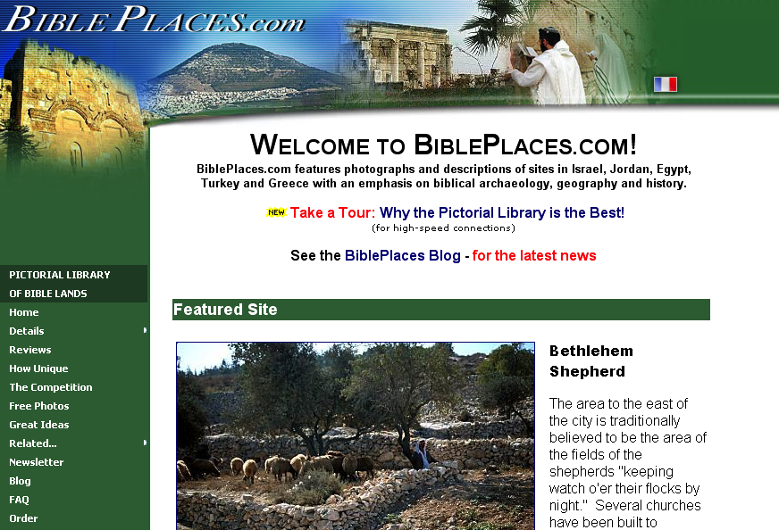
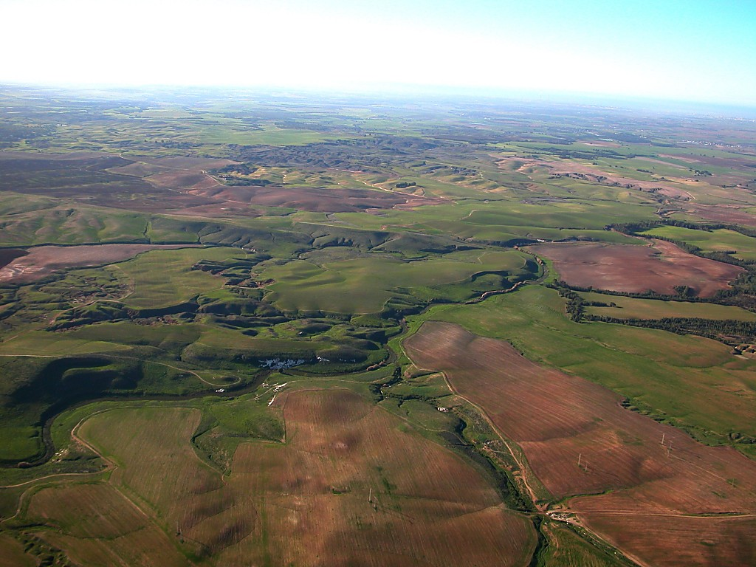
The Pictorial Library
of Bible Lands
私たちのミニストリーは、The Pictorial Library of Bible Landsの創設者トッド・ボレンから、バイブル・ベイシック®内で使用している画像の使用許可を得ることができなければ、成り立たなかったでしょう。バイブル・ベイシックの利用者はBiblePlaces.comにて数千枚の画像を是非堪能してください。聖地の画像に始まり、エーゲ海から地中海沿岸、キリスト教のルーツである南ヨーロッパの画像が楽しめます。 BiblePlaces.comは、教師や視覚教材製作者にとって、高画質なデジタル写真の素材の宝庫となることでしょう。是非、一度、ご覧ください。トッド、感謝します！
9.65.05a.
01a
Notes:
2

Slide 3


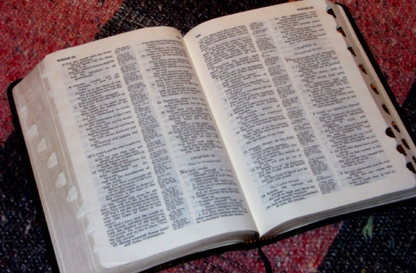
(何故それが起こったのか!)
バイブル
ベイシック
®
パート 5
聖書の基盤
9.65.05a.
©2006 TBBMI
02
Notes:
3
SEGMENT TITLE: BIBLICAL BEDROCK (A)
In THE QUICK CHRONOLOGY we found THE WHAT of what happened in the great Biblical panorama. Now it's time to discover THE WHY of those world-shaping events.

Slide 4

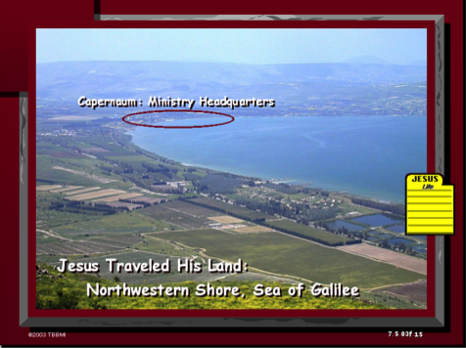
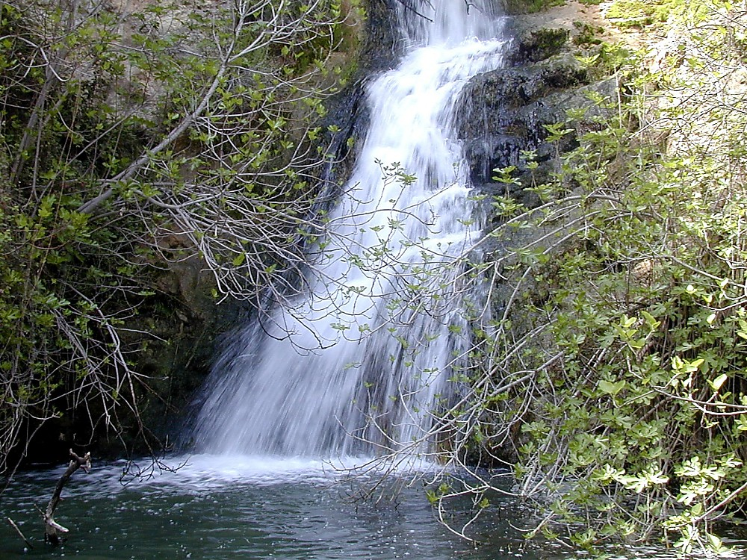
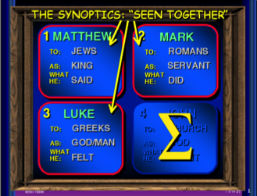
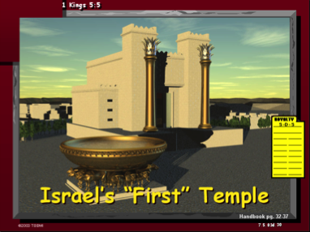
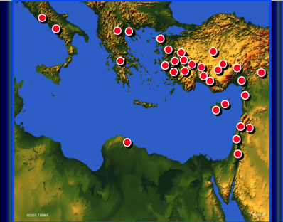
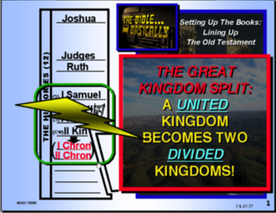
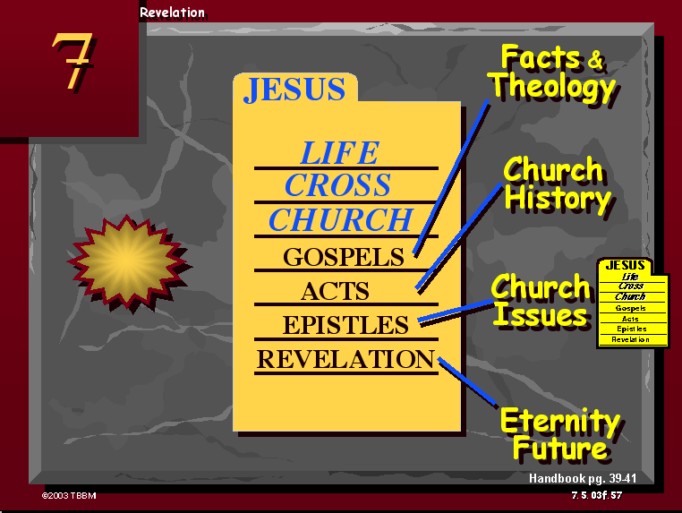
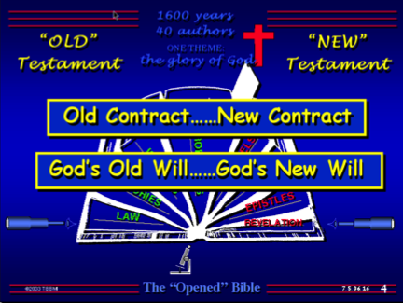
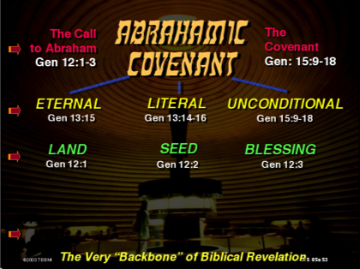
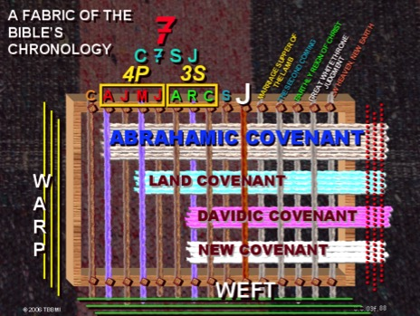
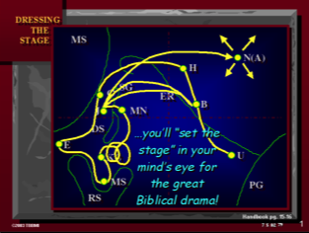
9.65.05a.
©2006 TBBMI
03
Notes:
4
[AUTO SLIDE MONTAGE-BLUE GRAPHIC LOWER LEFT IS THE LAST]
In everything we've encountered so far in THE BIBLE...BASICALLY, we have covered enormous epochs of time, a storyline of incredible dimension, presented to us in a collection of books that are unparalleled in divine authorship, human impact, and spiritual instruction.
So the question is this: what holds all this together? Are there concepts or basic ideas that run straight through the progress of each event and the presentation of each new revelation in God's unfolding program for Man?

Slide 5
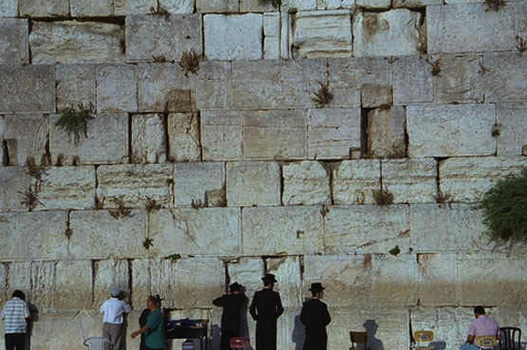
聖書の基盤
そこから
全てが
始まる！
9.65.05a.
1
©2006 TBBMI
04
Notes:
5
The answer is, yes. The ideas ARE there. And we call them, our BIBLICAL BEDROCK...because in that deepest stratum of biblical meaning, revelation and understanding...
//// ….that's where it all begins.

Slide 6



はた織りをしていると
想像してみてください…
聖書の年代記の
編み合わせ
スタディヘルプ #08
9.65.05a.
© 2006 TBBMI
05
Notes:
6
Remember that imaginary loom we built and threaded in the JESUS FILE? On Study Help #8 we called it "The Fabric of the Bible's Chronology.

Slide 7
聖書の年代記の
編み合わせ
7
4P
3S
J
C
A
J
M
J
A
R
C
S
これら10ヶの
文字を使います!
9.65.05a.
1
© 2006 TBBMI
06
Notes:
7
We prepared the loom with ten threads representing the C7SJ ideas…
//// …followed by those ten organizing words of THE BIBLE FILE.

Slide 8
聖書の年代記の
編み合わせ
7
4P
3S
J
C
A
J
M
J
A
R
C
S
CREATION(創造)
ABRAHAM (アブラハム)
JOSEPH(ヨセフ)
MOSES(モーセ)
JOSHUA(ヨシュア)
ANARCHY(無政府)
ROYALTY(王制)
CAPTIVITY(捕囚)
SILENCE(沈黙)
JESUS(イエス)
9.65.05a.
© 2006 TBBMI
07
Notes:
8
…CREATION, ABRAHAM, JOSEPH, MOSES, JOSHUA, ANARCHY, ROYALTY, CAPTIVITY, SILENCE, and Jesus.

Slide 9
聖書の年代記の
編み合わせ
7
4P
3S
J
C
A
J
M
J
A
R
C
S
CREATION(創造)
ABRAHAM (アブラハム)
JOSEPH(ヨセフ)
終末
MOSES(モーセ)
JOSHUA(ヨシュア)
ANARCHY(無政府)
ROYALTY(王制)
CAPTIVITY(捕囚)
SILENCE(沈黙)
JESUS(イエス)
9.65.05a.
© 2006 TBBMI
08
Notes:
9
Then we added five additional threads to represent the main events of the troubling END-TIMES scenario. The vast majority of the Body of Christ agrees – at least -- on these five future events. They are…

Slide 10
聖書の年代記の
編み合わせ
7
4P
3S
キリストによる地上の統治
新しい天と新しい地
J
子羊の婚宴
最後の裁き
C
A
J
M
J
A
R
C
S
再臨
CREATION(創造)
ABRAHAM (アブラハム)
JOSEPH(ヨセフ)
終末
MOSES(モーセ)
JOSHUA(ヨシュア)
ANARCHY(無政府)
ROYALTY(王制)
CAPTIVITY(捕囚)
SILENCE(沈黙)
JESUS(イエス)
9.65.05a.
4
© 2006 TBBMI
09
Notes:
10
the marriage supper of the Lamb…
//// the second coming of Christ
//// his thousand-year reign on earth…the Millennium…
//// followed by the Great White Throne Judgment,
//// culminating in that event that climaxes them all… the New Heaven and the New Earth.

Slide 11
聖書の年代記の
編み合わせ
7
4P
3S
キリストによる地上の統治
新しい天と新しい地
J
子羊の婚宴
最後の裁き
C
A
J
M
J
A
R
C
S
再臨
アブラハム契約
土地契約
ダビデ契約
新しい契約
9.65.05a..
5
© 2006 TBBMI
10
Notes:
11
Now…bring back to mind those strong bands of the covenants that we wove into that fabric of the Bible's chronology...Those covenants…unconditional promises from God…we believe are continuing to run at this very time. Those strong bands of the Old Testament promises are, in order,
//// THE ABRAHAMIC COVENANT...Genesis 12 and 15…
//// THE LAND COVENANT...Deuteronomy 30
//// THE DAVIDIC COVENANT…2 Samuel 7…and
//// the great NEW COVENANT…Jeremiah 31.
Taken together, all these grand events bring to a
//// close earth's history and the climax of all those glorious promises – and their complete fulfillment – made from God to old Abraham so long ago.

Slide 12
聖書啓示の「重要要素」
神様による無条件
契約プログラム
11
Notes:
12
SO...to further explore all this...let's get into THE BACKBONE OF BIBLICAL REVELATION...GOD'S UNCONDITIONAL COVENANTAL PROGRAM.

Slide 13
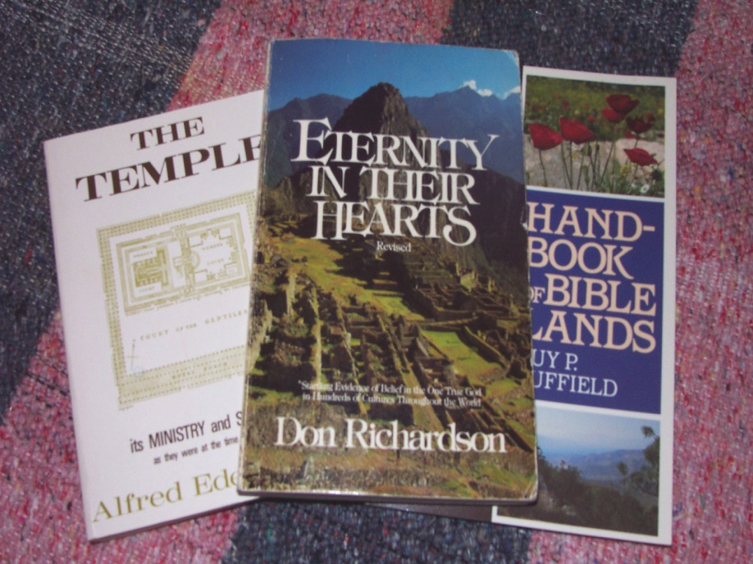
聖書啓示の「重要要素」：
神様による無条件契約プログラム
Don Richardson, Eternity in Their Hearts
12
Notes:
13
Here's another good quote to think about...it's by Christian author Don Richardson, a writer of wide and long experience on the mission field...a missionary who is also an expert linguist. Don Richardson wrote...in his book ETERNITY IN THEIR HEARTS…

Slide 14
聖書啓示の「重要要素」：
神様による無条件契約プログラム
アブラハム契約・・・聖書における非常に重要な要素で、特別啓示の核をなす。このため、その重要性を認めない教えは必然的にある種の物足りなさを呈し、
文字通り、その核を欠く。また、クリスチャンが、自分たちの民族だけではなく、地上の全ての人々に対して、その頂いている祝福を分け与えることに意義を見出せにくくなる傾向がある。
Don Richardson, Eternity in Their Hearts, 163
13
2
Notes:
14
“The Abrahamic Covenant...is the very backbone of the Bible – the spinal column of special revelation. Teaching which does not acknowledge that spinal column will inevitably have a certain spinelessness about it.
//// It will – quite literally – lack backbone. And it will tend to leave Christians less motivated than they would otherwise be to …
//// …pass on the blessing they have received, not merely to their own kind of people, but to all people on earth.”

Slide 15
聖書啓示の「重要要素」：
神様による無条件契約プログラム
「罪」という言葉に関して・・・
ヘブライ語とギリシャ語:
不正行為
不法行為
違反
悪意
不法侵害
邪悪・・・
スタディヘルプ #10
14
8
Notes:
15
Now let's put some parts of a Biblical puzzle together. There will be several pieces to work with. Begin with Study Help #10.
//// Starting with some ideas about that common little English word, SIN.
//// In both the Hebrew of the Old Testament and the Greek of the New...both words which, in English, are translated SIN ... actually have much wider meanings…such as…
//// MISBEHAVIOR...
//// INIQUITY...
//// TRANSGRESSION...
//// WICKEDNESS...
//// TRESPASS...
//// and EVIL...
Each of those words in their original languages means all these different kinds of negative behavior. As you can see, the word SIN is really an ineffective single word when we consider all the wider ORIGINAL meanings for which the only English word in translation is: SIN.

Slide 16
聖書啓示の「重要要素」：
神様による無条件契約プログラム
でも！恐らく、こんなこと
を考えていませんか・・・
「罪」という言葉に関して・・・
ヘブライ語とギリシャ語:
・・・「的」って言っても、
それは一体どこにある？
「的をはずすこと」
15
2
Notes:
16
But there is also a phrase common to both the Hebrew and the Greek
for the word that in English is translated as SIN.
//// the phrase is...TO MISS THE MARK…even as an archer might miss the mark of the target's bull's eye.
//// But you are probably thinking…where or what in the world…in the biblical sense...is that kind of mark?

Slide 17
聖書啓示の「重要要素」：
神様による無条件契約プログラム
「罪」という言葉に関して・・・
ヘブライ語とギリシャ語： 「的をはずすこと」
その完全な答えを知るためには・・・
聖句を見るしかありません！
「だから、あなたがたは、天の父が完全なように、完全でありなさい。」
マタイ5:48
16
1
Notes:
17
Well…for that plumb line of perfection…we go straight to Scripture. And there we discover God's own mark or expectation for perfect human behavior.
//// Jesus Himself said, “Be perfect, therefore, as your heavenly Father is perfect.” [Matthew 5:48]

Slide 18
神様の栄光ある御名！
ABBA…ADVOCATE…ALMIGHTY…ALPHA…AMEN…ANCIENT OF DAYS…
ANOINTED ONE…APOSTLE AND HIGH PRIEST…ARM OF THE LORD…
AUTHOR OF LIFE…AUTHOR OF OUR FAITH…BEGINNING AND THE END…
BLESSED AND ONLY RULER…BRANCH…BREAD OF LIFE…BREAD OF GOD… BRIDE GROOM…BRIGHT MORNING STAR…CHIEF SHEPHERD…CHOSEN ONE…CHRIST…CHRIST OF GOD…CHRIST THE LORD…CHRIST THE SON OF THE LIVING GOD… COMFORTER…COMMANDER…CONSOLATION OF ISRAEL…CONSUMING FIRE…CORNER STONE…COUNSELOR… CREATOR…DELIVERER…. DESIRED OF ALL NATIONS… DOOR…EL SHADDAI…ETERNAL GOD… EVERLASTING FATHER…EXACT REPRESENTATION OF HIS BEING… FAITHFUL AND TRUE…FAITHFUL WITNESS…FATHER… FIRSTBORN OVER ALL CREATION….FIRST FRUITS… FOUNDATION…FRIEND OF TAX COLLECTORS AND SINNERS…GENTLE WHISPER…GIFT OF GOD…GLORY OF THE LORD…GOD…GOD ALMIGHTY…GOD OVER ALL…GOD WHO SEES ME…GOOD SHEPHERD…GREAT HIGH PRIEST…GREAT SHEPHERD… GUIDE…HEAD OF THE BODY…HEAD OF THE CHURCH…HEIR OF ALL THINGS…HIGH PRIEST FOREVER…HOLY ONE…HOLY ONE OF ISRAEL…HOLY SPIRIT…HOPE …HORN OF SALVATION…I AM…IMAGE OF GOD…IMAGE OF HIS PERSON…IMMANUEL…JEHOVAH…JESUS…JESUS CHRIST OUR LORD…JUDGE…KING…KING ETERNAL…KING OF KINGS…KING OF THE AGES…LAMB OF GOD…LAST ADAM…LAW GIVER…LEADER… LIFE…LIGHT OF THE WORLD…LIKE AN EAGLE…LILY OF THE VALLEY…LION OF THE TRIBE OF JUDAH…LIVING STONE…LIVING WATER…LORD…LORD GOD ALMIGHTY…LORD JESUS CHRIST…LORD OF ALL…LORD OF GLORY…LORD OF LORDS…LORD OUR RIGHTEOUSNESS…LOVE…MAN OF SORROWS…MASTER… MEDIATOR…MERCIFUL GOD…NAZARENE…OFFSPRING OF DAVID…OMEGA…ONLY BEGOTTEN SON…OUR PASSOVER LAMB… OUR PEACE…POTTER…POWER OF GOD…PRINCE OF PEACE… PROPHET…PURIFIER…RABBONI [TEACHER]…RADIANCE OF GOD'S GLORY…REDEEMER…REFINER'S FIRE…RESURRECTION AND THE LIFE…RIGHTEOUS ONE…ROCK…ROOT OF DAVID…ROSE OF SHARON…RULER OF GOD'S CREATION…RULER OF THE KINGS OF THE EARTH…RULER OVER ISRAEL…SAVIOR…SCEPTER OUT OF ISRAEL…SEED…SERVANT…SHEPHERD AND OVERSEER OF YOUR SOULS…SHIELD…SON OF DAVID…SON OF GOD…STAR OUT OF JACOB…STONE…SON OF RIGHTEOUSNESS… TEACHER…TRUE LIGHT…TRUTH…VINE…WISDOM OF GOD…WONDERFUL COUNSELOR…WORD…WORD OF GOD.
主なる
キリスト
イエス
主なる
キリスト
主なる
キリスト
Mary Foxwell Loeks, The Glorious Names of God
スタディヘルプ #11
私たちは的をはずしているか、いないのか？
17
8
Notes:
18
With Study Help # 11…how exactly would you ever know the dimensions of “perfection?” For that…just look at the names of God right there in the Bible…names, terms and phrases that He uses in reference to Himself. That list gives us a good idea of the quality of the behavior and spiritual behavior expected of us. And, of course, among those dozens of the biblical names for God…are these…
//// ….ALMIGHTY…
//// ….COMFORTER…
//// ….FAITHFUL AND TRUE…
//// ….LAMB OF GOD…
//// ….RIGHTEOUS ONE…
//// ….TRUTH…
//// ….AND THAT NAME ABOVE ALL NAMES……CHRIST THE LORD…JESUS Himself!
These are some of the dimensions of expectation…to which none of us can compare. Then the question remains…
//// DO WE…OR DO WE NOT…MISS THE MARK? THAT'S why we need a Savior…Jesus Christ the Lord.

Slide 19
聖書啓示の「重要要素」：
神様による無条件契約プログラム
「罪」という言葉に関して・・・
誰がその基準を満たすことができるのか?
パウロがローマ人への手紙3:23で非常に上手にまとめています・・・
18
1
Notes:
19
Another question then: WHO can measure up to such criteria? How do we live life on this planet and NOT miss that mark?
//// We have an answer to that. Paul summed it up clearly in Romans.

Slide 20
「すべての人は、
罪を犯したので、
神からの栄誉を
受けることが
できず・・・」
19
Notes:
20
"FOR ALL HAVE SINNED AND FALL SHORT OF THE GLORY OF GOD." AGAIN…ALL HAVE SINNED!

Slide 21
聖書啓示の「重要要素」：
神様による無条件契約プログラム
古い
新しい
誓約(旧約)
誓約(新約)
契約
契約
約定
約定
遺言
遺言
遺言
契約
契約
スタディヘルプ #12
約定
誓約
20
19
Notes:
21
Now comes another puzzle piece...Study Help #12…this one is a matter of some interchangeable words. Beginning with
//// WILL.....then
//// CONTRACT...followed by
//// TESTAMENT...and finally
//// COVENANT.
Each of these terms has a legal idea behind its meaning.
In fact,
//// CONTRACT and TESTAMENT are interchangeable...as are
//// TESTAMENT and WILL...then
//// WILL and CONTRACT...and finally...each one...
//// CONTRACT,
//// TESTAMENT and
//// WILL…is an interchangeable term with
//// COVENANT.
So there is an enormous amount of contractual and legal nuance brought together in these four terms. In other words, according to the dictionary, we could call the parts of our Bible...God's OLD
//// ….WILL…
//// ….COVENANT...or
//// ….CONTRACT…
In the same way…we could refer to God's New
//// ….WILL
//// ….COVENANT or
//// ….CONTRACT
Interchangeable terms that give enormous insight into the depth and breadth of God's legal arrangements with his Creation. With all these possibilities…it was the decision of earlier translators to use the older inclusive term TESTAMENT…giving us
//// OLD TESTAMENT and
//// NEW TESTAMENT.
Then...with the idea of Biblical covenants and contracts in mind...think about this…

Slide 22
聖書啓示の「重要要素」：
神様による無条件契約プログラム
古代に
おける
契約と約定
21
Notes:
22
…the social or financial situations in those ancient times where covenants and contracts were a prominent part of civil discourse. As an example of ancient covenants, this situation…

Slide 23
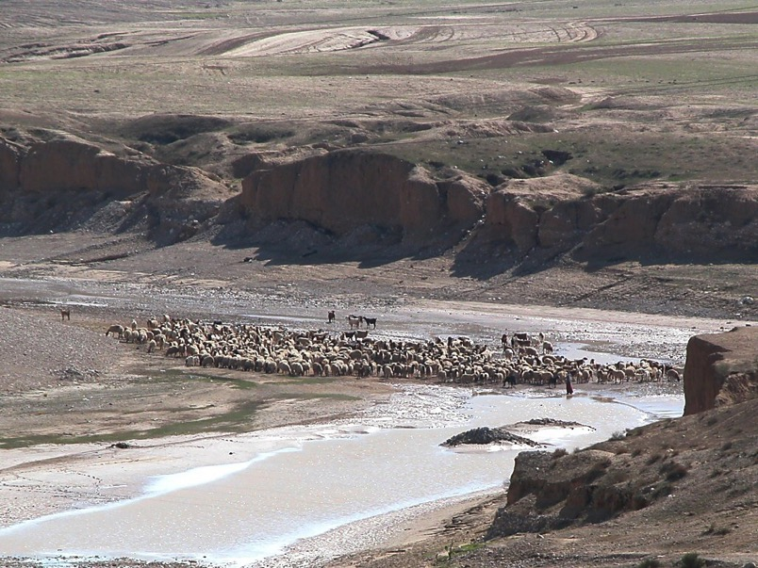
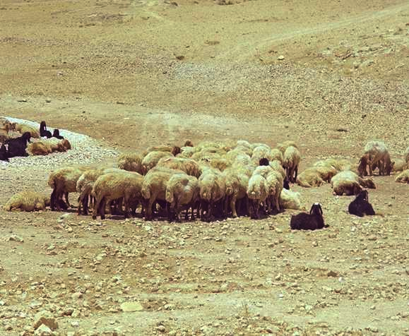
聖書啓示の「重要要素」：
神様による無条件契約プログラム
スタディヘルプ #13
古代の契約
22
1
Notes:
23
…with Study Help 13 in hand…suppose you own a herd of sheep…but you need additional land on which to graze that herd.
//// On the other hand, your friend owns a very large range of land and is quite willing to make some of it available to fill your needs.
How do you make that arrangement?
In Biblical times…in one of four ways...such as…

Slide 24

エズラ10:19； エゼキエル17:18
聖書啓示の「重要要素」：
神様による無条件契約プログラム
古代の契約
• 誓って(手をたたいて)
23
Notes:
24
The ancient HAND COVENANT…simply shaking hands…a basic gesture of understanding between people -- coming right on down to our own time.

Slide 25
ルツ4:8章
聖書啓示の「重要要素」：
神様による無条件契約プログラム
古代の契約
• 誓って(手をたたいて)
• はきもの
24
Notes:
25
With slightly more symbolic permanence…though temporary…the SHOE COVENANT. As a symbol of the agreement, each party exchanges a sandal, which will be retained by each...just as long as the agreement is in effect. To cancel it all, we simply give back each other's sandal, and the agreement is concluded. Things return to their original condition.

Slide 26
レビ2:13; 民数18:19; Ⅱ歴代13:5
聖書啓示の「重要要素」：
神様による無条件契約プログラム
古代の契約
• 誓って(手をたたいて)
• はきもの
• 塩
• 血
25
2
Notes:
26
Then…the SALT COVENANT…still another form of contract, this one requiring yet more commitment than the shoe covenant, though not by much. Each party to the agreement exchanged an amount of precious salt from a side condiment pouch many people carried. The idea here being that once the agreement was ended…the return of all the salt would be very difficult although, in theory, possible. And also, salt was used in ancient times as a way of ratifying an agreement. Sometimes the pouches were just exchanged between the parties. So, this contract could be nullified with some ease.
//// But now, we come to the most important and far-reaching ancient covenant or contract agreement of them all. This one we call a BLOOD COVENANT.
The Blood Covenant worked like this:
//// each of the parties to an agreement selects an animal, or animals, depending upon one's personal wealth.

Slide 27

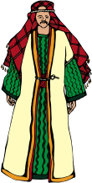








創世記15章
聖書啓示の「重要要素」：
神様による無条件契約プログラム
[神様が]来られ、アブラハムと公式な条約(アブラハム契約)を結ばれた(文字通りの意味は「切る」)。神様はご自分よりすぐれたものをさして「誓う」(契約を確認する)ことがありえないため、「ご自分をさして誓」われた(ヘブル6:13)。言い換えれば、これは一方的な契約であり、その約束は絶対に確かなものである。
Walvoord/Zuck, The Bible Knowledge Commentary
古代の契約
「血の契約」：
「契約した」当事者の内、
どちらか一方が死ぬまで
拘束力がある！
X
• 血
26
3
Notes:
27
The animals are slaughtered and the carcasses spread about on the ground with a passage between them,
//// …and then side-by-side, the parties walk together between the animal pieces. Significant? Yes…because blood has been spilled in behalf of the arrangement.
//// That BLOOD COVENANT then is utterly binding until the death of one of the parties! In other words, there is no abrogating a blood covenant. Why this emphasis? Here's a glimpse of that climactic scene in Genesis between Abraham and God:
//// “[God] came down and made…or literally CUT…a formal treaty with Abraham (the Abrahamic Covenant.) Since God could “swear” (confirm a covenant) by none greater, 'He swore by Himself' (Heb. 6:13). In other words this was a unilateral covenant. So its promises are absolutely sure.

Slide 28

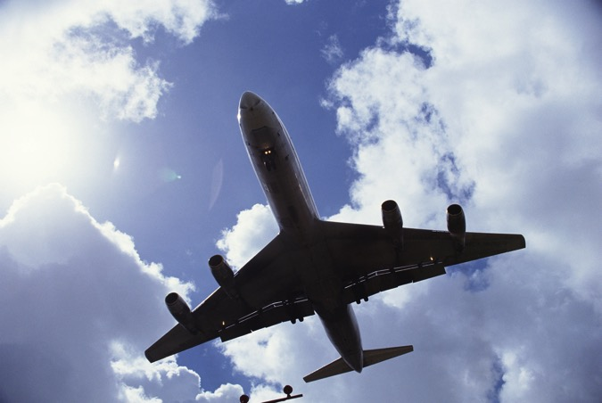
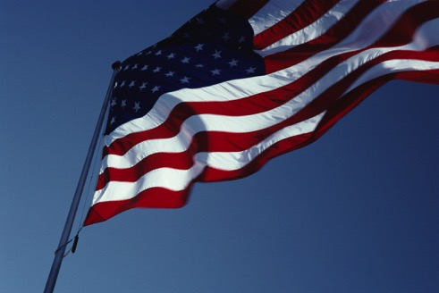
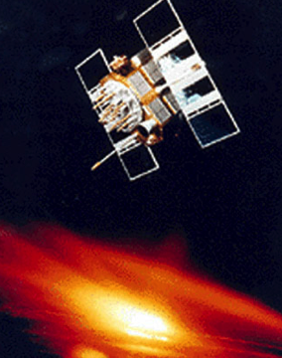
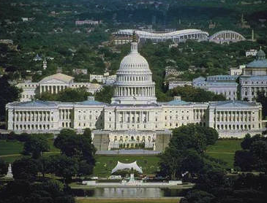

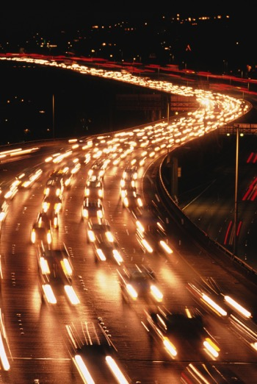
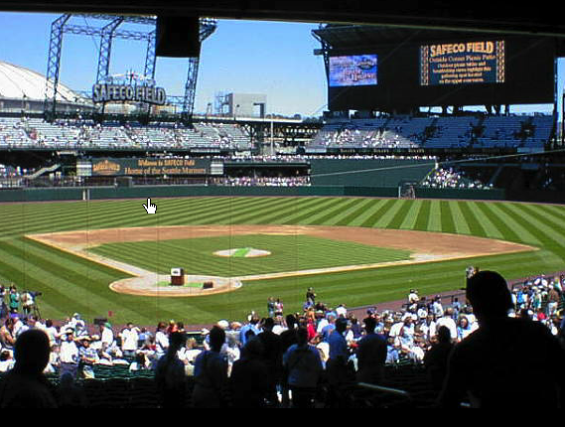
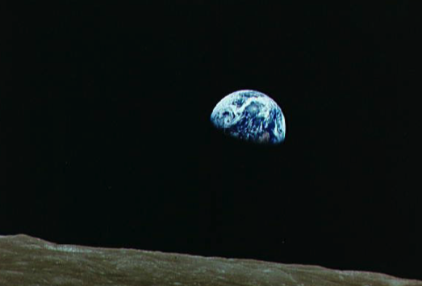
これら全てを支えている
ものは何でしょうか？
27
1
Notes:
28
Now the last puzzle piece...
Here is a series of sights and events that are common to life in the United States at this time in the world's history.
….And the majesty of the U.S. capitol building in Washington D.C.
With all of these varied aspects of our contemporary life...
//// ….there is a question here: is there one common concept that holds all this together? Is there an underlying idea or fundamental principle that brings all this – in this instance, the United States of America – together in what we could call –– in this case –– nationhood?

Slide 29
合衆国憲法
アメリカ人の生活における最重要要素
28
Notes:
29
We could suggest that the U.S. Constitution be considered as the very BACKBONE of American life. It is a legal document...not a divine instrument, of course. However, through the centuries that single written document has held the United States and its way of life together…through war and through peace...the good times and the very bad…a document of common understanding among all American people.

Slide 30
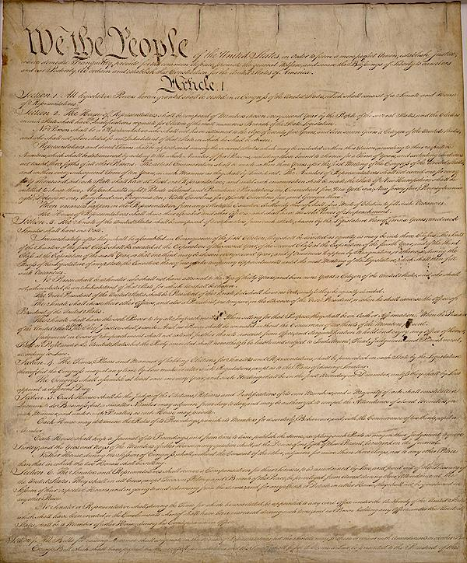
人と政府の関係を理解するための
法定文書！
合衆国憲法
アメリカ人の生活における最重要要素
29
1
Notes:
30
//// A LEGAL DOCUMENT OF UNDERSTANDING BETWEEN MEN AND THEIR GOVERNMENTS.

Slide 31
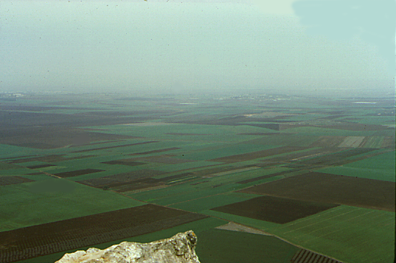
召命
カデシュ・バルネア
S - D - S
福音書
40
シナイ
使徒書簡
エリコ
領土分裂
430
出エジプト記
教会
70年
イスラエル
預言者
J - E
使徒の働き
奴隷
士師
ユダ
350
L - S - B
I - I
啓示
12部族
M - C - C
Z - E - N
5つの説教
3つの旅路・・・
9.65.05a.
© 2006 TBBMI
30
Notes:
31
Now think about all of these Biblical concepts, these ideas, the people, the events...all of them major parts of THE BIBLE…BASICALLY and THE QUICK CHRONOLOGY … the Bible's time and story lines we have moved through earlier…[DISSOLVING DIRECTLY INTO…]

Slide 32
召命
カデシュ・バルネア
S - D - S
福音書
40
シナイ
使徒書簡
エリコ
領土分裂
430
そして・・・
出エジプト記
教会
70年
主イエス・キリストの
宣教活動
イスラエル
預言者
J - E
使徒の働き
奴隷
士師
ユダ
350
L - S - B
I - I
啓示
12部族
M - C - C
Z - E - N
5つの説教
3つの旅路・・・
9.65.05a.
© 2006 TBBMI
31
Notes:
32
…including and culminating in the ministry of the Lord Jesus Christ! Now comes another question…

Slide 33
召命
カデシュ・バルネア
S - D - S
福音書
40
シナイ
使徒書簡
エリコ
領土分裂
430
そして・・・
出エジプト記
教会
70年
主イエス・キリストの
宣教活動
イスラエル
預言者
J - E
使徒の働き
奴隷
士師
ユダ
350
L - S - B
これら全ての出来事の間に
関連性はあるのだろうか？
I - I
啓示
12部族
M - C - C
Z - E - N
5つの説教
3つの旅路・・・
9.65.05a.
© 2006 TBBMI
32
Notes:
33
Is there here, also, a connection, a combining principle, or perhaps even A LEGAL DOCUMENT that would account for the Biblical events unfolding exactly as they did across the pages of Scripture? Of course, there is!

Slide 34
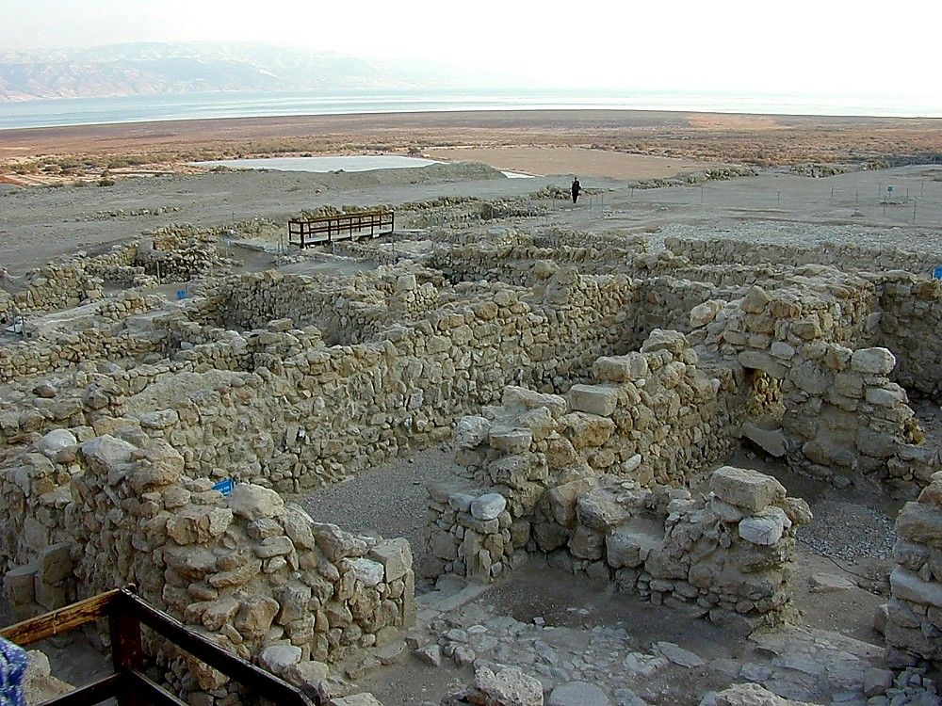
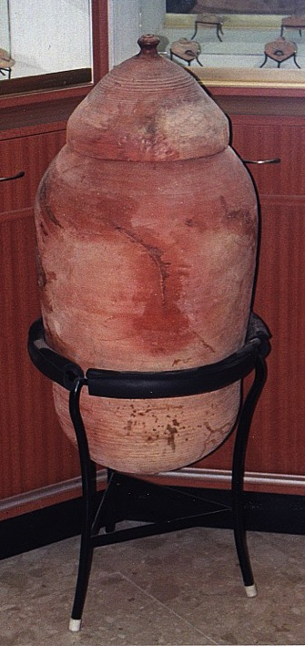
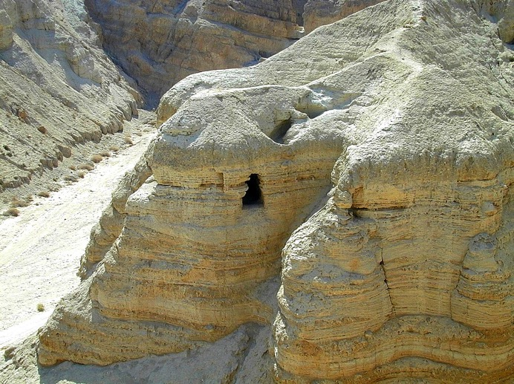
死海文書の隠し場所
クムランの古代遺跡
死海沿岸にある
エッセネ派の集落
33
2
Notes:
34
But first…let's make a framework in which to talk about all this. These are the ancient ruins of Qumran, a community of Essenes – a sect of extremely pious Jews – who lived apart on the shores of the Dead Sea not far from Jerusalem. Some scholars believe that John the Baptist was a member of this community.
//// The Essenes were known to have hand-copied the ancient Jewish scriptures. As Palestine was collapsing under the Romans, the Essenes spirited their precious copies of the Scriptures out of the community…hiding them across a dry streambed in a group of caves…
//// …preserving them in ceramic jars like this. And they stayed right there –– in the caves –– undisturbed until 1947 when they were discovered by a shepherd boy searching for his wandering sheep.

Slide 35
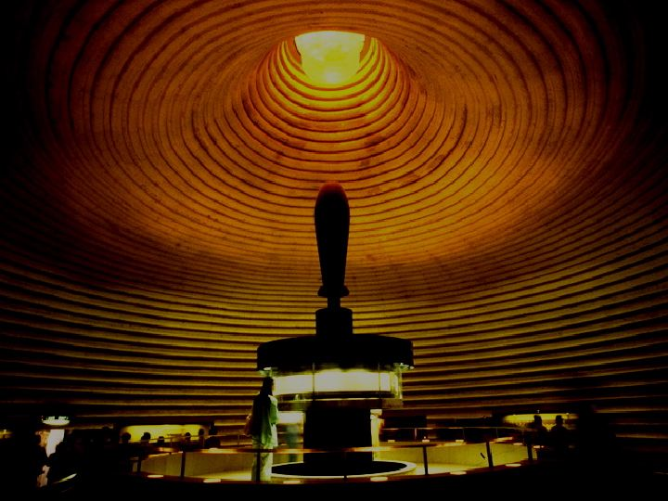
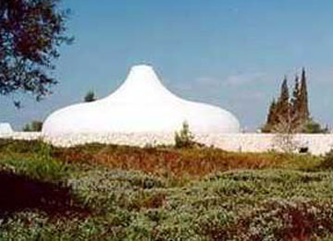
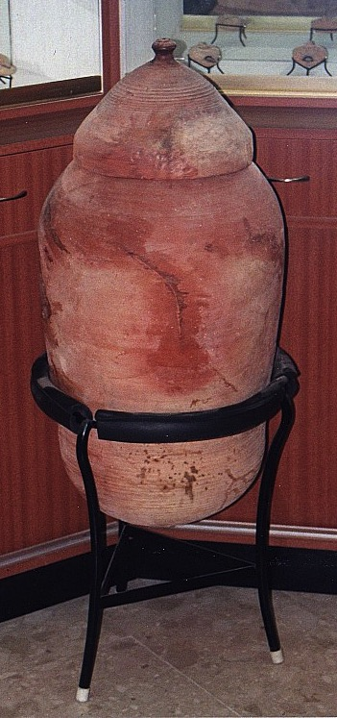
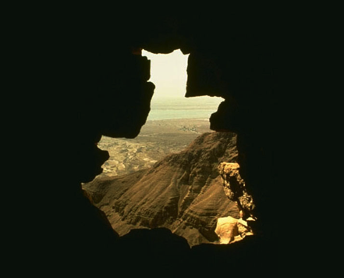
死海写本館
The Shrine of the Book
エルサレムのイスラエル博物館内
9.65.05a.
2
©2006 TBBMI
34
Notes:
35
Today, some of those ancient scrolls are preserved and displayed to the public in Jerusalem's…
//// …famed Shrine of the Book at Israel's National Museum.
//// So…from the caves…to the museum and to scroll researchers around the world…an enormous treasure of Essene writings has survived….held by many to be the most significant archeological discovery of the Twentieth Century.

Slide 36
死海写本館
The Shrine of the Book
エルサレムのイスラエル博物館内
死海写本館の内部
9.65.05a.
©2006 TBBMI
35
Notes:
36
Then…with this background inside Jerusalem's Shrine of the Book, let's explore the place of the Biblical legal understandings and promises between God and man…just as they have come down to us IN WRITING and preserved in the pages of Scripture in your own Bible.

Slide 37
アブラハム
契約
スタディヘルプ #14
9.65.05a.
1
©2006 TBBMI
36
Notes:
37
The arrows on the side of the screen will guide us through Study Help #14…
//// ….as we develop…first… THE ABRAHAMIC COVENANT.

Slide 38
アブラハム
契約
聖書啓示の
「最重要要素」：
神様による無条件
契約プログラムは
ここから始まる。
9.65.05a.
©2006 TBBMI
37
Notes:
38
This is Richardson's “VERY BACKBONE OF BIBLICAL REVELATION.” GOD'S UNCONDITIONAL COVENANTAL PROGRAM BEGINS RIGHT HERE!
That great ABRAHAMIC COVENANT....God's unconditional covenantal program of the ages was announced in two parts..

Slide 39
アブラハムの召命
創12:1-3
アブラハム
契約
契約
創15:9-18
聖書啓示の
「最重要要素」：
神様による無条件
契約プログラムは
ここから始まる。
9.65.05a.
2
©2006 TBBMI
38
Notes:
39
Guided on the Study Help by the arrows to the left…
The Abrahamic Promises originate in two different locations in Genesis...
//// First…Abraham received his famous CALL –– with its three promises –– in Genesis 12:1-3. Remember the time frame: about 2000 B.C.
//// Later on in Genesis 15:9-18, the actual Covenant is presented …in the form of a BLOOD COVENANT…as we described earlier…. followed by God –– in effect –– signing the actual COVENANT or contract between Himself and Abraham.
So then…what ARE the features of that ancient promise.

Slide 40
創世記12: 1-3
アブラハム契約
¹ 主はアブラムに仰せられた。「あなたは、あなたの生まれ故郷、あなたの父の家を出て、わたしが示す地へ行きなさい。
土地
子孫
²そうすれば、わたしはあなたを大いなる国民とし、あなたを祝福し、あなたの名を大いなるものとしよう。あなたの名は祝福となる。
アブラハム
³あなたを祝福する者をわたしは祝福し、あなたをのろう者をわたしはのろう。地上のすべての民族は、あなたによって祝福される。」 (新改訳)
召命
L - S - B
I - I
J - E
12
祝福
39
8
Notes:
40
Read along with this Covenant between God and Abraham as we touched on it much earlier...remember from Genesis 12: 1-3?
//// ….the L-S-B on the ABRAHAM File Folder. The verses read…
//// ¹ “ The Lord had said to Abram,
“Leave your country, your people and your father's household, and go to the land I will show you.
//// THIS IS THE PROMISE OF A LAND FOR THE ABRAHAM'S DESCENDANTS.
//// ²“I will make you into a great nation
and I will bless you;
I will make your name great,
and you will be a blessing.
//// THIS IS THE PROMISE OF A SEED, OR GREAT LINE OF DESCENDANTS, TO COME FROM HIM.
//// ³ I will bless those who bless you,
and whoever curses you I will curse;
and all peoples on earth
will be blessed through you.”
//// THIS IS THE BLESSING, THAT PART OF THE PROMISE THAT EXTENDS FAR BEYOND ABRAHAM'S LINE…OUT TO EVERY PERSON ON EARTH FROM THEN UNTIL THIS VERY DAY!
//// The significant points of that promise are these... L…S…B… presenting to Abraham
A LAND...A SEED......AND A BLESSING!

Slide 41
アブラハムの召命
創12:1-3
アブラハム
契約
契約
創15:9-18
土地
子孫
祝福
創12:1
創12:2
創12:3
聖書啓示の「最重要要素」
9.65.05a.
2
©2006 TBBMI
40
Notes:
41
So…in outline…The LAND provision is stated in Genesis 12:1...
//// The SEED aspect laid out in Genesis 12:2...
//// And that world-girdling BLESSING provision in Genesis 12:3.

Slide 42
創世記12:1-3
アブラハム契約
¹ 主はアブラムに仰せられた。「あなたは、あなたの生まれ故郷、あなたの父の家を出て、わたしが示す地へ行きなさい。
さて、もう一度
これらの言葉を
見てみましょう・・・
²そうすれば、わたしはあなたを大いなる国民とし、あなたを祝福し、あなたの名を大いなるものとしよう。あなたの名は祝福となる。
³あなたを祝福する者をわたしは祝福し、あなたをのろう者をわたしはのろう。地上のすべての民族は、あなたによって祝福される。」 (新改訳)
41
Notes:
42
Now take another quick look at those astonishing verses one more time. Two questions arise...

Slide 43
創世記12: 1-3
アブラハム契約
¹ 主はアブラムに仰せられた。「あなたは、あなたの生まれ故郷、あなたの父の家を出て、わたしが示す地へ行きなさい。
これらの言葉を
額面どおりに受け取れますか？
²そうすれば、わたしはあなたを大いなる国民とし、あなたを祝福し、あなたの名を大いなるものとしよう。あなたの名は祝福となる。
³あなたを祝福する者をわたしは祝福し、あなたをのろう者をわたしはのろう。地上のすべての民族は、あなたによって祝福される。」 (新改訳)
42
Notes:
43
FIRST… do we take them at their absolute face value…exactly what they say or mean?

Slide 44
創世記12: 1-3
アブラハム契約
¹ 主はアブラムに仰せられた。「あなたは、あなたの生まれ故郷、あなたの父の家を出て、わたしが示す地へ行きなさい。
²そうすれば、わたしはあなたを大いなる国民とし、あなたを祝福し、あなたの名を大いなるものとしよう。あなたの名は祝福となる。
³あなたを祝福する者をわたしは祝福し、あなたをのろう者をわたしはのろう。地上のすべての民族は、あなたによって祝福される。」 (新改訳)
43
Notes:
44
We are told plainly enough…God is promising Abraham and his descendants A LAND OF THEIR OWN…A GREAT NATION OF INDIVIDUALS…AND, THROUGH HIM, AN EVENTUAL BLESSING TO ALL FAMILIES OF THE EARTH!

Slide 45
創世記12: 1-3
アブラハム契約
¹ 主はアブラムに仰せられた。「あなたは、あなたの生まれ故郷、あなたの父の家を出て、わたしが示す地へ行きなさい。
²そうすれば、わたしはあなたを大いなる国民とし、あなたを祝福し、あなたの名を大いなるものとしよう。あなたの名は祝福となる。
³ あなたを祝福する者をわたしは祝福し、あなたをのろう者をわたしはのろう。地上のすべての民族は、あなたによって祝福される。」 (新改訳)
これらの言葉はアブラハムの時代と同じく、現代にも有効でしょうか？
もしそうでなければ・・・
聖書の記述内で
他のどの箇所を
もう既に有効でないと
あなたは考えますか？
44
1
Notes:
45
Are these words as valid today as they were in Abraham's time
…some 4,000 years ago when first revealed to the patriarch?
Of course, that's for you to answer…from your heart and from your intellect! Our response to that question has deep implications for our faith in the infallibility of God's Word…because…
//// Otherwise…IF NOT…what other parts of the biblical record would you put aside as no longer valid…or adjust to your more comfortable preferences?

Slide 46
創世記12:1-3
アブラハム契約
¹ 主はアブラムに仰せられた。「あなたは、あなたの生まれ故郷、あなたの父の家を出て、わたしが示す地へ行きなさい。
²そうすれば、わたしはあなたを大いなる国民とし、あなたを祝福し、あなたの名を大いなるものとしよう。あなたの名は祝福となる。
³ あなたを祝福する者をわたしは祝福し、あなたをのろう者をわたしはのろう。地上のすべての民族は、あなたによって祝福される。」 (新改訳)
そうです!
はい、それでは・・・
ここでは一体何が
問題なのでしょうか？
45
1
Notes:
46
A second question then follows: is there anything else at work here? Indeed…
//// Emphatically YES!

Slide 47
アブラハムの召命
創12:1-3
アブラハム
契約
契約
創15:9-18
永遠
創13:15
土地
子孫
祝福
創12:1
創12:2
創12:3
聖書啓示の「最重要要素」
9.65.05a.
©2006 TBBMI
46
Notes:
47
The scholars, the linguists and the teachers tell us that these words are ETERNAL in their application...an example is Genesis 13:15. Are these words in effect even as you read them here?

Slide 48
永遠・・・創世記13:15
¹⁵わたしは、あなたが見渡しているこの地全部を、永久にあなたとあなたの子孫とに与えよう。 (新改訳)
47
1
Notes:
48
God said..."All the land that you see I will give to you and your offspring FOREVER."
…Not a year...or a thousand years...but FOREVER…an unmistakable meaning in the Hebrew original.

Slide 49
アブラハムの召命
創12:1-3
アブラハム
契約
契約
創15:9-18
永遠
文字通り
創13:15
創13:14-16
土地
子孫
祝福
創12:1
創12:2
創12:3
聖書啓示の「最重要要素」
9.65.05a.
©2006 TBBMI
48
Notes:
49
Following ETERNAL…then…the covenant promises are LITERAL. They mean exactly what they say.

Slide 50
文字通り・・・創世記13:14-17
¹⁴ロトがアブラムと別れて後、主はアブラムに仰せられた。「さあ、目を上げて、あなたがいる所から北と南、東と西を見渡しなさい。
49
Notes:
50
Look at the larger context of that FOREVER verse…Genesis 13: 14-17.
"The LORD said to Abram after Lot has parted from him, "lift up your eyes from where you are and look north and south, east and west.”

Slide 51
¹⁵わたしは、あなたが見渡しているこの地全部を、永久にあなたとあなたの子孫とに与えよう。
文字通り・・・創世記13:14-17
50
Notes:
51
All the land that you see I will give to you and your offspring forever.

Slide 52
¹⁶わたしは、あなたの子孫を地のちりのようにならせる。もし人が地のちりを数えることができれば、あなたの子孫をも数えることができよう。
文字通り・・・創世記13:14-17
51
Notes:
52
I will make your offspring like the dust of the earth, so that if anyone could count the dust, then your offspring could be counted.

Slide 53
¹⁷立って、その地を縦と横に歩き回りなさい。わたしがあなたに、その地を与えるのだから。」 (新改訳)
文字通り・・・創世記13:14-17
52
1
Notes:
53
Go, walk through the length and breadth of the land, for
I AM GIVING IT TO YOU.

Slide 54
アブラハムの召命
創12:1-3
アブラハム
契約
契約
創15:9-18
永遠
文字通り
無条件
創13:15
創13:14-16
創15:9-18
土地
子孫
祝福
創12:1
創12:2
創12:3
聖書啓示の「最重要要素」
9.65.05a.
©2006 TBBMI
53
Notes:
54
Underlying every word of this additional information on the contract is the fact that God is giving the land – making the promises -- to Abraham and his descendants with no strings attached. In other words...it is an UNCONDITIONAL COVENANT arrangement. What does that imply… UNCONDITIONAL?

Slide 55
二つの重要な方式・・・
条件付きの合意・・・
「私はこれをしましょう・・・
もし、あなたがあれをするなら。」
無条件の合意・・・
「私はこれ、もしくはあれをしましょう。
あなたがするしないに関わらず。 」
54
5
Notes:
55
Think of these two crucial formulas:
//// A CONDITIONAL agreement would be...
//// "I will do THIS...if you will do THAT."
It's an agreement requiring mutual action on both sides of a bargain or agreement.
//// However, for an UNCONDITIONAL agreement to be arranged,
the formula must be…
//// "I will do this or that NO MATTER WHAT YOU MIGHT DO in the meantime."
It's an agreement between two parties with one side of the agreement carrying out its end of the deal with absolutely nothing required – no action whatever -- on the part of the other.
//// THAT was and is the very heart and soul of the Abrahamic Covenant, Contract, Testament, or...in this case, God's Will.

Slide 56
無条件・・・創世記15:9-18*
¹⁷さて、日は沈み、暗やみになったとき、そのとき、煙の立つかまどと、燃えているたいまつが、あの切り裂かれたものの間を通り過ぎた。
*これは血の契約の場面です。
55
2
Notes:
56
Now…for an event closer look…we'll read Genesis 15: 9-18:
//// It's the scene of that blood covenant agreement between God and Abraham. Here are two verses at the climax of the scene of signing the blood covenant –- a recognized legal contract in the culture of that day:
//// “When the sun had set and darkness had fallen, a smoking firepot with a blazing torch appeared and passed between the pieces.

Slide 57
無条件・・・創世記15:9-18*
¹⁸その日、主はアブラムと契約を結んで仰せられた。「わたしはあなたの子孫に、この地を与える。エジプトの川から、あの大川、ユーフラテス川まで・・・」 (新改訳)
56
Notes:
57
“On that day the Lord made a covenant with Abram and said, "To your descendants I give this land, from the river of Egypt to the great river, the Euphrates."

Slide 58
先に見たように、アブラハム契約は
血の契約に基づく神様と神様ご自身との間の
一方的で保証された約束。その約束を神様は
その友アブラハムと結ばれた。
ヘブル人への手紙 6章
¹³神は、アブラハムに約束されるとき、ご自分よりすぐれたものをさして誓うことがありえないため、ご自分をさして誓い・・・
(新改訳)
9.65.05a.
2
©2006 TBBMI
57
Notes:
58
We defined it earlier…THE ABRAHAMIC COVENANT then was a unilateral blood-covenant-based contractual promise between God and himself toward his friend, Abraham.
//// Over in the New Testament this is made clear…Hebrews 6: 13 tells us….
//// “When God made his promise to Abraham, since there was no one greater for him to swear by, he swore by himself…”

Slide 59
^{そのため・・・}
その約束の期間は永遠で、その意味は文字通りで、その契約は無条件に成就される。
永遠
文字通り
無条件
9.65.05a.
4
©2006 TBBMI
59
Notes:
59
So then...regarding these arrangements that God made with Abraham...
//// The promises are
//// ETERNAL in their duration...
//// LITERAL in the meaning...
//// and UNCONDITIONAL in their fulfillment.

Slide 60
そして・・・最後の仕上げ！
アブラハムは主を信じた。主はそれを彼の義と
認められた。
創世記15:6 (新改訳)
60
3
Notes:
60
Finally…a capstone to all that is revealed. It's there for us in a sentence of startling simplicity…at Genesis 15:6…we mentioned it in the ABRAHAM FILE FOLDER…
//// ABRAM BELIEVED THE LORD AND HE...[GOD]...CREDITED TO HIM AS RIGHTEOUSNESS.
Which gives us the powerful lesson: simple unquestioning belief in God's direction and provision is the proper definition for
//// righteousness in His sight. And it's presented to us clearly in words that we can easily understand...which makes
//// Genesis 15:6 one of the Old Testament's anchor points of basic evangelical
theology.

Slide 61
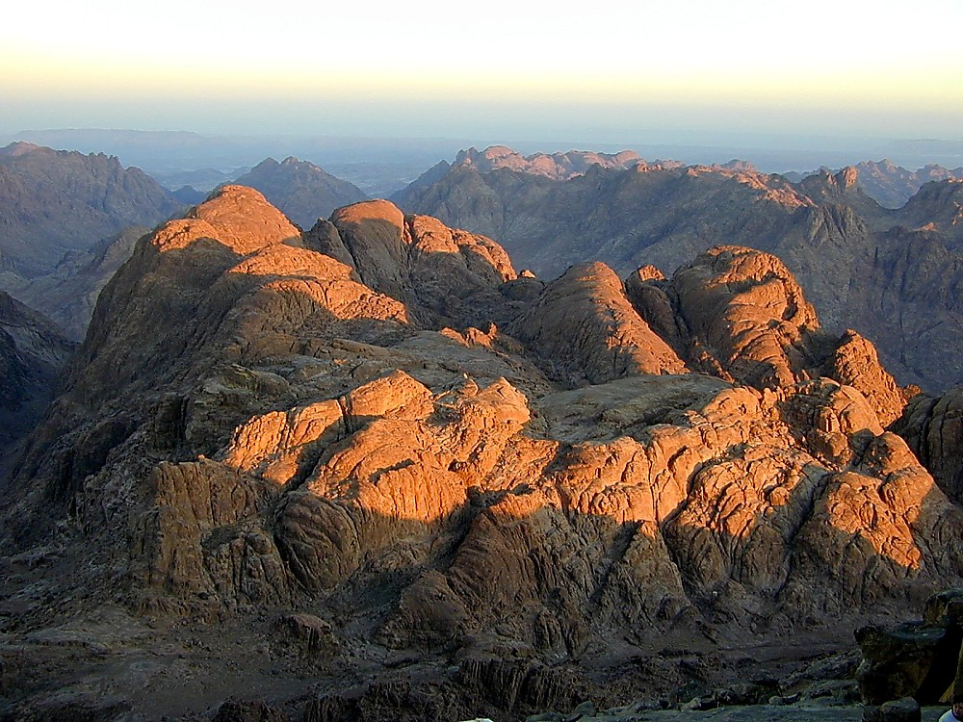
神様が結ぶ
モーセとの特別な協定
I
II
III
IV
V
VI
VII
VIII
IX
X
旧約聖書
出エジプト記：
「モーセ契約」
この協定の
意味するところは?
9.65.05a.
3
©2006 TBBMI
61
Notes:
61
Now we must journey onto a side road for just a moment.
//// There is another covenant in the Old Testament that you may have thought about already. We must consider it briefly.
//// However, its circumstances and its elements are very different from those in the Abrahamic promises. . IT'S GOD'S SPECIAL ARRANGEMENT WITH MOSES! This covenant is placed in the book of Exodus in the Old Testament…
//// and is called THE MOSAIC COVENANT. However…THE MOSAIC is NOT a part of that Abrahamic contract. What about THIS arrangement?

Slide 62
I
II
III
IV
V
VI
VII
VIII
IX
X
スタディヘルプ #15
62
Notes:
62
In our next session we will work through THE MOSAIC COVENANT with Study Help #15.

Slide 63
63
©2006 TBBMI
9.65.05a.
Notes:
63

Slide 64


バイブル ベイシック • BibleStudyDownloads.org
無料でダウンロードどうぞ
Notes:
The Bible…Basically (bb)

