Slide 1

バイブル ベイシック
A Presentation of The Bible…Basically Ministries International Inc.
Fort Worth, Texas
Designed by Dr. John Fryman, Texas, USA • BibleBasically.org
Taught by Dr. Rick Griffith, Singapore Bible College
All files in many languages for free download at BibleStudyDownloads.org
9.65.01.
©2004 TBBMI
04
Notes:
Japanese title slide

Slide 2



創世記からエステル書
7
天地創造
ANARCHY
天地創造
無政府
始めの男性と女性
始めの男性と女性
Judges
1st Sin
士師たち
1st Sin
350
350
1st Gospel
350
C
始めの福音
350
1st Family
始めの家族
(1000 B.C.)
(1000 B.C.)
ROYALTY
(1000 B.C.)
1st Murder
王制
始めの殺人
DC
S - D - S
DC
Flood/Rainbow
S - D - S
洪水／虹
••• SPLIT •••
Tower
••• 分裂 •••
塔
North South
北 南
(2000 B.C.)
(2000 B.C.)
Israel
Judah
ABRAHAM
(2000 B.C.)
イスラエル
ユダ
アブラハハム
10 2
10 2
３つの社会
The CALL
NC
召命
AC
NC
AC
THE PROPHETS
C 7 S J
L - S - B
預言者たち
L - S - B
20-J 20-R
I - I
20-J 20-R
I - I
200 350
J - E
200 350
J - E
Assyria Babylon
12
アッシリア バビロン
12
CAPTIVITY
捕囚
JOSEPH
ヨセフ
70 Years
7 = 4 + 3
70 年
Slavery
3 Treks
奴隷
3 つの長旅
430
100 Years / 50,000
４人の人々
430
100 年 / 50,000
Z - E - N
Z - E - N
(1500 B.C.)
(1500 B.C.)
MOSES
(1500 B.C.)
モーセ
沈黙
(500 B.C.)
Exodus
S
S
出エジプト
Sinai
シナイ
M - C - C
M - C - C
Kadesh Barnea
カデシュ・バルネア
イエス
40
40
40
40
LC
5 Sermons
LC
５つの説教
J
JOSHUA
ヨシュア
Jericho/Ai
エリコ／アイ
Land Divided
土地を分ける
01
2
Notes:
//// Continuing THE BIBLE FILE…we have set up the CREATION file…THE FOUR GREAT PEOPLE….THE THREE SOCIETIES…TIED TOGETHER IN MEANING AND PURPOSE BY FOUR UNCONDITIONAL BIBLICAL COVENANTS…and now we’re moving to a place actually outside of Scripture but at the same time, outlining a set of events that tie together both the Old and the New Testaments.
//// We call it the period of Biblical SILENCE.

Slide 3
おおまかな年代:
アブラハム-ヨセフ 2000 B.C.
モーセ-ヨシュア 1500 B.C.
無政府-王制 1000 B.C.
捕囚-沈黙 500 B.C.
02
Notes:
At this point, the biblical time line remains at about 500 B.C. A fascinating period of history follows, setting the stage for all that will shortly happen. Remember that the world is being prepared for the entrance of the Savior…yet some centuries away. Will events occur to prepare the way? Yes, indeed…significantly! Watch them unfold.

Slide 4
7
S
C 7 J
(旧約) 約４００年 (新約)
Handbook pg. 38-39
03
2
Notes:
This is the period called biblical SILENCE…the S in C 7 S and J.
//// Extending about 400 years between the Old and New Testaments, but with a crucial importance and difference.
//// The Protestant Bible records no other event or any additional revelation from God during that time. We have no more Biblical record until we arrive at the Gospel of Matthew in the New Testament.
The prophet Daniel HAD foreseen events of that time. However, regarding specific writings, as in other parts of Scripture, the Protestant Bible provides none in book form during the SILENCE period.

Slide 5
マラキ書からマタイによる福音書までの間
旧約聖書
天地創造
ABRAHAM
アブラハム
ABRAHAM
ヨセフ
ABRAHAM
モーセ
ヨシュア
無政府
王制
捕囚
沈黙
イエス
新約聖書
Handbook pg. 38-39
04
2
©2006 TBBMI
9.65.03e.
Notes:
Here is the SILENCE FOLDER in the Bible File collection. But remember this...although this period between the Testaments is traditionally called a period of BIBLICAL SILENCE, the stage of world history was anything but quiet.
//// The Bible File’s SILENCE Folder sits there squarely parked between the Old Testament…
//// ….and the New Testament…the JESUS file folder.

Slide 6
7
沈黙
ca. 500 B.C.
アレキサンダー大王
OT S NT
沈黙
アレキサンダー大王
Handbook pg. 38-39
05
1
Notes:
The SILENCE time frame…about 500 B.C.… with the Bible File’s two blank spaces marking this period of Biblical AND world history…. crucial turning points of enormous importance to Biblical understanding.
//// Let's begin with ALEX THE GREEK -- the reason for that temporary title is coming shortly.

Slide 7
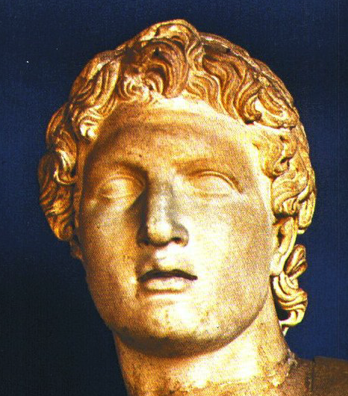
7
沈黙
アレキサンダー大王
アレキサンダー大王
Handbook pg. 38-39
06
Notes:
We refer, of course, to ALEXANDER THE GREAT…that remarkable young Greek military genius who changed the course of world history.

Slide 8
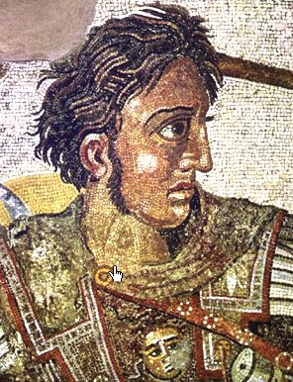
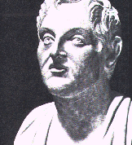
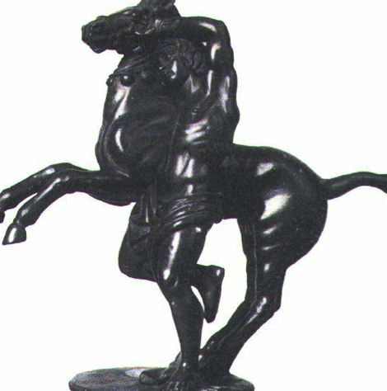
アレキサンダー大王
ブケファラスを 乗りこなしたアレクサンダー大王
沈黙
アレキサンダー大王
アリストテレスが師
Handbook pg. 38-39
07
Notes:
Some facts about the young Alexander: he was educated at the feet of Aristotle, eventually riding to fabulous victories on his famous horse, Bucephalus.

Slide 9
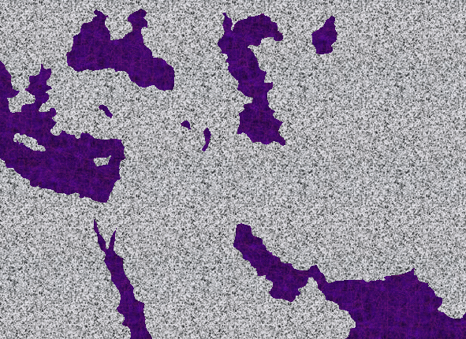
MACEDONIA: ALEXANDER’S BIRTHPLACE
マケドニア: アレキサンダー大王の出生地
SILENCE
ca. 500 B.C.
OT S NT
アジア
地中海
パレスチナ
沈黙
アレキサンダー大王
“ヘレニズム（ギリシャ思想）”… ギリシャの習慣 & “ギリシャの世知”
アラビア
古代フィリピ
アフリカ
Handbook pg. 38-39
08
5
Notes:
ALEXANDER was born in Macedonia…about 300 years before the birth of Jesus Christ…
//// …in the ancient city of Philippi, the son of King Philip. Alexander exerted a level of influence on world history like few others, before or since. His conquering armies swept through most of the known world of his day.
//// By the time of his death at age 33, Alexander had subdued an enormous extent of European and Asian lands…from North Africa to today's Turkey, and from today's Northern Greece all the way to India. A truly incredible life of unparalleled historic significance.
//// And right at the center of Alexander's conquests lay that troubling little land called Israel or Canaan, later known as Palestine during Roman times. Alexander’s influence heavily impacted The Land of Abraham’s inheritance.
//// Wherever he went, Alexander spread the cultural effects of "Hellenism," an important word that means doing things THE GREEK WAY. But riding out above all his accomplishments…in all his conquered lands ALEXANDER also left behind his most important cultural contribution…
//// …as far as the Gospel is concerned: the Greek language...a version called, in effect, street or Koine (KOIN-AY) Greek

Slide 10
使徒言行録17:16-34
沈黙
ca. 500 B.C.
アレキサンダー大王
ギリシャの知的天才を忘れずに。
SILENCE
Alex the Greek
パウロは忘れなかった!
Handbook pg. 38-39
09
1
Notes:
This is why we list him as ALEX THE GREEK in The Bible File. The presence of the Greek language throughout the Mediterranean Basin provided an improved ease of communication in the Apostle Paul's later missionary journeys in those distant lands.
//// And a reminder to our own time: never forget the intellectual genius of the Greeks. Paul did not. Only read the Book of Acts to understand his respect for the brilliance of the Greek mind…even though it was mired in pagan philosophy and spiritual darkness.

Slide 11
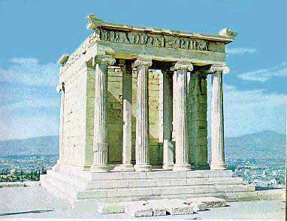
使徒言行録 17:16-34; 使徒言行録 18
7
沈黙
ca. 500 B.C.
ALEX THE GREEK
Corinth
沈黙
アレキサンダー大王
アテネ: アクロポリス と
アテネ・ニケ神殿
Handbook pg. 38-39
10
Notes:
Besides the Greek language spreading everywhere…remember, too, all the other accomplishments of Hellenism...such as Greek architectural and engineering skills... examples: the Athenian Acropolis and the smaller Temple of Nike. The remains of ancient Corinth…Paul lived there…still with us today!

Slide 12
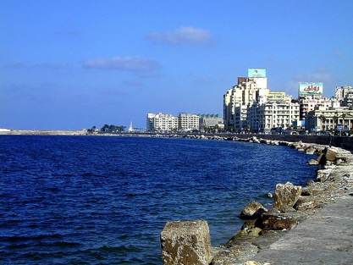
SILENCE
ca. 500 B.C.
アレキサンダー皇帝の地
OT S NT
小アジア
地中海
沈黙
アレキサンダー大王
エジプトの
アレキサンドリア
アラビア
アフリカ
Handbook pg. 38-39
11
2
Notes:
Throughout Alexander’s imperial lands, he built dozens of cities, which he named in his own honor.
//// One among them was Egyptian Alexandria on the Nile Delta.
//// Modern Alexandria exists today. At his great new city on the Mediterranean coast, Alexander established a fabulous center of international scholarship and commerce.

Slide 13
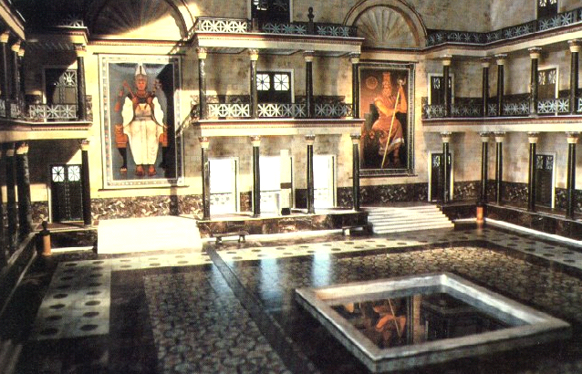
沈黙
アレキサンダー大王
ロイアルアレクサンドリア図書館
Handbook pg. 38-39
12
Notes:
Ancient records tell us that the Alexandrian library was a repository for all the world's learning up to that time. Tragedy struck in 272 A.D. when fire destroyed the library...containing at the time original works of the great Greek philosophers, poets and dramatists. With a collection of just under a half million catalogued scrolls, it was a loss of incalculable value.

Slide 14

学びの助け #05
SILENCE
ca. 500 B.C.
旧約と新約の間の 場面の動向に 目を留めよう。
アレキサンダー皇帝の地
OT S NT
アジア
地中海
沈黙
アレキサンダー大王
アラビア
アフリカ
Handbook pg. 38-39
13
1
Notes:
To this day, the works and accomplishments of Alexander the Great fascinate historians on every continent.
//// Looking at the stage of action between the Testaments – with Study Help #5 –– you realize that this one individual played a central role by preparing the Mediterranean world for the arrival of the Lord Jesus Christ…and for the rest of the planet’s history.

Slide 15
7
アレキサンダー大王は紀元３００年代に３３歳で死去。
彼の帝国は、彼の４人の将軍達によって分割される。
ギリシャ:
小アジア:
カッサンダー
リュシマコス
シリア:
セレウコス
沈黙
アレクサンダー大王
地中海
学びの助け #05
エジプト
プトレマイオス
Handbook pg. 38-39
14
9
Notes:
Alexander died at age 33 in the 300s B.C.
//// In his will his empire was divided among his four closest generals...
Among the lands that surrounded the eastern end of the Mediterranean Sea were…
//// Greece,
//// Asia Minor,
//// Syria, and
//// Egypt...
All these lands bordering the Mediterranean Sea were in Alexander's estate when it passed to
//// General Cassander, inheriting Greece…
//// Asia Minor to General Lysimachus…
//// Syria to General Seleucus...
//// and Egypt to General Ptolemy.

Slide 16
7
アレキサンダー大王は紀元３００年代に３３歳で死去。
彼の帝国は、彼の４人の将軍達によって分割される。
ギリシャ:
小アジア:
カッサンダー
リュシマコス
セレウコス朝の 皇帝たち
シリア:
‘地球のへそ”
セレウコス
SILENCE
Alex the Greek
地中海
パレスチナ
エジプト
プトレマイオス朝のファラオたち
プトレマイオス
Handbook pg. 38-39
15
2
Notes:
And right there in the middle, with decades of tension and struggle to follow, lay tiny Israel or Palestine -- as that region would be called in the near future.
In fact, as we know, many of the ancients called this region the very navel of the earth…a crucial pivot for events that redirected the history of our planet! Here are the beginnings of
//// the cruel Selucid Emperors of Syria and
//// the Ptolemaic Pharaohs of Egypt…of which Cleopatra was the most famous queen. She was Greek, by the way!
And these two royal houses became flash points for incredible evil and distress for the Jews…massively important events soon to follow.

Slide 17
7
１５冊の外典
プロテスタント:
これらの書簡を神の黙示と認めない。
カトリックでは１５４６年に７つの文書 も正典とした。
(旧約) 約４００年 (新約)
Handbook pg. 38-39
16
3
Notes:
It's also through this extended period of some 400 years between the Old and the New Testaments…
//// …that the 15 books of the Apocrypha emerged. Although there is much valuable lore and information available from these works…
//// …the Protestant sector of Christianity has never admitted the books into its official collection of Biblical literature …its canon… believing them NOT to be of divine origin.
//// Roman Catholics, however, admitted seven and only seven of them into their Catholic Bible, their canon…and that only as late as the sixteenth century.

Slide 18
7
１５冊の外典
エズラ記
第２エズラ記
トビト記
ユディト書
エステル書残篇
ソロモンの知恵
集会の書
バルク書
エレミヤの書簡
アザリアの祈りと三童子の歌
スザンナ
ベルと竜
マナセの祈り
マカバイ記
第２マカバイ記...
沈黙
アレキサンダー大王
Handbook pg. 38-39
17
1
Notes:
Here are the titles of the Apocryphal Books…15 in all. Among them there are two that merit special attention: First and Second Maccabees…and of those two…
//// …the book of First Maccabees is a primary source for historical details of the Silent Period…

Slide 19
7
１５冊の外典
エズラ記
第２エズラ記
トビト記
ユディト書
エステル書残篇
ソロモンの知恵
集会の書
バルク書
エレミヤの書簡
アザリアの祈りと三童子の歌
スザンナ
ベルと竜
マナセの祈り
マカバイ記
第２マカバイ記...
当時の歴史を知る上で重要な２冊の文献…
沈黙
マカバイ記
アレキサンダー大王
第２マカバイ記
Handbook pg. 38-39
18
Notes:
So, then…the two traditional historical resources for the Silent period include First Maccabees…and…the writings of Josephus. Taken together, these two accounts give us a rich backdrop for understanding the world immediately preceding the birth of the Savior.

Slide 20
7
学びの助け #05
アレキサンダー大王の
時代:
アリストテレス: 大王の教師
アリストテレス: 音楽理論
万里の長城
中国で鉄が使われる
アレキサンダー大王: ギリシャ学問の中心
ユークリッド: 幾何学の基本を記す
ローマ・始めてのコイン
コリントスが貿易の中心地となる
エジプトのユダヤ人貿易中心地
ヘレニズムとギリシャの都市
ギリシャ式生活スタイル
ギリシャ語
沈黙
アレキサンダー大王
ローマの様式
Handbook pg. 38-39
19
12
Notes:
Here are a few other world events and great accomplishments in the SILENCE period during the times of Alexander the Great and later...
//// ARISTOTLE was ALEXANDER’S TEACHER
//// ARISTOTLE develops his system of MUSIC THEORY
//// GREAT WALL OF CHINA arises
//// IRON USED IN CHINA
//// ALEXANDRIA becomes a CENTER OF GREEK LEARNING
//// EUCLID: writes a STANDARD WORK IN GEOMETRY
//// FIRST ROMAN COINS come into use
//// CORINTH BECOMES a great TRADING CENTER
//// JEWISH TRADING CENTERS develop IN EGYPT
And of course...
//// the Influence of HELLENISM and the GREEK CITIES
together with
//// GREEK STYLES OF LIVING…and most important…
//// the wide adoption of the GREEK LANGUAGE.

Slide 21
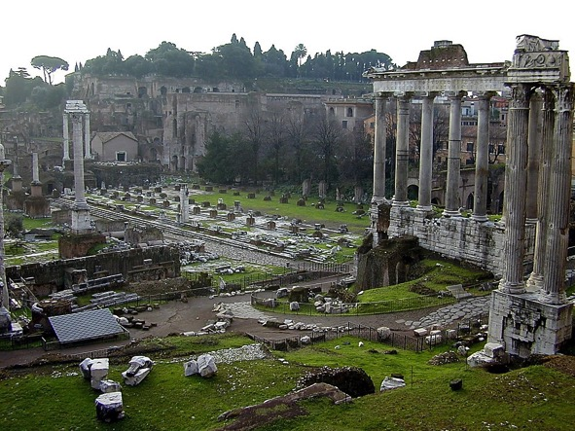
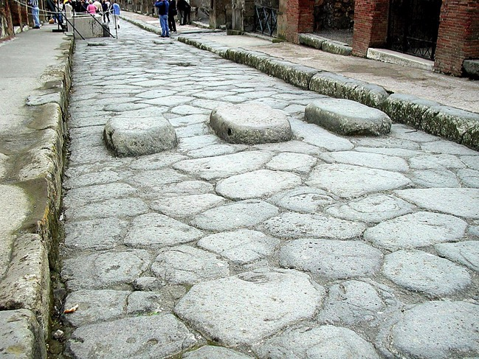
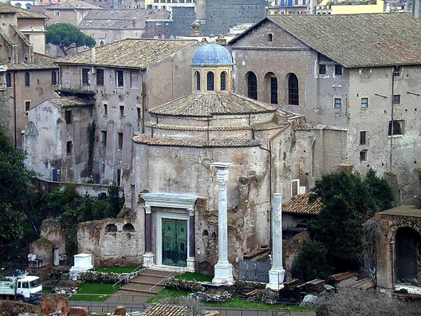
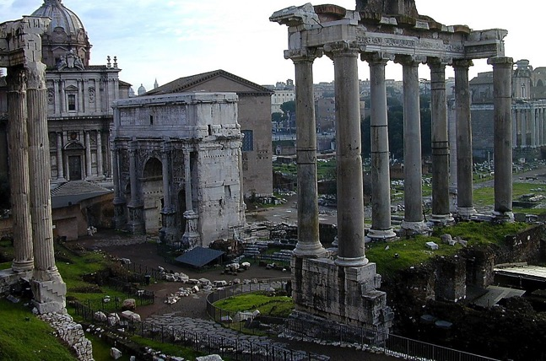
Acts 28: 11-16
沈黙
ca. 500 B.C.
アレキサンダー大王
ローマの様式
市民・軍事行政
法律
通信
交通
銀行や税金
パクスロマーナ...
沈黙
アレキサンダー大王
ローマ様式
Handbook pg. 38-39
20
6
Notes:
Still within the Bible File of SILENCE…around 500 B.C…..As ALEXANDER passes from the scene…the ROMAN EMPIRE enters world history with its ROMAN SYSTEMS of
//// civil and military administration,
//// law,
//// communication,
//// transportation,
//// banking and taxation. And cruel though it may have been,
//// Rome’s famous Pax Romana, the Peace of Rome, spreading across the continents as the most extensive era of relative peace the world had known up to that time…cruel though it was!

Slide 22
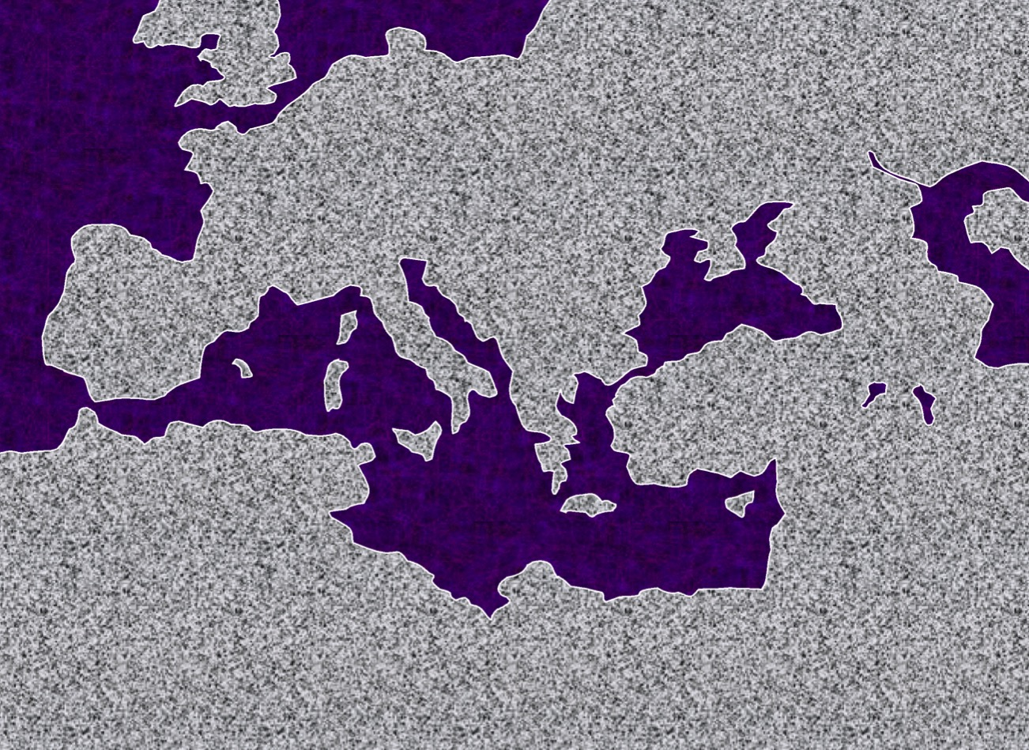

大西洋
ヨーロッパ
小アジア
ローマ皇帝
沈黙
あれ起算カー大王
ローマ様式
地中海
パレスチナ
アラビア
アフリカ
Handbook pg. 38-39
21
2
Notes:
Lands of the Roman Empire extended from England to Northern Arabia, and
//// from North Africa to today's southern Russia. And it is said that with a fresh change of relay horses, you could travel from the capital in Rome to the farthest point of the Empire in two weeks.
//// And here again, nestled down in the far southeast corner of the empire sat that troublesome little land, called Palestine.

Slide 23
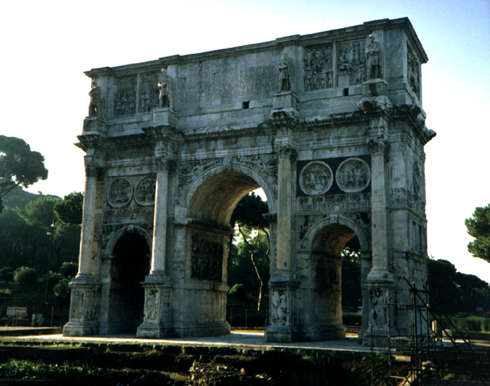
沈黙
アレキサンダー大王
ローマ様式
ローマ: コンスタンティヌスの凱旋門
Handbook pg. 38-39
22
Notes:
We stand in amazement at the incredible achievements of the Roman engineers and their conquering armies. The colossal Arch of Constantine remains today next to the Coliseum in Rome, as grand now as when it was originally designed and erected by Rome's first Christian emperor, Constantine.

Slide 24
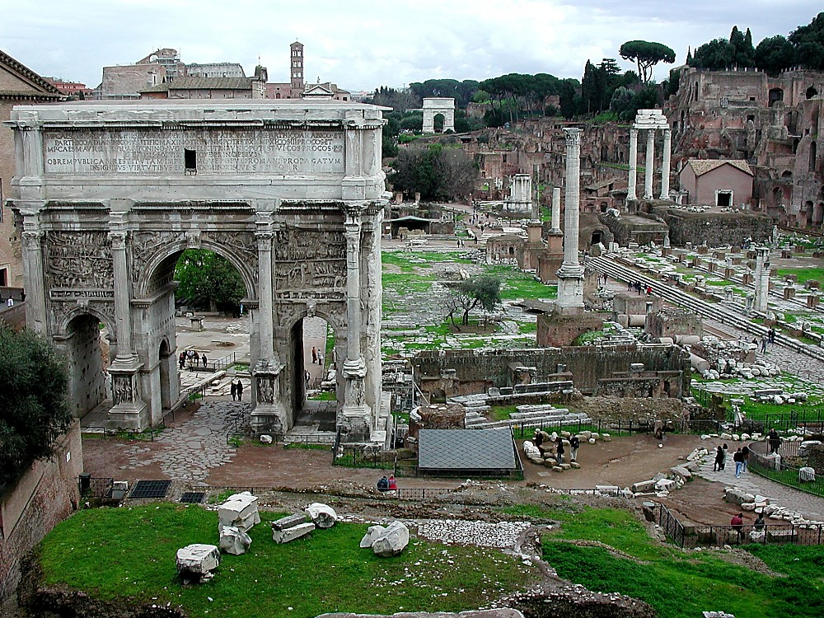
シーザーの暗殺
沈黙
アレキサンダー大王
ローマ様式
ローマ: 広場の道
Handbook pg. 38-39
23
1
Notes:
In the Roman Forum itself we are left with majestic reminders of the high level of civilization and political discourse that developed under the awesome power of Roman administration.
//// This tiny grotto in the Forum Romanum marks the place of assassination of Julius Caesar.

Slide 25
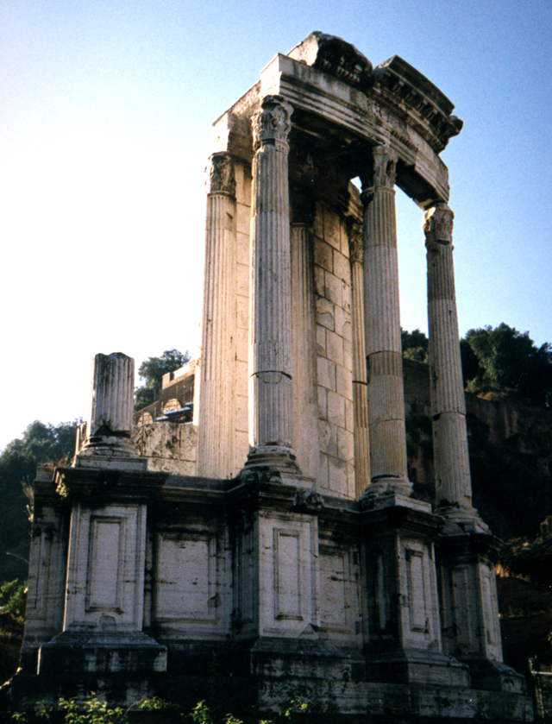
7
SI 沈黙E
アレキサンダー大王
ローマ様式
ローマ: 優雅なローマのデザイン
Handbook pg. 38-39
24
Notes:
Each of these structures, still standing after 2000 years, gives powerful evidence of the level of science, architecture, technology and social administration that developed under Roman rule. They point directly to the fact that the world was changing by epic strides from those simpler, more primitive life-styles known only a few centuries earlier.

Slide 26
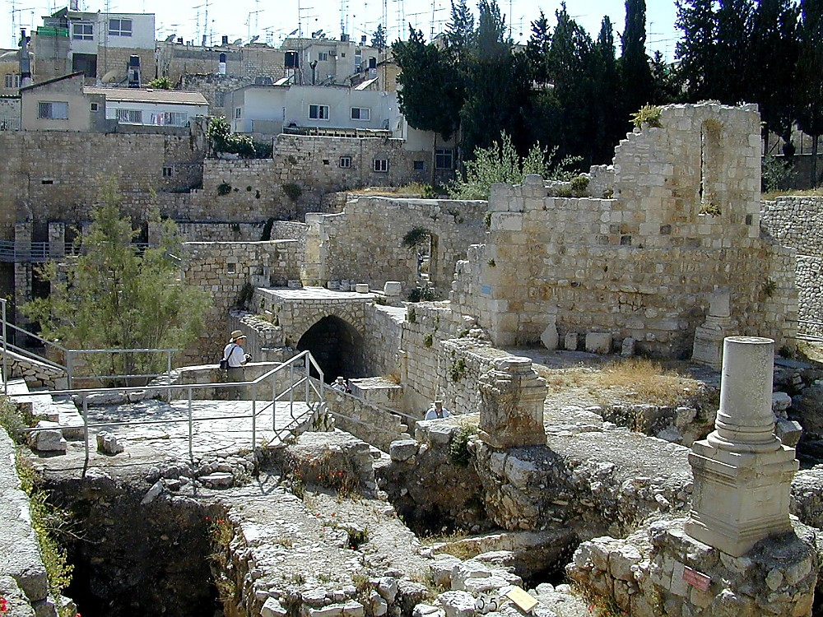
John 5:2
沈黙
アレキサンダー大王
ローマ様式
エルサレム: べテスダの池
Handbook pg. 38-39
25
Notes:
Throughout the Empire, in other locations beyond counting, ROMAN SYSTEMS were transforming the Mediterranean and European worlds. In Jerusalem, archeologists have uncovered the original pools of Bethesda -- a Roman construction – providing a rich background for one of the Bible's most powerful scenes in John’s gospel [John 5:2).

Slide 27
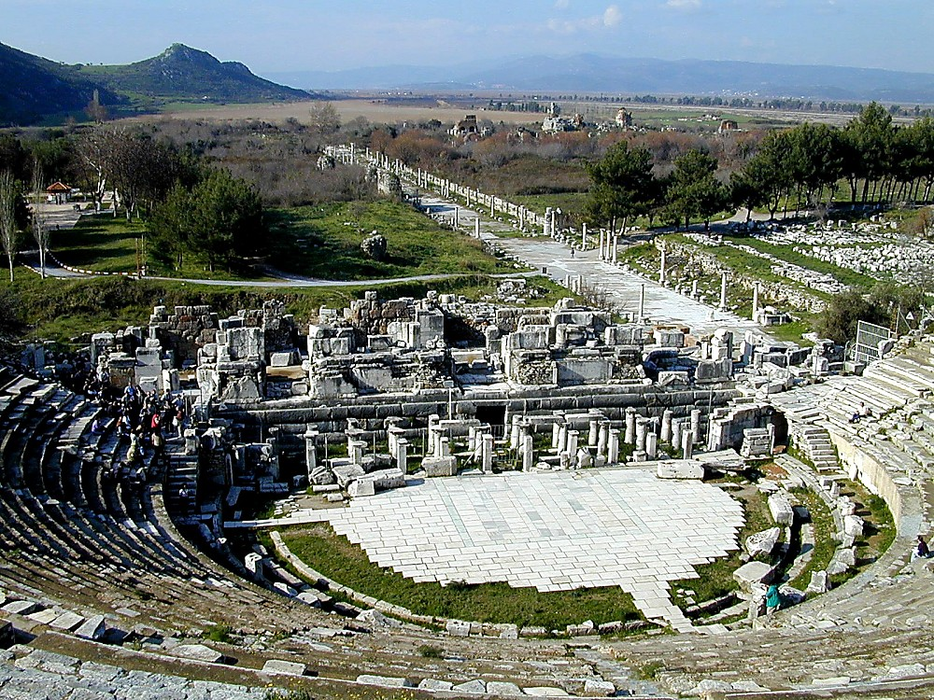
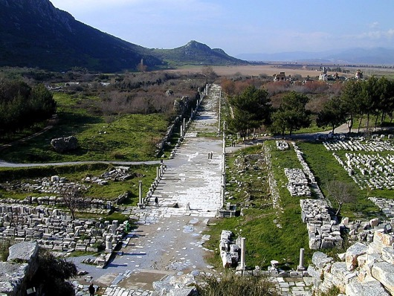
Acts 19: 23-41
沈黙
アレキサンダー大王
ローマ様式
エペソ: (パウロの) 円形劇場
Handbook pg. 38-39
26
1
Notes:
While far away in Ephesus, in today's Turkey, this amphitheater still stands. It marks the place where the Apostle Paul came up against the artisans of the goddess Diana.
//// In all probability, Paul walked that main boulevard to the waterfront, which was there in his time, but has long since been filled with silt.

Slide 28
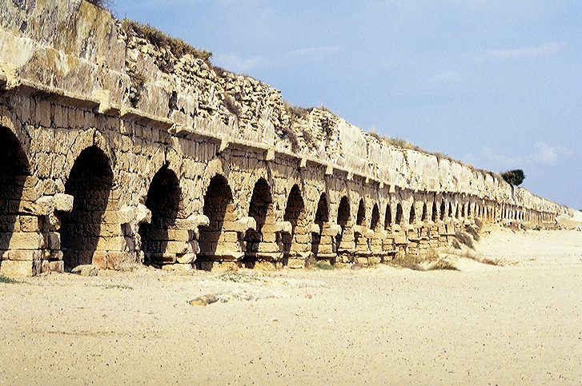
Acts 18:22
沈黙
アレキサンダー大王
ローマ様式
カイサリア・マリティマ, イスラエル: ローマ水道橋
Handbook pg. 38-39
27
Notes:
Back on Israel’s Mediterranean seacoast, the technological marvel of this dual-channeled, 22-mile-long aqueduct still stands. Roman engineers designed and built it to bring water from the distant hills of the Galilee to the new city of Caesarea, named in honor of the Roman Emperor.

Slide 29
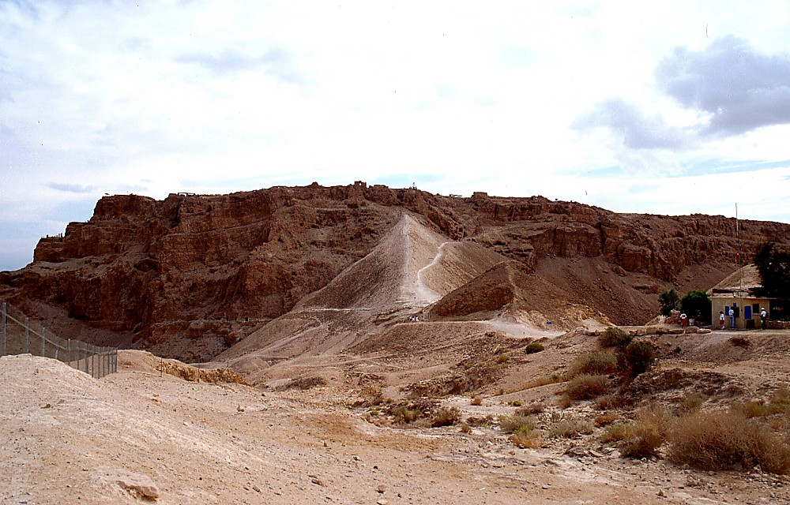
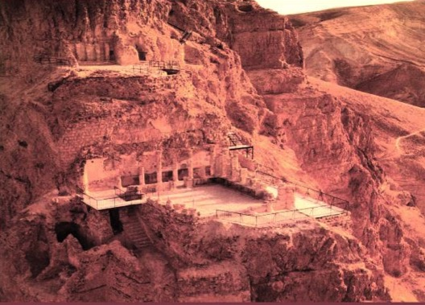
Matt 2:1
沈黙
アレキサンダー大王
ローマの包囲
ローマ様式
Photo Credit: Massada Ltd. Publishers Givatayim, Israel
ヘロデ大王:
王の城・要塞, イスラエル
28
Notes:
And this...the remains of an enormous fortress palace of Herod the Great at Masada overlooking the Dead Sea -- to which the last of Jerusalem's rebels held out against the Romans for three years. Eventually 900 ancient Israelis took their own lives in 73 A.D. rather than live under the yoke of Rome. Even today, new military cadets become commissioned in the Israeli Defense Force at this place....where they declare, "Never again!”

Slide 30
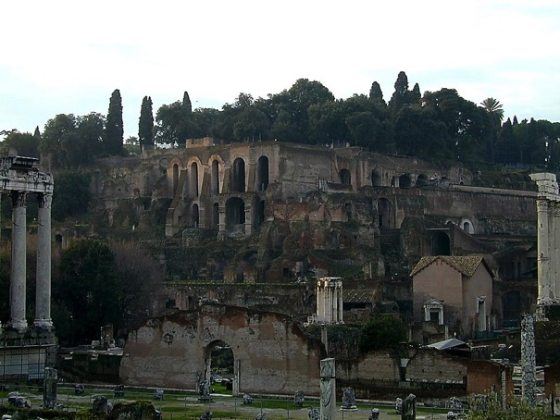
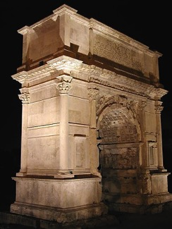
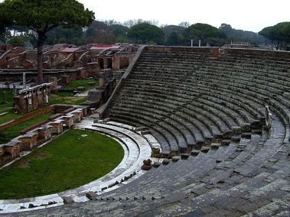
7
更に…
ローマの支配の時代とは:
STUDY HELP #05
政府の行政
歯車と水車の使用
三角法の発展
水時計
ロゼッタストーンが刻まれる
アレキサンドリア：技術の結集
ローマの銀行システム
新しい建築法
水道/排水システム; コンクリート
株式市場
帝国全体の道路網 (53K MIS)
３６５日カレンダーの採用
ラテン語を共通言語に
戦略軍事組織
パクス・ロマーナ
ローマがパレスチナを支配
THE ERA OF ALEXANDER THE GREAT:
アリストテレス: 大王の教師
アリストテレス: 音楽理論
万里の長城
中国で鉄が使われる
アレキサンダー大王: ギリシャ学問の中心
ユークリッド: 幾何学の基本を記す
ローマ・始めてのコイン
コリントスが貿易の中心地となる
エジプトのユダヤ人貿易中心地
ヘレニズムとギリシャの都市
ギリシャ式生活スタイル
ギリシャ語
Handbook pg. 38-39
29
16
Notes:
Continuing on Study Help #5, to sum up Rome’s enormous advances during this period of biblical SILENCE…just look at the list. These events and discoveries transformed the world...
//// ROME'S EFFICIENT GOVERNMENT & SOCIAL ADMINISTRATION
//// NEW USE OF GEARS...WATERWHEEL
//// DEVELOPMENT OF TRIGONOMETRY
//// WATER CLOCK
//// ROSETTA STONE INSCRIBED
//// COLLEGE OF TECHNOLOGY IN ALEXANDRIA
//// ROMAN BANKING SYSTEM
//// NEW CONSTRUCTION METHODS
//// WATER & SEWER SYSTEMS…CONCRETE
//// STOCK MARKETS AND INVESTMENTS
//// EMPIRE-WIDE HIGHWAY SYSTEM
//// ADOPTION OF THE 365-DAY YEAR
//// UNIVERSAL USE OF LATIN
//// A STRATEGIC MILITARY ORGANIZATION
//// producing the PAX ROMANA, and, of course, that continuing
thorn in Caesar’s side…
//// ROMAN-OCCUPIED PALESTINE

Slide 31
そして・・・
ローマ支配の時代:
7
政府の行政
歯車と水車の使用
三角法の発展
水時計
ロゼッタストーンが刻まれる
アレキサンドリア：技術の結集
ローマの銀行システム
新しい建築法
水道/排水システム; コンクリート
株式市場
帝国全体の道路網 (53K MIS)
３６５日カレンダーの採用
ラテン語を共通言語に
戦略軍事組織
パクス・ロマーナ
ローマがパレスチナを支配
アレクサンダー大王の
時代:
アリストテレス: 大王の教師
アリストテレス: 音楽理論
万里の長城
中国で鉄が使われる
アレキサンダー大王: ギリシャ学問の中心
ユークリッド: 幾何学の基本を記す
ローマ・始めてのコイン
コリントスが貿易の中心地となる
エジプトのユダヤ人貿易中心地
ヘレニズムとギリシャの都市
ギリシャ式生活スタイル
ギリシャ語
Handbook pg. 38-39
30
Notes:
Now…place the achievements of earlier Greece next to Rome’s later progress in science and technology. Comparing both in parallel and in sequence…an obvious fact emerges!

Slide 32
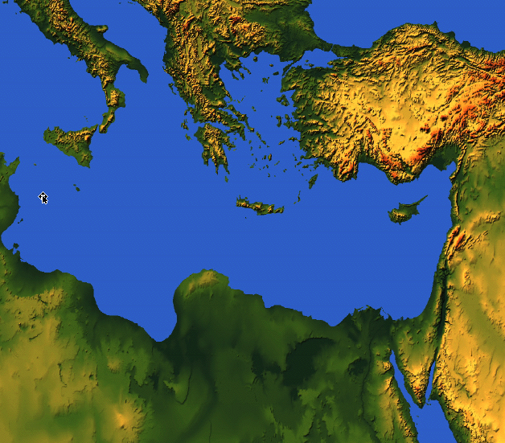
世界は
激変した!
Handbook pg. 38-39
4
03
9.65.02.
© 2006 TBBMI
31
Notes:
The world had enormously changed across the four hundred years since the close of the Old Testament!

Slide 33
STUDY HELP #06
7
“沈黙”の期間
マラキ書とマタイ書の間
４つの軸となる発展:
聖書的には:
歴史的には:
ヘブライ語
聖書
アレキサン
ダー
大王
______ ______ (旧約)
の完成。
3. ___________ _____ ________ 占領した土地中にヘレニズムを広める。
沈黙E
アレキサンダー大王
ローマ様式
ギリシャ語
ローマ
2. 旧約聖書が _________
に翻訳される。
4. パレスチナが ________の支配下に置かれる。:高度な _________ と 残酷な_______ として世界に知られる。
(パックス・ロマナ)
技術
(七十人訳聖書 -- “LXX” レファレンスブック)
平和
…ゆえに、遂に次の舞台への準備完了。それは、
神のアブラハムへの偉大な約束…
メシアの出現, 主、イエス・キリスト!
32
5
Notes:
With Study Help #6 –– between Malachi in the Old Testament and Matthew in the New –– we can chart four pivotal accomplishments that directly affected the march of Abraham’s promises toward the appearance of the Messiah…two Scriptural, two historical…
//// First, the Jews completed their Hebrew Canon…the official collection of Old Testament books…during the period of SILENCE.
//// Second, the Hebrew Old Testament was translated into Greek for the first time, thus becoming the foundation for all future Bible translations right up to our present day. It’s commonly known as the SEPTUAGINT, usually indicated by the Roman numerals “LXX” representing the 70 scholars who developed its translation in ancient Alexandria.
//// Third and historically, ALEXANDER THE GREAT spread the ways of the Greeks including their language, through the Mediterranean Basin and far beyond it.
//// Fourth and finally, Israel came under ROMAN occupation and domination bringing with it an era of high TECHNOLOGY, but enforced by a cruel PEACE throughout the Empire.
//// Taken together, these events set the stage for culmination of God’s Great Promise to Abraham, the appearance of the Messiah, the Lord Jesus Christ!

Slide 34
創世記からエステル書まで; それ以降マラキ書まで
7
CREATION
無政府
始めの男性と女性
士師たち
1st Sin
350
C
始めの福音
350
始めの家族
(1000 B.C.)
始めの殺人
王制
(1000 B.C.)
DC
洪水・虹
S - D - S
DC
党
・・分裂・・
北 南
(2000 B.C.)
アブラハム
(2000 B.C.)
イスラエル
ユダ
10 2
NC
NC
３つの社会
召命
AC
C 7 S J
AC
預言者たち
L - S - B
20-J 20-R
I - I
200 350
J - E
アッシリア バビロン
12
捕囚
7 = 4 + 3
ヨセフ
70 年
奴隷
3 つの長
430
100 年 / 50,000
４人の人々
Z - E - N
(1500 B.C.)
モーセ
(1500 B.C.)
(500 B.C.)
出エジプト
S
S
沈黙
シナイ
アレキサンダー大王
ローマ様式
M - C - C
カデシ・バルネア
イエス
40
40
LC
５つの説教
LC
J
ヨシュア
エリコ／アイ
土地を分ける
33
3
Notes:
So here we are…we’ve explored and mapped out
CREATION…FOUR PEOPLE…THREE SOCIETIES…
//// …held together by THE FOUR FOUNDATIONAL BIBLICAL COVENANTS, the ABRAHAMIC and the three amplifications of those covenant promises…the Land, the Davidic, and the New Covenants.
//// And then, with the cultural influence of ALEXANDER THE GREAT and the enormous social changes brought on by the ROMAN EMPIRE….
//// …the stage is now set for the last of the ten Bible files where we come face to face with the appearance of that One ---the Messiah…for Whom the entire glorious story has been revealed and preserved for us in Scripture in both the Old and the New Testaments.

Slide 35
34
©2006 TBBMI
9.65.03e.

Slide 36


バイブル ベイシック • BibleStudyDownloads.org
無料でダウンロードどうぞ
Notes:
The Bible…Basically (bb)

