Slide 1

バイブル ベイシック
A Presentation of The Bible…Basically Ministries International Inc.
Fort Worth, Texas
Designed by Dr. John Fryman, Texas, USA • BibleBasically.org
Taught by Dr. Rick Griffith, Singapore Bible College
All files in many languages for free download at BibleStudyDownloads.org
9.65.01.
©2004 TBBMI
04
Notes:
Japanese title slide

Slide 2



士師記からエステル書
7
天地創造
無政府
始めの男性と女性
1st Sin
C
始めの福音
始めの家族
王制
(1000 B.C.)
始めの殺人
洪水・虹
塔
アブラハム
(2000 B.C.)
C 7 S J
召命
AC
十戒・種・祝福
I - I
３つの社会
J - E
12
捕囚
7 = 4 + 3
ヨセフ
奴隷
430
４人の人々
モーセ
(1500 B.C.)
(500 B.C.)
出エジプト
S
S
沈黙
シナイ
道徳・民事・儀式
カデシュ・バルネア
イエス
40
40
LC
５つの説教
J
ヨシュア
エリコ/アイ
土地を分ける
01
3
Notes:
//// Now it’s time to move on through THE BIBLE FILE from CREATION and 4 PEOPLE into the
//// 3 KINDS OF SOCIETY or social structure. Remember their order “A-R-C”…
//// …ANARCHY, ROYALTY, CAPTIVITY.

Slide 3
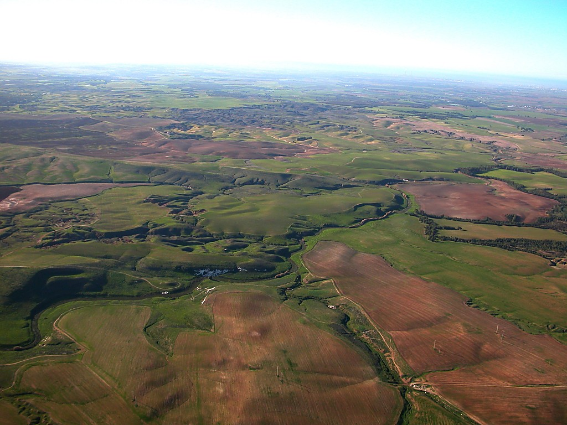
7
ﾖｼｭｱ記 14:5; 24:29; 士師記 17:6
場面は移って...
土地は征服され。
土地は分けられ。
ヨシュアは死ぬ。
もう偉大なリーダーはいない!
02
4
Notes:
The scene now makes a dramatic shift…
//// The Land is generally subdued...
//// The Land is divided...the people are settled in. At last, they are in their Promised Land.
//// When General JOSHUA dies, Israel arrives at a significant turning point in her history.
//// No longer is there one great national leader of the people to arise and take command. Every tribe and its people are doing -- as we said earlier -- that which seemed right in their own eyes – and hearts.

Slide 4
7
?
質問:
あなたは何が起こると思いますか….
03
Notes:
Here is a question for you: what do you think happened when…

Slide 5
ヨシュア記 14章21節
7
アシェル
ナフタリ
グレートシー・地中海
ゼブルン
ガリラヤ湖
タボ山
カルメル山
イッサカル
“それぞれが自分の目に正しい とすることを行った。”
ギルボア山
マナセ
マナセ
ヨシュア
エフライム
エリコ/アイ
土地を分ける
ダン
ベニアミン
ガド
ユダ
ヘブロン
死海
ルベン
シメオン..
レビ:住む為の町だけが与えられた。
04
Notes:
[ALLOW ALL TRIBAL NAMES TO APPEAR: SIMEON BEING THE LAST TO APPEAR]
..."each man – among those tribes of Israel, now settled in the Land –did that which was right in his own eyes”

Slide 6
士師記 17章6節
7
アシェル
ナフタリ
グレートシー・地中海
ゼブルン
ガリラヤ湖
Mt. Tabor
無政府!
カルメル山
イッサカル
“それぞれが自分の目に正しい とすることを行った。”
ギルボア山
エフライム
マナセ
ヨシュア
エフライム
エリコ/アイ
土地を分ける
ダン
ベニアミン
ガド
ユダ
ヘブロン
死海
ルベン
シメオン
レビ：住む為の町だけが与えられた
Handbook pg. 31-32
05
Notes:
The result is ANARCHY …leading us to the first of three kinds of societies.

Slide 7
士師記とルツ記
7
A R C
天地創造
ABRAHAM
アブラハム
ABRAHAM
ヨセフ
ABRAHAM
モーセ
ヨシュア
無政府
王権
捕囚
沈黙
イエス
Handbook pg. 31-32
06
Notes:
And here is the ANARCHY file in its proper place in THE BIBLE FILE line-up.

Slide 8
士師記 17章6節
7
無政府
３つの社会の
始めは:
無政府
人々は中央政府がないことに気がついた。
350
A R C
Handbook pg. 31-32
07
Notes:
During this time, the people recognized no central governing authority as they had back in Israel’s earlier days --in the time of MOSES and JOSHUA. Remember the A-R-C order? ANARCHY, ROYALTY, CAPTIVITY…this is the first of the three kinds of societies or social structures… ANARCHY.

Slide 9
士師記 2章16-19節
7
無政府
士師たち
無政府
士師
350
国家変革の時！
Handbook pg. 31-32
08
1
Notes:
So, during this era, God raised up a series of JUDGES to get the people back into righteous obedience to God and to bring them again in line toward the righteous life-style required by The Mosaic Law. Many of the Judges were also great military leaders.
//// The time of the JUDGES was a period of Israel’s national apostasy --- a falling away from the faith of Abraham. Circumstances go from bad to worse to good to bad to worse and on and on. But every time events seem to be at their worst, God calls out a new JUDGE for the Israelites.

Slide 10
士師記 2章16-19節
7
オトニエル
エフド
シャムガル
デボラと
バラク
ヤイル
アビメデク
トラ
ギデオン
エフタ
イブツァン
エロン
アブドン
サムソン
エリ
サムエル
無政府
デボラと
バラク
士師たち
どのように数えるかにもよりますが… 古代イスラエルには１３～１５人の士師がいました。
ギデオン
無政府
士師
350
サムソン
Handbook pg. 31-32
09
1
Notes:
Depending on how you count them, and here the scholars differ, there were between 13 and 15 JUDGES during the ANARCHY period.
//// Of those several JUDGES, you might recognize the names of some of them, such as Deborah & Barak…Deborah was a woman… there was Gideon…and of course, the legendary Samson

Slide 11
サムエル記上 7：15
7
しかし
イスラエルの多くの士師は...
最後の最も偉大な “要の人物,” は...
SAMUEL
無政府
士師
350
Handbook pg. 31-32
©2006 TBBMI
10
Notes:
But of those many Israelite Judges, the nation’s last and greatest JUDGE, a "hinge character," was Samuel. Except for Moses, Samuel is the first of the long line of Israel’s great prophets. His life marks the beginning of the Time of the Prophets.

Slide 12
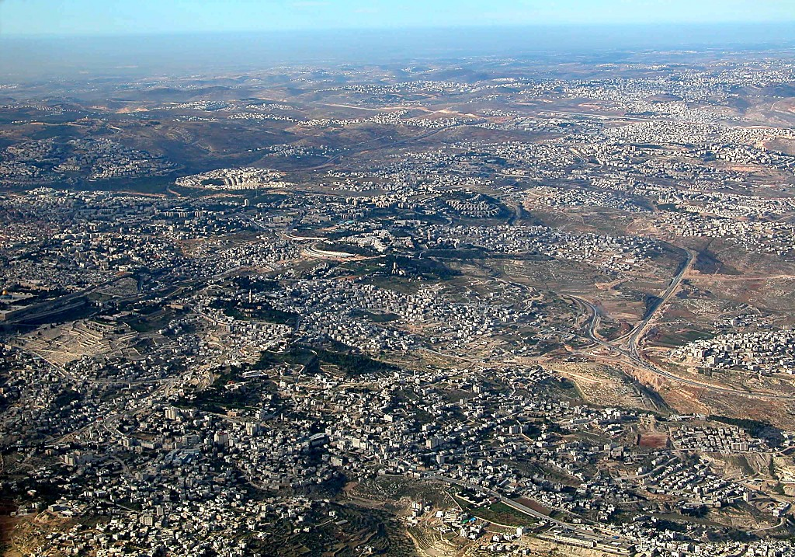
East Jerusalem and Mt of Olives aerial from s
1 Sam. 7:15
サムエル記上8章4-22節
7
ネビ・サンウイル (ラマ近辺)
BUT OF THE
MANY JUDGES
OF
ISRAEL...
サムエル: 預言者、士師; エルサレム北部に位置する、彼生まれ育ったと言い伝えられている地。
神殿の山
THE LAST AND GREATEST,
THE “HINGE CHARACTER,” WAS...
SAMUEL
サムエル記上 8:4-19
ANARCHY
オリーブ山
Judges
ベタニア
350
岩のドーム
エリコへの高速道路
Handbook pg. 31-32
11
1
©2006 TBBMI
9.7.03d.
Notes:
Within a very few miles of this region…at either the villages of Ramah or today’s Arabic Nebi Samwil…Samuel was born and lived out his life…within clear view of Jerusalem just a few miles to the south. From this aerial view, it’s easy to see the neighboring closeness of the ancient Biblical sites.
//// In this area, north of Jerusalem, tribal elders from all over Israel converged to meet with Samuel. They begged him to anoint a king for Israel so that their nation could be more like the other kingdoms surrounding Israel at that time.

Slide 13
7
無政府
士師
350
無政府
士師
350
350
“王が欲しいのです!”
“本当にそれを望むのか?”
Handbook pg. 31-32
12
2
Notes:
“We want a king!” they said. But through Samuel, God tells them that He is their only king, that they need no other. But the people are not satisfied.
//// Following their request, God says through Samuel, in effect, "Are you sure you want to do that?" God then tells Samuel, “All right, anoint a king for them so they will learn the difficult lessons in answering to an earthly sovereign instead of their heavenly authority.”
//// So after some 350 years of apostasy and national rebellion… a time of gross sin and falling away from the worship of the one true God, the era of ANARCHY comes to an end.

Slide 14
サムエル記上 9:17
7
イスラエルの１３人の士師...
デボラ
ギデオン
最後の偉大な,
“要の人物,” ...
無政府
王制
SAMUEL
Handbook pg. 31-32
13
1
Notes:
…with Samuel serving as that hinge character -- that enormous historic figure who moves Israel forward into the period of its second kind of society…
//// … quite different from ANARCHY. We call it...“ROYALTY.”

Slide 15
7
R
A C
“王制
14
2
Notes:
Still keeping in mind that geometric shape…
/// that finishes out a circle…called an arc…
//// spelled A…R…C…leading us to the period of Israel’s ROYALTY.

Slide 16
創世記からサムエル記上8章22節
7
天地創造
天地創造
ANARCHY
無政府
始めの男性と女性
始めの男性と女性
Judges
1st Sin
士師
1st Sin
350
350
350
始めの福音
350
C
始めの福音
始めの家族
始めの家族
王制
(1000 B.C.)
始めの殺人
始めの殺人
洪水/虹
洪水/虹
当
当
(2000 B.C.)
アブラハム
(2000 B.C.)
アブラハム
召命
C 7 S J
召命
AC
十戒・種・祝福
十戒・種・祝福
I - I
３つの社会
I - I
J - E
J - E
12
12
捕囚
ヨセフ
7 = 4 + 3
ヨセフ
無政府
奴隷
士師
奴隷
430
350
430
350
４人の人々
(1500 B.C.)
モーセ
(1500 B.C.)
モーセ
(500 B.C.)
出エジプト
S
S
沈黙
出エジプト
Sinai
シナイ
M - C - C
道徳・民事・儀式
Kadesh Barnea
カデシュ・バルネア
イエス
40
40
40
40
LC
5 Sermons
５つの説教
J
JOSHUA
ヨシュア
Jericho/Ai
エリコ/アイ
Land Divided
土地を分ける
15
4
Notes:
And here is the Bible File up to this point.
//// CREATION...
//// ABRAHAM.. JOSEPH...MOSES...JOSHUA...and
//// ANARCHY. Now we move into…
//// ROYALTY...with Samuel as the bridging character during the transition, a man of God enormously influential in the unfolding history of Israel.

Slide 17
おおまかな年代:
アブラハム-ヨセフ 2000 B.C.
モーセ-ヨシュア 1500 B.C.
無政府-王制 1000 B.C.
16
Notes:
The time line now moves to around 1000 BC…the most glorious time of ancient Israel’s history.

Slide 18
サムエル記上9章1節から列王記下25章21節
A R C
天地創造
ABRAHAM
アブラハム
ABRAHAM
ヨセフ
ABRAHAM
モーセ
ヨシュア
無政府
王制
捕囚
沈黙
イエス
Handbook pg. 32-37
17
©2006 TBBMI
9.7.03d.
Notes:
And the ROYALTY folder takes its place in the Bible File lineup.
Repeat the entire series aloud as a review: CREATION, ABRAHAM, JOSEPH, MOSES, JOSHUA, ANARCHY, ROYALTY, CAPTIVITY, SILENCE and JESUS.

Slide 19
舞台準備
MS
N(A)
H
統一 イスラエルは近隣諸国に対し豊かで影響力のある国へと成長する!
SG
C
ER
B
J
MN
DS
E
KB
U
MS
PG
RS
Handbook pg. 32-37
18
1
Notes:
On your map, there is no further path to be traced for now -- because the Israelites are NOW --- FINALLY settled in THE LAND of their inheritance! They will eventually occupy an area from south of the Dead Sea all the way up far north of the Sea of Galilee and from the Mediterranean Sea into the lands east of the Jordan River.
//// At this time…Israel is UNITED, She is to become an international power of enormous wealth and cultural influence among neighboring nations.

Slide 20

サムエル記上9章1節
7
王制
ca. 1000 B.C.
３つの社会の
２つ目は:
王制
A R C
Handbook pg. 32-37
19
1
Notes:
ROYALTY is the largest file folder in the Bible File because it is certainly the most complex. But we’ll take it apart…item by item.
//// Timeline again: around 1000 BC.

Slide 21
ｻﾑｴﾙ記上 15:1; ｻﾑｴﾙ記下 2:4; 列王記上 1:39
7
王制
ca. 1000 B.C.
S - D - S
サウル
A R C
ダビデ
王制
S - D - S
ソロモン
Handbook pg. 32-37
20
4
Notes:
The period of ROYALTY begins as old Samuel anoints SAUL, the first of the three kings of united Israel:
//// SAUL, then…
//// DAVID followed by his son…
//// SOLOMON.
You can remember the order of Israel’s first three kings this way:
//// S-D-S...SAUL, DAVID and SOLOMON.

Slide 22
7
ｻﾑｴﾙ記上 16章13-14節
王制
ca. 1000 B.C.
S - D - S
サウル王: 苦しみの男!
サムエルはサウルの後任（ベツレヘムにいた若いダビデ）に油を注ぐ為に召される。
A R C
王制
S - D - S
Handbook pg. 32-37
21
Notes:
Once on the throne, SAUL is an increasingly tormented man. Eventually, God deposes SAUL for his many failures of character and weakness in national leadership. Then once again, the old prophet, Samuel, is called to anoint Saul’s successor as a king for united Israel….and that is to be young David of Bethlehem.

Slide 23
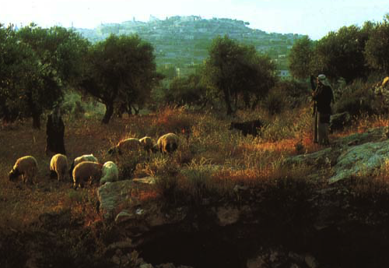
ｻﾑｴﾙ記上 16章1節
7
王制
ca. 1000 B.C.
S - D - S
A R C
王制
S - D - S
サムエルは、ベツレヘム近郊の牧草地で羊の世話をしていたダビデを探し出す。
Handbook pg. 32-37
22
1
Notes:
Samuel searches throughout the country, finally locating the family of:
//// …Jesse near Bethlehem. Jesse's young shepherd son, DAVID, is identified and anointed by Samuel as Israel’s next and certain king.
In time, King DAVID, the “man after God’s own heart”, succeeds SAUL on the throne of Israel.

Slide 24
7
王制
ca. 1000 B.C.
ダビデ 契約
S - D - S
DC
サムエル記下 ７章４～１６節
歴代誌上 17章3～15節
A R C
王制
S - D - S
Handbook pg. 32-37
23
1
Notes:
It is to DAVID that the Lord issues the great DAVIDIC COVENANT, His unconditional promise to Israel that she would always have a Son of David to sit upon her throne.
//// Notice that parchment scroll “DC” as it relates to the ROYALTY file folder. The coming Messiah is clearly prefigured…yet 1,000 years in Israel’s future. This is another part of that eternal contract between God and His people that began with Abraham. Add “DC” to your scroll figure

Slide 25
7
ダビデ契約
３つの約束
サムエル記下 ７章
¹⁶ あなたの 家 、あなたの王国 は、あなたの行く手にとこしえに続き、あなたの 王座 はとこしえに堅く据えられる。
王制
S - D - S
Handbook pg. 32-37
24
5
Notes:
Here are the central words of that unconditional Davidic contract: 2 Samuel 7, verse 16.
Through Nathan, David's household prophet, God speaks these words: "Your
//// house and your
//// kingdom will endure
//// forever before me; your
//// throne will be established
//// forever.”

Slide 26

アブラハム契約
(“召命”)
創世記12章1-3節
土地
種
祝福
土地
ダビデの
申命記
30章1-10節
サムエル記下
7章4 -16節
Handbook pg. 32-37
25
Notes:
So, then…the DAVIDIC COVENANT becomes an amplification of the Seed portion of the ABRAHAMIC COVENANT...the second part of the LAND, the SEED, and the BLESSING formula. This DAVIDIC promise is the SEED portion, the Davidic Covenant. Let’s take a look at David’s Jerusalem.

Slide 27
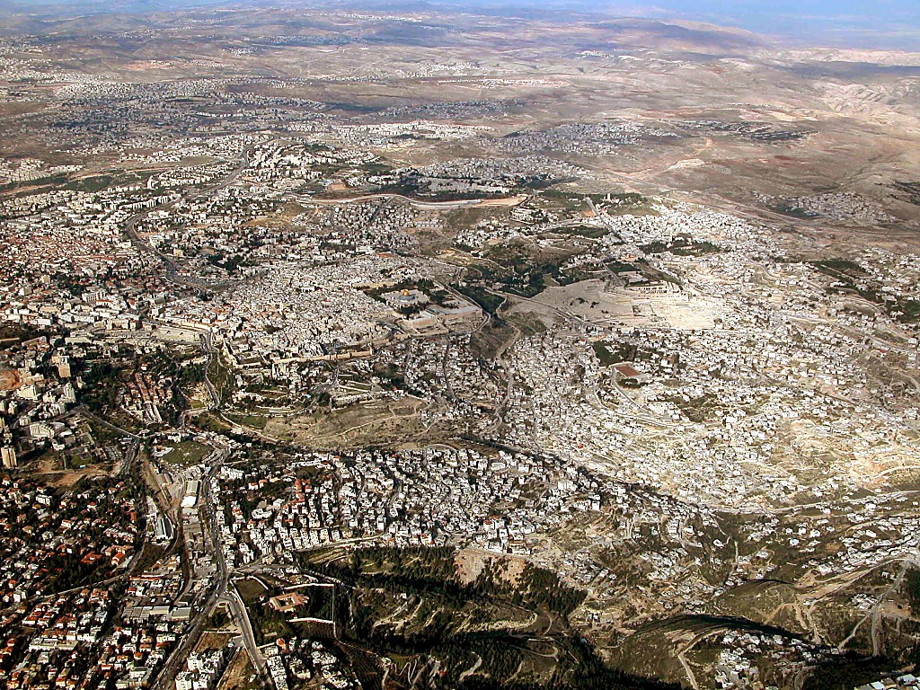
Jerusalem area aerial from south
サムエル記下 24章18-24; 歴代誌下 3:1
エルサレム: 南から神殿の山を臨む
26
1
©2006 TBBMI
9.7.03d.
Notes:
When you fly over Jerusalem today, this is the view as you approach the city from Bethlehem to the south.
//// And right there in the middle of this ancient city lies the focal point of almost every world crisis happening right now and certainly on into the future. It’s the ancient Temple Mount of the Old City.

Slide 28
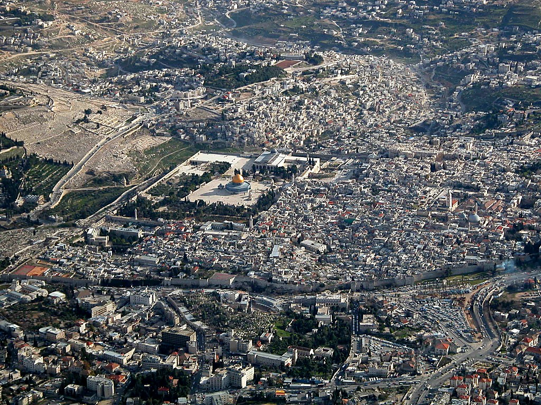
Old City aerial from north
ｻﾑｴﾙ記下 24:18-24; 歴代誌下 3:1
神殿の山: エルサレムにある世界の注目の地
9.7.03d.
©2006 TBBMI
27
Notes:
Flying closer, you would see on that Temple Mount the golden-roofed Islamic Dome of the Rock. Also known as Mount Moriah and Mount Zion, this site marks the location of the First Temple of King David and the later Second Temple – built by King Herod the Great -- around which Our Lord ministered to the multitudes. To the far left are the Mount of Olives and the Garden of Gethsemane.

Slide 29
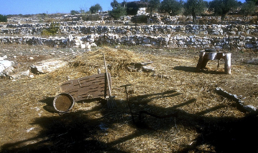
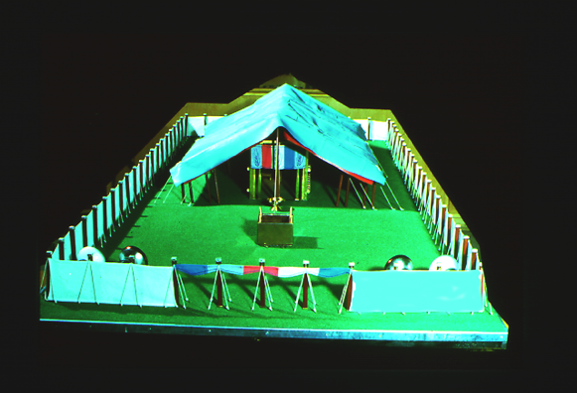
サムエル記下 24:18-24; 歴代誌下 3:1
古代麦打ち場
アラウナの麦打ち場…
ダビデは…
ここに主のための初めての祭壇を築いた!
モリア山の頂上!
28
5
©2006 TBBMI
9.7.03d.
Notes:
And the Temple Mount itself…47 acres of unending international intrigue, strife and dispute…currently controlled by local Moslem authorities. The octagonal Dome of the Rock has occupied this site for 1,400 years! Now…
//// Imagine this place without the Dome of the Rock…3,000 years ago, on the top of Mount Moriah…the same Moriah where Abraham had taken Isaac for sacrifice a thousand years earlier than that.
//// In David’s time, it had become a threshing floor owned by a man named Araunah.
//// David bought that threshing floor from Araunah – similar to this one – on which to build a great worship center…because ever since the time of Moses…
//// …the old tabernacle, housing the sacred Ark of the Covenant, had existed in the fierce winds of the desert. David wanted to see the Furniture of the Lord protected in a fine building…
//// …such as a great Temple to the Lord there atop Mount Moriah.

Slide 30


列王記上 5:5
王制
S - D - S
ダビデ王が計画。
しかし…建築は、その子ソロモンが担った!
Handbook pg. 32-37
29
1
Notes:
So David planned the Temple and brought supplies into town to build it. However, God did not allow David to erect it because he had spilled human blood.
//// It then became an assignment from God that David's son, Solomon, should build the First Temple.

Slide 31
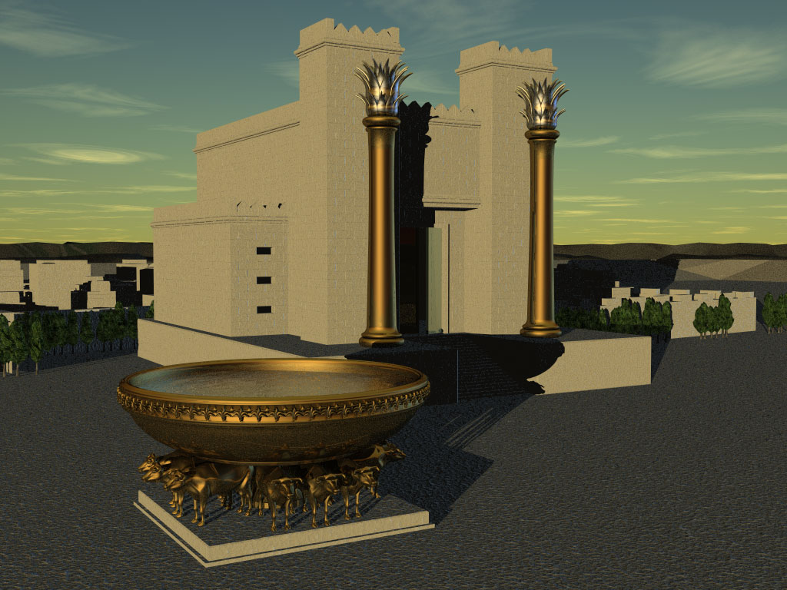
列王記上 5:5
王制
S - D - S
イスラエルの “始めの” 神殿
Handbook pg. 32-37
30
Notes:
Of course, we have no picture of that Temple. However, this painting shows us its probable grandeur and beauty.

Slide 32
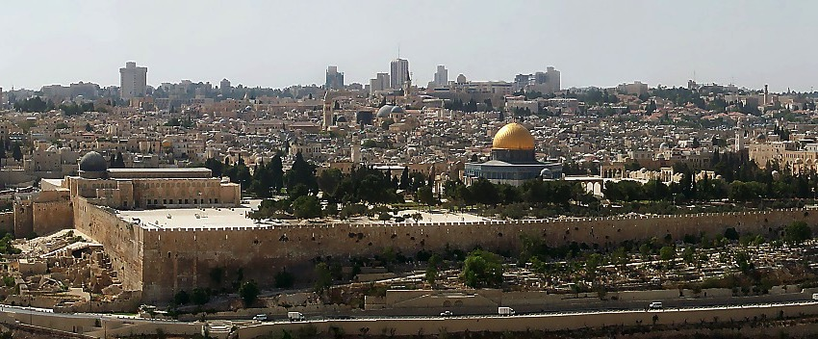
列王記上 6:14-38
現在のイスラエル・神殿の山
アブラハムがイサクを奉げた場所・・・モリア山・・・ザイオン山・・・
古代の人々はどのように建築したのか？
電力設備なし!
コンピュータなし!
王制
S - D - S
計算尺もなし!
人力のみ!
Handbook pg. 32-37
Handbook pg. 32-37
31
6
Notes:
Another idea about the Temple mount gives an appreciation of the thinking and planning processes of those ancient rulers and builders. Here is Jerusalem’s famous Temple Mount as it looks today viewed from atop the Mount of Olives to the east.
//// This place was also the site of ABRAHAM's offering up of ISAAC…on Mount Moriah or Mount Zion…
A question is this…
//// How did the ancient builders accomplish these feats? Searching for that answer gives an interesting insight into this part of Israel's history. How, we ask, were those massive structures built...
//// in a time of no power equipment,
//// no computers,
//// not even a slide rule!
//// There was nothing available but manpower and hard work! How did they even clear the ground for the structure? We have to respect the technology and the brilliance of these ancient people. Here’s an example:

Slide 33
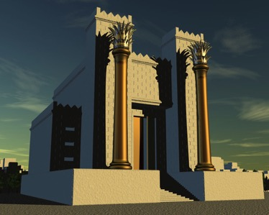
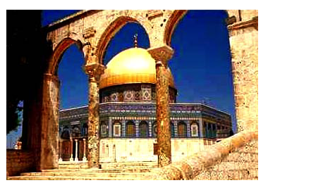
列王記上 6章14-38
現在のエルサレム・神殿の山
アブラハムがイサクを奉げた場所・・・モリア山・・・ザイオン山・・・
この様な驚きの構造の建築!
神殿の西壁 又は “嘆きの壁”
現在のイスラム教
岩のドーム
ソロモンによって立てられた“始めの神殿”
イエスの時代にはヘロデ王の
“第２の”神殿
Handbook pg. 32-37
32
6
Notes:
This could be an outline of Mt. Zion...the biblical name for today's Temple Mount.
//// To build these expensive structures, the first step was to clear off and level the top of the mountain ...
//// followed by the construction of a massive pavement with retaining walls of stone and gravel fill.
//// On the left, today, you can see a portion of the retaining wall known today as the Western Wall, or to some, the Wailing Wall.
//// At that site King Solomon built the First Temple to the Lord.
//// It was followed hundreds of years later by the Second Temple familiar in Jesus’ time. Today though, and for the past 1,400 years….
//// the Moslem Dome of the Rock has occupied that same great pavement…since A.D. 685.

Slide 34

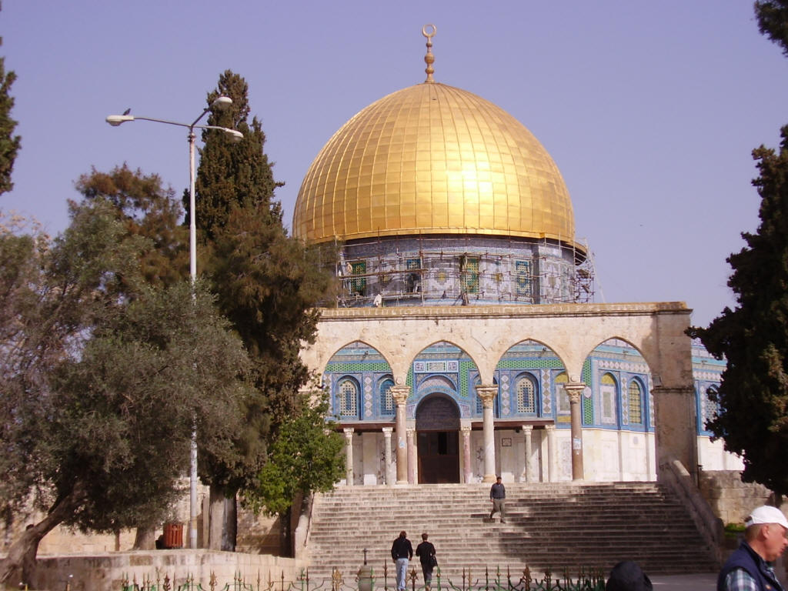
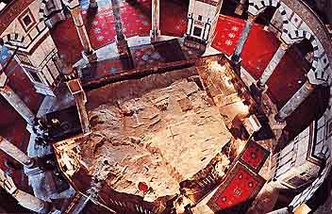
今日のエルサレム、神殿の山
岩のドームの内部
神殿の山にある
岩のドーム
Handbook pg. 32-37
32a
1
Notes:
Here is the octagonal shrine as you would approach it from the south, leaving the famed Al Aqsa Mosque, also held by Islam to be one of its most holy sites.
//// Inside the Dome, looking downward, is “The Rock” from which Mohammed is said to have taken his famous midnight ride. The building is covered throughout with hundreds of colorful carpets, its ancient roof supported by a multitude of stone columns.

Slide 35
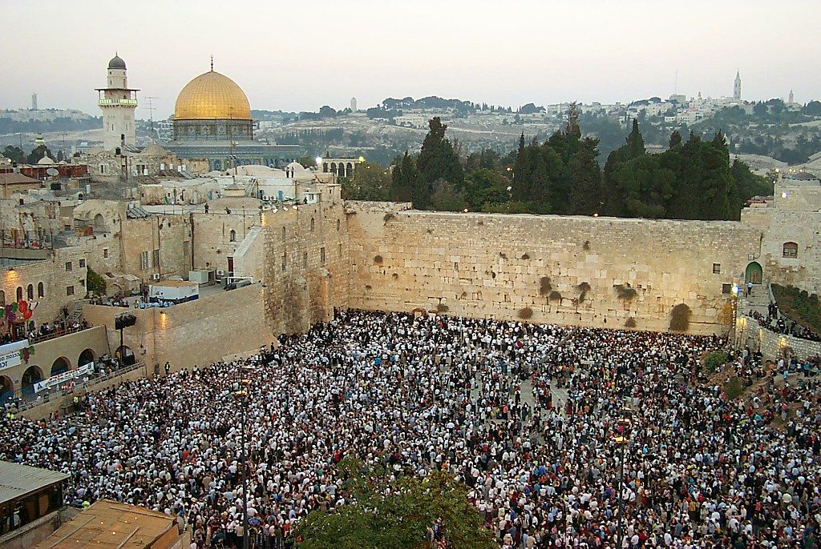
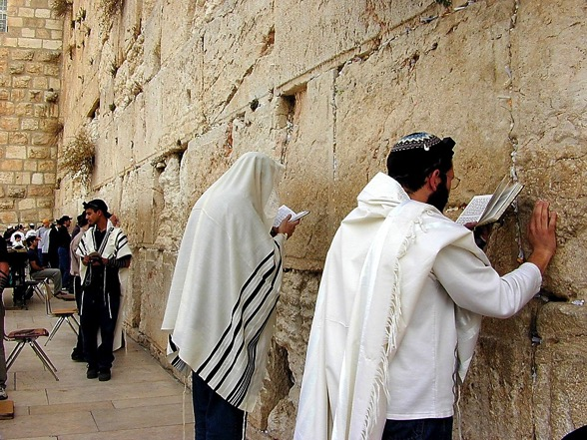
列王記上 6:14-38
壁での祈り
王制
S - D - S
神殿の山の西壁
Handbook pg. 32-37
33
1
Notes:
Directly below the great pavement is the Western Wall today. There are stones here from all the periods of Jerusalem's ancient history.
//// To Jewish people, like these multitudes at prayer, there is no place on the face of the earth more spiritually significant and historically important than right here. On the pavement above the Wall, where the cedars now grow, the great Second Temple stood and Jesus ministered to the multitudes of His day.

Slide 36

列王記上 6章14-38節; マタイによる福音書 21章12-17節
計り知れなく重要な要素をもつ神殿の山!
• 霊的に
• 神学的に
• 政治的に
• 地理学的に
王制
S - D - S
• 終末論的に
Handbook pg. 32-37
34
6
Notes:
So now…every time you see news footage of Jerusalem, reports of its internal conflicts between Jews and Arabs…just remember the enormous importance of the Temple Mount…the center of it all…
//// The First Temple of King David, the Second Temple built for the Jews by Zerubbabel and expanded by King Herod the Great. Finally, today, the Moslem Dome of the Rock and Al Aqsa Mosque stand on this site. This small acreage was…
//// Israel’s SPIRITUAL center and ritual focus…
//// its THEOLOGICAL and ritual cornerstone…
//// the POLITICAL center of the Jewish universe…
//// the GEOGRAPHICAL center of the Abraham’s inheritance…and
//// for all believers, a key to our understanding of the events of the End Times…that being, the study of Biblical ESCHATOLOGY.

Slide 37
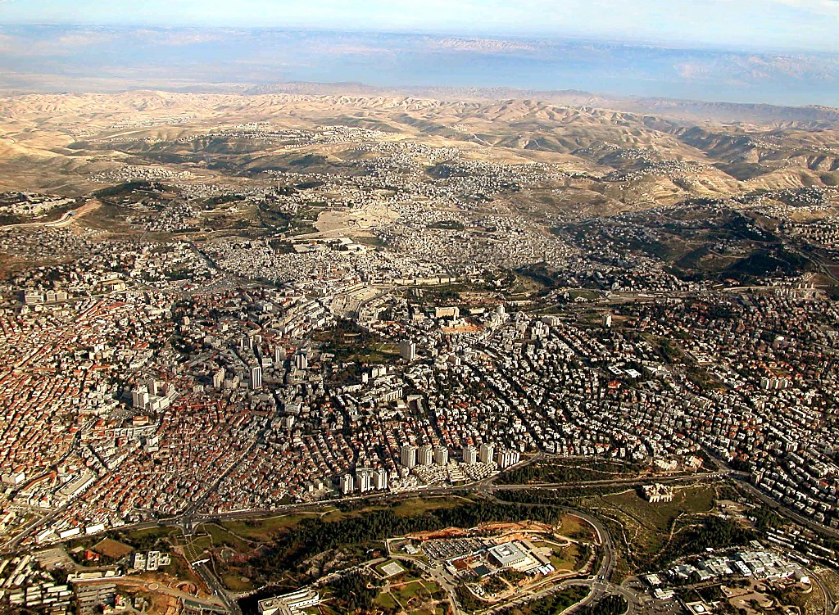
列王記上 6:14-38; マタイ 21:12-17
現在の神殿の山:
地球上の最も重要な焦点たる地
Handbook pg. 32-37
35
Notes:
Now we can pull back and view the entire Jerusalem panorama with much greater appreciation of all that has happened there. The Temple Mount of today's Jerusalem continues as the tightly focused center of world concern as the sons of Sarah and the sons of Hagar continue their ancient dispute in the land where it all began!

Slide 38

7
王制
ca. 1000 B.C.
S - D - S
DC
ｻﾑｴﾙ記下 7: 4-16
歴代誌上 17:3-15
A R C
王制
S - D - S
ソロモン: かなり偉大な計画!
大問題: 支払い期日迫る。
Handbook pg. 32-37
36
6
Notes:
Now back to the throne of international Israel in 1000 BC. Main players…
//// S-D-S...SAUL…the first anointed king, and not a very successful one at that.
//// While still living, old Samuel then anoints young DAVID, who follows SAUL to the throne. DAVID is then succeeded on Israel’s throne by one of his many sons,
//// SOLOMON, born through Bathsheba. Under SOLOMON's rule,
//// the great Solomonic Temple is built, and united Israel arises as a national power and a center of enormous wealth and international influence. SOLOMON becomes internationally known for his wisdom and for his ambitious building projects.
//// He had some really big ideas…erected at great cost to his kingdom. But the question finally had to be answered…
//// when the bills came due: who paid for all that? The people…of course…as they always do…through high taxes and/or forced labor.

Slide 39
列王記上 9, 10, 11章
7
王制
ca. 1000 B.C.
S - D - S
DC
建築!
重税!
破産!
偶像礼拝!
ｻﾑｴﾙ記下 7:4-16
歴代誌上 17:3-15
A R C
王制
S - D - S
Handbook pg. 32-37
37
4
Notes:
Solomon carried out a
//// construction program that was the envy of every king in the region.
//// But, in spite of his great wisdom, SOLOMON pays for it all through the burdens of enormous taxation which,
//// in the end, sent the country into bankruptcy…resulting in huge resentment on the part of the people toward their national government!
//// And if there were not enough problems: he himself fell into idolatry.

Slide 40
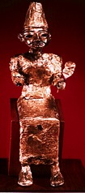

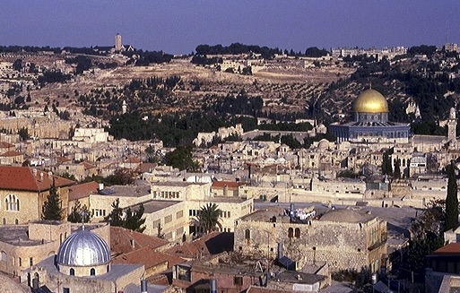
列王記上 11:4-13
王制
オリーブ山
ca. 1000 B.C.
S - D - S
DC
ｻﾑｴﾙ記下 7: 4-16
歴代誌上 17:3-15
A R C
神殿の山
王制
S - D - S
偶像礼拝!
Handbook pg. 32-37
38
4
Notes:
Why? Along with Solomon’s many foreign treaties he had also acquired many foreign wives from the country with which he made the treaty. The new wives moved into Jerusalem bringing with them their idolatrous religious practices.
//// On that site of today’s Temple Mount…after SOLOMON had completed the first Temple to the God of Israel – and worshiped there - he later could be seen…
//// …over on The Mount of Olives across the Kidron Valley from his newly built temple…
//// worshipping the pagan gods brought into town by those foreign wives.
//// So…once again…idol worship entered the day to day life of ancient Israel, foreshadowing other great national problems to come

Slide 41
列王記上 12章25節から14章31節
7
王制
ca. 1000 B.C.
S - D - S
DC
<<<< 分裂 >>>>
北 南
ｻﾑｴﾙ記下 7: 4-16
歴代誌上 17:3-15
A R C
ｲｽﾗｴﾙ ユダ
10 2
王制
S - D - S
••• 分裂••
北 南
ｲｽﾗｴﾙ
ユダ
10 2
Handbook pg. 32-37
39
3
Notes:
Upon the death of King SOLOMON, there was a vacuum of strong central leadership in Jerusalem.
//// There soon erupted a civil war... followed by a national SPLIT.
//// Quickly, the UNITED kingdom of the Israel of Saul, David, and Solomon...tears apart…becoming the TWO divided kingdoms of the NORTH and the SOUTH...as both descend into increasingly greater sin and spiritual separation from God.
//// TEN tribes join together to become known as the NORTHERN Kingdom, called ISRAEL, while the remaining TWO tribes (BENJAMIN and JUDAH) unite to become the SOUTHERN Kingdom of JUDAH. The Northern Kingdom was the larger…it retained the name ISRAEL.

Slide 42
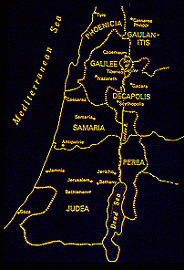
歴代誌上 12章25節から14章31節
7
北王国:
イスラエル
10 部族
サマリア
王制
S - D - S
••• 分裂•••
エルサレム
北 南
2 部族
イスラエル
ユダ
10 2
南王国:
ユダ
Handbook pg. 32-37
40
1
Notes:
As a result of the national split…the 10 tribes of the Northern Kingdom, Israel, move their capital north into the region known, even today, as Samaria...
//// …while the two Southern Kingdom tribes, Judah and Benjamin, retain their national capital in Jerusalem.
So...now...the period of ROYALTY continues, but permanently split nationally between the two kingdoms, ISRAEL IN THE NORTH and JUDAH IN THE SOUTH.
Old alliances and ancient tribal relationships come alive as gross sin, idolatry and separation from God and the Law continue to grow and spread through both kingdoms, especially ISRAEL in the North.
Now it's clear to see that the Israel BEFORE the national split was an entirely different nation -- IN CHARACTER AND NATIONAL STYLE -- than that AFTER the split. That is a key idea toward keeping things straight in the Old Testament AFTER King Solomon.

Slide 43
列王記上 17-22章; イザヤ書からマラキ書
7
王制
ca. 1000 B.C.
S - D - S
DC
<<<< 分裂 >>>>
北 南
ｻﾑｴﾙ記下 7:章4-16節
歴代誌上 17章3-15節
A R C
ｲｽﾗｴﾙ ﾕﾀﾞ
10 2
王制
預言者たち
S - D - S
••• 分裂•••
北 南
イスラエル
ユダ
10 2
預言者たち
Handbook pg. 32-37
41
Notes:
As the nation further disintegrates across the centuries, the Bible's great Old Testament PROPHETS raise strident voices against the national behavior, both NORTH and SOUTH.

Slide 44
イザヤ書からマラキ書
7
マラキ
ミカ
王制
ca. 1000 B.C.
エゼキエル
S - D - S
ｾﾞｼﾞｬﾆﾔ
ダニエル
<<<< 分裂 >>>>
ｾﾞｶﾘｱ
北 南
ｴﾚﾐﾔ
イスラエル ユダ
ｱﾓｽ
ハバクク
ヨエル
10 2
預言者たち
王制
S - D - S
ﾊｶﾞｲ
••• 分裂 •••
北 南
オバデヤ
イスラエル
ユダ
エリシャ
10 2
預言者たち
エリヤ
ｲｻﾞﾔ
ﾎｾｱ
ﾅﾎﾑ
ﾖﾅ…
Handbook pg. 32-37
42
Notes:
In many writings and in many other forms, the prophets repeatedly call the people back to the righteous ways of their Creator as handed down to MOSES in The Law. At the same time, they write and speak powerfully regarding a future Messiah whose appearance is imminent.

Slide 45
7
王制
ca. 1000 B.C.
S - D - S
DC
<<<< 分裂 >>>>
北 南
ｻﾑｴﾙ記下 7章4-16節
歴代誌上 17章3-15節
A R C
イスラエル ユダ
10 2
NC
王制
預言者たち
新しい
契約
S - D - S
••• 分裂 •••
北 南
イスラエル
ユダ
10 2
ｴﾚﾐﾔ書 31章
31-33節
預言者たち
Handbook pg. 32-37
43
Notes:
In the midst of this national depression, however, God speaks through the prophet Jeremiah.
//// The NC in the scroll image represents THE NEW COVENANT -- Jeremiah 31:31-33 -- where God proclaims unconditionally the approaching inauguration of a new program with His people and with all the people of the earth. Add “NC” to the scroll figure on your Study Help.

Slide 46
7
エレミヤ書３１章
新しい契約
³¹ “見よ、わたしがイスラエルの家、ユダの家と新しい契約を結ぶ日が来る、と主は言われる。
王制
S - D - S
••• 分裂 •••
北 南
イスラエル
ユダ
10 2
預言者たち
救い主の約束!
Handbook pg. 32-37
44
3
Notes:
Here are the words of the wonderful promise, from the Weeping Prophet, Jeremiah: "The time is coming," declares the Lord, "when I will make…
//// …a new covenant…
//// …with the house of Israel and the house of Judah."
//// In this way, we learn that a Messiah is promised -- one who will deliver all Israel and Judah and all people of the earth -- from the bondage of sin. He is the One who will return them to their original created, sinless relationship to their Creator.

Slide 47
アブラハム契約
(“召命”)
創世記 12章 1-3節
王制
土地
種
祝福
S - D - S
••• 分裂 •••
北 南
イスラエル
ユダ
土地
ダビデ
新たな
10 2
預言者たち
申命記
30章 1-10節
ｻﾑｴﾙ記下
7章 4 -16節
エレミヤ書
31章 31-33節
Handbook pg. 32-37
45
5
Notes:
Now we can see…the full amplification of the Abrahamic promise...
the Land, the Seed, and the Blessing statements...all of it represented by
//// the LAND Promise or Covenant…,
//// the DAVIDIC covenant, and, now,
//// the NEW covenant.
So, Jeremiah's announcement specifically amplifies that BLESSING portion of that ABRAHAMIC CONTRACT.

Slide 48
列王記上12章から、列王記下 24章
7
王制
ca. 1000 B.C.
S - D - S
DC
<<<< 分裂 >>>>
北 南
ｻﾑｴﾙ記下 7章4-16節
歴代誌上 17章3-15節
A R C
イスラエル ユダ
10 2
NC
王制
預言者たち
S - D - S
••• 分裂 •••
北 南
20-J 20-R
イスラエル
ユダ
10 2
南: レハブアム
預言者たち
北:ヤロブアム
20-J 20-R
良い王に恵まれず
幾人かの良い王も
Handbook pg. 32-37
46
2
Notes:
In each of the two kingdoms,
//// …20 kings reigned in the Northern Kingdom and 20 kings in the Southern…beginning with JEROBOAM in the NORTH…remember it by 20-J….and REHOBOAM in the SOUTH…20-R. You can remember that order this way: North above South; J before R.
//// The NORTHERN KINGDOM OF ISRAEL is, by far, the more wicked, rebellious and idolatrous of the two. There were NO GOOD KINGS IN THE NORTHERN KINGDOM. However, in the South, there were some, though very few, good kings.

Slide 49
列王記下 17章6節
7
王制
ca. 1000 B.C.
S - D - S
DC
<<<< 分裂 >>>>
北 南
ｻﾑｴﾙ記下 7章 4-16節
歴代誌上 17章3-15節
A R C
イスラエル ユダ
10 2
NC
王制Y
預言者たち
S - D - S
••• 分裂 •••
北 南
20-J 20-R
イスラエル
ユダ
ｴﾚﾐﾔ書 31章 31-33節
10 2
200
預言者たち
20-J 20-R
200
アッシリア
アッシリア
Handbook pg. 32-37
47
Notes:
Israel, the NORTHERN KINGDOM, existed for about 200 years. Then from out of the far northeast, God sends his judgment in the
form of the dreaded ASSYRIANS who…

Slide 50
列王記下 17章6節
舞台準備
MS
N(A)
H
SG
C
ER
B
J
MN
王制
DS
S - D - S
••• 分裂 •••
E
北 南
北王国
イスラエル(722 B.C.)
ユダヤ人離散
イスラエル
ユダ
KB
U
10 2
預言者たち
20-J 20-R
200
アッシリア
MS
PG
RS
Handbook pg. 32-37
48
1
Notes:
…sweep down to take the NORTHERN KINGDOM away.
The people are dispersed -- absorbed by the Assyrians and other cultures of that day. This becomes known as the great Diaspora, or Dispersion, of the Jews.
//// The year is 722 BC. In all of our study, there are only two specific dates that are helpful to remember. The capture of the NORTHERN KINGDOM, 722 BC, is one of them. Never again do we hear of the NORTHERN KINGDOM as a united people. Through the following centuries they are gradually dispersed throughout the world.

Slide 51
舞台準備
MS
では…
南王国は?
N(A)
H
SG
C
ER
B
J
MN
王制
DS
S - D - S
バビロンがアッシリアを征服!
••• 分裂•••
E
北 南
イスラエル
ユダ
KB
U
10 2
預言者たち
20-J 20-R
200
アッシリア
MS
PG
RS
Handbook pg. 32-37
49
2
Notes:
However…The SOUTHERN KINGDOM OF JUDAH experiences quite a different kind of judgment.
//// By this time, the Babylonians defeat the Assyrians. Then…
//// The Babylonian King Nebuchadnezzar now turns his attention toward Judah, that remaining Southern kingdom.

Slide 52
列王記下 25章
7
王制
ca. 1000 B.C.
S - D - S
DC
<<<< SPLIT >>>>
北 南
ｻﾑｴﾙ記下 7章 4-16節
歴代誌上 17章3-15節
A R C
イスラエル ユダ
10 2
NC
王制
預言者たち
S - D - S
••• 分裂 •••
北 南
20-J 20-R
イスラエル
ユダ
ｴﾚﾐﾔ書31章 31-33節
10 2
200
350
預言者たち
20-J 20-R
200
350
アッシリア
バビロン
アッシリア
バビロン
Handbook pg. 32-37
50
Notes:
IN JUDAH…where there were a few good kings…that kingdom lasts for about 150 years longer -- or for a total of 350 years after the national split.

Slide 53
列王記下25章1-21節
舞台準備
MS
N(A)
H
SG
C
ER
B
J
MN
王制
DS
S - D - S
••• 分裂 •••
E
北 南
イスラエル
ユダ
KB
U
10 2
南王国:
ユダ (586 B.C.)
バビロン追放
預言者たち
20-J 20-R
200
350
アッシリア
バビロン
MS
PG
RS
Handbook pg. 32-37
51
2
Notes:
Then, in the terrible onslaught of 586 BC, JUDAH, herself,
//// faces the invasion of the BABYLONIANS under King Nebuchadnezzar. All of Jerusalem -- including SOLOMON's great Temple -- is completely destroyed by the Babylonians. This is that second and important specific date to remember…586 B.C.
//// The SOUTHERN KINGDOM OF JUDAH is carried away into the famous Babylonian CAPTIVITY, sometimes called the EXILE.

Slide 54
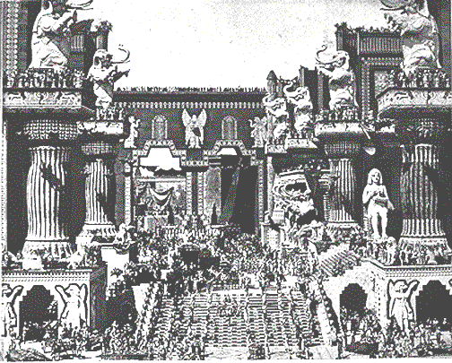
列王記下25章1-21節
王制
S - D - S
••• 分裂 •••
北 南
イスラエル
ユダ
10 2
預言者たち
20-J 20-R
200
350
アッシリア
バビロン
初期の映画 “イントレランス”の中の
古代バビロンの町
Handbook pg. 32-37
52
Notes:
…into a distant city and country where two of Judah's most famous prophets, Daniel and Ezekiel, will speak and write their messages of hope in foretelling the glorious Messiah. In this artist's conception, you can sense the flavor of Babylon…that enormous capital of the ancient world.

Slide 55
創世記からネヘミヤ書
7
天地創造
無政府
始めの男性と女性
士師
1st Sin
350
C
始めの福音
350
始めの家族
(1000 B.C.)
始めの殺人
王制
(1000 B.C.)
洪水/虹
S - D - S
DC
塔
••• 分裂 •••
３つの社会
北 南
(2000 B.C.)
アブラハム
(2000 B.C.)
イスラエル
ユダ
召命
AC
10 2
NC
C 7 S J
L - S - B
預言者たち
I - I
20-J 20-R
J - E
200 350
アッシリア バビロン
12
捕囚
7 = 4 + 3
ヨセフ
王制
奴隷
S - D - S
430
••• 分裂 •••
４人の人
北 南
(1500 B.C.)
イスラエル
ユダ
モーセ
(1500 B.C.)
(500 B.C.)
10 2
出エジプト
S
S
沈黙
預言者たち
シナイ
20-J 20-R
M - C - C
200
350
カデシュ・バルネア
イエス
アッシリア
バビロン
40
40
LC
５つの説教
J
ヨシュア
エリコ・アイ
土地を分ける
53
Notes:
So the ROYALTY period and its folder in THE BIBLE FILE come to an end.
As Israel and Judah face the judgment of dispersion for the one, and temporary exile for the other, history moves us from ROYALTY …

Slide 56
7
C
A R
“捕囚”
Handbook pg. 37-38
54
1
Notes:
...into the last of the three kinds of Biblical societies, CAPTIVITY.
//// Remember the geometric memory tool of A-R-C

Slide 57
列王記下25章21節からエズラ記1章3節
A R C
天地創造
ABRAHAM
アブラハム
ABRAHAM
ヨセフ
ABRAHAM
モーセ
ヨシュア
無政府
王制
捕囚
沈黙
イエス
Handbook pg. 37-38
55
©2006 TBBMI
9.7.03d.
Notes:
….we come to the eighth Bible File folder, the one called... “CAPTIVITY”

Slide 58
おおまかな年代:
アブラハム-ヨセフ 2000 B.C.
モーセ-ヨシュア 1500 B.C.
無政府-王制 1000 B.C.
捕囚-沈黙 500 B.C.
56
Notes:
Its time-line...moving now 500 years closer to the time of the Savior... about 500 BC

Slide 59
ユダは存続された!
イザヤ書 9章6-7節
舞台準備
まとめてみると…
MS
N(A)
H
SG
C
ER
B
J
MN
DS
E
KB
何故?
U
MS
何故なら: 救い主はユダ族から現れると
長く予言されてきたから。
PG
RS
Handbook pg. 37-38
57
8

Slide 60
列王記下 25:21
7
捕囚
３つの社会の
３番目は:
捕囚
A R C
Handbook pg. 37-38
58
Notes:
And here is CAPTIVITY's file folder from the Bible File sequence ready for the four items important to this period in the life of ancient Judah.

Slide 61
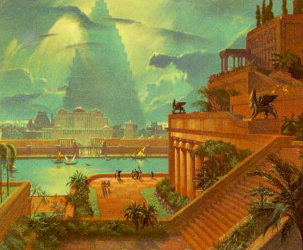
ダニエル書１章
古代のバビロン
捕囚
ユーフラテス川
バビロンの空中庭園
Handbook pg. 37-38
59
Notes:
Babylon -- that enormous Oriental metropolis next to the Euphrates River -- is the site of JUDAH's 70 years of captivity, shown here in an artist re-creation of the possible appearance of that incredible city. The famed Hanging Gardens of Babylon -- visible on the right -- were among the Seven Wonders of that Ancient World.

Slide 62
7
捕囚
捕囚の舞台
Handbook pg. 37-38
60
Notes:
Remember, also, that Babylon -- located on your map many miles upstream from the Persian Gulf – was very near the heart of today's troubled Persian Gulf region in the Middle East.

Slide 63
ｴﾚﾐﾔ 29:10; ｴｽﾞﾗ 3:8; ﾈﾍﾐﾔ 2:5-6
7
捕囚
70 年
3 つの長旅
A R C
捕囚
70 年
3 つの長旅
“ｲｽﾗｴﾙ人”
“ｲｽﾗｴﾙ人”
“ 神殿”
“神殿”
Handbook pg. 37-38
61
3
Notes:
After the 70 years of Judah’s exile, the Babylonian rulers allowed the captives from the SOUTHERN KINGDOM OF JUDAH to return to Jerusalem, and to rebuild their city, its walls and their Temple.
//// And it was during this time of the Babylonian Exile that the people of JUDAH came to be called Jews -- from the tribal name of JUDAH.
//// The worldwide Jewish tradition of the synagogue was also born in Babylon during Judah’s Captivity or Exile.
//// The Return to The Land took place in 3 massive treks. These were difficult trips on foot from Babylon back to the Land.

Slide 64
7
帰還への３つの旅
A R C
捕囚
70 年
３つの長旅
捕囚の舞台
Handbook pg. 37-38
62
Notes:
The returning Jews moved up along the Fertile Crescent route probably near the Euphrates River....then finally turning away southward toward the Land of Israel. That route was absolutely necessary. Otherwise the returnees would be unable to survive the harsh desert conditions that lay directly westward between Babylon and Jerusalem.

Slide 65
エズラ記 1～2章
7
捕囚
70 年
3 つの長旅
A R C
100 年 / 50,000
捕囚
70 年
3 つの長旅
100 年 / 50,000
Handbook pg. 37-38
63
Notes:
The THREE TREKS back to the land lasted about 100 years. During that time some 50,000 people returned.

Slide 66
エズラ記 1章4節
50,000 人が帰還!
しかし更に多くの者は居残って、帰還者たちを経済的に支援した。
捕囚
70 年
3 つの長旅
100 年 / 50,000
Handbook pg. 37-38
64
1
Notes:
Even though some 50,000 Jews left Babylon to return to the Land of their Promise…
//// …many Jews back in Babylon had been successful in business, living in their own houses. Those Jews were largely responsible for financing the trips back, and for the work of reconstruction by the returnees.

Slide 67
ｴﾚﾐﾔ29章; ｴｽﾞﾗ記3章; ﾈﾍﾐﾔ記2章
7
ゼルバベル
CAPTIVITY
70 年
エズラ
3 つの長旅
A R C
100 年 / 50,000
Z - E - N
捕囚
ネヘミヤ
70 年
3 つの長旅
100 年 / 50,000
Z - E - N
Handbook pg. 37-38
65
4
Notes:
During those difficult journeys back to Israel from Babylon, three famous names move into national leadership.
//// Remember those names by recalling the word Z-E-N...these three great men, sometimes called diplomat-priests, in order, were
//// ZERUBBABEL...
//// EZRA... and
//// NEHEMIAH.

Slide 68
ネヘミヤ記 3章
7
ゼルバベブ
ゼルバベブ…神殿再建に着手する。
捕囚
70 年
エズラ
エズラ…帰還して主の法を教える。
Z-E-N
3 つの長旅
100 年 / 50,000
Z - E - N
捕囚
３人の偉大な祭司
70 年
ネヘミヤ
ネヘミヤ…偉大な旧約聖書のリーダーとして帰還し町の門と壁を再建した。
3 つの長旅
100 年 / 50,000
Z - E - N
Handbook pg. 37-38
66
3
Notes:
ZERUBBABEL is remembered because of his crucial role in beginning the rebuilding of the actual Temple structure, small though it was…
//// EZRA...the great priest who went to Jerusalem to teach the law of the Lord to the returned people...
//// While NEHEMIAH, that famed Old Testament administrator and leader, returned to rebuild the cities’ gates and walls. In an astonishingly short time, he and his men rebuilt Jerusalem’s crucial defenses.
//// These three great men…Z-E-N….Zerubbabel, Ezra and Nehemiah…the diplomat-priests…were at the center of Judah’s return, carefully guiding the development of an exiled nation now back in its homeland.

Slide 69
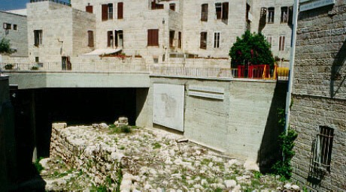
ネヘミヤ記 3章8節
エルサレム: ネヘミヤの壁の発掘
捕囚
70 年
3 つの長旅
100 年 / 50,000
Z - E - N
Handbook pg. 37-38
67
Notes:
In fact, biblical scholars are quite certain that these archeological digs, in the heart of Jerusalem, are, indeed, the remains of those walls rebuilt by Nehemiah and his Israeli construction crews.

Slide 70
Z-E-N
ｴﾚﾐﾔ書29:10; ｴｽﾞﾗ記3:8; ﾈﾍﾐﾔ記2:5-6
7
ゼルバベル
ゼルバベル…帰還して神殿の再建を着工。
捕囚
70 年
エズラ
エズラ…帰還して主の法を教育.
Z-E-N
3 つの長旅
100 年/ 50,000
Z - E - N
捕囚
３人の偉大な祭司
70 年
ネヘミヤ
ネヘミヤ…旧約聖書の偉大なリーダーとして帰還し、町の門と壁を再建。
3 つの長旅
100 年 / 50,000
Z - E - N
Handbook pg. 37-38
68
3

Slide 71
創世記からエステル書
7
天地創造
無政府
始めの男性と女性
士師たち
1st Sin
350
C
始めの福音
350
始めの家族
(1000 B.C.)
始めの殺人
王制
(1000 B.C.)
洪水／虹
S - D - S
DC
当
••• 分裂 •••
北 南
(2000 B.C.)
アブラハム
(2000 B.C.)
イスラエル
ユダ
召命
AC
10 2
NC
C 7 S J
L - S - B
預言者たち
20-J 20-R
I - I
３つの社会
J - E
200 350
アッシリア バビロン
12
捕囚
7 = 4 + 3
ヨセフ
70 年
捕囚
奴隷
3 つの長旅
70 年
430
100 年 / 50,000
４人の人々
3 つの長旅
Z - E - N
100 Years / 50,000
(1500 B.C.)
100 年 / 50,000
モーセ
(1500 B.C.)
(500 B.C.)
Z - E - N
出エジプト
S
S
沈黙
シナイ
M - C - C
カデシュ・バルネア
イエス
40
40
LC
５つの説教
J
ヨシュア
エリコ／アイ
土地を分ける
69
1
Notes:
At the eighth file folder of CAPTIVITY in the series of ten BIBLE FILE FOLDERS we are at the end of the Old Testament…also bringing us to the end of the 3 great societies.…ANARCHY ...ROYALTY...and CAPTIVITY…
//// …and showing us in their complete presentations THE FOUR OLD TESTAMENT CONVENANT PROMISES…the ABRAHAMIC…the LAND…the DAVIDIC…and THE NEW COVENANTS. Moving on now to SILENCE.

Slide 72
70
9.7.03d.

Slide 73


バイブル ベイシック • BibleStudyDownloads.org
無料でダウンロードどうぞ
Notes:
The Bible…Basically (bb)

