Slide 1
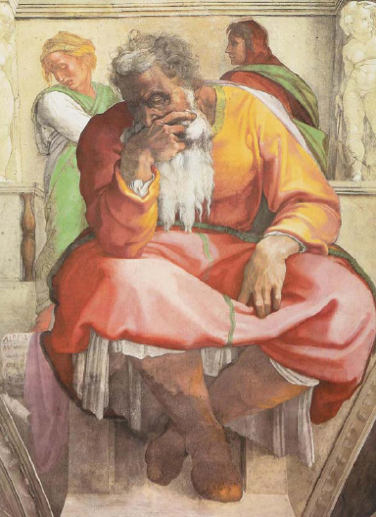
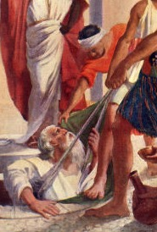
YEREMIA
"NABI YANG MENANGIS" ATAU "NABI PENGHARAPAN"?
Dr. Rick Griffith • Singapore Bible College • BibleStudyDownloads.org

Slide 2
Kata Kunci
474
343
Tak Terelakkan
Yeremia
Notes:
By the time we get to Yeremia, God proclaims that the exile will definitely come. It is inevitable.

Slide 3
Tema
474
Penahanan yang Layak & Pemulihan yang tidak
Pantas
Yeremia
Notes:
Yeremia’s theme is that captivity is deserved but also the restoration is undeserved and will also happen.

Slide 4
Ayat Kunci
474
"…Sebab TUHAN, Allah kita, membinasakan kita, memberi kita minum racun, sebab kita telah berdosa kepada TUHAN." (8:14b).
Yeremia
Notes:
Judgment was because of Judah’s sin, as the key verse indicates in 8:14.

Slide 5

Pernyataan Kerajaan
343
Penghakiman atas Yerusalem tidak terhindarkan karena penolakannya untuk mematuhi Perjanjian Lama (1–19), namun setelah penahanan 70 tahun (25:11-12) dan penghakiman atas orang bukan Yahudi, Israel akan tunduk pada pemerintahan Allah di bawah Perjanjian Baru (30–33).
Yeremia

Slide 6

Pernyataan Ringkasan
474
346
Kejatuhan Yerusalem yang pantas, 70 tahun penahanan, penghakiman atas bangsa-bangsa lain, dan pemulihan di bawah Perjanjian Baru memberi harapan dan menasihati Yehuda untuk menerima disiplin Allah yang tak terelakkan dengan menyerah kepada Babylon.
Yeremia

Slide 7

Perjanjian
347b
Loh batu perjanjian lama yang mengarah pada penghakiman Israel akan diganti dengan perjanjian baru melalui Roh Kudus berdiam di hati mereka setelah pertobatan dan pengampunan (31:31-33).
Yeremia

Slide 8

Penebusan
347b
Penebusan dalam pembaruan spiritual (pasal 30–33) menunggu Israel sampai ketidaksetiaannya berakhir, yang merupakan penebusan yang akan terjadi karena Israel tidak akan pernah berhenti menjadi sebuah bangsa (31:35-37).
Yeremia

Slide 9

Mesias
347b
Mesias Sang Gembala dan Cabang yang Adil (23:1-8) dan perjanjian baru yang Dia bawa (31:31-33) menunjuk pada aturan Kristus dan pengampunan dalam darahNya yang Dia gambarkan dalam perjamuan terakhir (Luke 22:20).
Yeremia

Slide 10
474
Penahanan yang Layak & Restorasi yang tidak Layak
Panggilan Kenabian | Penghakiman Yehuda Layak |  |  |  | Penghakiman Bangsa-Bangsa Layak |  |  |  | Kejatuhan Yerusalem
Pasal 1 | Pasal 2–45 |  |  |  | Pasal 46–51 |  |  |  | Pasal 52
Komisi | Penghukuman & Kenyamanan |  |  |  | Penghukuman |  |  |  | Penahanan
Penghakiman dengan Kehadiran Tuhan | Sebelum Jatuh 2–38 | Jatuh 39 | Setelah Jatuh 40–44 | Baruch 45 | Barat Daya 46–47 | Timur 48:1–49:22 | Utara49:23-33 | Timur Laut 49:34– 51:64 | Jatuh 52:1-30 | Bangkit 52:31-34
Prolog | Pelayanan |  |  |  |  |  |  |  | Epilog
Yehuda |  |  |  |  | Bangsa-Bangsa |  |  |  | Babilonia
c. 627-580 SM
Notes:
The book is divided into 4 main sections. After the first section in chapter 1 on Yeremia's call, his person and identity, Yeremia got down to work very quickly in Chapter 2. Many object lessons run through the 2nd segment where God asks Yeremia to do unusual things. These give the Judeans an obvious reminder of what they had not done and their failure to return and repent before God. However, buried between this segment in chapters 30-33 is a message of hope in a future restoration, often called Book of Comfort. Embedded here is also the new covenant. After that from chapter 34 onwards are warning after warning against disobedience. But interestingly, chapter 45 records an incident where Barush was encouraged 20 years earlier but is placed here to encourage and show God's sovereignty. This is also a reminder of the encouragement that God gave to Yeremia in 1:19.. The next segment includes prophecies against the nations that persecuted Judah, many of which where fulfilled while some remain still future. The prophecies end with Babylon, empahsizing how God would very certainly destroy them. This brought hope to the Israelites at that time when they couldn't see beyond their suffering and subjugation. So the reality that future judgment lay ahead for Babylon was also an important encouragement for them to know that their God was a just God.

Slide 11
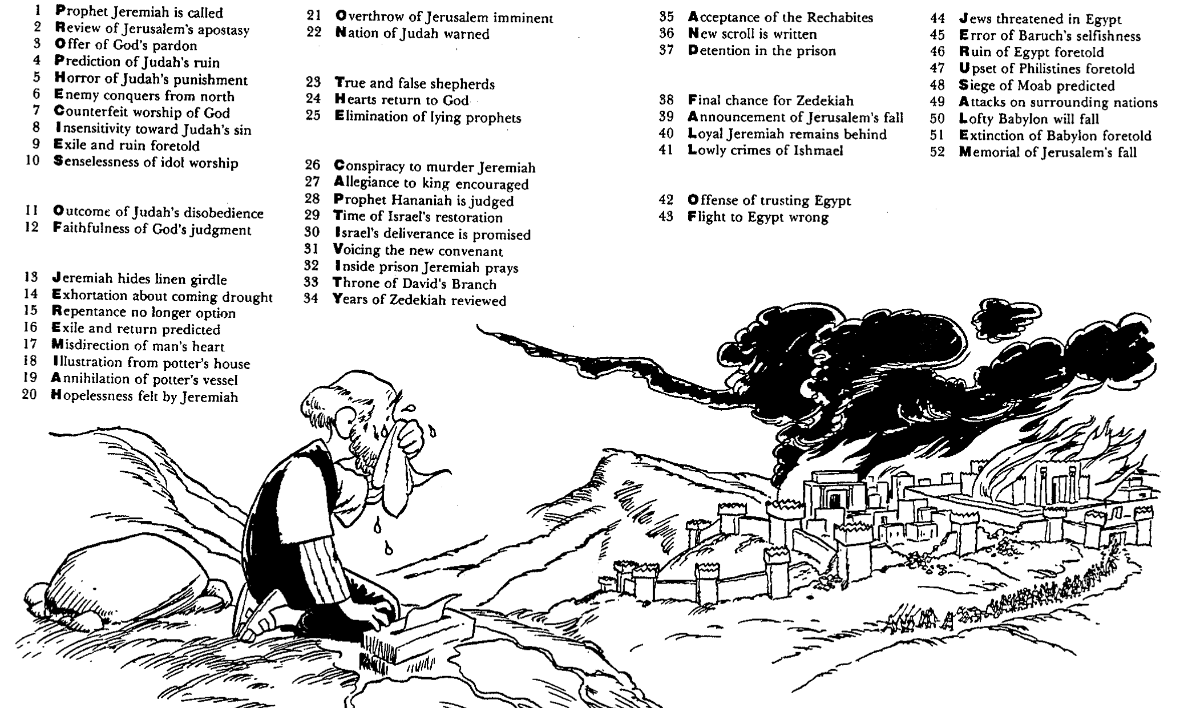
Barry Huddleston, The Acrostic Summarized Bible (Grand Rapids: Baker, 1992)
1 Inception of the world
2 Newlyweds placed in Eden
3 Temptation and man's fall
4 Hatred and first murder
5 Entire genealogy of Adam
6 Lessons on proper priorities
7 Outline for personal relationships
8 Faith of the centurion
Yeremia
29 Genealogy of Jesus Christ
30 Opposition of King Herod
31 Spirit's descent upon Jesus
32 Power over Satan's temptations
33 Expounding Sermon on Mount
34 Lessons on proper priorities
35 Outline for personal relationships
36 Faith of the centurion
9 Matthew's call from Jesus
10 Apostles sent to preach
11 Testimony about John's message
12 True Messiah called demonic
13 Hidden message of parables
14 Execution of the Baptist
15 Wisdom is answering Pharisees
37 Matthew's call from Jesus
38 Apostles sent to preach
39 Testimony about John's message
40 True Messiah called demonic
41 Hidden message of parables
42 Execution of the Baptist
43 Wisdom is answering Pharisees
16 Keys of the kingdom
17 Impact of Jesus' transfiguration
18 Need for true forgiveness
19 Grounds for divorce clarified
20 Opportunities in the vineyard
21 Fig tree is cursed
44 Keys of the kingdom
45 Impact of Jesus' transfiguration
46 Need for true forgiveness
47 Grounds for divorce clarified
48 Opportunities in the vineyard
49 Fig tree is cursed
22 Taxes paid to Caesar
23 Hypocrisy denounced by "woes"
24 Events of second coming
25 Judgment of the nations
26 Events on Calvary's eve
27 Way of the cross
28 Savior's resurrection and commission
50 Taxes paid to Caesar
51 Hypocrisy denounced by "woes"
52 Events of second coming
53 Judgment of the nations
54 Events on Calvary's eve
55 Way of the cross
56 Savior's resurrection and commission

Slide 12
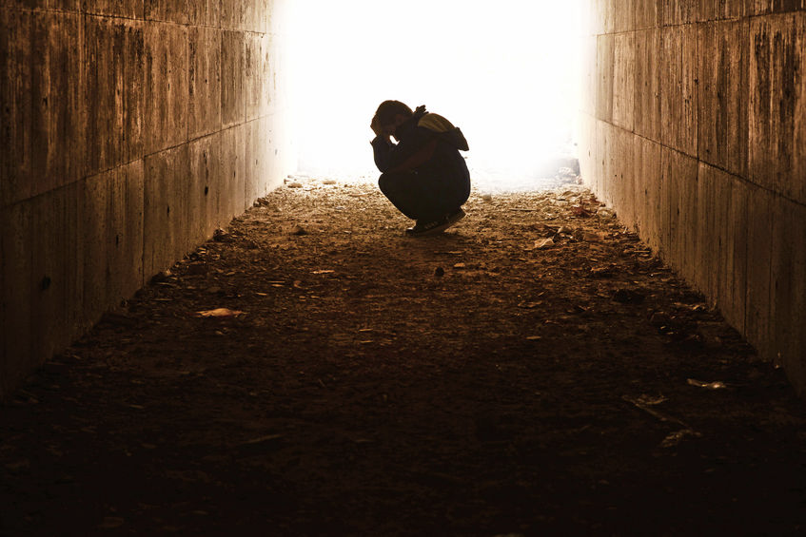
Dihibur
Yeremia
Dr. Rick Griffith • Crossroads International Church Singapore
CICFamily.com • BibleStudyDownloads.org

Slide 13
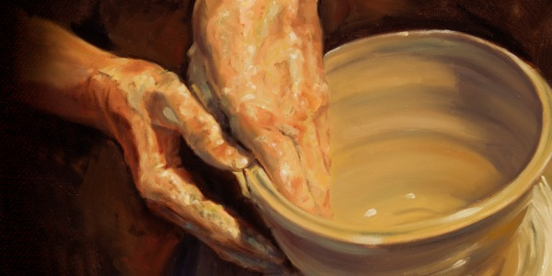
Bagaimana Tuhan menghibur orang yang dihukum?
Notes:
In what ways can we see God's compassion even when he has to punish sin?

Slide 14
Ide Utama Yeremia
Tuhan bekerja dalam keterbatasannya sehingga kami mau tunduk pada perintahNya.
Notes:
Be encouraged that the LORD restrains his own punishing our sin for us to return to him.

Slide 15
I. Tuhan memanggil utusan yang jujur dengan kami
(Yer 1).
Bagaimana Tuhan menghibur orang yang dihukum?
Notes:
The LORD assures that he has a representative who tells us both his discipline and restoration.

Slide 16
II. Tuhan memiliki disiplin yang terbatas tetapi berkatNya tak terbatas
(Yer 2–45).
Bagaimana Tuhan menghibur mereka yang Dia hukum?
Notes:
The LORD's punishment is always less than his rewards.

Slide 17
III. Tuhan menerapkan standar yang sama untuk semua orang (Yer 46–51).
Bagaimana Tuhan menghibur orang yang dihukum?
Notes:
He will judge unbelievers as well as his own people.

Slide 18
IV. God balances justice with mercy (Yer 52).
How does God comfort even those he disciplines?
Notes:
He judges but also restores.

Slide 19
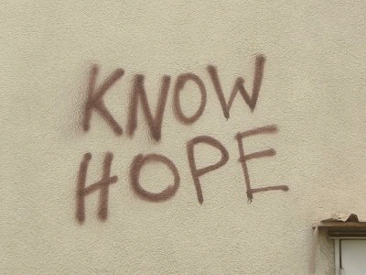
Apakah kamu bagian dari sisa yang setia?
NO HOPE?
  Apakah anda menaruh harapan pada Tuhan yang setia dan pemurah?
  Apakah anda menantikan Hari Tuhan dan pemulihan lengkap yang dijanjikanNya ?
or...

Slide 21

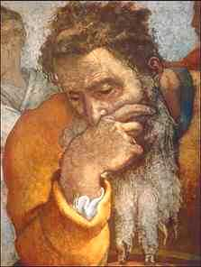
Overview
Background
Outline
Application

Slide 22
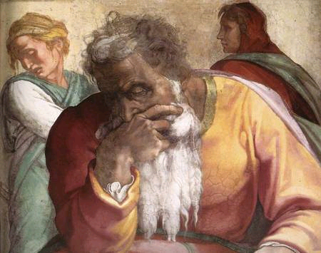
1. BACKGROUND OF Yeremia

Slide 23
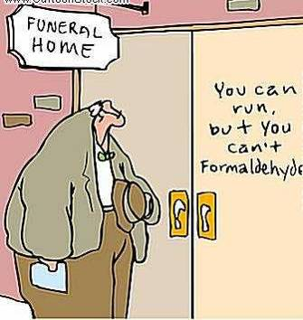
Ever felt like the future is uncertain?
Yeremia
=
INEVITABLE
Captivity
+
Restoration

Slide 24
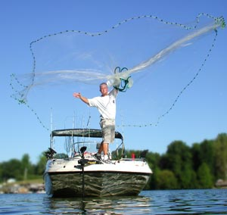
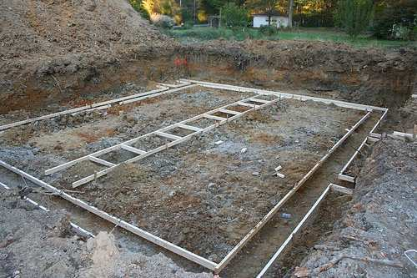
Yeremia - Yirməyāhū in Hebrew
475
From either of 2 roots meaning
"cast, shoot" or "loosen":
"Yahweh establishes,
appoints or sends"
2. "Yahweh throws,"
perhaps in the sense of
laying a foundation

Slide 25
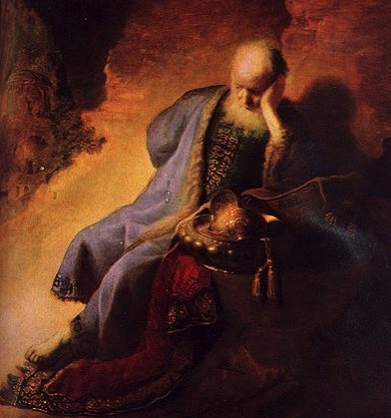
Who was Yeremia?
Rembrandt van Rijn –
Yeremia Lamenting
the Destruction of Jerusalem

Slide 26
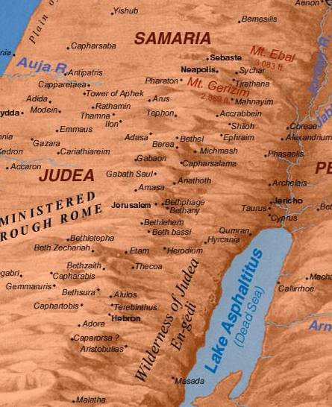
Biography:
485
Son of Hilkiah, a priest (Jer. 1:1)
Lived in town of Anathoth
3 miles (5 km.) NE of Jerusalem
Began his ministry around 20 years old
Was well-off enough to buy a field (Jer. 32)

Slide 27

Authorship
475
 | Yes, it was Yeremia! | No, it was not Yeremia!
External Evidence | 1) Explicitly: Daniel 9:2 Matthew 2:17-18 2) Implicitly in Matt. 21:13; Mark 11:17; Luke 19:46, Rom. 11:27 and Heb. 8:8-13 3) The Talmud, Josephus, and Ecclesiasticus | Chap 52 is nearly identical to 2 Kings 24:18–25:30 It is likely that chap 52 was recorded by the same author as the 2 Kings postscript under the direction of the Holy Spirit
Internal Evidence | Jer. 1:1, 11, 23; 29:27; 32:7-9. Yeremia is clearly identified with the biographical information provided. | 51:64 says "the words of Yeremia end here."

Slide 28
Placing the Prophetical Books
445
S "O" S
Pre-Exile
(800-606 BC)
Exile
(606-536 BC)
Post-Exile
(536-400 BC)
S
O
L
O
M
O
N
D
A
V
I
D
Israel
Hosea
Amos
Assyria
Jonah
Nahum
S
A
U
L
"HA"
"NAH"
Jews in Jerusalem
Haggai
Zechariah
Malachi
Judah
Habakkuk
Isaiah
Yeremia
Joel
Micah
Zephaniah
Lamentations
Jews in Exile
Ezekiel
Daniel
Edom
Obadiah
"HIJJMZL"
"IE"
(In Exile)
"HaZeMa"
(final
OT books)
"BAD"
The Daily Walk
Adapted from Walk Thru the Old Testament
Walk Thru the Bible Press, 1978
Notes:
Obadiah slide 14, Yeremia slide 28
The UK (United Kingdom) had the kings Saul, David, and Solomon.
Yet the UK had warning signs as SDS almost looks like SOS
Sure enough, the UK split with Israel in its own "Brexit" in the north
This began the Pre-Exile prophets
Israel was the first to say "HA" to God in rejection, so God sent Hosea and Amos
Meanwhile, Assyria was even worse. After first repenting under Jonah, they later said "NAH" so God sent both JoNAH and NAHum to warn them.
Of course, Edom as a blood relative to Israel and should have known better, so they were really BAD. Thus, God sent them OBADiah.
Jews in Exile included only Ezekiel and Daniel, who were the only two prophets with IE in their name = In Exile.
But God brought the people of Judah back as Jews in Jerusalem and raised up 3 prophets with the memory divice HaZeMa.
But we can't forget th largest group of prophets back in the Pre-Exile times, but how can we remember all 7 of them?
Fortunately, singing Twinkle, Twinkle with their first letters gives HIJJMZL, which, sung over and over, is unforgettable.

Slide 29
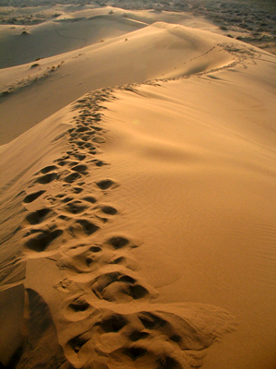
Yeremia in the Line of Prophets
344
Obadiah - Edom
Jonah - Compassion
Amos - Injustice
Hosea - Loyal
Isaiah - Restoration
Micah - Exploitation
Nahum - Nineveh
Habakkuk - Faith
Zephaniah - Day
Joel - Locusts
Yeremia – Inevitable
→ Lamentations
→ Daniel, Ezekiel (Exile)

Slide 30

Ample Warning For Judah
735-710 BC Micah: Judah will suffer exile for exploitation of poor
c. 630 BC Zephaniah: Day of the Lord is coming - Repent!
4 decades before Jerusalem's fall
607-5 BC Habakkuk: Judah will be disciplined by Babylon
590 BC Joel: Judgment by locusts should cause repentance before Babylon's invasion
627-580 BC Yeremia: Judgment is inevitable.
70 years captivity!

Slide 31
Length of Prophetic Ministries
Isaiah
65 Years
Hosea
45 Years
Yeremia
40+ Years
Micah
25 Years
Notes:
Yeremia reveals himself as author and reveals that his ministry lasted over four decades from Josiah's thirteenth year (627 BC) to the exile (1:1-3; 586 BC).

Slide 32
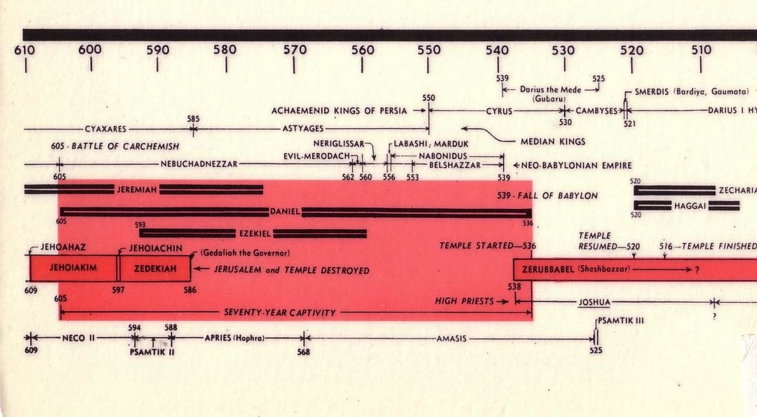
Chart of the Exile
232 & 342
The Babylonian Exile
John C. Whitcomb, 4th rev. ed., Winona Lake, IN: BMH Books, 1962, 1968

Slide 33
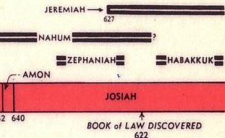
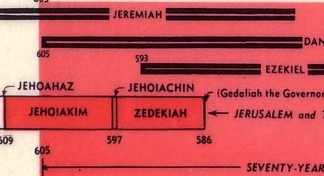
Chart of OT Kings & Prophets
342

Slide 34
Chronology of Yeremia
560
475
PERIODS OF PROPHETIC MINISTRY
627-622
608-605
593-586
586-585
627
609
605
597
586
Major Events:
Josiah's death
1
Babylonian invasion
2
Babylonian deportation
3
Babylonian exile
Call
Daniel ministers in Babylon
Kings of Judah:
Ezekiel ministers in Babylon
Josiah
(640-609)
Jehoahaz
(609)
Jehoiakim
(608-598)
Jehoiachin
(598-597)
Zedekiah
(597-586)
3 months
11 years
3 months
11 years
Yeremia prophesied from the 13th year of Josiah (627 BC)
past the fall of Judah (586 BC) to about 580 BC.
His ministry spanned 4 decades and the reigns of 5 kings of Judah.
Notes:
Same slide in:
24-Yeremia-130.pptx, slide 19
25-Lamentations-59.pptx slide 7

Slide 35
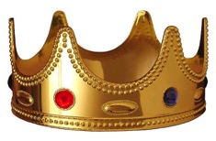
Rulers He Ministered Under
485
475-6
1. JOSIAH - Judah's last godly king
2. JEHOAHAZ - (son of Josiah) Weak ruler deposed by Pharaoh Neco in 3 mos.
2. JEHOIAKIM - (son of Josiah) Ungodly, Bible burning king
3. JEHOIACHIN - (son of Jehoiakim) a ninety-day wonder judged by God
4. ZEDEKIAH - (uncle of Jehoiachin) Judah's final king
5. NEBUCHADNEZZAR - Great Babylonian conqueror
6. GEDALIAH – Babylonian-appointed governor of occupied city of Jerusalem
7. JOHANAN - Successor of Gedaliah who was assassinated

Slide 36
An Evil End to Judah
256
1
Josiah
640-609
(31 yrs.)
Good king in white
Evil kings in yellow
3
5
2
Johanan
(no rule)
Jehoiakim (Eliakim)
609-597
(11 yrs.)
Zedekiah
(Mattaniah)
597-586
(11 yrs.)
Jehoahaz
(Shallum)
609
(3 mos.)
4
Jehoiachin
(Jeconiah/Coniah)
597
(3 mos.)
Babylon
Exiled
Notes:
The last five kings of Judah comprised only three generations. That's because it was such a turbulent time that two of them served only 3 months each! Josiah was the final good king with a long rule of 31 years,
• but his son Jehoahaz ruled only three months before getting exiled to Egypt, the rising superpower
• who replaced him with his brother Jehoiakim. However, Egypt lost to Babylon, the rising competitor to the north, so the third generation here in the person of
• Jehoiachin also reigned only 3 months like his uncle Jehoahaz. Jehoiachin was then exiled ahead of the rest of Judah to Babylon, and his other uncle,
• Zedekiah, became Judah's puppet king under Babylon. But none of these last four kings would submit to the LORD, and Zedekiah was the last Jewish king to this day. Yeremia tried to get him to submit to God's discipline, but to no avail. In 586 the city was destroyed, temple was raided and made into ruins, and 10,000 people were forcably exiled to Babylon.

Slide 37
Josiah's Sons & Prophets
232
342
Daniel
605
Ezekiel
City Fell
Jehoahaz
Josiah
Jehoiakim
Jehoiachin
Zedekiah
609
597
586
(3 mos.)
(11 yrs.)
(3 mos.)
(11 yrs.)
Yeremia
627
Brief Puppet Kings
Notes:
Yeremia was the only prophet to live through the 586 BC fall of Jerusalem. God called him to show God’s compassion even in Judah’s darkest hours. How? Josiah was the last good king, who died in 609. • After him the reigns of his descendants alternated between 3 months• to 11 years • to 3 months • to 11 years once again! • But God spoke to these godless kings through three major prophets. Yeremia was the only one to preach in Jerusalem until the city fell in 586, • while Daniel was taken to Babylon in 605 • and Ezekiel in 597.

Slide 38
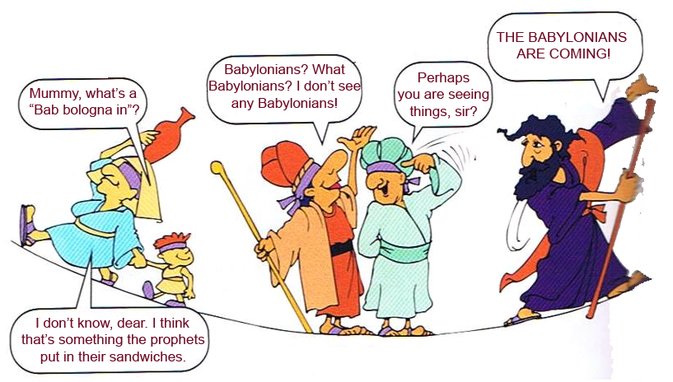
Bab bologna in – who??
RED ALERT!
RED ALERT!
Or what?? Something prophets put in their sandwiches??
Notes:
The people in Israel were not too concerned about Babylon, in fact they thought they were secure in their successes

Slide 39
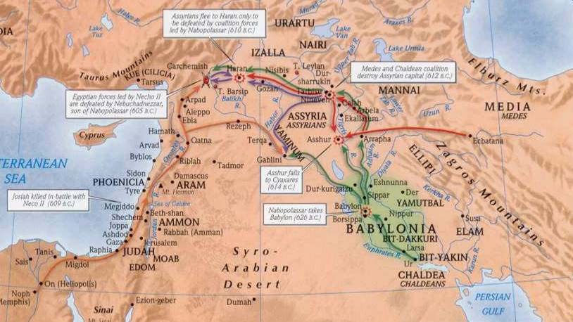
Geography of Yeremia
475-6
1
3
2
1. Assyria: Since 722 BC, Assyria dominated Jerusalem.
2. Babylon: In 612 BC Nineveh, Assyria's capital, fell to Babylon. This meant Judah would be subject to Babylon.
3. Egypt: Assyria-Babylon conflicts gave Egypt control of Israel. Pharaoh Neco killed Josiah of Judah in 609 BC, then his son Jehoahaz ruled 3 months. Neco replaced him with his brother Jehoiakim.

Slide 40
Geography of Yeremia
475-6
Geography of Yeremia
4
1
3
2
4. Babylon: When Egypt was defeated by Nebuchadnezzar of Babylon at the Battle of Carchemish (605 BC), Jehoiakim switched allegiance from Egypt to Babylon.

Slide 41
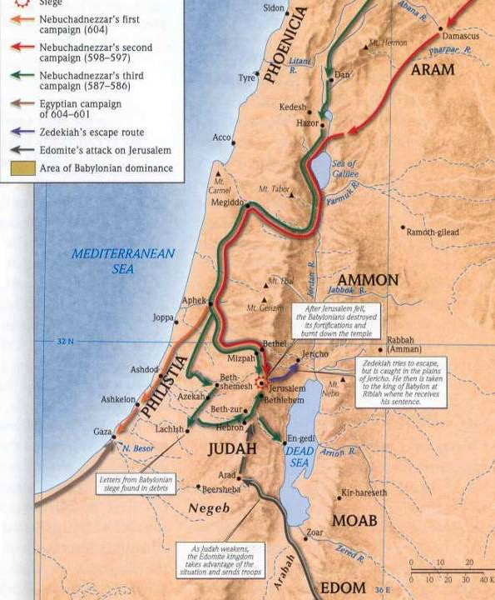
Campaigns
475-6
Egypt: Four years later
(601 BC), Egypt defeated Nebuchadnezzar and Jehoiakim switched his allegiance back to Egypt. What a mistake!
Babylon: In 597 BC Nebuchadnezzar attacked Jerusalem and killed Jehoiakim. He was replaced with Jehoiachin but 3 months later he deported him to Babylon with 10,000 others.
  He was replaced with his uncle Zedekiah, who ruled 11 years until the siege and fall of Jerusalem in 586 BC.
Notes:
Brown arrows from bottom represent the Egyptian campaign

Slide 42
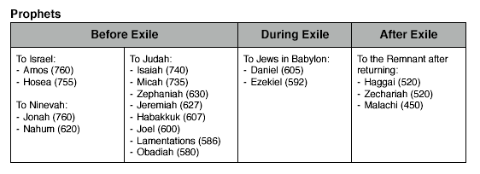
Who Were the Recipients? (1)
475
Notes:
A recap of which books were written to whom, as we see from this chart, Yeremia is written to Judah. Let's take a closer look.

Slide 43
Who Were the Recipients? (2)
475
Exiles in
Babylon
before the Fall:
Encouragement
Jer. 29
Judah
before
the Fall:
WARNING
Exiles
after
the Fall
Jer. 38-44, 52
Notes:
Yeremia addressed the people of Judah: (1) as a warning before the Fall, (2) as an encouragement to Exiles before the Fall, and (3) to Exiles after the Fall. The different widths of the circles represent the relative numbers of people.

Slide 44
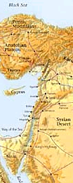
Nations Prophesied Against (Jer. 46–51)
485
1. EGYPT (46:1-27) - To be defeated by Babylonians
2. PHILISTIA (47:1-6) - To be overrun by Egyptians
3. MOAB (48:1-47) - To be conquered by Babylon
4. AMMON (49:1-6) - To be destroyed and re-established in the millennium.
5. EDOM (49:7-22) - To become as Sodom and Gomorrah
6. DAMASCUS (49:23-27) - To be destroyed in a single day
7. KEDAR & HAZOR (49:28-35) - To be destroyed by Nebuchadnezzar
8. ELAM (49:34-39) - To be overrun by Nebuchadnezzar and
re-established during the millennium.
9. BABYLON (50:1-51:64) - Final destruction of the empire
Notes:
However, more than just the people of Judah alone, there were prophecies addressed to the other non-Israelite cities in those days.

Slide 45
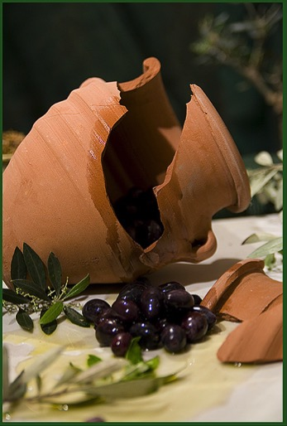
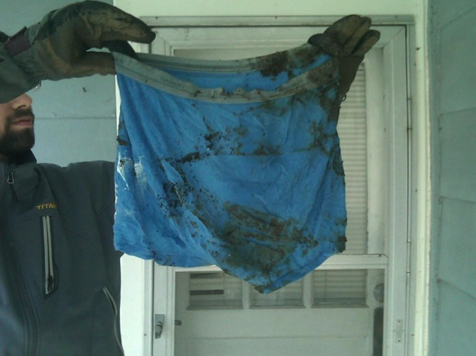
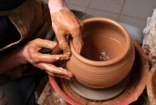
Unique Characteristics
476
Symbolic Acts
Broken Jar (Jer. 19)
Potter's Clay (Jer. 18)
Rotten Underwear (Jer. 13)

Slide 46
Unique Characteristics
476
Symbolic Acts
Literary Types
MT versus LXX

Slide 47
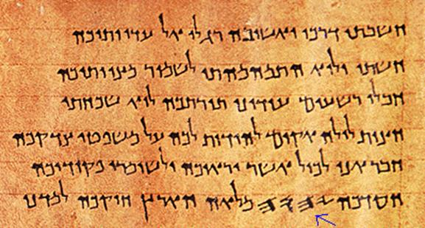
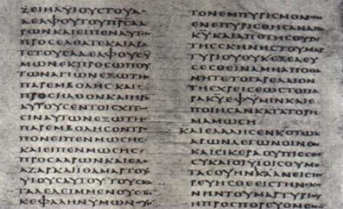
MT versus LXX
476
MT
(Heb.)
LXX
(Gr.)
1/8 shorter than MT

Slide 48
Unique Characteristics
476
Symbolic Acts
Literary Types
MT versus LXX
New Covenant

Slide 49
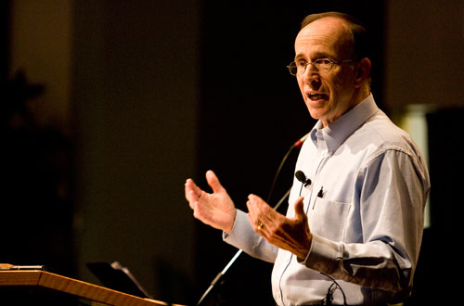
"How to Get Rid of the Jews"
³⁵ This is what the LORD says,
he who appoints the sun
to shine by day,
who decrees the moon and stars
to shine by night,
who stirs up the sea
so that its waves roar—
the LORD Almighty is his name:
³⁶ "Only if these decrees vanish
from my sight," declares the LORD,
"will the descendants of Israel ever cease
to be a nation before me."
³⁷ This is what the LORD says:
"Only if the heavens above can be measured
and the foundations of the earth below be searched out
will I reject all the descendants of Israel
because of all they have done,"
declares the LORD (Jer. 31:35-37 NIV).
Notes:
A pastor once announced to his congregation, • "Next week I will speak on the topic of 'How to Get Rid of the Jews.'" The news spread throughout the small town to the extent that on the next Sunday, after the doors had closed and just before a packed service began, the doors opened again and into the church walked the city's chief rabbi, followed by two of his lawyers! They walked down the center aisle all the way to the front, then took seats in the very front row.
The service continued with songs, prayers, offering and finally the pastor stood at the pulpit. "I am thrilled to see so many at church today, including our distinguished rabbi and his friends. My topic today is 'How to Get Rid of the Jews.' The text is from Yeremia, chapter 31. Please turn in your Bibles to Yeremia 31, verse 35.'" [Animate slide and read vv. 35-37]
At this point, the rabbi smiled, the pastor winked, the congregation sighed in relief, and the lawyers realized that their job was over.
God was clear to Yeremia that his covenant with the Jews is an eternal covenant, not dependent on them. He promised a New Covenant that assures that at some future point the nation will again trust in him by believing in Messiah, after which God will forgive their sins.

Slide 50
Unique Characteristics
476
Symbolic Acts
Literary Types
MT versus LXX
New Covenant
Logical Arrangement

Slide 51
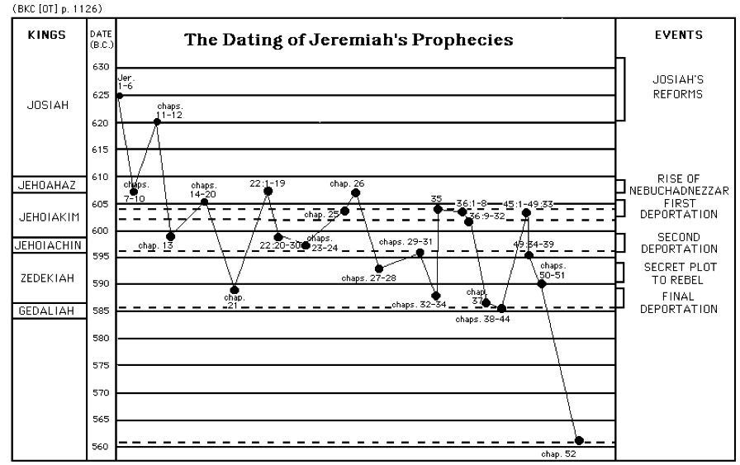
Structure is Logical not Chronological
477
KINGS
The Dating of Yeremia’s Prophecies
EVENTS
Josiah’s
Reforms
JOSIAH
JEHOAHAZ
Rise of Nebuchadnezzar
JEHOIAKIM
First Deportation
JEHOIACHIN
Second Deportation
ZEDEKIAH
Secret Plot to Rebel
GEDALIAH
Final Deportation
Notes:
Yeremia's prophecies were written down not in chronological order, but rather in a seemingly haphazard way, as shown in this chart. However, as we read the book of Yeremia we can see that there is a logical flow in what and who it was trying to address.

Slide 52
Unique Characteristics
476
Symbolic Acts
Literary Types
MT versus LXX
New Covenant
Logical Arrangement
70-year Prophecy

Slide 53

Two 70-Year Exiles
560
Two 70-Year Exiles
People Exile
605
586
539
536
516
Temple Exile
"'This entire land will become a desolate wasteland. Israel and her neighboring lands will serve the king of Babylon for seventy years. ¹²Then, after the seventy years of captivity are over, I will punish the king of Babylon and his people for their sins,' says the LORD. 'I will make the country of the Babylonians a wasteland forever'" (Jer 25:11-12 NLT).
Notes:
The first exile of people • in 605 was followed by the full destruction of the temple • in 586. These two key dates begin two separate 70-year exiles! • Cyrus decreed that the people could return in 539, • which was completed in 536, which was 70 years after Daniel was taken and can properly be called • the People Exile. But the temple was not rebuilt • until 516, giving us another 70-year exile called • the Temple Exile. God told Yeremia that the exile would last 70 years (Jer 25:11-12). This was doubly true, whether we consider him talking about the people or the temple! Both lasted 70 years!

Slide 54
Unique Characteristics
476-478
Symbolic Acts
Literary Types
MT versus LXX
New Covenant
Logical Arrangement
70-year Prophecy
Recorded Jerusalem's Fall Twice

Slide 55
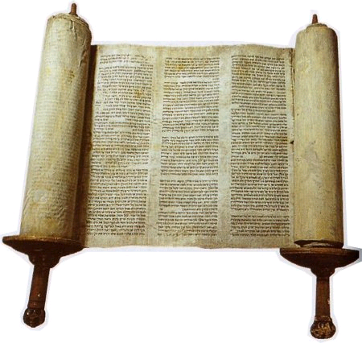
The Outline of Yeremia

Slide 56
474
Penahanan yang Layak & Restorasi yang tidak Layak
Panggilan Kenabian | Penghakiman Yehuda Layak |  |  |  | Penghakiman Bangsa-Bangsa Layak |  |  |  | Kejatuhan Yerusalem
Pasal 1 | Pasal 2–45 |  |  |  | Pasal 46–51 |  |  |  | Pasal 52
Komisi | Penghukuman & Kenyamanan |  |  |  | Penghukuman |  |  |  | Penahanan
Penghakiman dengan Kehadiran Tuhan | Sebelum Jatuh 2–38 | Jatuh 39 | Setelah Jatuh 40–44 | Baruch 45 | Barat Daya 46–47 | Timur 48:1–49:22 | Utara49:23-33 | Timur Laut 49:34– 51:64 | Jatuh 52:1-30 | Bangkit 52:31-34
Prolog | Pelayanan |  |  |  |  |  |  |  | Epilog
Yehuda |  |  |  |  | Bangsa-Bangsa |  |  |  | Babilonia
c. 627-580 SM
Notes:
The book is divided into 4 main sections. After the first section in chapter 1 on Yeremia's call, his person and identity, Yeremia got down to work very quickly in Chapter 2. Many object lessons run through the 2nd segment where God asks Yeremia to do unusual things. These give the Judeans an obvious reminder of what they had not done and their failure to return and repent before God. However, buried between this segment in chapters 30-33 is a message of hope in a future restoration, often called Book of Comfort. Embedded here is also the new covenant. After that from chapter 34 onwards are warning after warning against disobedience. But interestingly, chapter 45 records an incident where Barush was encouraged 20 years earlier but is placed here to encourage and show God's sovereignty. This is also a reminder of the encouragement that God gave to Yeremia in 1:19.. The next segment includes prophecies against the nations that persecuted Judah, many of which where fulfilled while some remain still future. The prophecies end with Babylon, empahsizing how God would very certainly destroy them. This brought hope to the Israelites at that time when they couldn't see beyond their suffering and subjugation. So the reality that future judgment lay ahead for Babylon was also an important encouragement for them to know that their God was a just God.

Slide 57
Unique Characteristics
476-478
Symbolic Acts
Literary Types
MT versus LXX
New Covenant
Logical Arrangement
70-year Prophecy
Recorded Jerusalem's Fall Twice
Lived through Jerusalem's Fall

Slide 58
Jerusalem's Fall
Jerusalem's Fall
232
342
560
Key Dates
627
Yeremia
605
Daniel
597
Ezekiel
586
538
Zephaniah
Joel
630
Lamentations
Habakkuk
590
606
Notes:
God raised up at least six prophets in association with the destruction of the first temple in 586 BC (many say 587 BC). Four spoke in Judah itself, which Daniel and Ezekiel ministered to those already brought to Babylon, as they were.

Slide 59
Unique Characteristics
476-478
Symbolic Acts
Literary Types
MT versus LXX
New Covenant
Logical Arrangement
70-year Prophecy
Recorded Jerusalem's Fall Twice
Lived through Jerusalem's Fall
Longest prophetic book (Psalms is the longest overall)

Slide 60
Longest Books of the Bible
478
Book | Chapters | Verses | Words
Psalms | 150 | 2461 | 43,743
Yeremia | 52 | 1364 | 42,659
Ezekiel | 48 | 1273 | 39,407
Genesis | 50 | 1533 | 38,267
Isaiah | 66 | 1292 | 37,044
http://www.kneeholedesk.com/Pages/Did_You_Know/Books_of_the_Bible.html

Slide 61
Unique Characteristics
478
Longest OT quote in the NT (Jer. 31:31-34 in Heb. 8:8-13)
Inevitable

Slide 62
How was judgment inevitable?
478
1. The people are encouraged to repent only up until chapter 19 (e.g., 15:19; 17:24; 18:8; cf. 5:3; 8:6). Yet after this point no exhortations to repent are forthcoming.
2. Yeremia was instructed by God not even to pray for the people of Judah (11:14; 14:11).
3. Yeremia told the people that each could individually have life instead of death if he/she would surrender to the Babylonians, but the destruction still would come on the nation as a whole (21:8-9; 24:1-10; 27:5-12, 16-17; 32:5; 38:17-23; 42:9-22; 52:24-27).

Slide 63
How was judgment inevitable?
478
4. God's determination of the length of the captivity at 70 years indicates that judgment was unavoidable (25:11-12; 29:10).
5. Yeremia smashed a pot to illustrate that God's decision to destroy the city was not retractable (19:1-2, 10-11).
6. Yeremia instructed those already in exile to settle down (29:4-14) in contrast to the false prophet Hananiah, who said the exile would only last two years (28:1-3, 10-12). This indicates that the "die was already cast" and even repentance of the people could not forestall God's judging hand.

Slide 64
Unique Characteristics
478
Longest OT quote in the NT (Jer. 31:31-34 in Heb. 8:8-13)
Inevitable
Deuteronomy 28 fulfillments
Dictation to Baruch
Autobiography
Matthew 27:9 quotes Yeremia 19:1-13 (or perhaps Jer. 18:2-12 or 32:6-9) along with Zechariah 11:12-13 but attributes it to the better known prophet Yeremia

Slide 65

Trivia Summary
476
Different types of literary material—such as poetic discourse (30–31), prose discourse (32–33) and prose narrative (46–51)
Yeremia 31:31-34 is the longest OT quote in the NT (Heb. 8:8-13)

Slide 66

Key Facts
474
Summary Statement
Yeremia prophesies at great personal cost the deserved fall of Jerusalem, seventy year captivity, judgment of Gentiles, and restoration under a new covenant, to give hope and exhort Judah to accept God's inevitable discipline by yielding to Babylon.
Key Word
INEVITABLE
Key Verse
"… For the LORD our God has doomed us to perish and given us poisoned water to drink, because we have sinned against him" (Yeremia 8:14b)

Slide 67
Dihibur
Yeremia
Dr. Rick Griffith • Crossroads International Church Singapore
CICFamily.com • BibleStudyDownloads.org

Slide 68
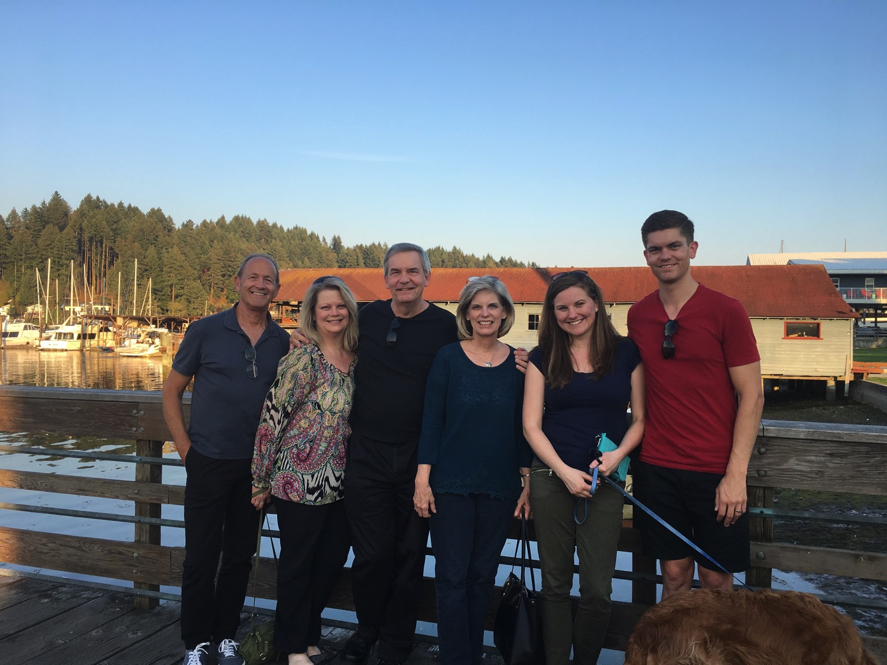
3-days travel, 4-day visit
Notes:
It is wonderful to be with you all again after taking a week off to be with my family in the USA. This is a first for us—three days of flying to have four and half days with my family—but when a $4000 trip costs only $100 now since our son is a pilot, we had little excuse not to go!

Slide 69
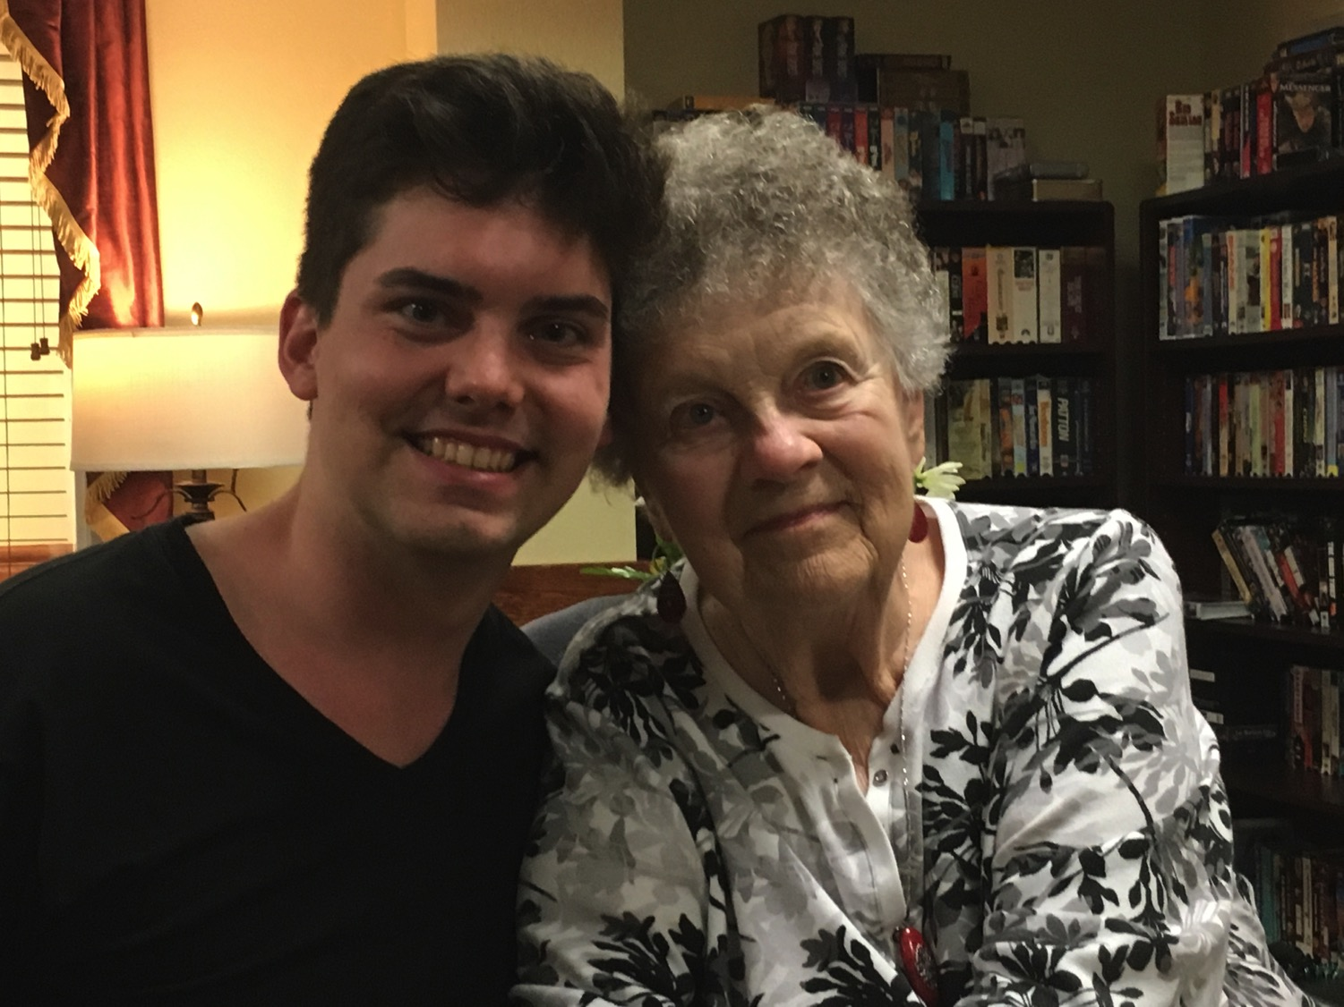
We all need to be comforted
Notes:
We had special times with our youngest son John and Susan's mother.

Slide 70
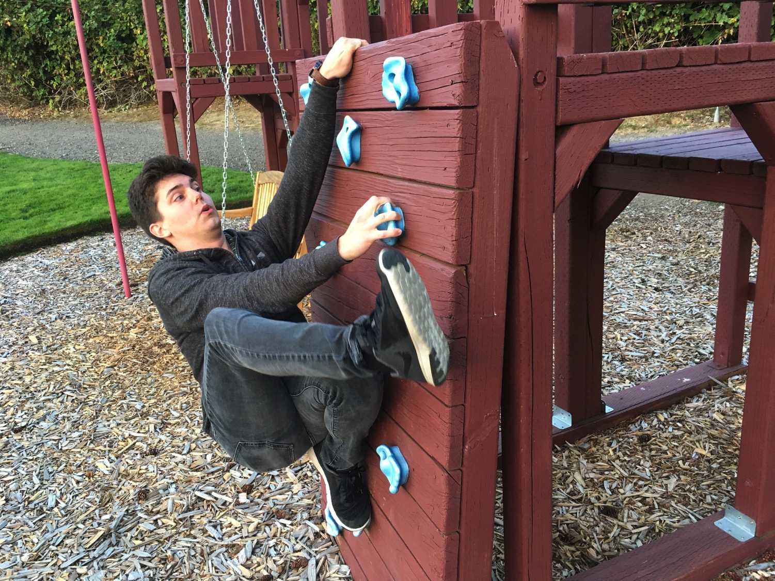
3-day travel, 4-day visit
Notes:
John even showed off his climbing skills.

Slide 71
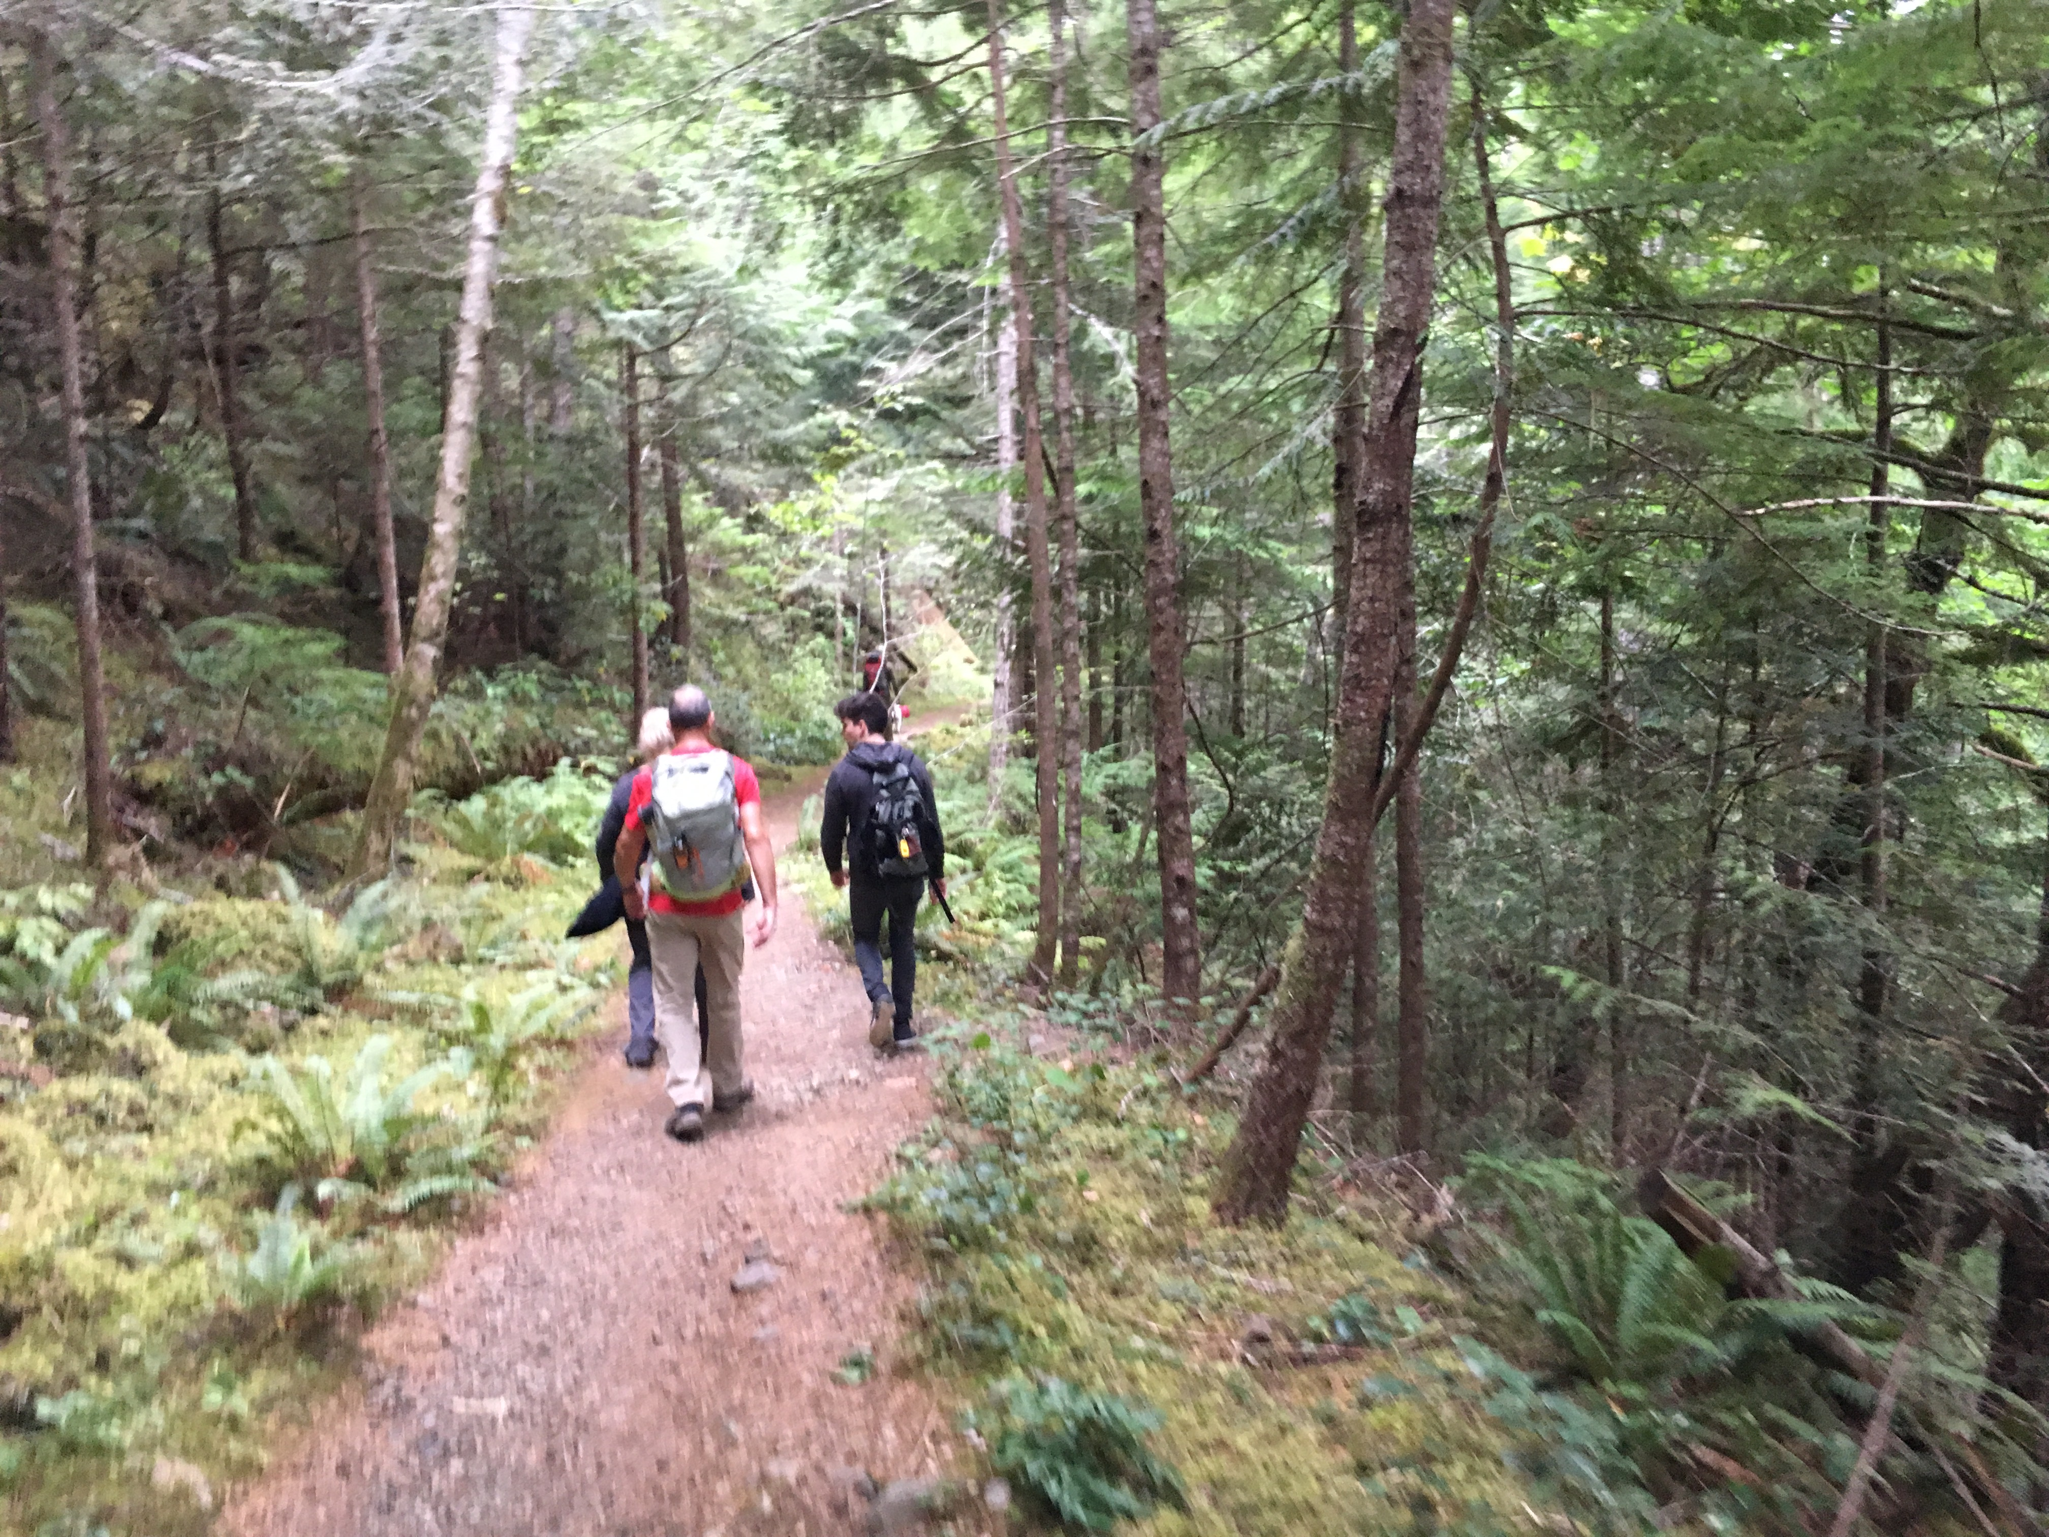
3-day travel, 4-day visit
Notes:
We got in some hiking…

Slide 72
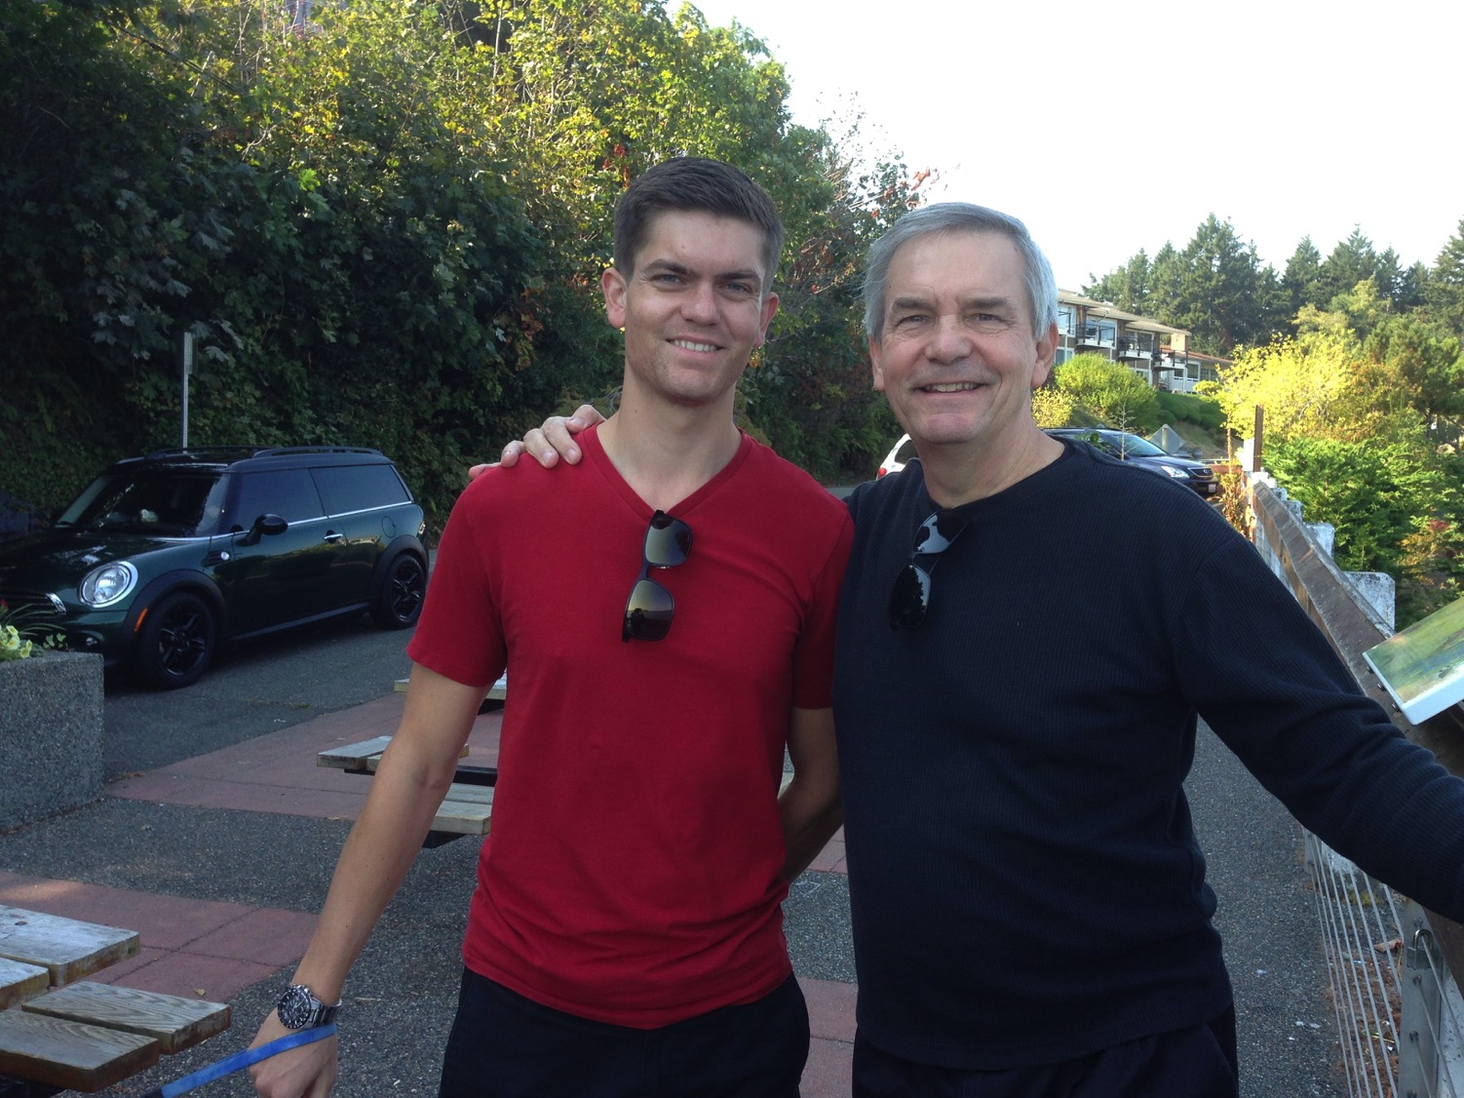
We all need to be comforted
Notes:
This was due to our United pilot son, Stephen.

Slide 73

Mari pelajari ayat demi ayat
Kitab Suci: Kitab demi kitab
Notes:
Kita sedang mempelajari seluruh Kitab Suci saat ini, kitab demi kitab. Tujuannya adalah memberikan kita pemahaman dasar dari setiap Kitab.

Slide 74
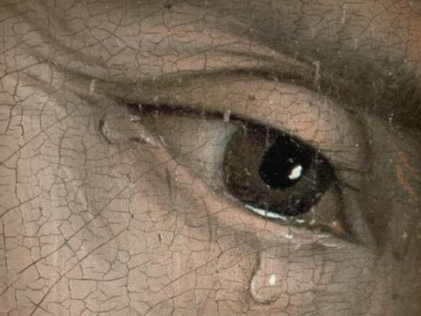
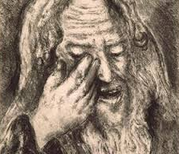
"The Weeping Prophet"
Notes:
Yeremia was the only prophet to live through the 586 BC fall of Jerusalem. God called him to show God’s compassion even in Judah’s darkest hours. Yeremia is known as "The Weeping Prophet." I suspect you would weep also if you saw your country ravaged and destroyed before your very eyes and you were powerless to stop it. It actually makes sense that God would call one like him who experienced such loss to be one who teaches us the need to be comforted.

Slide 75

We all need to be comforted
Notes:
That’s because we all need to be comforted at various times of our lives. This is true for women, of course, but not only for women.

Slide 76
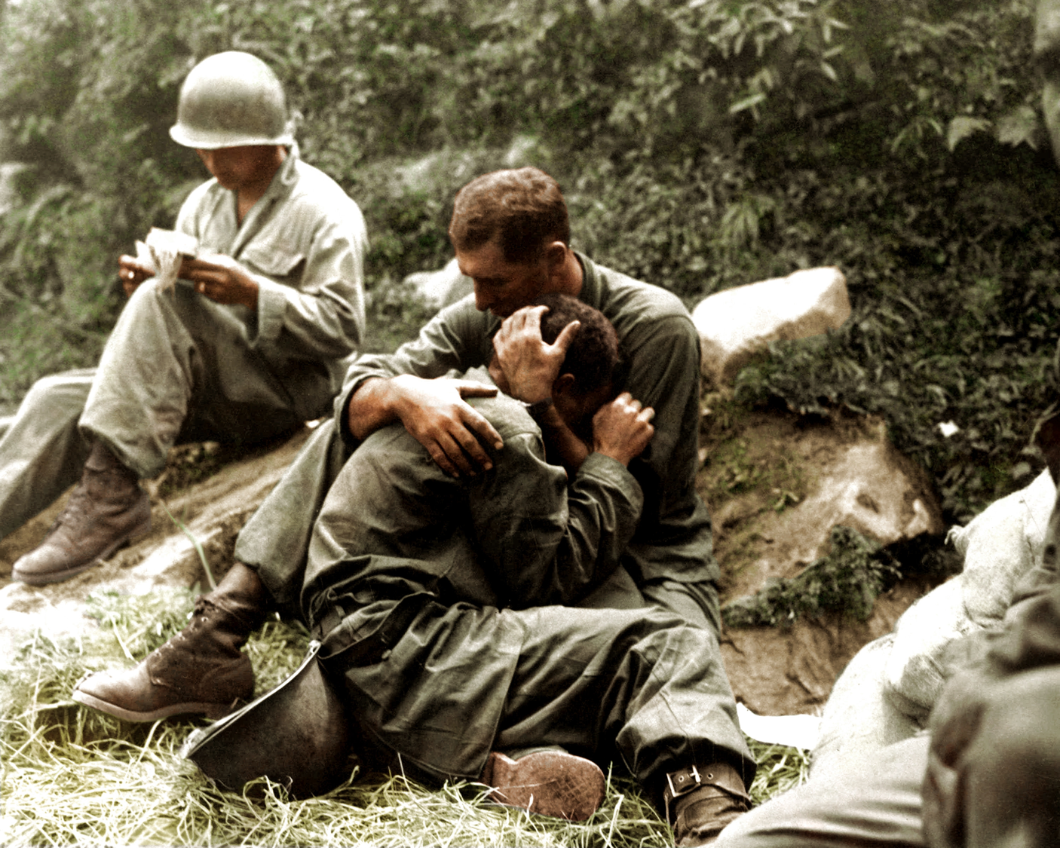
We all need to be comforted
Notes:
Men also need comfort many times.

Slide 77
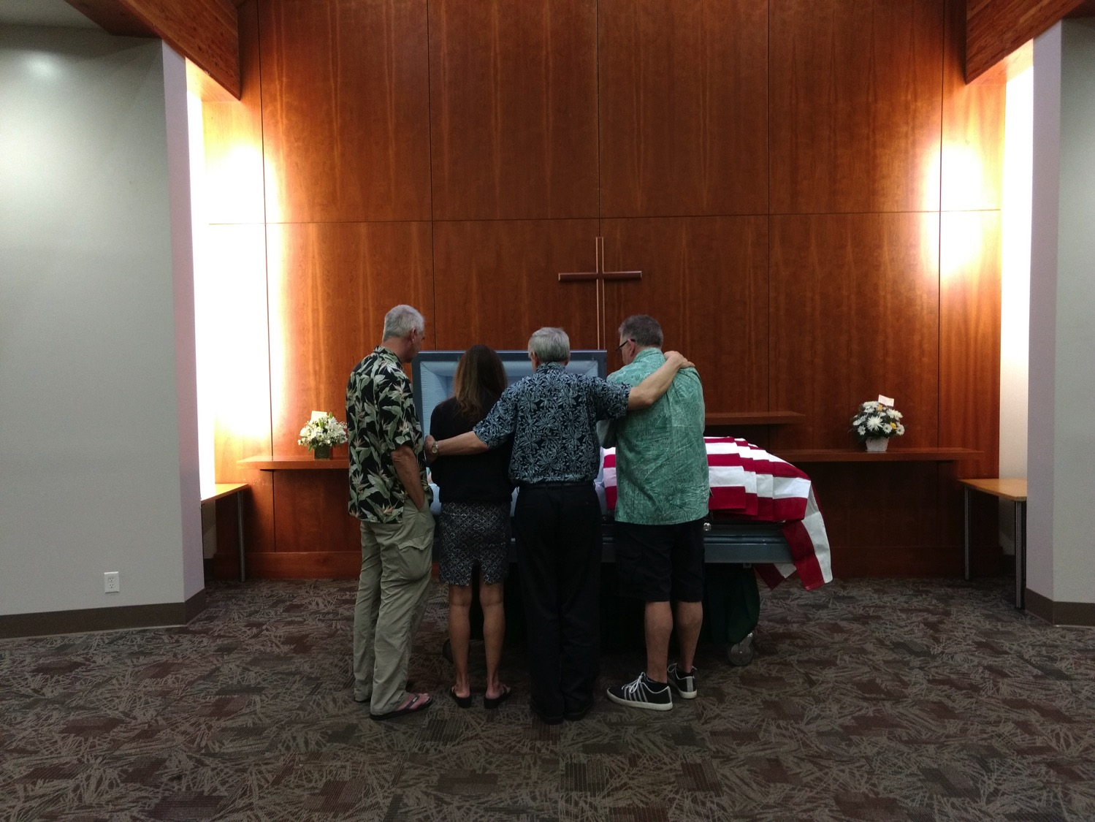
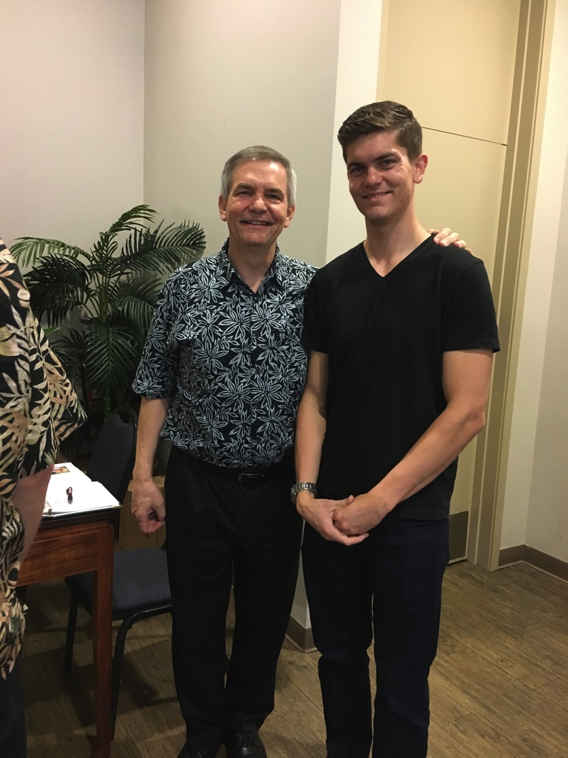
We all need to be comforted
Notes:
As one who often gives comfort, I found myself as one needing to be on the receiving end in January. It was challenging to be both the son and the officiating minister at my father’s memorial service,
• but God granted comfort from this same son, Stephen, who made the effort to fly to be there as a support.

Slide 78
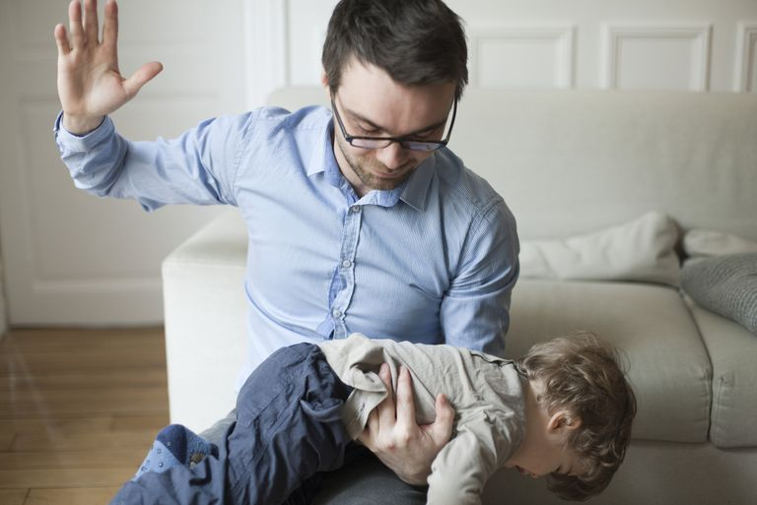
Balance discipline with comfort.
Notes:
Of course, we all know that life is not only about comfort. One of the signs of growing up is to realize that we must balance discipline with comfort.
Discipline shows us when we are off track and need to realign.

Slide 79
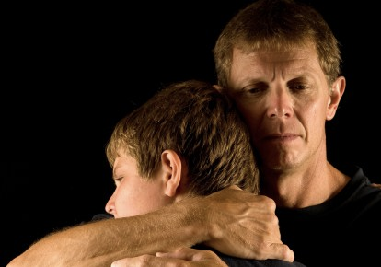
Balance discipline with comfort.
Notes:
But comfort helps us feel appreciated and loved.

Slide 80

Discipline.
Notes:
What images or memories come to your mind when you hear the word "discipline"?
When you were growing up, were you disciplined in a balanced way?
Did you receive mostly harsh discipline?
Or did your parents give you no discipline at all?
Or did you experience a good balance where standards (the principle of the thing) were matched with support? Did you receive comfort along with the discipline?

Slide 81
Bagaimana Tuhan menghibur orang yang dihukum?
Notes:
In what ways can we see God's compassion even when he has to punish sin?

Slide 82
Josiah's Sons & Prophets
232
342
Daniel
605
Ezekiel
City Fell
Jehoahaz
Josiah
Jehoiakim
Jehoiachin
Zedekiah
609
597
586
(3 mos.)
(11 yrs.)
(3 mos.)
(11 yrs.)
Yeremia
627
Brief Puppet Kings
Notes:
Yeremia was the only prophet to live through the 586 BC fall of Jerusalem. God called him to show God’s compassion even in Judah’s darkest hours. How? Josiah was the last good king, who died in 609. • After him the reigns of his descendants alternated between 3 months• to 11 years • to 3 months • to 11 years once again! • But God spoke to these godless kings through three major prophets. Yeremia was the only one to preach in Jerusalem until the city fell in 586, • while Daniel was taken to Babylon in 605 • and Ezekiel in 597.

Slide 83
Kata Kunci
474
343
Tak Terelakkan
Yeremia
Notes:
By the time we get to Yeremia, God proclaims that the exile will definitely come. It is inevitable.

Slide 84
Tema
474
Penahanan yang Layak & Pemulihan yang tidak
Pantas
Yeremia
Notes:
Yeremia’s theme is that captivity is deserved but also the restoration is undeserved and will also happen.

Slide 85
Ayat Kunci
474
"…Sebab TUHAN, Allah kita, membinasakan kita, memberi kita minum racun, sebab kita telah berdosa kepada TUHAN." (8:14b).
Yeremia
Notes:
Judgment was because of Judah’s sin, as the key verse indicates in 8:14.

Slide 86
Dihibur
Yeremia
Dr. Rick Griffith • Crossroads International Church Singapore
CICFamily.com • BibleStudyDownloads.org

Slide 87
Bagaimana Tuhan menghibur orang yang dihukum?
Notes:
In what ways can we see God's compassion even when he has to punish sin?

Slide 88
I. Tuhan memanggil utusan yang jujur dengan kami
(Yer 1).
Bagaimana Tuhan menghibur orang yang dihukum?
Notes:
The LORD assures that he has a representative who tells us both his discipline and restoration.

Slide 89
Slides on
Yeremia 1

Slide 90
Length of Prophetic Ministries
Isaiah
65 Years
Hosea
45 Years
Yeremia
40+ Years
Micah
25 Years
Notes:
Yeremia reveals himself as author and reveals that his ministry lasted over four decades from Josiah's thirteenth year (627 BC) to the exile (1:1-3; 586 BC).

Slide 91
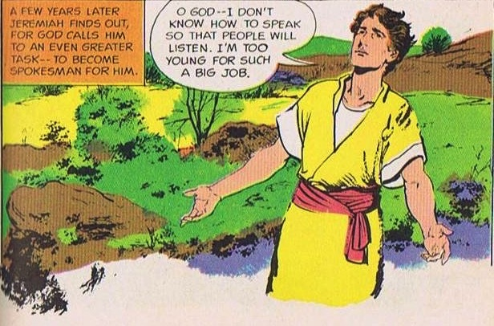
God Calls and Commissions Yeremia
King Josiah's reign and reforms did not last.
God calls a YOUNG MAN!
Jer. 1:4-9
Source: The Picture Bible (Chariot Books, David C Cook, 1978)
Notes:
When God called and commissioned him to be a prophet Yeremia was a young man, maybe a teenager, in the thirteenth year of King Josiah's reign. But he protests that he is too young for such a big job.

Slide 92

God's Assurance to Yeremia
"Before I formed you in the womb
I knew you, before you were born
I set you apart;
I appointed you as a prophet to
the nations…
Do not say, 'I am only a child.'
You must go to everyone I send you to and say whatever I command you. Do not be afraid of them for I am with you and will rescue you… Now, I have put my words in your mouth …
Jer. 1:5, 7-9
Notes:
God assured Yeremia – He knew, set apart, appointed him. And said he would put His words into His mouth. The Lord reached out His hand and touched his mouth. He is to stand up against nations and kingdoms, uproot and tear them down. He is to build up and plant others.
Yeremia’s success was not determined by the size of his “church”!
In fact, like Isaiah, Ezekiel, and, frankly, all the prophets, his success was in saying and doing what God commanded to a stubborn and rebellious people who were bent on their own way all their days until the Babylonians stormed the gates of their capital—and remained stubborn and rebellious even afterwards.

Slide 93
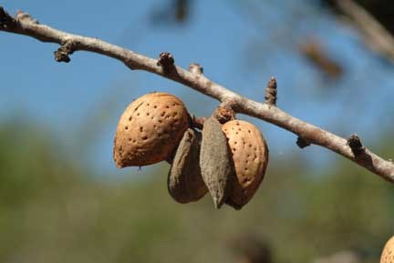
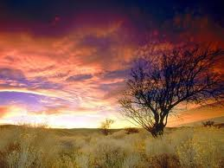
Object Lesson #1 – Almond Tree
God is watching to see that His Word is fulfilled.
("watching" sounds like "almond tree" in Hebrew)
Jer. 1:11-13
Notes:
God uses many object lessons to teach Yeremia and the people. God shows him the branch of an almond tree. The sign was a play on words. The word for almond tree sounds like God is watching over the fulfilment of His Word, thus assuring Yeremia that God will accomplish His word.

Slide 94
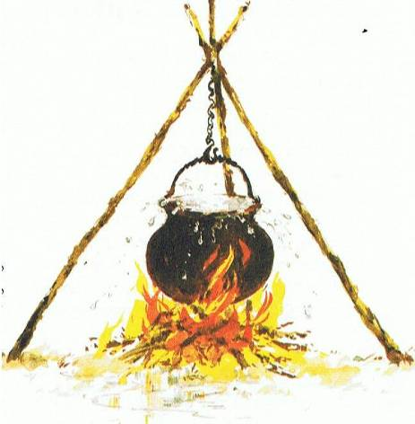
Object Lesson #2 – Boiling Pot
Over-boiling pot,
tilting from north –
Invaders from the north are going to overflow Judah and destroy
Jerusalem.
Jer. 1:13-19
Picture Source: The Children's Bible in 365 stories, Lion Publishing, 1985
Notes:
Next, God shows a boiling pot, overflowing, tiliting from the north, symbolizing the disaster God would pour onto the land using invaders from the north to destroy Jerusalem and Judah. But God assures Yeremia of His presence and encourages him to speak without fear of God's message.

Slide 95
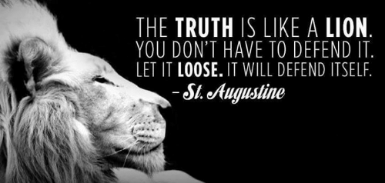
Is God trying to comfort you through his truthful messengers?
Notes:
I will be honest with you—my main goal is to be honest with you!
That honest truth includes both the things we like to hear and those things that we do not like.
• St. Augustine said, “The truth is like a lion. You don’t have to defend it. Let it loose. It will defend itself.”
My prayer is that those of us who need comfort will find it here today. God is, after, the “God of all comfort” (2 Cor). That is the “building up” aspect of pastoral ministry. I have come to build you up.
But God has also called me to “tear down.” That means that God’s primary goal in your life is not to make you comfortable. It is to make you like his son Jesus. That will take some tearing down of patterns that hinder Christlikeness in us.

Slide 96
Bagaimana Tuhan menghibur orang yang dihukum?
Notes:
In what ways can we see God's compassion even when he has to punish sin?

Slide 97
I. Tuhan memanggil utusan yang jujur dengan kami
(Yer 1).
Bagaimana Tuhan menghibur orang yang dihukum?
Notes:
The LORD assures that he has a representative who tells us both his discipline and restoration.

Slide 98
II. Tuhan memiliki disiplin yang terbatas tetapi berkatNya tak terbatas
(Yer 2–45).
Bagaimana Tuhan menghibur mereka yang Dia hukum?
Notes:
The LORD's punishment is always less than his rewards.

Slide 99
Slides on
Yeremia 2
Notes:
God comforted Judah throughout Jerusalem's fall that the 70-year exile would result in a new covenant (Jer 2–45).
God indicts the nation for its sinful treatment of God seen in its ingratitude, idolatry, immorality, and irrationality (Jer 2; see esp. 2:10-11).

Slide 100


Judah's Relationship With God
A young bride
Unfaithful …. many lovers,
one named Baal
Jer. 2–4
Notes:
So, Yeremia prophesies before the fall of Jerusalem. He proclaims God has just reasons for judging the nation – its punishment is deserved! God reminds them of the days He blessed them. But they have been idolatrous and spiritually rebellious.
• Judah is like an unfaithful wife who defiled herself with her lovers, to follow Baal and many other gods. He likens Israel and Judah to two sisters. Judah did not learn anything from Israel's judgment! Judgment will come from Babylon, so repent!

Slide 101
Slides on
Yeremia 3

Slide 102
Slides on
Yeremia 4

Slide 103
Slides on
Yeremia 5

Slide 104
Slides on
Yeremia 6
Notes:
God calls the nation to repent from spiritual adultery to motivate the people to escape the impending judgment of the Babylonians (Jer 3–6).

Slide 105
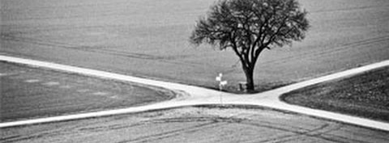
"This is what the LORD says:
'Stand at the crossroads and look; ask for the ancient paths, ask where the good way is, and walk in it, and you will find rest for your souls'"
(Yeremia 6:16a NIV).
Notes:
This verse reminds us of some of our key priorities based on this theme verse for Crossroads International Church:
1. We must look out for people in need going through various crossroads in their lives.
2. We must prioritize that which is proven and not be pursuing every new fad that comes down the road.
3. We must instead pursue the Word of God, making the Bible central to all we do—and obey it.
4. We must be a place of rest for people in the very stressed out country of Singapore.

Slide 106
Slides on
Yeremia 7
Notes:
Yeremia's temple address aims to convince the people to turn from their false reliance on the temple and idolatry to avoid impending judgment (Jer 7–10).

Slide 107
Worthless Public Worship
Trusted in empty words
And "God will not destroy the temple"
God tells Yeremia to ...
Stop praying for Judah
Their evil had become unthinkable.
They even sacrificed their own children!
Jer. 7–8
Notes:
Yeremia preaches at the temple as people came by to worship. He warns them they are trusting in the empty words to save them, thinking God will not allow the temple to be destroyed. They think God will bless Judah no matter how they lived just because of the Davidic covenant. God instructs Yeremia to stop praying for the people. Their evil had become unthinkable and were even sacrificing their children to pagan gods.

Slide 108
Slides on
Yeremia 8

Slide 109

Judgment is imminent & terrible!
He weeps …..
His lament models the kind of repentance God desires of the entire nation.
Jer. 8–10
Notes:
God is shocked at Judah. Animals observed God's laws, but not God's people. God details the coming judgment for the nation's idolatry. It will be imminent and terrible. The enemy will devastate the land. Yeremia mourns Judah's sad spiritual state and his lament models the kind of repentance God wants of the entire nation.

Slide 110
Slides on
Yeremia 9

Slide 111
Slides on
Yeremia 10

Slide 112
Slides on
Yeremia 11

Slide 113
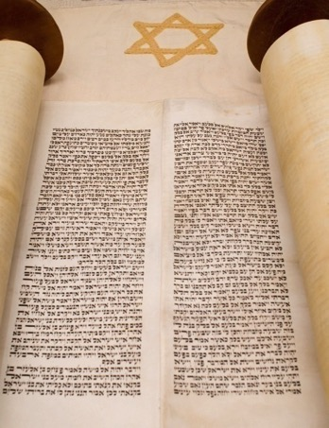


Covenant, Conspiracies & Complaints
Men from Anathoth
conspire to kill him
Yeremia preaches
Covenant broken
Yeremia complains
to God;
God encourages him
Jer. 11–12
Notes:
Yeremia preaches the covenant sermon to proclaim that Judah has violated God's covenant through its idolatry. What is their response? The men of Anathoth, Yeremia's own home town, plot against his life because they do not like what they hear. Yeremia struggles from their mocking and persecution. He complains to God about the prosperity of the wicked but God encourages him and warns him to continue. God says, Worse events are coming, but the destruction will bring Judah to repent.

Slide 114
Slides on
Yeremia 12

Slide 115
Slides on
Yeremia 13

Slide 116

Object lessons – signs of judgment
Like a ruined waistband rotting in rock crevice, Judah strayed from God, being exposed to pagan influences, and is now spiritually worthless.
Fill jugs with wine! Get drunk! – God will have no mercy and compassion when they suffer.
Jer. 13
Notes:
More object lessons ! God shows signs of judgment. He instructs Yeremia to purchase a linen waistband and hide in some rocks by the river. After some time, Yeremia went to retrieve the waistband which had rotted. God said the people were like the waistband. He had bound them to Himself, but they had strayed away after other gods. Through their exposure to such pagan influences, they are now spiritually worthless to Him. Yeremia also commands the people to 'drink it up!'. The Lord will bring spiritual drunkenness to Judah – He will not have compassion on them when they suffer sin's consequences.

Slide 117
Slides on
Yeremia 14

Slide 118

Hard times follow …
God sends a drought to warn Judah of judgment and need to repent.
God told Yeremia not to pray for them!
No marriage,
No funerals,
No parties
for Yeremia
Jer. 14–16
Notes:
God sends a drought to turn the people back to him. The ground cracked, and water became so scarce that animals deserted their young. Yeremia prays for the people, but God tells him not to. He has to deal severely with them so they would know the seriousness of their sin. Did God reject Judah forever, Yeremia wonders. Also, God restricts marriage, attendance to funerals or parties upon Yeremia because of the impending disasters.

Slide 119
Slides on
Yeremia 15

Slide 120

Yeremia to King Jehoiakim
Yeremia 15:1
"Even if Moses and Samuel were to stand before Me, My heart would not go out to this people. Send them away from My presence! Let them go!"
Notes:
"Even if Moses and Samuel were to stand before Me, My heart would not go out to this people. Send them away from My presence! Let them go!"

Slide 121
Yeremia to King Jehoiakim
Yeremia 15:4
"I will make them abhorrent to all the kingdoms of the earth because of what Manasseh son of Hezekiah king of Judah did in Jerusalem."
Notes:
"I will make them abhorrent to all the kingdoms of the earth because of what Manasseh son of Hezekiah king of Judah did in Jerusalem."

Slide 122
Slides on
Yeremia 16

Slide 123
Yeremia to King Jehoiakim
Yeremia 16:11-13
"...Your fathers forsook me… and did not keep my law. But you have behaved more wickedly than your fathers… instead of obeying Me. So I will throw you out of this land into a land neither you nor your fathers have known, and there you will serve other gods day and night, for I will show you no favour."
Notes:
"...Your fathers forsook me… and did not keep my law. But you have behaved more wickedly than your fathers… instead of obeying Me. So I will throw you out of this land into a land neither you nor your fathers have known, and there you will serve other gods day and night, for I will show you no favour."

Slide 124
Slides on
Yeremia 17

Slide 125
Slides on
Yeremia 18

Slide 126
I am the Potter, you are the Clay
O house of Israel, can I not do with you as this potter does? (v. 6)
If that nation I warned repents of its evil, then I will relent and not inflict on it the disaster I had planned (v. 8)
Jer. 18
Notes:
God sends Yeremia to the potter's house and gives a message there. The Lord shapes the nations according to His sovereign purpose. God is sovereign like a potter with the clay. People should not be presumptuous. God promises blessing to a nation, but will cancel the blessing if the nation turns against Him. But if the nation repents of its evil, He will relent of the disaster.

Slide 127
Slides on
Yeremia 19

Slide 128

Object lesson #? What the..??
You have forsaken me for other gods and shed innocent blood. I will smash you like the pot by your enemy.
Picture Source: The Children's Bible in 365 stories, Lion Publishing, 1985
Jer. 19
Notes:
Yeremia takes an earthenware jar from the potter's house to the Hinnom Valley in Jerusalem. He warns Judah of the terrible disaster that will come for they people abandoned the Lord to worship idols. They shed innocent blood and sacrificed their children. He describes the inevitable judgment to come – people will run out of food and turn to cannibalism. Corpses would lie everywhere and become food for wild animals. Yeremia smashes the jar, symbolizing Jerusalem's seemingly irreversible destruction.

Slide 129
Slides on
Yeremia 20

Slide 130

False Prophets & Priests Oppose Yeremia
Yeremia is beaten and placed in stocks by Pashhur, chief officer of the temple.
Jer. 20:1-3
After release, Baruch, a young scribe, offers to help him.
Picture Source: The Picture Bible, Chariot Books, David C Cook, 1978
Notes:
Pashhur reacts angrily to Yeremias' words against Jerusalem and Judah. He has Yeremia beaten and locked in the public stocks. But Yeremia is released, and pronounces judgment against Pashhur and his family. Yeremia laments to God for his suffering. Eventually, Baruch, a young scribe offers to help him.

Slide 131
Slides on
Yeremia 21

Slide 132

Yeremia prophesies against Judah's leaders and false prophets, but they refuse to listen
WARNING ! WARNING!
Jer. 21–23
Source: The Picture Bible, Chariot Books, David C Cook, 1978
Notes:
Yeremia continues to preach God's messages. He prophesies judgments against Judah's kings and leaders and false prophets, but promises that the Messiah will come to lead the nation justly. (Zedekiah will be judged and God will reject his request to save them from Babylon; Jehoahaz will die in exile, Jehoiakim will die a terrible death without burial, Jehoiachin will be judged by not having any immediate descendants on the throne). The false prophets and priests have disgraced God's temple and spoken lies.

Slide 133
Slides on
Yeremia 22

Slide 134
Slides on
Yeremia 23

Slide 135
Slides on
Yeremia 24

Slide 136

No Repentance in Jerusalem after Nebuchadnezzar
Depiction of People Through Figs at the Temple
Good figs
– Exiles in Babylon who had begun to repent.
– God will take care of them and bring them back.
Bad, rotten figs
– King Zedekiah and his court and all people in Jerusalem
– Still plotting and scheming against Babylon
– Not fit to keep
Jer. 24
Picture Source: The Children's Bible in 365 stories, Lion Publishing, 1985
Notes:
God uses another object lesson of two baskets of figs in front of the temple. The good figs are those in Babylon whom God will protect, bless and one day restore. The bad figs symbolizes Zedekiah and those who remained in Jerusalem who still refused to submit to Babylon rule. This faithless group will die by sword, famine and disease.

Slide 137
Slides on
Yeremia 25

Slide 138


Nebuchadnezzar comes (597 BC)
70-year captivity
predicted
Takes exiles and King Jehoiachin away. Places Zedekiah on throne, gives another chance for Judah to submit to Babylon.
Picture Source: The Children's Bible in 365 stories, Lion Publishing, 1985
Jer. 24–25
Notes:
Now 8 years after Yeremia's prophecy about Nebuchadnezzar, Nebuchadnezzar came and took King Jehoiachin away with many other exiles. He placed his uncle, Zedekiah (Josiah's other son) in charge and gave Judah one more chance to submit to Babylon's rule.
• Here God revealed to Yeremia the 70 years captivity.

Slide 139
Two 70-Year Exiles
560
Two 70-Year Exiles
People Exile
605
586
539
536
516
Temple Exile
"'This entire land will become a desolate wasteland. Israel and her neighboring lands will serve the king of Babylon for seventy years. ¹²Then, after the seventy years of captivity are over, I will punish the king of Babylon and his people for their sins,' says the LORD. 'I will make the country of the Babylonians a wasteland forever'" (Jer 25:11-12 NLT).
Notes:
The first exile of people • in 605 was followed by the full destruction of the temple • in 586. These two key dates begin two separate 70-year exiles! • Cyrus decreed that the people could return in 539, • which was completed in 536, which was 70 years after Daniel was taken and can properly be called • the People Exile. But the temple was not rebuilt • until 516, giving us another 70-year exile called • the Temple Exile. God told Yeremia that the exile would last 70 years (Jer 25:11-12). This was doubly true, whether we consider him talking about the people or the temple! Both lasted 70 years!

Slide 140
Nebuchadnezzar's Six Deportations to Babylon
492
Size | Date | King of Judah | Number taken | Key Captives | Results/ Comments
1 Minor | 605 BC | Jehoiakim | Few (Dan 1:3) | Daniel, 3 friends & nobility & royalty | Tribute imposed. Egypt powerful.
2 Moderate | 598 BC | Jehoiakim | 3023 (Jer. 52:28) |  | Minor deportation
3 Major | 597 BC | Jehoiachin | 10,000 (2 Kings 24:14) | Jehoiachin, Ezekiel, Mordecai | Neb. deports many; installs Zedekiah
4 Minor | 587 BC | Zedekiah | 832 (Jer. 52:29) |  | Before destruction
5 Major | 586 BC | Zedekiah | ca. 10,400 (2 Kings 25:11) | Zedekiah | Jerusalem & temple destroyed
6 Minor | 582 BC |  | 745 (Jer. 52:30) |  | 4 years after Jerusalem's destruction
Notes:
Nebuchadnezzar actually had SIX deportations to Babylon. The 597 BC deportation was the third of the six and the first of 2 major deportations, with 10,000 people deported.

Slide 141
Chart of the Exile
232 & 342
The Babylonian Exile
John C. Whitcomb, 4th rev. ed., Winona Lake, IN: BMH Books, 1962, 1968

Slide 142

Yeremia (25:11-12) vs. Hananya (28:2-3)
Benar
Salah
“Kau akan kembali dalam waktu 2
tahun!”
“Kau akan
disana selama
70 tahun!”
Hidup sampai 23 ta- hun berikutnya (51:64)
Mati 2 bulan berikutnya (28:17)

Slide 143
Slides on
Yeremia 26

Slide 144
Slides on
Yeremia 27
Notes:
Jerusalem’s leaders reject Yeremia and lead to captivity as unavoidable (Jer 26–29).

Slide 145

Yeremia to King Zedekiah
Yeremia 27:12, 13
"I gave the same message to Zedekiah king of Judah. I said, "Bow your neck under the yoke of the king of Babylon; serve him and his people, and you will live. Why will you and your people die by the sword, famine, and plague with which the Lord has threatened any nation that will not serve the King of Babylon?"
Notes:
"I gave the same message to Zedekiah king of Judah. I said, "Bow your neck under the yoke of the king of Babylon; serve him and his people, and you will live. Why will you and your people die by the sword, famine, and plague with which the Lord has threatened any nation that will not serve the King of Babylon?"

Slide 146


Jerusalem's leaders resist Babylon's rule
Yeremia wears a yoke to symbolize Judah's
future submission to Babylon.
Jer. 27–28
Notes:
At the beginning of Zedekiah's reign, there is talk of revolt against Babylon. As animals wore a yoke to inndicate their submissions, • so God instructs Yeremia to wear a yoke to symbolize Judah's future submission to Babylon. God will place all nations under Nebuchadnezzar's yoke; any nation that resisted would perish. He urges the king not to listen to the false prophets.

Slide 147
Slides on
Yeremia 28
Notes:
The false prophets continued to predict peace for the rebellious people in chapter 28.

Slide 148
Yeremia (25:11-12) vs. Hananya (28:2-3)
Benar
Salah
“Kau akan kembali dalam waktu 2
tahun!”
“Kau akan
disana selama
70 tahun!”
Hidup sampai 23 ta- hun berikutnya (51:64)
Mati 2 bulan berikutnya (28:17)

Slide 149
Slides on
Yeremia 29

Slide 150

Bagaimanakah para nabi dapat berbeda?
186a-b
Alkitabiah
Penyembah berhala
Tidak diminta
manusia
Ramalan
Panggilan ilahi
Berdasarkan keingin-
an nabi tersebut
Dimana saja
Tempat tertentu /
khusus
Memberikan
tantangan
Meramal masa depan

Slide 151

Nubuatan yang salah berubah
Saya sangat yakin bahwa dunia akan berakhir hari ini!!!

Slide 152

Opposition by False Prophets
The false prophet Hananiah breaks Yeremia's yoke to symbolize God breaking Babylon's power and claims that the captivity will be only two years. Two months later, he dies.
The false prophet Shemaiah also preaches against Yeremia.
Jer. 28–29
Notes:
Yeremia faces serious opposition from false prophets. Hananiah seizes Yeremia's yoke and breaks it, claiming God would break Babylon's power and the captivity is not 70 years, but only 2 years. Well, he pays for his lies with his own life. He dies 2 months later. After him, Shemaiah the false prophet also opposes Yeremia.

Slide 153
Bagaimanakah para nabi dapat berbeda?
186b
Alkitabiah
Penyembah berhala
Karakter ilahi
Tidak bermoral
Umumnya pria
Umumnya wanita
Diilhami oleh
Allah
Dari pikiran sendiri
Memiliki gaya
sendiri
Dipengaruhi roh jahat

Slide 154

Bagaimanakah para nabi dapat berbeda?
186c-d
Alkitabiah
Penyembah Berhala
Motif ilahi
Keuntungan
finansial
Pesan yang asli
Menjiplak
100% akurat
Nubuatan tidak
terpenuhi
Dianiaya
Dipuja manusia

Slide 155

Hal kontras antara nubuatan Alkitabiah & Penyembah Berhala
186b-d
Pertanyaan yang perlu dipikirkan:
Perbedaan apakah yang paling penting bagi Anda antara kedua tipe ini?
Mengapa?

Slide 156
Slides on
Yeremia 30
Notes:
Israel’s future restoration with a new covenant (The Book of Comfort) should encourage the remnant that God has not forgotten his promises (Jer 30–33).

Slide 157

Book of Comfort & New Covenant
Jer. 30–33
Yeremia redeems a field (Jer. 32) – a sign of hope!
God has not cast aside His people!
A glorious future would follow their judgment.
They will return to the land.
Notes:
Scholars refer to Yeremia 30–33 as the Book of Comfort or Book of Consolation. Yeremia's prophecies contained strong words against God's sinful people. But God has not cast aside His people nor forgotten His covenant. He promises a glorious future would follow their judgment and they will return to the land. The Lord instructs Yeremia to buy a field in Jerusalem from his cousin, Hanamel, as a sign of hope. The land will once again have value and God's people will return to claim it again.

Slide 158
Slides on
Yeremia 31
Notes:
Israel and Judah will be reunited in the land with a new heart under a new covenant [after Messiah’s second coming] (Jer 30–31).

Slide 159
"How to Get Rid of the Jews"
³⁵ This is what the LORD says,
he who appoints the sun
to shine by day,
who decrees the moon and stars
to shine by night,
who stirs up the sea
so that its waves roar—
the LORD Almighty is his name:
³⁶ "Only if these decrees vanish
from my sight," declares the LORD,
"will the descendants of Israel ever cease
to be a nation before me."
³⁷ This is what the LORD says:
"Only if the heavens above can be measured
and the foundations of the earth below be searched out
will I reject all the descendants of Israel
because of all they have done,"
declares the LORD (Jer. 31:35-37 NIV).
Notes:
A pastor once announced to his congregation, • "Next week I will speak on the topic of 'How to Get Rid of the Jews.'" The news spread throughout the small town to the extent that on the next Sunday, after the doors had closed and just before a packed service began, the doors opened again and into the church walked the city's chief rabbi, followed by two of his lawyers! They walked down the center aisle all the way to the front, then took seats in the very front row.
The service continued with songs, prayers, offering and finally the pastor stood at the pulpit. "I am thrilled to see so many at church today, including our distinguished rabbi and his friends. My topic today is 'How to Get Rid of the Jews.' The text is from Yeremia, chapter 31. Please turn in your Bibles to Yeremia 31, verse 35.'" [Animate slide and read vv. 35-37]
At this point, the rabbi smiled, the pastor winked, the congregation sighed in relief, and the lawyers realized that their job was over.
God was clear to Yeremia that his covenant with the Jews is an eternal covenant, not dependent on them. He promised a New Covenant that assures that at some future point the nation will again trust in him by believing in Messiah, after which God will forgive their sins.

Slide 160



New Covenant & Branch of David
Branch of David – New King
and Priest - Jer. 33
New Covenant – law written on our hearts and Spirit to guide - Jer. 31
Notes:
These wonderful chapters contain the New Covenant where God will forgive Judah's sins, God's laws will be written on their hearts and His Spirit will guide them. Yeremia also prophesies restoration of Judah under the new King from the Branch of David's line and promises to bless the priesthood.

Slide 161

The New Covenant
(Yeremia 31:31-34)
IN BRIEF
Notes:
These verses are the key verses on the New Covenant in the whole Bible.

Slide 162
Four Unconditional Biblical Covenants
476
ABRAHAMIC
Genesis 12:1-3
BLESSING
LAND
SEED
LAND
Deut. 30:1-10
DAVIDIC
2 Sam. 7:12-16
NEW
Jer. 31:31-34
The new covenant is God's unconditional amplification of the blessing promise in the Abrahamic Covenant where Judah and Israel will experience national and spiritual redemption.
Notes:
Three covenants amplify the Abrahamic covenant. The new covenant was one of them.
(cf. Deut. 30:1-10) promises:
Land from Wadi of Egypt to Euphrates River (Isa. 27:12)
Eternal possession of land (Gen. 17:8) after exile/restoration
Whole world blessed via the land (Isa. 14:1-2)
2 Samuel 7:12-16 promises perpetual:
Sons ("house" never wiped out)
Kingdom (political dynasty)
Throne (right to rule by descendants)
Temple (son to build it)
Yeremia 31:31-34 promises:
Forgiveness
Indwelling Spirit
New heart, nature, mind
Reunification of Israel and Judah
No need for evangelism

Slide 163

The New Covenant
Yeremia 31:31-34
³¹"The time is coming," declares the LORD, "when I will make a new covenant with the house of Israel and with the house of Judah.
³²It will not be like the covenant I made with their forefathers when I took them by the hand to lead them out of Egypt, because they broke my covenant, though I was a husband to them," declares the LORD.
³³"This is the covenant I will make with the house of Israel after that time," declares the LORD.

Slide 164
The New Covenant
Yeremia 31:31-34
^{33b} "I will put my law within them, and I will write it on their hearts. And I will be their God, and they shall be my people. And no longer shall each one teach his neighbor and each his brother, saying, 'Know the LORD,' for they shall all know me, from the least of them to the greatest, declares the LORD. For I will forgive their iniquity, and I will remember their sin no more."

Slide 165

Unconditional Nature
477
Eternal (Jer. 31:36, 40; 32:40; 50:5; Isa 61:2. 8-9; 24:5; Ezek. 37:26)
Amplification of the Abrahamic Covenant, which is unconditional
Unqualified "I will" statements of God
"God's love is unconditional. But you must act now. Offer may be withdrawn at any time. Void where prohibited by law."
Notes:
How do we know that it was unconditional?

Slide 166


… This cup is the
NEW COVENANT in my blood, which is POURED OUT for you.
The cup (not baptism) is the new covenant sign
LUKE 22:20

Slide 167
How could Jesus apply the new covenant promises to his disciples when the other provisions were not fulfilled then?
(What about Israel and Judah reunified? What about all people knowing God?)

Slide 168
How to Reconcile?
Yeremia 31:31-34 (for Israel)
'everlasting covenant'
'a new heart'
'a new spirit'
'a covenant of peace'
'a covenant'
Luke 22:20 (for church)

Slide 169

Provisions
477
FULFILLED
Indwelling of the Holy Spirit
(Jer. 31:33 with Ezek. 36:27)
New nature, heart & mind
(Jer. 31:33; Isa. 59:21)
Forgiveness of sins
(Jer. 31:34b)
NOT YET FULFILLED
Everyone will know the Lord
(Jer. 31:34a)
Israel and Judah will be reunited (Jer. 31:31)
Notes:
There are debates about the how far or when or to whom the covenant refers. This is because Yeremia 31 declares the covenant is for Israel and Judah but in the New Testament it is declared for the church (Luke 22:20; 1 Cor 11:25; 2 Cor.3:6; Heb 8:8;9:15).
So questions arise. Is there a new covenant? Is it especially for the church? Or is it only for Israel? Or was there two covenants? Or are these promises built upon each other?

Slide 170

Views on the Time of Fulfillment
477
Amillennialists often say all of the provisions of the New Covenant are being realized now in the church which they consider the "new Israel." But are they?
1. Partial Fulfillment in the present church age
Only one New Covenant for Israel (Darby)
Two New Covenants: one for Israel and one for the church (Chafer)
One New Covenant with a two fold- application: primarily to Israel, secondarily to the Church
2. Complete fulfillment after the return of Christ
Notes:
Ignores NT, Christ's words, Paul's teachings
Ignore present work of the Holy Spirit cue cards
1)Cannot reconcile same terminology for OT and NT covenants.
2) The distinctions are too sharp.
View most modern pre-mils take. Deals with both OT/NT data, forgiveness and the holy spirit are blessings that we experience now.
Ignoring OT data between the distinctions between church and Israel

Slide 171
Views on the New Covenant
490
View | Explanation | Group | Problems
Restated Mosaic | There is no new Covenant | Critical | OC/NC distinction in text ignored OC=conditional, NC= unconditional OC=temporal, NC=eternal OC=external, NC=internal OC=no enablement, NC=enablement NC=peace, prosperity, sanctuary and Spirit
Church Alone | No Israel Participation | Amil / Postmil | Ignores OT data - Israel =Church NC introduced not equal to fulfilled to Israel Present need to know YHWH AD 70 Jerusalem vs. Jer. 31:40

Slide 172
Views on the New Covenant (2)
490
View | Explanation | Group | Problems
Israel Alone | No Church Participation | Misc/ Classical Dispensational | Ignores NT Data Christ's Last Supper words Paul's statements in Romans Hebrews application to Church Ignores present work of Spirit
Two New Covenants | NC for Israel NC for Church | Early 1900s Dispensational | Same terminology for OT & NT NCs Israel/Church distinction too sharp Basis of forgiveness is the same If 2NCs then there's no OC for Church Church doesn't possess Israel's promises
Church Participation | Primarily for Israel Secondarily for the Church | Misc / Present Dispensational | Support Primary fulfillment future – Rom 11 Deals with both OT and NT data Forgiveness/ Spirit =Blessings now NC has new law Rebuttals to above views
Notes:
172

Slide 173


"Old" Replaced by "New"
Wayne Grudem, Systematic Theology, 521
"What then is the 'old covenant' in contrast with the 'new covenant' in Christ? It is not the whole of the Old Testament, because the covenants with Abraham and David are never called 'old' in the New Testament. Rather, only the covenant under Moses, the covenant made at Mount Sinai (Ex. 19-24) is called the 'old covenant' (2 Cor. 3:14; cf. Heb. 8:6, 13), to be replaced by the "new covenant" in Christ (Luke 22:20; 1 Cor. 11:25; 2 Cor. 3:6; Heb. 8:8, 13; 9:15; 12:24)."
Notes:
Christians are not under the covenant with Moses. We are new covenant believers.
__________
OS-24-Yeremia-173
NS-08-2 Corinthians-41
NS-19-Hebrews-298
FU-05-Bliblical Covenants-34

Slide 174
Waktu Kerajaan & Perjanjian
22 &
337
9g
Kerajaan Mengajarkan...
22
Adam memerintah dgn Tuhan (Kej. 1:26, 28; 2:19)
Setan memerintah sbg tuhan dari dunia ini (Kej. 3:15;
2 Cor. 4:4)
Perjanjian Tuhan dgn Abraham utk pengadaan kekuasaan manusia kembali melalui Israel sbg “kerajaan imam” (Kej. 12:1-3; Exod. 19:6)
Israel gagal mjd kesaksian bagi bangsa lain dan dihakimi dgn pengasingan oleh kekuasaan asing
Israel menolak tawarn Mesias (Mat. 12:41-42; 23:37-39)
Yesus menyatakan kerajaanNya dlm btk misteri
(Mat. 13)
Kristus menaklukkan musuh Israel (Rom. 11:26-27)
Kristus memerintah segalanya brsama org suci (Eph. 1:9-10; Rev. 20:1-6; 22:5b)
Kejatuhan (GKej 3)
Perjanjian dengan Nuh
Kejadian 6:18; 9:8-17
Tanah Perjanjian
ISRAEL
GEREJA
MESIAS KERAJAAN
(Fokus Nasional)
“Manusia Baru" (Ef. 2:15)
Seribu Thn Kekal
Perjanjian di Kej 15:18 (cf. Ul. 30:1-10):
Tanah dari Mesir sampai sungai Eufrat (Yes. 27:12)
Kepemilikan tanah selamanya (Kej. 17:8) stlh pengasingan
Seluruh dunia diberkati melalui tanah itu (Yes. 14:1-2)
Israel dihakimi karena menolak Mesiias dan disebar selama 19 abad
(AD 70–AD 1948) tetapi skrg sudah mulai dipulihkan (Hez 37:1-7)
Pemulihan penuh (Ezek. 37:8-28) Jerusalem world capital
(Isa. 2:1-5)
Yerusalem baru
(Rev. 21–22)
tanah
Perjanjian dengan Abraham
Perjanjian dengan Daud
Kristus adalah kepala dalam gerejaNya, yang merupakan bait suci sementara (Eph. 2:19-22; 2 Cor. 6:16)
Kristus memerintah dunia
(Isa. 11)
Dgn org suci (Rev. 5:10; 20:4-6)
Kristus menyerahkan kerajaan kpd Bapa
(1
Cor 15:24)
Kejadian 12:1-3
2 Samuel 7:12-16 perjanjian termasuk:
Anak-anak (“rumah” tdk akan musnah)
Kerajaan (dinasti politik)
Tahta (hak keturunan utk memerintah)
Bait Suci (dibangun oleh putranya)
benih
Perjanjian baru
Semua menjadi baru!
(Rev. 21:5)
Kelima elemen digenapi di pemulihan sepenuhnya
(Zech. 8)
Perjanjian di Yer 31:31-34:
Pengampunan
Roh yang tinggal
Hati dan pikiran yang baru
Pertemuan Israel dan Judah
Tidak perlu penginjilan
Perjanjian dgn Musa menggantikan tiga elemen pertama dari perjanjian baru( Luk 22:20; 2 Cor. 3:6)
berkat
Perjanjian dengan Musa
Hukum dimusnahkan dan digenaokan di kayu salib (Rom. 7:1-6;1 Cor. 9:19-21; Heb. 8:13)
Sixth Edition
15 June 2012
Sementara (Gal. 3:19) dan bersyarat(Deut. 28) untuk mengungkapkan dosa (Rom. 7:7) dan menobatkan Israel (Gal. 3:23-25)
Alkitab memiliki penekanan terhadap dua perjanjian kerajaan. Peran Israel dari Abraham sampai Kristus termasuk gereja(berkesinambungan), akan tetapi Gereja tidak pernah menggantikan bangsa itu sebagai “Isarel Baru” (tidak berkesinambungan). Israel akan menimati janji Tuhan kembali setelah mempercayai Kristus pada kedatanganNya yang kedua kali.
Notes:
Slides 13 and 127 repeated

Slide 175

Do you focus on God’s unlimited comfort or his limited discipline?
Notes:
You might ask, “Well which should I focus on? God has both, right?”
Yes, he does. Whatever your concern today, he offers you his unlimited comfort in this Book of Comfort. He cannot care for you more than he does right now!
But he also offers you his limited discipline. He will hold you accountable for how you live—not for salvation, since that is by faith in our Lord Jesus Christ—but accountable for your actions that lead to reward in the coming kingdom. Like the farmer who prunes his plant for greater yield later, he may be trimming you down in discipline for your glorious future.

Slide 176
Slides on
Yeremia 32

Slide 177

Why You Should Do Crazy Things
Dr. Rick Griffith
Singapore Bible College
Jer. 32

Slide 178



Black
Authorities
Money
Friends

Slide 179

Our Subject…
What should you do
when God asks you to do something
crazy?
Yeremia 32

Slide 180
The Babylonian Threat
Babylonian Expansion
Mediterranean
Sea
Syria
Babylon
Israel
Judah
586 BC
Persian
Gulf
Egypt

Slide 181

King Zedekiah's Accusations (32:3-5)
Verse 3:
"Jerusalem Fall?
That's negative!"
Jews as figs:
Verses 4-5a:
"Me captured?
That's treason!"
good
bad
Verse 5b:
"Stop fighting?
That's cowardice"!
Babylonians
Yeremia 24 Figs
Notes:
Yeremia 24 portrayed all the Jews as two types of figs:
The "bad figs" who refused to submit to God's discipline by the Babylonians would disobey Goxd by staying in the city and dying
The "good figs" whose lives would be spared would leave the city and surrender to the Babylonians outside!

Slide 182

Leviticus 25:25
"If one of your countrymen becomes poor and sells some of his property, his nearest relative is to come and redeem what his countryman has sold"
Notes:
What is the significance of buying a field?
Leviticus 25:25 says that if a person becomes so poor that he has to sell his land, his nearest relative must buy it.
Anathoth was Yeremia's hometown four kilometers north of Jerusalem. Since he was the closest relative, God's will was for him to buy the land.

Slide 183

587 BC
Aram
Israel
Anathoth
Jerusalem
Judah
Notes:
But what's really significant is he needed to buy the field at this time! Why?
Anathoth was in Babylonian hands! Waste money to buy enemy land?!
I bet King Zedekiah was sitting there thinking Yeremia was a lunatic to even consider this bad debt loss!

Slide 184

Singapore, January 1942
Your hometown in Kranji
Japanese Occupied in Green
Free Zone in Orange

Slide 185

I. Yeremia bought a seemingly useless field when God told him to (1-12)

Slide 186

II. When God asks you to do something "crazy…"
do it!

Slide 187

SBC Estimated Cost
Singapore Bible College
Academic Block
Estimated S$8.5 million
Notes:
Years ago at SBC we embarked on an aggressive building project called Project Nehemiah during the huge 1998 economic downturn. People said, "You're crazy! How in the world can you raise the needed S$8.5 million?"
We replied, "We're training 403 students now, but God wants us to train more students and train them better. We're confident that to do this we need a new academic block. Like the biblical Nehemiah, we too must expand."
So even though some said it was a dumb time to build, we built in His name.

Slide 188

Learn Spanish for Chinese?
圣经...
基要
La Biblia Simpatica?
Notes:
Learn Spanish in school and then minister to Chinese.

Slide 189

James Kanaganayagam
Notes:
[Work in a menial job that's below your abilities.]
One of our Sri Lankan students a few years back was James Kanaganayagam. He married a woman named Shevanthi Senanayaki Kanaganayagam who was a year behind him in school, so he needed to find work for a year until she graduated.
The only job available was to duplicate cassettes for a Christian tape ministry. He was paid pitiful wages, was treated unethically, and had to learn all kinds of things about audio-visual ministry that he didn't want to learn. After all, he was trained and qualified to be a pastor, not a cassette duplicator!
Though humanly James considered this plan "crazy," He also knew it was God's will since he knew God called him to live with his wife (1 Pet. 3:7), so he did it.

Slide 190

ICS
• Christian school began in 1993
• 13 students
• S$23,000/mo. lease signed with S$1000

Slide 191

III. Doing crazy things shows you're fitting into His plans (13-44)

Slide 192
Return from Babylon
Mediterranean
Sea
Babylon
Syria
Israel
Judah
538 BC
Egypt
Persian
Gulf

Slide 193
SBC Actual Cost
Singapore Bible College
Academic Block
Estimated S$8.5 million
Actual S$5.8 million
Notes:
At SBC, due to the economic slowdown, our new S$8.5 building ended up costing only S$5.8 million! We saved nearly S$3 million and now have 500 students!

Slide 194
Spanish was Very Useful
Greek
Hebrew
French
German
La Biblia Simpatica?
Notes:
What about my learning Spanish? This helped me learn French, German, Greek, and Hebrew to make it through my seven-year tribulation at Dallas Seminary.

Slide 195



Back to the Bible
Notes:
And what happened to James Kanaganayagam after returning to Sri Lanka? There was an opening for director of Back to the Bible Radio Ministry in Colombo. They were looking for a native Sri Lankan with both biblical training and broad experience in multimedia ministry! James told me that had he not worked for 3M (Miserable Media Ministry—not the real name!), he would never know how to direct his staff of 36 production engineers, announcers, script writers, and the like. He is now the International Director of BBTB for the entire world!

Slide 196

Susan at ICS
• Librarian
• Music teacher
• Art teacher
Notes:
But at times we don't know why God has us do "crazy" things.
I don't know why God called me to help start International Community School, but now ICS has 460 students and it provided Susan ministry opportunities for years—plus trained our sons.

Slide 197


Schooling for 400 + Our Sons

Slide 198

When God asks you to do something "crazy," do it!
It shows you're fitting into His plans.
Main Idea of Yeremia 32
Notes:
So the point of this passage is still clear: When God asks you to do something "crazy," do it! It shows you're fitting into His plans (Main Idea). Don't misunderstand me. Not every crazy idea is God's will, but only those in line with His Word.

Slide 199

What "field" does God want you to buy?
Notes:
What "field" is God telling you to buy? What "crazy" demand is He making of you? Let's bow together and consider what He's asking us to do…
Trust a crucified man who died for you 2000 years ago?
Share the gospel with that person whom you "just know won't respond"?
Learn one language and then witness in another?
Start a new ministry—or stay in your ministry—that others may think ludicrous?
Spend your money on what others may think stupid?

Slide 200
Slides on
Yeremia 33

Slide 201
Slides on
Yeremia 34

Slide 202
Slides on
Yeremia 35

Slide 203
Slides on
Yeremia 36

Slide 204

Yeremia's Messages Recorded
Yeremia dictates his prophetic words to his scribe Baruch for him to read to Judah's officials.
Jer. 36:2
Notes:
Flashback !! During Jehoiakim's days, God had instructed Yeremia to prepare a scroll that contained all the prophetic words Yeremia had received. Baruch read the scroll to many of Judah's officials who insisted the king heard the message.

Slide 205

The King's Response
King Jehoiakim cut and burned Yeremia's original manuscript…
So Yeremia and Baruch wrote another one!
Jer. 36:21-23
Notes:
The king showed his utter contempt for God's words by cutting the scroll into pieces and casting them into the fire. Unfazed, Yeremia rewrites an expanded prophecy to show how God's word cannot be thwarted.

Slide 206
Slides on
Yeremia 37

Slide 207

Yeremia's Imprisonment
Enemies accuse Yeremia of defecting to the Babylonians so he is put into a dungeon.
Zedekiah calls for him, but refuses to listen to his message, "Babylonians will return! Surrender!"
He is later thrown into a cistern. Ebed-melech rescues him by pleading before the king.
Jer. 37–38
Picture Source: The Children's Bible in 365 stories, Lion Publishing, 1985
Notes:
Yeremia continues to proclaim faithfully God's message of judgment to Zedekiah who refuses to listen to his message. He is accused of defecting to the Babylonians, put into a dungeon, and later a cistern. But he is rescued by God's foreign servant, Ebed-Melech, who is later spared for protecting Yeremia's life, showing benefits of obedience.

Slide 208
Slides on
Yeremia 38

Slide 209
Slides on
Yeremia 39

Slide 210


Jerusalem's Fall … inevitable!!
Jer. 39
Notes:
The terrible hour Yeremia had prophesied finally came. Babylonians breach Jerusalem's walls and capture the city. Jerusalem's fall fulfils God's promise of destruction upon disobedient Israelites. It is inevitable!! Zedekiah and his officials are captured and Zedekiah blinded. The last thing Zedekiah ever saw was the death of his sons.

Slide 211
474
Penahanan yang Layak & Restorasi yang tidak Layak
Panggilan Kenabian | Penghakiman Yehuda Layak |  |  |  | Penghakiman Bangsa-Bangsa Layak |  |  |  | Kejatuhan Yerusalem
Pasal 1 | Pasal 2–45 |  |  |  | Pasal 46–51 |  |  |  | Pasal 52
Komisi | Penghukuman & Kenyamanan |  |  |  | Penghukuman |  |  |  | Penahanan
Penghakiman dengan Kehadiran Tuhan | Sebelum Jatuh 2–38 | Jatuh 39 | Setelah Jatuh 40–44 | Baruch 45 | Barat Daya 46–47 | Timur 48:1–49:22 | Utara49:23-33 | Timur Laut 49:34– 51:64 | Jatuh 52:1-30 | Bangkit 52:31-34
Prolog | Pelayanan |  |  |  |  |  |  |  | Epilog
Yehuda |  |  |  |  | Bangsa-Bangsa |  |  |  | Babilonia
c. 627-580 SM
Notes:
The book is divided into 4 main sections. After the first section in chapter 1 on Yeremia's call, his person and identity, Yeremia got down to work very quickly in Chapter 2. Many object lessons run through the 2nd segment where God asks Yeremia to do unusual things. These give the Judeans an obvious reminder of what they had not done and their failure to return and repent before God. However, buried between this segment in chapters 30-33 is a message of hope in a future restoration, often called Book of Comfort. Embedded here is also the new covenant. After that from chapter 34 onwards are warning after warning against disobedience. But interestingly, chapter 45 records an incident where Barush was encouraged 20 years earlier but is placed here to encourage and show God's sovereignty. This is also a reminder of the encouragement that God gave to Yeremia in 1:19.. The next segment includes prophecies against the nations that persecuted Judah, many of which where fulfilled while some remain still future. The prophecies end with Babylon, empahsizing how God would very certainly destroy them. This brought hope to the Israelites at that time when they couldn't see beyond their suffering and subjugation. So the reality that future judgment lay ahead for Babylon was also an important encouragement for them to know that their God was a just God.

Slide 212
Jerusalem's Fall
Jerusalem's Fall
232
342
560
Key Dates
627
Yeremia
605
Daniel
597
Ezekiel
586
538
Zephaniah
Joel
630
Lamentations
Habakkuk
590
606
Notes:
God raised up at least six prophets in association with the destruction of the first temple in 586 BC (many say 587 BC). Four spoke in Judah itself, which Daniel and Ezekiel ministered to those already brought to Babylon, as they were.

Slide 213
Slides on
Yeremia 40

Slide 214

After Jerusalem's Fall ….
Yeremia ministers
to remnant in Judah and Egypt:
Gedaliah (governor) murdered (40–41)
Exhorts Judah to remain under Babylon and not go to Egypt (42)
Ignored and forced to go to Egypt (43–44)
Rebukes and warns in Egypt
Baruch comforted (45)
Jer. 40–45
Notes:
Nebuchadnezzar appoints Gedaliah as governor of Judah. He is murdered within 2 months. The people seek Yeremia's advice, who tells them to stay in the land and not run off to Egypt, but they ignore him and force him to go to Egypt with them. Yeremia continues to rebuke the remnant in Egypt.

Slide 215
Slides on
Yeremia 41

Slide 216
Slides on
Yeremia 42

Slide 217
Slides on
Yeremia 43

Slide 218
Slides on
Yeremia 44

Slide 219
Slides on
Yeremia 45

Slide 220
Bagaimana Tuhan menghibur orang yang dihukum?
Notes:
In what ways can we see God's compassion even when he has to punish sin?

Slide 221
I. Tuhan memanggil utusan yang jujur dengan kami
(Yer 1).
Bagaimana Tuhan menghibur orang yang dihukum?
Notes:
The LORD assures that he has a representative who tells us both his discipline and restoration.

Slide 222
II. Tuhan memiliki disiplin yang terbatas tetapi berkatNya tak terbatas
(Yer 2–45).
Bagaimana Tuhan menghibur mereka yang Dia hukum?
Notes:
The LORD's punishment is always less than his rewards.

Slide 223
III. Tuhan menerapkan standar yang sama untuk semua orang (Yer 46–51).
Bagaimana Tuhan menghibur orang yang dihukum?
Notes:
He will judge unbelievers as well as his own people.

Slide 224
Slides on
Yeremia 46

Slide 225
Nations Prophesied Against (46–51)
485
1. EGYPT (46:1-27) - To be defeated by Babylonians
2. PHILISTIA (47:1-6) - To be overrun by Egyptians
3. MOAB (48:1-47) - To be conquered by Babylon
4. AMMON (49:1-6) - To be destroyed and re-established in
the millennium.
5. EDOM (49:7-22) - To become as Sodom and Gomorrah
6. DAMASCUS (49:23-27) - To be destroyed in a single day
7. KEDAR & HAZOR (49:28-35) - To be destroyed by Nebuchadnezzar
8. ELAM (49:34-39) - To be overrun by Nebuchadnezzar and
re-established during the millennium.
9. BABYLON (50:1–51:64) - Final destruction of the empire.
Notes:
However, more than just the people of Judah alone, there were prophecies that were addressed to the other non-Israelite cities in those days.

Slide 226

Do you recognize that God has been fair with you?
Notes:
None of these nations received the same level of revelation that Israel got, but they still were responsible based on the moral law that God has put into the heart of every person. They should not have persecuted Israel.
Likewise, God has been and will be fair to you. Now “fair” doesn’t mean that every one of us has had the same experiences in life. It only means that the way God has dealt with you is just—as he dealt fairly with these nations who refused him.

Slide 227
Slides on
Yeremia 47

Slide 228
Slides on
Yeremia 48

Slide 229
Slides on
Yeremia 49

Slide 230
Slides on
Yeremia 50

Slide 231
Slides on
Yeremia 51

Slide 232
Slides on
Yeremia 52
Notes:
God balanced Jerusalem’s fall with Jehoiachin’s elevation so the exiles would see that they also would be elevated in a return to the land (Jer 52).

Slide 233
IV. God balances justice with mercy (Yer 52).
How does God comfort even those he disciplines?
Notes:
He judges but also restores.

Slide 234
An Evil End to Judah
256
1
Josiah
640-609
(31 yrs.)
Good king in white
Evil kings in yellow
3
5
2
Johanan
(no rule)
Jehoiakim (Eliakim)
609-597
(11 yrs.)
Zedekiah
(Mattaniah)
597-586
(11 yrs.)
Jehoahaz
(Shallum)
609
(3 mos.)
4
Jehoiachin
(Jeconiah/Coniah)
597
(3 mos.)
Babylon
Exiled
Notes:
The last five kings of Judah comprised only three generations. That's because it was such a turbulent time that two of them served only 3 months each! Josiah was the final good king with a long rule of 31 years,
• but his son Jehoahaz ruled only three months before getting exiled to Egypt, the rising superpower
• who replaced him with his brother Jehoiakim. However, Egypt lost to Babylon, the rising competitor to the north, so the third generation here in the person of
• Jehoiachin also reigned only 3 months like his uncle Jehoahaz. Jehoiachin was then exiled ahead of the rest of Judah to Babylon, and his other uncle,
• Zedekiah, became Judah's puppet king under Babylon. But none of these last four kings would submit to the LORD, and Zedekiah was the last Jewish king to this day. Yeremia tried to get him to submit to God's discipline, but to no avail. In 586 the city was destroyed, temple was raided and made into ruins, and 10,000 people were forcably exiled to Babylon.

Slide 235
474
Penahanan yang Layak & Restorasi yang tidak Layak
Panggilan Kenabian | Penghakiman Yehuda Layak |  |  |  | Penghakiman Bangsa-Bangsa Layak |  |  |  | Kejatuhan Yerusalem
Pasal 1 | Pasal 2–45 |  |  |  | Pasal 46–51 |  |  |  | Pasal 52
Komisi | Penghukuman & Kenyamanan |  |  |  | Penghukuman |  |  |  | Penahanan
Penghakiman dengan Kehadiran Tuhan | Sebelum Jatuh 2–38 | Jatuh 39 | Setelah Jatuh 40–44 | Baruch 45 | Barat Daya 46–47 | Timur 48:1–49:22 | Utara49:23-33 | Timur Laut 49:34– 51:64 | Jatuh 52:1-30 | Bangkit 52:31-34
Prolog | Pelayanan |  |  |  |  |  |  |  | Epilog
Yehuda |  |  |  |  | Bangsa-Bangsa |  |  |  | Babilonia
c. 627-580 SM
Notes:
The book is divided into 4 main sections. After the first section in chapter 1 on Yeremia's call, his person and identity, Yeremia got down to work very quickly in Chapter 2. Many object lessons run through the 2nd segment where God asks Yeremia to do unusual things. These give the Judeans an obvious reminder of what they had not done and their failure to return and repent before God. However, buried between this segment in chapters 30-33 is a message of hope in a future restoration, often called Book of Comfort. Embedded here is also the new covenant. After that from chapter 34 onwards are warning after warning against disobedience. But interestingly, chapter 45 records an incident where Barush was encouraged 20 years earlier but is placed here to encourage and show God's sovereignty. This is also a reminder of the encouragement that God gave to Yeremia in 1:19.. The next segment includes prophecies against the nations that persecuted Judah, many of which where fulfilled while some remain still future. The prophecies end with Babylon, empahsizing how God would very certainly destroy them. This brought hope to the Israelites at that time when they couldn't see beyond their suffering and subjugation. So the reality that future judgment lay ahead for Babylon was also an important encouragement for them to know that their God was a just God.

Slide 236
Jerusalem's Fall
Jerusalem's Fall
232
342
560
Key Dates
627
Yeremia
605
Daniel
597
Ezekiel
586
538
Zephaniah
Joel
630
Lamentations
Habakkuk
590
606
Notes:
God raised up at least six prophets in association with the destruction of the first temple in 586 BC (many say 587 BC). Four spoke in Judah itself, which Daniel and Ezekiel ministered to those already brought to Babylon, as they were.

Slide 237

Do you focus on God’s discipline instead of his mercy in your life?
Notes:
Few, if any, of us has had our country totally destroyed, though this still happens today in places like Iraq, Syria, Lebanon, and even closer to home like Jakarta in 1998 when a fourth of the city was destroyed. Yet even in these situations, God has shown his mercy. Many have trusted Christ by being expulse from their country.
But on a more personal level, do you think more of God’s judgment or his grace in your own life? Do you realize have much he has blessed you? The old song tells us to “count your many blessings, count them one by one.” Do you?

Slide 238
Bagaimana Tuhan menghibur orang yang dihukum?
Notes:
In what ways can we see God's compassion even when he has to punish sin?

Slide 239
Ide Utama Yeremia
Tuhan bekerja dalam keterbatasannya sehingga kami mau tunduk pada perintahNya.
Notes:
Be encouraged that the LORD restrains his own punishing our sin for us to return to him.

Slide 240
I. Tuhan memanggil utusan yang jujur dengan kami
(Yer 1).
Bagaimana Tuhan menghibur orang yang dihukum?
Notes:
The LORD assures that he has a representative who tells us both his discipline and restoration.

Slide 241
II. Tuhan memiliki disiplin yang terbatas tetapi berkatNya tak terbatas
(Yer 2–45).
Bagaimana Tuhan menghibur mereka yang Dia hukum?
Notes:
The LORD's punishment is always less than his rewards.

Slide 242
III. Tuhan menerapkan standar yang sama untuk semua orang (Yer 46–51).
Bagaimana Tuhan menghibur orang yang dihukum?
Notes:
He will judge unbelievers as well as his own people.

Slide 243
IV. God balances justice with mercy (Yer 52).
How does God comfort even those he disciplines?
Notes:
He judges but also restores.

Slide 244

APPLICATIONS
Notes:
Where does Yeremia show up in our lives today?

Slide 245

APPLICATION #1: ARE YOU LIKE Yeremia?
The prophet Yeremia's life illustrates how costly serving the Lord can be.

Slide 246

Yeremia's Difficult & Sacrificial Ministry
Preached for 40+ years
Noted people's sins to show God's justice
Preached accepting God's discipline by submitting to 70-year Babylonian captivity
Commanded to remain unmarried (16:2)
Persecuted by his family, hometown people and the religious world
Thrown into prison (37:5)
Carried off by force to Egypt where he continued to preach against sin (43:1-7)
Notes:
• He remained faithful over the long haul—are you?
• He did not shy away or reinterpret God’s difficult words to those who needed to see he was fair (just) to them for their sins
• His message was so out-of-the-ordinary that he even told his people to give up during war
• Singleness may not have been his preference, but he submitted to God’s will here
• His family rejected him, as did his hometown people. - Therefore thus says the LORD concerning the men of Anathoth, who seek your life, and say, "Do not prophesy in the name of the LORD, or you will die by our hand"
• He was thrown into prison after being accused of being in league with the enemy by Zedekiah
• He was forced to go to Egypt. How would you feel if you were forced to do something against your own will?
After the fall, facing the prospect of real trouble from Babylon, the people sought Yeremia's advice.
Yeremia told God wanted them to stay in the land but they rejected his counsel.
A large group still fled to Egypt, taking Yeremia and Baruch.
Even in Egypt, Yeremia continued to prophesy that God would use Babylon to judge Egypt.

Slide 247
God's Assurance to Yeremia
"Before I formed you in the womb
I knew you, before you were born
I set you apart;
I appointed you as a prophet to
the nations…
Do not say, 'I am only a child.'
You must go to everyone I send you to and say whatever I command you. Do not be afraid of them for I am with you and will rescue you… Now, I have put my words in your mouth …
Jer. 1:5,7-9
Notes:
God assures Yeremia – He knew, set apart, appointed him. And said he would put His words into His mouth. The Lord reached out His hand and touched his mouth. He is to stand up against nations and kingdoms, uproot and tear them down. He is to build up and plant others.

Slide 248

Are You Like Yeremia?
  How does Yeremia's costly service convict you of what you need to do to be more faithful and obedient to God?
  Do you question your calling? Do you resent the task God has given you to do?

Slide 249

APPLICATION #2: ARE YOU LIKE JUDAH?
If we choose to continue to sin we'll eventually come to the point where God's discipline is inevitable.

Slide 250
Judah's Sin
"Even the stork that flies across the sky knows the time of her migration, as do the turtledove, the swallow, and the crane. They all return at the proper time each year.
But not my people! They do not know the LORD’s laws."
Animals observe God's laws but not God's people.
People act as though they have never heard His laws.
Yeremia 8:7 NLT
Notes:
Judah’s sin focused on “I” priorities: ingratitude, idolatry, immorality, irrationality

Slide 251

Judah's Sin Eventually Resulted in God's Discipline
  Judah's kings and leaders were judged and punished. Yeremia 22
2. Jews endured 70 years of Babylonian exile. Yeremia 25:11
  God also judged nations that persecuted Judah.
  Yeremia 46–51
Notes:
Jehoahaz will be judged through his death in exile (22:10-12).
Jehoiakim will be judged through a terrible death without burial (22:13-23).
Jehoiachin will be judged by not having any of his immediate descendents sit upon the throne (22:24-30)

Slide 252

Are You Like Judah?
  In what area of your life do you continue in sin or resist repenting?
  Do you accept God's just discipline?

Slide 253

APPLICATION #3: ARE YOU LIKE THE FAITHFUL REMNANT?
There is hope after discipline because God's justice is balanced with mercy and faithfulness.

Slide 254

Nature of Judgment in Yeremia
1. Against both Judah and Gentile Nations
2. Reveals God's justice, sovereignty, faithfulness and mercy
3. Balanced with hope in New Covenant and Restoration

Slide 255
Are You Part of the Faithful Remnant?
NO HOPE?
  Do you put your hope in your faithful and merciful God?
  Do you look forward to the Day of the LORD and the complete restoration it promises?
or...

Slide 256
How Then Should You Live?

Slide 257
Black

Slide 258


Khotbah PL • BibleStudyDownloads.org
Dapatkan presentasi dan bahan ini secara gratis!
Notes:
OT Survey (os)

Slide 259

A Great Movie on Yeremia
Notes:
Review at http://www.tower.com/bible-Yeremia-patrick-dempsey-dvd/wapi/107038227
The overwhelming conclusion of this 94-minute movie is that being a prophet is tough. Yeremia (Patrick Dempsey) is repeatedly imprisoned and beaten, dropped into a muddy well face first, and forced to witness the stabbing death of his fiancée. And all for repeating messages from God, most of them urging the Judeans to submit to Babylon's King Nebuchadnezzar (Klaus Maria Brandauer). Dempsey gives an earnest performance, ably assisted by a strong supporting cast. Writer-director Harry Winer spends the first part of the film on Yeremia's formative years of visions, moving on to his contentious relationship with King Zedekiah, who ultimately--and tragically--listened to his general (Oliver Reed) rather than the prophet. This bleak film ends with the fall of Jerusalem to the Babylonians and Yeremia's self-comforting thought that the city will rise again. Parents should be aware of some disturbing violence: in addition to Yeremia's fiancée's murder, Zedekiah sees his sons fatally stabbed before he has his eyes blinded. –adapted from Kimberly Heinrichs

Slide 261
Link survey PL di BibleStudyDownloads.org
Dapatkan slide ini tanpa biaya
Notes:
Old Testament Survey PPT in Bahasa Indonesia

