Slide 1
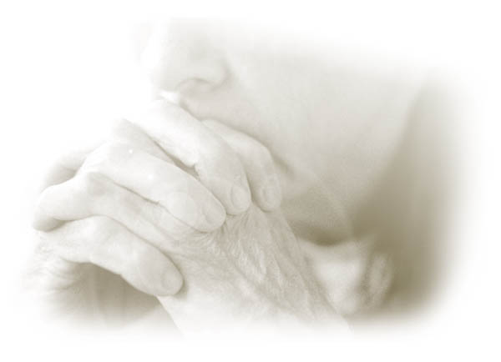
Amsal
Dr. Rick Griffith, Singapore Bible College
BibleStudyDownloads.org

Slide 2
Kata Kunci
394
343
Hikmat
Amsal

Slide 3
Tema
394
Nilai dan Jalan Hikmat
Amsal

Slide 4
Ayat Kunci
394
“Percayalah kepada Tuhan dengan segenap hatimu dan janganlah bersandar kepada pengertianmu sendiri; akuilah Dia di dalam lakumu maka Ia akan meluruskan jalanmu." (3:5-6).
Amsal

Slide 5

Pernyataan Kerajaan
343
Tunduk pada Hukum Tuhan adalah dasar dari hidup berhikmat (1:7).
Amsal

Slide 6

Pernyataan Ringkasan
394
346
Hikmat Salomo dan kutipan orang-orang bijak bertujuan untuk mengajar kaum muda tentang nilai hikmat yang lebih baik daripada kebodohan dengan cara hidup taat di hadapan Allah dalam setiap segi kehidupan.
Amsal

Slide 7

Perjanjian
347a
Perjanjian pernikahan tidak sakral bagi para pelacur (2:17), juga bagi orang bodoh yang membenci hikmat.
Amsal

Slide 8

Penebusan
347a
Hikmat akan melepaskan kamu dari orang-orang jahat (2:12) dan dari perempuan jalang (2:16)—permulaan Hikmat adalah takut akan Tuhan (1:7).
Amsal

Slide 9

Mesias
347a
Lambang kebijaksanaan (Ps. 8) menunjuk kepada Yesus, kebijaksanaan yang sejati (1 Cor. 1:24, 30; Col. 2:3).
Amsal

Slide 10
Amsal
Nilai dan Jalan Hikmat
Solomon |  |  | Wise Men (Anonymous) | Solomon | Wise Men (Agur, Lemuel, Anonymous)
1:1–22:16 |  |  | 22:17–24:34 | Ch. 25–29 | Ch. 30–31
13 firman 375 dua-baris |  |  | 36 firman | ±100 dua-baris | 3 firman
 |  |  | Sosial & Lain-Lain | Social & Lain-Lain
Pro-log | Prinsip-Prinsip Hikmat |  |  |  | Epilog
Sekitar tahun 950-700 SM
394
Penguasa 31:1-9
Tujuan 1:1-7
Sosial & Alam Ch. 30
Istri yang Saleh 31:10-31
Nilai Kebijaksanaan 1:8–9:18
Kontras & Kesalehan
10:1–22:16

Slide 11
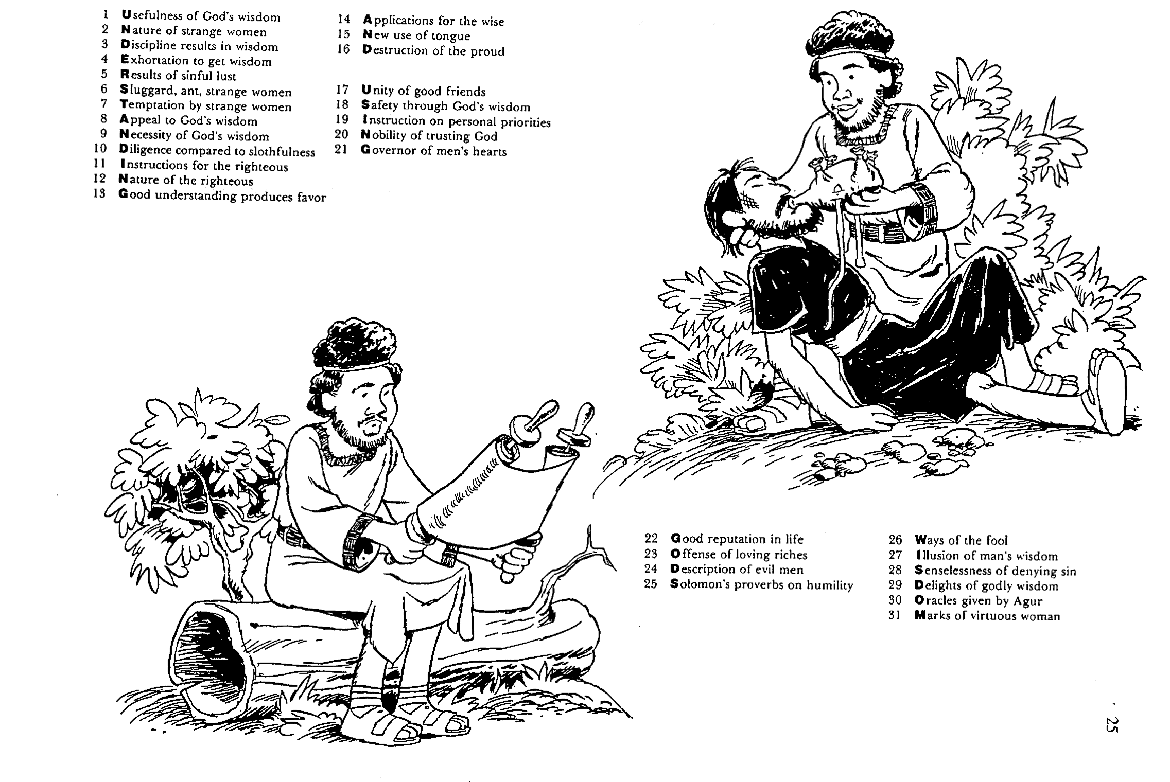
Barry Huddleston, The Acrostic Summarized Bible (Grand Rapids: Baker, 1992)
Amsal
1 Usefulness of God’s wisdom
2 Nature of strange women
3 Discipline results in wisdom
4 Exhortation to get wisdom
5 Results of sinful lust
6 Sluggard, ant, strange women
7 Temptation by strange women
8 Appeal to God’s wisdom
9 Necessity of God’s wisdom
10 Diligence compared to slothfulness
11 Instructions for the righteous
12 Nature of the righteous
13 Good understanding produces favor
14 Applications for the wise
15 New use of tongue
16 Destruction of the proud
17 Unity of good friends
18 Safety through God’s wisdom
19 Instruction on personal priorities
20 Nobility of trusting God
21 Governor of men’s hearts
26 Ways of the fool
27 Illusion of man’s wisdom
28 Senselessness of denying sin
29 Delights of godly wisdom
30 Oracles given by Agur
31 Marks of virtuous woman
22 Good reputation in life
23 Offense of loving riches
24 Description of evil men
25 Solomon’s Amsal on humility

Slide 12

Jadilah Bijaksana
Amsal
Dr. Rick Griffith • Crossroads International Church Singapore
CICFamily.com • BibleStudyDownloads.org

Slide 13

Apakah kamu mau punya hikmat?
Notes:
Text

Slide 14


Kata Kunci dari Amsal :
394
Panah + Mulut=
Paham
Hikmat
Siang
atau
Matahari
Notes:
Knowledge means the words coming out your mouth are like arrows
The word for ”day” is the same as that for “sun” so that one who has knowledge can see daylight instead of darkness.

Slide 15


Tipe-Tipe Amsal
396
Deskripsi
Petunjuk
Bagaimana
keadaannya
Bagaimana
kita hidup
Kombinasi

Slide 16
Pedoman Hermeunetik
397
Jangan menganggap Amsal sebagai janji dari Tuhan, tetapi lebih sebagai pengamatan umum dan prinsip yang biasanya valid tetapi tidak selalu.
  Contoh Amsal 22:6, “Didiklah orang muda menurut jalan yang patut baginya, maka pada masa tuanya pun ia tidak akan menyimpang daripada jalan itu."

Slide 17
Pedoman Hermeneutik
397
Pengajaran PL harus dipahami sejalan dengan wahyu yang diberikan langsung kepada gereja (Kisah Para Rasul dan Surat Para Rasul) dalam dispensasi ini.
  Pernyataan yang diulang
  Pernyataan yang dikutip
  Pernyataan paralel
  Jika bukkan a-c, jangan dianggap sebagai perintah tetapi sebagai prinsip

Slide 18

Ide Utama Amsal
Takut akan Tuhan dengan memperhatikan Amsal-Nya tentang nilai dan jalan hikmat.
Notes:
Restatement

Slide 19
Aplikasi
394
Ajarlah Amsal kepada remaja (& anak-anak)
Ingatlah Amsal untuk mendukung hidup berhikmat
Bacalah SATU pasal Kitab Amsal setiap hari

Slide 20
Black

Slide 21
Amsal

Slide 22
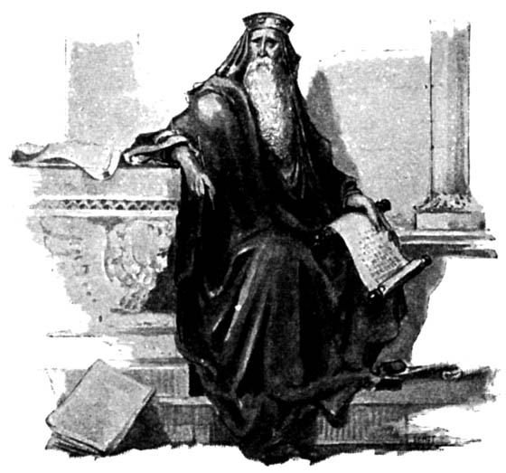
Didactic Wisdom – Amsal
"The plans of the righteous are just,
but the advice of the wicked is deceitful"
(Prov. 12:5)
Amsal guide us in challenges we face:
How to get along with people
How to make the right choices in personal and business affairs
How to win God's favor and avoid disaster
Amsal concern all areas of life no matter how great or small
Michael V. Fox, Amsal 1-9 The Anchor Bible (New York, Doubleday, 2000) 7.
Jeffrey Arthurs, Gordon-Conwell Theological Seminary
(SBC preaching conference, July 2014)

Slide 23
"Amsal are high points of human insight. To use a literary term, a proverb is a moment of epiphany (insight, revelation)."
Leland Ryken, How to Read the Bible as Literature
(Grand Rapids: Zondervan, 1984), 124
Jeffrey Arthurs, Gordon-Conwell Theological Seminary
(SBC preaching conference, July 2014)

Slide 24
Amsal are a universal literary form
Chinese: "Talk does not cook rice."
Sumerian: "A donkey eats its own bedding."
Spanish: "He who knows little soon repeats it."
French: "All are not hunters who blow the horn."
English: "Call a man a thief and he will steal."
Nigerian: "A single partridge flying through the bush leaves no path."
Modern American: "Time is money." "No pain, no gain." "Different strokes for different folks."
Jeffrey Arthurs, Gordon-Conwell Theological Seminary
(SBC preaching conference, July 2014)

Slide 25
"The essence of a proverbial saying is that it is based on observations of how things are in the world. It is a flash of insight into the repeatable situations of life on the world, and its aphoristic form not only represents insight but compels it . . . . Naturally, in the context of firm belief in God, the proverb comes to express insight into the way things are, or should be, in the world ordered by God and a challenge to behavior that God will reward."
Norman Perrin, The New Testament: An Introduction, 296.
Jeffrey Arthurs, Gordon-Conwell Theological Seminary
(SBC preaching conference, July 2014)

Slide 26

Walk Thru the Poetical Books
355
Ecclesiastes……..Vanity
Song…..Love in Marriage
“Wisdom can
overcome life’s vanities”
“Wisdom can
maintain a godly marriage”
Amsal 31:30 “Charm is deceitful and beauty is vain, but a woman who fears the Lord will be praised.”
Amsal 5:18 “Let your fountain be blessed, and rejoice in the wife of your youth.”
Amsal............Wisdom
“The Fear of the Lord
is the beginning of wisdom.”
Psalm 111:10 “The fear of the Lord is the beginning of wisdom; A good understanding have all those who do His commandments…”
Psalms..............Worship
“Worship develops the
Fear of the Lord”
Job 42:2 “I know that You can do all things, and that no purpose of yours can be thwarted.”
Source:
Walk Thru the Bible Ministries
Job…...........Sovereignty
“Seeing God’s Sovereignty
causes us to worship”

Slide 27
Amsal versus Ecclesiastes
Contrasts
402b
Amsal | ECCLESIASTES
Challenges of life | Meaning of life
Practical advice | Philosophical musings
How to live for God | Why to live for God
Ideals | Reality
Several authors | One man's testimony
Godly wisdom only | Godly and worldly wisdom
Positive | Negative
General | Exceptions
Present orientation | Eternal orientation
Black & white orientation | Gray areas
Wisdom praised | Wisdom doubted

Slide 28

Thy Word 1 of 5
Thy Word is a lamp unto my feet
and a light unto my path.
Thy Word is a lamp unto my feet
and a light unto my path.

Slide 29

Thy Word 2 of 5
When I feel afraid,
think I've lost my way,
still You're there right beside me.
And nothing will I fear
as long as You are near.
Please be near me to the end.

Slide 30

Thy Word 3 of 5
Thy Word is a lamp unto my feet
and a light unto my path.
Thy Word is a lamp unto my feet
and a light unto my path.

Slide 31

Thy Word 4 of 5
I will not forget
Your love for me and yet
my heart forever is wandering.
Jesus be my guide
and hold me to Your side,
and I will love You to the end.

Slide 32

Thy Word 5 of 5
Thy Word is a lamp unto my feet
and a light unto my path.
Thy Word is a lamp unto my feet
and a light unto my path.

Slide 33
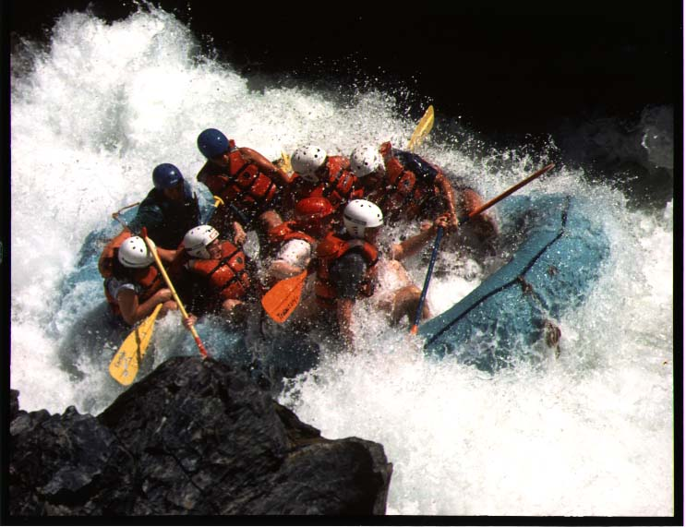
Key Verse
394
"Trust in the LORD with all your heart
Amsal 3:5-6

Slide 34
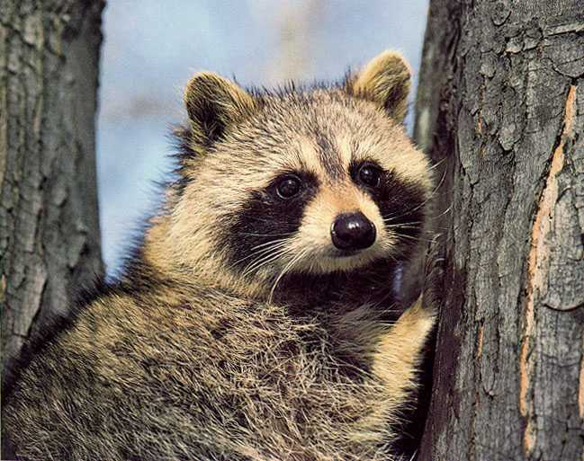
Key Verse
394
and lean not on your own understanding;
Amsal 3:5-6

Slide 35

Key Verse
in all your ways acknow-ledge him
394
Amsal 3:5-6

Slide 36

Key Verse
and he will make your paths straight."
394
Amsal 3:5-6

Slide 37
Authorship
395
External Evidence
  1 Kings 4:32
Internal Evidence
  1:1; 10:1; 25:1
  22:17–24:34
  Chapter 30
  Chapter 31
Solomon
Solomon
Wise Men
Agur
Lemuel, Unknown

Slide 38
Authorship
396
Multiple authorship
(others: Psalms, 1 Samuel, portions of Deuteronomy, Joshua, etc.)

Slide 39
Recipients
395
"my son" and "my sons"
  A home setting, or
  A school environment where students were called "sons" of their teachers
However…
"Listen, my child, when your father corrects you. Don't neglect your mother's instruction" (1:8)
This shows a family setting as primary

Slide 40
Occasion
395
It is likely that King Hezekiah authorized the compilation of Solomon's Amsal (which were not in an existing collection) to be added to the book

Slide 41
Amsal
Nilai dan Jalan Hikmat
Solomon |  |  | Wise Men (Anonymous) | Solomon | Wise Men (Agur, Lemuel, Anonymous)
1:1–22:16 |  |  | 22:17–24:34 | Ch. 25–29 | Ch. 30–31
13 firman 375 dua-baris |  |  | 36 firman | ±100 dua-baris | 3 firman
 |  |  | Sosial & Lain-Lain | Social & Lain-Lain
Pro-log | Prinsip-Prinsip Hikmat |  |  |  | Epilog
Sekitar tahun 950-700 SM
394
Penguasa 31:1-9
Tujuan 1:1-7
Sosial & Alam Ch. 30
Istri yang Saleh 31:10-31
Nilai Kebijaksanaan 1:8–9:18
Kontras & Kesalehan
10:1–22:16

Slide 42
Types of Amsal
396
Descriptive
- how things are

Slide 43

Descriptive…
"Like clouds and wind
without rain is a man who boasts
of his gifts falsely."
Amsal 25:14

Slide 44
Tipe-Tipe Amsal
396
Deskripsi
Petunjuk
Bagaimana
keadaannya
Bagaimana
kita hidup

Slide 45
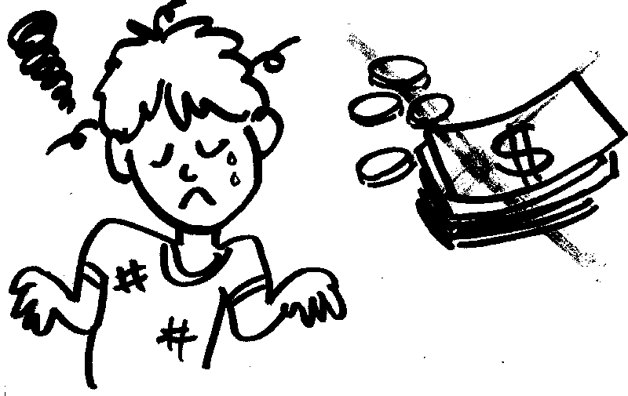
Descriptive or Prescriptive?
"Do not wear yourself out
to get rich" (Prov. 23:4)

Slide 46
Tipe-Tipe Amsal
396
Deskripsi
Petunjuk
Bagaimana
keadaannya
Bagaimana
kita hidup
Kombinasi

Slide 47
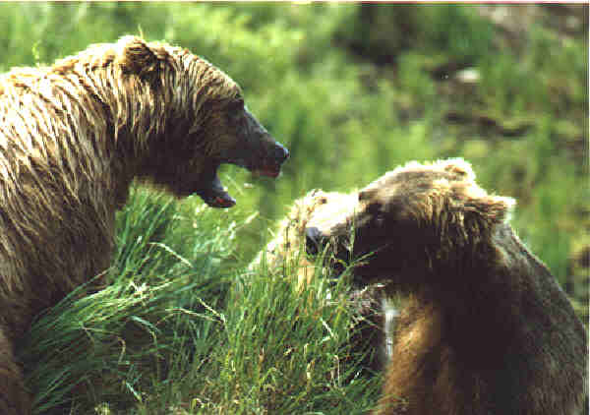
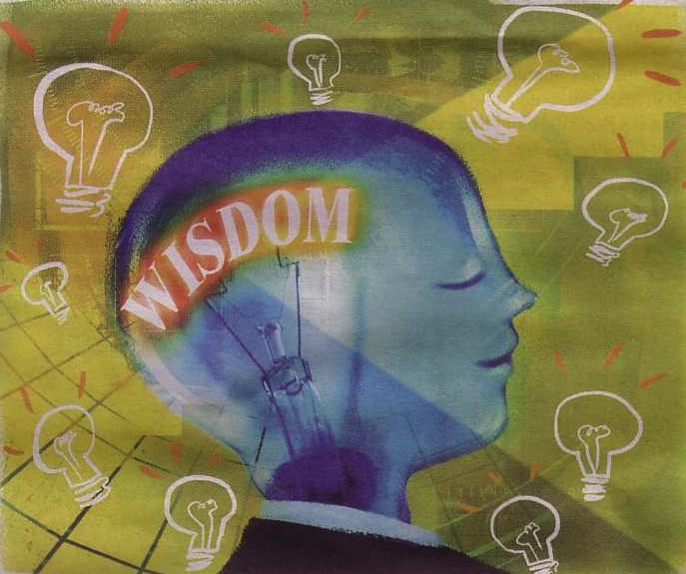
Prescriptive or Descriptive?
"Faithful are the wounds of a friend; profuse are the kisses of an enemy."
Amsal 27:6

Slide 48
Characteristics
396
Emphasis: On life now
––little about the afterlife
Multiple authorship
Humor

Slide 49
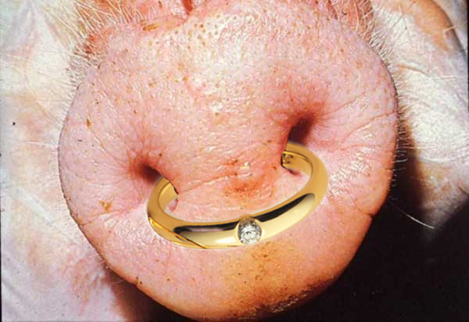
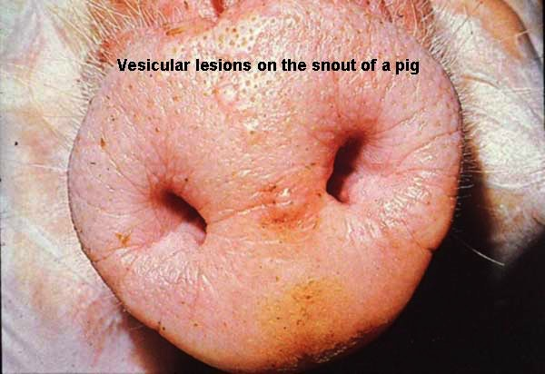
VERY Descriptive!
"As a ring of gold in a swine's snout, so is a beautiful woman who lacks discretion"
(Amsal 11:22)

Slide 50
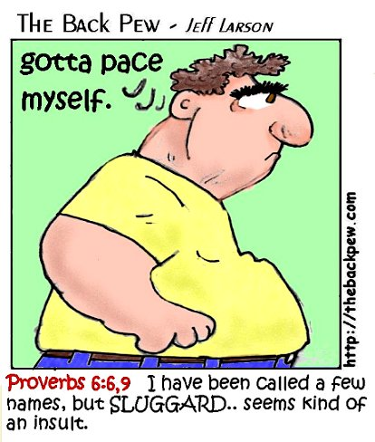
The Sluggard
"The sluggard buries his hand in the dish, and will not even bring it back to his mouth."
- Amsal 19:24

Slide 51
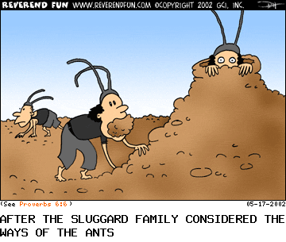
The Ant (6:6)
"Go to the ant, O sluggard.
Observe her ways and be wise."
After the Sluggard family considered the ways of the ants

Slide 52
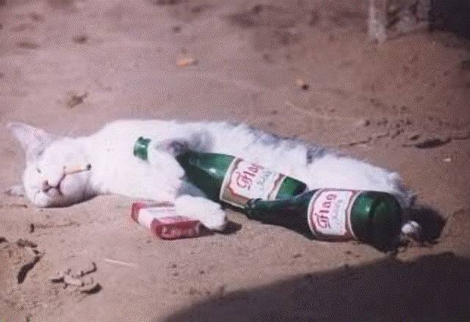
The Drunk
"They struck me, but I did not become ill; they beat me, but I did not know it. When shall I awake? I will seek another drink."
(Amsal 23:35)

Slide 53

The Lazy
"'A little sleep, a little slumber, a little folding of the hands to rest,'
then your poverty will come as a robber…" Amsal 24:33, 34a

Slide 54
Uniqueness of Sayings
396
Meet human urge for order
Striking and memorable
Wilhoit & Ryken, Effective Bible Teaching, 237-39

Slide 55
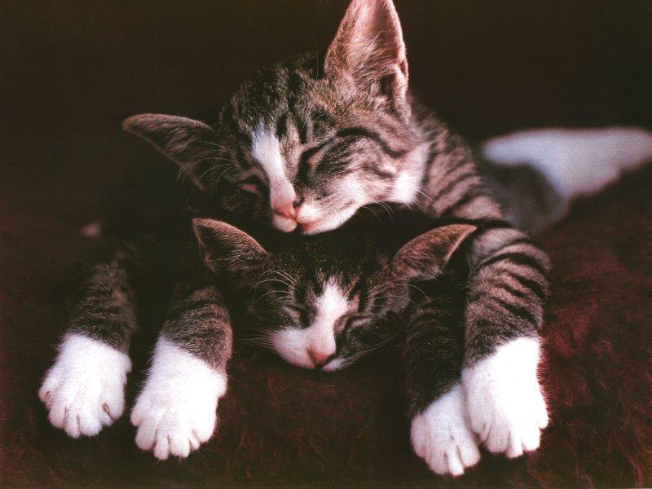
Crying "Wolf"
    "The sluggard says, 'There is a lion in the road, a fierce lion roaming the streets!'"
    Amsal 26:13

Slide 56
Uniqueness of Sayings
396
Meet human urge for order
Striking and memorable
Simple and profound; meditative
Wilhoit & Ryken, Effective Bible Teaching, 237-39

Slide 57

Watch your passions!
"Watch over your heart with all diligence,
for from it flow the springs of life."
(Amsal 4:23)

Slide 58
Uniqueness of Sayings
396
Meet human urge for order
Striking and memorable
Simple and profound; meditative
Poetic in form
Wilhoit & Ryken, Effective Bible Teaching, 237-39

Slide 59
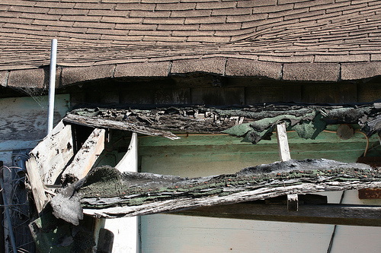
Poetic in Form
"Through sloth the roof sinks in"
(Eccles. 10:18)

Slide 60
Uniqueness of Sayings
396
Meet human urge for order
Striking and memorable
Simple and profound; meditative
Poetic in form
Specific and universal at the same time
Wilhoit & Ryken, Effective Bible Teaching, 237-39

Slide 61
Specific & Universal Simultaneously
"Through sloth the roof sinks in"
(Eccles. 10:18)

Slide 62
Interpretation
397
This genre of Amsal requires greater discernment in interpretation
Are Amsal absolute, unconditional promises? In other words, are they principles with no exceptions?

Slide 63
Pedoman Hermeunetik
397
Jangan menganggap Amsal sebagai janji dari Tuhan, tetapi lebih sebagai pengamatan umum dan prinsip yang biasanya valid tetapi tidak selalu.
  Contoh Amsal 22:6, “Didiklah orang muda menurut jalan yang patut baginya, maka pada masa tuanya pun ia tidak akan menyimpang daripada jalan itu."

Slide 64

"Train children in the right way,
and when old, they will not stray"
(Prov. 22:6 NRS)
Jeffrey Arthurs, Gordon-Conwell Theological Seminary
(SBC preaching conference, July 2014)

Slide 65
Pedoman Hermeneutik
397
Pengajaran PL harus dipahami sejalan dengan wahyu yang diberikan langsung kepada gereja (Kisah Para Rasul dan Surat Para Rasul) dalam dispensasi ini.
  Pernyataan yang diulang
    "Thou shalt not bear false witness against your neighbor" (Exodus 20:16)
    "Stop lying to one another" (Ephesians 4:25)

Slide 66
Pedoman Hermeneutik
397
Pengajaran PL harus dipahami sejalan dengan wahyu yang diberikan langsung kepada gereja (Kisah Para Rasul dan Surat Para Rasul) dalam dispensasi ini.
  Pernyataan yang diulang
  Pernyataan yang dikutip
    Amsal 25:21, "If your enemy hungers, feed him," reappears in Romans 12:20

Slide 67
Pedoman Hermeneutik
397
Pengajaran PL harus dipahami sejalan dengan wahyu yang diberikan langsung kepada gereja (Kisah Para Rasul dan Surat Para Rasul) dalam dispensasi ini.
  Pernyataan yang diulang
  Pernyataan yang dikutip
  Pernyataan paralel
    Amsal 6:24 and 1 Thessalonians 4:3

Slide 68
Pedoman Hermeneutik
397
Pengajaran PL harus dipahami sejalan dengan wahyu yang diberikan langsung kepada gereja (Kisah Para Rasul dan Surat Para Rasul) dalam dispensasi ini.
  Pernyataan yang diulang
  Pernyataan yang dikutip
  Pernyataan paralel
  Jika bukkan a-c, jangan dianggap sebagai perintah tetapi sebagai prinsip

Slide 69
Literary/rhetorical Characteristics:
Short.
  This aids memory!
Indicative mood.
  This disarms us more than imperatives.
Poetry
  This encourages us to use poetic devices.
Jeffrey Arthurs, Gordon-Conwell Theological Seminary
(SBC preaching conference, July 2014)

Slide 70
Poetic Devices
Repetition
Alliteration
Assonance
Simile
Metaphor
Rhyme
Compare and contrast
Duane Garret, The New American Commentary: Amsal, Ecclesiastes & Song of Songs (Nashville, Broadman Press, 1993) 38.
Jeffrey Arthurs, Gordon-Conwell Theological Seminary
(SBC preaching conference, July 2014)

Slide 71
Literary/rhetorical Characteristics:
Short.
  This aids memory!
Indicative mood.
  This disarms us more than imperatives.
Poetry
  This encourages us to use poetic devices.
"Case studies"
  This encourages us to tell stories.
Jeffrey Arthurs, Gordon-Conwell Theological Seminary
(SBC preaching conference, July 2014)

Slide 72

Themes in
Amsal

Slide 73
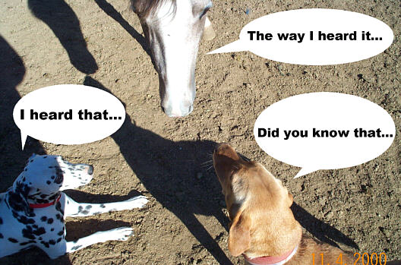
Words and Speech
401
The way I heard it…
"He who goes about as a talebearer
reveals secrets, but he who is
trustworthy conceals a matter"
(Amsal 11:13)
I heard that…
Did you know that…

Slide 74

Money

Slide 75
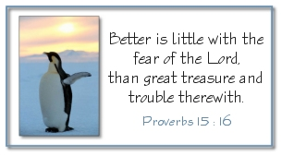
Godliness over Gold
"Better is little with the fear of the LORD
than great treasure and trouble with it."
Amsal 15:16

Slide 76


True Success
SUCCESS
IN GOD'S
EYES?

Slide 77
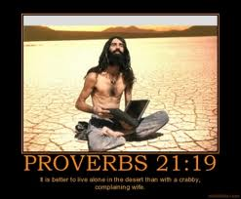
Amsal 21:19
"It is better to live alone in the desert
than with a crabby, complaining wife."

Slide 78
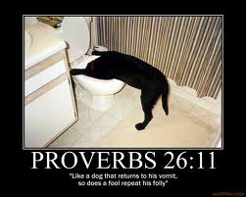
Amsal 26:11
"Like a dog that returns to his vomit,
so does a fool repeat his folly."

Slide 79

The Way to Success
Righteousness (10:7; 12:3)
Hate what is false (13:5)
Commit all work to God (16:3)
Use words with restraint (17:27-28)
Love wisdom (19:8)
Humility and fear of the LORD (22:4)

Slide 80

Diligence and Laziness
"The soul of the sluggard craves and gets nothing,
but the soul of the diligent is made fat"
(Prov. 13:4)

Slide 81
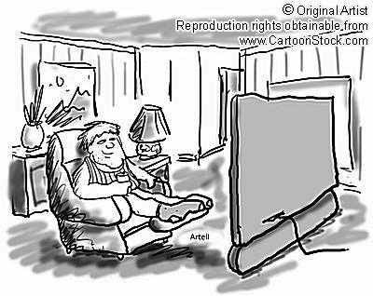
American, idle
American, idle

Slide 82
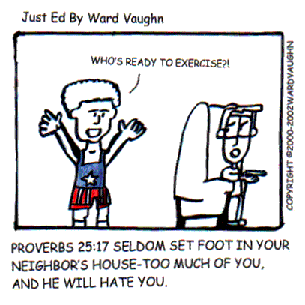
Relationships
Who's ready to exercise?!
Amsal 25:17 "Seldom set foot in your neighbor's house—too much of you, and he will hate you."

Slide 83
Amsal
Nilai dan Jalan Hikmat
Solomon |  |  | Wise Men (Anonymous) | Solomon | Wise Men (Agur, Lemuel, Anonymous)
1:1–22:16 |  |  | 22:17–24:34 | Ch. 25–29 | Ch. 30–31
13 firman 375 dua-baris |  |  | 36 firman | ±100 dua-baris | 3 firman
 |  |  | Sosial & Lain-Lain | Social & Lain-Lain
Pro-log | Prinsip-Prinsip Hikmat |  |  |  | Epilog
Sekitar tahun 950-700 SM
394
Penguasa 31:1-9
Tujuan 1:1-7
Sosial & Alam Ch. 30
Istri yang Saleh 31:10-31
Nilai Kebijaksanaan 1:8–9:18
Kontras & Kesalehan
10:1–22:16

Slide 84

How can you be wise?
Notes:
Restatement

Slide 85

I. Learn discipline and fear of the LORD (1:1-7).
How to be wise...
Notes:
Restatement

Slide 86

II. Value wisdom that leads to a prosperous life (1:8–9:18).
How to be wise...
Notes:
Restatement

Slide 87
Wisdom
gives honor to keep youth from the shame of foolishness (1:8-9).
Notes:
Text

Slide 88
Wisdom
preserves youth from disaster (1:10-33).
Notes:
Text

Slide 89
Wisdom
helps maintain moral behavior (Prov 2).
Notes:
Text

Slide 90
Wisdom
helps us relate
with God and man (Prov 3).
Notes:
Text

Slide 91
Wisdom
provides a gracious life (4:1-9).
Notes:
Text

Slide 92
Wisdom
preserves youth from trouble (4:10-19).
Notes:
Text

Slide 93
Wisdom
produces healthy young people (4:20-27).
Notes:
Text

Slide 94
Wisdom
helps avoid sexual sin (Prov 5).
Notes:
Text

Slide 95
Wisdom
preserves from poverty (6:1-11).
Notes:
Text

Slide 96
Wisdom
preserves from dissension (6:12-19).
Notes:
Text

Slide 97
Wisdom
preserves youth from sexual immorality
(6:20–7:27).
Notes:
Text

Slide 98
Wisdom
has valuable virtues, rewards and was used in creation (Prov 8).
Notes:
Text

Slide 99
Wisdom
is valuable compared to the claims of foolishness (Prov 9).
Notes:
Text

Slide 100

III. Heed advice of wise men on relationships
(Prov 10–31).
How to be wise...
Notes:
Restatement

Slide 101

About 375 two-line Amsal of Solomon teach the practical benefits of wisdom over wickedness in everyday life (10:1–22:16).
Notes:
Text

Slide 102

Wisdom
Longer sayings of wise men admonish practical wisdom in many areas
(22:17–24:34).
Notes:
Text

Slide 103

Wisdom
The final collection of Solomon's Amsal by Hezekiah's scribes 250 years later guide social relationships and various activities (Prov 25–29).
Notes:
Text

Slide 104

Wisdom
Sayings of Agur to Ithiel and Ucal show insights from nature and social relationships (Prov 30).
Notes:
Text

Slide 105

Wisdom
The unknown Lemuel’s mother prepares him for kingship by advising him to avoid the excesses of women and wine, and to protect the rights of the underprivileged (31:1-9).
Notes:
Text

Slide 106
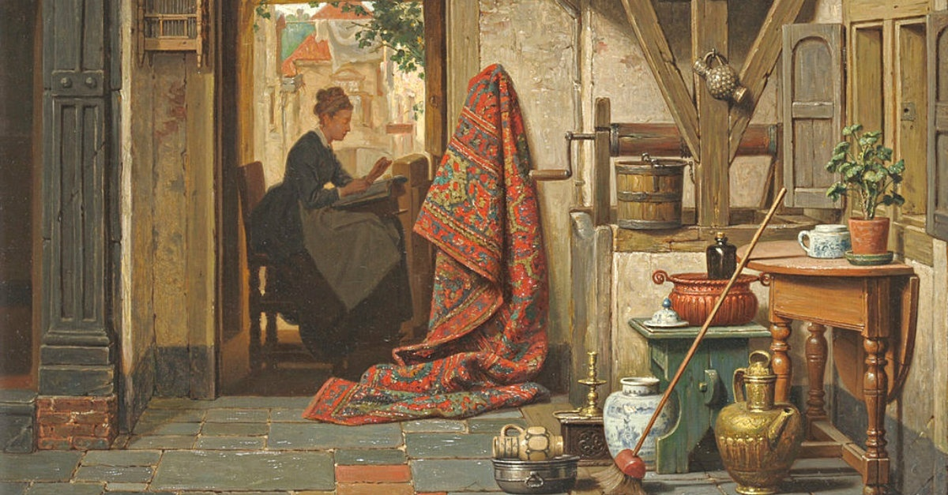
Wisdom
An acrostic and anonymous poem of a noble wife exhorts young women to be godly and diligent and exhorts young husbands to praise these qualities in their wives (31:10-31).
Notes:
Text

Slide 107
Jadilah Bijaksana
Amsal
Dr. Rick Griffith • Crossroads International Church Singapore
CICFamily.com • BibleStudyDownloads.org

Slide 108

What are people passionate about?
Notes:
Money—so Singapore has the highest percentage of millionaires worldwide (16.5%)
Education—few feel you could be overeducated
Power—many are not happy with their job
Sex—few people remain with one person for life
Fun—the last experience didn’t satisfy, so try another
Travel—never before have so many traveled
Food—some travel across the country for a certain stall
Sports—depression if their team loses, elation if it wins

Slide 109
Apakah kamu mau punya hikmat?
Notes:
Text

Slide 110
How can you be wise?
Notes:
What is the way for you to gain true wisdom? Not knowledge, but discernment in life—the question we'll address today is HOW this type of prudence is gained. Such sense will not keep trouble from finding you, but it will keep you from finding trouble.

Slide 111

Mari pelajari ayat demi ayat
Kitab Suci: Kitab demi kitab
Notes:
Kita sedang mempelajari seluruh Kitab Suci saat ini, kitab demi kitab. Tujuannya adalah memberikan kita pemahaman dasar dari setiap Kitab.

Slide 112
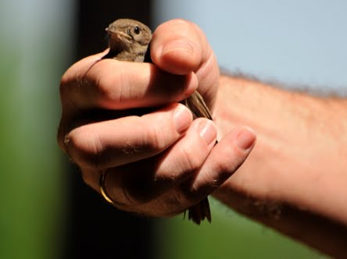
Modern Day Amsal
"A bird in the hand is worth two in the bush!"
Notes:
Today we study the book of Amsal. This may seem strange to be studying short, pithy sayings, but actually, you and I encounter Amsal all the time. Can you think of the proverb associated with this picture?
• Yes, a bird in the hand is worth two in the bush.
This proverb isn't just talking about birds. It means we should be satisfied with the blessing that we have rather than long for those we will never have. You may like the two birds over in a bush, but try going after them and they will fly away. It's better to be satisfied with the chicken you have to eat today than chase after two Peking ducks that you'll never catch.

Slide 113
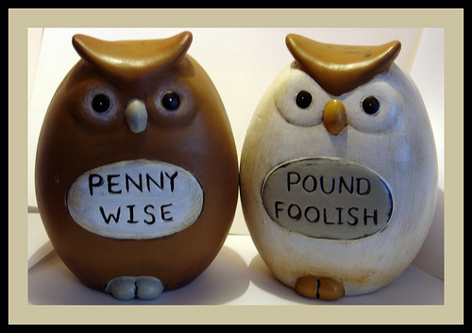
Modern Day Amsal
"Penny-wise but pound foolish!"
Notes:
Don't spend one British pound to save one penny. Wisdom is allowing yourself to waste something small to preserve something big. That's why we all pay money for insurance.

Slide 114

Modern Day Amsal
"Waste not, want not!"
Notes:
If you don't spend frivously, then you won't have financial woes in the future.

Slide 115
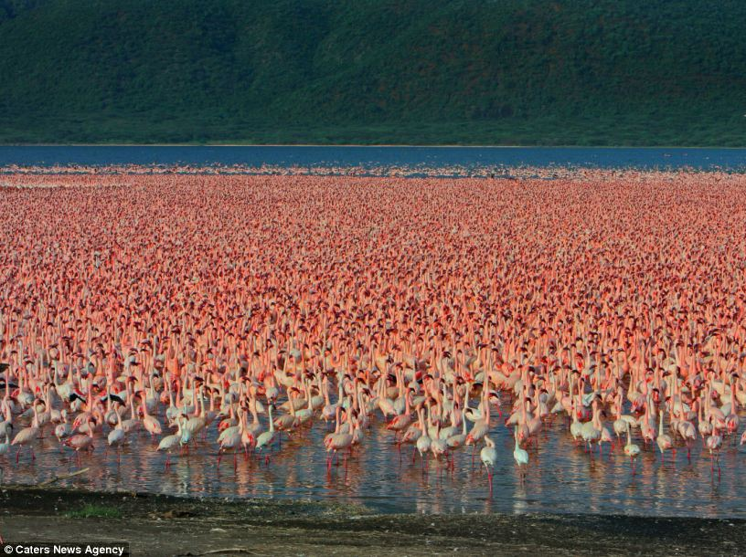
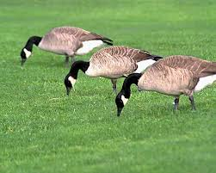

Modern Day Amsal
"Birds of a feather flock together."
Chavez &
Ahmadinejad

Slide 116

JUST DO IT.

Slide 117

"Time is money."

Slide 118
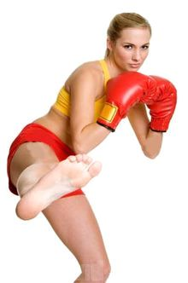

"Different strokes for different folks"
Notes:
http://www.wordwizard.com/phpbb3/viewtopic.php?f=7&t=20582
"The earliest use of DIFFERENT STROKES FOR DIFFERENT FOLKS that I could find was from 1966 (see quote below) by boxer and world heavyweight champion Muhammad Ali (Cassius Marcellus Clay, Jr.). Rhythm and soul singer Syl Johnson (father of Syleena) released the single titled 'DIFFERENT STROKES' in 1967 with the line also appearing in the song. But its appearance in Sly and the Family Stone's 1968 big hit single Everyday People is probably what put the phrase on the map. Additional exposure of the expression was burned into our collective psyches with the television comedy Diff'rent Strokes [1978-86] (an often used abbreviated form of the expression, but without the apostrophe) about a millionaire white widower who adopts two Black boys (one of which was that cute little guy Gary Coleman), and which was subsequently shown in the U.K where, so I've read, when the expression is used, the word folks may sometimes be replaced by blokes.
<1966 [quoting boxer Cassius Clay]" I got DIFFERENT STROKES FOR DIFFERENT FOLKS."—Great Bend Daily Tribune (Kansas), 11 November, page 6>
<1969 "The Adult has something to work on: what must I do to gain their STROKES, or their approval?"—I'm OK, You're OK by T. A. Harris, iii. page 45>
<1973 "The popular saying around the P[almer]D[rug]A[buse]P[rogram] is 'DIFFERENT STROKES FOR DIFFERENT FOLKS,' and that's the basis of the program."—Houston Chronicle Magazine, 14 October, page 4/1>
<1978 "He started off dishing out some nice STROKES. With an admiring smile he told me how smart I was, how honest, so absolutely reliable."—Fools Die by Mario Puzzo, xi. page 122>
<1981 "Let's face it, everybody needs their STROKES and that would be very ego-satisfying."—TV Picture Life, March, page 12/3>
<1986 "The whole point, says John Poindexter, [[President]] Reagan's national security adviser, is DIFFERENT STROKES FOR DIFFERENT FOLKS. 'We need different policies toward Communist dictatorships . . . , . . . for non-democratic regimes that are slowly evolving toward democracy, and different policies for non-democratic regimes in which there is no viable democratic center . . .'"—in New York (magazine), "How Reagan Does It" by Michael Kramer>
<1999 "There are a hundred times as many people addicted to alcohol, antidepressants and nicotine as there are to heroin or Charlie [cocaine]. DIFFERENT STROKES FOR DIFFERENT FOLKS, right?"—Spanish Highs by Wayne Anthony, page 65>
<2003 "If one motto sums up the [[weight loss]] industry, it could be 'DIFFERENT STROKES FOR DIFFERENT FOLKS.' At No. 1, with revenues this year expected to reach $1 billion, is 40-year-old Weight Watchers, with its program of weekly meetings and group support. Next comes Slim-Fast, the maker of bar and shake replacement meals. . . ."— U.S. News & World Report, 16 July>
<2008 "Suddenly [[Professor Wolfgang]] Mieder [[renowned expert on Amsal at the University of Vermont]] reminds me that he hasn't yet told me his favorite proverb. Can he really have a favorite? . . . But Mieder is a decisive man. 'DIFFERENT STROKES FOR DIFFERENT FOLKS is my favorite proverb,' he says. . . . 'I would argue it had to grow on American ground, because it doesn't tell you what to do. It says, "Accept the differences in people." . . . 'I think it's a truly liberating proverb.'"—Christian Science Monitor, 6 March>" (accessed 20 Aug 2014)

Slide 119
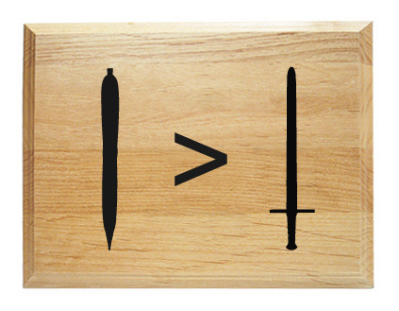
"The pen is mightier than the sword."

Slide 120
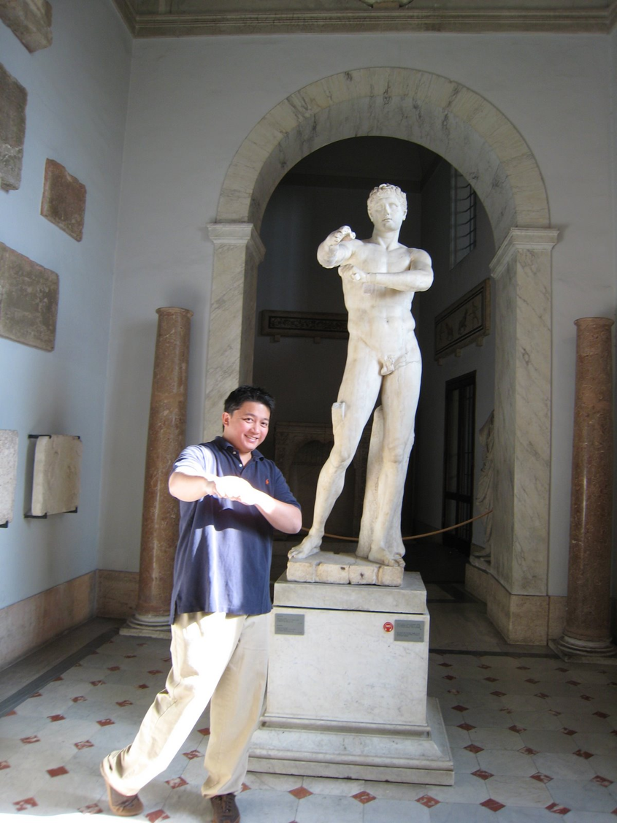
Rome
"When in Rome,
do as the Romans."

Slide 121
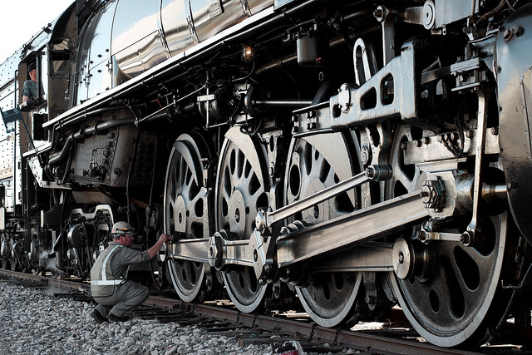
"The squeaky wheel gets the grease."
grease

Slide 122

"No man is an island."

Slide 123
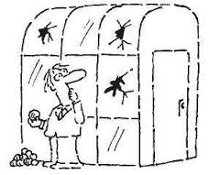
"People who live in glass houses shouldn't throw stones."

Slide 124
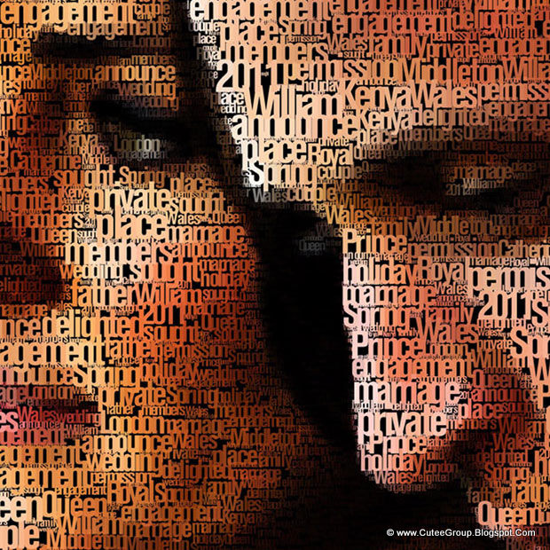
"A picture is worth a thousand words."

Slide 125

"There's no such thing as a free lunch."

Slide 126
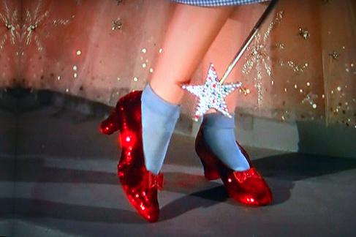
"There's no place like home."

Slide 127
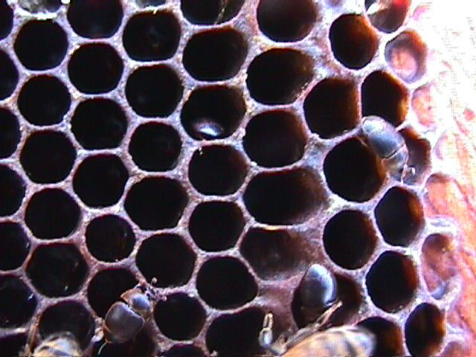
Wisdom is good for you
"My son, eat honey, for it is good,
Yes, the honey from the comb is
sweet to your taste;
Know that wisdom is thus for
your soul." ~ Amsal 24:13-14a

Slide 128
Amsal
Nilai dan Jalan Hikmat
Solomon |  |  | Wise Men (Anonymous) | Solomon | Wise Men (Agur, Lemuel, Anonymous)
1:1–22:16 |  |  | 22:17–24:34 | Ch. 25–29 | Ch. 30–31
13 firman 375 dua-baris |  |  | 36 firman | ±100 dua-baris | 3 firman
 |  |  | Sosial & Lain-Lain | Social & Lain-Lain
Pro-log | Prinsip-Prinsip Hikmat |  |  |  | Epilog
Sekitar tahun 950-700 SM
394
Penguasa 31:1-9
Tujuan 1:1-7
Sosial & Alam Ch. 30
Istri yang Saleh 31:10-31
Nilai Kebijaksanaan 1:8–9:18
Kontras & Kesalehan
10:1–22:16

Slide 129
Kata Kunci dari Amsal :
394
Panah + Mulut=
Paham
Hikmat
Siang
atau
Matahari
Notes:
Knowledge means the words coming out your mouth are like arrows
The word for ”day” is the same as that for “sun” so that one who has knowledge can see daylight instead of darkness.

Slide 130
Title of the Book
395
"Proverb" – "to be like" or
"compared with"
A proverb is a statement which makes a comparison or describes a common experience.
Latin title: a proverb is a "word that stands for" many words (i.e., combined into one short saying).

Slide 131
Themes in
Amsal

Slide 132
Words and Speech
401
The way I heard it…
"He who goes about as a talebearer
reveals secrets, but he who is
trustworthy conceals a matter"
(Amsal 11:13)
I heard that…
Did you know that…

Slide 133
Money

Slide 134
Godliness over Gold
"Better is little with the fear of the LORD
than great treasure and trouble with it."
Amsal 15:16

Slide 135
True Success
SUCCESS
IN GOD'S
EYES?

Slide 136
Amsal 21:19
"It is better to live alone in the desert
than with a crabby, complaining wife."

Slide 137
Amsal 26:11
"Like a dog that returns to his vomit,
so does a fool repeat his folly."

Slide 138
Diligence and Laziness
"The soul of the sluggard craves and gets nothing,
but the soul of the diligent is made fat"
(Prov. 13:4)

Slide 139
American, idle
American, idle

Slide 140
Relationships
Who's ready to exercise?!
Amsal 25:17 "Seldom set foot in your neighbor's house—too much of you, and he will hate you."

Slide 141
How can you be wise?
Notes:
Restatement

Slide 142
Slides on
Amsal 1

Slide 143
I. Learn discipline and fear of the LORD (1:1-7).
How to be wise...
Notes:
Restatement

Slide 144
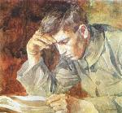
Why Read Amsal?
Check out 1:1-7

Slide 145

¹These are the Amsal of Solomon,
David’s son, king of Israel.
²Their purpose is to teach people wisdom and discipline,
to help them understand the insights of the wise.
³Their purpose is to teach people to live disciplined and successful lives,
to help them do what is right, just, and fair.
Amsal 1:1-7 NLT

Slide 146
⁴These Amsal will give insight to the simple,
knowledge and discernment to the young.
⁵Let the wise listen to these Amsal and become even wiser.
Let those with understanding receive guidance
Amsal 1:1-7 NLT

Slide 147
⁶ by exploring the meaning in these Amsal and parables,
the words of the wise and their riddles.
⁷ The fear of the LORD is the foundation of true knowledge, but fools despise wisdom and discipline.
Amsal 1:1-7 NLT

Slide 148
II. Value wisdom that leads to a prosperous life (1:8–9:18).
How to be wise...
Notes:
Restatement

Slide 149
Wisdom
gives honor to keep youth from the shame of foolishness (1:8-9).
Notes:
Text

Slide 150
Wisdom
preserves youth from disaster (1:10-33).
Notes:
Text

Slide 151
Slides on
Amsal 2

Slide 152
Wisdom
helps maintain moral behavior (Prov 2).
Notes:
Text

Slide 153
Amsal
Nilai dan Jalan Hikmat
Solomon |  |  | Wise Men (Anonymous) | Solomon | Wise Men (Agur, Lemuel, Anonymous)
1:1–22:16 |  |  | 22:17–24:34 | Ch. 25–29 | Ch. 30–31
13 firman 375 dua-baris |  |  | 36 firman | ±100 dua-baris | 3 firman
 |  |  | Sosial & Lain-Lain | Social & Lain-Lain
Pro-log | Prinsip-Prinsip Hikmat |  |  |  | Epilog
Sekitar tahun 950-700 SM
394
Penguasa 31:1-9
Tujuan 1:1-7
Sosial & Alam Ch. 30
Istri yang Saleh 31:10-31
Nilai Kebijaksanaan 1:8–9:18
Kontras & Kesalehan
10:1–22:16

Slide 154
Slides on
Amsal 3

Slide 155
Wisdom
helps us relate
with God and man (Prov 3).
Notes:
Text

Slide 156
Key Verse
394
"Trust in the LORD with all your heart
Amsal 3:5-6

Slide 157
Key Verse
394
and lean not on your own understanding;
Amsal 3:5-6

Slide 158
Key Verse
in all your ways acknow-ledge him
394
Amsal 3:5-6

Slide 159
Key Verse
and he will make your paths straight."
394
Amsal 3:5-6

Slide 160
Slides on
Amsal 4

Slide 161
Wisdom
provides a gracious life (4:1-9).
Notes:
Text

Slide 162
Wisdom
preserves youth from trouble (4:10-19).
Notes:
Text

Slide 163
Wisdom
produces healthy young people (4:20-27).
Notes:
Text

Slide 164
Slides on
Amsal 5

Slide 165
Wisdom
helps avoid sexual sin (Prov 5).
Notes:
Text

Slide 166

Straight Talk on Sex
Amsal 5
Dr. Rick Griffith, Crossroads International Church Singapore
BibleStudyDownloads.org

Slide 167
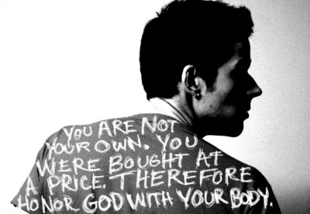
"My son, pay attention to my wisdom; listen carefully to my wise counsel.
²Then you will show discernment, and your lips will express what you've learned" (5:1-2 NLT).

Slide 168
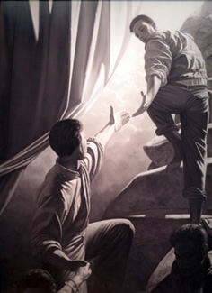
Relevant to You?
      Are your thoughts about women completely honorable?
      Are you tempted to look at images that you know you shouldn't—especially online?
      If so, you need this passage today.

Slide 169
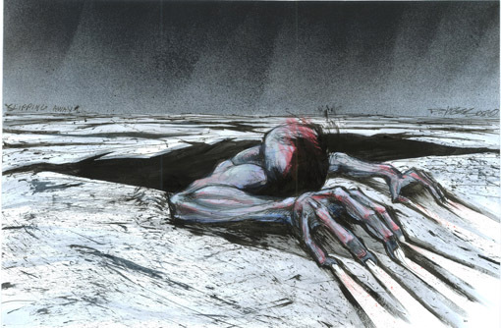
Why should we avoid sexual sin?
Notes:
Background:
Solomon didn't avoid sexual sin (1 Kings 11; Eccl. 2).
However, he wrote today's text to spare us the pain of this particular sin that trips men up.
Text: Amsal 5
Preview: We will see four basic reasons to avoid this trap of sexual sin—and we will discover these in small groups that each take a portion of Scripture and then report back to the group.
Transition: What reason(s) should we avoid sexual sin in the passage assigned to you?

Slide 170
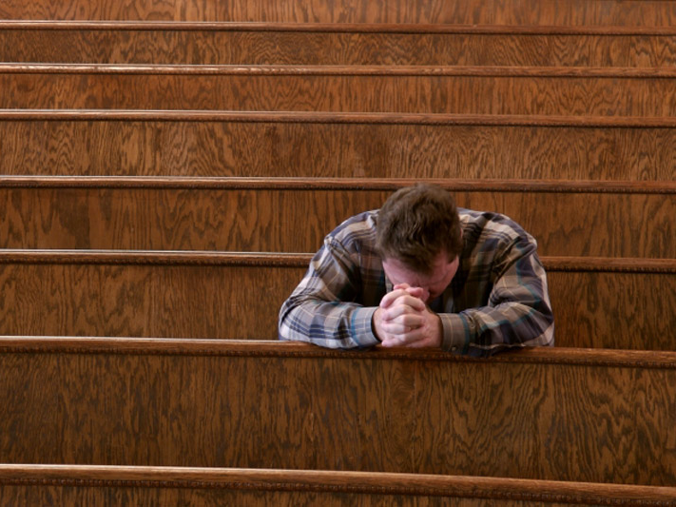
I. Amsal 5 gives four good reasons to avoid sexual sin.

Slide 171

A. Sexual sin is enjoyable in the short run but bitter in the end (5:3-6).

Slide 172

"For the lips of an immoral woman are as sweet as honey, and her mouth is smoother than oil"
(5:3 NLT).
Notes:
(5:3) Immoral people's advances are genuinely enticing in touch and sound.

Slide 173

"But in the end she is as bitter as poison, as dangerous as a double-edged sword. ⁵Her feet go down to death; her steps lead straight to the grave"
(5:4-5 NLT).
Notes:
(5:4-5) However, following such advances leads to certain ruin.

Slide 174

"For she cares nothing about the path to life. She staggers down a crooked trail and doesn't realize it" (5:6 NLT).
Notes:
(5:6) Sex addicts can't discern momentary pleasure from long-term goals.

Slide 175

B. Avoid sexual sin to escape its physical, financial, and emotional woes (5:7-14).

Slide 176
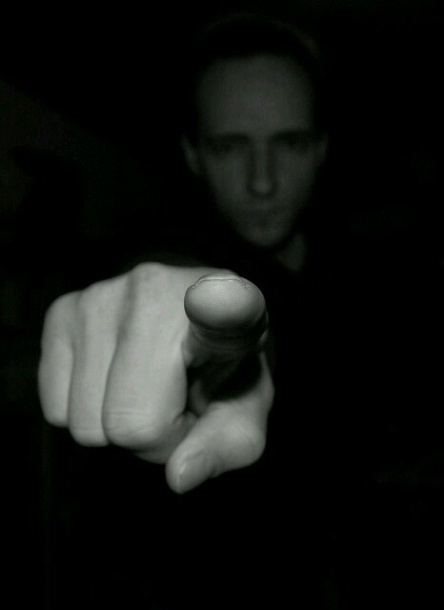
"So now, my sons, listen to me.
Never stray from what I am about to say:
⁸Stay away from her!
Don't go near the door of her house!"
(5:7-8 NLT).
Notes:
(5:7-8) Don't expose yourself to temptations in the sexual arena.

Slide 177


"If you do, you will lose your honor and will lose to merciless people all you have achieved " (5:9 NLT).
Notes:
(5:9-10) Sexual sin diverts the physical strength and money saved for one's spouse to strangers instead.

Slide 178

"Strangers will consume your wealth, and someone else will enjoy the fruit of your labor" (5:10 NLT).
Notes:
(5:9-10) Sexual sin diverts the physical strength and money saved for one's spouse to strangers instead.

Slide 179
"In the end you will groan in anguish when disease consumes your body.
¹²You will say, "How I hated discipline!
If only I had not ignored all the warnings!
¹³Oh, why didn't I listen to my teachers?
Why didn't I pay attention to my instructors?
¹⁴I have come to the brink of utter ruin, and now I must face public disgrace"
(5:11-14 NLT).
Notes:
(5:11-14) Sexual sin leads to a life of public regret for disobeying teachers.

Slide 180

C. Sex with one partner in marriage is the most enjoyable experience (5:15-20).
SAFE SEX
get married and be faithful

Slide 181

"Drink water from your own well— share your love only with your wife.
¹⁶Why spill the water of your springs in the streets, having sex with just anyone?
¹⁷You should reserve it for yourselves.
Never share it with strangers" (5:15-17 NLT).
Notes:
(5:15-17) Sex should be shared with only one person.

Slide 182
"Let your wife be a fountain of blessing for you.
Rejoice in the wife of your youth.
¹⁹She is a loving deer, a graceful doe.
Let her breasts satisfy you always.
May you always be captivated by her love.
²⁰Why be captivated, my son, by an immoral woman, or fondle the breasts of a promiscuous woman?" (5:18-20 NLT).
Notes:
(5:18-20) Sex is most satisfying with one's own spouse.

Slide 183
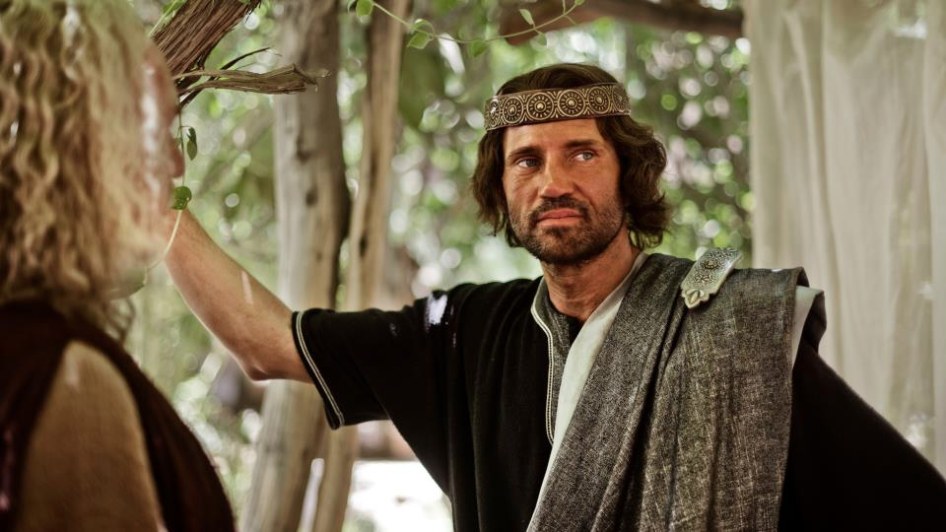
D. Avoid sexual sin because God calls it evil and will judge us for it (5:21-23).
Notes:
(5:21) Resist sexual sin because God sees everything we do and judges each deed.

Slide 184

"For the LORD sees clearly what a man does, examining every path he takes"
(5:21 NLT).

Slide 185

"An evil man is held captive by his own sins; they are ropes that catch and hold him. ²³He will die for lack of self-control; he will be lost because of his great foolishness" (5:22-23 NLT).
Notes:
(5:22-23) Resist sexual sin because it is an evil deed that causes personal ruin.

Slide 186
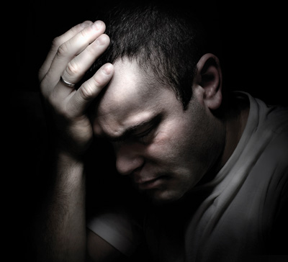
II. Here are ideas to avoid the trap of sex sin.

Slide 187

Realize that your eye is the gateway to your mind.

Slide 188


WARNING! facebook may lead to adultery
Notes:
Remove your sources of temptation!

Slide 189

Safeguard your computer and mobile phone!

Slide 190
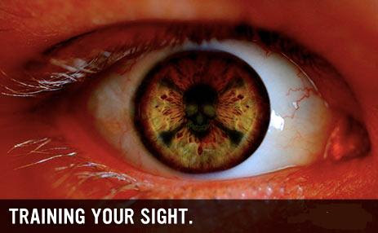
"The eye is the lamp of the body; so then if your eye is clear, your whole body will be full of light"
(Matthew 6:22).
Train your eye not to see things that stimulate lust.

Slide 191

Guard your hands from lust (Matt 5:30)

Slide 192
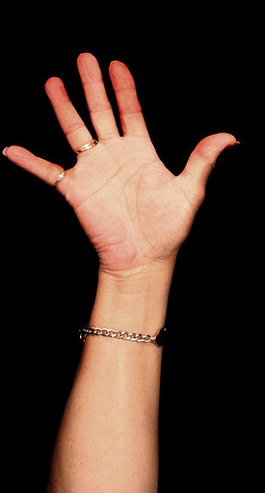
"And if your right hand causes you to sin, cut it off and throw it away. It is better for you to lose one part of your body than for your whole body to go into hell"
(Matt 5:30 NIV).
Notes:
Would a one eyed and one-handed person be guaranteed not to sin?
Obviously not—you can still lust with the left eye and still touch someone inappropriately with the left hand.
Both the right eye and right hand were viewed as more valuable in antiquity, as most people then (as now) were right-handed. So the point is that we must be willing to take severe measures to protect ourselves from sin.

Slide 193
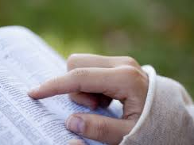
"How can a young man keep his way pure? By keeping it according to Your word. With all my heart I have sought You; Do not let me wander from Your commandments" (Psalm 119:9-10).
Replace your sources of temptation with sources of purity.

Slide 194

Hug right.
Notes:
Avoid touching anything or anyone that encourages lust. Hug right—

Slide 195
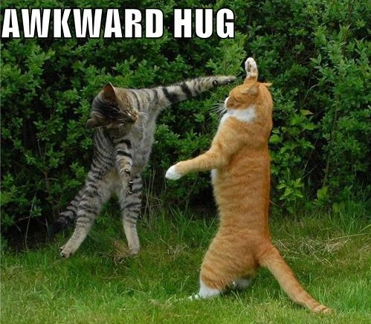
Avoid the AWKWARD HUG
Notes:
—but not the awkward hug!

Slide 196

How can you guard yourself from sexual sin?

Slide 197
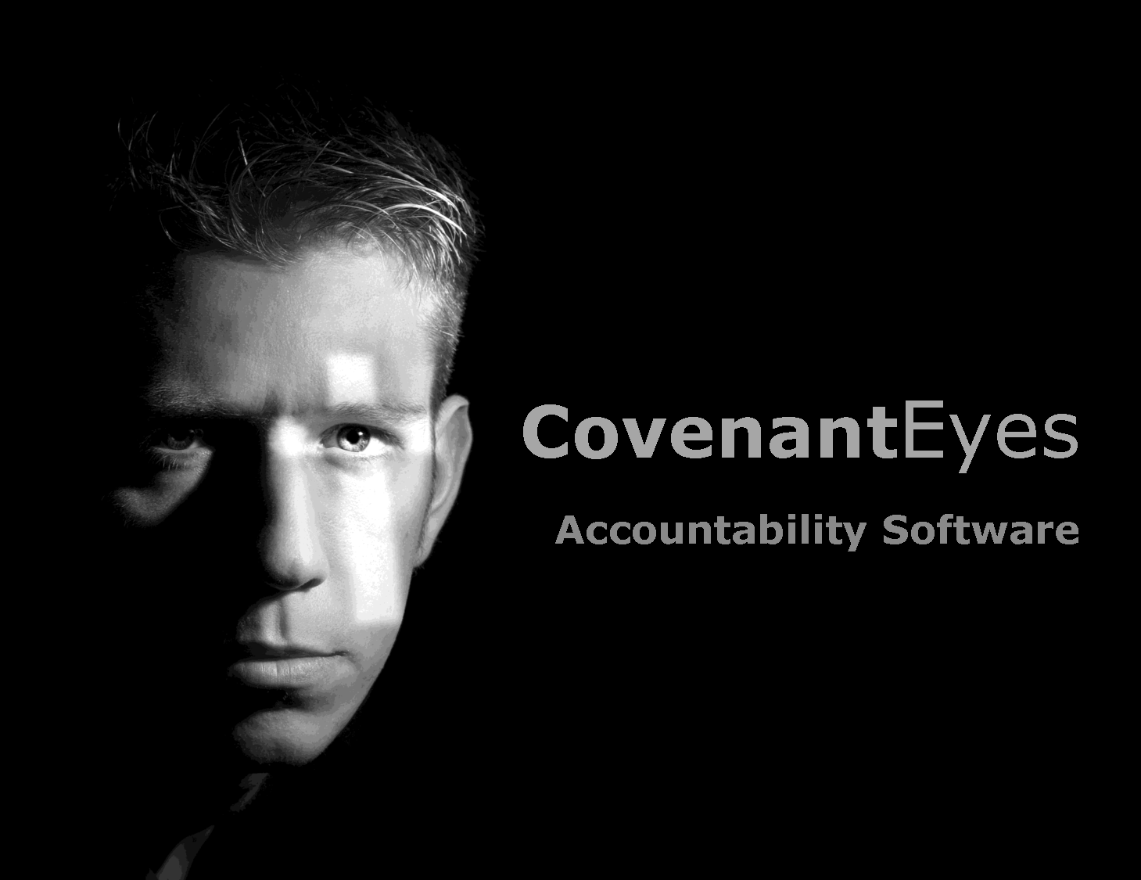
Wisdom gives us many reasons to avoid sexual sin.
Main Idea:
Notes:
Vow and guard!

Slide 198
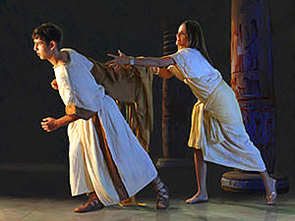
"How could I sin against God?"
(Gen. 39:9)
Notes:
Obviously Potiphar's wife was the one to blame, but other women are like her.

Slide 199

How to Quit Porn
Want to quit porn
Do things you haven't done before
Be brutally honest with another person
"Clean house"
Block entry points
Get accountable to a man
Douglas Weiss
CovenantEyes.com
Notes:
How to Quit Porn: 6 Essential Steps
Monday, April 23, 2012 | Written by Guest Author
Accessed 19 Feb 2017
The first part to quitting porn is you really have to want to quit porn. You need to be sick and tired of porn and the sickness that it causes you in order to quit. If you are not committed, you will only be quitting until the next time you look. Deep inside you have to want to stop.
Secondly, you have to be willing to do things you haven't done before. Seriously, if you keep quitting the same way, you're likely to fail again. To quit, you have to give up what you've been doing and do what you have to do.
Thirdly, you have to be brutally honest with another person. This person may be a male friend, your wife, a person of clergy, a life coach or a twelve step group person. Somebody has to know the truth about your porn usage for you to get and stay free.
Next, you have to do what I call "clean house." You have to get rid of the porn you have. Throw away the discs, magazines, anything you have used as pornography, and make sure to dump and clean out your computer. This is just a start, some you have to clean house regularly.
The next step is you have to block entry points. This means have a porn blocker and accountability software like Covenant Eyes on your phone, computer at home, and at the office. If you have people sending you compromising emails, block them. Unsubscribe from porn websites. You may have to decide if credit cards are a problem. You know how porn is coming into your life. If you had a gun to your head in a minute you could block entry points.
Finally, get accountable to a man on a daily basis about your porn usage. Make a call a day and a commitment to call this person before you even consider looking at porn. People who set consequences for porn relapse do better. Seriously, if you look at porn, set a consequence. Some guys run laps, give money to the political party they don't vote for, do leg lunges for a half mile, give up some privilege or just pick up trash on the highway for a few hours.
You have to decide that you are worth living porn free. I decided that almost 25 years ago and just passed a polygraph verifying my freedom. I believe you're worth it but your behavior will show you if you are. Don't believe your words. Believe only your behaviors; otherwise, you can be in denial as to your commitment to being porn free.
Remember, you are not the only one being affected if you are married. She is in pain because of your porn usage. Your children are being affected as well. They deserve the best man you can be. You decide. Do they get the porn-drunk you or the porn-free you? I recommend the porn-free you. It's the better you.
Photo credit: um_gngama
. . . .
Douglas Weiss, Ph.D. is a nationally known author, speaker and licensed psychologist. He has appeared on many national talk shows including Oprah, Dr. Phil, Good Morning America and 20/20. Dr. Weiss travels the country training professionals in the treatment of marriage, sexual addiction, and sexual abuse. Dr. Weiss is currently the executive director of Heart to Heart Counseling Center where his staff offers 3-Day Intensives and Telephone Counseling in his Colorado Springs, Colorado office.

Slide 200

"What's the big deal? All men look at porn. It is perfectly normal. Well, most men look at porn. This is normal."

Slide 201
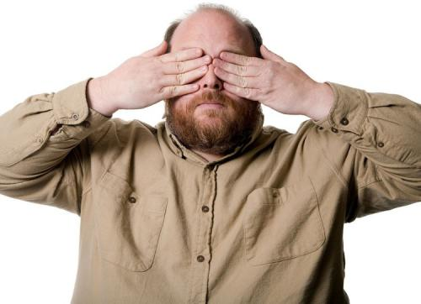
"Flee [sexual] immorality. Every other sin that a man commits is outside the body, but the immoral man sins against his own body" (1 Cor. 6:18 ).

Slide 202

"I made a covenant with my eyes not to look with lust at a young woman"
Job 31:1 NLT

Slide 203

SIGN UP FOR
COVENANT EYES
SOFTWARE

Slide 204

Covenant Eyes

Slide 205

Christian Accountability
Christ-Centered Questions for Accountability Partners
Notes:
We men need to help each other here.

Slide 206



Covenant Eyes
Notes:
Protect your kids too.

Slide 207

Title
Your Brain on Porn
Notes:
Download this pdf for free.

Slide 208



Resources
Notes:
XXXChurch.com is a free porn addiction accountability program.
Investigate movies with Plugged In to see how many times sexually explicit images appear in a movie.

Slide 209
Main Points (Amsal 5):
Preserving yourself will…
      Keep you from regret (3-6)
      Guard your body, money, emotions, and reputation (7-14)
      Help you enjoy sex in marriage (15-20)
      Enable you to account to God (21-23)

Slide 210

Questions
Have you promised purity to God?
Are you going down the path of the simpleton right now? How?
What should you do about it?

Slide 211
Slides on
Amsal 6

Slide 212
Wisdom
preserves from poverty (6:1-11).
Notes:
Text

Slide 213
The Ant (6:6)
"Go to the ant, O sluggard.
Observe her ways and be wise."
After the Sluggard family considered the ways of the ants

Slide 214
Wisdom
preserves from dissension (6:12-19).
Notes:
Text

Slide 215
Wisdom
preserves youth from sexual immorality
(6:20–7:27).
Notes:
Text

Slide 216
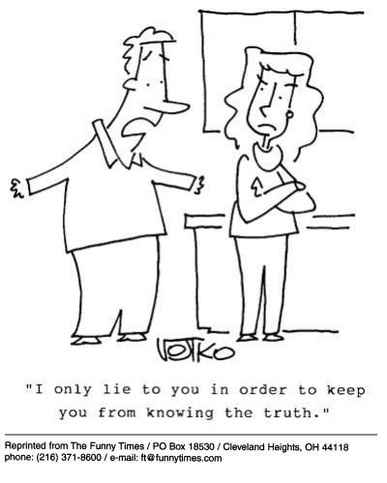

Things God Hates (6:16-19)
Violent people
Those who are untruthful
"I only lie to keep you from knowing the truth."

Slide 217

Things God Hates (6:16-19)
Violent people
Those who are untruthful
Sacrifice of the wicked
Way of the wicked
Thoughts of the wicked

Slide 218

Things God Hates (6:16-19)
Violent people
Those who are untruthful
Sacrifice of the wicked
Way of the wicked
Thoughts of the wicked
Those who are proud

Slide 219

Things God Hates (6:16-19)
Violent people
Those who are untruthful
Sacrifice of the wicked
Way of the wicked
Thoughts of the wicked
Those who are proud
Those who judge unjustly

Slide 220

"The one who commits adultery with a woman is lacking sense; He who would destroy himself does it. Wounds and disgrace he will find, and his reproach will not be blotted out" (Prov. 6:32-33).

Slide 221
Slides on
Amsal 7

Slide 222

— Mark Twain —
It is better to keep your mouth closed and let people think you are a fool
than to open it and remove all doubt.
Notes:
And yet, is Mark Twain known for opening his mouth or for keeping silent?

Slide 223

— Mark Twain —
It's easier to fool people
than to convince them
that they have been fooled.
Notes:
Twain showed himself to be a wise fool.

Slide 224

— Mark Twain —
THE BIBLE
"It is full of interest.
It has noble poetry in it; and some clever fables; and some blood-drenched history;
and some good morals; and a wealth of obscenity;
and upwards of a thousand lies."
Notes:
He was a godless man who rejected God's Word and encouraged others to do so also.

Slide 225
Slides on
Amsal 8

Slide 226
Wisdom
has valuable virtues, rewards and was used in creation (Prov 8).
Notes:
Text

Slide 227
Slides on
Amsal 9

Slide 228
Wisdom
is valuable compared to the claims of foolishness (Prov 9).
Notes:
Text

Slide 229
I. Learn discipline and fear of the LORD (1:1-7).
How to be wise...
Notes:
Restatement

Slide 230
II. Value wisdom that leads to a prosperous life (1:8–9:18).
How to be wise...
Notes:
Restatement

Slide 231
Slides on
Amsal 10

Slide 232
III. Heed advice of wise men on relationships
(Prov 10–31).
How to be wise...
Notes:
Restatement

Slide 233
About 375 two-line Amsal of Solomon teach the practical benefits of wisdom over wickedness in everyday life (10:1–22:16).
Notes:
Text

Slide 234
Slides on
Amsal 11

Slide 235
Words and Speech
401
The way I heard it…
"He who goes about as a talebearer
reveals secrets, but he who is
trustworthy conceals a matter"
(Amsal 11:13)
I heard that…
Did you know that…

Slide 236
VERY Descriptive!
"As a ring of gold in a swine's snout, so is a beautiful woman who lacks discretion"
(Amsal 11:22)

Slide 237

Hefner Had Three Rings of Gold
TODAY 28 Aug 06
On Hefner's 80th birthday
Notes:
Hugh Marston Hefner (born April 9, 1926) is an American adult magazine publisher, businessman, and a well-known playboy. Hefner is a native of Chicago, Illinois and a former journalist for Esquire. Hefner is also a World War II veteran. He is best known for being the founder and chief creative officer of Playboy Enterprises.^{[1]} A self-made multi-millionaire, his net worth is over $43 million, because of his success as the founder of Playboy magazine. Hefner is also a political activist and philanthropist active in several causes and public issues…
Spouse(s):
Mildred Williams (1949–59)
Kimberley Conrad (1989–2010)
Crystal Harris (2012–present)
Partner(s):
Barbi Benton (1969–76)
Brande Roderick (2000–01)
Holly Madison (2001–08)
Bridget Marquardt (2002–09)
Kendra Wilkinson (2004–08)
Children:
Christie Hefner
David Hefner
Marston Hefner
Cooper Hefner
https://en.wikipedia.org/wiki/Hugh_Hefner
Accessed 13 Sep 2016

Slide 238

Hefner's One Ring of Gold
At age 86 he married Crystal Harris on
31 Dec 2012 (age 26)
Notes:
In January 2009, Harris started dating Hugh Hefner,^{[12]} joining the Shannon Twins after his previous "number one girlfriend", Holly Madison, had ended their 7-year relationship.^{[13]} On December 24, 2010, she became engaged to Hefner, to become his third wife.^{[14]} Harris broke off their engagement on June 14, 2011, five days before their planned wedding.^{[15]} In anticipation of the wedding, the July issue of Playboy, which reached store shelves and customers' homes within days of the wedding date, featured Harris on the cover and in a photo spread as well. The headline on the cover read "Introducing America's Princess, Mrs. Crystal Hefner".^{[16]} It was later covered on newsstand issues with a sticker that read "Runaway Bride". The two later reconciled, and on December 31, 2012, Harris and Hefner married at the Playboy Mansion in a small private ceremony; he was 86 and she was 26.^{[17][18]}
In 2016 Hefner announced on Twitter that she's been suffering from Lyme disease.
https://en.wikipedia.org/wiki/Crystal_Hefner

Slide 239
Slides on
Amsal 12

Slide 240
Slides on
Amsal 13

Slide 241
Diligence and Laziness
"The soul of the sluggard craves and gets nothing,
but the soul of the diligent is made fat"
(Prov. 13:4)

Slide 242
Slides on
Amsal 14

Slide 243
Slides on
Amsal 15

Slide 244
Godliness over Gold
"Better is little with the fear of the LORD
than great treasure and trouble with it."
Amsal 15:16

Slide 245
Slides on
Amsal 16

Slide 246
Slides on
Amsal 17

Slide 247
Slides on
Amsal 18

Slide 248


The power of words
Amsal 18:21

Slide 249


Amsal 18:21 NLT
"The tongue can bring death or life; those who love to talk will reap the consequences."

Slide 250
Slides on
Amsal 19

Slide 251
The Sluggard
"The sluggard buries his hand in the dish, and will not even bring it back to his mouth."
- Amsal 19:24

Slide 252
Slides on
Amsal 20

Slide 253
Slides on
Amsal 21

Slide 254
Amsal 21:19
"It is better to live alone in the desert
than with a crabby, complaining wife."

Slide 255
Slides on
Amsal 22

Slide 256
Wisdom
Longer sayings of wise men admonish practical wisdom in many areas
(22:17–24:34).
Notes:
Text

Slide 257

Wisdom Literature Parallels
OTB 188b
Amen-em-opet
Amsal 22:17–24:22
"Give thine ear, and hear what I say, And apply thine heart to apprehend; It is good for thee to place them in thine heart, let them rest in the casket of thy belly; That they may act as a peg upon thy tongue” (chap. 1)
"Incline thine ear, and hear the words of the wise, And apply thine heart to my doctrine; For it is pleasant if thou keep them in thy belly, that they may be established together upon thy lips” (Amsal 22:17-18)
Notes:
"The Legacy of Egypt", S. R. K. Glanville, contributor W. O. E Oesterley, p. 246-248, Oxford, 1942 (http://en.wikipedia.org/wiki/Instruction_of_Amenemope accessed 9 July 2014)

Slide 258
Wisdom Literature Parallels
OTB 188b
Amen-em-opet
Amsal 22:17–24:22
"Beware of robbing the poor, and oppressing the afflicted” (chap. 2)
"Rob not the poor, for he is poor, neither oppress (or crush) the lowly in the gate” (Amsal 22:22)
Notes:
"The Legacy of Egypt", S. R. K. Glanville, contributor W. O. E Oesterley, p. 246-248, Oxford, 1942 (http://en.wikipedia.org/wiki/Instruction_of_Amenemope accessed 9 July 2014)

Slide 259
Slides on
Amsal 23

Slide 260
Descriptive or Prescriptive?
"Do not wear yourself out
to get rich" (Prov. 23:4)

Slide 261
The Drunk
"They struck me, but I did not become ill; they beat me, but I did not know it. When shall I awake? I will seek another drink."
(Amsal 23:35)

Slide 262
Slides on
Amsal 24

Slide 263
Wisdom is good for you
"My son, eat honey, for it is good,
Yes, the honey from the comb is
sweet to your taste;
Know that wisdom is thus for
your soul." ~ Amsal 24:13-14a

Slide 264
The Lazy (24:33-34)
"'A little sleep, a little slumber, a little folding of the hands to rest,'
then your poverty will come as a robber…" Amsal 24:33, 34a

Slide 265
Slides on
Amsal 25

Slide 266
Wisdom
The final collection of Solomon's Amsal by Hezekiah's scribes 250 years later guide social relationships and various activities (Prov 25–29).
Notes:
Text

Slide 267
Descriptive…
"Like clouds and wind
without rain is a man who boasts
of his gifts falsely."
Amsal 25:14

Slide 268
Relationships
Who's ready to exercise?!
Amsal 25:17 "Seldom set foot in your neighbor's house—too much of you, and he will hate you."

Slide 269
Slides on
Amsal 26

Slide 270
Amsal 26:11
"Like a dog that returns to his vomit,
so does a fool repeat his folly."

Slide 271
Slides on
Amsal 27

Slide 272
Slides on
Amsal 28

Slide 273
Slides on
Amsal 29

Slide 274
Amsal
Nilai dan Jalan Hikmat
Solomon |  |  | Wise Men (Anonymous) | Solomon | Wise Men (Agur, Lemuel, Anonymous)
1:1–22:16 |  |  | 22:17–24:34 | Ch. 25–29 | Ch. 30–31
13 firman 375 dua-baris |  |  | 36 firman | ±100 dua-baris | 3 firman
 |  |  | Sosial & Lain-Lain | Social & Lain-Lain
Pro-log | Prinsip-Prinsip Hikmat |  |  |  | Epilog
Sekitar tahun 950-700 SM
394
Penguasa 31:1-9
Tujuan 1:1-7
Sosial & Alam Ch. 30
Istri yang Saleh 31:10-31
Nilai Kebijaksanaan 1:8–9:18
Kontras & Kesalehan
10:1–22:16

Slide 275
Slides on
Amsal 30

Slide 276
Wisdom
Sayings of Agur to Ithiel and Ucal show insights from nature and social relationships (Prov 30).
Notes:
Text

Slide 277




Amsal 30:18-20 (NIV)
"There are three things that are too amazing for me, four that I do not understand:"
the way of an eagle in the sky,
the way of a snake on the rock,
the way of a ship on the high seas,
and the way of a man with a maiden

Slide 278
Slides on
Amsal 31

Slide 279
Wisdom
The unknown Lemuel’s mother prepares him for kingship by advising him to avoid the excesses of women and wine, and to protect the rights of the underprivileged (31:1-9).
Notes:
Text

Slide 280
Wisdom
An acrostic and anonymous poem of a noble wife exhorts young women to be godly and diligent and exhorts young husbands to praise these qualities in their wives (31:10-31).
Notes:
Text

Slide 281


The Two Women:
Wisdom & Folly

Slide 282

Amsal 31
The Wise Woman

Slide 283

Each society has its ideal woman
"The model of women in tribal patriarchalism is a brood mare;
in hedonistic naturalism, she is the bunny or plaything;
in feminist ideology, she is the self-sufficient career woman;
in romanticism, she is the fairy princess or maiden in distress waiting to be rescued;
in biblical faith, she is the partner in ministry."
Theologian Donald Bloesch (1928-2010)

Slide 284

"Who can find a virtuous and capable wife? She is more precious than rubies"
(Prov. 31:10 NLT).

Slide 285

Amsal 31
She Rises Early
"She rises while it is still night and gives food to her household and portions to her maidens" (Prov. 31:15)

Slide 286

Amsal 31
She Smiles at Her Future
"Strength and dignity are her clothing, and she smiles at the future" (Prov. 31:25)
Notes:
Chrystal Evans Hurst
https://www.Amsal31.org/speakers

Slide 287

Amsal 31:30
"Charm is deceptive…Beauty is fleeting… But a woman who fears the Lord is to be praised"
(Prov. 31:30).

Slide 288



She is deemed the best model

Slide 289

Stop comparing yourself to the Amsal 31 woman.
http://924jeremiah.wordpress.com/2014/03/21/stop-comparing-yourself-to-the-Amsal-31-woman/ advises…
Learn who invented the Amsal 31 woman and why this list of "ideal" qualities doesn't align with God's priorities for you.
Notes:
For all you women who are trying to please God but feel utterly despaired every time someone whips out Amsal 31: take heart! God is not comparing you to this fictitious female, nor should you be interpreting this passage as His personal calling on your life. To put this passage in perspective, you need to put the whole book of Amsal in perspective. A proverb is simply a saying. The Holy Spirit will make it clear to you when a particular proverb has any value for you in a given moment. But let's be clear about the kind of effect the Holy Spirit's Voice has on us. When He speaks to your heart, you don't end up feeling beat down, discouraged, and hopelessly flawed. So as you're reading through Amsal 31, if it feels like someone is shoveling wet cement onto your back and you're feeling more and more burdened with every word you read, then you're not hearing from the Holy Spirit. You're hearing from that nasty old deceiver Satan, or one of his many sordid friends.
Demons are the ones who want you to go through life feeling like a flop because you don't live up to someone's fantasy woman. And fantasy is what we're dealing with in Amsal 31, because the woman described there has magically escaped the burden of carnal flesh. Not only is this woman utterly selfless, she's also in perfect health, she's got bundles of energy, she's super social, she's physically strong, and she clearly has more than 24 hours in a day. And as this charming lady is busy making everything from scratch and running a charity house for the poor out of her home, she's also super wealthy (since she and her children only wear the best of threads), plus she's politically powerful. Her husband is one of the leaders in the land (v23), which puts her hobnobbing in higher society. And to top it all off, this lady who weaves her own fabric and sews everything she owns from scratch also gets by on only a few hours of sleep. We're told she works late into the night and is up before the sun feeding the servant girls. She never wastes her time (v27), and she gives her husband everything he needs. So of course her family praises her and everyone thinks this lady is fabulous. And by the time she's done making wardrobes from scratch, planting vineyards, cooking meals and running a booth at the local marketplace, we wonder what those servant girls do besides get up before dawn to eat their pre-made breakfast.
So how do we put things in perspective here? Well, for one thing, let's remember how credit is assigned to people in the Old Testament. For example, we're told that King Solomon built God's Temple, per the instructions of his father King David. But while Solomon gets all the glory for creating that massive structure, what did he really contribute besides a long prayer on dedication day? In real life King Solomon didn't lift a single stone—he just told other people to go and build the Temple while he went off and parked in a nice shaded room with lots of goodies and soft sofas. When all the laborers were done sweating and slaving under the hot sun, their accomplishments were recorded as Solomon's accomplishments. This is how it works when you're the king or the head of a household. In Amsal 31, the woman being described is running a rich household. That means she'd have a bunch of servants who she'd get to boss around all day. Would a woman in her position really be trimming wool off the sheep and weaving it into thread? No, because such tasks are beneath her. What we really have being described in Amsal 31 is a good delegator—someone who is definitely busy, but she's also telling everyone else what to do all day and then taking the glory for both their work and hers. Well, no wonder she gets so much done.
Look up rich people in the Bible and you'll find they are credited for all sorts of things that they didn't do. In a culture where women got the credit for the babies their slave girls birthed, we have to read records of accomplishments with caution.
So who wrote Amsal 31, anyway? It's a man named King Lemuel who is sharing things his mother drilled into his brain. In verse 1 we're told: "These are the words of King Lemuel, the message his mother taught him." Lemuel's mom then starts off by telling her son to stay away from liquor because kings don't rule well when they're drunk. Then she tells him to look out for the needs of the poor. This is certainly sound advice. Interestingly in verse 3, Mom doesn't sound very keen on women in general, for she tells her son:
"Don't waste your strength on women, or your time on those who ruin kings."
The way poetry works in the Bible, these two phrases are meant to be descriptions of the same people: Mom is defining women as "those who ruin kings." Now we all know that rich men become targets for Delilah type vipers. Mom sounds pretty protective, and she has good reason to be. There's a reason kings have harems—once a guy gets some rank, his hormones have a way of taking him over and pretty soon he cares more about sex than he does about his kingdom and God. This is what happened with King Solomon and his 1,000 recorded lovers (plus who knows how many unrecorded flings). Solomon has had a lot more airtime in the book of Amsal. We only hear about Lemuel here at the end, when Mom pipes up to tell her son "no wine and no women." Rather harsh. One wonders if Mom is ruling out all women or just the shady ones. It's interesting that she doesn't use any extra adjectives to pinpoint what percentage of her own gender she disapproves of. The way her words are written, it sounds like Mom's pretty much anti-female. Perhaps she's been burned in the past by seeing evil women corrupt those she cares about and she's not going to let that happen to her Lemuel.
Now it's not very realistic to think Lemuel isn't going to get married, so after Mom tells him to stay away from women in general, she then supplies a long, detailed definition of an acceptable wife. Because Lemuel is crediting Mom for everything he's saying in this passage, we have to assume that this perfect wife is something she's come up with—and this would make sense because the passage has a very female tone to it. Women are the nurturing gender and we hear the nurturing instinct coming through in a comment about the woman being concerned for her family's warmth in the winter months (v21), plus we hear an awful lot about clothes and cooking. The Amsal 31 perspective is very much that of a homemaker and not at all that of a busy king. Clearly Lemuel's mom is a fan of the textile industry for we hear all about fabric in this passage—weaving it, sewing it, and selling it. We hear about raw material: wool and flax. We hear about the quality of the finished product: fine linen. And we hear about colors: scarlet and purple. With such a strong focus on fabric, it's quite possible that Lemuel's inherited wealth came from the clothing business. So what we find in Amsal 31 is not a description of God's ideal woman, but of one king's mother's ideal vision for the kind of woman she wants her son to marry. What mother doesn't hope for the stars when it comes to marrying off her pride and joy? And with Mom's hostility towards women in general so openly expressed, it's no wonder that she's demanding the best of the best for her son. She wants Lemuel to find a woman who will satisfy his every need, make him a bunch of money, and be a total workaholic. With her daughter-in-law working hard day in and day out, she certainly wouldn't be much competition for Lemuel's attention. When we realize who is really supplying the words of this passage, it's interesting to wonder about all the ulterior motives that went into painting a picture of an "ideal" woman—a woman who clearly doesn't exist. Obviously Mom isn't in any rush for grandchildren. And clearly she isn't going to be an easy sell to anyone Lemuel tries to bring home for dinner.
"An excellent wife, who can find?" (v10)
Indeed, and as we read through Mom's list of impossible requirements, we wonder if she ever wants Lemuel to get a wife. It's really Mom's character that's coming through in this passage more than anything else. Whoever Lemuel's mother was, she clearly felt that lollygagging about was a major sin. She sounds like a very driven woman—obsessed with productivity and very concerned with social reputation. What does God tell us about these themes elsewhere in the Bible? Well, when Martha complained that her sister Mary was slacking with the household chores, Jesus took the side of the slacker. Productivity is all fine and well, but God tell us not to store up our treasures here on earth, or to spend our lives focused on accumulating wealth.
As for all people thinking well of us—this is another dream that both Yahweh and Jesus shoot down. As Christians, we don't want to be agitating others just to do it. But God's truth is a divisive thing, and His influence is often greeted with great hostility. Jesus said He didn't come to bring peace to the world, but to cause division and strife (Lk 12:51). The more we mature in the faith, the more division we will cause as well. Lukewarm Christians are generally tolerated by the world, but fully devoted ones are met with opposition in both the world and the Church. Who was it that really pushed for Jesus to be crucified? It was the religious leaders, not the lay people. It was the ancient Jewish equivalent of our modern pastors, theologians and elders. The more like Christ we are, the more we can expect the same hostile treatment He received. So while Lemuel's mom dreams of a daughter-in-law who is both righteous in character and super popular, in real life, these two

Slide 290

Amsal 31
Is this for women only?
Not really. It gives an example of what wisdom looks like in a woman.
Men need the same qualities!

Slide 291
Pernyataan Ringkasan
394
Hikmat Salomo dan kutipan orang-orang bijak bertujuan untuk mengajar kaum muda tentang nilai hikmat yang lebih baik daripada kebodohan dengan cara hidup taat di hadapan Allah dalam setiap segi kehidupan.

Slide 292
Ide Utama Amsal
Takut akan Tuhan dengan memperhatikan Amsal-Nya tentang nilai dan jalan hikmat.
Notes:
Restatement

Slide 293
Aplikasi
394
Ajarlah Amsal kepada remaja (& anak-anak)
Ingatlah Amsal untuk mendukung hidup berhikmat
Bacalah SATU pasal Kitab Amsal setiap hari

Slide 294
Black

Slide 295


Khotbah PL • BibleStudyDownloads.org
Dapatkan presentasi dan bahan ini secara gratis!
Notes:
OT Survey (os)

Slide 296

Be thou my vision 1/4
Be thou my vision,
O Lord of my heart;
Naught be all else to me,
save that thou art-
Thou my best thought,
by day or by night,
Waking or sleeping,
Thy presence my light.

Slide 297

Be thou my vision 2/4
Be Thou my Wisdom,
and Thou my true Word;
I ever with Thee and Thou with me, Lord;
Thou my great Father,
I Thy true son,
Thou in me dwelling,
and I with Thee one.

Slide 298

Be thou my vision 3/4
Riches I heed not nor
man's empty praise,
Thou my inheritance,
now and always;
Thou and thou only,
first in my heart,
High King of heaven,
my treasure Thou art.

Slide 299

Be thou my vision 4/4
High King of heaven, my victory won,
May I reach heaven's joys,
O bright heav'ns Son!
Heart of my own heart, whatever befall,
Still be my Vision, O ruler of all!

Slide 300
8 October 2003 Group Presentation
Amsal
Old Testament Survey

Slide 301
Black

Slide 302
Link survey PL di BibleStudyDownloads.org
Dapatkan slide ini tanpa biaya
Notes:
Old Testament Survey PPT in Bahasa Indonesia

