Slide 1
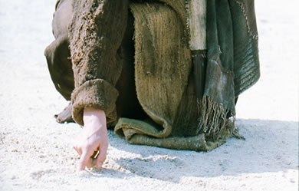
Pelayanan Literatur Kristus
Dr. Rick Griffith • Singapore Bible College • BibleStudyDownloads.org
Notes:
We have NO actual accounts of Jesus writing anything except what he wrote in the sand in John 8—and we have no idea what he wrote!

Slide 2

Jika Yesus menulis surat untuk ke gerejamu, apa yang Yesus katakan?
W
Wahyu

Slide 3

Asia Minor tahun AD 95
335
Adramyttium
Aezani
Cyme
Erythrae
Eumenia
Lebedus
Colophon
Nysa
Hierapolis
Trailes
Heraclea
Aphrodisias
Colossae
Alabanda
Patmos
Miletus
Notes:
In AD 95 John was exiled to the lonely island of Patmos out in the Adriatic Sea. Jesus Christ had a revelation of comfort to the suffering believers of Asia Minor, but how could this message reach them?

Slide 4
Ke 7 Gereja (Wahyu 2–3)
335
Adramyttium
Aezani
Pergamus
Tiatira
Cyme
Erythrae
Sardis
Smirna
Eumenia
Filadelfia
Lebedus
Colophon
Efesus
Nysa
Laodikia
Hierapolis
Trailes
Heraclea
Aphrodisias
Colossae
Alabanda
Patmos
Miletus
Notes:
Jesus designed a brilliant strategy by having his revelation sent to capital of the province, Ephesus. It included an individual letter to Ephesus, as well as letters to 6 other key churches. The Ephesians copied the entire book of Revelation, though, and sent the original to the next city, Smyrna. Smyrna then made their own copy and sent the original to Pergamum, which lay on the main road to the north. This city then sent the prophecy to Thyatira, which sent it to Sardis, then Philadelphia, and finally to Laodicea.

Slide 5
Ke 7 Gereja (Wahyu 2–3)
335
Pergamum
Thyatira
Sardis
Smyrna
Philadelphia
Ephesus
Laodicea
Notes:
These 7 churches were neither the largest, nor the most influential cities in Asia Minor. However, they were strategically located on a key highway that linked them all.
[Animate} From their own locations we understand that they also copied the prophecy and sent these copies to other churches near them.

Slide 6
Kondisi ke 7 Gereja?
324
Menderita namun menginjili
Menderita namun tekun
Tidak menyangkal namun kompromi
Menyucikan diri namun mati
Berlimpah namun suam kuku
Berkobar kobar namun rohani luntur
Aktif melayani namun tidak bermoral
Reformasi
Era Penginjilan modern
Konstantin
Abad Pertengahan
Materialistis
Para Rasul
Bapak Gereja
33
100
313
476
1453
1795
1900
Filadelfia
Efesus
Smirna
Pergamus
Tiatira
Sardis
Laodikia
Notes:
33—The Apostles of Christ pass on the gospel, but by AD 95 the love at Ephesus had grown cold
100—Last Apostle died (John) with the message passed on to their disciples, called the "Church Fathers"
313—Constantine began to merge Christianity and paganism. With paganism illegal, it took on a "Christianized" form.
476—Rome's Fall ushered in 1000 years of deviation from classical learning called the "Middle Ages" with Rome's influence through the RCC
1453—The conquest of Constantinople by the Turks began the Renaissance, followed by the Reformation
1793—William Carey left England for India, sparking the movement of the gospel from the West to the Two-Thirds World
1900—The decline of Christianity in Europe began to be replaced with humanism, materialism, modernism, and post-modernism

Slide 7
Empat Pandangan Mengenai Why 2–3
345
Pergamus
Gereja Bersejarah
Kenabian Bersejarah
Pandangan Kenabian
Tiatira
Sardis
Smirna
Filadelfia
Efesus
Laodikia
Khas (Representatif)
Notes:
Empat pandangan:
Gereja Bersejarah: Ketujuh gereja merupakan gereja yang benar-benar ada pada masa Yohanes. Semua memegang pandangan ini kecuali Bulllinger, yang pada tahun 1935 mengajarkan ketujuh gereja sebagai tujuh kongregasi Yahudi pada masa Kesengsaraan yang akan datang. Hampir semua melihat hal ini sebagai gambaran ketujuh gereja yang dapat ditemukan di segala masa.
Kenabian: Pasal ini berurusan semata-mata dengan tahapan sejarah gereja tanpa mengidentifikasi gereja manapun di abad pertama, ditunjukkan dengan kemiripan luar biasa di zaman sejarah gereja yang berikutnya (diajarkan oleh Cohen, Understanding Revelation, 48-49; and J. A. Seiss, The Apocalypse [London: Marshall, Morgan, and Scott, n.d.], 76-86).
Kenabian Bersejarah: Gereja tersebut menggambarkan gereja-gereja bersejarah dan tahapan sejarah gereja. “Pendekatan ini umumnya diambil pada tafsiran dispensasionalisme; lihat Herman A. Hoyt, The Revelation of the Lord Jesus Christ (Winona Lake, IN: BMH, 1966) 17,25-29, dan John F. Walvoord, The Revelation of Jesus Christ (Chicago: Moody, 1966) 52, yang berpegang teguh pada pandangan ini. Juga lihat Menno J. Brunk, "The Seven Churches in Revelation 2-3," BSac 126 (1969) 240-46, dan Gary G. Cohen, Understanding Revelation (Collingswood, NJ: Christian Beacon, 1968) 44-65, yang memberikan argumen yang lebih impresif. Tentu saja, Pandangan kenubuatan dipegang oleh kaum yang sebaliknya juga (contoh J. P. Lange, Commentary on the Holy Scriptures- Revelation [reprint; Grand Rapids: Zondervan, n.d.] 139). Lihat juga penelitian R. C. Trench, Commentary on the Epistles to the Seven Churches in Asia (6th ed., rev.; reprint; Minneapolis: Klock and Klock, 1978) 237-45” (James L. Boyer, “Are the Churches of Revelation 2–3 Prophetic?” Grace Theological Journal 6.2 [1985] 267-273). Ia menjawab IYA.
Khas (Representatif): Mereka merupakan gereja yang sebenarnya di masa itu, namun juga sebagai representasi tipe-tipe gereja yang ditemukan di sepanjang sejarah gereja. Maka, pandangan ini juga disebut khas atau representatif.
Kritik:
Kenabian: Keraguan apakah semua gereja yang ada bercacat—hanya karena kita tidak tahu setiap gereja bukan berarti mereka tidak ada (penyanggahan dari senyap)
Kenabian Bersejarah: Sejarah gereja tidak memiliki 7, namun 3, tahapan: Kuno (sampai 590), Pertengahanl (590-1517), dan Modern (1517-sekarang); pengangkatan hanya sewenang-wenang (contoh: apakah Sardis sebelum Reformasi atau Reformasi itu sendiri?)
Sejarah Gereja: (a) Unsur nabi manapun akan menghancurkan doktrin bahwa akan segera terjadi, jadi pasal-pasal tersebut harus berhubungan hanya dengan gereja-gereja di abad pertama sejak surat keempat dan keenam mengacu pada kedatangan Kristus yang segera terjadi, dan Filadelfia akan diberikan harapan palsu akan pembebasan dari murka (3:10) jika gereja harus menunggu sampai “masa Laodikia.” (b) Tidak ada petunjuk di pasal ini atau di mana saja dalam PB yang menunjukkan ini sebagai tahapan sejarah gereja. (c) Surat-surat ini berbeda dengan bagian kenabian dalam kitab Wahyu (Why 4–22) dalam hal mereka hanyalah surat rasul yang mirip dengan surat-surat yang ditulis Paulus.
Khas (Representatif): (a) Kesegeraan akan rusak hanya “jika hal tersebut dinyatakan secara jelas maka akan ada periode minimal dua ribu tahun sebelum kedatangan kedua, atau meskipun telah dinyatakan secara jelas bahwa akan ada ‘tujuh periode sejarah gereja’ (Boyer, 269-70. (b) Ketujuh gereja ini tidak merepresentasikan semua tipe gereja di abad pertama atau berikutnya, karena tipe lainnya ada sebelum ini (contoh Galatia or Korintus), “tujuh” gambsrsan yang lebih baik dari semua masa gereja.

Slide 8

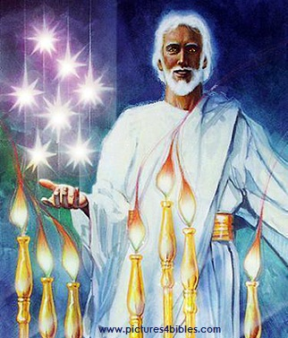
Apakah 7 Bintang & 7 Kaki Dian (1:20)?
"Dan rahasia ketujuh bintang yang telah kaulihat pada tangan kanan-Ku dan ketujuh kaki dian emas itu: ketujuh bintang itu ialah malaikat ketujuh jemaat dan ketujuh kaki dian itu ialah ketujuh jemaat."

Slide 9
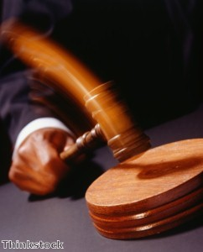
Kristus memiliki otoritas atas semua gereja

Slide 10
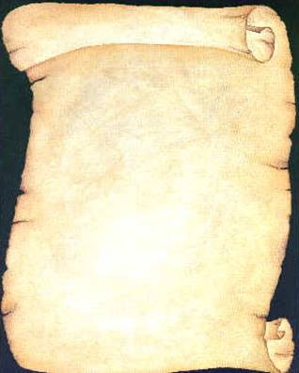
Jadi Yesus menulis surat untuk ke tujuh gereja
(Wahyu 2–3)
Efesus
Smirna
Pergamus
Tiatira
Sardis
Filadelfia
Laodikea

Slide 11
Wahyu
Kedaulatan Kristus dalam Kemenangan Masa Depan
Kedaulatan dalam umatNya |  |  | Kedaulatan atas Gereja-gereja | Kedaulatan dalam Kejadian-kejadian Zaman Akhir
Pasal 1 |  |  | Pasal 2–3 | Pasal 4–22
“Apa yang telah kaulihat” (1:19a) |  |  | “Apa yang terjadi sekarang” (1:19b) | “Apa yang akan terjadi sesudah ini” (1:19c)
Masa Lampau |  |  | Masa Kini | Masa Depan
Kristus Disingkapkan |  |  | Gereja-gereja Disingkapkan | Kesempurnaan Disingkapkan
Allah di bumi |  |  | Duta Allah di bumi | Neraka di bumi sampai Surga di bumi
Hakim |  |  | Pengangkatan | Penghakiman dan Upah
SubjeK 1:1-3 | Penyem-bahan kepada Allah Tritunggal 1:4-8 | Kristus yang mulia 1:9-20 | Tujuh Gereja di Asia: Efesus Smirna Pergamus Tiatira Sardis Filadelfia Laodikia | Kesusah-an 4:1–19:10 | Keda-tangan Kedua Kali 19:11-21 | Milenium (seribu tahun) 20 | Kondisi Kekal 21:1–22:5 | Penutup: Kesegeraan 22:6-21
95 M
318

Slide 12
Ke 7 Gereja (Wahyu 2–3)
335
Janji
Pergamus
Peringatan
Tiatira
Nasehat
Teguran
Pujian
Smirna
Sardis
N/A
Kristus
N/A
N/A
N/A
Efesus
Filadelfia
N/A
Laodikia

Slide 13
Black

Slide 14
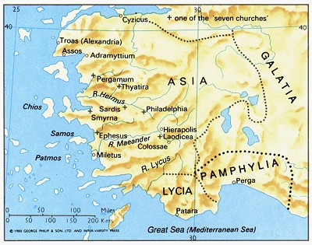
Ephesus adalah ibukota Asia
176

Slide 15
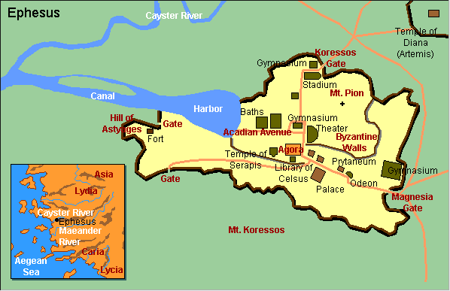
Diagram Kota Efesus

Slide 16
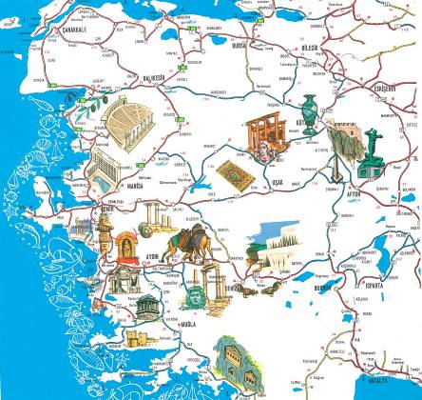
Pusat Kebudayaan

Slide 17

Album Foto

Slide 18
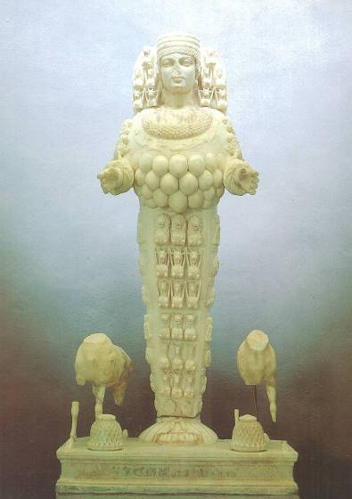
Artemis, Dewi Kesuburan

Slide 19
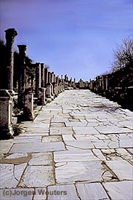
Jalan Marmer
Notes:
Marble city, chariot ruts, speed humps, after earthquake columns put back up again.

Slide 20
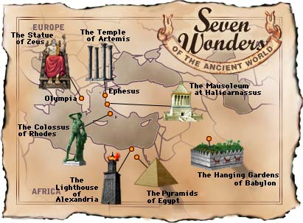
7 Keajaiban Dunia Kuno

Slide 21
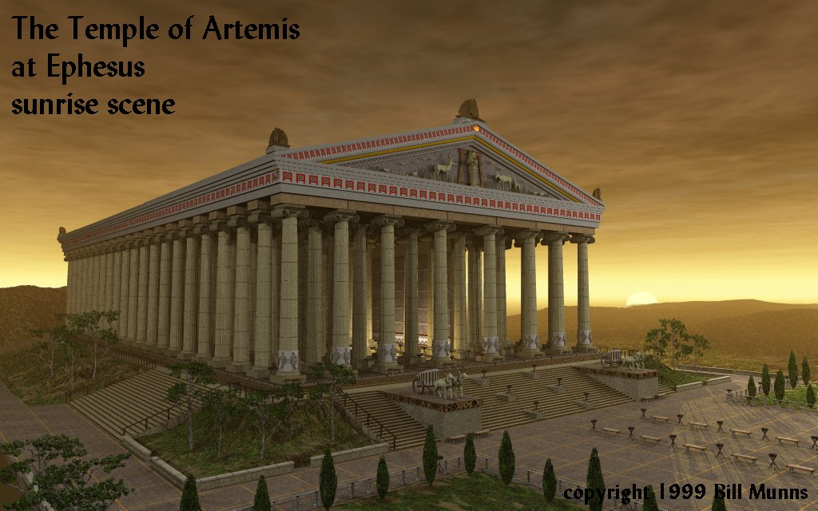

Kuil Artemis di Efesus

Slide 22
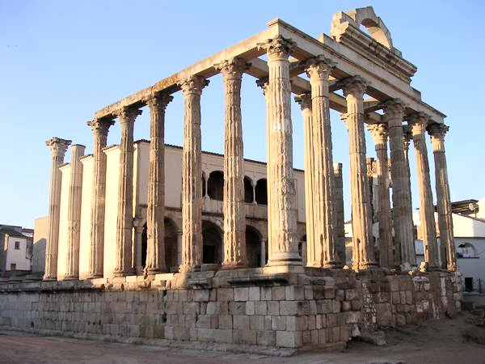
Kuil Diana (Artemis) Hari Ini
Notes:
“In Roman mythology, Diana (lt. "heavenly" or "divine") was the goddess of the hunt and moon and birthing, being associated with wild animals and woodland, and having the power to talk to and control animals. She was equated with the Greek goddess Artemis, though she had an independent origin in Italy.” (http://en.wikipedia.org/wiki/Diana_%28mythology%29)
Temple had 127 Marble pillars, Artemis (Gk), Diana (Latin)

Slide 23
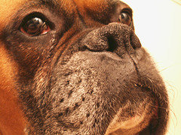
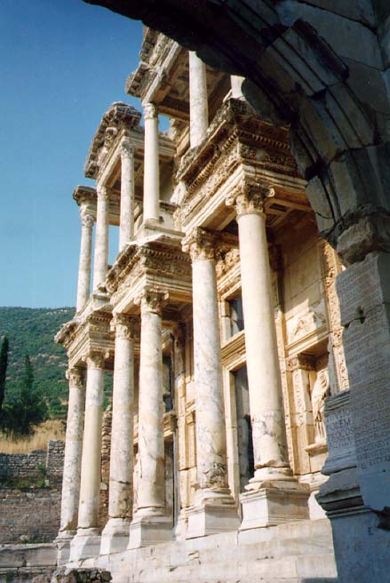
Perpustakaan Caesar
Caesar
Notes:
Marble city, chariot ruts, speed humps, after earthquake, columns put back up again. Diana-the goddess mother of e/t, 127 Marble pillars, Artemis (Gk), Diana (Latin)
Sid Caesar, Venerate: Bow to Caesar or die

Slide 24
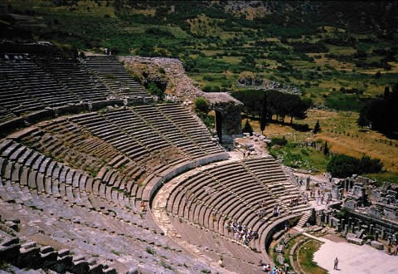
Theater berkapasitas 25,000 kursi
theh'-at-ron
Kisah Para Rasul 19:29
Notes:
The place where the Ephesian clerk averted a riot in Acts 19:29

Slide 25
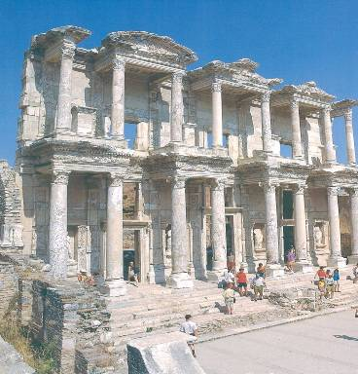
Perpustakaan

Slide 26
Amphitheatre

Slide 27
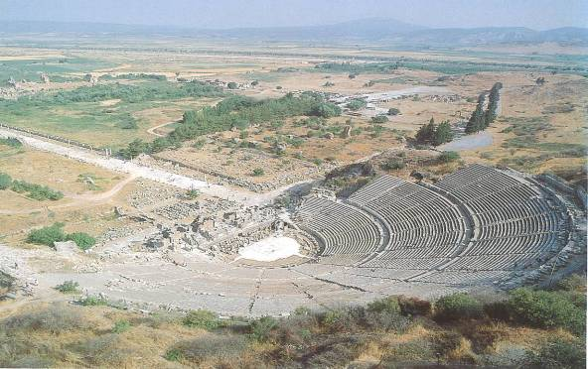
Arcadian Avenue

Slide 28
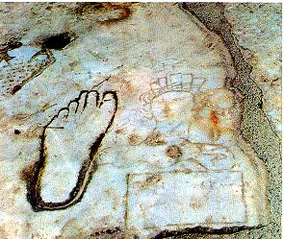
Petunjuk ketidakmoralan

Slide 29
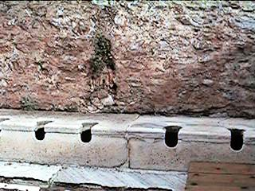
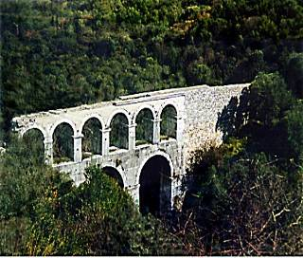
Toilet dan sistem kanal

Slide 30
Efesus (Wahyu 2:1-7)
324
Janji
Engkau akan makan dari pohon kehidupan
Pergamus
Peringatan
Jika engkau tidak bertobat,
Aku akan mengambil kaki dianmu dari tempatnya
Tiatira
Nasehat
Ingat kasih semula
Bertobat
Kembali kepada kasih semula
Teguran
Engkau telah meninggalkan kasihmu semula
Pujian:
perbuatan, kerja keras, ketekunan,
tidak toleran terhadap orang fasik, sabar menderita, membenci perbuatan pengikut Nikolaus
Kristus:
7 bintang di tangan kananNya, berjalan di antara kaki dian emas
Smirna
Sardis
Efesus
Filadelfia
Laodikia

Slide 31
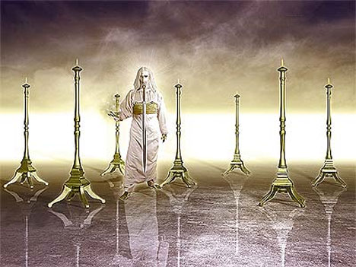
Inilah firman dari Dia, yang memegang ketujuh bintang itu di tangan kanan-Nya dan berjalan di antara ketujuh kaki dian emas itu (2:1b)
349

Slide 32

Tabel Kitab Efesus
175

Slide 33
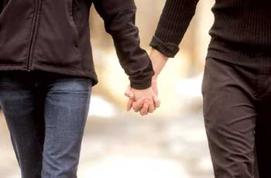
Revelation 2:4 (NIV)
Ingatkah bagaimana engkau mencintai pada mulanya?
Yet I hold this against you:
You have forsaken
your first love.

Slide 34
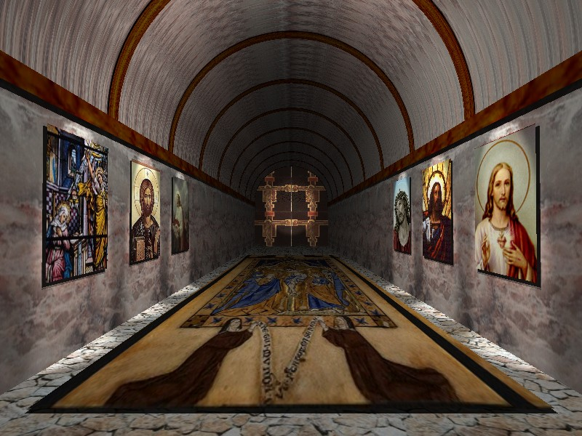
Wahyu 2:4
Efesus: Sibuk Namun Murtad
Namun demikian Aku mencela engkau, karena engkau telah meninggalkan kasihmu yang semula.

Slide 35
Black

Slide 36
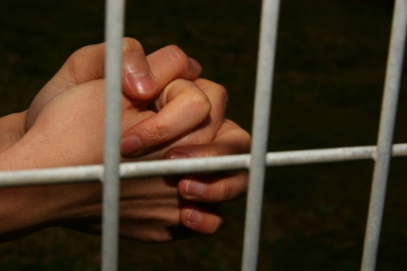
Menderita Namun Tabah
Gereja di Smirna
(Wahyu 2:8-11)
Rick Griffith • Crossroads International Church • biblestudydownloads.com

Slide 37
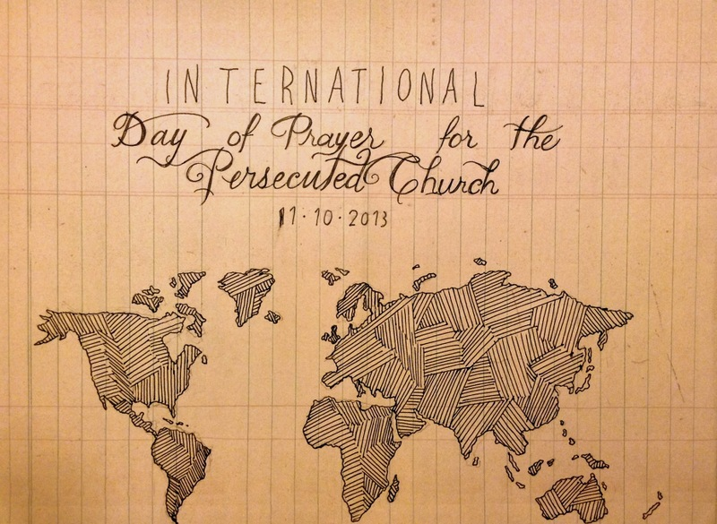
IDOP
Hari Berdoa Internasional untuk Gereja yang Dianiaya 11-10-2013
Notes:
Hari ini dan hari Minggu sebelumnya, lebih dari sejuta gereja di seluruh dunia memperingati Hari Berdoa Internasional untuk Gereja yang Dianiaya. Kami berdiri dengan mereka dan telah merancang seluruh ibadah kami untuk memperingati saudara dan saudari kita yang menderita yang kehilangan rumah, lingkungan tempat tinggal, dan orang-orang yang dicintai—ya, bahkan yang kehilangan nyawa—karena iman mereka kepada Yesus Kristus Tuhan kita.

Slide 38
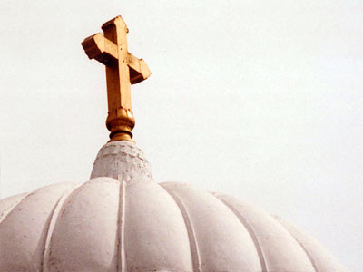
All-Saints Church
22 Sep 2013
Notes:
Pemikiran kami pada hari ini kembali pada tujuh minggu lalu sejak hari ini sampai All-Saints Church (Gereja Orang Suci).

Slide 39
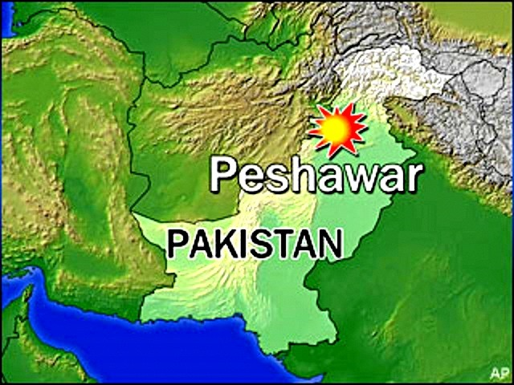
All-Saints Church
22 Sep 2013
Notes:
Gereja tersebut terletak di daerah utara Pakistan di kota Peshawar, dekat dengan batas dengan Afghanistan.

Slide 40
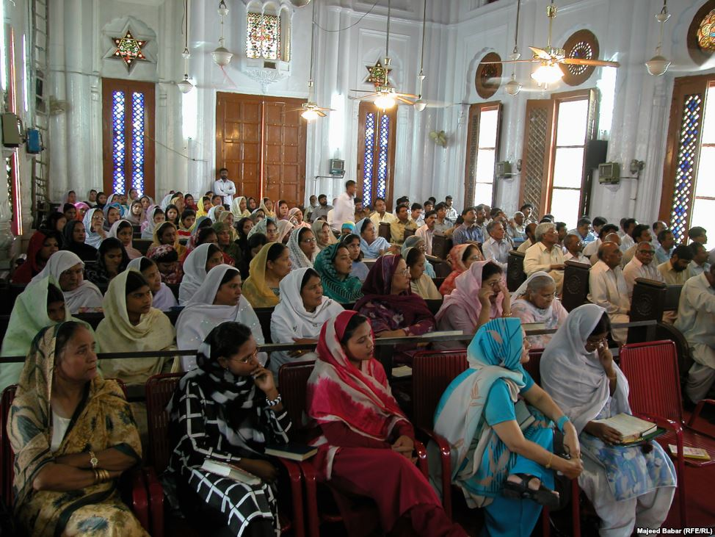
All-Saints Church
22 Sep 2013
Notes:
Inside the church it looks much like many others in that region where the men and the women sit on opposite sides.

Slide 41
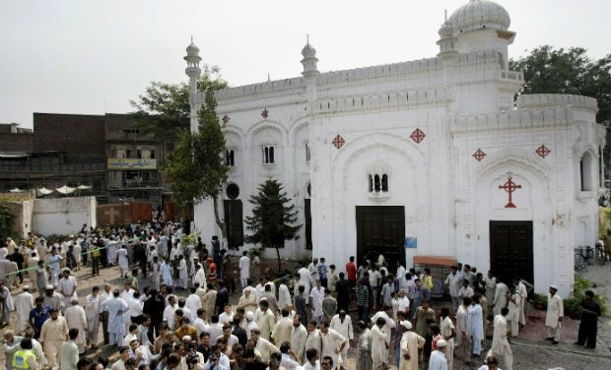
All-Saints Church
22 Sep 2013
Notes:
Pada 22 September 2013 setelah ibadah orang-orang percaya berkumpul di halaman luar gedung untuk bercakap-cakap, makan—lebih dari 200 pria, wanita dan anak-anak.

Slide 42
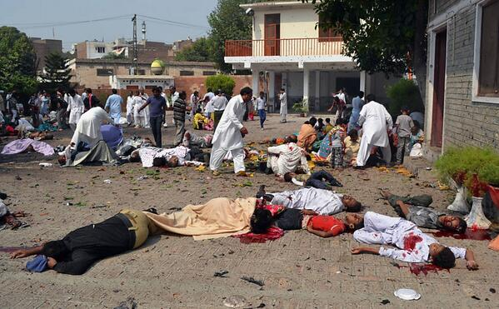
All-Saints Church
22 Sep 2013
Notes:
Di tengah-tengah mereka ada dua orang penyusup bom bunuh diri, yang mengenai anggota gereja tersebut setelah ibadah minggu itu, membunuh lebih dari 90 orang dan melukai lebih dari 150. Korban tersebut termasuk banyak anak-anak.

Slide 43
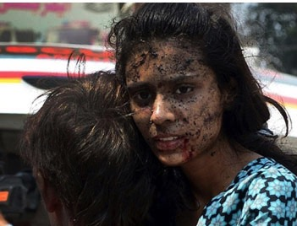
All-Saints Church
22 Sep 2013
Notes:
None of us can imagine the horror of that moment.

Slide 44
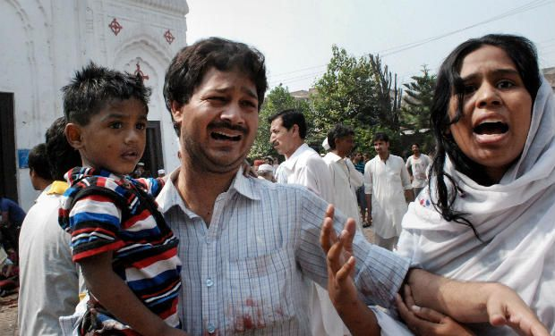
All-Saints Church
22 Sep 2013
Notes:
Tidak seorangpun dari kita dapat membayangkannya.

Slide 45
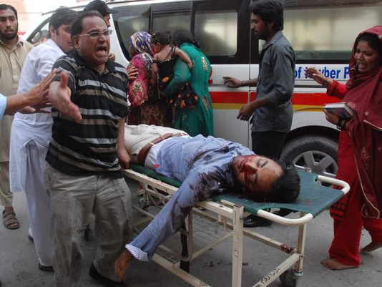
All-Saints Church
22 Sep 2013
Notes:
A wing of the Pakistani Taliban claimed responsibility for the bombing, saying it would continue to target non-Muslims until the United States stopped drone attacks in the country's remote tribal region.

Slide 46
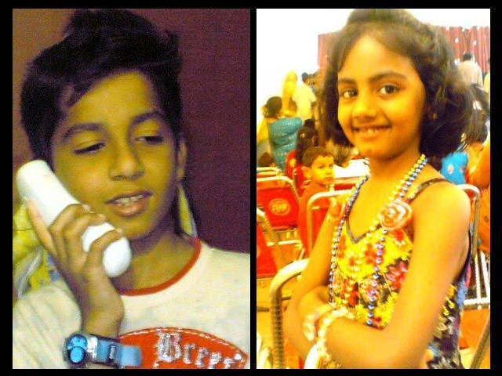
Eshaan & Neha
Notes:
Kisah tersedih melibatkan anak-anak. Ayah dari Eshaan dan Neha berada di US untuk urusan bisnis saat itu, namun setelah itu ia menulis, “Seperti yang biasa ia lakukan setelah ibadah hari Minggu, Eshaan bermain dekat gerbang gereja dengan teman-temannya. Ia tidak tahu bahwa ini adalah kali terakhir ia dapat berdoa di gereja, bermain dengan temannya, menggoda saudarinya atau memeluk ibunya. Kepalanya terlepas dari tubuhnya oleh ledakan itu dan saudarinya, Neha, yang sedang mengejar dia saat itu, sangat trauma oleh pemandangan tersebut hingga jantung kecilnya menyerah dan ia rebah di samping tubuh Eshaan yang terkoyak."
Artikel lengkap:
"The twin bombs that exploded on Sunday at All Saints Church, Peshawar, killed more than 90 people, injured nearly 150 others, and emotionally scarred thousands more.
Investigations are under way while recovery and treatment has begun for the injured and their families. For some, healing will be swift while others may take small steps over months, maybe even years. Many more might never fully recover from this tragedy.
The most heartbreaking of this and such tragedies is the number of young lives lost in these attacks. Since the blast took place on Sunday, the All Saints Church was packed to the brim with Christians from the locality; many of them students, volunteers, youth leaders, activists and Sunday school children. These were children we all knew, if not in person, at least by face. Even now as I close my eyes, I can visualise the happy little angels skipping through the church doors.
It is therefore, with great sorrow and a heavy heart that I share my memories of Neha and Eshaan.
Since the blast, I have not had a moment’s peace as I keep remembering how they used to make me laugh at their playful antics. Today I realised that the only way to alleviate my pain, even if a little bit, is by sharing their story.
These little victims of the senseless violence that rocked Peshawar in general and the Christian community in particular, were gems treasured by their parents, family, friends and teachers alike.
As he did after every Sunday mass, Eshaan was playing near the church gate with his friends. Little was he to know that this was the last time he would pray in church, play with his friends, tease his sister or hug his mother. His head was ripped off by the blast and his sister Neha, who was running after him at the time, was so traumatised by the sight that her little heart gave in and she collapsed next to Eshaan’s torn body.
I cannot even begin to imagine what Eshaan and Neha’s parents must be feeling right now. I can’t imagine the horror that any parent would feel upon hearing such news – that their two young children, the apples of their eyes, the stars in their life – are no more. There can be nothing more traumatic than raising your children, caring for them, loving them and already dreaming of their future only to have them ripped away from you.
In Eshaan and Neha’s case, the situation was worsened because their father, Insar, was in the United States at the time of the blast. In a cracked voice, he said over the phone,
“They were little angels sent down to me to love and protect. Like most fathers, I was often over-protective and sometimes downright clingy. After all, my children were my treasure.”
His voice completely broke then, and all we heard for a few minutes was the heart-wrenching weeping of a man in physical and emotional trauma. Mustering up his strength, he said,
“No parent should ever have to encounter a day like today; no parent should ever have to hear the words that your child is no more. Parents are never prepared to lose their children, not even children who have a terminal illness. Then how do I deal with something I did not even have an inkling of?”
After every few minutes of crying and talking about his children, he repeated, almost like a mantra,
“If only I was in Pakistan.”
While their father is in the US and has not been able to catch a flight back home yet, their mother, Uzma, is in the Intensive Care Unit (ICU). She still has no idea of what happened to her children.
Remembering his children, Insar says,
“Children change our life. They show us new ways to love, new things to find joy in, and new ways to look at the world.”
However, for Insar and Uzma the world has become dark and empty. This one incident has taken the light of their lives away and every room, every toy, every scribble will bring back painful memories. Their only wish will be to turn back time and see their children one last time, hold them tight and kiss their glowing faces. There will be times when getting through the day will feel like torture.
All we can do is pray that with time, these memories will become less painful and that one day, Insar and Uzma will begin to re-build their lives. We hope that they will learn to carry with them, happy memories of the love they shared with their precious children, even if it was for such a short time.
http://blogs.tribune.com.pk/story/18971/they-were-just-children-not-christian-children/

Slide 47
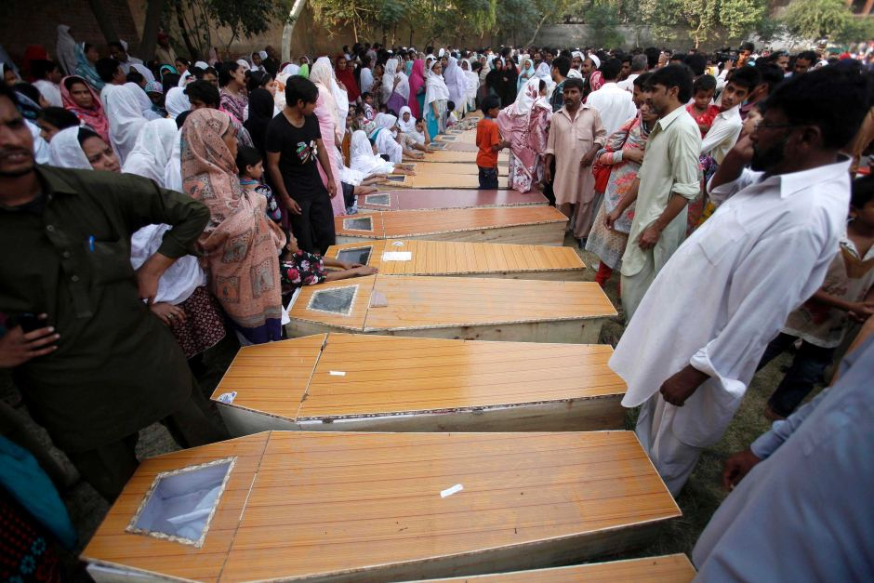
All-Saints Church
90 terbunuh
150 terluka
13 janda
36 yatim piatu
53 keluarga kehilangan tulang punggung keluarga
Notes:
Jumlah korban yang mengejutkan!

Slide 48
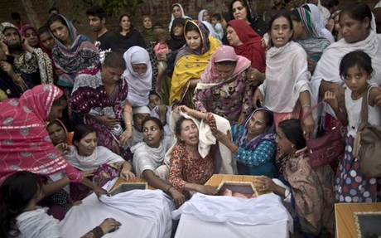
All-Saints Church
22 Sep 2013
Notes:
The grief is unimaginable.

Slide 49
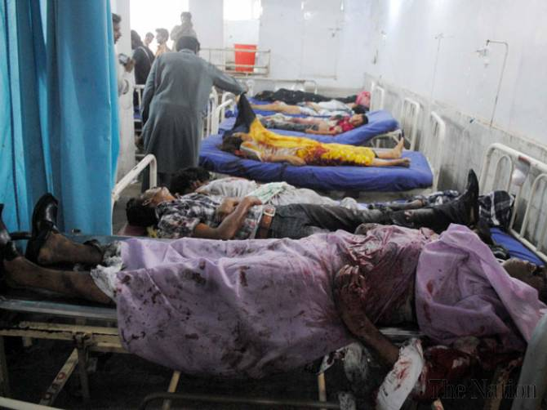
All-Saints Church
Para dokter tidak hadir
Notes:
Tragedi tersebut dipersulit dengan fakta bahwa Rumah Sakit lokal tidak dapat menangani krisis ini terutama karena dokter lokal dan paramedis menolak datang ke Rumah Sakit untuk mengobati orang Kristen—sampai pemimpin politikus lokal memerintahkan mereka untuk datang ke Rumah Sakait atau pekerjaan mereka akan terancam.
Artikel lengkap:
PESHAWAR - Death toll from Sunday’s twin bombings at All Saints Church was horrendous and Lady Reading Hospital was running out of caskets, beds and medicine for the wounded; and on top of that doctors and paramedics were absent.
To give vent to their anger over sorry state of affairs at the public health centre, attendants of the injured ransacked the hospital and chanted slogans against Khyber Pakhtunkhwa government for its inability to ensure every sort of health facility during the emergency situation.
Insufficient number of doctors and nurses was present at the hospital that could hardly provide first aid treatment to over 100 injured ferried from the blast site. Despite the fact that an emergency was declared, most of the doctors remained absent from their duties.
It came as a shock to learn that a provincial government so willing to provide free of cost treatment and medicines slipped on ensuring hassle-free health services. As a result, most of the injured could not get medical aid in a timely manner, while many of the injured had to lie down across the floor due to shortage of beds.
Nevertheless, when Pakistan Tehreek-e-Insaf chief Imran Khan came in, most of the doctors had to pull up their socks in order to save their skin.
People from different walks of life criticised PTI-led provincial government for its poor performance and asked it to provide all sort of health facilities to the injured. They also demanded stern action against the negligent doctors.
http://www.nation.com.pk/pakistan-news-newspaper-daily-english-online/national/23-Sep-2013/peshawar-hospital-ransacked-for-absence-of-docs-facilities

Slide 50
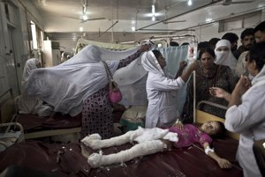
All-Saints Church
22 Sep 2013
Notes:
Jadi mereka datang, namun sudah terlambat bagi korban-korban yang membutuhkan pengobatan segera untuk menyelamatkan nyawa mereka.

Slide 51
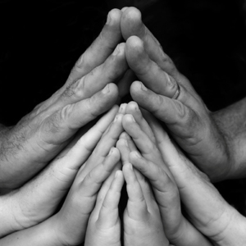
Dalam bidang apa engkau “terbentur” karena imanmu kepada Kristus?
Notes:
Tempat kerjamu melewatkanmu untuk kenaikan pangkat.
Alasanmu disalahartikan.
Engkau disamakan dengan fanatik.
Imanmu diejek oleh keluargamu.
Bidang lain?

Slide 52
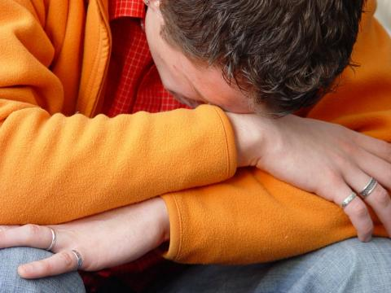
Bagaimana Yesus ingin engkau merespon kesengsaraan?
Notes:
Yang paling penting adalah pandangan Kristus tentang kesengsaraan—bagaimana Ia mau kita mengatasinya!

Slide 53
Pelayanan Literatur Kristus
Notes:
We have NO actual accounts of Jesus writing anything except what he wrote in the sand in John 8—and we have no idea what he wrote!

Slide 54
Jika Yesus menulis surat untuk ke gerejamu, apa yang Yesus katakan?
W
Wahyu

Slide 55
Asia Kecil Tahun 95 Masehi
335
Adramyttium
Aezani
Cyme
Erythrae
Eumenia
Lebedus
Colophon
Nysa
Hierapolis
Trailes
Heraclea
Aphrodisias
Colossae
Alabanda
Patmos
Miletus
Notes:
In AD 95 John was exiled to the lonely island of Patmos out in the Adriatic Sea. Jesus Christ had a revelation of comfort to the suffering believers of Asia Minor, but how could this message reach them?

Slide 56
Ketujuh Gereja (Wahyu 2–3)
335
Adramyttium
Aezani
Pergamus
Tiatira
Cyme
Erythrae
Sardis
Smirna
Eumenia
Filadelfia
Lebedus
Colophon
Efesus
Nysa
Laodikia
Hierapolis
Trailes
Heraclea
Aphrodisias
Colossae
Alabanda
Patmos
Miletus
Notes:
Jesus designed a brilliant strategy by having his revelation sent to capital of the province, Ephesus. It included an individual letter to Ephesus, as well as letters to 6 other key churches. The Ephesians copied the entire book of Revelation, though, and sent the original to the next city, Smyrna. Smyrna then made their own copy and sent the original to Pergamum, which lay on the main road to the north. This city then sent the prophecy to Thyatira, which sent it to Sardis, then Philadelphia, and finally to Laodicea.

Slide 57
Ketujuh Gereja (Wahyu 2-3)
335
Pergamus
Tiatira
Sardis
Smirna
Filadelfia
Efesus
Laodikia
Notes:
These 7 churches were neither the largest, nor the most influential cities in Asia Minor. However, they were strategically located on a key highway that linked them all.
[Animate} From their own locations we understand that they also copied the prophecy and sent these copies to other churches near them.

Slide 58
Apakah sebenarnya maksud ketujuh bintang dan ketujuh kaki dian tersebut? (Wahyu 1:20)
“Dan rahasia ketujuh bintang yang telah kaulihat pada tangan kanan-Ku dan ketujuh kaki dian emans itu: ketujuh bintang itu ialah malaikat ketujuh jemaat dan ketujuh kaki
dian itu ialah ketujuh jemaat.”

Slide 59
Kristus memiliki otoritas atas semua gereja

Slide 60
Jadi Yesus menulis surat untuk ketujuh gereja
(Wahyu 2–3)
Efesus
Smirna
Pergamus
Tiatira
Sardis
Filadelfia
Laodikea

Slide 61
Wahyu
Kedaulatan Kristus dalam Kemenangan Masa Depan
Kedaulatan dalam umatNya |  |  | Kedaulatan atas Gereja-gereja | Kedaulatan dalam Kejadian-kejadian Zaman Akhir
Pasal 1 |  |  | Pasal 2–3 | Pasal 4–22
“Apa yang telah kaulihat” (1:19a) |  |  | “Apa yang terjadi sekarang” (1:19b) | “Apa yang akan terjadi sesudah ini” (1:19c)
Masa Lampau |  |  | Masa Kini | Masa Depan
Kristus Disingkapkan |  |  | Gereja-gereja Disingkapkan | Kesempurnaan Disingkapkan
Allah di bumi |  |  | Duta Allah di bumi | Neraka di bumi sampai Surga di bumi
Hakim |  |  | Pengangkatan | Penghakiman dan Upah
SubjeK 1:1-3 | Penyem-bahan kepada Allah Tritunggal 1:4-8 | Kristus yang mulia 1:9-20 | Tujuh Gereja di Asia: Efesus Smirna Pergamus Tiatira Sardis Filadelfia Laodikia | Kesusah-an 4:1–19:10 | Keda-tangan Kedua Kali 19:11-21 | Milenium (seribu tahun) 20 | Kondisi Kekal 21:1–22:5 | Penutup: Kesegeraan 22:6-21
95 M
318

Slide 62
Ketujuh Gereja (Wahyu 2–3)
335
Janji
Pergamus
Peringatan
Tiatira
Nasehat
Teguran
Pujian
Smirna
Sardis
N/A
Kristus
N/A
N/A
N/A
Efesus
Filadelfia
N/A
Laodikia

Slide 63
Efesus adalah ibu kota Asia
176
Adramyttium
Aezani
Pergamus
Tiatira
Cyme
Erythrae
Sardis
Smirna
Eumenia
Filadelfia
Lebedus
Colophon
Efesus
Nysa
Laodikia
Hierapolis
Trailes
Heraclea
Aphrodisias
Colossae
Alabanda
Patmos
Miletus

Slide 64
Wahyu 2:4 (TB)
Efesus: Gereja yang sibuk, namun mengalami kemunduran
Namun demikian Aku mencela engkau, karena engkau telah meninggalkan kasihmu yang semula.

Slide 65
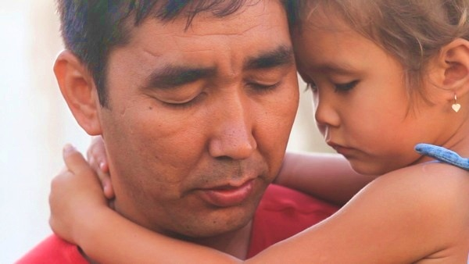
Bagaimana caranya kita menanggapi penderitaan?
Kristus memberikan tiga cara kepada jemaat Smirna.
Notes:
So today we come to the second letter, written to believers in Smyrna. This letter addresses this question…

Slide 66
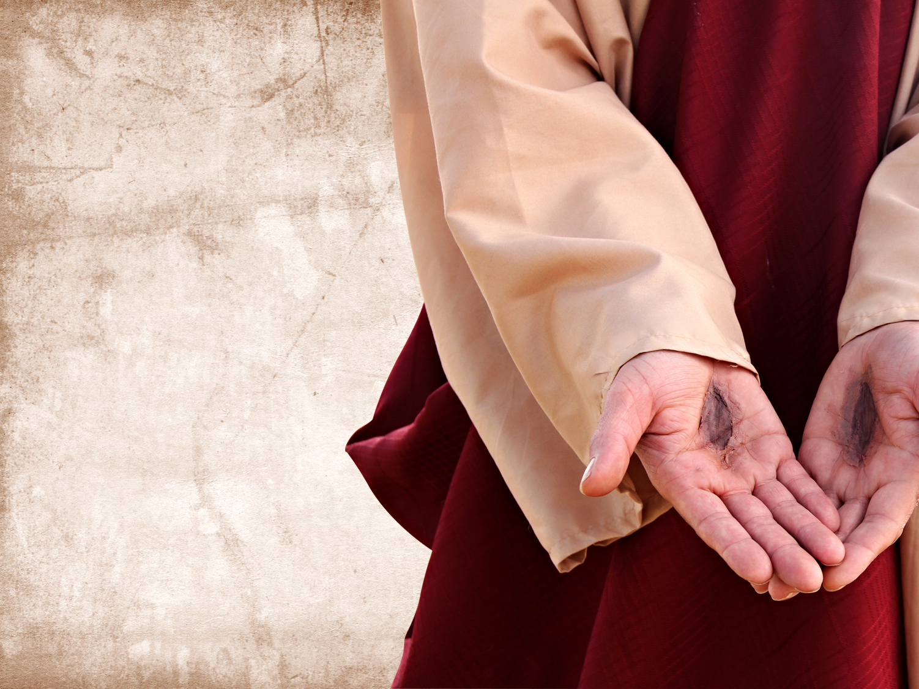
I. Sadari bahwa
Kristus mengerti penderitaanmu. (2:8-9)
Notes:
Know that Jesus has "been there, done that."

Slide 67
Ketujuh Gereja (Wahyu 2–3)
345
Adramyttium
Aezani
Pergamus
Tiatira
Cyme
Erythrae
Sardis
Smirna
Eumenia
Filadelfia
Lebedus
Colophon
Efesus
Nysa
Laodikia
Hierapolis
Trailes
Heraclea
Aphrodisias
Colossae
Alabanda
Patmos
Miletus
Notes:
Smyrna was a seaport city like Ephesus, about 35 miles north. It still exists today with the name of Izmir.

Slide 68
Smirna (Wahyu 2:8-11)
351
Pergamus
Tiatira
Teguran
Tidak Ada!
Pujian:
menderita
penganiayaan
dan kemiskinan
Kristus:
Yang Awal dan Yang Akhir, yang mati dan bangkit kembali
Smirna
Sardis
Efesus
Filadelfia
Laodikia

Slide 69
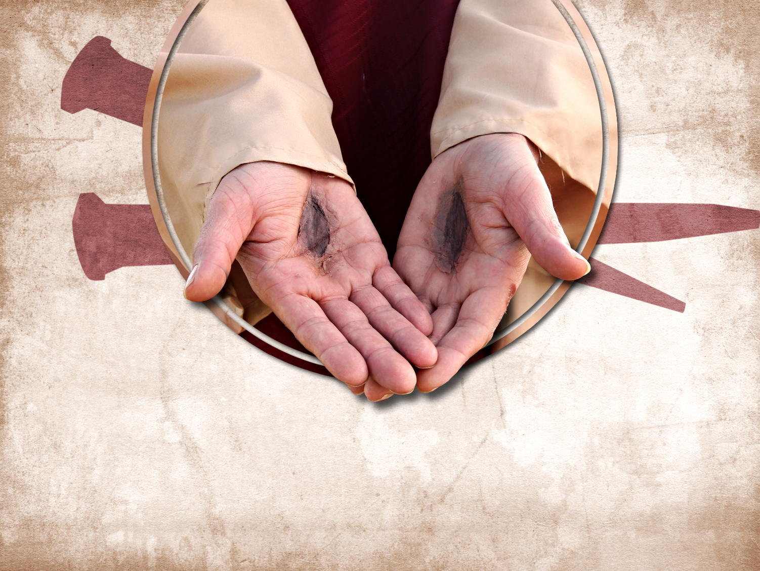
Bersyukurlah kepada Kristus karena Dia memahami area-area penderitaanmu.

Slide 70
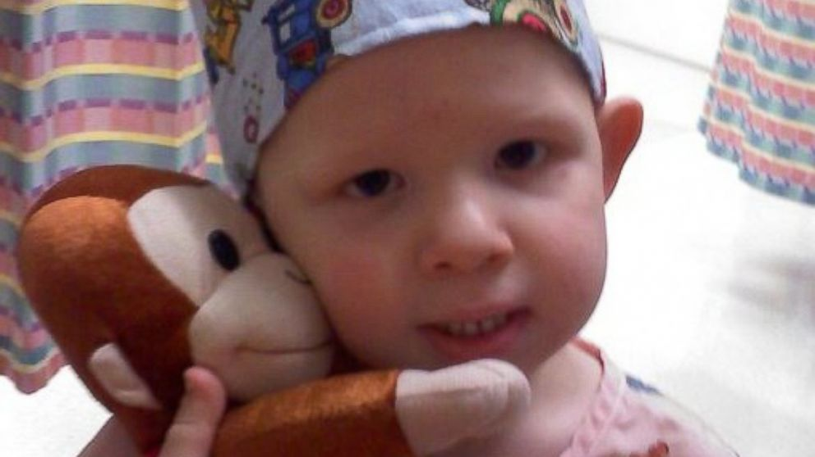
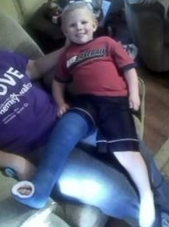
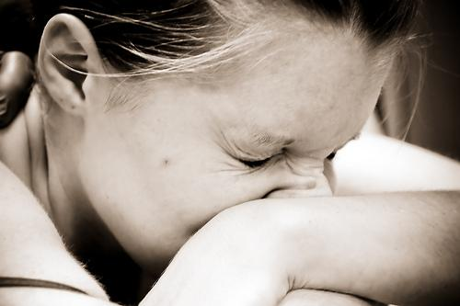
Isaac Brown
Seorang Anak yang TIDAK BISA merasakan sakit
http://abcnews.go.com/Health/meet-toddler-feels-pain/story?id=20658484
Notes:
Is pain good? Most of us do not think so!
• Isaac
Little Isaac Brown is five years old. Like other kids his age, he's learning to read and write his ABCs and to calculate simple addition and subtraction. But there is one thing Isaac is learning that rare few other children will ever have to learn. Isaac is learning about pain.
"We're doing the best we can to just teach him; he knows blood is bad," said Brown. "We taught him even when he was little to say 'ow.' You don't have to tell normal kids to say 'ow.'"
• Baby
Isaac was born with an extremely rare genetic insensitivity to pain. Like a modern day leper, Isaac doesn't know when he's touching a hot stove, when he's stepped on broken glass, or when he's broken a bone. For example, he broke his pelvis and felt no pain at all.
• Leg
Because he doesn't feel injuries, Isaac's parents, Carrie and Randy Brown, are teaching him how to identify them to stay healthy.

Slide 71
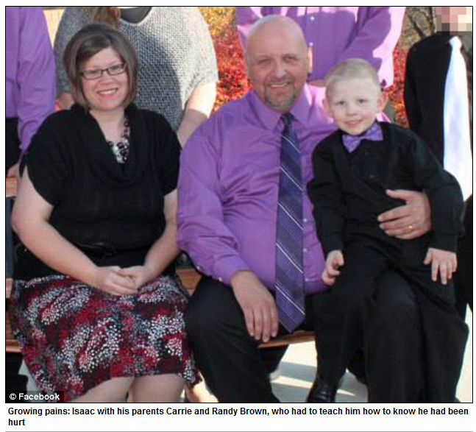
Isaac Brown
The Boy Who Feels NO Pain
“Saat dia terdiagnosa, dokter mengatakan tidak ada yang dapat kita lakukan untuk Isaac, setidak belum sampai saat ini,” kenang Carrie (Ibu Isaac). “Namun faktanya, mereka dapat mengambil gen-nya yang termutasi dan digunakan untuk meringankan rasa sakit orang lain yang sakit kronis. Ide tersebut sangat tidak masuk akal… mungkin Tuhan memberikan Isaac untuk tujuan ini.”
http://www.medicaldaily.com/can-boy-who-feels-no-pain-help-chronic-pain-sufferers-261005
Notes:
Family
"The toddler years were an absolute nightmare," said Isaac's mother, Carrie Brown. "He would just drop to the ground and smack his face on the table. He thought the fall was fun."
Isaac has dunked his hand in hot coffee without flinching. He once placed his palm on a working oven burner without shedding a tear.
His parents are believers. His mother noted..
Read quote

Slide 72
Alasan Untuk Penderitaan
John Walvoord, "Revelation," dalam The Bible Knowledge Commentary, 2:935
      “Penderitaan mungkin wajar untuk orang-orang jahat, namun mengapa orang baik malah juga menderita? Alkitab menjelaskan beberapa alasan. Penderitaan dapat saja merupakan:
        Pendisiplinan (1 Kor. 11:30-32; Ibr. 12:3-13),
        Pencegahan (seperti duri dalam daging pada Paulus, 2 Kor. 12:7)
        Pembelajaran ketaatan (sebagaimana penderitaan Kristus, Ibr. 5:8; bandingkan dengan Roma 5:3-5), atau
        Mempersiapkan kesaksian bagi Kristus (seperti di Kis. 9:16).”

Slide 73
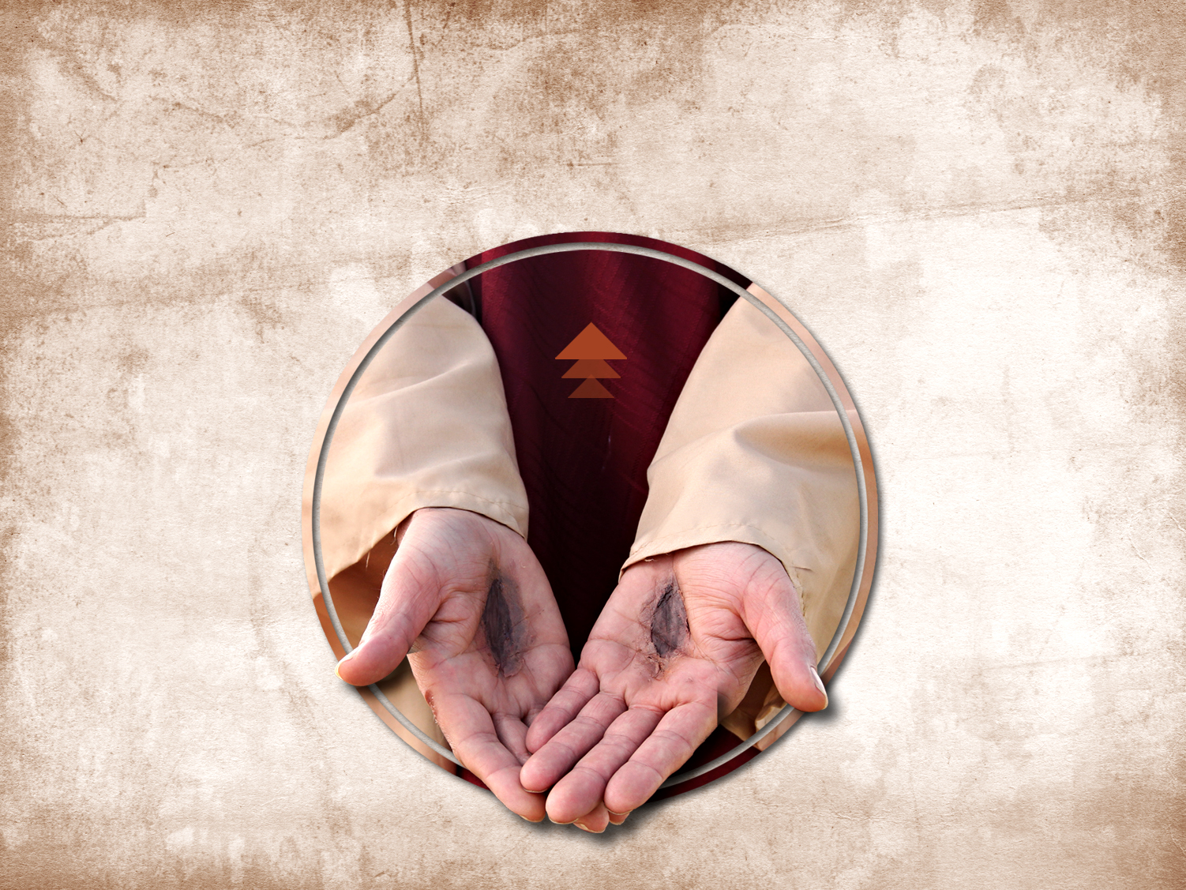
Kristus merasakan penderitaanmu

Slide 74
I. Sadari bahwa
Kristus mengerti penderitaanmu. (2:8-9)
Notes:
Know that Jesus has "been there, done that."

Slide 75
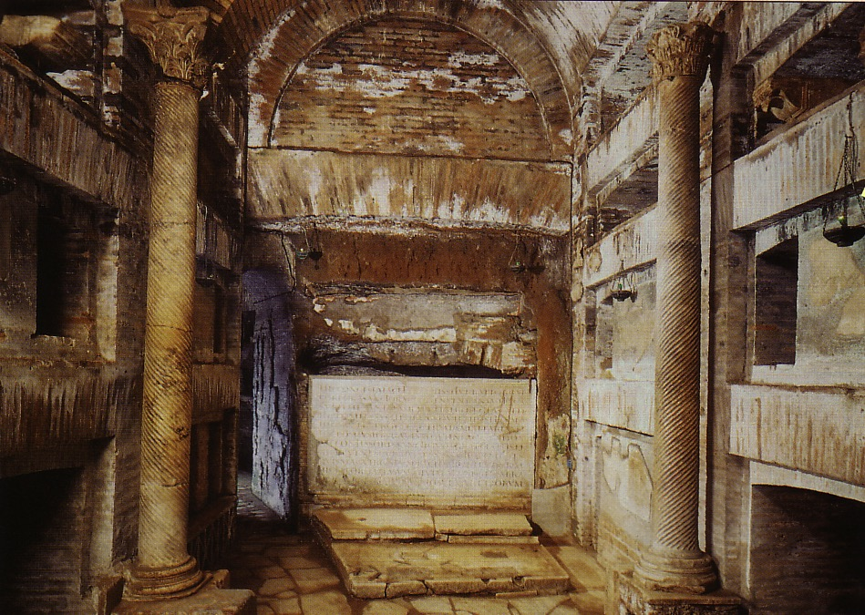
II. Jangan TAKUT menderita untuk Kristus (2:10a)
Notes:
During Nero's persecutions Christians refused to stop worshipping Christ, so they held their services underground in the tombs beneath Rome.

Slide 76
Smirna (Wahyu 2:8-11)
324
Pergamus
Tiatira
Nasihat
Jangan takut
Teguran
Tidak Ada!
Pujian:
menderita
penganiayaan
dan kemiskinan
Kristus:
Yang Awal dan Yang Akhir, yang mati dan bangkit kembali
Smirna
Sardis
Efesus
Filadelfia
Laodikia

Slide 77
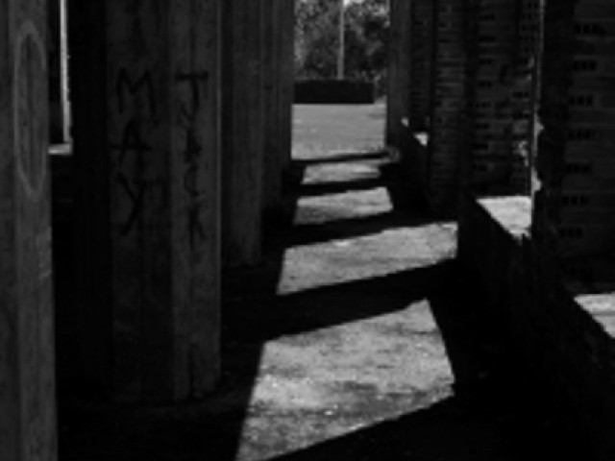
Siapa yang lebih takut?
Penganiaya?
Yang teraniaya?
“Sebab itu janganlah kamu takuti apa yang mereka [penganiaya] takuti...
(1 Petrus 3:14b)

Slide 78

Memberi
“…dan jika aku memberikan tubuhku untuk dibakar, namun tidak memiliki kasih, semuanya sia sia…”
“Darah Para Martir adalah cikal bakal Gereja”
-Tertullian-

Slide 79

All-Saints Church
Respon
Didedikasikan untuk para Martir dari Gereja All Saint Peshawar Blast
Tidak ada yang mampu memindahkan mereka , tidak juga mereka gentar.

Slide 80

All-Saints Church
Kadang kita bereaksi karena rasa takut

Slide 81

Umat Kristen India Ingin Mengakhiri Hubungan Dengan Pakistan
Respon Politik
Notes:
Indian Christians burn Pakistan’s flag to protest church attack in Peshawar - See more at: http://post.jagran.com/christians-burn-pakistans-flag-to-protest-church-attack-in-peshawar-1380097718#sthash.drVPwCB0.dpuf

Slide 82

All-Saints Church
Respon Kemarahan

Slide 83

All-Saints Church
22 Sep 2013
Notes:
Note the large words in English that the people of All Saints read prior to their martyrdom or suffering in the courtyard

Slide 84

Tanggapan Kita
Jika satu anggota menderita…
Notes:
We have committed S$3000 to help 6 families who lost their bread winners for three months.

Slide 85

Akankah kamu mengakui ketakutanmu akan penderitaan saat ini?

Slide 86
I. Sadari bahwa
Kristus mengerti penderitaanmu. (2:8-9)
Notes:
Know that Jesus has "been there, done that."

Slide 87
II. Jangan TAKUT menderita untuk Kristus (2:10a)
Notes:
During Nero's persecutions Christians refused to stop worshipping Christ, so they held their services underground in the tombs beneath Rome.

Slide 88

III. Tetaplah Setia dalam Penderitaan (2:10b-11)
Notes:
Commit now not to waver or give up your faith due to persecution.

Slide 89
Smirna (Wahyu 2:8-11)
324
Pergamus
Tiatira
Peringatan
Iblis akan melemparkan beberapa dari antaramu ke dalam penjara dan engkau akan menderita selama 10 hari
Nasehat
Jangan takut
Tetaplah setia,
sampai mati
Teguran
Tidak Ada!
Pujian:
menderita
penganiayaan
dan kemiskinan
Kristus:
Yang Awal dan Yang Akhir, yang mati dan bangkit kembali
Smirna
Sardis
Efesus
Filadelfia
Laodikia

Slide 90

Smirna: Menderita namun bertahan
“Sesungguhnya Iblis akan melemparkan beberapa orang dari antaramu ke dalam penjara supaya kamu dicobai dan kamu akan beroleh kesusahan selama sepuluh hari (2:10b)

Slide 91
Smirna (Wahyu 2:8-11)
324
Pergamus
Tiatira
Nasehat
Jangan takut
Tetaplah setia,
sampai mati
Teguran
Tidak Ada!
Pujian:
menderita
penganiayaan
dan kemiskinan
Kristus:
Yang Awal dan Yang Akhir, yang mati dan bangkit kembali
Smirna
Sardis
Efesus
Filadelfia
Laodikia

Slide 92

“Tetaplah setia sampai mati” (2:10c)

Slide 93

Kemartiran Perpetua (AD 203)
Notes:
She refused to offer incense to Diana's image and thus was killed for it.

Slide 94
Smirna (Wahyu 2:8-11)
324
Janji
Akan menerima mahkota kehidupan
Pergamus
Tiatira
Peringatan
Iblis akan melemparkan beberapa diantaramu ke dalam penjara dan engkau akan menderita selama 10 hari
Nasehat
Jangan takut
Tetaplah setia,
sampai mati
Teguran
Tidak Ada!
Pujian:
menderita
penganiayaan
dan kemiskinan
Kristus:
Yang Awal dan Yang Akhir, yang mati dan bangkit kembali
Smirna
Sardis
Efesus
Filadelfia
Laodikia

Slide 95

ENDA
Bagaimana hal ini ditanggapi…
JUNJUNG KESAMAAN HAK
Employment
Non-
Discrimination
Act
ENDA adalah
undang-undang anti-diskriminasi bagi para pekerja.
Notes:
ENDA has been presented in the two houses of the US Congress several times in the past 40 years, each time being defeated. However, the margin of defeat is narrowing and proponents are at it again.

Slide 96

ENDA
Bagaimana hal ini ditanggapi…
STOP DISKRIMINASI LEGAL!!!

Slide 97

ENDA
Bagaimana hal ini ditanggapi…
SAYA MANDI DI SEBELAH SEORANG HOMOSEKSUAL.
KAMU DAPAT JUGA BEKERJA DI SEBELAHNYA.
SEBARKAN “ENDA”

Slide 98

Banyak orang Kristen yang konservatif menolak “ENDA”
STOP
ATURAN “ENDA”

Slide 99

Pengecualian pada “ENDA”
Bagaimana hal ini ditanggapi…
http://www.washingtonblade.com/2013/10/30/enda-heats/
“Sumber Berita Terdepan Untuk Kaum Gay di Amerika"
“Baru-baru ini (30 Okt. 2013), ENDA memiliki pengecualian tentang agama yang memberikan celah bagi organisasi keagamaan, seperti gereja ataupun sekolah tinggi agama, untuk mendiskriminasi karyawan LGBT (Lesbian, Gay, Biseksual, Transeksual). Celah yang sama tidak ditemukan di Pasal VII Undang-undang Hak Sipil tahun 1964, yang melarang organisasi keagamaan untuk mendiskriminasi berdasarkan ras, jender, dan asal negara.
Notes:
Supporters have convinced people that homosexuality is not only OK, but it MUST be supported as it is as unchangeable as one’s race, gender, or national origin.
http://www.washingtonblade.com/2013/10/30/enda-heats/

Slide 100

Pernyataan Aktual ENDA
“Sangat tidak sah apabila perusahaan (pemberi kerja) akan menolak untuk merekrut atau memecat, juga apabila melakukan diskriminasi terhadap seseorang terkait dengan kompensasi, syarat dan ketentuan, serta hak-hak pekerja, hanya karena orientasi seksual atau identitas jender seseorang yang aktual maupun kecenderungannya.

Slide 101

Voting Senator Amerika terkait ENDA
(5 Nov. 2013)
“Dengan perbandingan suara 61-30, Senat Amerika menyelesaikan hambatan terakhir untuk ENDA sebelum menuju Gedung Pemerintahan. Tidak seperti versi-versi sebelumnya, peraturan ini mengambil langkah radikal dengan menyertakan ‘identitas jender’ sebagai golongan yang dilindungi oleh hukum. Berdasarkan 61 Senator Amerika, setiap sekolah, organisasi, perusahaan, dan lembaga sosial harus berhenti memperhatikan keselamatan, keuntungan, dan masa depan bisnis mereka sendiri; mereka juga diminta untuk mendukung laki-laki yang berpakaian seperti wanita di tempat kerja (dan sebaliknya) selain itu juga menyediakan akomodasi khusus untuk mereka.
Tony Perkins' Washington Update Family Research Council 6 Nov 2013

Slide 102

Dewan Perwakilan
Juru Bicara: John Boehner Menentang ENDA
“Juru bicara percaya bahwa perundang-undangan ini akan meningkatkan pengadilan yang tidak berguna dan berdampak pada lapangan kerja di Amerika, terutama usaha kecil.” Boehner dan departemennya melanjutkan bahwa mereka “selalu percaya bahwa hal ini dilindungi oleh hukum yang berlaku.”
Tony Perkins' Washington Update Family Research Council 7 Nov 2013

Slide 103

Ide Pokok
Gantikan ketakutan dengan kesetiaan saat menderita karena Yesus sangat memahami apa yang kamu rasakan.
Siapkah kamu?

Slide 104

Bagaimana penderitaan-mu sekarang?
      Sadari bahwa Yesus memahami situasimu.
      Jangan takut untuk menderita bagi Kristus di area ini.
      Tetaplah setia kepada-Nya terlepas apapun hasilnya.

Slide 105
Black

Slide 106
INDIA
“…dan jika aku memberikan tubuhku untuk dibakar, namun tidak memiliki kasih, semuanya sia sia…”
“Darah Para Martir adalah cikal bakal Gereja”
-Tertullian-

Slide 107

Bangunan Gereja yang Dibakar

Slide 108

Api menghanguskan bangunan gereja ini

Slide 109

Sebagian orang Kristen selamat

Slide 110

Sebagian pulang ke Yesus

Slide 111
Black

Slide 112
Yang terhormat,
Jemaat Pergamus
Gereja Yang Hidup
Namun Berkompromi

Slide 113
Pergamus (Wahyu 2:12-17)
324
Janji
Menerima manna tersembunyi dan batu putih bertuliskan nama baru
Pergamus
Tiatira
Peringatan
Jika engkau tidak bertobat,
Aku akan memerangi kamu dengan pedang dari mulutKu
Nasehat
Bertobatlah!
Teguran
Ada yang mengikuti ajaran Bileam dan pengikut Nikolaus
Pujian:
tetap berpegang nama Kristus; tidak menyangkal iman
Kristus:
Seperti pedang bermata dua
Smirna
Sardis
Efesus
Filadelfia
Laodikia

Slide 114
Wahyu 2:12-17
¹² "Dan tuliskanlah kepada malaikat jemaat di Pergamus: Inilah firman Dia, yang memakai pedang yang tajam dan bermata dua: ¹³ Aku tahu di mana engkau diam, yaitu di sana, di tempat takhta Iblis; dan engkau berpegang kepada nama-Ku, dan engkau tidak menyangkal imanmu kepada-Ku, juga tidak pada zaman Antipas, saksi-Ku, yang setia kepada-Ku, yang dibunuh di hadapan kamu, di mana Iblis diam.
¹⁴Tetapi Aku mempunyai beberapa keberatan terhadap engkau: di antaramu ada beberapa orang yang menganut ajaran Bileam, yang memberi nasihat kepada Balak untuk menyesatkan orang Israel, supaya mereka makan persembahan berhala dan berbuat zinah. ¹⁵Demikian juga ada padamu orang-orang yang berpegang kepada ajaran pengikut Nikolaus. ¹⁶ Sebab itu bertobatlah! Jika tidak demikian, Aku akan segera datang kepadamu dan Aku akan memerangi mereka dengan pedang yang di mulut-Ku ini.
¹⁷ Siapa bertelinga, hendaklah ia mendengarkan apa yang dikatakan Roh kepada jemaat-jemaat: Barangsiapa menang, kepadanya akan Kuberikan dari manna yang tersembunyi; dan Aku akan mengaruniakan kepadanya batu putih, yang di atasnya tertulis nama baru, yang tidak diketahui oleh siapapun, selain oleh yang menerimanya."

Slide 115
Surat Perintah Kristus
Yesus memberitahu Yohanes untuk mengirimkan surat ini
“kepada malaikat (penyampai pesan)
jemaat di Pergamus” (2:12)

Slide 116
Pujian Kristus
2:13 Aku tahu di mana engkau diam, yaitu di sana, di tempat takhta Iblis; dan engkau berpegang kepada nama-Ku, dan engkau tidak menyangkal imanmu kepada-Ku, juga tidak pada zaman Antipas, saksi-Ku, yang setia kepada-Ku, yang dibunuh di hadapan kamu, di mana Iblis diam.

Slide 117

Maket Pergamus:
Tidak menyangkal namun kompromi
353
Notes:
It has long been assumed that the temple was dedicated to Zeus. The altar is mentioned in the Book of Revelation, 2:11-12: "To the angel of the church in Pergamum, write this: . . . 'I know that you live where Satan's throne is . . . . '" This is a scale model of the altar.

Slide 118

Takhta Iblis (2:11-12)
353
“Aku tahu di mana engkau diam, yaitu di sana, di tempat takhta Iblis " (2:13)
Notes:
It has long been assumed that the temple was dedicated to Zeus. The altar is mentioned in the Book of Revelation, 2:11-12: "To the angel of the church in Pergamum, write this: . . . 'I know that you live where Satan's throne is . . . . '" This is a scale model of the altar.

Slide 119
Kecaman Kristus
    2:14-15 Tetapi Aku mempunyai beberapa keberatan terhadap engkau: di antaramu ada beberapa orang yang menganut ajaran Bileam, yang memberi nasihat kepada Balak untuk menyesatkan orang Israel, supaya mereka makan persembahan berhala dan berbuat zinah. ¹⁵ Demikian juga ada padamu orang-orang yang berpegang kepada ajaran pengikut Nikolaus.

Slide 120
Sebagian anggota jemaat berpegang pada ajaran Bileam
2:14 "Tetapi Aku mempunyai beberapa keberatan terhadap engkau: di antaramu ada beberapa orang yang menganut ajaran Bileam, yang memberi nasihat kepada Balak untuk menyesatkan orang Israel, supaya mereka makan persembahan berhala dan berbuat zinah.”

Slide 121

Bilangan
135
Persiapan menduduki Tanah Perjanjian
Menyiapkan Generasi pendahulu
Penundaan akibat ketidakpercayaan
Menyiapkan Generasi baru
1:1–10:10
10:11–25:18
26–36
Kesetiaan Allah
Ketidakpercayaan Israel
Kesetiaan Allah
Berkat Allah
Disiplin Allah
Berkat Allah
Komitmen Allah
Sungutan Israel
Komitmen Israel
Order
Disorder
Reorder
Gunung Sinai
Pengembaraan
Moab
20 Hari
38 Tahun, 3 Bulan, 10 Hari
ca. 5 Bulan
Pengorganisasian
(1-4)
Penyucian
(5:1-10:10)
Sampai Kadesi (10:11-
12:16)
Dosa Kadesi
(13-14)
Pengembaraan (15-19)
Sampai Moab (20-21)
Dosa Moab
(22-25)
Pembagiaan Tanah
(26-27)
Persembahan dan Janji
(28-30)
Persiapan Akhir
(31-36)

Slide 122

Peristiwa menyeberangi Sungai Yordan
OTS 140
Kemenangan atas Sihon dan Og (Bilangan 21)
Balak gagal mengutuk Israel–berkat oleh Bileam (Bilangan 22-24)

Slide 123


Balaam
Bileam
Bilangan 22-24

Slide 124
Wahyu 2:14-15
Namun, aku mempunyai beberapa keberatan terhadap engkau:
Ada beberapa diantaramu yang mengikuti ajaran Bileam, yang menasehati Balak untuk menyeesatkan Israel dengan persembahan berhala dan berzinah. Adapun ada diantaramu yang menjadi pengikut Nikolaus

Slide 125
2 Petrus 2:15-16
Mereka telah meninggalkan jalan yang benar, dan mengikuti jalan yang ditempuh Bileam, anak Beor, yang mencintai upah kefasikan.
Namun ia ditegur dengan keras dari kesalahannya oleh keledai – binatang yang bisu – yang berbicara dengan suara manusia untuk mencegah kebebalan nabi itu.

Slide 126
Yudas 1:11
Celakalah mereka! Mereka mengikuti jalan yang ditempuh Kain; mementingkan kekayaan seperti kesalahan Bileam; mereka binasa karena kedurhakaan seperti Korah.

Slide 127
Peristiwa menyeberangi Sungai Yordan
140
Kemenangan atas Sihon dan Og (Bilangan. 21)
Balak gagal mengutuk Israel–berkat oleh Bileam (Bilangan 22-24)
Balak berhasil menyesatkan Israel dengan ketidakmoralan di Beth Peor (Bilangan 25)

Slide 128
Sebagian anggota jemaat berpegang pada ajaran Nikolaus
2:15 "Demikian juga ada padamu orang-orang yang berpegang kepada ajaran pengikut Nikolaus.

Slide 129
Koreksi Kristus
2:16 "Sebab itu bertobatlah! Jika tidak demikian, Aku akan segera datang kepadamu dan Aku akan memerangi mereka dengan pedang yang di mulut-Ku ini. ¹⁷ Siapa bertelinga, hendaklah ia mendengarkan apa yang dikatakan Roh kepada jemaat-jemaat: Barangsiapa menang, kepadanya akan Kuberikan dari manna yang tersembunyi; dan Aku akan mengaruniakan kepadanya batu putih, yang di atasnya tertulis nama baru, yang tidak diketahui oleh siapapun, selain oleh yang menerimanya.”

Slide 130
Pertobatan…
2:16 "Sebab itu bertobatlah! Jika tidak demikian, Aku akan segera datang kepadamu dan Aku akan memerangi mereka dengan pedang yang di mulut-Ku ini.”

Slide 131
Menerima…
2:17 "Siapa bertelinga, hendaklah ia mendengarkan apa yang dikatakan Roh kepada jemaat-jemaat: Barangsiapa menang, kepadanya akan Kuberikan dari manna yang tersembunyi; dan Aku akan mengaruniakan kepadanya batu putih, yang di atasnya tertulis nama baru, yang tidak diketahui oleh siapapun, selain oleh yang menerimanya”

Slide 132
Menerima… Roti Kehidupan
"Barangsiapa menang, kepadanya akan Kuberikan dari manna yang tersembunyi"
(2:17a)

Slide 133
John 6:30-35
Maka kata mereka kepada-Nya: "Tanda apakah yang Engkau perbuat, supaya dapat kami melihatnya dan percaya kepada-Mu? Pekerjaan apakah yang Engkau lakukan? Nenek moyang kami telah makan manna di padang gurun, seperti ada tertulis: Mereka diberi-Nya makan roti dari sorga."
Maka kata Yesus kepada mereka: "Aku berkata kepadamu, sesungguhnya bukan Musa yang memberikan kamu roti dari sorga, melainkan Bapa-Ku yang memberikan kamu roti yang benar dari sorga. Karena roti yang dari Allah ialah roti yang turun dari sorga dan yang memberi hidup kepada dunia."
Maka kata mereka kepada-Nya: "Tuhan, berikanlah kami roti itu senantiasa.“ Kata Yesus kepada mereka: "Akulah roti hidup; barangsiapa datang kepada-Ku, ia tidak akan lapar lagi, dan barangsiapa percaya kepada-Ku, ia tidak akan haus lagi.

Slide 134
Menerima… Hidup Kekal
“… dan Aku akan mengaruniakan kepadanya batu putih, yang di atasnya tertulis nama baru, yang tidak diketahui oleh siapapun, selain oleh yang menerimanya"
(2:17b)

Slide 135
Black

Slide 136

Tiatira:
Terlibat Namun
Tak Bermoral
Rick Griffith • Crossroads International Church • biblestudydownloads.com

Slide 137

Right way, wrong way
Jalan Kebenaran
Jalan Sesat

Slide 138

Pornografi

Slide 139




Pornografi
Menjual seks adalah
bisnis tertua di dunia. Bisnis ini tidak pernah menurun melainkan saat ini pornografi sedang menyebar dengan cepat dan berbahaya lewat komputer dan layar TV, merambah banyak rumah, keluarga, dan pernikahan.

Slide 140







Pornografi
Setiap detik:
30.000 orang
melihat hal-hal
berbau porno.
Setiap 30 menit, satu film porno diproduksi di AS.
Amerika memproduksi 89% dari seluruh situs porno.
42,7% pengguna internet melihat situs porno. (102.434.567 orang)

Slide 141



Pornografi
Pornografi adalah sebuah…
INDUSTRI
Keuntungan dari pornografi > jumlah keuntungan berbagai perusahaan top ini.

Slide 142




Pornography
TIAP HARI:
68 JUTA PERMINTAAN PENCARIAN TENTANG PORNOGRAFI
25%
dari total permintaan
MERUPAKAN
TOPIK #1
DI INTERNET
TIAP HARI: 2,5 MILYAR EMAIL MENGANDUNG PORNOGRAFI (8% DARI JUMLAH EMAIL)
TIAP HARI:
SEORANG PENGGUNA INTERNET MENERIMA
RATA-RATA 4-5 EMAIL PORNO

Slide 143



Pornography
Usia rata-rata seseorang melihat Porno pertama kalinya: 11 tahun
Persentase Pengunjung
Situs Porno di Internet
28% WANITA 72% PRIA
Jumlah laki-laki yang melihat porno 6X lebih banyak dan biasanya dengan durasi lebih lama dibanding wanita
17% Wanita
mengakui bergumul dengan kecanduan pornografi.

Slide 144




Pornografi
Sekitar 200.000 orang Amerika kecanduan pornografi: menikmati pornografi online lebih dari 11 jam/minggu
Melihat pornografi terus-menerus
berakibat buruk pada dorongan seksual
Lebih dari 50% penikmat interaksi seksual lewat internet mengakui kehilangan selera terhadap hubungan seksual.
Sepertiga dari pasangan mereka juga kehilangan selera.

Slide 145

Pornografi
KECANDUAN PORNOGRAFI DAPAT BERAKIBAT PADA:
40% “Sex Addict” kehilangan pasangan mereka
58% mengalami kebangkrutan
SEPERTIGANYA kehilangan pekerjaan
Menikmati pornografi meningkatkan jumlah perselingkuhan
dalam pernikahan lebih dari
300%

Slide 146

Pornography
56% kasus perceraian diakibatkan salah satu pasangan terobsesi pada situs porno.
Penikmat pornografi di internet dilaporkan 2X lebih rentan menderita depresi berat dibandingkan non-pengguna.
Dibandingkan orang yang tidak kecanduan, para pecandu seks punya kecenderungan 23 kali lebih banyak untuk mengatakan:
“Menemukan materi seksual di internet adalah
HAL TERBURUK SEPANJANG HIDUP SAYA”

Slide 147


Pornografi
Laki-laki berusia 18-24 tahun mengunjungi
situs porno setiap bulannya.

Slide 148




Pornografi
Rata-rata waktu kunjungan situs porno pada umumnya: 6 menit 29 detik
HARI PALING TIDAK TEPAT DALAM SETAHUN UNTUK MENGUNJUNGI SITUS PORNO ADALAH
HARI THANKSGIVING
HARI PALING TEPAT
DALAM SEMINGGU UNTUK MENGUNJUNGI SITUS PORNO ADALAH
HARI MINGGU
PALING jarang
PALING sering
THANKSGIVING
MINGGU

Slide 149

Pornografi

Slide 150

Pornografi di dalam Gereja

Slide 151

Bagaimana Yesus bereaksi terhadap perzinahan di antara orang percaya?

Slide 152
Jika Yesus menulis surat untuk ke gerejamu, apa yang Yesus katakan?
W
Wahyu

Slide 153
Ketujuh Gereja (Wahyu 2–3)
335
Adramyttium
Aezani
Pergamus
Tiatira
Cyme
Erythrae
Sardis
Smirna
Eumenia
Filadelfia
Lebedus
Colophon
Efesus
Nysa
Laodikia
Hierapolis
Trailes
Heraclea
Aphrodisias
Colossae
Alabanda
Patmos
Miletus
Notes:
Jesus designed a brilliant strategy by having his revelation sent to capital of the province, Ephesus. It included an individual letter to Ephesus, as well as letters to 6 other key churches. The Ephesians copied the entire book of Revelation, though, and sent the original to the next city, Smyrna. Smyrna then made their own copy and sent the original to Pergamum, which lay on the main road to the north. This city then sent the prophecy to Thyatira, which sent it to Sardis, then Philadelphia, and finally to Laodicea.

Slide 154
Jadi Yesus menulis surat untuk ketujuh gereja
(Wahyu 2–3)
Efesus
Smirna
Pergamus
Tiatira
Sardis
Filadelfia
Laodikea

Slide 155

Wahyu 2:18-29 STRUKTUR
Negatif
Positif
Negatif
Positif

Slide 156
Bagaimana Yesus bereaksi terhadap perzinahan di antara orang percaya?

Slide 157
I. Yesus menghakimi dosa orang percaya (2:18)

Slide 158
Ketujuh Gereja (Wahyu 2–3)
335
Adramyttium
Aezani
Pergamus
Tiatira
Cyme
Erythrae
Sardis
Smirna
Eumenia
Filadelfia
Lebedus
Colophon
Efesus
Nysa
Laodikia
Hierapolis
Trailes
Heraclea
Aphrodisias
Colossae
Alabanda
Patmos
Miletus
Notes:
Jesus designed a brilliant strategy by having his revelation sent to capital of the province, Ephesus. It included an individual letter to Ephesus, as well as letters to 6 other key churches. The Ephesians copied the entire book of Revelation, though, and sent the original to the next city, Smyrna. Smyrna then made their own copy and sent the original to Pergamum, which lay on the main road to the north. This city then sent the prophecy to Thyatira, which sent it to Sardis, then Philadelphia, and finally to Laodicea.

Slide 159

Tiatira
355
Tiatira terkenal dengan produksi kain ungu-nya dan ramai dengan serikat penyamak kulit, serikat pewarna tekstil, serta serikat pengrajin wol dan linen. Semua bisnis ini berakibat pada penggunaan tembikar yang masif dan masing-masing serikat biasanya menganut penyembaan berhala tertentu.
Banyak orang Kristen yang memilih mati daripada berkompromi dengan perayaan serikat tsb.

Slide 160

Tiatira
355
Perserikatan dagang di Tiatira erat dengan penyembahan berhala. Umat Kristen yang menolak untuk menyembah berhala, mengalami kesulitan untuk bertahan dalam bisnis dan akhirnya kehilangan penghasilan untuk menghidupi diri.

Slide 161
Tiatira (Wahyu 2:18-29)
325
Pergamus
Tiatira
Kristus:
Anak Allah dengan mata seperti nyala dan kaki seperti tembaga
Smirna
Sardis
Efesus
Filadelfia
Laodikia

Slide 162

Deskripsi tentang Kristus
“Inilah firman Anak Allah, yang mata-Nya bagaikan nyala api dan kakinya bagaikan tembaga”
(2:18 TB)

Slide 163
Bagaimana Yesus bereaksi terhadap perzinahan di antara orang percaya?

Slide 164

II. Yesus memuji pelayanan mereka (2:19)

Slide 165
Tiatira (Wahyu 2:18-29)
325
Pergamus
Tiatira
Pujian:
perbuatan baik, kasih,
iman, pelayanan, ketekunan, melakukan lebih dari semula
Kristus:
Anak Allah dengan mata seperti nyala dan kaki seperti tembaga
Smirna
Sardis
Efesus
Filadelfia
Laodikia

Slide 166

“Aku tahu segala pekerjaanmu: baik kasihmu maupun imanmu, baik pelayananmu maupun ketekunanmu. Aku tahu bahwa pekerjaanmu yang terakhir lebih banyak dari pada yang pertama. " (2:19 TB)

Slide 167

Siapa yang harus dipuji di antara kita?

Slide 168

Miriam Burnett

Slide 169

Lewis, Barbara & Christine Winkler

Slide 170

Lewis Winkler

Slide 171

Lewis Winkler

Slide 172

Lewis Winkler

Slide 173

Lewis Winkler

Slide 174

Lewis Winkler

Slide 175

Susan Griffith

Slide 176

Yesus tahu!
Luar biasa
Sangat baik
Baik
Rata-rata
Buruk

Slide 177
Bagaimana Yesus bereaksi terhadap perzinahan di antara orang percaya?

Slide 178

III. Yesus memilah antara umat yang tidak setia dan yang setia (2:20-25)

Slide 179
Tiatira (Wahyu 2:18-29)
325
Pergamus
Tiatira
Teguran
Membiarkan Izebel dengan ketidakmoralan dan penyembahan berhalanya
Kristus:
Anak Allah dengann mata seperti nyala dan kaki seperti tembaga
Pujian:
perbuatan baik, kasih,
iman, pelayanan, ketekunan, melakukan lebih dari semula
Smirna
Sardis
Efesus
Filadelfia
Laodikia

Slide 180

“²⁰ Tapi aku mencela engkau, karena engkau membiarkan wanita Izebel, yang menyebut dirinya nabiah, mengajar dan menyesatkan hamba-hamba-Ku supaya berbuat zinah dan makan persembahan-persembahan berhala. ²¹ Dan Aku telah memberikan dia waktu untuk bertobat, tetapi ia tidak mau bertobat dari zinahnya."
(2:20-21 TB)

Slide 181

Siapakah Izebel?

Slide 182

Dan
Baal
Elia melawan 850 orang nabi-nabi Izebel di akhir masa kekeringan selama 3,5 tahun di tanah kekuasaan Baal, yang dikenal sebagai “dewa petir” dan “dewa hujan”.
Betel
Yerusalem
1 Raja-Raja 16:31-33

Slide 183

“Nilai-nilai yang diterima oleh masyarakat ternyata dibenci oleh Kristus. Mereka telah meninggalkan moralitas mereka selama beberapa waktu (ay.21). Gereja di Tiatira telah mendengar Injil dari Lidia, seorang wanita yang bertobat melalui pelayanan Paulus (Kis. 16:14-15). Yang menarik adalah, sekarang seorang wanita yang mengaku dirinya ‘nabiah’ juga mempengaruhi gereja. Nama ‘Izebel’ digunakan untuk menggambarkan bagaimana wanita ini merusak gereja Tiatira seperti Izebel (istri Raja Ahab) merusak bangsa Israel (1 Raja-raja 16:31-33)”
(Walvoord, BKC)

Slide 184
Tiatira (Wahyu 2:18-29)
325
Pergamus
Tiatira
Peringatan
Aku akan menimpakan
[Izebel] kesakitan, dan pezinah yang bersama-sama dengannya dengan kesusahan yang amat sangat, kecuali mereka bertobat; Aku akan menimpakan kematian bagi pengikutnya, dan jemaat akan mengetahui bahwa Akulah yang menguji pikiran dan hati. Aku akan membalaskan setiap orang menurut perbuatannya.
Nasehat
Bertobat!
Berpegang kepada apa yang ada padamu
Teguran
Membiarkan Izebel dengan ketidakmoralan dan penyembahan berhalanya
Kristus:
Anak Allah dengann mata seperti nyala dan kaki seperti tembaga
Pujian:
perbuatan baik, kasih,
iman, pelayanan, ketekunan, melakukan lebih dari semula
Smirna
Sardis
Efesus
Filadelfia
Laodikia

Slide 185

HIV • AIDS

Slide 186

HIV & AIDS di seluruh dunia
Asia Selatan dan Asia Tenggara

Slide 187

“Lihatlah, Aku akan melemparkan dia ke atas ranjang orang sakit dan mereka yang berbuat zinah dengan dia akan Kulemparkan ke dalam kesukaran besar, jika mereka tidak bertobat dari perbuatan-perbuatan perempuan itu. ²³ Dan anak-anaknya akan Kumatikan…”
(2:22-23a TB)

Slide 188
Tiatira (Wahyu 2:18-29)
325
Pergamus
Tiatira
Peringatan
Aku akan menimpakan
[Izebel] kesakitan, dan pezinah yang bersama-sama dengannya dengan kesusahan yang amat sangat, kecuali mereka bertobat; Aku akan menimpakan kematian bagi pengikutnya, dan jemaat akan mengetahui bahwa Akulah yang menguji pikiran dan hati. Aku akan membalaskan setiap orang menurut perbuatannya.
Nasehat
Bertobat!
Berpegang kepada apa yang ada padamu
Teguran
Membiarkan Izebel dengan ketidakmoralan dan penyembahan berhalanya
Kristus:
Anak Allah dengann mata seperti nyala dan kaki seperti tembaga
Pujian:
perbuatan baik, kasih,
iman, pelayanan, ketekunan, melakukan lebih dari semula
Smirna
Sardis
Efesus
Filadelfia
Laodikia

Slide 189


Obat untuk AIDS

Slide 190

Umat yang setia harus bertahan (2:24-25)
Notes:
"To all who have not learned the so-called "deep secrets of Satan," I do not burden you further; however, hold what you have until I come."
Does Jesus really just expect some of us simply to remain faithful to the truth we have been taught (24-25)?
Yes, he expects perseverance, since growth and blessing are his responsibility.
Since the church was so small, Jesus did not ask them to leave it but to remain until he purged it of false teachers.
We often think we need to do great things for Christ. Actually, it is HE who does the great things! He only asks us to remain faithful.
Obviously, those caught up in immorality were not faithful!

Slide 191
Bagaimana Yesus bereaksi terhadap perzinahan di antara orang percaya?

Slide 192

IV. Yesus memberikan penghargaan atas kesetiaan (2:26-29).

Slide 193
Tiatira (Wahyu 2:18-29)
325
Janji
Berkuasa atas bangsa-bangsa
Pergamus
Tiatira
Peringatan
Aku akan menimpakan
[Izebel] kesakitan, dan pezinah yang bersama-sama dengannya dengan kesusahan yang amat sangat, kecuali mereka bertobat; Aku akan menimpakan kematian bagi pengikutnya, dan jemaat akan mengetahui bahwa Akulah yang menguji pikiran dan hati. Aku akan membalaskan setiap orang menurut perbuatannya.
Nasehat
Bertobat!
Berpegang kepada apa yang ada padamu
Teguran
Membiarkan Izebel dengan ketidakmoralan dan penyembahan berhalanya
Kristus:
Anak Allah dengann mata seperti nyala dan kaki seperti tembaga
Pujian:
perbuatan baik, kasih,
iman, pelayanan, ketekunan, melakukan lebih dari semula
Smirna
Sardis
Efesus
Filadelfia
Laodikia

Slide 194


Tiatira
355
²⁶ Dan barangsiapa menang dan melakukan pekerjaan-Ku sampai kesudahannya, kepada-Nya akan kukaruniakan kuasa atas bangsa-bangsa; ²⁷ dan ia akan memerintah mereka dengan tongkat besi; mereka akan diremukkan seperti tembikar tukang periuk”
Wahyu 2:26-27 TB

Slide 195
Sang Pemenang (Wahyu 2–3)
365
Pergamus
Tiatira
Frase
“Barangsiapa menang" digunakan sekali untuk masing-masing dari ketujuh jemaat, dan 1x di pasal 21:7. Total 8 kali di seluruh kitab Wahyu.
Smirna
Sardis
Efesus
Filadelfia
Laodikia

Slide 196
Sang Pemenang (Wahyu 2–3)
365
Pergamus
Tiatira
Barangsiapa menang, dia akan Kuberi makan dari pohon kehidupan yang ada diTaman Firdaus Allah. (2:7)
Smirna
Sardis
Efesus
Filadelfia
2:7
Laodikia

Slide 197
Sang Pemenang (Wahyu 2–3)
365
Pergamus
Tiatira
Barangsiapa menang, ia tidak akan menderita apa-apa oleh kematian yang kedua (2:11).
Smirna
Sardis
2:11
Efesus
Filadelfia
2:7
Laodikia

Slide 198
Sang Pemenang (Wahyu 2–3)
365
Pergamus
Tiatira
2:17
Barangsiapa
menang,
kepadanya akan
Kuberikan dari manna yang tersembunyi; dan Aku akan mengaruniakan kepadanya batu putih, yang di atasnya tertulis nama baru,
yang tidak diketahui oleh siapapun, selain oleh yang menerimanya. (2:17)
Smirna
Sardis
2:11
Efesus
Filadelfia
2:7
Laodikia

Slide 199
Sang Pemenang (Wahyu 2–3)
365
Pergamus
Tiatira
2:17
2:26
Dan
barangsiapa
menang dan melakukan pekerjaan-Ku sampai kesudahannya, KEPADANYA AKAN KUKARUNIAKAN KUASA ATAS
BANGSA-BANGSA.
(2:26)
Smirna
Sardis
2:11
Efesus
Filadelfia
2:7
Laodikia

Slide 200

Siapkah kamu untuk memerintah dunia?

Slide 201

Pemerintahan Kristus
Mazmur 2:8-9 dikutip di Wahyu 2:27

Slide 202




Masa Depan Kita
(Wahyu 19–20)
Surga
(Wahyu 21–22)
Milenium [1000 tahun]
(Wahyu 20)
Kedatangan Kembali
(Wahyu 19)

Slide 203

Siapkah kamu untuk meme-rintah?

Slide 204
Wahyu 20:4 (TB)
⁴ Lalu aku melihat takhta-takhta dan orang-orang yang duduk di atasnya; kepada mereka diserahkan kuasa untuk menghakimi. Aku juga melihat jiwa-jiwa mereka, yang telah dipenggal kepalanya karena kesaksian tentang Yesus dan karena firman Allah; yang tidak menyembah binatang itu dan patungnya dan yang tidak juga menerima tandanya pada dahi dan tangan mereka; dan mereka hidup kembali dan memerintah sebagai raja bersama-sama dengan Kristus untuk masa seribu tahun.

Slide 205
“Atau tidak tahukah kamu, bahwa orang-orang kudus akan menghakimi dunia?"
(1 Kor. 6:2a)

Slide 206

“jika kita bertekun, kita pun akan ikut memerintah dengan Dia"
(2 Tim. 2:12 TB)

Slide 207

“Barangsiapa menang, ia akan Kududukkan bersama-sama dengan Aku di atas takhta-Ku, sebagaimana Aku pun telah menang dan duduk bersama-sama dengan Bapa-Ku di atas takhta-Nya"
(Wahyu 3:21 TB).

Slide 208
Bagaimana Yesus bereaksi terhadap perzinahan di antara orang percaya?

Slide 209

IDE POKOK
PELAYANAN
TIDAK BISA MENGGANTIKAN KESUCIAN HIDUP!
Notes:
Activities can't replace adoration.
Good works can't replace godliness.
Perseverance can't replace purity.

Slide 210

Bagaimana Yesus bereaksi terhadap perzinahan di antara orang percaya?
Menghakimi
Memuji
Memilahkan
Memberi Penghargaan

Slide 211


Slide 212

Agar tidak jatuh dalam Pornografi:
Filter yang ketat
Akuntabilitas

Slide 213


Title
Your
BRAIN
On Porn

Slide 214


Link survey PB di BibleStudyDownloads.org
Dapatkan presentasi ini gratis!

Slide 215
Black

