Slide 1
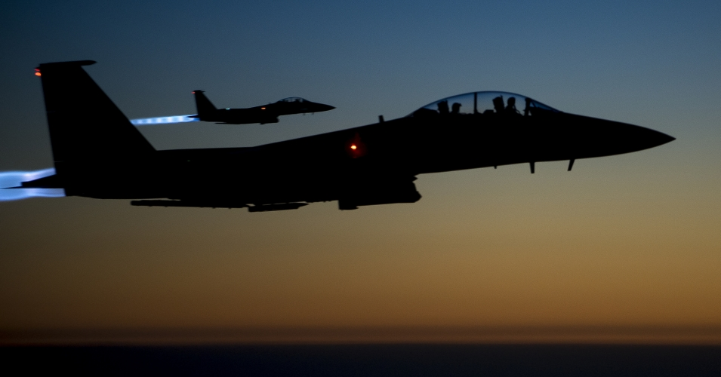

2 Timotius
Suara
Doktrin Melawan Oposisi
Dr. Rick Griffith • Singapore Bible College • BibleStudyDownloads.org

Slide 2
Kata Kunci
237
Doktrin
2 Timotius

Slide 3
Ayat Kunci
237
“Segala tulisan yang diilhamkan Allah memang bermanfaat untuk mengajar, untuk menyatakan kesalahan, untuk memperbeiki kelakuan, dan untuk mendidik orang dalam kebenaran. Dengan demikian tiap-tiap manusia kepunyaan Allah diperlengkapi untuk setiap perbuatan baik……..beritakanlah Firman” (2 Timotius 3:16-17; 4:2).
2 Timotius

Slide 4
237
Rangkuman
Paulus mendesak Timotius berlatih dan memberitakan Firman Tuhan dengan setia ditengah kesulitan, guna mendukungnya untyuk melawan ajaran sesat dan kemurtadan dengan gigih.

Slide 5

2 Timothy Kingdom Statement
237
27d
237
The mention “by His appearing and His kingdom” (4:1 NAU) links Christ’s return with his millennial rule while “bring me safely to His heavenly kingdom” (4:18 NAU) shows its eternal nature.

Slide 6

Covenant in 2 Timothy
27d
Paul was “an apostle of Christ Jesus by the will of God, according to the promise of life that is in Christ Jesus” (1:1).

Slide 7

Redemption in 2 Timothy
27d
The Scriptures make us “wise for salvation through faith in Christ Jesus” (3:15; cf. 2:10).

Slide 8
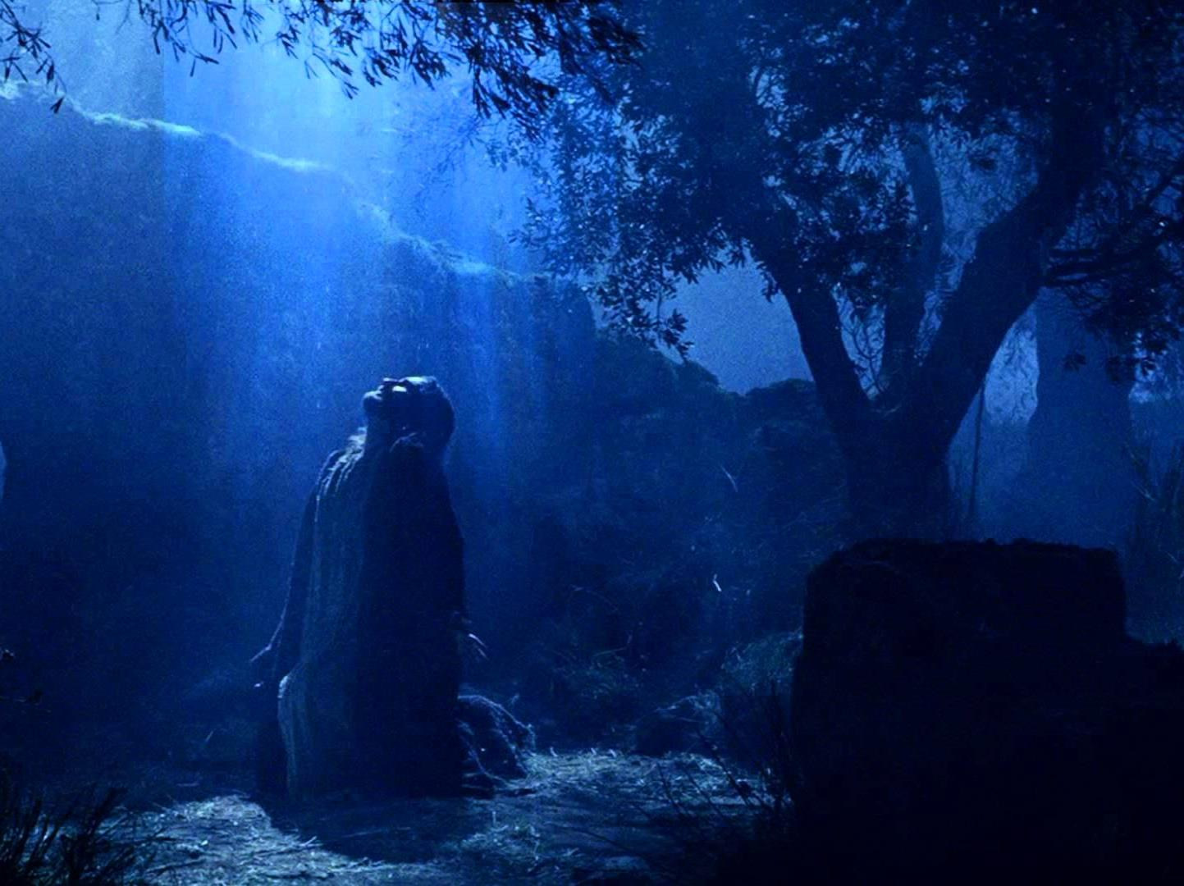
Prophecy in 2 Timothy
(Lord, Deity)
27d
Jesus is called Lord 16 times in only four short chapters (e.g., 1:8; 2:19; 4:8), which makes sense as Paul was about to die for proclaiming His deity.

Slide 9


Summary Chart
2 Timotius
237
Doktrin yang benar melawan penentang
Sound Doctrine Against Opposition
Gigih dalam kesulitan sekarang
Persevere in Present Hardship
Gigih dalam kesulitan masa depan
Persevere in Future Hardship
pasal 1—2
Chapters 1—2
pasal 3—4
Chapters 3—4
Contoh-contoh kesetiaan 1
Examples
of Faithfulness
1
Karakter-karakter kesetiaan 2
Characteristics
of Faithfulness
2
Masalah: Kemurtadan
3:1-9
Problem:
Apostasy
3:1-9
Solusi: Beritakan Firman Tuhan
3:10—4:5
Solution:
Preach the Word
3:10—4:5
Harapan Paulus
4:6-22
Paul’s Hope
4:6-22
Eunike
Lois
Paulus
Onesiforus
Eunice
Lois
Paul
Onesiphorus
Pemuridan * Satu prinsip * Ketaatan * Kerja keras * Rohani
* Suci * Berani
Discipling * Single-minded * Obedient * Hardworking * Biblical
* Holy * Gentle
Tidak mengakui Tuhan, kemunafikan
Godlessness
Hypocrisy
Berkhotbah
Gigih
Memarahi
Mendukung
Menyebarkan ajaran Kristen
Preaching
Persevering
Rebuking
Encouraging
Evangelism
Kesyahidan
Pengkhianatan
Salam
Penyerahan
Martyrdom
Betrayals
Greetings
Benediction
Roma ke Efesus
Rome to Ephesus
Musim Gugur AD 67 (Dipenjara di Roma yang kedua)
Autumn AD 67 (second Roman imprisonment)

Slide 10
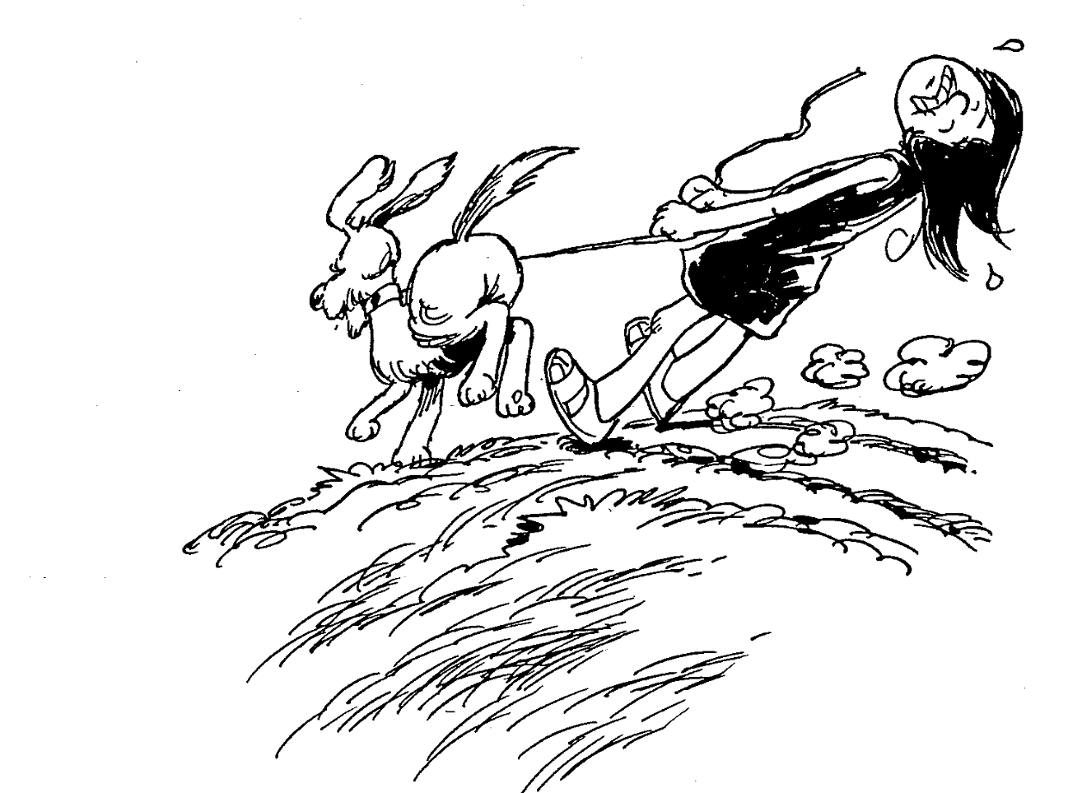
SECOND TIMOTHY
1
2
3
4
Hold onto true faith
Obey and teach Word
Last days bring apostasy
Diligently preach God's Word
Barry Huddleston, The Acrostic Bible

Slide 11
Ikhtisar PB (Ajaran Paulus Kata Kunci)
38
124
39-41
“Sampai keujung bumi" (Kis 1:8)
Kis 9 13 14 15 16 18 21 27 28
Apr 50-
Sep 52
2
Aegean
Spr 53-
Mei 57
3
Asia
Feb 60-
Mar 62
1
Roma
Spr 62-
Musim Gugur 67
4
Spanyol
Aut 67-
Spr 68
2
Roma
Musim Panas 35-
37
Damsyik
Antiokhia
Apr 48-
Sep 49
1
Galatia
Mei 57-
Aug 59
Pengadilan
Musim Gugur 49
Dewan
Musim Semi 68
Perluasan Gereja
35 48 49 50 52 53 57 60 62 67 68 95
Matt
Kerajaan
Luke
Acts
Mark
Murid
John
Kedaulatan 1
Kedaulatan 2
Percaya
Gal
Membenarkan
1 Thess
1 Cor
Eph
1 Tim
2 Tim
Pengangkatan
Pengkudusan
Persatuan
Keteraturan
Doktrin
2 Thess
2 Cor
Col
Keilahian
Titus
Kesengsaraan
Rasul
Kelakuan
Romans
Philem
Kebenaran
Memaafkan
Injil & Kitab para rasul
Phil
Sikap
Surat-surat Paulus
1234
Perjalanan
Roma
Pemenjaraan
Pauline Key Words

Slide 12
Pendahuluan
238
satu dari 3 surat-surat penggembalaan ( 1 & 2 Timotius dan Titus)
Paulus menujukan ini kepada individu-individu (dibandingkan dengan surat-suratnya yang lain kepada gereja-gereja)

Slide 13
Authorship
238
Apostle Paul
(stated clearly in verses 1 & 2 “Paul, an apostle of Jesus Christ……to Timothy my beloved child…” )
Notes:
Need to not only talk about Paul authorship, other opinions about others view of authorship

Slide 14
Authorship
2 Timotius
Penulisan
238
Bukti Eksternal Pengesahan untuk penulisan surat-surat Paulus sebaik surat lainnya kecuali Roma dan 1 Korintus
Bukti Internal
Surat tersebut menyatakan penulisan surat-surat Paulus (2 Tim. 1:1) dan berisi karakter tipe surat-surat Paulus

Slide 15

Origins / Recipients
2 Timotius
Tempat asal
238
Paulus menulis 2 Timotius kepada rekan perjalanannya, Timotius (2 Tim. 1:2), 5 tahun kemudian setelah suratnya yang pertama.
Beranggapan bahwa Timotius masih tinggal di Efesus (1 Tim. 1:3b), 2 Timotius juga punya tujuan yang sama (2 Tim. 1:16-18; 4:19).
Surat tersebut ditulis dari Roma (1:17; 2:9) selama Paulus di penjara di Roma untuk yang kedua kalinya, setelah pembelaannya yang pertama di pengadilan (4:16-17).
Roma
Efesus

Slide 16
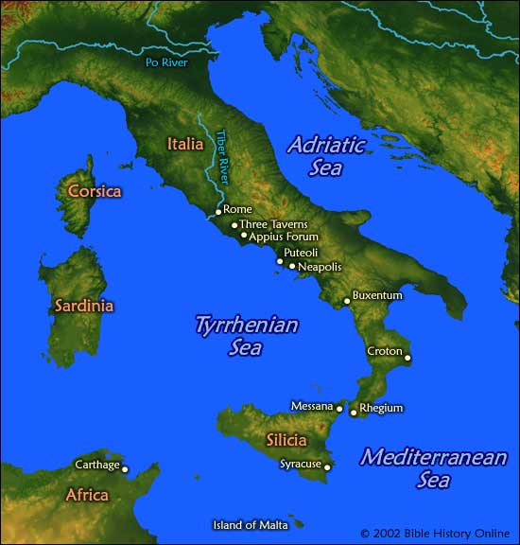
Tempat
238
Selama Paulus dipenjara di Roma untuk kedua kalinya
Roma

Slide 17
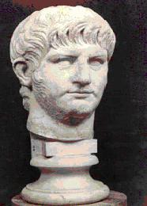
Date
2 Timothy
238
Emperor Nero
Reigning (AD 67)

Slide 18

Date 1
2 Timotius
Penanggalan
238
Urutan kejadian tahun-tahun terakhir Paulus tidak jelas, berikut adalah perpaduan dari data-data eksternal dan internal:
Dipenjara di Roma pertama kali Februari 60—Maret 62
(Kis. 28:30-31)
Paulus menulis Efesus, Musim Gugur 60—early Musim Semi 62 Kolose, Filemon,
dan Filipi
Martir dari Yakobus, Musim Semi 62
saudara Tuhan

Slide 19
Date 2
2 Timotius
Penanggalan
238
Bebas dari penjara Musim Semi 62—Musim Gugur 67
Paulus di Efesus dan Kolose Musim Semi—Musim Panas 62
(Timotius tinggal di Efesus)
Petrus pergi ke Roma 62
Paulus di Makedonia Akhir musim panas 62-musim dingin 62/63
1 Timotius ditulis di Makedonia Musim Gugur 62
untuk Timotius di Efesus
Paulus di minor Asia Musim Semi 63-Musim Semi 64
Paulus di Spanyol Musim Semi 64-Musim Semi 66
(diantisipasi di Rom. 15:24)
Orang-orang Kristen dianiaya oleh Nero Musim Panas 64
dan Petrus menjadi maritr

Slide 20
Date 3
2 Timothy
Penaggalan
238
Paulus di Kreta Awal Musim panas 66
(Titus tinggal disana; Tit. 1:5)
Paulus di minor Asia Musim panas-musim gugur 66
Titus ditulis dari minor Asia Musim panas66
untuk Titus di Kreta
Paulus di Nikopolis (Tit. 3:12) Musim dingin 66/67
Paulus di Troas (2 Tim. 4:13), Musim semi—Musim Gugur 67
Makedonia and Yunani
Titus ditulis dari minor Asia Musim panas 66
untuk Titus di Kreta
Dipenjara di Roma yang kedua Musim gugur67—musim semi 68
Paulus ditahan dan dibawa ke Roma Muism gugur 67
2 Timotius ditulis dari Roma Musim gugur 67
untuk Timotius di Efesus
Paulus dipenggal kepalanya Musim semi 68
2 Timotius ditulis dari Roma Musim gugur 67
kepada Timotius di Efesus
Kehancuran Yerusalem September 2, 70

Slide 21
PENERIMA
238
Timotius – Rekan perjalanan Paulus yang lama
Jenis
Surat yang sangat pribadi dan emosional.

Slide 22
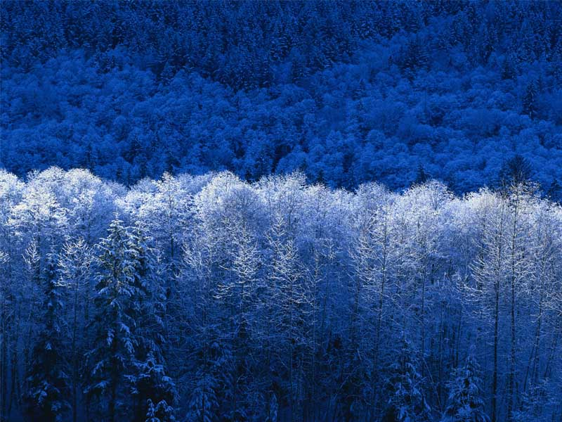
PERISTIWA
238
ditulis 5 tahun setelah 1 Timotius
Paulus dipenjara di Roma yang kedua
(4: 6-8)
Sebelum eksekusi Paulus (4: 9, 21)
ketika Nero menyalahkan orang-orang Kristen

Slide 23

Occasion
2 Timotius
Peristiwa
238
Ketika Paulus menulis 2 Timotius pada AD 67 sia adalah seorang tahanan yang berpengalaman di beberapa kota:
Yerusalem: 10 tahun lebih awal (Mei 29-Juni 9, 57)
Kaisaria: 8-10 tahun lebih awal (Juni 57-Aug 59)
Roma: 5-7 tahun lebih awal (Feb 60-Maret62)
Selama menghabiskan hampir 5 dari 10 tahun dibelakang layar,dia tahu tentang penjara dan prosedur politik.Dia tahu bahwa pemenjaraan Roma yang kedua ini akan berujung pada eksekusi (2 Tim. 4:6-8).
Sejak Peulus tidak mengharapkan hidup yang lebih lama lagi di penjara Roma,dia minta Timotius untukl segera datang padanya sebelum musim dingin (2 Tim. 4:9, 21).

Slide 24
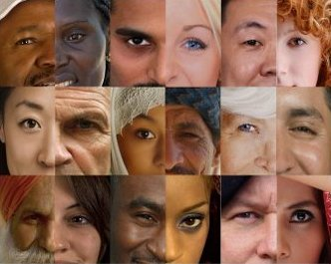
How to Deal with Secularism
2 Timothy 3
Dr. Rick Griffith, Crossroads International Church
BibleStudyDownloads.org

Slide 25
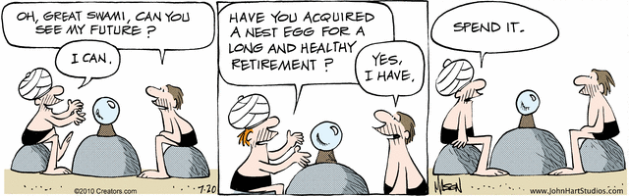
The Future
Oh, Great Swami, can you tell me my future?
Have you acquired a nest egg for a long and healthy retirement?
Spend it.
Nephew
I can.
Yes,
I have.
Notes:
A man in the cartoon strip "B.C." seeks crystal ball advice [read].
"B.C" gives a negative view of the future!

Slide 26

As a Christian, should you be optimistic about the future?

Slide 27
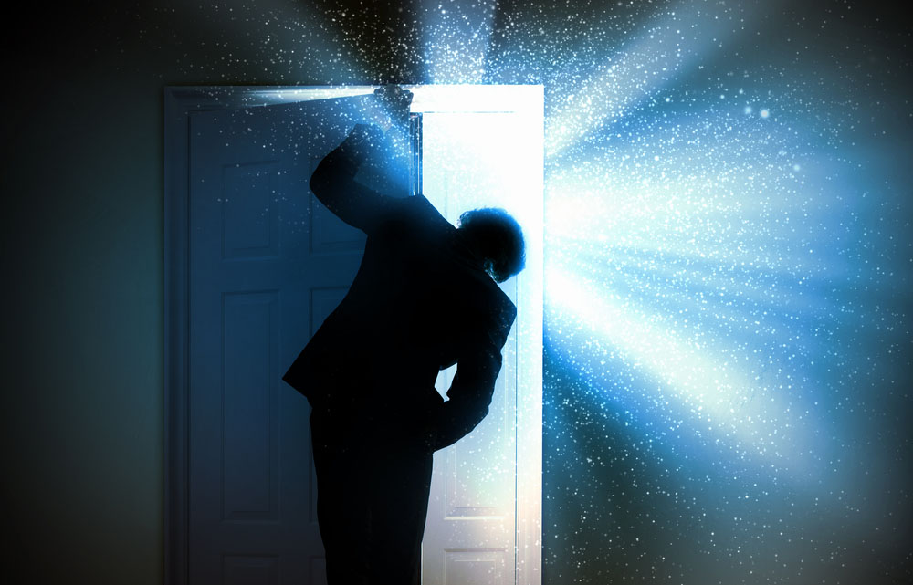
The Future
Notes:
One could say that Christians ought to be the most positive people on the planet

Slide 28

The Future
Notes:
After all, who else has the assurance of sins forgiven and a heavenly home? Who else has a Guide right now who knows everything, loves us unconditionally, and can do anything? Doesn't it seem that believers ought to be the most confident people about the future?

Slide 29

THE FUTURE IS OURS
Notes:
What about you? Are you an optimist? Shouldn't you be?

Slide 30
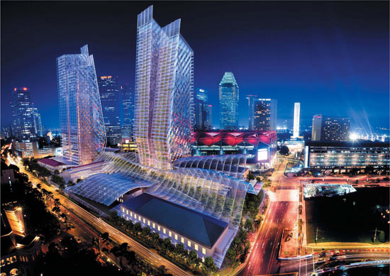
The Future Singapore
Notes:
Singapore is now in its 50th year, having grown from a sleepy fishing village to a major player on the global scene.

Slide 31

The Future Singapore
Notes:
The economy is looking up—employment is full, property prices are stable or rising.

Slide 32
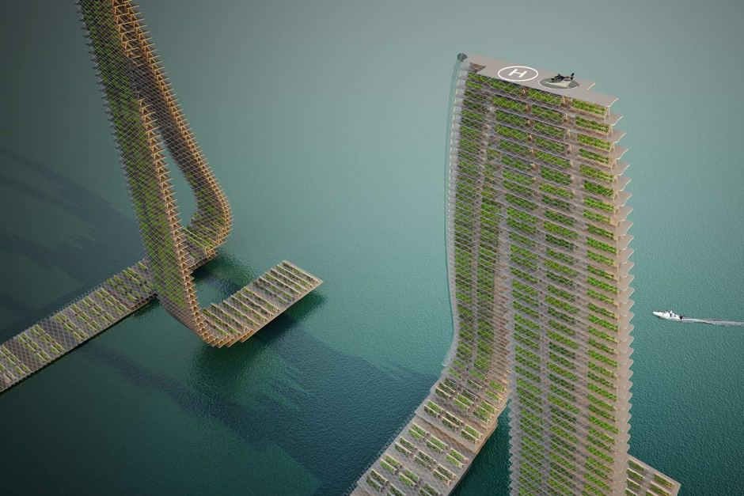
Singapore Floating Farms
Notes:
Singapore marches forward toward floating farms…

Slide 33

Singapore Floating Farms
Notes:
…just outside Marina Bay.

Slide 34

Shouldn't we be encouraged?
Notes:
Even looking at eternal things, the percentage of Christians in Singapore continues to rise, as does the number of churches—growing even faster than the general population increase. Shouldn't Christians be encouraged?

Slide 35

You shouldn't.
As a Christian, do you have optimism about the future?

Slide 36
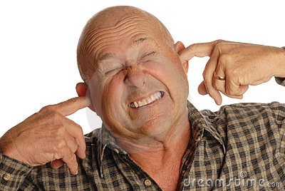
It will get worse.
Notes:
The Bible says that the worst days are ahead prior to Christ's return. It is going to get worse. In fact, it started getting worse in the first century. How's that?

Slide 37
Ikhtisar PB (Surat-surat Paulus)
38
124
39-41
“Sampai keujung bumi" (Kis 1:8)
Kis 9 13 14 15 16 18 21 27 28
Apr 50-
Sep 52
2
Aegean
Spr 53-
Mei 57
3
Asia
Feb 60-
Mar 62
1
Roma
Spr 62-
Musim Gugur 67
4
Spanyol
Aut 67-
Spr 68
2
Roma
Musim Panas 35-
37
Damsyik
Antiokhia
Apr 48-
Sep 49
1
Galatia
Musim Semi 68
Perluasan Gereja
Musim Gugur 49
Dewan
Mei 57-
Aug 59
Pengadilan
35 48 49 50 52 53 57 60 62 67 68 95
Matius
Lukas
Kis
Markus
Yoh
Galatia
1 Tes
1 Kor
Efesus
1 Tim
2 Tim
2 Tes
2 Kor
Kolose
Titus
Misionari
Roma
Filemon
Pastoral
Injil & Kisah para rasul
Filipi
Surat-surat Paulus
1234
Perjalanan
Penjara
Roma
Pemenjaraan
Pauline

Slide 38
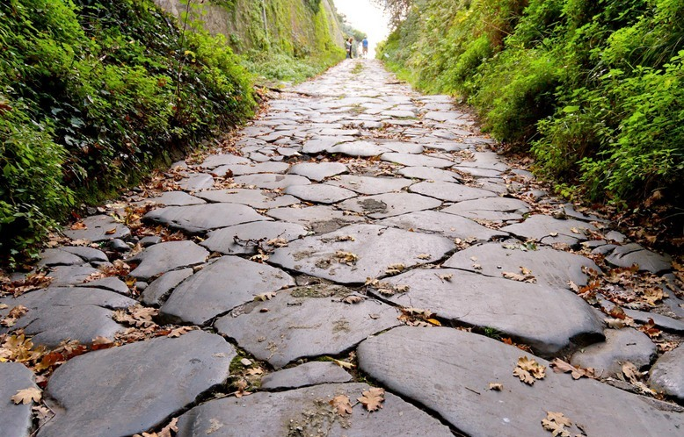
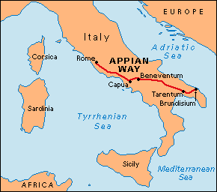
First Roman Imprisonment (AD 60-62; Acts 28:15)
"The brothers and sisters in Rome had heard we were coming, and they came to meet us at the Forum on the Appian Way. Others joined us at The Three Taverns. When Paul saw them, he was encouraged and thanked God" (NLT).
Notes:
Paul was warmly welcomed by the believers in AD 60 when he first came to Rome…

Slide 39
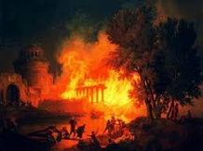
Contrasting the Roman Imprisonments
38
124
39-41
Feb 60-
Mar 62
1
Rome
Spr 62-
Fall 67
4
Spain
Aut 67-
Spr 68
2
Rome
60 62 67 68
Eph
2 Tim
Col
Philem
Phil
Pauline Epistles
1234
Journeys
Rome
Imprisonments

Slide 40
Contrasting the Roman Imprisonments
38
124
39-41
Feb 60-
Mar 62
1
Rome
Spr 62-
Fall 67
4
Spain
Aut 67-
Spr 68
2
Rome
60 62 67 68
Nero's Mental Health
Stable
Insane
AD 64 Fire of Rome
Before
After
View of Christians
Jewish Sect
Mostly Gentiles
Tolerance by Rome
Protected
No restraints
Persecution by Rome
Infrequent
Widespread
Result for Paul
Released
Beheaded

Slide 41
Second Roman Imprisonment (AD 67-68)
"As you know, everyone from the province of Asia has deserted me—even Phygelus and Hermogenes" (2 Tim. 1:15 NLT)
"Yes, and everyone who wants to live a godly life in Christ Jesus will suffer persecution. ¹³But evil people and impostors will flourish. They will deceive others and will themselves be deceived" (2 Tim. 3:12-13 NLT)
Notes:
However, seven years later the scene was entirely different. Nero had initiated a persecution of believers and it was very unpopular to be a Christian. May had denied the faith and most had gone underground to the catacombs if they still continued in the faith.

Slide 42
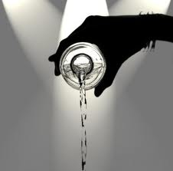
Second Roman Imprisonment (AD 67-68)
"As for me, my life has already been poured out as an offering to God. The time of my death is near. ⁷I have fought the good fight, I have finished the race, and I have remained faithful"
(2 Tim. 4:6-7 NLT)

Slide 43
Friends of Paul’s Second Roman Imprisonment (AD 67-68)
"Timothy, please come as soon as you can. ¹⁰Demas has deserted me because he loves the things of this life and has gone to Thessalonica. Crescens has gone to Galatia, and Titus has gone to Dalmatia. ¹¹Only Luke is with me. Bring Mark with you when you come, for he will be helpful to me in my ministry. ¹²I sent Tychicus to Ephesus. ¹³When you come, be sure to bring the coat I left with Carpus at Troas. Also bring my books, and especially my papers. ¹⁴Alexander the coppersmith did me much harm, but the Lord will judge him for what he has done. ¹⁵Be careful of him, for he fought against everything we said" (2 Tim. 4:9-15 NLT).

Slide 44
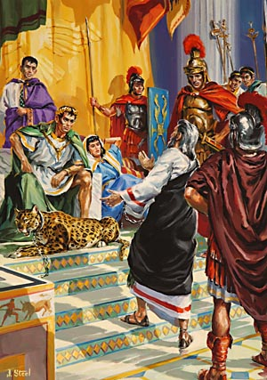
Paul's Second Imprisonment (AD 67-68)
"The first time I was brought before the judge, no one came with me. Everyone abandoned me. May it not be counted against them. ¹⁷But the Lord stood with me and gave me strength so that I might preach the Good News in its entirety for all the Gentiles to hear. And he rescued me from certain death"
(2 Tim. 4:16-17 NLT).

Slide 45
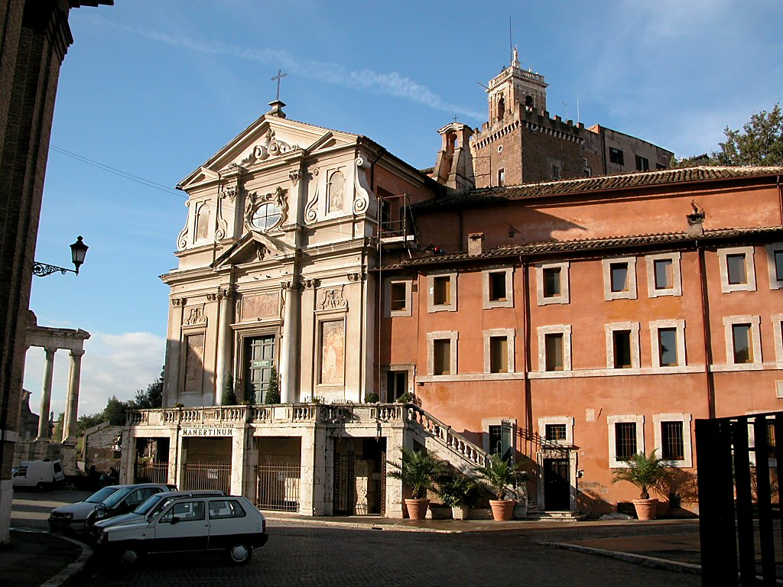
The Mamertine Prison Building
Notes:
The traditional site of the Apostle Paul's and the Apostle Peter's imprisonment in Rome, this prison was simply known as "Carcer" ("prison") in Paul's day. "Mamertine" was attributed to the prison in the Medieval Period. —Todd Bolen, BiblePlaces.com

Slide 46
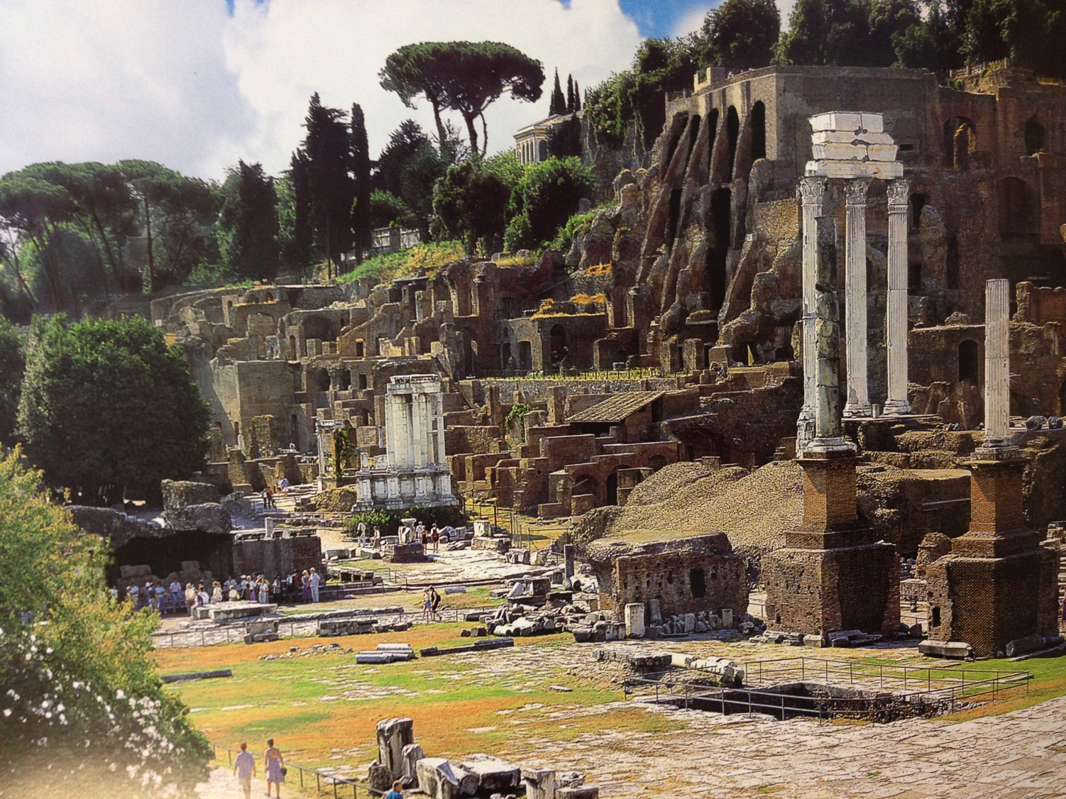
Rome's Central Forum (Modern Ruins)

Slide 47
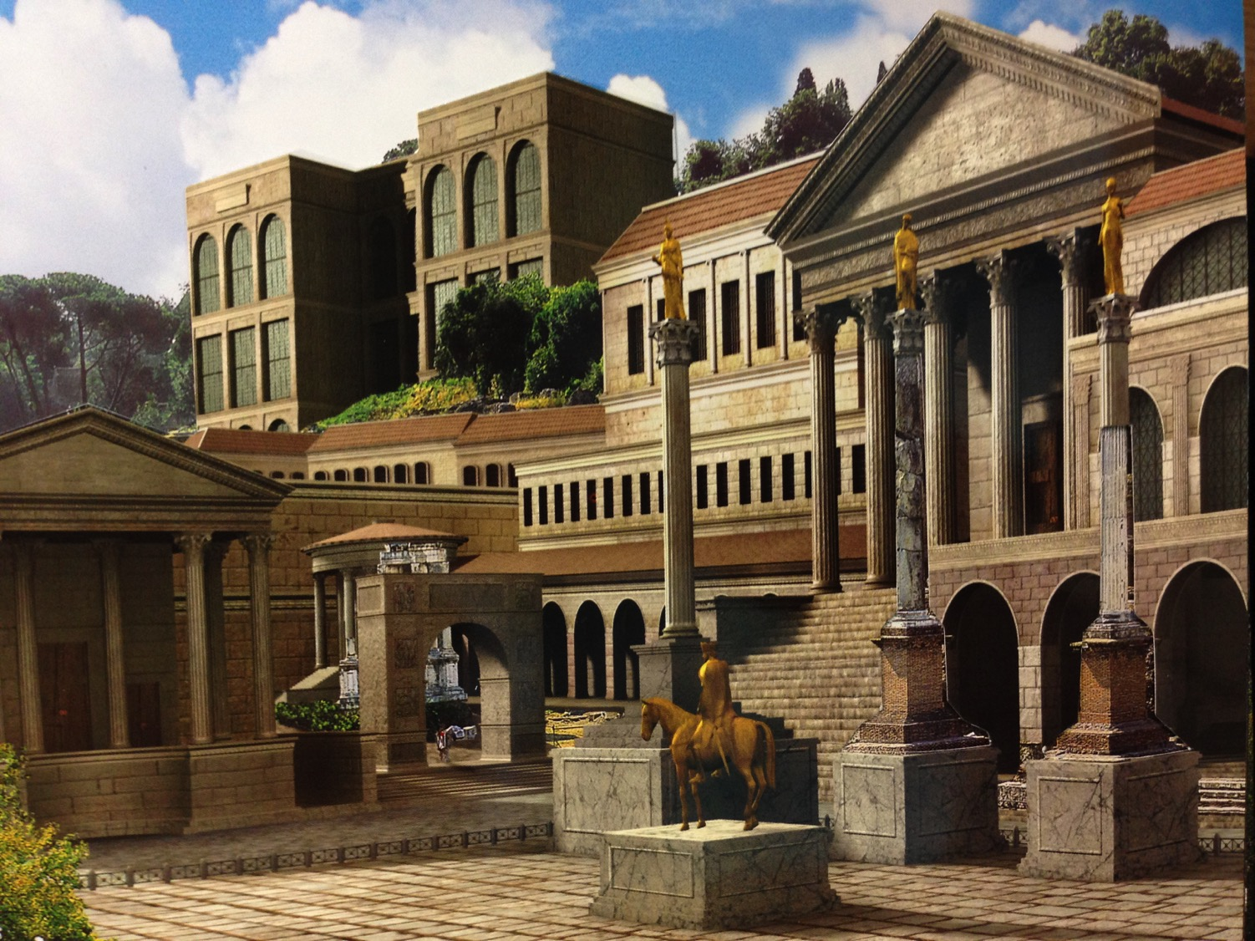
Rome's Central Forum (4th Century AD)

Slide 48
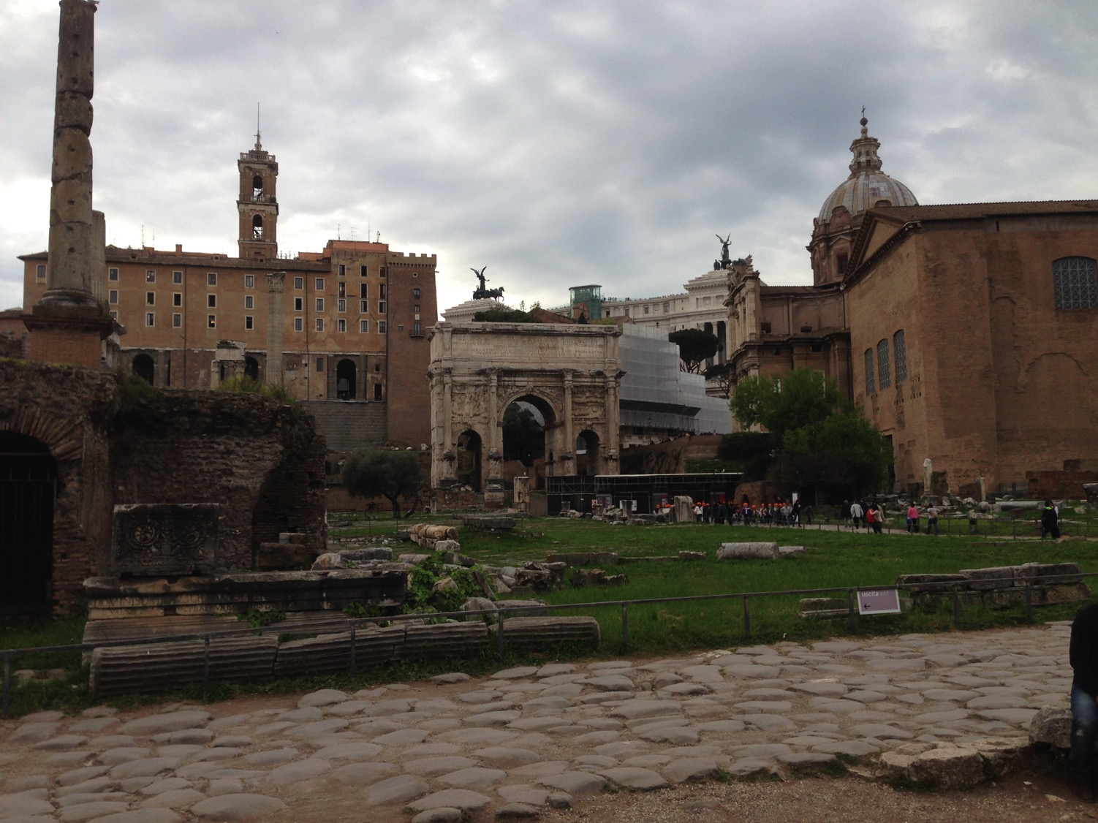
Eastern Forum From Above
Mamertine Prison
Curia (Senate "Court")

Slide 49
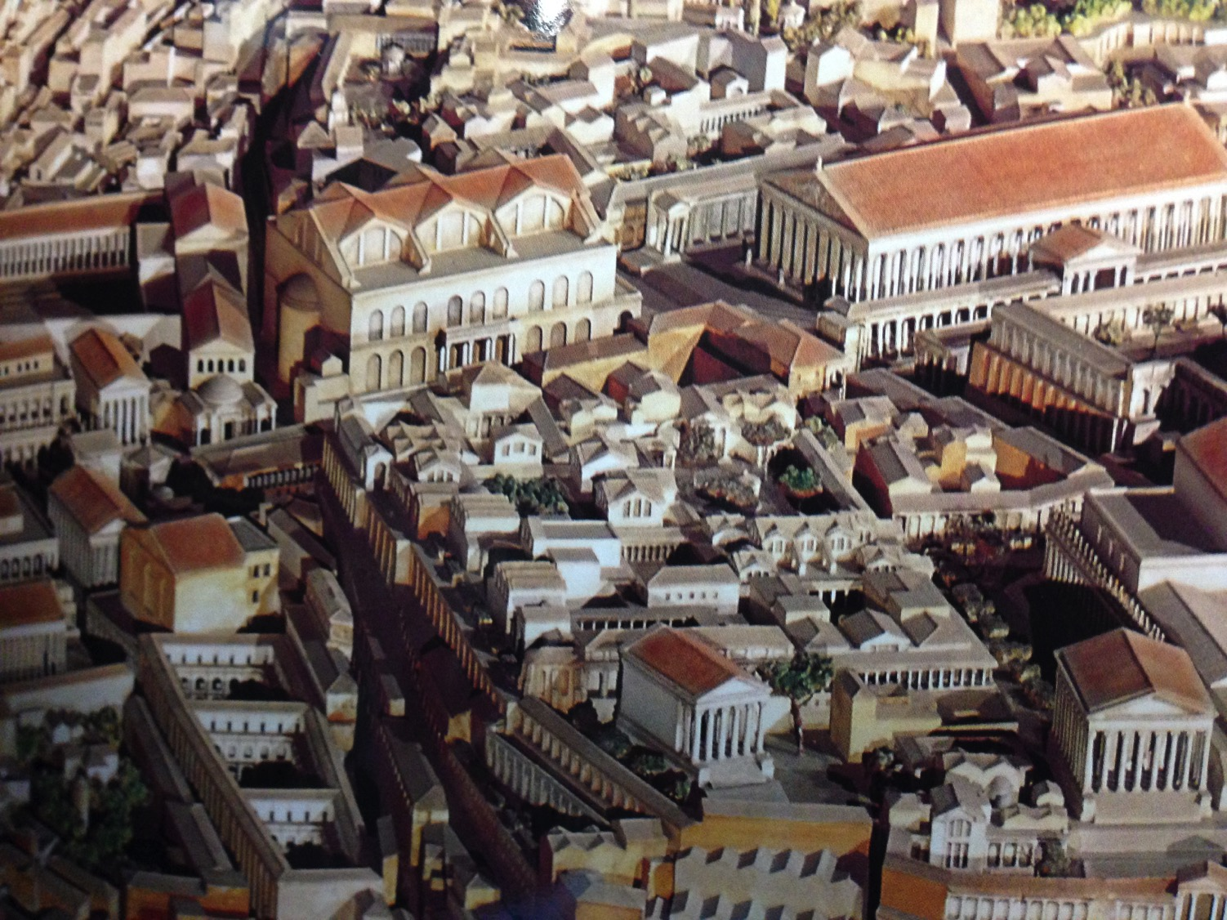
Central Forum From Above

Slide 50
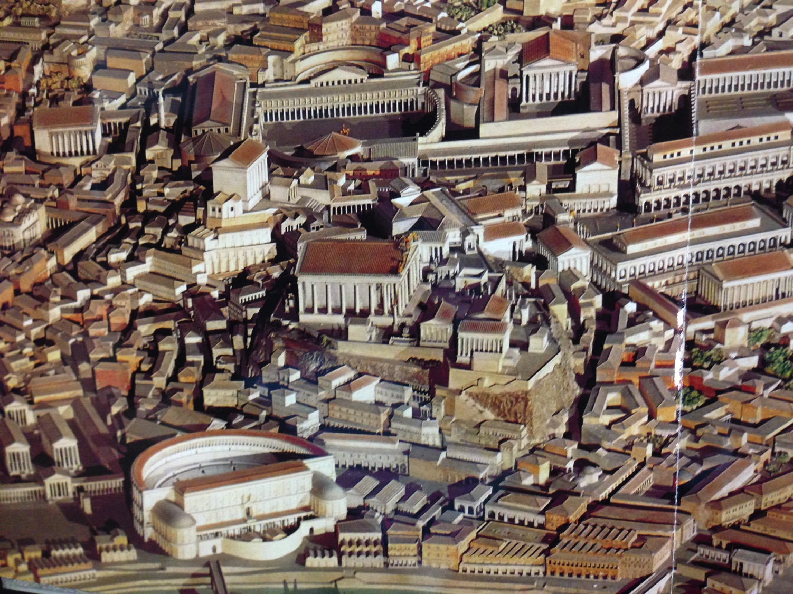
Western Forum From Above

Slide 51
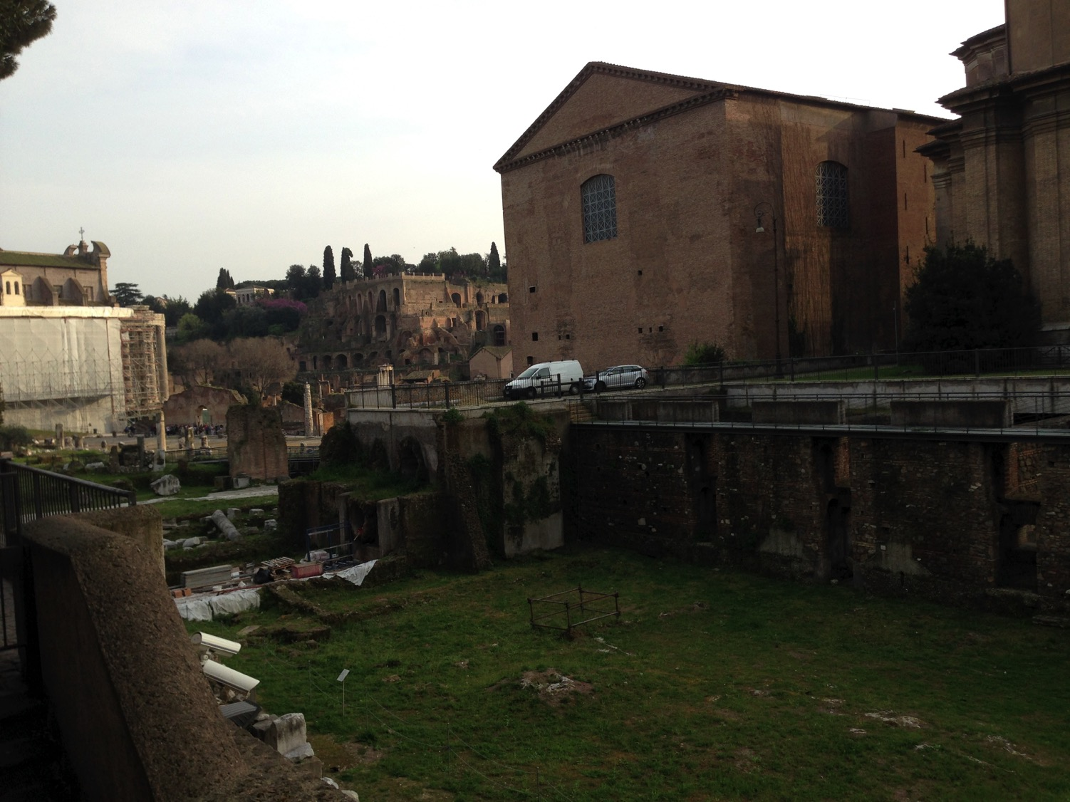
Close Locations!
Mamertine Prison
Curia (Senate "Court")

Slide 52
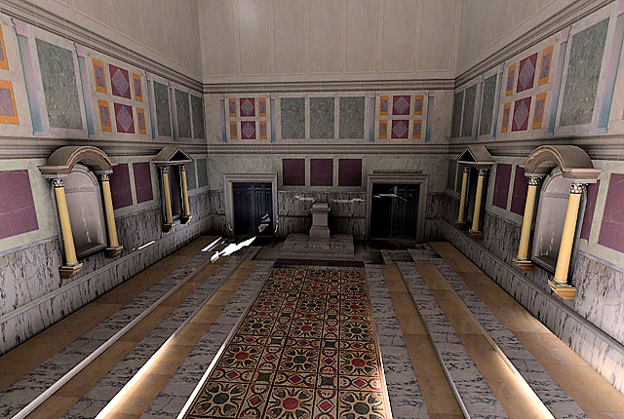
Curia Inside
Reconstruction of interior of the Curia Julia, created by the UCLA Experiential Technologies Center
Notes:
http://www.vroma.org/~bmcmanus/curiainterior.html

Slide 53
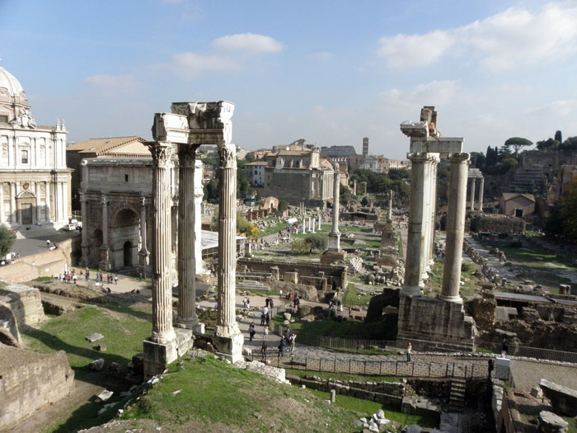
View of the Forum from the Mamertine Prison (AD 2014)

Slide 54
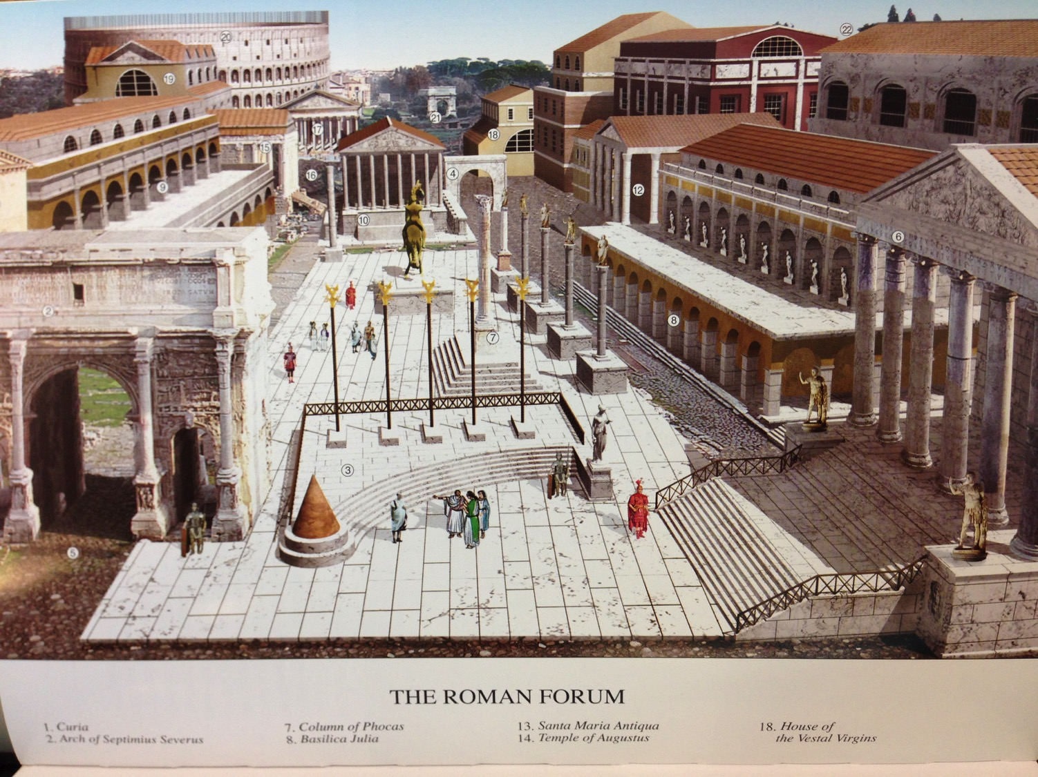
View of the Forum from the Mamertine Prison (AD 4th cent.)

Slide 55
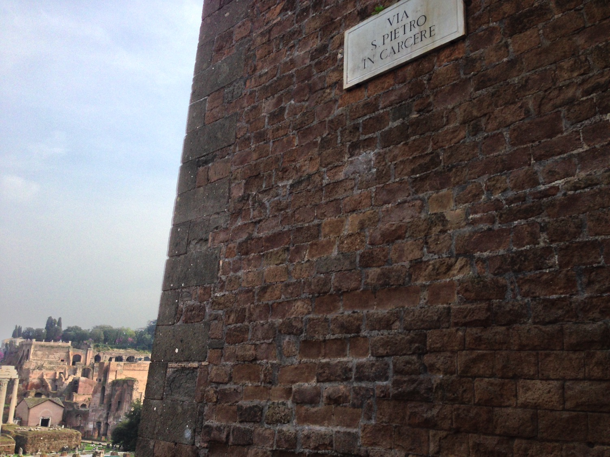
"Peter in Prison Street"

Slide 56
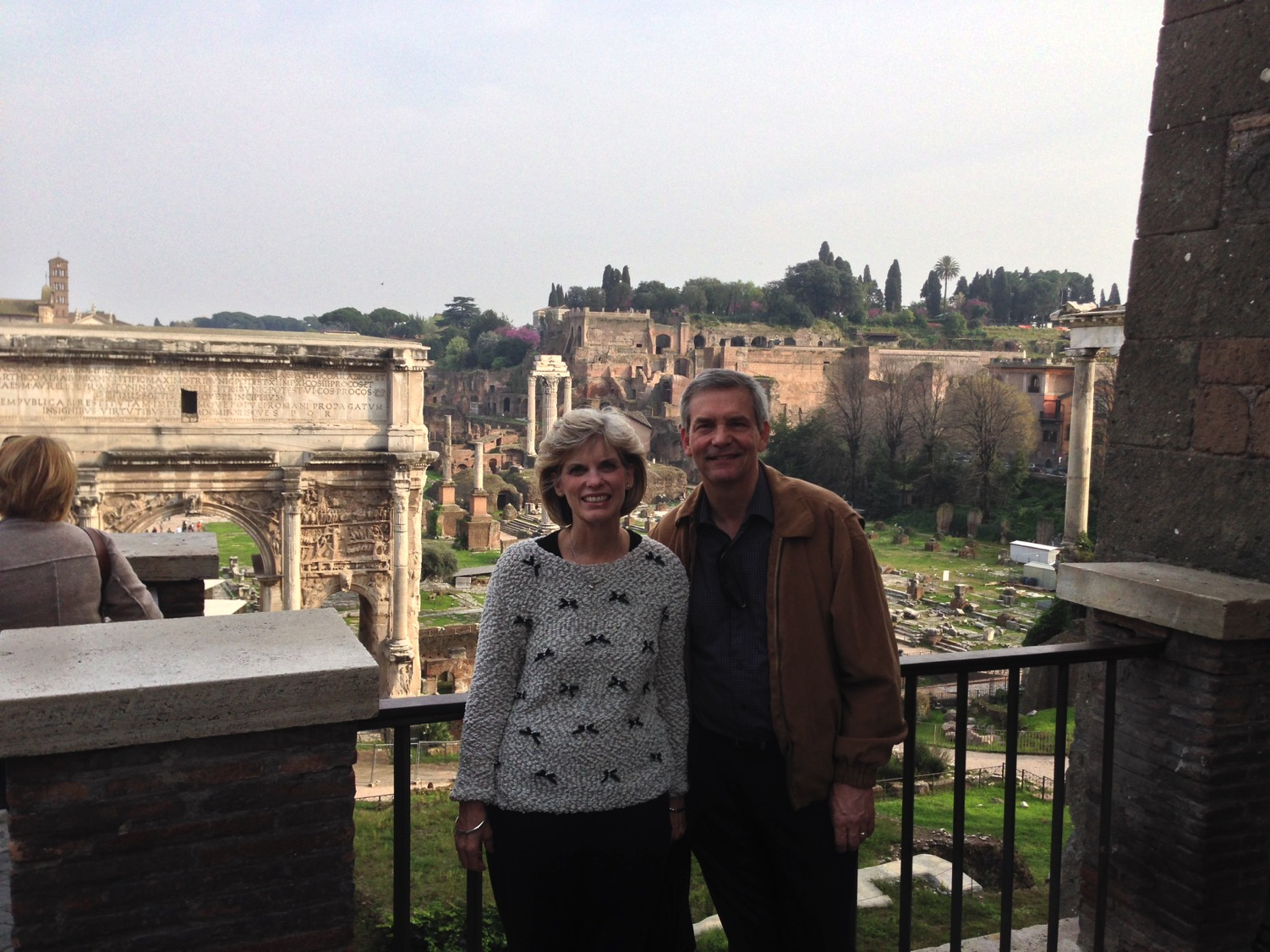
Susan & Rick free because of Peter's & Paul's imprisonment

Slide 57
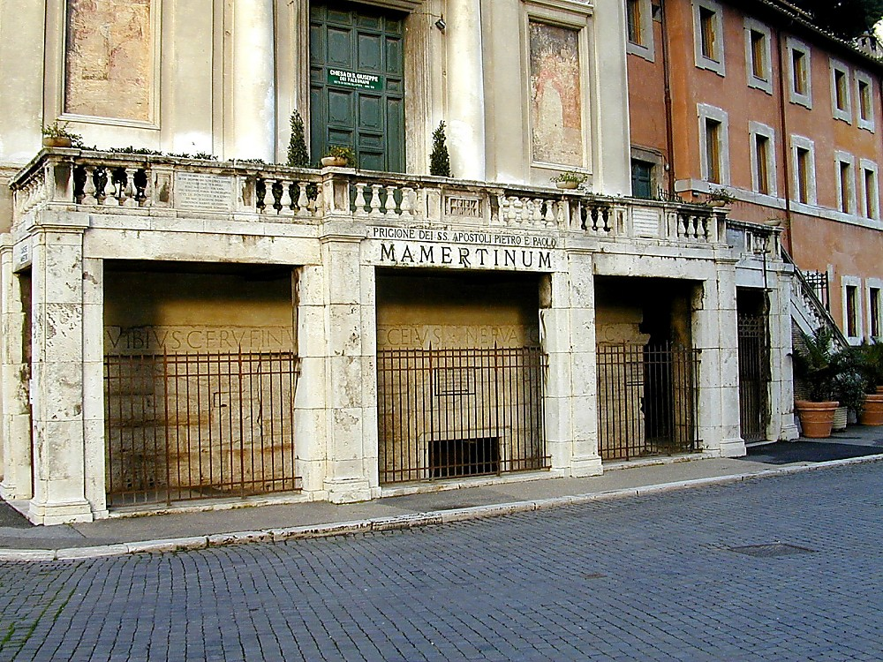

"Mamertine Prison of the Apostles Peter & Paul"
Notes:
—Todd Bolen, BiblePlaces.com

Slide 58
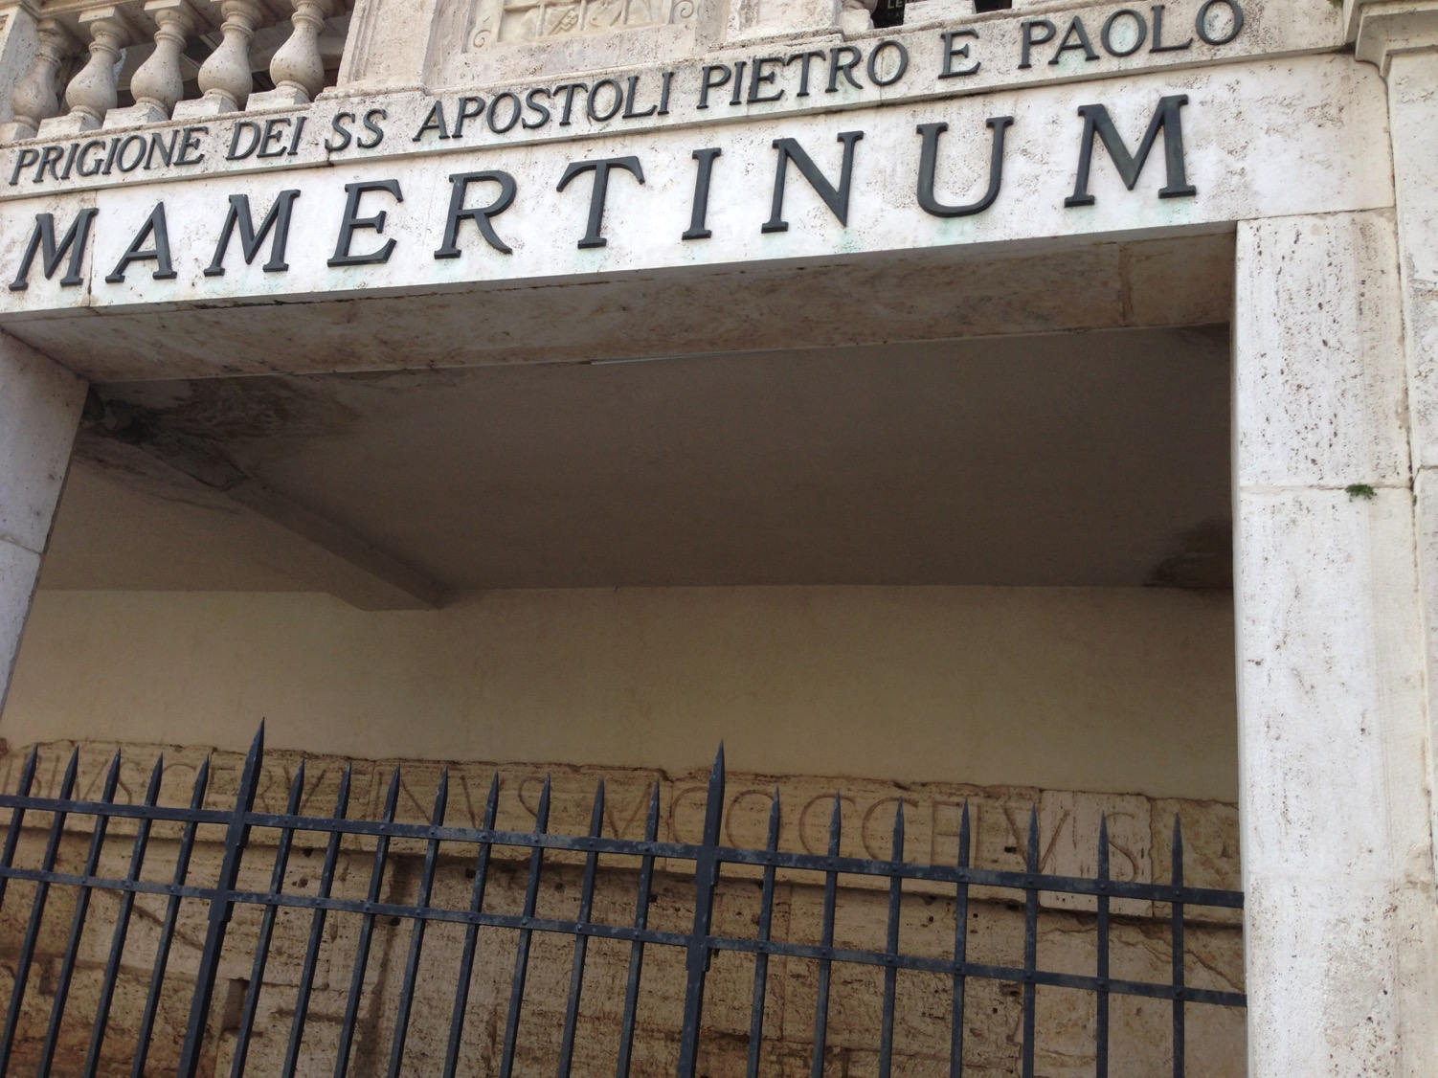
"Mamertine Prison of the Apostles Peter & Paul"

Slide 59
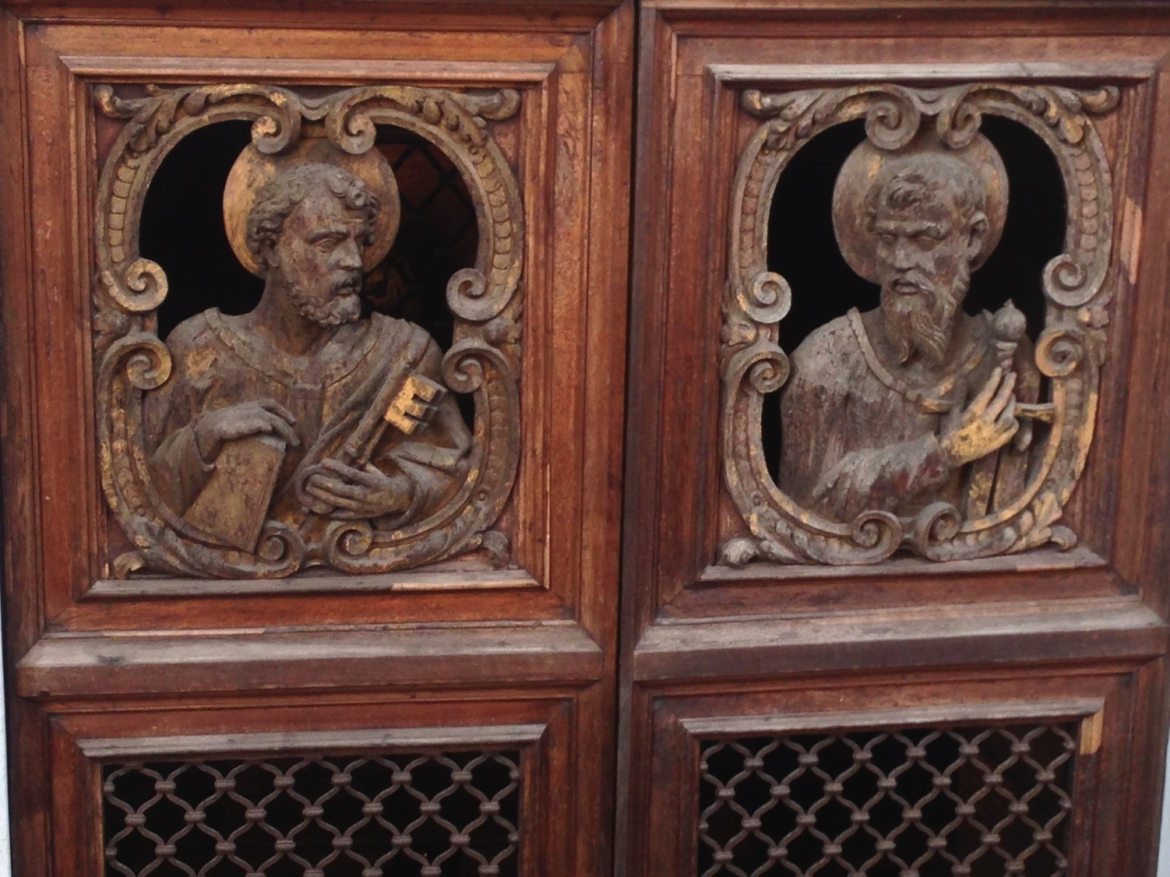
Mamertine Doors Depict Peter & Paul

Slide 60
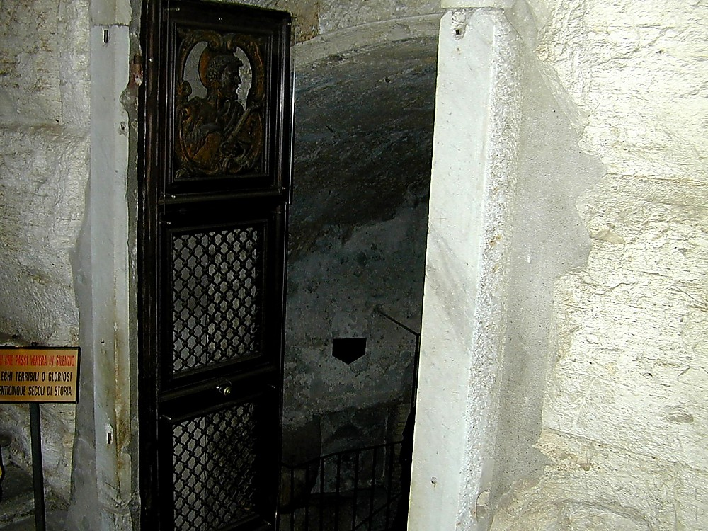
Mamertine Prison Entrance

Slide 61
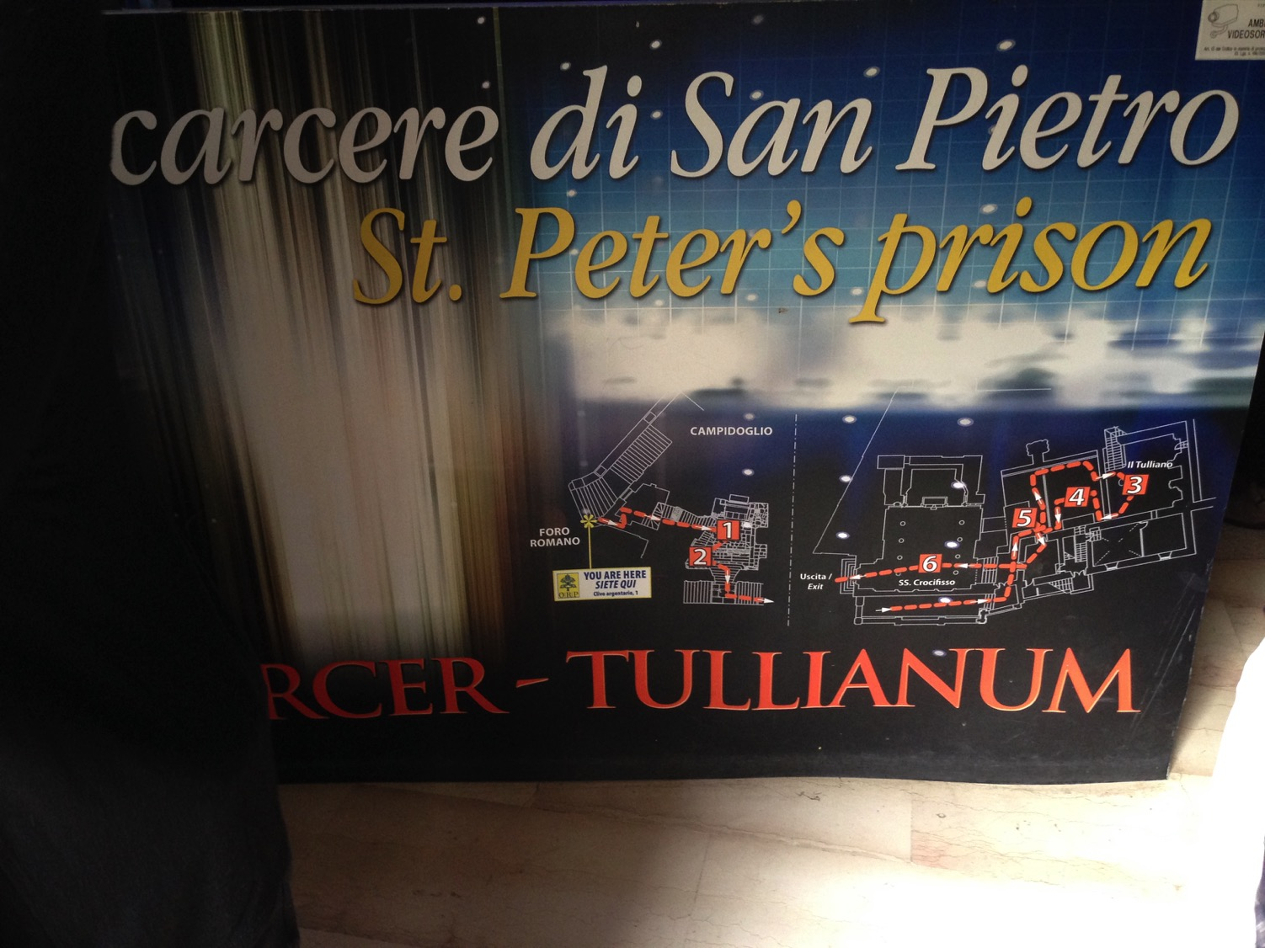
The Mamertine Tour

Slide 62
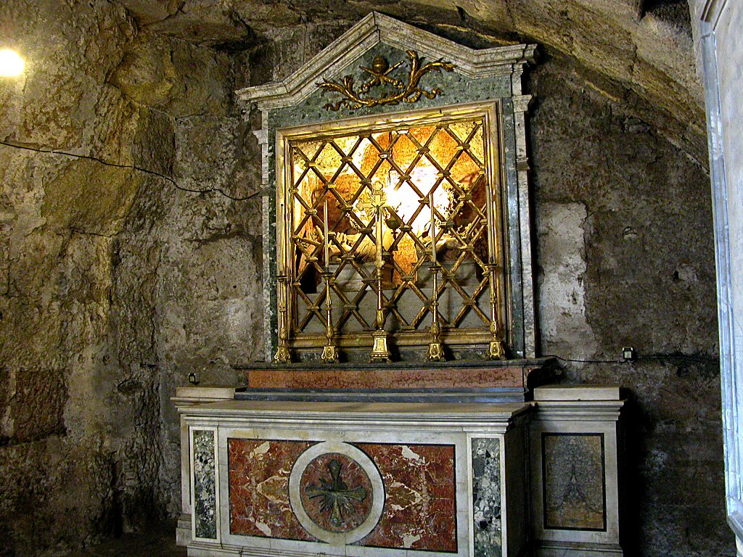
The Upper Mamertine room busts of Peter and Paul

Slide 63
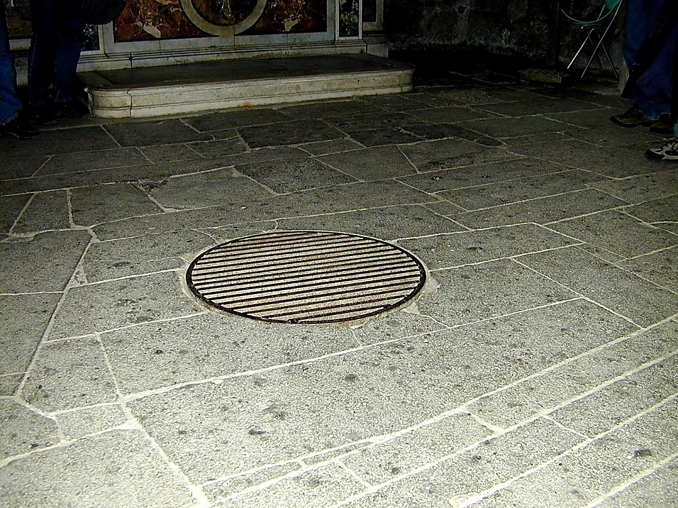
Prisoners were lowered through the manhole into the former cistern below
Notes:
The Carcer was the only prison in ancient Rome. It had two sections, an upper and a lower; the upper was known as the "Carcer" proper, while the lower (originally thought to have been a cistern) was known as the "Tullianum." Those prisoners that entered the Tullianum from the Carcer were lowered through a hole in the Carcer's floor. The name "Tullianum" is probably derived from the Latin word for a spring of water, and incidentally, this section of the prison does, in fact, house a well. According to tradition, the Apostle Peter caused the well-water to spring up so that he might baptize his jailors, St. Processus and St. Martinianus. It is debated whether Peter was actually incarcerated here. —Todd Bolen, BiblePlaces.com

Slide 64
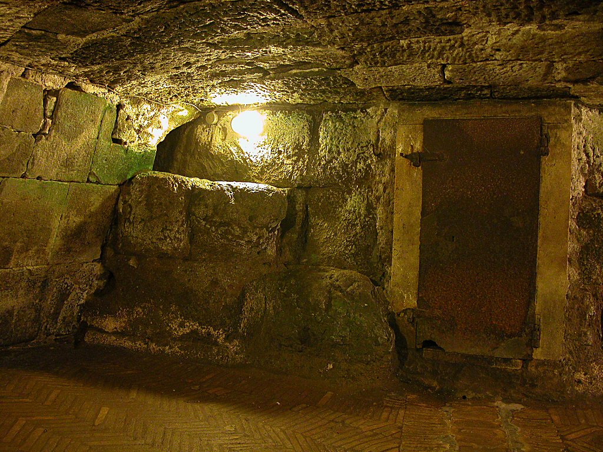
Mamertine Prison writing area and door
Mamertine Prison writing area and door
Notes:
The state rarely incarcerated common criminals but kept the Mamertine Prison for political prisoners doomed for execution by being thrown off the Tarpeian Rock. Enemies of the State, such as Jugurtha and Vercingetorix, were often strangled in the Tullianum. Sallust, a Roman writer in 40 B.C., described the Tullianum as "about twelve feet deep, closed all round by strong walls and a stone vault. Its aspect is repugnant and fearsome from its neglect, darkness, and stench." —Todd Bolen, BiblePlaces.com

Slide 65
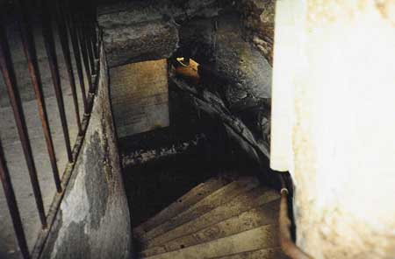
Down the Steps

Slide 66
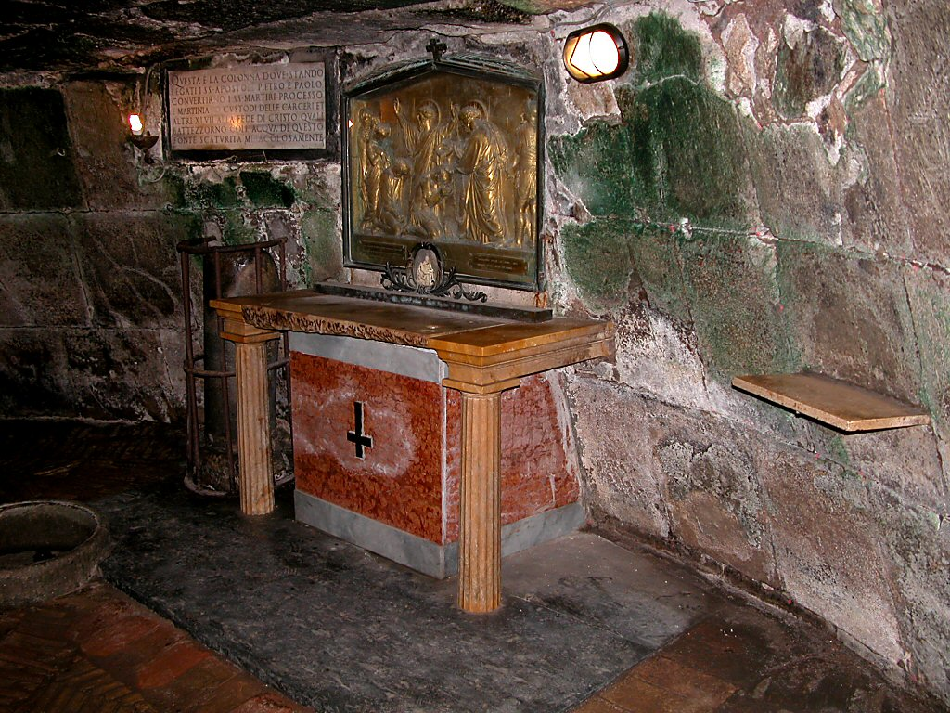
Peter's (AD 64) & Paul's (AD 67-68) Cell Below

Slide 67
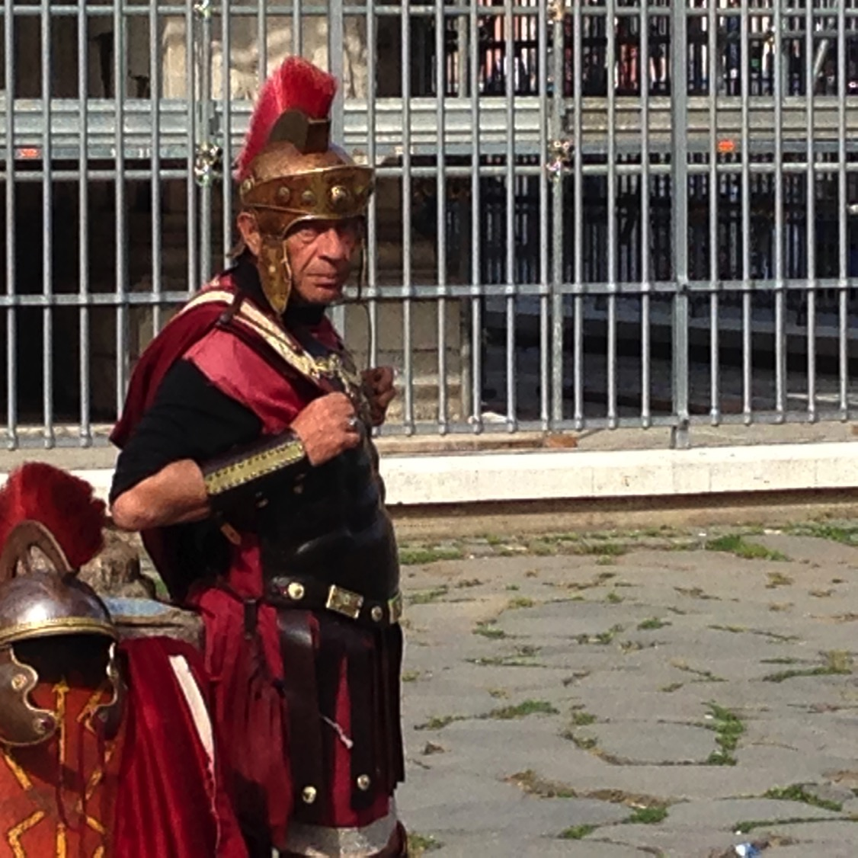
Tell your Neighbor: If you were to write your final letter before being executed, who would you write and what would you say?
2 Timothy

Slide 68
Characteristics
2 Timotius
Karakteristik
239
Surat ini untuk anak didik Paulus yang lebih muda adalah unik karena ini merupakan tulisannya yang masih ada.
Surat ini menyediakan penjelasan Perjanjian Baru yang paling jelas yang mana dibutuhkan untuk eksposisi (4:2):
Menunjukkan keharusan untuk menjaga Injil (1:14)
Menekankan pemusatan dari Alkitab (2:15)
Mencatat bagaimana kita harus gigih dalam Injil (3:14)
Menunjukkan akan penderitaan untuk Injil (1:8; 2:3)
Menjelaskan dengan baik akan inspirasi Alkitab (3:16-17)

Slide 69
Key Word / Verse
2 Timotius
238
Kata Kunci
Doktrin
Ayat Kunci
“Segala tulisan yang diilhamkan Allah memang bermanfaat untuk mengajar, untuk menyatakan kesalahan, untuk memperbeiki kelakuan, dan untuk mendidik orang dalam kebenaran. Dengan demikian tiap-tiap manusia kepunyaan Allah diperlengkapi untuk setiap perbuatan baik……..beritakanlah Firman”
(2 Timothy 3:16-17; 4:2).

Slide 70

Perbedaan Pendapat
238
Memberitahu Timotius apa yang sebenarnya penting
Mendukungnya untuk terus bertekun dalam kehidupan kekristenan dan beriman sebagai seorang hamba Tuhan.
- Mendukungnya untuk terus dengan setia memberitakan Firman Tuhan di wajah kesusahan dan guru palsu.

Slide 71
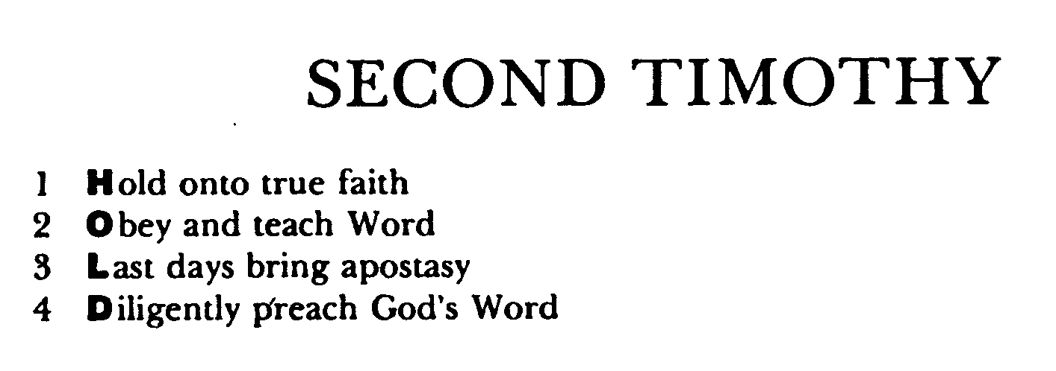
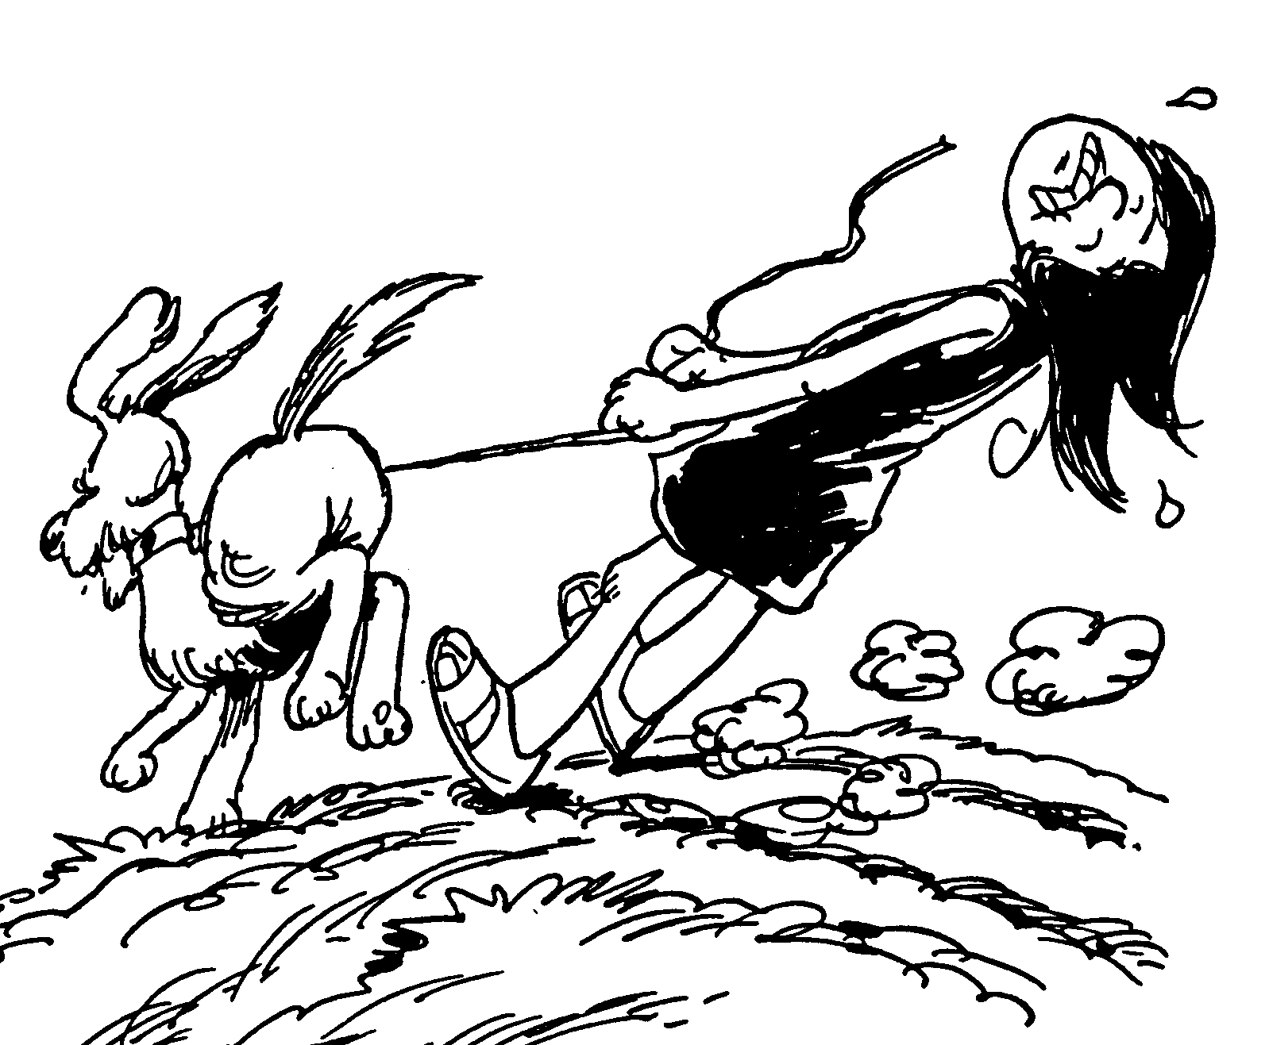
Acrostic Bible – 2 Timothy
2 Timotius
Berpegang pada iman yang benar
Mentaati dan mengajarkan Firman Tuhan
Hari-hari terakhir membawa kemurtadan
Dengan tekun memberitakan Firman Tuhan

Slide 72
Argument
2 Timotius
Perbedaan pendapat
239
Surat ini lebih tertuju pada Timotius daripada gerjanya (seperti surat yang pertama).
Dengan usaha yang keras sebelum kematiannya, Paulus membuat pernyataan terakhirnya dengan sedemikian rupa supaya dapat meyakinkan Timotius untuk tetap setia pada imannya sampai mati.
Rasul menyelesaikan ini dengan mendesaknya untuk bertekun dalam kesulitan sekarang dengan karakter Tuhan (pasal 1-2) karena masa depan akan lebih buruk (pasal 3-4).
Dia secara khusus harus melawan kemurtadan dengan cara tetap setia memberitakan Firman Tuhan (3:10—4:5).

Slide 73
Summary Statement
2 Timotius
Rangkuman
237
Paulus mendesak Timotius berlatih dan memberitakan Firman Tuhan dengan setia ditengah kesulitan, guna mendukungnya untyuk melawan ajaran sesat dan kemurtadan dengan gigih.

Slide 74
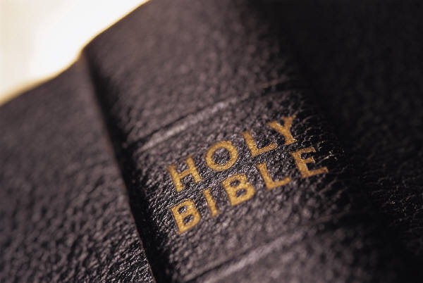
Synthesis
2 Timotius
Perpaduan
239
Doktrin yang benar melawan penentang
1—2 Gigih dalam kesulitan sekarang
3—4 Gigih dalam kesulitan masa depan

Slide 75
KERANGKA
237
Pasal 1 & 2
Pasal 3 & 4
Gigih dalam kesulitan sekarang
Gigih dalam kesulitan masa depan
Contoh-contoh kesetiaan
Solusi: Beritakan Firman Tuhan
Harapan Paulus
Karakter-karakter kesetiaan
Masalah : Kemurtadan

Slide 76
Summary Chart
2 Timotius
237
Doktrin yang benar melawan penentang
Sound Doctrine Against Opposition
Gigih dalam kesulitan sekarang
Persevere in Present Hardship
Gigih dalam kesulitan masa depan
Persevere in Future Hardship
pasal 1—2
Chapters 1—2
pasal 3—4
Chapters 3—4
Contoh-contoh kesetiaan 1
Examples
of Faithfulness
1
Karakter-karakter kesetiaan 2
Characteristics
of Faithfulness
2
Masalah: Kemurtadan
3:1-9
Problem:
Apostasy
3:1-9
Solusi: Beritakan Firman Tuhan
3:10—4:5
Solution:
Preach the Word
3:10—4:5
Harapan Paulus
4:6-22
Paul’s Hope
4:6-22
Eunike
Lois
Paulus
Onesiforus
Eunice
Lois
Paul
Onesiphorus
Pemuridan * Satu prinsip * Ketaatan * Kerja keras * Rohani
* Suci * Berani
Discipling * Single-minded * Obedient * Hardworking * Biblical
* Holy * Gentle
Tidak mengakui Tuhan, kemunafikan
Godlessness
Hypocrisy
Berkhotbah
Gigih
Memarahi
Mendukung
Menyebarkan ajaran Kristen
Preaching
Persevering
Rebuking
Encouraging
Evangelism
Kesyahidan
Pengkhianatan
Salam
Penyerahan
Martyrdom
Betrayals
Greetings
Benediction
Roma ke Efesus
Rome to Ephesus
Musim Gugur AD 67 (Dipenjara di Roma yang kedua)
Autumn AD 67 (second Roman imprisonment)

Slide 77
Tema Besar
Kesetiaan
Kemurtadan
Firman Tuhan

Slide 78
Slides on
2 Timotius 1

Slide 79
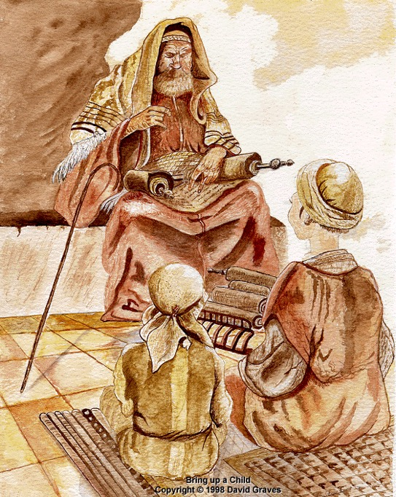
Tema Besar 1 : Kesetiaan
Contoh-contoh kesetiaan:
a. Belajar dari ibu, Eunike, dan nenek, Lois (1:3-7)
Belajar di dalam rumah sendiri, dengan orang tua sebagai contoh kesetiaan.

Slide 80

Tema Besar 1 : Kesetiaan
b. Belajar dari Paulus
(1:8-14)
Paulus tetap setia dalam kesulitan karena dia yakin dan percaya Tuhan akan menjaganya sampai akhir (1:11-12).

Slide 81
KU TAHU SIAPA YANG KU PERCAYA
Aku tidak tahu kenapa Tuhan mengasihiku
Mengapa layak, Kasih Kristus menebusku untuk menjadi milikNya
Chorus:
Tapi ku tahu siapa yang ku percaya
Dan aku yakin Dia mampu
Menyimpan janjiku hari itu
Aku tak tahu apakah nantinya aku akan baik atau sakit,
Dalam kekuatiran atau sukacita, kulihat wajahNYA.

Slide 82

Tema Besar 1: Kesetiaan
  c. Belajar dari Onesiforus (1:15-18)
  Onesiforus tidak malu mempunyai teman Paulus sebagai narapidana. Dia terus dengan giat mencari Paulus dan akhirnya menemukannya.

Slide 83

DISCIPLESHIP
"…make disciples of all nations…" (Matt. 28:19)
But how?
Notes:
We all know that our basic calling is to make disciples among the nations.

Slide 84
Slides on
2 Timotius 2

Slide 85



Multiply Yourself into Trustworthy Men!
"You have heard me teach things that have been confirmed by many reliable witnesses. Now teach these truths to other trustworthy people who will be able to pass them on to others" (2 Tim. 2:2 NLT).
Discipleship
Paul
Timothy
Reliable Men
Others
Notes:
Get mentored by godly people (2 Tim. 2:2).

Slide 86

Levels of Discipleship
Mentor (Paul)
Peer
Peer (Timothy)
Mentored (Others)
Notes:
Each of us should be like Timothy to learn from someone more mature than us, and also be a "Paul" to someone less mature to help that person grow in Christ.

Slide 87

Life Transformation Groups
The Commitment: Meet one hour a week with 1-2 others of the same sex to provide accountability in 3 areas
Confess sin around 10 questions
Read 3 Bible chapters daily
Pray for lost friends
Church Multiplication Associates––www.CMAResources.org
Notes:
How can you mentor and get mentored? Life Transformation Groups are 2-3 people meeting weekly for accountability.
An LTG has 2-3 persons committed to growing spiritually. They meet in a home, restaurant, church, business, or wherever they can have a 60-minute accountability session each week.

Slide 88


Life Transformation Groups
Church Multiplication Associates––www.CMAResources.org
Notes:
No LTG should be larger than 3 people. Once a member invites a 4th person and it is shown that this 4th person will be committed to the LTG concept, the group of 4 multiplies into 2 groups of 2 persons. The additional members can be believers or unbelievers, as long as they are committed to confession, Bible reading, and prayer.

Slide 89



Life Transformation Groups
Church Multiplication Associates––www.CMAResources.org
Notes:
Ideally, the church is then composed of many LTG groups at different stages, growing to multiply more groups so that accountability remains intact in a small group for each person.

Slide 90


Singapore Bible College Students
USA
MONGOLIA
JAPAN
KOREA
CHINA
NEPAL
HONG KONG
MYANMAR
INDIA
THAILAND
VIETNAM
PHILIPPINES
MALAYSIA
SINGAPORE
SRI LANKA
INDONESIA
SBC
NEW ZEALAND

Slide 91
Karakter-karakter Kesetiaan
  Prajurit (2: 3-4) – berperang dengan baik, seorang prajurit harus memisahkan dirinya dari hal-hal duniawi sehingga dia bisa konsentrasi pada tugasnya dan menyenangkan pemimpinnya.

Slide 92
Sekilas Berita
Sekilas Berita

Slide 93
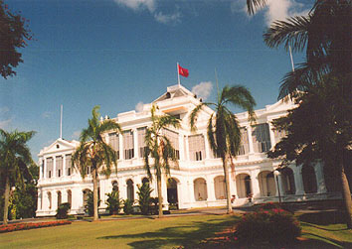
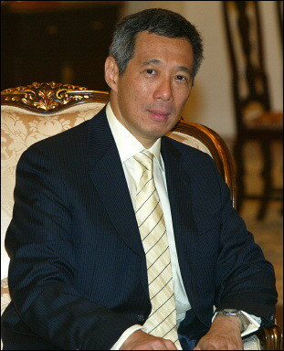
Kami menyesal memberitahukan bahwa Perdana Menteri Lee Hsien Loong baru saja diculik dari Istana…

Slide 94
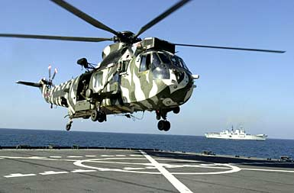
Bagaimanapun, sebuah kelompok tentara khusus telah diutus untuk menyelamatkan Perdana Menteri.

Slide 95
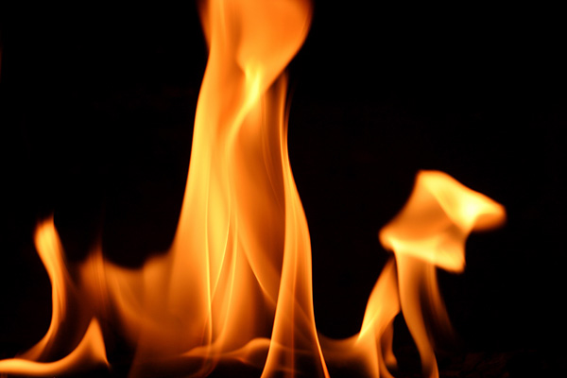
The job will be tough. Can you handle it?

Slide 96
Sayangnya, satu tidak mampu mengatasi niat jahat dari youth…

Slide 98
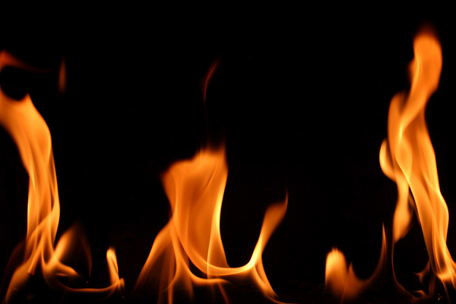
Mengingat…
Yang lain tidak mampu mengatasi panasnya (pencobaan)

Slide 99


  2. Atlit (2:5) – Seorang atlit tidak dapat memenangkan petandingan jikalau dia tidak mentaati peraturan.

Slide 100
  3. Petani (2:6-13) – Seorang petani harus bekerja keras untuk mendapatkan hasil panen yang baik.
Kesetiaan = setia pada Kristus,komandan kita, mengikuti hukum Tuhan dan bekerja keras

Slide 101
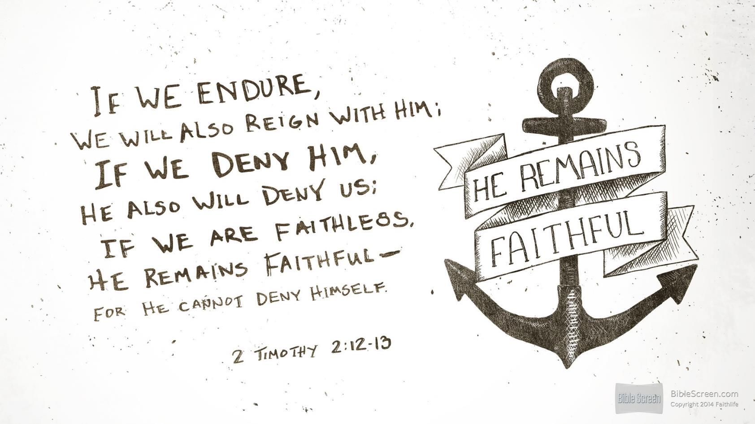

Slide 102

"If we endure hardship, we will reign with him"
(2 Tim. 2:12 NLT)

Slide 103


Slide 104
Protection from False Teachers (2 Tim 2:14-26)
Protect the Flock
(14-19)
Protect the Shepherd (20-26)

Slide 105

Religious Distribution in Singapore
Buddhist
Buddhist
Muslim
Christian
No Religion
Christian
No Religion
Taoist
Hindu
Other
Muslim
The Straits Times 14 Jan 2013 - 10:37am
Notes:
Singapore may have seen church growth, but it is only a microcosm of the world as a whole. Even here, the increase of so-called "free thinkers" who claim no religion continues to increase. Christians are afraid to share their faith in the marketplace and are going underground in many ways, fearing they might lose their job.
http://therealsingapore.com/content/op-ed-straits-times-different-under-god

Slide 106
Slides on
2 Timotius 3

Slide 107

"There is no God."
How should you deal with secularism?
2 Timothy 3
gives 2 ways
Notes:
How should you deal with secularism? How should believers respond to the increasing godlessness of our age?

Slide 108

I. Avoid godless teachers (3:1-5).
Notes:
[Reject any teaching out of line with God's Word.]

Slide 109

"You should know this, Timothy, that in the last days there will be very difficult times"
(3:1 NLT).
Notes:
We are promised difficulty (3:1).
Paul was experiencing great trials when he wrote this.

Slide 110
Tema Besar 2 : Kemurtadan
Paulus mendata 18 karakter hari terakhir yang adalah sasaran yang mudah untuk ajaran sesat.
Waktu yang akan menjawab ketika manusia menolak ajaran yang benar (4:3-4)
- Menasihati Timotius agar menghindari orang-orang yang seperti demikian (3:5-8)

Slide 111
"You should know this, Timothy, that in the last days there will be very difficult times"
(3:1 NLT).
Notes:
When did the "last days" begin and are we in the "last days" today?
This period began in the first century. Paul noted in 1 Timothy 4:1 that apostasy would characterize the "last days," and Jude 18 applies this his own time in the first century.
These "last days" then continue up to the present time and until Christ's return.

Slide 112

Life will be tough because the godless deceive others (3:2-5a).

Slide 113

18 Karakter Kemurtadan
Mencintai diri sendiri
Mencintai uang
Sombong
Tinggi hati
Kejam
Tiadak patuh orang tua
Tidak bisa bersyukur
Tidak kudus
Tanpa kasih
Tidak pemaaf
Pemfitnah
Tanpa pengendalian diri
Brutal
Tidak mencintai kebaikan
Pengkhianat
Gegabah
Congkak
Mencintai kenikmatan daripada Tuhan

Slide 114

What should we do?
DANGER
Notes:
What should we do with such people? Should we confront them? Should we debate them? No. Paul says to…

Slide 115

Avoid godless leaders
"Avoid such men as these"
(3:5b NAU).
"Stay away from people like that!"
(3:5b NLT).
Notes:
The advice to us today is often to engage with false teachers. However, Paul's meaning here is to "purposely to avoid associating with someone, turn away from, avoid" (BDAG).

Slide 116

Avoid godless leaders
Notes:
But how could Timothy avoid godless people when they were all around him (5b)? "No doubt Paul had in mind here Timothy's official associations, since he had already instructed Timothy to be kind to everyone (cf. 2 Tim. 2:24)" (BKC)
(But why should we avoid associations with such heretical leaders? It is because…)

Slide 117

"They are the kind who work [lit. creep] their way into people's homes and win the confidence of vulnerable women who are burdened with the guilt of sin and controlled by various desires. ⁷(Such women are forever following new teachings, but they are never able to understand the truth.)" (3:6-7 NLT).
Notes:
Heretics are doomed despite their popularity (3:6-9).
Gullible women loved the latest heresy (3:6-7).
(Why is it a waste of time listening to heretics?)

Slide 118

People-Pleasing Preaching

Slide 119

"These teachers oppose the truth just as Jannes and Jambres opposed Moses. They have depraved minds and a counterfeit faith. ⁹But they won't get away with this for long. Someday everyone will recognize what fools they are, just as with Jannes and Jambres" (3:8-9 NLT).
Notes:
Godless teachers are doomed due to their depraved minds that reject truth (3:8-9).
"The reference to Jannes and Jambres and their opposition to Moses draws not on the Old Testament but on a widespread Jewish legend about two of Pharaoh's magicians who competed against Moses and lost (cf. Ex. 7:11; 9:11). The comparison between the false teachers and the Egyptians, and implicitly therefore Timothy and Moses, must have encouraged the young minister" (BKC).
————————
Common Core State Standards in Mathematics, Grades 3–8
In this timely and practical course, Dr. Kanold and Dr. Briars explain both the whys and the how-tos for implementing the CCSS
http://www.solution-tree.com/authors/tim-kanold/ccss-math-3-8-online-course.html

Slide 120

THANK YOU FOR NOT LITTERING YOUR MIND
Our values are revealed by what we consider trash. God desires for us today to invest our energies in efforts that will last.

Slide 121
I. Avoid godless teachers (3:1-5).
Notes:
How else can we deal with heretics besides avoiding them? What are those efforts that will last? Paul says, "But you…" in verse 10 to give us what to do instead of following godless teachers. We can deal with secularism when we…

Slide 122

II. Accept truth (3:10-17).
Notes:
Feed yourself reality from God's servants and God's Word.

Slide 123

Follow God's servants (3:10-13)

Slide 124

"But you, Timothy, certainly know what I teach, and how I live, and what my purpose in life is. You know my faith, my patience, my love, and my endurance. ¹¹You know how much persecution and suffering I have endured. You know all about how I was persecuted in Antioch, Iconium, and Lystra—but the Lord rescued me from all of it" (3:10-11 NLT).
Notes:
Follow Paul's example in suffering (3:10-11).
We often say, "Don't follow me. Follow Christ." That sounds humble, but people need to see contemporary examples of Jesus.
Paul said to follow Christ, but he also encouraged his readers to follow him. "Follow me, as I follow Christ" (Eph. 5:1)

Slide 125

Expect to suffer for godliness like Paul did (3:12).

Slide 126

"Yes, and everyone who wants to live a godly life in Christ Jesus will suffer persecution. ¹³But evil people and impostors will flourish. They will deceive others and will themselves be deceived" (3:12-13 NLT).

Slide 127

"Yes, and everyone who wants to live a godly life in Christ Jesus will suffer persecution" (3:12 NLT).
Notes:
This verse seems so incredible to us that we strain at a gnat to explain it away. "Surely that look they gave me is a form of persecution!" we rationalize.
More likely, we are fooling ourselves into thinking that we are really living a godly life.

Slide 128

Persecution of Children
Notes:
We need not look too far to find examples of the godly facing persecution. In fact, in 2014 we heard of examples of even Christian children in Iraq who refused to deny Christ and were literally crucified and beheaded as a result.
Perhaps it is time to realize that this verse really isn't as perplexing as it seems. More perplexing is our ability to explain it away.

Slide 129

"But evil people and impostors will flourish. They will deceive others and will themselves be deceived" (3:13 NLT).
Notes:
Here is why we need godly examples: the ungodly ones are sure to increase.
The very deceptive part is that when a person is deceived, he doesn't even know it. That is why he is deceived! Are you?

Slide 130
How can we accept truth instead of lies?
Truth
Lies
Notes:
How can we accept truth instead of lies?

Slide 131
Follow God's servants (3:10-13)
Notes:
Godly examples can help, but there must be an absolute standard, so Paul also says to…

Slide 132

Follow God's Word (3:14-17)

Slide 133

"But you must remain faithful to the things you have been taught. You know they are true, for you know you can trust those who taught you. ¹⁵You have been taught the holy Scriptures from childhood…"
(3:14-15a NLT).
Notes:
Stay true to God's truth that you learned (3:14-15a).
We must remain, abide, or stay (BDAG) faithful to the truth (3:14a).
Paul gives two reasons we must keep the truth (3:14b-15a).
(1) Our teachers are trustworthy (3:14a).
Timothy first learned from his believing mother and grandmother (cf. 2 Tim. 1:5; Acts 16:1).
Paul later referred to him as his "son" in the faith (1 Tim. 1:2; 2 Tim. 1:2).
(But how can teachers be trustworthy?)
(2) They are trustworthy because they taught us the Bible (3:15a).
Survey any Christian gathering and you will find that most trusted Christ before age 18.
We cannot overemphasize how vital it is to train children in God's Word.
(But why is teaching the Bible so important?)

Slide 134

Blessings of God's Word (3:15b-17)
Notes:
Why is teaching the Bible so important?
Because when you continue in God's Word it blesses you in many ways (3:15b-17)

Slide 135

"and [the Scriptures] have given you the wisdom to receive the salvation that comes by trusting in Christ Jesus" (3:15b NLT).
Notes:
Scripture gives us wisdom to accept Christ (3:15b).
True wisdom focuses on what's most important.
Since the Scripture is genuine wisdom, it helps us trust in the only source of salvation—Christ Jesus.

Slide 136

"All Scripture is inspired by God…"
(3:16a NLT).
Notes:
Scripture comes from God's own "mouth" (3:16a).

Slide 137

"All Scripture is God-breathed…"
(3:16a NIV).
Notes:
The Greek word for "inspiration" literally means "God-breathed."

Slide 138

"All Scripture is God-breathed…"
(3:16a NIV).
Notes:
True, God used people, but his Spirit spoke through them so the Scriptures are without error.

Slide 139

WHY IS GOD'S WORD SO VITAL?
"All Scripture is God-breathed and is useful for teaching, rebuking, correcting and training in righteousness, so that the man of God may be thoroughly equipped for every good work."
2 Timothy 3:16-17 (NIV)

Slide 140

Four Results of God's Word
Rebuking
Correcting
Teaching
Training
(in Righteousness)
2 Timothy 3:16-17
Notes:
If you read sequentially through the Bible, you will have the divine balance in these four areas:
Teaching tells people how to walk God's road
Rebuking tells them when they get off the path
Correcting shows how to get back to the right way
Training in righteousness is the result of the cycle of teaching, rebuking and correcting over and over.

Slide 141
Tema Besar 3 : Alkitab
Pandangan Paulus tentang Alkitab
  a. Inspirasi Tuhan (3:16; 2 Petrus1:21)
  b. Berguna (3:17)
  - Mengajar
  Memarahi
  Mengkoreksi
  Melatih dalam kebenaran
Tujuannya adalah untuk melengkapi anak-anak Tuhan melawan ajaran sesat dan untuk mendapatkan jkerja yang baik

Slide 142

How to Be Secular
Notes:
So we live in a world that is increasingly secular.

Slide 143

"All religions are the same."
Notes:
We are told lies like all the world's religions are the same.

Slide 144

"All religions are the same."
Notes:
Many seek to combine them all as if there is no real truth.

Slide 145
"There is no God."
How should you deal with secularism?
Notes:
So how should you deal with this kind of secularism—a kind that often portrays itself as having a form of godliness without God?

Slide 146

Main Idea
Replace lies with truth.
Notes:
Don't get sucked into secular thinking—but instead rely upon godly values, truth.
But how can you learn truth instead of lies?

Slide 147
I. Avoid godless teachers (3:1-5).
Notes:
[Reject any teaching out of line with God's Word.]

Slide 148
II. Accept truth (3:10-17).

Slide 149

What does replacing lies with truth look like specifically?

Slide 150

Garbage in, Garbage out
Garbage
In…
Garbage
Out!
Everything that enters the mind influences how we think and act.
Don’t let garbage enter your mind.
Notes:
Watch your input—your reading, news, friends, movies, TV, and especially the Internet.
We often teach this to children—and rightly so.

Slide 151

Garbage in, Garbage out
Notes:
But GIGO applies to adults too.

Slide 152

Does your reading, news, friends, movies, TV, and especially the Internet build your faith or tear it down?

Slide 153
Tema Besar 2 : Kemurtadan
Apa di gerejamu ada orang-orang yang seperti itu?
Telinga menginginkan apa yang memuaskan jasmani, keinginan daging. Hati jasmaniah lebih memilih cerita-cerita yang tak masuk akal daripada kebenaran yang teguh.

Slide 154
Outline
2 Timotius
Kerangka
239-240
I. (Pasal 1-2) Paulus mendukung Timotious untuk gigih dalm kesulitan sekarang dan menggambarkan karakter-karakter yang harus dia contohkan untuk membasmi ajaran sesat dan kemurtadan.
II. (Pasal 3-4) Paulus mndesak Timotius untuk gigih dalam pencobaan masa depan, dan melengkapi sikap-sikap positifnya menghadapi kematian untuk mendukung Timotius memberitakan Firman Tuhan dengan setia daripada meningkatkan kemurtadan dalam ajaran.

Slide 155

Application
2 Timotius
Penerapan
237
Adakah sesuatu yang lebih berkuasa daripada Firman Tuhan – metode, logika, mengabaikan ajaran sesat, …?
Sekalipun ajaran yang benar bukan hanya satu yang dibutuhkan, tetap adalah hal yang terpenting.

Slide 156
KEY
2 Timothy
237
Key Word: DOCTRINE
Key Verse:
“All Scripture is God-breathed and is useful for teaching, rebuking, correcting and training in righteousness, so that man of God may be thoroughly equipped for every good work…. Preach the Word.”
2 Timothy 3:16-17 & 4:2

Slide 157
SUMMARY STATEMENT
2 Timothy
237
Preach the Word
HARDSHIP
HARDSHIP
faithfully practice

Slide 158
APPLICATIONS
2 Timothy
Are you an Onesiphorus, upholding Christian confession in time of trial and persecution? What characteristics of faithfulness do you possess—soldier's loyalty, athlete's obedience, farmer's hard work?
2. Are there apostates in your ministry? What can you do to survive?
3. Reflect on what kind of testimony you would write at the end of your life. What are your words of encouragement and challenge for the next generation?

Slide 159
Slides on
2 Timotius 4

Slide 160
KESIMPULAN
Kesaksian yang efektif
“Aku telah mengakhiri pertandingan yang baik, aku telah mencapai garis akhir dan aku telah memelihara iman.”
2 Timotius 4:7
Nasihat Paulus untuk Timotius adalah benar.

Slide 161
KESIMPULAN
2. Kemenangan Akhir
“Sekarang telah tersedia bagiku mahkota kebenaran yang akan dikaruniakan padaku oleh Tuhan, Hakim yang adil, pada hariNya; tetapi bukan hanya kepadaku, melainkan juga kepada semua orang yang merindukan kedatanganNya.”
2 Timotius 4:8
Dengan penghargaan di depan, tugas di tangan tersa lebih ringan.

Slide 162
KETIKA KITA BERTEMU YESUS
Seringkali waktu terasa panjang, pencobaan susah dipikul, Kita tergoda untuk mengeluh, dan putus asa
Tapi Kristus akan segera muncul untuk mendapatkan mempelai-NYA
Semua air mata akan berakhir di hari abadi TUHAN.
Reff:
Semua berharga ketika kita bertemu Yesus,
Pencobaan hidup terlihat kecil ketika kita bertemu Yesus;
Sekilas pandang wajah NYA akan menghapus semua duka
Dengan berani menyelesaikan pertandingan sampai akhir.

Slide 163

Terkadang langit terlihat begitu gelap tanpa cahaya,
Kita terombang-ambing dan tak ada yang menolong;
Tapi ada satu di surga yang tahu kepedulian kita yang terdalam,
Biarlah Yesus menyelesaikan masalahmu, datanglah pada NYA dalam doa
Reff:
Semua berharga ketika kita bertemu Yesus,
Pencobaan hidup terlihat kecil ketika kita bertemu Yesus;
Sekilas pandang wajah NYA akan menghapus semua duka
Dengan berani menyelesaikan pertandingan sampai akhir

Slide 164
Kehidupan akan segera berakhir, semua badai akan berlalu,
Kita akan menyeberang ke keselamatan yang mulia pada akhirnya;
Kita akan berbagi kesukaan surga : harpa, rumah, mahkota,
Penggoda akan di hukum, kita tanggalkan beban kita.
Reff:
Semua berharga ketika kita bertemu Yesus,
Pencobaan hidup terlihat kecil ketika kita bertemu Yesus;
Sekilas pandang wajah NYA akan menghapus semua duka
Dengan berani menyelesaikan pertandingan sampai akhir

Slide 165
Black

Slide 166
Title
2 Timotius
Judul
238
Surat 2 Timotius
(Pro.j Timo.qeon b Second to Timothy)
Adalah satu dari tiga buku yang biasa disebut “surat penggembalaan, yang unik karena ditujukan pada individu (bukan gereja) dan merupakan tulisan Paulus yang terakhir

Slide 167
238
KARAKTERISTIK
Penjelasan yang paling penting dari Alkitab (3:16-17)
Eksposisi Perjanjian Baru yang paling jelas (4:2)
Pentingnya menjaga Firman Tuhan (1:14)
Pusat dari Alkitab (2:15)
Bertekun dalam Firman Tuhan (3:14)
Menderita demi Firman Tuhan (1:8; 2:3)

Slide 168
2 Timotius
Anggota Tim
Lee Siew Boon, Vincent
Mary Magdalene
Tong Hang Fong, Connie
Akshay Rajkumar
Ang Jing Chai
Lau Geoffrey
Lee May Sze, Astrid
Oh, Dennis
Low Eng Hoon, Casurine

Slide 169
Black

Slide 170
Sekarang untuk kuis…

Slide 171
1. Apa olahraga nasional Singapura?
A – Sepakbola
B – Bulutangkis
C – Tenis meja
D – Semua jawaban salah

Slide 172


Ya!
Belanja dan makan adalah benar!
Selamat!

Slide 173
2. Apa bahasa nasional Singapura?
A – Mandarin
B – Melayu
C – Tamil
D – Semua jawaban salah

Slide 174
Ya lagi!
Selamat!
Anda benar!
Jawabannya adalah “d” karena “Singlish” tidak ada dalam pilihan.

Slide 175
Produk ini telah ditetapkan sebagai barang terkutuk oleh pemerintah Singapura, tidak bertoleransi diantara remaja. Diselundupkan di negara setiap hari.
A – Kokain
B – Alkohol
C – Opium
D – Semua jawaban salah

Slide 176


Ya! Mengunyah permen karet adalah benar!

Slide 177

Selamat!
Anda lulus ujian!

Slide 178
Black

Slide 179


Link survey PB di BibleStudyDownloads.org
Dapatkan slide ini tanpa biaya
Notes:
New Testament Survey PPT in Bahasa Indonesia

