Slide 1
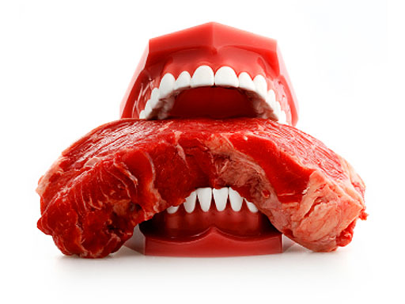
1 Korintus 10–16
Dr. Rick Griffith, Singapore Bible College
BibleStudyDownloads.org
Notes:
Slide 48 in Chinese needs to be made into two slides for 1 Cor. 10:23-27
Slides 75-77 added for veils
Slide 104 expanded to two slides into slide 105
Slides 109-153 added as 1 Cor. 11:17-24 section missing in previous edition

Slide 2
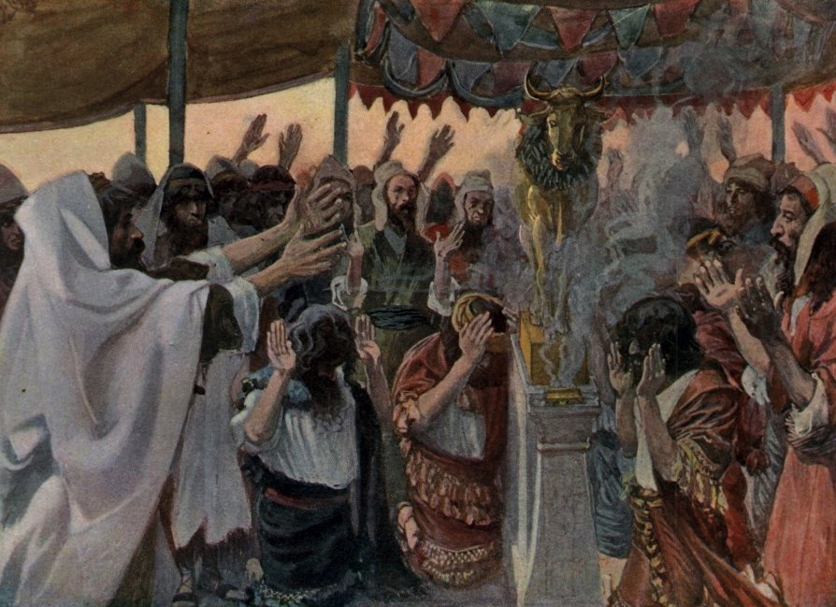
When You're Idle About Idols
1 Corinthians 10

Slide 3
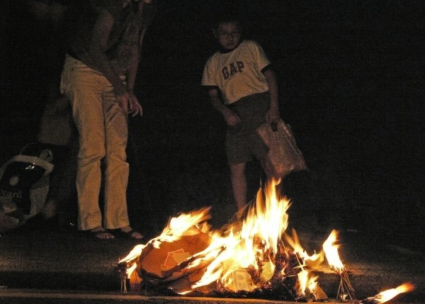
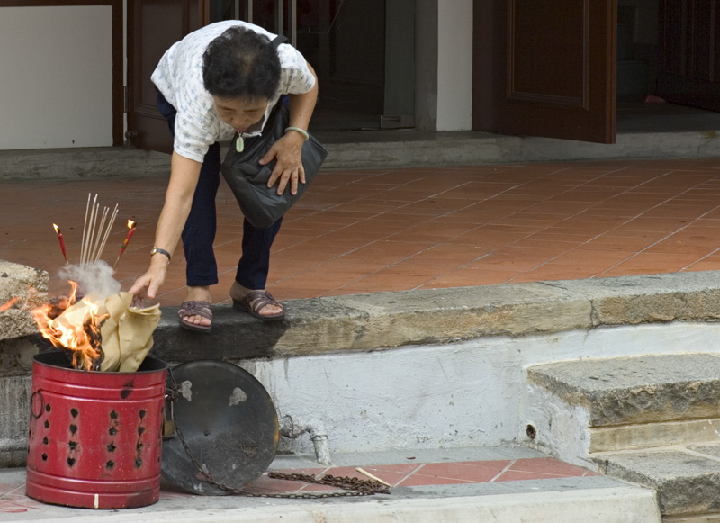
Fires

Slide 4
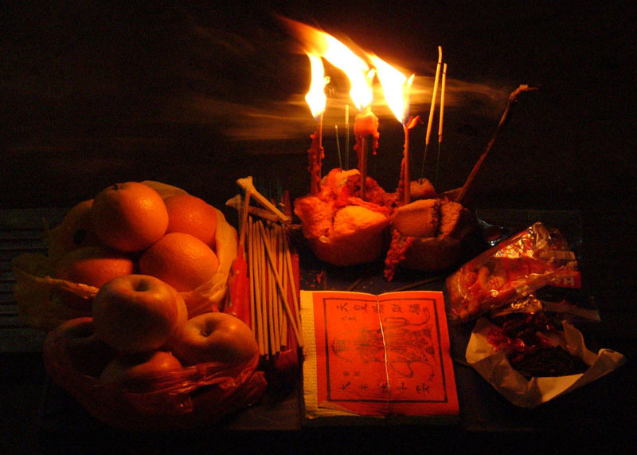
The Hungry Ghost

Slide 5

Ghost Eats It All!

Slide 6
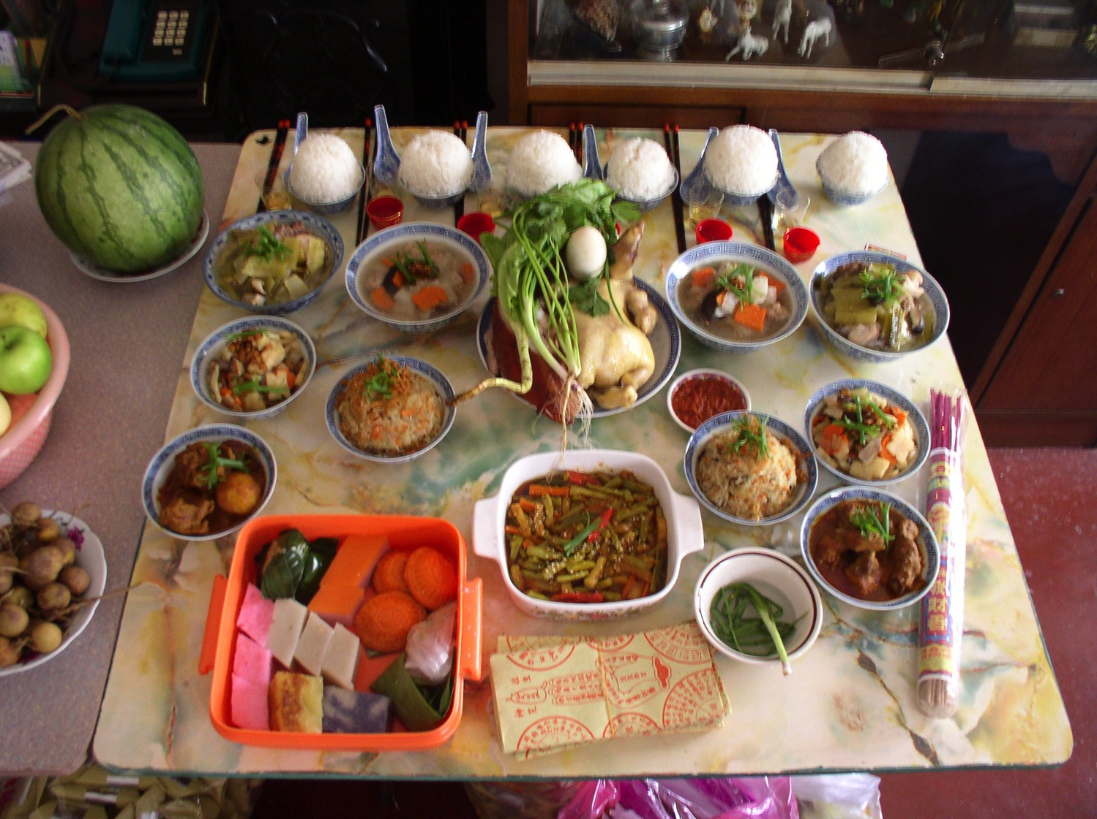
The Hungry Ghost

Slide 7
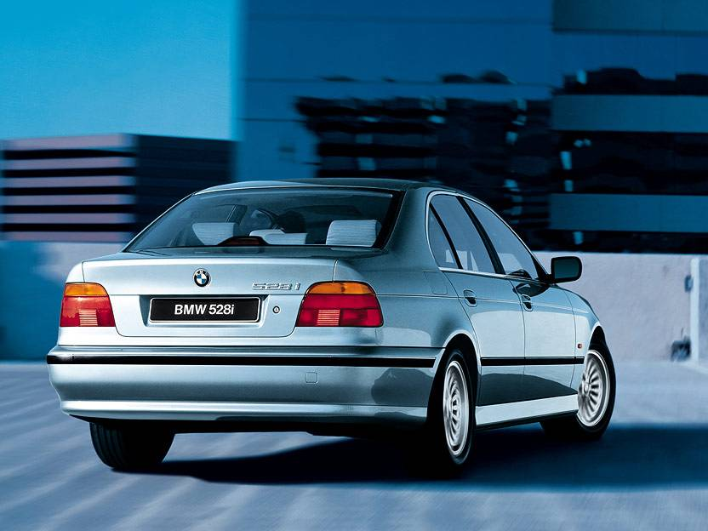
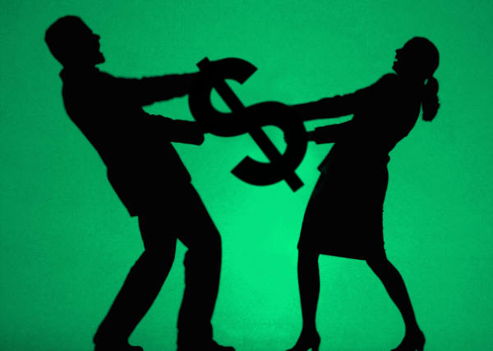

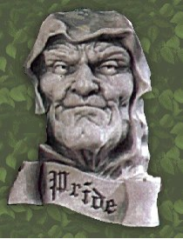

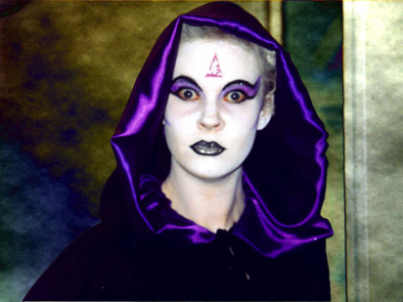
Why no…
368
Idolatry?

Slide 8

I. Idolatry reaps God's discipline (10:1-13).
SPANKING
Sometimes nothing else will do the job

Slide 9
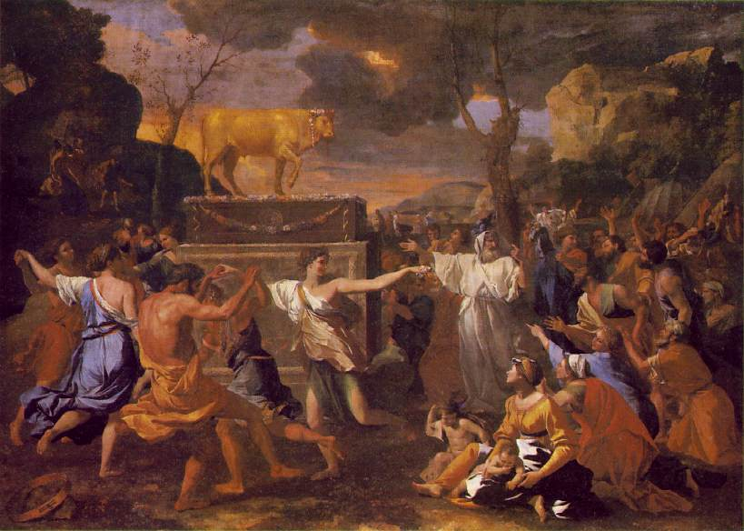
A. God judged Israel for its evil practices as a warning to us
(10:1-11).

Slide 10
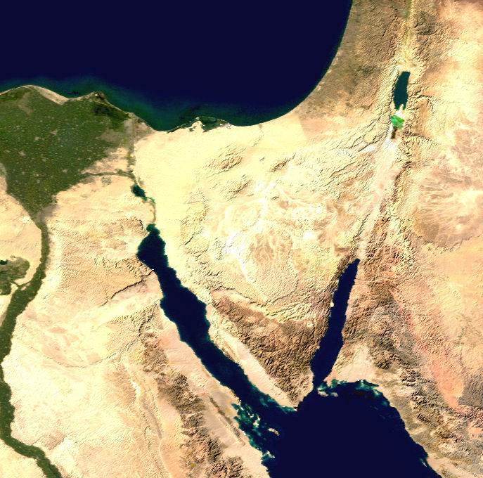
Wandering Map
Kadesh- barnea
Mt. Hor
Mt. Sinai
Route of the Journey

Slide 11
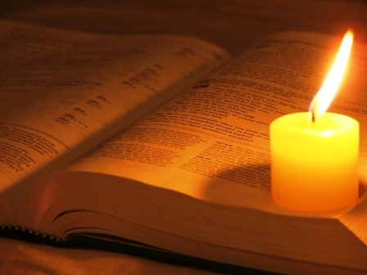
1 Cor. 10:1-4 (NLT)
¹I don't want you to forget, dear brothers and sisters, about our ancestors in the wilderness long ago. All of them were guided by a cloud that moved ahead of them, and all of them walked through the sea on dry ground. ²In the cloud and in the sea, all of them were baptized as followers of Moses. ³All of them ate the same spiritual food, ⁴and all of them drank the same spiritual water. For they drank from the spiritual rock that traveled with them, and that rock was Christ.

Slide 12
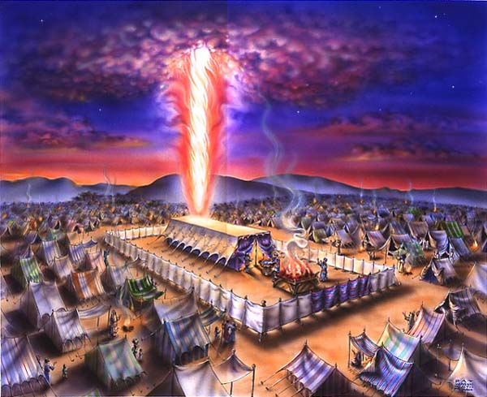
The Cloud
Exodus 40

Slide 13
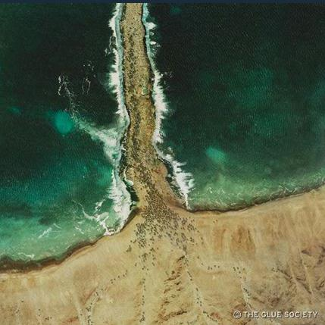
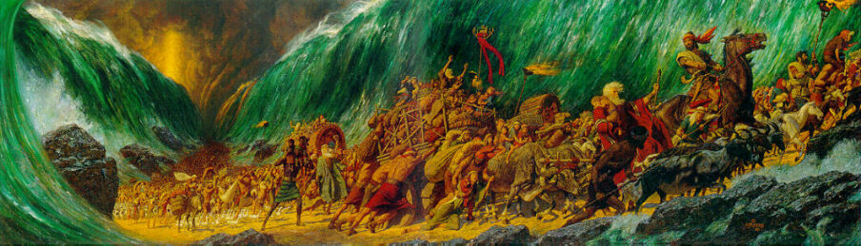
The Sea
Exodus 12

Slide 14
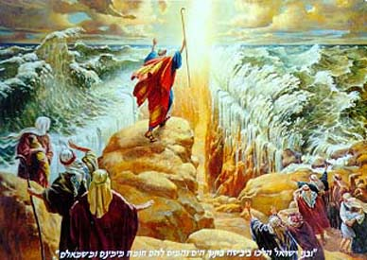
The Leader
Exodus 12

Slide 15
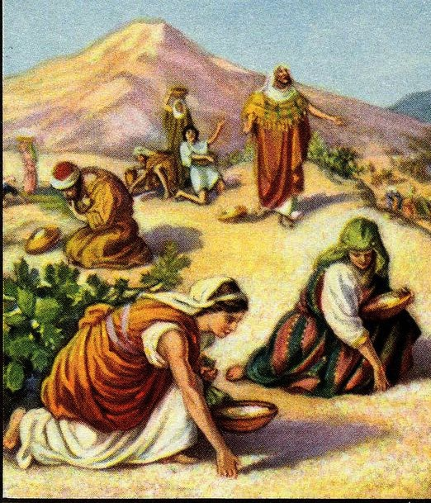
The Food
Exodus 16

Slide 16
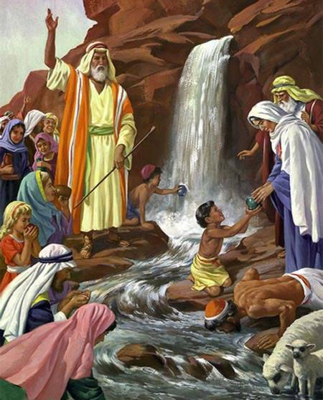
The Water
Exodus 17

Slide 17
1 Cor. 10:5 (NLT)
⁵Yet God was not pleased with most of them, and their bodies were scattered in the wilderness.

Slide 18
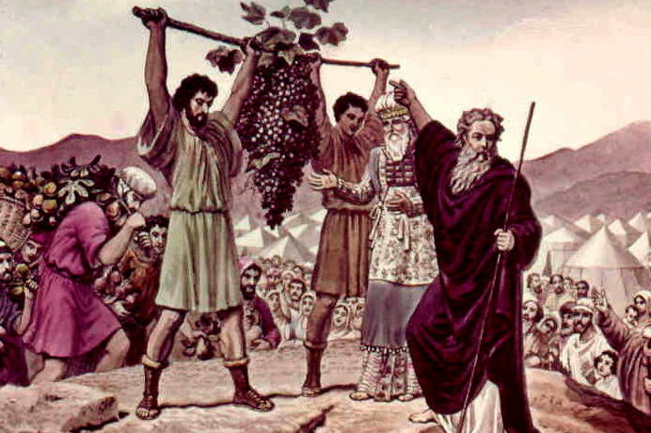
The Spies Return
Numbers 13

Slide 19
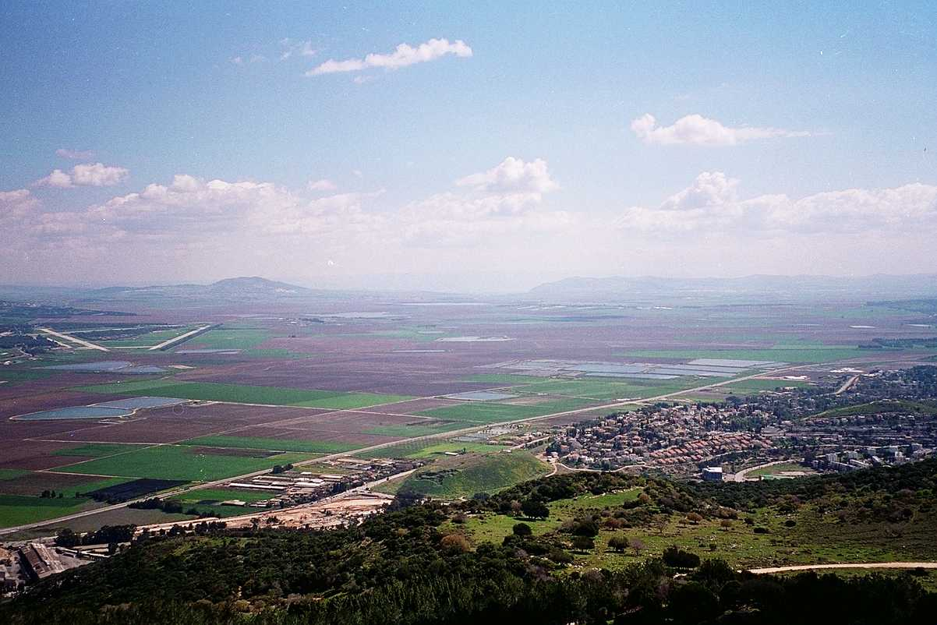
The Majority Report
G
ood
iants
rasshoppers
Numbers 13:26-33

Slide 20
The Minority Report
G
OD
Numbers 13:26-33

Slide 21
God's Report
Num. 13:26-14:9
DRESSING
THE
STAGE
Here's the situation:
MS
TWELVE SPIES: TWO REPORTS
10 SPIES: A MAJORITY OPINION
LAND OF MILK AND HONEY!
GIANTS IN THE LAND!
GO BACK TO EGYPT!
2 SPIES: A MINORITY OPINION
LAND OF MILK AND HONEY!
GIANTS IN THE LAND!
GOD IS WITH US!
N(A)
TRIP CANCELLED!
H
SG
C
ER
B
J
MN
MOSES
DS
Exodus
Sinai
E
M - C - C
Kadesh Barnea
KB
U
40
MS
PG
SO...LET'S GO!!!!!
RS
Handbook pg. 26-29
21

Slide 22
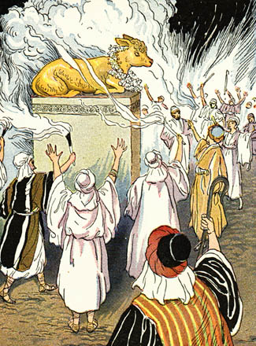
The Golden Calf Incident
Exodus 32

Slide 23
1 Cor. 10:6-8 (NLT)
These things happened as a warning to us, so that we would not crave evil things as they did, ⁷or worship idols as some of them did. As the Scriptures say, "The people celebrated with feasting and drinking, and they indulged in pagan revelry." ⁸And we must not engage in sexual immorality as some of them did, causing 23,000 of them to die in one day.

Slide 24
1 Cor. 10:9-11 (NLT)
⁹Nor should we put Christ to the test, as some of them did and then died from snakebites. ¹⁰And don't grumble as some of them did, and then were destroyed by the angel of death. ¹¹These things happened to them as examples for us. They were written down to warn us who live at the end of the age.

Slide 25
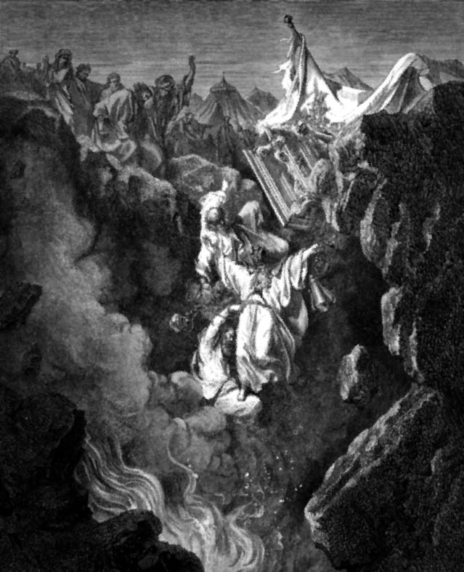
Korah's Rebellion
Korah, Dathan and Abiram Numbers 16

Slide 26
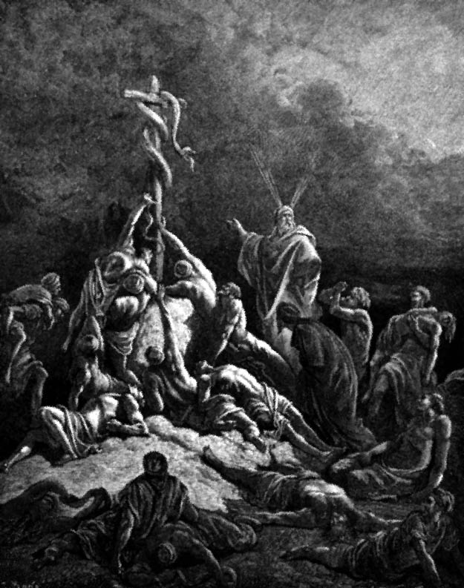
The Bronze Serpent
Numbers 21

Slide 27
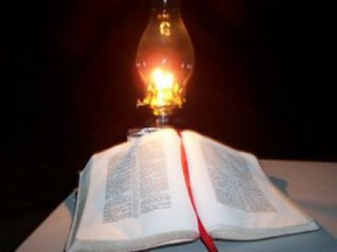
B. Humbly accept God's help when tempted (10:12-13).

Slide 28
1 Cor. 10:12 (NLT)
12 If you think you are standing strong, be careful not to fall.

Slide 29
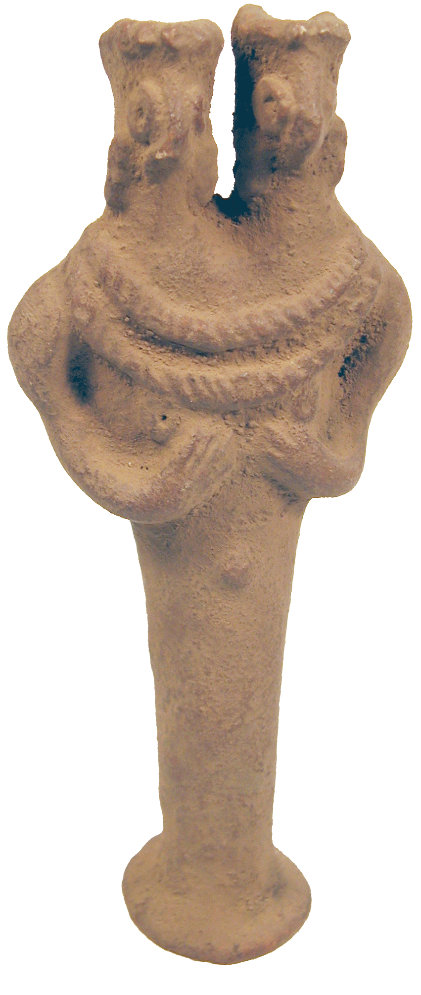

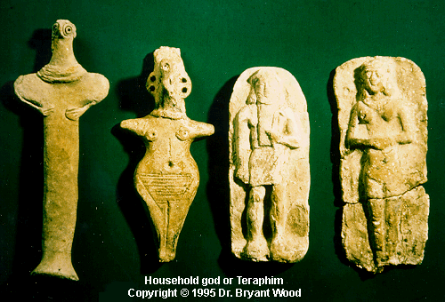
Idols are Wrong

Slide 30

"Idolatry is OK" Man

Slide 31

"Idolatry is OK" Woman

Slide 32
1 Cor. 10:13 (NLT)
¹³The temptations in your life are no different from what others experience. And God is faithful. He will not allow the temptation to be more than you can stand. When you are tempted, he will show you a way out so that you can endure.

Slide 33
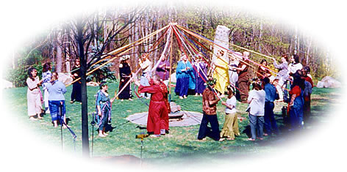
C. God will judge you for your involvement in paganism.

Slide 34
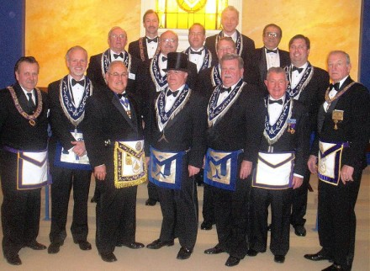
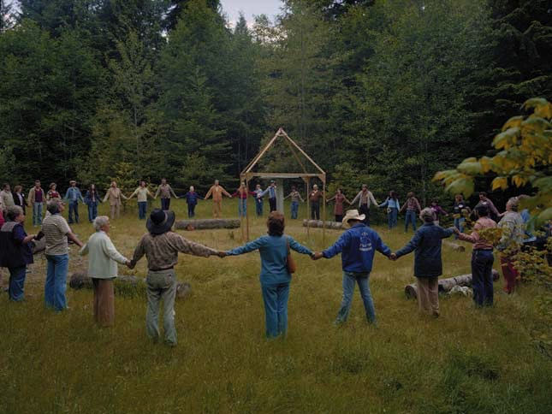
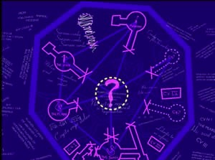
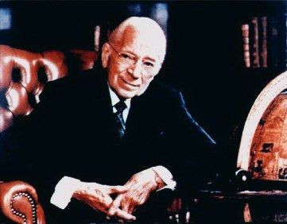
Principal Candidate
Masons
New Age
Armstrong's Worldwide Church of God
Rosicrucian Fellowship

Slide 35

God judges sexual sin too
HPV
50% of sexually active women ages 18-22!

Slide 36

How many really have AIDS?

Slide 37
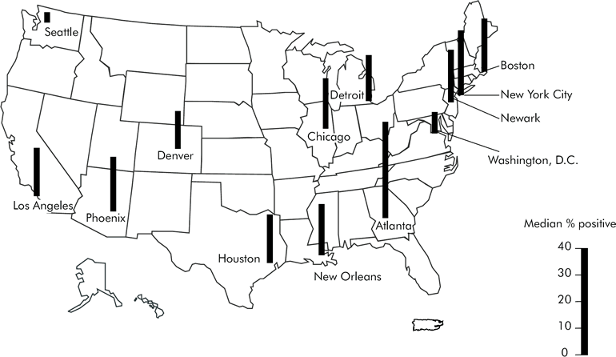
HIV Stricken Homosexual Men, 1997
Includes only areas with sufficient data for analysis.
http://www.cdc.gov/hiv/topics/testing/resources/reports/hivser97/figures.htm

Slide 38
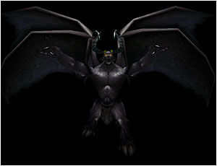
II. God judges our idolatry because it is demonic (10:14-22).

Slide 39

A. Avoid idol feasts since they're as demonic as the Lord's Supper is godly (10:14-22).

Slide 40
1 Cor. 10:14 (NLT)
¹⁴So, my dear friends, flee from the worship of idols.

Slide 41
1 Cor. 10:15-18 (NLT)
¹⁵You are reasonable people. Decide for yourselves if what I am saying is true. ¹⁶When we bless the cup at the Lord's Table, aren't we sharing in the blood of Christ? And when we break the bread, aren't we sharing in the body of Christ? ¹⁷And though we are many, we all eat from one loaf of bread, showing that we are one body. ¹⁸Think about the people of Israel. Weren't they united by eating the sacrifices at the altar?

Slide 42
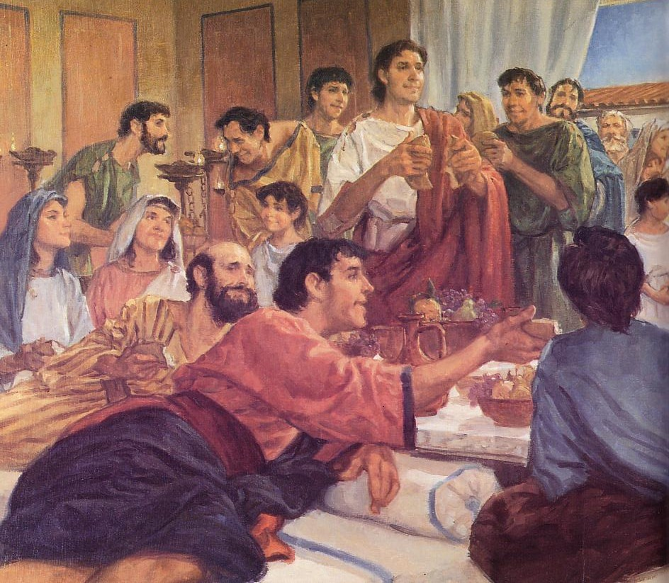
The Agape (Love) Feast

Slide 43
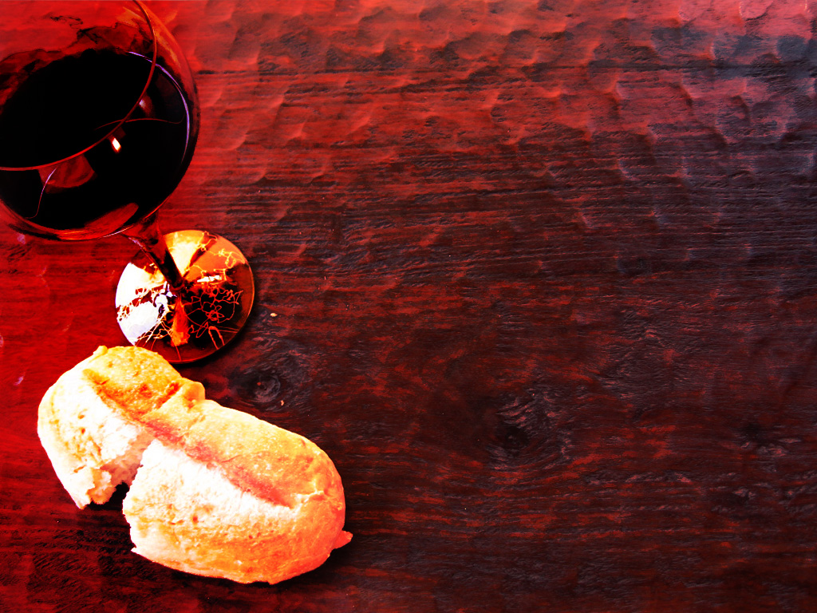
The Cup
Christ
The Bread
Others
1 Corinthians 10:16

Slide 44
1 Cor. 10:19-22 (NLT)
¹⁹What am I trying to say? Am I saying that food offered to idols has some significance, or that idols are real gods? ²⁰No, not at all. I am saying that these sacrifices are offered to demons, not to God. And I don't want you to participate with demons. ²¹You cannot drink from the cup of the Lord and from the cup of demons, too. You cannot eat at the Lord's Table and at the table of demons, too. ²²What? Do we dare to rouse the Lord's jealousy? Do you think we are stronger than he is?

Slide 45
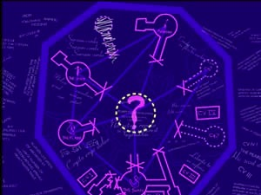
B. Exposing ourselves to demons in pagan celebrations invites God's discipline.

Slide 46
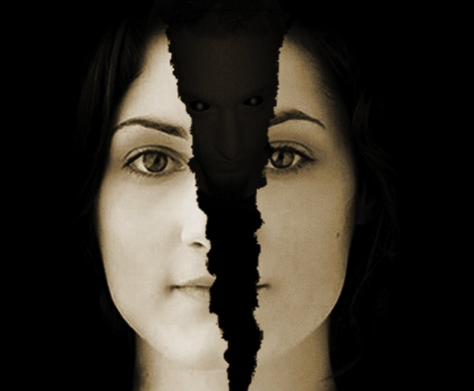
Avoid idolatry or God may discipline you for this involvement with demons
Main Idea of 1 Cor. 10

Slide 47
How NOT to be idle with idols…
  Be humble (10:12)
  Trust in God's faithfulness (10:13)
  Flee every form of idolatry (10:14)
  Seek the good of others (10:23-30)

Slide 48
1 Cor. 10:23-24 (NLT)
²³You say, "I am allowed to do anything"–but not everything is good for you. You say, "I am allowed to do anything"–but not everything is beneficial. ²⁴Don't be concerned for your own good but for the good of others.

Slide 49
1 Cor. 10:25-27 (NLT)
²⁵So you may eat any meat that is sold in the marketplace without raising questions of conscience. ²⁶For "the earth is the Lord's, and everything in it."
²⁷If someone who isn't a believer asks you home for dinner, accept the invitation if you want to. Eat whatever is offered to you without raising questions of conscience.

Slide 50
1 Cor. 10:28-30 (NLT)
²⁸(But suppose someone tells you, "This meat was offered to an idol." Don't eat it, out of consideration for the conscience of the one who told you. ²⁹It might not be a matter of conscience for you, but it is for the other person.) For why should my freedom be limited by what someone else thinks? ³⁰If I can thank God for the food and enjoy it, why should I be condemned for eating it?

Slide 51
How NOT to be idle with idols…
  Be humble (10:12)
  Trust in God's faithfulness (10:13)
  Flee every form of idolatry (10:14)
  Seek the good of others (10:23-30)
  Glorify God (10:31–11:1)

Slide 52
1 Cor. 10:31–11:1 (NLT)
³¹So whether you eat or drink, or whatever you do, do it all for the glory of God. ³²Don't give offense to Jews or Gentiles or the church of God. ³³I, too, try to please everyone in everything I do. I don't just do what is best for me; I do what is best for others so that many may be saved. ^{11:1} And you should imitate me, just as I imitate Christ.

Slide 53
Slides on
1 Korintus 11

Slide 54

Androgini
Di Korintus dan Singapore
Apakah pria dan wanita mempunyai peran yang berbeda di gereja dan masyarakat?

Slide 55
Apakah yang dilakukan seorang wanita?
161o
Catatan: konteks dari ketiga fasal di bawah ini adalah dalam konteks ibadah umum
Seperti ada perbedaan antara 1 Korintus 11, 1 Korintus 14 dan 1 Timotius 2
1 Korintus 11 | 1 Korintus 14 | 1 Timotius 2
Dapat berdoa di depan umum (ay. 5, 13) |  | Doa di depan umum hanya untuk kaum pria (ay. 8)
Dapat bernubuat di depan umum (ay. 5) | Dilarang berbicara (ay. 34) | Harus diam (ay. 12c)
Boleh berbicara (implikasi) | Berbicara tidak diperkenan (ay. 35)
 |  | Tidak boleh mengajar pria (ay. 12a)
 |  | Tidak boleh memimpin pria (ay. 12b)
Tudung dipraktekkan secara umum (ay.16) | Diam dipraktekkan secara umum (ay. 33) | Doa dipraktekkan oleh laki-laki secara umum (ay. 8)
Apakah ini merupakan peraturan umum atau ada kekecualian?
Untuk melihat bagaimana masyarakat menjawab persoalan ini, lihat fasal 8 berikut ini

Slide 56
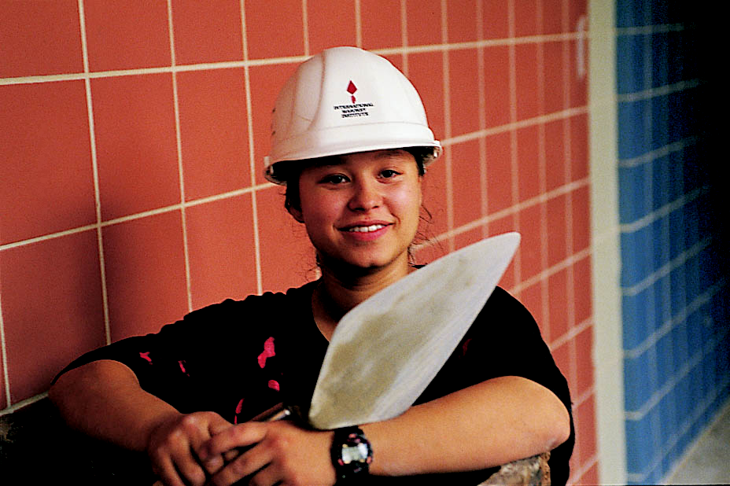
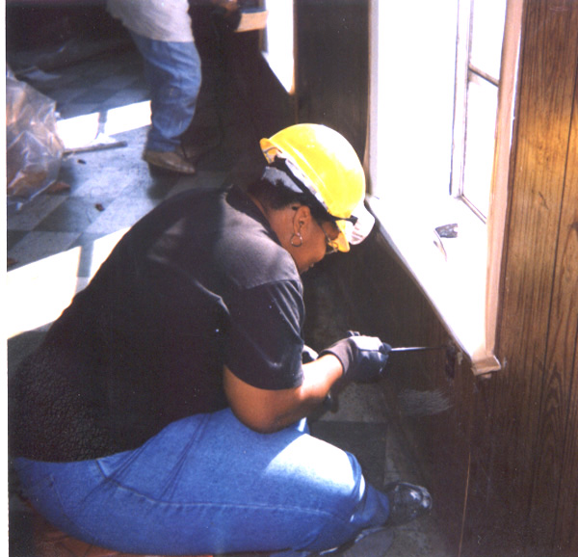
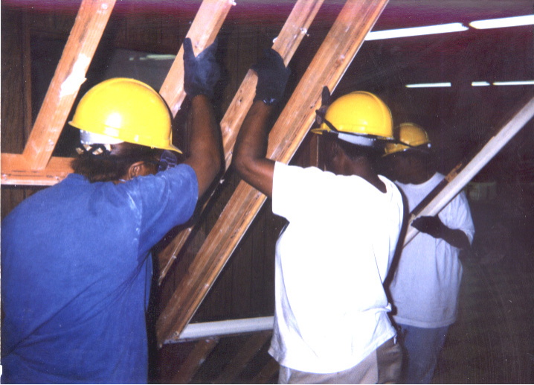
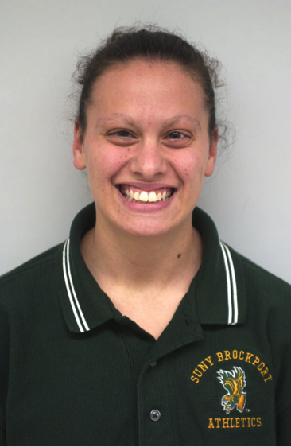

WOW
Bricklayer
(Wider Opportunities for Women)
Electrician
Carpenter
Coach
Notes:
56
www.work4women.org/multimedia/ photos.cfm

Slide 57
My, how language has changed…
Mankind
Humankind
Stewardess
Flight Attendant
Fireman
Fire Fighter
The Past
The Present
Policeman
Police Person
Boss
Bosset

Slide 58

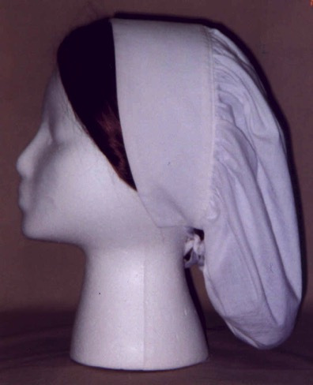
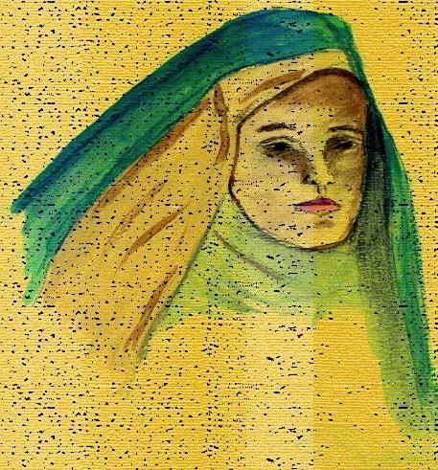

Who wore head coverings?
?
ASSYRIA
ISRAEL
Corinth

Slide 59
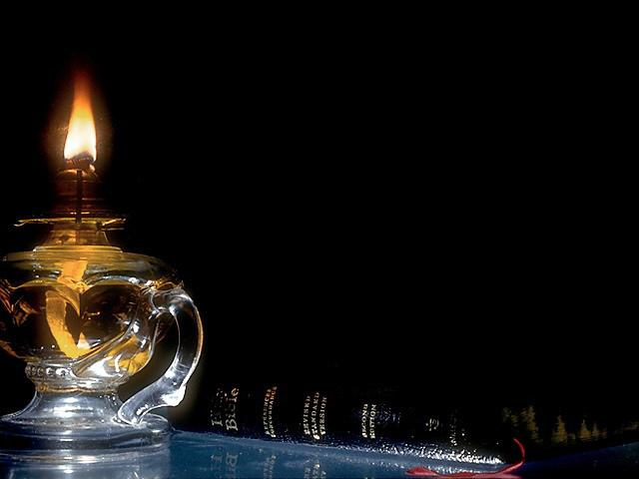
1 Corinthians 11:2 NLT
²I am so glad that you always keep me in your thoughts, and that you are following the teachings I passed on to you.

Slide 60
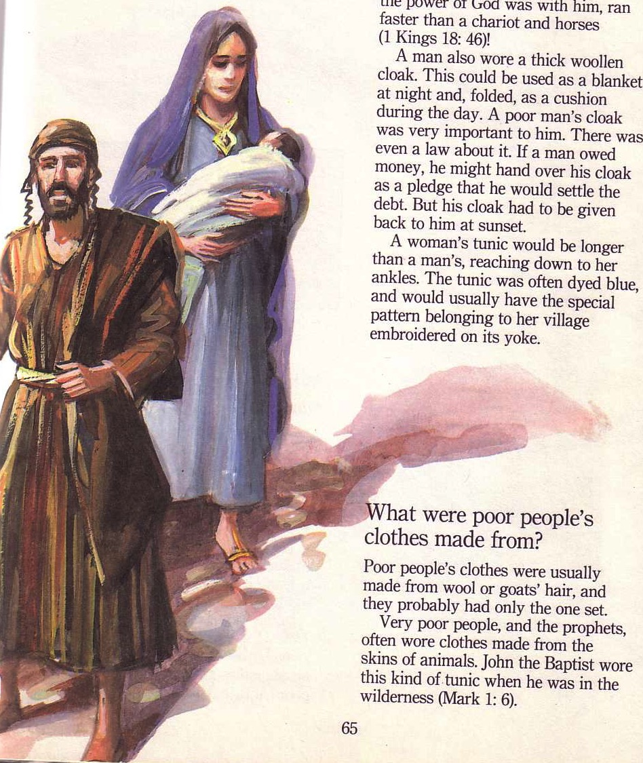
Towards the Main Idea…
Men and women are equal but different--so the church must maintain these sexual distinctions.
But why?
1 Corinthians 11

Slide 61
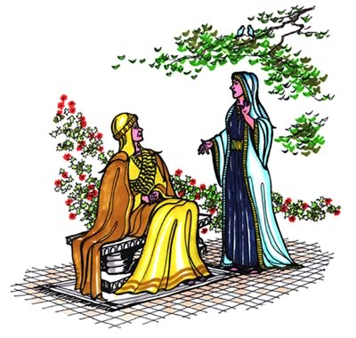
I. Resisting sex distinctions shames our authorities.
Why maintain distinctions?

Slide 62
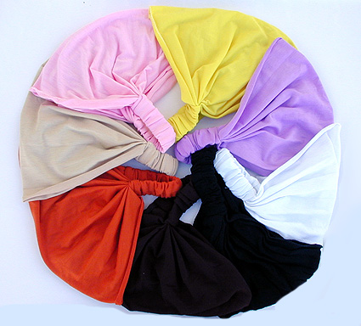
Why maintain distinctions?
A. Wrong use of a head covering at the church of Corinth shamed their authorities
(11:3-6).

Slide 63
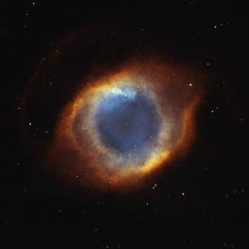
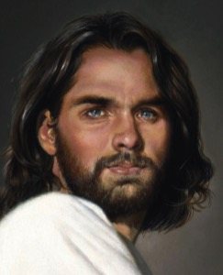


God's Authority Structure
God
Christ
The head of every man is Christ, the head of woman is man, and the head of Christ is God
(1 Cor. 11:3 NLT)
Husband
Wife

Slide 64

What does "head" mean?
Notes:
64

Slide 65


What does "head" mean?
"source"?
"authority"?
Notes:
65

Slide 66
God's Authority Structure
God
Christ
The head of every man is Christ, the head of woman is man, and the head of Christ is God
(1 Cor. 11:3 NLT)
Husband
Wife
Notes:
66

Slide 67
1 Corinthians 11:4 NLT
⁴A man dishonors his head if he covers his head while praying or prophesying.
Notes:
67

Slide 68

Wayne Grudem's
Definition of Prophecy
"telling something that God has spontaneously brought to mind"
"Why Christians Can Still Prophesy" Christianity Today (16 Sept 1988), 29

Slide 69

What is Prophecy?
"knowing this first of all, that no prophecy of Scripture comes from someone's own interpretation. For no prophecy was ever produced by the will of man, but men spoke from God as they were carried along by the Holy Spirit"
2 Peter 1:20-21 (ESV)

Slide 70
1 Corinthians 11:4 NLT
⁴A man dishonors his head if he covers his head while praying or prophesying.
Notes:
70

Slide 71
1 Corinthians 11:5-6 NLT
⁵But a woman dishonors her head if she prays or prophesies without a covering on her head, for this is the same as shaving her head. ⁶Yes, if she refuses to wear a head covering, she should cut off all her hair! But since it is shameful for a woman to have her hair cut or her head shaved, she should wear a covering.
Notes:
71

Slide 72

Flowing Hair
Notes:
72

Slide 73

Bald Mona Lisa
Notes:
73

Slide 74

Bald Hair
Notes:
74

Slide 75

Should women worship with the veil?
Notes:
75

Slide 76

Veils at a wedding are beautiful…
Notes:
76

Slide 77

In most societies today, head coverings send the wrong signal––that we are out of touch with societal convention
Notes:
77

Slide 78

B. Today we must honor our authorities during worship.
Men
Women
Notes:
78

Slide 79


1 Timothy 2:11-15
¹¹A woman should learn in quietness and full submission. ¹²I do not permit a woman to teach or to have authority over a man; she must be silent.
¹³For Adam was formed first, then Eve. ¹⁴And Adam was not the one deceived; it was the woman who was deceived and became a sinner. ¹⁵But women {Gr. she} will be saved {or restored} through childbearing-- if they continue in faith, love and holiness with propriety.

Slide 80
B. Today we must honor our authorities during worship.
Men
Women
All
Notes:
80

Slide 81
I. Resisting sex distinctions shames our authorities.
Why maintain distinctions?

Slide 82

II. A wife should let her husband lead due to the creation order.
Why maintain distinctions?

Slide 83

A. A wife's head covering at Corinth showed the husband's leadership since creation (11:7-12)

Slide 84
1 Corinthians 11:7 NLT
⁷A man should not wear anything on his head when worshiping, for man is made in God's image and reflects God's glory. And woman reflects man's glory.
Notes:
84

Slide 85

Equality of Sexes
God's Creation…Day 6
So God created man in his own image
in the image of God he created him
male and female he created them
(Gen 1:27).

Slide 86


Did Jewish men cover their heads during prayer in NT times?

Slide 87



Women in Corinth were to pray with a head covering because husbands have always led their wives (11:8-10)
Notes:
87

Slide 88
1 Corinthians 11:8-10 NLT
⁸For the first man didn't come from woman, but the first woman came from man. ⁹And man was not made for woman, but woman was made for man. ¹⁰For this reason, and because the angels are watching, a woman should wear a covering on her head to show she is under authority.
Notes:
88

Slide 89
1 Corinthians 11:11-12 NLT
¹¹But among the Lord's people, women are not independent of men, and men are not independent of women. ¹²For although the first woman came from man, every other man was born from a woman, and everything comes from God.
Notes:
89

Slide 90

"In the Lord, however, woman is not independent of man, nor is man independent of woman."
1 Corinthians 11:11
Notes:
90

Slide 91
1 Corinthians 11:11-12 NLT
¹¹But among the Lord's people, women are not independent of men, and men are not independent of women. ¹²For although the first woman came from man, every other man was born from a woman, and everything comes from God.
Notes:
91

Slide 92

B. Wives today must respect their husband's leadership.

Slide 93

III. Don't hinder your witness by blurring the sexes
Why maintain distinctions?
Male or female?

Slide 94

Don't blur proper roles of…
Society (11:13)
Notes:
94

Slide 95
1 Corinthians 11:13 NLT
¹³Judge for yourselves. Is it right for a woman to pray to God in public without covering her head?
Notes:
95

Slide 96

Prayer with head uncovered
Notes:
96

Slide 97
Don't blur proper roles of…
Society (11:13)
Nature (11:14-15)
Notes:
97

Slide 98
1 Corinthians 11:14-15 NLT
¹⁴Isn't it obvious that it's disgraceful for a man to have long hair? ¹⁵And isn't long hair a woman's pride and joy? For it has been given to her as a covering.
Notes:
98

Slide 99




Quellendorf, Germany
Mr. Michaela Lindner
Mr. Norbert Lindner
Notes:
99

Slide 100

Look your part
Notes:
100

Slide 101
Don't blur proper roles of…
Society (11:13)
Nature (11:14-15)
Churches (11:16)
Notes:
101

Slide 102
1 Corinthians 11:16 NLT
¹⁶But if anyone wants to argue about this, I simply say that we have no other custom than this, and neither do God's other churches.
Notes:
102

Slide 103


It can be better!
"So many people expect that fairy tale where everyone is going to be together forever, but I don't subscribe to that. I'd love for it to happen, but I think 10 years with someone is enough."
--Twice divorced actor Jim Carrey
The Internet Movie Database
(www.imdb.com/news/wenn/2004-04-02)
Notes:
103
Brown's views of "free sex" finds a welcome audience in western society that has largely abandoned the marriage institution. England even has more unmarried living partners than it has married couples.

Slide 104

Don't confuse society into thinking that husbands shouldn't lead their wives (Main Idea of 1 Cor. 11:1-16)
Notes:
104
Brown's views of "free sex" finds a welcome audience in western society that has largely abandoned the marriage institution. England even has more unmarried living partners than it has married couples.

Slide 105

Why should husbands lead?
Confusing sex roles shames our authorities (11:2-6)
An unsubmissive wife fights God's creation order (11:7-12)
Blurring the sexes hinders our witness (11:13-16)
Notes:
105
Brown's views of "free sex" finds a welcome audience in western society that has largely abandoned the marriage institution. England even has more unmarried living partners than it has married couples.

Slide 106





What should you wives do?
"Strenuously avoid whatever forms of dress or grooming [that] communicate to the non-Christian world sexual misconduct or idolatrous worship"
(Blomberg, 215)

Slide 107

What should you others do?
Don't Demand Your Rights

Slide 108

Give up your rights to…
• sue another believer (1 Cor. 6)
• marriage or singleness (1 Cor. 7)
• eat food offered to idols (1 Cor. 8)
• practices hindering your witness (1 Cor. 9)
• join pagan celebrations (1 Cor. 10)
• deny God's authority structure (1 Cor. 11)

Slide 109

No Ordinary Supper
1 Corinthians 11:17-34
Rick Griffith, Crossroads International Church
www.biblestudydownloads.com
Notes:
109

Slide 110

Sarah went to Big Church…

Slide 111

"Do this to remember me"
????
Notes:
111

Slide 112

How can you honor God in the Lord's Supper?
Notes:
112

Slide 113


Passover & the Lord's Supper
Four Comparisons

Slide 114

I. Look outward at your relationships with other believers
The Four Directions
outward

Slide 115


1 Corinthians 11:17-19 (NLT)
Notes:
115

Slide 116

1 Corinthians 11:20-22 (NLT)
Notes:
116

Slide 117
The Agape (Love) Feast

Slide 118
1 Cor. 10:15-18 (NLT)
¹⁵You are reasonable people. Decide for yourselves if what I am saying is true. ¹⁶When we bless the cup at the Lord's Table, aren't we sharing in the blood of Christ? And when we break the bread, aren't we sharing in the body of Christ? ¹⁷And though we are many, we all eat from one loaf of bread, showing that we are one body. ¹⁸Think about the people of Israel. Weren't they united by eating the sacrifices at the altar?

Slide 119

Seating at Jesus' Passover

Slide 120

Modern Passover

Slide 121
Matthew 5:23-24
?
"Therefore if you are presenting your offering at the altar, and there remember that your brother has something against you, leave your offering there before the altar and go; first be reconciled to your brother, and then come and present your offering."

Slide 122
I. Look outward at your relationships with other believers
The Four Directions
outward

Slide 123
II. Look back at Christ's death for you
The Four Directions
outward
back

Slide 124
1 Corinthians 11:23-25
²³For I received from the Lord what I also passed on to you: The Lord Jesus, on the night he was betrayed, took bread, ²⁴and when he had given thanks, he broke it and said, "This is my body, which is for you; do this in remembrance of me." ²⁵In the same way, after supper he took the cup, saying, "This cup is the new covenant in my blood; do this, whenever you drink it, in remembrance of me."
Notes:
124

Slide 125


Passover's Past Significance

Slide 126

The Four Cups (Exod. 6:6-7)
Blessing
Plagues
Redemption
Praise

Slide 127
The Order of the Celebrations
Passover | Lord's Supper
Light candles | Assumed (not recorded)
1st Cup: Blessing/Sanctification, saying, "I will bring you out from under the burdens of the Egyptians" (1st of 4 "I wills" of Exod. 6:6-7) | "Take this and divide it among yourselves… I will not drink again of the fruit of the vine until the kingdom of God comes" (Luke 22:17b-18)
Washing of one's own hands | Washed disciples feet during meal (John 13:2, 4)
Parsley dipped in salt water (bitterness), middle matzah (bread) made visible and broken and 1/2 called "afikomen" (Gr. "he who comes later") wrapped with napkin and hidden | Son of God (second member of the Trinity) made visible, broken, body wrapped, and buried in a tomb (this tradition was added to the Passover by first century AD Jewish believers)
Passover story read (Exod. 12:1-13), 4 Questions, 4 sons, 10 Plagues | Assumed (not recorded)

Slide 128


Seder Plate

Slide 129
The Order of the Celebrations
Passover | Lord's Supper
2nd Cup: Plagues/Judgment, saying, "I will rid you of their bondage"
Washing hands, eat upper and 1/2 middle matzah and bitter herbs with bottom matzah (bondage)
Passover Supper begins
Eat bitter herbs with charoseth of dates, honey, & almonds (sweetness of life with God's redemption), roasted egg (temple offerings & destruction, grief and new life), shankbone | Jesus dips the sop with Judas and Judas leaves (?)
Eat afikomen—"This is the bread of affliction…" | "This is my body…" (Luke 22:19)

Slide 130

"This is my body, which is for you…"
Notes:
130

Slide 131
The Four Cups (Exod. 6:6-7)
Blessing
Plagues
Redemption
Praise

Slide 132
The Order of the Celebrations
144
Passover | Lord's Supper
3rd Cup: Redemption, saying, "I will redeem you with an outstretched arm" | "This is my blood…" (Luke 22:20) Jesus dips the sop with Judas and Judas leaves (?)
4th Cup: Praise/Regathering, saying, "I will take you to me for a people" & read Pss. 113–118 | "For as often as you eat this bread and drink this cup, you proclaim the Lord's death until he comes"
Declaration ("Next year in Jerusalem!"), hymn (Ps. 118), poem, or national anthem | Sang hymn & went to Mt. of Olives (Matt. 26:30)
Cup of Elijah: Filled but untouched; symbolizes his return before Messiah (Mal. 4:5-6; Matt. 11:13-14; 17:11-12; Rev. 11:3-12; 19:11-21), youngest child opens front door "for Elijah" | Assumed (not recorded)

Slide 133

"This cup is the new covenant in my blood" (Jer. 31: 31-34)
Israel and Judah reunited (31:31-32)
Spirit indwelling (31:33)
No need for evangelism (31:34a)
Israel forgiven (31:34b)
Notes:
133

Slide 134

Song
"I'm not what
I wanna be,
I'm not what
I'm gonna be,
But thank God
I'm not what I was!"
Notes:
134

Slide 135
II. Look back at Christ's death for you
The Four Directions
outward
back

Slide 136
III. Look forward to Christ's return
The Four Directions
outward
back
forward

Slide 137
1 Corinthians 11:26 (NIV)
²⁶For whenever you eat this bread and drink this cup, you proclaim the Lord's death until he comes.
Notes:
137

Slide 138
The Order of the Celebrations
144
Passover | Lord's Supper
3rd Cup: Redemption, saying, "I will redeem you with an outstretched arm" | "This is my blood…" (Luke 22:20) Jesus dips the sop with Judas and Judas leaves (?)
4th Cup: Praise/Regathering, saying, "I will take you to me for a people" & read Pss. 113–118 | "For as often as you eat this bread and drink this cup, you proclaim the Lord's death until he comes"
Declaration ("Next year in Jerusalem!"), hymn (Ps. 118), poem, or national anthem | Sang hymn & went to Mt. of Olives (Matt. 26:30)
Cup of Elijah: Filled but untouched; symbolizes his return before Messiah (Mal. 4:5-6; Matt. 11:13-14; 17:11-12; Rev. 11:3-12; 19:11-21), youngest child opens front door "for Elijah" | Assumed (not recorded)

Slide 139

"This year we are here.
Next year in Jerusalem!"

Slide 140
III. Look forward to Christ's return
The Four Directions
outward
back
forward

Slide 141
IV. Look inward to confess all sin
The Four Directions
outward
back
forward
inward

Slide 142
1 Corinthians 11:27-29 (NIV)
²⁷Therefore, whoever eats the bread or drinks the cup of the Lord in an unworthy manner will be guilty of sinning against the body and blood of the Lord. ²⁸A man ought to examine himself before he eats of the bread and drinks of the cup. ²⁹For anyone who eats and drinks without recognizing the body of the Lord eats and drinks judgment on himself.
Notes:
142

Slide 143
1 Corinthians 11:30-32 (NIV)
³⁰ That is why many among you are weak and sick, and a number of you have fallen asleep. ³¹But if we judged ourselves, we would not come under judgment. ³²When we are judged by the Lord, we are being disciplined so that we will not be condemned with the world.
Notes:
143

Slide 144
1 Corinthians 11:33-34 (NIV)
³³So then, my brothers, when you come together to eat, wait for each other. ³⁴If anyone is hungry, he should eat at home, so that when you meet together it may not result in judgment. And when I come I will give further directions.
Notes:
144

Slide 145




Feast of Unleavened Bread
Notes:
www.stephenwilliamson.com/ Hobbies/bakin.htm (Yeast bloom)

Slide 146

"Burn All the Yeast!"

Slide 147

Think!
inward

Slide 148
How can you honor God in the Lord's Supper?
Notes:
148

Slide 149
Look in all four directions!
The Four Directions
outward
back
forward
inward

Slide 150
The Four Directions
(Adapted from David Watson, I Believe in the Holy Spirit)
143
Look... | Passover (Jewish) | Lord's Supper (Christian)
Outward | Whole family involved (Exod. 12:3-4, 16) | Fellowship and unity (1 Cor. 11:17-22; 10:16-17)
Back | Deliverance from Egypt (Exod. 12:31-42) | Deliverance from sin (1 Cor. 11:23-25)
Forward | Wait for messianic age (Ezek. 45:21) | Anticipate return of Christ (1 Cor. 11:26; Mark 14:25)
Inward | Purify house of leaven or evil (Exod. 12:8, 15) | Examine sin in yourself (1 Cor. 11:27-32; cf. 5:6-8)

Slide 151
To properly look back on His death and look forward to His return, we need to look outward for others and look inward at our own lives.
The Main Idea
outward
back
forward
inward

Slide 152

John 3:16

Slide 153
What outward or inward issues do you need to address right NOW?
Two Directions
outward
inward

Slide 154
Slides on
1 Korintus 12

Slide 155

Spiritual Gifts
Where should we begin studying gifts?

Slide 156
I. Understanding gifts begins with seeing Christ as God (12:1-3).
Father
is
is not
is not
GOD
is
is
Son
Spirit
is not

Slide 157
1 Corinthians 12:1-3 (NIV)
¹Now about spiritual gifts, brothers,
I do not want you to be ignorant.
²You know that when you were pagans, somehow or other you were led astray to mute idols.
³Therefore I tell you that no one who is speaking by the Spirit of God says, "Jesus is Lord," except by the Holy Spirit.

Slide 158
Basic Issues in 1 Cor 12
2
What
Who
Where
When
Why

Slide 159
What is a spiritual gift?
"a God-given ability for service" (Ryrie)
"a spiritual capacity for development"
(Radmacher)

Slide 160
What is a spiritual gift?
NOT
Place of service
Age group ministry
Natural talent

Slide 161

Me? Gifted?

Slide 162
Basic Issues in 1 Cor 12
2
What
Who
Where
When
Why

Slide 163
1 Corinthians 12:1-3 (NIV)
¹Now about spiritual gifts, brothers,
I do not want you to be ignorant.
²You know that when you were pagans, somehow or other you were led astray to mute idols.
³Therefore I tell you that no one who is speaking by the Spirit of God says, "Jesus is Lord," except by the Holy Spirit.

Slide 164
II. Our different gifts are united in the triune God (12:4-6).
Father
is
is not
is not
GOD
is
is
Son
Spirit
is not
H. Wayne House, Charts of Christian Theology and Doctrine, 45

Slide 165
1 Corinthians 12:4-6 (NIV)
There are different kinds of gifts,
but the same Spirit.
There are different kinds of service,
but the same Lord.
There are different kinds of working,
but the same God
works all of them in all men.

Slide 166
GIVES
"There are different kinds of gifts,
but the same Spirit" (12:4).
Father
is
is not
is not
GOD
is
is
Son
Spirit
is not
H. Wayne House, Charts of Christian Theology and Doctrine, 45

Slide 167

The Basis & Nature of Gifts
3
1) Charisma (ca,risma)
Roots: charis means grace (basis)
chara means joy (result)

Slide 168
GIVES
Father
is
is not
is not
GOD
"spiritual"
is
is
Son
Spirit
is not
H. Wayne House, Charts of Christian Theology and Doctrine, 45

Slide 169
APPOINTS
"There are different kinds of service,
but the same Lord" (12:5).
Father
is
is not
is not
GOD
is
is
Son
Spirit
is not
H. Wayne House, Charts of Christian Theology and Doctrine, 45

Slide 170
The Basis & Nature of Gifts
3
2) Diakonia (dia,konia)
• Place of service (1 Cor. 12:5)
• Category of gifts (1 Pet. 4:11)
• "service" (NIV), "ministries" (NASB)

Slide 171
EMPOWERS
Father
is
is not
is not
"There are different kinds of working,
but the same GOD
works all of them in all men" (v. 6).
is
is
Son
Spirit
is not
H. Wayne House, Charts of Christian Theology and Doctrine, 45

Slide 172
The Basis & Nature of Gifts
3
2) Diakonia (dia,konia)
• Place of service (1 Cor. 12:5)
• Category of gifts (1 Pet. 4:11)
• "service" (NIV), "ministries" (NASB)
3) Energema (e;nerghma)
• Energy operating gifts (1 Cor. 12:6)
• "working" (NIV), "effects" (NASB)

Slide 173

The Key Idea
Q: Where should we begin studying gifts?
A: Gifts praise the triune God—not us!

Slide 174
The Triune Involvement
EMPOWERS
Father
is
is not
is not
GOD
is
is
Son
Spirit
APPOINTS
GIVES
is not
H. Wayne House, Charts of Christian Theology and Doctrine, 45

Slide 175

How do you see the Spirit working in your life?
Notes:
Intro to MPI: But do you identify with this? How do you see the Spirit working in your life?

Slide 176


One evidence of the Spirit's work in your life is your spiritual gift
(12:7-11)
"A spiritual gift is given to each of us so we can help each other" (1 Cor. 12:7 NLT)

Slide 177

The Spirit gives every gift (12:8)
⁸To one person the Spirit gives the ability to give wise advice [a word of wisdom]; to another the same Spirit gives a message of special knowledge [a word of knowledge].*

Slide 178
The Spirit gives every gift (12:9-10a)
⁹The same Spirit gives great faith to another, and to someone else the one Spirit gives the gift of healing. ¹⁰He gives one person the power to perform miracles.

Slide 179
The Spirit gives every gift (12:10b-11a)
and another the ability to prophesy. He gives someone else the ability to discern whether a message is from the Spirit of God or from another spirit. Still another person is given the ability to speak in unknown languages,* while another is given the ability to interpret what is being said. ¹¹It is the one and only Spirit who distributes all these gifts.

Slide 180
The Spirit alone chose your gift (12:11b)
He alone decides which gift each person should have.

Slide 181

Whom do you need?
Everyone!
Notes:
181

Slide 182

But why do you need others in this church (12:12-31)?
155dd
Notes:
182

Slide 183

I. It takes all the different gifts for the church to exist (12:12-13).
Notes:
183

Slide 184

A. A human body has different parts (12:12).
"The body is a unit, though it is made up of various parts; and though all its parts are many, they form one body. So it is with Christ"
(12:12)
Notes:
184

Slide 185
B. Believers are different but still part of one body (12:13)
"For we were all baptized by one Spirit into one body—whether Jews or Greeks, slave or free—and we were all given one Spirit to drink" (1 Cor. 12:13)
Notes:
185

Slide 186



ATHENS
Ecclesia
"called out ones"
Idiotes
"one who does his own thing"
Kurioikos
"house of the Lord"
"church" via Latin
Notes:
186
The church is a body—not a building.
In ancient Athens, the citizens were very appreciative of their privilege to be a vital part of the city-state—and they recognized their responsibility as well. When a herald would call a meeting of the citizens, each would close his shop, drop what he was doing, and walk out of the city, past the Acropolis and to the next hill for a meeting. This group became known as the ecclesia, or "called out ones."
Some citizens, of course, loved the privileges of being part of the city-state but felt no responsibility for it. They left their shops open and refused to join the ecclesia, so the latter called them idiotes, or ones who did their own thing for selfish purposes. We derive our English word "idiot" from this group of lazy people characterized by self concern and social irresponsibility (CHURCH definition of—"called out ones" by Stuart Briscoe, Singapore missionary retreat, 92).
For the first three centuries of Christianity, the body of believers was always called the ecclesia. Only in the time of Constantine in the 4th century did the term kurioikos, "house of the Lord," come about, from which through the Latin we arrive at our English word "church." The early Christians never associated themselves with a building called the "church" (CHURCH body, not a building by W.A. Criswell at DTS chapel). They saw themselves only as the ecclesia, or "called out ones"—called out from the world to be God's own people!

Slide 187

What is Spirit Baptism?
www.ohiem.org/ photo-album/index.htm
Notes:
187
If you're asked if you've received the "baptism of the Spirit," what will you say?

Slide 188

Swimming in the Spirit - Perth, Western Australia
www.ohiem.org/ photo-album/index.htm
Notes:
188
So many aberrations of this exist today—even "swimming in the Spirit"!
www.ohiem.org/ photo-album/index.htm

Slide 189

What really happened at Pentecost?
The baptism of the Spirit
The baptism with the Spirit
The baptism in the Spirit
The baptism by the Spirit
baptizo en pneumati
Notes:
I say, "There's no such thing as the baptism of the Spirit. Scripture never once uses this phrase. The Greek can be translated as "baptized with, in, or by the Spirit." But if you mean am I baptized by the Spirit, the answer is YES—every Christian has been baptized by the Spirit into the body of Christ."
189

Slide 190
Diagram tentang Pandangan Baptisan Roh
161z
Terjemahan
“dengan Roh”
“dalam satu Roh”
“oleh satu roh”
“dengan satu roh”
Agen: oleh
Kristus
Kristus?
Roh
Kristus?
Instrumen: dengan
Roh
?
?
roh
bidang: ke
Tubuh?
Roh
tubuh
tubuh
Tujuan: menjadi?
?
Satu tubuh
?
?

Slide 191
Pandangan tentang Baptisan Roh
161z
Injil/Kisah
1 Korintus 12:13
Mat. 3:11; Mark 1:8; Luk 3:16; Yoh 1:33; Kis 1:5; 2:33; 11:16
Pandangan A
dari sudut penafsiran kelompok Pantekosta
Pentecostal Interpretation
Pandangan B
Terjemahan semua Alkitab,
Pandangan dari yg bukan Pentakosta
Pandangan C
Pandangan yang bukan Pentakosta lainnya, pandangan penulis
Terjemahan: Bagaimana baptizo dan pneumati terjemahkan?
“akan membaptis engkau dengan Roh Kudus”
“Kita semua dibaptis dalam satu Roh supaya menjadi satu tubuh
“Kita semua dibaptis dalam satu Roh supaya menjadi satu tubuh”
“Kita semua dibaptis dalam
satu Roh supaya menjadi
satu tubuh
Agen: Siapa yang membaptis? (“oleh…”)
Kristus
(Unstated)
Roh Kudus
(dibawah Kristus)
(Unstated)—Injil menunjuk kepada Yesus Kristus
Alat: dengan apa atau siapa orang percaya dibaptis
Roh Kudus — Mat. 3 mengatakan bahwa kita semua telah dibaptis dengan Roh (ay. 11, orang percaya) atau dengan api (ay. 12, yg tidak percaya)
(Unstated)
(Unstated)
Roh Kudus
Pengaruh: kedalam hal apa saja pengaruh baptisan?
()
Roh Kudus
Tubuh Kristus
Tubuh Kristus
Tujuan: Apa yang menjadi sasaran akhir dan tujuan baptisan ituaptism?
(Unstated)
Tubuh Kristus
(Unstated)
(Unstated)
Bagaimana menterjemahkan eis hen soma?
N/A
“supaya kita menjadi satu tubuh” (tujuan dan hasilnya)
“dalam satu tubuh” (lingkup)
“dalam satu tubuh” (lingkup)—seperti yang terdapat di dalam Rom. 6:3-4;
Gal. 3:26-27
Korelasi Injil/Kisah Rasul dengan 1 Kor 12:13
—
Tidak konsisten
Lebih konsisten
Lebih konsisten
Semua orang Kristen telah mengalami Baptisan Roh (kita tidak perlu mencarinya) Baptisan dan kepenuhan meruapakan dua peristiwa yang berbeda
Semua orang Kristen telah
mengalami Baptisan Roh (kita
tidak perlu mencarinya) Baptisan
dan kepenuhan meruapakan dua peristiwa yang berbeda
Pemahaman Teologia yang dihasilkan
N/A
Tidak semua memiliki Baptisan Roh (kita harus mencarinya) Baptisan dan kepenuhan merupakan dua kejadian yang sama

Slide 192
Baptisan dan Kepenuhan
161aa
 | Dibaptis dengan Roh Kudus | Dipenuhi dengan Roh Kudus
Definisi dan tujuan | Pekerjaan Roh Kudus adalah menempatkan orang percaya ke dalam tubuh Kristus | Roh Kudus memampulan prang percaya untuk melayani dan melengkapi mereka dengan karakter Kristus
Alkitab | Bernubuat (Mat. 3:11; Mrk 1:8; Luk 3:16; Yoh 1:33; Kis 1:5); Memenuhi (Kis 2:1dst.; bdg. 11:15-16); Menerangkan (1 Kor. 12:13) | Berjalan dalam Roh” (Gal. 5:16) “Hidup oleh Roh” (Gal. 5:25) “Dipimpin oleh Roh” (Gal. 5:18)
Nats kunci | 1 Korintus 12:13 | Efesus 5:18
Tenses | Aorist: kejadian masa lalu, kejadian tanpa batas waktu | Waktu sekarang: terus-menerus, tindakan yang berulang terjadi
Suasana | Penyataan: meneguhkan suatu fakta (“kita semua dibaptis”), bukan suatu perintah atau penunjukkan tentang bagaimana memperoleh baptisan” | Perintah: perintah untuk diperhatikan (“hendaklah dipenuhi”), menunjukkan bagaimana dapat dipenuhi Roh Kudus, melalui menyerahkan hidup kepada Kristus
Waktu terjadi | At salvation: "promise...is for all" (Acts 2:38-39), when they believed (Acts 11:16-17), "every spiritual blessing" (Eph. 1:3), "Pada saat pertobatan: “janji...untuk semua” (Kis 2:38-39), ketika mereka percaya (Kis 11:16-17), “setiap anugerah rohani” (Ef. 1:3), “sempurna di dalam Dia” (Kol. 2:9-10), orang percaya telah “dianugerahi segala sesuatu.. untuk hidup yang saleh” (2 Pet. 1:3) in Him" (Col. 2:9-10), "everything pertaining to... godliness" (2 Pet. 1:3) | Pada saat dan setelah pertobatan

Slide 193
Baptisan dan Kepenuhan
161aa
 | Dibaptis dengan Roh Kudus | Dipenuhi dengan Roh Kudus
Frekwensi | Tidak berulang (pengalaman sekali saja) | Berulang (pengalaman seumur hidup; bandingkan Kis 9:17; 13:9)
Peserta | Semua orang kristen (rohani dan jasmani) (“Kita semua telah dibaptis)” 1 Cor. 12:13; cf. Gal. 3:2, 14; 4:6) | Orang Kristen rohani
Ketetapan | Kekal: tidak dapat dilakukan | Sementara: dapat hilang (Kis 2:4; 4:8, 31)
Prasyarat | Beriman dalam Kristus | Kepatuhan kepada Kristus
Tampilan PL | Tidak: tidak pernah terjadi sebelum Pentakosta | Ya: : orang percaya PL kadang dipenuhi Roh Kudus untuk suatu pelayanan tertentu, tetapi tidak tinggal tetap
Hasilnya | Posisi: Ditempatkan di dalam tubuh Kristus (gereja) | Praktika: pujian, penyembahan, ucapan syukur, kepatuhan (Ef. 5:19-21); Serupa dengan Kristus(Gal. 5:22-23); Keterlibatan dalam penginjilan (Kis 2:4 dan 2:41; 4:31 dan 5:14; 6:3 dan 6:7)
Diperintahkan? | Tidak | Ya
Dicari? | Tidak (Kis 11:15-16) | Ya

Slide 194
II. It takes the serving gifts for the church to function (12:14-20)
155dd
Speaking | Serving
Teaching | Administering
Evangelism | Faith
Pastor-Teacher | Giving
Encouraging | Service
 | Mercy
Notes:
194

Slide 195

A. The church has many people with different gifts (12:14)
Notes:
195

Slide 196
"Now the body is not made up of one part, but many" (12:14)
155dd
Speaking | Serving
Teaching | Administering
Evangelism | Faith
Pastor-Teacher | Giving
Encouraging | Service
 | Mercy
Notes:
196

Slide 197





B. Believers with less honored gifts shouldn't feel unneeded (12:15-16).
¹⁵ If the foot should say,
"Because I am not a hand, I do not belong to the body,"
it would not for that reason cease to be part of the body.
¹⁶ And if the ear should say,
"Because I am not an eye, I do not belong to the body,"
it would not for that reason cease to be part of the body.

Slide 198

C. Diversity in the church makes it more effective (12:17-20).
¹⁷If the whole body were an eye, where would the sense of hearing be? If the whole body were an ear, where would the sense of smell be? ¹⁸But in fact God has arranged the parts in the body, every one of them, just as he wanted them to be. ¹⁹If they were all one part, where would the body be? ²⁰As it is, there are many parts, but one body.

Slide 199


III. It takes humble use of all the gifts for the church to care (12:21-26).
Notes:
199

Slide 200



"Up-front" believers, don't arrogantly say,
"I don't need you with less honored roles" (12:21)
"The eye cannot say to the hand,
"I don't need you!"
And the head cannot say to the feet,
"I don't need you!"

Slide 201
Weaker gifts are indispensable (12:22)
²²On the contrary, those parts of the body that seem to be weaker are indispensable
Notes:
201

Slide 202
Less honorable gifts are honored (12:23a)
²²On the contrary, those parts of the body that seem to be weaker are indispensable, ²³and the parts that we think are less honorable we treat with special honor.
Notes:
202

Slide 203
But gifts never to be seen are also guarded with modesty (12:23b)
…And the parts that are unpresentable are treated with special modesty
Notes:
203

Slide 204
Yet the "up-front" believers need less acknowledgment (12:24a)
²⁴while our presentable parts need no special treatment.
Notes:
204

Slide 205
God gives greater honor to "behind-the-scenes" believers (12:24b).
But God has combined the members of the body and has given greater honor to the parts that lacked it
Notes:
205

Slide 206
God honors serving gifts so we'll care for them too (12:25-26).
²⁵so that there should be no division in the body, but that its parts should have equal concern for each other. ²⁶If one part suffers, every part suffers with it; if one part is honored, every part rejoices with it.
Notes:
206

Slide 207

IV. It takes all of our gifts for the church to be diversified (12:27-31).
Notes:
207

Slide 208

A. The church is composed of diversified members (12:27).
"Now you are the body of Christ, and each one of you is a part of it."
Unity
Notes:
208

Slide 209
B. The hierarchy of members shows that all don't have the same gifts
(12:28-30).
And in the church God has appointed
first of all apostles,
second prophets,
third teachers,
then workers of miracles,
also those having gifts of healing,
those able to help others,
those with gifts of administration,
and those speaking in different kinds of tongues.
Are all apostles? Are all prophets? Are all teachers?
Do all work miracles? Do all have gifts of healing?
Do all speak in tongues? Do all interpret?
Notes:
209

Slide 210
C. Emphasize the gifts that edify the most members (12:31).
1 Corinthians 12:31 "But eagerly desire the greater gifts."
"desire" = "all of you desire" (second person plural)
"greater gifts" = verse 28
Notes:
210

Slide 211

Four reasons we need others
It takes all the different gifts for the church to exist (12:12-13)
It takes serving gifts for the church to function (12:14-20)
It takes humble use of all the gifts for the church to care (12:21-26)
It takes all of our gifts for the church to be diversified (12:27-31)
Notes:
211

Slide 212

Main Idea of 1 Cor. 12
So why do you need
everyone in this church?
You're only one part of the body!
Notes:
212

Slide 213
Slides on
1 Korintus 13

Slide 214
Key Idea of 1 Cor. 13
The "glue" that holds together the Bible's teaching on gifts is love.
But why do we need to use our gifts with love?

Slide 215

I. Love is superior to gifts (13:1-3).

Slide 216

Tongues used to the max without love produces nothing (13:1).
"If I speak with the tongues of men and of angels, but have not love, I am a noisy gong and a clanging cymbal"

Slide 217

Reversing Babel
Reversing Babel

Slide 218

Prophecy without love is worthless to edify others (13:2a)
Prophecy
"If I have the gift of prophecy…"

Slide 219

Wisdom that knows all previously hidden doctrines but without love is worthless to edify others (13:2b)
"…and can fathom all mysteries…"

Slide 220

Knowledge that knows all facts but without love is worthless to edify others (13:2c)
"…and all knowledge…"

Slide 221

Faith that can move mountains but without love is worthless to edify others (13:2d).
"…and if I have a faith that can move mountains but have not love,
I am nothing…" (NIV)

Slide 222

Giving
"…and if I give my body to be burned but have not love,
I am nothing…" (NIV)
"The Blood of the Martyrs is the seed of the Church"
-Tertullian-

Slide 223
INDIA
"…and if I give my body to be burned but have not love,
I am nothing…" (NIV)
"The Blood of the Martyrs is the seed of the Church"
-Tertullian-

Slide 224

Destroyed Church
Notes:
224

Slide 225

Burned Christian Girl
Notes:
225

Slide 226

Burned Church
Notes:
226

Slide 227

Killed Girl
Notes:
227

Slide 228

II. Love benefits others (13:4-7).

Slide 229

Relational Aspects of Love (13:4-7)
Love benefits others both passively and actively (13:4a-b):
Passively patient
Actively kind

Slide 230

Heart Size
"It is not the size of a man but the size of his heart that matters"

Slide 231
Relational Aspects of Love (13:4-7)
Love doesn't hurt others in seven negative ways (13:4c-5):
Envy
Love benefits others both passively and actively (13:4a-b):
Passively patient
Actively kind

Slide 232

Don't feel inferior about your gift!
You're included–I'm excluded

Slide 233
Relational Aspects of Love (13:4-7)
Love doesn't hurt others in seven negative ways (13:4c-5):
Envy
Boasting
Pride
Love benefits others both passively and actively (13:4a-b):
Passively patient
Actively kind

Slide 234

Don't think highly of your gift!
"Forgive me for talking about my gift so much! Now YOU talk about it!"

Slide 235
Relational Aspects of Love (13:4-7)
Love doesn't hurt others in seven negative ways (13:4c-5):
Envy
Boasting
Pride
Behaving improperly
Selfish
Irritable
Unforgiving
Love benefits others both passively and actively (13:4a-b):
Passively patient
Actively kind

Slide 236

Love knows the right things to get happy about (13:6).
It does not rejoice about injustice…
… but rejoices whenever the truth wins out

Slide 237




Love doesn't give up on others (13:7)
"endures"
"hopes"
"believes"
"perseveres"
Notes:
"Love never gives up, never loses faith, is always hopeful, and endures through every circumstance" (NLT)

Slide 238

III. Love outlasts gifts (13:8-13).
"Love never fails…"

Slide 239
Gifts are temporary and partial
8 Love never fails. But where there are prophecies, they will cease; where there are tongues, they will be stilled; where there is knowledge, it will pass away.
9 For we know in part and we prophesy in part,
10 but when perfection comes, the imperfect disappears.
to teleion (Gr)
1 Corinthians 13:8-12 NIV

Slide 240

To teleion is a mega issue!

Slide 241
1 Korintus 13:8-13
161b-c
____________________________________________________________________________
Pertanyaan-pertanyaan
penting Kanon (Alkitab) Pengangkatan Tubuh (Gereja)
_____________________________________________________________________________
13:8 Apakah natur dari:
a) nubuatan&pengetahuan? Pewahyuan Bukan pewahyuan Pewahyuan
b) bahasa roh? Peneguhan bukan peneguhan peneguhan
Kapankan semua karunia itu- kanonisasi pada kedatangan kanonisasi
berhenti? Kristus kembali
13:10 Apakah maksud to teleion? “utuh” “sempurna” Kedewasaan
(Alkitab) (Kedatangan- (tubuh)
Kristus)
13:11 Apakah tujuan mem- Bagaimanakah sebelum dan se- sebelum dan sesudah
presentasikan pertubumbuhan? Pertumbuhan itu sudah kedatangan kedewasaan tubuh
seorang manusia? menyempurnakan Yesus kembali (ditandai dengan Alkitab)
Alkitab?
13:12 Apakah pengetahuan yang sebelum dan se- sebelum dan se- sebelum dan se-
sebagian, penuh dan sudah Alkitab ter- kedatangan kedewasaan tubuh
sempurna itu? bentuk Kristus kembali (sempurna padaparousia )
________________________________________________________________________________
Robert L. Thomas, JETS (1974): 81-89

Slide 242


Pandangan Golongan Kanon akan 1 Korintus 13:8-13
161b-c
1. Golongan Kanon meihat bahwa to teleion berarti “yang utuh, yang sempurna,” rmenunjuk kepada “Alkitab yang telah sempurna.” Oleh karena itu, nubutan, pengetahuan dan bahasa lidah akan berhenti sebelum Perjanjian Baru selesai dan tidak ada lai hari ini.
Kekuatan
Kelemahan
a.
Konteks pengetahuan yang diwahyukan (ay. 8-9).
a.
Tidak dapat dikaitkan dengan kedatangan Kristus kembali (parousia) di dalam ayat 12.
b.
Konfirmasi natur dari bahasa lidah
(bdg. 14:22).
b.
Konteksnya tidak mendukung keutuhan PB. Dan sangat diragukan Paulus pernah mengimpikan salah satu.
c.
Perbedaan natur nubuatan dan pengetahuan yang sebagian
c.
“Keutuhan” (to ek pantos) lebih tepat di bandingkan dengan “sebagian” daripada to teleion karena keduanya bersifat kuantitatif.
d.
to teleion seringkali berarti “lengkap.”
e.
“lengkap” lawan kata dari “sebagian” (v. 10).
Robert L. Thomas, JETS (1974): 81-89

Slide 243
Pandangan Kelompok Pengangkatan dalam 1 Korintus 13:8-13
161b-c
2. Pandangan Pengangkatan menganggap kata to teleion berarti “sempurna” (sebagai lawan dari “yang utuh” di atas), menunjuk kepada kedatangan Yesus pada saat pengangkatan. Sekalipun, nubuatan, pengetahuan dan bahasa Roh akan hilang pada saat Kristus datang, namun mereka tetap ada hari nin sebagai karunia yang sah.
Kekuatan
Robert L. Thomas, JETS (1974): 81-89
Kelemahan
a.
Penjelasan yang memadai akan “mengenal dengan sempurna” di dalam ayat 12.
a.
Penjelasan yang tidak memadai terhadap konsep kedewasaan yang bertumbuh secara alamiah, seperti ayat 11
b.
“Muka dengan muka” (ay. 12) gambaran yang sangat tepat pada saat kedatangan Kristus kembali (bdg. 1 Kor. 1:7) dan pengalaman pribadi yang sama dalam PL.
b.
Gagal untuk mengenali perbedaan antara natur nubuatan yang diwahyukan dan pengetahuan dan natur bahasa Roh (fs. 14:22)
c.
“Sempurna” merupakan gambaran yang sangat tepat pada saat parousia (pengangkatan).
c.
Paulus tidak pernah menggunakan kata to teleion dengan maksud “sempurna” dalam pengertian seutuhnya.
d.
to teleion senantiasa berarti “sempurna” di dunia sekular, filsafat Yunani (mis. Plato) sebagaimana di dalam Yak 3:2.
d.
“Sempurna” (istilah kualitatif) perbedaan yang kurang tepat dengan “sebagian” (istilah kuantitatif, ay. 10).

Slide 244
The Body View

Slide 245


Robert L. Thomas…
"It pictures the Christian church collectively, growing up as one body, beginning with its birth, progressing through different stages of development during the present [relative maturity in v. 11] and reaching maturity at the return of Christ [ultimate maturity in v. 12]."
Robert L. Thomas, JETS (1974): 81-89

Slide 246
Pandangan tentang tubuh dalam 1 Corinthians 13:8-13
161b-c
3. Pandangan Tubuh melihat bahwa arti kata to teleion sebagai “dewasa,” menunjuk kepada kedewasaan tubuh Kristus. “Ini menggambarkan orang Kristen secara kolektif, bertumbuh sebagai satu tubuh, berawal dari kelahirannya, bertumbuh melalui berbagai macam tingkat perkembangan [kedewasaan relatif, ay. 11] dan mencapai kesempurnaan pada saat parousia [kedewasaan yang sempurna, ay. 12; Thomas, 86].” Melalui penggunaan istilah-istilah yang ganda maknanya (to teleion ) Paulus membiarkan 2 kemungkinan yang terjadi : (1) terjadi pada saat PB sudah selesai atau (2) sempurna utuh pada saat kedatanganNya kembali. Tentu pandangan ini sejalan dengan kesimpulan dari Pandangan Kanonisasi
Kekuatan
Kelemahan
a.
Fasal paralel 1 Kor kontras dengan to teleion (berarti “dewasa”) dengan “bayi, anak” (nhvpioς; 2:6 & 3:1; 14:20; bdg. Ibr. 5:13-14)
a.
“Dewasa” (istilah kualitatif) sangat tidak tepat dikontraskan dengan “sebagian” (istilah kuantitatif, ay. 10).
b.
Konsisten baik dengan kedewasaan relatif (ay.11) maupun kedewasaan sepenuhnya (ay. 12).
b.
Menggunakan dua pengertianuntuk to teleion yang nampaknya tidak sama
c.
Sangat pas dengan konteks “tubuh dan karunia” di 1 Kor. 12-14 memiliki kesamaan dengan Ef. 4:1-16.
d.
Memiliki kekuatan yang sama untuk a., b., & c. di dalam Pandangan Kanonisasi
Robert L. Thomas, JETS (1974): 81-89

Slide 247
Two Illustrations
11 When I was a child, I talked like a child, I thought like a child, I reasoned like a child. When I became a man, I put childish ways behind me.
12 Now we see but a poor reflection as in a mirror; then we shall see face to face. Now I know in part; then I shall know fully, even as I am fully known.
1 Corinthians 13:11-12 NIV

Slide 248

Love will outlast even faith and hope (13:13)
"Three things will last forever
–faith, hope, and love–
and the greatest of these is love."

Slide 249


Main Idea of 1 Cor. 13
Why must we use our gifts with love? Because…
love is superior to gifts, love benefits others, and love outlasts gifts

Slide 250

Love is Life. And if you miss love, you miss life.

Slide 251

How are you at loving others?

Slide 252

Motive is Everything
"Ask not what a man does to determine whether his work is sacred or secular. Ask why he does it. The motive is everything. Let a man sanctify the Lord God in his heart and he can thereafter do no secular act" -- A.W. Tozer

Slide 253
Slides on
1 Korintus 14

Slide 254

I. Prophecy benefits other believers (1 Cor. 14:2-5)
Notes:
254

Slide 255

A. Prophecy is understood by others while tongues is understood only by God (14:2-3).
²For if you have the ability to speak in tongues, you will be talking only to God, since people won't be able to understand you. You will be speaking by the power of the Spirit, but it will all be mysterious.
³But one who prophesies strengthens others, encourages them, and comforts them (NLT).
Notes:
255

Slide 256

Tests of a True Prophet (Deut. 18:20, 22)
Predictions 100% true
Worships the LORD
"But any prophet who falsely claims to speak in my name or who speaks in the name of another god must die…If the prophet speaks in the Lord's name but his prediction does not happen or come true, you will know that the Lord did not give that message. That prophet has spoken without my authority and need not be feared."

Slide 257
Bahasa Roh dalam Kisah dan 1 Korintus
161cc
Perbandingan | Bahasa Roh dalam Kisah | Bahasa Roh dalam 1 Korintus
Keduanya berbicara di dalam bahasa yang tidak dikenal | Bahasa-bahasa di dunia Romawi yang digunakan (Kis 2:7-11) | Dengan menggunakan istilah yang sama, kita dapat membuat kesimpulan bahwa setiap pemberian adalah sama
Keduanya sebagai tanda bagi yang tidak percaya | Yang menerima diharapkan dapat mengalami pengampunan (Kis 2:38) | Bagi orang yang tidak percaya memerlukan penterjemah untuk medapatkan berkat (1 Kor.14:21-22)
Keduanya berpusat kepada Allah sebagai sumber ketimbang diri sendiri | Para pembicara tidak berusaha untuk mendapatkannya (Kis 2:2) | Bahasa Roh adalah salah satu pemberian (1 Kor. 12–14)

Slide 258
Bahasa Roh dalam Kisah dan 1 Korintus
161cc
Perbedaan | Bahasa Roh dalam Kisah | Bahasa Roh dalam 1 Korintus
Kontrol si pembicara | Tidak terkontrol | Terkontrol
Diberikan kepada | Hanya suatu kelompok | Pribadi yang mendapat karunia
Fenomena | Angin dan api (Kis 2:2) | Tidak ada
Frekuensi | Satu kali | Berulang kalli
Mereka yang mengerti | Pembicara asli tempat itu | Semua karunia ini diterjemahkan
Penterjemah | Tidak otomatis karunia menterjemahkan | Ya (otomatis ada karunia menafsirkan)
Penanggalan | Tahun 33-53 (Kis 2–19) | Tahun 56 M
Kapan munculnya | Pada umumnya ketika bertoba | Pada umumnya setelah pertobatan
Penggunaan | Senantiasa digunakan pada tempatnya | Sering disalahgunakan
Larangan | Tidak ada | Beberapa kali: hanya 2-3 setiap ibadah, bergilir dan membutuhkan penterjemah (1 Kor. 14:27)

Slide 259
B. Prophecy edifies the church while tongues only edifies the speaker (14:4-5).
⁴A person who speaks in tongues is strengthened personally, but one who speaks a word of prophecy strengthens the entire church.
⁵I wish you could all speak in tongues, but even more I wish you could all prophesy. For prophecy is greater than speaking in tongues, unless someone interprets what you are saying so that the whole church will be strengthened (NLT).
Notes:
259

Slide 260

II. Uninterpreted tongues are incomprehensible (1 Cor. 14:6-19)
Notes:
260

Slide 261

Modern "Tongues" are Not Languages
"To my knowledge there is universal agreement among linguists who have taped and analyzed thousands of examples of modern tongues-speaking that the contemporary phenomenon is not any human language.
"The patterns and structures that all known languages require are simply not there. Occasionally a recognizable word slips out; but this is statistically likely, given the sheer quantity of verbalization."
D. A. Carson, Showing the Spirit, 83
Notes:
261

Slide 262


I once knew a little Greek…
VEn avrch/| h=n o` lo,goj( kai. o` lo,goj h=n pro.j to.n qeo,n( kai. qeo.j h=n o` lo,gojÅ
²ou-toj h=n evn avrch/| pro.j to.n qeo,nÅ
³pa,nta diV auvtou/ evge,neto( kai. cwri.j auvtou/ evge,neto ouvde. e[nÅ o] ge,gonen
⁴evn auvtw/| zwh. h=n( kai. h` zwh. h=n to. fw/j tw/n avnqrw,pwn\

Slide 263

III. Prophecy has a superior purpose and results (1 Cor. 14:20-25).
Notes:
263

Slide 264

A. Prophecy has a superior purpose (14:20-22).
Far superior is prophecy, for prophecy edifies believers (14:22b)
Tongues authenticate God's work to unbelievers (14:21-22a)
Notes:
264

Slide 265
Purpose for Unbelievers (especially Jews)
In the Law it is written:
"Through men of strange tongues and through the lips of foreigners I will speak to this people [Jews], but even then they will not listen to me," says the Lord
[Isa. 28:11].
Tongues, then, are a sign, not for believers but for unbelievers;
prophecy, however, is for believers,
not for unbelievers.
1 Cor. 14:21-22
Notes:
265

Slide 266

A Biblical Definition of Tongues
29
"The God-given ability to speak divine revelation in a foreign language by the speaker to unbelieving Jews in their language (as a sign) that a gifted interpreter can translate to edify the church"
Notes:
266

Slide 267



Today:
Real Languages?
For Unbelievers?
Notes:
267

Slide 268

Why can't tongues be a special prayer language?
31
Edifies others (14:26)
For unbelievers (14:22)
Not understood (14:14-15)
Limited to some (12:30)
Interpretation required (14:26-28)
Keep quiet in the church (14:28)
Outside church as a sign (14:20)
Notes:
268

Slide 269
Apakah bahasa lidah di kisah pola untuk masa kini?
161l
Diagram ini diambil dari Stanley Toussaint, “Acts,” in The Bible Knowledge Commentary, 2:408
Fasal | Pembicara | Pendengar | Hubungan dengan pertobatan | Tujuan
2:1-4 | Para rasul + | Orang Yahudi yang belum bertobat pada hari Pentakosta | Setelah pertobatan | Keabsahan penggenapan Yoel 2 bagi orang Yahudi
8:14-17 | Orang Samaria | Yahudi yang sudah bertobat tetapi meragukan rencana Allah (Petrus) | Setelah pertobatan | Keabsahan bagi orang Yahudi bahwa Allah menerima orang Samaria
10:44-47 | Kafir (Kornelius) | Yahudi yang sudah bertobat tetapi meragukan rencana Allah (Petrus) | Saat bertobat | Keabsahan bagi orang Yahudi bahwa Allah menerima orang kafir
19:1-7 | Orang PL yang percaya kepada Mesias | Orang Yahudi yang membutuhkan peneguhan berita Injil | Saat bertobat | Keabsahan bagi orang Yahudi bahwa Firman Allah itu melalui Paulus

Slide 270
Bahasa Roh vs Nubuatan
161m
Contrasts | Bahasaa Roh | Nubuatan
Nilai | Rendah diri (14:5a) | Yang diunggulkan (14:1)
Hubungan dengan karunia lainnya | Yang terakhir dari karunia utama (12:28) | Yang kedua dari karunia utama (12:28)
Bahasa yang digunakan | Asing (14:10) | Logat asli (14:19)
Karunia yang berkaitan | Penafsiran Bahasa roh(12:30; 14:27-28) | Karunia untuk membedakan (12:10; 14:29)
Pengetahuan pembicara akan Bahasa itu | Tidak diketahui: “jika aku berdoa dengan bahasa Roh maka rohku yang berdoa" (14:2b, 14) | Diketahui: “berdoa dengan akal budi” (14:15, 19)
Nilai (tanpa penterjemahan) | Menyakitkan: umat tidak mengerti dan tidak dibangun (14:16-17, 23, 28) | Luar biasa: umat dapat mengerti dan dibangun (14:5b, 24-25)
Pembinaan (tanpa penterjemahan) | Diri sendiri (14:4a; cf. 10:24; 12:7, 11) | Keseluruhan gereja (14:4b)

Slide 271
Bahasa Roh vs Nubuatan
161m
Contrasts | Bahasa roh | Nubuatan
Kepada siapa ditujukan… | Allah (14:2) | Manusia (14:3)
Hasil-hasilnya | Pewahyuan, pengetahuan, nubuat, kata-kata pengajaran (14:6) | Peneguhan, penghiburan, dan menasehati (14:3b)
Tipe komunikasi | Berbicara (14:6), berdoa (14:14), pujian (14:16), nyanyian? (14:15b) | Mengungkapkan masa depan, “bernubuat” atau menyatakan kebenaran doktrin (14:19)
Tujuan | Tanda untuk orang Yahudi yang belum percaya (14:21-22a) | Berita untuk orang percaya 14:22b)
Larangan | 2-3 orang setiap ibadah(14:27a), bergiliran (14:27b), yang lain harus menterjemahkan (14:27c-28) | 2-3 orang bernubuat setiap ibadah (14:29a), bergiliran (14:30-31), mempertimbangkan apa yang dikatakan(14:29b, 32)
Dorongan | Negatif: jangan dilaran berbahasa Roh (14:39b) | Positif: Berusahalah untuk bernubuat (14:39a)
Yang dapat menghentikan | Diri sendiri: suara yang menengah (13:8b) | Orang lain daripada diri sendiri: suara pasif (13:8a)

Slide 272
Ringkasan Pandangan Nubuatan
161g
Pandangan Grudem
Pandangan Alkitab
Bernubuat adalah menyatakan segala hal (benar atau salah) yang Roh Kudus sampaikan dalam pikiran seseorang
Bernubuat adalah menyatakan bahwa Allah telah menginspirasikan wahyu yang tidak bersalah kepada orang lain.
Definisi di atas populerkan oleh by Wayne Grudem, pada tahun 1988
Definisi diatas sudah diajarkan kepada gereja selama 20 abad
Nabi-nabi PL sama dengan nabi-nabi PB
Nabi-nabi PL sama dengan nabi-nabi PB
Allah telah mengubah definisi bernubuat dari zaman PL ke zaman PB
Allah tetap memelihara terus menerus arti bernubuat baik di PL atau juga di PB.
Allah memberikan beberapa nubuatan melalui kesalahan-kesalahan
Allah memberikan semua nubuatan: tanpa kesalahan-kesalahan
(2 Pet. 1:20-21)
Setiap orang percaya dapat bernubuat
Hanya mereka yang mendapat karuni bernubuat dapat bernubuat (1 Kor. 12:29)
Ada 2 macam nubuatan PB
(salah/tidak salah)
Hanya ada satu macam nubuatan PB (tidak bersalah)
Nubuatan yang benar diinspirasikan
Nubuatan yang tidak terbukti adalah nubuat palsu
(Ul. 13:1-5; 18:14-20)
Allah terkadang berbohong
Allah selalu menyatakan kebenaran, Ia tidak mungkin berbohong (Heb. 6:18)

Slide 273
Pengajaran vs Bernubuat
161h
Contrasts | Pengajaran | Bernubuat
Nilai | Sederhana: pengajaran didaftarkan setelah bernubuat di dalam struktur kepemimpinan gereja Antiokhia (Kis 13:1) | Keunggulang: bernubuat sudah dipahami dalam sejarah panjang PL sebagai salah satu cara menyampaikan Firman Allah (2 Pet. 1:20-21) sebagaimana pengajar harus menafsirkannya
Hubungan dengan karunia lain | Karunia yang kurang penting: diletakkan setelah karunia bernubuat dalam daftar karunia utama (1 Kor. 12:28) | Karunia utama yang kedua, yang hanya dapat digantikan oleh kerasulan (1 Kor. 12:28)
Otoritas | Otoritasnya kurang dibandingkan nabi, disebabkan para pengajar masih harus menterjemahkan Alkitab | Lebih berotoritas dibandingkan pengajaran yang adalah kata-kata yang dinspirasikan secara ilahi dan tidak diterjemahkan 2 Pet. 1:20-21)
Sumber kebenaran | Firman Allah (Kol. 3:16) | Roh Allah (2 Pet. 1:21)
Natur Pewahyuan | Karena kebenaran sudah nyata tidak perlu diinspirasikan (Kis 15:35; 11:12, 26; Rom. 2:21; 15:4; Ibr. 5:12) | Ucapan-ucapan tentang masa depan yang diinspirasikan (pernyataan kebenaran doktrinal) yang diterima melalui pewahyuan (1 Kor. 14:19, 26, 29-30; Ef. 3:5)

Slide 274
Pengajaran vs Bernubuat
161h
Contrasts | Pengajaran | Bernubuat
Bentuk | Sistematis | Spontan (Kiss 11:28; 21:4, 10-11)
Pembatasan-pembatasan | Tidak ada batasan dalam pengajaran yang diberikan dalam ibadah | 2-3 berita nubuatan setiap ibadah (14:29a), bergiliran (14:30-31), apa yang ingin ditekankan (14:29b, 32)
Syarat-syarat kepemimpinan | Keharusan bagi para penatua (1 Tim. 3:2; 5:17; Tit. 1:9) karena gereja membutuhkan pengajaran yang berkesinambungan disepanjang sejarahnya | Tidak wajib para penatua memiliki standar seperti setinggi ini, dan juga nubuatan tidak lagi diperlukan setelah kanon Alkitab lengkap (Rev. 22:18-19)
Dasar bagi gereja | Bukan—dasar gereja bukanlah berita yang ditafsirkan tetapi ucapan-ucapan ilahi dan berita tertulis dari Allah kepada rasul-rasul dan nabi-nabiNya | Mendasar bagi kerasulan (Ef. 2:20), berarti tidak ini tidak harus berkelanjutan di dalam sejarah gereja (misal: hari ini tidak ada rasul)
Penghentian | Tidak ada tanda dalam PB bahwa karunia ini akan berakhir atau juga pada zaman gereja | Karunia ini akan dihentikan oleh orang lain ketimbang diri sendiri (1 Kor. 13:8a; bdg. Catatan Karunia rohani, 29)

Slide 275
Slides on
1 Korintus 15

Slide 276

His Body, Our Bodies
His Body, Our Bodies
1 Corinthians 15

Slide 277

"The Bones of Jesus"
James Cameron
26 February 2007
REUTERS/Mike Segar
Notes:
In February 2007 members of the media gathered at a news conference in New York to photograph two ossuaries (a chests with human skeletal remains) said to have been found in a 2000-year-old tomb in Talpiot Jerusalem in 1980 that may have held the bones of Jesus and Mary Magdalene. Filmmaker James Cameron unveiled the artifacts in New York to promote a documentary film which claims scientists may have found the lost tomb of Jesus Christ and that Jesus and Mary Magdalene may have had a son named Judah.
26 Feb 2007 REUTERS/Mike Segar

Slide 278

What difference does it make to you?

Slide 279

The Garden Tomb

Slide 280


He is not here – for he is risen
"He is not here – for he is risen"
What's so important about Christ's resurrection?

Slide 281

I. Christ's resurrection is a key part of the gospel (15:1-11).
THE THIRD DAY

Slide 282

What's the Gospel?

Slide 283


The Full Gospel
"Let me now remind you… of the Good News [Gospel]
I preached to you before…" (NLT)
Burial
Risen
Death
"Christ died for our sins…"
"He was raised from the dead on the third day…"
"He was buried…"
1 Cor. 15:3-4

Slide 284


What's the Difference?
Dead
Buddha
Mohammed
Marx
Alive

Slide 285
What's the Difference?
⁵He was seen by Peter and then by the Twelve. ⁶After that, he was seen by more than 500 of his followers at one time, most of whom are still alive, though some have died. ⁷Then he was seen by James and later by all the apostles.
Dead
Jesus
Alive
Buddha
Mohammed
Marx

Slide 286


II. Christ's resurrection will resurrect us in new bodies later (15:12-57).
VICTORY

Slide 287

THE RISEN CHRIST

Slide 288


Doubting the resurrection leads to hopelessness (15:12-19)
• Both resurrections stand or fall together (15:12-13)
• Preaching/faith useless (15:14)
• Preachers are liars (15:15-16)
• No forgiveness (15:17)
• No heaven (15:18)
• Most pitiful creature (15:19)

Slide 289

Believing the resurrection leads to hope (15:20-28)
• Hope for resurrection (15:20-23)
• Will reign with Christ (15:24-27a)
• Kingdom over all (15:27b-28)

Slide 290

Hope for our resurrection comes from His victory over the Cross (15:20-23)

Slide 291

• We will reign with Christ (15:24-27a)!

Slide 292

Real Rule Never Changes

Slide 293

First Century Christian Baptism
In memory of believers who had died

Slide 294


Resurrection?
REINCARNATION
or…

Slide 295

What is Reincarnation?
?
birth
death
life
Subtitle

Slide 296

Some Terms
Reincarnation believes that after death people return to earth again in another human body (cf. Latin carne, "flesh")

Slide 297
Reincarnation in America
1 in 5 Americans!
Gallup Poll 2005
Notes:
http://home.sandiego.edu/~baber/logic/gallup.html
In 1994 it was 27% and 2001 at 25%, so the belief is going down but still strong.

Slide 298


Out on a Limb
Shirley MacLaine's 1987 book influenced the USA towards reincarnation

Slide 299




Silk Air MI 185 Crash
19 December 1997
Notes:
On 19 December 1997, a SilkAir Boeing 737- 300 en route from Jakarta to Singapore crashed near Palembang, Sumatra. All 97 passengers on board, the five cabin crew, Captain Tsu Way Ming and co- pilot Duncan Ward died in the crash. The Jakarta to Singapore flight never made it—and no one can say for sure why it crashed in Indonesia. A website was set up and different religious leaders where asked to give words of comfort. One Buddhist priest wrote…

Slide 300

"Hope" in reincarnations…
Notes:
"What is in store in your next life depends on what you do in this one… If [you don't share your wealth with others], you could be born into the world of the hungry ghosts or be reborn as an animal… At times of tragedies and sudden deaths, it helps to regard death as escape from this imperfect world to a possibly better next life, so surviving relatives can find peace in their loss."
It struck me how this viewpoint is filled with admirable compassion, but ultimately little hope—perhaps you'll be an animal or human and possibly have a better next life? Not much comfort indeed…

Slide 301

B. Christ's resurrection will give us bodies that far outshine our earthly bodies (15:35-57).

Slide 302

Three Illustrations of Our New Bodies:
• Plant Life (15:36-38)
• Animal Life (15:39)
• Inanimate Objects (15:40-41)

Slide 303

The Resurrected Body

Slide 304

The Rapture

Slide 305

We will join him in the clouds

Slide 306

III. Our future resurrection should spur us to serve Him confidently now (15:58).
• Stand firm in the resurrection
• Don't let anyone shake your faith
• You'll be rewarded

Slide 307


Since Christ rose, you will too! So live like it!
The Main Idea of 1 Corinthians 15

Slide 308
Slides on
1 Korintus 16

Slide 309

Others-Centered Christianity
1 Corinthians 16

Slide 310


Transitions
What's yours?
Notes:
310

Slide 311

Transitions often turn us inward

Slide 312

Origin & Destination
1 Corinthians on the Third Missionary Journey
157
Destination:
Corinth
Origin:
Ephesus

Slide 313

How to advance the gospel during transition…

Slide 314

I. Give to needy saints (16:1-4).
How to advance the gospel during transition…
"Now about the collection for the saints…"
(1 Cor. 16:1)
Notes:
314
What about our finances? I'll leave this report to our intern and treasurer, Manik Corea.

Slide 315

The Collection (16:1-2)
154f

Slide 316

Four of God's Commands on Giving
1. Give to believers in need (16:1)
2. Give regularly (16:2a)
3. Give proportionately (16:2b)
1 Corinthians 16
Notes:
316

Slide 317

What about the tithe?
Can you loan me ten bucks for my tithe?

Slide 318


Should Christians tithe?

Slide 319

Do you want God to bless you based on your net or your gross?

Slide 320
Four of God's Commands on Giving
1. Give to believers in need (16:1)
2. Give regularly (16:2a)
3. Give proportionately (16:2b)
4. Give responsibly (16:3-4)
1 Corinthians 16
Notes:
320

Slide 321

II. Minister as a team (16:5-18)
How to advance the gospel during transition…
1 Corinthians 16
Notes:
321
Like a sports team needs a common goal, so do we.
Praise God for the unity of this body. I have been a part of 13 churches in my 36 years as a Christian--and this is the most united!

Slide 322

A. Show teamwork with your leaders (16:5-18)
• Assist them financially (16:5-9)
• Encourage them (16:10-11)
• Recognize their calling (16:12)
• Submit to them (16:13-18)

Slide 323
B. Show teamwork with your yourselves (16:19-24)

Slide 324


Main Idea of 1 Corinthians 16
Advance the gospel by…
giving and…
teamwork

Slide 325
Black

Slide 326


Link survey PB di BibleStudyDownloads.org
Dapatkan slide ini tanpa biaya
Notes:
New Testament Survey PPT in Bahasa Indonesia

