Slide 1
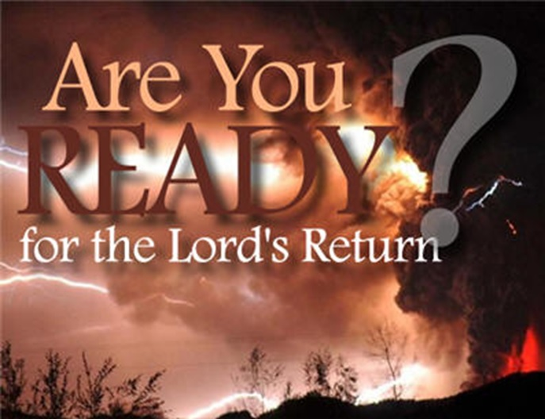
Are You Ready for the Lord’s Return?
1 Thessalonians 4:13-18
Dr. Rick Griffith • Crossroads International Church Singapore
CICFamily.com • BibleStudyDownloads.org

Slide 2
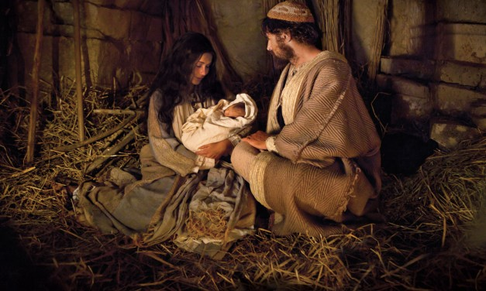
Christ's First Coming
Notes:
This past month over Christmas we have focused upon the first coming of our Savior in Bethlehem.

Slide 3
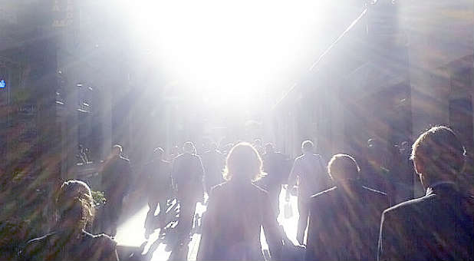
Are you ready for his return?
Notes:
But my title today is "Are You Ready For the Lord's Return?"

Slide 4
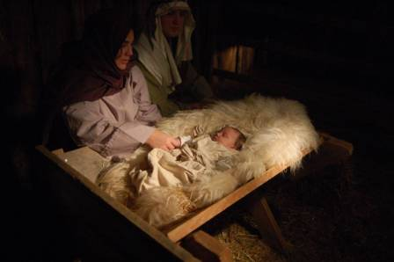
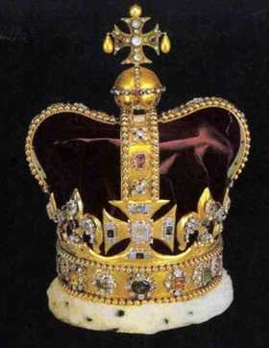
Christ's Two Comings
420
FIRST COMING | (CHURCH AGE) | SECOND COMING
Laid in a manger |  | Lands on a mountain
Came as a lamb |  | Comes as the Lord
Lowly and poor |  | Lavish and powerful
Died for His enemies |  | Death to His enemies
Tempted by Satan |  | Traps Satan in bottomless pit
Lived in a world of unrighteousness |  | Leads the world in righteousness
Died for sins and rose again |  | Directs and reigns
Ruth & Larry Moody; cited by Terry Hall, Bible Panorama, 117
Notes:
Today as we experience the new year I believe the Scripture has some words of encouragement for us in regard to Christ's second coming to earth at the Rapture.

Slide 5
Amillennialism
433
Second Coming
Millennium is Church Age:
Spiritual reign of Christ
Tribulations
Satan Bound
Eternal Kingdom
Judgment
Revelation 6–18
Revelation 20
19
21–22
Notes:
The Amil view does not view the book of Revelation in chronological order. It puts chapter 20 BEFORE chapter 19 as it sees the Rev 20 millennium as the present church age that is followed by Christ's return in Rev 19.

Slide 6
Postmillennialism
433
Second Coming
Millennium Gradually Comes as Golden Age
of the Gospel
Tribulations
Satan Bound
Church Age
Eternal Kingdom
Judgment
Revelation 6–18
20
19
21–22
Notes:
Like the Amil view, the Postmil view also does not view the book of Revelation in chronological order. It puts chapter 20 BEFORE chapter 19 as it sees the Rev 20 millennium as the present church age that is followed by Christ's return in Rev 19. However, it has even more difficulties as it sees the judgments of Rev 6-18 during a millennium that supposedly gets better and better, while these chapters show the world getting progressively worse.

Slide 7
Premillennialism
433
Rapture
Second Coming
Second
=
Advent
signs
Tribulation
Millennium
Church Age (no signs)
Eternal Kingdom
7 years
1000 years
Satan Bound
Saints Reign
Judgment
Judgment
Revelation 6–18
19
20
21–22
Notes:
In my thinking, the Premil view is the most logical and biblical as it sees the chapters as a straightforward chronology. It also does not see the binding of Satan as simply applying to nations but to all people who comprise these nations.

Slide 8

Eschatology
eschatos
+
ology
"last"
"study of"
= study of the last things (future)
Notes:
But first let's define three terms: eschatology, the Rapture, and the Revelation.

Slide 9
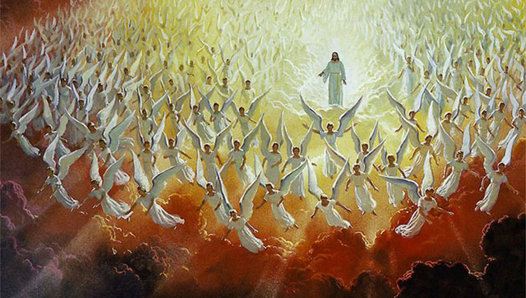
Two Stages of His Return
Notes:
Within that study an important doctrine is Christ’s Second Coming, but allow me to clarify what I mean by Christ's Second Coming. I am really using this as an umbrella term that encompasses two events separated by seven years: the Rapture that is followed by the Revelation.

Slide 10
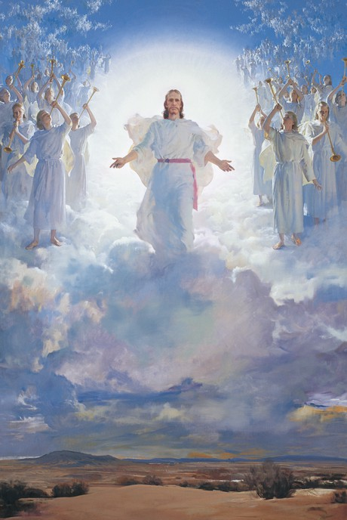
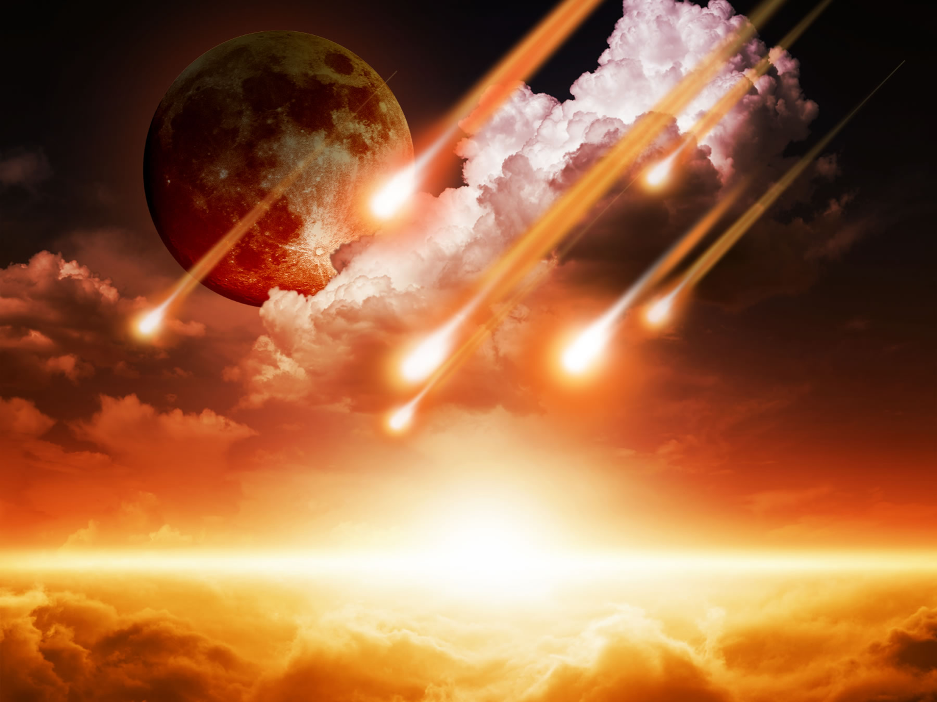
Two Stages of His Return
Literal
Christ
Future
"Coming"
Rapture
Revelation
Notes:
The Rapture (the coming of Christ for His own in the air to take the church from the earth prior to the Great Tribulation) differs from the Revelation (the coming of Christ with His own to judge unbelievers upon the earth after the Great Tribulation).
• Both events are literal returns. Never does the Scripture refer to these events as only allegorical returns for in both instances Christ actually will return to the earth.
• Both events find Christ as their central figure. Although humanity is involved in both, Christ Himself is at the forefront.
• Both events are still future. They are yet to be seen on God's prophetic calendar.
• Both events are sometimes referred to by the same word (e.g., "coming" refers to the Rapture in 1 Thessalonians 4:15 and the Revelation in Matthew 24:27).

Slide 11
Premilenialisme
208
433
208
433
Kedatangan Kedua
Advent
=
Kedua
Penganiayaan
Milenium
Masa Gereja
Kerajaan Kekal
7 tahun
1000 tahun
SELURUH 5 PANDANGAN PENGANGKATAN ADALAH PREMILLENNIAL
Penghakiman

Slide 12
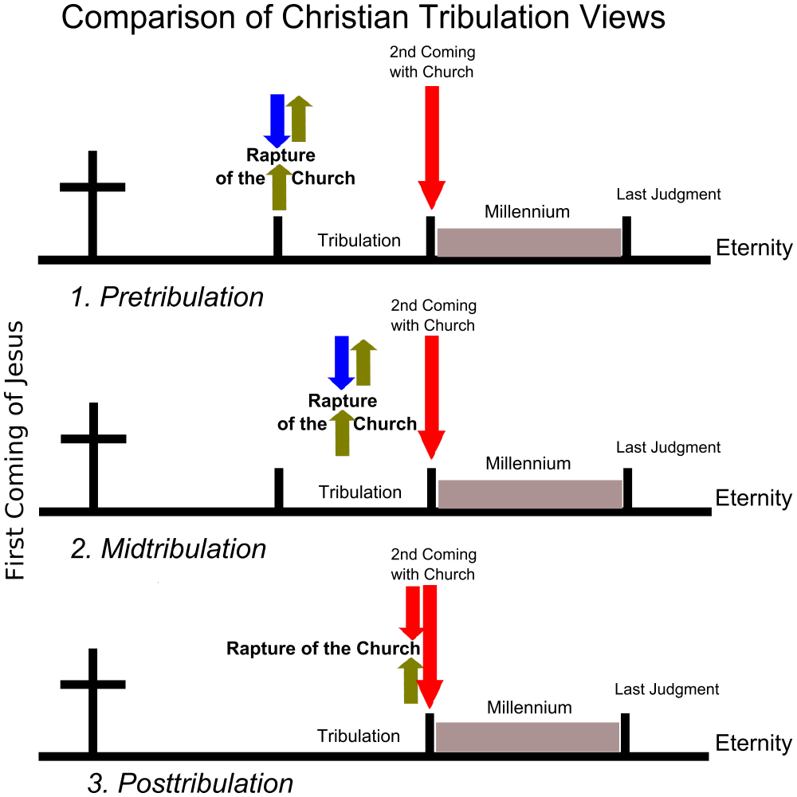
The Main Tribulation Views
Second Coming
with Church
Rapture of the Church
Millennium
Last Judgment
Tribulation
Eternity
1. Pretribulation
Second Coming
with Church
Rapture of the Church
First Coming of Jesus
Last Judgment
Millennium
Tribulation
Eternity
2. Midtribulation
Second Coming
with Church
Rapture of the Church
Millennium
Last Judgment
Tribulation
Eternity
3. Posttribulation

Slide 13
Pengangkatan “Pre-Trib”
208
Kedatangan Kedua
Pengangkatan
Tribulasi
Milenium
Zaman Gereja
Kerajaan Kekal
7 tahun
1000 tahun
Penghakiman

Slide 14
Tahap-tahap Kedatangan Kedua
210
 | Pengangkatan/Repture | Penyataan/
1 | Pre-tribulasi (Wah. 3:10) | Post-tribulasi (Wah. 19:11-21)
2 | Kristus akan datang di udara(1 Tes. 4:16) | Kristus akan datang ke bumi, kaki-Nya akan berpijak di Bukit Zaitun (Zak 14:4)
3 | Kedatangan untuk orang kudus (Yoh 14:1-2; 1 Tes. 4:15-17) | Kedatangan bersama orang kudus(Mat. 25:31; 1 Tes. 3:13; Wah. 19:14)
4 | Orang-orang Kudus (yg mati atau hidup) akan diangkat(“raptured”) dari bumi bertemu Tuhan di udara dan diangkat ke surga (1 Tes. 4:16-17) | Orang-orang Kudus yang sudah ada di bumi akan menetap di bumi(tidak ada pengangkatan) masuk ke dalam Kerajaan Seribu Tahun (Kis 15:16; Wah. 5:10; bd. Mat. 6:10; ps. 24)
5 | Menimbulkan kedamaian dan harapan (1 Tes. 4:18) | Menimbulkan ketakutan dan tuduhan (Mat. 24:27-31; Luk 21:20-28; Wah. 6:15-17)

Slide 15
Tahap-tahap Kedatangan Kedua
210
 | Pengangkatan/Rapture | Penyataan/Revelation
6 | Misteri kebenaran hanya dinyatakan dalam masa Perjanjian Baru (1 Kor. 15:51) | Pusat di dalam nubuat PL di buat jelas dalam PB (Yr. 30:7; Zak 14:1-3; Mat. 24:30; Kol. 3:4)
7 | Tubuh jemaat kudus dimuliakan(1 Kor. 15:51-58; Flp. 3:20-21) dan dibawah ke surga (1 Tess. 4:17) | Bodies of tribulation saints left in mortal state to continue to live on the earth in the millennium (Matt. 25:31-34)
8 | Iminen, tidak ada tanda (1 Thess. 4:16) | Tidak iminen tetapi didahului dengantanda-tanda spektakuler di langit dan di (Mat. 24:29-31; Luk 21:25-28; Kis 2:19-21; Wah. 1:7; ps. 6-19)
9 | Tujuan utama adalah membebaskan orang kudus dari dunia ini(1 Thes. 1:10) | Tujuan utama adalah menghakimi orang-orang yang tidak(Matt. 25:31-46)

Slide 16
Tahap-tahap Kedatangan Kedua
210
 | Pengangkatan/Rapture | Penyataan
10 | Tidak terlihat dan pribadi, hanya orang percaya yang dapat melihat Kristus dan Allah mengirim penyesatan yang luar biasa melalui Antikristus. (2 Tes. 2:11) | Tampak dan bersifat umum. “setiap mata akan melihat DIA” (Wah. 1:7)
11 | Pemenuhan janji kepada Gereja dimana tidak ada pembedaan Yahudi-Gentile (non-Yahudi) (1 Tes. 4:15; bd. Yoh 14:1-3; Ef. 2:11-16) | Pemenuhan janji dari Perjanjian Israel yang dibuat dalam Perjanjian Lama(Kej. 12:1-3; Mzm. 89; Yes. 11:11-14; bd. Rom. 11:26-27)
12 | Kejahatan meningkat(2 Tes. 2:1-12) | Kejahatan ditahan (2 Tes. 1:7; Mzm. 37:9-10)
13 | Gereja diangkat (1 Tes. 4:13-18) | Setan dilenyapkan (Rev. 20:1-3)

Slide 17
Tahap-tahap Kedatangan Kedua
210
 | Pengangkatan/Repture | Penyataan
14 | Kristus dipandang sebagai Kepala Gereja dan segala sesuatu (Ef. 1:10, 22; 4:15; Kol. 1:18; 2:10) | Kristus sebagai Mesias utk Israel (Za. 14:3-4; bd. Kis 1:6 dg v. 11)
15 | Penghakiman Tahta Kristus utk orang percaya (2 Kor. 5:10; 1 Kor. 3:13) | Penghakiman untuk Israel dan orang tidak percaya (Yeh. 20:34-38; Mat. 25; Za. 14:4; bd.hal. 160)
16 | Tuhan sudah dekat (Flp. 4:5) | Kerajaan Surga sudah dekat (Mat. 24:14)
17 | Nature subsequently ruined (Why. 6–16) | Nature subsequently restored (Rom. 8:19-22; Yes. 11:6-9; 35:9; 65:25)

Slide 18
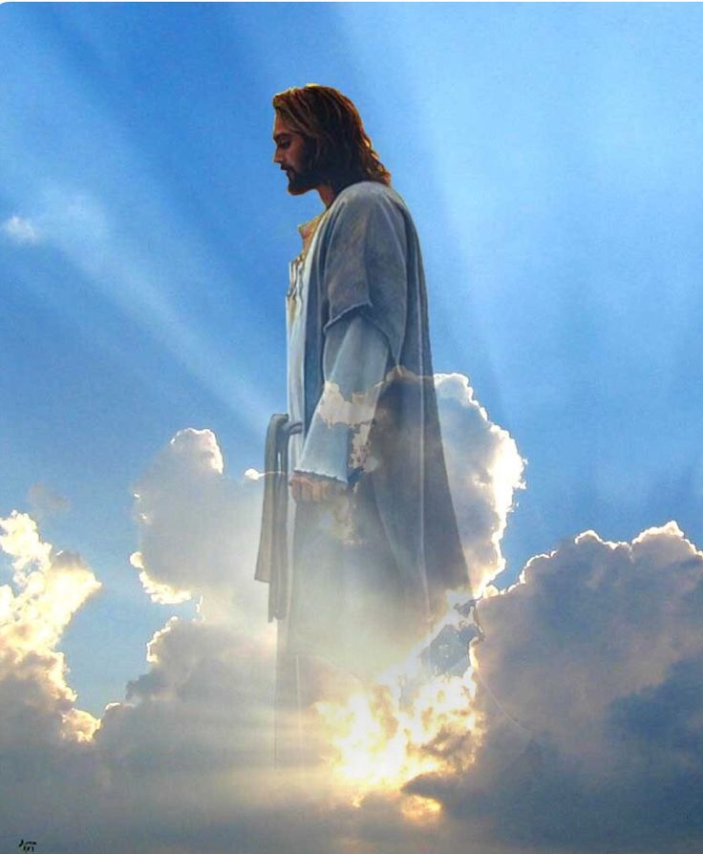
Pengangkatan
Notes:
Today we will focus on the first stage: The Rapture.

Slide 19
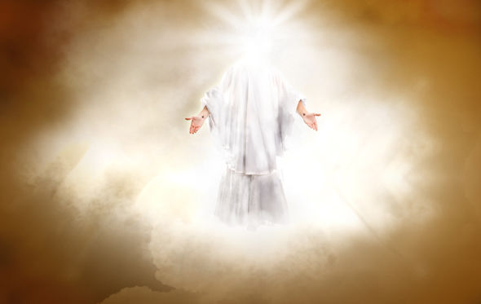
Why should we look forward to the Rapture with expectancy?
Notes:
So are you looking to Christ’s return at the Rapture?
What reasons can we give to anticipate Jesus coming back?

Slide 20
Two Stages of His Return
Rapture
Revelation
Notes:
My comments today will focus upon the first of these two events: the Rapture. We'll be looking at the key passage in all Scripture relating to this very important event in God's timetable of the ages. Believers at Thessalonica had died and those left were wondering when and if they would see them again.

Slide 21
Why should we look forward to the Rapture with expectancy?
1 Thessalonians 4:13-18
3 Reasons
Notes:
Paul gave them three reasons to have hope in the Lord’s return. So today we’ll see these three reasons to look forward to the Lord’s return at the Rapture.

Slide 22

I. The Rapture helps us grieve with hope
(1 Thess 4:13-14).
Notes:
Knowing the destiny of Christians at death helps us to control our grief.

Slide 23
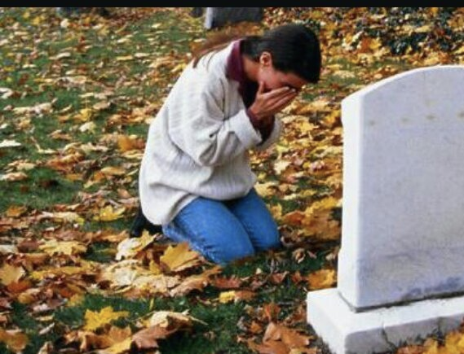
"And now, dear brothers and sisters, we want you to know what will happen to the believers who have died..."
(4:13a NLT).

Slide 24
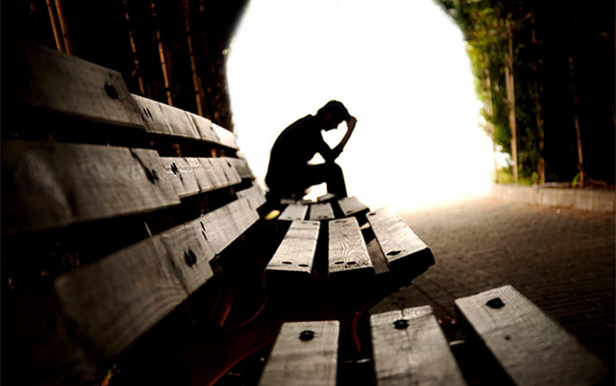
Know about the future destiny of believers who die (4:13a).
Notes:
Many people think that eschatology is unimportant.
This is seen in what some say about the time of the Rapture: I'm not pretrib, midtrib, or posttrib. I am pantrib, because it will all pan out in the end!

Slide 25
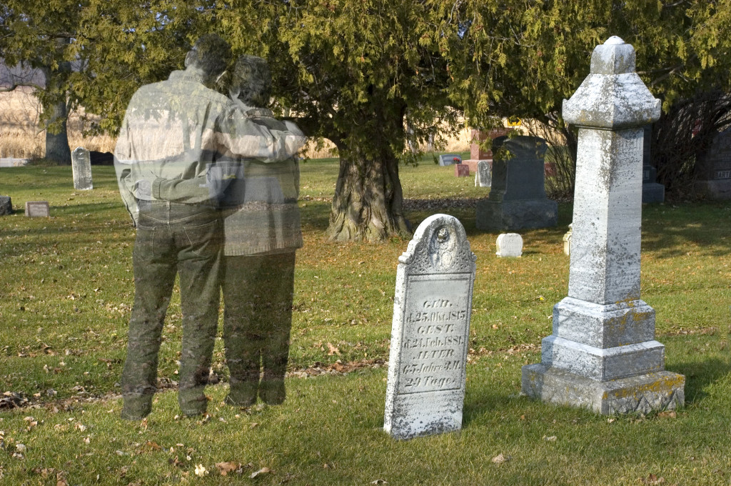
Grief is hard
Notes:
Text

Slide 26
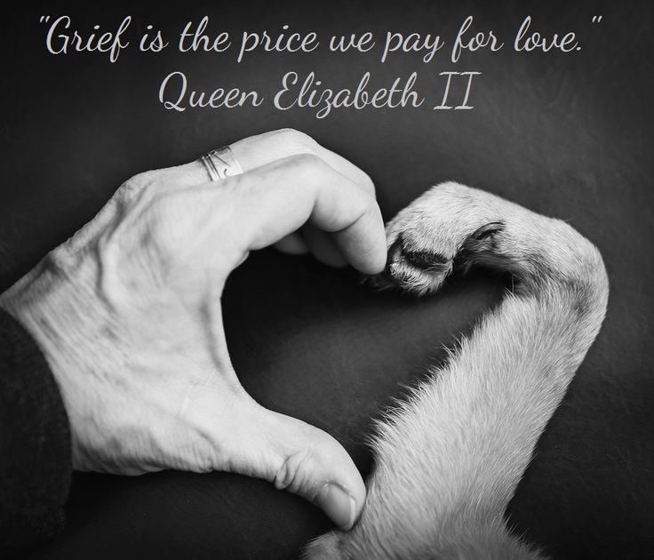
"Grief is the price we pay for love."
Queen Elizabeth II
Notes:
Why is it so important that we know about future things such as the destiny of believers? Paul saw eschatology as vital because it affects our hope. It's important because…

Slide 27

Being informed about believers who have died will prevent us from hopeless grief (4:13b).

Slide 28
"And now, dear brothers and sisters, we want you to know what will happen to the believers who have died so you will not grieve like people who have no hope"
(4:13 NLT).

Slide 29
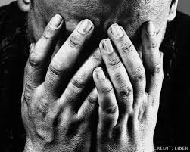
Should Christians grieve when a fellow believer dies?

Slide 30
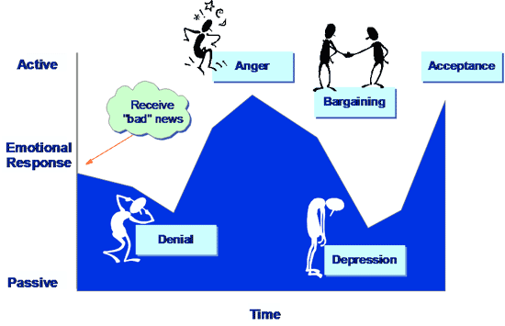
Five Stages of Grief
Active
Anger
Acceptance
Receive the "bad" news
Bargaining
Emotional Response
Denial
Depression
Passive
Time

Slide 31
"And now, dear brothers and sisters, we want you to know what will happen to the believers who have died so you will not grieve like people who have no hope"
(4:13 NLT).
Notes:
Notice what Paul is really saying in this verse.
He is not saying that Christians will not grieve.
He is only addressing the issue of how they should grieve. They should grieve in such a way that shows hope—like when Jesus grieved over Lazarus.

Slide 32

Pengangkatan
Notes:
Why did Paul say these things though? What problem was he addressing in the church?
Paul had already taught the believers about the Rapture when he was with them personally. He told them that when Christ comes all who have trusted Him will be removed from the earth.
Apparently the Thessalonians were confused regarding the destiny of believers who have died before the Rapture.
—Perhaps some thought these would miss the Rapture and have to wait until the Great White Throne Judgment.
—Perhaps some wondered whether they would be saved at all.

Slide 33
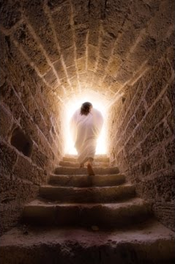
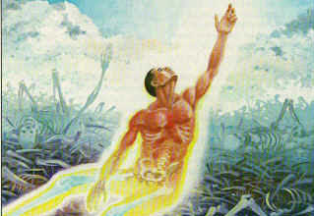
Christ's resurrection guarantees the believer's resurrection (4:14).

Slide 34
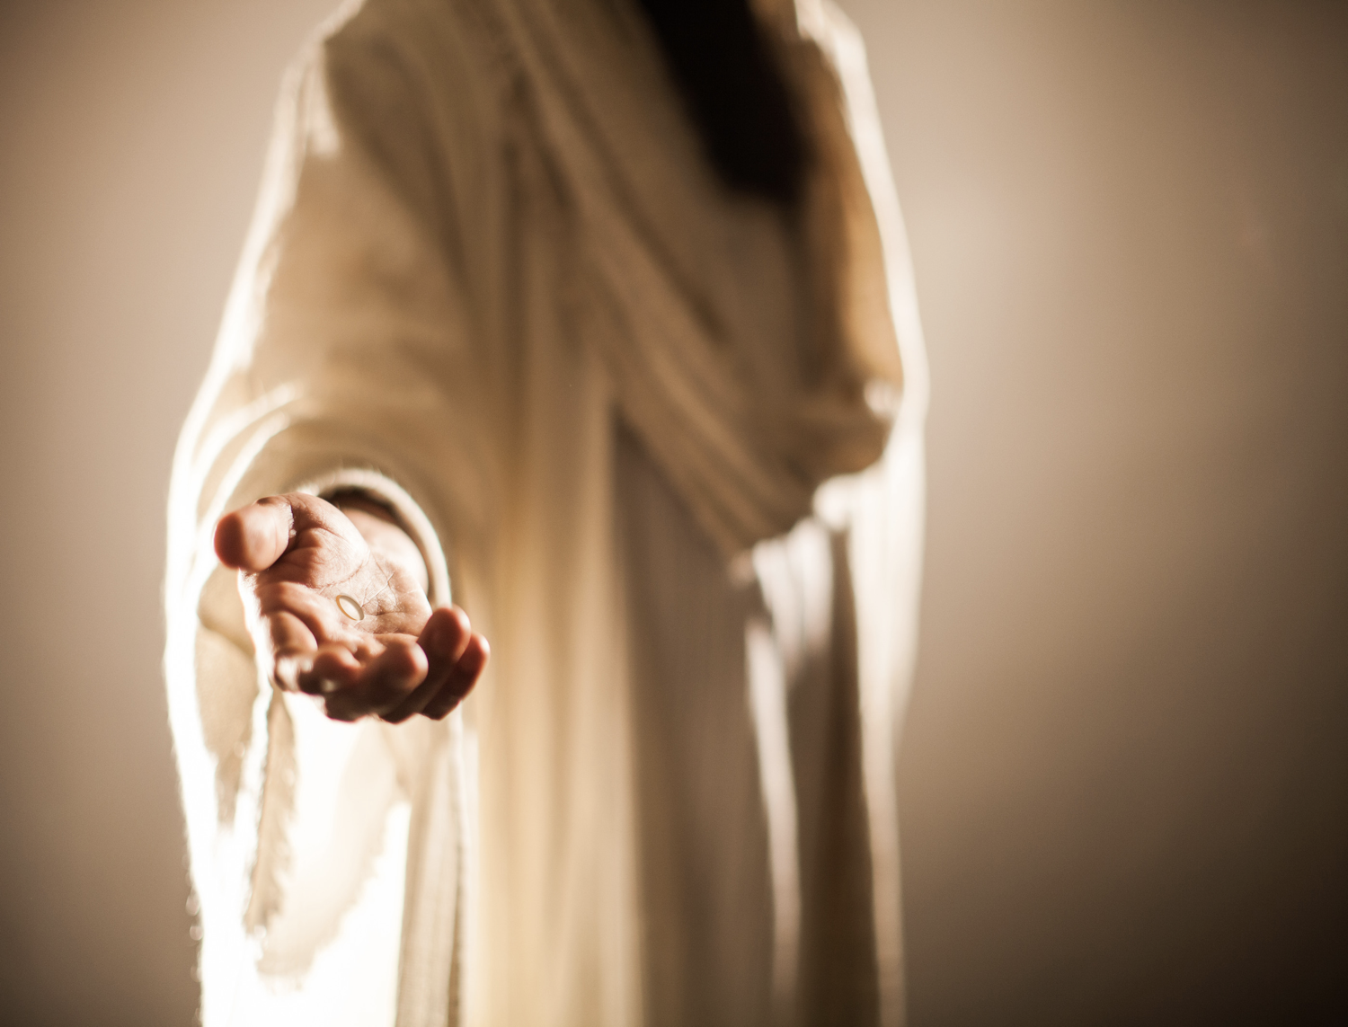
"For since we believe that Jesus died and was raised to life again, we also believe that when Jesus returns, God will bring back with him the believers who have died" (4:14 NLT).
Notes:
The "if" here (in the NASB & KJV) is better translated "since" (as in the NIV & NLT) because of the Greek construction.
1) Therefore, it really means "since we believe that Christ died…"
2) Paul had no doubt regarding the validity of the resurrection.

Slide 35
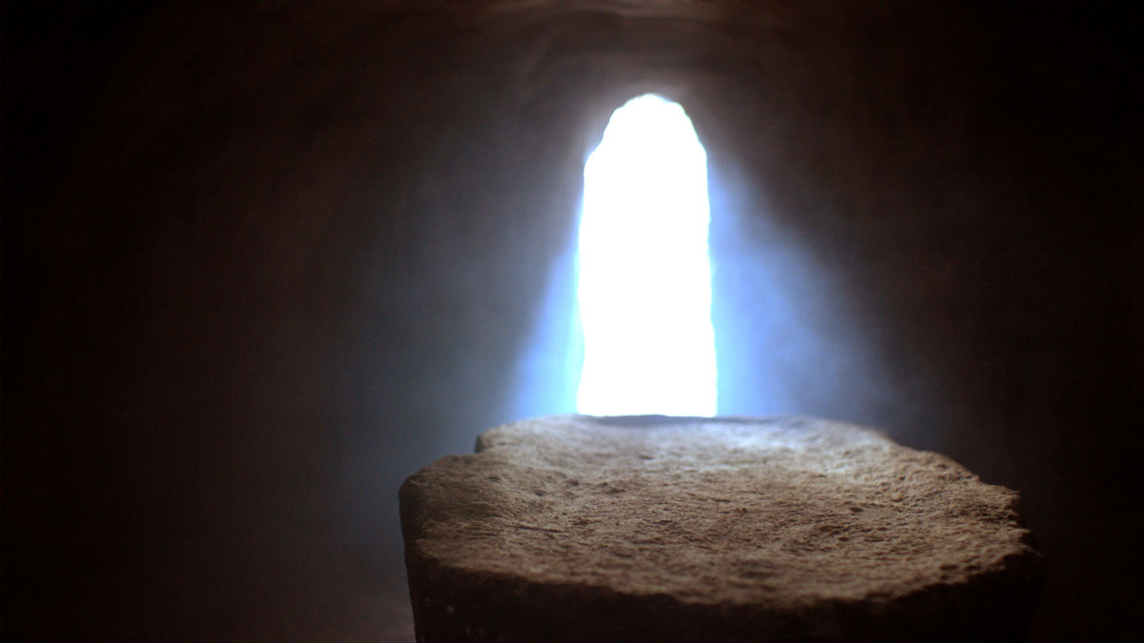
The Implictions
Notes:
This historical basis provides assurance that the bodies of all Christians also will be raised (4:14b).
Paul declared that both Christ's resurrection and our resurrection stand or fall together.
This is taught in 1 Corinthians 15:12-20.

Slide 36
I. The Rapture helps us grieve with hope
(1 Thess 4:13-14).
Notes:
So Paul has told us that when we undergo affliction to the point of death we shouldn't grieve hopelessly because all believers will be resurrected. But how will this come about when Christ comes to receive His church? Who will be the first to be bodily with the Lord—those who have died or those of us who are living? This leads us into the second reason to expect his return…

Slide 37
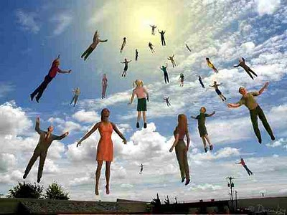
II. Christians who have died will meet Christ in the air before those living (4:15-17).
Notes:
We who are alive when the Rapture comes will be taken up only after the dead in Christ.
Now the living moving faster than the dead—but then the dead will move faster than the living!

Slide 38
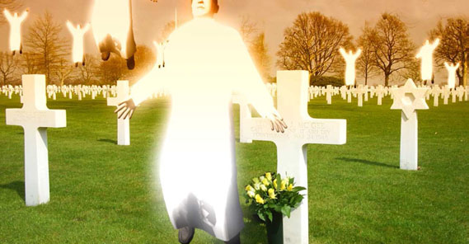
"We tell you this directly from the Lord: We who are still living when the Lord returns will not meet him ahead of those who have died"
(1 Thess 4:15 NLT).
Notes:
1. Notice how the verse expresses that this great truth wasn't something that Paul made up. It was Christ's own promise.
Perhaps this was an unrecorded statement of Christ (cf. Acts 20:35).
Maybe Paul received this word by direct revelation.
In either case, there was no need to worry since the dead will have a prominent place in the Rapture because they will rise even before the living.
2. Notice that Paul included himself among the living group and evidently expected to be living when Christ returned.
Here we see more evidence for a pre-tribulation Rapture.
According to Paul, the next event on God's timetable was the return of Christ since it could happen at any moment.

Slide 39
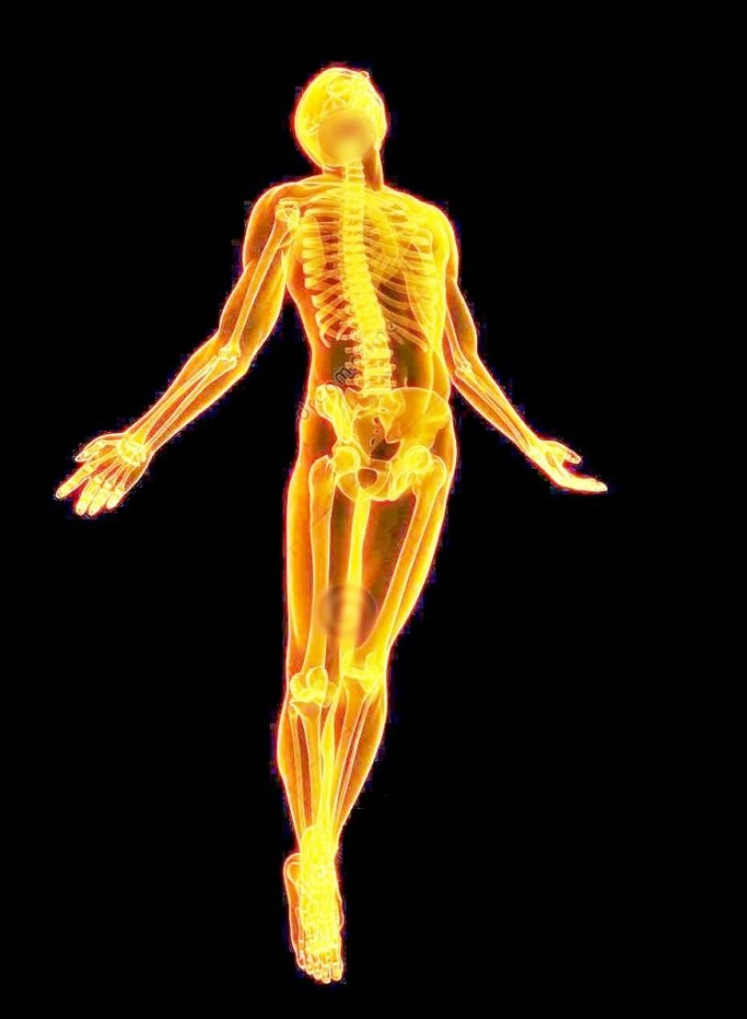
Some future day
4 amazing events will happen without a moment's notice (4:16-17)
Notes:
These four events will happen in the following order, each event beginning with the letter "R" (cf. Ryrie)…

Slide 40
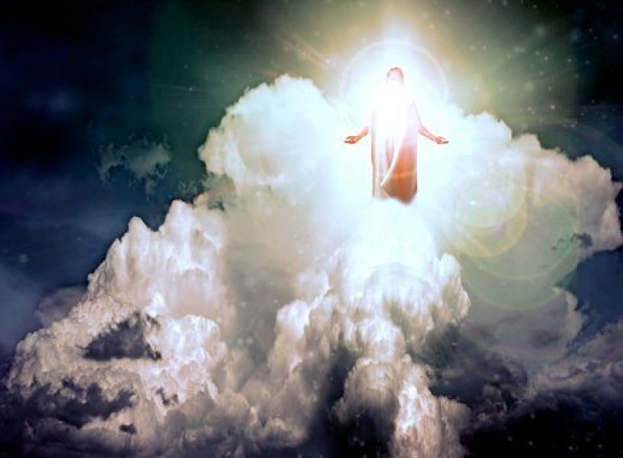
Return
"For the Lord himself will come down from heaven with a commanding shout, with the voice of the archangel, and with the trumpet call of God"
(1 Thess 4:16a NLT).
Notes:
Where is Christ right now? In heaven seated at the right side of the Father.
Christ Himself (not an angel) will return for the church.
His return will be accompanied by three things:

Slide 41
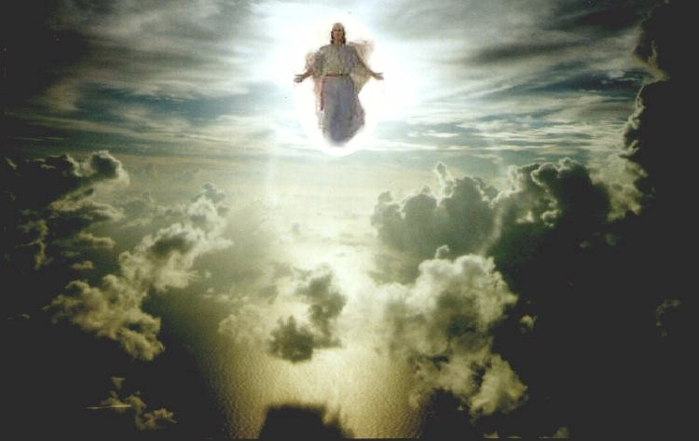
Christ's Commanding Shout
Notes:
Is this from Christ or an angel or Michael the archangel? The text isn't clear, but I like to think that it's from Christ.
The word for "loud command" or "shout" is "used of the cry of the charioteer to his horses or the hunter to his hounds; it is the shout of the ship's master to the rowers, or of the commander to his soldiers" (Morris).
What is the command? "Rise!" "Come forth!" "It's time!" ????
The word carries with it a ring of authority and urgency.

Slide 42
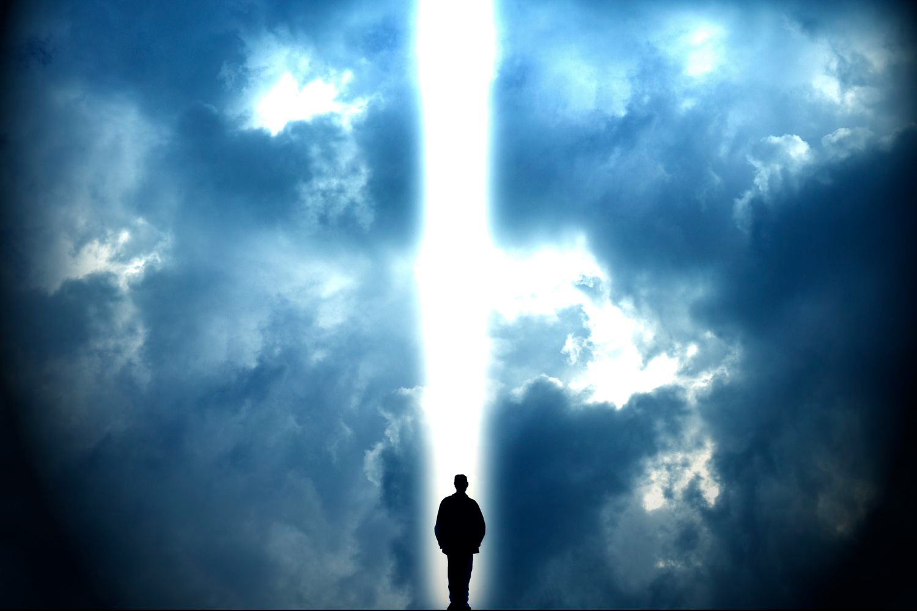
Voice of the Archangel
Notes:
The Jews listed seven chief angels, but which one is the archangel?
The identity of this angel is somewhat unclear since Michael is the only angel in Scripture specifically referred to as an archangel, but here the word appears without a definite article.
"Voice" also lacks the word "the" in the Greek.
However, a definite article is not necessary to be definite so this is probably Michael.

Slide 43
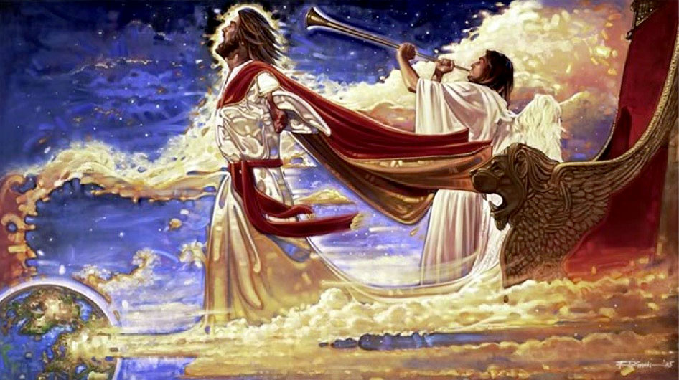
The Trumpet Call of God
Notes:
Trumpets are associated with God's activity in the Bible:
-Ex 19:16 has a trumpet at Mt. Sinai
-Isa 27:13 uses the trumpet to signal the return to the land from Assyria
-Joel 2:1 mentions the trumpet sounding in judgment
-Matt 24:31 has a trumpet sound when Christ returns after the Tribulation
Through the use of the trumpet God calls attention to this event as a majestic, dramatic, spectacular one worthy of Christ who is King of kings and Lord of lords.

Slide 44
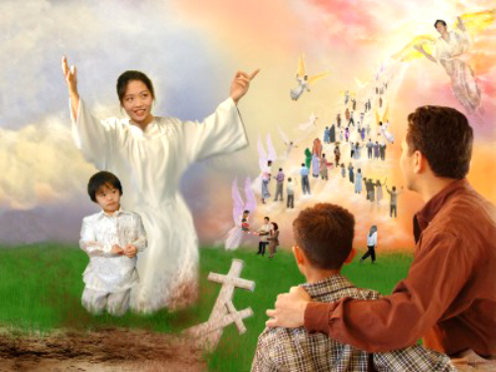
Resurrection
"First, the Christians who have died will rise from their graves"
(1 Thess 4:16b NLT).
Notes:
Christians who have died during the church age will rise first.
The designation "in Christ" refers only to those who have died since Christ's death and resurrection in the Church Age.
So those who have died as Christians will be rejoined with their spirits which have already been with Christ.

Slide 45

“The dead in Christ will rise first”
(1 Thess. 4:16b)
Notes:
But what happens to the bodies of these who have died? Are they changed? (RAPTURE transformation of the body= farmer's wife in elevator).
For sure! Read 1 Corinthians 15:50-55.
Exactly how these bodies are reassembled and resurrected is not stated.

Slide 46

Rapture
"Then, together with them, we who are still alive and remain on the earth will be caught up in the clouds to meet the Lord in the air"
(1 Thess 4:17a NLT).
"caught up"—not "disappear"

Slide 47
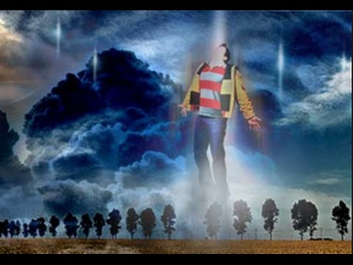
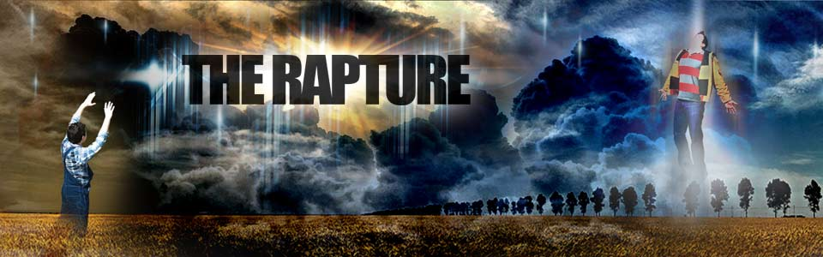
THE RAPTURE
From rapturo, "to catch up" (Latin)
Notes:
Text

Slide 48


Slide 49
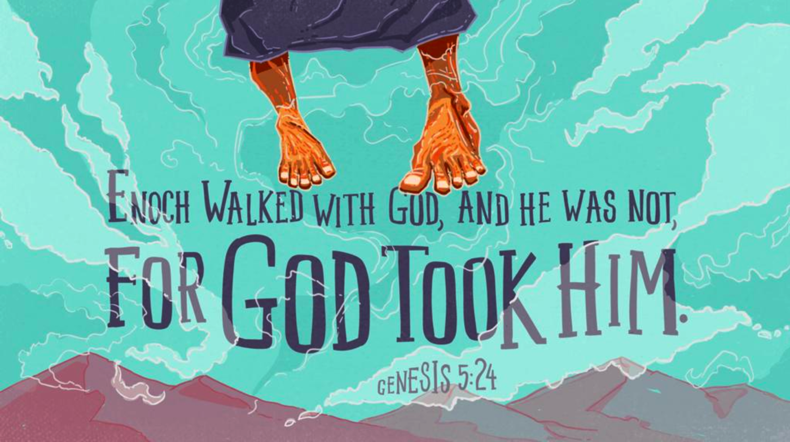
Enoch
Notes:
Text

Slide 50
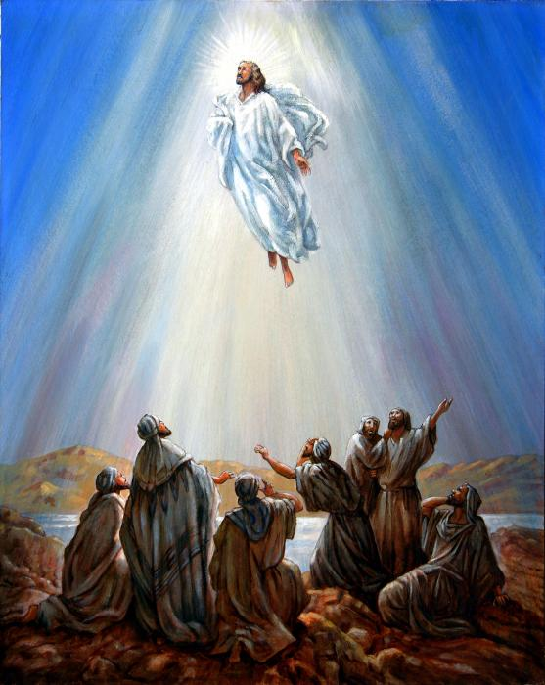
Christ Ascended
Notes:
Text

Slide 51
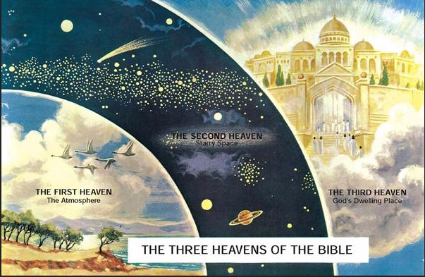
"I was caught up to the third heaven"
(2 Cor 12:2 NLT)
  THE SECOND HEAVEN
  Starry Space
  THE FIRST HEAVEN
  The Atmosphere
  THE THIRD HEAVEN
  God's Dwelling Place
  THE THREE HEAVENS OF THE BIBLE
Notes:
Paul already had a private "Rapture" to the “third heaven” in 2 Corinthians 12:2, 4

Slide 52
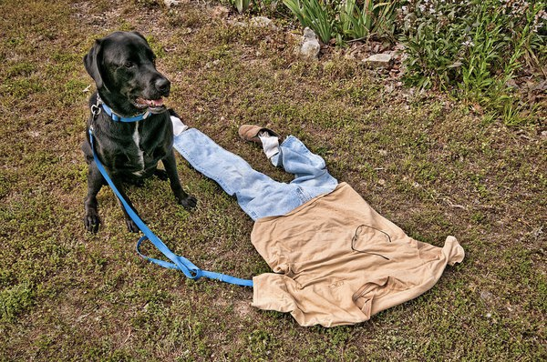
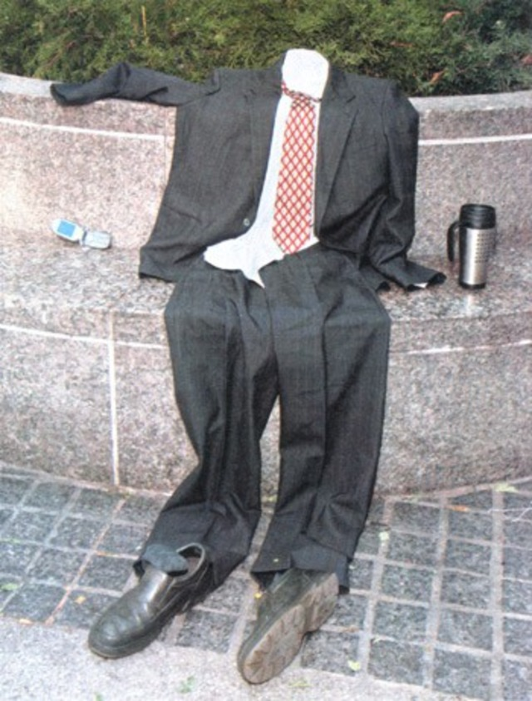
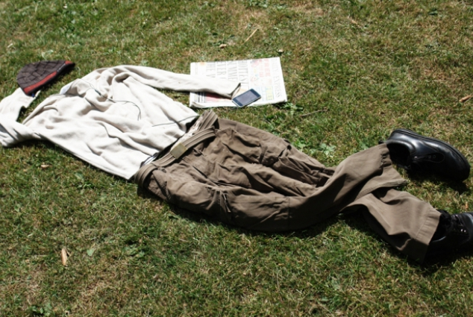
Rapture Chaos
Notes:
Text

Slide 53
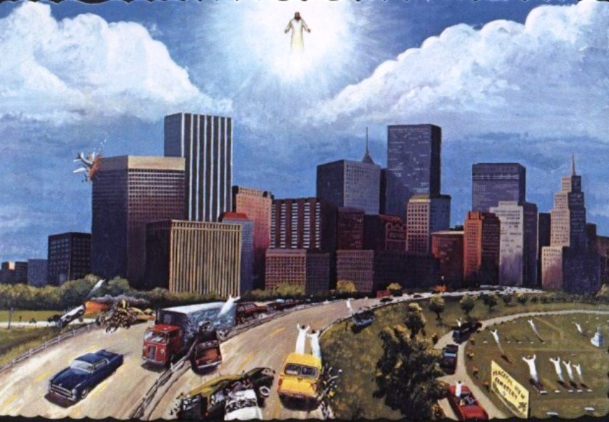
Rapture Chaos
Notes:
Text

Slide 54
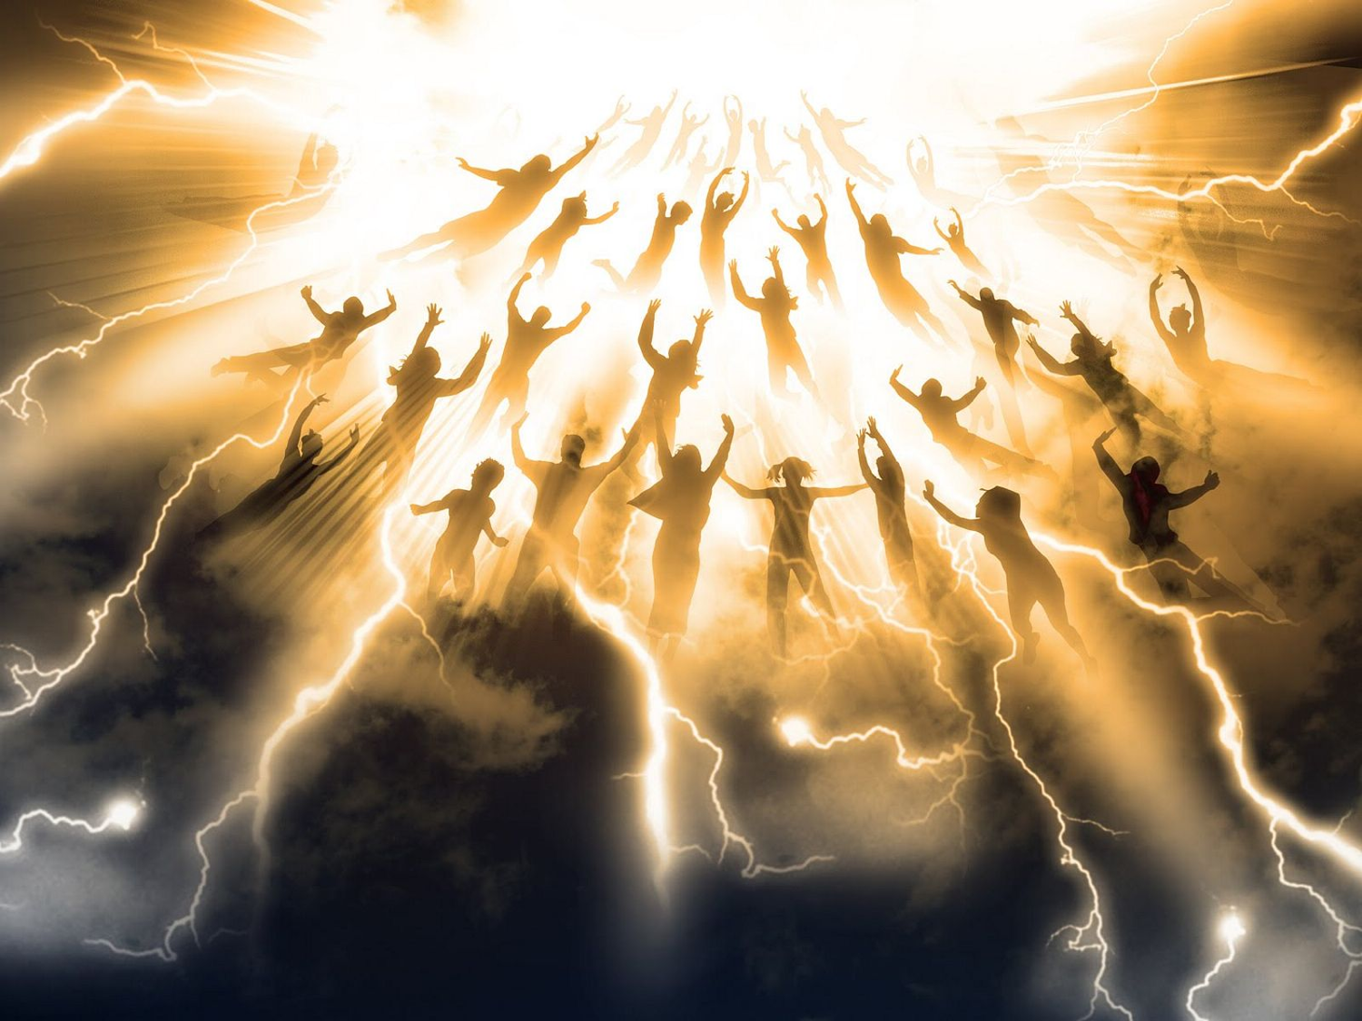
The Translation

Slide 55
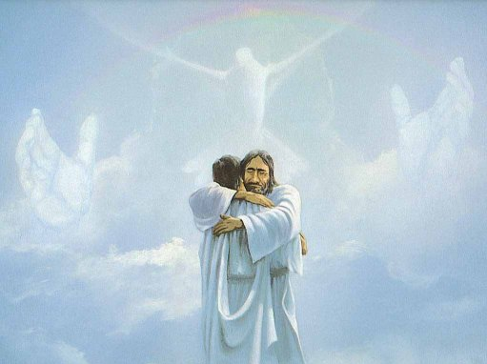
Reunion
"Then we will be with the Lord forever"
(1 Thess 4:17b NLT).

Slide 56

We will join him in the clouds

Slide 57
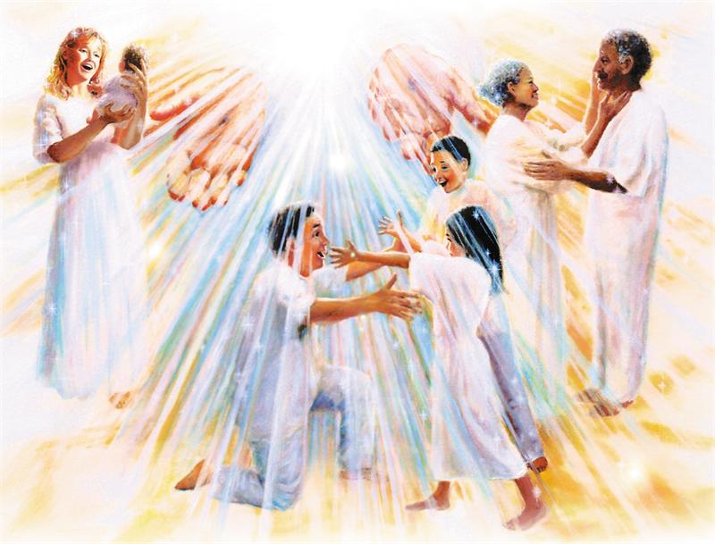
III. Christ’s return helps us encourage one another (4:18).
Notes:
The word for "comfort" (or "encourage") here literally means to "come alongside to help (Read Charles Swindoll, Contagious Christianity, 46-47).
We're also guaranteed escape from the coming wrath of the Tribulation, which is something to be encouraged about! (A post-tribulation rapture would be no comfort to anyone!)

Slide 58
Why should we look forward to the Rapture with expectancy?
Notes:
So are you looking to Christ’s return at the Rapture?
What reasons can we give to anticipate Jesus coming back?

Slide 59
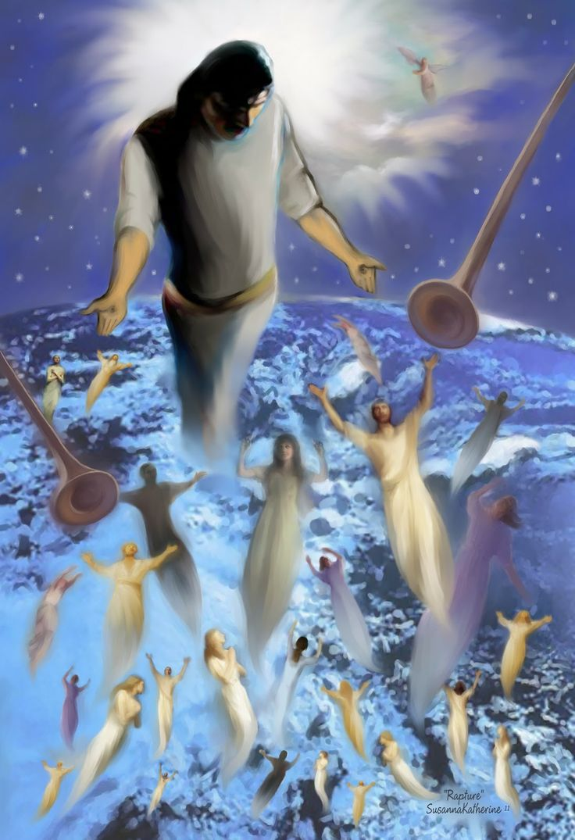
Main Idea
The Rapture gives hope and encouragement that he will come for you.
Notes:
Restatement

Slide 60

"I've got time..."
Notes:
Restatement

Slide 61
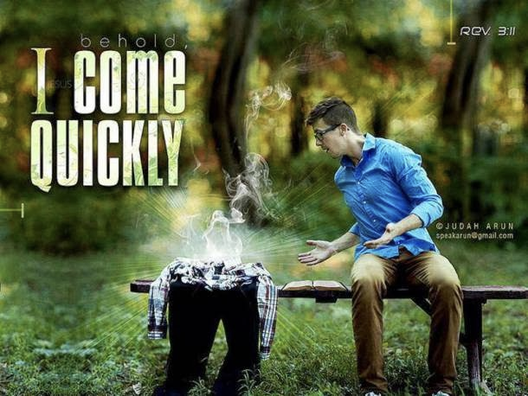
Behold,
I COME QUICKLY
Rev 3:11
Notes:
Text

Slide 62

1 Thessalonians 5:2
"like a thief in the night"

Slide 63
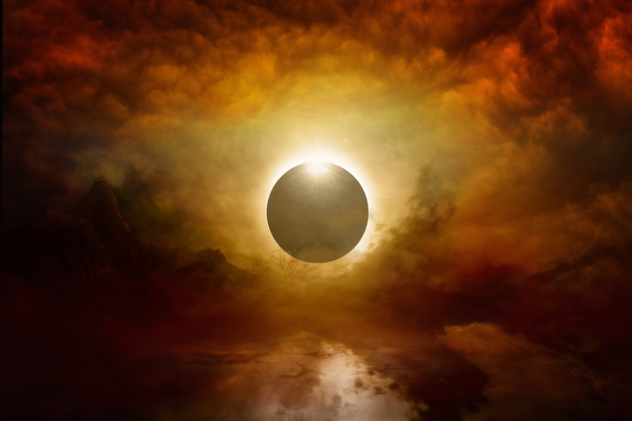
How to live?
Charles R. Swindoll, Contagious Christiantiy, 47
Notes:
Text

Slide 64
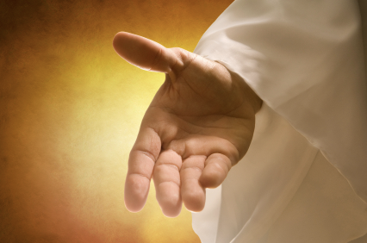
Make sure that you have received the salvation God freely offers you (Titus 2:11 NLT).
"For the grace of God has been revealed, bringing salvation to all people."
Charles R. Swindoll, Contagious Christiantiy, 47

Slide 65
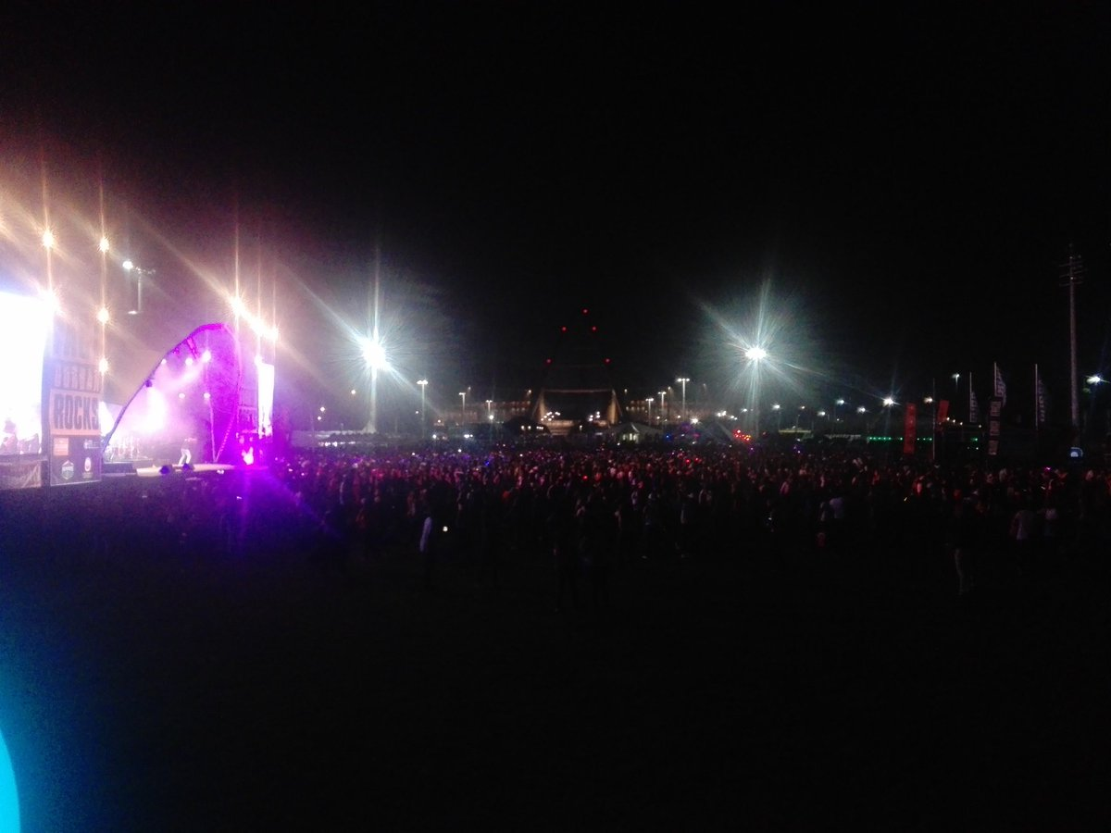
Continue to resist a corrupt lifestyle (Titus 2:12a NLT).
"And we are instructed to turn from godless living and sinful pleasures."
Charles R. Swindoll, Contagious Christiantiy, 47

Slide 66
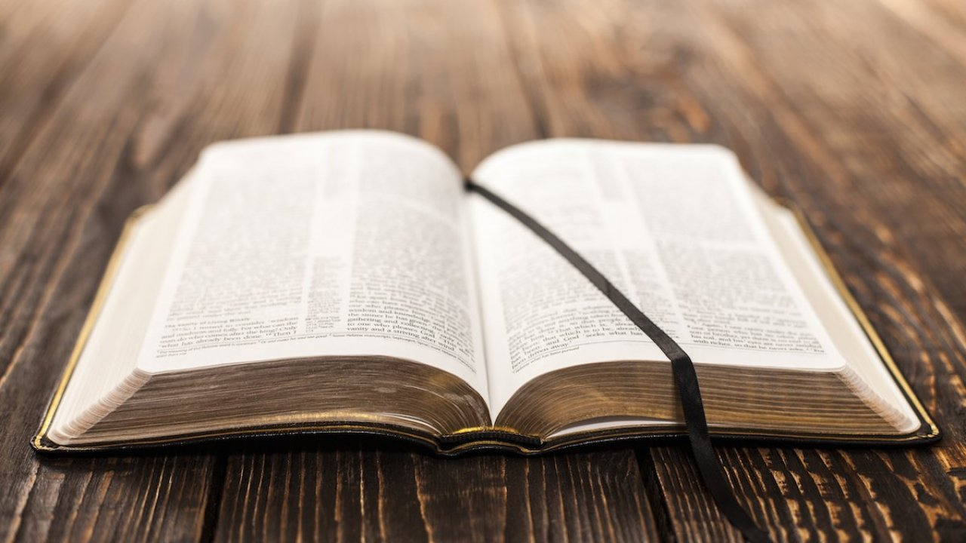
Live in a sensible, godly manner (Titus 2:12b-13 NLT).
"We should live in this evil world with wisdom, righteousness, and devotion to God, ¹³while we look forward with hope to that wonderful day when the glory of our great God and Savior, Jesus Christ, will be revealed."
Charles R. Swindoll, Contagious Christiantiy, 47

Slide 67
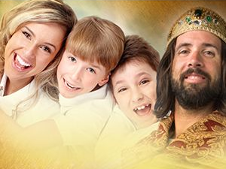
The faithful will reign with Christ
Notes:
Text

Slide 68
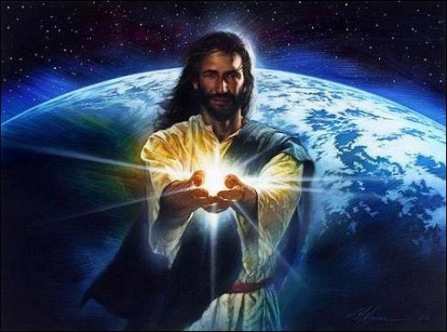
Black

Slide 69
Black

Slide 70


Link Eskatologi di BibleStudyDownloads.org
Dapatkan slide ini tanpa biaya
Notes:
New Testament Survey PPT in Bahasa Indonesia

