Slide 1
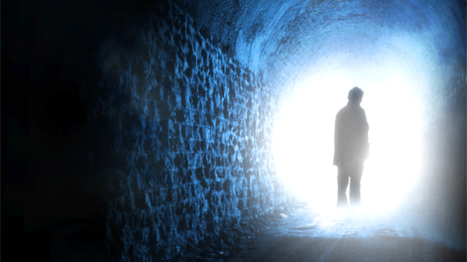
Kematian & Keadaan Peralihan
Eskatologi
Dr. Rick Griffith • Singapore Bible College • BibleStudyDownloads.org

Slide 2
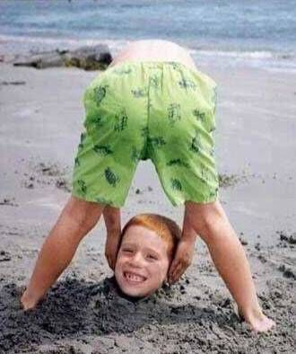
Many ignore prophecy today and put their head in the sand.

Slide 3
Why Study the Afterlife?
11

Slide 4
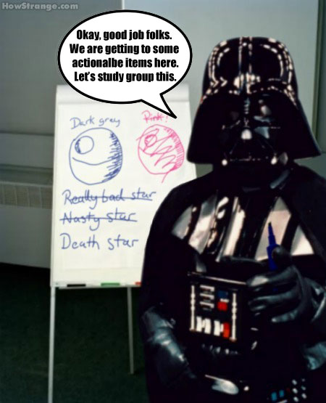
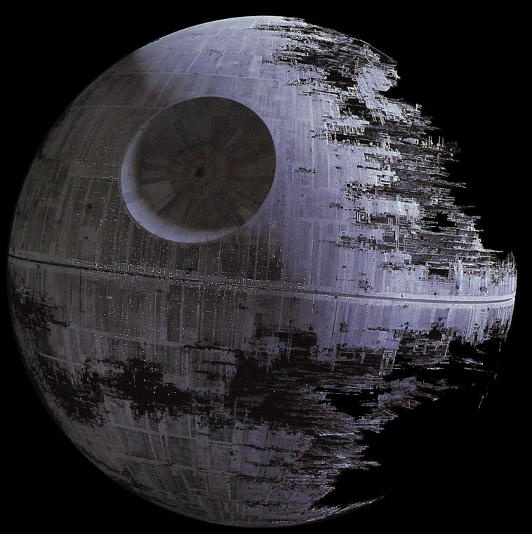
Death Star
OK, good job, folks. We are getting to some actionable items here. Let's study group this.
Notes:
Death is talked about in a flippant way today…

Slide 5
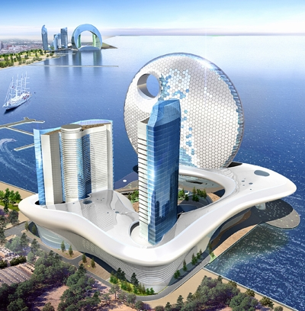
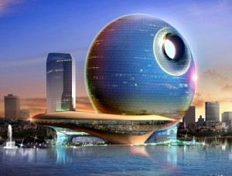
A New Hotel in Baku, Azerbaijan
The Death Star Hotel
Notes:
~Queue the evil music~ Now that's weird. Beautiful, but weird. Here are the proposed specs: 521-feet-high, 104,182 square meters, 382 rooms and over 35 floors. I'm sure the new construction will offer first-class amenities! Who's on board for a trip to Baku?! From http://www.4hotels.us/death-star-hotel/

Slide 6
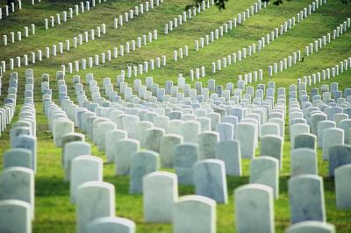
Death
For Your Small Group:
Most people don't like to think or talk about death. Why not?

Slide 7
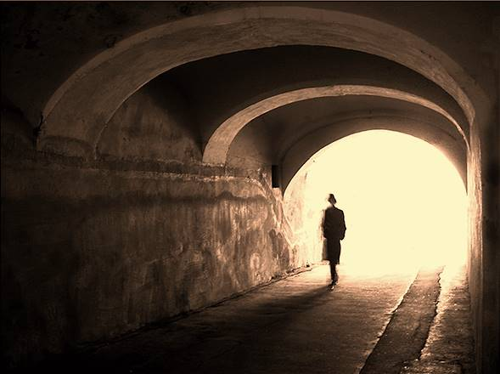
Death is Real
Everyone dies eventually (by old age, accident, war, murder, natural disaster, famine, etc.)
No one can avoid one's own death
"…man is destined to die once, and after that to face judgment" (Hebrews 9:27)

Slide 8
Types of Death
12
Three Types of Death:
Physical Death: Separation of the soul from the body (Gen. 35:18-19; Eccl. 12:7; James 2:26)
Spiritual Death: Separation of the person from God (Eph. 2:1-2)
Second Death (Eternal Death) Separation from the presence of God in an endless period of punishment (Rev. 20:14; 21:8)

Slide 9
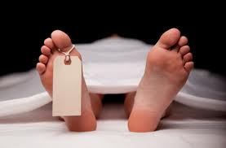
Physical Death
Natural or Unnatural?
"Though death is both real and inevitable, it is unnatural. When God created the heavens and the earth, death was not part of it. And that is why, eventually, death will be finally conquered (1 Cor. 15:26)."
Paul Benware, Understanding End Times Prophecy, 346

Slide 10
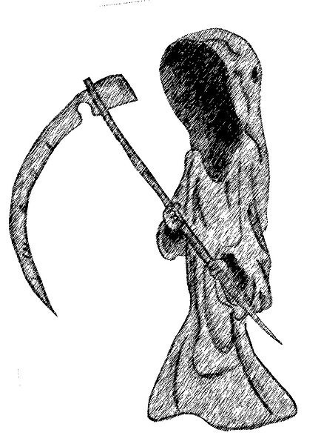
Physical Death
Natural or Unnatural?
"Physical death was not an original part of the human condition. It is something foreign and hostile. Paul pictures it as an enemy
(1 Cor. 15:26)"
Erickson, Christian Theology, 1177

Slide 11
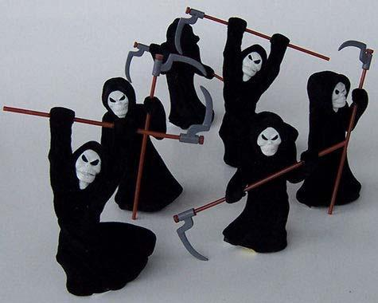
Physical Death
Natural or Unnatural?
"We must still remember that death is not natural, it is not right; and in a world created by God it is something that ought not to be. It is an enemy, something that Christ will finally destroy (1 Cor. 15:26)"
Grudem, Systematic Theology, 812

Slide 12
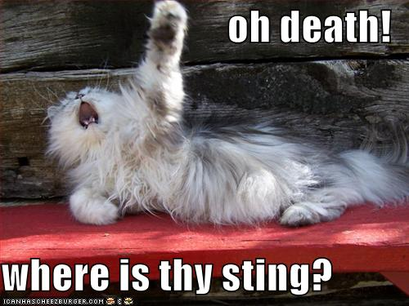
Death
Oh death!
Death is not natural because it is the penalty for sin and needs to be destroyed.
"For the wages of sin is death, but the gift of God is eternal life in Christ Jesus our Lord"
(Rom. 6:23)
"The last enemy to be destroyed is death"
(1 Cor. 15:26)
Where is thy sting?

Slide 13
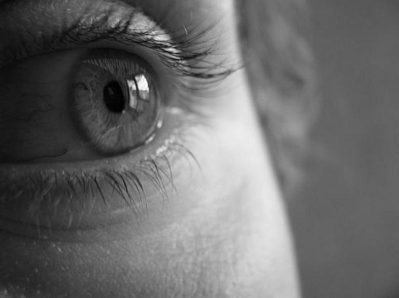
Reponses to Death
12
Death to the Unsaved = Fear:
Death is a curse, penalty, & enemy.
They will experience physical, spiritual, and eternal death for not believing in Christ as their Savior.
Therefore, the penalty for sin is upon them in these three areas of death (Rom. 6:23).

Slide 14
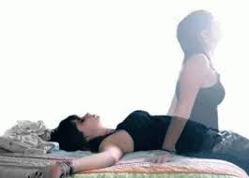
Reponses to Death
13
Death of the Believer
The believer still dies physically, but its curse is gone because Christ himself become a curse for us by dying on the cross (Gal. 3:13).
While believers still die physically, they do not experience spiritual and eternal death.

Slide 15
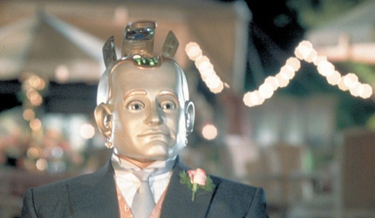
Bicentennial Man (1998)
Notes:
This movie exalts death. The robot who "lives" 200 years is finally granted the "privilege" to legally die in the end, which is deemed to make him human. What a twisted theology!

Slide 16
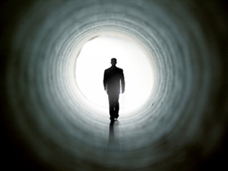
Reponses to Death
13
How should we think of our own death?
We do not fear our own death because when we die, our spirit will be with the Lord (2 Cor. 5:8).
Scripture also assures us that death cannot separate us from the love of God in Jesus Christ (Rom. 8:38-39).

Slide 17
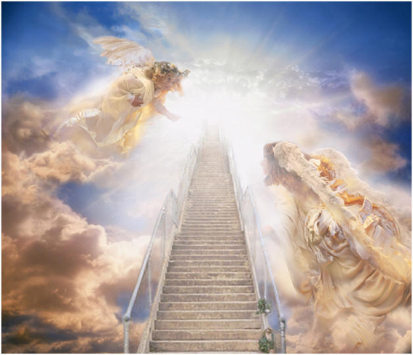
Reponses to Death
13
How should we think of the death of Christian friends and relatives?
We may mourn for them in sorrow.
However, at the same time we have hope and joy because they will be with the Lord (2 Cor. 5:8) and they will live with the Lord (1 Thess. 5:10).

Slide 18
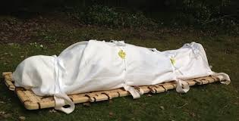
Reponses to Death
How should we think of the death of unbelievers?
Our sorrow will be very deep because they will go through spiritual and eternal death forever.

Slide 19
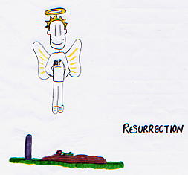
Summary
For Believers…
Our penalty for sin was paid by Jesus Christ.
We should not fear death though we will die someday.
We will be with our Lord Jesus when we die.
Death is but an entrance into a better mode of life.
Death is…
unnatural
not God's intention
penalty for sin
not extinction

Slide 20
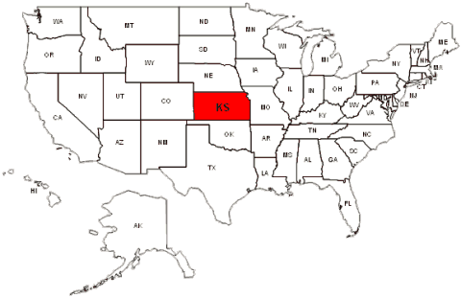
The Intermediate State
13

Slide 21
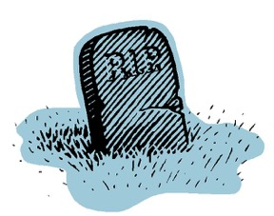
The Intermediate State
13
What does it mean?
The intermediate state debate is not about the body since it "suffers dissolution into its component chemical elements… As a result the body goes back to the dust from whence it came, until the resurrection (Gen. 2:7; 3:19; Eccles. 3:20)" (Hoyt, 34)
It's about the soul and spirit!

Slide 22
The Intermediate State
13
Spirit of the Person
Death of the Body
Resurrection of the Body
"The condition of humans between their death and the resurrection" – Millard Erickson

Slide 23
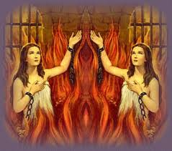
The Intermediate State
The early Catholic church held that the intermediate state had four distinct areas:
Hades: the realm of the dead with a separate place for the evil and righteous.
Purgatory. Those who would enter heaven could be cleansed ("purged") of their remaining sins through suffering.
Notes:
Here are some views of the intermediate state as held by the early Christian Church.
Which is essentially the Roman Catholic Theory of Purgatory.

Slide 24
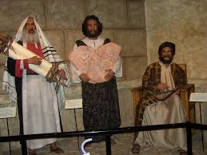
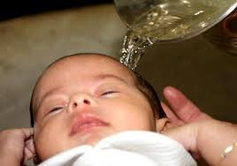
The Intermediate State
Limbus Patrum: OT saints who waited for Christ's death and resurrection to take them to heaven
Limbus Infantum: Souls of all infants who died without being baptized
Notes:
Here are some views of the intermediate state as held by the early Christian Church.
Which is essentially the Roman Catholic Theory of Purgatory.

Slide 25
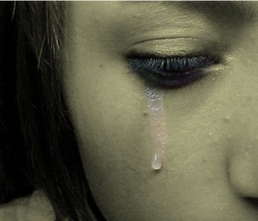
The Intermediate State
13
The Importance of this Doctrine
We must have practical answers for bereaved people on this question
Notes:
Here are some views of the intermediate state as held by the early Christian Church.
Which is essentially the Roman Catholic Theory of Purgatory.

Slide 26
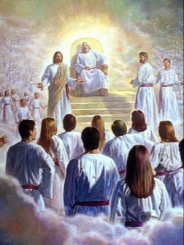
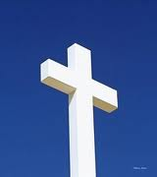
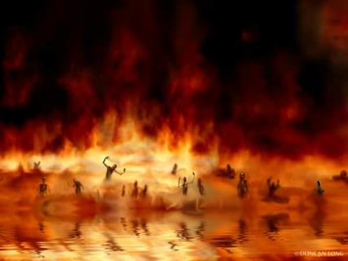
Pemindahan Surga
“Itulah sebabnya kata nas: "Tatkala Ia naik ke tempat tinggi, Ia membawa tawanan-tawanan; Ia memberikan pemberian-pemberian kepada manusia.“ 9 Bukankah "Ia telah naik" berarti, bahwa Ia juga telah turun ke bagian bumi yang paling bawah? 10 Ia yang telah turun, Ia juga yang telah naik jauh lebih tinggi dari pada semua langit, untuk memenuhkan segala sesuatu.”
14 & 16
NLT
HEAVEN
Ef. 4:8-10
“..hari ini juga engkau akan ada bersama-sama dengan Aku di dalam Firdaus.”
“orang itu tiba-tiba diangkat ke tingkat yang ketiga dari sorga.”
Luk. 23:43
2 Kor. 12:2-4
S H E O L
“Sebab juga Kristus telah mati sekali untuk segala dosa kita, Ia yang benar untuk orang-orang yang tidak benar, supaya Ia membawa kita kepada Allah; Ia, yang telah dibunuh dalam keadaan-Nya sebagai manusia, tetapi yang telah dibangkitkan menurut Roh, 19 dan di dalam Roh itu juga Ia pergi memberitakan Injil kepada roh-roh yang di dalam penjara, 20 yaitu kepada roh-roh mereka yang dahulu pada waktu Nuh tidak taat kepada Allah, ketika Allah tetap menanti dengan sabar waktu Nuh sedang mempersiapkan bahteranya, di mana hanya sedikit, yaitu delapan orang, yang diselamatkan oleh air bah itu.”
Surga
HADES
1 Pet. 3:18-20
HADES
Why. 20:14-15
Luk. 16:26
Hell
Gehenna
Lautan api
Lautan belerang yang terbakar
Kematian Kedua
“…di antara kami dan engkau terbentang jurang yang tak terseberangi, supaya mereka yang mau pergi dari sini kepadamu ataupun mereka yang mau datang dari situ kepada kami tidak dapat menyeberang.”
"Lalu maut dan kerajaan maut itu dilemparkanlah ke dalam lautan api. Itulah kematian yang kedua: lautan api. 15 Dan setiap orang yang tidak ditemukan namanya tertulis di dalam kitab kehidupan itu, ia dilemparkan ke dalam lautan api itu.”
Notes:
Itulah sebabnya kata nas: "Tatkala Ia naik ke tempat tinggi, Ia membawa tawanan-tawanan; Ia memberikan pemberian-pemberian kepada manusia."4:9Bukankah "Ia telah naik" berarti, bahwa Ia juga telah turun ke bagian bumi yang paling bawah?4:10Ia yang telah turun, Ia juga yang telah naik jauh lebih tinggi dari pada semua langit, untuk memenuhkan segala sesuatu.
OB-38-Salvation-45
FU-02-Death & Intermediate State-26
NS-21-1 Peter-157

Slide 27
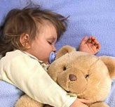
The Intermediate State
17
Erroneous Views:
Soul Sleep
Holds that the soul, during a time period between death and resurrection, exists in a state of unconsciousness or sleep.
This view denies a separate existence at death for the soul of man and that the sleep of the physical body will one day "wake up" in the resurrection.

Slide 28
The Intermediate State
17
Soul Sleep misunderstands passages where the imagery of sleep refers to death:
Stephen's death is described as sleep (Acts 7:60)
Paul noted that David fell asleep after serving God's purpose (Acts 13:36)
Paul uses the same imagery repeatedly (1 Cor. 15:6, 18, 20, 51; 1 Thess. 4:13-15)
Jesus used the same imagery for Lazarus (John 11:11, 14)

Slide 29
The Intermediate State
17
The Issue:
Soul Sleep misinterprets Scripture. Death is often depicted as sleep in the NT, but it is clear that we are dealing with a word that speaks of appearance and not fact.
Notes:
Another view: Annihilation of the unbeliever at death. Both soul and physical body..

Slide 30
The Intermediate State
17
2 Corinthians 5:6-8 (NIV) Therefore we are always confident and know that as long as we are at home in the body we are away from the Lord. We live by faith, not by sight. We are confident, I say, and would prefer to be away from the body and at home with the Lord.
Philippians 1:21-23 (NIV) For to me, to live is Christ and to die is gain. If I am to go on living in the body, this will mean fruitful labor for me. Yet what shall I choose? I do not know! I am torn between the two: I desire to depart and be with Christ, which is better by far;
Notes:
There are 2 verses which destroys the concept of soul sleep even if just taken at face value.
There is a separation of the body and soul after death, and not a state of sleep.

Slide 31
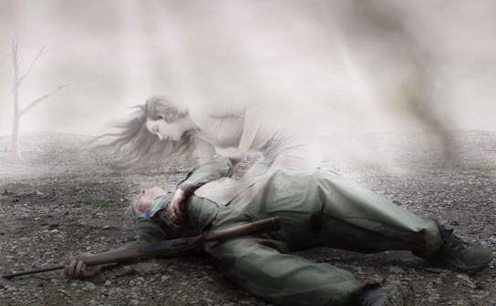
The Intermediate State
Based on Scripture, we conclude that at death, both the saved and unsaved continue their existence (Luke 16:19-31).
There is not a cessation of the being, but rather a separation of body and soul: the believer immediately into Christ's presence and the unbeliever to a place of punishment.
Notes:
Although there is not yet a resurrection of the body for the believer, the believer still consciously enjoys the glorious presence of Christ in paradise while the unbeliever consciously exists in a place of punishment till the resurrection of the unsaved.

Slide 32
The Intermediate State
17
Purgatory
Catholics teach that immediately upon death, the individual's eternal status is determined and the soul becomes aware of God's judgment upon it.
The soul is "moved of its own accord to hasten either to Heaven, or Hell, or Purgatory, according to its desserts."

Slide 33
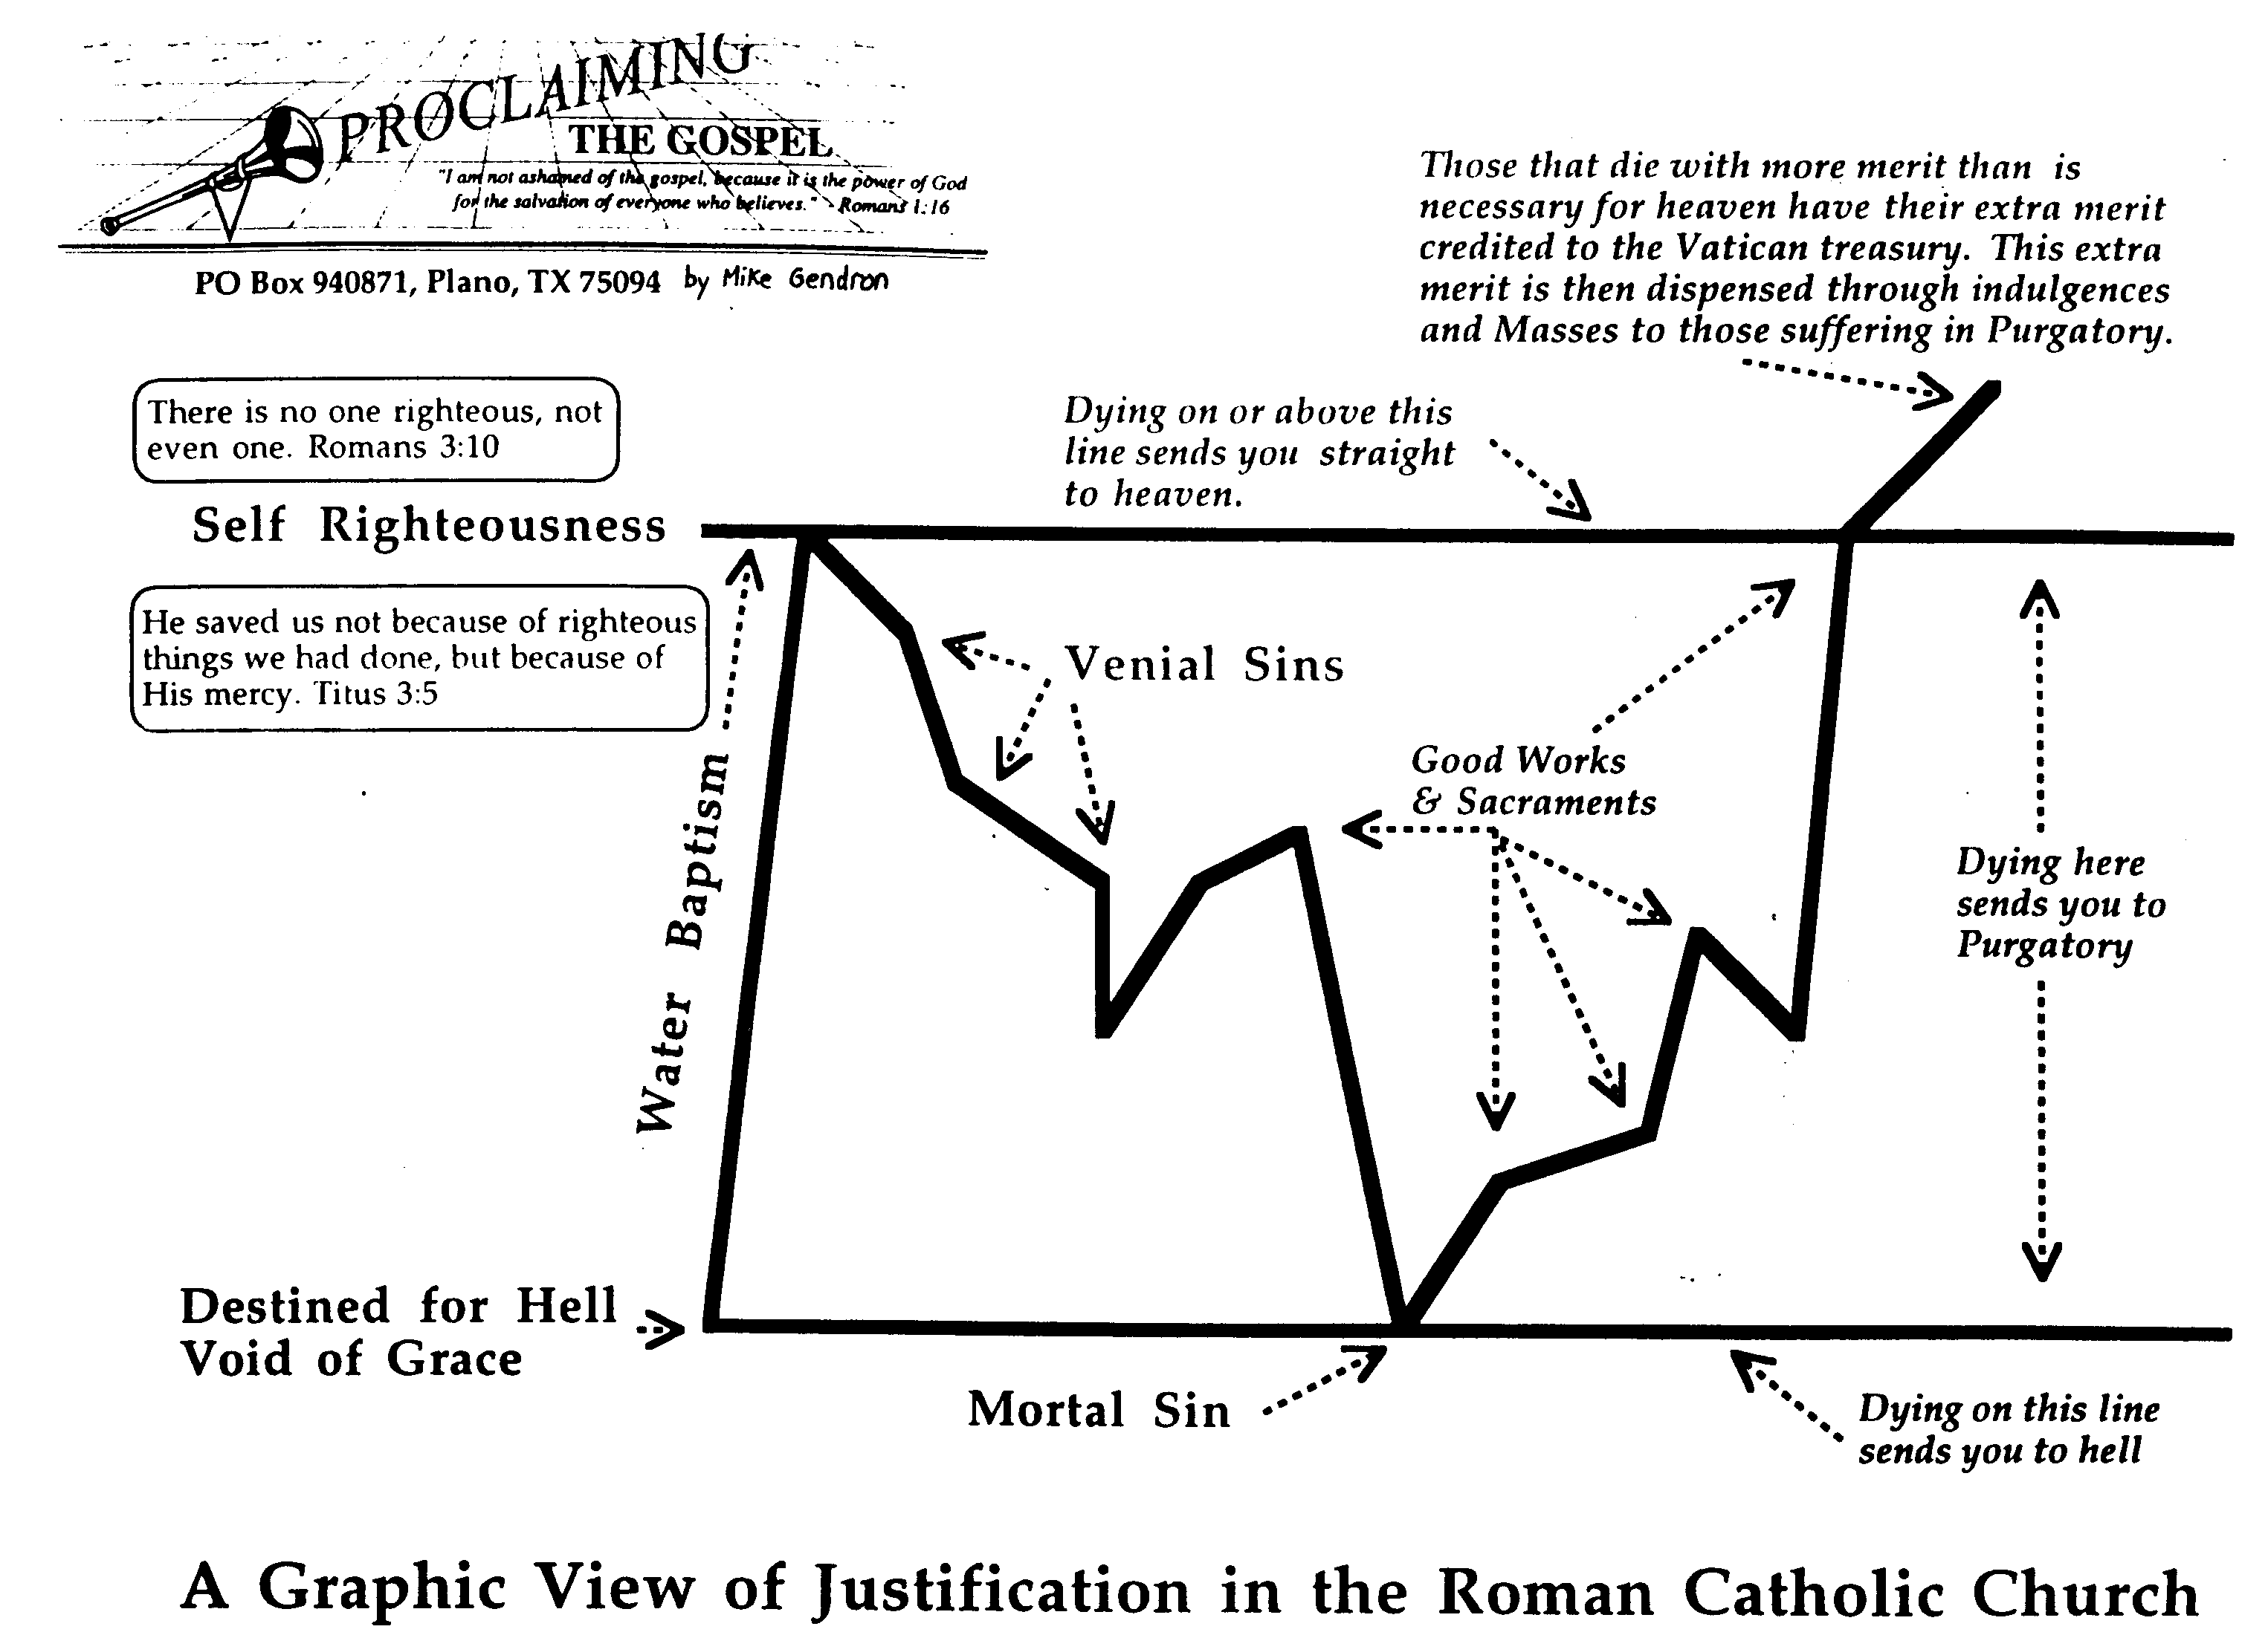
Pandangan Katolik tentang Pembenaran
174b
Mereka yang mati dalam kelebihan kebaikan maka kelebihan ini akan diberikan kepada Bendahara Vatikan kelebihan ini kemudian akan diberikan kepda mereka yang menderita di api penyucian melalui indulgensia dan misa .
Mereka yang mati dalam kelebihan kebaikan maka kelebihan ini akan diberikan kepada Bendahara Vatikan kelebihan ini kemudian akan diberikan kepda mereka yang menderita di api penyucian melalui indulgensia dan misa .
Tidak ada yang benar, seorang tidak Roma 3:10
Tidak ada yang benar, seorang tidak Roma 3:10
Mati di sini atau di atas garis ini akan langsung masuk surga
Mati di sini atau di atas garis ini akan langsung masuk surga
Kebenaran diri sendiri
Kebenaran diri sendiri
Pada waktu itu, Dia telah menyelamatkan kita, bukan karena perbuatan baik yang telah kita lakukan, tetapi karena rahmatnya Titus 3:5
Pada waktu itu, Dia telah menyelamatkan kita, bukan karena perbuatan baik yang telah kita lakukan, tetapi karena rahmatnya Titus 3:5
Dosa Ringan
Perbuatan Baik dan Sakramen
Dosa Ringan
Perbuatan Baik dan Sakramen
Mati di sini masuk api penyucian
Mati di sini masuk api penyucian
Baptisan Air
Baptisan Air
Ditakdirkan ke Neraka
Tanpa Anugerah
Ditakdirkan ke Neraka
Tanpa Anugerah
Dosa yang mematikan
Mati di sini akan masuk neraka
Dosa yang mematikan
Mati di sini akan masuk neraka
Grafik Pembenaran menurut Gereja Roma Katolik
Grafik Pembenaran menurut Gereja Roma Katolik
Notes:
FU-02-Death & Intermediate State-33
NS-09-Galatians-110

Slide 34
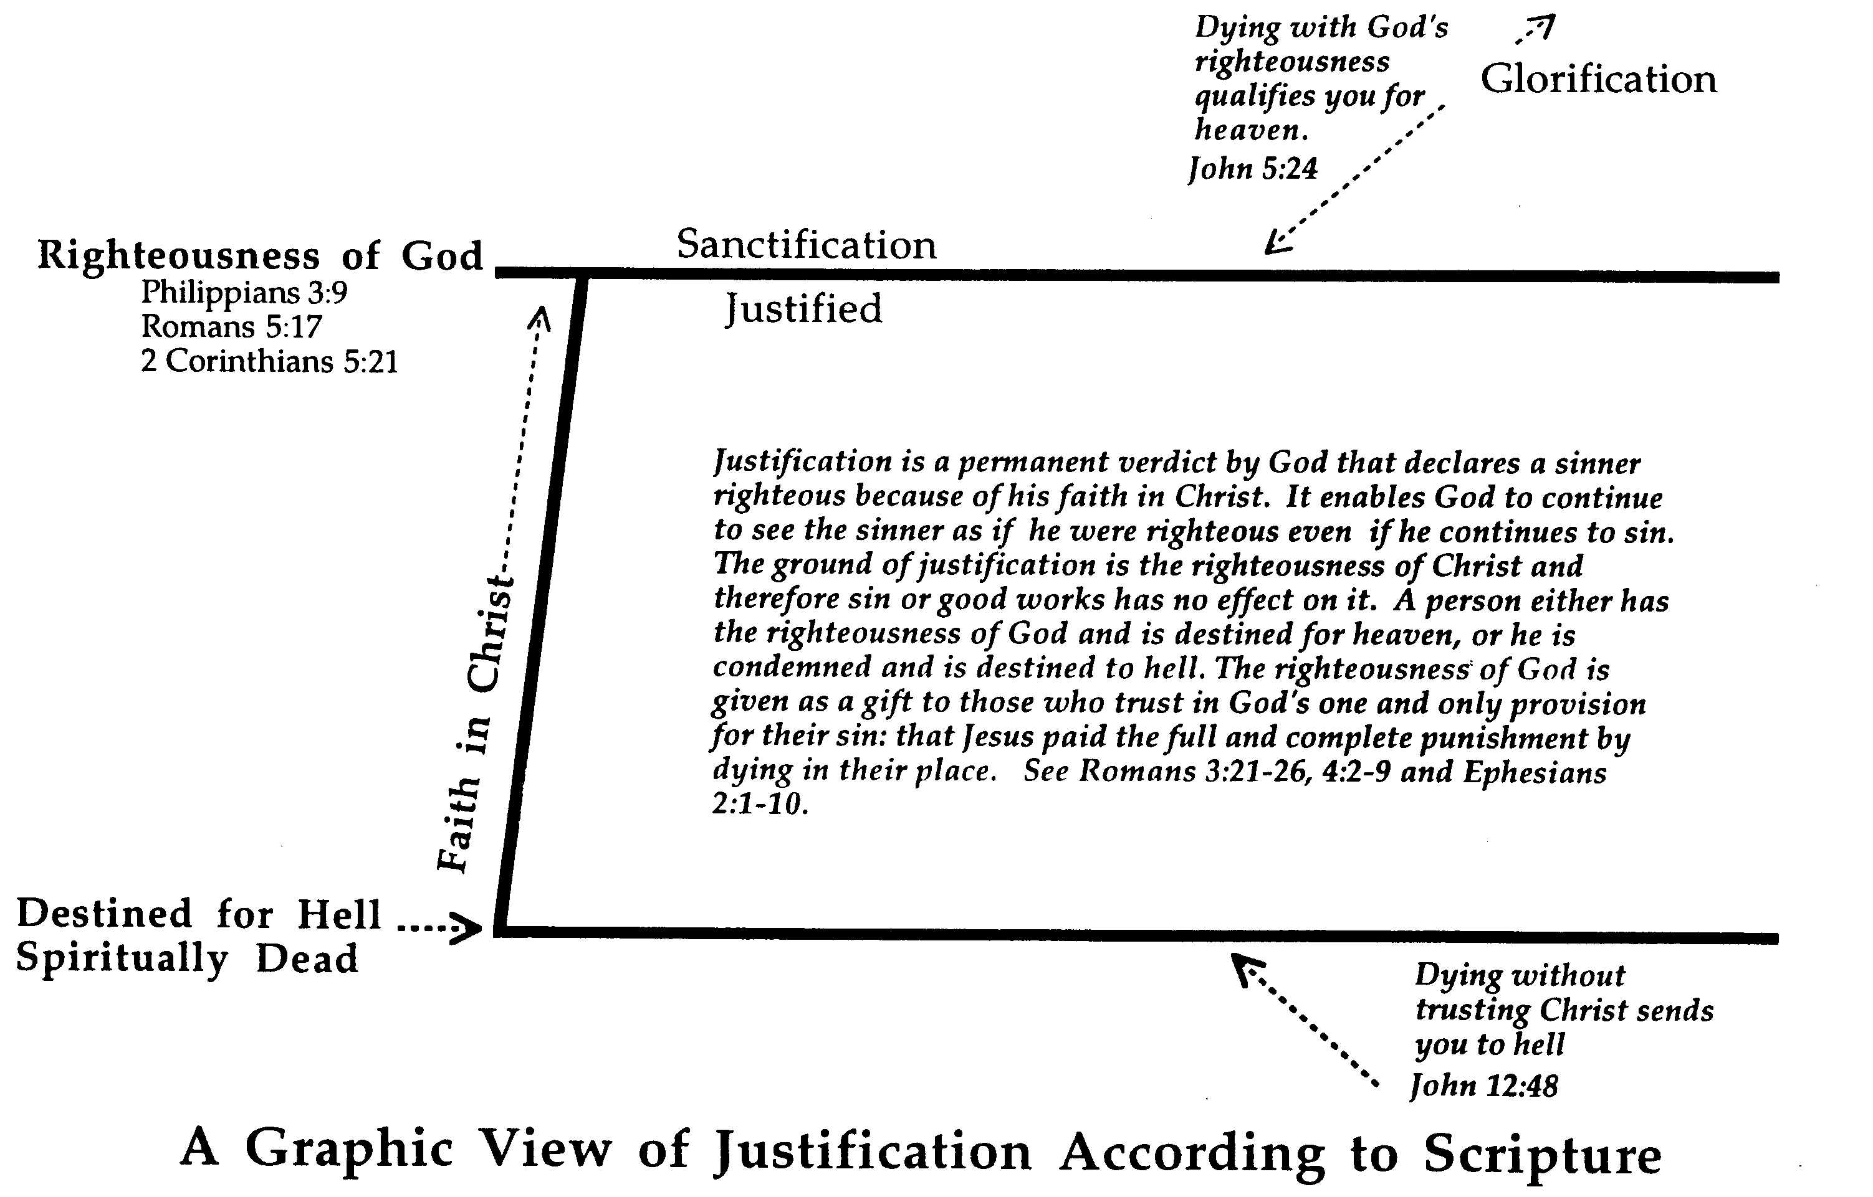
Pandangan Alkitab terhadap Pembenaran
174c
Mati dgn pembenaran Allah membolehkan kamu masuk surga. Yoh 5:24
Mati dgn pembenaran Allah membolehkan kamu masuk surga. Yoh 5:24
Pemuliaan
Pemuliaan
Pengudusan
Pengudusan
Kebenaran Tuhan Filipi 3:9
Roma 5:17
2 Korintus 5 : 21
Kebenaran Tuhan Filipi 3:9
Roma 5:17
2 Korintus 5 : 21
Pembenaran
Pembenaran
Pembenaran adalah keputusan Allah yg permanen yg menya-takan seorang berdosa itu benar karena imannya kpd Kristus. Hal ini memungkinkan Allah terus melihatnya sebagai orang benar sekalipun ia terus berbuat dosa. Dasar pembenaran adalah kebenaran Kristus, maka dosa atau perbuatan baik tidak memiliki dampak atasnya. Pilihannya memiliki pembenaran Allah dan ditetapkan masuk surga atau dihukum dan ditetapkan masuk neraka.Pembenaran Allah dikaruniakan kpd yg percaya kpd satu-satunya cara yg disediakan untuk dosa mereka, yaitu Yesus membayar secara penuh dan tuntas hukuman dgn mati menggantikan mereka. Rom 3:21-26; 4:2-9 & Ef 2:1-10
Pembenaran adalah keputusan Allah yg permanen yg menya-takan seorang berdosa itu benar karena imannya kpd Kristus. Hal ini memungkinkan Allah terus melihatnya sebagai orang benar sekalipun ia terus berbuat dosa. Dasar pembenaran adalah kebenaran Kristus, maka dosa atau perbuatan baik tidak memiliki dampak atasnya. Pilihannya memiliki pembenaran Allah dan ditetapkan masuk surga atau dihukum dan ditetapkan masuk neraka.Pembenaran Allah dikaruniakan kpd yg percaya kpd satu-satunya cara yg disediakan untuk dosa mereka, yaitu Yesus membayar secara penuh dan tuntas hukuman dgn mati menggantikan mereka. Rom 3:21-26; 4:2-9 & Ef 2:1-10
Iman dalam Kristus
Iman dalam Kristus
Ditakdirkan ke Neraka
Kematian Rohani
Ditakdirkan ke Neraka
Kematian Rohani
Kematian tanpa percaya Kristus akan ke Neraka
Yohanes 12:48
Kematian tanpa percaya Kristus akan ke Neraka
Yohanes 12:48
Grafik Pembenaran menurut Alkitab
Grafik Pembenaran menurut Alkitab

Slide 35
The Intermediate State
17
Purgatory is taught as a state of temporary punishment for those who are not entirely free from sins or have not yet fully paid for their venial sins. The forgiveness of such venial sins can be accomplished through three different ways:
Unconditional forgiveness by God
Suffering and the performance of penitential works
Contrition

Slide 36
17
Catholics believe Jesus told St. Gertrude the Great that this prayer releases 1000 souls from Purgatory each time:
"Eternal Father, I offer Thee the most precious blood of Thy Divine Son, Jesus, in union with the Masses said throughout the world today, for all the holy souls in Purgatory. Amen."

Slide 37
The Intermediate State
17
Protestants reject Purgatory because this theory appeals mainly to the Apocrypha, which Protestants do not accept as Canonical.
It also implies a salvation attainable by works, which is contrary to Scripture.

Slide 38
The Intermediate State
Instantaneous Resurrection
This is a more novel and creative concept of recent years.
This teaches that immediately upon death, the believer receives the resurrection body.
W.D. Davies holds that Paul had two different concepts of the resurrection: one in 1 Corinthians 15 and another in 2 Corinthians 5.
By 2 Corinthians 5, Paul no longer believed in an intermediate state but rather in an immediate transition into the final state.

Slide 39
The Intermediate State
17
Nothing can separate the believer from the Lord Jesus Christ, not even death (Rom. 8:38-39)
Believers need not fear death because Jesus, who overcame death, is with us (Ps. 23:4)
Death brings believers immediately into the presence of Christ. One is either living in the physical body or has left it, going into Christ's presence. There are only two states of being mentioned here (2 Cor. 5:6-8)
Notes:
Another passage which suggests this is Phil 1:21-23, where Paul believes that death meant to be in the presence of Christ.
There is not a lot of information regarding this intermediate state because our hope is in the resurrection when all will be complete.
However, there are some certainties given by the Scriptures regarding what happens to the believer at death.

Slide 40
Black

Slide 41
Link Eskatologi di BibleStudyDownloads.org
Dapatkan slide ini tanpa biaya
Notes:
New Testament Survey PPT in Bahasa Indonesia

