Slide 1
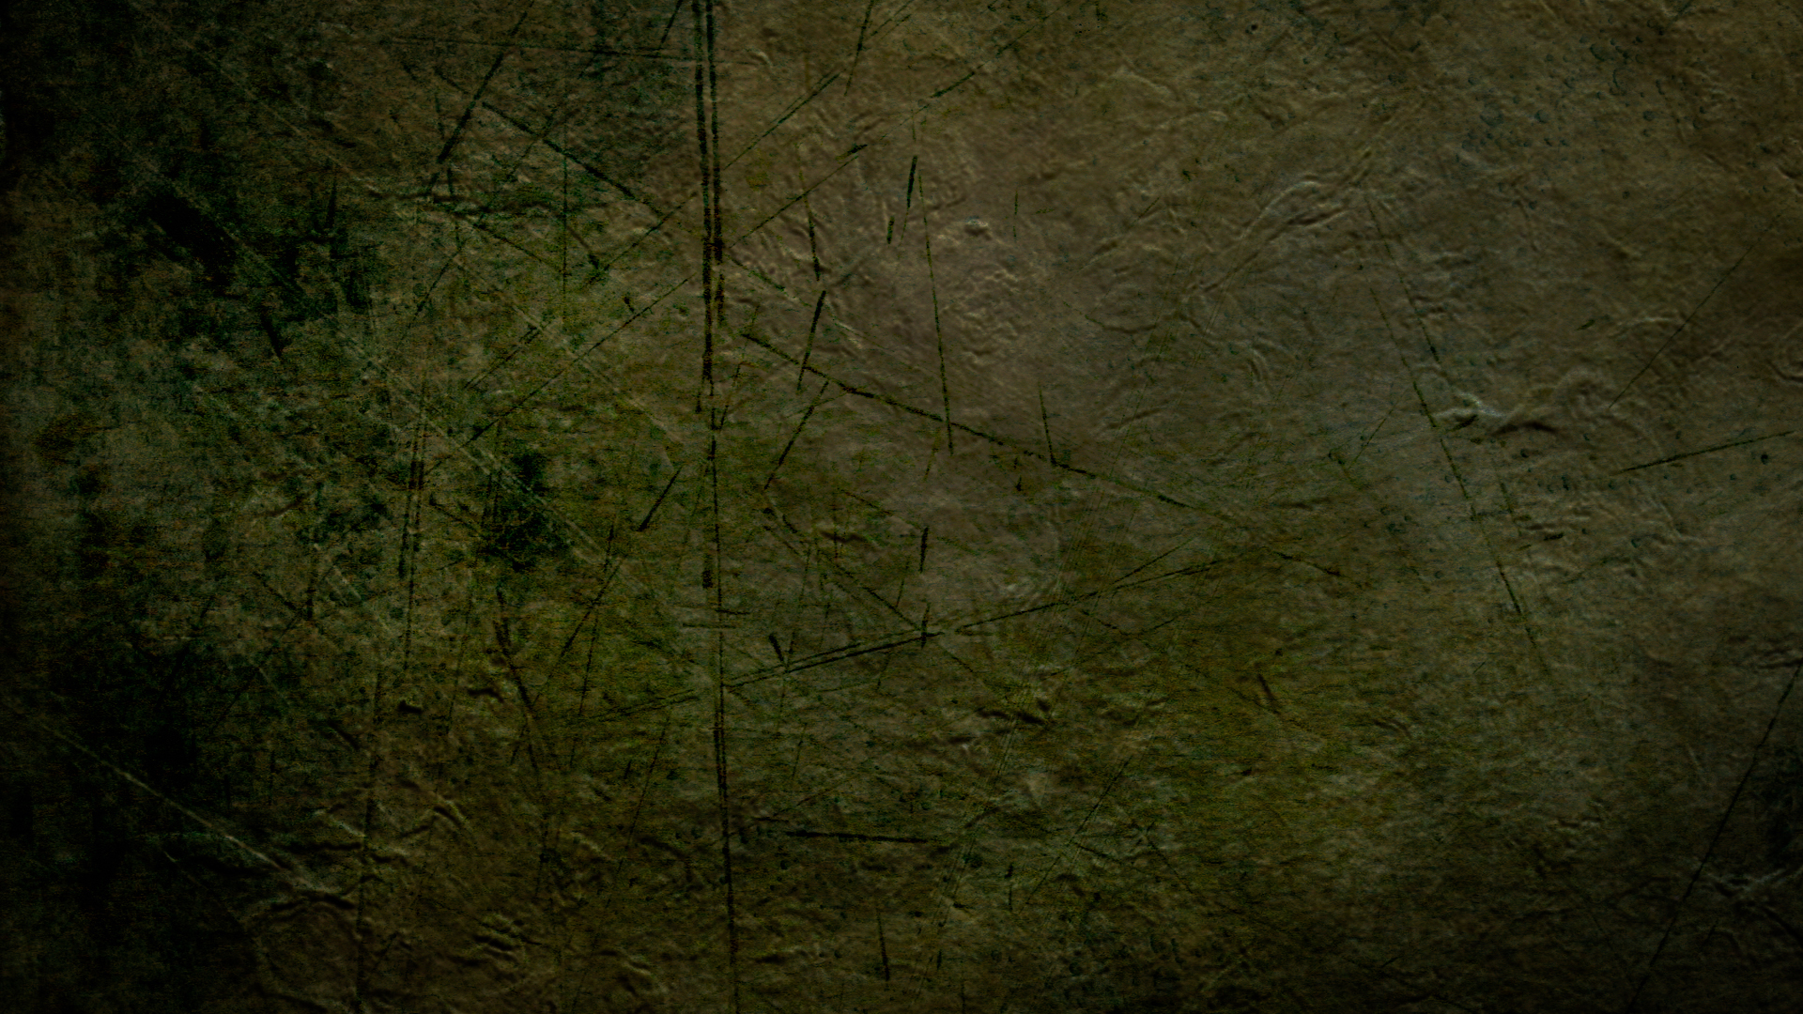
Homme-singe, Adam
et l'Évangile
Taught by Dr. Terry Mortenson, AnswersinGenesis.org
Uploaded by Dr. Rick Griffith, Singapore Bible College
All files in many languages for free download at BibleStudyDownloads.org

Slide 2


Slide 3
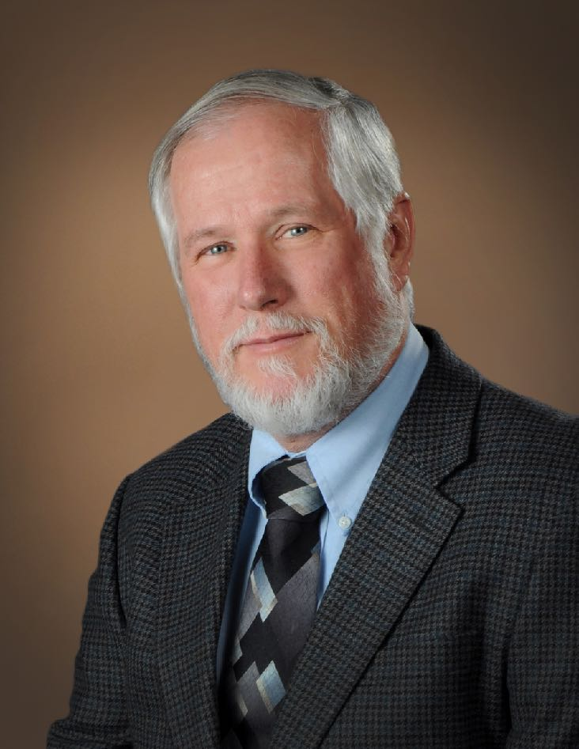






Dr. Danny Faulkner
Dr. Nathaniel Jeanson
Dr. Andrew Snelling
Dr. David Menton
Dr. Georgia Purdom
Dr. Tommy Mitchell
Notes:
Danny: PhD in Astronomy, Indiana University, became YEC in 10th grade, before he did PhD
Nathaniel: PhD in Cell and Developmental Biology, Harvard University, raised YEC.
Andrew: PhD in Geology, University of Sydney, Australia, became YEC before he did PhD, from a young age
David: PhD in Cell Biology, Brown University, became YEC before he did PhD
Georgia: PhD in Molecular Genetics, Ohio State University, became YEC after she did PhD (was theistic evolutionist professor after PhD)
Tommy: MD, Vanderbilt University School of Medicine, became YEC after he did MD (was theistic evolutionist before that)

Slide 4


Creation Museum, Petersburg, KY

Slide 5


Ark Encounter, Williamstown, KY

Slide 6
Homme-singe, Adam
et l'Évangile
DR. TERRY MORTENSON

Slide 7
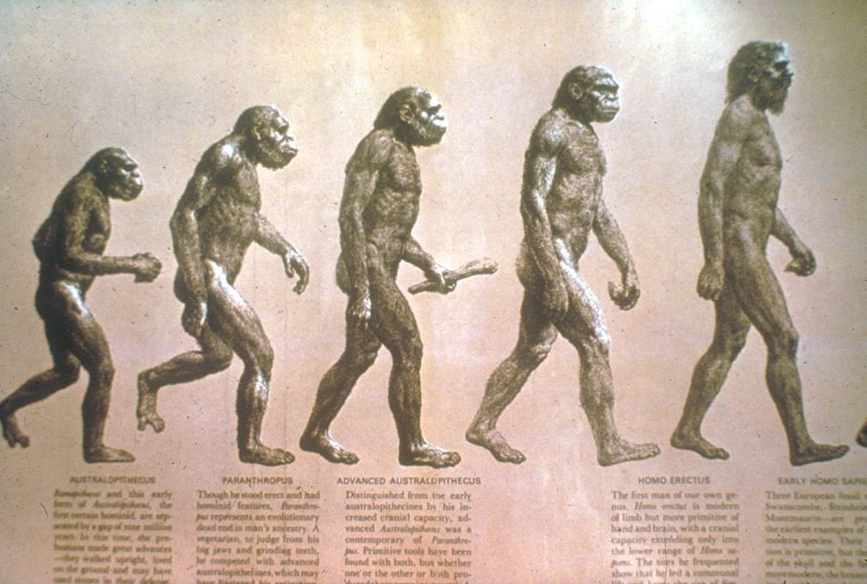
Évolution de l'Homme?

Slide 8
Perception américaine sur les origines de l’Homme
(Gallup Poll, May 2017)
Vision biblique
Évolution théiste
Vision athéiste
57% des américans pensent que nous déscendons du “singe”
Notes:
Not surprisingly, 65% of those who attend church weekly hold to the biblical view, whereas those who don’t attend church tend to believe en human evolution.
Not surprisingly, the more education (brainwashing) the more people believe the evolution story.
“Higher education levels are associated with less support for création ism and higher levels of belief en the evolutionary explanation for human origins. Belief en création ism is 21% among those with postgraduate education versus 48% of those with no more than a high school diploma. Agreement with evolution without God's involvement is 31% among postgrads versus 12% among Americans with a high school education or less. However, even among adults with a college degree or postgraduate education, more believe God had a role en evolution than say evolution occurred without God.”
Art Swift, “In U.S., Belief en Création ist View of Humans at New Low,” http://www.gallup.com/poll/210956/belief-création ist-view-humans-new-low.aspx?g_source=POLITICS&g_medium=topic&g_campaign=tiles, 2017 May 22, accessed 2017 May 23.

Slide 9
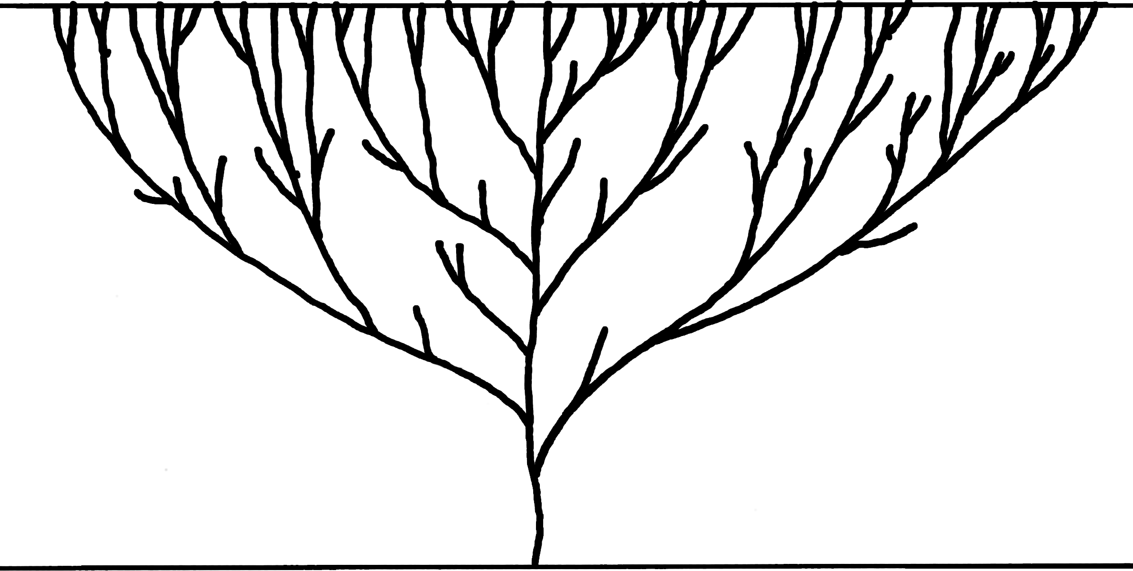

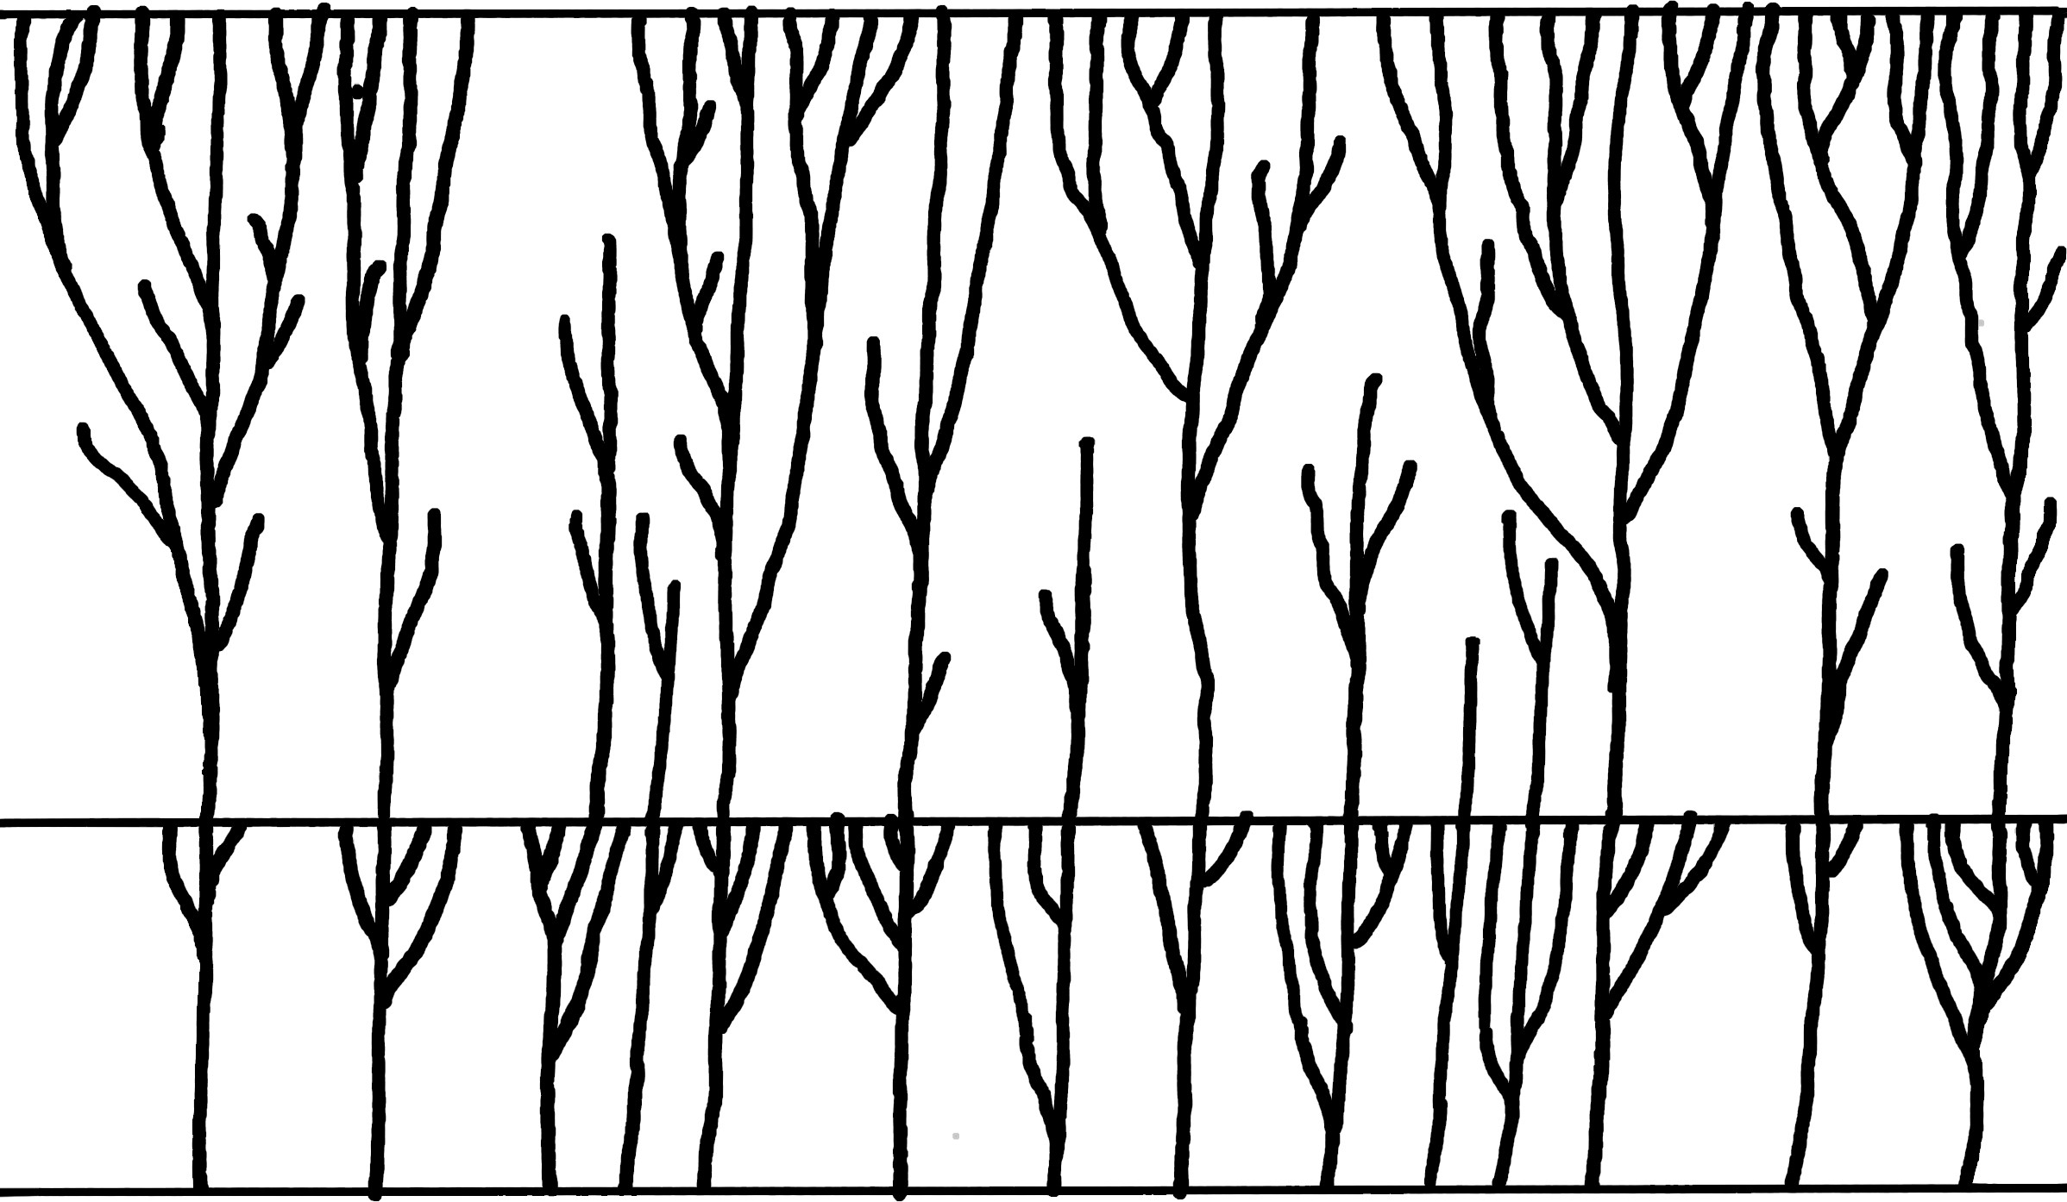

ARBRE DE VIE DE L'ÉVOLUTION
Présent
Millions d'années
Commencement
Première cellule vivante
FORÊT DE VIE DE LA CRÉATION
Présent
Milliers d'années
Déluge
Création
Espèces Créees Originales

Slide 10
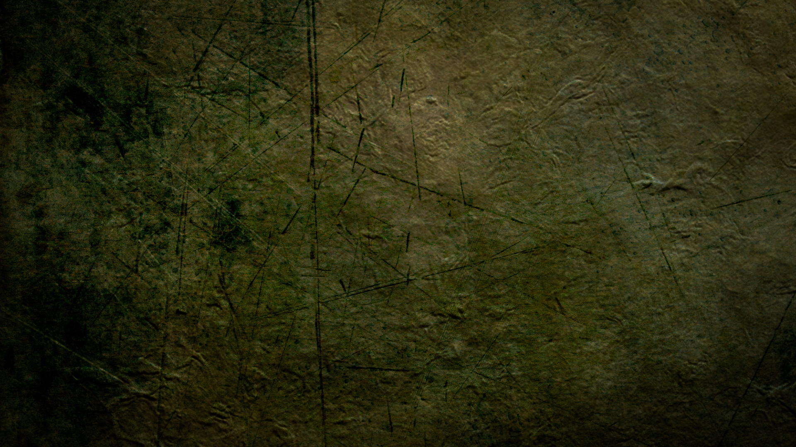
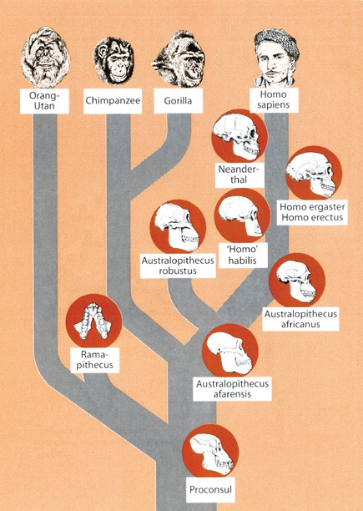
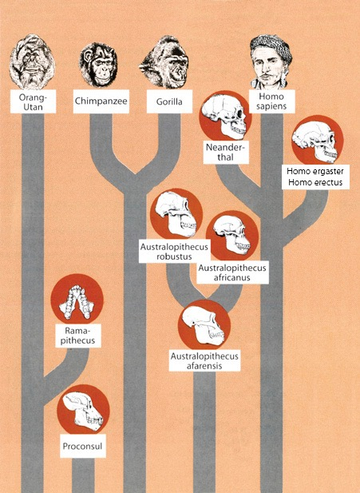
Arbre de l'Évolution
Forêt de l'Évolution
Notes:
A hominid is any member of the biological family Hominidae (the "great singes"), including the extinct and extant humans, chimpanzees, gorillas, and orangutans. This classification has been revised several times en the last few decades. These various revisions have led to a varied use of the word "hominid": the original meaning of Hominidae referred only to the modern meaning of Hominina, i.e. only humans and their closest relatives. The meaning of the taxon changed gradually, leading to the modern meaning of "hominid," which includes all great singes.
The primatological term hominid is easily confused with a number of very similar words:
A hominoid or singe is a member of the superfamily Hominoidea: extant members are the lesser singes (gibbons) and great singes.
A hominid is a member of the family Hominidae: all of the great singes.
A hominine is a member of the subfamily Homininae: gorillas, chimpanzees, humans (excludes orangutans).
A hominin is a member of the tribe Hominini: chimpanzees and humans.
A hominan is a member of the sub-tribe Hominina: modern humans and their extinct relatives.
A human is a member of Homo sapiens. The word is sometimes also used to refer to any extinct member of the genus Homo or members from other hominan genera.
A humanoid is a vaguely human-shsinged entity; the term is typically used en science fiction.
Certain morphological characteristics are still used conventionally to support the idea that hominid should only denote humans and human ancestors, namely bipedalism (walking on two feet) and large brains. These points of departure between human beings and the other great singes are important, but according to genetically based taxonomic classification, are not enough to divide us into separate families. Genetics, rather than morphology, is more widely accepted as the critical standard. Many scientists, including anthropologists, use the term to mean humans and their direct and near-direct bipedal ancestors.
Two charts from Reinhard Junker, Is Man Descended from Adam? (Biblical Création Society, 2000, translated by Steven Robinson), p. 10-11.

Slide 11
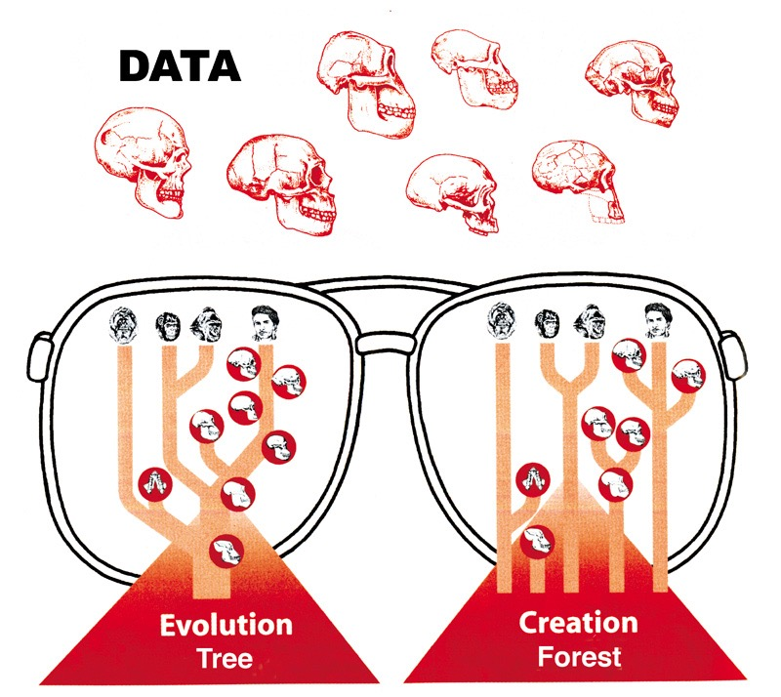


DONNÉES
Quelle vue
correspond aux faits?
Arbre de l’Évolution
Forêt de la Création
Notes:
As we look at what the evolutionists say and what the Bible says, we will see that the scientific evidence fits with the Bible but it does not at all confirm the evolutionist story.
Chart adapted from Reinhard Junker, Is Man Descended from Adam? (Biblical Création Society, 2000, translated by Steven Robinson), p. 6.

Slide 12
Australopithèque
“singe du sud”

Slide 13
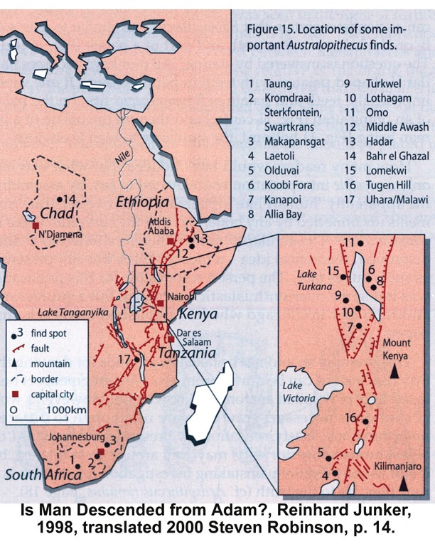


Notes:
Most of the evidence for australopithecus has been trouvé en east Africa, especially Kenya and Éthiopie

Slide 14
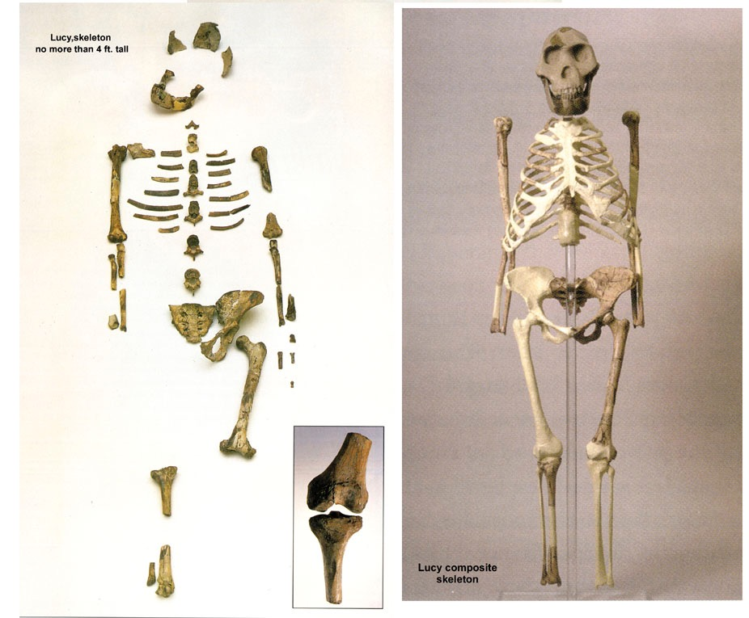
“Lucy” trouvée en Éthiopie (1974)
Australopithèque afarensis
Notes:
100s of bone pieces representing 40% of body, say evolutionists. but actually trouvé only 47 of the 207 bones (25%). Estimated height: 3’ 1”
Australopithèque afarensis trouvé by Donald Johanson en 1974 en Hadar Formation of Awash Valley en Ethiopia’s Afar triangle. She’s been dated at 3.2 million years old.
Johanson named her “Lucy” because as he came back into camp, the Beatles song “Lucy en the sky with diamonds” was playing.
Research has since shown that Lucy was male not female (David Menton’s video: Lucy: She’s no lady)
More australopithecines have been trouvé and the evolutionist consensus is that they are transitional forms between chimps and humans. But the australopithecine fingers are long and curved like a chimpanzee and the wrist has a locking mechanism like chimpanzees that walk on their knuckles on all fours. The organ of balance is also very chimp-like en the australopithecines. Conclusions can be difficult to draw because these fossils are fragmentary and broken and must be reassembled.

Slide 15
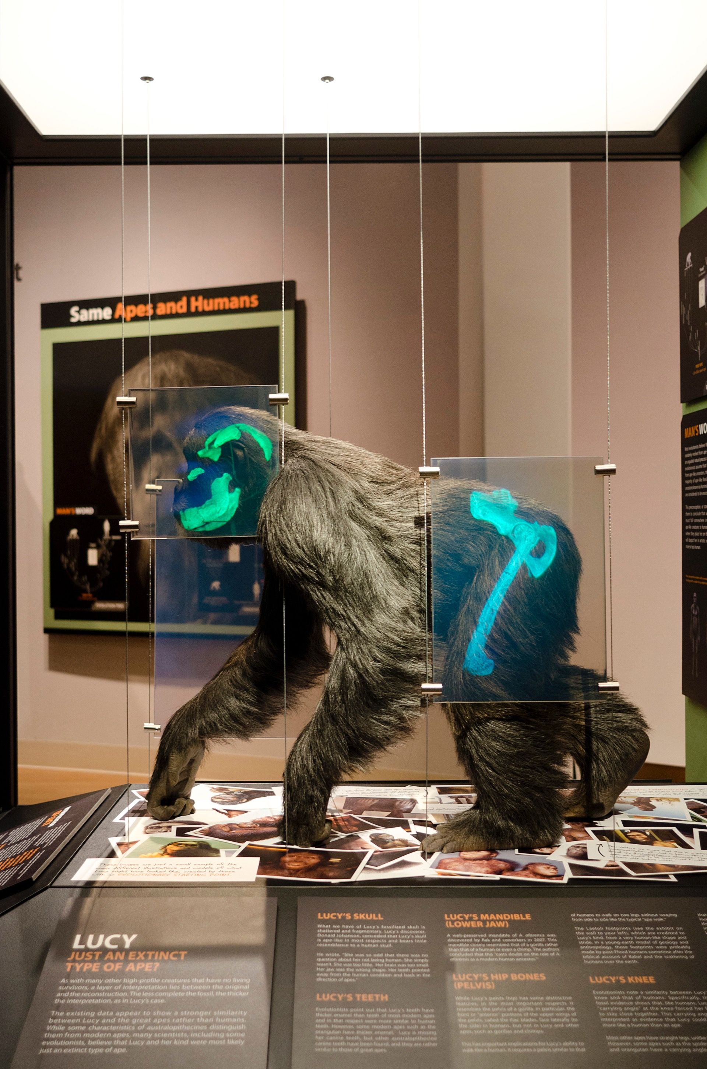
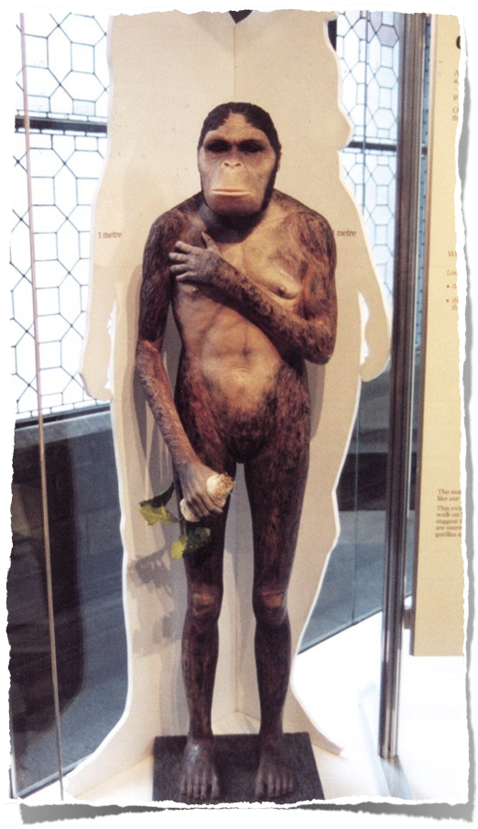
Musée de la Création
Remarque
Mains et pieds humains
posture verticale
Visage de singe
Vérité
Locomotion sur les articulations, semblable à un bonobo (chimp. nain) ou à un gorille
Notes:
Bonobo (formerly called pigmy or dwarf chimpanzee)
PNAS (Proc. Nat. Acad. Sci), vol 104:16 (17 April 2007, pp. 6568-6572: research concludes that Lucy most closely resembles a gorilla or at least the robust australopithecines (no longer considered to be ancestral to man).
Photo by Ken Ham at Natural History Musée en London, 2009
The fossil evidence shows that Lucy (a specimen of Australopithèque afarensis) had very chimp-like body proportions (only 4 feet tall when upright) with long arms and short legs, wrists designed for knucklewalking, long curved hands and feet (with opposing big toes like en singes, not like en humans) for grasping trees, and hip/pelvic shsinge that indicates that she spent much time en trees, not walking like humans. See critique of the BBC’s Walking with Cavemen, at <www.biblicalcréation .org> and the video by Dr. David Menton (anatomy professor), called “Lucy: She’s no lady!” available from <www.answersingenesis.org>.

Slide 16
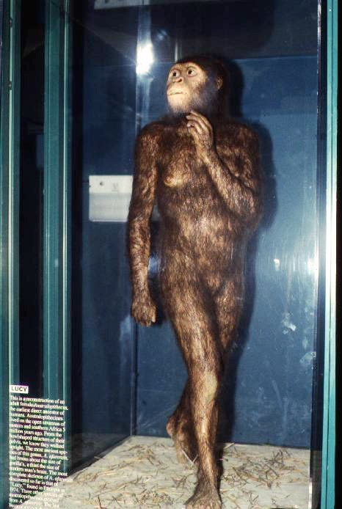
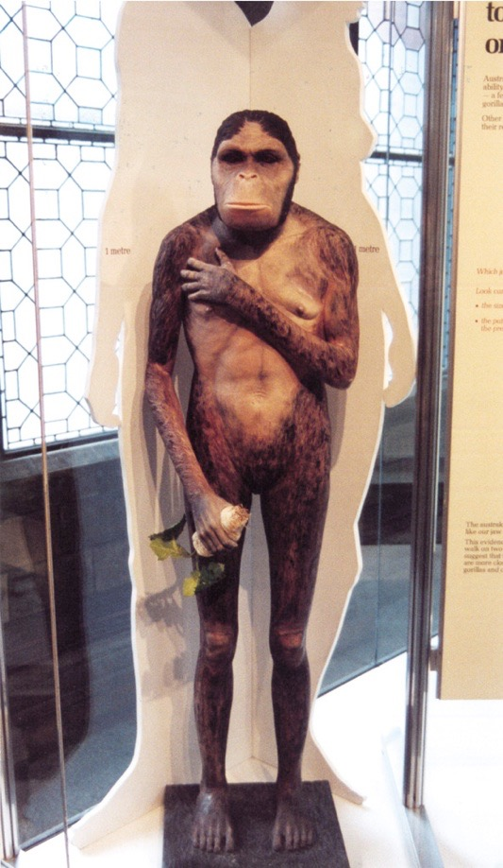
Musée d’histoire naturelle de Londres
Zoo de St. Louis
Notes:
London photo by Ken Ham from his visit to the Natural History Musée en 2009
St. Louis Zoo’s “Living World” exhibit photo by David Menton (en his DVD, “Lucy: She’s No Lady!”) taken en about 1995 (en the exhibit for at least 20 years from the very beginning en 1985)
Chicago Field Musée’s model (en their “The Evolving Planet” permanent exhibition), photo by Carl Kerby en March 2006 (http://www.answersingenesis.org/docs2006/0313field_trip.asp, 13 Mar 2006, accessed 29 June 2011.
BBC photo: article reporting on Lucy’s bones touring America. The caption under photo en the article: “Lucy's remains were trouvé en 1974 en Hadar, Éthiopie.” See http://news.bbc.co.uk/1/hi/world/americas/6082990.stm, “Lucy’s Ancient Bones to Tour US, 25 Oct. 2006.” She will be on loan from Éthiopie to the Houston Musée of natural Science en Texas for scientific study till 2013. Officials say that money from the tour will be used to improve museums across the country.

Slide 17
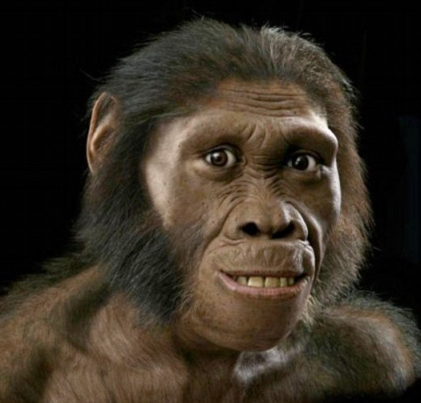
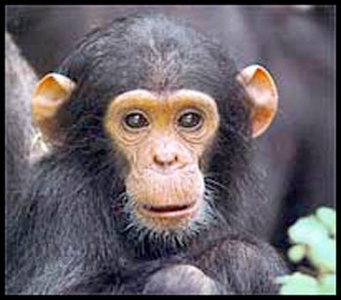
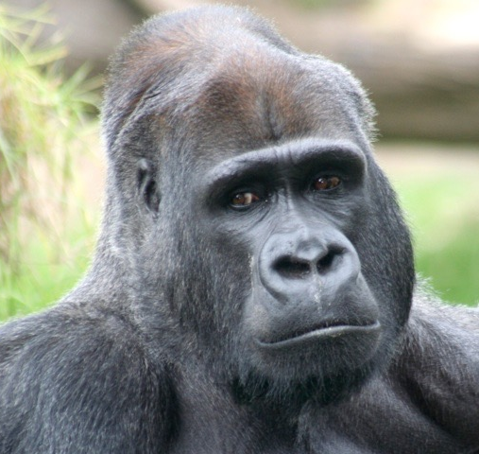
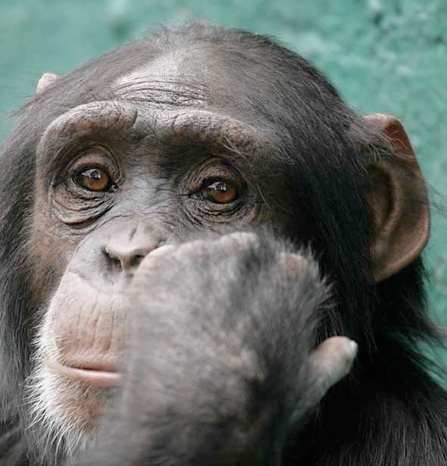
Notes:
Karabo (aka Australopithèque sediba): http://www.dailymail.co.uk/sciencetech/article-2062514/Revealed-The-face-missing-link-singe-man.html, accessed 2011 Dec 28
Chimps are on the right, gorilla on the lower left, Karabo artistic reconstruction on upper left
Article begins:
A curious smile playing on his face, the eyes and mouth are unmistakably human while the cheekbones and jutting brow say wild animal.
Meet Karabo, probably our earliest ancestor and the ‘missing link’ between man and singe – ‘seen’ for the first time thanks to this incredible portrait.
Created by paleo-artist John Gurche, it is based on the remarkably well-preserved skeleton of a boy aged around 13, trouvé en a cave en South Africa.
Read more: http://www.dailymail.co.uk/sciencetech/article-2062514/Revealed-The-face-missing-link-singe-man.html#ixzz1hrHWtMN7

Slide 18
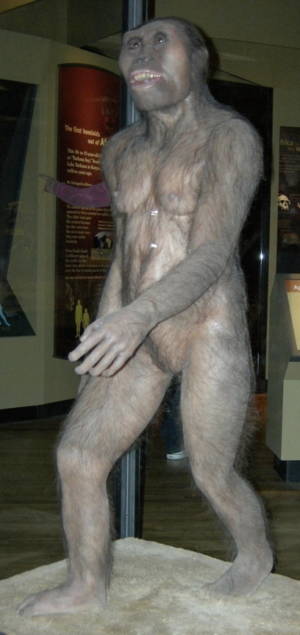
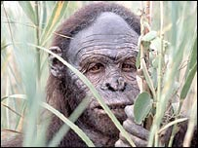
BBC, 2006
Zoo de St. Louis
Musée de Chicago
Musée d’histoire naturelle de Londres
Notes:
London photo by Ken Ham from his visit to the Natural History Musée en 2009
St. Louis Zoo’s “Living World” exhibit photo by David Menton (en his DVD, “Lucy: She’s No Lady!”) taken en about 1995 (en the exhibit for at least 20 years from the very beginning en 1985)
Chicago Field Musée’s model (en their “The Evolving Planet” permanent exhibition), photo by Carl Kerby en March 2006 (http://www.answersingenesis.org/docs2006/0313field_trip.asp, 13 Mar 2006, accessed 29 June 2011.
BBC photo: article reporting on Lucy’s bones touring America. The caption under photo en the article: “Lucy's remains were trouvé en 1974 en Hadar, Éthiopie.” See http://news.bbc.co.uk/1/hi/world/americas/6082990.stm, “Lucy’s Ancient Bones to Tour US, 25 Oct. 2006.” She will be on loan from Éthiopie to the Houston Musée of natural Science en Texas for scientific study till 2013. Officials say that money from the tour will be used to improve museums across the country.

Slide 19
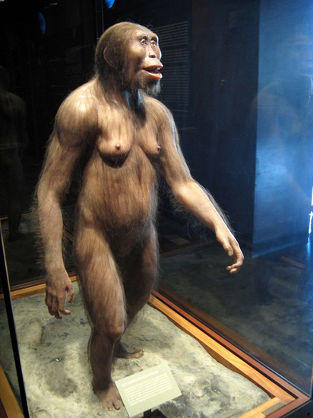
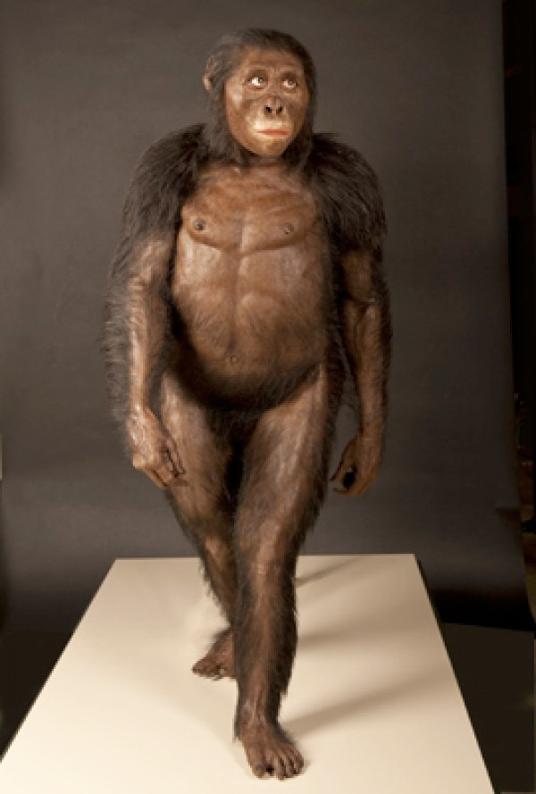
Smithsonian, 2012
Science, 2013
Notes:
Elizabeth Culotta, “ScienceShot: Lucy's Svelte Look,” http://news.sciencemag.org/paleontology/2013/09/scienceshot-lucys-svelte-look, 2013 Sept 23, accessed 2013 Nov 2.
“Did Lucy Walk Too Slow for Her Taller Group Mates?” http://blogs.smithsonianmag.com/hominids/2012/11/did-lucy-walk-too-slow-for-her-taller-group-mates/, 2012 Nov. 5, accessed 2013 Nov 2

Slide 20
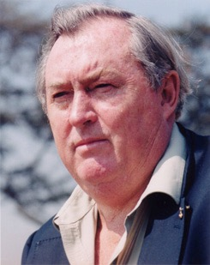
En 1981: « Nous pouvons maintenant dire que les australopithèques ont certainement marché debout.»
Richard Leakey (Directeur, Kenya National Musées), Apparition de l’espèce humaine (New York: E. P. Dutton, 1981), p. 71.
Notes:
Picture from http://www.midland.edu/~events/davidson/leakey.html, downloaded 14 April 2005

Slide 21
Mais en 1982 . . .
« Et Leakey fait remarquer que les paléontologues ne savent pas si l'Australopithèque a marché debout. "Personne n'a encore trouvé un squelette associé à un crâne", dit-il. »
Anonyme, “Leakey change d’avis sur l’âge de l’homme,” New Scientist, March 1982, p. 695.

Slide 22
«Je suis stupéfait de savoir qu’il y a moins d’un an, j’avais fait de telles déclarations.», a déclaré Richard Leakey devant l’élégant auditoire du discours du soir de l’ Institution Royale... Il en est arrivé à admettre que la sagesse conventionnelle, qu’il avait récemment adoptée dans sa série télévisée de la BBC, The Making of Mankind, était «probablement erronée dans un certain nombre de domaines cruciaux».
Anonyme, “Leakey change d’avis sur l’âge de l’homme,” New Scientist, March 1982, p. 695.
Notes:
Note that his errors were broadcast on BBC for millions to hear, but his recantation was made before an elite audience at the Royal Institution and then quoted en a minor article en New Scientist. But judging from the article he didn’t explicitly recant the error en his book [and no doubt en the BBC-TV series] about australopithecines walking upright.

Slide 23
« En particulier, il considère désormais que le plus vieil ancêtre de l’homme est considérablement plus jeune que les 15 à 20 millions d’années pour lesquels il s’était décidé à la télé. Leakey affirme que la base sur laquelle les paléontologues classifient les fossiles de singes et les humains est trompeuse, et il aimerait voir un épisode de classification entièrement nouveau. »
1982
Anonyme, “Leakey change d’avis sur l’âge de l’homme,” New Scientist, March 1982, p. 695.

Slide 24
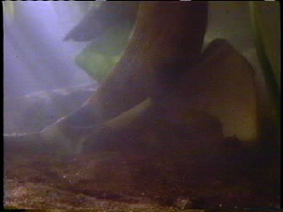
Dr. Owen Lovejoy & Dr. Donald Johanson
L’ajustement parfait était une illusion qui donnait l’impression que l’os de la hanche de Lucy s'évasait comme celle d'un chimpanzé. Mais tout n'a pas été perdu.
Il coupa les morceaux endommagés et les assembla tels qu'ils étaient avant la mort de Lucy.
Cela a fait que les deux os s'emboîtent si bien qu'ils forment une position anatomiquement impossible.
C'était un travail difficile. Mais après avoir éliminé le pli du bassin, tout s’emboîte parfaitement, comme un casse-tête en trois dimensions en forme de pièces de puzzle.
Lovejoy a décidé de restaurer le bassin dans son état naturel. Il ne voulait pas altérer l’original, il en a donc fait une copie en plâtre.
Le résultat est que, l’angle de la hanche ne ressemble en rien à celui du chimpanzé, mais ressemble beaucoup au nôtre.
Notes:
NOT typewriter animation, just wipe-down boxes (text for each box is below)
This clip is en my “Apemen: the Grand Illusion” DVD. But here is the clip online en Dr. David Menton’s lecture: https://www.youtube.com/watch?v=EeO0JlZsXio.
Dr. Owen Lovejoy, famous anthropology professor at Kent State University en Ohio. The other voice is that of Donald Johanson, who trouvé “Lucy”.
Dr. David Menton (before joining AiG staff he was for 34 years a human anatomy professor at Washington Medical School en St. Louis) comments on this clip:
Lovejoy was totally convinced that Lucy’s kind made the human-like footprints en Laetoli and those prints would not be possible for a creature to make unless it had a human-type pelvis. Therefore before Lovejoy manipulated Lucy’s hipbones he had a massive observer bias.
For Lovejoy to cut along existing cracks and then to fit things together would have been scientifically permissible, but to grind material away is totally unacceptable as a scientist.
This article by cjobrien (evidently an anthropology professor) http://northstatescience.wordpress.com/2011/01/01/correcting-création ists-redux-was-lucy%E2%80%99s-pelvis-reconstruction-a-fraud/ says the clip was from In Search of Human Origins (Part 1) on NOVA en 1994. The author accuses création ists of fraudulently misrepresenting the clip. You be the judge.
Textbox 1
Cela a fait que les deux os s'emboîtent si bien qu'ils forment une position anatomiquement impossible.
Textbox 4
L’ajustement parfait était une illusion qui donnait l’impression que l’os de la hanche de Lucy s'évasait comme celle d'un chimpanzé. Mais tout n'a pas été perdu.
Textbox 2
Lovejoy a décidé de restaurer le bassin dans son état naturel. Il ne voulait pas altérer l’original, il en a donc fait une copie en plâtre.
Textbox 3
Il coupa les morceaux endommagés et les assembla tels qu'ils étaient avant la mort de Lucy.
Textbox 5
C'était un travail difficile. Mais après avoir éliminé le pli du bassin, tout s’emboîte parfaitement, comme un casse-tête en trois dimensions en forme de pièces de puzzle.
Textbox 6
Le résultat est que, l’angle de la hanche ne ressemble en rien à celui du chimpanzé, mais ressemble beaucoup au nôtre.
---
Textbox 1
This has caused the two bones en fact to fit together so well that they are en an anatomically impossible position.
Textbox 2
The perfect fit was an illusion that made Lucy’s hip bone seem to flare out like a chimp’s. But all was not lost.
Textbox 3
Lovejoy decided he could restore the pelvis to its natural shsinge. He didn’t want to tamper with the original, so he made a copy en plaster.
Textbox 4
He cut the damaged pieces out and put them back together the way they were before Lucy died.
Textbox 5
It was a tricky job. But after taking the kink out of the pelvis, it all fit together perfectly—like a 3-dimensional zig-saw puzzle.
Textbox 6
As a result, the angle of the hip looks nothing like a chimp’s, but a lot like ours.

Slide 25
Dr. Owen Lovejoy & Dr. Donald Johanson
This has caused the two bones in fact to fit together so well that they are in an anatomically impossible position.
Lovejoy decided he could restore the pelvis to its natural shape. He didn’t want to tamper with the original, so he made a copy in plaster.
He cut the damaged pieces out and put them back together the way they were before Lucy died.
The perfect fit was an illusion that made Lucy’s hip bone seem to flare out like an chimp’s. But all was not lost.
It was a tricky job. But after taking the kink out of the pelvis, it all fit together perfectly—like a 3-dimensional zig-saw puzzle.
As a result, the angle of the hip looks nothing like a chimp’s, but a lot like ours.
Notes:
NOT typewriter animation, just wipe-down boxes (text for each box is below)
This clip is in my “Apemen: the Grand Illusion” DVD. But here is the clip online in Dr. David Menton’s lecture: https://www.youtube.com/watch?v=EeO0JlZsXio.
Dr. Owen Lovejoy, famous anthropology professor at Kent State University in Ohio. The other voice is that of Donald Johanson, who found “Lucy”.
Dr. David Menton (before joining AiG staff he was for 34 years a human anatomy professor at Washington Medical School in St. Louis) comments on this clip:
Lovejoy was totally convinced that Lucy’s kind made the human-like footprints in Laetoli and those prints would not be possible for a creature to make unless it had a human-type pelvis. Therefore before Lovejoy manipulated Lucy’s hipbones he had a massive observer bias.
For Lovejoy to cut along existing cracks and then to fit things together would have been scientifically permissible, but to grind material away is totally unacceptable as a scientist.
This article by cjobrien (evidently an anthropology professor) http://northstatescience.wordpress.com/2011/01/01/correcting-creationists-redux-was-lucy%E2%80%99s-pelvis-reconstruction-a-fraud/ says the clip was from In Search of Human Origins (Part 1) on NOVA in 1994. The author accuses creationists of fraudulently misrepresenting the clip. You be the judge.
Textbox 1
This has caused the two bones in fact to fit together so well that they are in an anatomically impossible position.
Textbox 2
The perfect fit was an illusion that made Lucy’s hip bone seem to flare out like a chimp’s. But all was not lost.
Textbox 3
Lovejoy decided he could restore the pelvis to its natural shape. He didn’t want to tamper with the original, so he made a copy in plaster.
Textbox 4
He cut the damaged pieces out and put them back together the way they were before Lucy died.
Textbox 5
It was a tricky job. But after taking the kink out of the pelvis, it all fit together perfectly—like a 3-dimensional zig-saw puzzle.
Textbox 6
As a result, the angle of the hip looks nothing like a chimp’s, but a lot like ours.

Slide 26
L’Homme de Néanderthal
Notes:
As a content template, this is best suited for standard content such as outlines, quotations, Scriptures, and maybe illustrations or photos. Présentation Team recommends 48–60 pt. font for headings and 28–40 pt. for body text. Because of eye flow and visual psychology, the top line may be a little closer than all other sides. This also contains a floating AiG logo that can be repositioned or removed as appropriate for the overhead’s content.

Slide 27
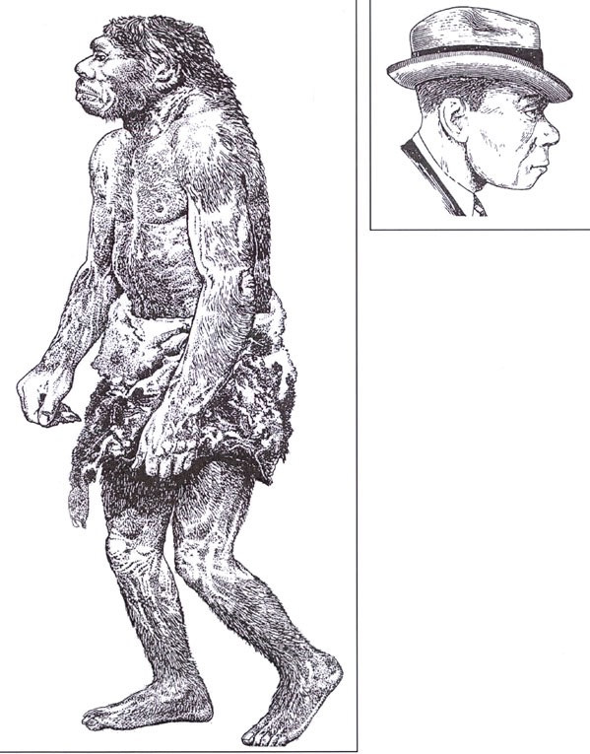
1983
1856
Notes:
1856 is when the first Neanderthal was trouvé en the Neander Valley near Dusseldorf, Germany. 490 Neanderthal skeletons have been trouvé en Europe and western Asia as of 2006. Initially thought by scientists to be fully human, a man with rickets
1863 TH Huxley called it ancient human but not direct ancestor to modern man
1864 William King (Irish geologist) declared at meeting of BAAS that it was a different species and named it Homo neanderthalensis
1908 three RC priests excavated a nearly complete skeleton near La Chsingelle-aux-Saints, France, and gave it to Marcellin Boule, anatomist at Musée d’Histoire Naturelle en Paris to declared it to be a hairy bestial creature with large brain but little intellect, which became the widely accepted view, even today.
The drawing was made by Zdenek Burian, according to Reinhard Junker, Is Man Descended from Adam? (Biblical Création Society, 2000, translated by Steven Robinson), p. 7, from which the picture was taken. The right picture is from p. 8 of the same book and was done by Haviland en 1983. A similar contrast between the early singe-like and recent, modern-human-like (en a suitcoat and tie even) reconstructions is en Rick Gore, “Neandertals,” National Geographic 189:1 (Jan. 1996), pp. 32-33. The picture of the two en NG is taken from the Neanderthal Musée en Erkrath, Germany.

Slide 28
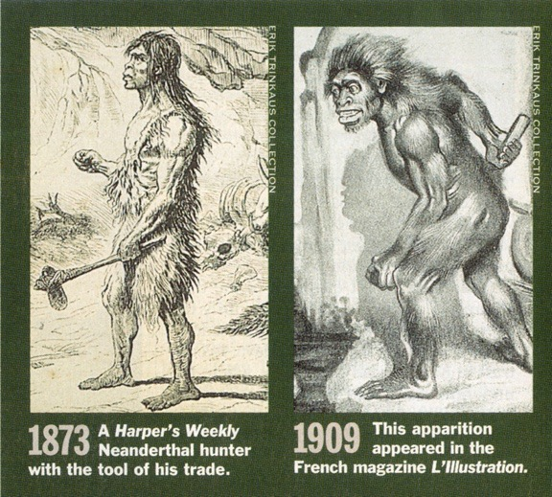
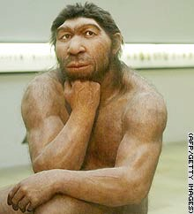
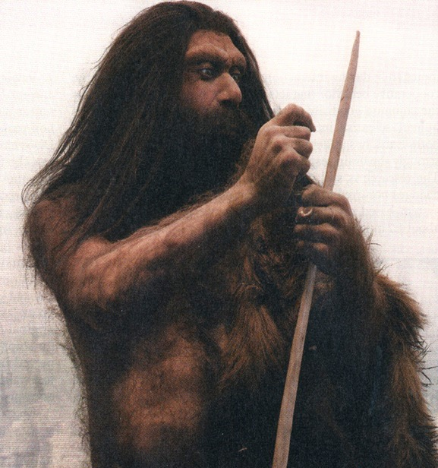
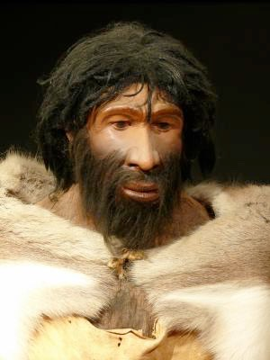
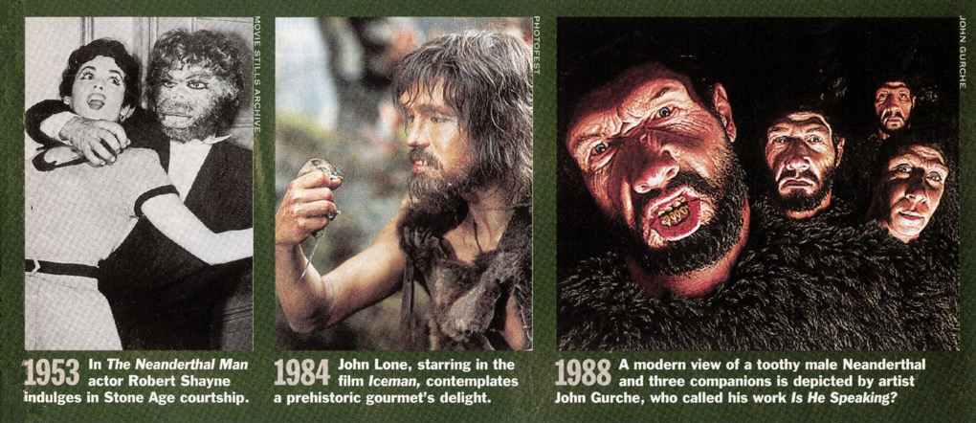
Changement
de visage du Néandertalien
Time,
Mars 1994
Newsweek,
Mars 2007
CNN 2006
ScienceDaily.com
Août 2008
Notes:
From TIME, 14 March 1994, pp. 86-87.
CNN picture: http://www.cnn.com/2006/TECH/science/11/15/neanderthal.ap/index.html, “Neanderthal bone gives DNA clues,” 15 Nov. 2006.
The subtitle of the Newsweek picture said, “Neanderthal: In Europe 200,000 to 30,000 years ago, but not our ancestor.” Sharon Begley, “Beyond Stones and Bones,” Newsweek (19 Mar. 2007), p. 58.
Photo 2008: http://www.sciencedaily.com/releases/2008/08/080825203924.htm, accessed 26 Aug 2008. The article said that they made stone tools just as sophisticated as Homo sapiens made—overthrowing an evolutionist belief held to the contrary for over 60 years.

Slide 29
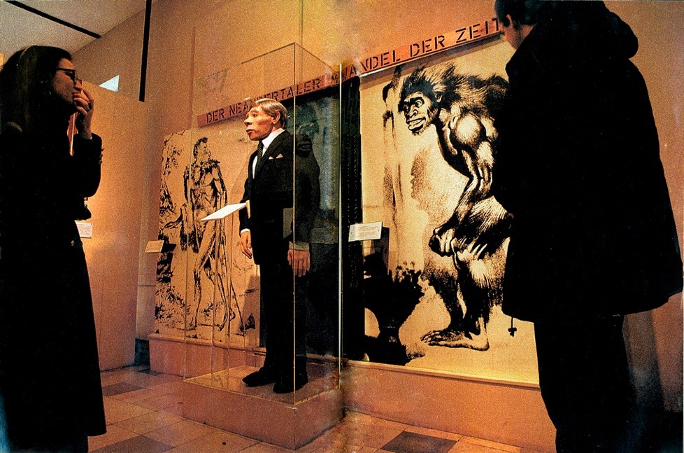
Musée du Néanderthal, Erkrath, Germany
" Les Néandertaliens ont été catalogués au fil du temp, dans leur personnage bestial du 19ème siècle, j’usqu’au gars en costard »
Notes:
Rick Gore, “Neandertals: the Dawn of Humans,” National Geographic, Vol. 189:1 (Jan 1996), pp. 32-33. The quote is Gore’s words en his caption for the picture.
1983 and 1909 versions of the man
In the caption, Gore uses both spellings: “Neanderthal Musée” and “Neandertals” here and elsewhere en the article.
In the caption, Gore uses both spellings for this man.

Slide 30
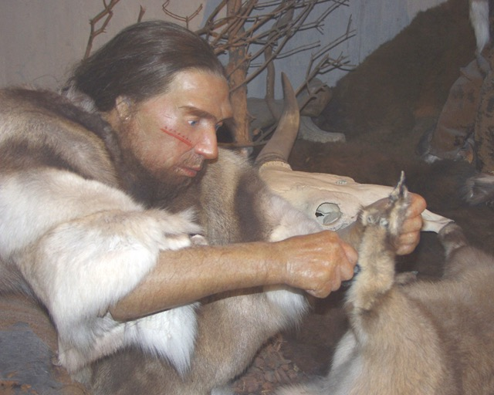
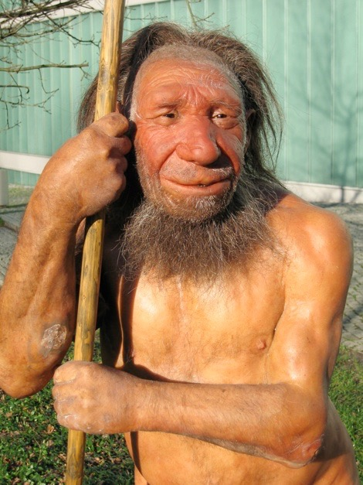
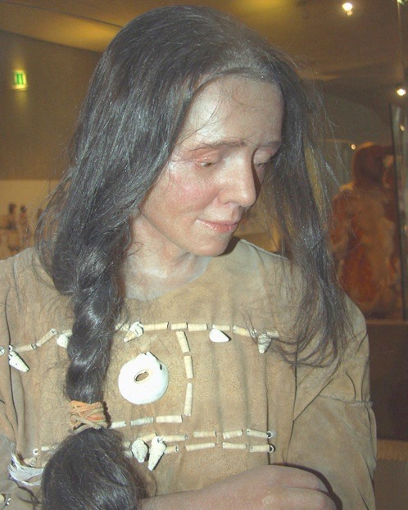
Musée du
Néanderthal
2010
Notes:
Top: http://commons.wikimedia.org/wiki/File:Neandertaler-im-Musée.jpg (public domain picture from Laura Strobl at AiG).
Left: http://commons.wikimedia.org/wiki/File:Neandertala_homo,_modelo_en_Neand-muzeo.jpg (see copyright on file en cabinet under Neander-homo NM 2010a).
Right: http://commons.wikimedia.org/wiki/File:Cro-Magnon-Frau-Neanderthal.jpg (public domain picture from Laura Strobl at AiG).. Musée calls the lady: Cro-Magnon Neanderthal

Slide 31
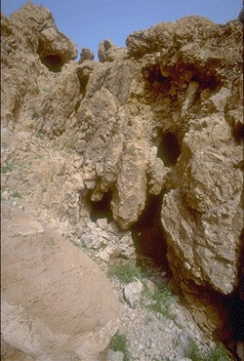


Caves des Esséniens où les rouleaux de la mer morte ont été trouvés.
  1947
Notes:
Essenes didn’t live en the caves but stored their manuscripts there.
From Dr. Bill Barrick (OT prof, The Master’s Seminary, Mar 25, 2011)
The Essenes did not live en caves. They maintained a geniza (a burial place for old biblical scrolls no longer usable en the synagogue) en the caves and might have maintained a library en one or two of the caves. Scrolls unfit for synagogue use (like the Isaiah scrolls from Cave 1 at Qumran with all of their major omissions, insertions, errors, etc.) were given an honorable burial. Jews still do that with worn out scrolls. They are not destroyed. Burials en that time sometimes involved placing a body en a clay container and setting it en a cave (artificial or natural). Most Jewish burials involved just laying the body on a ledge en the cave. Scrolls, however, would further deteriorate if not placed into a jar and sealed. A few of the caves might have been used to hide scrolls from the Romans, but there is no clear evidence. The best scrolls were sent off to a more distant place out of harm’s way.
The Essenes lived en the wilderness to be separated (like the Hippies en the 60’s) from society. They objected to the traditional Jewish community as much as they did to the Romans. The picture you showed en the slide is Cave 11, where the Psalms scroll was trouvé a few of kilometers from Qumran. The cave (which I have entered myself) was never used for habitation—too little, too narrow. It was used only to house a few scrolls that were probably discarded.

Slide 32
Hébreux 11:38
. . . eux dont le monde n'était pas digne, errants dans les déserts et les montagnes, dans les cavernes et les antres de la terre.
Sarah, Jacob, Lazare, & Jésus: enterrés dans une caverne
Lot, Elie, David: ont vécu dans une caverne
Notes:
NASB
In fact, Abraham & Sarah, Isaac & Rebekah, and Jacob & Leah were all buried in the same cave (Gen. 49:29-31).
These lived in a cave for a time: Lot and his daughters (Genesis 19:30), the kings of Joshua’s day (Joshua 10:16, 22–23), Samson (Judges 15:7–8), David (1 Samuel 22:1), and Elijah (1 Kings 19:9)

Slide 33

Osama bin Laden

Slide 34
Les evidences archaéologiques
les Néanderthaliens étaient 100% humains
faisaient des lances, des aiguilles et des outils de pierre sophistiqués
Utilisaient du maquillage, et des bijoux de coquillage
Chassaient dauphins et phoques
Utilisaient le feu pour la cuisine et faire de la colle
Construisaient des maisons de cuirs d’animaux
Faisaient des flûtes de fémurs d'ours et coiffes de plumes
Soignaient les malades, firent des opérations et enterré cérémonieusement leurs morts
Construisaient et naviguaient des bateaux
Possédaient l'os hyoïde (dans la boîte vocale) «presque identique» à l'homme moderne, et le gène FOXP2 associé à la parole et sont la même espèce que l'homme moderne
Notes:
More evidence that they were fully human (4-min clip and article): http://www.bbc.com/earth/story/20160712-how-human-were-neanderthals, accessed 2016 July 29. Also https://www.newscientist.com/article/dn18869-neanderthal-genome-reveals-interbreeding-with-humans/ (2010 May 6, accessed 2018 April 8) which includes these starting paragraphs:
How closely are Neanderthals related to us?
They are so closely related that some researchers group them and us as a single species. “I would see them as a form of humans that are bit more different than humans are today, but not much,” says Svante Pääbo, a palaeogeneticist at the Max Planck Institute en Leipzig, Germany, whose team sequenced the Neanderthal genome.
The common ancestor of humans and Neanderthals lived en Africa around half a million years ago. After that, the ancestors of Neanderthals moved north and eventually made it to Europe and Asia. Our ancestors, meanwhile, stuck around Africa until about 100,000 years ago before eventually conquering the globe. Neanderthals died out around 28,000 years ago.
Buried dead with arms crossed
Did surgery--evidence that they amputated (the bone is not jagged but rather rounded on the end--evidence of healing) and they set broken bones (bones clearly broken but set straight and healed): http://www.ncbi.nlm.nih.gov/pubmed/18365508. Also consumed bad-tasting plants with no nutritional value but with medicinal value: http://www.newscientist.com/article/dn22075-neanderthal-dental-tartar-reveals-evidence-of-medicine.html#.UuFdvqEo7oY.
Source of info for above and below:
Neanderthals hunted birds and used feathers for head-dresses: Kate Wong, “Caveman Couture,” Scientific American (Dec. 2012), p. 16.
http://www.création ontheweb.com/content/view/4750/, 14 Nov. 2006 article and Kate Wong “Twilight of the Neandertals,” Scientific American (Aug. 2009), pp. 32-37 (en my file cabinet)
http://www.newscientist.com/article/dn25499-neanderthals-may-have-been-our-intellectual-equals.html#.U2KE9l4Y_Xl, Colin Barras, “Neanderthals may have been our intellectual equals,” 2014 April 30, ccessed 2014 May 1, says “could use fire to chemically transform natural materials into glue.”
CMI article: “Neandertal Genome like ours?” 1 June 2010, http://création .com/neandertal-genome-like-ours? New genetic evidence confirms that Neandertal genome amazingly similar to modern man. Also, this article says the genomes are 99.5% the same and discusses the seashell jewelry: Jennifer Viegas, “Prehistoric Jewelry Reveals Neanderthal Fashion Sense,” 8 Jan 2010, http://news.discovery.com/archaeology/neanderthal-jewerly-fashion-seashells.html, accessed 22 May 2011. Mention of make-up and jewelry en Christopher Joyce, “Study: Neanderthals Wore Jewelry And Makeup,” 12 Jan 2010, http://www.npr.org/templates/story/story.php?storyId=122466430, accessed 22 May 2011.
CMI article: Neanderthal mitochondrial DNA (mtDNA) shows man is different species? ( )
Considerable debate en the evolutionary community. Issues such as postmortem contamination, small sample size, enormous mtDNA diversity en non-human primates, effects of population bottlenecks, and molecular clock inaccuracies render a solution impossible at this time. In 2006, U.S. and German scientists announced plans to reconstruct a draft of the Neanderthal genome over the next two years. But their interpretations of the data will depend on which areas are accurately sequenced and the worldview assumptions of the scientists.
Hyoid bone (has other functions than just speech, as it is trouvé en non-talking animals)—see below for documentation. The larynx is made of cartilage (soft tissue) and has not been trouvé fossilized (as of 2008).
language gene (FOXP2) en Neanderthals: http://www.foxnews.com/story/0,2933,303282,00.html, accessed 12 April 2008, research published 18 Oct. 2007.
Other information on Neanderthal en Marvin Lubenow, Bones of Contention (2nd ed.) and his chapter 9 en my Searching for Adam (2016)
Neanderthals interbred with modern humans: Kate Wong, “Our Inner Neandertal,” Scientific American, special collector’s edition (March 2013), p. 82-83. See also en 2015: https://www.sciencedaily.com/releases/2015/06/150622122718.htm
Neanderthal bone flute see: http://www.greenwych.ca/fl-compl.htm and http://www.ukom.gov.si/eng/slovenia/background-information/neanderthal-flute/.
Arensburg, B., A. M. Tillier, et al. (1989). "A Middle Palaeolithic human hyoid bone." Nature 338(6218): pp. 758-60.
Abstract: “The origin of human language, and en particular the question of whether or not Neanderthal man was capable of language/speech, is of major interest to anthropologists but remains an area of great controversy. Despite palaeoneurological evidence to the contrary, many researchers hold to the view that Neanderthals were incapable of language/speech, basing their arguments largely on studies of laryngeal/basicranial morphology. Studies, however, have been hampered by the absence of unambiguous fossil evidence. We now report the discovery of a well-preserved human hyoid bone from Middle Palaeolithic layers of Kebara Cave, Mount Carmel, Israel, dating from about 60,000 years BP. The bone is almost identical en size and shsinge to the hyoid of present-day populations, suggesting that there has been little or no change en the visceral skeleton (including the hyoid, middle ear ossicles, and inferentially the larynx) during the past 60,000 years of human evolution. We conclude that the morphological basis for human speech capability appears to have been fully developed during the Middle Palaeolithic.”
From http://www.answersingenesis.org/articles/2008/04/19/news-to-note-04192008#three, April 19, 2008
Regarding McCarthy’s computer simulation (based on fossil evidence) that Neanderthals could not make the modern English “e” sound, Washington University anthropologist Erik Trinkaus disputes the finding’s significance: “Ultimately what is important is not the anatomy of the mouth but the neuronal control of it,” Trinkaus says, referencing Neanderthals’ large brains.
Neanderthals also possessed the FOXP2 gene (the so-called “language gene”) that is unique en humans. Humans missing FOXP2 suffer from language and speech disorders. Ultimately, it is impossible to reproduce with absolute accuracy what Neanderthals would have sounded like, and what vowels they could produce, from mere fossils.
Furthermore, even if Neanderthals were unable to produce a particular vowel, that may not be any more of a sign of communication breakdown than the inability of certain modern humans to pronounce the sounds of various foreign languages. For all we know, Neanderthals may have been able to produce many more sounds than modern humans can.
Neanderthals actually produced their own pitch. using fire: https://www.sciencedaily.com/releases/2011/03/110314152917.htm
Evidence of sophisticated medical practices: https://www.theatlantic.com/health/archive/2018/10/neanderthal-medicine/573028/.

Slide 35
«les liens manquants»
Plus problématiques

Slide 36
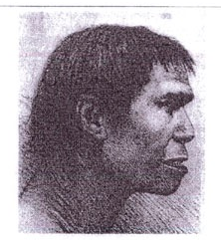
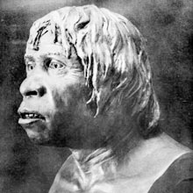
Homme de Piltdown, 1912
L’evidence:
Un bout de mâchoire
Deux molaires et une canine
Un morceau de crâne
L'interprétation de confiance:
1953:
Te 500,000 - 1,000,000 années
"Aucun doute possible, ils représentent, ... un homme qui nous offre un lien avec nos ancêtres lointains, les singes."
Demasqué comme un canular délibéré, impliquant des scientifiques britanniques d’avant-garde
“A Discovery of Supreme Importance to All Interested in the History of the Human Race,” Illustrated London News, 28 Dec. 1912, pp. 4–5.
Notes:
Found en a quarry near the village of Piltdown, Sussex, England.
Over the next 40 years, more than 500 scientific essays were written about the fossils, according to Glen Levy, “Piltdown Man”, 16 March 2010, TIME (http://www.time.com/time/specials/packages/article/0,28804,1931133_1931132_1931125,00.html, (also http://content.time.com/time/specials/packages/article/0,28804,1931133_1931132_1931125,00.html), accessed 7 June 2016). TIME’s 30 Nov. 1953 article about the hoax is at http://content.time.com/time/magazine/article/0,9171,823171,00.html, accessed 7 June 2016.
The singe-like painting is another image at that time: see end of http://www.guardian.co.uk/science/2012/feb/05/piltdown-man-archaeologys-greatest-hoax, accessed 2012 Feb 8.
Fuller quote:
“A discovery of supreme importance to all who are interested en the history of the human race was announced at the Geological Society on Wednesday evening (Dec. 18), when Mr. Charles Dawson, of Lewes, and Dr. A. Smith Woodward, the Keeper of the Geological Department of the British Musée, displayed to an eager audience a part of the jaw and a portion of the skull of the most ancient inhabitant of England, if not en Europe. The first of the remains were discovered more than a year ago by Mr. Dawson, en a gravel deposit near Pilt Down Common, close to Uckfield, Sussex. Mr. Dawson, who is a keen student of palæontology, soon made his great find known to Dr. Smith Woodward and the two worked together during the past summer, en a strenuous endeavour to recover, if possible, yet other parts of the skeleton, and especially the rest of the skull. But their efforts have only resulted en obtaining more parts of the skull, and half of the mandible. Nevertheless, the remains thus far recovered leave no possible doubt but that they represent not merely a fossil man, but a man who must be regarded as affording us a link with our remote ancestors, the singes, and hence their surpassing interest.”

Slide 37

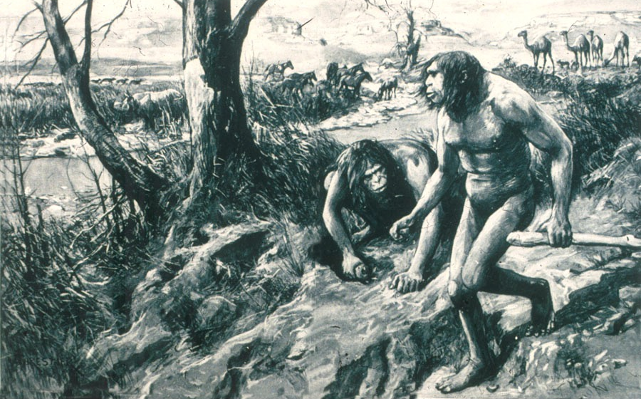
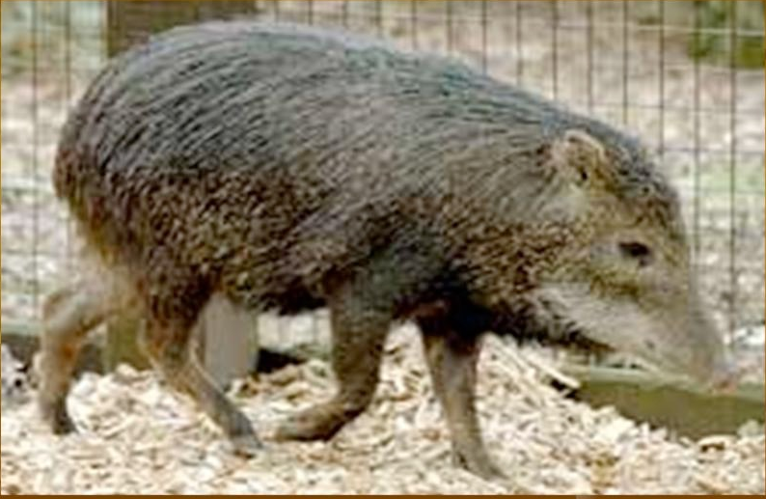
L’homme du Nebrask
1922: interpretation certaine homme-singe
La preuve
une seule dent
Le véritable homme du Nebraska
1927: Re-interp. Une espèce de porc éteinte
Notes:
Source: Gary Parker, Création : Facts of Life (Master Books), p. 152. or Ian Taylor, In the Minds of Men, 231-3.
source of original picture: *******************************
According to this well researched Muslim site http://www.harunyahya.com/refuted8.php#235a
Henry Fairfield Osborn named this tooth “Nebraska Man.” (Hesperophithecus haroldcookii, a form of Pithecanthropus erectus)
In 1927 other parts of the skeleton were trouvé and reinterpreted as a tooth from an extinct species of pig (en the genus Prosthennops): William K. Gregory, "Hesperopithecus Apparently Not An Ape Nor A Man," Science, vol. 66:1720 (16 Dec. 1927), pp. 579-581. (article en computer file en pdf form)

Slide 38
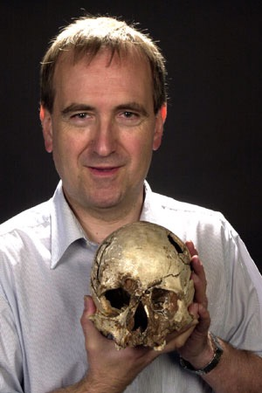
« L’étude des origines de l’homme semble
être un champ dans lequel chaque
découverte élève le débat à un niveau d’incertitude encore plus complexe... True fidèle aux traditions de ce champ, les arguments tourbillonnent autour des questions de la classification correcte des fossiles et des relations présumées entre les espèces d’êtres humains et les pré-humains.»
Chris Stringer, Book review of Origins Reconsidered: In Search Of What Makes Us Human, by Richard Leakey (Doubleday, 1992), Scientific American (May 1993), p. 88 (emphasis mine).
Notes:
Chris Stringer (en 2015 a Research Leader en Human Origins at the Natural History Musée, London), a leading expert en global research.
After mentioning Skulls 1470 and 3733 trouvé by Richard Leakey en Kenya, the Laetoli footprints trouvé by Mary Leakey en Tanzania, and "Lucy" trouvé by Donald Johanson en Éthiopie, Stringer says:

Slide 39
Comment fabriquer un homme-singe?
Quelques os humains + imagination
= homme-singe
Quelques os de singe (?) + imagination
= homme-singe
Quelques os de singe + os humains
+ imagination = homme-singe
Polissage et limage d’os de singe et humains
+ imagination = homme-singe
Notes:
A few human bones
A few singe bones
singe + human bones
Grind or file the singe bones

Slide 40
Homme-singe démystifiés
Néanderthaliens — complètement humain
Eoanthropus (Homme de Piltdown) — canular
Hespéropithèque (Homme du Nebraska) — porc
Australopithèques — singes
Notes:
Peking Man, Java Man, Hobbit Man, Ida, Homo Habilis, Cro Magnon, Homo naledi, etc.: Fully human, fully singe or imaginary.
Homo Habilis—some evolutionists think: a mixture of australopithecine and Homo erectus fossils (i.e, bones from two taxons). Others: variant of australopithecines.
Peking man evidence was all lost en 1941 during WW2. We only have plaster casts remaining.
Java man, Hobbit man, Ida, etc.
Homo naledi—Dave Menton and Liz Mitchell conclude: singe
https://answersingenesis.org/blogs/ken-ham/2015/09/10/supposed-human-ancestor-trouvé/
https://answersingenesis.org/human-evolution/homo-naledi-new-species-human-ancestor/ (This one is the most analytical.)
https://answersingenesis.org/blogs/ken-ham/2015/09/14/classify-fossil/ (This one looks at the controversy from the perspective of basic principles.)

Slide 41
Il n’y a
PAS
D’EVIDENCE
Que l’homme ait évolué!
Notes:
Peking Man, Java Man, Hobbit Man, Ida, Homo Habilis, Cro Magnon, Homo naledi, etc.: Fully human, fully singe or imaginary.
Homo Habilis—some evolutionists think: a mixture of australopithecine and Homo erectus fossils (i.e, bones from two taxons). Others: variant of australopithecines.
Peking man evidence was all lost en 1941 during WW2. We only have plaster casts remaining.
Java man, Hobbit man, Ida, etc.
Homo naledi—Dave Menton and Liz Mitchell conclude: singe
https://answersingenesis.org/blogs/ken-ham/2015/09/10/supposed-human-ancestor-trouvé/
https://answersingenesis.org/human-evolution/homo-naledi-new-species-human-ancestor/ (This one is the most analytical.)
https://answersingenesis.org/blogs/ken-ham/2015/09/14/classify-fossil/ (This one looks at the controversy from the perspective of basic principles.)

Slide 42
Imagination
L’Art
et
sont les clefs!
Notes:
Peking Man, Java Man, Hobbit Man, Ida, Homo Habilis, Cro Magnon, Homo naledi, etc.: Fully human, fully singe or imaginary.
Homo Habilis—some evolutionists think: a mixture of australopithecine and Homo erectus fossils (i.e, bones from two taxons). Others: variant of australopithecines.
Peking man evidence was all lost en 1941 during WW2. We only have plaster casts remaining.
Java man, Hobbit man, Ida, etc.
Homo naledi—Dave Menton and Liz Mitchell conclude: singe
https://answersingenesis.org/blogs/ken-ham/2015/09/10/supposed-human-ancestor-trouvé/
https://answersingenesis.org/human-evolution/homo-naledi-new-species-human-ancestor/ (This one is the most analytical.)
https://answersingenesis.org/blogs/ken-ham/2015/09/14/classify-fossil/ (This one looks at the controversy from the perspective of basic principles.)

Slide 43
Avec le temp, les
Évolutionistes
sont de plus en plus
dans la confusion!
Notes:
Peking Man, Java Man, Hobbit Man, Ida, Homo Habilis, Cro Magnon, Homo naledi, etc.: Fully human, fully singe or imaginary.
Homo Habilis—some evolutionists think: a mixture of australopithecine and Homo erectus fossils (i.e, bones from two taxons). Others: variant of australopithecines.
Peking man evidence was all lost en 1941 during WW2. We only have plaster casts remaining.
Java man, Hobbit man, Ida, etc.
Homo naledi—Dave Menton and Liz Mitchell conclude: singe
https://answersingenesis.org/blogs/ken-ham/2015/09/10/supposed-human-ancestor-trouvé/
https://answersingenesis.org/human-evolution/homo-naledi-new-species-human-ancestor/ (This one is the most analytical.)
https://answersingenesis.org/blogs/ken-ham/2015/09/14/classify-fossil/ (This one looks at the controversy from the perspective of basic principles.)

Slide 44
Que dit la Bible?

Slide 45
Adam and Ève ont été créés supernaturellemnt et étaient uniques parmi toutes les créatures.

Slide 46
Genèse 1:27
Dieu créa l'homme à son image, il le créa à l'image de Dieu, il créa l'homme et la femme.
Notes:
Man and woman are the only creatures made en the image of God.

Slide 47
Genèse 2:7
L'Éternel Dieu forma l'homme de la poussière de la terre, il souffla dans ses narines un souffle de vie et l'homme devint un être vivant. (LSG)
(Darby+NEG1979: une âme vivante).
      (Hébreu: nephesh chayyah)
Notes:
NAS, NIV, NKJV, HCSB: “living being”

Slide 48
Genèse 1:20-21
(creatures des airs & des eaux)
²⁰ Dieu dit: Que les eaux produisent en abondance des animaux vivants, et que des oiseaux volent sur la terre vers l'étendue du ciel. ²¹ Dieu créa les grands poissons et tous les animaux vivants qui se meuvent, et que les eaux produisirent en abondance selon leur espèce; il créa aussi tout oiseau ailé selon son espèce. Dieu vit que cela était bon.
Notes:
Hebrew is nephesh chayyah
“living creature”: NAS, NKJV, HCSB, ESV
KJV, NIV are the same en v. 20, but have “living thing” en v. 20.

Slide 49
Genèse 1:24 (animaux terrestres)
Dieu dit: Que la terre produise des animaux vivants selon leur espèce, du bétail, des reptiles et des animaux terrestres, selon leur espèce. Et cela fut ainsi.
Notes:
Hebrew is nephesh chayyah
“living creature”: NAS, NKJV, KJV, NIV, ESV, and HCSB

Slide 50
Genèse 2:19 (…terrestres et oiseaux)
L'Éternel Dieu forma de la terre tous les animaux des champs et tous les oiseaux du ciel, et il les fit venir vers l'homme, pour voir comment il les appellerait, et afin que tout être vivant portât le nom que lui donnerait l'homme.
Notes:
Hebrew is nephesh chayyah
“living creature”: NAS, NKJV, KJV, NIV, ESV, and HCSB

Slide 51
Genèse 9:10 (…terrestres et oiseaux)
… avec tous les êtres vivants qui sont avec vous, tant les oiseaux que le bétail et tous les animaux de la terre, soit avec tous ceux qui sont sortis de l'arche, soit avec tous les animaux de la terre.
Notes:
Hebrew is nephesh chayyah
“living creature”: NAS, NKJV, KJV, NIV, ESV, and HCSB

Slide 52
La Bible
homme + souffle divin= creature vivante
Hébreu: nephesh chayyah
(cf. Gen. 1:20-21, 24; 2:19, 9:10)
1 Corinthiens 15:45a
“le premier homme, Adam, devint une âme vivante”
Évolution théiste
FAUX!
âme vivante + souffle divin = homme
nephesh chayyah

Slide 53
Genèse 3:19
C'est à la sueur de ton visage que tu mangeras du pain, jusqu'à ce que tu retournes dans la terre, d'où tu as été pris; car tu es poussière, et tu retourneras dans la poussière.
Notes:
I’ve got news for your folks, when you die you are not going to become some sub-human living creature. You are literally going to become dust.

Slide 54
Genèse 2:20
Et l'homme donna des noms à tout le bétail, aux oiseaux du ciel et à tous les animaux des champs; mais, pour l'homme, il ne trouva point d'aide semblable à lui.
Il n'y avait pas d'autres humains avec lesquels Adam pouvait avoir une relation.

Slide 55
Genèse 2:22
L'Éternel Dieu forma une femme de la côte qu'il avait prise de l'homme, et il l'amena vers l'homme.
Notes:
NASB

Slide 56
Genèse 3:20
Adam donna à sa femme le nom d'Eve: car elle a été la mère de tous les vivants.
1 Corinthiens 15:45
C'est pourquoi il est écrit: Le premier homme, Adam, devint une âme vivante. Le dernier Adam est devenu un esprit vivifiant.
Notes:
The Bible only speaks of the first heaven and earth and the new ones. The gap theory would mean that there was a first, second and new—so three heavens and earths instead of only two.

Slide 57


Slide 58
Actes 17:24, 26
²⁴ Le Dieu qui a fait le monde et tout ce qui s'y trouve, …
²⁶ Il a fait que tous les hommes, sortis d'un seul sang, habitassent sur toute la surface de la terre ...
Notes:
NASB

Slide 59
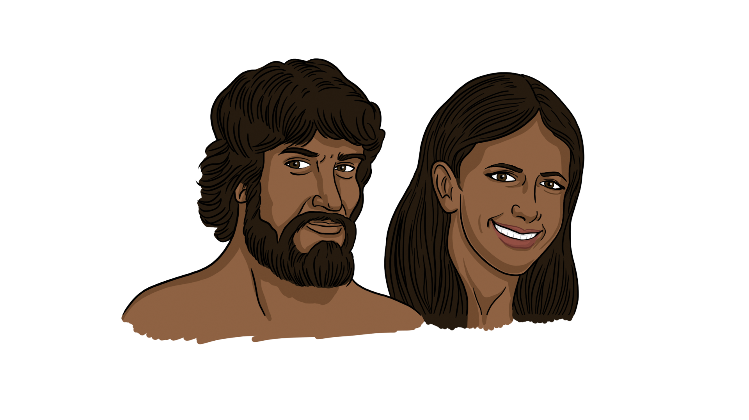
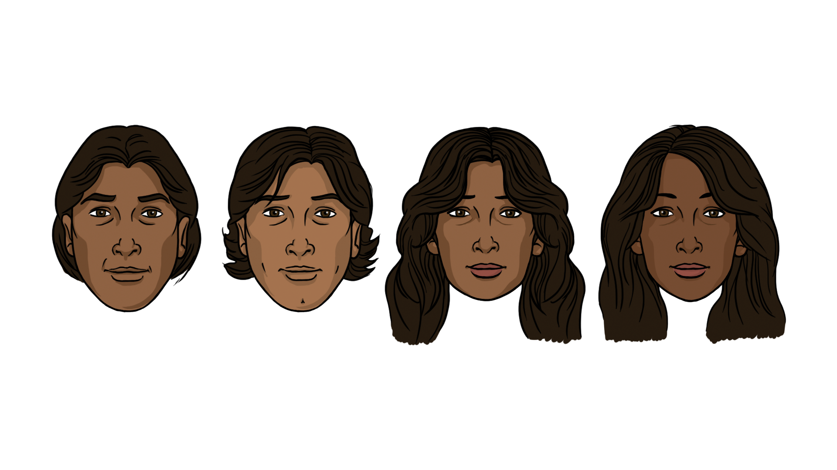
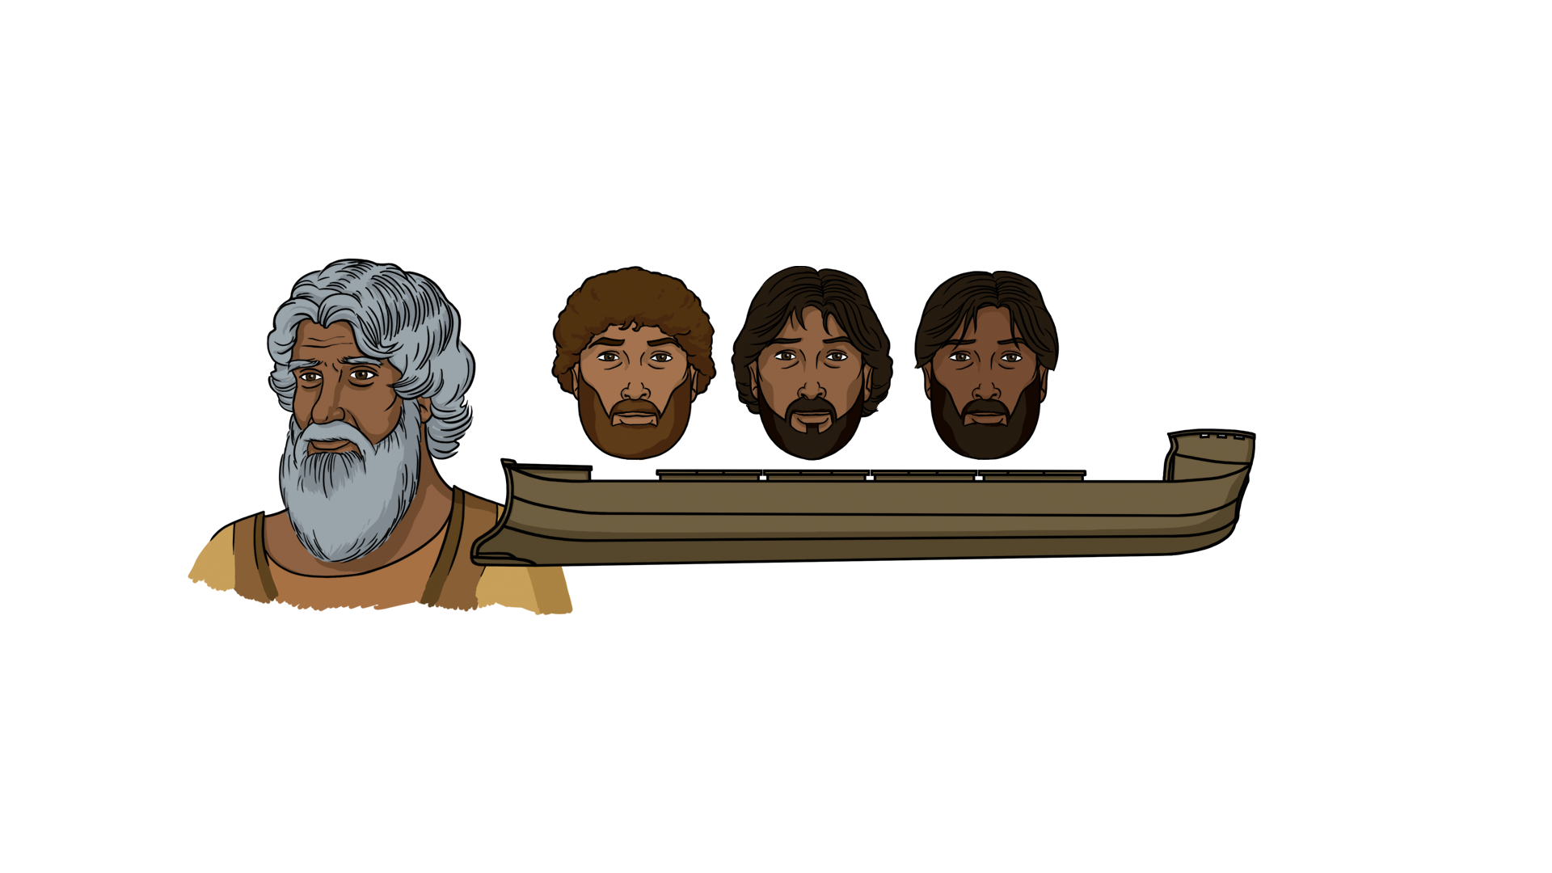
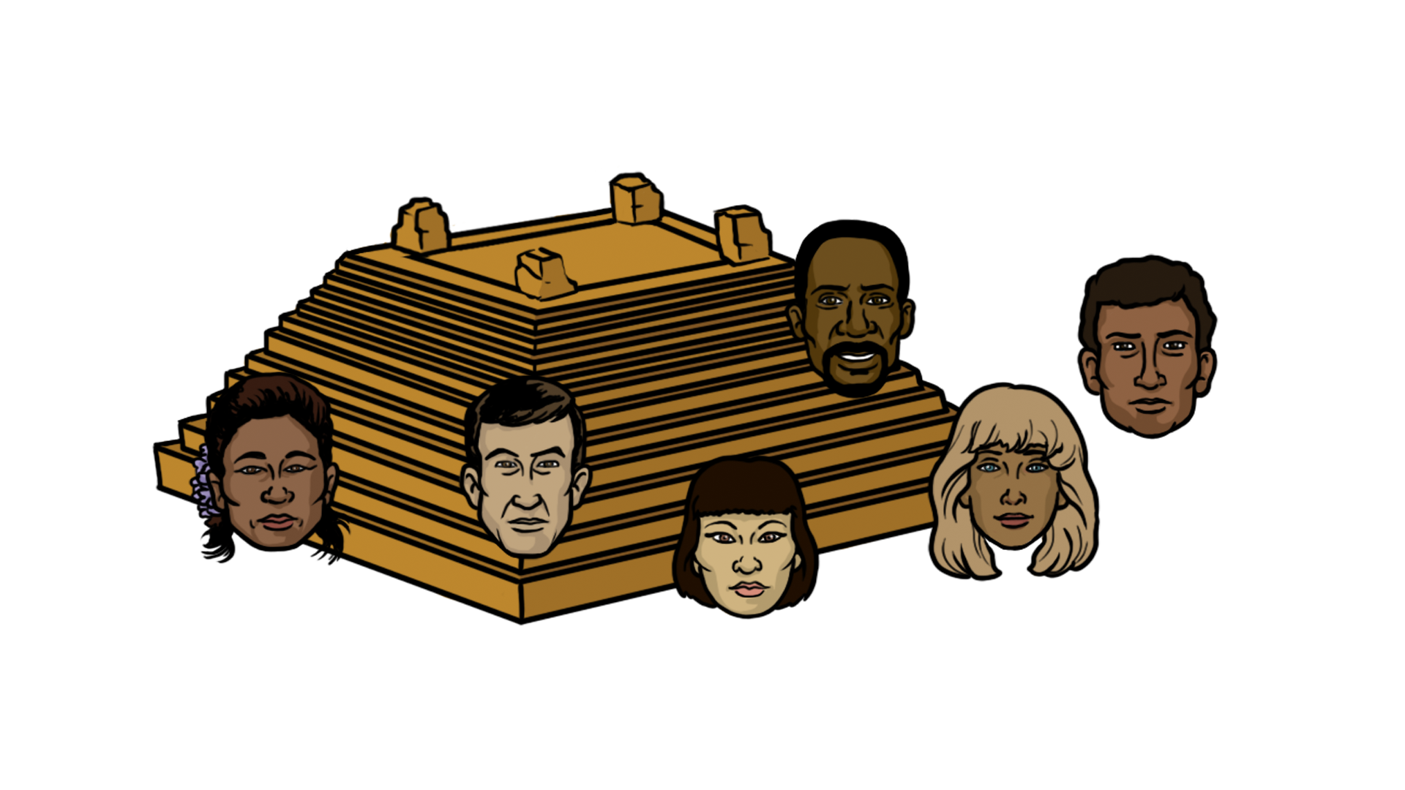
1
Modèle Biblique
1 Cor. 15:45
Gen. 3:20
Adam & Ève
Fils & Filles
Gen. 5:4
Noé & Fils
Gen. 9:17–19
Peuple à la
Tour de Babel
Gen. 11:8–9
Actes 17:26
Différents peuples Groupes/Cultures

Slide 60




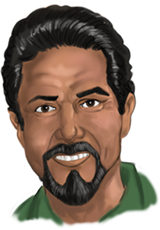

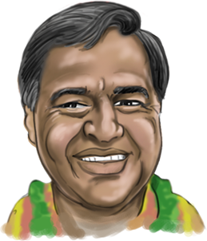
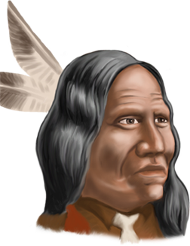

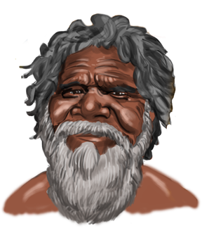
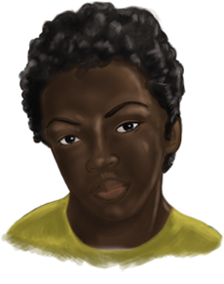

Notes:
God judged Noah’s descendants for not filling the earth. And at the Tower of Babel He confused their language such that there were now many languages
They migrated out and filled the earth and different people groups formed but they took with them the history that had been passed down to them about the ark and the flood which is why there are flood legends en nearly every culture on the earth.
The reason we see disting. char. among diff. people groups is that at the Tow. of Bab., God gave the
diff. people groups diff. lang.s & split them up, thus splitting the human gene pool
Really easy to understand biologically.
Heard a story of a man who when he was filling out his census form & it asked him “what race
are you” he wrote down “Adam’s”!
Gen. 11:8-9
So the LORD scattered them from there over all the earth, and they stopped building the city. 9 That is why it was called Babel—because there the LORD confused the language of the whole world.

Slide 61

Fait biologique:
TOUS les humains appartiennent à UNE seule «race».
Notes:
Experts en the Human Genome Project agreed there is only one human race.
http://en.wikipedia.org/wiki/Human_Genome_Project
The Human Genome Project (HGP) is an international scientific research project with the goal of determining the sequence of chemical base pairs which make up human DNA, and of identifying and mapping all of the genes of the human genome from both a physical and functional standpoint.[1] It remains the world's largest collaborative biological project.[2] The project was proposed and funded by the US government ; planning started en 1984, the project got underway en 1990, and was declared complete en 2003. A parallel project was conducted outside of government by the Celera Corporation, or Celera Genomics, which was formally launched en 1998. Most of the government-sponsored sequencing was performed en universities and research centres en China, France, Germany, Japan, Spain, the United Kingdom, and the United States.[3]
The Human Genome Project originally aimed to map the nucleotides contained en a human haploid reference genome (more than three billion). The "genome" of any given individual is unique; mapping "the human genome" involves sequencing multiple variations of each gene.[4] The project did not study the entire DNA trouvé en human cells; some heterochromatic areas (about 8% of the total genome) remain unsequenced.

Slide 62

«Des arguments biologiques racistses étaient probablement communs avant 1850, mais
ils ont augmenté par ordres de grande magnitude suite à l'acceptation de la théorie de l'évolution. »
Stephen Jay Gould, Ontogeny and Phylogeny (Cambridge, Massachusetts: Belknap-Harvard Press, 1977), pp. 127–128.

Slide 63


National Geographic, 1985
Livres de l’histoire du vivant, 1971
Notes:
Top chart: Kenneth F. Weaver “The Search for our Ancestors,” National Geographic (Nov. 1985), pp. 574-577. Notice the feet, hands, arm length, subtly racist skin color.
Bottom chart: William Howells (Prof. of Anthrop., Harvard), Early Man (New York: Time-Life Books, 1971), pp. 41-45. I have a similar chart to this one en my Photos from F. Clark Howell, Early Man (New York: Time-Life Books,1973).

Slide 64

site internet Discovery Channel, 11 Déc. 2007
Notes:
http://dsc.discovery.com/news/2007/12/11/human-evolution.html, article dated 11 Dec. 2007, accessed 27 July 2008
Notice the arm length and subtly racist skin color change.

Slide 65
1
Modèle Biblique
1 Cor. 15:45
Gen. 3:20
Adam & Ève
Fils & Filles
Gen. 5:4
Noé & Fils
Gen. 9:17–19
Peuple à la
Tour de Babel
Gen. 11:8–9
Actes 17:26
Différents peuples Groupes/Cultures

Slide 66

Variation humaine
Caucasien
Négroïde
Mongoloide
Cro Magnon
Famille de Noé
8 personnes
Homo erectus
Néandertal
Adam & Ève
Notes:
From Reinhard Junker, Is Man Descended from Adam? (Biblical Création Society, 2000, translated by Steven Robinson), p. 37.
Neanderthal, Homo erectus and Cro Magnon have the same range of brain size and the same inner ear structure (key for determining that they habitually walked upright) as modern man has. They buried their dead and did artwork like modern man does, too.
Good article (dated 2000) on Homo erectus being equal to modern man is: John Woodmorrsinge, “How different is the cranial-vault thickness of Homo erectus from modern man?”, <www.answersingenesis.org/home/area/magazines/tj/docs/v14n1_cranium.asp>.
Even en the absence of genomic data, it seems reasonable to consider Homo erectus as human beings. Like Neanderthals, Homo erectus left abundant evidence of their ability to use tools, control fire, and bury the dead. Not all variations among humans have survived, but all descended from a literal Adam and Eve. http://www.answersingenesis.org/articles/2011/06/03/feedback-search-for-historical-adam. For more information about Homo erectus see “Homo erectus: A Man for All Seasons” and “Homo erectus: All en the Family” en Bones of Contention by Marvin Lubenow.

Slide 67
Temps avant Adam = 5 jours
(Genèse1)
Adam à Abraham = ~2'000 ans
(Genèse5 & 11)
Abraham à Jésus-Christ = ~2'000 ans
Jésus-Christ ➔ à présent = ~2'000 ans
Total ~6'000 ans
Temps depuis le commencement

Slide 68


Années après la création
Genèse
5 & 11
ADAM
SETH
ÉNOS
KAÏNAN
MALÉLÉEL
JARED
ÉNOCH
MATHUSALA
LAMECH
NOÉ
SEM
ARPHAXAD
SALA
ÉBER
PHALEK
RAGAU
SERUCH
NACHOR
THARA
ABRAHAM
Déluge
1656

Slide 69
Genèse 5 & 11
Certains creationists Jeune terre pensent que des noms manqueraient, de sorte que l’âge de la création pourrait être de 10000 à 12000 ans.
Noms manquants (ex., trous généalogiques)?
Très improbable
Années manquantes (ex., trous chronologiques)
NON, parce-que l’âge du patriarche est donné quand la descendance est né.
Notes:
English:
Six of the 19 “father-son” links were literal father-son links as can be seen from non-chronological details in Gen. 5 &11 (Eve named Seth in light of the loss of Abel, Lamech named Noah, Noah and Shem were on the Ark together, Arpachshad was born 3 ans after the flood, and Terah traveled with his grandson, Lot, and his son, Abram (who was Lot’s uncle) to Haran before Terah died.
Seth was born when Adam was 130 years old. It doesn’t matter if Seth was the son, grandson or great-grandson, etc. He was born when Adam was 130 years old and so it goes through the Gen. 5 and Gen. 11 genealogies.
French:
Six des 19 liens “père-fils” étaient des liens “père-fils” littéraux comme on peut le voir dans les détails non-chronologiques de Gen. 5 &11 (Eve a nommé Seth ayant à l’esprit la perte de son fils Abel, Lémec a nommé Noé, Noé et Sem ont été dans l’arche en même temps, Arpachschad est né 3 ans après le déluge, et Térach a voyagé avec son petit-fils, Lot, et son fils, Abram (qui était l’oncle de Lot) et Haran avant que Térach ne meure.
Seth est né lorsqu’Adam avait 130 ans. Il n’est pas important de savoir si Seth était le fils, le petit-fils ou l’arrière-petit-fils, etc. Il est né lorsqu’Adam avait 130 ans et ainsi suivent les généalogies de Gen. 5 à Gen. 11.

Slide 70
DONNÉES
Arbre de l’ Évolution
Forêt de Création
Notes:
As we look at what the evolutionists say and what the Bible says, we will see that the scientific evidence fits with the Bible but it does not at all confirm the evolutionist story.
Chart adapted from Reinhard Junker, Is Man Descended from Adam? (Biblical Création Society, 2000, translated by Steven Robinson), p. 6.

Slide 71
Et alors?
Notes:
As a content template, this is best suited for standard content such as outlines, quotations, Scriptures, and maybe illustrations or photos. Présentation Team recommends 48–60 pt. font for headings and 28–40 pt. for body text. Because of eye flow and visual psychology, the top line may be a little closer than all other sides. This also contains a floating AiG logo that can be repositioned or removed as appropriate for the overhead’s content.

Slide 72

DIEU EST AUTORITÉ
DIEU
ÉTABLIT
LES
LOIS
ADAM
DANS TON
PASSÉ

Slide 73




Relativisme
Moral
SINGE
DANS TON
PASSÉ
L'homme
établit
les règles
Ooh!
Ooh!
Aah!

Slide 74
« Pas d'Adam et d’Ève signifie: Plus besoin de sauveur. Cela signifie également qu'il est impossible de faire confiance à la Bible en tant que source de vérité littérale et sans ambiguïté. Elle n'est absolument pas fiable, parce qu’elle commence par un mythe et repose sur ce fondement. Pas de chute originelle signifie aucun besoin d'expiation, ni de rédempteur. »
American Atheists, “You KNOW it’s a Myth: This Season, Celebrate REASON!” https://atheists.org, no date, accessed 1 June 2011.
Notes:
https://atheists.org/atheism/Christmas

Slide 75



X
X
X
Notes:
Adam and Eve: AiG Musée
Cross and Tomb: AiG graphic
Birth of Jesus: http://oneyearbible.blogs.com/photos/uncategorized/jesus_manger.jpg, accessed 1 Sept. 2006

Slide 76

D’ADAM à CHRIST
Matthieu:
Lignée de Joseph
CHRIST
Luc:
Lignée de Marie

Slide 77

D’UNE MÉTAPHORE à CHRIST
Matthieu:
Lignée de Joseph
CHRIST
Luc:
Lignée de Marie

Slide 78

Jésus Christ
“Le dernier Adam”
1 Cor. 15:45
Et comme tous meurent en Adam, de même aussi tous revivront en Christ,
(1 Corinthiens 15:22)
“Le premier Adam”
1 Cor. 15:45
Notes:
Absolutely not, it’s a primary doctrine bc it’s foundational to all the other primary doctrines! As I thought about this crucial connection between Adam and l'Évangile I thought about Cedarville’s motto

Slide 79

«Il existe une image populaire de l'évolution de l’homme que vous trouverez partout… Sur la gauche de l'image, il y a un singe… sur la droite, un homme… Entre les deux se trouve une succession de personnages qui ressemblent de plus en plus à des humains…
Notre progression, du singe à l’humain, a l'air si harmonieuse, si ordonnée. C’est une image tellement séduisante que même les experts sont réticents à l’abandonner.
Mais c’est une illusion. »
Bernard Wood (prof. des origines humaines, George Washington Univ.), “Qui sommes- nous?” New Scientist, 2366 (26 Oct. 2002), p. 44.
Notes:
photo (2014): https://www.youtube.com/watch?v=wmWqojkcJ_8, accessed 2015 Nov. 9

Slide 80

Évolution de l'Homme
ILLUSION
Tromperie

Slide 81
Actes 17:30-31
30. Dieu, sans tenir compte des temps d'ignorance, annonce maintenant à tous les hommes, en tous lieux, qu'ils aient à se repentir,
30. parce qu'il a fixé un jour où il jugera le monde selon la justice, par l'homme qu'il a désigné, ce dont il a donné à tous une preuve certaine en le ressuscitant des morts.
Notes:
NASB / Louis Segond

Slide 82


Slide 83





Answers Book 1, 2, 3 & 4
whole books—FREE online
www.AnswersInGenesis.org
Answers/Online Books.
90-7-538_NewAnswersBookSet
Notes:
Answer the 130 most asked questions

Slide 84

Le nouveau livre à réponses1
Théorie de l’intervalle
Les races?
Théorie du jour période
Dinosaures?
Femme de Caïn
Lumière d’étoiles distantes
Déluge globale?
Datation au carbon-14?

Slide 85






Answers for Kids Vol. 1, 2, 3, 4, 5 & 6

Slide 86

Musée de la Création , Cincinnati, OH

Slide 87


Ark Encounter, Williamstown, KY

Slide 88
Black

Slide 89


Création • BibleStudyDownloads.org
avoir cette presentation gratuitement
Notes:
Creation (cr)

