Slide 1
Empirical Judgments in Ethical Decisions
Session 27
Dr. Lewis Winkler • East Asia School of Theology (Singapore) Uploaded by Dr. Rick Griffith • Jordan Evangelical Theological Seminary Files in many languages for free download at BibleStudyDownloads.org

Slide 2
I. Introduction:

Slide 3
II. Reality and the Utilization of Raw Factual Data
Everyone selectively notices and uses the raw facts that are presented to us.

Slide 4
II. Reality and the Utilization of Raw Factual Data
Two or more people can examine the same data and come to very different interpretations concerning the significance and meaning of that data.

Slide 5
II. Reality and the Utilization of Raw Factual Data
People’s interpretive impressions of a situation will often determine how they ultimately assess the moral nature and propriety of any given action or set of actions.

Slide 6
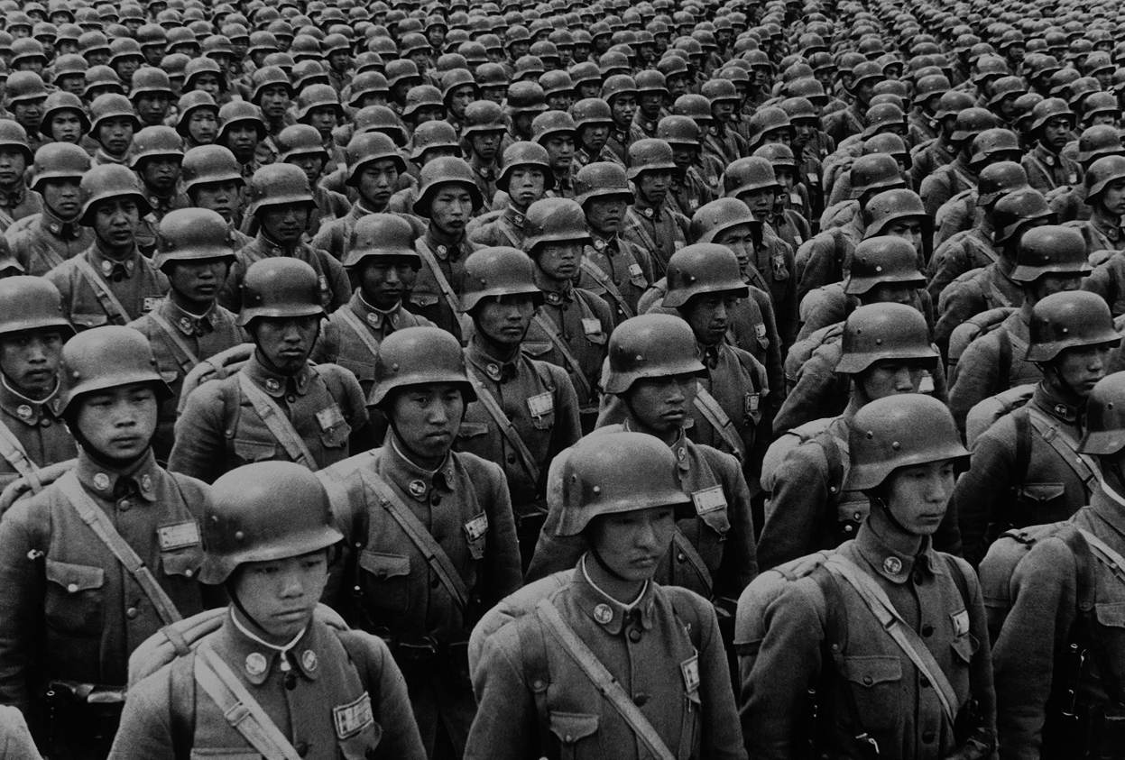
III. Some Helpful Illustrative Examples
War

Slide 7
III. Some Helpful Illustrative Examples
War
Environmental Issues

Slide 8
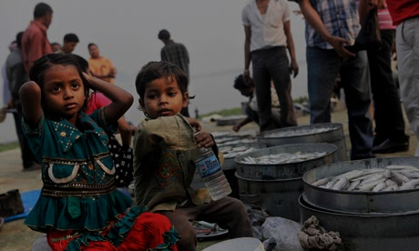
III. Some Helpful Illustrative Examples
War
Environmental Issues
Poverty and Economic Justice

Slide 9
IV. Key Factors Influencing Empirical Judgments
Social Mores

Slide 10
IV. Key Factors Influencing Empirical Judgments
Social Mores
Ideologies

Slide 11
IV. Key Factors Influencing Empirical Judgments
Social Mores
Ideologies
Vested Interests

Slide 12
IV. Key Factors Influencing Empirical Judgments
Social Mores
Ideologies
Vested Interests
Personal Dispositions

Slide 13
V. Possible Responses to the Reality of Differing Empirical Judgments
Moral Cynicism

Slide 14
V. Possible Responses to the Reality of Differing Empirical Judgments
Moral Cynicism
Moral Relativism

Slide 15
V. Possible Responses to the Reality of Differing Empirical Judgments
Moral Cynicism
Moral Relativism
Critical Realism

Slide 16
VI. Conclusion:

Slide 17
Black

Slide 18
Worldview link at BibleStudyDownloads.org
Get this presentation for free!
Notes:
WV (Worldviews)

