Slide 1
Taught by Dr. Ron Man for Doctor of Ministry Students Uploaded by Dr. Rick Griffith • Singapore Bible College Files in many languages for free download at BibleStudyDownloads.org

Slide 3
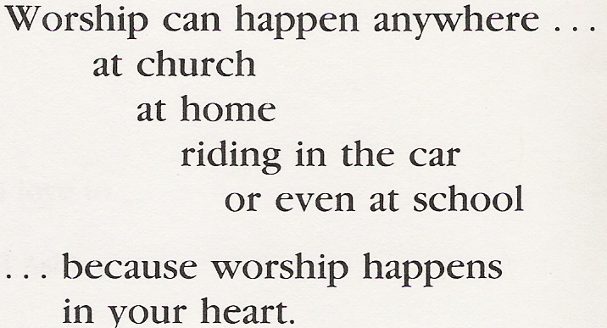

Slide 13
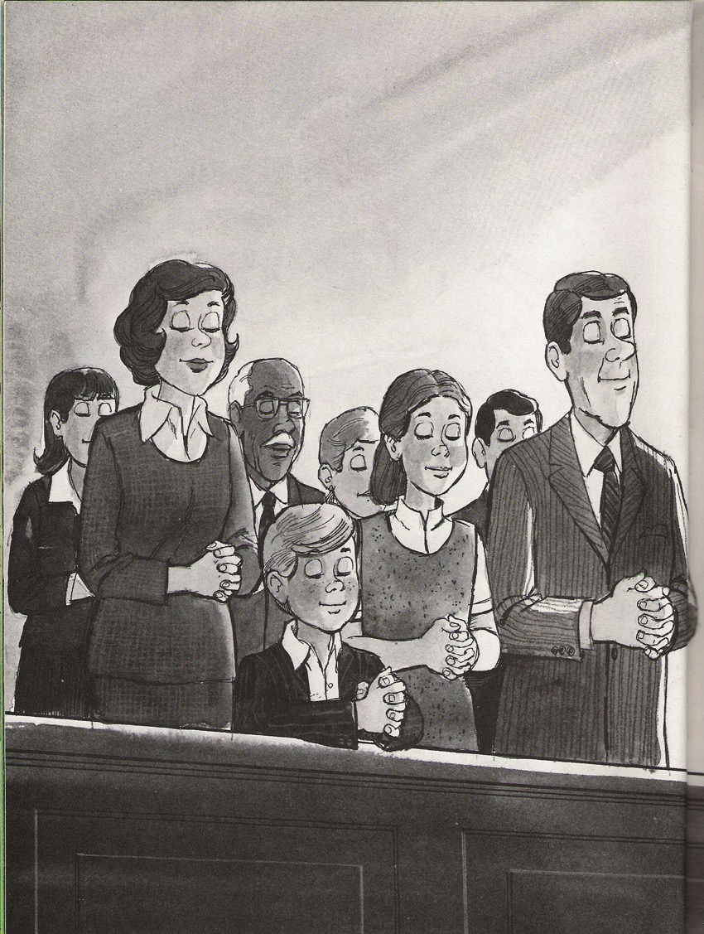
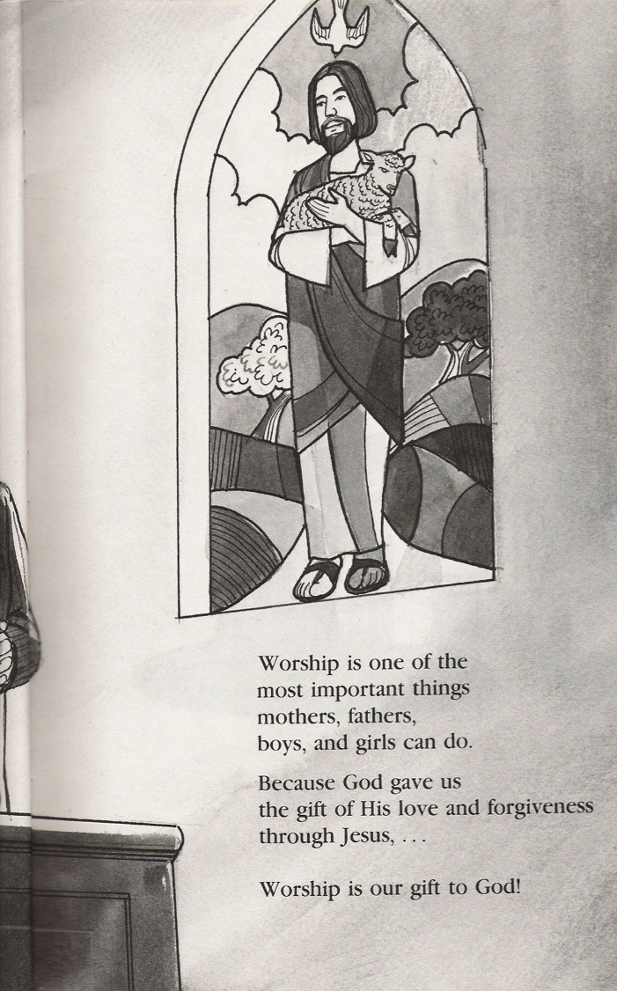
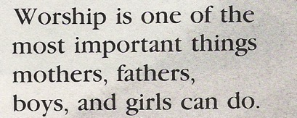

Slide 15
Black

Slide 16
Worship link at BibleStudyDownloads.org
Get this presentation for free!
Notes:
The Bible…Basically (bb)

