Slide 1
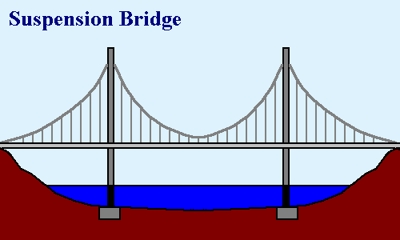
Cultural
FLEXIBILITY
OF FORM
BIBLICAL
CONSTANTS
(Acts 2:42,46-47)
BIBLICAL
PRINCIPLES
Biblical
Taught by Dr. Ron Man for Doctor of Ministry Students Uploaded by Dr. Rick Griffith • Singapore Bible College Files in many languages for free download at BibleStudyDownloads.org
Notes:
Biblical parameters, framework-- flexibility
Each congregation & leadership– how to obey the biblical constants and apply the biblical principles in their own unique context
When I come in as an itinerant teacher: no right
Some of you earn the right to address also the top issues by living long-term in the culture—but still the biblical framework, foundation must remain the same
Change: all occurs on top—biblical doesn’t change

Slide 2
“Biblical Principles of Worship”
www.worr.org/articles
Notes:
One suggested set of principles (listed on back of half-sheet on free table)
On website: application in a particular local church setting (Germany); “therefore, we will…”

Slide 3
God’s glory, and our joyful celebration of it in worship, should be the focus and goal of all life and ministry.
Whether, then, you eat or drink or whatever you do, do all to the glory of God.
(1 Cor 10:31)
Worship is an end it itself. By definition other types of ministry necessarily have horizontal, man-focused aspects; but worship is purely vertically focused. It is the primary purpose for which God created us and therefore our highest endeavor and greatest fulfillment. (Isaiah 43:6-7; Psalm 16:11; Matthew 22:35-38; 1 Peter 4:11)
THEREFORE: We shall give worship careful focus and attention in the life of this church. We will relate all of our activities to it and to the goal of magnifying the glory of God. We will make explicit God’s glory as our most important pursuit, aim and preoccupation.
God’s glory, and our joyful celebration of it in worship, should be the focus and goal of all life and ministry.
Whether, then, you eat or drink or whatever you do, do all to the glory of God. (1 Cor 10:31)
Worship is an end it itself. By definition other types of ministry necessarily have horizontal, man-focused aspects; but worship is purely vertically focused. It is the primary purpose for which God created us and therefore our highest endeavor and greatest fulfillment. (Isaiah 43:6-7; Psalm 16:11; Matthew 22:35-38; 1 Peter 4:11)
THEREFORE: We shall give worship careful focus and attention in the life of this church. We will relate all of our activities to it and to the goal of magnifying the glory of God. We will make explicit God’s glory as our most important pursuit, aim and preoccupation.

Slide 4
DOXOLOGICAL WORSHIP
1. God’s glory, and our joyful celebration of it in worship, should be the focus and goal of all life and ministry.
“Whether, then, you eat or drink or whatever you do, do all to the glory of God.”
(1Cor. 10:31)

Slide 5
NOT:
“What great worship
we had today!
BUT:
“What a great God
we worshiped today!”

Slide 6
THEOCENTRIC WORSHIP
2. Worship is first and foremost for God.
“Worship God.”
(Revel. 19:10; 22:9)
“Worship is the only Christian activity which is an end in itself.” (John Piper)
“I don’t have any trouble with consumer-oriented worship, as long as we remember Who the Consumer is.” (Eric Alexander)
Notes:
Eric Alexander: “I don’t have any trouble with consumer-oriented worship, as long as we remember who the Consumer is.”

Slide 7
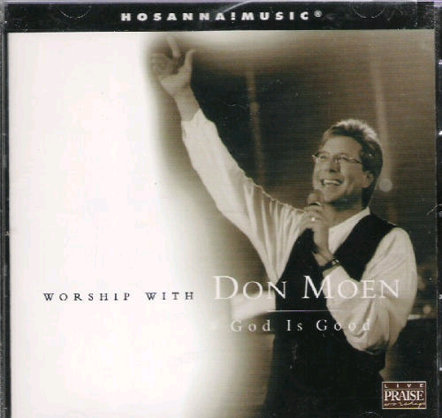

Slide 8
DIALOGICAL WORSHIP
3. Worship is a dialogue between God and His people, a rhythm of revelation and response.
“Great is the Lord,
and greatly to be praised.”
(Psalm 96:4)

Slide 9
“God needs to be known before He can be worshiped.”
(Eric Alexander)
Notes:
God reveals His glory, worship is our response
Order is important: God always initiates
Rom. 11:33-36 eleven chapters of doctrine, then Paul bursts out in praise: „Oh, the depth of the riches ¹both of the wisdom and knowledge of God!”
Worship services to be a dialogue betw, God and man, a dialogue of revel. & response
This is why the Scriptures are so important; Stott and others remind us how we need much more Scr. In our services– been in many churches where first first of Scr. Is when preacher gets up– means 30 mintues of response w/o anything to respond to!!

Slide 10
“Our worship is our answer to God who has first addressed us. Man worships the God who has made Himself known.”
(William Nicholls)
Notes:
God reveals His glory, worship is our response
Order is important: God always initiates
Rom. 11:33-36 eleven chapters of doctrine, then Paul bursts out in praise: „Oh, the depth of the riches ¹both of the wisdom and knowledge of God!”
Worship services to be a dialogue betw, God and man, a dialogue of revel. & response
This is why the Scriptures are so important; Stott and others remind us how we need much more Scr. In our services– been in many churches where first first of Scr. Is when preacher gets up– means 30 mintues of response w/o anything to respond to!!

Slide 11
““The purpose of
theology is doxology;
we study in order to praise.”
(J. I. Packer)
Notes:
God reveals His glory, worship is our response
Order is important: God always initiates
Rom. 11:33-36 eleven chapters of doctrine, then Paul bursts out in praise: „Oh, the depth of the riches ¹both of the wisdom and knowledge of God!”
Worship services to be a dialogue betw, God and man, a dialogue of revel. & response
This is why the Scriptures are so important; Stott and others remind us how we need much more Scr. In our services– been in many churches where first first of Scr. Is when preacher gets up– means 30 mintues of response w/o anything to respond to!!

Slide 12
WORD-SATURATED WORSHIP
4. The Word must be central in our worship.
“Praise Him
according to His excellent greatness.”
(Psalm 150:2)
Notes:
Biblical pattern of Rev. and Resp.: worship is a DIALOGUE
We need to let God speak to us through His Word; then we respond with our worship
Not just talk about, sing about God– but hear from His own Word what He says about Himself– and then respond with our hearts and voices

Slide 13
PARTICIPATORY WORSHIP
5. Worship is the responsibility of all God’s people.
“So we Your people and the sheep of Your pasture will give thanks to You forever.”
(Psalm 79:13)

Slide 14
Worship Is a Verb
(Robert Webber)
The question is not,
‘Do you have a voice?’
but
‘Do you have a song?’

Slide 15
Not too loud
Not too high
Not too complex
Not too new

Slide 16
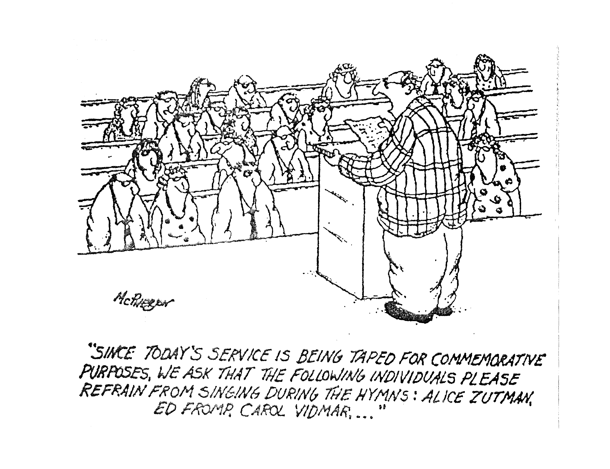

Slide 17
CHRIST-LED WORSHIP
6. Our worship is acceptable in and through Christ our High Priest.
“In the midst of the assembly I will sing Your praise.” (Hebrews 2:12)
Notes:
Not the excellence of what we do; not because we have found the right from or style; not because we're so committed or worthy– but because of Christ's excellence and worthiness. We need to be conscious of our total acceptance and acces to the Father because we come in Christ– no fear, no doubt– blessed assurance.

Slide 18
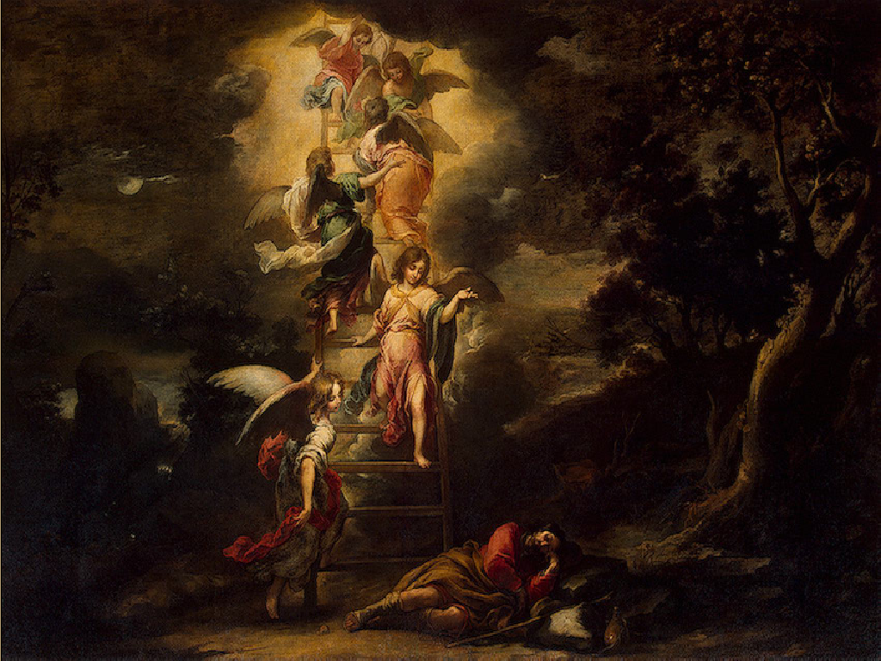

Slide 19
SPIRIT-ENABLED WORSHIP
7. Our response of worship is enabled, motivated and empowered by the Holy Spirit.
“We are the true circumcision, who worship in the Spirit of God and glory in Christ Jesus and put no confidence in the flesh.”
(Philippians 3:3)
Notes:
Not the excellence of what we do; not because we have found the right from or style; not because we're so committed or worthy– but because of Christ's excellence and worthiness. We need to be conscious of our total acceptance and acces to the Father because we come in Christ– no fear, no doubt– blessed assurance.

Slide 20
Notes:
God reveals His glory, worship is our response
Order is important: God always initiates
Rom. 11:33-36 eleven chapters of doctrine, then Paul bursts out in praise: „Oh, the depth of the riches ¹both of the wisdom and knowledge of God!”
Worship services to be a dialogue betw, God and man, a dialogue of revel. & response
This is why the Scriptures are so important; Stott and others remind us how we need much more Scr. In our services– been in many churches where first first of Scr. Is when preacher gets up– means 30 mintues of response w/o anything to respond to!!

Slide 21
WHOLE-LIFE WORSHIP
8. Worship is the response of our entire lives to God.
“Therefore I urge you, brethren, by the mercies of God, to present your bodies a living and holy sacrifice, acceptable to God, which is your spiritual service of worship.”
(Romans 12:1)

Slide 22
HEART WORSHIP
9. God is much more concerned
with our heart than with the form
of our worship.
“I delight in loyalty rather than sacrifice.”
(Hosea 6:6)
Notes:
Freedom of form
Cultivate a lifestyle of worship from the heart

Slide 23
“Man looks on the outward appearance,
but God looks on the heart.”
(1 Samuel 16:7)
Notes:
Freedom of form
Cultivate a lifestyle of worship from the heart

Slide 24
EDIFYING WORSHIP
10. Worship should promote the unity and edification of the body.
“Do nothing from selfishness or empty conceit, but with humility of mind regard one another as more important than yourselves.”
(Philippians 2:3)
“So then we pursue the things which make for peace and the building up of one another.”
(Romans 14:19)
Notes:
Importance of Community: in the church, we worship together-"O magnify the Lord with me, and let us exalt His name TOGETHER:"
Not a gathering for everyone to worship individually (face forward)
More important than the idolatry of our presonal preferences
Not a natural grouping of people; not an affinity group, not a club of people who are drawn together
Unity is elusive, must be worked at, HS must produce

Slide 25
TRANS-GENERATIONAL WORSHIP
11. Young and old need each other
in the Body of Christ.
"Young men and maidens, old men and children:
Let them praise the name of the Lord, for His name alone is exalted.” (Psalm 148:12-13)
"Older men. . . . Older women. . . . Young women. . . .
Young men. . . . ” (Titus 2:2-8)
Notes:
Young people need to honor and learn from those who have been walking with the Lord for 20, 30, 40 years or more: But older people also need the freshness and vitality which younger belivers can bring to the body. Doens't cut it to have each group run off to its own corner to do worship ist own way. Need tolearn from each other (BOTH ways); need to enage in the hard work of trying to tolerate and understand the faith expressions of others within the body.
The Psalmist almost certainly was not saying, "Alright, young men and maidens down in the gym, older people in the fellowship hall."

Slide 26
TAUGHT WORSHIP
12. These things must be taught and re-taught.
“Finally then, brethren, we request and exhort you in the Lord Jesus, that as you received from us instruction as to how you ought to walk and please God (just as you actually do walk), that you excel still more.”
(1 Thess. 4:1)
Notes:
We must continually teach these principles, pointing people constantly to God and explaining the "why" and not just the "what" of what we are doing.

Slide 27
FLEXIBILITY OF FORM
BIBLICAL
PRINCIPLES
BIBLICAL
CONSTANTS
(Acts 2:42,46-47)

Slide 28
May the God of endurance and encouragement grant you to live in such harmony with one another, in accord with Christ Jesus, that together you may with one voice glorify the God and Father of our Lord Jesus Christ.
(Romans 15:5-6)

Slide 29
Worship, the Bible and Culture
Notes:
How do we balance the need for biblical fidelity with the need for cultural sensitivity and relevance in our worship? Of course you face that issue no matter where in the world you are, no matter what culture you are ministering in. It is an ongoing challenge– but of course not a new one. The early church faced its own set of cultural and cross-cultural challenges in this area, as Jews and Greeks and Romans were included in one body in Christ.
And with all the debates about worship forms, styles and practices which continue to rage today, the church of Jesus Christ desperately needs a unifying understanding of the unchanging, non-negotiable foundations of worship—and we must turn to the Scriptures for this purpose. We need a sense of what MUST NOT change, as well as some guidance in what MAY change– and above all we need the wisdom and discernment to tell the difference.
Yet even with this commitment to the Scriptures as our guide for worship, we immediately run into a problem when we go to the New Testament for models and guidelines for congregational worship. That problem has been summarized by John Piper as the “stunning indifference” of the New Testament writers to issues of form and practice of corporate worship. We search the pages of the New Testament in vain for much in the way of specifics, much less structures or liturgies. Even in the epistles, where we might reasonably expect Paul and the other writers to address these issues as they write to guide and encourage brand new churches, we find frustratingly little.
It is a reasonable assumption that the virtual silence of the New Testament writers on the matters of form and style for worship means that the Lord intends for us to have considerable latitude and flexibility in these areas. But that does not mean TOTAL freedom– does not mean that just anything is appropriate or allowed. How do we discern the balance? How do we bridge the historical and practical gap between the Scriptural mandates and our cultural context? How can our worship be “in” the world but not “of” the world? Where do worship and culture intersect?
I would like to suggest a model which at the same time gives biblical guidance yet allows for true Biblical freedom.

Slide 30
Black

Slide 31
Worship link at BibleStudyDownloads.org
Get this presentation for free!
Notes:
The Bible…Basically (bb)

