Slide 1
Unit 6
Biblical Worship
WORSHIP IN THE CHURCH
Taught by Dr. Ron Man for Doctor of Ministry Students Uploaded by Dr. Rick Griffith • Singapore Bible College Files in many languages for free download at BibleStudyDownloads.org

Slide 2
COURSE OUTLINE
1. THE GOD WHOM WE WORSHIP
2. THE CENTRALITY OF WORSHIP
3. WORSHIP IN THE OLD TESTAMENT
4. WORSHIP IN THE NEW TESTAMENT
5. WORSHIP IN CHURCH HISTORY
6. WORSHIP IN THE CHURCH

Slide 3
A. The Importance of Worship in the Church
Honors the Father
Celebrates Christ and His work
Draws us into fellowship with God
Foreshadows the Kingdom
Used by the Holy Spirit (in believers and unbelievers)
Give identity to the church (reminds us who, and whose, we are; inhale/exhale)
Testifies to the world (challenge and invitation)
Prepares us for preaching

Slide 4
B. THE PASTOR AND WORSHIP

Slide 5
The PASTOR and worship
1. Be a private worshiper
2. Sing, pray and preach out of a walk of worship
3. Study worship
4. Preach on worship
5. Model worship publicly

Slide 6
The PASTOR and worship
6. Lead worship
7. Handle the text reverently and responsively in sermon preparation
8. Preach as an act of worship
9. Preach as an invitation to worship

Slide 7
BREAKOUTS: discuss
1. Be a private worshiper
2. Sing, pray and preach out of a walk of worship
3. Study worship
4. Preach on worship
5. Model worship publicly
6. Lead worship
7. Handle the text reverently and responsively in sermon preparation
8. Preach as an act of worship
9. Preach as an invitation to worship

Slide 8
C. Worship and Culture
Notes:
How do we balance the need for biblical fidelity with the need for cultural sensitivity and relevance in our worship? Of course you face that issue no matter where in the world you are, no matter what culture you are ministering in. It is an ongoing challenge– but of course not a new one. The early church faced its own set of cultural and cross-cultural challenges in this area, as Jews and Greeks and Romans were included in one body in Christ.
And with all the debates about worship forms, styles and practices which continue to rage today, the church of Jesus Christ desperately needs a unifying understanding of the unchanging, non-negotiable foundations of worship—and we must turn to the Scriptures for this purpose. We need a sense of what MUST NOT change, as well as some guidance in what MAY change– and above all we need the wisdom and discernment to tell the difference.
Yet even with this commitment to the Scriptures as our guide for worship, we immediately run into a problem when we go to the New Testament for models and guidelines for congregational worship. That problem has been summarized by John Piper as the “stunning indifference” of the New Testament writers to issues of form and practice of corporate worship. We search the pages of the New Testament in vain for much in the way of specifics, much less structures or liturgies. Even in the epistles, where we might reasonably expect Paul and the other writers to address these issues as they write to guide and encourage brand new churches, we find frustratingly little.
It is a reasonable assumption that the virtual silence of the New Testament writers on the matters of form and style for worship means that the Lord intends for us to have considerable latitude and flexibility in these areas. But that does not mean TOTAL freedom– does not mean that just anything is appropriate or allowed. How do we discern the balance? How do we bridge the historical and practical gap between the Scriptural mandates and our cultural context? How can our worship be “in” the world but not “of” the world? Where do worship and culture intersect?
I would like to suggest a model which at the same time gives biblical guidance yet allows for true Biblical freedom.

Slide 9
CULTURE
“the behaviors and beliefs characteristic of a particular social, ethnic, or age group”
or simply:
“the way we do things around here”
Notes:
Yet even with this commitment to the Scriptures as our guide for worship, we immediately run into a problem when we go to the New Testament for models and guidelines for congregational worship. That problem has been summarized by John Piper as the “stunning indifference” of the New Testament writers to issues of form and practice of corporate worship. We search the pages of the New Testament in vain for much in the way of specifics, much less structures or liturgies. Even in the epistles, where we might reasonably expect Paul and the other writers to address these issues as they write to guide and encourage brand new churches, we find frustratingly little.
It is a reasonable assumption that the virtual silence of the New Testament writers on the matters of form and style for worship means that the Lord intends for us to have considerable latitude and flexibility in these areas. But that does not mean TOTAL freedom– does not mean that just anything is appropriate or allowed. How do we discern the balance? How do we bridge the historical and practical gap between the Scriptural mandates and our cultural context? How can our worship be “in” the world but not “of” the world? Where do worship and culture intersect?
I would like to suggest a model which at the same time gives biblical guidance yet allows for true Biblical freedom.

Slide 10
Christian worship
“swims in creation as a fish swims in water.”
(Aidan Kavanaugh)
Notes:
Yet even with this commitment to the Scriptures as our guide for worship, we immediately run into a problem when we go to the New Testament for models and guidelines for congregational worship. That problem has been summarized by John Piper as the “stunning indifference” of the New Testament writers to issues of form and practice of corporate worship. We search the pages of the New Testament in vain for much in the way of specifics, much less structures or liturgies. Even in the epistles, where we might reasonably expect Paul and the other writers to address these issues as they write to guide and encourage brand new churches, we find frustratingly little.
It is a reasonable assumption that the virtual silence of the New Testament writers on the matters of form and style for worship means that the Lord intends for us to have considerable latitude and flexibility in these areas. But that does not mean TOTAL freedom– does not mean that just anything is appropriate or allowed. How do we discern the balance? How do we bridge the historical and practical gap between the Scriptural mandates and our cultural context? How can our worship be “in” the world but not “of” the world? Where do worship and culture intersect?
I would like to suggest a model which at the same time gives biblical guidance yet allows for true Biblical freedom.

Slide 11
How to be
BIBLICALLY FAITHFUL
and at the same time
CULTURALLY RELEVANT?
Notes:
Yet even with this commitment to the Scriptures as our guide for worship, we immediately run into a problem when we go to the New Testament for models and guidelines for congregational worship. That problem has been summarized by John Piper as the “stunning indifference” of the New Testament writers to issues of form and practice of corporate worship. We search the pages of the New Testament in vain for much in the way of specifics, much less structures or liturgies. Even in the epistles, where we might reasonably expect Paul and the other writers to address these issues as they write to guide and encourage brand new churches, we find frustratingly little.
It is a reasonable assumption that the virtual silence of the New Testament writers on the matters of form and style for worship means that the Lord intends for us to have considerable latitude and flexibility in these areas. But that does not mean TOTAL freedom– does not mean that just anything is appropriate or allowed. How do we discern the balance? How do we bridge the historical and practical gap between the Scriptural mandates and our cultural context? How can our worship be “in” the world but not “of” the world? Where do worship and culture intersect?
I would like to suggest a model which at the same time gives biblical guidance yet allows for true Biblical freedom.

Slide 12
THE CHALLENGES
The silence of the New Testament
Notes:
Yet even with this commitment to the Scriptures as our guide for worship, we immediately run into a problem when we go to the New Testament for models and guidelines for congregational worship. That problem has been summarized by John Piper as the “stunning indifference” of the New Testament writers to issues of form and practice of corporate worship. We search the pages of the New Testament in vain for much in the way of specifics, much less structures or liturgies. Even in the epistles, where we might reasonably expect Paul and the other writers to address these issues as they write to guide and encourage brand new churches, we find frustratingly little.
It is a reasonable assumption that the virtual silence of the New Testament writers on the matters of form and style for worship means that the Lord intends for us to have considerable latitude and flexibility in these areas. But that does not mean TOTAL freedom– does not mean that just anything is appropriate or allowed. How do we discern the balance? How do we bridge the historical and practical gap between the Scriptural mandates and our cultural context? How can our worship be “in” the world but not “of” the world? Where do worship and culture intersect?
I would like to suggest a model which at the same time gives biblical guidance yet allows for true Biblical freedom.

Slide 13
In the New Testament, all the focus is on the reality of the glory of Christ, not the shadow and copy of religious objects and forms. It is stunning how indifferent the New Testament is to such things: there is no authorization in the New Testament for worship buildings, or worship dress, or worship times, or worship music, or worship liturgy or worship size or thirty-five-minute sermons, or Advent poems or choirs or instruments or candles. . . .

Slide 14
Almost every worship tradition we have is culturally shaped rather than Biblically commanded.
(John Piper)

Slide 15
Old Testament
“Come and see”
Notes:
God extended an invtiation to all peoples, but to come to HIM they had to come THROUGH Israel, had to become a Jew. He centralized His presence and working among His chosen people.

Slide 16
New Testament
“Go and tell”
Notes:
In the New Testament we see a totally different pattern. Christianity is "go and tell" faith, a missionary faith. We're to go to every people and tribe and tongue and nation with the message of the gospel. The church is not a national entity, but a spiritual nation spread throughout all the earth. That means that worship needs to fit in with many different cultures and traditions. This is perhaps one of the main reasons why the NT gives no guidelines as to the exact FORM of worship: so that it can be adjusted to many diffente cultures.
But still has to look like something!

Slide 17
THE CHALLENGES
The silence of the New Testament
Human diversity
Notes:
Yet even with this commitment to the Scriptures as our guide for worship, we immediately run into a problem when we go to the New Testament for models and guidelines for congregational worship. That problem has been summarized by John Piper as the “stunning indifference” of the New Testament writers to issues of form and practice of corporate worship. We search the pages of the New Testament in vain for much in the way of specifics, much less structures or liturgies. Even in the epistles, where we might reasonably expect Paul and the other writers to address these issues as they write to guide and encourage brand new churches, we find frustratingly little.
It is a reasonable assumption that the virtual silence of the New Testament writers on the matters of form and style for worship means that the Lord intends for us to have considerable latitude and flexibility in these areas. But that does not mean TOTAL freedom– does not mean that just anything is appropriate or allowed. How do we discern the balance? How do we bridge the historical and practical gap between the Scriptural mandates and our cultural context? How can our worship be “in” the world but not “of” the world? Where do worship and culture intersect?
I would like to suggest a model which at the same time gives biblical guidance yet allows for true Biblical freedom.

Slide 18
The Sunday morning service was a real downer.
Sunday was powerful for me – a feast of worship. I appreciated the reverence and awe.
Sunday morning seemed like a funeral.
Sunday was super!!!!! – simple but profound.
Sunday morning worship was extremely boring and difficult to sit through.
The time of worship on Sunday was a very special blessing.
Notes:
GEM Conference– Sun. WS, evaluation
READ
Same service!!!
AGAIN: We need pastors with knowledge, convictions, biblical understanding and experience to help their congregations to walk through these discussions
Be a worshiper
Lead cong.– NOT MUSICIANS alone! Must be involved in planning and evaluating
Study with leaders
Teach and preach

Slide 19
What common elements
do you find in every tradition
of Christian worship?

Slide 20
Notes:
Suspension bridge

Slide 21
BIBLICAL
CONSTANTS
(Acts 2:42,46-47)

Slide 22
BIBLICAL CONSTANTS (Acts 2:42,46-47)
They were continually devoting themselves to the apostles’ teaching and to fellowship, to the breaking of bread and to prayer. . . . Day by day continuing with one mind in the temple, and breaking bread from house to house, they were taking their meals together with gladness and sincerity of heart, praising God and having favor with all the people. And the Lord was adding to their number day by day those who were being saved.

Slide 23
BIBLICAL CONSTANTS (Acts 2:42,46-47)
They were continually devoting themselves to the apostles’ teaching and to fellowship, to the breaking of bread and to prayer. . . . Day by day continuing with one mind in the temple, and breaking bread from house to house, they were taking their meals together with gladness and sincerity of heart, praising God and having favor with all the people. And the Lord was adding to their number day by day those who were being saved.

Slide 24
BIBLICAL CONSTANTS (Acts 2:42,46-47)
the apostles’ teaching
fellowship
the breaking of bread
prayer
praising God

Slide 25
BIBLICAL CONSTANTS (Acts 2:42,46-47)
the Word of God
fellowship
the Lord’s Supper
prayer
praise

Slide 26
CULTURAL
LATITUDE/FREEDOM
BIBLICAL
CONSTANTS
(Acts 2:42,46-47)
Notes:
Biblical parameters, framework-- flexibility
Each congregation & leadership– how to obey the biblical constants and apply the biblical principles in their own unique context
When I come in as an itinerant teacher: no right
Some of you earn the right to address also the top issues by living long-term in the culture—but still the biblical framework, foundation must remain the same
Change: all occurs on top—biblical doesn’t change

Slide 27
The Silence of the New Testament
Notes:
Yet even with this commitment to the Scriptures as our guide for worship, we immediately run into a problem when we go to the New Testament for models and guidelines for congregational worship. That problem has been summarized by John Piper as the “stunning indifference” of the New Testament writers to issues of form and practice of corporate worship. We search the pages of the New Testament in vain for much in the way of specifics, much less structures or liturgies. Even in the epistles, where we might reasonably expect Paul and the other writers to address these issues as they write to guide and encourage brand new churches, we find frustratingly little.
It is a reasonable assumption that the virtual silence of the New Testament writers on the matters of form and style for worship means that the Lord intends for us to have considerable latitude and flexibility in these areas. But that does not mean TOTAL freedom– does not mean that just anything is appropriate or allowed. How do we discern the balance? How do we bridge the historical and practical gap between the Scriptural mandates and our cultural context? How can our worship be “in” the world but not “of” the world? Where do worship and culture intersect?
I would like to suggest a model which at the same time gives biblical guidance yet allows for true Biblical freedom.

Slide 28
The Silence of the New Testament
[We are] free to find place and time and dress and size and music and elements and objects that help us orient radically toward the supremacy of God in Christ.
(John Piper)
“Christianity is almost infinitely culturally adaptable . . .
because of how little we are told.”
(John Piper)
Why has Christianity, more than any other major religion of the world, been able to infiltrate so many different radically different cultures? There is of course a core of teachings . . . to which all forms of Christianity are committed. Nevertheless, there is a great deal of freedom in how these absolutes are expressed and take form within a particular culture. Contrary to popular opinion, then, Christianity is not a Western religion that destroys local cultures. Rather Christianity has taken more culturally diverse forms than other faiths. (Tim Keller, The Reason for God, chapter 4)
Notes:
Yet even with this commitment to the Scriptures as our guide for worship, we immediately run into a problem when we go to the New Testament for models and guidelines for congregational worship. That problem has been summarized by John Piper as the “stunning indifference” of the New Testament writers to issues of form and practice of corporate worship. We search the pages of the New Testament in vain for much in the way of specifics, much less structures or liturgies. Even in the epistles, where we might reasonably expect Paul and the other writers to address these issues as they write to guide and encourage brand new churches, we find frustratingly little.
It is a reasonable assumption that the virtual silence of the New Testament writers on the matters of form and style for worship means that the Lord intends for us to have considerable latitude and flexibility in these areas. But that does not mean TOTAL freedom– does not mean that just anything is appropriate or allowed. How do we discern the balance? How do we bridge the historical and practical gap between the Scriptural mandates and our cultural context? How can our worship be “in” the world but not “of” the world? Where do worship and culture intersect?
I would like to suggest a model which at the same time gives biblical guidance yet allows for true Biblical freedom.

Slide 29
TESTIMONIES FROM CHURCH HISTORY
ABOUT CULTURAL FREEDOM IN WORSHIP

Slide 30
A Diversity of Cultures and Musical Values
(TOM AVERY [1950-2008], Ethnomusicologist,
Wycliffe Bible Translators)
1. It is common for people to feel very strongly about the music with which they identify, and to find the music with which they don’t identify to be extremely distasteful.
2. We live in a society where different generations may and often do have different musical cultures. (This is caused by the rapid rate of cultural change experienced by society, which is probably unprecedented in the history of the world.)
3. We have people in the same churches who partake of radically different musical cultures.
4. Music is NOT a universal language.
Notes:
The reality of diverse cultures and musical in our world, in our country, in our city—even in our church. The late Tom Avery . . His global cultural experiences gave him some fascinating insights into our own situation.

Slide 31
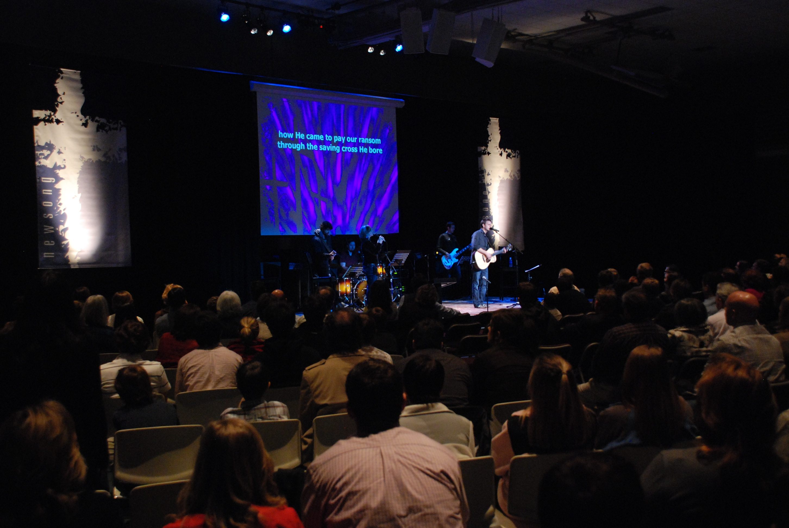
Devil’s beat, drugs, rebellion! The incessant beat fogs the mind and if the words weren’t so repetitious they couldn’t be understood, anyway!
Isn’t God wonderful! That music reminds me how much He loves me and I love Him! I want to praise Him with my whole heart!
Joe Traditional
Johnny NewSong
Notes:
Here we have –these things may not have been said or thought here at First Evan, but they are Avery’s examples of the kinds of things that are often said or thought in the context of these debates. [add photo] Joe and Johnny take a look at NewSong, and may respond quite differently (like the survey I shed with you earlier): [add Words1] [add Words2]

Slide 32
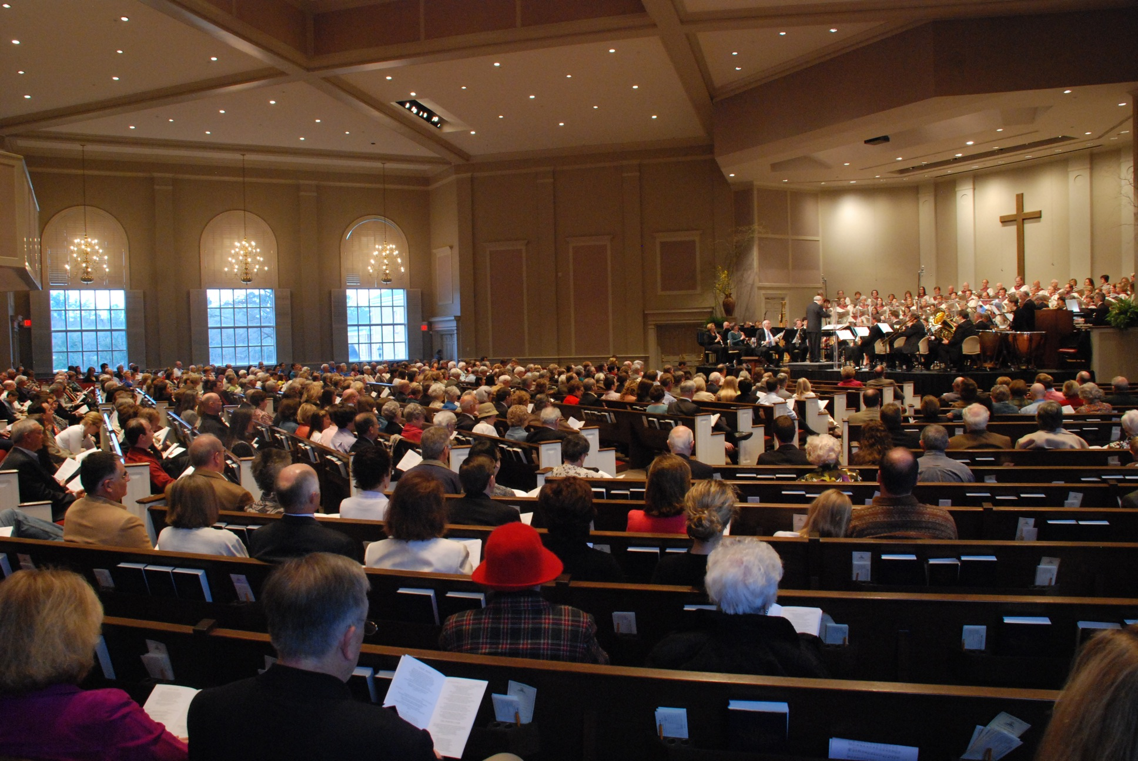
Isn’t God wonderful! That music reminds me how much He loves me and I love Him! I want to praise Him with my whole heart!
Where did they dredge up that funeral dirge? It’s flaccid and without any energy! Don’t those people care about what they are singing?
Joe
Johnny
Notes:
Then they show up in the Trad. Service, and we find quite a different response from them both: [add Words 1] [add Words 2]
Music is NOT a universal language; differences in people and their cultural backgrounds can lead to many misunderstandings and disagreements about music and what is appropriate or helpful in worship. NOT A NEW ISSUE→

Slide 33
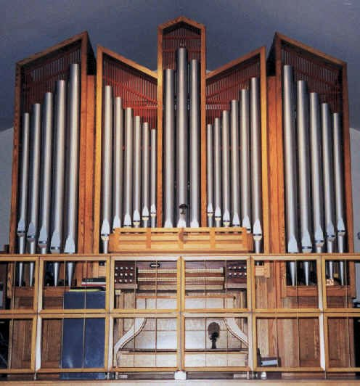
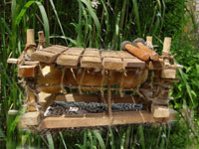
The Devil’s instrument??
Ballophone

Slide 34
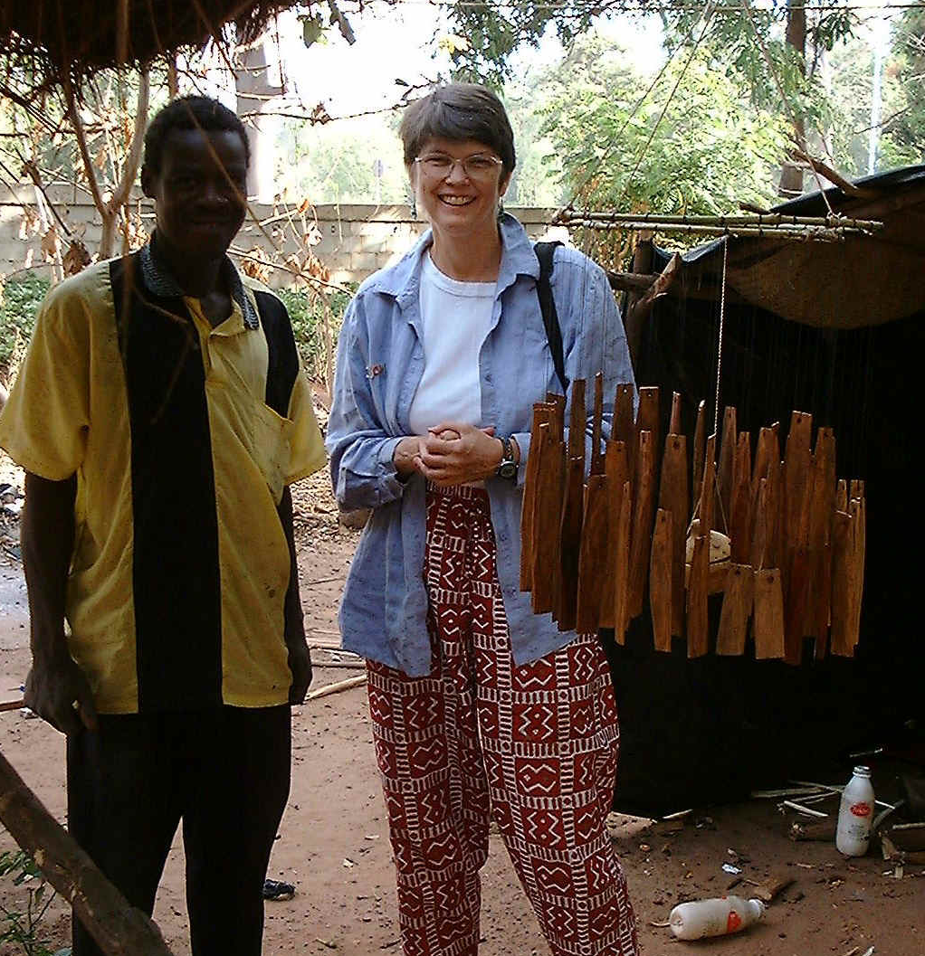
Ballo-
phone

Slide 35
CULTURAL LATITUDE/FREEDOM
Implications
No one right way
Biblical constants/principles set limits
God’s taste is broader than any of ours!!

Slide 36
Factors
CULTURAL LATITUDE/FREEDOM
Church/denominational history and traditions
“Tradition is a wonderful servant, but a terrible master”
Cultural context
“The heart language of the people”
Notes:
Guides:
1. Ch/denom history and trads.– tradition is not an enemy!! UNLESS it's put on the same level of authority and unchangeability as Scripture "tradition…."
2. Culture: take into account the heart language of the people (no Bach fugues in African village), though with DISCERNMENT– some cultural aspects may not be appropriate to use for the worship of God because of their associations; culture shouldn't control, but shouldn't be ignored either

Slide 37
FLEXIBILITY OF PRACTICE
OR CULTURAL?
BIBLICAL?

Slide 38
BIBLICAL OR CULTURAL?
How often do you celebrate Communion
in your church?

Slide 39
BIBLICAL OR CULTURAL?
Communion
Sermon
Candles
Hymns
Choruses
Giving
Guitars
Organ
Prayer
Pass Communion trays
Come up to take Communion
Pass offering plates/bags
Use offering chests
Praise
Dark room
Sunny room
Loud music
Soft music
God-centered lyrics
30-minute sermon
60-minute sermon
15-minute sermon
Prayer seated
Prayer standing
Prayer with eyes closed
Sit on floor
Sit on chairs
When to stand?
Scripture reading
Responsive readings

Slide 40
MISSIONS

Slide 41
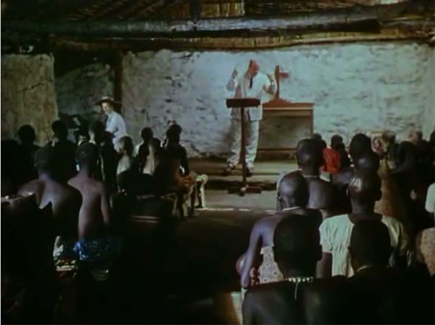
The African Queen

Slide 42
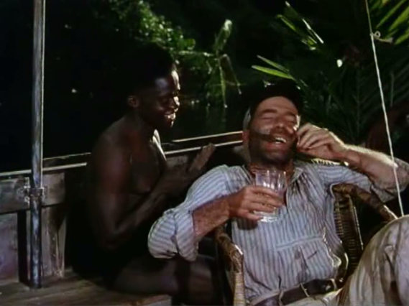

Slide 43
“When missionaries came to our lands they brought not only the seed of the Gospel, but their own plant of Christianity, flower pot included! So, what we have to do is to break the flower pot, take out the seed of the Gospel, sow it in our own cultural soil, and let our own version of Christianity grow.”
—D.T. Niles (1908-1970), Sri Lanka

Slide 44
“I have never been to heaven, so I cannot tell you what kind of music is sung in God’s royal village. But know this, God has no personal favorite songs. He hears all that we sing in whatever language. It is sufficient for us to compose hymns of praise to Him with our own music and in our own language for Him to understand.
—William Wadé Harris, Liberian missionary to Côte d’Ivoire, 1914 (cited in Worship and Mission for the Global Church: An Ethnodoxology Handbook)

Slide 45
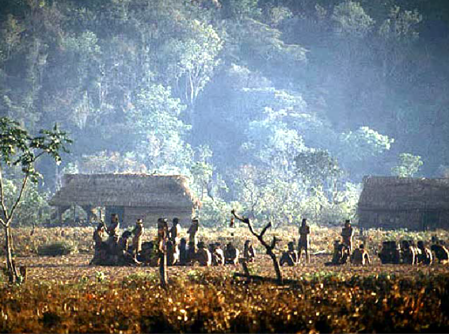
The Canela people

Slide 46
OUTGROWTHS
A new professional field
ETHNODOXOLOGY
“the study of how and why people of diverse cultures glorify the true and living God”
A new breed of missionary
ETHNODOXOLOGISTS, ARTS SPECIALISTS
A new fellowship
INTERNATIONAL COUNCIL OF ETHNODOXOLOGISTS
New courses INTRODUCTION TO ETHNODOXOLOGY
ARTS FOR A BETTER FUTURE

Slide 47
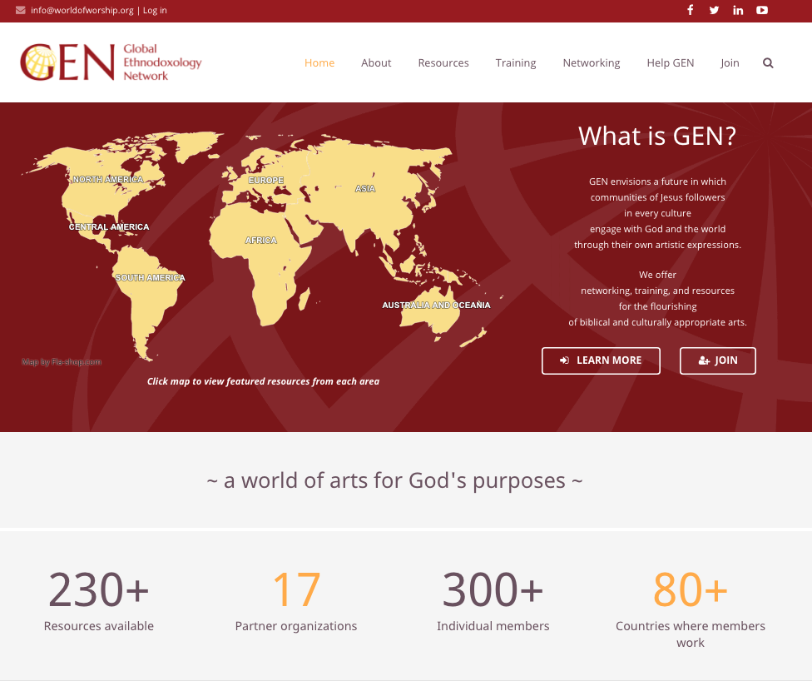
GEN
What is GEN?
GEN envisions a future in which communities of Jesus followers in every culture engage with God and the world through their own artistic expressions.
We offer networking, training, and resources for the flourishing of biblical and culturally appropriate arts.
—a world of arts for God's purposes—
Resources available
Partner organizations
Individual members
Countries where members work

Slide 48
OUTGROWTHS
New textbooks

Slide 49
Arts Consultant

Slide 50
How might an Arts Consultant
function in your local context?

Slide 51
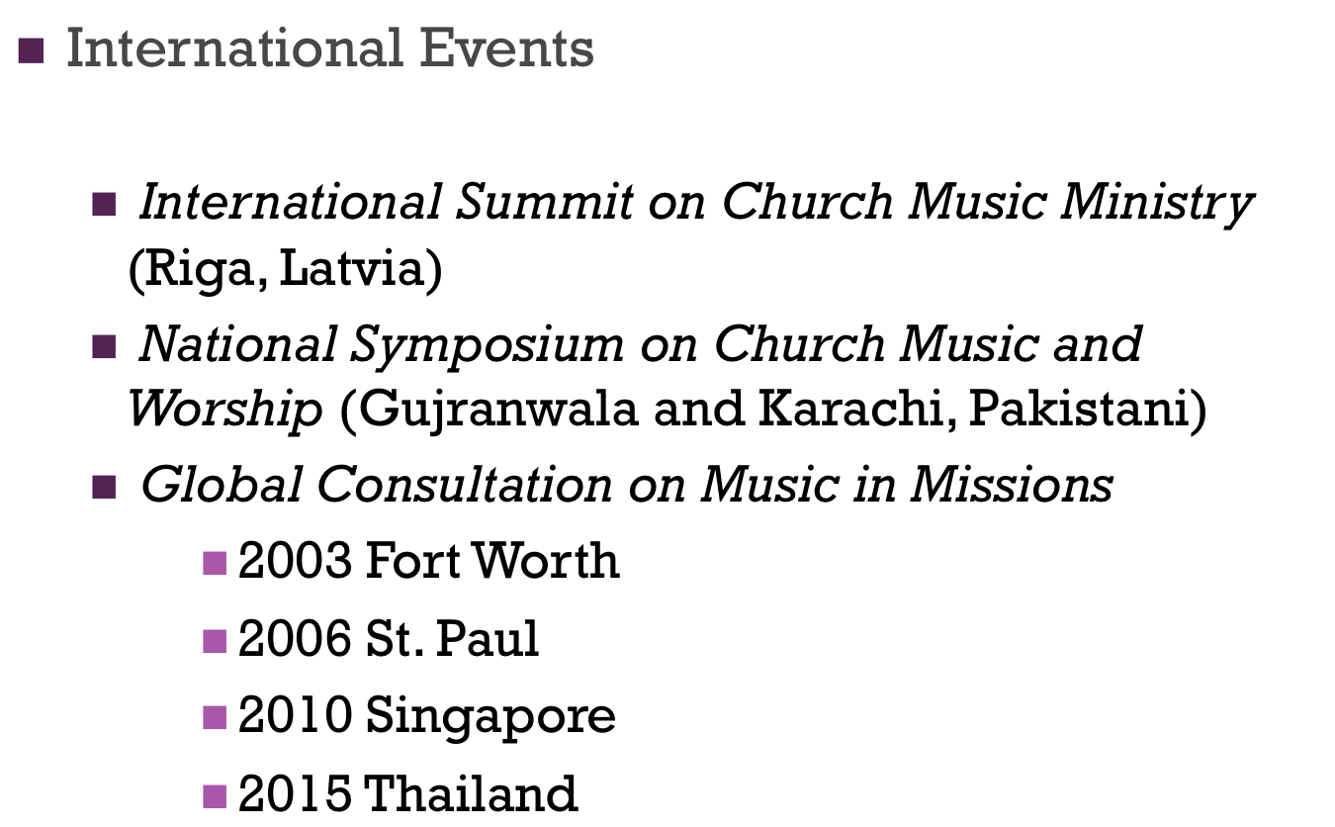
OUTGROWTHS
2018 Kenya

Slide 52
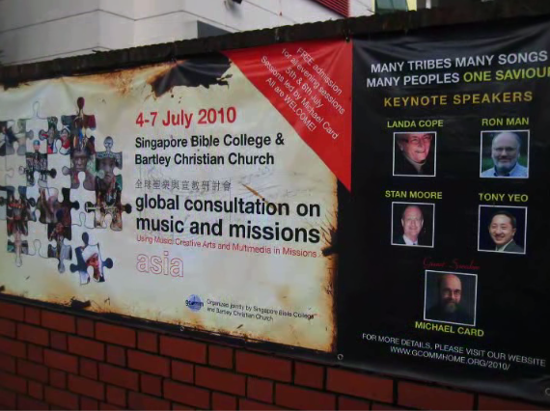

Slide 53
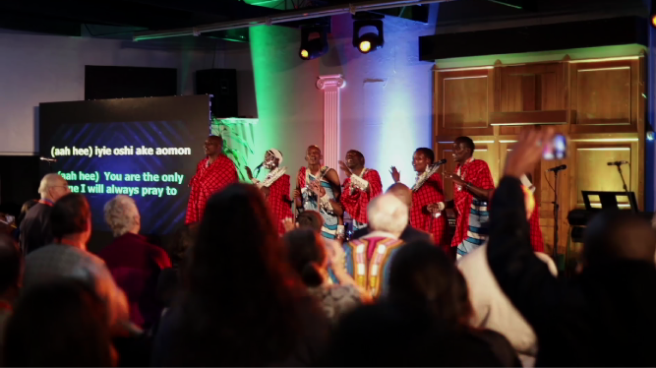

Slide 54
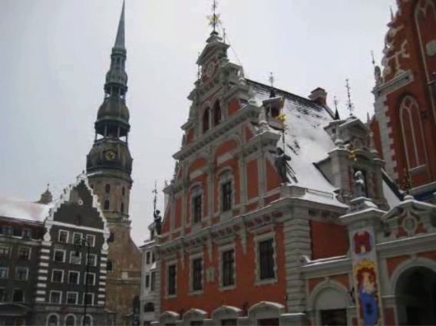

Slide 55
CONTEXTUALIZATION
Contextualization, within evangelical Christianity, is communicating the gospel using methods and terms appropriate to a given audience. It represents the understanding that although the gospel message is abiding and universal, the cultural contexts in which God revealed it and in which it is delivered are distinct and different.
(Theopedia.com)

Slide 56
CONTEXTUALIZATION
the message is abiding and universal,
the cultural contexts . . . are distinct and different.

Slide 57
Contextualizing
Language (learning the host language; Bible translation)
Modes of communication and preaching
Music and the other arts
Worship

Slide 58
On the ground
Back in the 90s, the president of Wycliffe shared that when the translators got the new believers to sing the newly translated Scriptures, using their own melodies and music styles, churches grew rapidly. When that did not happen, churches grew slowly.

Slide 59
Roy Fabella,Windsong Ministries
(Philippines)
Notes:
----- Meeting Notes (1/11/15 22:06) -----
at the end of this month, lyn & i (with jeiel) have scheduled a trip to the sierra madre mountains to visit a tribal group called Bogkalot or Ilongot. They are former headhunters who have turned to Jesus Christ and has vibrant & growing churches in every village. They are so well grounded in the faith that this year they are planning to send 5 missionary families to another completely different tribal group in the South. It will be a cross-cultural missionary outreach. Sad though that when we visited them last July 2010, their church was set up like an urban church. they have full bands (keyboard, electric guitar, bass guitar, drums) for p&w. and to think this church was high up and in the middle of the forest. as we were talking with the worship team members, we asked them how they got to learn how to play those instruments. they said they don't really know if they are doing it right. they just play it the way they think it was supposed to be played. so they were requesting for a workshop. but we went further with our questions and asked them if they have their own indigenous instruments and songs. they said they have. and we asked again if they have every considered using them in their worship. they said, "Is that possible?" we said it's very possible, and they asked how to do it? amazing that the young ones in that tribal group don't really know how to play those instruments and sing their songs.
so when we come up on jan23, we will be talking with the tribal & church elders in every village to allow us to organize a worship seminar/workshop in the middle of this year. it will be a two-fold approach. we will first instruct/train them in the use of their electronic instruments as well as teach them the principles of biblical worship. simultaneously, we will be documenting their indigenous instruments, songs & dances (maybe even art forms) so we can analyze them and determine which ones can be used for worship.
after this trip, we will try to learn their music, songs & dances so we can find a way to integrate them into their existing worship. then we will go back to their elders and present to them our ideas/suggestions and see what they have to comment. if everything is a go, we will plan for a second trip to do a songwriting workshop to help them create their own worship songs using their heart language and heart music.

Slide 60
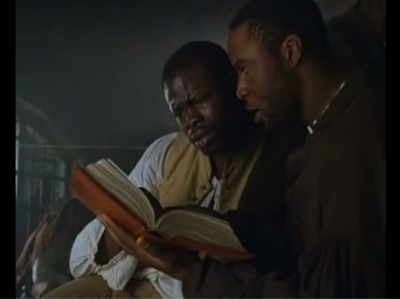
Amistad

Slide 61
an UNCHANGING MESSAGE
CHANGING EXPRESSIONS of that message

Slide 62
Keeping the main thing
(the Gospel)
the main thing

Slide 63
The frightening freedom of worship in the New Testament is a missionary mandate. We must not lock this gospel treasure in any cultural strait-jacket. Rather let us find the place, the time, the dress, the forms, the music that kindles and carries a passion for the supremacy of God in all things.
(John Piper)

Slide 64
Nairobi Statement on Worship & Culture
“Christian worship relates dynamically to culture in at least four ways.
First, it is transcultural, the same substance for everyone everywhere, beyond culture.
Second, it is contextual, varying according to the local situation (both nature and culture).
Third, it is counter-cultural, challenging what is contrary to the Gospel in a given culture.
Fourth, it is cross-cultural, making possible sharing between different local cultures.”
Notes:
Transcultural: biblical constants and principles we’ve looked at
Contextual: contextualization; heart language
Counter-cultural: not buy into everything- informed by a secular, worldly, materialistic, even immoral mindset– or a religious one which runs counter to Chrty. or the gospel; Scripture must guide and control; as you know: use wisdom and discernment; ASSOCIATIONS in culture (many of you could give examples)
Cross-cultural: the positive side of globalization—draw from riches of other cultures’ worship expressions (globalization: influence of Western popular music—like it or not, part of young people’s culture everywhere, can’t ignore; but other influences too)

Slide 65
TRANSCULTURAL
Notes:
What are non-negotiables? (every Christian tradition)
2. Constants: different ways practiced?
3. Principles: different ways applied?
4. How would you teach the transcultural, biblical foundation of W?

Slide 66
“Churches in every generation and in every context must ask in what ways their worship practice can/should transcend their particular culture, placing them within the universal Christian tradition.”
“The Cartigny Statement on Worship and Culture” in Worship and Culture, 33
Notes:
What are non-negotiables? (every Christian tradition)
2. Constants: different ways practiced?
3. Principles: different ways applied?
4. How would you teach the transcultural, biblical foundation of W?

Slide 67
CONTEXTUAL
Notes:
What kinds of things could this mean?
What did it mean in your project?

Slide 68
“The contextual aspect of worship involves recognizing the cultural particularity of Christian worship—the use of local cultural patterns, images, materials, and terms to make worship meaningful and relevant in specific contexts.”
Charles E. Farhadian, “Beyond Lambs and Logos” in Christian Worship Worldwide, 22
Notes:
What kinds of things could this mean?
What did it mean in your project?

Slide 69
“The apostolic decree of Acts 15 builds cultural diversity into the Christian church forever.”
Andrew Walls, “The Ephesians Moment in Worldwide Worship” in Christian Worship Worldwide, 30
Notes:
What kinds of things could this mean?
What did it mean in your project?

Slide 70
COUNTERCULTURAL
Notes:
Examples:
N. America
Elsewhere

Slide 71
“There must always be some tension between gospel and culture. . . . The gospel doesn’t carry with it a culture of its own. It must always find its place in the culture of the time and place. Nevertheless, it always questions the local culture and holds it accountable before the cross.”
(Ronald P. Byars, Christian Worship, 110)

Slide 72
CROSSCULTURAL
Notes:
Examples:
Immigrant groups in community (inside or outside the church)
Your church’s missions parterships
What else?

Slide 73
“While it is clear that each church, within its cultural context, will need to ask these questions for itself and find answers appropriate to its own situation, it also clear that this inquiry will require each church to attend to the experiences of the other churches and to the treasures of other cultures.”
“The Cartigny Statement on Worship and Culture” in Worship and Culture, 33
Notes:
What kinds of things could this mean?
What did it mean in your project?

Slide 74
Nairobi Statement on Worship & Culture
“Christian worship relates dynamically to culture in at least four ways.
First, it is transcultural, the same substance for everyone everywhere, beyond culture.
Second, it is contextual, varying according to the local situation (both nature and culture).
Third, it is counter-cultural, challenging what is contrary to the Gospel in a given culture.
Fourth, it is cross-cultural, making possible sharing between different local cultures.”
BREAKOUTS
Which is strongest in
your church/ context?
Which needs the
most work?
Notes:
Transcultural: biblical constants and principles we’ve looked at
Contextual: contextualization; heart language
Counter-cultural: not buy into everything- informed by a secular, worldly, materialistic, even immoral mindset– or a religious one which runs counter to Chrty. or the gospel; Scripture must guide and control; as you know: use wisdom and discernment; ASSOCIATIONS in culture (many of you could give examples)
Cross-cultural: the positive side of globalization—draw from riches of other cultures’ worship expressions (globalization: influence of Western popular music—like it or not, part of young people’s culture everywhere, can’t ignore; but other influences too)

Slide 75
Cultural
CULTURAL
LATITUDE/FREEDOM
BIBLICAL
CONSTANTS
(Acts 2:42,46-47)
BIBLICAL
PRINCIPLES
Biblical
Notes:
Biblical parameters, framework-- flexibility
Each congregation & leadership– how to obey the biblical constants and apply the biblical principles in their own unique context
When I come in as an itinerant teacher: no right
Some of you earn the right to address also the top issues by living long-term in the culture—but still the biblical framework, foundation must remain the same
Change: all occurs on top—biblical doesn’t change

Slide 76
“Worship is the most universal [following unchanging biblical guidelines] and at the same time the most particular [embodying distinct cultural expressions] of the activities in which Christian communities engage.”
(John H. Erickson and Eileen W. Lindner, “Worship and Prayer in Ecumenical Formation,” Theological Education 34, Supplement [1997]: 23).

Slide 77
BIBLICAL PRINCIPLES
Notes:
One suggested set of principles (listed on back of half-sheet on free table)
On website: application in a particular local church setting (Germany); “therefore, we will…”

Slide 78
God’s glory, and our joyful celebration of it in worship, should be the focus and goal of all life and ministry.
Whether, then, you eat or drink or whatever you do, do all to the glory of God.
(1 Cor 10:31)
Worship is an end it itself. By definition other types of ministry necessarily have horizontal, man-focused aspects; but worship is purely vertically focused. It is the primary purpose for which God created us and therefore our highest endeavor and greatest fulfillment. (Isaiah 43:6-7; Psalm 16:11; Matthew 22:35-38; 1 Peter 4:11)
THEREFORE: We shall give worship careful focus and attention in the life of this church. We will relate all of our activities to it and to the goal of magnifying the glory of God. We will make explicit God’s glory as our most important pursuit, aim and preoccupation.
God’s glory, and our joyful celebration of it in worship, should be the focus and goal of all life and ministry.
Whether, then, you eat or drink or whatever you do, do all to the glory of God. (1 Cor 10:31)
Worship is an end it itself. By definition other types of ministry necessarily have horizontal, man-focused aspects; but worship is purely vertically focused. It is the primary purpose for which God created us and therefore our highest endeavor and greatest fulfillment. (Isaiah 43:6-7; Psalm 16:11; Matthew 22:35-38; 1 Peter 4:11)
THEREFORE: We shall give worship careful focus and attention in the life of this church. We will relate all of our activities to it and to the goal of magnifying the glory of God. We will make explicit God’s glory as our most important pursuit, aim and preoccupation.

Slide 79
DOXOLOGICAL WORSHIP
1. God’s glory, and our joyful celebration of it in worship, should be the focus and goal of all life and ministry.
“Whether, then, you eat or drink or whatever you do, do all to the glory of God.”
(1 Cor. 10:31)

Slide 80
NOT:
“What great worship
we had today!
BUT:
“What a great God
we worshipped today!”

Slide 81
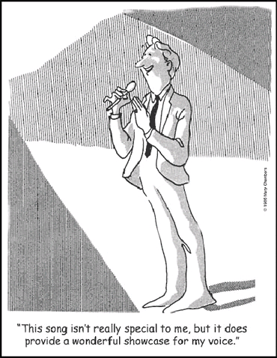
"This song isn't really special to me, but it does provide a wonderful showcase for my voice."

Slide 82
THEOCENTRIC WORSHIP
2. Worship is first and foremost for God.
“Worship God.”
(Revel. 19:10; 22:9)
“I don’t have any trouble with consumer-oriented worship, as long as we remember Who the Consumer is.” (Eric Alexander)
Notes:
Eric Alexander: “I don’t have any trouble with consumer-oriented worship, as long as we remember who the Consumer is.”

Slide 83
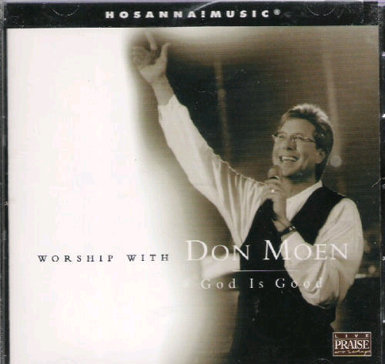

Slide 84
DIALOGICAL WORSHIP
3. Worship is a dialogue between God and His people, a rhythm of revelation and response.
“Great is the Lord,
and greatly to be praised.”
(Psalm 96:4)

Slide 85
“Our worship is our answer to God who has first addressed us. Man worships the God who has made Himself known.”
(William Nicholls)
Notes:
God reveals His glory, worship is our response
Order is important: God always initiates
Rom. 11:33-36 eleven chapters of doctrine, then Paul bursts out in praise: „Oh, the depth of the riches ¹both of the wisdom and knowledge of God!”
Worship services to be a dialogue betw, God and man, a dialogue of revel. & response
This is why the Scriptures are so important; Stott and others remind us how we need much more Scr. In our services– been in many churches where first first of Scr. Is when preacher gets up– means 30 mintues of response w/o anything to respond to!!

Slide 86
““The purpose of
theology is doxology;
we study in order to praise.”
(J. I. Packer)
Notes:
God reveals His glory, worship is our response
Order is important: God always initiates
Rom. 11:33-36 eleven chapters of doctrine, then Paul bursts out in praise: „Oh, the depth of the riches ¹both of the wisdom and knowledge of God!”
Worship services to be a dialogue betw, God and man, a dialogue of revel. & response
This is why the Scriptures are so important; Stott and others remind us how we need much more Scr. In our services– been in many churches where first first of Scr. Is when preacher gets up– means 30 mintues of response w/o anything to respond to!!

Slide 87
WORD-SATURATED WORSHIP
4. The Word must be central in our worship.
“Praise Him
according to His excellent greatness.”
(Psalm 150:2)
Notes:
Biblical pattern of Rev. and Resp.: worship is a DIALOGUE
We need to let God speak to us through His Word; then we respond with our worship
Not just talk about, sing about God– but hear from His own Word what He says about Himself– and then respond with our hearts and voices

Slide 88
WORD-SATURATED WORSHIP
“Thank you for ministering the Word
to us this evening.”
Notes:
Biblical pattern of Rev. and Resp.: worship is a DIALOGUE
We need to let God speak to us through His Word; then we respond with our worship
Not just talk about, sing about God– but hear from His own Word what He says about Himself– and then respond with our hearts and voices

Slide 89
PARTICIPATORY WORSHIP
5. Worship is the responsibility of all God’s people.
“So we Your people and the sheep of Your pasture will give thanks to You forever.”
(Psalm 79:13)

Slide 90
Worship Is a Verb
(Robert Webber)
The question is not,
‘Do you have a voice?’
but
‘Do you have a song?’

Slide 91
Not too loud
Not too high
Not too complex
Not too new

Slide 92
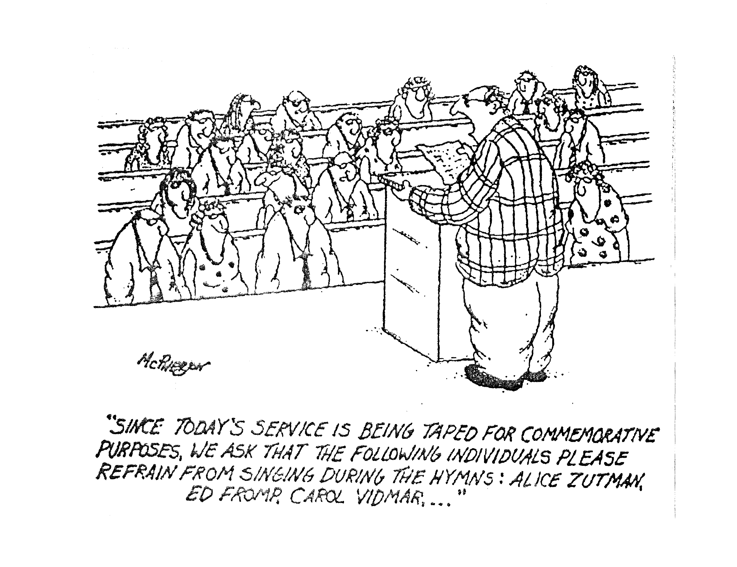
"Since today's service is being taped for commemorative purposes, we ask that the following individuals please refrain from singing during the hymns: Alice Zutman, Ed Fromp, Carol Vidmar,…"

Slide 93
CHRIST-LED WORSHIP
6. Our worship is acceptable in and through Christ our High Priest.
“In the midst of the assembly I will sing Your praise.” (Hebrews 2:12)
Notes:
Not the excellence of what we do; not because we have found the right from or style; not because we're so committed or worthy– but because of Christ's excellence and worthiness. We need to be conscious of our total acceptance and acces to the Father because we come in Christ– no fear, no doubt– blessed assurance.

Slide 94
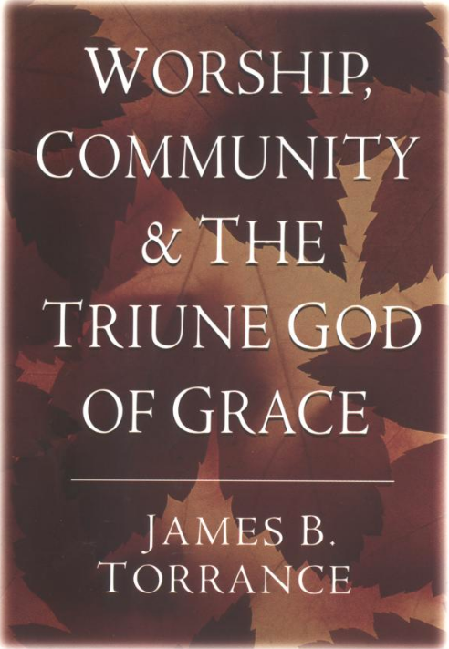
Notes:
And so we can complete last week‘s definition of worship by adding the component of Christ‘s ministry in leading our worship, leading our response. We need a new awareness of the presence of the living Christ in the midst of His people, proclaiming to us the Father‘s name by the Holy Spirit as the Word of God is read and sung and preached, and leading us in our response to the Father, gathering up our imperfect efforts into His perfect offering of praise to the Father.

Slide 95
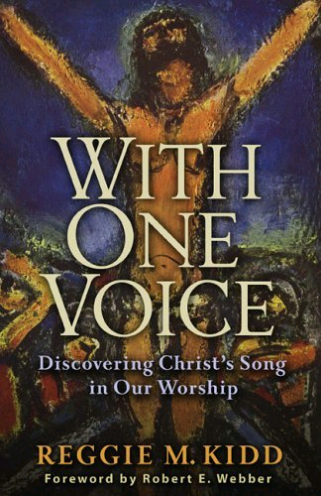
Notes:
And so we can complete last week‘s definition of worship by adding the component of Christ‘s ministry in leading our worship, leading our response. We need a new awareness of the presence of the living Christ in the midst of His people, proclaiming to us the Father‘s name by the Holy Spirit as the Word of God is read and sung and preached, and leading us in our response to the Father, gathering up our imperfect efforts into His perfect offering of praise to the Father.

Slide 96
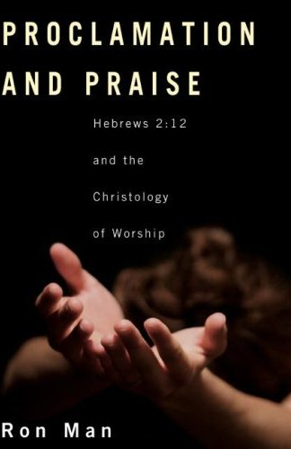

Slide 97
CHRIST-LED WORSHIP
album blurb:
“[The artist] ushered the crowd into His Presence with uplifting praise and worship melodies throughout the night.”
NOT!
Notes:
Not the excellence of what we do; not because we have found the right from or style; not because we're so committed or worthy– but because of Christ's excellence and worthiness. We need to be conscious of our total acceptance and acces to the Father because we come in Christ– no fear, no doubt– blessed assurance.

Slide 98
SPIRIT-ENABLED WORSHIP
7. Our response of worship is enabled, motivated and empowered by the Holy Spirit.
“We are the true circumcision, who worship in the Spirit of God and glory in Christ Jesus and put no confidence in the flesh.”
(Philippians 3:3)
Notes:
Not the excellence of what we do; not because we have found the right from or style; not because we're so committed or worthy– but because of Christ's excellence and worthiness. We need to be conscious of our total acceptance and acces to the Father because we come in Christ– no fear, no doubt– blessed assurance.

Slide 99
Revelation
Response
Holy Spirit

Slide 100
WHOLE-LIFE WORSHIP
8. Worship is the response of our entire lives to God.
“Therefore I urge you, brethren, by the mercies of God, to present your bodies a living and holy sacrifice, acceptable to God, which is your spiritual service of worship.”
(Romans 12:1)

Slide 101
HEART WORSHIP
9. God is much more concerned
with our heart than with the form
of our worship.
“I delight in loyalty rather than sacrifice.”
(Hosea 6:6)
Notes:
Freedom of form
Cultivate a lifestyle of worship from the heart

Slide 102
“Man looks on the outward appearance,
but God looks on the heart.”
(1 Samuel 16:7)
Notes:
Freedom of form
Cultivate a lifestyle of worship from the heart

Slide 103
EDIFYING WORSHIP
10. Worship should promote the unity
and edification of the body.
“Do nothing from selfishness or empty conceit, but with humility of mind regard one another as more important than yourselves.”
(Philippians 2:3)
“So then we pursue the things which make for peace and the building up of one another.”
(Romans 14:19)
Notes:
Importance of Community: in the church, we worship together-"O magnify the Lord with me, and let us exalt His name TOGETHER:"
Not a gathering for everyone to worship individually (face forward)
More important than the idolatry of our presonal preferences
Not a natural grouping of people; not an affinity group, not a club of people who are drawn together
Unity is elusive, must be worked at, HS must produce

Slide 104
A Sacrifice of Praise
(retreat: songs you don’t like)

Slide 105
TRANS-GENERATIONAL WORSHIP
11. Young and old need each other
in the Body of Christ.
"Young men and maidens, old men and children:
Let them praise the name of the Lord, for His name alone is exalted.” (Psalm 148:12-13)
"Older men. . . . Older women. . . . Young women. . . .
Young men. . . . ” (Titus 2:2-8)
Notes:
Young people need to honor and learn from those who have been walking with the Lord for 20, 30, 40 years or more: But older people also need the freshness and vitality which younger belivers can bring to the body. Doens't cut it to have each group run off to its own corner to do worship ist own way. Need tolearn from each other (BOTH ways); need to enage in the hard work of trying to tolerate and understand the faith expressions of others within the body.
The Psalmist almost certainly was not saying, "Alright, young men and maidens down in the gym, older people in the fellowship hall."

Slide 106
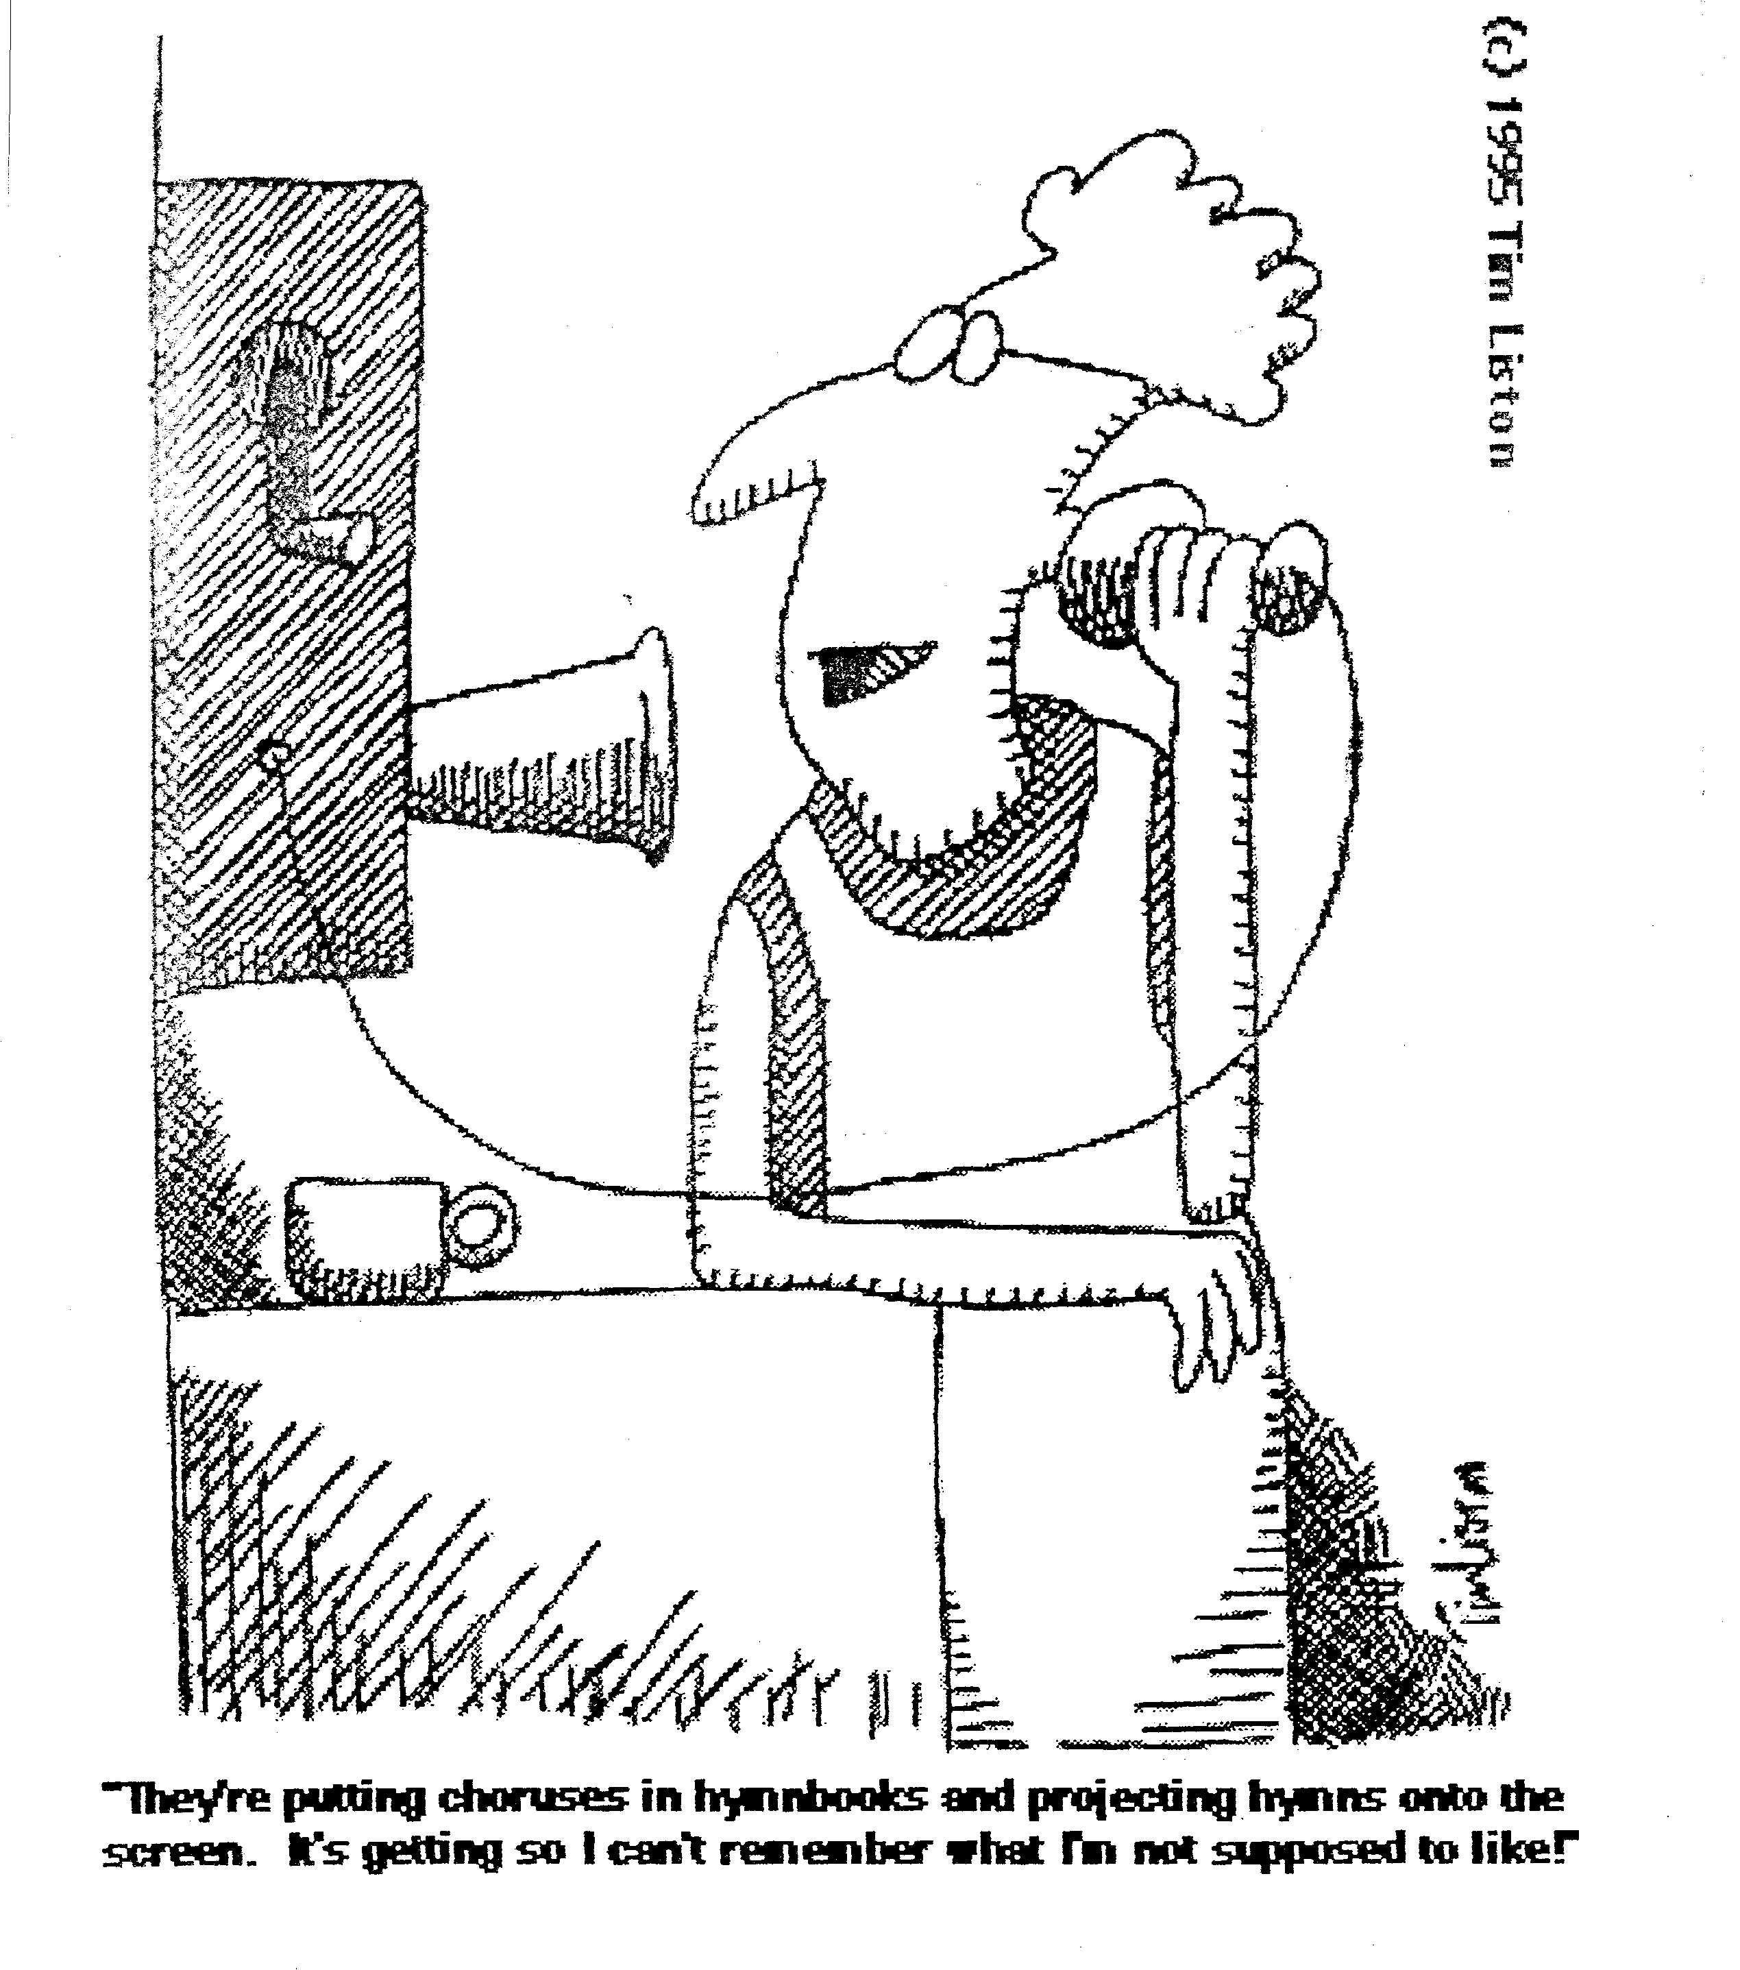
"They're putting choruses in hymnbooks and projecting hymns onto the screen. It's getting so I can't remember what I'm not supposed to like!"

Slide 107
TAUGHT WORSHIP
12. These things must be taught and re-taught.
“Finally then, brethren, we request and exhort you in the Lord Jesus, that as you received from us instruction as to how you ought to walk and please God (just as you actually do walk), that you excel still more.”
(1 Thessalonians 4:1)
Notes:
We must continually teach these principles, pointing people constantly to God and explaining the "why" and not just the "what" of what we are doing.

Slide 108
BREAKOUTS:
BIBLICAL PRINCIPLES
OF WORSHIP
1. Are any of these new to you?
2. Which of them means the most to you?
Notes:
We must continually teach these principles, pointing people constantly to God and explaining the "why" and not just the "what" of what we are doing.

Slide 109
Cultural
CULTURAL
LATITUDE/FREEDOM
BIBLICAL
CONSTANTS
(Acts 2:42,46-47)
BIBLICAL
PRINCIPLES
Biblical
Notes:
Biblical parameters, framework-- flexibility
Each congregation & leadership– how to obey the biblical constants and apply the biblical principles in their own unique context
When I come in as an itinerant teacher: no right
Some of you earn the right to address also the top issues by living long-term in the culture—but still the biblical framework, foundation must remain the same
Change: all occurs on top—biblical doesn’t change

Slide 110
CONTEXTUALIZATION
Contextualization, within evangelical Christianity, is communicating the gospel using methods and terms appropriate to a given audience. It represents the understanding that although the gospel message is
abiding and universal,
the cultural contexts in which God revealed it and in which it is delivered are
distinct and different.
(Theopedia.com)

Slide 111
Cultural
“distinct and different”
CULTURAL
LATITUDE/FREEDOM
BIBLICAL
CONSTANTS
(Acts 2:42,46-47)
BIBLICAL
PRINCIPLES
Biblical
“abiding and universal”
Notes:
Biblical parameters, framework-- flexibility
Each congregation & leadership– how to obey the biblical constants and apply the biblical principles in their own unique context
When I come in as an itinerant teacher: no right
Some of you earn the right to address also the top issues by living long-term in the culture—but still the biblical framework, foundation must remain the same
Change: all occurs on top—biblical doesn’t change

Slide 112
LIVING ROOT BRIDGE MODEL
FLEXIBILITY OF FORM
BIBLICAL CONSTANTS
(Acts 2:42, 46-47)
BIBLICAL PRINCIPLES

Slide 113
Stone Soup

Slide 114
Worship: Our Gift to God

Slide 115
What about the course impacted you the most?

Slide 116
Now may the God who gives perseverance and encouragement grant you to be
of the same mind with one another according to Christ Jesus, so that with one accord
you may with one voice
glorify the God and Father
of our Lord Jesus Christ.
(Romans 15:5-6)

Slide 117
Whatsapp: 01-901-517-0155
Facebook: ronmanwri
Skype: ronmangem
Twitter: @ronmanwri

Slide 118
Black

Slide 119
Worship link at BibleStudyDownloads.org
Get this presentation for free!
Notes:
Worship (wo)

