Slide 1
The
Reformation
at 500
Taught by Dr. Ron Man for Doctor of Ministry Students Uploaded by Dr. Rick Griffith • Singapore Bible College Files in many languages for free download at BibleStudyDownloads.org
Notes:
During the month of October we will be celebrating the 500th anniversary of the Protestant Reformation.

Slide 2
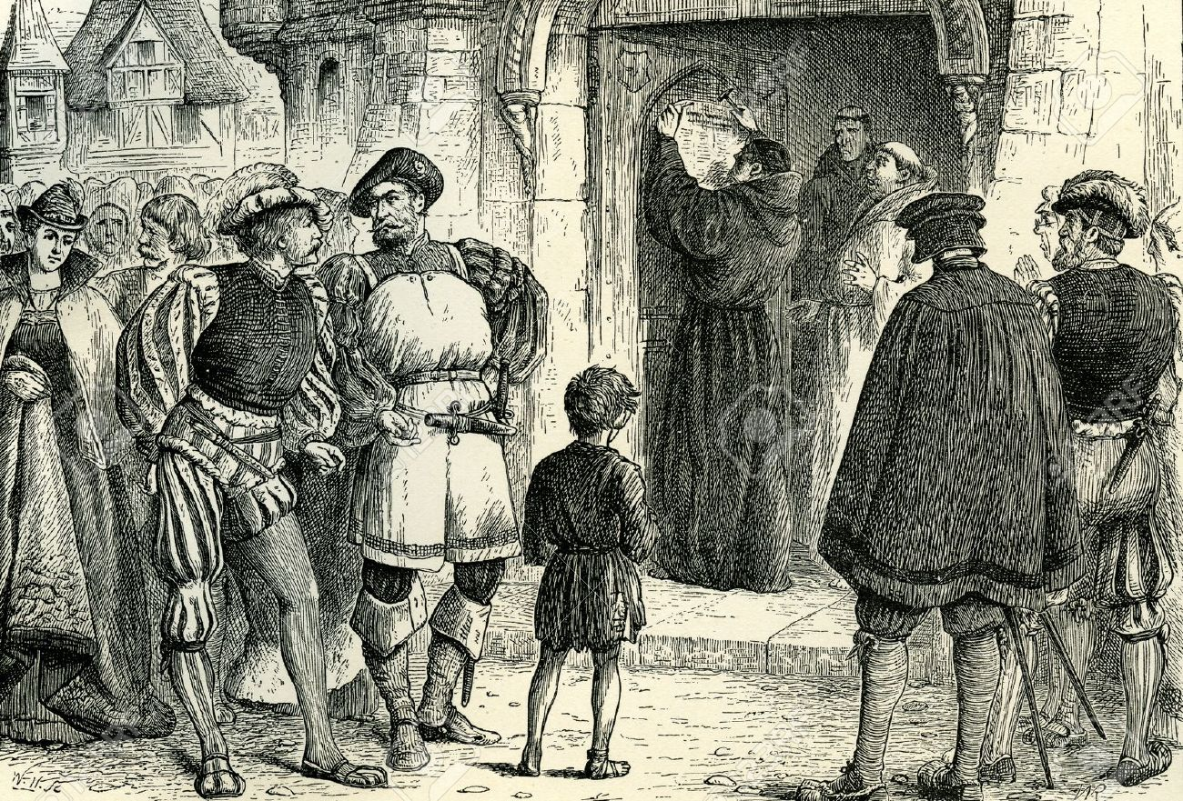
October 31, 1517
October 31, 1517
Notes:
Because 500 years ago, on October 31, 1517, was when Martin Luther nailed his 95 These to the church door in Wittenberg, Germany. The concerns he expressed in this document about the practices and teaching of the established church of his day ended up touching off what we now know as the Reformation.

Slide 3
Jan Hus
John Wycliffe
William Tyndale
Martin Luther
Ulrich Zwingli
Thomas Cranmer
Burned at stake
Declared a heretic
Strangled
Excommunicated
Killed in battle
Burned at stake
Notes:
At tremendous personal cost, as you can see here, the Reformers took a bold and courageous stand against all the civil and religious authorities of their day, armed only with an unshakeable confidence in God and commitment to the truth of Scripture.

Slide 4
Remember your leaders, those who spoke to you the word of God.
Consider the outcome of their way of life, and imitate their faith.
(Hebrews 13:7)
Notes:
We honor these true Christian heroes. We owe them a great debt, because in a very real sense every one of us is here today because God used them to restore the biblical gospel that had been obscured.

Slide 5
A Reformation
of Doctrine
Recovering the biblical Gospel
Restoring the apostolic teachings about salvation
Notes:
Luther and the other Reformers were not seeking to start a new church, but wanted to reform the church from within. They were not bringing new teachings, but rather seeking to restore the biblical gospel and the apostolic teachings about the way of salvation and how a sinner can be justified before a holy God.

Slide 6
JUSTIFICATION:
by GRACE alone
Through FAITH alone
In CHRIST alone
as revealed in the SCRIPTURES alone
To the GLORY OF GOD alone
Notes:
The reformers stressed the New Testament teaching that justification comes from God, as a gift of His grace received through faith, faith in Christ, as revealed in the Scriptures; that salvation is a work of God for which He receives all the glory. These 5 “solas” (meaning “alone”) will be unpacked by Cole through October, and will also be the focus of our worship.

Slide 7
A Reformation
of Worship
Notes:
But the Reformation was not just a Reformation of doctrine, but was a Reformation of WORSHIP in some crucial ways. For the next 3 weeks we’re to take a few minutes to highlight some of the major changes in worship effected by the Reformers.

Slide 8
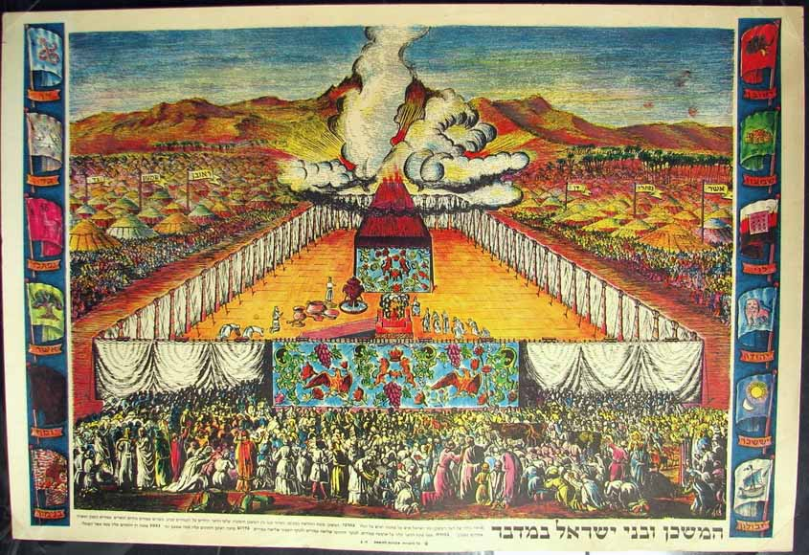
Notes:
In the Old Testament, the people of God had to stand outside the Tabernacle, and could only watch as the priests inside did their worship for them.

Slide 9
Middle Ages
Less and less participatory
Still in Latin
Notes:
While the New Testament emphasized that Christian worship should actively engage the whole people of God, yet during the Middle Ages turned back more and more to the Old Testament model, where priests did it all and the people sat silently and watched. In fact, services continued to be conducted in Latin, even though most people did not even understand it anymore. So they didn’t even know what was going on.

Slide 10
Reformation
Return to participatory worship
Service in the language of the people
“Faith comes by hearing,
and hearing by the word of Christ.”
(Romans 10:17)
Notes:
The Reformers initiated a major change to a much more participatory kind of worship. They insisted that worship be held in the language of the people, so that they could understand and fully participate.

Slide 11
Reformation
Return to participatory worship
Active role for the people of God
“the priesthood of all believers”
Notes:
The Reformers reemphasized the New Testament teaching about the priesthood of all believers, that every Christian has direct access to the presence of God through Christ.

Slide 12
Reformation
Return to participatory worship
Congregational song
“Let the word of Christ dwell in you richly…singing psalms and hymns and spiritual songs, with thankfulness in your hearts to God.”
(Colossians 3:16)
Notes:
Key to this full participation of the people in worship is congregational singing, which Luther, Calvin and other Reformers especially emphasized the importance of the people singing God’s truth, as well as hearing it preached.

Slide 13
Worship is a Verb
It’s something we do, not something we watch
Notes:
One important book is entitled Worship is a VERB, reflecting the biblical and Reformational truth that worship is something we DO, not something we watch.

Slide 14
NOT: Do I have a VOICE?
BUT: Do I have a SONG?
Notes:
The question being: NOT Do I have a VOICE? BUT: Do I have a SONG? Every believer in Christ has a song of gratitude to sing to the God who saved us.

Slide 15
The Reformation
of Worship
Return to participatory
worship
Service in the language of the people
Active role for the people of God
Congregational song
Notes:
In previous weeks we saw that the Reformers brought about a RETURN TO PARTICIPATORY WORSHIP—by insisting that the worship service be conducted in the language of the people, and that the congregation have amore active role in worship, especially through congregational singing, which the Reformers were great champions of.

Slide 16
The Reformation
of Worship
Return to the Word of God
The Bible in the language
of the people
The primacy of the Word
in worship
The prominence of preaching
in worship
Notes:
Last week we celebrated the Word of God and how the Reformers brought it back to its proper place in the church and in the lives of people—first by translating the Bible into the local language of the people, then by bringing it back to the center of worship to be read, prayed, sung and preached; and then by elevating the ministry of preaching as the faithful exposition of the Scripture.

Slide 17
The Reformation
of Worship
Return to the Sole Priesthood of Christ
Notes:
Finally today we want to see how the Reformers brought Christ back into the center of worship as our priest who leads us into the presence of God.

Slide 18
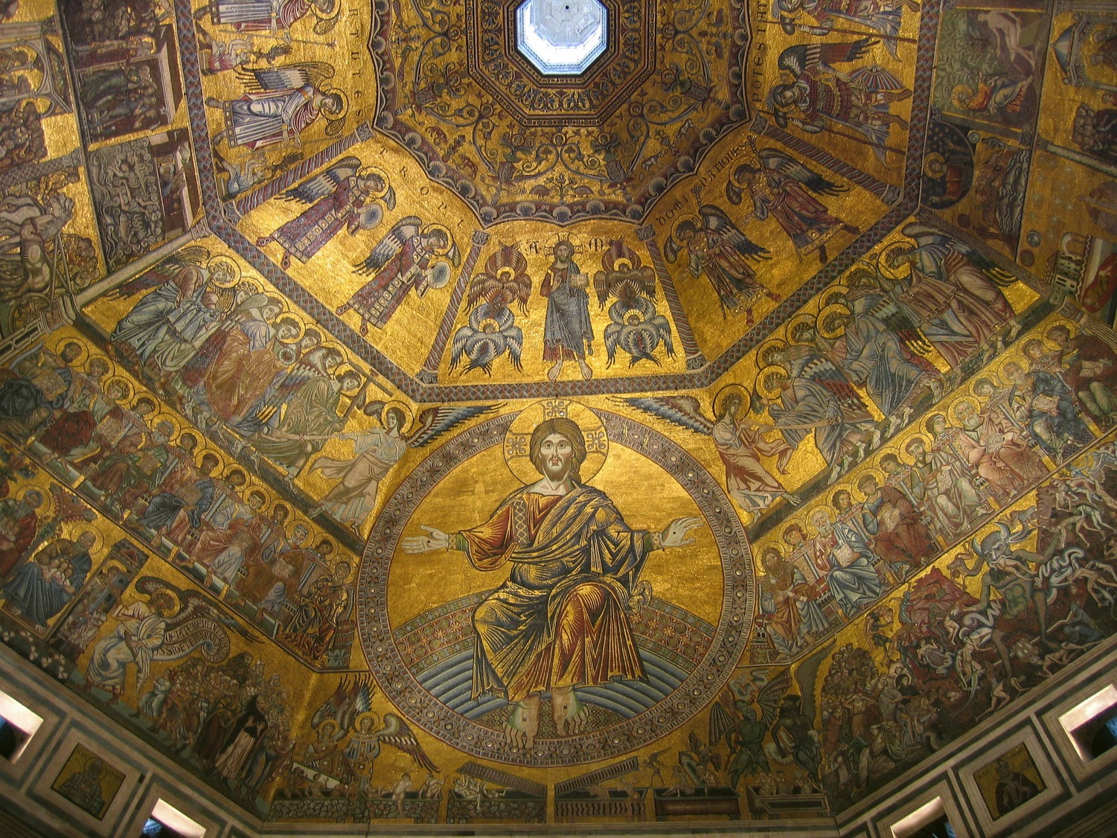
Notes:
During the early church there were many debates about the true nature of Christ, especially about His true deity. Church councils and creeds finally settled these issues. But in the process, because there was no much needed emphasis on Christ’s deity, the true humanity of Christ began to be neglected in the Middle Ages, with huge implications for the church.

Slide 19
Defending the deity of Christ
in the early Church
led to neglect of His humanity
in the middle ages
Notes:
But in the process, because there was no much needed emphasis on Christ’s deity, the true humanity of Christ began to be neglected in the Middle Ages, with huge implications for the church.

Slide 20
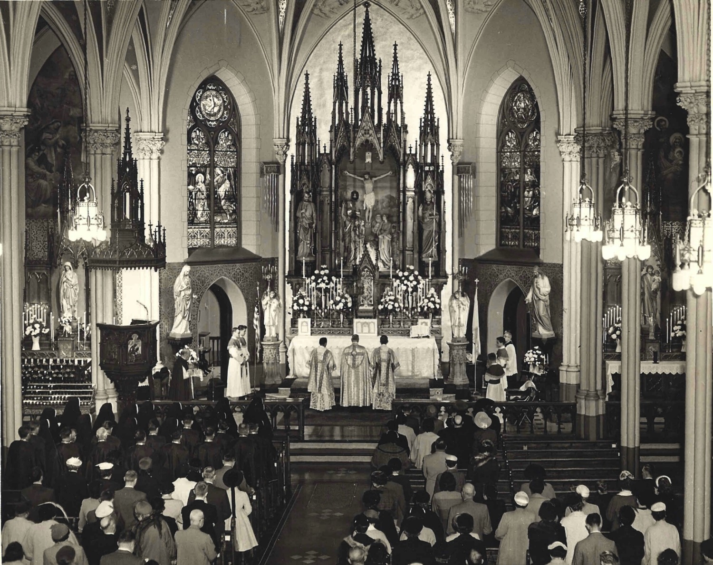
In the Middle Ages there arose the need for a human priesthood to mediate between sinful humanity and the exalted Christ, the majestic Judge and King.
Praying through the saints
Notes:
In the Middle Ages, the church, as we’ve seen, tended to gravitate back to Old Testament type of practices, and that included a growing emphasis on the need to go through a PRIEST in order to get to God.

Slide 21
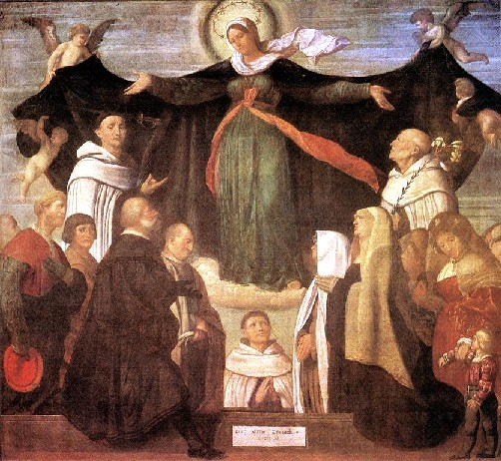
Praying through Mary
Notes:
And not only was there the emphasis on going through a priest to reach God, but there arose the teaching that in order to get your prayers heard and answered, you had to pray through Mary…

Slide 22
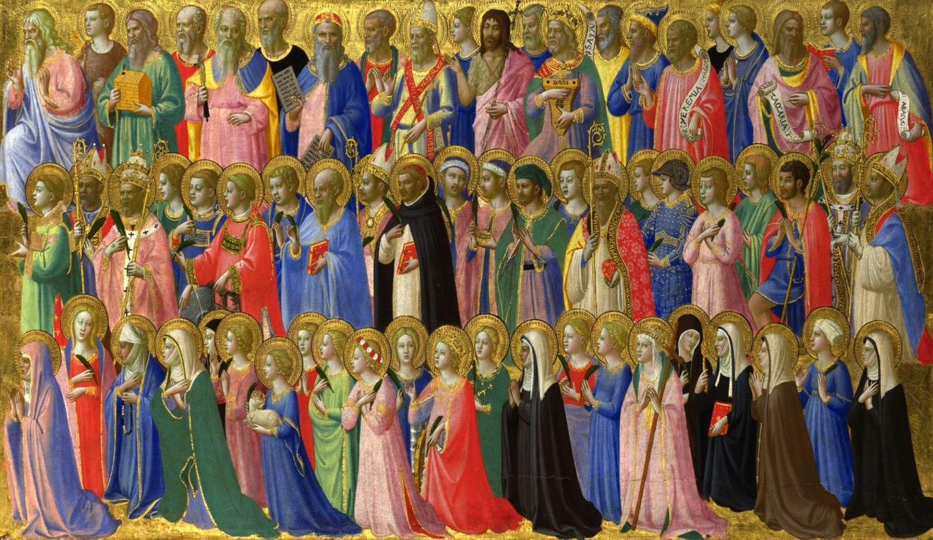
Praying through the saints
Notes:
… or you had to pray to one of the saints, as someone who could represent you before God.

Slide 23
There is one God,
and ONE MEDIATOR between man and God,
the man Christ Jesus.
(1 Timothy 2:5)
Notes:
One of the great emphases of the Reformers was that, in Paul’s words, “There is ONE mediator between God and man, the man Christ Jesus.” Every believer has DIRECT access to God through Jesus Christ—He is the only Priest, the only go-between we need. We do not need to go through a priest, or through Mary, or through one of the saints to get to God. We go THROUGH CHRIST.

Slide 24
Solus Christus
IN CHRIST ALONE
Therefore, brethren, since we have confidence to enter the holy places by the blood of Jesus…LET US DRAW NEAR with a true heart in full assurance of faith.
(Hebrews 10:19,22)
Notes:
Salvation is by grace through in Christ alone, and He is the one way to the Father—through Him we can draw near with confidence and assurance, as the writer of Hebrews encourages us.

Slide 25
A UNIFYING TRUTH FOR OUR WORSHIP
Whatever outward form our worship may take, there is
ONLY ONE WAY
to come to the Father, namely through Christ in the power of the Holy Spirit
Notes:
This is a critical unifying truth for the church’s worship: Whatever outward form our worship may take, there is ONLY ONE WAY to come to the Father, and that is through CHRIST in the power of the Holy spirit.

Slide 26
“No worship leader, pastor, band, or song will ever bring us close to God. . . .
Worship itself cannot lead us into God’s presence. Only Jesus himself can bring us into God’s presence.”
(Bob Kauflin)
Notes:
And a crucial corollary is this: No worship leader, pastor, band, or song will ever bring us close to God….Worship itself cannot lead us into God’s presence, Only Jesus Himself can bring us into God’s presence.

Slide 27
He doesn’t just show us the way:
as our Mediator and High Priest
HE TAKES US WITH HIM
Notes:
And a crucial corollary is this: doesn’t just show us the way to he Father. As Our Mediator and High Priest HE TAKES US WITH HIM into the Father’s presence. HE leads us in our worship. (I’ll have the opportunity of sharing some of these great truths in Wittenberg later this week.)

Slide 28
Black

Slide 29
Worship link at BibleStudyDownloads.org
Get this presentation for free!
Notes:
The Bible…Basically (bb)

