Slide 1
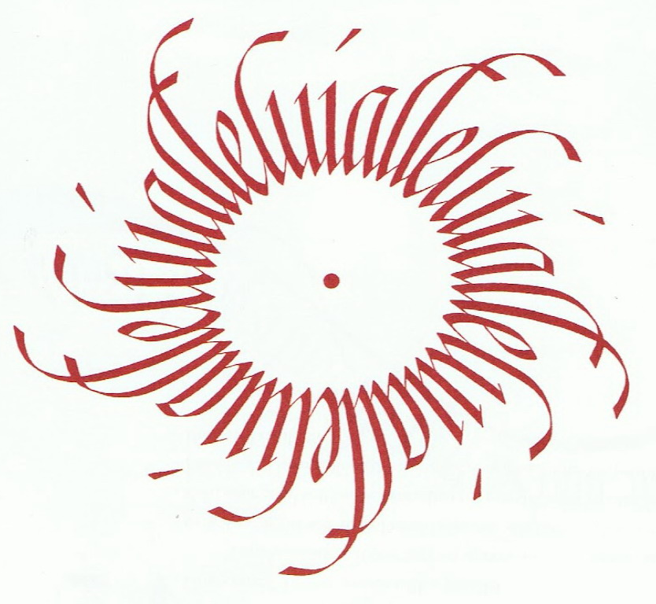
Unit 5
Biblical Worship
WORSHIP IN CHURCH HISTORY
Taught by Dr. Ron Man for Doctor of Ministry Students Uploaded by Dr. Rick Griffith • Singapore Bible College Files in many languages for free download at BibleStudyDownloads.org

Slide 2
COURSE OUTLINE
1. THE GOD WHOM WE WORSHIP
2. THE CENTRALITY OF WORSHIP
3. WORSHIP IN THE OLD TESTAMENT
4. WORSHIP IN THE NEW TESTAMENT
5. WORSHIP IN CHURCH HISTORY
6. WORSHIP IN THE CHURCH

Slide 3
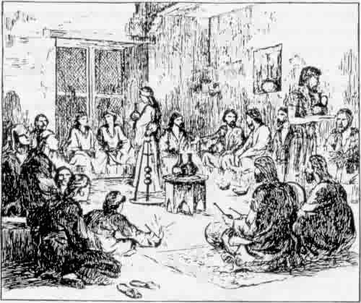
The Apostolic Age 0-100 A.D.

Slide 4
The Apostolic Age 0-100 A.D.
Little detailed information
Continuity, but growing discontinuity, with Judaism
Influence of Temple and Synagogue
House meetings: common meals, Lord’s Supper
Elements: apostles’ teaching/fellowship/Lord’s Supper/prayer/praise (Acts 2:42,64); singing (Ephesians 5:18-20; Colossians 3:16
Word/Table structure

Slide 5
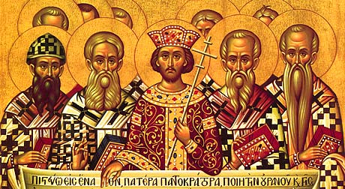
The Patristic Age 100-400 A.D.

Slide 6
The Patristic Age 100-400 A.D.
Small communities
Periodic persecutions (and hence eschatological expectations)
Developing traditions and patterns of worship
Canon of Scripture decided
Creeds formulated in response to heresies (lex orandi, lex credendi); Trinity, hypostatic union
Growing sacramentalism, ceremonialism (OT); baptism and Lord’s Supper grow in importance
A.D. 312: conversion of Constantine; official religion/church and state “Christianity captured the Roman Empire, and was captured by it.” (Bernard Lewis)

Slide 7
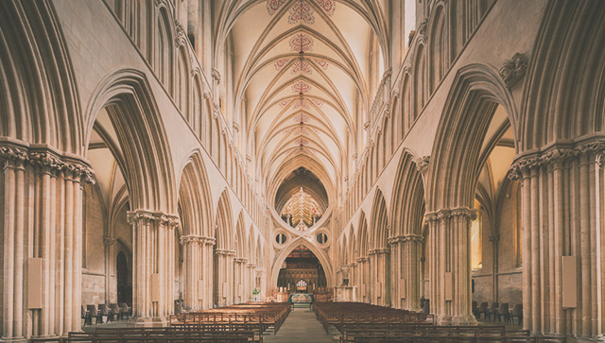
The Middle Ages 400-1500 A.D.

Slide 8
The Middle Ages 400-1500 A.D.
Rise of priesthood, saints, Mariology
Ascendancy of the Mass (transubstantiation), decline of preaching
Non-participatory (Latin only, backs to people)
“Mass was offered FOR the people . . . not celebrated BY the people.” (Wainwright) (like OT)
No Bible in vernacular (Latin only)
Church tradition equal authority with the Bible
A.D. 1054: The “Great Schism” (Western and Eastern Churches)
Corruption in the church (rival popes, worldly clergy, commercialism)
Growing sense of needing reformation

Slide 9
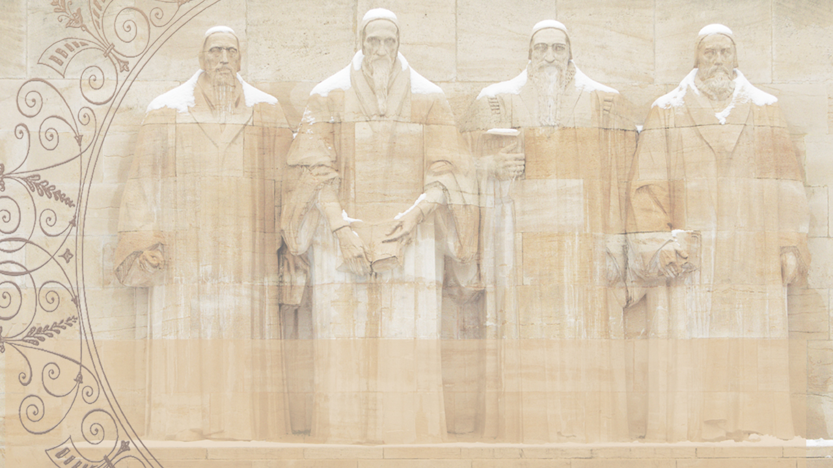
The Reformation 1500-1650 A.D.

Slide 10
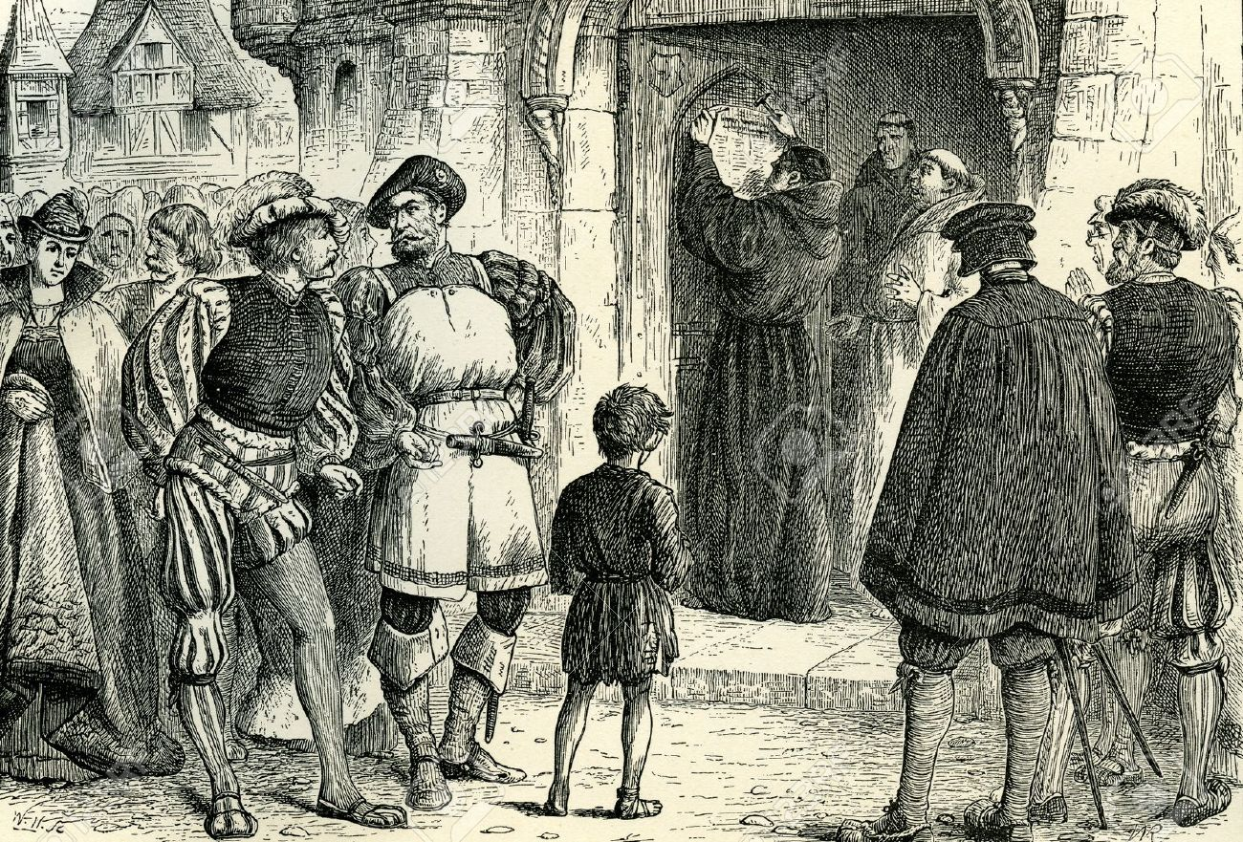
October 31, 1517
October 31, 1517
Notes:
Because 500 years ago, on October 31, 1517, was when Martin Luther nailed his 95 These to the church door in Wittenberg, Germany. The concerns he expressed in this document about the practices and teaching of the established church of his day ended up touching off what we now know as the Reformation.

Slide 11
Jan Hus
John Wycliffe
William Tyndale
Martin Luther
Ulrich Zwingli
Thomas Cranmer
Burned at stake
Declared a heretic
Strangled
Excommunicated
Killed in battle
Burned at stake
Notes:
At tremendous personal cost, as you can see here, the Reformers took a bold and courageous stand against all the civil and religious authorities of their day, armed only with an unshakeable confidence in God and commitment to the truth of Scripture.

Slide 12
Remember your leaders, those who spoke to you the word of God.
Consider the outcome of their way of life, and imitate their faith.
(Hebrews 13:7)
Notes:
We honor these true Christian heroes. We owe them a great debt, because in a very real sense every one of us is here today because God used them to restore the biblical gospel that had been obscured.

Slide 13
A Reformation
of Doctrine
Recovering the biblical Gospel
Restoring the apostolic teachings about salvation
Notes:
Luther and the other Reformers were not seeking to start a new church, but wanted to reform the church from within. They were not bringing new teachings, but rather seeking to restore the biblical gospel and the apostolic teachings about the way of salvation and how a sinner can be justified before a holy God.

Slide 14
JUSTIFICATION:
Sola Gratia by GRACE alone
Sola Fide through FAITH alone
Solus Christus in CHRIST alone
Sola Scriptura as revealed in the SCRIPTURES alone
Soli Deo Gloria to the GLORY OF GOD alone
Notes:
The reformers stressed the New Testament teaching that justification comes from God, as a gift of His grace received through faith, faith in Christ, as revealed in the Scriptures; that salvation is a work of God for which He receives all the glory. These 5 “solas” (meaning “alone”) will be unpacked by Cole through October, and will also be the focus of our worship.

Slide 15
A Reformation
of Worship
Notes:
But the Reformation was not just a Reformation of doctrine, but was a Reformation of WORSHIP in some crucial ways. For the next 3 weeks we’re to take a few minutes to highlight some of the major changes in worship effected by the Reformers.

Slide 16
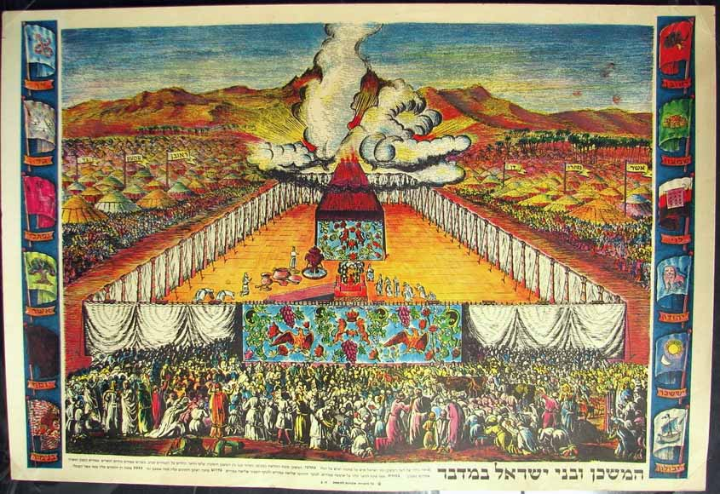
Notes:
In the Old Testament, the people of God had to stand outside the Tabernacle, and could only watch as the priests inside did their worship for them.

Slide 17
Middle Ages
Less and less participatory
Still in Latin
Notes:
While the New Testament emphasized that Christian worship should actively engage the whole people of God, yet during the Middle Ages turned back more and more to the Old Testament model, where priests did it all and the people sat silently and watched. In fact, services continued to be conducted in Latin, even though most people did not even understand it anymore. So they didn’t even know what was going on.

Slide 18
“Worship is a Verb”
(Robert Webber)
It’s something we do,
not something we watch
Notes:
One important book is entitled Worship is a VERB, reflecting the biblical and Reformational truth that worship is something we DO, not something we watch.

Slide 19
NOT: Do I have a VOICE?
BUT: Do I have a SONG?
Notes:
The question being: NOT Do I have a VOICE? BUT: Do I have SONG? Every believer in Christ has a song of gratitude to sing to the God who saved us.

Slide 20
The Reformation
of Worship
Return to participatory
worship
The service in the language of the people
“Faith comes by hearing,
and hearing by the word of Christ.”
(Romans 10:17)
Notes:
The Reformers initiated a major change to a much more participatory kind of worship. They insisted that worship be held in the language of the people, so that they could understand and fully participate.

Slide 21
The Reformation
of Worship
Return to participatory
worship
An active role for the people of God
“the priesthood of all believers”
Notes:
The Reformers reemphasized the New Testament teaching about the priesthood of all believers, that every Christian has direct access to the presence of God through Christ.

Slide 22
The Reformation
of Worship
Return to participatory
worship
Congregational song
“Let the word of Christ dwell in you richly…singing psalms and hymns and spiritual songs, with thankfulness in your hearts to God.”
(Colossians 3:16)
Notes:
Key to this full participation of the people in worship is congregational singing, which Luther, Calvin and other Reformers especially emphasized the importance of the people singing God’s truth, as well as hearing it preached.

Slide 23
The Reformation
of Worship
Return to the Word of God
The Bible in the language
of the people
The primacy of the Word
in worship
The prominence of preaching
in worship
Notes:
Last week we celebrated the Word of God and how the Reformers brought it back to its proper place in the church and in the lives of people—first by translating the Bible into the local language of the people, then by bringing it back to the center of worship to be read, prayed, sung and preached; and then by elevating the ministry of preaching as the faithful exposition of the Scripture.

Slide 24
The Reformation
of Worship
Return to the Sole Priesthood
of Christ
Notes:
Finally today we want to see how the Reformers brought Christ back into the center of worship as our priest who leads us into the presence of God.

Slide 25
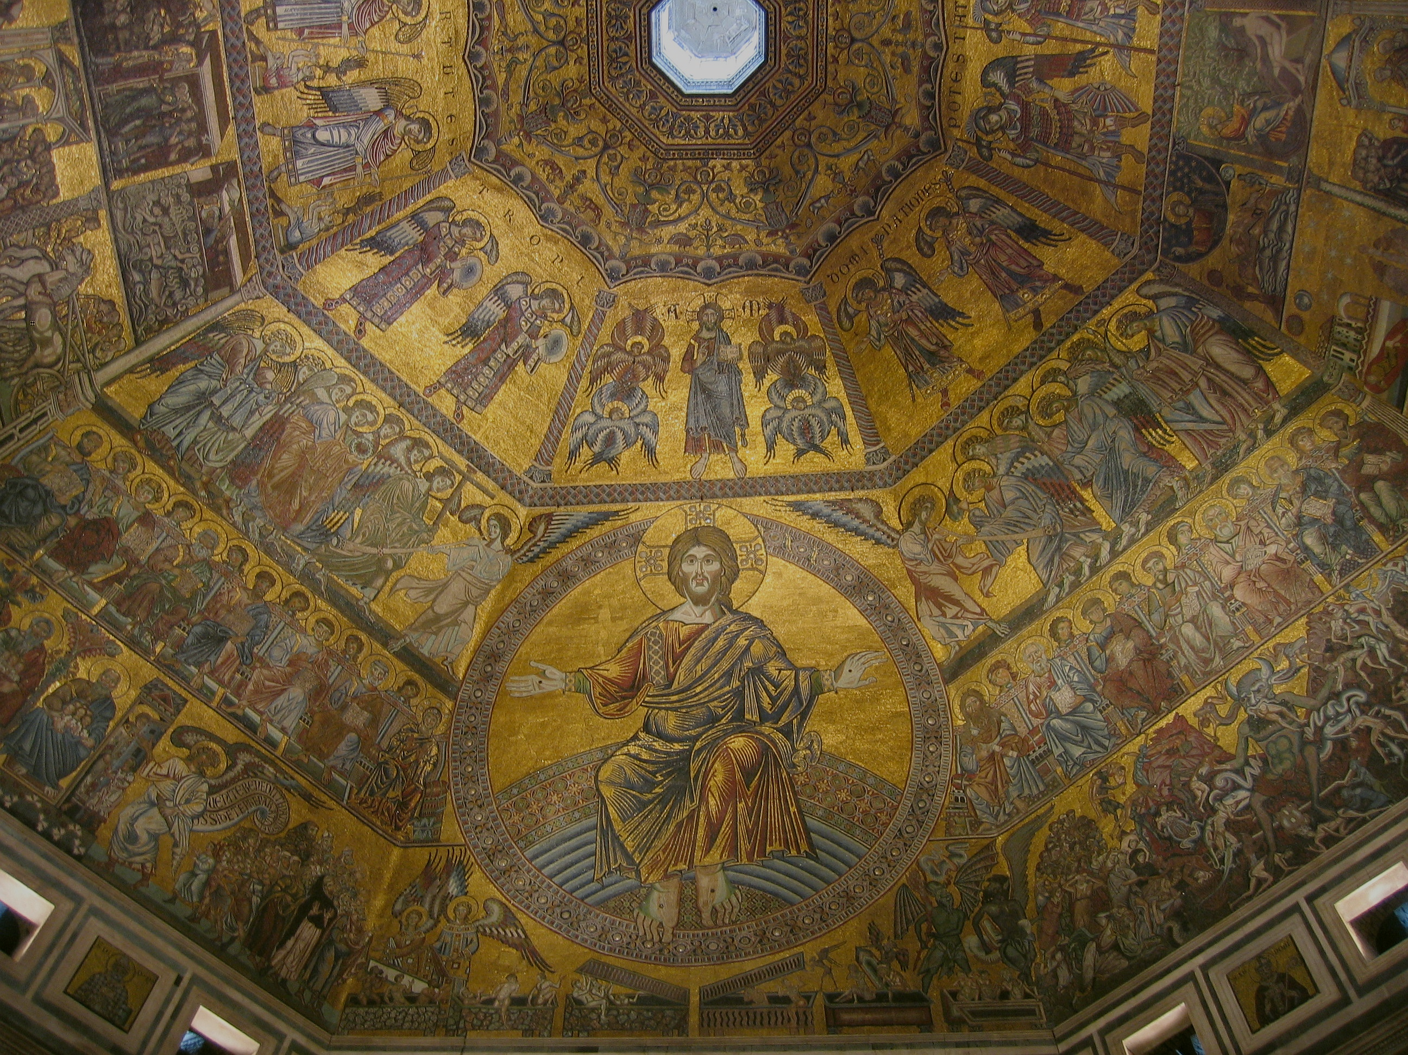
Defending the deity of Christ
in the early Church
led to neglect of His humanity
in the middle ages
Notes:
But in the process, because there was no much needed emphasis on Christ’s deity, the true humanity of Christ began to be neglected in the Middle Ages, with huge implications for the church.

Slide 26
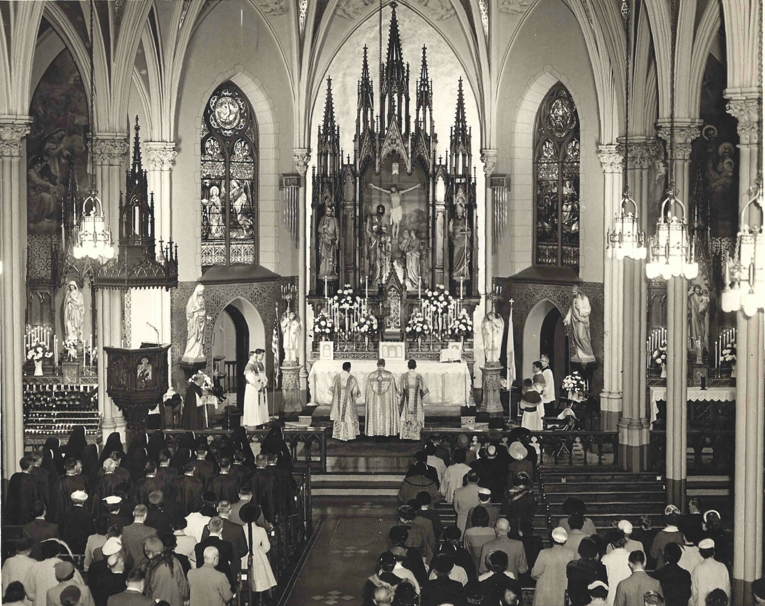
In the Middle Ages assumed the need for a human priesthood to mediate between sinful humanity and the exalted Christ, the majestic Judge and King.
Praying through the saints
Notes:
In the Middle Ages, the church, as we’ve seen, tended to gravitate back to Old Testament type of practices, and that included a growing emphasis on the need to go through a PRIEST in order to get to God.

Slide 27
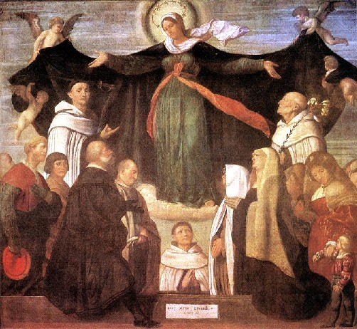
Praying through Mary
Notes:
And not only was there the emphasis on going through a priest to reach God, but there arose the teaching that in order to get your prayers heard and answered, you had to pray through Mary…

Slide 28
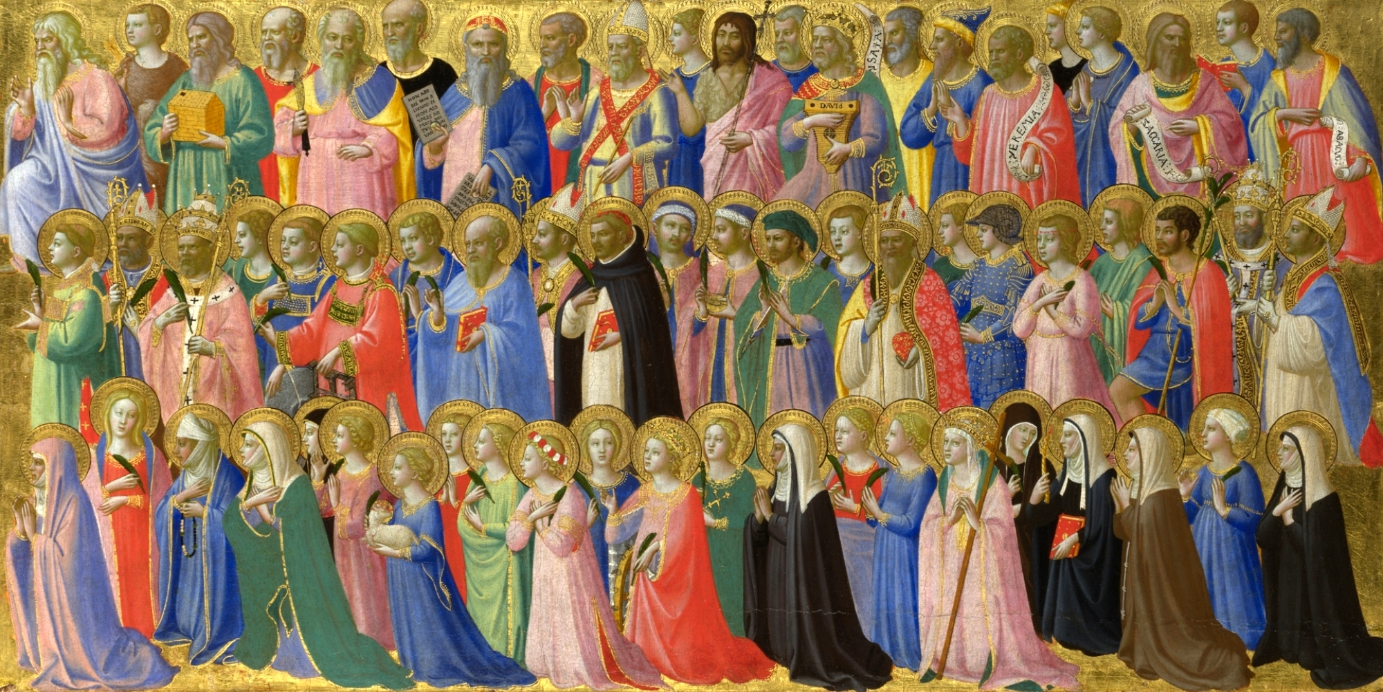
Praying through the saints
Notes:
… or you had to pray to one of the saints, as someone who could represent you before God.

Slide 29
There is one God,
and ONE MEDIATOR
between man and God,
the man Christ Jesus.
(1 Timothy 2:5)
Notes:
One of the great emphases of the Reformers was that, in Paul’s words, “There is ONE mediator between God and man, the man Christ Jesus.” Every believer has DIRECT access to God through Jesus Christ—He is the only Priest, the only go-between we need. We do not need to go through a priest, or through Mary, or through one of the saints to get to God. We go THROUGH CHRIST.

Slide 30
Solus Christus
IN CHRIST ALONE
Therefore, brethren, since we have confidence to enter the holy places by the blood of Jesus…LET US DRAW NEAR with a true heart in full assurance of faith.
(Hebrews 10:19,22)
Notes:
Salvation is by grace through in Christ alone, and He is the one way to the Father—through Him we can draw near with confidence and assurance, as the writer of Hebrews encourages us.

Slide 31
A UNIFYING TRUTH FOR OUR WORSHIP
Whatever outward form
our worship may take, there is
ONLY ONE WAY
to come to the Father,
namely through Christ
in the power of the Holy Spirit
Notes:
This is a critical unifying truth for the church’s worship: Whatever outward form our worship may take, there is ONLY ONE WAY to come to the Father, and that is through CHRIST in the power of the Holy spirit.

Slide 32
“No worship leader, pastor, band, or song will ever bring us close to God. . . .
Worship itself cannot lead us into God’s presence. Only Jesus himself can bring us into God’s presence.”
(Bob Kauflin)
Notes:
And a crucial corollary is this: No worship leader, pastor, band, or song will ever bring us close to God….Worship itself cannot lead us into God’s presence, Only Jesus Himself can bring us into God’s presence.

Slide 33
He doesn’t just show us the way:
as our Mediator and High Priest
HE TAKES US WITH HIM
Notes:
And a crucial corollary is this: doesn’t just show us the way to he Father. As Our Mediator and High Priest HE TAKES US WITH HIM into the Father’s presence. HE leads us in our worship. (I’ll have the opportunity of sharing some of these great truths in Wittenberg later this week.)

Slide 34
A REFORMATION OF DOCTRINE
Justification by Grace through Faith
A REFORMATION OF WORSHIP
Participation
The Word of God
Access through Christ alone
Notes:
And a crucial corollary is this: doesn’t just show us the way to he Father. As Our Mediator and High Priest HE TAKES US WITH HIM into the Father’s presence. HE leads us in our worship. (I’ll have the opportunity of sharing some of these great truths in Wittenberg later this week.)

Slide 35
The Post-Reformation Age 1650 A.D. – present

Slide 36
The Post-Reformation Age 1650 A.D. – present
Left-wing Central Right-wing
16th c. | Anabaptist Reformed Anglican Lutheran
17th c. | Quaker Puritan
18th c. | Methodist
19th c. | Frontier
20th c. | Pentecostal
(James White, Protestant Worship: Traditions in Transition, 23)

Slide 37
The Post-Reformation Age 1650 A.D. – present
Ascendancy of preaching, decline of worship
Reaction and over-reaction
Differing views on biblical worship:
Normative principle
Regulative principle
Hymnody (Isaac Watts, Charles Wesley, Gettys)
The Enlightenment, rationalism, and theological liberalism
The rise of evangelicalism and free churches
The neglect of worship (Tozer)
The “reformation” of worship
Vatican II
The charismatic movement
Contemporary worship

Slide 38
The Post-Reformation Age 1650 A.D. – present
Middle Ages | Reformed | Pietism | Revivalism | Liberalism | Evangelicalism | Charis.Rev.
Mass | Preaching, doctrine | Devotion, experience | Decision | Social engagement | Teaching | Experience, love
Mass-centered | Preaching-centered | Emotion-centered | Music-> Sermon-> Invitation | Formal | Preaching-centered | Emotion-centered
>Word | >Worship | >Word | >Edification | >Gospel | >Worship | >Doctrine
<Lord’s Supper | <Word | <Adoration | <Mission | <Social action | <Doctrine | <Relationships <Worship

Slide 39
Need for BALANCE
Revelation & Response
Theology and Doxology
Complete the cycle
Notes:
God reveals His glory, worship is our response
Order is important: God always initiates
Rom. 11:33-36 eleven chapters of doctrine, then Paul bursts out in praise: „Oh, the depth of the riches ¹both of the wisdom and knowledge of God!”
Worship services to be a dialogue betw, God and man, a dialogue of revel. & response
This is why the Scriptures are so important; Stott and others remind us how we need much more Scr. In our services– been in many churches where first first of Scr. Is when preacher gets up– means 30 mintues of response w/o anything to respond to!!

