Slide 1
Taught by Dr. Ron Man for Doctor of Ministry Students Uploaded by Dr. Rick Griffith • Singapore Bible College Files in many languages for free download at BibleStudyDownloads.org

Slide 3
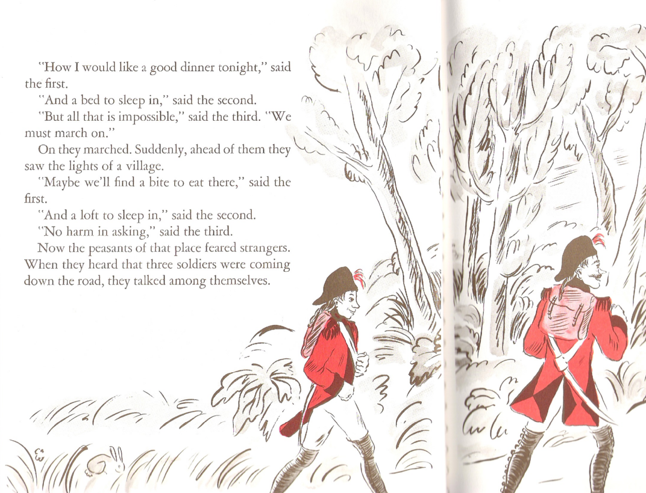

Slide 4
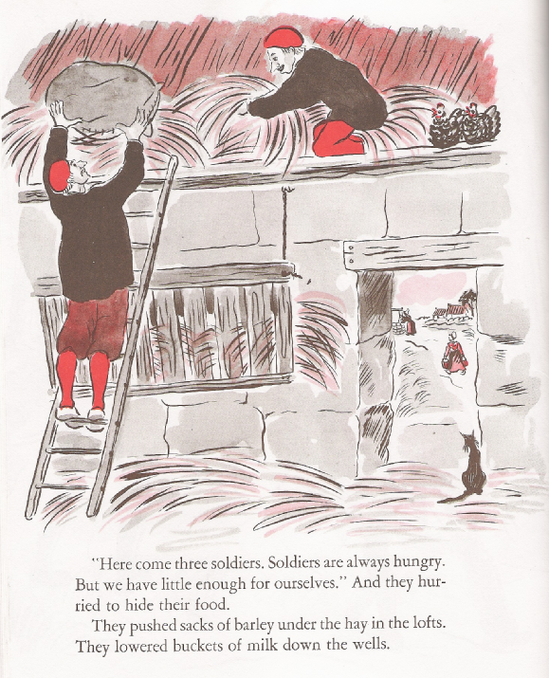

Slide 5
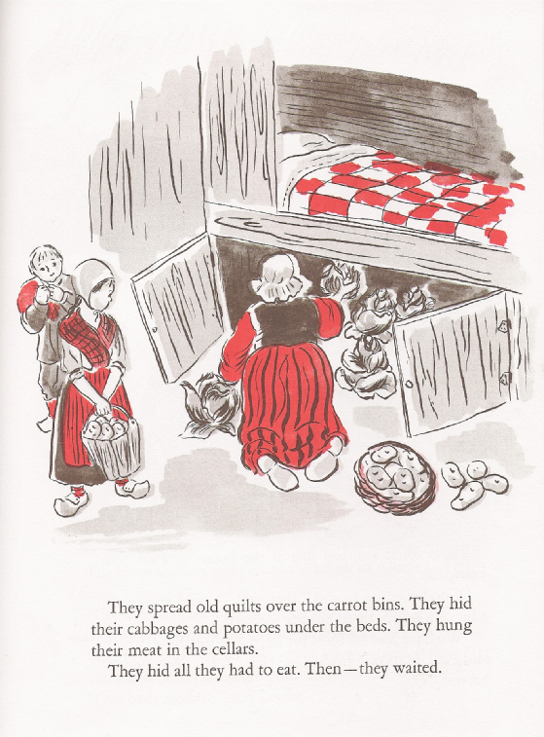

Slide 6
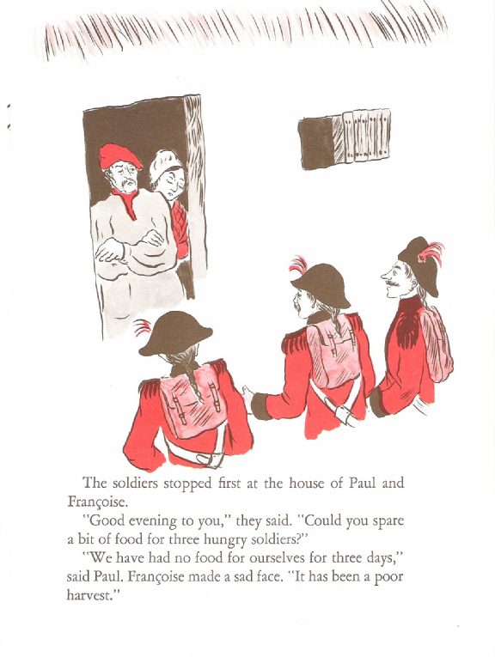

Slide 8
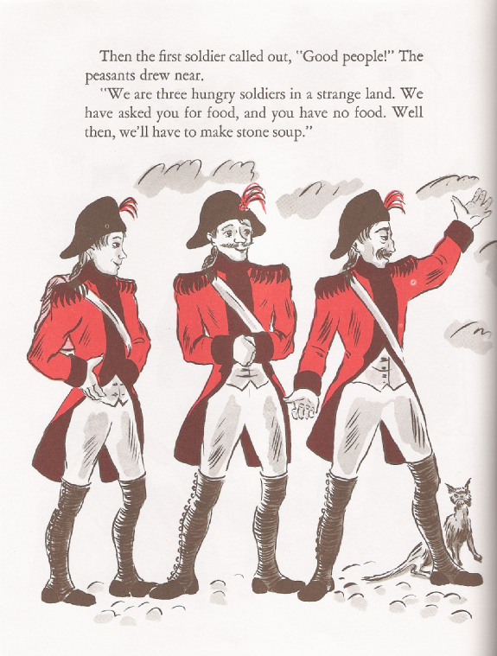

Slide 9
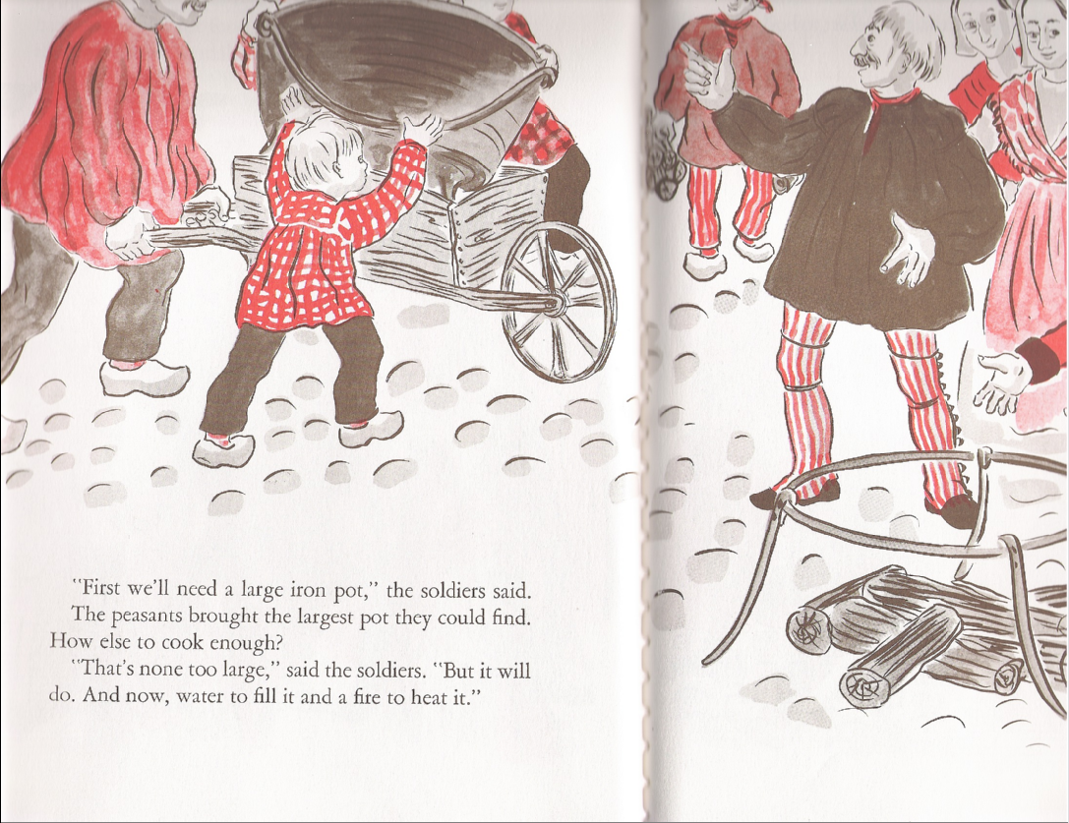

Slide 10
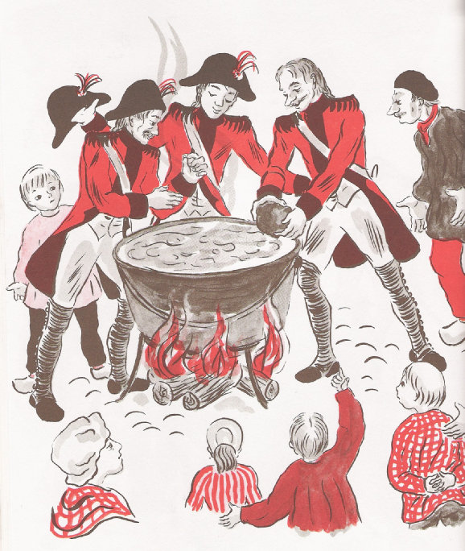
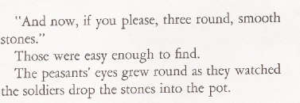

Slide 11
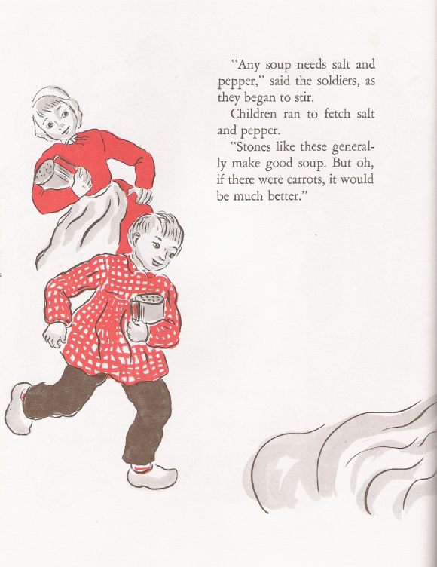
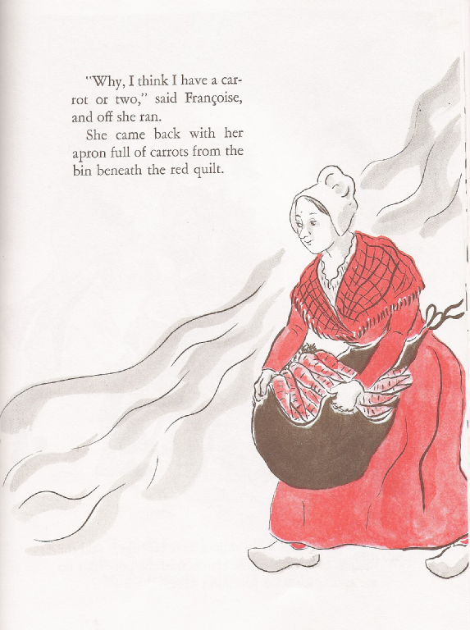

Slide 12
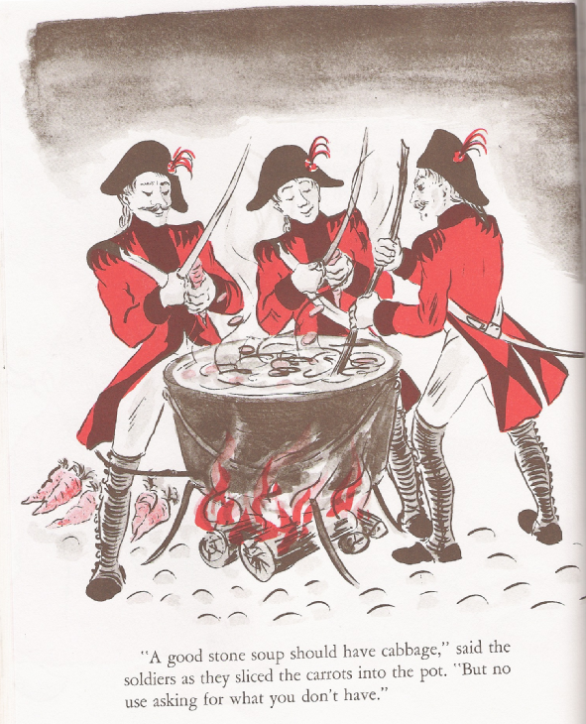

Slide 14
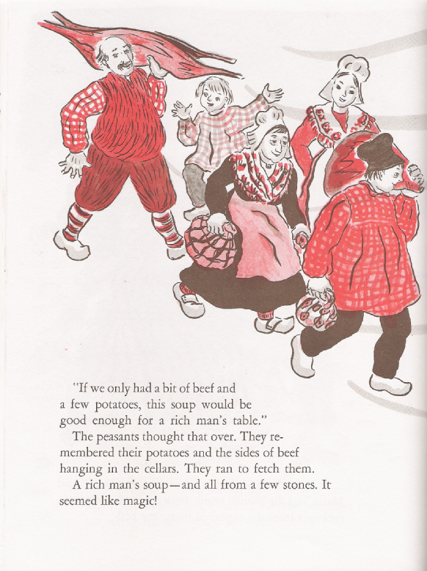

Slide 15
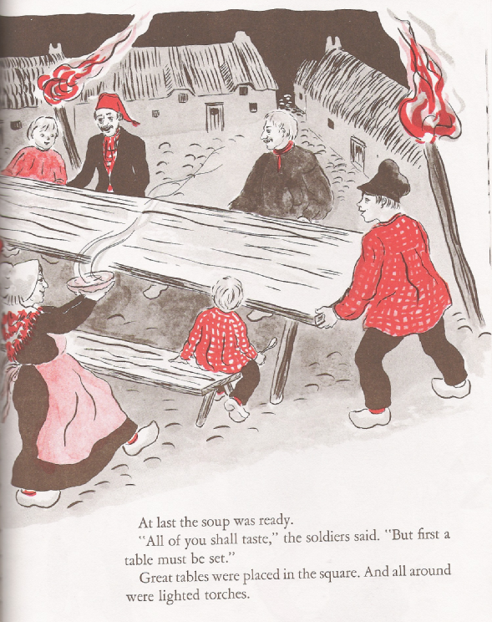

Slide 16
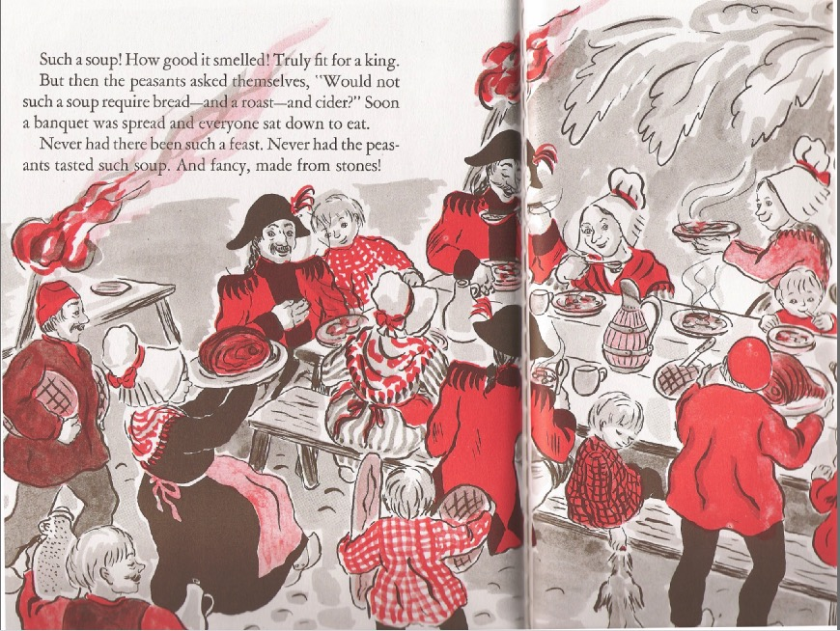

Slide 18
WORSHIP

Slide 19
Black

Slide 20
Worship link at BibleStudyDownloads.org
Get this presentation for free!
Notes:
The Bible…Basically (bb)

