Slide 1
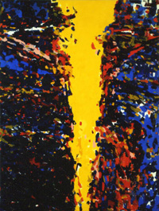
WORSHIP IN HEBREWS
“Let Us Draw Near”
Taught by Dr. Ron Man for Doctor of Ministry Students Uploaded by Dr. Rick Griffith • Singapore Bible College Files in many languages for free download at BibleStudyDownloads.org
Notes:
Worship book of NT (Revel.?)

Slide 2
“The glory of the gospel, is this:
The one from whom we need to be saved is the One who saved us.”
(R. C. Sproul)

Slide 3
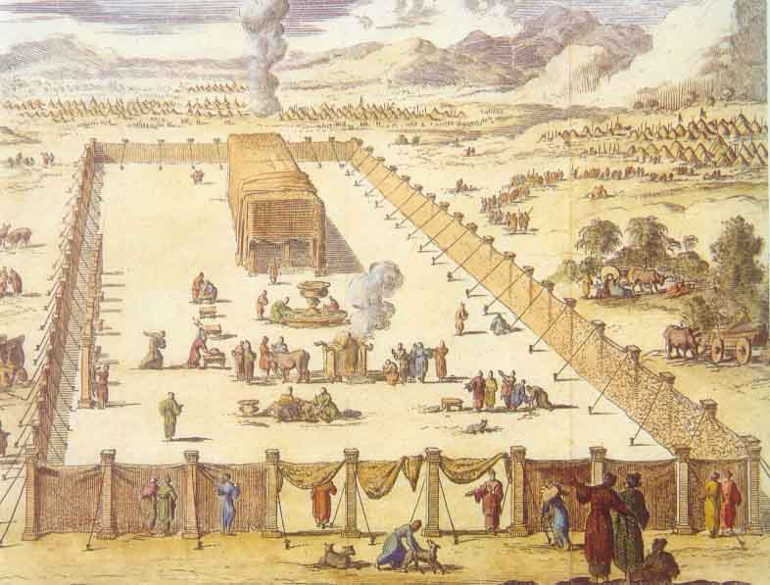
Barriers between the individual and God
under the Old Covenant

Slide 4
The Veil
Was Torn
Exodus 26:33
And you shall hang the veil from the clasps. Then you shall bring the ark of the Testimony in there, behind the veil. The veil shall be a divider for you between the holy place and the Most Holy.
Matthew 27:51
Then, behold, the veil of the temple was torn in two from top to bottom; and the earth quaked, and the rocks were split.
In the New Covenant,
you have direct access to God.
Notes:
____________
04-WO-Centrality-71
08-WO-Hebrews-4

Slide 5
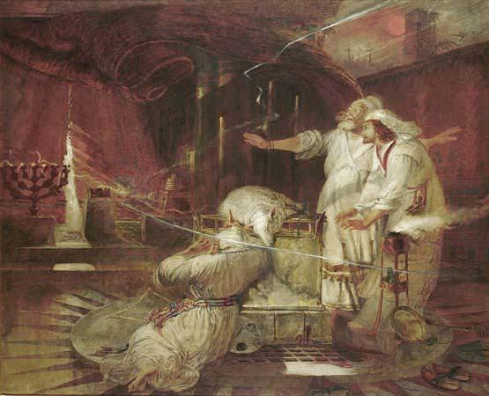

Slide 6
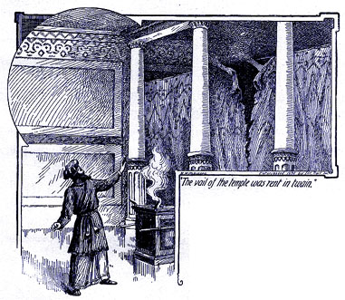
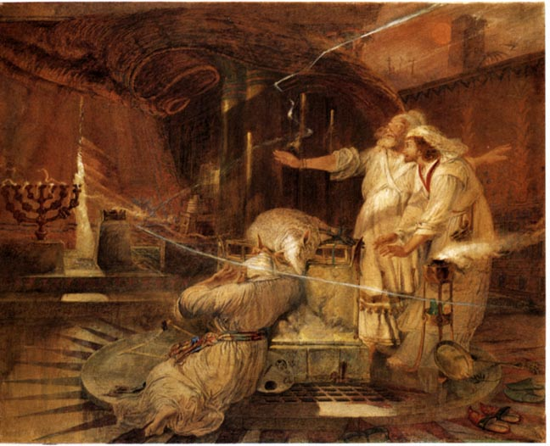
Barriers between the individual and God
under the Old Covenant

Slide 7
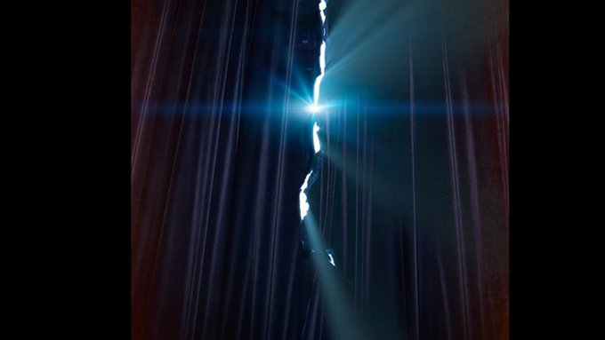
ACCESS!
Let us draw near …
(Hebrews 10:22)

Slide 8
Notes:
ACCESS: unique defining characteristic of NEW COVENANT worship

Slide 9
If we take Christ out of Hebrews, we are left with NOTHING.
(Noel Due)

Slide 10
He is the substance of the book, and without Him the whole reality of the new covenant and the life of Christian belief and worship collapses.
(Noel Due)
Notes:
Prof. Hastings: Christianity IS Christ

Slide 11
I. A BETTER WAY
II. A BETTER MEDIATOR
III. A BETTER WORSHIP

Slide 12
I. A BETTER WAY
Notes:
Written to Jewish Christians…
“why would you ever go back???”

Slide 13
BETTER:
1:2-14 spokesman for God (the Son)
2:2-3 message (salvation)
3:3 rest
4:15 High Priest (tempted but sinless)
7:7,15-17 priestly order (of Melchizedek)
7:19 hope
7:21 priesthood (eternal)
7:22 covenant (better guarantor)
7:27; 9:26 sacrifice (priest Himself)
7:28 priest (perfect)
8:2; 9:11 tabernacle
8:6 ministry (better covenant)
8:6 covenant (better promises)
8:6 promises
Notes:
27 things BETTER!

Slide 14
BETTER:
8:11 knowledge of Lord
9:12; 12:24 blood
9:12 redemption (eternal)
9:14; 10:22 cleansing (of conscience)
9:14-15 inheritance (eternal)
9:23 sacrifices
9:24 holy place (in heaven)
9:26; 10:12,14 frequency (once for all)
8:10; 10:16 law (written on heart, mind)
8:19 access (to holy place)
12:22 mountain/city (Zion)
12:28 kingdom (cannot be shaken)
13:9 food (grace)
13:10 altar (Christ)
Notes:
Superiority of Christ and of the New Covenant

Slide 15
II. A BETTER MEDIATOR
Notes:
Better way because it has a better MEDIATOR

Slide 16
A. Two Natures & Roles (1–2)
Notes:
Of Christ

Slide 17
Worship of the Son
a. His deity (1:1-6)
God . . . has spoken to us by His Son, whom He appointed the heir of all things, through whom also He created the world. He is the radiance of the glory of God and the exact imprint of His nature, and He upholds the universe by the word of His power. . . . “Let all God’s angels worship Him.”
Notes:
Worship of Son because of His deity AND authority

Slide 18
Worship of the Son
b. His authority (1:7-14)
Of the Son He says, “Your throne, O God, is forever and ever. . . . the scepter of uprightness is the scepter of Your kingdom. . . . You are the same, and Your years will have no end. . . . Sit at My right hand until I make Your enemies a footstool for your feet.”

Slide 19
2. Worship by the Son
a. His humanity (2:6-11)
“You made Him for a little while lower than the angels. . . .” For He who sanctifies and those who are sanctified all have one origin. That is why He is not ashamed to call them brethren.
Notes:
Worship BY the Son

Slide 20
2. Worship by the Son
b. His priesthood (2:12-18)
“In the midst of the congregation I will sing Your praise.” . . . He had to be made like His brethren in every respect, so that He might become a merciful and faithful high priest in the service of God, to make propitiation for the sins of the people.
Notes:
A priest leads people in worship
Reformation: ONE Mediator, ONE priest

Slide 21
3. Summary (3:1)
Therefore, holy brethren, you who share in a heavenly calling, consider Jesus, the Apostle and High Priest of our confession.

Slide 22
APOSTLE
(deity)
HIGH PRIEST
(humanity)
As Apostle, Christ bears witness for God, that
He is Holy. As High Priest He acknowledges
that witness and says Amen to it. Again as
Apostle of God He confesses the mercy and
grace of God, His will to pardon and reconcile.
As High Priest He intercedes for men, and con-
fesses them before the face of God.
(T. Torrance)
Revelation
Response
Notes:
deity, humanity
Order is important: God always initiates
Rom. 11:33-36 eleven chapters of doctrine, then Paul bursts out in praise: „Oh, the depth of the riches ¹both of the wisdom and knowledge of God!”
Worship services to be a dialogue betw, God and man, a dialogue of revel. & response
This is why the Scriptures are so important; Stott and others remind us how we need much more Scr. In our services– been in many churches where first first of Scr. Is when preacher gets up– means 30 mintues of response w/o anything to respond to!!

Slide 23
B. Two Presthoods (5-10)

Slide 24
Levitical Priesthood/ Order of Aaron
weak, imperfect, sinful
mortal, therefore temporary
served a copy and shadow
had to sacrifice for self too
repeated sacrifices
no cleansing of conscience
no making perfect
offered blood of bulls and goats

Slide 25
Levitical Priesthood/ Order of Aaron
weak, imperfect, sinful
mortal, therefore temporary
served a copy and shadow
had to sacrifice for self too
repeated sacrifices
no cleansing of conscience
no making perfect
offered blood of bulls and goats
How was the Priesthood of Christ different?

Slide 26
2. Priesthood of Christ/ Order of Melchizedek
a. Christ like Melchizedek
“king of Salem [Shalom]” (7:1)
“king of righteousness” (7:2)
without human pedigree (7:3,6)
greater than Abraham and Levi (7:6-10)
not from priestly line (7:11-16; 8:4)
Notes:
Shalom
King AND Priest

Slide 27
Genesis 14:18-20
And Melchizedek king of Salem brought out bread and wine. (He was priest of God Most High.)
And he blessed him and said, “Blessed be Abram by God Most High, Possessor of heaven and earth;
and blessed be God Most High, who has delivered your enemies into your hand!” And Abram gave him a tenth of everything.

Slide 28
Melchizedek blesses Abraham on behalf of God,
AND blesses GOD on behalf of Abraham
MEDIATOR

Slide 29
CHRIST
Two-way mediation
God to man man to God
Notes:
deity, humanity
Order is important: God always initiates
Rom. 11:33-36 eleven chapters of doctrine, then Paul bursts out in praise: „Oh, the depth of the riches ¹both of the wisdom and knowledge of God!”
Worship services to be a dialogue betw, God and man, a dialogue of revel. & response
This is why the Scriptures are so important; Stott and others remind us how we need much more Scr. In our services– been in many churches where first first of Scr. Is when preacher gets up– means 30 mintues of response w/o anything to respond to!!

Slide 30
2. Priesthood of Christ/ Order of Melchizedek
b. Entering the heavenly tabernacle
(His sacrifice)
Hebrews 9:11 Christ . . . entered through the greater and more perfect tabernacle, not made with hands, that is to say, not of this creation; and not through the blood of goats and calves, but through His own blood.

Slide 31
2. Priesthood of Christ/ Order of Melchizedek
c. Ministering in the heavenly tabernacle
(His session and ongoing ministry)
Hebrews 8:1-2 We have such a high priest, who has taken His seat at the right hand of the throne of the Majesty in the heavens, a minister in the sanctuary and in the true tabernacle.

Slide 32
3. Summary (7:23-25)
The former priests were many in number, because they were prevented by death from continuing in office,
But He holds His priesthood permanently, because He continues forever.
CONSEQUENTLY, He is able to save FOREVER those who draw near to God through him, since He always lives to make intercession for them.
Notes:
The superiority of Christ’s priesthood: guarantees our eternal salvation!

Slide 33
3. Summary (10:11-14)
And every priest stands daily at his service, offering repeatedly the same sacrifices, which can never take away sins.
But when Christ had offered for all time a single sacrifice for sins, He sat down at the right hand of God. . . . For by a single offering He has perfected for all time those who are being sanctified.
Notes:
The superiority of Christ’s preisthood:

Slide 34
What are all the ways the priesthood of Christ is superior?
Notes:
The superiority of Christ’s preisthood:

Slide 35
III. A BETTER WORSHIP
(10:19-22’s summary of themes)

Slide 36
III. A BETTER WORSHIP (10:19-22)
THEREFORE, brethren,
since we have confidence to enter the holy place by the blood of Jesus, by the new and living way that He opened for us through the curtain, that is, through His flesh,
and since we have a great priest over the house of God,
let us draw near with a true heart in full assurance of faith, with our hearts sprinkled clean from an evil conscience and our bodies washed with pure water.
Notes:
Summary of what’s come before: superiority of Christ and His priesthood, superiority of the New Covenant

Slide 37
III. A BETTER WORSHIP (10:19-22)
Therefore, brethren,
since we have confidence to enter the holy place by the blood of Jesus, by the new and living way that He opened for us through the curtain, that is, through His flesh,
and since we have a great priest over the house of God,
LET US DRAW NEAR with a true heart in full assurance of faith,with our hearts sprinkled clean from an evil conscience and our bodies washed with pure water.
Notes:
APPLICATION OF LETTER

Slide 38
“LET US DRAW NEAR”
proserchomai

Slide 39
Hebrews 4:16 Let us then with confidence draw near to the throne of grace, that we may receive mercy and find grace to help in time of need.
Hebrews 7:25 Consequently, He is able to save to the uttermost those who draw near to God through Him, since He always lives to make intercession for them.
Hebrews 10:1 the law has but a shadow of the good things to come instead of the true form of these realities, it can never, by the same sacrifices that are continually offered every year, make perfect those who draw near.

Slide 40
Hebrews 12:18,22,28 For you have not come to what may be touched . . . but you have come to Mount Zion and to the city of the living God, the heavenly Jerusalem. . . . Therefore . . . let us offer to God acceptable worship, with reverence and awe.
1 Peter 2:4-5 As you come to Him, a living stone rejected by men but in the sight of God chosen and precious, you yourselves like living stones are being built up as a spiritual house, to be a holy priesthood, to offer spiritual sacrifices acceptable to God through Jesus Christ.

Slide 41
III. A BETTER WORSHIP (10:19-22)
Therefore, brethren,
SINCE we have confidence to enter the holy place by the blood of Jesus,
by the new and living way that He opened for us
through the curtain, that is, through His flesh,
and SINCE we have a great priest over the house of God,
let us draw near with a true heart in full assurance of faith, with our hearts sprinkled clean from an evil conscience and our bodies washed with pure water.
PAST WORK
PRESENT WORK
Notes:
WHY we can draw near

Slide 42
CHRIST’S PRIESTLY MINISTRY
Past
1:3
2:9-10
3:1
5:7-8
7:26-27
9:11-14
9:23
9:26
10:10
10:12-14
10:19-20
12:2
12:24
13:12
13:20

Slide 43
CHRIST’S PRIESTLY MINISTRY
Present
He leads our worship (2:12; 3:1; 8:1-2,6; 10:21; 13:15)
He intercedes for us and comes to our aid (2:18; 4:14-16; 7:25; 9:24; 13:21
He guarantees our eternal salvation (7:25)
1:3
2:9-10
3:1
5:7-8
7:26-27
9:11-14
9:23
9:26
10:10
10:12-14
10:19-20
12:2
12:24
13:12
13:20
Notes:
More than any other place in NT

Slide 44
III. A BETTER WORSHIP (10:19-22)
Therefore, BRETHREN,
since we have confidence to enter the holy place by the blood of Jesus, by the new and living way that He opened for us through the curtain, that is, through His flesh,
and since we have a great priest over the house of God,
let US draw near with a true heart in full assurance of faith, with our hearts sprinkled clean from an evil conscience and our bodies washed with pure water.
Notes:
CORPORATE INVITATION TO DRAW NEAR

Slide 45
III. A BETTER WORSHIP (10:19-22)
“He is not ashamed
to call [us] brethren!” (2:11)
(see also 2:13,17; 3:1,12; 7:5; 13:22)

Slide 46
Hebrews 10:24-25 And let us consider how to stir up one another to love and good works, not neglecting to meet together, as is the habit of some, but encouraging one another, and all the more as you see the Day drawing near.
Notes:
US

Slide 47
Hebrews 10:19-22 Therefore, brothers, since we have CONFIDENCE to enter the holy places by the blood of Jesus . . . let us draw near with a true heart in full ASSURANCE of faith
Hebrews 4:16 Let us then with CONFIDENCE draw near to the throne of grace
Notes:
ATTITUDES: Confidence, assurance, security

Slide 48
Hebrews 12:28 Therefore let us be GRATEFUL for receiving a kingdom that cannot be shaken, and thus let us offer to God acceptable worship, with REVERENCE and AWE
Hebrews 13:15 Through Him then let us continually offer up a sacrifice of PRAISE to God, that is, the fruit of lips that acknowledge His name.
Notes:
ATTITUDES: gratitude, reverence, praise

Slide 49
CONCLUSION
Hebrews 13:15
THROUGH HIM
then let us continually offer up a sacrifice of praise to God, that is, the fruit of lips that acknowledge his name.
Hebrews 7:25 Consequently, He is able to save to the uttermost those who draw near to God THROUGH HIM, since He always lives to make intercession for them.
Notes:
CHRIST is central

Slide 50
2 Corinthians 1:20 therefore also THROUGH HIM is our Amen to the glory of God through us.
Ephesians 2:18 For THROUGH HIM we both have access in one Spirit to the Father.
Colossians 3:17 And whatever you do, in word or deed, do everything in the name of the Lord Jesus, giving thanks to God the Father THROUGH HIM.

Slide 51
WORSHIP
Through Christ
In Christ
By Christ
With Christ
Notes:
To Him be the glory forever! Amen.

Slide 52
“LET US DRAW NEAR…”
…through Christ
…in Christ
…with Christ
Notes:
To Him be the glory forever! Amen.

Slide 53
Your favorite passage in Hebrews?
Notes:
To Him be the glory forever! Amen.

Slide 54
Breathe!
Notes:
To Him be the glory forever! Amen.

Slide 55
Black

Slide 56
Worship link at BibleStudyDownloads.org
Get this presentation for free!
Notes:
Worship (wo)

