Slide 1

Unit 4
Biblical Worship
WORSHIP IN THE NEW TESTAMENT
Taught by Dr. Ron Man for Doctor of Ministry Students
Uploaded by Dr. Rick Griffith • Singapore Bible College
Files in many languages for free download at BibleStudyDownloads.org

Slide 2
Similarities/Differences
between OT and NT Worship

Slide 3
1. Important Themes
in New Testament Worship

Slide 4
1. Important Themes
Inward worship
    “In the NT there is a stunning degree of indifference to worship as an outward form and a radical intensification of worship as an inward experience of the heart.” (John Piper)
Jesus said to her, “Woman, believe me, the hour is coming when neither on this mountain nor in Jerusalem will you worship the Father. . . . But the hour is coming, and is now here, when the true worshipers will worship the Father in spirit and truth, for the Father is seeking such people to worship Him. God is spirit, and those who worship Him must worship in spirit and truth.” (John 4:21,23-24)

Slide 5
1. Important Themes
Whole-life worship
        I appeal to you therefore, brethren, by the mercies of God, to present your bodies as a living sacrifice, holy and acceptable to God, which is your spiritual worship. (Romans 12:1)
      “And you shall love the Lord your God with all your heart and with all your soul and with all your mind and with all your strength.” (Mark 12:30)

Slide 6
1. Important Themes
Freedom of form
In the New Testament, all the focus is on the reality of the glory of Christ, not the shadow and copy of religious objects and forms. It is stunning how indifferent the New Testament is to such things: there is no authorization in the New Testament for worship buildings, or worship dress, or worship times, or worship music, or worship liturgy or worship size or thirty-five-minute sermons, or Advent poems or choirs or instruments or candles. . . . Almost every worship tradition we have is culturally shaped rather than Biblically commanded. . . . [We are] free to find place and time and dress and size and music and elements and objects that help us orient radically toward the supremacy of God in Christ.
(John Piper)

Slide 7
1. Important Themes
Access
      Therefore, brethren, since we have confidence
      to enter the holy places by the blood of Jesus, by the new and living way that He opened for us through the curtain, that is, through his flesh, and since we have a great priest over the house of God, let us draw near with a true heart in full assurance of faith, with our hearts sprinkled clean from an evil conscience and our bodies washed with pure water.
      (Hebrews 10:19-22)

Slide 8
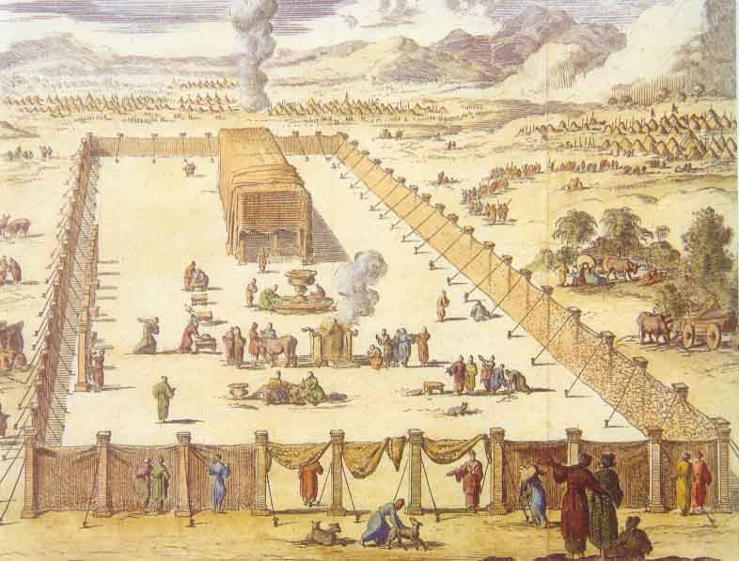

Barriers between the individual and God
under the Old Covenant

Slide 9
Worship is . . .the gift of participating
through the Spirit in the incarnate Son's
communion with the Father.
(James Torrance)

Slide 10
Draw near . . .

Slide 11
2. Important Vocabulary
in New Testament Worship
a. “to bow down one’s self in honor,
to pay homage, to do reverence, to worship”
                proskuneō
                (similar to OT: ḥistahavah)
“

Slide 12
2. Important Vocabulary
in New Testament Worship
b. “to serve, worship”
                latreuō
                (similar to OT: ‘abad)
I appeal to you therefore, brethren, by the mercies of God, to present your bodies as a living sacrifice, holy and acceptable to God, which is your spiritual worship. (Romans 12:1)
For we are the circumcision, who worship by the Spirit of God and glory in Christ Jesus and put no confidence in the flesh. (Philippians 3:3)
Therefore let us be grateful for receiving a kingdom that cannot be shaken, and thus let us offer to God acceptable worship, with reverence and awe. (Hebrews 12:28)

Slide 13
2. Important Vocabulary
in New Testament Worship
c. OT sacrificial language
                (living, spiritual) sacrifice (Rom 12:1;
                1 Pet 2:5; Heb 13:15)
                priesthood (1 Pet 2:5)
                temple (1 Cor 3:16; Ephes 2:21)
                drink offering (Phil 2:17)

Slide 14
3. Important NT Passages on Worship
Matthew
  4:10
  6:7
  6:9
  6:33
        11:28-30
  15:8-9
  16:25
  23:12
  26:39

Slide 15
3. Important NT Passages on Worship
Mark 12:28-34

Slide 16
3. Important NT Passages on Worship
Mark 14:3-9

Slide 17
3. Important NT Passages on Worship
2 CORINTHIANS 1:20
For as many as are the promises of God,
in Him they are YES;
therefore also through Him is our AMEN to the glory of God through us.
Revelation
Response
Notes:
God reveals His glory, worship is our response
Order is important: God always initiates
Rom. 11:33-36 eleven chapters of doctrine, then Paul bursts out in praise: „Oh, the depth of the riches ¹both of the wisdom and knowledge of God!”
Worship services to be a dialogue betw, God and man, a dialogue of revel. & response
This is why the Scriptures are so important; Stott and others remind us how we need much more Scr. In our services– been in many churches where first first of Scr. Is when preacher gets up– means 30 mintues of response w/o anything to respond to!!

Slide 18
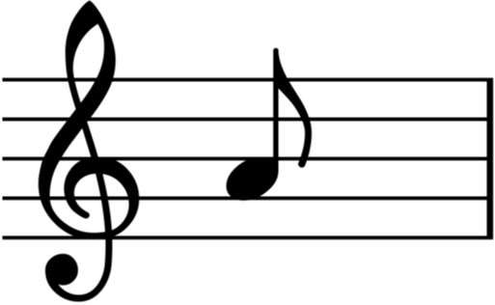
The Ministry of Song
(Ephesians 5:18-20)
3. Important NT Passages
on Worship

Slide 19

A Spirit-filled ministry

Slide 20
A mutual ministry

Slide 21
A varied ministry

Slide 22
A God-focused ministry

Slide 23

An internal ministry

Slide 24
A responsive ministry

Slide 25

A Christ-empowered ministry

Slide 26
A Trinitarian ministry

Slide 27
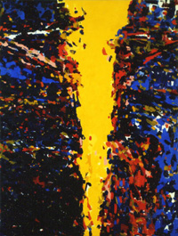
WORSHIP IN HEBREWS

Slide 28
1. A BETTER WAY
Notes:
Written to Jewish Christians…
“why would you ever go back???”

Slide 29
BETTER:
1:2-14 spokesman for God (the Son)
2:2-3 message (salvation)
3:3 rest
4:15 High Priest (tempted but sinless)
7:7,15-17 priestly order (of Melchizedek)
7:19 hope
7:21 priesthood (eternal)
7:22 covenant (better guarantor)
7:27; 9:26 sacrifice (priest Himself)
7:28 priest (perfect)
8:2; 9:11 tabernacle
8:6 ministry (better covenant)
8:6 covenant (better promises)
8:6 promises
Notes:
27 things BETTER!

Slide 30
BETTER:
8:11 knowledge of Lord
9:12; 12:24 blood
9:12 redemption (eternal)
9:14; 10:22 cleansing (of conscience)
9:14-15 inheritance (eternal)
9:23 sacrifices
9:24 holy place (in heaven)
9:26; 10:12,14 frequency (once for all)
8:10; 10:16 law (written on heart, mind)
8:19 access (to holy place)
12:22 mountain/city (Zion)
12:28 kingdom (cannot be shaken)
13:9 food (grace)
13:10 altar (Christ)
Notes:
Superiority of Christ and of the New Covenant

Slide 31
2. A BETTER MEDIATOR
Notes:
Better way because it has a better MEDIATOR

Slide 32
CHRIST
Two-way mediation
God to man man to God
Notes:
deity, humanity
Order is important: God always initiates
Rom. 11:33-36 eleven chapters of doctrine, then Paul bursts out in praise: „Oh, the depth of the riches ¹both of the wisdom and knowledge of God!”
Worship services to be a dialogue betw, God and man, a dialogue of revel. & response
This is why the Scriptures are so important; Stott and others remind us how we need much more Scr. In our services– been in many churches where first first of Scr. Is when preacher gets up– means 30 mintues of response w/o anything to respond to!!

Slide 33
A BETTER WORSHIP
(Hebrews 10:19-22)
Therefore, brethren,
since we have confidence to enter the holy place by the blood of Jesus, by the new and living way that he opened for us through the curtain that is, through his flesh, and since we have a great priest over the house of God,
LET US DRAW NEAR with a true heart in full assurance of faith, with our hearts sprinkled clean from an evil conscience and our bodies washed with pure water.

Slide 34
5. The Holy Spirit and Worship

Slide 35
The main focus of His ministry is to glorify Christ
“When the Spirit of truth comes . . . He will glorify Me.”
(John 16:13-14)

Slide 36
He glorifies Christ by . . .
Acting in Christ’s earthly ministry (conception, baptism, miracles, death, resurrection)
Continuing Christ’s earthly ministry (Christ-centeredness of all His activities in the New Testament)
“And I will ask the Father, and He will give you another Helper, to be with you forever.” (John 14:16)
When the Spirit of truth comes, He will guide you into all
the truth, for He will not speak on his own authority, but
whatever He hears He will speak, and He will declare to you the
things that are to come. He will glorify me, for He will take
what is mine and declare it to you. (John 16:13-14)

Slide 37
He glorifies Christ by . . .
Bringing us to faith in Christ
  And when He comes, He will convict the world concerning sin and righteousness and judgment. (John 16:8)
  Jesus answered, “Truly, truly, I say to you, unless one is born of water and the Spirit, he cannot enter the kingdom of God. (John 3:5)
  But when the goodness and loving kindness of God our Savior appeared, He saved us . . . by the washing of regeneration and renewal of the Holy Spirit. (Titus 3:4-5)

Slide 38
He glorifies Christ by . . .
Giving us assurance of our relationship to God in Christ
  For you did not receive the spirit of slavery to fall back into fear, but you have received the Spirit of adoption as sons, by whom we cry, “Abba! Father!” (Romans 8:15)
  And because you are sons, God has sent the Spirit of His Son into our hearts, crying, “Abba! Father!” (Galatians 4:6)

Slide 39
He glorifies Christ by . . .
Motivating and empowering our worship of the Father through Christ
  For we are the true circumcision, who worship by the Spirit of God and glory in Christ Jesus and put no confidence in the flesh. (Philippians 3:3)
  Be filled with the Spirit, addressing one another in psalms and hymns and spiritual songs, singing and making melody to the Lord with your heart. (Ephesians 5:18-19)

Slide 40
He glorifies Christ by . . .
Motivating and empowering our worship of the Father through Christ
  Connecting Revelation and Response/Head and Heart

Slide 41
Revelation Response
Holy Spirit
(Romans 8; 1 Corinthians 2:12)

Slide 42
He glorifies Christ by . . .
Motivating and empowering our worship of the Father through Christ
  Connecting Revelation and Response/Head and Heart
  Christ is the Way – the Holy Spirit is the Guide
  We CAN come to the Father in worship because of the ministry of Christ; we WANT to come to the Father in worship because of the ministry of the Holy Spirit.

Slide 43
He glorifies Christ by . . .
Producing growth in Christlikeness in us individually and as a Church. (Spiritual gifts)
  And we all, with unveiled face, beholding the glory of the Lord, are being transformed into the same image from one degree of glory to another. For this comes from the Lord who is the Spirit. (2 Corinthians 3:18)
  In Christ you also are being built together into a dwelling place for God by the Spirit. (Ephesians 2:22)

Slide 44
The utter Christ-centeredness
of all the Spirit’s work
(J. I. Packer)

Slide 45
1. How would you describe the Holy Spirit’s unique role?
2. Do you think we should worship the Holy Spirit?

Slide 46
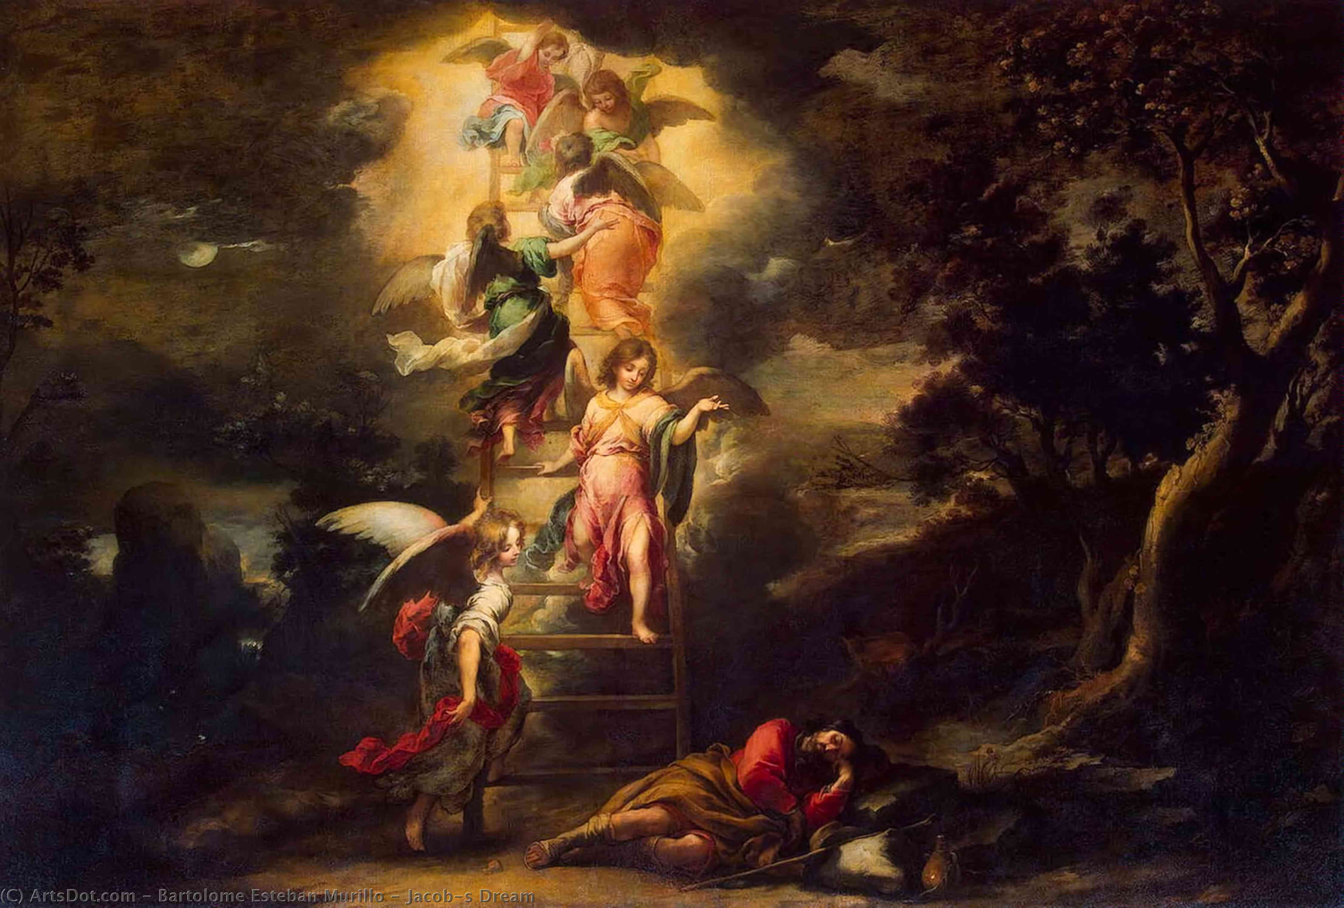
6. The Role of Jesus Christ
in Worship
Type to enter a caption.

Slide 47
“Truly, truly, I say to you, you will see heaven opened, and the angels of God ascending and descending on the Son of Man.”
John 1:51

Slide 48
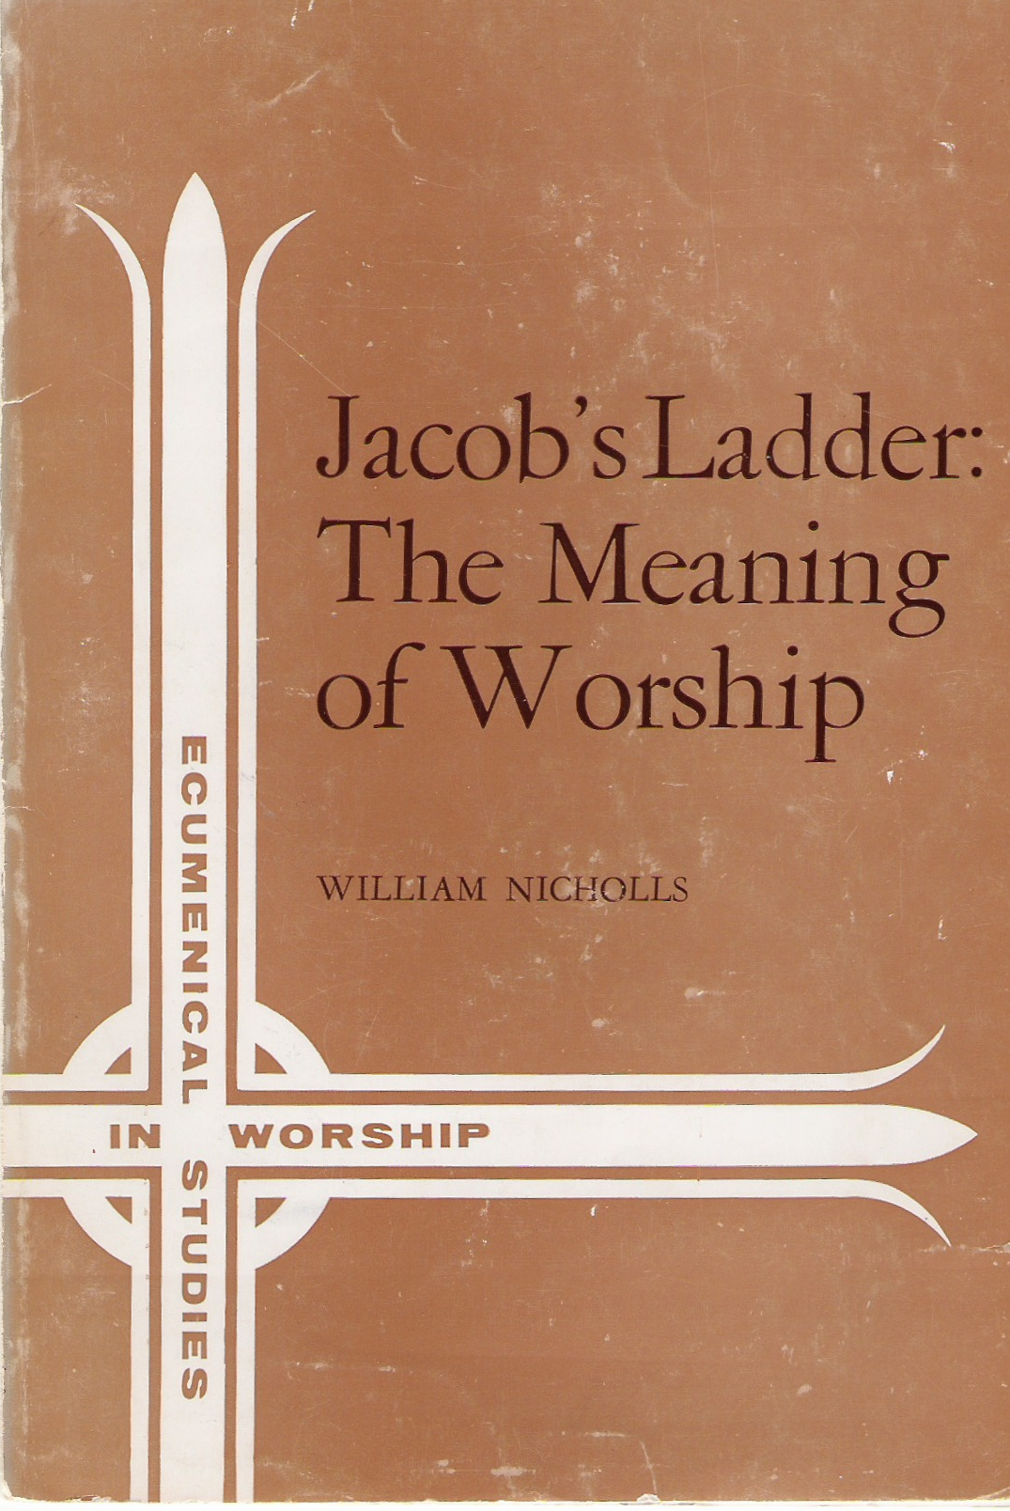

Slide 49
WHAT MAKES WORSHIP “GOOD”?
the right song?
the right worship leader?
the right group of talent?
the right amount of sincerity?

Slide 50
the sin of trying to do worship in our own strength

Slide 51
Are you so foolish?
Having begun by the Spirit,
are you now being perfected by the flesh?
(Galatians 3:3)
Notes:
Paul wrote these words to the Galatians. (READ) Now this is a RHETORICAL question, a question the answer to which the answer should be SO obvious that the question merely serves to emphasize the point.
Paul is saying, having begun by the Spirit, OF COURSE you are not now being perfected by the flesh! In fact, Paul says that it would FOOLISH for them to think otherwise!
God commits Himself to complete the good work He has begun in us. Iwant to show you a number of other NT verses which show pretty much the same thing, s that you can see what a common theme it is.

Slide 52
How God works
Notes:
We don‘t even know how to PRAY as we should, but God helps us through the HS.

Slide 53
Romans 8:26
Philippians 2:12-13
1 Corinthians 15:10
Colossians 1:29
1 Thessalonians 5:21-24
Hebrews 13:20-21
Notes:
We don‘t even know how to PRAY as we should, but God helps us through the HS.

Slide 54
In the same way the Spirit also helps our weakness; for we do not know how to pray as we should, but the Spirit Himself intercedes for us with groanings too deep for words.
(Romans 8:26)
Notes:
We don‘t even know how to PRAY as we should, but God helps us through the HS.

Slide 55
So then, my beloved, just as you have always obeyed, not as in my presence only, but now much more in my absence, work out your salvation with fear and trembling; FOR it is God who is at work in you, both to will and to work for His good pleasure.
(Philippians 2:12-13)
Notes:
We‘re to work out our salvation; but it is GOD…

Slide 56
But by the grace of God I am what I am, and His grace toward me did not prove vain; but I labored even more than all of them, yet not I, but the grace of God with me.
(1 Corin. 15:10)
Notes:
Paul labored, but saw the source of his strength as the grace of God working in Him.

Slide 57
For this purpose also I labor, striving according to His power, which mightily works within me.
(Col. 1:29)
Notes:
We‘re to work out our salvation; but it is GOD…

Slide 58
Test everything; hold fast what is good. Abstain from every form of evil.
Now may the God of peace himself sanctify you completely, and may your whole spirit and soul and body be kept blameless at the coming of our Lord Jesus Christ. He who calls you is faithful; he will surely do it.
(1 Thessalonians 5:21-24)
Notes:
It is GOD who sanctifies us; it is HE who will bring it to pass.
So we see in all these verses that having begun by the Spirit, we are certainly not perfected by the flesh, but rather by the enabling power of God working in us. This is certainly NOT „Do It Yourself“ religion!!! But rather a dependence on God‘s and His promised provision. In a word, we‘re talking about:

Slide 59
Now may the God of peace who brought again from the dead our Lord Jesus, the great Shepherd of the sheep, by the blood of the eternal covenant, equip you with everything good that you may do His will, working in us that which is pleasing in His sight, through Jesus Christ, to whom be glory forever and ever. Amen.
(Hebrews 13:20-21)
Notes:
It is GOD who sanctifies us; it is HE who will bring it to pass.
So we see in all these verses that having begun by the Spirit, we are certainly not perfected by the flesh, but rather by the enabling power of God working in us. This is certainly NOT „Do It Yourself“ religion!!! But rather a dependence on God‘s and His promised provision. In a word, we‘re talking about:

Slide 60
in a word:
GRACE
God doing for us what we could never do for ourselves.
Notes:
Grace means God doing for us what we could never do for ourselves. We are not capable of living the Christian life by oruselves…but we don‘t have to by ourselves! God in His grace has made provision for our need. And that grace is not just a past provision for our salvation, but a present provision for our sanctification as well.

Slide 61
What God requires,
He provides.
Notes:
Another way of saying this is, WHAT GOD REQUIRES, HE PROVIDES. This is amazing truth, and is what makes Christianity differnet from every other fasith system in the world, different from „religion.“ The difference is the GRACE OF GOD.
This is NOT „Do It Yourself“ religion!!! It‘s acknowledging that only God can do it, and that He has made provision to do just that.

Slide 62
Why does God works that way?
Notes:
Another way of saying this is, WHAT GOD REQUIRES, HE PROVIDES. This is amazing truth, and is what makes Christianity differnet from every other fasith system in the world, different from „religion.“ The difference is the GRACE OF GOD.
This is NOT „Do It Yourself“ religion!!! It‘s acknowledging that only God can do it, and that He has made provision to do just that.

Slide 63
Whoever speaks, is to do so as one who is speaking the utterances of God; whoever serves is to do so as one who is serving by the strength which God supplies;
SO THAT in all things God may be glorified through Jesus Christ, to whom belongs the glory and dominion forever and ever. Amen.
(1 Peter 4:11)
Notes:
But, we might ask, WHY does God choose to work in this way, to provide what He requires, to do for us what we can‘t do for ourselves. The answer is found in 1 Pet. 4:8-11. (READ)
And we come again to the theme of God‘s glory: it‘s the hub around which all these other truths turn. He made all things for His glory, so all things inevitably lead back to His glory. (I‘m sorry if you‘re tired of that theme, but it‘s the most important biblical theme of all– all roads lead from it and back to it again.)
God makes gracious provision for us, He provides what He requires of us, so that ultimately all glory would go to Him as the One who alone is fully sufficient. It‘s like what Paul says in 1 Cor. 1: God chose the weak and foolish of the world, so that he who boasts would boast in the LORD. As John Piper has put it, WE get the grace; HE gets the glory!

Slide 64
What God requires,
He provides—in Jesus Christ.
Apart from Me you can do nothing.
(John 15:5)
I can do all things through him who strengthens me.
(Philippians 4:13)
Notes:
So what God requires, He provides… and He provides throuhg His Son, who said….Apart….
Paul stated the same thing in opposite way around when he wrote….I can..

Slide 65
What God requires,
He provides—in Jesus Christ. salvation sanctification worship
Notes:
God requires perfect holiness to enter heaven… we are not capable of that, but He provides it in Jesus Christ.
God requires a sanctified life.. And,as we have seen, though we are not capable of it, He has provided for that in Jesus Christ.
God requires and deserves perfect worship… we are certianly not capable of that, but we want to see this morning how God has indeed in His grace provided for that as well in Jesus Christ.

Slide 66
Three Common Misunderstandings
Jesus is gone
Jesus is no longer a man
Jesus is no longer a High Priest

Slide 67
Jesus is here!
“I am with you always, to the end of the age.”
(Matthew 28:20)
“I will never leave you nor forsake you.”
(Hebrews 13:5)

Slide 68
Jesus is still a man
For there is one God, and there is one mediator
between God and men, the MAN Christ Jesus.
(1 Timothy 2:5)

Slide 69
Jesus is still a High Priest
We have such a high priest.
(Hebrews 8:1; also 4:14-15; 7:26; 10:21)
“You are a priest forever. . . ”
(Hebrews 5:6; also 6:20; 7:17,21)

Slide 70
Jesus is still a High Priest
The former priests, on the one hand, existed in greater numbers because they were prevented by death from continuing, but Jesus, on the other hand, because He continues forever, holds His priesthood permanently. Therefore He is able also to save forever those who draw near to God through Him, since He always lives to make intercession for them.
(Hebrews 7:23-25)

Slide 71
The Pattern of Biblical Worship:
REVELATION AND RESPONSE
Moses & Aaron
Prophet & Priest
J E S U S C H R I S T
Notes:
Let‘s look at the two parts of this verse:
Jesus earthly ministry was to reveal the Father– to reveal His name, that is His glory.
STILL His ministry (thru the H.S.)– to make the Father known (jn. 17:26, night before His crucifixion, He says to the Father, „I have made Your name known to them, and will make it known“; and so Jesus says, I will proclaim…“
For those involved in preaching or teaching the bible in any way (many of you are), there are some impt implications:
a. it is JESUS‘S ministry to proclaim the truth about Jesus; not Your ministry, but HIS→ should humble us
b. You are REPRESENTING Christ when you get up to teach about God→ it‘s a high and holy privilege to be Christ‘s instrument, to stand in for Him, so to speak, in proclaiming the Father‘s name to the brethren

Slide 72
Proclamation & Praise (Hebrews 2:12)
"I WILL PROCLAIM YOUR NAME TO MY BRETHREN;
IN THE MIDST OF THE CONGREGATION I WILL SING YOUR PRAISE."
Notes:
Let‘s look at the two parts of this verse:
Jesus earthly ministry was to reveal the Father– to reveal His name, that is His glory.
STILL His ministry (thru the H.S.)– to make the Father known (jn. 17:26, night before His crucifixion, He says to the Father, „I have made Your name known to them, and will make it known“; and so Jesus says, I will proclaim…“
For those involved in preaching or teaching the bible in any way (many of you are), there are some impt implications:
a. it is JESUS‘S ministry to proclaim the truth about Jesus; not Your ministry, but HIS→ should humble us
b. You are REPRESENTING Christ when you get up to teach about God→ it‘s a high and holy privilege to be Christ‘s instrument, to stand in for Him, so to speak, in proclaiming the Father‘s name to the brethren

Slide 73
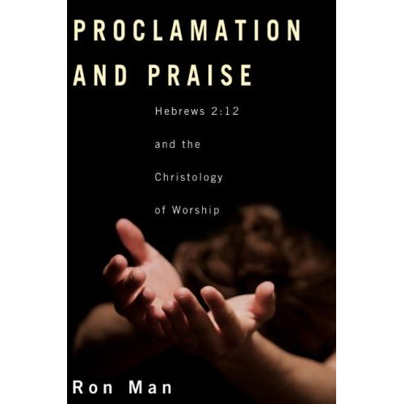
Notes:
And so we can complete last week‘s definition of worship by adding the component of Christ‘s ministry in leading our worship, leading our response. We need a new awareness of the presence of the living Christ in the midst of His people, proclaiming to us the Father‘s name by the Holy Spirit as the Word of God is read and sung and preached, and leading us in our response to the Father, gathering up our imperfect efforts into His perfect offering of praise to the Father.

Slide 74
HEBREWS 2:12
and in the midst of the congre-gation I will sing Your praise.
I will proclaim Your Name to my brethren . . .
3:1
Revelation
Response
Notes:
God reveals His glory, worship is our response
Order is important: God always initiates
Rom. 11:33-36 eleven chapters of doctrine, then Paul bursts out in praise: „Oh, the depth of the riches ¹both of the wisdom and knowledge of God!”
Worship services to be a dialogue betw, God and man, a dialogue of revel. & response
This is why the Scriptures are so important; Stott and others remind us how we need much more Scr. In our services– been in many churches where first first of Scr. Is when preacher gets up– means 30 mintues of response w/o anything to respond to!!

Slide 75
Jesus’ dual, two-way mediating ministry
as
God
REVELATION
RESPONSE
as
man
Notes:
Basic paradigm for God’s dealings with us

Slide 76
JESUS HIMSELF
is the ultimate fulfillment
of the biblical pattern of
REVELATION AND RESPONSE
Notes:
God reveals His glory, worship is our response
Order is important: God always initiates
Rom. 11:33-36 eleven chapters of doctrine, then Paul bursts out in praise: „Oh, the depth of the riches ¹both of the wisdom and knowledge of God!”
Worship services to be a dialogue betw, God and man, a dialogue of revel. & response
This is why the Scriptures are so important; Stott and others remind us how we need much more Scr. In our services– been in many churches where first first of Scr. Is when preacher gets up– means 30 mintues of response w/o anything to respond to!!

Slide 77
"I WILL PROCLAIM YOUR NAME TO MY BRETHREN"
Notes:
Let‘s look at the two parts of this verse:
Jesus earthly ministry was to reveal the Father– to reveal His name, that is His glory.
STILL His ministry (thru the H.S.)– to make the Father known (jn. 17:26, night before His crucifixion, He says to the Father, „I have made Your name known to them, and will make it known“; and so Jesus says, I will proclaim…“
For those involved in preaching or teaching the bible in any way (many of you are), there are some impt implications:
a. it is JESUS‘S ministry to proclaim the truth about Jesus; not Your ministry, but HIS→ should humble us
b. You are REPRESENTING Christ when you get up to teach about God→ it‘s a high and holy privilege to be Christ‘s instrument, to stand in for Him, so to speak, in proclaiming the Father‘s name to the brethren

Slide 78
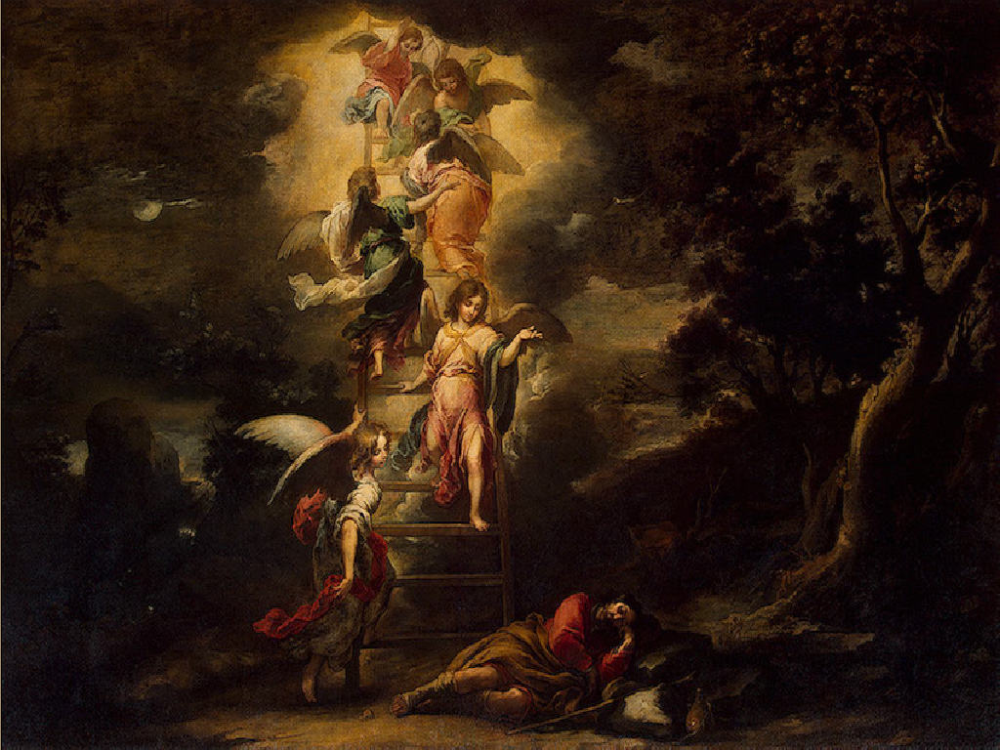
“No one knows the Father except the Son and anyone to whom the Son chooses to reveal Him.”
(Matthew 11:27b)
No one has ever seen God; the only God, who is at the Father’s side, He has made Him known.
(John 1:18)
“I have manifested Your name to the people whom You gave Me out of the world.”
(John 17:6)
Notes:
Let‘s look at the two parts of this verse:
Jesus earthly ministry was to reveal the Father– to reveal His name, that is His glory.
STILL His ministry (thru the H.S.)– to make the Father known (jn. 17:26, night before His crucifixion, He says to the Father, „I have made Your name known to them, and will make it known“; and so Jesus says, I will proclaim…“
For those involved in preaching or teaching the bible in any way (many of you are), there are some impt implications:
a. it is JESUS‘S ministry to proclaim the truth about Jesus; not Your ministry, but HIS→ should humble us
b. You are REPRESENTING Christ when you get up to teach about God→ it‘s a high and holy privilege to be Christ‘s instrument, to stand in for Him, so to speak, in proclaiming the Father‘s name to the brethren

Slide 79
“I made known to them Your name, and I will continue to make it known, that the love with which You have loved Me may be in them, and I in them.”
(John 17:26)
In the first book, O Theophilus, I have dealt with all that Jesus began to do and teach . . .
(Acts 1:1)
Notes:
Let‘s look at the two parts of this verse:
Jesus earthly ministry was to reveal the Father– to reveal His name, that is His glory.
STILL His ministry (thru the H.S.)– to make the Father known (jn. 17:26, night before His crucifixion, He says to the Father, „I have made Your name known to them, and will make it known“; and so Jesus says, I will proclaim…“
For those involved in preaching or teaching the bible in any way (many of you are), there are some impt implications:
a. it is JESUS‘S ministry to proclaim the truth about Jesus; not Your ministry, but HIS→ should humble us
b. You are REPRESENTING Christ when you get up to teach about God→ it‘s a high and holy privilege to be Christ‘s instrument, to stand in for Him, so to speak, in proclaiming the Father‘s name to the brethren

Slide 80
PREACHING AND TEACHING THE WORD OF GOD:
Christ’s ministry
“Let the Word of Christ dwell richly among you.”
(Colossians 3:16)
“The sheep hear His voice. . . .
The sheep follow Him, for they know His voice.”
(John 10:3,4)
Notes:
Let‘s look at the two parts of this verse:
Jesus earthly ministry was to reveal the Father– to reveal His name, that is His glory.
STILL His ministry (thru the H.S.)– to make the Father known (jn. 17:26, night before His crucifixion, He says to the Father, „I have made Your name known to them, and will make it known“; and so Jesus says, I will proclaim…“
For those involved in preaching or teaching the bible in any way (many of you are), there are some impt implications:
a. it is JESUS‘S ministry to proclaim the truth about Jesus; not Your ministry, but HIS→ should humble us
b. You are REPRESENTING Christ when you get up to teach about God→ it‘s a high and holy privilege to be Christ‘s instrument, to stand in for Him, so to speak, in proclaiming the Father‘s name to the brethren

Slide 81
"IN THE MIDST OF THE CONGREGATION I WILL SING YOUR PRAISE."
Notes:
The second half is just as important, though perhaps a little surprising.
Jesus SINGS the Father‘s praise in our midst when we gather for worship. He mediates our response to the Father. He LEADS US in our worship! Calvin in his commentary on this passge calls Christ „the chief Conductor of our hymns“!
There some preachers and others who think that the singing, the music, the so-called „Worship“ part of the service is not that important, is just preliminary to the main event, which is the sermon, and serves only to „warm the people up“ for that.
Well, Jesus Himself disagrees with that assessment– it‘s important to HIM!! So much so that He‘s in the middle of it, leading it! Jesus Christ Himself leads us into taking part in that Communion which He himself has with the Father. We come IN CHRIST, and He leads the way.
Thomas Torrance: „From first to last the worship and ministry of the Church on earth must be governed by the fact that Christ substitutes himself in our place, and that our humanity with its own acts of worship, is displaced by his, so that we appear before God not in our own name, not in our own significance, not in virtue of our own acts of confession, contrition, worship, and thanksgiving, but solely in the name of Christ and solely in virtue of what he has done in our name and on our behalf, and in our [place]. Justification by Christ alone means that from first to last in the worship of God and in the ministry of the Gospel Christ himself is central, and that we draw near in worship and service only through letting him take our place. He only is Priest. He only represents humanity. He only has an offering with which to appear before God and with which God is well-pleased. He only presents our prayers before God, and he only is our praise and thanksgiving and worship as we appear before the face of the Father. Nothing in our hands we bring--simply to his Cross we cling.”
This gives a whole new understand, I think, to what we mean when we say that in worship we come through Christ; it is not just because of His past work opening the way for us, but also because He presently and actively goes before us and leads the way. And that‘s what the author of Hebrews says in chapter 10 (TURN).
Summarizing what he‘s been saying about the superiority of Christ and the New Covenant, the writer says „therefore“… LET US DRAW NEAR. Two reasons we can: v. 20 Christ‘s PAST work; v. 21 Christ‘s PRESENT work.
Likewise, when we say we „pray in Jesus‘s name,“ it‘s not just a formula which tacks on His name as sort of an insurance policy to get what we want– rather we pray IN JESUS, we come through Him and allow Him as our Mediator and Intercessor to offer our requests to the Father for us.

Slide 82
album blurb:
“[The artist] ushered the crowd into His Presence
with uplifting praise and worship melodies throughout the night.”
NOT!
Notes:
And so we can complete last week‘s definition of worship by adding the component of Christ‘s ministry in leading our worship, leading our response. We need a new awareness of the presence of the living Christ in the midst of His people, proclaiming to us the Father‘s name by the Holy Spirit as the Word of God is read and sung and preached, and leading us in our response to the Father, gathering up our imperfect efforts into His perfect offering of praise to the Father.

Slide 83
“No worship leader, pastor, band, or song will ever bring us close to God. . . . Worship itself cannot lead us into God’s presence. Only Jesus himself can bring us into God’s presence.”
(Bob Kauflin)

Slide 84
LEADING WORSHIP:
Christ’s ministry
“In the midst of the congregation
I will sing Your praise.”
(Hebrews 2:12)
Notes:
Let‘s look at the two parts of this verse:
Jesus earthly ministry was to reveal the Father– to reveal His name, that is His glory.
STILL His ministry (thru the H.S.)– to make the Father known (jn. 17:26, night before His crucifixion, He says to the Father, „I have made Your name known to them, and will make it known“; and so Jesus says, I will proclaim…“
For those involved in preaching or teaching the bible in any way (many of you are), there are some impt implications:
a. it is JESUS‘S ministry to proclaim the truth about Jesus; not Your ministry, but HIS→ should humble us
b. You are REPRESENTING Christ when you get up to teach about God→ it‘s a high and holy privilege to be Christ‘s instrument, to stand in for Him, so to speak, in proclaiming the Father‘s name to the brethren

Slide 85
III. A BETTER WORSHIP
(10:19-22)
Therefore, brethren,
SINCE we have confidence to enter the holy place by the blood of Jesus,
by the new and living way that He opened for us
through the curtain, that is, through His flesh,
and SINCE we have a great priest over the house of
God,
let us draw near with a true heart in full assurance of faith, with our hearts sprinkled clean from an evil conscience and our bodies washed with pure water.
PAST WORK
PRESENT WORK
Notes:
WHY we can draw near

Slide 86
New Testament worship IS Christ.
There is ONE Mediator between God and man:
the Man Christ Jesus.
(1 Tim. 2:5)
Notes:
[READ whole slide]
Christ mediates God‘s revelation to us, in the preaching and the Scripture readings and the Scripture songs, everything in the service which speaks to us of the Father and His nature.
AND Christ‘s mediates our response back to God, leading us in our praises and singing and prayers and meditations and at the Lord‘s Supper.
He‘s the One Mediator between God and man. NT Worship IS Christ. He‘s in and through it all, leads it all, empowers it all.

Slide 87
HEBREWS 2:12
and in the midst of the congre-gation I will sing Your praise.
I will proclaim Your Name to my brethren . . .
3:1
Revelation
Response
Notes:
God reveals His glory, worship is our response
Order is important: God always initiates
Rom. 11:33-36 eleven chapters of doctrine, then Paul bursts out in praise: „Oh, the depth of the riches ¹both of the wisdom and knowledge of God!”
Worship services to be a dialogue betw, God and man, a dialogue of revel. & response
This is why the Scriptures are so important; Stott and others remind us how we need much more Scr. In our services– been in many churches where first first of Scr. Is when preacher gets up– means 30 mintues of response w/o anything to respond to!!

Slide 88
JESUS HIMSELF
is the fulfillment of the biblical pattern of
REVELATION and
RESPONSE
Notes:
Basic paradigm for God’s dealings with us

Slide 89
Implications for Our Worship
The presence of Christ
Notes:
And so we can complete last week‘s definition of worship by adding the component of Christ‘s ministry in leading our worship, leading our response. We need a new awareness of the presence of the living Christ in the midst of His people, proclaiming to us the Father‘s name by the Holy Spirit as the Word of God is read and sung and preached, and leading us in our response to the Father, gathering up our imperfect efforts into His perfect offering of praise to the Father.

Slide 90
Implications for Our Worship
The presence of Christ
The constant of Christ (not
form or style)
Notes:
And so we can complete last week‘s definition of worship by adding the component of Christ‘s ministry in leading our worship, leading our response. We need a new awareness of the presence of the living Christ in the midst of His people, proclaiming to us the Father‘s name by the Holy Spirit as the Word of God is read and sung and preached, and leading us in our response to the Father, gathering up our imperfect efforts into His perfect offering of praise to the Father.

Slide 91
There is only ONE WAY to come to the Father, namely, through Christ in the communion of the Spirit, in the communion of saints, whatever outward form our worship may take.
(James Torrance)
Notes:
And so we can complete last week‘s definition of worship by adding the component of Christ‘s ministry in leading our worship, leading our response. We need a new awareness of the presence of the living Christ in the midst of His people, proclaiming to us the Father‘s name by the Holy Spirit as the Word of God is read and sung and preached, and leading us in our response to the Father, gathering up our imperfect efforts into His perfect offering of praise to the Father.

Slide 92
Implications for Our Worship
The presence of Christ
The constant of Christ (not
form or style)
The excellence of Christ
Notes:
And so we can complete last week‘s definition of worship by adding the component of Christ‘s ministry in leading our worship, leading our response. We need a new awareness of the presence of the living Christ in the midst of His people, proclaiming to us the Father‘s name by the Holy Spirit as the Word of God is read and sung and preached, and leading us in our response to the Father, gathering up our imperfect efforts into His perfect offering of praise to the Father.

Slide 93
God does not accept us because we have offered worthy worship. In His love, He accepts us freely and the Person of His beloved Son, who in our name and on our behalf, in our humanity, has made the One offering to the Father, which alone is acceptable to God for all humanity, for all nations, for all times, and who unites us with Himself in the One Body, in His communion with the Father.
(James Torrance)
Notes:
There are some crucial implications that come from this understanding of Christ‘s role in our worship:
Christ is here! And He is active, leading us through the HS in ours response of worship to God. I think we usually go through life and through worship with little consciousness of the presence of the Lord Jesus Christ. James Torrance has said that most evangelcial worship is UNITARIAN in nature– in other words, God is way out there somewhere, and we just try the best we can to pull off worship in our strength– what he calls „do it yourself with the help of the leader“ worship. But in true worship we draw near to God through our living High Priest in the power of the HS. The POWER of true worship is the minstry of the LIVING CHRIST in leading our worship.
We need to remind ourselves, over and over, that the focus of Sunday worship must be upon the living Christ among us.
In truth, if Christ were bodily present and we could see him with more than our soul's eyes, all our worship would become intentional. If Christ stood on our platforms, we would bend our knees without asking. If we could hear His voice leading the hymns, we too would sing heartily; the words would take on meaning. The Bible reading would be lively; meaning would pierce to the marrow of our souls. If Christ walked our aisles, we would hasten to make amends with that brother or sister to whom we have not spoken. We would volunteer for service, the choir loft would be crowded. If we knew Christ would attend our church Sunday after Sunday, the front pews would fill fastest, believers would arrive early, offering plates would be laden with sacrificial but gladsome gifts, prayers would concentrate our attention.
Yet, the startling truth is that Christ is present, through His Holy Spirit, in our churches; it is we who must develop eyes to see and ears to hear Him.
2. Around the world today, and down through the centuries, there has been an incredible diversity of forms and styles of worship in the church of Jesus Christ– and the NT seems to allow for that, as we‘ll see next Sunday. But there is a CONSTANT in the midst of all this diversity, and that constant is the mediating ministry of Jesus Christ in the midst of His people. There is only ONE way to come to the Father: through Christ. „O come to the Father through Jesus the Son, and give HIM the glory, great things He hath done.“
there is only one way to come to the Father, namely through Christ in the communion of the Spirit and in the communion of the saints, whatever outward form our worship may take. (James B. Torrance, Contemplating the Trinitarian Mystery of Christ, Chap. 12 in Alive to God: Studies in Spirituality , ed. J.I. Packer & Loren Wilkinson [IVP, 1992], p. 143)
Our worship and prayer are finally shaped and structured by the invariant pattern of Christ's mediatorial office. . . . When our worship and prayer are objectively grounded in Christ in this way, we are free to use and adapt transient forms of language and culture in our worship of God.
T.Torrance, "The Mind of Christ in Worship" p. 213
However much, therefore, worship and prayer may vary in linguistic and behavioural forms, as they inevitably and rightly do when they are expressed in the habits of different societies, peoples, cultures and ages, they nevertheless have embedded in them an invariant element which derives from the normative pattern of the incarnate love of God in Jesus Christ. In so far as worship and prayer are through, with and in Christ, they are not primarily forms of man’s self- expression or self-fulfilment or self-transcendence in this or that human situation or cultural context, but primarily forms of Christ’s vicarious worship and prayer offered on behalf of all mankind in all ages. T. Torrance, "The Mind of Christ in Worship" 213
3. God accepts and delights in our worship, not because of its excellence, and certainly not because of our worthiness, but rather because of CHRIST‘S excellence and worthiness. It‘s not the size of our church or the size of our choir, or whether we have an orchestra or a big organ or a big band, or whether we choice the right songs or sing them the right way. We come IN CHRIST, dressed in His righteousness, and that is what the Father accepts and delights in.
C.S. Lewis: “We must beware of the naïve idea that our music can ‘please’ God as it would please a cultivated human hearer. That is like thinking, under the old Law, that He really needed the blood of bulls and goats. . . . [compares our worship to the picture a small child paints of his parents– they value it, not because it‘s a great work of art, but because it‘s a gift of love from their beloved child. That‘s the way od looks at our worship.] (C.S. Lewis, “On Church Music” in Christian Reflections, pp. 98-99
James Torrance: “We are accepted by God, not because we have offered worthy worship, but in spite of our unworthiness, because He has provided for us a Worship, a Way, a Sacrifice, a Forerunner in Christ our Leader and Representative. This is the heart of all true Christian worship. . . . God does not throw us back upon ourselves to make our response to His Word. But graciously He helps our infirmities by giving us Jesus Christ and the Holy Spirit to make the appropriate response for us and in us. ” (James B. Torrance, “The Place of Jesus Christ in Worship,” in Theological Foundations for Ministry, p. 352,9)
Who can love God with his heart, mind, and soul?
Who can achieve perfect union with God?
Who can worship God with a pure and unstained heart?
Not me! . . .
Not you. Not Billy Graham. . . .
Not anybody I know or you know.
Only Jesus can. And he does for me and for you what neither of us can do for ourselves.
This is the message that is missing in the literature of contemporary [and most other!] worship. It is too much about what I ought to do and too little about what God has done for me. God has done for me what I cannot do for myself. He did it in Jesus Christ. Therefore my worship is offered in a broken vessel that is in the process of being healed, but is not yet capable of fullness of joy, endless intense passion, absolute exaltation, and celebration. But Jesus, who shares in my humanity yet without sin, is not only my Savior-- he is also my complete and eternal worship, doing for me, in my place, what I cannot do. . . .
He is eternally interceding to the Father on our behalf. And for this reason, our worship is always in and through Christ. . . .
Thanks for Jesus Christ, who is my worship. We are free! And in gratitude, we offer our stumbling worship in the name of Jesus with thanksgiving.
(Robert E. Webber in Exploring the Worship Spectrum, p. 130)

Slide 94
God’s grace for our worship!
TRUE FREEDOM: we don’t have to worry:
If our worship was good enough
If my attitude was good enough
If our musicians were good enough
Notes:
There are some crucial implications that come from this understanding of Christ‘s role in our worship:
Christ is here! And He is active, leading us through the HS in ours response of worship to God. I think we usually go through life and through worship with little consciousness of the presence of the Lord Jesus Christ. James Torrance has said that most evangelcial worship is UNITARIAN in nature– in other words, God is way out there somewhere, and we just try the best we can to pull off worship in our strength– what he calls „do it yourself with the help of the leader“ worship. But in true worship we draw near to God through our living High Priest in the power of the HS. The POWER of true worship is the minstry of the LIVING CHRIST in leading our worship.
We need to remind ourselves, over and over, that the focus of Sunday worship must be upon the living Christ among us.
In truth, if Christ were bodily present and we could see him with more than our soul's eyes, all our worship would become intentional. If Christ stood on our platforms, we would bend our knees without asking. If we could hear His voice leading the hymns, we too would sing heartily; the words would take on meaning. The Bible reading would be lively; meaning would pierce to the marrow of our souls. If Christ walked our aisles, we would hasten to make amends with that brother or sister to whom we have not spoken. We would volunteer for service, the choir loft would be crowded. If we knew Christ would attend our church Sunday after Sunday, the front pews would fill fastest, believers would arrive early, offering plates would be laden with sacrificial but gladsome gifts, prayers would concentrate our attention.
Yet, the startling truth is that Christ is present, through His Holy Spirit, in our churches; it is we who must develop eyes to see and ears to hear Him.
2. Around the world today, and down through the centuries, there has been an incredible diversity of forms and styles of worship in the church of Jesus Christ– and the NT seems to allow for that, as we‘ll see next Sunday. But there is a CONSTANT in the midst of all this diversity, and that constant is the mediating ministry of Jesus Christ in the midst of His people. There is only ONE way to come to the Father: through Christ. „O come to the Father through Jesus the Son, and give HIM the glory, great things He hath done.“
there is only one way to come to the Father, namely through Christ in the communion of the Spirit and in the communion of the saints, whatever outward form our worship may take. (James B. Torrance, Contemplating the Trinitarian Mystery of Christ, Chap. 12 in Alive to God: Studies in Spirituality , ed. J.I. Packer & Loren Wilkinson [IVP, 1992], p. 143)
Our worship and prayer are finally shaped and structured by the invariant pattern of Christ's mediatorial office. . . . When our worship and prayer are objectively grounded in Christ in this way, we are free to use and adapt transient forms of language and culture in our worship of God.
T.Torrance, "The Mind of Christ in Worship" p. 213
However much, therefore, worship and prayer may vary in linguistic and behavioural forms, as they inevitably and rightly do when they are expressed in the habits of different societies, peoples, cultures and ages, they nevertheless have embedded in them an invariant element which derives from the normative pattern of the incarnate love of God in Jesus Christ. In so far as worship and prayer are through, with and in Christ, they are not primarily forms of man’s self- expression or self-fulfilment or self-transcendence in this or that human situation or cultural context, but primarily forms of Christ’s vicarious worship and prayer offered on behalf of all mankind in all ages. T. Torrance, "The Mind of Christ in Worship" 213
3. God accepts and delights in our worship, not because of its excellence, and certainly not because of our worthiness, but rather because of CHRIST‘S excellence and worthiness. It‘s not the size of our church or the size of our choir, or whether we have an orchestra or a big organ or a big band, or whether we choice the right songs or sing them the right way. We come IN CHRIST, dressed in His righteousness, and that is what the Father accepts and delights in.
C.S. Lewis: “We must beware of the naïve idea that our music can ‘please’ God as it would please a cultivated human hearer. That is like thinking, under the old Law, that He really needed the blood of bulls and goats. . . . [compares our worship to the picture a small child paints of his parents– they value it, not because it‘s a great work of art, but because it‘s a gift of love from their beloved child. That‘s the way od looks at our worship.] (C.S. Lewis, “On Church Music” in Christian Reflections, pp. 98-99
James Torrance: “We are accepted by God, not because we have offered worthy worship, but in spite of our unworthiness, because He has provided for us a Worship, a Way, a Sacrifice, a Forerunner in Christ our Leader and Representative. This is the heart of all true Christian worship. . . . God does not throw us back upon ourselves to make our response to His Word. But graciously He helps our infirmities by giving us Jesus Christ and the Holy Spirit to make the appropriate response for us and in us. ” (James B. Torrance, “The Place of Jesus Christ in Worship,” in Theological Foundations for Ministry, p. 352,9)
Who can love God with his heart, mind, and soul?
Who can achieve perfect union with God?
Who can worship God with a pure and unstained heart?
Not me! . . .
Not you. Not Billy Graham. . . .
Not anybody I know or you know.
Only Jesus can. And he does for me and for you what neither of us can do for ourselves.
This is the message that is missing in the literature of contemporary [and most other!] worship. It is too much about what I ought to do and too little about what God has done for me. God has done for me what I cannot do for myself. He did it in Jesus Christ. Therefore my worship is offered in a broken vessel that is in the process of being healed, but is not yet capable of fullness of joy, endless intense passion, absolute exaltation, and celebration. But Jesus, who shares in my humanity yet without sin, is not only my Savior-- he is also my complete and eternal worship, doing for me, in my place, what I cannot do. . . .
He is eternally interceding to the Father on our behalf. And for this reason, our worship is always in and through Christ. . . .
Thanks for Jesus Christ, who is my worship. We are free! And in gratitude, we offer our stumbling worship in the name of Jesus with thanksgiving.
(Robert E. Webber in Exploring the Worship Spectrum, p. 130)

Slide 95
Give Him our best
BUT
that is NOT why He accepts and delights in our worship
→He delights in His Son, whose worship is always good enough
Notes:
There are some crucial implications that come from this understanding of Christ‘s role in our worship:
Christ is here! And He is active, leading us through the HS in ours response of worship to God. I think we usually go through life and through worship with little consciousness of the presence of the Lord Jesus Christ. James Torrance has said that most evangelcial worship is UNITARIAN in nature– in other words, God is way out there somewhere, and we just try the best we can to pull off worship in our strength– what he calls „do it yourself with the help of the leader“ worship. But in true worship we draw near to God through our living High Priest in the power of the HS. The POWER of true worship is the minstry of the LIVING CHRIST in leading our worship.
We need to remind ourselves, over and over, that the focus of Sunday worship must be upon the living Christ among us.
In truth, if Christ were bodily present and we could see him with more than our soul's eyes, all our worship would become intentional. If Christ stood on our platforms, we would bend our knees without asking. If we could hear His voice leading the hymns, we too would sing heartily; the words would take on meaning. The Bible reading would be lively; meaning would pierce to the marrow of our souls. If Christ walked our aisles, we would hasten to make amends with that brother or sister to whom we have not spoken. We would volunteer for service, the choir loft would be crowded. If we knew Christ would attend our church Sunday after Sunday, the front pews would fill fastest, believers would arrive early, offering plates would be laden with sacrificial but gladsome gifts, prayers would concentrate our attention.
Yet, the startling truth is that Christ is present, through His Holy Spirit, in our churches; it is we who must develop eyes to see and ears to hear Him.
2. Around the world today, and down through the centuries, there has been an incredible diversity of forms and styles of worship in the church of Jesus Christ– and the NT seems to allow for that, as we‘ll see next Sunday. But there is a CONSTANT in the midst of all this diversity, and that constant is the mediating ministry of Jesus Christ in the midst of His people. There is only ONE way to come to the Father: through Christ. „O come to the Father through Jesus the Son, and give HIM the glory, great things He hath done.“
there is only one way to come to the Father, namely through Christ in the communion of the Spirit and in the communion of the saints, whatever outward form our worship may take. (James B. Torrance, Contemplating the Trinitarian Mystery of Christ, Chap. 12 in Alive to God: Studies in Spirituality , ed. J.I. Packer & Loren Wilkinson [IVP, 1992], p. 143)
Our worship and prayer are finally shaped and structured by the invariant pattern of Christ's mediatorial office. . . . When our worship and prayer are objectively grounded in Christ in this way, we are free to use and adapt transient forms of language and culture in our worship of God.
T.Torrance, "The Mind of Christ in Worship" p. 213
However much, therefore, worship and prayer may vary in linguistic and behavioural forms, as they inevitably and rightly do when they are expressed in the habits of different societies, peoples, cultures and ages, they nevertheless have embedded in them an invariant element which derives from the normative pattern of the incarnate love of God in Jesus Christ. In so far as worship and prayer are through, with and in Christ, they are not primarily forms of man’s self- expression or self-fulfilment or self-transcendence in this or that human situation or cultural context, but primarily forms of Christ’s vicarious worship and prayer offered on behalf of all mankind in all ages. T. Torrance, "The Mind of Christ in Worship" 213
3. God accepts and delights in our worship, not because of its excellence, and certainly not because of our worthiness, but rather because of CHRIST‘S excellence and worthiness. It‘s not the size of our church or the size of our choir, or whether we have an orchestra or a big organ or a big band, or whether we choice the right songs or sing them the right way. We come IN CHRIST, dressed in His righteousness, and that is what the Father accepts and delights in.
C.S. Lewis: “We must beware of the naïve idea that our music can ‘please’ God as it would please a cultivated human hearer. That is like thinking, under the old Law, that He really needed the blood of bulls and goats. . . . [compares our worship to the picture a small child paints of his parents– they value it, not because it‘s a great work of art, but because it‘s a gift of love from their beloved child. That‘s the way od looks at our worship.] (C.S. Lewis, “On Church Music” in Christian Reflections, pp. 98-99
James Torrance: “We are accepted by God, not because we have offered worthy worship, but in spite of our unworthiness, because He has provided for us a Worship, a Way, a Sacrifice, a Forerunner in Christ our Leader and Representative. This is the heart of all true Christian worship. . . . God does not throw us back upon ourselves to make our response to His Word. But graciously He helps our infirmities by giving us Jesus Christ and the Holy Spirit to make the appropriate response for us and in us. ” (James B. Torrance, “The Place of Jesus Christ in Worship,” in Theological Foundations for Ministry, p. 352,9)
Who can love God with his heart, mind, and soul?
Who can achieve perfect union with God?
Who can worship God with a pure and unstained heart?
Not me! . . .
Not you. Not Billy Graham. . . .
Not anybody I know or you know.
Only Jesus can. And he does for me and for you what neither of us can do for ourselves.
This is the message that is missing in the literature of contemporary [and most other!] worship. It is too much about what I ought to do and too little about what God has done for me. God has done for me what I cannot do for myself. He did it in Jesus Christ. Therefore my worship is offered in a broken vessel that is in the process of being healed, but is not yet capable of fullness of joy, endless intense passion, absolute exaltation, and celebration. But Jesus, who shares in my humanity yet without sin, is not only my Savior-- he is also my complete and eternal worship, doing for me, in my place, what I cannot do. . . .
He is eternally interceding to the Father on our behalf. And for this reason, our worship is always in and through Christ. . . .
Thanks for Jesus Christ, who is my worship. We are free! And in gratitude, we offer our stumbling worship in the name of Jesus with thanksgiving.
(Robert E. Webber in Exploring the Worship Spectrum, p. 130)

Slide 96
Who can love God with his heart, mind, and soul?
Who can achieve perfect union with God?
Who can worship God with a pure and unstained heart?
Not me! . . .
Not you. Not Billy Graham. Not Matt Redman . . .
Not anybody I know or you know.
Only Jesus can. And He does for me and for you what neither of us can do for ourselves.
Notes:
There are some crucial implications that come from this understanding of Christ‘s role in our worship:
Christ is here! And He is active, leading us through the HS in ours response of worship to God. I think we usually go through life and through worship with little consciousness of the presence of the Lord Jesus Christ. James Torrance has said that most evangelcial worship is UNITARIAN in nature– in other words, God is way out there somewhere, and we just try the best we can to pull off worship in our strength– what he calls „do it yourself with the help of the leader“ worship. But in true worship we draw near to God through our living High Priest in the power of the HS. The POWER of true worship is the minstry of the LIVING CHRIST in leading our worship.
We need to remind ourselves, over and over, that the focus of Sunday worship must be upon the living Christ among us.
In truth, if Christ were bodily present and we could see him with more than our soul's eyes, all our worship would become intentional. If Christ stood on our platforms, we would bend our knees without asking. If we could hear His voice leading the hymns, we too would sing heartily; the words would take on meaning. The Bible reading would be lively; meaning would pierce to the marrow of our souls. If Christ walked our aisles, we would hasten to make amends with that brother or sister to whom we have not spoken. We would volunteer for service, the choir loft would be crowded. If we knew Christ would attend our church Sunday after Sunday, the front pews would fill fastest, believers would arrive early, offering plates would be laden with sacrificial but gladsome gifts, prayers would concentrate our attention.
Yet, the startling truth is that Christ is present, through His Holy Spirit, in our churches; it is we who must develop eyes to see and ears to hear Him.
2. Around the world today, and down through the centuries, there has been an incredible diversity of forms and styles of worship in the church of Jesus Christ– and the NT seems to allow for that, as we‘ll see next Sunday. But there is a CONSTANT in the midst of all this diversity, and that constant is the mediating ministry of Jesus Christ in the midst of His people. There is only ONE way to come to the Father: through Christ. „O come to the Father through Jesus the Son, and give HIM the glory, great things He hath done.“
there is only one way to come to the Father, namely through Christ in the communion of the Spirit and in the communion of the saints, whatever outward form our worship may take. (James B. Torrance, Contemplating the Trinitarian Mystery of Christ, Chap. 12 in Alive to God: Studies in Spirituality , ed. J.I. Packer & Loren Wilkinson [IVP, 1992], p. 143)
Our worship and prayer are finally shaped and structured by the invariant pattern of Christ's mediatorial office. . . . When our worship and prayer are objectively grounded in Christ in this way, we are free to use and adapt transient forms of language and culture in our worship of God.
T.Torrance, "The Mind of Christ in Worship" p. 213
However much, therefore, worship and prayer may vary in linguistic and behavioural forms, as they inevitably and rightly do when they are expressed in the habits of different societies, peoples, cultures and ages, they nevertheless have embedded in them an invariant element which derives from the normative pattern of the incarnate love of God in Jesus Christ. In so far as worship and prayer are through, with and in Christ, they are not primarily forms of man’s self- expression or self-fulfilment or self-transcendence in this or that human situation or cultural context, but primarily forms of Christ’s vicarious worship and prayer offered on behalf of all mankind in all ages. T. Torrance, "The Mind of Christ in Worship" 213
3. God accepts and delights in our worship, not because of its excellence, and certainly not because of our worthiness, but rather because of CHRIST‘S excellence and worthiness. It‘s not the size of our church or the size of our choir, or whether we have an orchestra or a big organ or a big band, or whether we choice the right songs or sing them the right way. We come IN CHRIST, dressed in His righteousness, and that is what the Father accepts and delights in.
C.S. Lewis: “We must beware of the naïve idea that our music can ‘please’ God as it would please a cultivated human hearer. That is like thinking, under the old Law, that He really needed the blood of bulls and goats. . . . [compares our worship to the picture a small child paints of his parents– they value it, not because it‘s a great work of art, but because it‘s a gift of love from their beloved child. That‘s the way od looks at our worship.] (C.S. Lewis, “On Church Music” in Christian Reflections, pp. 98-99
James Torrance: “We are accepted by God, not because we have offered worthy worship, but in spite of our unworthiness, because He has provided for us a Worship, a Way, a Sacrifice, a Forerunner in Christ our Leader and Representative. This is the heart of all true Christian worship. . . . God does not throw us back upon ourselves to make our response to His Word. But graciously He helps our infirmities by giving us Jesus Christ and the Holy Spirit to make the appropriate response for us and in us. ” (James B. Torrance, “The Place of Jesus Christ in Worship,” in Theological Foundations for Ministry, p. 352,9)
Who can love God with his heart, mind, and soul?
Who can achieve perfect union with God?
Who can worship God with a pure and unstained heart?
Not me! . . .
Not you. Not Billy Graham. . . .
Not anybody I know or you know.
Only Jesus can. And he does for me and for you what neither of us can do for ourselves.
This is the message that is missing in the literature of contemporary [and most other!] worship. It is too much about what I ought to do and too little about what God has done for me. God has done for me what I cannot do for myself. He did it in Jesus Christ. Therefore my worship is offered in a broken vessel that is in the process of being healed, but is not yet capable of fullness of joy, endless intense passion, absolute exaltation, and celebration. But Jesus, who shares in my humanity yet without sin, is not only my Savior-- he is also my complete and eternal worship, doing for me, in my place, what I cannot do. . . .
He is eternally interceding to the Father on our behalf. And for this reason, our worship is always in and through Christ. . . .
Thanks for Jesus Christ, who is my worship. We are free! And in gratitude, we offer our stumbling worship in the name of Jesus with thanksgiving.
(Robert E. Webber in Exploring the Worship Spectrum, p. 130)

Slide 97
This is the message that is missing in the literature of contemporary worship. It is too much about what I ought to do and too little about what God has done for me. God has done for me what I cannot do for myself. He did it in Jesus Christ. Therefore my worship is offered in a broken vessel that is in the process of being healed, but is not yet capable of fullness of joy, endless intense passion, absolute exaltation, and celebration. But Jesus, who shares in my humanity yet without sin, is not only my Savior—He is also my complete and eternal worship, doing for me, in my place, what I cannot do. . . .
Notes:
That‘s grace!! It‘s all of grace– God doing for us what we could never do for ourselves. God providing four us what He requires of us.
Christ in our place, acting on our behalf– that‘s grace for our salvation, for our sanctification, and for our worship.
As it says on the bulletin cover, It is no longer I who live, but Christ lives in me.

Slide 98
He is eternally interceding to the Father on our behalf. And for this reason, our worship is always in and through Christ. . . .
Thanks for Jesus Christ, who is my worship. We are free! And in gratitude, we offer our stumbling worship in the name of Jesus with thanksgiving.
(Robert Webber)
Notes:
That‘s grace!! It‘s all of grace– God doing for us what we could never do for ourselves. God providing four us what He requires of us.
Christ in our place, acting on our behalf– that‘s grace for our salvation, for our sanctification, and for our worship.
As it says on the bulletin cover, It is no longer I who live, but Christ lives in me.

Slide 99
ALL OF GRACE
What God requires, He provides.
Notes:
That‘s grace!! It‘s all of grace– God doing for us what we could never do for ourselves. God providing four us what He requires of us.
Christ in our place, acting on our behalf– that‘s grace for our salvation, for our sanctification, and for our worship.
As it says on the bulletin cover, It is no longer I who live, but Christ lives in me.

Slide 100
THROUGH HIM then, let us continually offer up a sacrifice of praise to God, that is, the fruit of lips that give thanks to His name.
(Hebrews 13:15)
Notes:
At the end of his letter, the writer of Hebrews sums it all up for us, and I‘d like to close with that thought too, found in Hebrews 13:15 [READ]
LUTHER: von Staupitz
Let‘s pray:
Praise the Father for His grace, providing what He requires for our salv, sanc, worship
Praise the Father for a living Savior, who‘s with us, who ever lives to intercede for us, who is the great go-between between heaven and earth, between God and man.
Rejoice now in Jesus‘ presence among us, proclaiming to us the Father‘s name, leading us into the Father‘s presence with our praises, beckoning us to His table…

Slide 101
Martin Luther and
Johann von Staupitz
Notes:
That‘s grace!! It‘s all of grace– God doing for us what we could never do for ourselves. God providing four us what He requires of us.
Christ in our place, acting on our behalf– that‘s grace for our salvation, for our sanctification, and for our worship.
As it says on the bulletin cover, It is no longer I who live, but Christ lives in me.

Slide 102
Notes:
That‘s grace!! It‘s all of grace– God doing for us what we could never do for ourselves. God providing four us what He requires of us.
Christ in our place, acting on our behalf– that‘s grace for our salvation, for our sanctification, and for our worship.
As it says on the bulletin cover, It is no longer I who live, but Christ lives in me.

Slide 103
Black

Slide 104


Worship link at BibleStudyDownloads.org
Get this presentation for free!
Notes:
Worship (wo)

