Slide 1
Unit 3
Biblical Worship
WORSHIP IN THE OLD TESTAMENT
Taught by Dr. Ron Man for Doctor of Ministry Students Uploaded by Dr. Rick Griffith • Singapore Bible College Files in many languages for free download at BibleStudyDownloads.org

Slide 2
For His lovingkindness is everlasting!
(Psalm 136)

Slide 3
WOMEN: The LORD is gracious and merciful; Slow to anger and great in lovingkindness.
MEN: The LORD is good to all, And His mercies are over all His works.
WOMEN: All Your works shall give thanks to You, O LORD, And Your godly ones shall bless You.
MEN: They shall speak of the glory of Your kingdom And talk of Your power;
ALL: To make known to the sons of men Your mighty acts And the glory of the majesty of Your kingdom.
Psalm 145:8-12

Slide 4
1. Important Themes in Old Testament Worship

Slide 5
Important Themes
a. WORSHIP AS RESPONSE
To revelation (Exodus 3:13-14)
To redemption (Exodus 3:12)
To relationship (Exodus 6:7)

Slide 6
Important Themes
a. WORSHIP AS RESPONSE
“The entire sacrificial system, as it is presented in the OT, is comprised within the covenant between the Lord and His people; God has taken the initiative, having both prescribed and provided the means of access to Himself. Worship was thus Israel’s response to the covenant relationship and the means of ensuring its continuance.” (J.G. Davies, “Worship,” in A Dictionary of Biblical Traditions in English Literature, ed. David Lyle Jeffrey, p. 851)

Slide 7
Important Themes
b. GOD’S GRACE, MERCY,
LOVINGKINDNESS
ḥesed
248 x in OT; 127x in Psalms
“The LORD is gracious and merciful, slow to anger and abounding in steadfast love. (Psalm 145:8)
“Surely goodness and mercy shall follow me all the days of my life, and I shall dwell in the house of the LORD forever.” (Psalm 23:6)

Slide 8
Important Themes
c. WORSHIP OF THE HEART
(spiritual sacrifices)
verses

Slide 9
Important Themes
c. WORSHIP OF THE HEART
(spiritual sacrifices)
HEZEKIAH
2 Chronicles 30:1-10

Slide 10
Important Themes
c. WORSHIP OF THE HEART
(spiritual sacrifices)
“Man looks on the outward appearance,
but God looks on the heart” (1 Samuel 16:7)
The Pharisee and the Tax Collector (Luke 18:9-14)
The widow’s mites (Luke 21:1-4)

Slide 11
Important Themes
d. CALLING ON THE NAME OF THE LORD
“NAME”: nature, character, reputation
RESPONSE: personal & public acts of worship
“And there Abraham built an altar to the LORD and called upon the name of the LORD.” (Genesis 12:8)
CONTRAST: “Let us make a name for ourselves.” (Genesis 11:4)

Slide 12
Acts 2:21 And it shall come to pass that everyone who calls upon the name of the Lord shall be saved.’
Acts 9:14 “And here he has authority from the chief priests to bind all who call on Your name.”
Acts 9:21 And all who heard him were amazed and said, “Is not this the man who made havoc in Jerusalem of those who called upon this name?”
Acts 22:16 ‘And now why do you wait? Rise and be baptized and wash away your sins, calling on His name.’
Rom. 10:13 For “everyone who calls on the name of the Lord will be saved.”

Slide 13
Important Themes
e. THE PRESENCE OF GOD
(especially in the Tabernacle and Temple)
lipne Yahweh
“before the (face of the) LORD”: 236 times in OT
“face is a synecdoche for the whole person”
Speaks of RELATIONSHIP
“The LORD bless you and keep you;
the LORD make His face to shine upon you and be gracious to you;
the LORD lift up His face upon you and give you peace.”
(Numbers 6:24-26)

Slide 14
Important Themes
e. THE PRESENCE OF GOD
The triune God desires a personal relationship with His people and so makes His presence known to establish and cultivate this relationship. . . . This relational presence of God lies at the heart of the Bible’s overall message.
(J. Scott Duvall and J Daniel Hays, God’s Relational Presence: The Cohesive Center of Biblical Theology, 325)

Slide 15
Important Themes
e. THE PRESENCE OF GOD
passages

Slide 16
2. Important Vocabulary in Old Testament Worship

Slide 17
Important Vocabulary
a. “to bow down, honor”
ḥistahavah
(NT: proskuneō)
“Ascribe to the LORD the glory due His name;
bring an offering and come before Him!
Worship the LORD in the splendor of holiness.” (1 Chronicles 16:29)

Slide 18
Important Vocabulary
b. “to serve”
‘abad
(NT: latreuō)
“‘as for me and my house, we will serve the LORD.’” (Joshua 24:15)
“you will not worship them or serve them” (Exodus 20:5)

Slide 19
BREAKOUTS
Discuss the statement:
“Worship is the only Christian activity which is an end in itself.” (John Piper)

Slide 20
“Worship is the only Christian activity which is an end in itself.” (John Piper)
Evangelism activities:
MORE worshipers
Edification activities:
BETTER worshipers

Slide 21
3. Worship in Old Testament History

Slide 22
3. Worship in Old Testament History
a. The Beginning Period (Genesis 1–11)
Creation (1–2)
Fall (3)

Slide 23
3. Worship in Old Testament History
a. The Beginning Period (Genesis 1–11)
Cain and Abel (4:1-17)
“By faith Abel offered to God a more acceptable sacrifice than Cain” (Hebrews 11:4)
Jubal (4:21)
(first mention of music in the Bible)
“His brother’s name was Jubal;
he was the father of all those who play the lyre and pipe.”
Seth and Enosh (4:26)
“To Seth also a son was born, and he called his name Enosh. At that time people began to call upon the name of the LORD.” (Genesis 4:26)

Slide 24
3. Worship in Old Testament History
a. The Beginning Period (Genesis 1–11)
Noah and the Flood (6–8)
“Then Noah built an altar to the LORD and took some of every clean animal and some of every clean bird and offered burnt offerings on the altar.”
(Genesis 8:20)

Slide 25
3. Worship in Old Testament History
a. The Beginning Period (Genesis 1–11)
The Tower of Babel (11)
“‘Come, let us build ourselves a city and a tower with its top in the heavens, and let us make a name for ourselves.’”
(Genesis 11:4)
Judgement

Slide 26
3. Worship in Old Testament History
a. The Beginning Period (Genesis 1–11)
The Tower of Babel (11)
Praise
“After this I looked, and behold, a great multitude that no one could number, from every nation, from all tribes and peoples and languages, standing before the throne and before the Lamb, clothed in white robes, with palm branches in their hands, and crying out with a loud voice, 'Salvation belongs to our God who sits on the throne, and to the Lamb!’” (Revelation 7:9-10)
“It was the spectacular sin on the plains of Shinar that gave rise to the multiplying of language that ends in the most glorious praise to Christ from every language on earth.” (John Piper)

Slide 27
3. Worship in Old Testament History
b. The Patriarchal Period (Genesis 12–50)

Slide 28
3. Worship in Old Testament History
b. The Patriarchal Period (Genesis 12–50)
Abraham

Slide 29
Adam & Eve
Noah
Abraham
Israel
JESUS
3
12
70
Jews
Gentiles (Nations)

Slide 30
Abraham
Call (12:1-3)
a unique worshiping people
“the people whom I formed for Myself
that they might declare my praise.” (Isaiah 43:21)

Slide 31
Abraham
Call (12:1-3)
a worldwide purpose
“and in you all the families the earth will be blessed.” (Genesis12:3)

Slide 32
Abraham
Call (12:1-3)
Response (12:8)

Slide 33
Abraham
Revelation (promises,
names of God,
appearances)

Slide 34
Abraham
Revelation
NAMES
El Elyon (“God Most High,” 14:18-19)
El Shaddai ("God Almighty,” 17:1-2)
El Olam (“the Everlasting God,” 21:33)
Yahweh Jireh (“the LORD who Sees/ Provides,” 22:14)

Slide 35
Abraham
Revelation (promises,
names of God,
appearances)
Response (faith, 15:6;
altars, sacrifices, prayers)

Slide 36
Abraham
A TEST OF LOVE (Genesis 22)
The Test (22:1-2)

Slide 37
Abraham
A TEST OF LOVE (Genesis 22)
The Test (22:1-2)
The Response of Worship (22:3-11)
The Provision and Promises of God (22:12-20)

Slide 38
Isaac
From there [Isaac] went up to Beersheba. And the LORD appeared to him the same night and said, “I am the God of Abraham your father. Fear not, for I am with you and will bless you and multiply your offspring for my servant Abraham’s sake.” So he built an altar there and called upon the name of the LORD and pitched his tent there.
(Genesis 26:23-25)

Slide 39
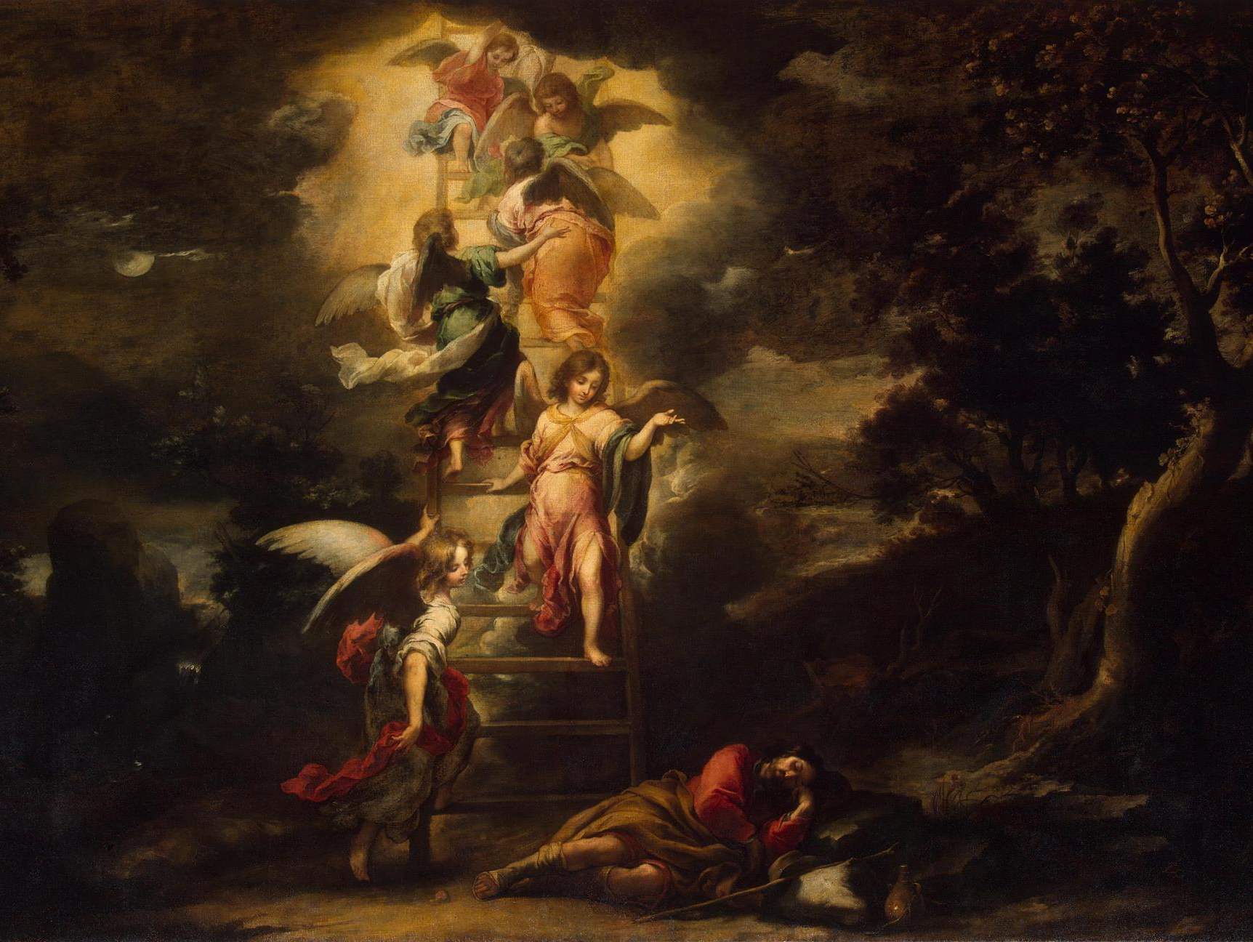
Jacob
Genesis 28:10-22
(John 1:47-51)
Type to enter a caption.
Notes:
We don‘t even know how to PRAY as we should, but God helps us through the HS.

Slide 40
Jacob
“By faith Jacob, when dying, blessed each of the sons of Joseph, bowing in worship over the head of his staff.”
(Hebrews 11:21)

Slide 41
3. Worship in Old Testament History
c. The Exodus

Slide 42
c. The Exodus
3 purposes of God:
1) TO MAKE HIS NAME GREAT
to demonstrate His greatness
and power

Slide 43
BEFORE MOSES AND THE PEOPLE
Israel saw the great power that the LORD
used against the Egyptians, so the people feared
the LORD, and they believed in the LORD
and in His servant Moses.
(Exodus 14:31)
Exodus 8:22; 10:2; 14:14; 15:11; Psalm 106:8

Slide 44
BEFORE EGYPT
“Egypt will know that I am the Lord.” (Exodus 7:5)
Exodus 8:22; 10:2; 14:14; 14:31; 15:11

Slide 45
BEFORE PHAROAH
“But for this purpose I have raised you up, to show you My power, so that My name may be proclaimed in all the earth.”
(Exodus 9:16)
Exodus 7:17; 8:10; 9:14, 29

Slide 46
BEFORE THE NATIONS
[Rahab] said to the men, “I know that the LORD has given you the land, and that the fear of you has fallen upon us,
and that all the inhabitants of the land melt away before you. For we have heard how the LORD dried up the water of the Red Sea before you when you came out of Egypt, and what you did to the two kings of the Amorites who were beyond the Jordan, to Sihon and Og, whom you devoted to destruction. And as soon as we heard it, our hearts melted, and there was no spirit left in any man because of you,
for the LORD your God, He is God in the heavens above and on the earth beneath.” (Joshua 2:9-11)
Exodus 15:13-16; I Chronicles 17:21

Slide 47
c. The Exodus
3 purposes of God:
2) TO JUDGE THE FALSE GODS AND FALSE WORSHIP OF EGYPT
to show the power
of the true God

Slide 48
“For ^{p}I will pass through the land of Egypt that night, and I will strike all the firstborn in the land of Egypt, both man and beast; and on ^{q}all the gods of Egypt I will execute judgments: I am the LORD.”
(Exodus 12:12)
Exodus 7:4; 8:18-19; 11:9-10

Slide 49
c. The Exodus
3 purposes of God:
3) TO REDEEM A WORSHIPING PEOPLE FOR HIMSELF

Slide 50
“Let my people go, that they may serve [worship] Me.”
(Exodus 5:1; 7:16; 8:1, 20; 9:1, 13; 10:3) When Israel went out from Egypt,
the house of Jacob from a people of strange language,
Judah became His sanctuary, Israel His dominion. (Psalm 114:1-2)
“…the people whom I formed for Myself
that they might declare My praise.”
(Isaiah 43:21)

Slide 51
d. The Mosaic Covenant
GOD’S PROMISES
1) The PRESENCE of God among His
people

Slide 52
Then the cloud covered the tent of meeting,
and the glory of the LORD filled the tabernacle.
(Exodus 40:34)

Slide 53
d. The Mosaic Covenant
GOD’S PROMISES
2) A unique RELATIONSHIP
with His people

Slide 54
“And I . . . will be your God,
and you shall be My people.”
(Leviticus 26:12)

Slide 55
d. The Mosaic Covenant
GOD’S PROMISES
GOD’S EXPECTATION IN RESPONSE:
their WORSHIP

Slide 56
God’s expectation: their worship
Exclusive worship
Word-directed worship
Lifestyle worship
Ritual worship
Testimony worship
Typological worship

Slide 57
God’s expectation: their worship
Exclusive worship
And God spoke all these words, saying,
“I am the LORD your God, who brought you out of the land of Egypt, out of the house of slavery.
You shall have no other gods before Me.”
(Exodus 20:1-3; Deuteronomy 5:6-7)

Slide 59
God’s expectation: their worship
Word-directed worship
Moses came and told the people all the words of the LORD and all the rules. And all the people answered with one voice and said, “All the words that the LORD has spoken we will do.” And Moses wrote down all the words of the LORD. (Exodus 24:3-4)

Slide 60
God’s expectation: their worship
Lifestyle worship
“You shall be to me a kingdom of priests and a holy nation.” (Exodus 19:6)

Slide 61
God’s expectation: their worship
Ritual worship
Exodus/Leviticus
BREAKOUT
Why do you think God instituted such a complicated system?

Slide 62
God’s expectation: their worship
Ritual worship: Why so complicated?
Holiness, beauty and majesty of God
Seriousness of sin
Grace (temporary covering for sin)
Test of obedience
Frustration/preparation

Slide 63
God’s expectation: their worship
Testimony worship
in obedience: Deut 28:1-14; 2 Chron 7:17-18
May God be gracious to us and bless us
and make His face to shine upon us,
that Your way may be known on earth,
Your saving power among all nations.
Let the peoples praise You, O God;
let all the peoples praise You!
Let the nations be glad and sing for joy. (Psalm 67:1-4)

Slide 64
God’s expectation: their worship
Testimony worship
in obedience: Deut 28:1-14; 2 Chron 7:17-18
in disobedience: Deut 28:15-68; 2 Chron 7:19-22)
Everyone passing by will be astonished and say, ‘“Why has the LORD done thus to this land and to this house?” Then they will say, “because they abandoned the LORD, the God of their fathers who brought them out of the land of Egypt, and laid hold on other gods and worshiped them and served them. Therefore He has brought all this disaster on them.”
(2 Chron 7:21-22)

Slide 65
God’s expectation: their worship
Typological worship
Day of Atonement
Tabernacle (Exodus 25:40; Hebrews 8:5;
9:24; 10:1)

Slide 66
e. Pre-exilic Israel
Conquest of the land
Destruction of false worship
Establishment of true worship
BUT: Psalm 106:34-39

Slide 67
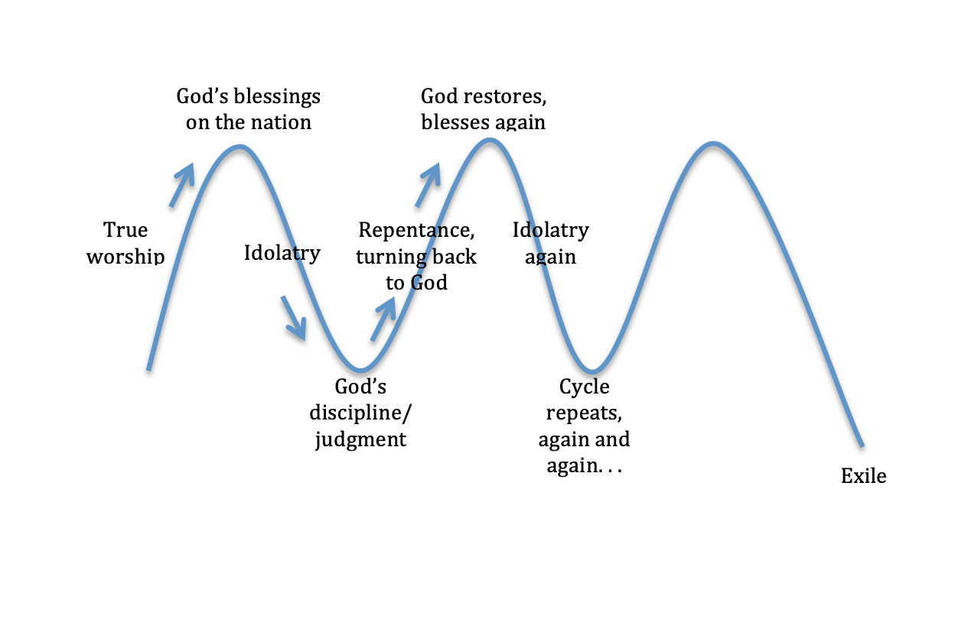
5. Pre-exilic Israel
Cycles
God's blessings on the nation
God restores, blesses again
Idolatry
Repentance, turning back to God
Idolatry again
True worship
God's discipline/ judgment
The cycle repeats, again and again…
Exile

Slide 68
e. Pre-exilic Israel
Cycles
They did not destroy the peoples,
as the LORD commanded them,
but they mixed with the nations
and learned to do as they did.
They served their idols,
which became a snare to them.

Slide 69
Then the anger of the LORD was kindled against his people, and He abhorred His heritage; He gave them into the hand of the nations,
so that those who hated them ruled over them. Their enemies oppressed them,
and they were brought into subjection under their
power.

Slide 70
Many times He delivered them,
but they were rebellious in their purposes
and were brought low through their iniquity.
Nevertheless, He looked upon their distress,
when He heard their cry.
For their sake He remembered His covenant,
and relented according to the abundance
of His steadfast love. (Psalm 106:34-35,40-45)

Slide 71
e. Pre-exilic Israel
King David

Slide 72
King David
1. Organized the worship life of the nation
Then he appointed some of the Levites as ministers before the ark of the LORD, to invoke, to thank, and to praise the LORD, the God of Israel. Asaph was the chief, and second to him were Zechariah, Jeiel, Shemiramoth, Jehiel, Mattithiah, Eliab, Benaiah, Obed-edom, and Jeiel, who were to play harps and lyres; Asaph was to sound the cymbals, and Benaiah and Jahaziel the priests were to blow trumpets regularly before the ark of the covenant of God. Then on that day David first appointed that thanksgiving be sung to the LORD by Asaph and his brothers.
(1 Chronicles 16:4-7)
1 Chronicles 6:31-48; 9:33-34; 15:16-22; 25:1-7

Slide 73
And [Hezekiah] stationed the Levites in the house of the LORD with cymbals, harps, and lyres, according to the commandment of David and of Gad the king’s seer and of Nathan the prophet, for the commandment was from the LORD through His prophets.
(2 Chronicles 29:25)

Slide 74
King David
2. An example of a true worshiper
“a man after My own heart” (1 Samuel 13:14
Because Your steadfast love is better than life,
my lips will praise You.
So I will bless You as long as I live;
in Your name I will lift up my hands.
(Psalm 63:3-4)

Slide 75
King David
3. Wrote many songs for private and corporate worship
73 of the Psalms

Slide 76
e. Pre-exilic Israel
Solomon and the Temple
And when the priests came out of the Holy Place, a cloud filled the house of the LORD, so that the priests could not stand to minister because of the cloud, for the glory of the LORD filled the house of the LORD.
(1 Kings 8:10-11; also 2 Chronicles 7:1)

Slide 77
e. Pre-exilic Israel
Worsening idolatry
Manasseh was twelve years old when he began to reign, and he reigned fifty-five years in Jerusalem. . . . And he did what was evil in the sight of the LORD, according to the despicable practices of the nations whom the LORD drove out before the people of Israel.
(2 Chronicles 21:1-2)

Slide 78
e. Pre-exilic Israel
Worsening idolatry (though a few revivals)
In the third year of Hoshea son of Elah, king of Israel, Hezekiah the son of Ahaz, king of Judah, began to reign. . . . And he did what was right in the eyes of the LORD, according to all that David his father had done. He removed the high places and broke the pillars and cut down the Asherah. (2 Chronicles 18:1-2)

Slide 79
e. Pre-exilic Israel
Exile 586 B.C.
The LORD, the God of their fathers, sent persistently to them by His messengers, because He had compassion on his people and on his dwelling place. But they kept mocking the messengers of God, despising His words and scoffing at His prophets, until the wrath of the LORD rose against His people, until there was no remedy.
(2 Chronicles 36:15-16)

Slide 80
e. Pre-exilic Israel
Exile 586 B.C.
And many nations will pass by this city, and every man will say to his neighbor, “Why has the LORD dealt thus with this great city?” And they will answer, “Because they have forsaken the covenant of the LORD their God and worshiped other gods and served them.”
(Jeremiah 22:8-9)

Slide 81
e. Pre-exilic Israel
Exile 586 B.C.
Then the glory of the LORD went out from the
threshold of the house, and stood over the cherubim.
(Ezekiel 10:18)

Slide 82
f. Exilic and Post-exilic Worship
The synagogue
The Shema
Prayers
Reading of the Torah and commentary
(cf. Luke 4:16-27; Acts 13:15, 27; 15:21)

Slide 83
f. Exilic and Post-exilic Worship
The return
City wall, city, temple rebuilt (no glory)
(Ezra, Nehemiah, Haggai)
Reinstitution of priesthood and sacrifices
Extensive development of traditions and
legalism
After Malachi: 400 years of silence

Slide 84
D. The Psalms
Their uniqueness
“It is reported that Athanasius, an outstanding Christian leader of the fourth century, declared that the Psalms have a unique place in the Bible because most of Scripture speaks TO US, while the Psalms speak FOR US.”
(Bernhard W. Anderson,Out of the Depths: The Psalms Speak for Us Today, x)

Slide 85
D. The Psalms
Different authors
David (73)
Asaph (12)
Sons of Korah (11)
Solomon (2)
Moses (1)
Heman (1)
Ethan (1) unknown (49)

Slide 86
D. The Psalms
Different themes
Salvation History Psalms
Laments (Community and Individual)
Songs of Thanksgiving
Hymns of Praise
Festival Songs and Liturgies
Songs of Trust and Meditation
(Anderson, Out of the Depths, 170-71)

Slide 87
D. The Psalms
Their tone
“I want to stress what I think that we (or at least I) need more [than instruction about sacrifice]; the joy and delight in God which meet us in the Psalms. . . . These poets knew far less reason than we for loving God. They did not know that He offered them eternal joy; still less that He would die to win it for them. Yet they express a longing for Him, for His mere presence, which comes only to the best Christians or to Christians in their best moments.

Slide 88
They long to live all their days in the Temple so that they may constantly see ‘the fair beauty of the Lord’ (Psalm 27:4). Their longing to go up to Jerusalem and ‘appear before the presence of God’ is like a physical thirst (42). From Jerusalem His presence flashes out ‘in perfect beauty’ (50:2). Lacking that encounter with Him, their souls are parched like a waterless countryside (63:1). They crave to be ‘satisfied with the pleasures’ of His house (65:4). Only there can they be at ease, like a bird in the nest (84:1-3). One day of those ‘pleasures’ is better than a lifetime spent elsewhere (84:11-12).
I have rather-- though the expression may seem harsh to some-- call this the ‘appetite for God’ than the ‘love of God’. . . . It has all the cheerful spontaneity of a natural, even a physical, desire.” (C. S. Lewis, Reflections on the Psalms, 50-51)

Slide 89
D. The Psalms
God in the Psalms
His Powerful Protection
His Gentle Care
His Loyal Love (ḥesed)

Slide 90
D. The Psalms
Rejoice with trembling. (Psalm 2:11)
The LORD is my strength and my shield;
in Him my heart trusts, and I am helped; my heart exults,
and with my song I give thanks to Him. (Psalm 28:7)
Not to us, O LORD, not to us, but to Your name give glory. (Psalm 115:1)

Slide 91
D. The Psalms
Psalm 150
Hallelu-jah!

Slide 93
Leader reads (also: Psalm 150, “Praise!”)
Other readers (incl. children, Psalm 23)
Read together
Responsive reading: leader/people; left/right; men/women; Psalm 136
Dramatic reading: one person/different voices; different persons
Act out (with or without costumes)
Sung response (Psalm 136)

Slide 94
Reading Scripture
PREPARE
Study the text
Pray
Mark: keywords, pauses
READ
Don’t rush!
Expressive: emphasis, pauses
Declare it as God’s truth!

Slide 95
Your favorite psalm?
Why?
What does the Psalm teach you about worship?
Read 1-2 verses expressively

Slide 96
III. Worship in the Old Testament
Revelation and Response
God’s ḥesed
Worship of the Heart
Promise of a New Covenant
(Law written on the heart; Holy Spirit within)
Promise of God’s Presence (John 1:14)

Slide 97
Black

Slide 98
Worship link at BibleStudyDownloads.org
Get this presentation for free!
Notes:
Worship (wo)

