Slide 1
Unit 2
Biblical Worship
THE CENTRALITY OF WORSHIP IN GOD’S PROGRAM
Taught by Dr. Ron Man for Doctor of Ministry Students Uploaded by Dr. Rick Griffith • Singapore Bible College Files in many languages for free download at BibleStudyDownloads.org

Slide 2
It is good to give thanks to the Lord And to sing praises to Your name, O Most High;
To declare Your lovingkindness in the morning and Your faithfulness by night.
For You, O Lord, have made me glad by what You have done; I will sing for joy at the works of Your hands.
(Psalm 92:1-2,4)

Slide 3
WORSHIP MATTERS
Everybody Worships

Slide 4
COMPETING WORSHIPS
The problem is NOT that there are people in this world who do not worship
Rather it is that so many worship the wrong thing

Slide 5
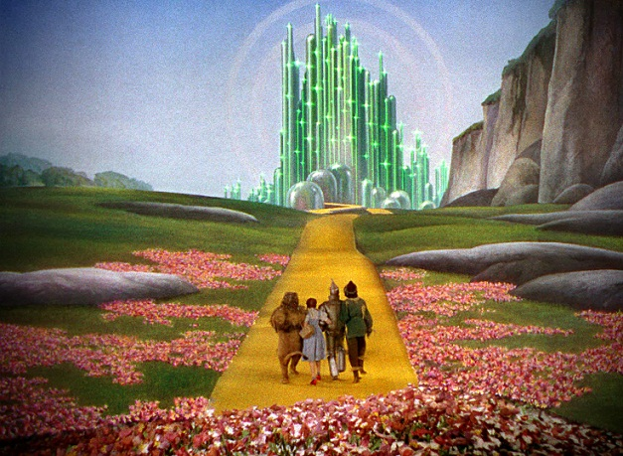

Slide 6
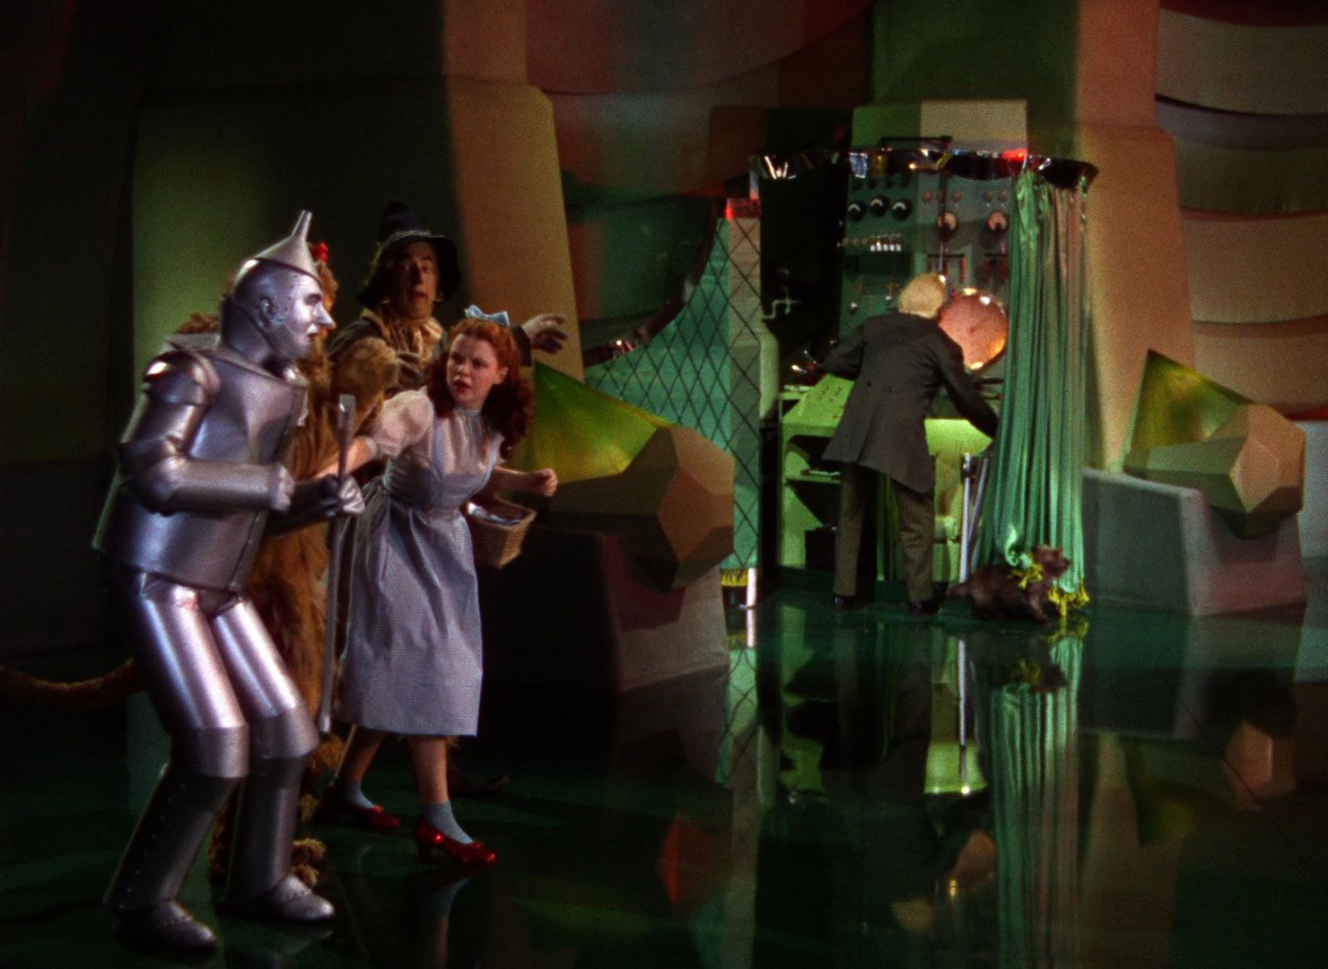
Max Lucado:
“You don’t need what Dorothy found.”

Slide 7
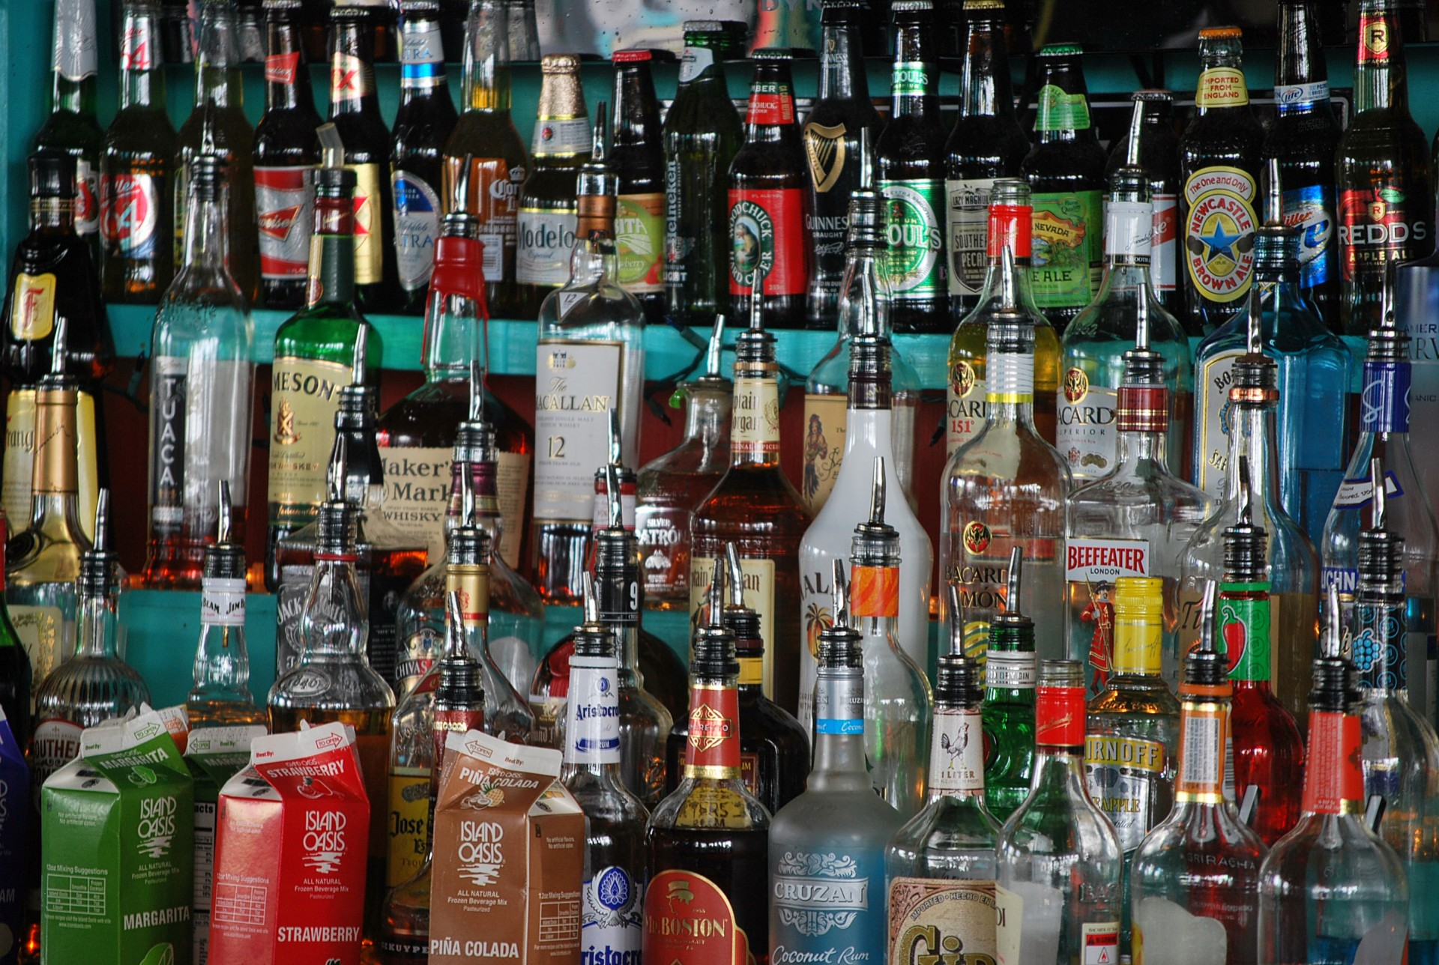
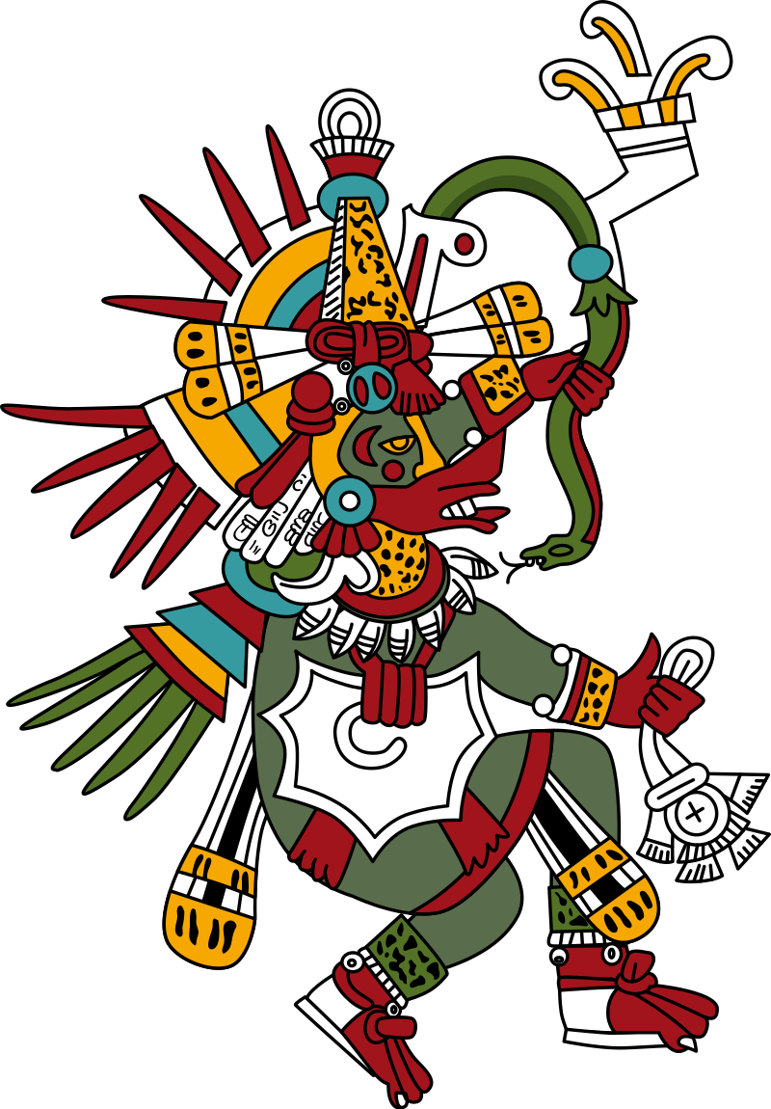
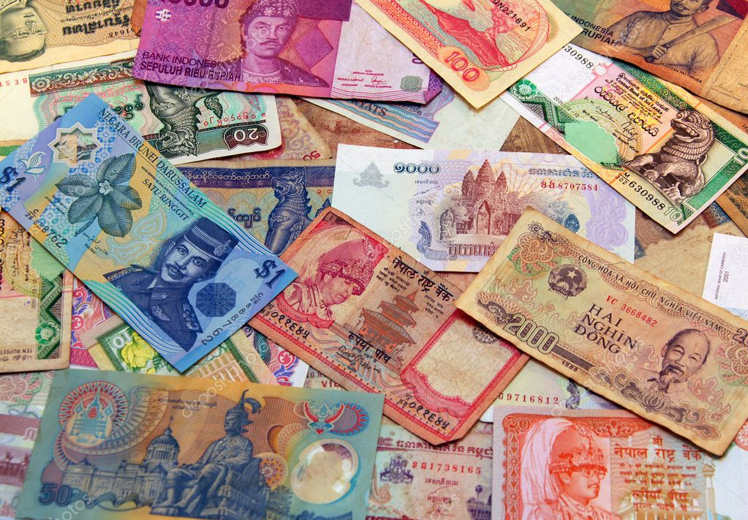
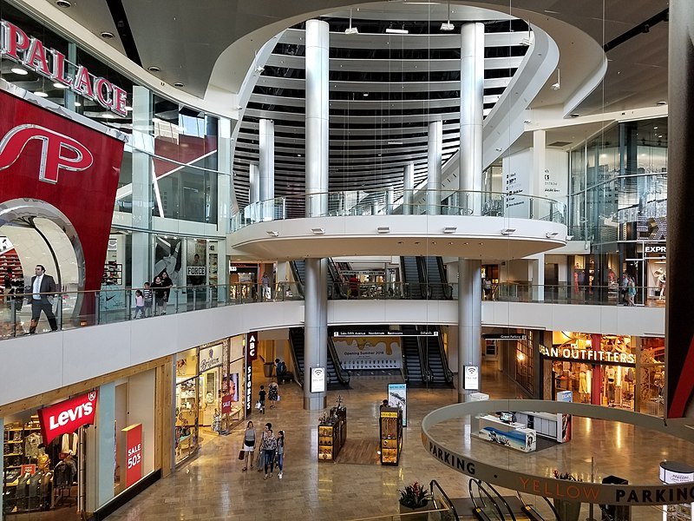
“You don’t need to carry the burden of a lesser god, a god on a shelf, a god in a box, or a god in a bottle.”

Slide 8
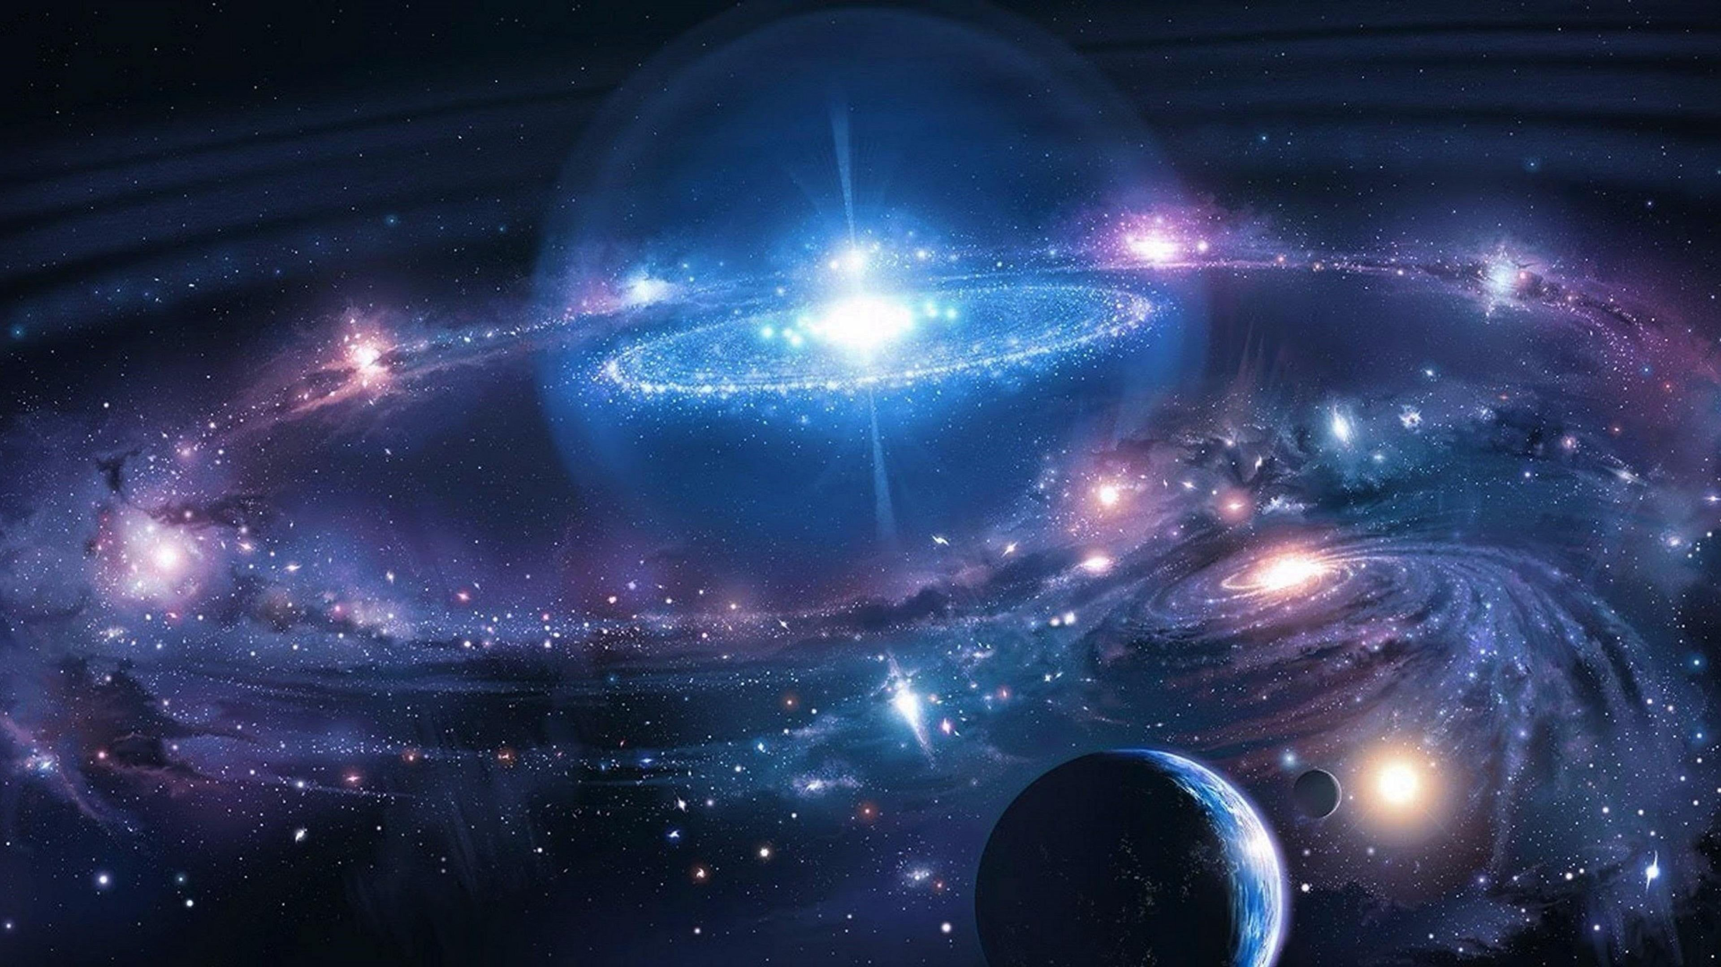
"No, you need a God who can place 100 billion stars in our galaxy and 100 billion galaxies in the universe."

Slide 9
COMPETING WORSHIPS
“The great hindrance to worship is not that we are a pleasure-seeking people, but that we are willing to settle for such pitiful pleasures.”
(John Piper)

Slide 12
TRUE WORSHIP
In Your presence there is
fullness of joy;
At Your right hand are
pleasures forevermore.
(Psalm 16:11)

Slide 13
DISCUSSION
Competing worships

Slide 14
The Centrality of Worship
in Creation

Slide 15
God the Creator
Most basic truth about God
2. First truth about God—Genesis 1:1
All that is not God was made by Him
“God creates, out of generous love, all that is not God, so that He can fill it with His glory.” (N. T. Wright)
4. A fundamental distinction
Notes:
Most basic truth we can learn about God
FIRST truth we learn about God in the Bible
Everything else which exists because He brought it into being; only He has no cause or beginning; everything has its cause, beginning and origin in Him
Between the Creator and creation:
a. God is completely separate, distinct, different from and above creation; UNIQUE
b. “wholly other”; holiness– completely different and distinct from everything else which exists, because He MADE everything which exists
c. why idolatry so terrible
d. why people reject creation

Slide 16
OT Testimonies
to the fundamental distinction
O God, who is like You? (Psalm 71:19)
O Lord, there is none like You, nor is there any God besides You. (1 Chronicles 17:20)
There is no one like the Lord our God. (Exodus 8:10)
“I am God, and there is no other; I am God, and there is no one like Me.” (Isaiah 46:9)
“I am the Lord, that is My name; I will not give My glory to another.” (Isaiah 42:8)
Notes:
God of Israel is unique is attested again and again in OT– distinct from pagan gods, the One who created all things

Slide 17
True worship presupposes this
fundamental distinction
“You are God, and I am not.”
“Worthy are You, our Lord and our God, to receive glory and honor and power; for You created all things, and because of Your will they existed, and were created.” (Revelation 4:11)
Come, let us worship and bow down, Let us kneel before the LORD our Maker. (Psalm 95:6)
Notes:
„Four Spir. Laws of Worship.“
This distinction is crucial for understanding true worship: God is unique AND therefore uniquely worthy of our worship
There is nothing else in His category!!! Nothing even close. He is Creator, everything else is created.

Slide 18
True worship presupposes this
fundamental distinction
“You are God, and I am not.”
I, John, am the one who heard and saw these things. And when I heard and saw, I fell down to worship at the feet of the angel who showed me these things. But he said to me, “Do not do that! I am a fellow servant of yours and of your brethren the prophets and of those who heed the words of this book. Worship God.”
(Revelation 22:8-9; cf. 19:10)
Notes:
„Four Spir. Laws of Worship.“
This distinction is crucial for understanding true worship: God is unique AND therefore uniquely worthy of our worship
There is nothing else in His category!!! Nothing even close. He is Creator, everything else is created.

Slide 19
The Centrality of Worship
in the Fall

Slide 20
The Fall challenged this fundamental distinction: God‘s unique glory
Lucifer/Satan:
“I will make myself like the Most High.”
(Isaiah 14:14)

Slide 21
The Fall challenged this fundamental distinction: God‘s unique glory
“I will make MYSELF like the Most High.”
(Isaiah 14:14)
Lucifer/Satan:
Notes:
Piper: „the essence of sin is the belittling of God‘s glory.“ And they belittled it by robbing it of its claim to uniqueness. If God the Creator is not unique, He‘s not God at all!

Slide 22
The Fall challenged this fundamental distinction: God‘s unique glory
[Satan said:] “YOU will be like God. ”
(Genesis 3:5)
Adam & Eve
Notes:
Piper: „the essence of sin is the belittling of God‘s glory.“ And they belittled it by robbing it of its claim to uniqueness. If God the Creator is not unique, He‘s not God at all!

Slide 23
Adam & Eve
For since the creation of the world His invisible attributes, His eternal power and divine nature, have been clearly seen, being understood through what has been made, so that they are without excuse.
For even though they knew God, they did not honor [glorify] Him as God or give thanks.
(Romans 1:20-21)
Notes:
Piper: „the essence of sin is the belittling of God‘s glory.“ And they belittled it by robbing it of its claim to uniqueness. If God the Creator is not unique, He‘s not God at all!

Slide 24
False
presupposition →
False
worship
worship
Professing to be wise, they became fools, and exchanged the glory of the incorruptible God for an image in the form of corruptible man and of birds and four-footed animals and crawling creatures. (Romans 1:22-23)
For they exchanged the truth of God for a lie, and worshiped and served the creature rather than the Creator. (Romans 1:25)
Notes:
False presupposition: God is NOT unique, not glorifying God AS GOD, not acknowledging and bowing before His unique glory
Rejected the presupposition of true worship, could only result in false worship

Slide 25
WORSHIP was the central issue in the Fall
WHOM are you going to worship?
Notes:
Who is WORTHY of your worship?
In the fall: man said: well, I am, and these idols, and all the things I pursue in place of God and give Him His rightful place in my life
The clay said to the potter (to use the biblical image), I can handle things on my own, thank you very much.
Did not glorfy God as God, or give thanks.

Slide 26
COMPETING WORSHIPS
The problem is NOT that there are people in this world who do not worship
Rather it is that so many worship the wrong thing
What’s all-important is WHOM you worship

Slide 27
The Centrality of Worship
in Redemption

Slide 28
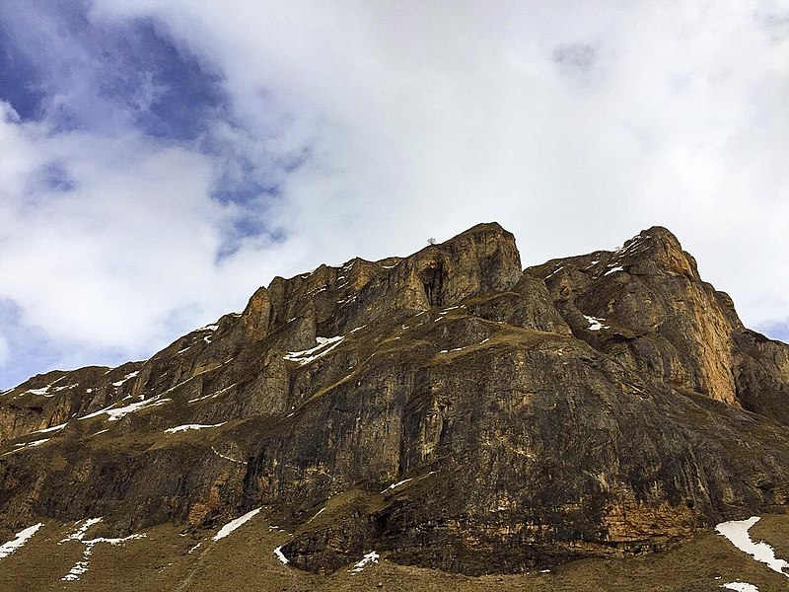
The SECOND ADAM chose differently
Again, the devil took Him to a very high mountain and showed Him all the kingdoms of the world and their glory; and he said to Him, “All these things I will give You, if You fall down and worship me.”
Then Jesus said to him, “Go, Satan! For it is written, ‘You shall worship the Lord your God, and serve Him ONLY.’ ”
(Matthew 4:8-10)
Notes:
HE answered correctly the question, “Whom will you worship? ” “Who is worthy of your worship?”
GOD, and God alone
HE glorified God as God, acknowledging His uniqueness and glory.

Slide 29
Why did Christ come? Why was He conceived? Why was He born? Why was He crucified? Why did He rise again? Why is He now at the right hand of the Father?
The answer to all these questions is, “in order that He might make worshipers out of rebels; in order that He might restore us again to the place of worship we knew when we were first created.”
(A. W. Tozer)
Notes:
As our heritage from the first Adam is that of God-belittling self-worship, so our legacy from the SECOND Adam is God-glorfiying worship. He came to set things right. He is our model – we are to worship the Lord our God, and serve Him ONLY.

Slide 30
ROMANS 1
(v. 21) Enabling us to glorify God as God, and give thanks
(v. 23) Enabling us to exchange images for the glory of God
(v. 25) Enabling us to exchange the lie for the truth of God
(v. 25) Enabling us to worship and serve the Creator rather than the creature
Notes:
And so Christ reverse all those effects of the fall we see in Romans 1
1:16 the gospel is „the power of God for salavation to evryone who believes,“ and that power is seen in the reversal of all of these effects of the fall

Slide 31
“But an hour is coming, and now is, when the true worshipers will worship the Father in spirit and truth; for such people the Father seeks to be His worshipers.”
(John 4:23)
Notes:
And so Christ reverse all those effects of the fall we see in Romans 1
1:16 the gospel is „the power of God for salavation to evryone who believes,“ and that power is seen in the reversal of all of these effects of the fall

Slide 32
The Centrality of Worship
in the Gospel

Slide 33
The Gospel is a call to turn from false to true worship
For they themselves report about us what kind of a reception we had with you, and how you turned to God from idols to serve a living and true God. (1 Thessalonians 1:9)
“Men, why are you doing these things? We are also men of the same nature as you, and preach the gospel to you that you should turn from these vain things to a living God, Who made the heaven and the earth and the sea and all that is in them. (Acts 14:15)
Notes:
If the issue in the fall was worship, and the issue in Christ‘s redemptive work was the restoration of true worship, then the GOSPEL is an invitation to trade in our false worship for true worship. And not only an invitation, but in Christ it is the POWER OF GOD unto salvation, including the power to reverse our descent into false worship and idolatry.
Acts 14: Paul & Barnabas in Lystra: vain things = idols; also in context, people trying to worship THEM; turn to living God (not DEAD idols), to CREATOR
1 Thess. 1: Thessalonians turned to God from idols, to serve the true God
-→we see the themes from Roamsn 1: God is the Creator; turn away from idols, glorify Him as God– gospel has the power in Christ to enable us to turn away from false worship to true worship

Slide 34
The Goal of the Gospel
Therefore, brethren,
since we have confidence to enter the Most Holy Place by the blood of Jesus, by a new and living way opened for us through the curtain, that is, his body, and since we have a great priest over the house of God,
let us draw near to God
with a sincere heart in full assurance of faith.
(Hebrews 10:19-22)
Notes:
The work of Christ for our salvation is a means to the end of bringing us to the Father,
.

Slide 35
The Goal of the Gospel
The triune God has eternally desired to bless His people with the greatest possible gift, and the greatest possible gift He can give is nothing other than the enjoyment of His own eternal, fecund [fruitful] fellowship. Communion in the Son’s eternal life of love, glory and giving with the Father in the Spirit constitutes the ultimate blessing of the gospel.
(Andreas Köstenberger & Scott Swain)
Notes:
The work of Christ for our salvation is a means to the end of bringing us to the Father,
.

Slide 36
Worship and the Gospel
God is the Creator, unique in His glory and alone worthy of worship.
The Fall usurped God’s claim to exclusive worship.
Christ came to undo the effects of the fall and to enable true worship.
The Gospel then is a call to all mankind to come to the Father through Christ, a call to worldwide worship, to the glory of God.

Slide 37
The Centrality of Worship
in Missions
Notes:
GOD-centered view of missions, ultimate goal to give God the glory He is due (usurped and robbed in the Fall)
And as we have seen, God‘s glory and worship are two sides of the same coin– the upper side God‘s glory, and from our perspective it is offering God acceptable worship

Slide 38
MISSIONS
the worldwide application
of the gospel’s call
for true worship
to the glory of God
Notes:
GOD-centered view of missions, ultimate goal to give God the glory He is due (usurped and robbed in the Fall)
And as we have seen, God‘s glory and worship are two sides of the same coin– the upper side God‘s glory, and from our perspective it is offering God acceptable worship

Slide 39
MISSIONS
The ultimate missionary compulsion is not simply that there are people who are dying without knowing Christ, nor is it that God has given us the Great Commission to go out into the world; it is that there are areas of the world, whether here or to the ends of the earth, where God is being robbed of His glory.
—Eric Alexander—

Slide 40
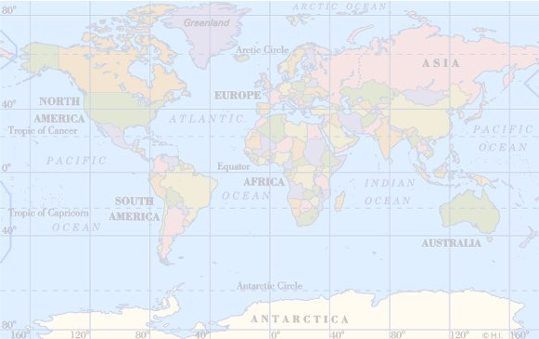

Slide 41
“Missions is not the ultimate goal of the church. Worship is. Missions exists because worship doesn’t. . . . Missions is a temporary necessity. But worship abides forever.”
(John Piper, Let the Nations Be Glad)

Slide 42
Worship is the GOAL of missions
“The goal of missions is the gladness of the peoples in the greatness of God.”
“Let the peoples praise You, O God; Let all the peoples praise You. Let the nations be glad and sing for joy.” (Psalm 67:3-4)
MISSIONS WORSHIP

Slide 44
Worship is also the FUEL of missions
“Passion for God in worship precedes the offer of God in preaching. You can’t commend what you don‘t cherish.”
WORSHIP MISSIONS

Slide 45
Praise His name, we are called to
doxological evangelism:
If we do not praise His name,
we do not preach the gospel.
(Edmund Clowney, Urbana 1976)
WORSHIP MISSIONS

Slide 46
Worship and mission are so bound together in the economy of God that you really cannot have one without the other.
No one can truly worship God and at the same time have an apparently total indifference to whether anyone else is worshiping Him or not.
True worship and true mission always go together.
—Eric Alexander, Urbana, 1981—
العبادة الإرساليات

Slide 47
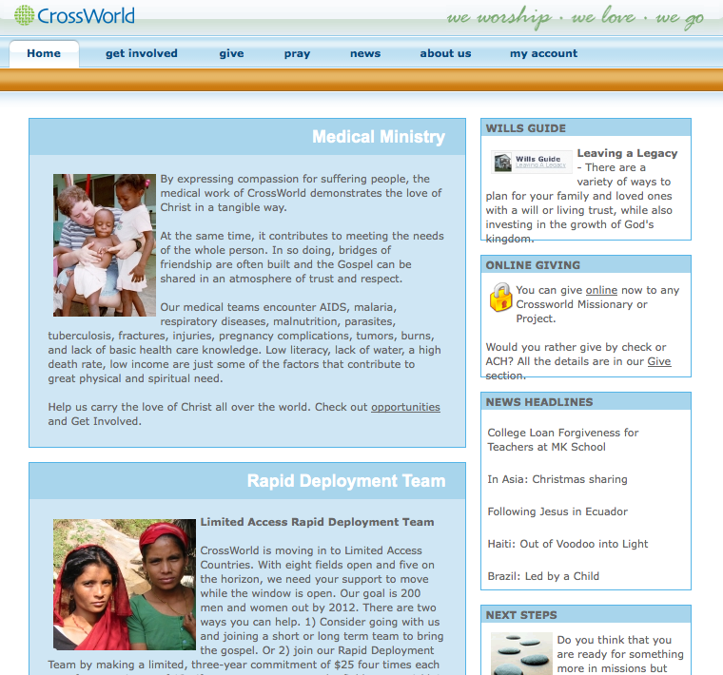

Slide 48
Amy Carmichael
(1867-1951)
“to remind us that worship must always precede service”
WORSHIP MISSIONS

Slide 49
“Seek first the kingdom of God and His righteousness, and all these things will be added to you.” (Matthew 6:33)
WORSHIP MISSIONS

Slide 50
God’s Goal for the Nations
God be gracious to us and bless us, And cause His face to shine upon us—
That Your way may be known on the earth, Your salvation among all nations. Let the peoples praise You, O God; Let all the peoples praise You. Let the nations be glad and sing for joy.
(Psalm 67:1-4)

Slide 51
God’s Goal for the Nations
“God is pursuing with omnipotent passion
a worldwide purpose of gathering joyful
worshipers for Himself from every tribe
and tongue and people and nation.”
(John Piper)

Slide 52
God’s Sufficiency for the Nations
All the ends of the earth will remember and turn to the LORD, and all the families of the nations will worship before You. (Psalm 22:27)
“Be still, and know that I am God; I will be exalted among the nations, I will be exalted in the earth.” (Psalm 46:10)

Slide 53
“Probably the hardest thought of all for our natural egotism to entertain is that God does not need our help. We commonly represent Him as a busy, eager, somewhat frustrated Father hurrying about seeking help to carry out His benevolent plan to bring peace and salvation to the world. The God who worketh all things
surely needs no help and no helpers.” (Tozer)

Slide 54
God’s Call to the Nations
Kings of the earth and all peoples;
Princes and all rulers on earth;
young men and maidens; old men and children.
Let them praise the name of the Lord,
For His name alone is exalted;
His glory is above earth and heaven.
(Psalm 148:11-13)

Slide 55
The QUESTION of the ages
WHOM are you going
to worship?

Slide 56
The MESSAGE to the nations
Worship GOD!

Slide 57
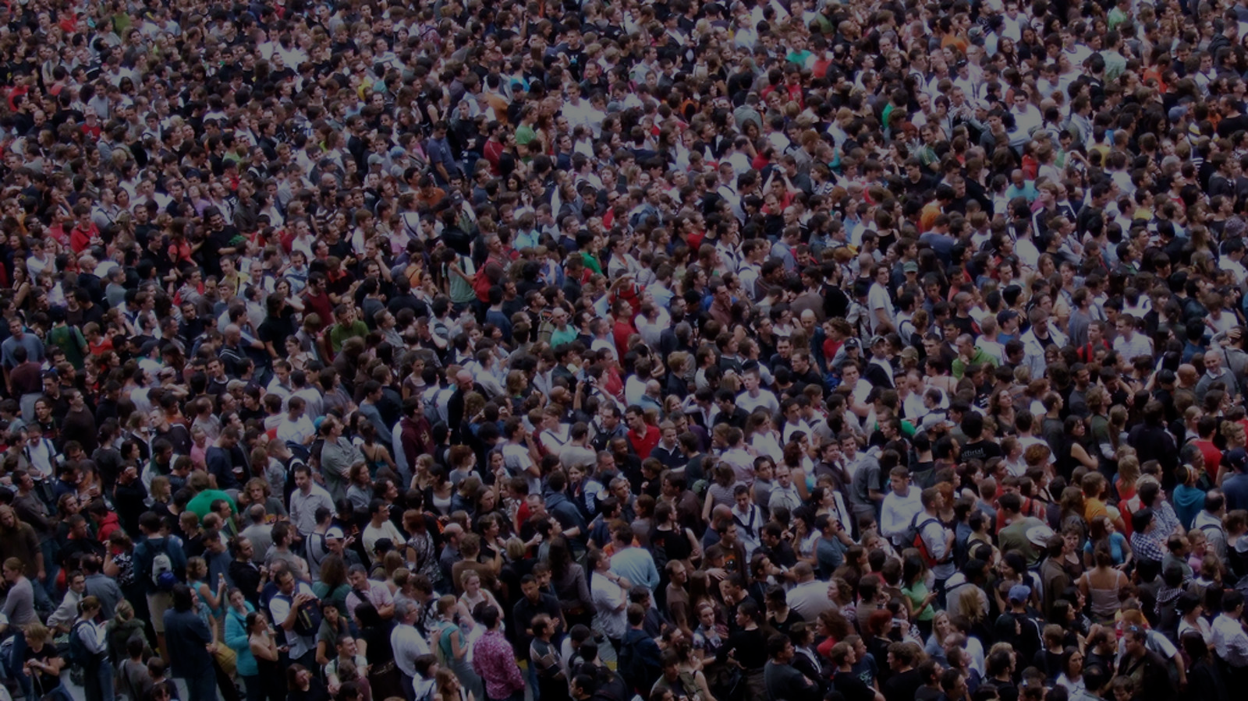
Our Role
to proclaim: Praise the Lord, all nations; Laud Him, all peoples!
(Psalm 117:1)
Notes:
To join in with Him in His purpose: to make His name and glory known

Slide 58
Sing to the LORD a new song; Sing to the LORD, all the earth. Sing to the LORD, bless His name; Proclaim good tidings of His salvation from day to day.
Tell of His glory among the nations, His wonderful deeds among all the peoples.
For great is the LORD and greatly to be praised; He is to be feared above all gods. For all the gods of the peoples are idols, But the LORD made the heavens.
(Psalm 96:1-5)

Slide 59
DISCUSSION
How will/should this understanding of the relationship between worship and missions impact our missionary endeavors?

Slide 60
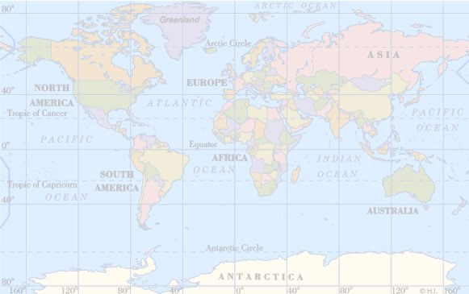
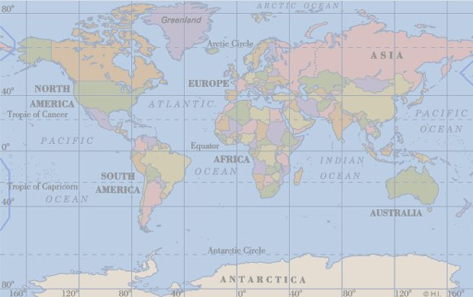
Great
Commission (Matthew 28:18-20)
Great
Commandment (Matthew 22:35-38)
man-focused
temporary
means
secondary
God-focused
eternal
end
primary
Notes:
Great Commandment „love the Lord...“ very close to worship
Great Commission is disciplemaking– last step is „teaching them...“ and Jesus said the greatest thing He commanded them was „to love...“ So the Great Commission lead to, feeds into love for God when it is fully carried out– that‘s the goald, the end.
Same idea as Piper‘s assertion that worship is the goal of missions; AND also that worship fuels missions, because love for God (and neighbor) will lead to seeing others as God sees them
→ We see application here to the WHOLE ministry of the church, not just missions→

Slide 61
The Centrality of Worship
in All of Life
(John 4:19-24)

Slide 62
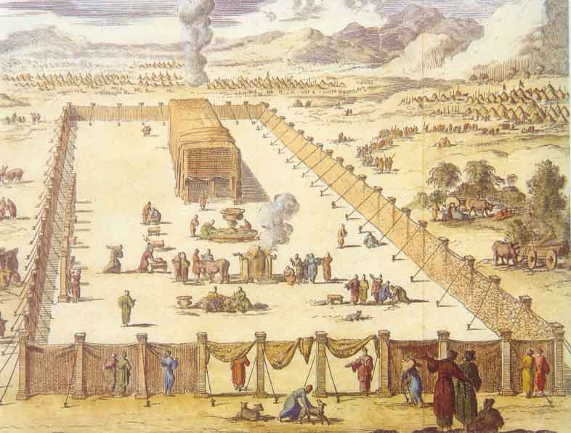
Barriers between the individual and God
under the Old Covenant

Slide 63
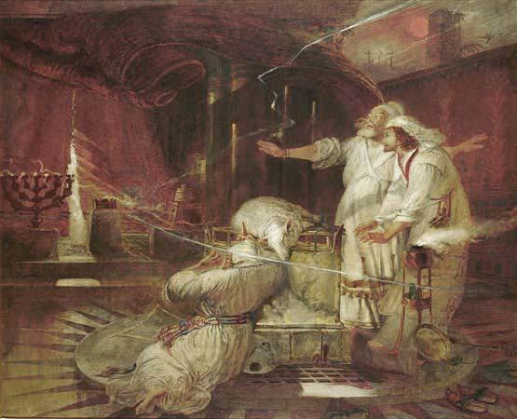

Slide 64
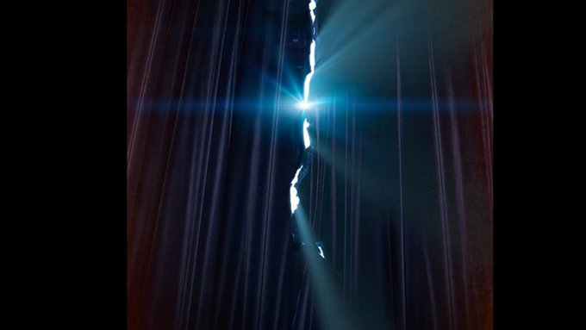

Slide 65
Jesus breaks down
geographical
barriers
(4:3-4)
WORSHIP:
Notes:
Worship 9X

Slide 66
Samaritans
hated by Jews:
WORSHIP:
Half-breeds
Rejected most of OT
Worshiped on Mt. Gerizim
Notes:
FUNDAMENTAL TO TRUE WORSHIP: “He is God, and I am not.” As Creator, totally unique, and therefore alone worthy of worship.
True worship focuses on His supreme worthiness as God. There is none like You, O Lord.
Sin: wanting to be like God (Eve), instead of taking our proper place and giving Him His.

Slide 67
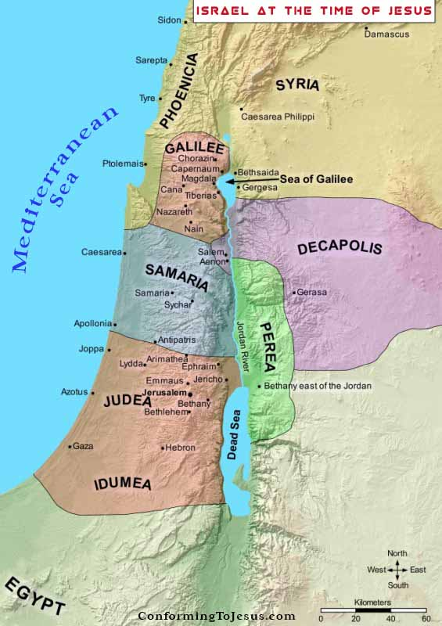
A TALE OF TWO MOUNTAINS
(John 4:19-)
Notes:
Worship 9X

Slide 68
A TALE OF TWO MOUNTAINS
(John 4:19-)
Notes:
Worship 9X

Slide 69
Jesus breaks down
ethnic and social
barriers
(4:5-9)
WORSHIP:
Notes:
Worship 9X

Slide 70
Jesus breaks down
spiritual
barriers
(4:10-15)
WORSHIP:
Notes:
Worship 9X

Slide 71
Jesus breaks down
religious
barriers
(4:16-26)
WORSHIP:
Notes:
Worship 9X

Slide 72
WORSHIP:
a “question” about worship (vv. 19-20)
Notes:
Read 21-24

Slide 73
Jesus changes the rules (vv. 21, 23):
“neither IN this mountain,
nor IN Jerusalem”
but “IN spirit and truth”
WORSHIP:
Notes:
Mt. Gerizim or Mt. Zion

Slide 74
No longer a matter of
WHERE or WHEN you worship,
but
HOW you worship
WORSHIP:

Slide 75
worship in spirit
WORSHIP:
(contrast the Jews)
Notes:
FUNDAMENTAL TO TRUE WORSHIP: “He is God, and I am not.” As Creator, totally unique, and therefore alone worthy of worship.
True worship focuses on His supreme worthiness as God. There is none like You, O Lord.
Sin: wanting to be like God (Eve), instead of taking our proper place and giving Him His.

Slide 76
“Beware of practicing your righteousness before other people in order to be seen by them, for then you will have no reward from your Father who is in heaven. Thus, when you give to the needy, sound no trumpet before you, as the hypocrites do in the synagogues and in the streets, that they may be praised by others. . . . And when you pray, you must not be like the hypocrites. For they love to stand and pray in the synagogues and at the street corners, that they may be seen by others.” (Matthew 6:1-2, 5)
“You hypocrites! Well did Isaiah prophesy of you, when he said: ‘This people honors Me with their lips, but their heart is far away from Me. But in vain do they worship Me, teaching as doctrines the precepts of men.’” (Matthew 15:8-9)
WORSHIP:
Notes:
FUNDAMENTAL TO TRUE WORSHIP: “He is God, and I am not.” As Creator, totally unique, and therefore alone worthy of worship.
True worship focuses on His supreme worthiness as God. There is none like You, O Lord.
Sin: wanting to be like God (Eve), instead of taking our proper place and giving Him His.

Slide 77
“Woe to you, scribes and Pharisees, hypocrites! For you tithe mint and dill and cumin, and have neglected the weightier matters of the law: justice and mercy and faithfulness. These you ought to have done, without neglecting the others.
Woe to you, scribes and Pharisees, hypocrites! For you clean the outside of the cup and the plate, but inside they are full of greed and self-indulgence. . . .
Woe to you, scribes and Pharisees, hypocrites! For you are like whitewashed tombs, which outwardly appear beautiful, but within are full of dead people’s bones and all uncleanness. So you also outwardly appear righteous to others, but within you are full of hypocrisy and lawlessness.” (Matthew 23:25-28)
WORSHIP:
Notes:
FUNDAMENTAL TO TRUE WORSHIP: “He is God, and I am not.” As Creator, totally unique, and therefore alone worthy of worship.
True worship focuses on His supreme worthiness as God. There is none like You, O Lord.
Sin: wanting to be like God (Eve), instead of taking our proper place and giving Him His.

Slide 78
worship in truth
WORSHIP:
(contrast the Samaritans)
Notes:
25-26
Sams.: see 22

Slide 79
“you worship what you do not know” (4:22)
Mount Gerizim worship
Notes:
God reveals His glory, worship is our response
Order is important: God always initiates
Rom. 11:33-36 eleven chapters of doctrine, then Paul bursts out in praise: „Oh, the depth of the riches ¹both of the wisdom and knowledge of God!”
Worship services to be a dialogue betw, God and man, a dialogue of revel. & response
This is why the Scriptures are so important; Stott and others remind us how we need much more Scr. In our services– been in many churches where first first of Scr. Is when preacher gets up– means 30 mintues of response w/o anything to respond to!!

Slide 80
WORSHIP:
spirit AND truth

Slide 81
What God wants: OUR HEARTS
WORSHIP:
Worship in spirit

Slide 82
What God wants: OUR LIVES
WORSHIP:
Rom 12:1 Therefore I urge you, brethren, by the mercies of God, to present your bodies a living and holy sacrifice, acceptable to God, which is your spiritual service of worship.
All of life is worship!

Slide 83
What God wants: OUR LIVES
WORSHIP:
1 Cor 10:31 Whether you eat or drink, or whatever you do, do all to the glory of God.
a life and lifestyle of worship

Slide 84
What God wants: OUR WORSHIP
WORSHIP:
"But an hour is coming, and now is, when the true worshipers will worship the Father in spirit and truth; for such people the Father seeks to be His worshipers."
John 4:23
He's seeking WORSHIPPERS

Slide 85
The Centrality of Worship
in Heaven
(Revelation 5)

Slide 86
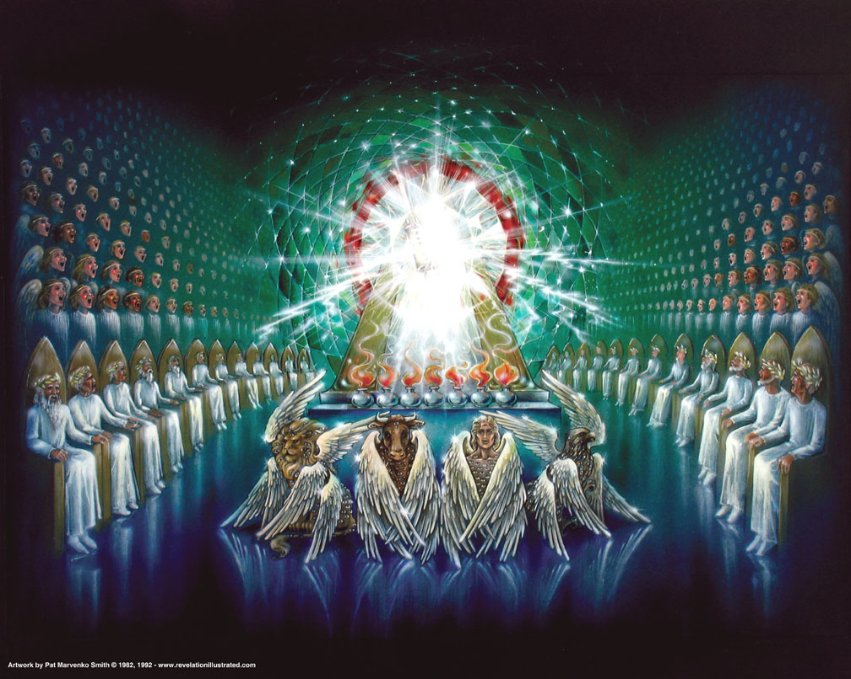

Slide 87
But our citizenship is in heaven, and from it we await a Savior, the Lord Jesus Christ, (Philippians 3:20)

Slide 88
BREAKOUTS
Discuss the statement:
“Worship is the only Christian activity which is an end in itself.” (John Piper)

Slide 89
“Worship is the only Christian activity which is an end in itself.” (John Piper)
Evangelism activities:
MORE worshipers
Edification activities:
BETTER worshipers

Slide 90
Great
Commission (Matthew 28:28-30)
Great
Commandment (Matthew 22:35-38)
man-focused
temporary
means
secondary
God-focused
eternal
end
primary
Notes:
Great Commandment „love the Lord...“ very close to worship
Great Commission is disciplemaking– last step is „teaching them...“ and Jesus said the greatest thing He commanded them was „to love...“ So the Great Commission lead to, feeds into love for God when it is fully carried out– that‘s the goald, the end.
Same idea as Piper‘s assertion that worship is the goal of missions; AND also that worship fuels missions, because love for God (and neighbor) will lead to seeing others as God sees them
→ We see application here to the WHOLE ministry of the church, not just missions→

Slide 91
Unit 2
Biblical Worship
THE CENTRALITY OF WORSHIP
in Creation
in the Fall
in Redemption
in the Gospel
in Missions
in All of Life
in Heaven

Slide 92
Black

Slide 93
Worship link at BibleStudyDownloads.org
Get this presentation for free!
Notes:
Worship (wo)

