Slide 1
Unit 1
Biblical Worship
THE GOD WE WORSHIP
Taught by Dr. Ron Man for Doctor of Ministry Students Uploaded by Dr. Rick Griffith • Singapore Bible College Files in many languages for free download at BibleStudyDownloads.org

Slide 2
the biblical pattern of worship
Revelation
THEOLOGY
Response
DOXOLOGY
Notes:
worship Him as He really is, as He wants to be worshiped
Order is important: God always initiates
Rom. 11:33-36 eleven chapters of doctrine, then Paul bursts out in praise: „Oh, the depth of the riches ¹both of the wisdom and knowledge of God!”
Worship services to be a dialogue betw, God and man, a dialogue of revel. & response
This is why the Scriptures are so important; Stott and others remind us how we need much more Scr. In our services– been in many churches where first first of Scr. Is when preacher gets up– means 30 mintues of response w/o anything to respond to!!

Slide 3
(photo)

Slide 4
THE GLORY OF GOD
Not an attribute; but rather the sum total of ALL His attributes, all His perfections
All that makes Him God
His complete and utter perfection in every way
The greatest subject of all!
“The beauty of God’s manifold perfections”
“The glory of God is His greatness, His beauty, and His worth on display.” (John Piper)

Slide 5
The Bible is the Story of His Glory
in CREATION
in the FALL
in JESUS CHRIST
in REDEMPTION
in SANCTIFICATION
in HEAVEN

Slide 6
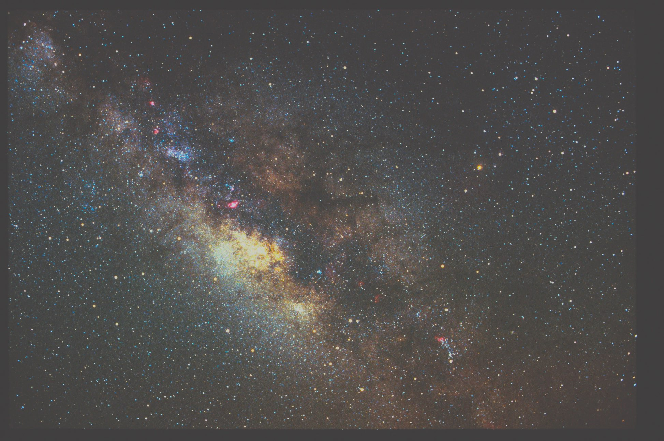
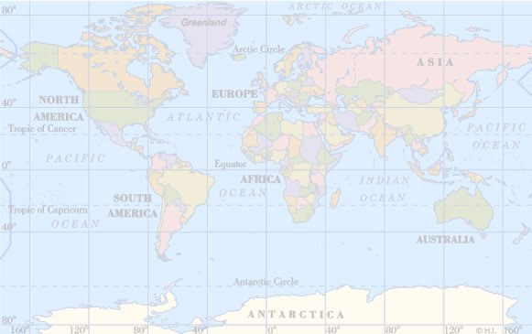
in Creation
in Creation
The heavens are telling of the glory of God.
(Psalm 19:1)
Bring My sons from afar and My daughters from the ends of the earth, everyone who is called by My name, and whom I have created for My glory.
(Isaiah 43:6-7)
The heavens are telling of the glory of God (Psalm 19:1)
Bring My sons from afar and My daughters from the ends of the earth, everyone who is called by My name, and whom I have created for My glory (Isaiah 43:6-7)

Slide 7
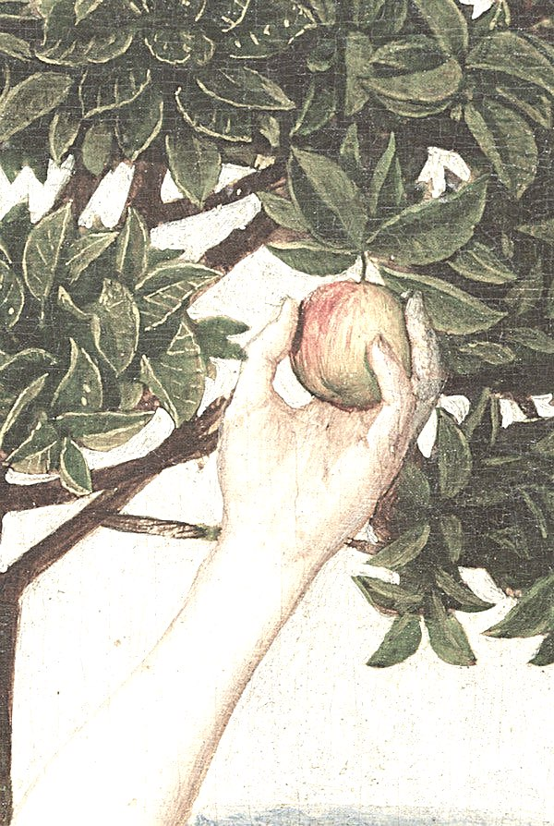
in the Fall
Even though they knew God, they did not glorify Him as God or give thanks . . .
Professing to be wise, they became fools, and exchanged the glory of the incorruptible God for images . . .
They exchanged the truth about God for a lie
and worshiped and served the creature rather than the Creator.
(Romans 1:21,22-23,25)

Slide 8
in the Fall
For all have sinned and fall short
of the glory of God.
(Romans 3:23)
“The essence of sin is the belittling
of God’s glory.”
(John Piper)

Slide 9
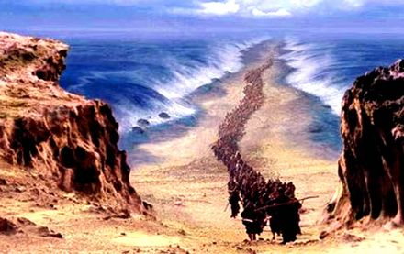
in Israel
“You are my servant,
Israel, in whom I will be glorified.”
(Isaiah 49:3)

Slide 10
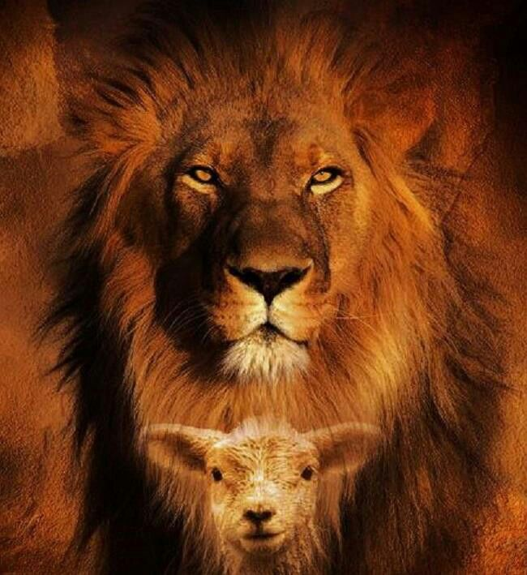
in Jesus Christ
And the Word became flesh, and dwelt among us, and we beheld His glory, glory as of the only begotten from the Father, full of grace and truth.
(John 1:14)
God . . . has spoken to us in His Son . . . He is the radiance of His glory and the exact representation of His nature.
(Hebrews 1:1-3)

Slide 11
in Jesus Christ
John 17:5
John 12:41
John 1:14
John 2:11
Hebrews 2:9
1 Peter 1:21
1 Timothy 3:16
John 17:5
2 Thessalonians 1:9-10
Revelation 5:13

Slide 12
in Jesus Christ
His Preincarnate Glory
His Incarnate Glory Foretold
His Incarnation and Ministry
His Suffering and Death
His Resurrection
His Ascension
His Exaltation
His Second Coming
In Heaven

Slide 13
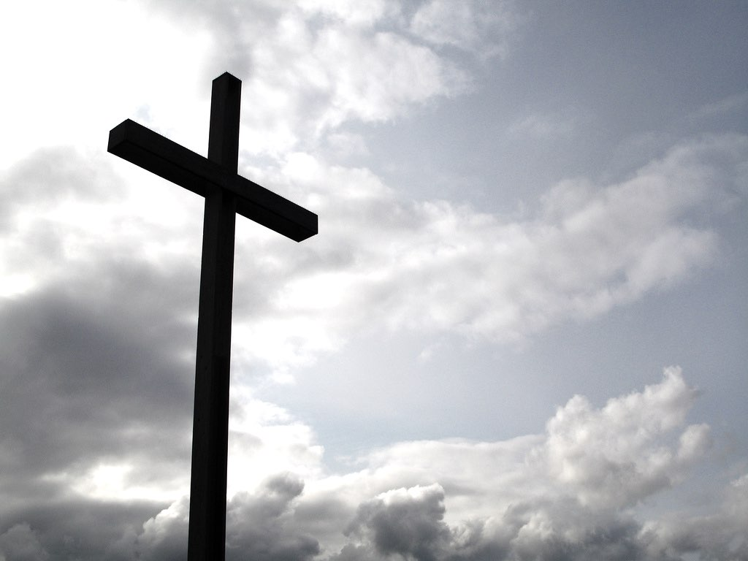
in Redemption
He predestined us to adoption as sons through Jesus Christ to Himself, according to the kind intention of His will, to the praise of the glory of His grace…to the end that we who were the first to hope in Christ would be to the praise of His glory . . . with a view to the redemption of God's own possession, to the praise of His glory (Ephesians 1:5-6, 12, 14)

Slide 14
in Redemption
For I tell you that Christ became a servant to the circumcised to show God’s truthfulness, in order to confirm the promises given to the patriarchs, and in order that the Gentiles might glorify God for His mercy.
(Romans 15:8-9)

Slide 15
in Redemption
Christ redeemed us that we might:
Glorify God as God and give thanks
Exchange images for the glory of the incorruptible God
Exchange the lie for the truth of God
Worship and serve the Creator rather than the creature (Romans 1)

Slide 16
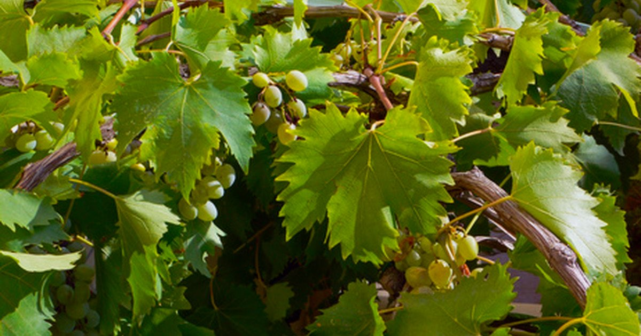
in Sanctification
Whether, then, you eat or drink or whatever you do, do all to the glory of God. (1 Cor. 10:31)
“My Father is glorified by this, that you bear much fruit, and so prove to be My disciples.” (John 15:8)
Whoever serves is to do so as one who is serving by the strength which God supplies; so that in all things God may be glorified through Jesus Christ. (1 Peter 4:11)

Slide 17
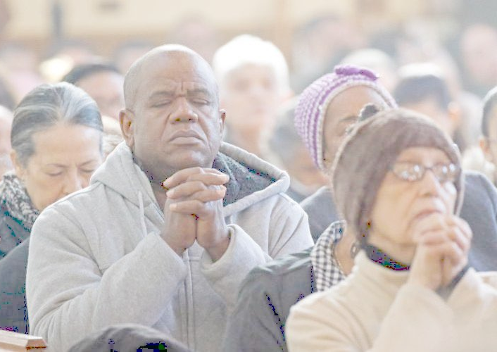
in the Church
To Him be glory in the church and in Christ Jesus throughout all generations, forever and ever. Amen.
(Ephesians 3:21)

Slide 18
in Heaven
And the city has no need of the sun or of the moon to shine on it, for the glory of God has illumined it, and its lamp is the Lamb (Rev 21:23)
“To Him who sits on the throne, and to the Lamb, be blessing and honor and glory and dominion forever and ever” (Rev 5:13)
Notes:
And finally, God‘s glory is the ultimate and final theme and focus and delight of heaven. His absolute worthiness is the refrain of all creation as they gather around the throne to offer Him the worship of which he alone is worthy.
[Consummation of history „The earth will be filled with the knowledgr of the glory of the Lord, as the waters cover the sea.“ (Habakkuk 2:14)9

Slide 19
The Story of His Glory
For from Him
and through Him
and to Him
are all things.
To Him be the glory forever.
Amen!
(Romans 11:36)
Notes:
Source
Means
Goal

Slide 20
it’s not about us
it’s about God and His glory

Slide 21
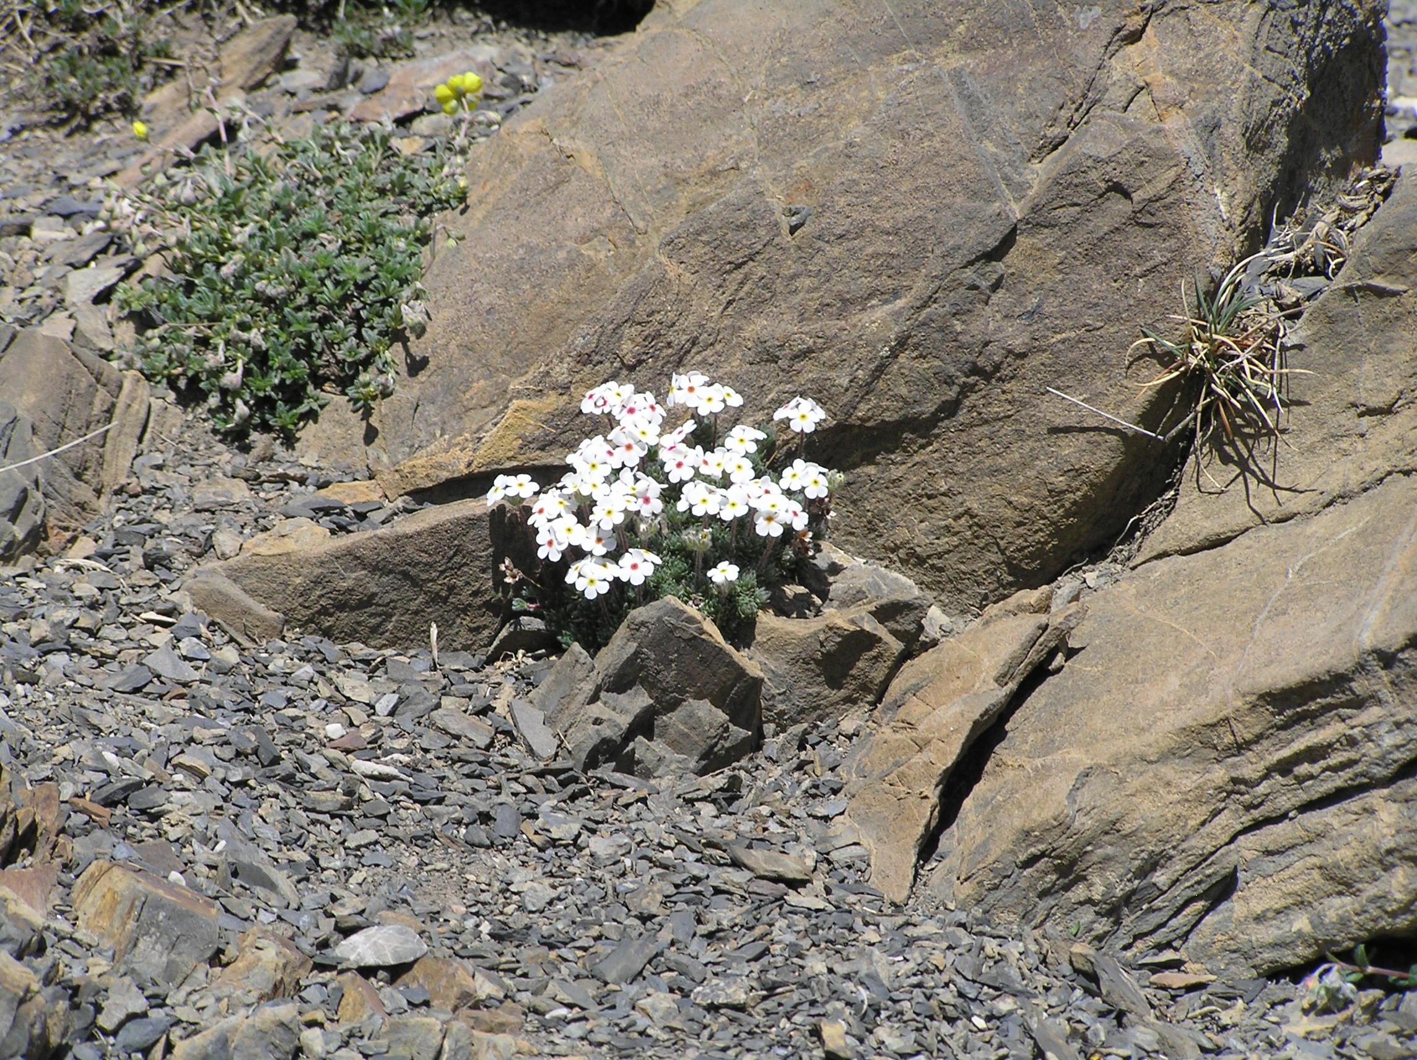

Slide 22
WORSHIP
is our response to the Glory of God all that we are responding to all that He is
Notes:
Why we were created (Rom. 1); Piper: „The menaing of the universe is God going public for the glory of God.“
David Martyn Lloyd-Jones: “If I were to ask you,” he said, “what was the greatest activity in which the people of God could ever engage; if I were to ask you what was the highest ambition that any man or woman created by God could ever have; if I were to ask you what would remain when every other activity in this world has fallen away-- what would you say?”
And He proposed a considerable list of answers to is question which were manifestly not the right one, and then came ultimately to the answer. “The answer,” he says, “is this: it is to offer to God acceptable worship. This,” he said, “is why God has formed the universe and created human beings. This is why God has sent His Son to redeem a people. This why God is sanctifying and purifying the Church of Jesus Christ and preparing them for glory. It is in order that He might have a people who will bring Him acceptable worship. And when you focus it down to your own life, this is why God has made you. This is why God has given you a tongue and lips and a voice; this why God has created every faculty of your being, that it might be engaged in the proper worship of Almighty God.”
What we refused to do in the Fall; what Christ came to restore

Slide 23
WORSHIP
is our response to the Glory of God
Recognizing the glory of God with our minds
Cherishing the glory of God with our hearts
Proclaiming the glory of God with our mouths
Celebrating the glory of God in all of life

Slide 24
Revelation
Response
Notes:
God reveals His glory, worship is our response
Order is important: God always initiates
Rom. 11:33-36 eleven chapters of doctrine, then Paul bursts out in praise: „Oh, the depth of the riches ¹both of the wisdom and knowledge of God!”
Worship services to be a dialogue betw, God and man, a dialogue of revel. & response
This is why the Scriptures are so important; Stott and others remind us how we need much more Scr. In our services– been in many churches where first first of Scr. Is when preacher gets up– means 30 mintues of response w/o anything to respond to!!

Slide 25
Worship is about God (about His Glory)
Ascribe to the LORD, O mighty ones, ascribe to the LORD glory and strength. Ascribe to the LORD the glory due His name; worship the LORD in the splendor of His holiness. (Psalm 29:1-2)
Praise Him according to His excellent greatness. (Psalm 150:2)
But you are a chosen race, a royal priesthood, a holy nation, a people for God's own possession, so that you may proclaim the excellencies of Him who has called you out of darkness into His marvelous light. (1 Peter 2:9)
Notes:
We reflect back to Him His glory, we acknowledge and celebrate His glory; Scr. Important because we must worship Him as He really is. God‘s glory is the SUBJECT of our worship.

Slide 26
Worship is for God (for His Glory)
I will give thanks to You, O Lord my God, with all my heart, And will glorify Your name forever. (Psalm 86:12)
Now may the God who gives perseverance and encouragement grant you to be of the same mind with one another according to Christ Jesus, so that with one accord you may with one voice glorify the God and Father of our Lord Jesus Christ. (Romans 15:5-6)
Fear God, and give Him glory . . . ; worship Him who made the heavens and the earth and sea and springs of waters. (Revelation 14:7)
Notes:
IN worship we give Him glory, glorify Him; we glorify Him AS GOD, as we proclaim, „O Lord, there is none like You.“
God‘s glory is the OBJECT of our worship, the motivation, the goal.

Slide 27
There is only one end for which God created and formed the world and made us, and that is for His own exclusive glory and honor. There is only one end for which our Lord redeemed His people, and that was to bring Him a revenue of glory. And when you and I find the thirst that God implants within our souls, it is only going to be satisfied when our souls are set on the same longing that God Himself has: for His glory and honor.
(Eric Alexander)
Notes:
That‘s worship!!
In worship we‘re simply alighning ourselves with God‘s own purpose: to display and further His own glory!

Slide 28
For from Him
and through Him
and to Him
are all things.
To Him be the glory forever.
Amen!
(Romans 11:36)
Notes:
Source
Means
Goal

Slide 29
Black

Slide 30
Worship link at BibleStudyDownloads.org
Get this presentation for free!
Notes:
Worship (wo)

