Slide 1
Biblical Worship
Taught by Dr. Ron Man • Worship Resources International Uploaded by Dr. Rick Griffith • Jordan Evangelical Theological Seminary All files in many languages for free download at BibleStudyDownloads.org

Slide 2
O come, let us sing for joy to the Lord,
Let us shout joyfully to the rock of our salvation!
Let us come before His presence
with thanksgiving,
Let us shout joyfully to Him with psalms.
For the Lord is a great God
and a great King above all gods,
In whose hand are the depths of the earth,
The peaks of the mountains are His also.
The sea is His, for it was He who made it,
And His hands formed the dry land.

Slide 3
Come, let us worship and bow down,
Let us kneel before the Lord our Maker.
For He is our God, and we are the people of His pasture and the sheep of His hand.
(Psalm 95:1-7)

Slide 4
RON MAN

Slide 5
RON MAN
I

Slide 6
I
RON MAN

Slide 7
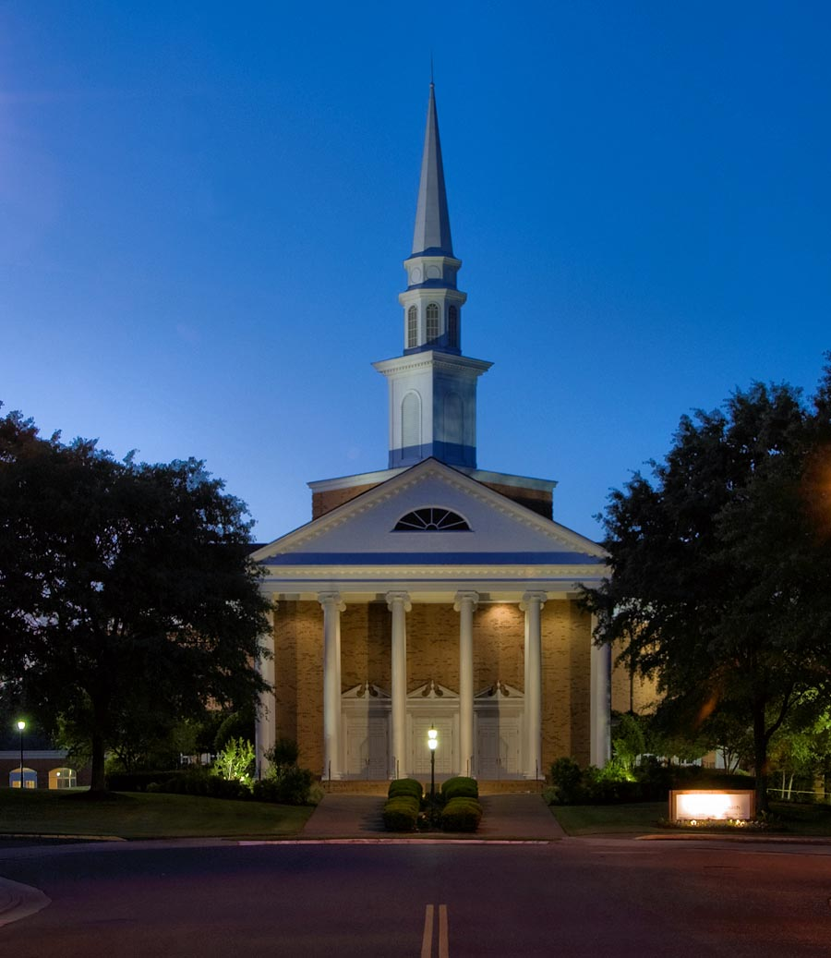
First Evangelical Church
Memphis, Tennessee

Slide 8
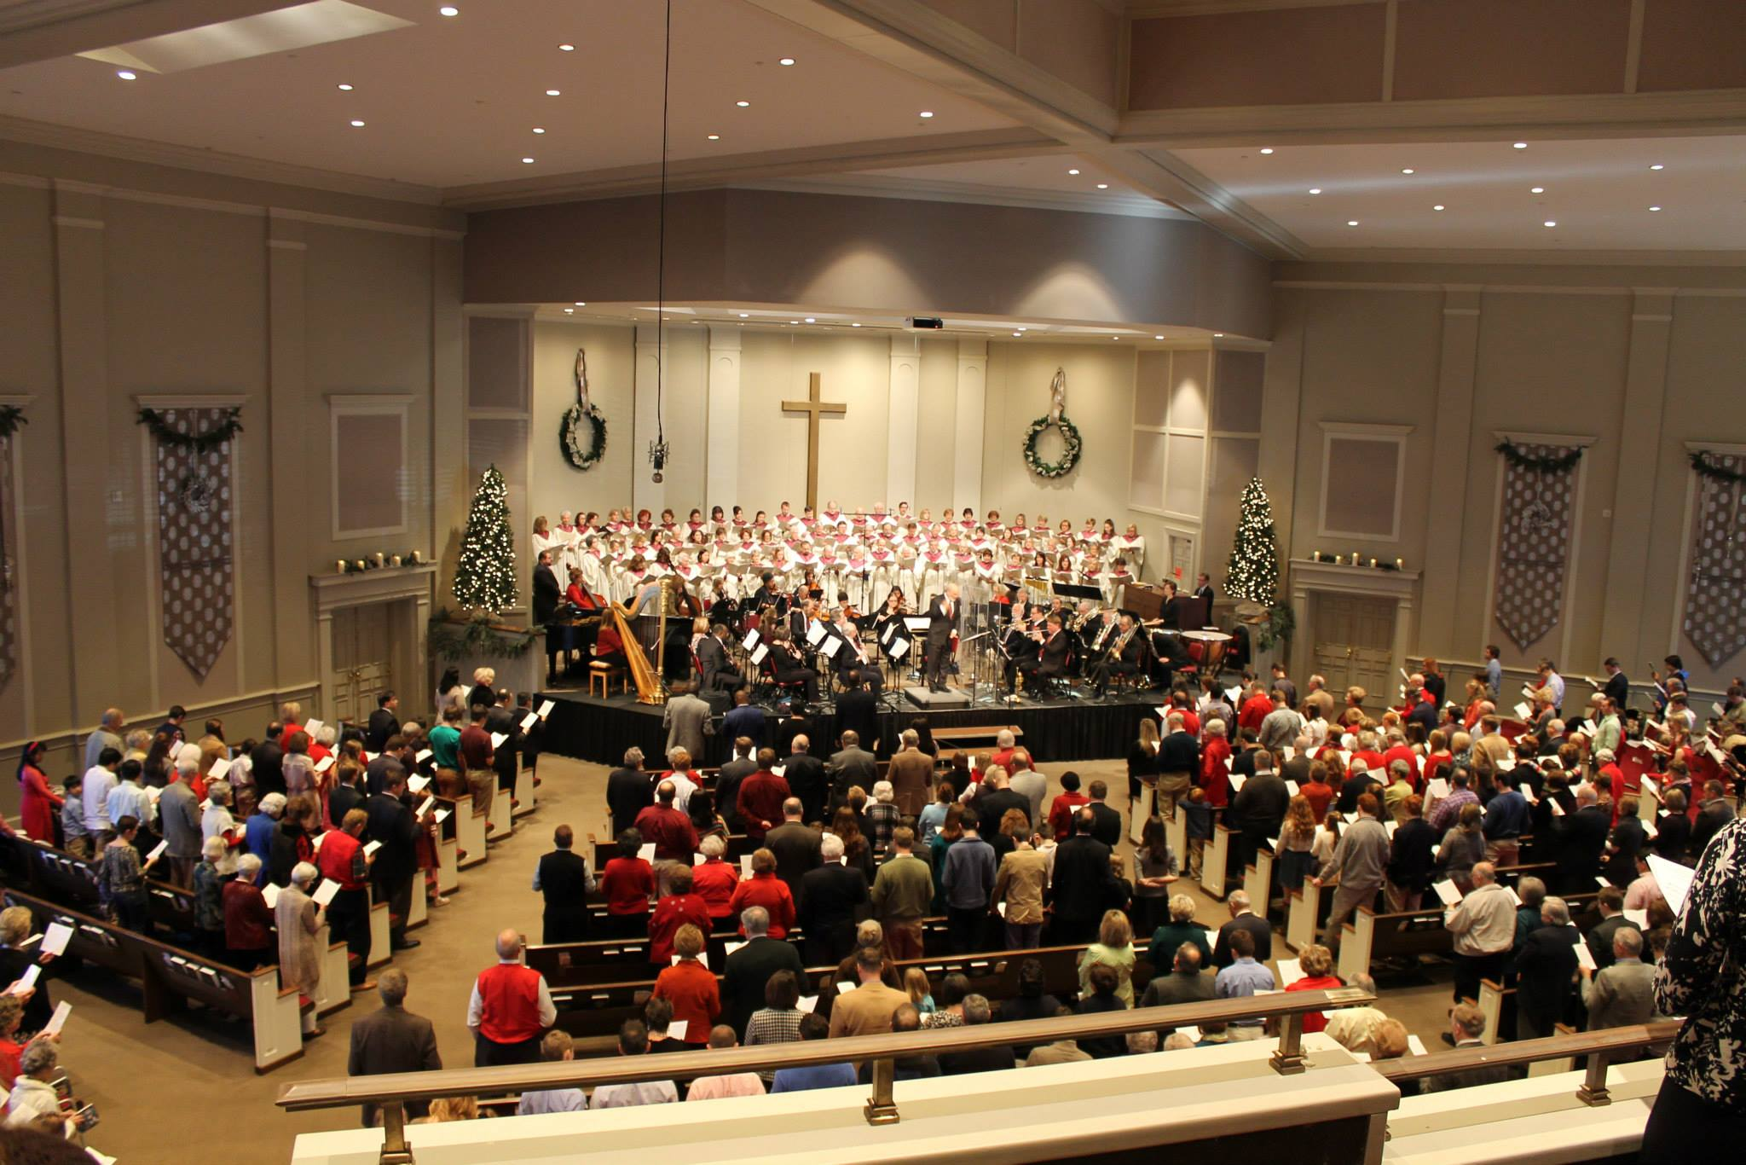
ETERNAL PRAISE
AND THE NATIONS
Revelation 7

Slide 11
Your stories
My story

Slide 12
Course Outline
1. The God We Worship
2. The Centrality of Worship
3. Worship in the Old Testament
4. Worship in the New Testament
5. Worship in Church History
6. Worship in the Church

Slide 13
introduction, part 1
Biblical Worship
Type to enter a caption.
The Theology of Worship

Slide 14
Now, worship is the missing jewel in modern evangelicalism.
We’re organized; we work; we have our agendas.
We have almost everything, but there’s one thing that the churches, even the gospel churches, do not have:
that is the ability to worship.
We are not cultivating the art of worship.
It’s the one shining gem that is lost to the modern church,
and I believe that we ought to search for this until we find it.
(A. W. Tozer, 1961)

Slide 15
SINCE
Worship books
Worship conferences
Worship songs
Worship courses
Worship degrees
Worship consultations

Slide 16
Good news
and
Bad news

Slide 17
Why study the “theology of worship”?
What a “theology” is
What a “theology of worship” is

Slide 18
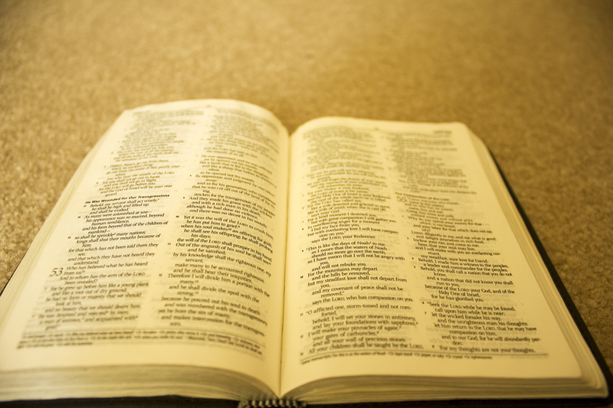
The Importance of a Theology
(Biblical Understanding) of Worship

Slide 19
The Importance of a Theology
(Biblical Understanding) of Worship
1. GOD’S WORD tells us who God is.
GOD is the subject of our worship.
Worship is about Him.
We must worship Him as He really is.
Notes:
SUBJECT

Slide 20
The Importance of a Theology
(Biblical Understanding) of Worship
2. GOD’S WORD tells us what God wants.
GOD is the object of our worship.
Worship is for Him, for His pleasure..
We must worship Him as He wants to be worshiped.
Notes:
SUBJECT

Slide 21
The Importance of a Theology (Biblical Understanding) of Worship
3. GOD’S WORD is our guide.
“Your Word is a lamp to my feet
and a light to my path.”
(Psalm 119:105)
Notes:
SUBJECT

Slide 22
The Importance of a Theology
(Biblical Understanding) of Worship
4. GOD’S WORD tells us that all of life is to be worship.
“. . . present your bodies a living
and holy sacrifice,
acceptable to God,
which is your spiritual service
of worship.”
(Romans 12:1)
Notes:
SUBJECT

Slide 23
The Importance of a Theology
(Biblical Understanding) of Worship
5. GOD’S WORD is our only unchanging standard.
“Forever, O Lord,
Your Word is settled in heaven.”
(Psalm 119:89)
Notes:
SUBJECT

Slide 24
The Importance of a Theology
(Biblical Understanding) of Worship
6. Only GOD’S WORD can give us a unified understanding of worship.
What are the essentials?
What does not change?
Notes:
SUBJECT

Slide 25
The Importance of a Theology
(Biblical Understanding) of Worship
1. GOD’S WORD tells us who God is.
2. GOD’S WORD tells us what God wants.
3. GOD’S WORD is our guide.
4. GOD’S WORD tells us that all of life is to be worship.
5. GOD’S WORD is our only unchanging standard.
6. Only GOD’S WORD can give us a unified understanding of worship.
BREAKOUT
How do you react to these points?
Can you think of any other reasons why a theology of worship is important?
How might our theology of worship relate to other areas of theology?

Slide 26
The Importance of Worship for Theology
1. Theology/Biblical study is a means to an end.
“The purpose of theology is doxology –
we study in order to praise.”
(J.I. Packer)
Notes:
SUBJECT

Slide 27
The Importance of Worship for Theology
2. Most Protestant churches have traditionally emphasized doctrine over worship.
Notes:
SUBJECT

Slide 28
What we will talk about
Biblical foundations of worship;
not much about specific forms or styles
The centrality of worship in all life and ministry; NOT just on Sunday morning
Biblical principles of worship which can be applied in any culture
Notes:
SUBJECT

Slide 29
introduction, part 2
Biblical Worship
Type to enter a caption.
Revelation and Response

Slide 30
Black

Slide 31
Worship link at BibleStudyDownloads.org
Get this presentation for free!
Notes:
Worship (wo)

