Slide 1
Historical Development of the Trinity
Designed by Matt Lyle • Crossroads International Church Singapore Uploaded by Dr. Rick Griffith • Jordan Evangelical Theological Seminary All files in many languages for free download at BibleStudyDownloads.org

Slide 2
Some questions for thought
Is Trinity in the Bible?
What is the doctrine of the Trinity?
Why do Christians believe in the Trinity?
What will I learn today?

Slide 3
Some questions for thought
Is Trinity in the Bible?
What is the doctrine of the Trinity?
Why do Christians believe in the Trinity?
What will I learn today?
See Handout Trinity in the Bible

Slide 4
Some questions for thought
Is Trinity in the Bible?
What is the doctrine of the Trinity?
Why do Christians believe in the Trinity?
What will I learn today?

Slide 5
4.1 God – The one true God coexists eternally in three persons—Father, Son, and Holy Spirit—who share the same attributes in one indivisible nature. He alone deserves our worship and service (Deuteronomy 6:4; Matthew 28:19-20).
4.2 Jesus Christ – Jesus Christ is the unique Son of God who is at the same time very God and very man. He was conceived by the Holy Spirit and born of the Virgin Mary, lived a sinless life but suffered and died in the place of sinful man, was buried, resurrected, ascended bodily into heaven, and will return one day in power and authority to earth to establish His earthly kingdom (John 1:1-14; 14:1-3; Philippians 2:5-11; Revelation 5:10; 19:11–20:6).
4.3 The Holy Spirit – The Holy Spirit is God who is actively at work in the world. He dwells permanently in every Christian, helps us to pray, equips and empowers us to serve God, strengthens and molds us to be more like Christ, and protects us to guarantee our eternal life (Acts 5:3-4; Romans 8:14-16, 26; Ephesians 1:13-14).
CIC Beliefs

Slide 6
Creed of Constantinople (AD 381)
We believe in one God, the Father Almighty, Maker of heaven and earth, and of all things visible and invisible.
And in one Lord Jesus Christ, the only-begotten Son of God, begotten of the Father before all worlds (æons), Light of Light, very God of very God, begotten, not made, being of one substance with the Father; by whom all things were made; who for us men, and for our salvation, came down from heaven, and was incarnate by the Holy Ghost of the Virgin Mary, and was made man; he was crucified for us under Pontius Pilate, and suffered, and was buried, and the third day he rose again, according to the Scriptures, and ascended into heaven, and sitteth on the right hand of the Father; from thence he shall come again, with glory, to judge the quick and the dead; whose kingdom shall have no end.
And in the Holy Ghost, the Lord and Giver of life, who proceedeth from the Father, who with the Father and the Son together is worshiped and glorified, who spake by the prophets. In one holy catholic and apostolic Church; we acknowledge one baptism for the remission of sins; we look for the resurrection of the dead, and the life of the world to come. Amen.

Slide 7
Some questions for thought
Is Trinity in the Bible?
What is the doctrine of the Trinity?
Why do Christians believe in the Trinity?
What will I learn today?

Slide 8
Creed of Constantinople (AD 381)
Why wait so long?

Slide 9
The Church Was Busy

Slide 10
Thomas answered and said to Him
my Lord and my God
John 20:28

Slide 11
100 Bible Verses about Studying The Bible
https://www.openbible.info/topics/studying_the_bible
John 5:39-40 ESV
You search the Scriptures because you think that in them you have eternal life; and it is they that bear witness about me, yet you refuse to come to me that you may have life.
John 6:63 ESV
It is the Spirit who gives life; the flesh is no help at all. The words that I have spoken to you are spirit and life.
Joshua 1:8 ESV
This Book of the Law shall not depart from your mouth, but you shall meditate on it day and night, so that you may be careful to do according to all that is written in it. For then you will make your way prosperous, and then you will have good success.

Slide 12
The Bible can be confusing

Slide 13
Romans 3:1-9
¹ Then what’s the advantage of being a Jew? Is there any value in the ceremony of circumcision?
² Yes, . . .
⁹ Well then, should we conclude that we Jews are better than others?
No, not at all,

Slide 14
Does the Bible say God is greater than Jesus?
John 14 ²⁵ “These things I have spoken to you while I am still with you. ²⁶ But the Helper, the Holy Spirit, whom the Father will send in my name, he will teach you all things and bring to your remembrance all that I have said to you. ²⁷ Peace I leave with you; my peace I give to you. Not as the world gives do I give to you. Let not your hearts be troubled, neither let them be afraid. ²⁸ You heard me say to you, ‘I am going away, and I will come to you.’ If you loved me, you would have rejoiced, because I am going to the Father, for the Father is greater than I. ²⁹ And now I have told you before it takes place, so that when it does take place you may believe. ³⁰ I will no longer talk much with you, for the ruler of this world is coming. He has no claim on me, ³¹ but I do as the Father has commanded me, so that the world may know that I love the Father. Rise, let us go from here.
John 14:28

Slide 15
Does the Bible say God is greater than Jesus?
John 14 ²⁵ “These things I have spoken to you while I am still with you. ²⁶ But the Helper, the Holy Spirit, whom the Father will send in my name, he will teach you all things and bring to your remembrance all that I have said to you. ²⁷ Peace I leave with you; my peace I give to you. Not as the world gives do I give to you. Let not your hearts be troubled, neither let them be afraid. ²⁸ You heard me say to you, ‘I am going away, and I will come to you.’ If you loved me, you would have rejoiced, because I am going to the Father, for the Father is greater than I. ²⁹ And now I have told you before it takes place, so that when it does take place you may believe. ³⁰ I will no longer talk much with you, for the ruler of this world is coming. He has no claim on me, ³¹ but I do as the Father has commanded me, so that the world may know that I love the Father. Rise, let us go from here.

Slide 16
Does the Bible say God is greater than Jesus?
John 14 ²⁵ “These things I have spoken to you while I am still with you. ²⁶ But the Helper, the Holy Spirit, whom the Father will send in my name, he will teach you all things and bring to your remembrance all that I have said to you. ²⁷ Peace I leave with you; my peace I give to you. Not as the world gives do I give to you. Let not your hearts be troubled, neither let them be afraid. ²⁸ You heard me say to you, ‘I am going away, and I will come to you.’ If you loved me, you would have rejoiced, because I am going to the Father, for the Father is greater than I. ²⁹ And now I have told you before it takes place, so that when it does take place you may believe. ³⁰ I will no longer talk much with you, for the ruler of this world is coming. He has no claim on me, ³¹ but I do as the Father has commanded me, so that the world may know that I love the Father. Rise, let us go from here.

Slide 17
Does the Bible say God is greater than Jesus?
John 10:29
My Father is greater than all

Slide 18
Does the Bible say God is greater than Jesus?
John 10 ²² At that time the Feast of Dedication took place at Jerusalem. It was winter, ²³ and Jesus was walking in the temple, in the colonnade of Solomon. ²⁴ So the Jews gathered around him and said to him, “How long will you keep us in suspense? If you are the Christ, tell us plainly.” ²⁵ Jesus answered them, “I told you, and you do not believe. The works that I do in my Father's name bear witness about me, ²⁶ but you do not believe because you are not among my sheep. ²⁷ My sheep hear my voice, and I know them, and they follow me. ²⁸ I give them eternal life, and they will never perish, and no one will snatch them out of my hand. ²⁹ My Father, who has given them to me, is greater than all, and no one is able to snatch them out of the Father's hand. ³⁰ I and the Father are one.”

Slide 19
Does the Bible say God is greater than Jesus?
John 10 ²² At that time the Feast of Dedication took place at Jerusalem. It was winter, ²³ and Jesus was walking in the temple, in the colonnade of Solomon. ²⁴ So the Jews gathered around him and said to him, “How long will you keep us in suspense? If you are the Christ, tell us plainly.” ²⁵ Jesus answered them, “I told you, and you do not believe. The works that I do in my Father's name bear witness about me, ²⁶ but you do not believe because you are not among my sheep. ²⁷ My sheep hear my voice, and I know them, and they follow me. ²⁸ I give them eternal life, and they will never perish, and no one will snatch them out of my hand. ²⁹ My Father, who has given them to me, is greater than all, and no one is able to snatch them out of the Father's hand. ³⁰ I and the Father are one.”

Slide 20
Did Jesus ever call himself God?
John 10 ³¹ The Jews picked up stones again to stone him. ³² Jesus answered them, “I have shown you many good works from the Father; for which of them are you going to stone me?” ³³ The Jews answered him, “It is not for a good work that we are going to stone you but for blasphemy, because you, being a man, make yourself God.”

Slide 21
Did Jesus ever call himself God?
John 10 ³¹ The Jews picked up stones again to stone him. ³² Jesus answered them, “I have shown you many good works from the Father; for which of them are you going to stone me?” ³³ The Jews answered him, “It is not for a good work that we are going to stone you but for blasphemy, because you, being a man, make yourself God.”
The Bible clearly calls Jesus God!

Slide 22
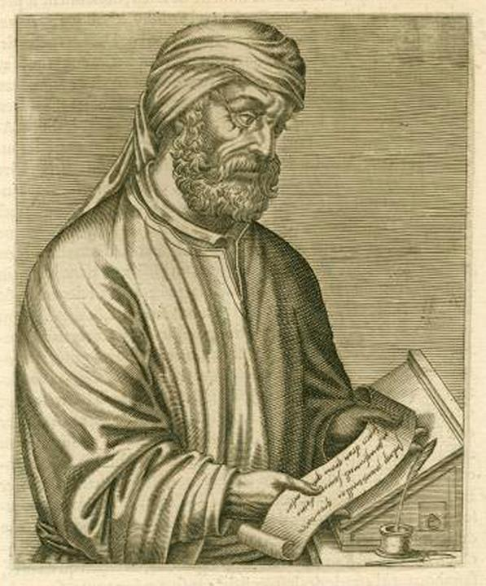
Tertullian ~AD200
Made little attempt to explore the eternal relations among the three; rather, they concentrated on the ways in which the Triad were manifested in creation and redemption.
Pro:
Did not say much => not wrong
Con:
Did not say much => vague

Slide 23
Dynamic Monarchianism/Adoptionism
God’s reason (Logos)
God
fills
Jesus (man)
Taught that Jesus was born totally human and only later was “adopted” – either at his baptism or at his resurrection – by God in a special (i.e., divine) way.

Slide 24
Modalistic Monarchianism/Sabellianism
Father
One God
Son
Holy Spirit
Taught that the three persons of the Trinity as different “modes” of the Godhead. Believed not distinct personalities, but different modes of God's self-revelation. God exists as Father, Son and Spirit in different eras, but never as triune.

Slide 25
Modalistic Monarchianism/Sabellianism
Problems: Presence of Triune God at the baptism of Jesus
God the Father
This is my Son and I love Him! Matthew 3:17
The Holy Spirit
Jesus

Slide 26
Arianism is a doctrine first attributed to Arius that holds that Jesus Christ is the Son of God, who was begotten by God the Father with the difference that the Son of God did not always exist but was begotten within time by God the Father, therefore Jesus was not co-eternal with God the Father.

Slide 27
Arianism
God creates
God’s Word (Logos)
fills
God
Jesus (man)
Taught that the preexistent Christ was the first and greatest of God’s creatures but denied his fully divine status. Was addressed definitively in the Nicene Creed.

Slide 28
Creed of Constantinople (AD 381)
We believe in one God, the Father Almighty, Maker of heaven and earth, and of all things visible and invisible.
And in one Lord Jesus Christ, the only-begotten Son of God, begotten of the Father before all worlds (æons), Light of Light, very God of very God, begotten, not made, being of one substance with the Father; by whom all things were made; who for us men, and for our salvation, came down from heaven, and was incarnate by the Holy Ghost of the Virgin Mary, and was made man; he was crucified for us under Pontius Pilate, and suffered, and was buried, and the third day he rose again, according to the Scriptures, and ascended into heaven, and sitteth on the right hand of the Father; from thence he shall come again, with glory, to judge the quick and the dead; whose kingdom shall have no end.
And in the Holy Ghost, the Lord and Giver of life, who proceedeth from the Father, who with the Father and the Son together is worshiped and glorified, who spake by the prophets. In one holy catholic and apostolic Church; we acknowledge one baptism for the remission of sins; we look for the resurrection of the dead, and the life of the world to come. Amen.

Slide 29
Athanasian Creed (6th century)
For like as we are compelled by the Christian verity; to acknowledge every Person by himself to be God and Lord; So are we forbidden by the catholic religion; to say, There are three Gods, or three Lords. The Father is made of none; neither created, nor begotten. The Son is of the Father alone; not made, nor created; but begotten. The Holy Ghost is of the Father and of the Son; neither made, nor created, nor begotten; but proceeding. So there is one Father, not three Fathers; one Son, not three Sons; one Holy Ghost, not three Holy Ghosts. And in this Trinity none is before, or after another; none is greater, or less than another. But the whole three Persons are coeternal, and coequal. So that in all things, as aforesaid; the Unity in Trinity, and the Trinity in Unity, is to be worshipped. He therefore that will be saved, let him thus think of the Trinity.

Slide 30
Westminster Confession of Faith (1646)
2.1. There is but one only, living, and true God, who is infinite in being and perfection, a most pure spirit, invisible, without body, parts, or passions; immutable, immense, eternal, incomprehensible, almighty, most wise, most holy, most free, most absolute; working all things according to the counsel of His own immutable and most righteous will, for His own glory; most loving, gracious, merciful, long-suffering, abundant in goodness and truth, forgiving iniquity, transgression, and sin; the rewarder of them that diligently seek Him; and withal, most just, and terrible in His judgments, hating all sin, and who will by no means clear the guilty.

Slide 31
Westminster Confession of Faith (1646)
2.3. In the unity of the Godhead there be three Persons of one substance, power, and eternity: God the Father, God the Son, and God the Holy Ghost. The Father is of none, neither begotten nor proceeding; the Son is eternally begotten of the Father; the Holy Ghost eternally proceeding from the Father and the Son.

Slide 32
Athanasian Creed
Westminster Confession
And the catholic faith is this: That we worship one God in Trinity, and Trinity in Unity; Neither confounding the Persons; nor dividing the Essence. For there is one Person of the Father; another of the Son; and another of the Holy Ghost.
In the unity of the Godhead there be three Persons of one substance, power, and eternity: God the Father, God the Son, and God the Holy Ghost.

Slide 33
Analogies
An analogy is something that shows how two things are alike, but with the ultimate goal of making a point about this comparison.
Analogies attempt to explain the Trinity but ultimately fail

Slide 34
Common Analogies
Egg: Shell/White/Yolk
Water: Liquid/Ice/Vapor
Math: 1 x 1 x 1 = 1
Sun: Sun itself/Light/Heat
Persons: Peter/Paul/John
Composition of Person: Soul/Spirit/Body

Slide 35
Notes:
You can watch part 1 of this series at https://www.youtube.com/watch?v=AQkFlzFJ3kA
This video can be found at https://www.youtube.com/watch?v=mvj87QCF0lg

Slide 36
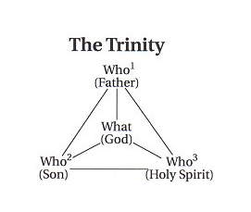

Slide 37
The Trinity Diagrammed
198
Father
is
is not
is not
GOD
is
is
Son
Spirit
is not

Slide 38
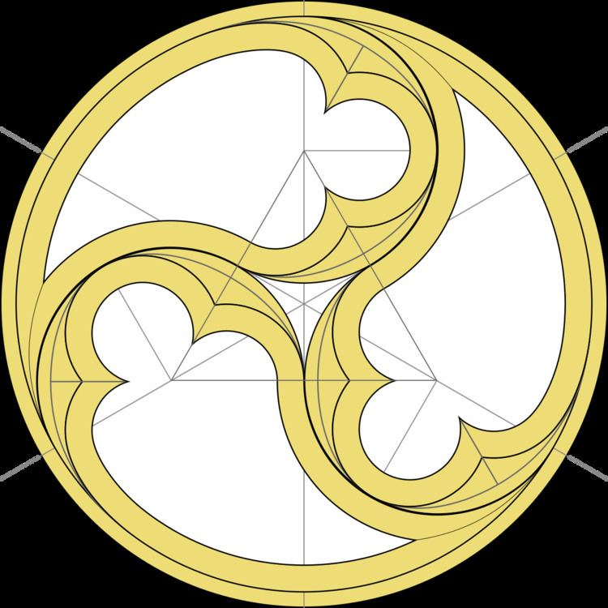

Slide 39
Requirements for a Trinitarian Doctrine
The unity of God is basic.
The deity of each of the three persons, Father, Son, and Holy Spirit, must be affirmed.
The threeness and the oneness of God are not in the same respect.
The Trinity is eternal.
The function of one member of the Trinity may for a time be subordinate to one or both of the other members, but that does not mean he is in any way inferior in essence.
Conclusion: The Trinity is incomprehensible.

Slide 42
Father
eternity
generation
procession
“processions”
immanent
Son
Spirit
time
“missions”
economic
Incarnation
(Christmas)
Outpouring
(Pentecost)
Without the Son and the Spirit, we cannot know the Father

Slide 43
Salvation
The Father
Eph 1:4-6: ⁴ For he chose us in him before the creation of the world to be holy and blameless in his sight. In love ⁵ he predestined us for adoption to sonship through Jesus Christ, in accordance with his pleasure and will— ⁶ to the praise of his glorious grace, which he has freely given us in the One he loves.
The Son
Eph 1.7-8: ⁷ In him we have redemption through his blood, the forgiveness of sins, in accordance with the riches of God’s grace ⁸ that he lavished on us…
The Spirit
Eph 1.13-14: ¹³ And you also were included in Christ when you heard the message of truth, the gospel of your salvation. When you believed, you were marked in him with a seal, the promised Holy Spirit, ¹⁴ who is a deposit guaranteeing our inheritance until the redemption of those who are God’s possession—to the praise of his glory.

Slide 44
Some questions for thought
Is Trinity in the Bible? (See 16-slide handout)
What is the doctrine of the Trinity?
Why do Christians believe in the Trinity?
What did I learn today?

Slide 45
Some questions for thought
What is the doctrine of the Trinity?
Why do Christians believe in the Trinity?
Is Trinity in the Bible?
What did I learn today?

Slide 47
Trinity link at BibleStudyDownloads.org
Get this presentation for free!
Notes:
Trinity (tr)
_____________
Common-41

