Slide 1


Spiritual Gifts
Dangers & Durations
Dr. Rick Griffith, Singapore Bible College
BibleStudyDownloads.org

Slide 2
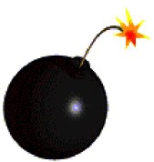
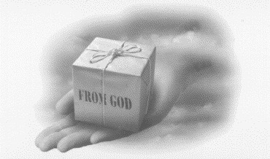
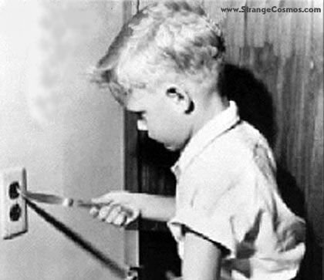
Some Dangers of
Studying Spiritual Gifts
13
SPIRITUAL GIFTS

Slide 3
Dangers of Studying Gifts
13
1) Division from comparison and competition
a) Seeing your gift as unimportant
(inferiority problem)
i.e. "My gift is not like yours!" (1 Cor. 12:15-16)

Slide 4
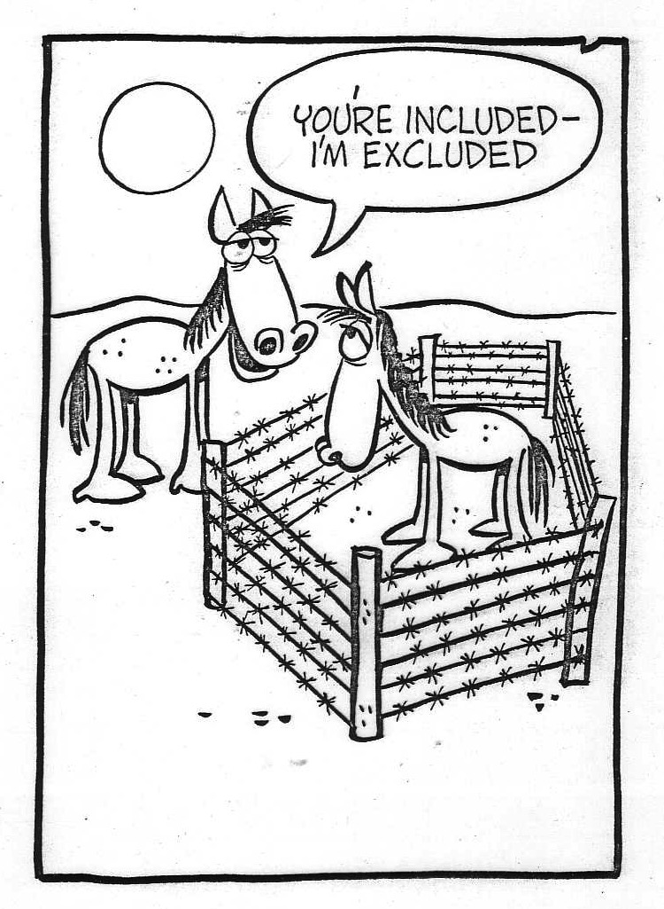
Don't feel inferior about your gift!
You're included–
I'm excluded

Slide 5
Dangers of Studying Gifts
13
1) Division from comparison and competition
a) Seeing your gift as unimportant
(inferiority problem)
i.e. "My gift is not like yours!" (1 Cor. 12:15-16)
b) Seeing your gift as superior
(pride problem)
i.e. "Your gift is not like mine!" (1 Cor. 12:15-16)

Slide 6
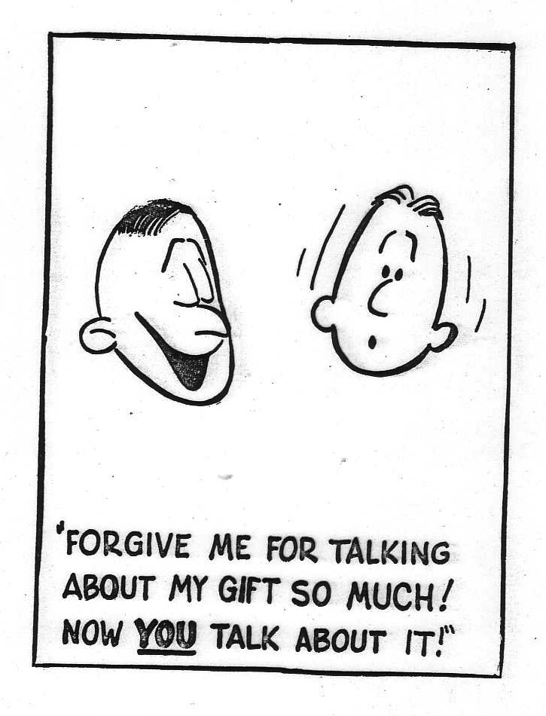
Don't think highly of your gift!
"FORGIVE ME FOR TALKING ABOUT MY GIFT SO MUCH! NOW YOU TALK ABOUT IT!"

Slide 7

I. It takes all the different gifts for the church to exist (1 Cor. 12-13).
Notes:
7

Slide 8
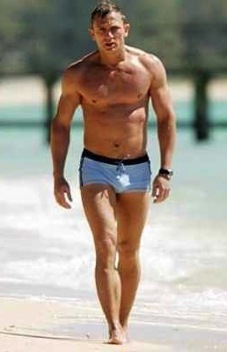
A. A human body has different parts (12).
"The body is a unit, though it is made up of various parts; and though all its parts are many, they form one body. So it is with Christ"
(1 Cor. 12:12)
Notes:
8

Slide 9
B. Believers are different but still part of one body (13)
"For we were all baptized by one Spirit into one body—whether Jews or Greeks, slave or free—and we were all given one Spirit to drink" (1 Cor. 12:13)
Notes:
9

Slide 10
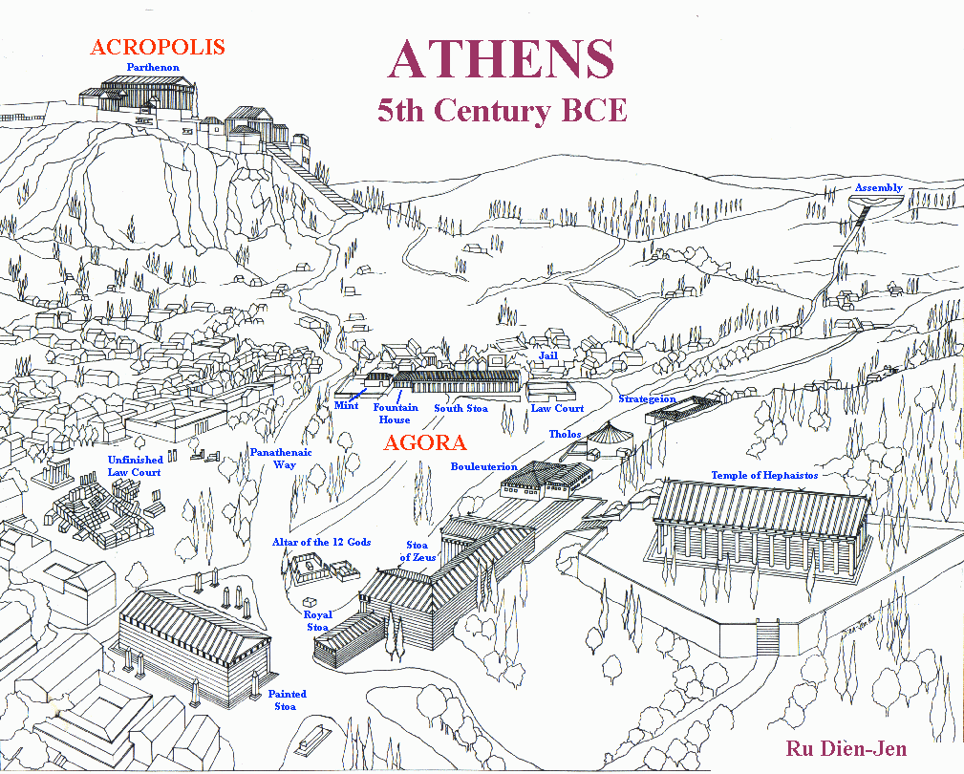
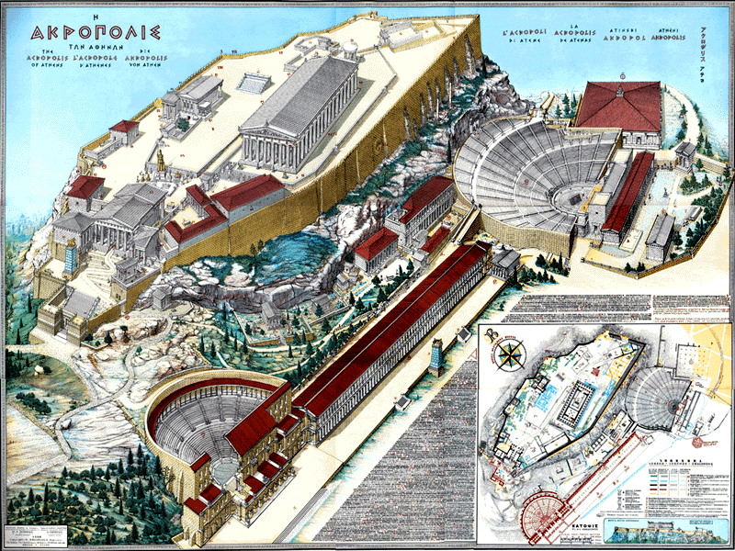
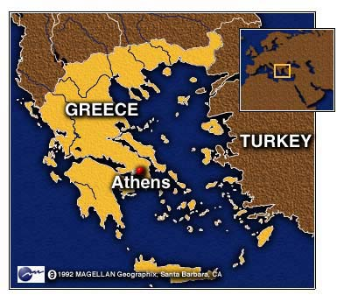
ATHENS
Ecclesia
"called out ones"
Idiotes
"one who does his own thing"
Kurioikos
"house of the Lord"
"church" via Latin
Notes:
10
The church is a body—not a building.
In ancient Athens, the citizens were very appreciative of their privilege to be a vital part of the city-state—and they recognized their responsibility as well. When a herald would call a meeting of the citizens, each would close his shop, drop what he was doing, and walk out of the city, past the Acropolis and to the next hill for a meeting. This group became known as the ecclesia, or "called out ones."
Some citizens, of course, loved the privileges of being part of the city-state but felt no responsibility for it. They left their shops open and refused to join the ecclesia, so the latter called them idiotes, or ones who did their own thing for selfish purposes. We derive our English word "idiot" from this group of lazy people characterized by self concern and social irresponsibility (CHURCH definition of—"called out ones" by Stuart Briscoe, Singapore missionary retreat, 92).
For the first three centuries of Christianity, the body of believers was always called the ecclesia. Only in the time of Constantine in the 4th century did the term kurioikos, "house of the Lord," come about, from which through the Latin we arrive at our English word "church." The early Christians never associated themselves with a building called the "church" (CHURCH body, not a building by W.A. Criswell at DTS chapel). They saw themselves only as the ecclesia, or "called out ones"—called out from the world to be God's own people!

Slide 11
INDWELLING OF THE SPIRIT
"For we were all baptized by one Spirit into one body—whether Jews or Greeks, slave or free—and we were all given one Spirit to drink" (1 Cor. 12:13)
Notes:
11

Slide 12
II. It takes the serving gifts for the church to function (1 Cor. 12: 14-20)
47
Speaking | Serving
Teaching | Administering
Evangelism | Faith
Pastor-Teacher | Giving
Encouraging | Service
 | Mercy
Notes:
12

Slide 13

A. The church has many people with different gifts (1 Cor 12:14)
47
Many members,
one body.
Notes:
13

Slide 14
"Now the body is not made up of one part, but many" (1 Cor 12:14)
47
Speaking | Serving
Teaching | Administering
Evangelism | Faith
Pastor-Teacher | Giving
Encouraging | Service
 | Mercy
Notes:
14

Slide 15
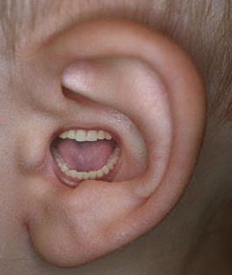
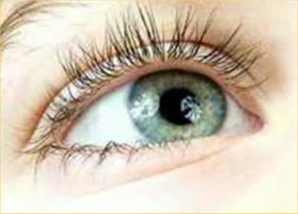
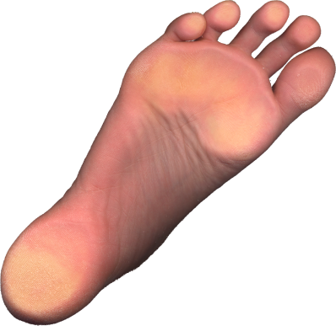
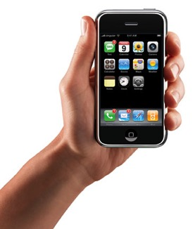

B. Believers with less honored gifts shouldn't feel unneeded (1 Cor 12:15-16).
¹⁵ If the foot should say,
"Because I am not a hand, I do not belong to the body,"
it would not for that reason cease to be part of the body.
¹⁶ And if the ear should say,
"Because I am not an eye, I do not belong to the body,"
it would not for that reason cease to be part of the body.

Slide 16
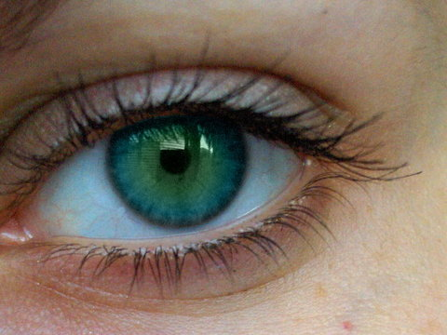
C. Diversity in the church makes it more effective (1 Cor 12:17-20).
¹⁷If the whole body were an eye, where would the sense of hearing be? If the whole body were an ear, where would the sense of smell be? ¹⁸But in fact God has arranged the parts in the body, every one of them, just as he wanted them to be. ¹⁹If they were all one part, where would the body be? ²⁰As it is, there are many parts, but one body.

Slide 17
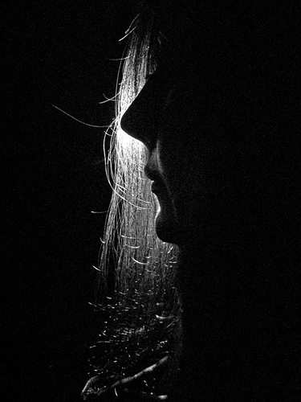
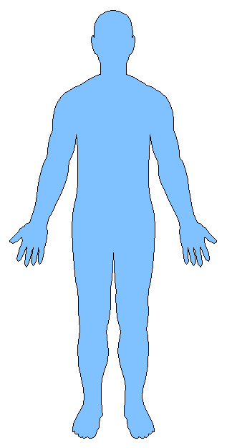
III. It takes humble use of all the gifts for the church to care (1 Cor 12:21-26).
Notes:
17

Slide 18
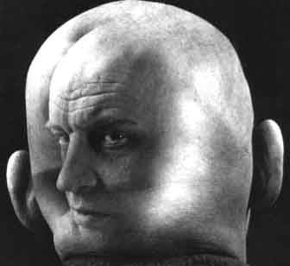
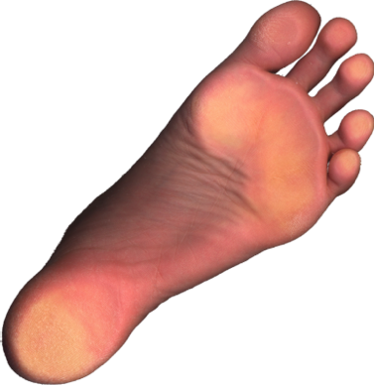
"Up-front" believers, don't pridefully say,
"I don't need you with less honored roles" (1 Cor 12:21)
"The eye cannot say to the hand,
"I don't need you!"
And the head cannot say to the feet,
"I don't need you!"

Slide 19
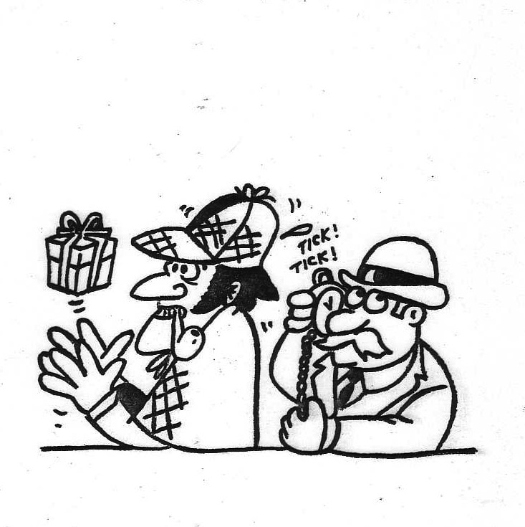
Dangers of Studying Gifts
13
2) Confusion with natural talents

Slide 20
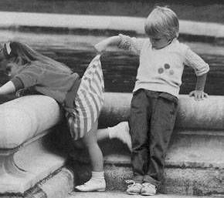
Dangers of Studying Gifts
13
3) Seeking sign (controversial) gifts and neglecting ministering gifts

Slide 21
Dangers of Studying Gifts
13
4) Seeking "up-front" ministering gifts while neglecting "behind-the-scenes" ministering gifts
5) Willing to be ignorant of gifts because of the subject's complexity and the varying views of respected scholars (1 Cor. 12:1)

Slide 22
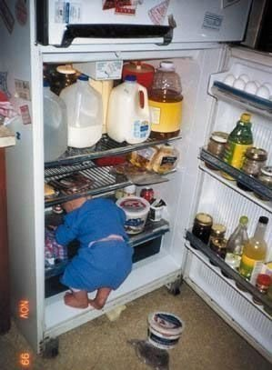
Don't accept being ignorant about gifts

Slide 23
Dangers of Studying Gifts
13
6) Focusing upon gifts as a more significant evidence of the Spirit than fruit (Gal. 5:22-23)
"Doing" that neglects "being"
"Service" that neglects "character"

Slide 24


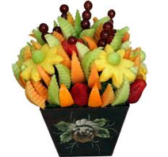
Gifts versus Fruit of the Spirit
xlii
Gifts | Fruit
Abilities | Christ-likeness
Relate to service | Relate to character
Means to an end | The end itself
What a Christian has | What a Christian is

Slide 25
Gifts versus Fruit of the Spirit
xlii
Gifts | Fruit
Plural: many | Singular: one (love)
Often misused in the church | Rarely misused in the church
No believer possesses all | Every believer should strive for all
Will cease (temporary) | Will last (permanent)

Slide 26

The Fruit of the Spirit
xliii

Slide 27
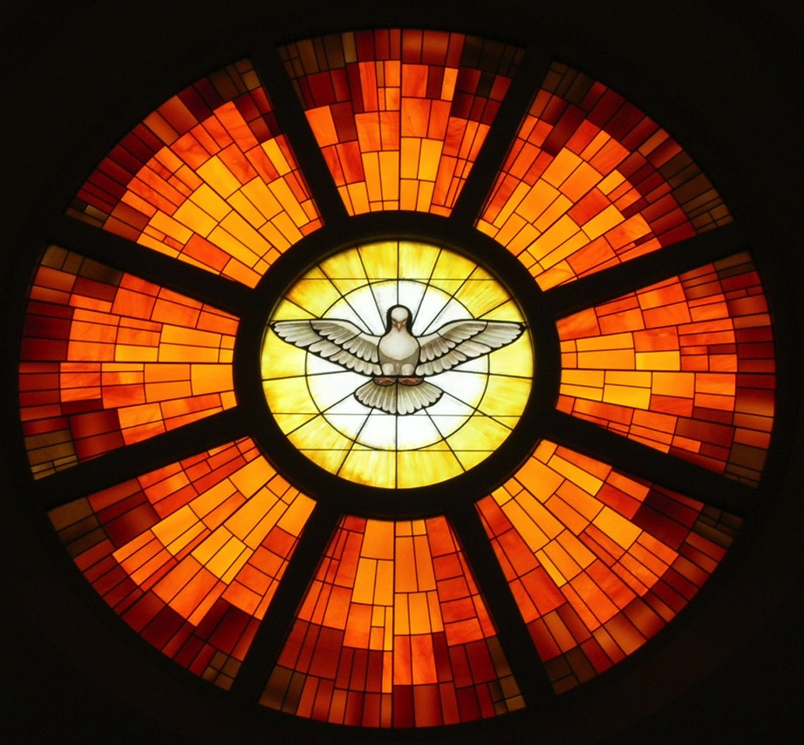
The Fruit of the Spirit
xliii
Inner Life
Principles of Conduct
Joy
Self-Control
Peace
Gentleness
Love
Patience
Faithfulness
Kindness
Goodness
Social Relationships
Galatians 5:22-23

Slide 28
The Fruit of the Spirit
xliii
Joy
Feelings
Self-Control
Peace
Behavior
Gentleness
Love
Patience
Attitudes
Faithfulness
Kindness
Goodness
Character
Galatians 5:22-23

Slide 29
The Fruit of the Spirit
xliii
Strength
Joy
Security
Self-Control
Peace
Victory
Gentleness
Love's
Patience
Humility
Endurance
Faithfulness
Kindness
Conduct
Confidence
Goodness
Character
Galatians 5:22-23

Slide 30
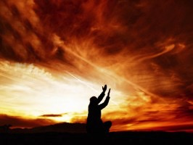
Are you surrendered to Christ?

Slide 31
Dangers of Studying Gifts
13
6) Focusing upon gifts as a more significant evidence of the Spirit than fruit (Gal. 5:22-23)
"Doing" that neglects "being"
"Service" that neglects "character"
7) Rejecting opportunities to serve in "non-gifted" areas because you don't have that particular gift that would make service easier (2 Tim. 4:5)

Slide 32
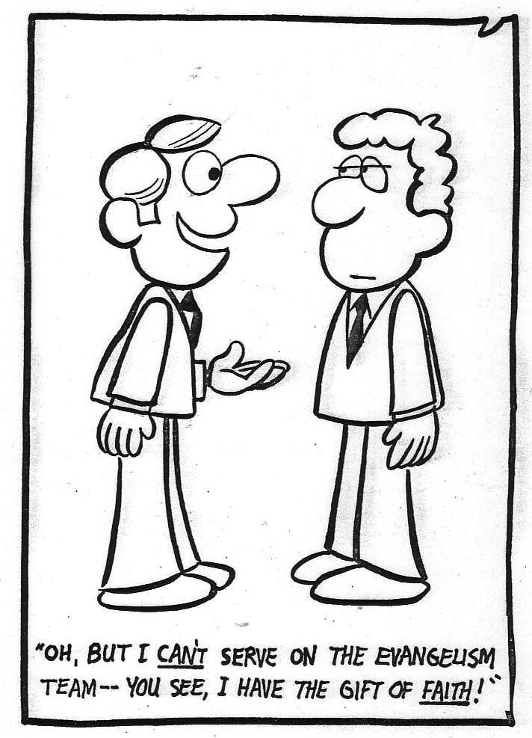
Don't reject opportunities to discern your gift!
"OH, BUT I CAN'T SERVE ON THE EVANGELISM TEAM––YOU SEE, I HAVE THE GIFT OF FAITH!"

Slide 33
Dangers of Studying Gifts
13
8) Supposing that spiritual gifts are rewards for service, for holiness, for sincerity, for maturity, or for anything else!

Slide 34
Dangers of Studying Gifts
13
9) Believing that there is any correspondence between spiritual gifts and spirituality
10) Supposing that God has withdrawn your gift since he does not use it at the present time
"For the gifts and calling of God are irrevocable" (Rom. 11:29)

Slide 35
Dangers of Studying Gifts
13
11) Seeking gifts and overlooking love (Rom. 12:9ff.; 1 Cor. 13:1ff.)
"By this shall all know that you are my disciples, if you show your gifts"
(John 13:35 GSV)
"By this shall all know that you are my disciples, if you love one another"
(John 13:35 NIV)

Slide 36

Spiritual Gifts
How Long Will They Last?

Slide 37
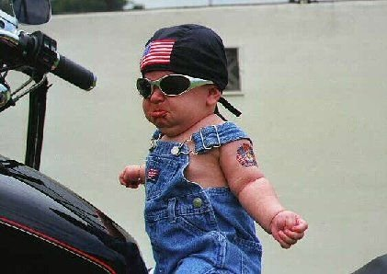
Does this gifts study make you feel like you're not ready just yet?

Slide 38
Views on the Duration of Gifts
14-15
14
1. No gifts passed away (non-cessationist)
2. All gifts passed away (total cessationist)
3. Some gifts passed away (partial cessationist)

Slide 39
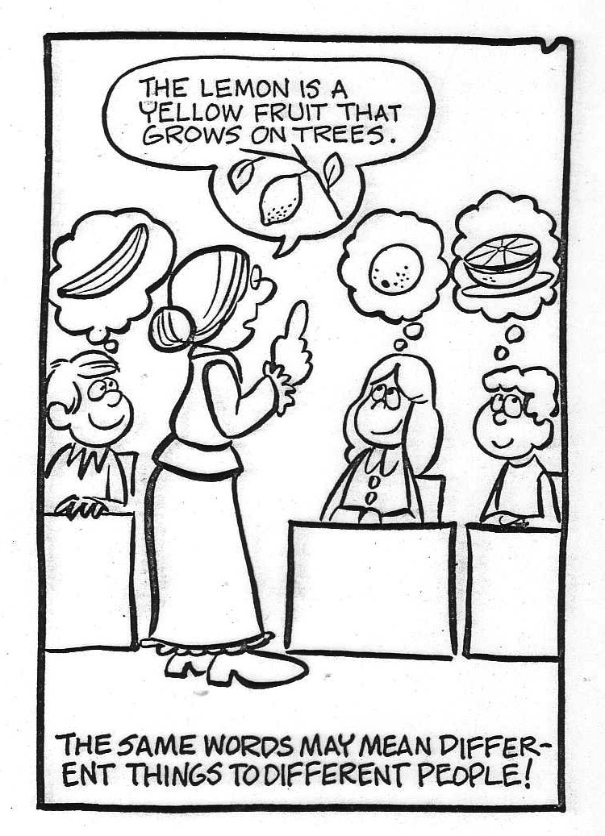
We need to define each gift
The lemon is a yellow fruit growing on trees
THE SAME WORDS MAY MEAN DIFFERENT THINGS TO DIFFERENT PEOPLE!

Slide 40
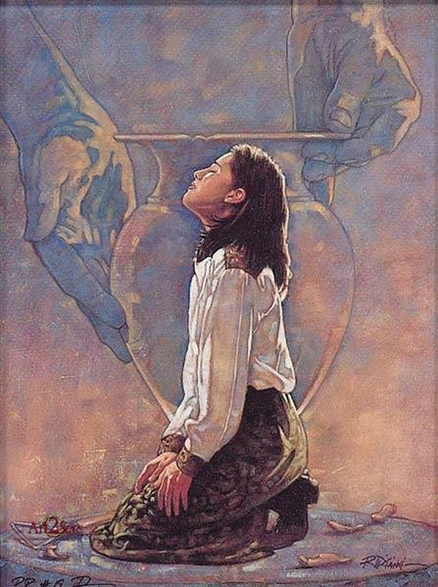
New Testament Gift Lists
6
Gifts (All) | Rom 12:6-8 | Eph 4:11 | 1 Cor 12:28 | 1 Cor 12:29-30 | 1 Cor 12:8-10
Teaching | Teaching |  | Teaching | Teaching
Evangelism |  | Evangelists
Pastor-Teacher |  | Pastor-Teachers
Exhortation | Exhortation
Administration |  |  | Administration
Faith |  |  |  |  | Faith
Giving | Giving
Service | Service |  | Helping
Showing Mercy | Mercy
Apostleship |  | Apostles | Apostles | Apostles
Wisdom |  |  |  |  | Wisdom
Knowledge |  |  |  |  | Knowledge
Prophecy | Prophecy | Prophets | Prophecy | Prophecy | Prophecy
Discerning Spirits |  |  |  |  | Discerning Spirits
Tongues |  |  | Tongues | Tongues | Tongues
Interpretation |  |  |  | Interpretation | Interpretation
Miracles |  |  | Miracles | Miracles | Miracles
Healings |  |  | Healings | Healings | Healings
Speaking
1 Pet. 4:11a
Permanent
Serving
1 Pet. 4:11b
Foundational
Eph. 2:20
Temporary
Sign
Heb. 2:4

Slide 41
1 Corinthians 13:8-12
8 Love never fails. But where there are prophecies, they will cease; where there are tongues, they will be stilled; where there is knowledge, it will pass away.
9 For we know in part and we prophesy in part,
10 but when perfection comes, the imperfect disappears.

Slide 42
1 Corinthians 13:8-12
11 When I was a child, I talked like a child, I thought like a child, I reasoned like a child. When I became a man, I put childish ways behind me.
12 Now we see but a poor reflection as in a mirror; then we shall see face to face. Now I know in part; then I shall know fully, even as I am fully known.

Slide 43
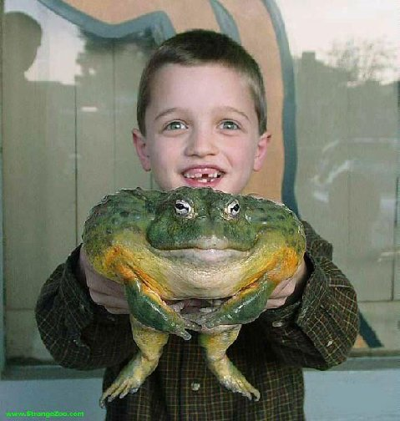
This is a mega passage!

Slide 44
1 Corinthians 13:8-13
16
______________________________________________________________________________
Crucial Questions Canon (Bible) Rapture Body (Church)
______________________________________________________________________________
13:8 What is the nature of:
a) prophecy & knowledge? revelatory non-revelatory revelatory
b) tongues? confirmatory non-confirmatory confirmatory
When do the these gifts cease? with canon at Christ's coming with canon
13:10 What is to teleion? the "complete" the "perfect" the "mature"
(the canon) (Christ's coming) (the body)
13:11 What does growth to before and after before and after before and after
manhood represent? completed canon Christ's coming body's maturity
(shown by canon)
13:12 What are partial and before and after before and after before and after
full sight and knowledge? completed canon Christ's coming body's maturity
(completed by
parousia )
________________________________________________________________________________
Robert L. Thomas, JETS (1974): 81-89

Slide 45
The Canon View of 1 Corinthians 13:8-13
16
1. The Canon View sees to teleion as "the complete, the totality," referring to "the completed Scriptures." Therefore, prophecy, knowledge and tongues ceased before the New Testament was finished and are not existing today.
Strengths
Weaknesses
a.
Revelational knowledge context (vv. 8-9).
a.
Irreconcilable with Christ's coming (the parousia) in verse 12.
b.
Confirmatory nature of tongues
(cf. 14:22).
b.
The context does not refer to a completed New Testament. It's also doubtful that Paul ever envisioned one.
c.
Contrasts with partial nature of prophecy and knowledge.
c.
"The whole" (to ek pantos) better contrasts "partial" than to teleion in that both are quantitative.
d.
to teleion often means "complete."
e.
"Complete" best contrasts "partial" (v. 10).
Robert L. Thomas, JETS (1974): 81-89

Slide 46
The Rapture View of 1 Corinthians 13:8-13
17
2. The Rapture View sees to teleion as "the perfect" (as opposed to "the complete" above), referring to the coming of Christ at the Rapture. Therefore, prophecy, knowledge and tongues will cease only when Christ comes and exist today as legitimate gifts.
Robert L. Thomas, JETS (1974): 81-89
Strengths
Weaknesses
a.
Adequately explains "knowing fully" in verse 12.
a.
Inadequately explains the gradual maturing development of verse 11.
b.
"Face to face" (v. 12) well describes seeing Christ at His coming (cf. 1 Cor. 1:7) and has OT parallels to seeing God personally.
b.
Fails to recognize the distinctions between the revelatory nature of prophecy and knowledge and the confirmatory nature of tongues (cf. 14:22)
c.
"Perfect" well describes the condition at the parousia (Rapture).
c.
Paul never uses to teleion as "the perfect" in the absolute sense.
d.
to teleion often means "perfect" in secular, philosophical Greek (e.g. Plato) as well as James 3:2.
d.
"Perfect" (a qualitative term)
poorly contrasts with "partial"
(a quantitative term, v. 10).

Slide 47
The Body View of 1 Corinthians 13:8-13
16
3. The Body View sees to teleion as "the mature," referring to the maturity of the body of Christ. "It pictures the Christian church collectively, growing up as one body, beginning with its birth, progressing through different stages.... during the present [relative maturity, v. 11] and reaching maturity at the parousia [ultimate maturity, v. 12; Thomas, 86]." By using the ambiguous to teleion Paul left open two possibilities, the church as: (1) relatively complete at the completion of the NT or (2) ultimately complete at Christ's return. This view comes to the same conclusion as the Canon View.
Strengths
Weaknesses
a.
Parallel 1 Cor. Texts contrast to teleion ("mature") with "babes, child" (nh,pioj; 2:6 & 3:1; 14:20; cf. Heb. 5:13-14)
a.
"Mature" (a qualitative term) poorly contrasts "partial" (a quantitative term, v. 10).
b.
Consistent with both the relative maturity of v. 11 and the absolute maturity of v. 12.
b.
Assigns a double sense for to teleion which may be unlikely.
c.
Best fits the "body and gifts context" of 1 Cor. 12-14 and the striking similarity to Eph. 4:1-16.
d.
Has the same strengths of a., b., & c. in the Canon View.
Robert L. Thomas, JETS (1974): 81-89

Slide 48
Doubting Thomases
Robert Thomas
Satisfied by the Promise of the Spirit
Thomas Edgar
Are Miracles for Today?

Slide 49

Holy Spirit PPT link at BibleStudyDownloads.org
Get this presentation for free!

Slide 50
Black

