Slide 1
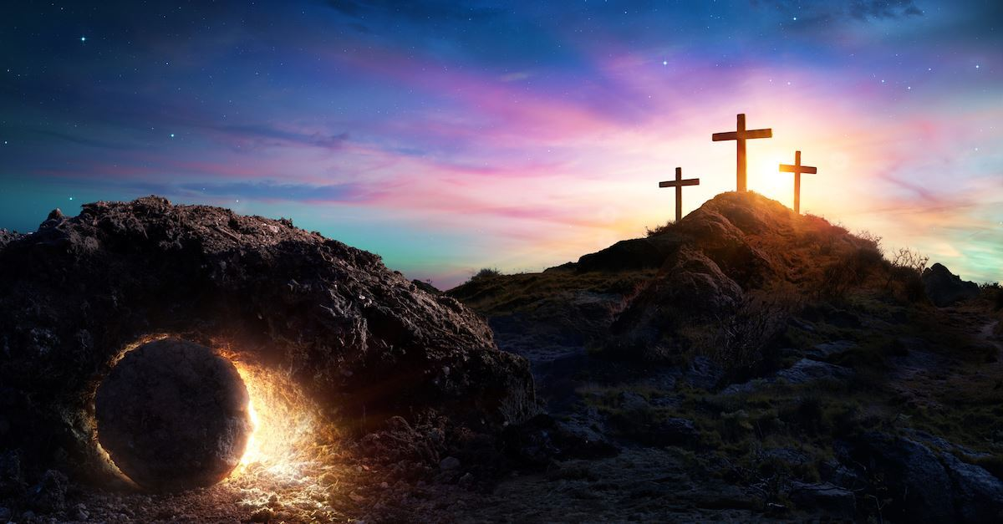
Easter
To Die is Gain!
Preached by Dan Bridges at Amman International Church Uploaded by Dr. Rick Griffith, Jordan Evangelical Theological Seminary All files in many languages for free download at BibleStudyDownloads.org

Slide 2
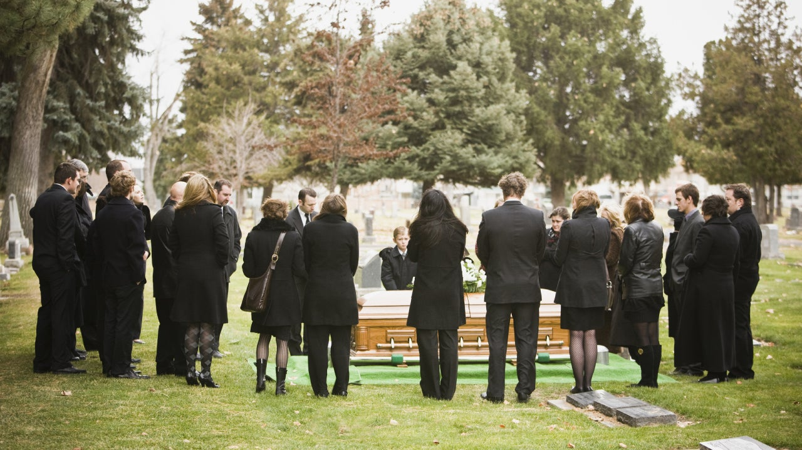
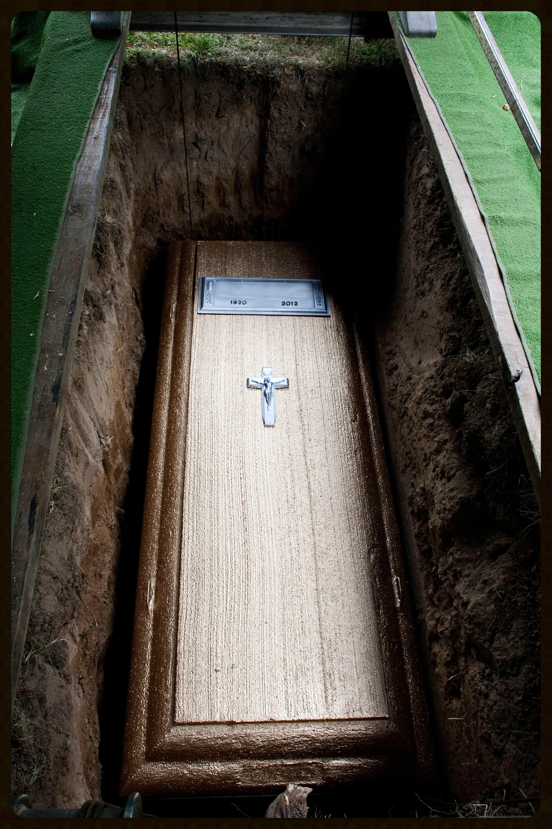
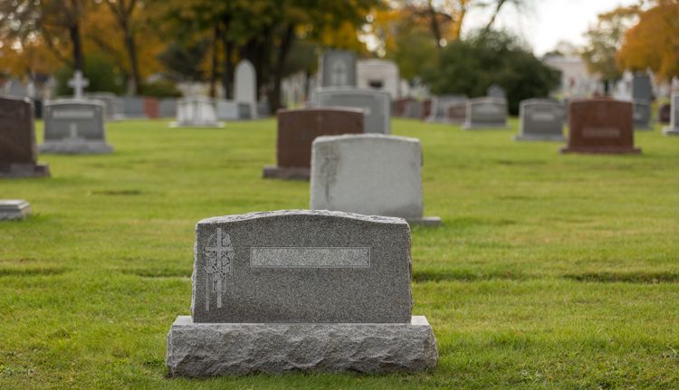
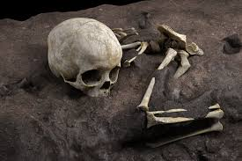
What happens to you after you die???

Slide 3
Definitions: Who are We?
Body – Our outward self
Soul – Our mind, will, emotions
Spirit – The part of us that enables us to relate to God
spirit
soul
body
Eternal

Slide 4
Definitions: What is Death?
Physical Death (body): Separation of the soul from the body
(Gen. 35:18-19; Eccl. 12:7; James 2:26)
Spiritual Death (soul / spirit): Separation of the person from God (Eph. 2:1-2)
Second Death (Eternal Death) Separation from the presence of God in an endless period of punishment (Rev. 20:14; 21:8)
Dr. Rick Griffith

Slide 5
Spiritual Death:
¹ And you were dead in the trespasses and sins ² in which you once walked, following the course of this world, following the prince of the power of the air, the spirit that is now at work in the sons of disobedience— ³ among whom we all once lived in the passions of our flesh, carrying out the desires of the body and the mind, and were by nature children of wrath, like the rest of mankind. Ephesians 2:1-3
On the way to the Second Death (eternal punishment)

Slide 6
The Message of Easter:
For I delivered to you as of first importance what I also received: that Christ died for our sins in accordance with the Scriptures, that he was buried, that he was raised on the third day in accordance with the Scriptures…
1 Corinthians 15:3-4
Notes:
The message of Easter is that Jesus died a physical death so that you and I would not need to die an eternal death!

Slide 7
Spiritual Life:
⁴ But God, being rich in mercy, because of the great love with which he loved us, ⁵ even when we were dead in our trespasses, made us alive together with Christ—by grace you have been saved— ⁶ and raised us up with him and seated us with him in the heavenly places in Christ Jesus. Ephesians 2:4-6
Our eternal relationship with Christ in the presence of God starts when we put our faith in Christ!

Slide 8
So what is death for those who accept the message of Easter?

Slide 9
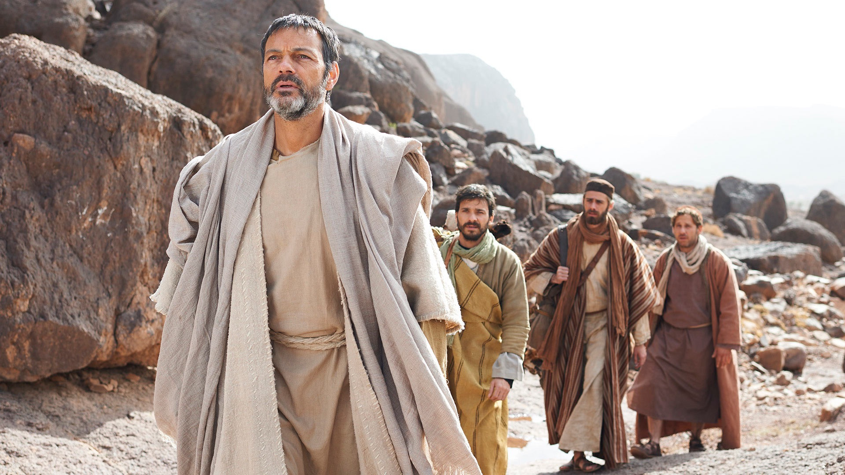
What Happens When We Die?
Paul said,
“For me to live is Christ, and to die is gain.”
Philippians 1:21
What was Paul’s view of life after death?

Slide 10
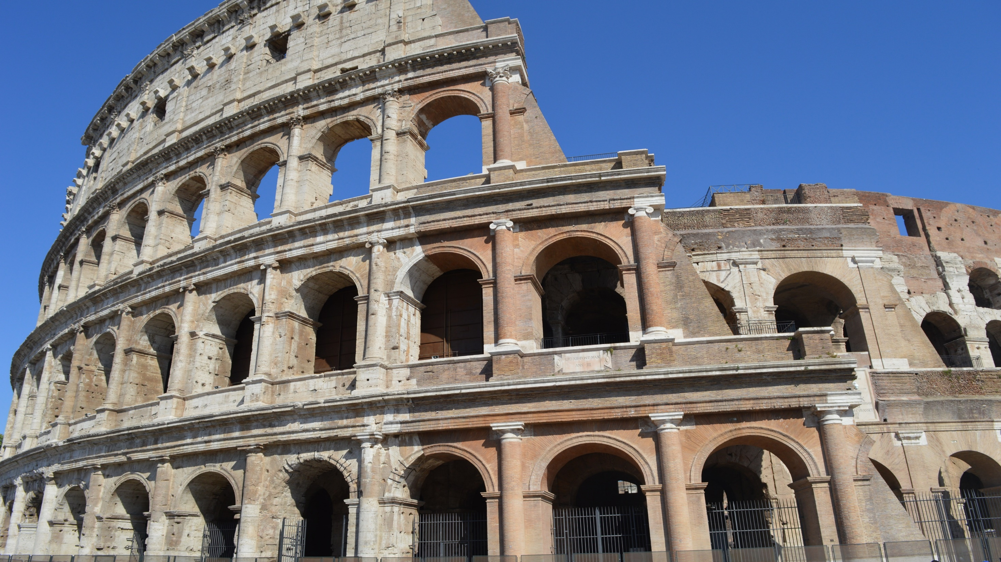
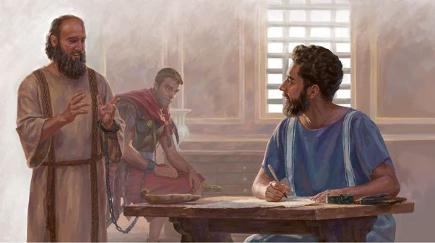
Context:
Paul is in prison in Rome
Paul is awaiting his verdict – release or death
Writing about his present circumstances

Slide 11
²⁰ … it is my eager expectation and hope that I will not be at all ashamed, but that with full courage now as always Christ will be honored in my body, whether by life or by death. ²¹ For to me to live is Christ, and to die is gain. ²² If I am to live in the flesh, that means fruitful labor for me. Yet which I shall choose I cannot tell. ²³ I am hard pressed between the two. My desire is to depart and be with Christ, for that is far better. ²⁴ But to remain in the flesh is more necessary on your account.
Philippians 1:20-24

Slide 12
What did Paul know about death?
How could he confidently say,
“…to die is gain”?

Slide 13
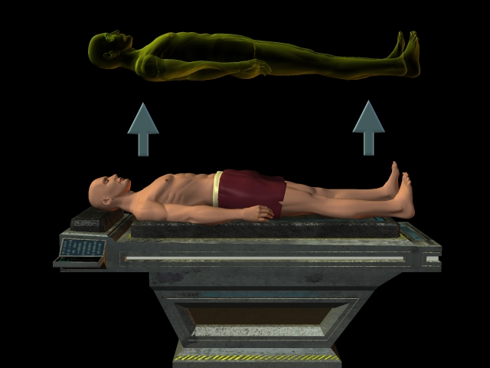
How can we know what happens after death?
By Philosophy?
By Experiment?
By “after death”
Experiences?

Slide 14
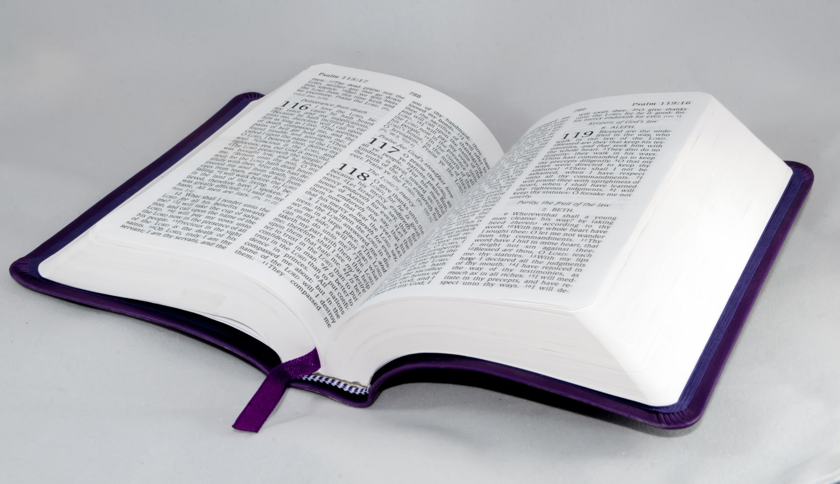
God’s Word!

Slide 15
Jesus’ Second Coming
(Resurrection)
Death
What happens here?
Commonly Understood
What we know to start:
Death for a believer is better than life!
“For me to live is Christ, and to die is gain.”

Slide 16
²⁰ … it is my eager expectation and hope that I will not be at all ashamed, but that with full courage now as always Christ will be honored in my body, whether by life or by death. ²¹ For to me to live is Christ, and to die is gain. ²² If I am to live in the flesh, that means fruitful labor for me. Yet which I shall choose I cannot tell. ²³ I am hard pressed between the two. My desire is to depart and be with Christ, for that is far better. ²⁴ But to remain in the flesh is more necessary on your account.
Dying = Being with Jesus!
Philippians 1:20-24

Slide 17
⁶ So we are always confident, even though we know that as long as we live in these bodies we are not at home with the Lord. ⁷ For we live by believing and not by seeing. ⁸ Yes, we are fully confident, and we would rather be away from these earthly bodies, for then we will be at home with the Lord.
2 Corinthians 5:6-8
Dying = Being at home with Jesus!

Slide 18
⁹ For God has not destined us for wrath, but to obtain salvation through our Lord Jesus Christ, ¹⁰ who died for us so that whether we are awake or asleep (alive or dead) we might live with him.
1 Thessalonians 5:9-10
Dying = Continuing to live with Jesus!

Slide 19
Moses … calls the Lord the God of Abraham and the God of Isaac and the God of Jacob. Now he is not God of the dead, but of the living, for all live to him. Luke 20:37-38
And he said, “Jesus, remember me when you come into your kingdom.” And he said to him, “Truly, I say to you, today you will be with me in paradise.” Luke 23:42-43

Slide 20
Other Stories:
Jesus’ story of the Rich Man and Lazarus
Lazarus “died and was carried by the angels to Abraham’s side”
Conversation between the rich man (in Hades) and Abraham
The transfiguration
Appearance of Moses and Elijah

Slide 21
Soul/Spirit goes to be with Jesus!
Death
Resurrection
Body
Jesus’ Second Coming
Physical body decays & disappears

Slide 22
In what ways would death be gain?
In Knowledge
Notes:
For these thoughts, I am indebted to a sermon by Dr Albert Martin, who in turn got them from a commentary by Robert Johnstone

Slide 23
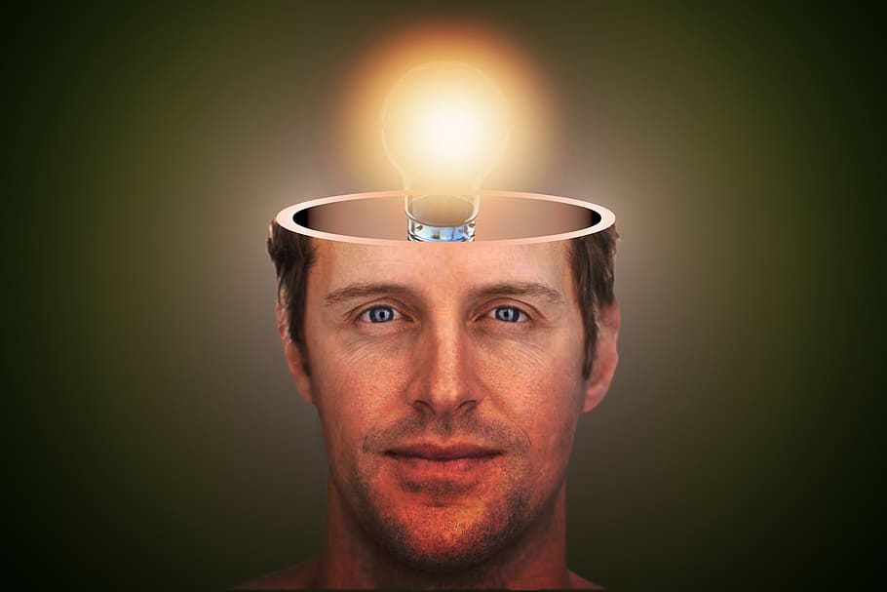
Knowledge:
And so, from the day we heard, we have not ceased to pray for you, asking that you may be filled with the knowledge of his will in all spiritual wisdom and understanding…
Colossians 1:9
And it is my prayer that your love may abound more and more, with knowledge and all discernment… Philippians 1:9
Notes:
For these thoughts, I am indebted to a sermon by Dr Albert Martin, who in turn got them from a commentary by Robert Johnstone

Slide 24
Knowledge:
For now we see in a mirror dimly, but then face to face. Now I know in part; then I shall know fully, even as I have been fully known.
1 Corinthians 13:12
Notes:
For these thoughts, I am indebted to a sermon by Dr Albert Martin, who in turn got them from a commentary by Robert Johnstone

Slide 25
Knowledge (example):
Transfiguration:
²⁹ And as he was praying, the appearance of his face was altered, and his clothing became dazzling white. ³⁰ And behold, two men were talking with him, Moses and Elijah, ³¹ who appeared in glory and spoke of his departure, which he was about to accomplish at Jerusalem.
Luke 9:29-31
Notes:
For these thoughts, I am indebted to a sermon by Dr Albert Martin, who in turn got them from a commentary by Robert Johnstone

Slide 26
In what ways would death be gain?
In Knowledge
In Holiness

Slide 27
Holiness:
²² You were taught, with regard to your former way of life, to put off your old self, which is being corrupted by its deceitful desires; ²³ to be made new in the attitude of your minds; ²⁴ and to put on the new self, created to be like God in true righteousness and holiness.
Ephesians 4:22-24
Notes:
For these thoughts, I am indebted to a sermon by Dr Albert Martin, who in turn got them from a commentary by Robert Johnstone

Slide 28
Holiness:
²¹ So I find it to be a law that when I want to do right, evil lies close at hand. ²² For I delight in the law of God, in my inner being, ²³ but I see in my members another law waging war against the law of my mind and making me captive to the law of sin that dwells in my members. ²⁴ Wretched man that I am! Who will deliver me from this body of death? ²⁵ Thanks be to God through Jesus Christ our Lord!
Romans 7:21-25
Notes:
For these thoughts, I am indebted to a sermon by Dr Albert Martin, who in turn got them from a commentary by Robert Johnstone

Slide 29
Holiness:
²² But you have come to Mount Zion and to the city of the living God, the heavenly Jerusalem, and to innumerable angels in festal gathering, ²³ and to the assembly of the firstborn who are enrolled in heaven, and to God, the judge of all, and to the spirits of the righteous made perfect, ²⁴ and to Jesus, the mediator of a new covenant, and to the sprinkled blood that speaks a better word than the blood of Abel. Hebrews 12:22-24
Notes:
For these thoughts, I am indebted to a sermon by Dr Albert Martin, who in turn got them from a commentary by Robert Johnstone

Slide 30
In what ways would death be gain?
In Knowledge
In Holiness
In Companionship

Slide 31
Companionship:
Then the Lord God said, “It is not good that the man should be alone; I will make him a helper fit for him.” Genesis 2:18
A new commandment I give to you, that you love one another: just as I have loved you, you also are to love one another. By this all people will know that you are my disciples, if you have love for one another. John 13:34-35

Slide 32
Companionship:
²² But you have come to Mount Zion and to the city of the living God, the heavenly Jerusalem, and to innumerable angels in festal gathering, ²³ and to the assembly of the firstborn who are enrolled in heaven, and to God, the judge of all, and to the spirits of the righteous made perfect, ²⁴ and to Jesus, the mediator of a new covenant, and to the sprinkled blood that speaks a better word than the blood of Abel. Hebrews 12:22-24

Slide 33
In what ways would death be gain?
In Knowledge
In Holiness
In Companionship
In Communion with Christ

Slide 34
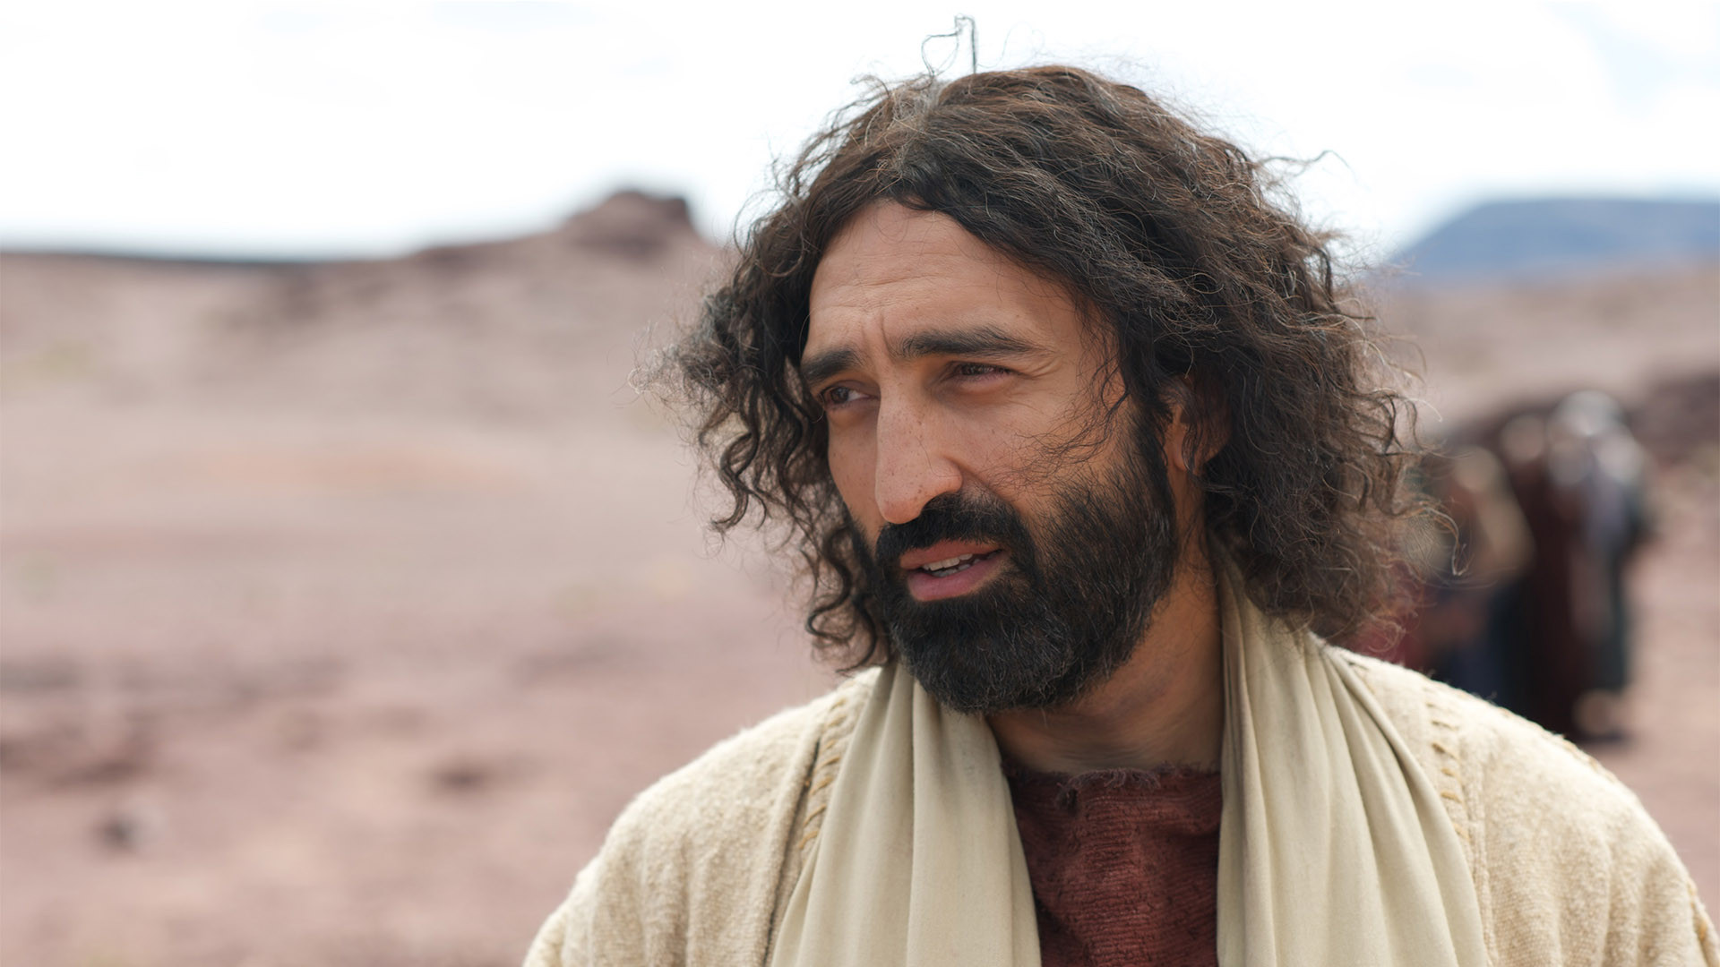
Communion with Christ:
What is more, I consider everything a loss because of the surpassing worth of knowing Christ Jesus my Lord, for whose sake I have lost all things. I consider them garbage, that I may gain Christ
Philippians 3:8

Slide 35
Communion with Christ:
I am hard pressed between the two. My desire is to depart and be with Christ, for that is far better.
Philippians 1:23
Yes, we are of good courage, and we would rather be away from the body and at home with the Lord.
2 Corinthians 5:8

Slide 36
As believers, we can look to death with hope and anticipation rather than fear and dread!

Slide 37
If you are not a believer in Jesus,
how do you see death?
Are you ready to die?

Slide 38
⁴² And he said, “Jesus, remember me when you come into your kingdom.” ⁴³ And he said to him, “Truly, I say to you, today you will be with me in paradise.”
Luke 23:43

Slide 39
Easter
To Die is Gain!

Slide 41
Topical Preaching link at BibleStudyDownloads.org
Get this presentation for free!
Notes:
NT Preaching (np)

