Slide 1
Principles 8-10
Preached by Dr. Jim Harmeling at Crossroads International Church Singapore • CICFamily.com Uploaded by Dr. Rick Griffith • Jordan Evangelical Theological Seminary Files in many languages for free download at BibleStudyDownloads.org

Slide 2
God Owns It All
God Invests in Us
Work Hard
Plan What You Get
Plan for the Future
Avoid High Risk Investments
Guard Against Sinful Attitudes
PRINCIPLES

Slide 3
Give God Firstfruits

Slide 4
⁹ Honor the Lord with your wealth and with the firstfruits of all your produce; ¹⁰ then your barns will be filled with plenty, and your vats will be bursting with wine.
Proverbs 3:9-10

Slide 5
¹⁴ “But who am I, and what is my people, that we should be able thus to offer willingly? For all things come from you, and of your own have we given you. ¹⁵ For we are strangers before you and sojourners, as all our fathers were. Our days on the earth are like a shadow, and there is no abiding. ¹⁶ O Lord our God, all this abundance that we have provided for building you a house for your holy name comes from your hand and is all your own. ¹⁷ I know, my God, that you test the heart and have pleasure in uprightness. In the uprightness of my heart I have freely offered all these things, and now I have seen your people, who are present here, offering freely and joyously to you.
1 Chronicles 29:14-17

Slide 6
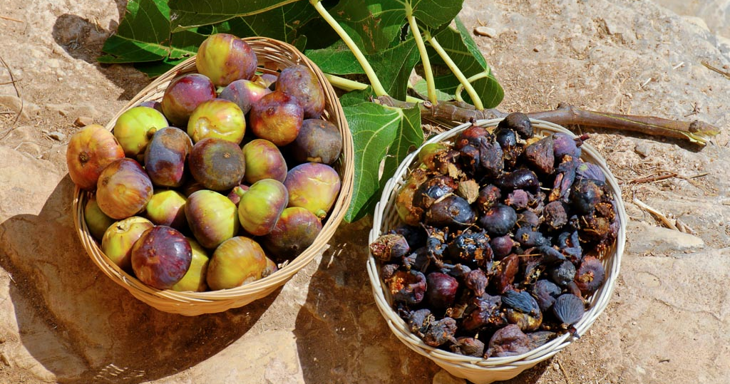
We give God firstfruits to increase our interest and commitment to Him
We give God firstfruits to deepen our trust in Him

Slide 7
¹⁰ Bring the full tithe into the storehouse, that there may be food in my house. And thereby put me to the test, says the Lord of hosts, if I will not open the windows of heaven for you and pour down for you a blessing until there is no more need. ¹¹ I will rebuke the devourer for you, so that it will not destroy the fruits of your soil, and your vine in the field shall not fail to bear, says the Lord of hosts. ¹² Then all nations will call you blessed, for you will be a land of delight, says the Lord of hosts.
Malachi 3:10-12

Slide 8
And God is able to make all grace abound to you, so that having all sufficiency in all things at all times, you may abound in every good work.
2 Corinthians 9:8
And my God will supply every need of yours according to his riches in glory in Christ Jesus.
Philippians 4:19

Slide 9
We give God firstfruits to increase our interest and commitment to Him
We give God firstfruits to deepen our trust in Him
We give God firstfruits to gain eternal rewards

Slide 10
¹⁷ As for the rich in this present age, charge them not to be haughty, nor to set their hopes on the uncertainty of riches, but on God, who richly provides us with everything to enjoy. ¹⁸ They are to do good, to be rich in good works, to be generous and ready to share, ¹⁹ thus storing up treasure for themselves as a good foundation for the future, so that they may take hold of that which is truly life.
1 Timothy 6:17-19

Slide 11
Prayerfully Determine Where Giving Goes and How Much to Give

Slide 12
Each person must decide how much to give

Slide 13
Israel’s giving requirement
Priest tithe (Num 18:21-24)
National feasts (Deut 12:5-7, 17-18; 14:22-27)
Welfare for the poor (Deut 14:28-29)
Temple upkeep (Exod 30:13; 28:25-26; Matt 17:24-27)
Grand total requirement 23%
Additional offerings
Free-will offerings (Num 15:3)
Gleaning laws (Lev 19:9-10)

Slide 14
Each person must decide how much to give
Give generously with the right attitude

Slide 15
¹ Now concerning the collection for the saints: as I directed the churches of Galatia, so you also are to do. ² On the first day of every week, each of you is to put something aside and store it up, as he may prosper, so that there will be no collecting when I come. ³ And when I arrive, I will send those whom you accredit by letter to carry your gift to Jerusalem.
1 Corinthians 16:3

Slide 16
Each person must decide how much to give
Give generously with the right attitude
Recognize that sacrifice outweighs volume

Slide 17
Do not neglect to do good and to share what you have, for such sacrifices are pleasing to God.
Hebrews 13:16

Slide 18
10
Trust the Lord to Provide Personal Living Expenses
PRINCIPLE

Slide 19
Give, and it will be given to you. Good measure, pressed down, shaken together, running over, will be put into your lap. For with the measure you use it will be measured back to you.
Luke 6:38
He who did not spare his own Son but gave him up for us all, how will he not also with him graciously give us all things?
Romans 8:32

Slide 20
God owns everything
God invests in us
We work hard
We plan what we receive
We invest in the future
We avoid high risk investments
We guard against sinful attitudes
Give God firstfruits
Prayerfully determine where giving goes
Trust the Lord for provision

Slide 21
Black

Slide 22
Topical Preaching link at BibleStudyDownloads.org
Get this presentation for free!
Notes:
The Bible…Basically (bb)

