Slide 1
Selflessness in Marriage
Philippians 2:1-4
Rick & Susan Griffith • WorldVenture Marriage Seminar BibleStudyDownloads.org

Slide 2
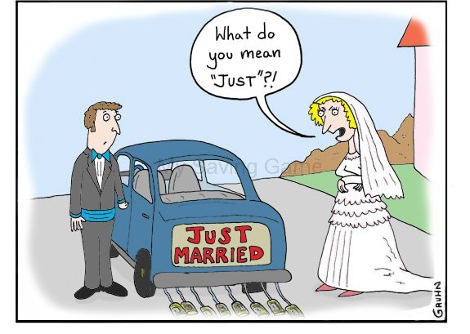
575 × 409

Slide 3
The Stand-Up Game

Slide 5
The Rules…
#1: Only one may stand.
#2: If you tie, work it out who stands that time.
#3: If your spouse isn’t here, sit or stand anyway.

Slide 6
Who washes more dishes in your marriage?

Slide 7
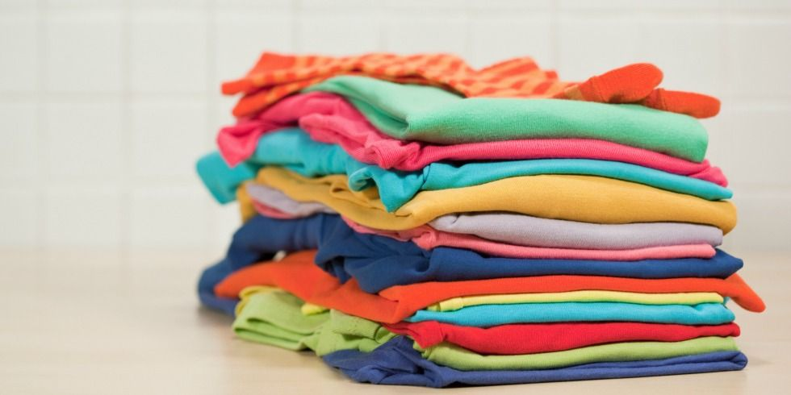
Who folds the most laundry?

Slide 8
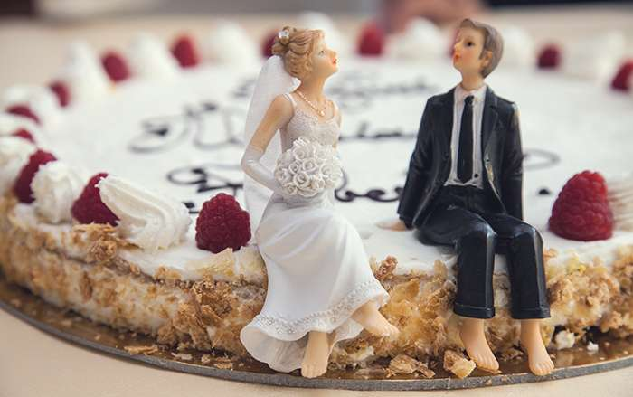
Who’s the key cook?

Slide 9
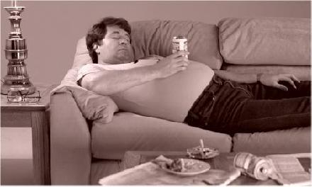
Who collects the trash?

Slide 10
Who takes out the trash?

Slide 11
Who spends the most money in your marriage?

Slide 12
Who finds out where all the money went in your household?

Slide 13
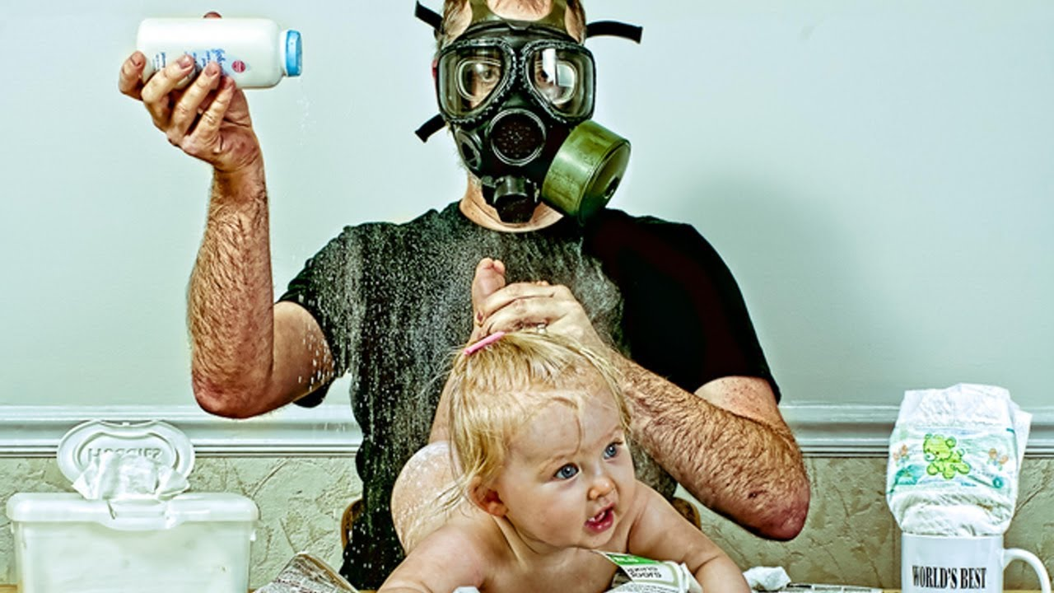
Who historically has changed more diapers?

Slide 14
Who listens better?

Slide 15
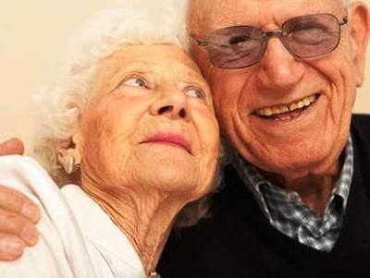
So who’s the talker then?

Slide 16
Will the introvert please stand?

Slide 17
Who gives in more during disagreements?

Slide 18
How to have unity in your marriage
Notes:
18
We didn't start out unified, so we had to work at it.
Susan thought I had all the right answers! Not.
We're all familiar with the marriage passages.
So we decided to hit the key area that we help couples address in pre-marriage counseling.
So here's the big idea for tonight...

Slide 19
I. Selflessness leads to unity (Phil 2:1-4).
Notes:
Considering the other person results in oneness!
This principle applied to a local church also applies to marriage.

Slide 20
The Text of Phil 2:1-4 (NASB)
Therefore if there is any encouragement in Christ, if there is any consolation of love, if there is any fellowship of the Spirit, if any affection and compassion,
make my joy complete by being of the same mind, maintaining the same love, united in spirit, intent on one purpose.
Do nothing from selfishness or empty conceit, but with humility of mind regard one another as more important than yourselves;
do not merely look out for your own personal interests, but also for the interests of others.
Notes:
SUSAN
Note in verse 4 that the New American Standard Bible (NASB 1977 and NASB Updated 1995) translators added the word “merely” and so it appears in italics. It is not in the Greek text, but they felt it makes the sense clearer. However, the original makes complete sense to say that all we do should be for the sake of others—even brushing our teeth and eating properly and getting enough exercise and sleep can ultimately be for others as these activities prolong our lives to enable us to serve other people!

Slide 21
The Greek of 2:1-4
Εἴ τις οὖν παράκλησις ἐν χριστῷ, εἴ τι παραμύθιον ἀγάπης, εἴ τις κοινωνία πνεύματος, εἴ τις σπλάγχνα καὶ οἰκτιρμοί, ² πληρώσατέ μου τὴν χαράν, ἵνα τὸ αὐτὸ φρονῆτε, τὴν αὐτὴν ἀγάπην ἔχοντες, σύμψυχοι, τὸ ἓν φρονοῦντες· ³ μηδὲν κατὰ ἐρίθειαν ἢ κενοδοξίαν, ἀλλὰ τῇ ταπεινοφροσύνῃ ἀλλήλους ἡγούμενοι ὑπερέχοντας ἑαυτῶν· ⁴ μὴ τὰ ἑαυτῶν ἕκαστος σκοπεῖτε, ἀλλὰ καὶ τὰ ἑτέρων ἕκαστος.
The New Testament in the Original Greek: Byzantine Textform 2005, With Morphology (Bellingham, WA: Logos Research Systems, 2006), Php 2:1-4.
Notes:
Verses 1-4 are one, long sentence in the Greek—no period until the end!

Slide 22
My Translation of 2:1-4
Therefore if there is any encouragement in Christ, if there is any consolation of love, if there is any fellowship of the Spirit, if any affection and compassion,
make my joy complete by being of the same mind, maintaining the same love, united in spirit, intent on one purpose,
doing nothing from selfishness or empty conceit, but with humility of mind regarding one another as more important than yourselves,
not merely looking out for your own personal interests, but also for the interests of others.
Notes:
So, here it is in the GLT. Never of the GLT? That’s the Griffith Literal Translation—my more literal translation that only puts a period at the end.

Slide 23
The Structure of 2:1-4 (NASB)
Therefore if there is any encouragement in Christ, if there is any consolation of love, if there is any fellowship of the Spirit, if any affection and compassion,
make my joy complete by being of the same mind, maintaining the same love, united in spirit, intent on one purpose.
Do nothing from selfishness or empty conceit, but with humility of mind regard one another as more important than yourselves;
do not merely look out for your own personal interests, but also for the interests of others.
4 “if” phrases: “Please...”
Main Verb: “give me joy...”
4 “by” phrases: “by being united...”
2 means: “from being selfless”
Notes:
In any case, in the Greek the main verb is in verse 2: “make my joy complete.”
• It’s preceded by four phrases
• and followed by four phrases
• and two means/”how tos” (“ing” words) commands (NASB) to be selfless.
Here’s my paraphrase:
Please give me joy… (1-2a)
…by being united (2b)
from being selfless (3-4).

Slide 24
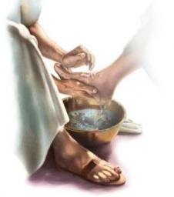
Selflessness leads to unity (2:1-4).
Selflessness
Unity
Notes:
Simply put, “Selflessness leads to unity.”
So Paul is saying that there’s a problem with disunity in the church (explained more in chapter 4) and that this problem of disunity is solved with selflessness. Doesn't this begin in the home? Isn't marriage the foundation of either unity or disunity?

Slide 25
Attitude words in 2:1-4 (NASB)
Therefore if there is any encouragement in Christ, if there is any consolation of love, if there is any fellowship of the Spirit, if any affection and compassion,
make my joy complete by being of the same mind, maintaining the same love, united in spirit, intent on one purpose.
Do nothing from selfishness or empty conceit, but with humility of mind regard one another as more important than yourselves;
do not merely look out for your own personal interests, but also for the interests of others.
Notes:
The key is our attitude.
The words for “attitude” appear four times in these four verses. Attitude appears 20 times in the letter.
What kind of attitude? Humility!

Slide 26
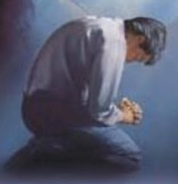
The Sequence
Selflessness
Humility
Unity
Notes:
But how is selflessness shown? Selflessness leads to humility which leads to unity.

Slide 27
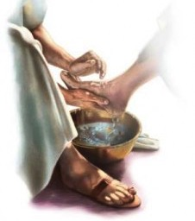
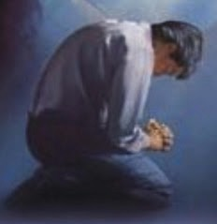
The Opposite
Selfishness
Pride
Division
Notes:
How is selfishness shown? Putting your own needs first leads to pride, which leads to division.

Slide 28
Two Ways to Relate to Your Spouse Philippians 2:1-4
Selfish
Selfless
Produces grumbling (2:14)
Produces joy (2:2a)
Notes:
This means considering other people’s needs more important than your own. There are only two ways to relate to others…

Slide 29
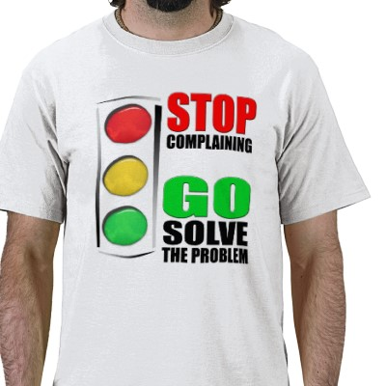
"Do everything without complaining and arguing" (2:14)

Slide 30
The Dinner Debrief
1
1. A roasted Frank footer
Notes:
SUSAN: Did you check your email this afternoon?
RICK: Not yet—too busy. Someone write both of us?
SUSAN: Yes, Frank wrote from the Philippines.
RICK: Oh—so what does he want?
SUSAN: Well, you know the WorldVenture conference coming up in Thailand?
RICK: The GAG?
SUSAN: GAG?
RICK: Yeah, GAG—Go Asia Gathering.
SUSAN: I think that’s AAG—All Asia Gathering. Anyway, Frank asked if we’d do a seminar on marriage…
RICK: Seriously? Marriage? What do I know about marriage? My specialty is Biblical Studies, not telling people how to apply the Bible!
SUSAN: Well, maybe he thinks you know more than you do.
RICK: Yeah, but… I mean, Rosa is a marriage counselor, for crying out loud. Why don’t they do the seminar themselves? We’ve only been married 35 years. They’ve been married—how many years? (Look at Frank for answer.) It’s longer than us!
SUSAN: I agree. They have no idea how busy we are, and they have a lot more experience at this than us. They should do it!
________
OK now for a footnote. So what did my complaining do? (Answers)
It resulted in a roasted Frank footer. Susan had two options: (1) Fight against my bad attitude or (2) join me in my complaining.

Slide 31
A Better Debrief
Notes:
SUSAN: Did you check your email this afternoon?
RICK: Not yet—too busy. Someone write both of us?
SUSAN: Yeah, Frank wrote from the Philippines.
RICK: Oh, good. I wonder how we can help him!
SUSAN: Well, you know WorldVenture thing coming up in Thailand?
RICK: The GAG?
SUSAN: GAG?
RICK: Yeah, GAG—Go Asia Gathering.
SUSAN: I think that’s AAG—All Asia Gathering. Anyway, Frank asked if we’d do a seminar on marriage…
RICK: Seriously? Marriage? He thinks we know something about marriage? Wow, but why would he ask us?
SUSAN: Well, maybe he thinks we know more than we do.
RICK: Yeah, but… I mean, Rosa is a marriage counselor, and they have been married longer than us. They’ve been married—how many years? (Look at Frank for answer.) It’s longer than us! Honestly, I am amazed he would ask us.
SUSAN: I agree. Personally, I’m so impressed that Frank and Rosa would share their responsibilities with us. What a great privilege they have given us.

Slide 32
"Do everything without complaining and arguing" (2:14)

Slide 33
Two Ways to Relate to Your Spouse Philippians 2:1-4
186d
Selfish
Selfless
Produces grumbling (2:14)
Produces joy (2:2a)
Leads to division (4:2)
Leads to unity (2:2b)
Proud (2:3a)
Humble (2:3b)
Considers self
better than others (2:3a)
Considers others
better than self (2:3b)
Looks out for self (2:4a)
Looks out for others (2:4b)
Imitates Satan
Imitates Christ (2:5)

Slide 34
What is Humility?
Humility does not mean you think less of yourself.
It means you think of yourself less.
—Ken Blanchard—
Notes:
In one of my past ministries, I got along with all eight of the other colleagues—except one. She thought I was very proud. What do you do when someone thinks you are proud? Defend your humility, right? I decided to try to serve her in any way I could. This wasn’t easy, for she didn’t want me to do anything for her that she could do herself! But eventually I found I could do some things that she couldn’t—like use a power drill to hang pictures in her house. I discovered that the best way to defeat pride is to serve others. By the way, trying to serve her really worked—now she’s my wife!

Slide 35
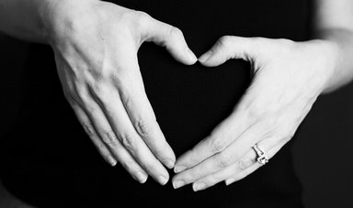
Don'ts and Do's
of Upside Down Living
³Do nothing from selfishness or empty conceit,
but with humility of mind regard one another as more important than yourselves;
⁴do not merely look out for your own personal interests,
but also for the interests of others.
Notes:
Some translations add "merely" (NASB) or "only" (NIV, NKJV, NCV, NET)
Do you want to know what I think is the key to a successful marriage?
It’s right here in verses 3-4! Selflessness!

Slide 36
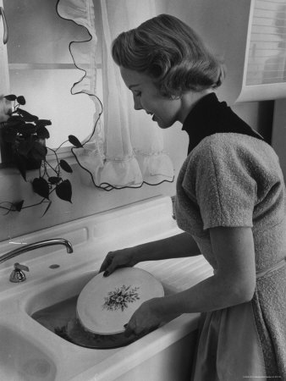
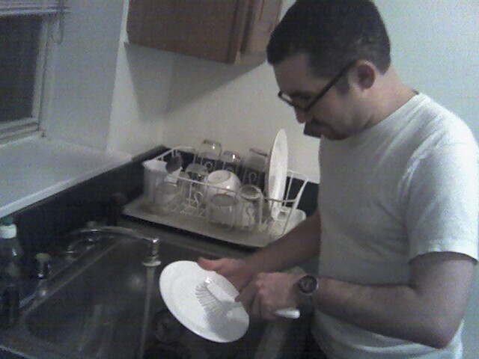
Who's to wash the dishes?
Notes:
SUSAN: Try to out-give your spouse! If you are going to have any arguments, argue over who’s going to serve most! “Oh, let me wash the dishes! You’ve had a hard day!” “No, honey, I’ll do it—you have a lot to do tonight!”

Slide 37
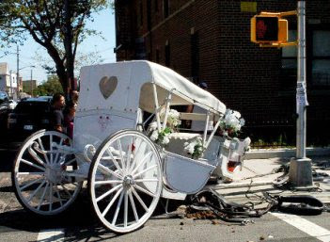
A rough start…
Notes:
In contrast, there’s the true story of a couple who got married and on their honeymoon night, before getting into bed, the groom took off his underwear and dropped it on the floor. “What are you doing?” his bride asked. “Dropping my underwear on the floor,” he answered. “And who’s supposed to pick it up?” she said. “Well, all my life my mother has,” he answered. “Well,” the wife noted, “I’m not your mother.” The underwear remained there all day and he did the same thing the second night—so did she—and the third night and so on for the first 30 days of their marriage. Then he ran out of clean underwear, so he went to the department store and purchased $100 worth of underwear (and they only had $300 in the bank at that!). Finally, when all that underwear piled up they visited a marriage counselor.
The courts actually allow people to get divorces on the grounds of “incompatibility.” In reality the real reason is selfishness!
As selflessness is the key to a unified marriage, so selflessness is the key to a unified church.
(So how can couples achieve unity? Only through humility! Humility is the key to unity!)

Slide 38
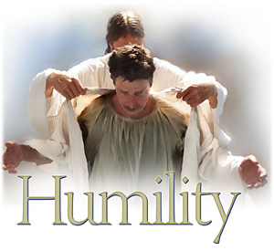
II. Your marriage can be united only to the degree that each spouse is truly humble.
Notes:
The opposite of unity through humility is…
Disunity through pride.

Slide 39
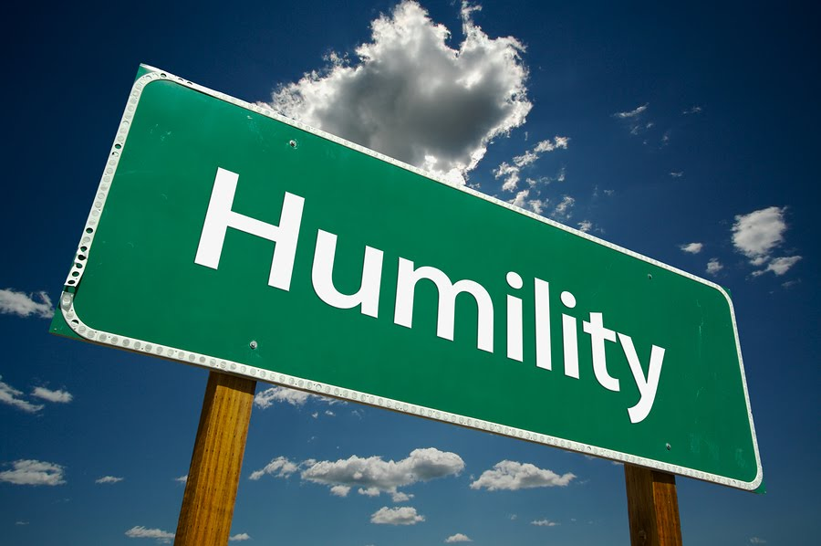
Are YOU Humble? Four questions to discuss…
Notes:
Let me address you as an individual…

Slide 40
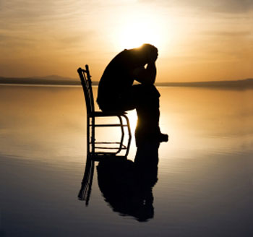
Question 1: How do you respond when your spouse expects you to serve him/her?
Notes:
Where in your own marriage have you been like the wife whose husband treated her like a servant?

Slide 41
Flying First Class
Notes:
A Christian businessman requested an aisle seat in the economy section of the airplane he was about to board. Through the negligence of the airline, a seat wasn’t available so they offered to put him in first class. He readily obliged!
As he settled down into his seat, he noticed a rather wealthy looking couple near him—and the flight attendant talking to the husband about his lunch order. Then she turned to the wife and sweetly asked, “And you, Ma’am, would you prefer chicken or beef?”
The woman didn’t respond, so the flight attendant asked again, slightly louder, “Excuse me, would you prefer chicken or beef for your lunch?”
The woman continued to remain still, eyes open, nose up, staring straight ahead. By this time the flight attendant wondered whether she had a hearing problem, so she nearly shouted—loud enough for everyone in first class to hear her, “Ma’am, I need to know whether you would like chicken or beef!” Silence. No response!
At this point the husband turned to the flight attendant and said under his breath, “I’m sorry but my wife doesn’t speak to servants.” (Joe Stowell, DTS chapel, 1980s)
How would you feel if you were this flight attendant? Angry? or have compassion for the woman?

Slide 42
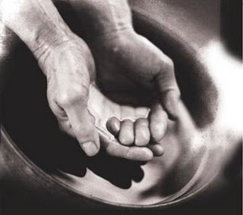
Question 2: How do you treat your spouse when he/she serves you?

Slide 43
Many serve you here…
Notes:
People have organized this conference (Madison, Frank & Rosa, etc.)
SAM serves

Slide 44
Question 3: Are you proud of your humility?
The strange thing about humility is the minute you think you've got it, you've lost it.

Slide 45
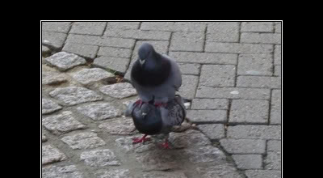
Question 3: Are you proud about your humility?
HUMILITY “If I have seen further, it is only by standing on the shoulders of giants" –Isaac Newton
Notes:
A hundred years ago Dr. H. A. Ironside felt that he was not as humble as he thought he ought to have been. So he asked an elderly friend what he could do about it. His mature friend replied, “Make a sandwich board with the plan of salvation in Scripture on it and wear it, then walk through the business and shopping area of downtown Chicago for a whole day.”
He followed his friend’s advice. Upon completion of this humiliating experience he returned to his apartment. As he took off the sandwich board, he caught himself thinking, “There’s not another person in Chicago that would be willing to do a thing like that.” (HUMILITY pride about)
Wouldn’t it be great and really unifying for your marriage if each person genuinely served without ever feeling even a bit of pride over their humility?
What if each spouse picked up his or her own clothes or paper—and didn't even have any pride over it? Or didn't even feel tempted to resentment?

Slide 46
Question 4: How much appreciation do you expect from your spouse?
Notes:
How many times do you think your spouse should say "thank you" or recognize what you have done?

Slide 47
Recognition Quotes
“Do all the good you can in the world, and make as little noise about it as possible.”
“There is no limit to the good that a man can do if he doesn’t care who gets the credit.”
“When a man forgets himself, he usually does something everybody else remembers.”
Notes:
MARRIAGE
What would your marriage be like if both of you were genuinely humble?
Discussions over issues would go very smoothly! (They do!)
There would be a noticeable absence of strong personalities. (There is!)
Neither would have to beg the other to serve—to help the kids, take out the trash, and do other behind-the-scene jobs.
____________________
CHURCH
What would this church be like if everyone was genuinely humble?
Church meetings would go very smoothly! (They do!)
There would be a noticeable absence of strong personalities. (There is!)
Leaders would not have to beg members to serve—especially to teach the children, serve in the nursery, and do other behind-the-scene jobs like taking down the stage.

Slide 48
Selflessness leads to unity (Main Idea)
Notes:
Considering the needs of your spouse (or fellow believer) results in a oneness that will surprise you.

Slide 49
Is your selflessness contributing to your marriage unity?
How do you respond when your spouse expects you to serve him/her?
How do you treat your spouse when he/she serves you?
Are you proud of your humility?
How much appreciation do you expect from your spouse?
Notes:
Think of the question most applicable to you.
Use that as a prayer point with your spouse as we close the session praying in couples.

Slide 50
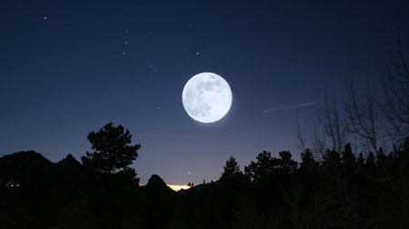
“Humility, like darkness, reveals the heavenly lights.” – Henry David Thoreau

Slide 51
NT Preaching link at BibleStudyDownloads.org
Get this presentation and script for free!
Notes:
NT Preaching (np)

Slide 52
Black

Slide 53
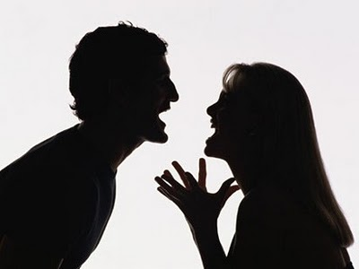
Results of a Bad Attitude Philippians 2:14-16
186e
If we complain and argue
We won't be blameless & innocent
We won't stand out with a positive impact
Those who invested in us will wish they had invested in others

Slide 54
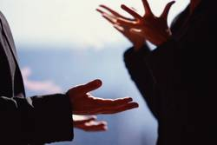
Complaining = ﻿γογγυσμῶν
goggusmoan
John 7:12 Jesus
Acts 6:1 Food
1 Pet 4:9 Hospitality
Notes:
﻿[GING] goggusmo,j goggusmo,j, ou/, o` grumbling, complaint, displeasure Ac 6:1 ; Phil 2:14; 1 Pt 4:9; secret talk, whispering J 7:12.* [pg 40]

Slide 55
Results of a Good Attitude Philippians 2:14-16
186f
Those who invested in us will rejoice that their efforts had been worth it
We will shine like stars in the universe
We will be blameless & innocent, children of God above reproach
If we do everything without complaining & arguing

Slide 56
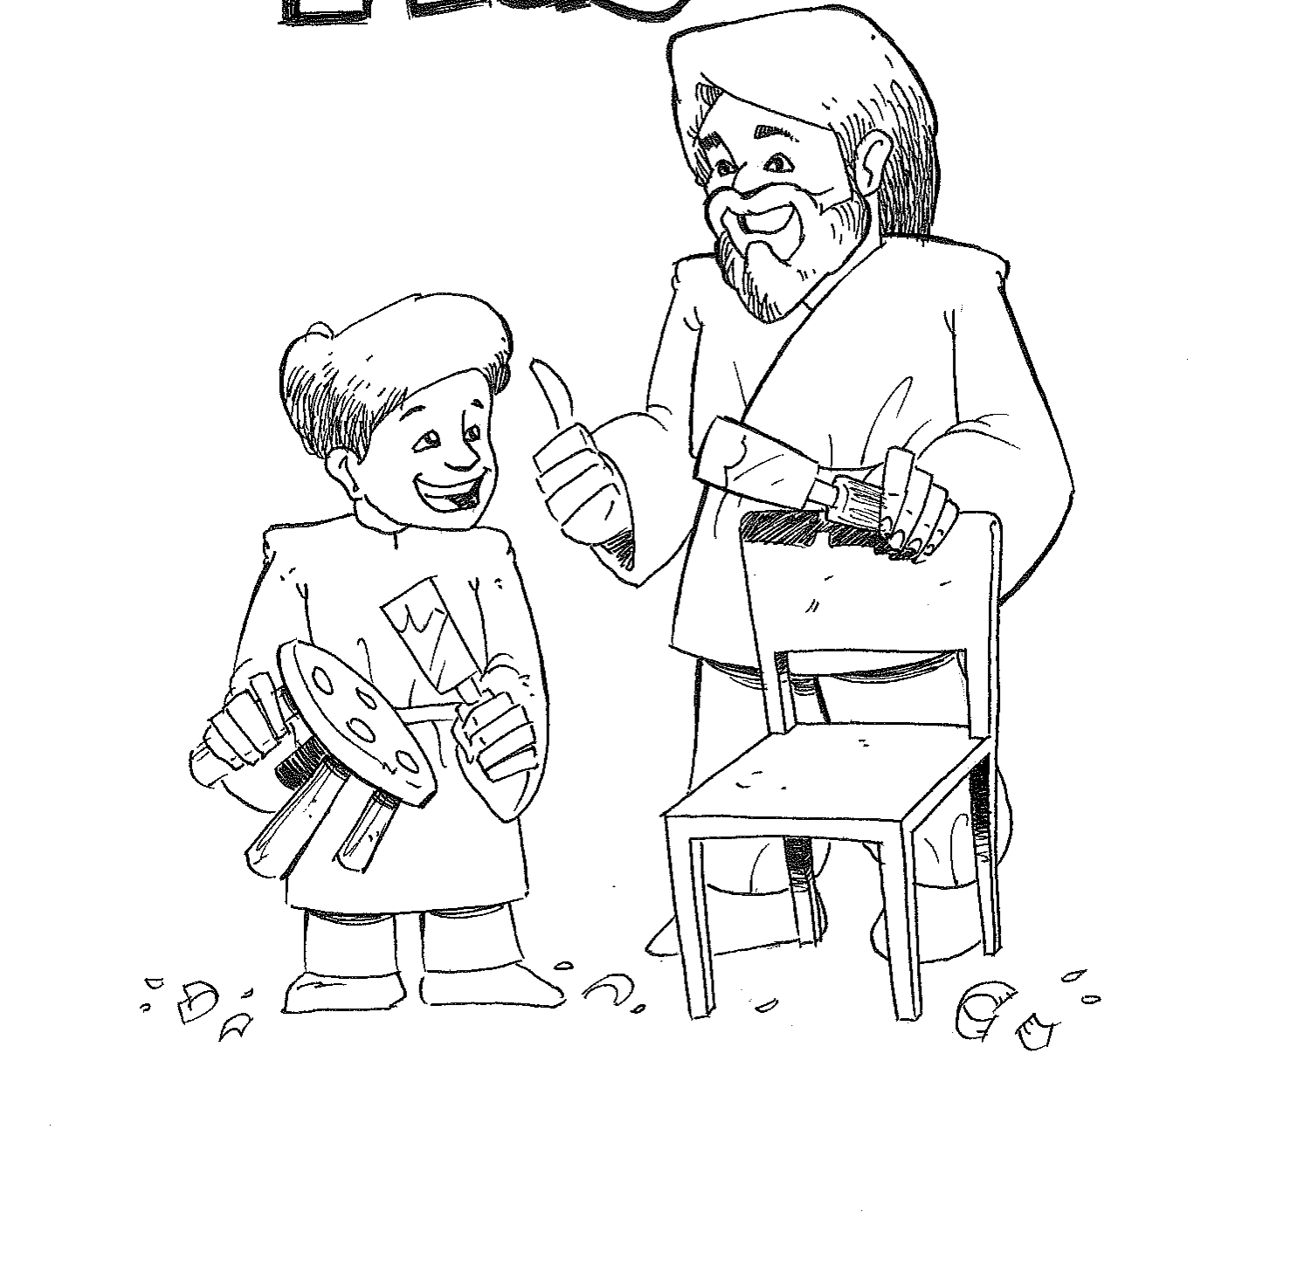
Mimicking the Master
Key Verse
“Your attitude should be the same as that of Christ Jesus” (Phil. 2:5).

