Slide 1
Topical Sermon
Preached by Dr. Jim Harmeling at Crossroads International Church Singapore Uploaded by Dr. Rick Griffith, CIC & Singapore Bible College All files in many languages for free download at BibleStudyDownloads.org

Slide 2
The Names of the Meal
“The Lord’s Supper” (1 Cor 11:20)
“The table of the Lord” (1 Cor 11:21)
“Communion” or “partaking” (1 Cor 10:16)
“Breaking of bread” (Acts 2:42, 46; 20:7, 11)
“Eucharist” (Luke 22:17, 19; 1 Cor 11:24)

Slide 3
Roots: The Old Testament Feast of Passover
Covenant bond meal
Isaac’s covenant with Abimelech (Gen 26:6-33)
Jacob’s agreement with Laban (Gen 31:54)

Slide 4
Exodus 24:6-11
⁶ And Moses took half of the blood and put it in basins, and half of the blood he threw against the altar. ⁷ Then he took the Book of the Covenant and read it in the hearing of the people. And they said, “All that the Lord has spoken we will do, and we will be obedient.” ⁸ And Moses took the blood and threw it on the people and said, “Behold the blood of the covenant that the Lord has made with you in accordance with all these words.”
⁹ Then Moses and Aaron, Nadab, and Abihu, and seventy of the elders of Israel went up, ¹⁰ and they saw the God of Israel. There was under his feet as it were a pavement of sapphire stone, like the very heaven for clearness. ¹¹ And he did not lay his hand on the chief men of the people of Israel; they beheld God, and ate and drank.

Slide 5
Roots: The Old Testament Feast of Passover
Passover significance for Israel
They were helpless in bondage to an unrelenting taskmaster bent on their destruction.
An individual from among their own nation delivers them out of bondage.
The power of God breaks the power of their oppressor.
The final sign of power is the death of every first-born son.

Slide 6
Roots: The Old Testament Feast of Passover
God provides a substitute sacrifice to Israel so that they do not experience death. This substitute is a lamb.
When the lamb’s blood covers the doorposts of the house, the death angel passes over and does not bring death.
God delivers Israel out of bondage and into a new identity as an elect people reflecting Him.

Slide 7
Roots: The Old Testament Feast of Passover
Moses tells Israel to observe Passover in the Promised Land (Deut 16:1-8)
Joshua observes Passover in the Promised Land (Josh 5:10-11)
Josiah reveals Israel’s failure to keep Passover in the Promised Land (2 Kgs 23:21-23)
Israel observes Passover in the Promised Land after exile (Ezra 6:19-22)

Slide 8
Roots: The Old Testament Feast of Passover
The New Testament Last Supper
Jesus, Food, and Passover
Mark 2:16-17 = Jesus eats with tax collectors
Mark 6:30-44 = Jesus feeds 5,000
John 6:22-59 = Jesus is the food for Passover
Mark 8:1-10 = Jesus feeds 4,000
Mark 8:14-21= Jesus warns about the “leaven” of the Pharisees
Luke 14:12-24 = Jesus uses parables of banquets
John 6–19 = preparation and teaching at Lord’s Supper
Luke 24:13-35 = Jesus reveals himself while breaking bread

Slide 9
Roots: The Old Testament Feast of Passover
The New Testament Last Supper
The practice of the early church
Acts 2:42, 46
⁴² And they devoted themselves to the apostles' teaching and the fellowship, to the breaking of bread and the prayers.
⁴⁶ And day by day, attending the temple together and breaking bread in their homes, they received their food with glad and generous hearts.

Slide 10
What is the Meaning of the Lord’s Supper?

Slide 11
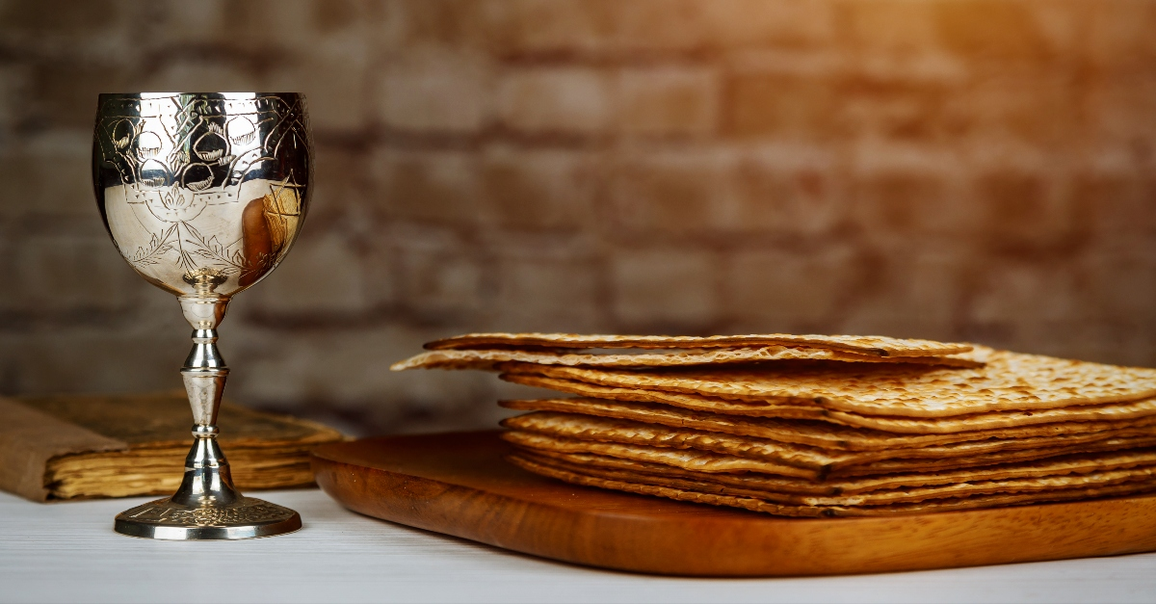
The Presence of Christ
Memorial Actual
of death -------------------------- presence

Slide 12
What is the Meaning of the Lord’s Supper?
Identification with Christ
Fellowship bond with other Christians
Joyful anticipation of our future realization of salvation
Matthew 26:29
“I tell you I will not drink again of this fruit of the vine until that day when I drink it new with you in my Father's kingdom.”

Slide 14
Black

Slide 15
Topical Preaching link at BibleStudyDownloads.org
Get this presentation and notes for free!
Notes:
NT Preaching (np)

