Slide 1

The Inheritance of the Believer
Blessings in Hebrews
Message 4 of 4
Soteriology: God’s Rescue Program
Dr. Rick Griffith • Jordan Evangelical Theological Seminary
BibleStudyDownloads.org
Notes:
Here is Part 4 of the 4-part study on The Inheritance of the Believer.

Slide 2
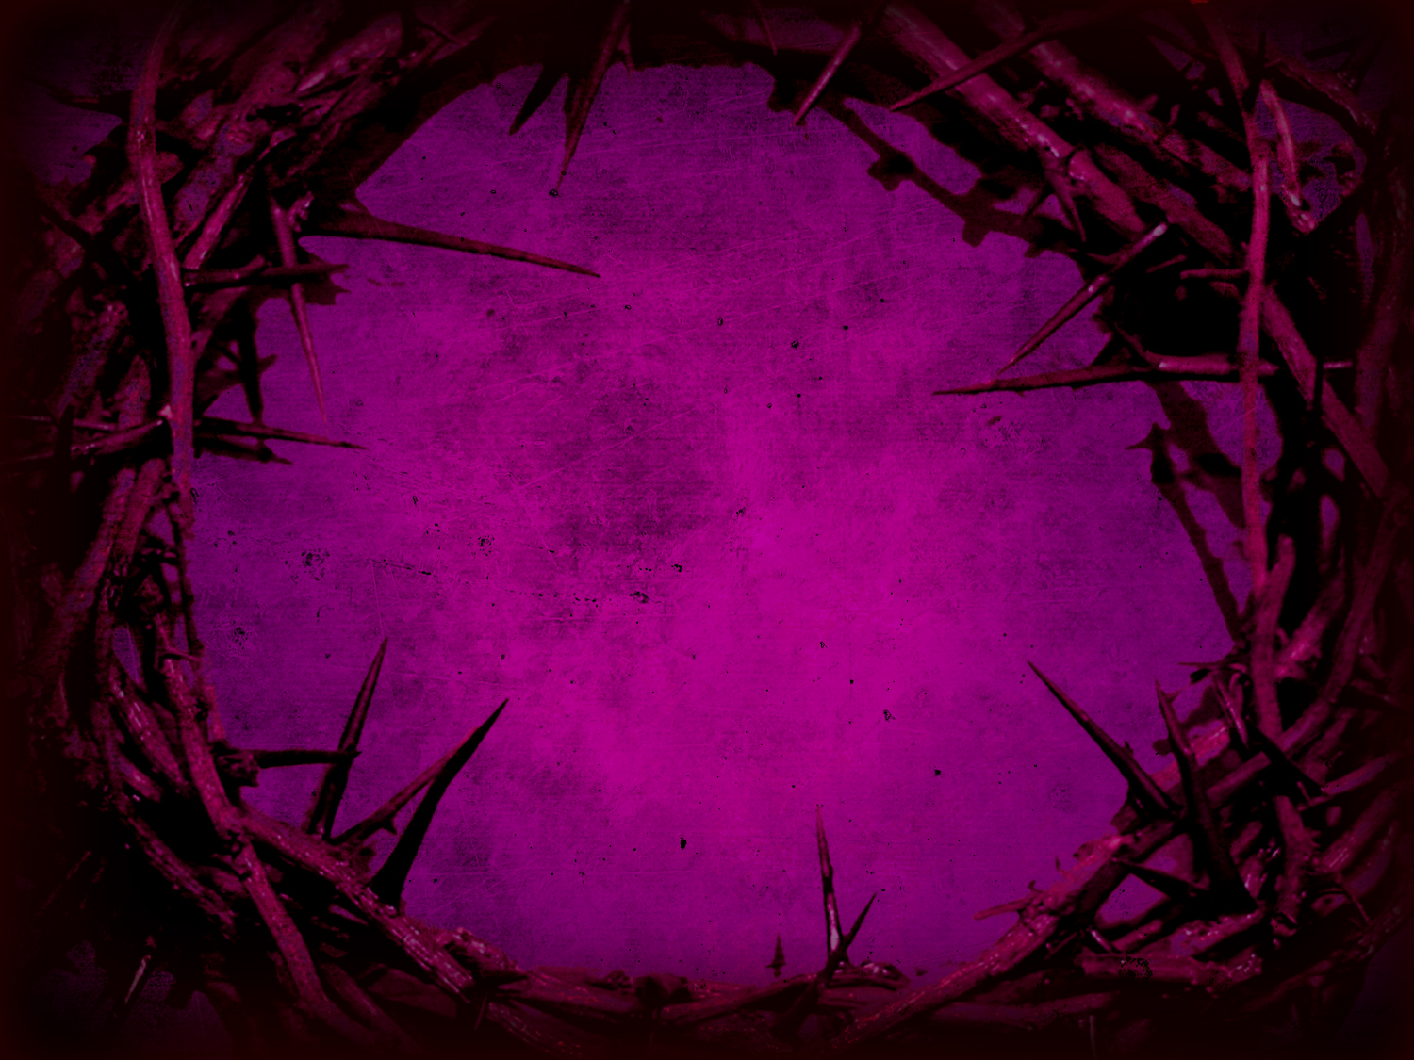

Have you ever met someone with too high a view of Jesus?
JESUS

Slide 3

Press On!
A Study of Hebrews
Notes:
But is waiting to be contrasted with running? After all, the overall theme of Hebrews is to press on! This section ends with a specific exhortation…

Slide 4
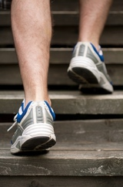
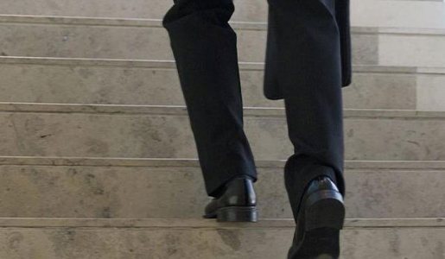
Why press on with Christ?
Notes:
What reasons can you give to remain faithful to Jesus?
The Book of Hebrews warns Christians from abandoning the Christian race. They needed reasons to stay in the race.
We already addressed last week their need to press on to avoid God’s discipline.
The Five Warning Passages have at least five different ways to view the salvation race (intro to 5 white slides).

Slide 5
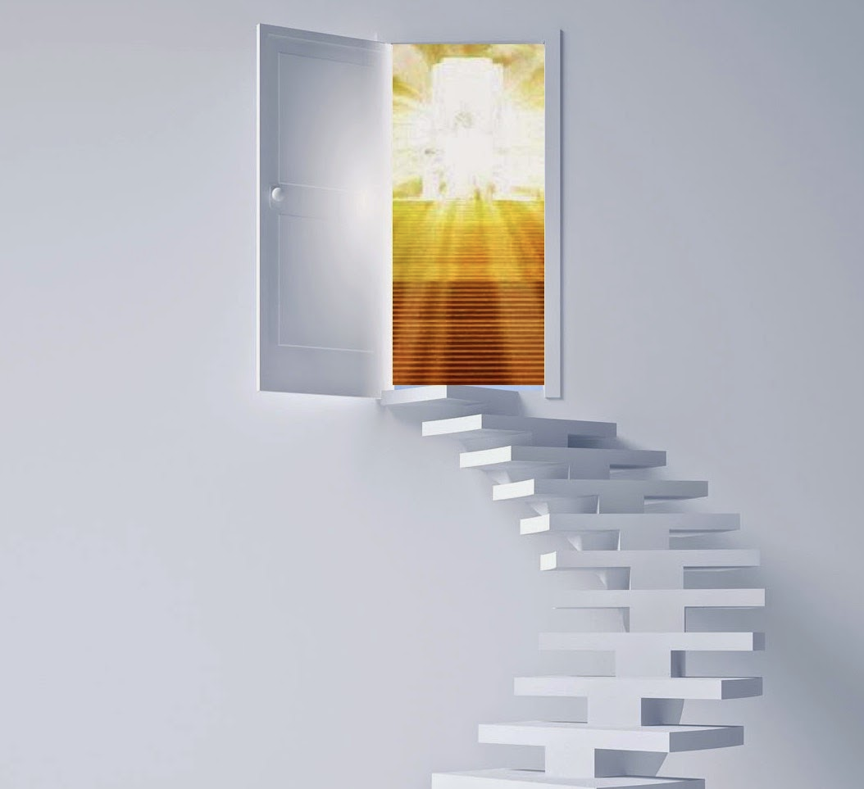
Why press on with Christ?
ENTER
MILLENNIAL
RULE
Notes:
[Perseverance in the Christian race leads to reigning with Jesus for 1000 years.]

Slide 6
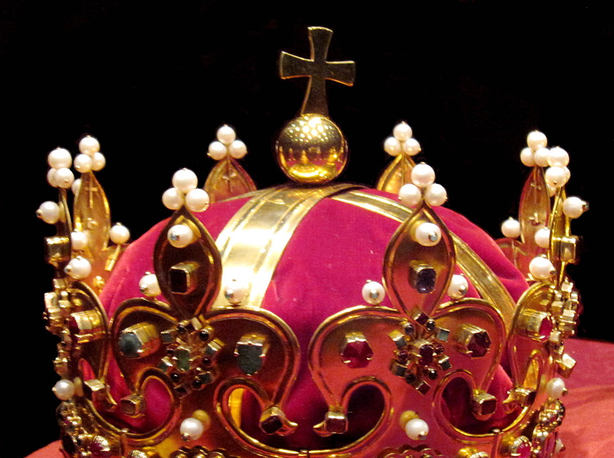
The Hebrews readers were in danger of losing their kingdom rule (Hebrews 3:7–4:13).

Slide 7

Hebrews 3:7-9 (NLT)
That is why the Holy Spirit says, "Today when you hear his voice, ⁸don't harden your hearts as Israel did when they rebelled, when they tested me in the wilderness. ⁹There your ancestors tested and tried my patience, even though they saw my miracles for forty years.

Slide 8
Hebrews 3:10-11 (NLT)
So I was angry with them, and I said, 'Their hearts always turn away from me. They refuse to do what I tell them.' ¹¹So in my anger I took an oath: 'They will never enter my place of rest.'"

Slide 9
Hebrews 3:12-14 (NLT)
Be careful then, dear brothers and sisters. Make sure that your own hearts are not evil and unbelieving, turning you away from the living God. ¹³You must warn each other every day, while it is still "today," so that none of you will be deceived by sin and hardened against God. ¹⁴For if we are faithful to the end, trusting God just as firmly as when we first believed, we will share [Gr. we have become partakers] in all that belongs to Christ.
Notes:
Here in verse 12, we see what I call “unbelieving believers.” They believed in God for salvation, but they didn’t believe him later.
The word for “turning away” in verse 12 is apostenai (BDAG): to withdraw, move, depart, leave; revolt—
to cause someone to move from a reference point, trans., in our lit. in ref. to altering allegiance cause to revolt, mislead
to distance oneself from some pers. or thing
The sharing of verse 14 is where we get the word “partakers” of the Partakers View. Note the big IF one is faithful to the end and only IF will one fully share in all that belongs to Christ.

Slide 10
Hebrews 3:1-2 (NLT)
And so, dear brothers and sisters who belong to God and are partners with those called to heaven, think carefully about this Jesus whom we declare to be God's messenger [Gr. Apostle] and High Priest. ²For he was faithful to God, who appointed him, just as Moses served faithfully when he was entrusted with God's entire house.
Notes:
We are partners with Jesus (3:1)—but only IF “we keep our courage and remain confident in our hope in Christ” (3:6).
———————
Christ's glory supersedes Moses since Jesus is Apostle, High Priest and Creator (3:1-4).
• Jesus was God's messenger, sent directly from God while Moses was only human. The word can be rendered "Apostle" here—the only time this word is used of Christ, showing that he has the authority of the one who sent him.
• Jesus was High Priest while Moses wasn't

Slide 11
Hebrews 3:15-16 (NLT)
Remember what it says: "Today when you hear his voice, don't harden your hearts as Israel did when they rebelled." ¹⁶And who was it who rebelled against God, even though they heard his voice? Wasn't it the people Moses led out of Egypt?

Slide 12
Hebrews 3:17-19 (NLT)
And who made God angry for forty years? Wasn't it the people who sinned, whose corpses lay in the wilderness? ¹⁸And to whom was God speaking when he took an oath that they would never enter his rest? Wasn't it the people who disobeyed him? ¹⁹So we see that because of their unbelief they were not able to enter his rest.

Slide 13
Christ is Superior in His Person
258-59
Superior to the Prophets 1:1-3
Superior to the Angels 1:4–2:18

Slide 14
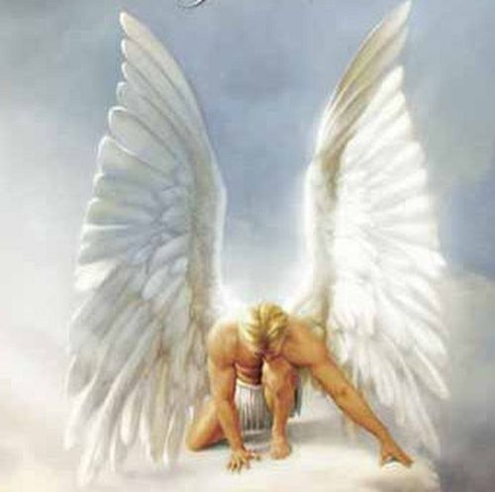
"Therefore, angels are only servants—spirits sent to care for people who will inherit salvation"
(1:14 NLT).
Notes:
In contrast, angels are but servants who care for us (1:14).

Slide 15
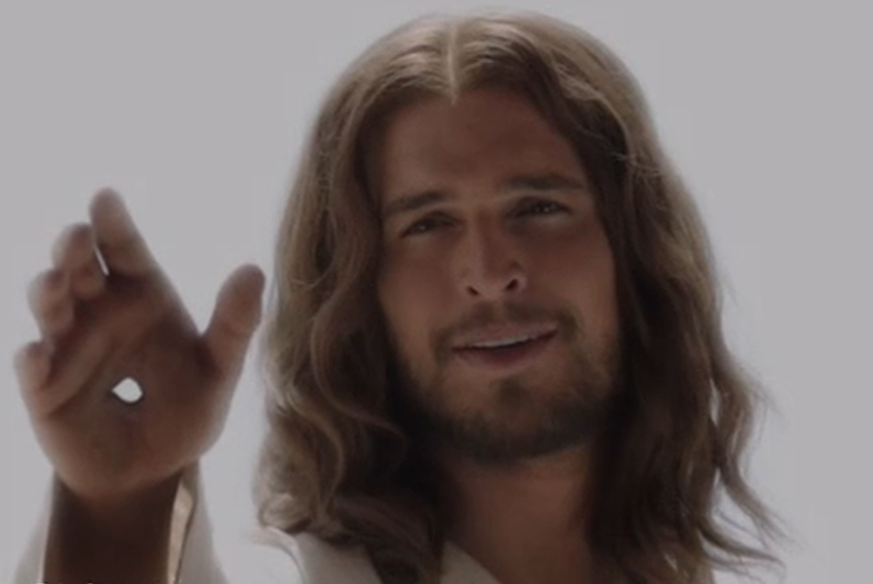
(Hebrews 2:5 NLT)
"And furthermore, it is not angels who will control the future world we are talking about."
Notes:
Angels will not control the future world, but Christ will share this rule with man in "the world to come," or millennium (2:5).

Slide 16

"And you have caused them to become a Kingdom of priests for our God.
And they will reign on the earth"
(Rev. 5:10 NLT).
369

Slide 17
Why press on with Christ?
ENTER
MILLENNIAL
RULE
ENTER
MILLENNIAL
REST
Notes:
[Perseverance in the Christian race leads to a “restful rule” for 1000 years.]

Slide 18
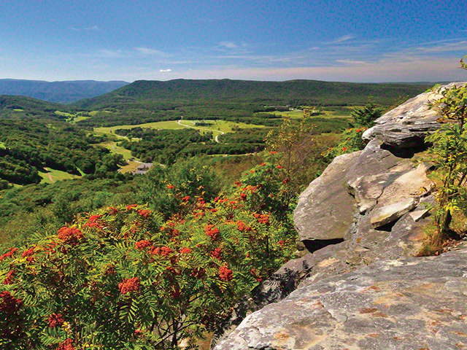

Israel's unbelief should warn these Hebrew Christians against rejecting Christ, as disobedience would forfeit their Canaan rest (Hebrews 4:1-13).

Slide 19
Hebrews 4:1-3a (NLT)
God's promise of entering his rest still stands, so we ought to tremble with fear that some of you might fail to experience it. ²For this good news—that God has prepared this rest—has been announced to us just as it was to them. But it did them no good because they didn't share the faith of those who listened to God. ³For only we who believe can enter his rest.
Notes:
The OT Jews believers who stopped believing failed to enter Canaan rest as an example of the same judgment happening to us (4:1-3a).

Slide 20
Hebrews 4:8-11 (NLT)
Now if Joshua had succeeded in giving them this rest, God would not have spoken about another day of rest still to come. ⁹So there is a special [Gr. Sabbath] rest still waiting for the people of God. ¹⁰For all who have entered into God's rest have rested from their labors, just as God did after creating the world. ¹¹So let us do our best to enter that rest. But if we disobey God, as the people of Israel did, we will fall.
Notes:
But the readers could be guilty of also not continuing to trust Christ and thus miss the millennial Sabbath rest.
————————
The millennial view best explains the "work" in 4:10: "for anyone who enters God's rest also rests from his own work, just as God did from his." Most commentators see the work here as a figurative "abstention from servile work" or sinful deeds at all times. However, ceasing work in a literal sense makes better sense since the text compares man's rest with God's rest from His literal work of creation; certainly God does not rest from sinful deeds.

Slide 21

Seven views on the Hebrews 4
"Sabbath-rest for the people of God"
266g-h
Present Sabbath Rest & Future Heavenly Rest
Present Sunday & Grace Rests & Future Heavenly Rest
Present Spiritual Rest
Present Spiritual & Future Heavenly Rest
Future Heavenly Rest
Millennial Rest with Present Day Application
Future Millennial Rest

Slide 22
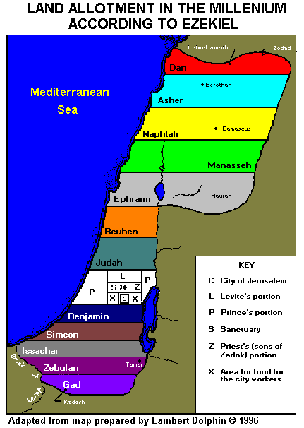
Support for the Future Millennial Rest in Hebrews 4
Land Allotment in the Millennium (Ezekiel 47–48)
266i
The context

Slide 23
Christ is Superior in His Person
258-59
Superior to the Prophets 1:1-3
Superior to the Angels 1:4–2:18
Superior to Moses 3:1–4:7

Slide 24
Hebrews 3:1-2 (NLT)
And so, dear brothers and sisters who belong to God and are partners with those called to heaven, think carefully about this Jesus whom we declare to be God's messenger [Gr. Apostle] and High Priest. ²For he was faithful to God, who appointed him, just as Moses served faithfully when he was entrusted with God's entire house.
Notes:
We are partners with Jesus (3:1)—but only IF “we keep our courage and remain confident in our hope in Christ” (3:6).
———————
Christ's glory supersedes Moses since Jesus is Apostle, High Priest and Creator (3:1-4).
• Jesus was God's messenger, sent directly from God while Moses was only human. The word can be rendered "Apostle" here—the only time this word is used of Christ, showing that he has the authority of the one who sent him.
• Jesus was High Priest while Moses wasn't

Slide 25
Hebrews 3:5-6 (NLT)
Moses was certainly faithful in God's house as a servant. His work was an illustration of the truths God would reveal later. ⁶But Christ, as the Son, is in charge of God's entire house. And we are God's house, if we keep our courage and remain confident in our hope in Christ.
Notes:
We are partners with Jesus (3:1)—but only IF “we keep our courage and remain confident in our hope in Christ” (3:6).
———————
Christ's position supersedes Moses because He doesn't just serve along with those destined to rule, but he reigns supremely as God's Son (3:5-6).

Slide 26
Hebrews 4:3-5 (NLT)
For only we who believe can enter his rest. As for the others, God said, "In my anger I took an oath: 'They will never enter my place of rest,'" even though this rest has been ready since he made the world. ⁴We know it is ready because of the place in the Scriptures where it mentions the seventh day: "On the seventh day God rested from all his work." ⁵But in the other passage God said, "They will never enter my place of rest."
Psalm 95
Notes:
Hebrews 3–4 quotes Psalm 95 five times (3:7-11, 15; 4:3, 5, 7) to emphasize millennial rest in Canaan. Surely the "rest" of Psalm 95 is not eternal rest in heaven or the spiritual rest of salvation, but the repose Israel sought in having her own land. Psalm 95 is an enthronement psalm that depicts the time of the Messiah's rule, it is appropriate that the author of Hebrews use this particular psalm to refer to the millennial rest.

Slide 27
Christ is Superior in His Person
258-59
Superior to the Prophets 1:1-3
Superior to the Angels 1:4–2:18
Superior to Moses 3:1–4:7
Superior to Joshua 4:8-13

Slide 28
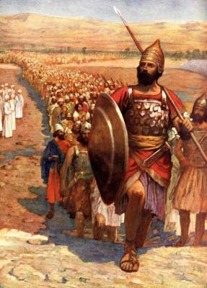
Joshua offered rest in Canaan
"I will give you every place where you set your foot, as I promised Moses"
(Josh. 1:3 NIV)
Notes:
The "rest" in this passage must be something that Joshua could have offered his people had they believed. Certainly he could not have offered them salvation (spiritual peace) or eternal life (heaven). But what he did offer was access to the land so that wherever the people would tread, that land would be theirs (Josh. 1:3).

Slide 29
Hebrews 4:8-11 (NLT)
Now if Joshua had succeeded in giving them this rest, God would not have spoken about another day of rest still to come. ⁹So there is a special rest still waiting for the people of God. ¹⁰For all who have entered into God's rest have rested from their labors, just as God did after creating the world. ¹¹So let us do our best to enter that rest. But if we disobey God, as the people of Israel did, we will fall.
Notes:
The millennial view best explains the "work" in 4:10: "for anyone who enters God's rest also rests from his own work, just as God did from his." Most commentators see the work here as a figurative "abstention from servile work" or sinful deeds at all times. However, ceasing work in a literal sense makes better sense since the text compares man's rest with God's rest from His literal work of creation; certainly God does not rest from sinful deeds.

Slide 30

Psalm 132:14 (NLT)
"'This is my resting place forever,'
[the LORD] said.
'I will live here, for this is the home I desired.'"
Notes:
Psalm 132:14 depicts God as resting in the millennial age.

Slide 31
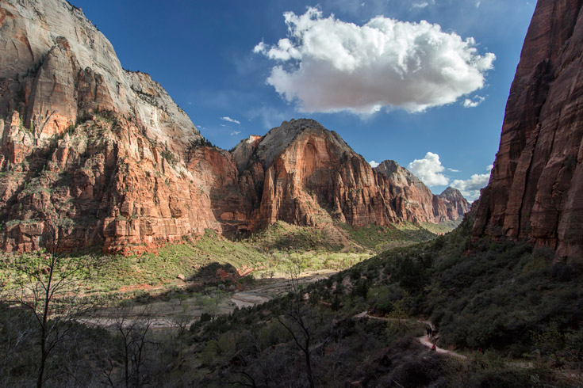
Isaiah 32:18 (NLT)
"My people will live in safety,
quietly at home.
They will be at rest."
Notes:
He also promises, "My people will live in peaceful dwelling places, in secure homes, in undisturbed places of rest" (Isa. 32:18; cf. Ezek. 34:15).
The kingdom age is spoken of as a time in which God "will rest in His love" (Zeph. 3:17)

Slide 32



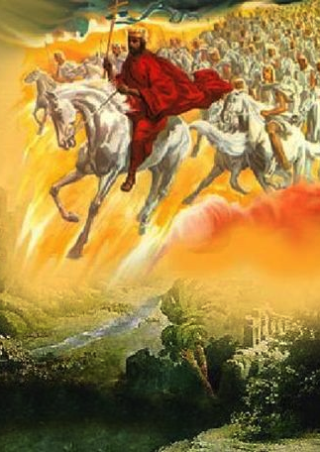
Future Benefits
(Rev. 19–22)
421
Heaven
(Rev. 21–22)
Millennium
(Rev. 20)
Return
(Rev. 19)
Notes:
Believers will reign with Christ for 1000 years! It makes sense that this period is between Christ’s return in Rev 19 and the eternal state in Rev 21–22.
___________
FU-
OS-17-Esther-146
NS-27-Rev20-22-slide

Slide 33
Hebrews 4:8-11 (NLT)
Now if Joshua had succeeded in giving them this rest, God would not have spoken about another day of rest still to come. ⁹So there is a special rest still waiting for the people of God. ¹⁰For all who have entered into God's rest have rested from their labors, just as God did after creating the world. ¹¹So let us do our best to enter that rest. But if we disobey God, as the people of Israel did, we will fall.
Notes:
Hebrews 4:8 refers to the Sabbath rest as a time period: "For if Joshua had given them rest, God would not have spoken later about another day." Obviously "day" refers to another time period, not another state of being. This does not definitively argue for the millennial view since the heavenly rest view relates to a future time period; however, it is consistent with the kingdom view and inconsistent with the "present spiritual rest" orientation.

Slide 34
Hebrews 4:1-2 (NLT)
God's promise of entering his rest still stands, so we ought to tremble with fear that some of you might fail to experience it. ²For this good news—that God has prepared this rest—has been announced to us just as it was to them. But it did them no good because they didn't share the faith of those who listened to God.

Slide 35
Hebrews 4:3-5 (NLT)
For only we who believe can enter his rest. As for the others, God said, "In my anger I took an oath: 'They will never enter my place of rest,'" even though this rest has been ready since he made the world. ⁴We know it is ready because of the place in the Scriptures where it mentions the seventh day: "On the seventh day God rested from all his work." ⁵But in the other passage God said, "They will never enter my place of rest."
Notes:
Hebrews 4:3 and Hebrews 4:5 refer to the Sabbath rest (katapausin) as ”rest” (NIV, NAU) or “place of rest” (NLT). Where else would this place be but the same place Israel entered—Canaan itself?

Slide 36
Hebrews 4:6-7 (NLT)
So God's rest is there for people to enter, but those who first heard this good news failed to enter because they disobeyed God. ⁷So God set another time for entering his rest, and that time is today. God announced this through David much later in the words already quoted: "Today when you hear his voice,
don't harden your hearts."
Notes:
But is that rest today? Certainly what we do today determines if we will enter Canaan rest in the millennium. But note also what the author says in verse 11…

Slide 37
Hebrews 4:8-11 (NLT)
Now if Joshua had succeeded in giving them this rest, God would not have spoken about another day of rest still to come. ⁹So there is a special rest still waiting for the people of God. ¹⁰For all who have entered into God's rest have rested from their labors, just as God did after creating the world. ¹¹So let us do our best to enter that rest. But if we disobey God, as the people of Israel did, we will fall.
Notes:
Verse 11 shows that the readers had not yet entered rest since they are commanded to be faithful to enter in the future.

Slide 38
Why press on with Christ?
ENTER
MILLENNIAL
RULE
ENTER
MILLENNIAL
REST
Notes:
What reasons can you give to remain faithful to Jesus?
I. Press on to enter your millennial rule (Heb 3:7-19).
[Perseverance in the Christian race leads to reigning with Jesus for 1000 years.]
II. Press on to enter your millennial rest (Heb 4:1-13).
[Perseverance in the Christian race leads to a “restful rule” for 1000 years.]

Slide 39
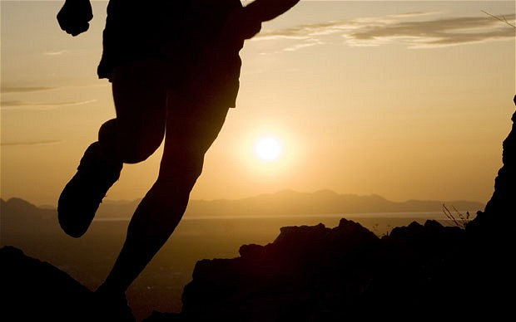
Press on to rule and rest with Christ
Main Idea:
Notes:
Instead of God’s discipline, choose his blessing of reigning with him in the future Sabbath rest in the kingdom (millennial) age (MI restated).

Slide 40

Turning away from Christ forfeits your future rule.
Notes:
Christians who abandon Jesus will not reign with him after he returns.

Slide 41

Salvation is by faith, but rewards are by works.
Main Idea of Message 1
Notes:
This is message 3 of my 4-part series on the Inheritance of the Believer. In the first message, we saw this key truth: We come into a right relationship with God by placing our trust in Christ—but that is just the beginning as we need to obey him to be fully blessed (MI restated).
Then, the second message concluded that…

Slide 42

Our salvation is secure, but defectors lose rewards.
Main Idea of Message 2
Notes:
Then we learned that the Bible teaches both assurance and apostasy—so believers can lose rewards but not salvation (MI restated).

Slide 43
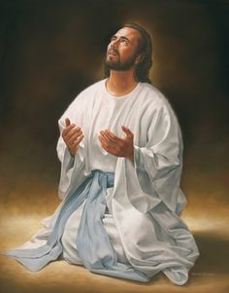
Don't convince God to bring you to heaven early!
Main Idea of Message 3
Notes:
Turning away from Jesus—apostasy—can result in the Lord not only taking away our rewards but also taking away our lives!

Slide 44
Press on to rule and rest with Christ
Main Idea of Message 4
Notes:
Instead of God’s discipline, choose his blessing of reigning with him in the future Sabbath rest in the kingdom (millennial) age (MI restated).

Slide 45
ثابر حتى تحكم و ترتاح
مع المسيح
الفكرة الرئيسية
Notes:
Instead of God’s discipline, choose his blessing of reigning with him in the future Sabbath rest in the kingdom (millennial) age (MI restated).

Slide 46


علم الخلاص • BibleStudyDownloads.org
أحصل علي هذا العرض مجانا!
Notes:
SA Salvation (Soteriology) in Arabic

Slide 47
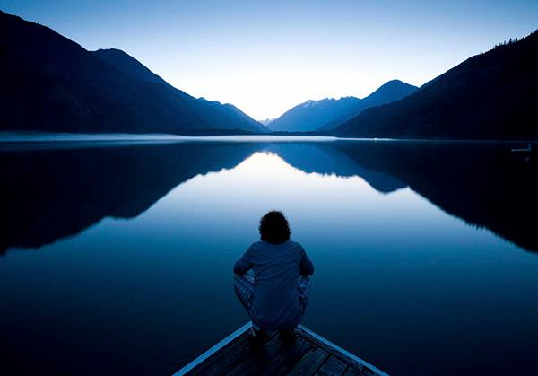
"There remains, then, a Sabbath-rest for the people of God; ¹⁰for anyone who enters God's rest also rests from his own work, just as God did from his. ¹¹Let us, therefore, make every effort to enter that rest, so that no one will fall by following their example of disobedience" (Hebrews 4:9-11 NIV).
Notes:
But believers whose hearts are soft and lives are faithful will experience a wonderful rule and rest (4:9-11).

Slide 48
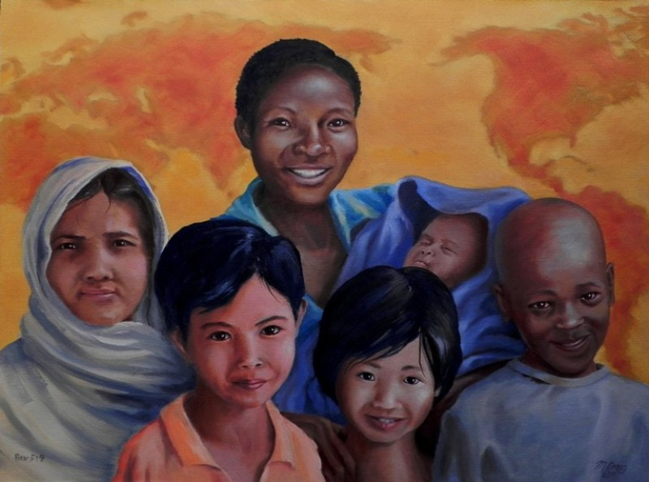
"From every tribe, nation, language and people" (Rev. 5:9)
Notes:
Are you committed to help reach people “from every tribe, nation, language, and people” (Rev 5:9)?

Slide 49
Hebrews 3:12-14 (NLT)
Be careful then, dear brothers and sisters. Make sure that your own hearts are not evil and unbelieving, turning you away from the living God. ¹³You must warn each other every day, while it is still "today," so that none of you will be deceived by sin and hardened against God. ¹⁴For if we are faithful to the end, trusting God just as firmly as when we first believed, we will share in all that belongs to Christ.
Notes:
Let’s be “faithful to the end, trusting God just as firmly as when we first believed [so] we will share in all that belongs to Christ” (Heb 3:14).

Slide 50
Hebrews 4:12-13 (NLT)
For the word of God is alive and powerful. It is sharper than the sharpest two-edged sword, cutting between soul and spirit, between joint and marrow. It exposes our innermost thoughts and desires.
¹³Nothing in all creation is hidden from God. Everything is naked and exposed before his eyes, and he is the one to whom we are accountable.
Notes:
What concerns you about the fact that, "Nothing in all creation is hidden from God. Everything is naked and exposed before his eyes, and he is the one to whom we are accountable" (4:13)? Confess this to God.
______________
Only God knows our state as nothing is hidden from him (Heb 4:12-13).

Slide 51
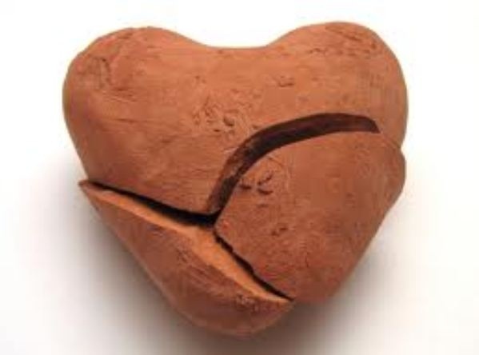
Is your heart hardening?
Notes:
Three times the author told them not let their hearts harden (3:7, 15; 4:7). Is God also telling you? Let's bow for prayer.
Are you softer or harder towards Jesus than 5 years ago? Why? Tell him that you want to be softened.

Slide 52
Black

Slide 53
Topical Preaching link at BibleStudyDownloads.org
Get this presentation and script for free!
Notes:
TP Topical Preaching

