Slide 1

The Inheritance of the Believer
Warnings in Hebrews
Soteriology: God’s Rescue Program
Dr. Rick Griffith • Jordan Evangelical Theological Seminary
BibleStudyDownloads.org
Notes:
Here is Part 3 of the 4-part study on The Inheritance of the Believer.

Slide 2
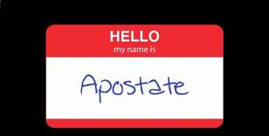
Apostates don't wear nametags
Notes:
I guess that you have never seen a nametag like this.
• That’s because apostates don’t wear nametags.

Slide 3

Apostates Destroy From Within
The Men who Destroyed the Christian West
Notes:
Believers have failed to fight apostasy for the past 200+ years.
• Apostates are believers who turn away from Christ and yet live among the saints and destroy the church within. This has happened significantly in what used to be called the "Christian West."

Slide 4
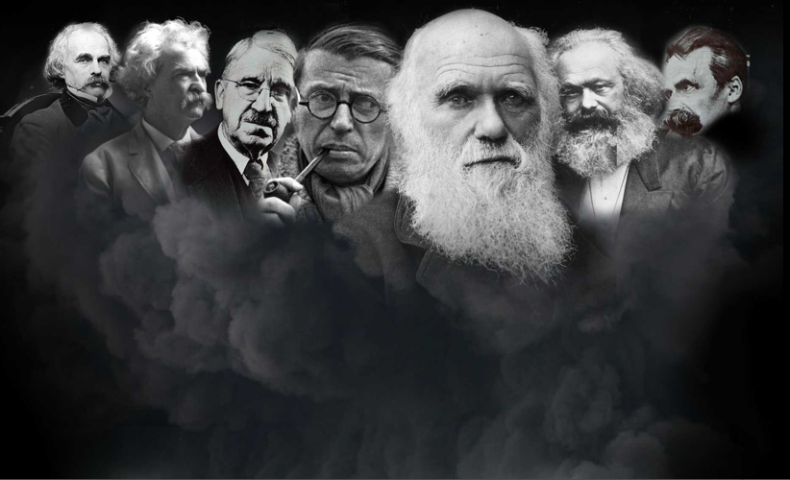
Who are the apostates?
Charles Darwin
Nathaniel Hawthorne
John Dewey
Friedrich Nietzsche
Mark Twain
Karl Marx
Jean-Paul Sartre
Ernest Hemingway
Lady Gaga
Notes:
This includes many well-known men of the past—and even moderns like Ernest Hemingway and Lady Gaga. One thing they all have in common is that they all grew up in Christian homes but later turned away from the faith. The word “apostate” means to turn away so they originally trusted in Christ but then turned away. Notice that none of them smile.

Slide 5
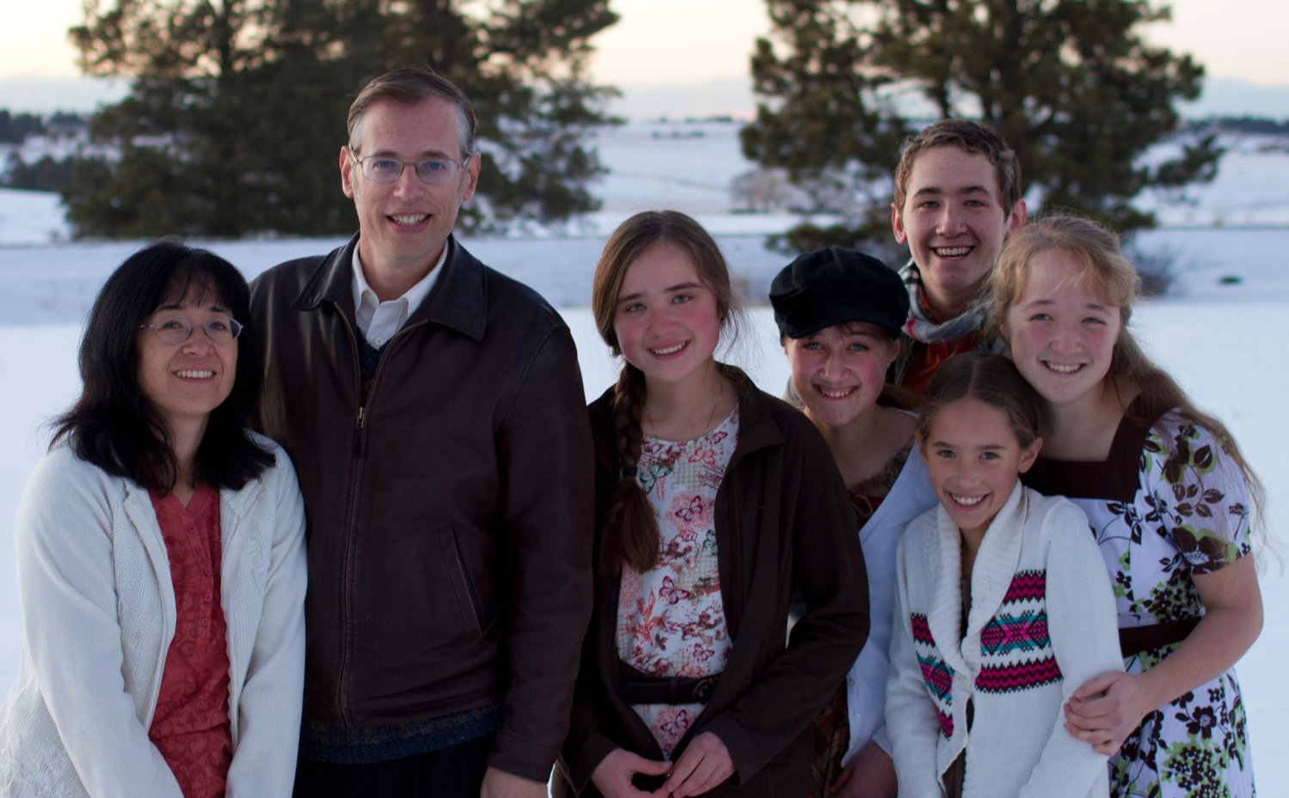
The Book Apostate
Kevin Swanson and his family
Notes:
Kevin Swanson chronicles the history of Western apostasy in his book called Apostate.

Slide 6

Why are they significant?
"This is the story of the decline and fall of Western civilization. It is the story of uncommonly powerful men, unfathomably evil men. . . apostates."
–Kevin Swanson

Slide 7
What did the apostates teach?
Charles Darwin
Nathaniel Hawthorne
John Dewey
Friedrich Nietzsche
Mark Twain
Karl Marx
Jean-Paul Sartre
"Eliminate home schools!"
"There is no God!"
"God didn't create. We evolved!"
Notes:
• John Dewey founded the US public education system to eliminate home schools.
• Darwin convinced the world to believe in evolution instead of creation.
• And Marx was an atheist.

Slide 8
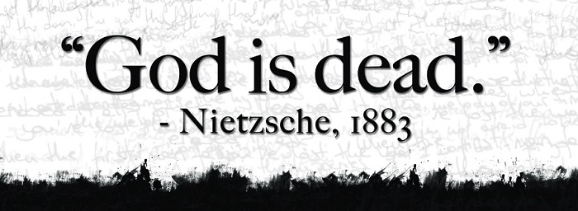
Godless Philosophy
"God is dead."
– Nietzsche, 1883
"Nietzsche is dead."
– God, 1900
Used with permission
Notes:
Nietzsche popularized the saying, “God is dead” in 1883.
• But God responded 17 years later, “Nietzsche is dead.”

Slide 9

Rob Bell & Oprah Winfrey
Notes:
Modern apostates who also grew up in Christian homes include Rob Bell (author of Love Wins, a universalist book), and Oprah Winfrey—the most popular apostate in the world as the most influential woman who teaches the same belief that all are saved.

Slide 10
The Inheritance of the Believer
Warnings in Hebrews
Message 3 of 4
Soteriology: God’s Rescue Program
Dr. Rick Griffith • Jordan Evangelical Theological Seminary
BibleStudyDownloads.org
Notes:
Here is Part 3 of the 4-part study on The Inheritance of the Believer.

Slide 11

Salvation is by faith, but rewards are by works.
Main Idea of Message 1
Notes:
This is message 3 of my 4-part series on the Inheritance of the Believer. In the first message, we saw this key truth: We come into a right relationship with God by placing our trust in Christ—but that is just the beginning as we need to obey him to be fully blessed (MI restated).
Then, the second message concluded that…

Slide 12

Our salvation is secure, but defectors lose rewards.
Main Idea of Message 2
Notes:
Then we learned that the Bible teaches both assurance and apostasy—so believers can lose rewards but not salvation (MI restated).

Slide 13
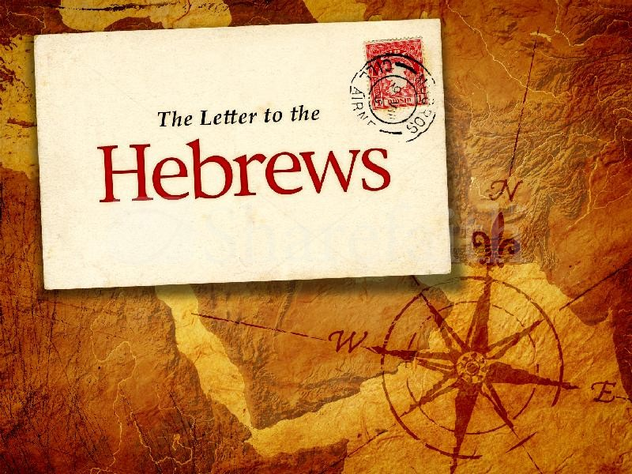

Hebrews
The Letter to the
Notes:
Today we will see that the book of Hebrews warns Jewish believers from apostasy—do you know what they are warned about?

Slide 14
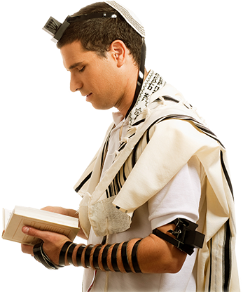
How do we know that the readers were Jews?
Notes:
The whole book assumes they know the OT law and sacrifices.

Slide 15
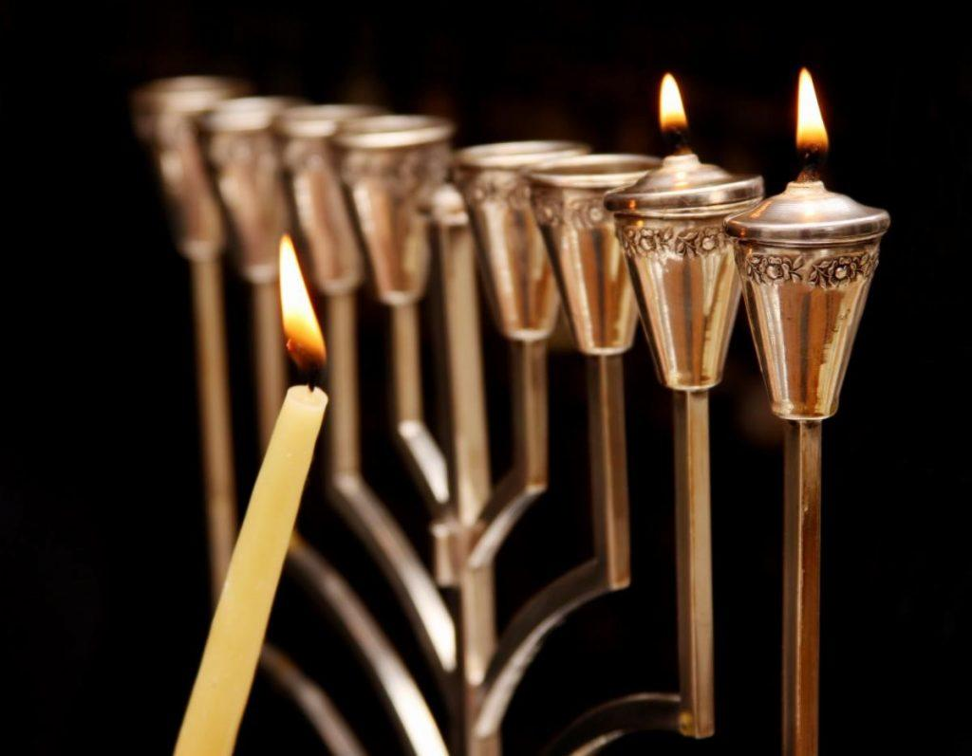
The readers were Jewish Christians
"brothers and sisters who belong to God and are partners with those called to heaven" (3:1)
"…let us hold firmly to what we believe. This High Priest of ours understands…"
(4:14b-15a)
"…dear brothers and sisters, we can boldly enter heaven's Most Holy Place because of the blood of Jesus" (10:19)
"…those early days when you first learned about Christ…you remained faithful even though it meant terrible suffering" (10:32)
Notes:
We also know the readers were Christians. These are clearly believers—why else would he repeatedly call them "brothers and sisters"? These Jews were second-generation (2:1-4) believers (3:1; 4:14b-15a; 10:19, 32; cf. 12:7; 13:1, 20-22) who should have matured beyond their present immature state in Christ (5:11-14).

Slide 16

"Should I go back?"
"So we must listen very carefully to the truth we have heard, or we may drift away from it" (Hebrews 2:1 NLT).
Notes:
These believing Jews were undergoing so much difficulty that they were considering a return to Judaism—a temptation to turn away or turn back to their Jewish roots.

Slide 17

The Supremacy of Jesus in the Book of Hebrews
Notes:
So the writer sought to convince them that Jesus is better than anything they ever experienced in Judaism.

Slide 18
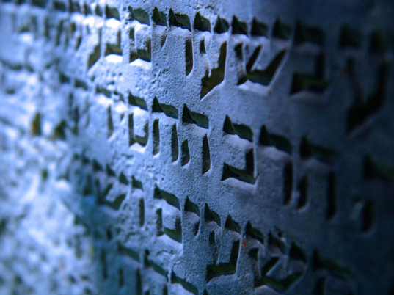
The "Better" Book
Hebrews uses the word "better" 13 times…
266f
1:4 Christ is "better than the angels"
6:9 We are confident of "better things in your case"
7:7 Melchizedek "better" ("greater") than Abraham
7:19 "We have confidence in a better hope"
7:22 Jesus is the "guarantee of a better covenant"
8:6 Christ is the "mediator of a better covenant"
8:6 New covenant "established on better promises"
9:23 Priestly garments need "better sacrifices"
10:34 Heaven a "better and lasting possession"
11:16 Heaven a "better country"
11:35 They obtain a "better resurrection" experience
11:40 God "provided something better for us"
12:24 Christ's blood is "better than the blood of Abel"
Note:
11:4 "Abel offered to God a better sacrifice" uses a different Greek word often translated "better"
Notes:
The writer told them not to reject the superior NT walk with Jesus for the inferior OT law.

Slide 19
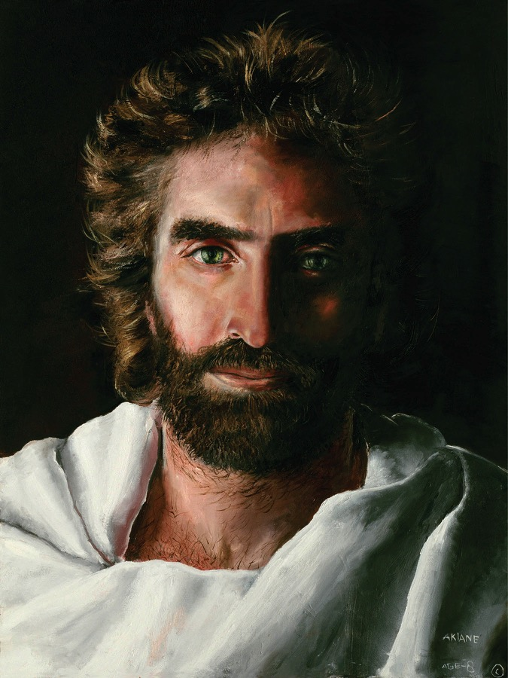
Christ is Superior in His Person (1:1–4:13)
Notes:
The first movement of the book notes that Christ is superior in his person to anyone in the OT.

Slide 20

5 Warnings in Hebrews
258
Warning of drifting from truth (2:1-4)
Warning of unbelief (3:7-19)
Warning of immaturity (5:11–6:12)
Warning of wilful sin (10:19-39)
Warning of unconcern (12:14-29)
Today we will see two key warnings in Hebrews on apostasy
Notes:
Spread throughout the letter are FIVE dire admonitions not to apostatize (read them).
• Subject: Today we will see two key warnings from Hebrews about apostasy.
There are 5 warnings in total.
But we do not have time for all 5 today.
Preview: We will look only at Warning 3 and Warning 4.
Text: These are the two most controversial texts in Hebrews—and probably the whole NT.

Slide 21

Warning 1
Abandoning Jesus brings discipline
(2:1-4).
Notes:
Turning our backs on Christ makes God turn up the heat in our lives.

Slide 22
Warning 2
Abandoning Jesus forfeits our future rule (3:7-19).
Notes:
Turning our backs on Christ disinherits us from our millennial reign with Christ.

Slide 23
Warning 3
Rejecting Christ can lead to physical death (5:11–6:20).
Notes:
Christians who later reject Jesus can die before their time.

Slide 24
Warning 4
Willful sin can lead to physical death
(10:26-31).
Notes:
Believers who purposely reject Christ can die before their time.

Slide 25
Warning 5
Refusing God has consequences
(12:25-29).
Notes:
Ignore the Lord and you will experience his discipline rather than his grace.

Slide 26
Warning 3
Rejecting Christ can lead to physical death (5:11–6:20).
Notes:
Christians who later reject Jesus can die before their time.

Slide 27

It is impossible to repent from apostasy because you’re dead
(Hebrews 6:4-8).

Slide 28

An Impossibility (Heb. 6:4-6 NLT)
"For it is impossible to bring back to repentance those who were once enlightened—those who have experienced the good things of heaven and shared in the Holy Spirit, ⁵who have tasted the goodness of the word of God and the power of the age to come— ⁶and who then turn away from God. It is impossible to bring such people back to repentance; by rejecting the Son of God, they themselves are nailing him to the cross once again and holding him up to public shame."
Notes:
Too often we read this as if it says, “For it is impossible to bring back to SALVATION…”
But it doesn’t say “SALVATION.” It says “REPENTANCE” and no one can be brought BACK to repentance unless he has already FIRST repented, right? This text refers to Christians!

Slide 29
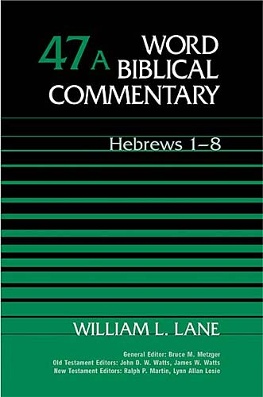
Will some Christians go to hell?
He says yes.
Notes:
The two-volume massive commentary series by William Lane addresses questions relevant to us all.

Slide 30
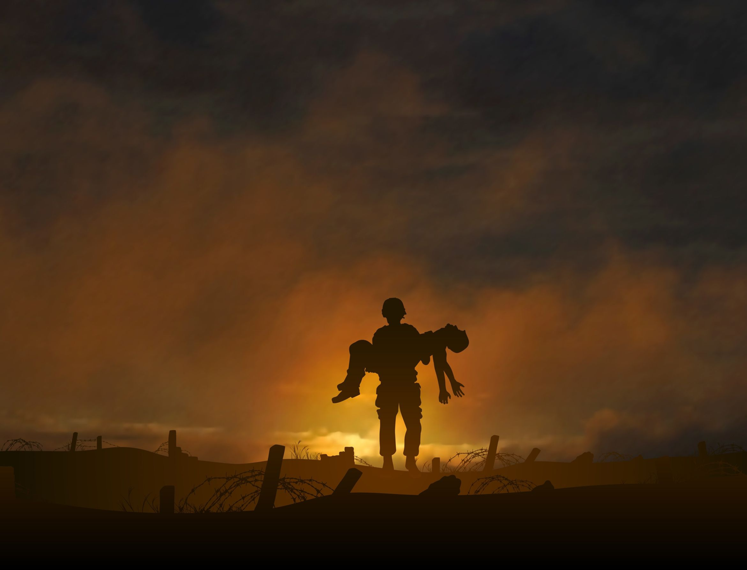
What is the danger in 6:4-8?
A Christian who loses his salvation?
A hypothetical, impossible situation that could never happen?
A profession that really wasn't genuine and thus results in hell?
A believer who is disqualified for Christian service and will never again return to spiritual commitment due to death has the best evidence

Slide 31


I think the readers lived in Israel
256
Rome
Israel

Slide 32
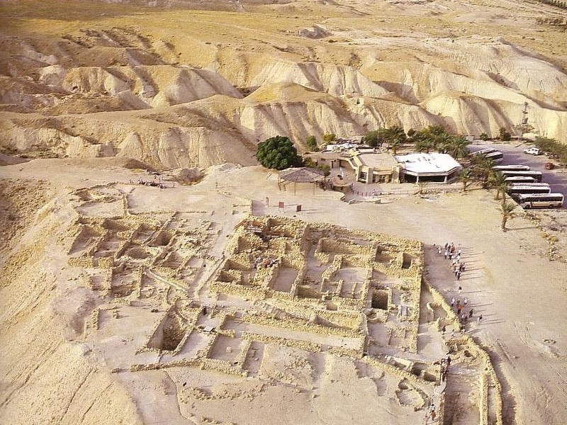

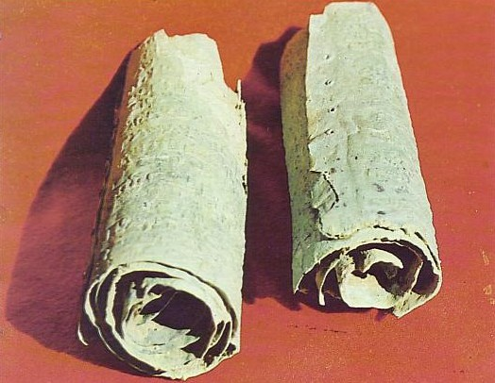
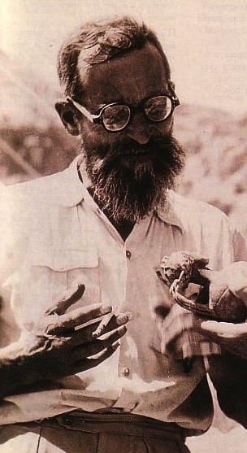
The Qumran Ruins
De Vaux
Notes:
Maybe they were even from a secluded community like Qumran.
• Excavated by Roland De Vaux

Slide 33

Israel
(AD 67-68)
Jerusalem
Notes:
During the Jewish Revolt of AD 66-73, all the Jews—believers and unbelievers alike—found refuge in Jerusalem against the Roman armies.

Slide 34
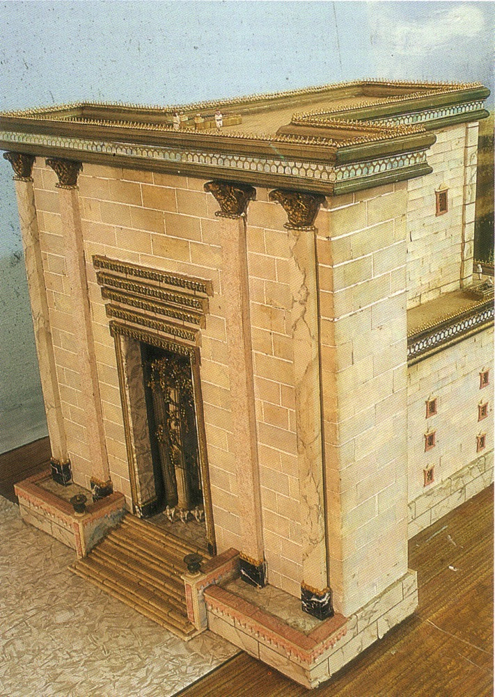
The Temple Sanctuary
Notes:
The temple had stood for almost 600 years. In fact, this Second Temple had just been completed in AD 64 but Jesus said that not one of its stones would remain on another (Matt 24:2).

Slide 35
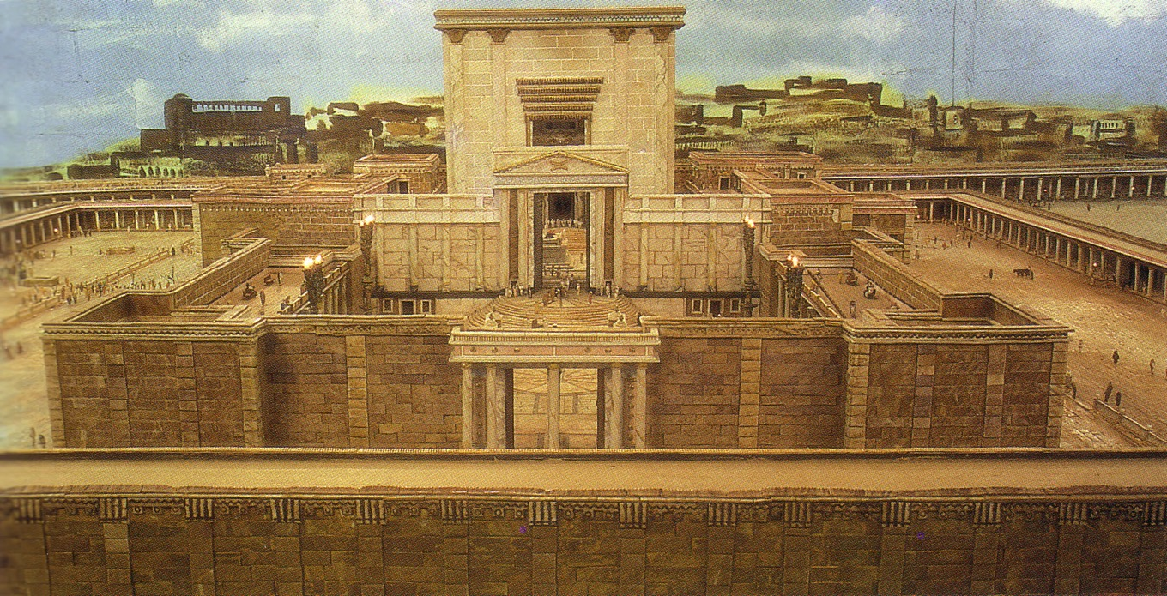
The Temple from the east
Notes:
The temple was a massive complex that ended up being the last part of the city for the Jews to defend. Was this temple worth defending?

Slide 36
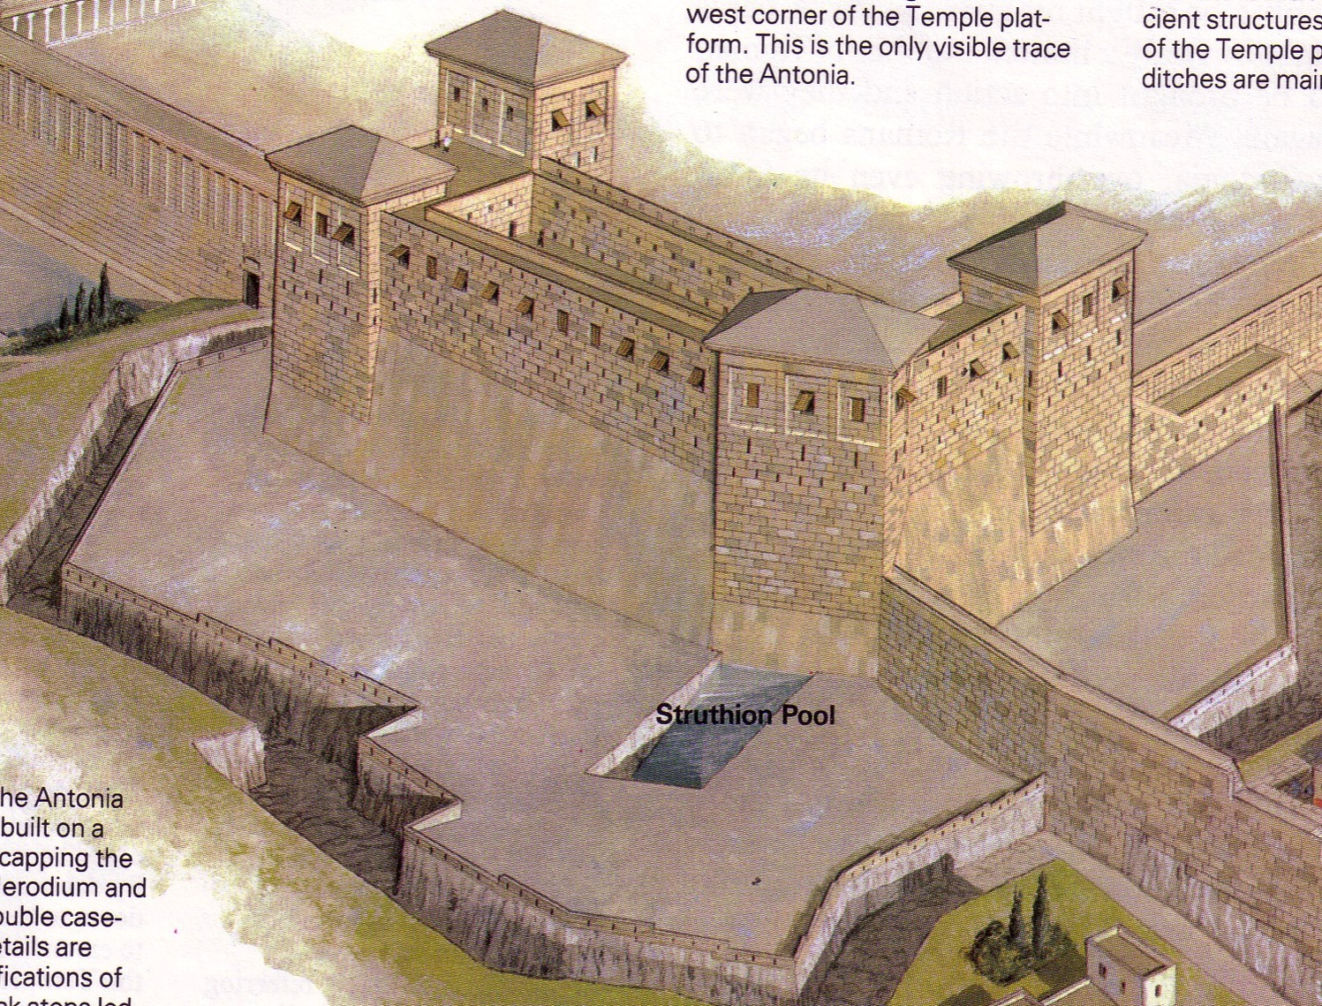
Antonia Fortress
Notes:
Of particular importance was this fortress with four towers overlooking the temple complex.

Slide 37
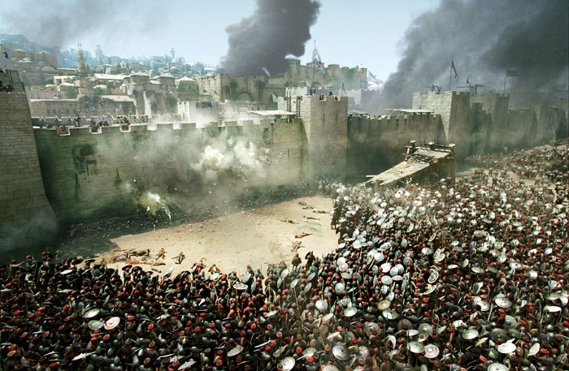
Antonia Fortress Leveled
Notes:
The Romans strategically focused their attack on the northern side to capture Antonia Fortress.

Slide 38
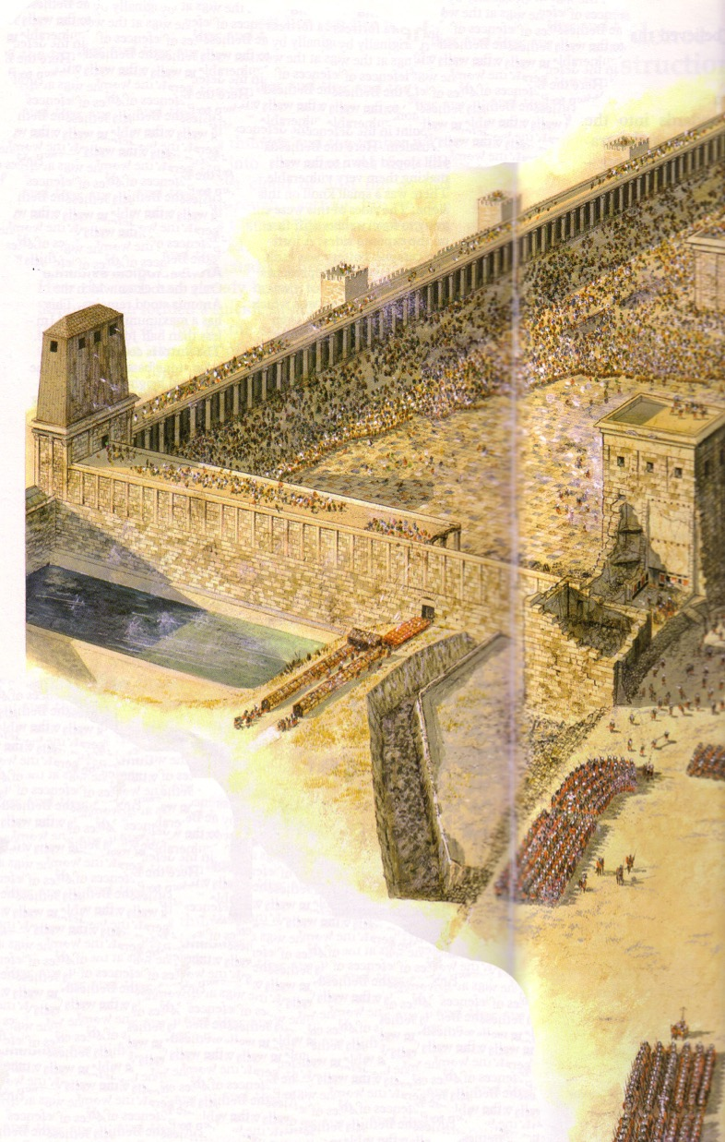
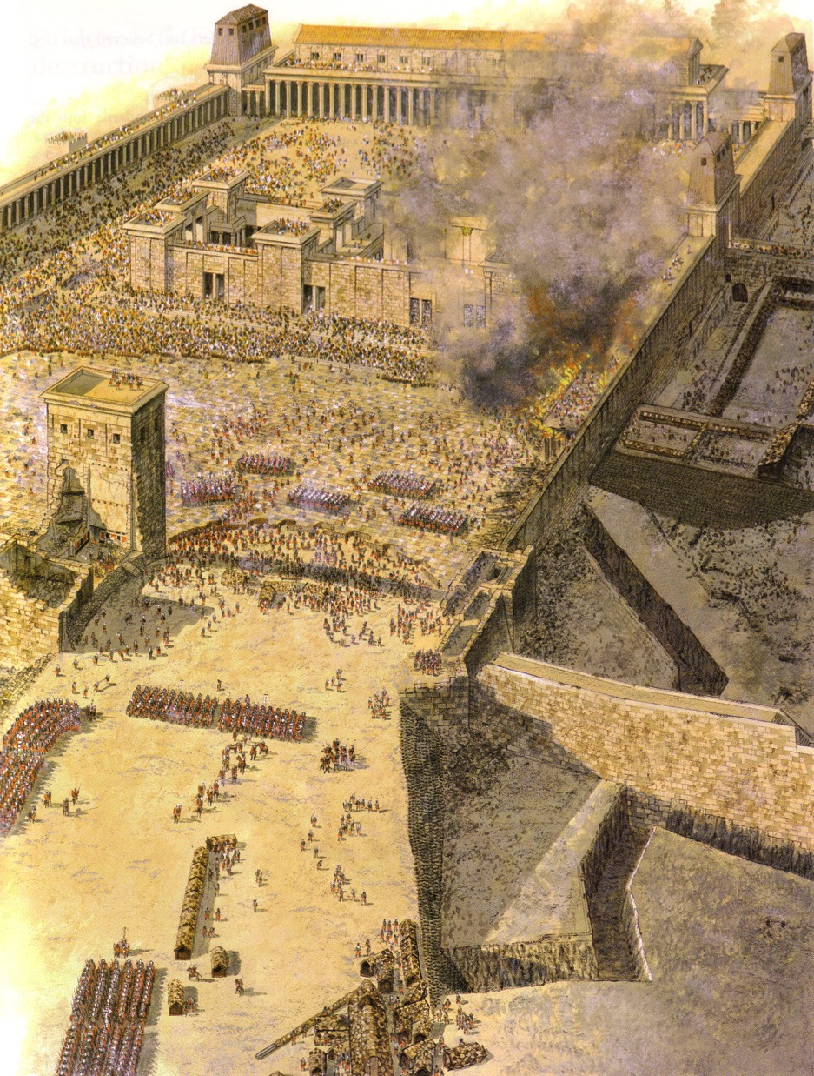
Antonia Fortress Leveled
Notes:
Finally it was leveled except for one tower that Titus used to command his troops.

Slide 39
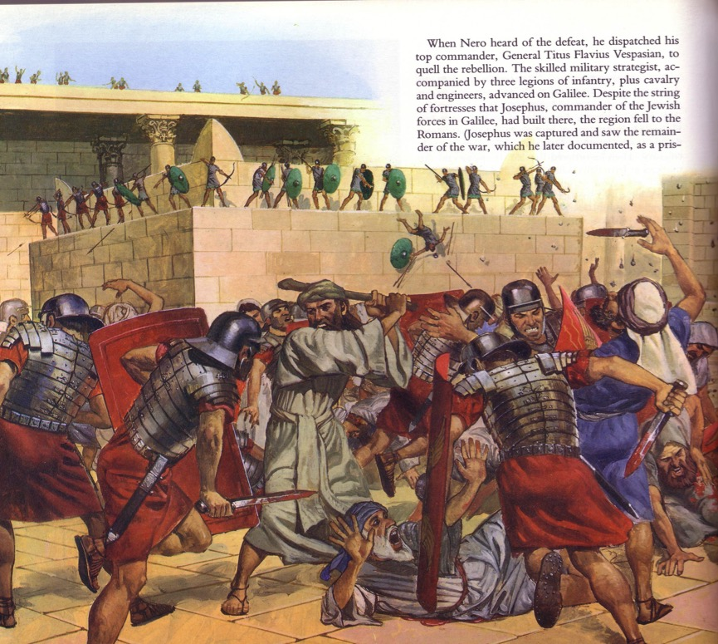
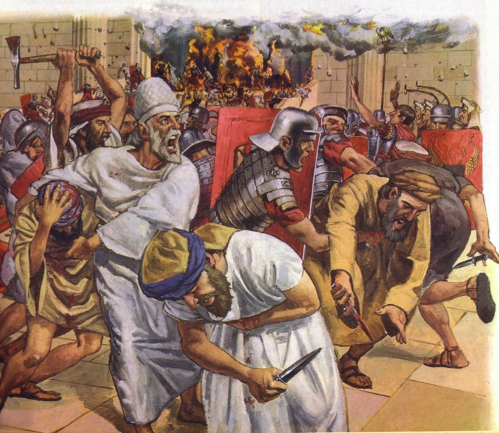
The Temple Assault
Notes:
The assault was an absolute bloodbath.
• This was especially against commoners and priests inexperienced in war to face the professional Roman soldiers, who killed them by the thousands.

Slide 40
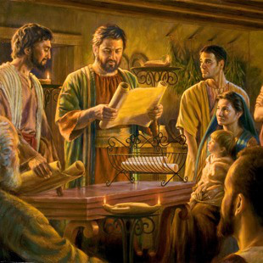
Jerusalem Christians
Notes:
But before this time, Jerusalem also had many Christians. This letter addressed believing Jews during these years of the Jewish-Roman War (AD 66-73).

Slide 41
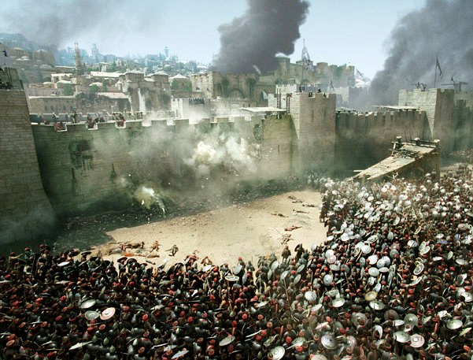
Should the Christians stay and fight?
Notes:
The question for Christian Jews was simply this: Should they also join with their unbelieving Jewish brothers to fight against Rome? Should they risk their lives to preserve the obsolete temple system instead of persevering in their belief in a risen Savior?

Slide 42
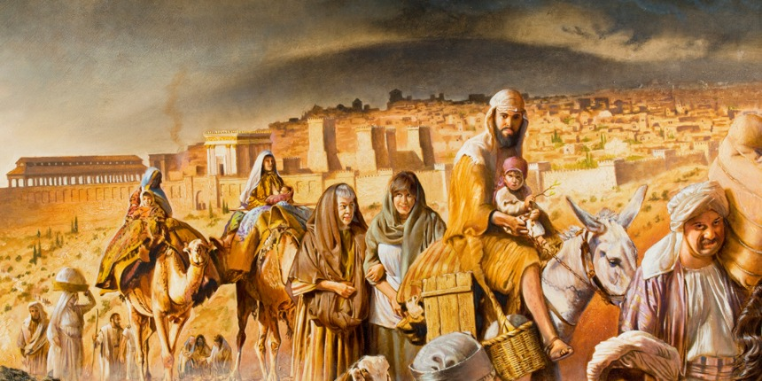
Jerusalem Christians left
Notes:
The believers left Jerusalem before Rome destroyed it in AD 70.

Slide 43
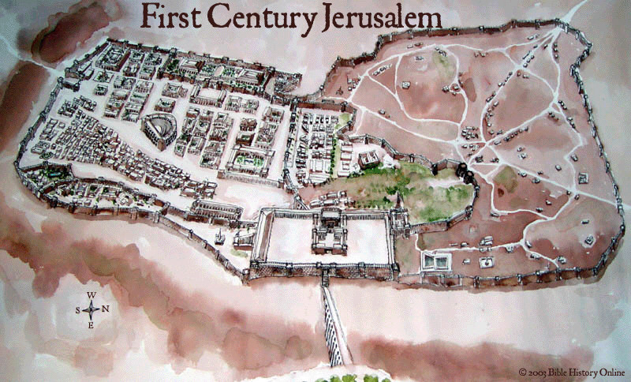

First Century Jerusalem
Notes:
No Christian was left in the city—but would these readers go with them?

Slide 44

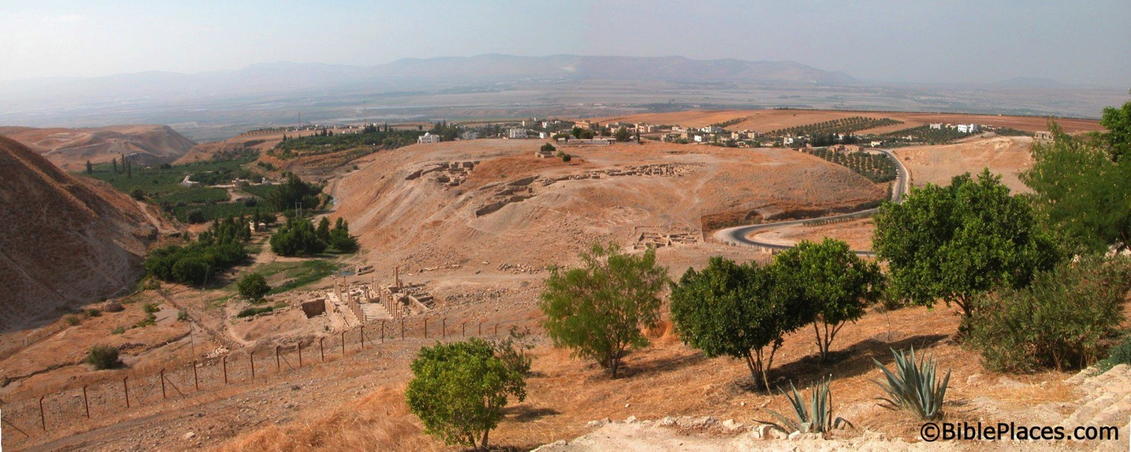
What happened to the Christians in Jerusalem?
A revelation told them to find protection in Pella.
Pella
Jerusalem
Notes:
• The church historian Eusebius says that God gave a revelation.
• So they left Jerusalem, crossed over into modern-day Jordan, and settled in Pella.
• This peaceful city has the same name today.
________
"Pella/Pehel is not mentioned explicitly in the Bible but it was prominent in biblical times. In the days of the judges, it led a rebellion against Egypt which was crushed by Pharaoh Seti I. In NT days, Pella was the site where Christians sought refuge during the Jewish Revolt against the Romans in 66-70 A.D. Eusebius records that the Jewish believers fled here in obedience to a revelation, which some correlate with Jesus' words in Matthew 24:16. This photo views the tell from the east. Several Byzantine churches have been excavated as well as a building believed to be a Late Bronze temple. The Jordan Rift and the mountains of Israel are visible in the background.” —Todd Bolen, BIblePlaces.com

Slide 45
Warning 3
Rejecting Christ can lead to physical death (5:11–6:20).
Notes:
Christians who later reject Jesus can die before their time—so they cannot repent!

Slide 46
Warning 4
Willful sin can lead to physical death
(10:26-31).
Notes:
Christians who deliberately turn away from Jesus can die before their time.
Believers who purposely reject Christ can enter heaven earlier than God intended.

Slide 47

"…if we deliberately continue sinning after we have received knowledge of the truth, there is no longer any sacrifice that will cover these sins. ²⁷There is only the terrible expectation of God's judgment and the raging fire that will consume his enemies"
(10:26-27 NLT).
ARE THESE PEOPLE CHRISTIANS?

Slide 48
Why believers?
The letter repeatedly refers to the readers as believers.
They had already professed this hope in Christ (10:23).
They should build one another up in the faith (10:24-25).
They had "received the knowledge of the truth" (10:26).
The author also could sin like this (10:26).
They had been "sanctified" (10:29).
They had faithfully suffered for Christ (10:32-34).
They had confidence in the Lord (10:35).
They needed only to persevere in that faith (10:36).
They were deemed among "the righteous" (10:38).
Notes:
There are many verses in Hebrews 10 that show them to be believers in Christ.

Slide 49
The Fire
²⁶ Dear friends, if we deliberately continue sinning after we have received knowledge of the truth, there is no longer any sacrifice that will cover these sins. ²⁷ There is only the terrible expectation of God's judgment and the raging fire that will consume his enemies (Heb. 10:26-27 NLT).
Hell fire?
No, Jerusalem fire!
Notes:
God’s judgment on these readers if they turned away would be “the raging fire that will consume his enemies.”
• Most commentaries claim that this means the readers would go to hell.
But is this hell fire? If so, that would mean these Christians would then go to hell! This is against all that the NT teaches about believers having eternal life.
• No, it refers to Jerusalem fire! Their salvation was secure—but their apostasy would lead to being killed along with the unbelieving Jews who stayed in Jerusalem to protect the temple!

Slide 50
Hebrews 8:13
"By calling this covenant 'new,'
he has made the first one obsolete; and what is obsolete and aging will soon disappear."
Obsolete
AD 33
Hebrews Written
AD 67-68
Disappeared
AD 70
Notes:
Hebrews 8:13 appropriately warns that the old covenant would soon disappear in the temple destruction.
• The arrival of the new covenant in Jesus meant that God no longer wanted us to follow the old covenant under Moses. It became obsolete at the death of Christ in AD 33.
• Hebrews was written about 35 years later when the sacrificial system still operated. I guess someone sewed the veil of the temple back together!
• The writer then amazingly wrote that this obsolete old covenant would soon disappear—the event that happened in AD 70 with the destruction of the temple and the sacrificial system. Since then a Jew has not been able to offer sacrifices even if he wanted to do so.

Slide 51
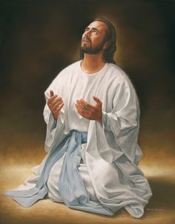
Don't convince God to bring you to heaven early!
Main Idea
Notes:
Turning away from Jesus—apostasy—can result in the Lord not only taking away our rewards but also taking away our lives!

Slide 52
Warning 3
Rejecting Christ can lead to physical death (5:11–6:20).
Notes:
Christians who later reject Jesus can die before their time.

Slide 53
Warning 4
Willful sin can lead to physical death
(10:26-31).
Notes:
Christians who deliberately turn away from Jesus can die before their time.

Slide 54
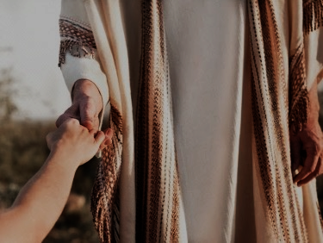
It's happened.
Ananias & Sapphira died
(Acts 5:1-11)
Lord's Supper abuses
(1 Cor. 11:30)
Some sin leads to death
(1 John 5:16-17)
Some escape "as through fire"
(1 Cor. 3:15)
Notes:
We already saw in message 2 how God disciplined believers with death for the serious sin of apostasy.

Slide 55
The Problem with Labels
266c
Must we be one or the other…?
Reformed?
…or…
Arminian?
Many do Fall Away
Loss of Salvation
Weaknesses
Eternal Security
Reality of Apostasy
Strengths
Partakers View Has Both Strengths & Neither Weakness
Notes:
The Partakers View sees death for apostasy while maintaining eternal security.

Slide 56


The Reign of the Servant Kings
Jody Dillow is the key author of the Partakers View
Final Destiny
The Future Reign of the Servant Kings
Joseph Dillow
Notes:
• There is a future reign of the Servant Kings—that is you and me!
• Our future inheritance is well articulated by Joseph Dillow in his massive book, Final Destiny
• Dillow is the key author of what he calls the Partakers View.
This view explains inheritance in the OT.
Inheritance in the OT was of two types:
All Israelites who believed in the LORD would have God as their inheritance—or be saved.
But only those Israelites that obeyed the LORD wholeheartedly would inherit Canaan—or be rewarded.
Dillow calls this view the Partakers View based on Hebrews 3:14 that promises believers who persevere to be partakers or sharers with Jesus in his future rule.
___________
Common-257
OS-04-Numbers-148
OS-06-Joshua-175
NS-19-Hebrews-58, 186, 448
SA-15-Inheritance-35, 173
TP-01-Our Inheritance OT Summary-35
TP-03-Our Inheritance Hebrews Warnings-56

Slide 57


Application: "Leave Jerusalem"
"So also Jesus suffered and died outside the city gates to make his people holy by means of his own blood"
(Heb. 13:12 NLT)
¹³ So let us go out to him, outside the camp, and bear the disgrace he bore"
(Heb. 13:13 NLT)
Leen & Kathleen Ritmeyer, "Akeldama: Potter's Field or High Priest's Tomb?" BAR 20 (Nov/Dec 94): 34
Notes:
The application for the Hebrews was to leave Jerusalem (13:13).

Slide 58
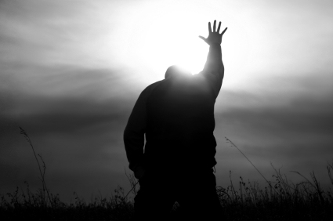
Commit yourself to him.
Notes:
The application for you is to commit yourself to him (leave sin).

Slide 59


Topical Preaching link at BibleStudyDownloads.org
Get this presentation and script for free!
Notes:
TP Topical Preaching

Slide 60
Black

