Slide 1
The Inheritance of the Believer
New Testament Summary
Soteriology: God’s Rescue Program
Dr. Rick Griffith • Jordan Evangelical Theological Seminary
BibleStudyDownloads.org
Notes:
Here is Part 2 of the 4-part study on The Inheritance of the Believer.

Slide 2
Will each genuine Christian persevere in faithfulness at death?
Notes:
I suspect every one of us knows someone who used to walk with Jesus but doesn't follow Christ anymore. What do you think of this person now? It raises this key question:
• Will each genuine Christ persevere in faithfulness at death?
We are talking ONLY about TRUE Christians here—not those who THINK they are believers but are not.
We all still struggle with sin after trusting Christ, but this question asks if every REAL Christian will continue to walk with Christ to the extent that he or she will die believing.
Or can that genuine believer deny Jesus during his or her life and die in that state of disbelief?
Turn to your neighbor and answer YES, NO, or DON’T KNOW.

Slide 3
Distinguishing Terms
67
 | Eternal Security | Assurance of Salvation
Basic Meaning | Being saved from the penalty of sin forever (once saved, always saved) | Knowing that we are saved from the penalty of sin forever
Definition | “The work of God which guarantees that the gift of salvation, once received, is forever and cannot be lost” (Ryrie, Basic Theology, 328) | “The realization of the truth of eternal security or perseverance” (Ryrie, Basic Theology, 328)
Notes:
Two often we use these terms interchangeably, but they are distinct.
——
HS-04-Sealing, Indwelling-79
NS-04-John1-11-slide 97
NS-04-John12-21-slide 288
NS-19-Hebrews-50
NS-23-1 John-151
SA-14-Eternal Security-57
SA-15-Inheritance-47

Slide 4
Distinguishing Terms
67
 | Eternal Security | Assurance of Salvation
Spirit’s Ministry | Sealing (Eph 1:13-14) | Assuring (Rom 8:15-17)
Believer’s… | Position as child of God (Rom 8:16b) | Practice or confidence (Rom 8:16a)
Recipients | All Christians possess | Some Christians doubt
Permanence | Can’t be lost (John 6:39-40; 10:27-29; Rom 8:30, 38-39; Heb 7:25) | Can be lost (for this reason John wrote 1 John 5:11-13)
Songs | “I Know Whom I Have Believed” “In Christ Alone” “The Solid Rock” | “Blessed Assurance” “Now I Belong to Jesus”
Notes:
God wants us to have both eternal security and assurance of salvation.
Sadly, some believers are not taught correctly and have eternal security, but they do not know assurance of salvation.
There are even others who falsely think they have assurance when in fact, they are not saved and thus do not have eternal security.
——
HS-04-Sealing, Indwelling-80
NS-04-John1-11-slide 98
NS-04-John12-21-slide 289
NS-19-Hebrews-51
NS-23-1 John-152
SA-14-Eternal Security-58
SA-15-Inheritance-48

Slide 5
Will each genuine Christian persevere in faithfulness at death?
274j
Yes
No
Reformed
Partakers
Arminian
Apostasy Cannot Happen
Apostasy Leads to Loss of Rewards
Apostasy Leads to Loss of Salvation
Eternal Security but No Assurance
Eternal Security and Assurance
No Eternal Security and No Assurance
Notes:
Essentially three views are possible to answer the perseverance question. Though the Partakers View is the newest, I believe it is the most faithful to the Bible. It also has the strengths of the other views while avoiding their weaknesses, thus advocating a mediating view.
______________
Common English-155
NS-19-Hebrews-52
NS-20-James-115
SA-15-Inheritance-47

Slide 6
Views on Apostasy
Reformed
(Calvinist)
Arminian (Wesleyan)
The Bible distinguishes our two inheritances.
Perseverance of believers
(Apostasy impossible)
Partakers
Apostasy leads to loss of salvation
Security but no assurance
Eternal Security
Apostasy Possible
No security, no assurance
Apostasy leads to loss of rewards
How can we hold both apostasy and assurance?
Assurance
Notes:
6
Believers hold one of three basic views on eternal security, perseverance, and rewards.
1 • The Reformed view upholds perseverance saying that no believer can deny the faith—if someone does, he was not really a Christian as apostasy cannot happen.
2 • The Reformed View thus believes in security but you cannot tell if the person is a true believer until he dies without denying the Lord—thus no assurance of salvation.
3 • Arminians are the opposite. They advocate that true Christians can and do turn away from Christ—and this leads to them losing eternal life!
4 • Thus there is no security in salvation for the Arminian as one must keep walking with Christ to maintain salvation, which provides no assurance that one is saved.
5 • The Partakers View seeks to draw the best from both camps.
6 • Partakers teach that true Christians do abandon the faith—so they share this in common with the Arminian camp.
7 • But Partakers also share with the Reformed View the belief in eternal security—once saved, always saved—so salvation cannot be lost.
8 • Partakers also agree with Arminians that some believers do turn away, but this apostasy is seen as depriving them of rewards rather than losing salvation.
9 • In contrast to the other views, the Partakers have genuine assurance of salvation. But they do not give assurance of reward.
Though the Partakers View is the newest, I believe it is the most faithful to the Bible. It also has the strengths of the other views while avoiding their weaknesses, thus advocating a mediating view.
[Both the OT and NT teach that we can be heirs in two ways.]
______________
NS-19-Hebrews-64
SA-15-Inheritance-36

Slide 7
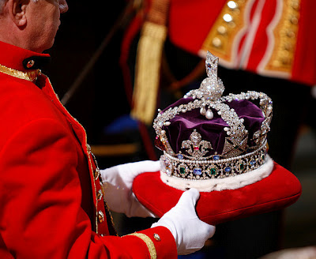
The Reign of the Servant Kings
Jody Dillow is the key author of the Partakers View
Final Destiny
The Future Reign of the Servant Kings
Joseph Dillow
Notes:
• There is a future reign of the Servant Kings—that is you and me!
• Our future inheritance is well articulated by Joseph Dillow in his massive book, Final Destiny
• Dillow is the key author of what he calls the Partakers View.
This view explains inheritance in the OT.
Inheritance in the OT was of two types:
All Israelites who believed in the LORD would have God as their inheritance—or be saved.
But only those Israelites that obeyed the LORD wholeheartedly would inherit Canaan—or be rewarded.
Dillow calls this view the Partakers View based on Hebrews 3:14 that promises believers who persevere to be partakers or sharers with Jesus in his future rule.
___________
Common-257
OS-04-Numbers-148
OS-06-Joshua-175
NS-19-Hebrews-58, 186, 448
SA-15-Inheritance-35, 173
TP-01-Our Inheritance OT Summary-35
TP-03-Our Inheritance Hebrews Warnings-56

Slide 8
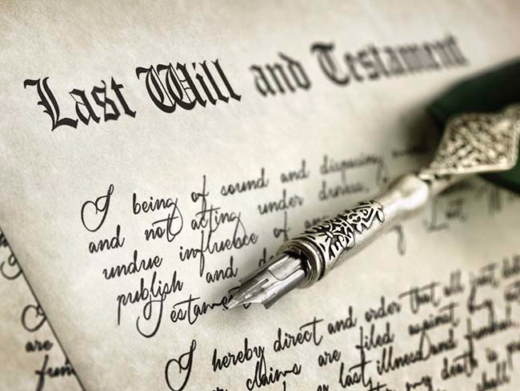
Inheritance Today

Slide 9
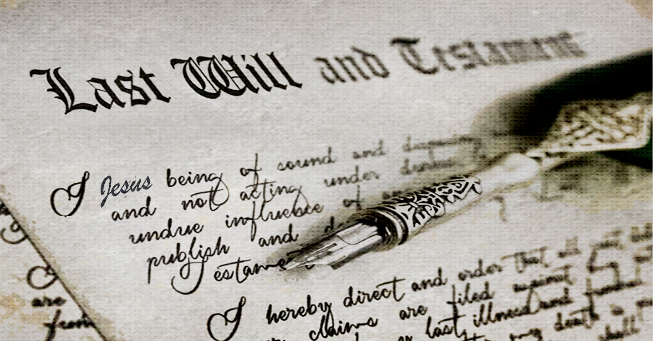
Inheritance from Christ

Slide 10
Inheritance in the NT

Slide 11
Two Types of Inheritance
"Now if we are children, then we are heirs—heirs of God and co-heirs with Christ, if indeed we share in his sufferings in order that we may also share in his glory" (Rom. 8:17 NIV).
= Salvation
= Reward
Notes:
Being "heirs of God" and "co-heirs with Christ" are different blessings in Romans 8:17. We know this because the latter has a conditional "if"—"if indeed we share in his sufferings."
All Christians are "heirs of God" by faith in Jesus Christ, leading to salvation. This means that they all have eternal life and a new standing (position) with God as sons. Paul explains this much in Romans 8.
But not all believers share in his sufferings, as Paul notes in 1 Corinthians 2:14–3:5 which shows many to be carnal (fleshly), or not walking with Christ in a consistent manner as is true of the "spiritual man." However, those Christians that sacrifice for Christ will also suffer with Christ and then "share in his glory" as "co-heirs with Christ," meaning that they will reign with him on the earth after Jesus returns (1 Cor 6:1-2; Rev 20:4-6).
________
Common-264
OP-04-Numbers-93
OS-04-Numbers-155
OS-06-Joshua-182
OS-37-Haggai-160
NP-02-Inheritance NT Summary-11
NS-Rom5-8-Slide149
NS-19-Hebrews-66, 193
SA-15-Inheritance-35

Slide 12
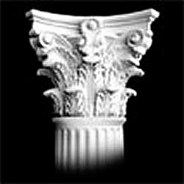
Kingdom Entering
##
Enter into Salvation
Enter into Discipleship
Salvation
Rewards
Entering into a Rich Experience of Life!
All believers
Faithful believers
Millennial dwelling
Millennial ruling
Wood, hay, straw
Gold, silver, jewels
Based on faith alone
Based on works
Notes:
"There are two kinds of inheritance - a salvation inheritance and a reward inheritance - see chapter 4. There are also several kinds of 'entering'—e.g., entering into salvation or into a way of kingdom living, a call to discipleship. E.g. Matt 5:19-20" (taught by Joseph Dillow, Final Destiny, 4th ed.) but I cannot find the exact quote.

Slide 13
##
Kingdom Entering
Enter into Salvation
Enter into Discipleship
Faith for salvation
Matt. 5:19 “So if you ignore the least commandment and teach others to do the same, you will be called the least in the Kingdom of Heaven. But anyone who obeys God’s laws and teaches them will be called great in the Kingdom of Heaven.’”
Notes:
Matthew certainly believed in salvation by faith alone, but here he says that some disciples who are not very faithful will still be in the kingdom. "Jesus has made it clear in Matthew 5:19 that a life of good works is not necessary to be in the kingdom" (Joseph Dillow, Final Destiny, 4th ed., 242).
_____________
"Are Works a Condition for Entering the Kingdom?
The New Testament includes 23 references to entering the kingdom, entering into “life,” seeking “life,” or seeking the kingdom. These passages, commonly called the “entry sayings,” are usually understood to refer to entrance into personal salvation either now or in the eschatological future. However, in many of these passages, entry into the kingdom or into “life” appears to be predicated on works. If the traditional idea that “the kingdom” always refers to individual salvation and that “entrance into the kingdom” always refers to “getting saved” or going to heaven when one dies is accepted, as Bill did, then there emerges an apparent conflict with the faith-alone gospel of the New Testament.
For example to “enter the kingdom” requires a righteousness that is greater than that of the scribes and Pharisees (Matthew 5:20). Those who enter the kingdom must do so through the path of discipleship, the narrow gate (Matthew 7:13, 14). In order to enter the kingdom, one must do the “will of the Father,” that is, obey the precepts taught in the Sermon on the Mount (Matthew 7:21). To “enter into life,” which is an equivalent phrase, one must deal radically with sin, reject it, and remove it from one’s lifestyle (Matthew 18:3, 9). To enter the kingdom, one must be “converted” (Matthew 18:3, 9). Jesus tells the rich young ruler that to “enter into life” (which he equates with entering the kingdom, v. 23) one must “keep the commandments” (Matthew 19:17). Strenuous moral effort is required if one is to enter the kingdom (Mark 10:24, “how hard”).
It should be obvious to any unbiased reader that the calls to enter the kingdom are conditioned upon works" (Joseph Dillow, Final Destiny, 4th ed., 230-31).

Slide 14
##
Kingdom Entering
Enter into Salvation
Enter into Discipleship
Faith for salvation
Matt. 5:20 “But I warn you—unless your righteousness is better than the righteousness of the teachers of religious law and the Pharisees, you will never enter the Kingdom of Heaven!”
Notes:
Is this imputed righteousness? "The factor causing most scholars to reject this view is that Matthew himself defines what he means by “righteousness.” The word “righteousness” in Matthew’s gospel never means “imputed righteousness.” In this sermon righteousness refers to ethical kingdom behavior as will be demonstrated in the following discussion….
"The view that most closely fits the immediate context is that the greater righteousness is the ethical behavior described in the Sermon on the Mount. This behavior is achieved by daily dependence upon Christ and reflects an inner attitude that complies with the spirit of the Law. When the Law is obeyed with this spirit, it leads to a kingdom way of living and higher status in the kingdom. The Pharisees had reduced Torah to external legalisms and specific acts of obedience.
Matthew is writing to a Jewish audience, an audience steeped in the Old Testament. Therefore, a starting place to understanding righteousness is their Scripture744 which speaks of righteousness in two ways. First, and fundamentally, they knew that their faith could be counted as righteousness, as the encounter with Abraham clearly explained (Genesis 15:6). That kind of righteousness led to personal salvation. But the Old Testament also spoke of righteousness as ethical behavior, just like Matthew does" (Joseph Dillow, Final Destiny, 4th ed., 233).

Slide 15
##
Kingdom Entering
Enter into Salvation
Enter into Discipleship
Faith for salvation
Matt. 7:21 “Not everyone who calls out to me, ‘Lord! Lord!’ will enter the Kingdom of Heaven. Only those who actually do the will of my Father in heaven will enter.”
Notes:
"Entering the kingdom now involves entering into an aspect of the future kingdom available under the New Covenant, a new way of life now, a rich way of living before God by means of the Spirit" (Joseph Dillow, Final Destiny, 4th ed., 254).
______
Footnote 731: "The “entry sayings” refer to these phrases: (1) “enter the kingdom of heaven” (Matthew 5:20; 7:21; 18:3; 19:23, 24; 23:13; Mark 9:47; 10:15, 25; Luke 18:17, 24, 25; John 3:5; Acts 14:22); (2) “entering into life” (Matthew 18:8, 9; 19:17; Mark 9:43; (3) “seeking life” (Luke 17:33; Romans 2:7); (4) “seeking the kingdom” (Matthew 6:33; 13:45; Luke 12:31). These seem to be parallel and explain one another" (Dillow, 230).

Slide 16
##
Kingdom Entering
Enter into Salvation
Enter into Discipleship
Faith for salvation
Matt. 19:23 "Then Jesus said to his disciples, ‘I tell you the truth, it is very hard for a rich person to enter the Kingdom of Heaven.’"
Notes:
"Jesus tells the rich young ruler that to “enter into life” (which he equates with entering the kingdom, v. 23) one must “keep the commandments” (Matthew 19:17)…
It should be obvious to any unbiased reader that the calls to enter the kingdom are conditioned upon works" (Joseph Dillow, Final Destiny, 4th ed., 231).

Slide 17
The Kingdom
##
Enter
Inherit
Faith for salvation
1 Cor. 6:9 "Don’t you realize that those who do wrong will not inherit the Kingdom of God …Those who indulge in sexual sin, or who worship idols, or commit adultery, or are male prostitutes, or practice homosexuality…

Slide 18
The Kingdom
##
Enter
Inherit
Faith for salvation
1 Cor. 6:10 “or are thieves, or greedy people, or drunkards, or are abusive, or cheat people—none of these will inherit the Kingdom of God.”

Slide 19
Crowns in the NT
Incorruptible
1 Cor 9:25
Hope
1 Thess 2:19
Righteousness
2 Tim 4:8
Life
Jas 1:12; Rev 2:10
Glory
1 Pet 5:4
Notes:
Rick Griffith, Eschatology notes, 189
2. What is the nature of the heavenly rewards? What will these rewards be like?
a. Rewards of Possession
1) Five crowns (stephanos) are noted as personal possessions in heaven (cf. p. 76). These crowns are not kingly crowns (diadems) but victor’s wreaths made of vines or leaves (or even gold and silver in the form of a garland or wreath):
An incorruptible crown is for those who master their flesh (1 Cor. 9:25).
A crown of hope or joy is for those who bore fruit in others’ lives for Christ (1 Thess. 2:19). This is sometimes called the soul-winner’s crown.
A crown of life is for believers who patiently endure trials and suffering (James 1:12; Rev. 2:10).
A crown of glory rewards spiritual shepherds who feed the flock (1 Pet. 5:4).
A crown of righteousness is for one longing for Christ’s return (2 Tim. 4:8).
b. Rewards of Responsibility (cf. W. A. Criswell and Paige Patterson, Heaven, 208-14)
1) In Luke 19:11-27 (Parable of the Ten Minas) Jesus taught that before going on a journey, a nobleman gave each of his ten servants the same amount of money—one mina each. Upon returning, the master rewarded each accordingly with differing degrees of responsibility based on their faithfulness.
2) Matthew 25:14-30 (Parable of the Talents) records a similar story, except each man received a different amount of money to invest for his master (the one who buried his master’s money depicts an unsaved man, v. 30). This parable also depicts varying degrees of reward: “His master replied, ‘Well done, good and faithful servant! You have been faithful with a few things; I will put you in charge of many things. Come and share your master’s happiness’” (v. 21).
2) We too often view ownership as sinful, though this is not scriptural.
a) As joint-heirs with Christ (Rom. 8:17; Heb. 1:2), we own what He owns! This is joint-ownership in a communal sense but “to deny private property inevitably ends in denying privacy” (Gilmore, 302) much like the mystical idea of blending into the “Total One.” Ownership in heaven will not include the sinful possessiveness of earth.
b) We have a heavenly inheritance which is “imperishable and undefiled, and will not fade away, reserved in heaven for you” (1 Pet. 1:4 NASB).
3. However, a recent article argues against levels of reward (Craig L. Blomberg, “Degrees of Reward in the Kingdom of Heaven?” Journal of the Evangelical Theological Society 35 [June 1992]: 159-72). He provides some interesting thoughts:
a. The vineyard worker parable teaches that each worker received the same pay no matter how long he worked (Matt. 20:1-16). This teaches that all believers are rewarded equally since all receive pay by grace. The ending, “the last shall be first, and the first, last” (v. 16), means that all positions in heaven are interchangeable.
Response: Do they indeed receive pay by grace? In each case the pay was for work, not faith. The main point that “the last shall be first, and the first, last” (v. 16) may better indicate that God’s system of ranking people in heaven differs from that which man uses on earth.
b. Scholars do not agree on the form these differing heavenly rewards will take. Suggestions include capacity for service, added responsibilities, degree of bliss, possessions, and an enriched relationship with God.
Response: Our ignorance of the type of reward does not deny its existence (see preceding discussion for more details on types of reward).
c. If heaven is perfection, how can there be varying degrees of perfection?
Response: This may seem inappropriate from our vantage point since we are not God, but he has made many perfect things which differ in quality even in our present world. For example, plants are perfectly made yet less durable than jewels.
d. Blomberg considers passages generally used to teach rewards not convincing.
1) The crown passages speak of the reward of eternal life itself, not something in addition to it (1 Cor. 9:25; 1 Thess. 2:19; 2 Tim. 4:8; Jas. 1:12; 1 Pet. 5:4). [But this does not seem to be the normal reading of each passage.]
2) The texts about those who are the “least” or “greatest” relate only to the “present aspects of the kingdom” (Matt. 5:19; 11:11; 18:4; Mark 9:34-35; Luke 9:48). [No, for people here are compared with the least of the people there.]
3) The quality of each man’s works and their rewards (1 Cor. 3:11-15) relates to degree of shame or satisfaction at the judgment (cf. 1 John 2:28), not the lasting results of it which persist for all time in an everlasting hierarchy. [Even this is not correct, since verse 14 declares that “if what he has built survives, he will receive his reward.” It is true that the nature of the reward is not stated, so the belief that it is merely momentary satisfaction may be true or false—no one knows. However, 2 Corinthians 5:10 does indicate that each will be judged for his deeds and “will receive what is due him.”]
Other arguments of Blomberg should be considered. This article is worth reading. Perhaps we need to re-evaluate long-held views in this area.

Slide 20
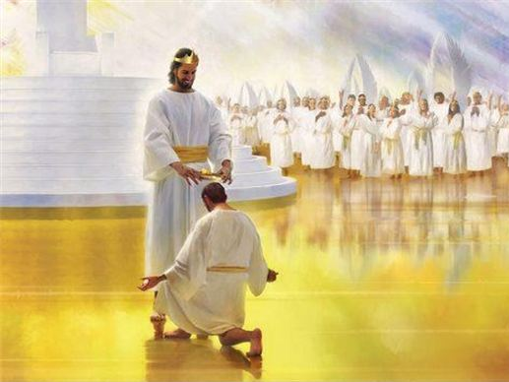
"And there will be no night there—no need for lamps or sun—for the Lord God will shine on them. And they will reign forever and ever" (Rev 22:5 NLT).

Slide 21
Assurance and Apostasy
Reformed
(Calvinist)
Arminian (Wesleyan)
The Bible distinguishes our two inheritances.
Perseverance of believers
(Apostasy impossible)
Partakers
Apostasy leads to loss of salvation
Only overcomers will reign with Christ.
Security but no assurance
Eternal Security
Apostasy Possible
No security, no assurance
Apostasy leads to loss of rewards
How can we hold both apostasy and assurance?
Assurance
Notes:
21
[The privilege to rule with Jesus is reserved for the faithful.]

Slide 22
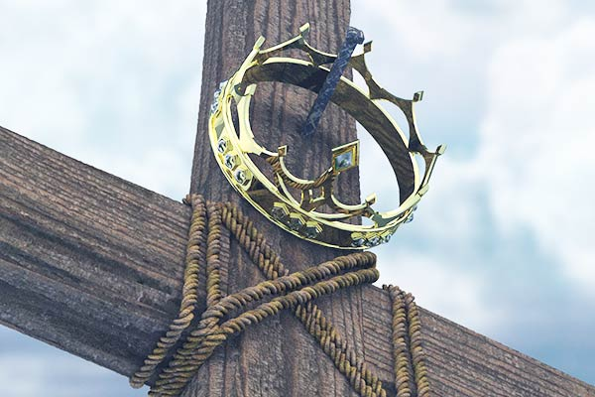
The Overcomers of Revelation 2–3

Slide 23
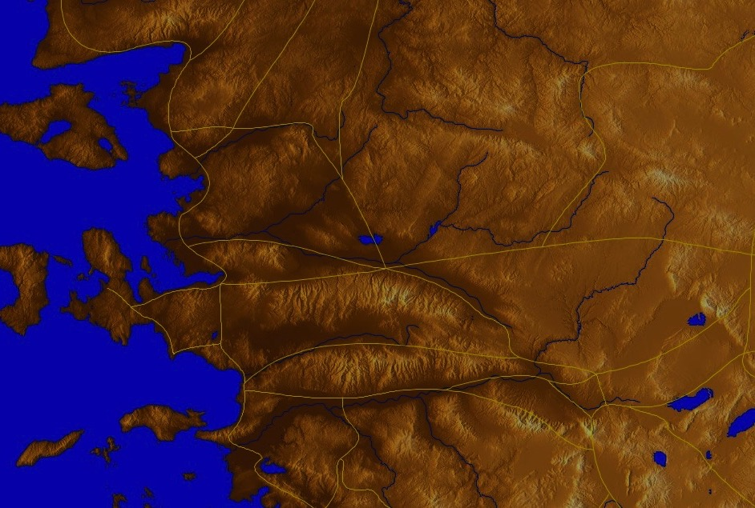
The 7 Churches (Rev. 2–3)
345
Adramyttium
Aezani
Pergamum
Thyatira
Cyme
Erythrae
Sardis
Smyrna
Eumenia
Philadelphia
Lebedus
Colophon
Ephesus
Nysa
Laodicea
Hierapolis
Trailes
Heraclea
Aphrodisias
Colossae
Alabanda
Patmos
Miletus
Notes:
Jesus designed a brilliant strategy by having his revelation sent to the capital of the province, Ephesus. It included an individual letter to Ephesus, as well as letters to 6 other key churches. The Ephesians copied the entire book of Revelation, though, and sent the original to the next city, Smyrna. Smyrna then made their own copy and sent the original to Pergamum, which lay on the main road to the north. This city then sent the prophecy to Thyatira, which sent it to Sardis, then Philadelphia, and finally to Laodicea.

Slide 24
The Overcomers (Rev. 2–3)
365
“For everyone born of God overcomes the world. This is the victory that has overcome the world, even our faith. ⁵Who is it that overcomes the world? Only he who believes that Jesus is the Son of God”
(1 John 5:4-5 NIV)
The overcomer has “kept my command to endure patiently” (Rev 3:10 NIV) and “does my will to the end” (Rev 2:26 NIV)
All believers overcome
Faithful believers overcome

Slide 25
The Overcomers (Rev. 2–3)
365
“…whoever hates his brother is in the darkness and walks around in the darkness… because the darkness has blinded him” (1 John 2:11)
“Only the crowned and rewarded church in heaven will rule” (Dillow, 664)
Are all Christians overcomers?
“You have made them to be a kingdom and priests to serve our God,
and they will reign on the earth” (Rev 5:10).
All believers overcome in 1 John 5:4-5, yet some will still “shrink away in shame” (1 John 2:28)
No. Only faithful ones.

Slide 26
The Overcomers (Rev. 2–3)
365
Unbelievers: “But the cowardly, the unbelieving, the vile, the murderers, the sexually immoral, those who practice magic arts, the idolaters and all liars—their place will be in the fiery lake of burning sulphur. This is the second death” (21:8).
The context of Rev 21:6-8 presents three types of people:
All Saints: “He said to me: 'It is done. I am the Alpha and the Omega, the Beginning and the End. To him who is thirsty I will give to drink without cost from the spring of the water of life'” (21:6).
He who overcomes will inherit these things, and I will be his God and he will be My son (21:7)

Slide 27
The Overcomers (Rev. 2–3)
365
If all overcome, then none could lose their crown: “I am coming soon. Hold on to what you have, so that no one will take your crown” (3:11).
“The seven letters deal with Christian works, not salvation (2:2, 9, 13, 19; 3:1, 8, 15)” —Yates, BibSac (2006): 227
Are all Christians overcomers?
If we all overcome, then why all the warnings and promises?
No. Only faithful ones.
His name will not be removed from the book of life (3:5)

Slide 28
The Overcomers (Rev. 2–3)
365
Pergamum
Thyatira
"He who overcomes" (NAU) is used once for each of the 7 churches, plus 21:7 with a total of 8 times in Revelation
Smyrna
Sardis
Ephesus
Philadelphia
Laodicea

Slide 29
The Overcomers (Rev. 2–3)
365
Pergamum
Thyatira
To him who overcomes, I will grant to eat of the tree of life which is in the Paradise of God (2:7)
Smyrna
Sardis
Ephesus
Philadelphia
2:7
Laodicea

Slide 30
The Overcomers (Rev. 2–3)
365
Pergamum
Thyatira
He who overcomes will not be hurt by the second death (2:11)
Smyrna
Sardis
2:11
Ephesus
Philadelphia
2:7
Laodicea

Slide 31
The Overcomers (Rev. 2–3)
365
Pergamum
Thyatira
To him who overcomes, to him I will give some of the hidden manna, and I will give him a white stone, and a new name written on the stone which no one knows but he who receives it (2:17)
2:17
Smyrna
Sardis
2:11
Ephesus
Philadelphia
2:7
Laodicea

Slide 32
The Overcomers (Rev. 2–3)
365
Pergamum
Thyatira
2:17
2:26
He who overcomes, and he who keeps My deeds until the end, TO HIM I WILL GIVE AUTHORITY OVER THE NATIONS (2:26)
Smyrna
Sardis
2:11
Ephesus
Philadelphia
2:7
Laodicea

Slide 33
The Overcomers (Rev. 2–3)
365
Pergamum
Thyatira
2:17
2:26
He who overcomes will thus be clothed in white garments; and I will not erase his name from the book of life, and I will confess his name before My Father and before His angels (3:5)
Smyrna
Sardis
2:11
3:5
Ephesus
Philadelphia
2:7
Laodicea

Slide 34
The Overcomers (Rev. 2–3)
365
Pergamum
Thyatira
2:17
2:26
He who overcomes, I will make him a pillar in the temple of My God, and he will not go out from it anymore; and I will write on him the name of My God, and the name of the city of My God, the new Jerusalem, which comes down out of heaven from My God, and My new name (3:12)
Smyrna
Sardis
2:11
3:5
Ephesus
Philadelphia
2:7
3:12
Laodicea

Slide 35
The Overcomers (Rev. 2–3)
365
Pergamum
Thyatira
2:17
2:26
He who overcomes, I will grant to him to sit down with Me on My throne, as I also overcame and sat down with My Father on His throne (3:21)
Smyrna
Sardis
2:11
3:5
Ephesus
Philadelphia
2:7
3:21
3:12
Laodicea

Slide 36
Rule with Christ just as he rules with the Father (Rev 3:21-22).
365

Slide 37
Laodicea (Rev. 3:14-22)
363
Promise
Overcomers will eat with Christ and rule with Christ
Warning
None!
Pergamum
Thyatira
Exhortation
Buy from Christ refined gold, white clothes, and eye salve.
Be earnest and repent.
Rebuke
Lukewarm, neither cold nor hot.
Wretched, pitiful, poor, blind, and naked
Christ: The Amen, the faithful and true Witness, the Ruler of God's creation
Commendation:
None!
Smyrna
Sardis
Ephesus
Philadelphia
Laodicea
Notes:
http://www.truthwhys.com/news/revelation-part-15-chapter-3-sardis-philadelphia-and-laodicea/ has many good historical notes

Slide 38
The Overcomers (Rev. 2–3)
365
Pergamum
Thyatira
2:17
2:26
Smyrna
He who overcomes will inherit these things, and I will be his God and he will be My son (21:7)
Sardis
2:11
3:5
Ephesus
Philadelphia
2:7
3:21
3:12
Laodicea

Slide 39
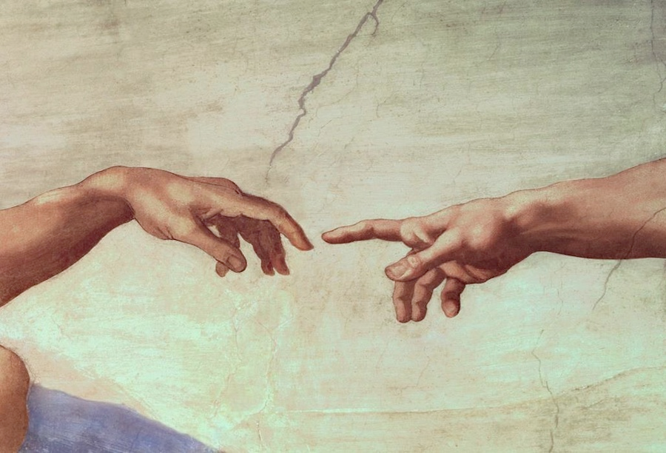
Are you ready to rule the world?

Slide 40
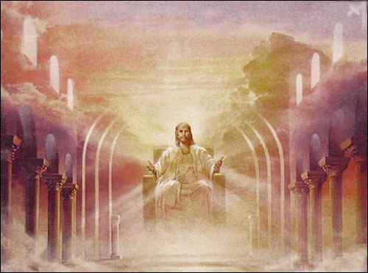
The Rule of Christ
Psalm 2:8-9 quoted in Rev. 2:27

Slide 41
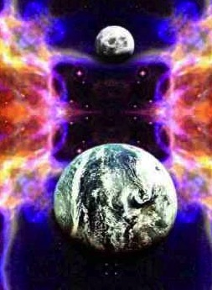
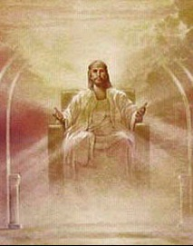
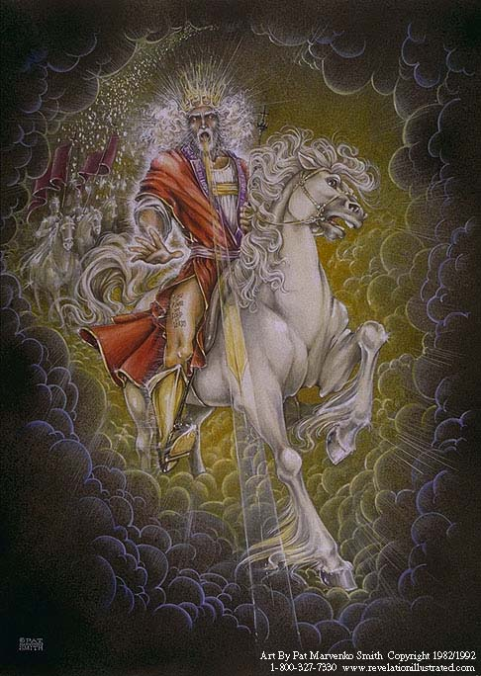
Our Future (Rev. 19–20)
Heaven (Rev. 21–22)
Millennium (Rev. 20)
Return (Rev. 19)

Slide 42
Revelation 20:4 (NAU)
⁴Then I saw thrones, and they sat on them, and judgment was given to them. And I saw the souls of those who had been beheaded because of their testimony of Jesus and because of the word of God, and those who had not worshiped the beast or his image, and had not received the mark on their forehead and on their hand; and they came to life and reigned with Christ for a thousand years.

Slide 43
"Do you not know that saints will judge the world?" (1 Cor. 6:2a)

Slide 44
"If we endure hardship, we will reign with him" (2 Tim. 2:12 NLT)

Slide 45
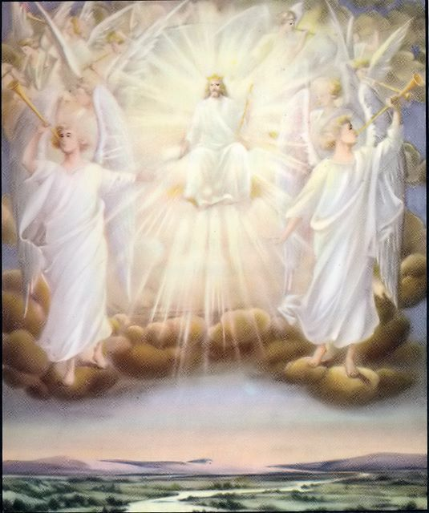
"Those who are victorious will sit with me on my throne, just as I was victorious and sat with my Father on his throne" (Rev. 3:21 NLT).

Slide 46
Assurance and Apostasy
Reformed
(Calvinist)
Arminian (Wesleyan)
The Bible distinguishes our two inheritances.
Perseverance of believers
(Apostasy impossible)
Partakers
Apostasy leads to loss of salvation
Only overcomers will reign with Christ.
Security but no assurance
Eternal Security
Apostasy Possible
No security, no assurance
Believers abandoning Jesus lose rewards and rule.
Apostasy leads to loss of rewards
How can we hold both apostasy and assurance?
Assurance
Notes:
46
[Apostates will be saved but not rewarded.]

Slide 47
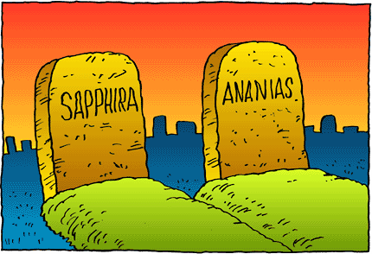
However, there is still divine discipline…

Slide 48
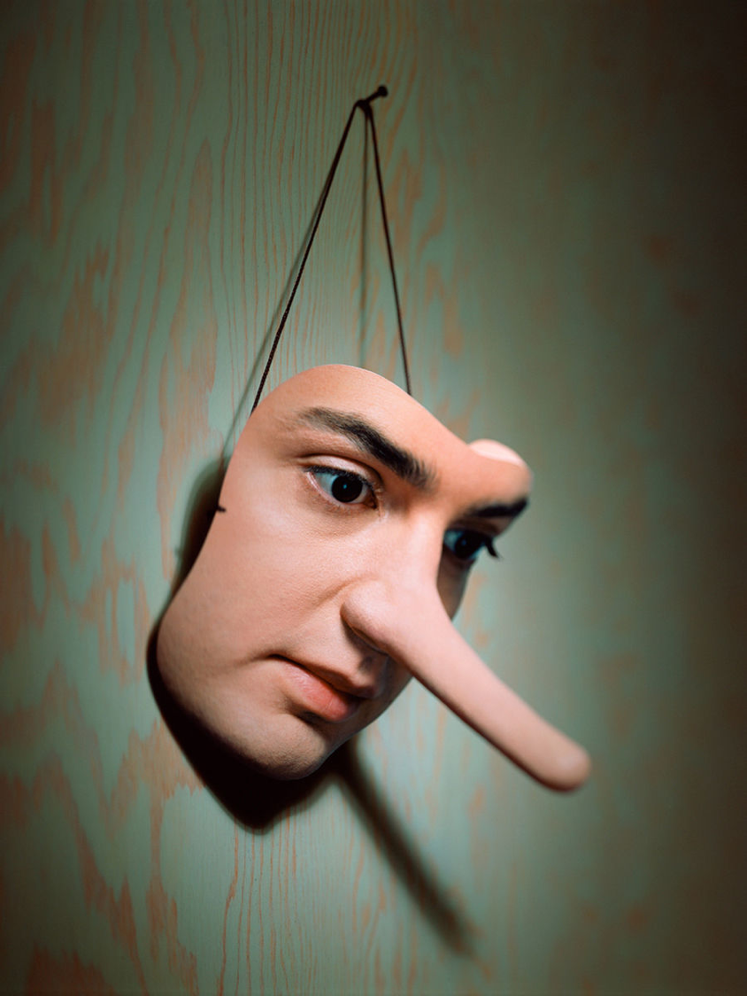
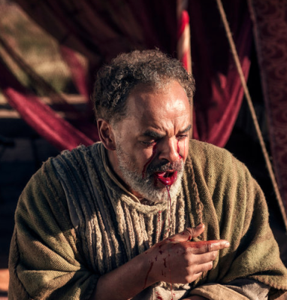
Ananias & Sapphira
Acts 5

Slide 49
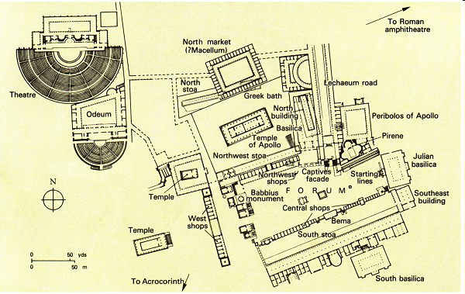
The Bema at Corinth
Lawsuits 1 Cor. 6
Bema
Paul at the speaker rostrum
Acts 18

Slide 50
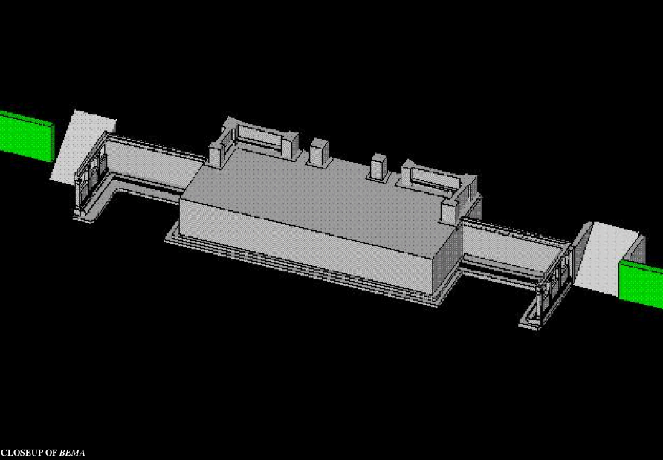
Bema Close-up
“So we make it our goal to please him, whether we are at home in the body or away from it. ¹⁰For we must all appear before the judgment seat [bema] of Christ, that each one may receive what is due him for the things done while in the body, whether good or bad” (2 Cor. 5:9-10 NIV).
Notes:
50
http://corinth.sas.upenn.edu/schola.html

Slide 51
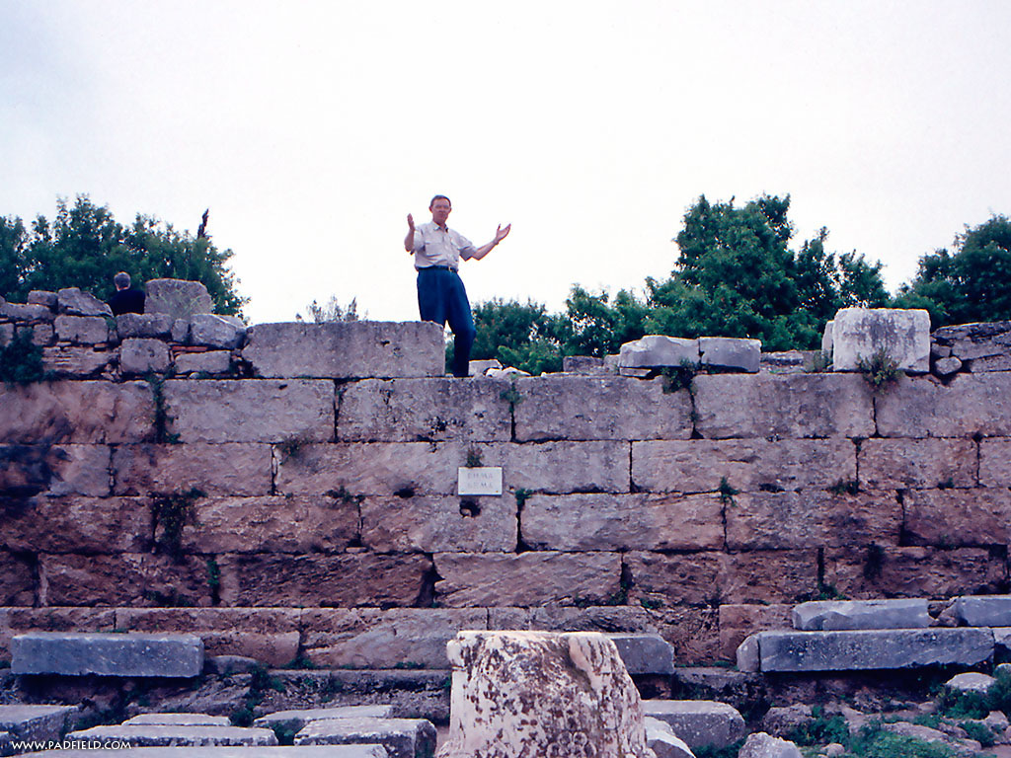
The Speaker or Judge Above
The Speaker or Judge Above
Notes:
51

Slide 52
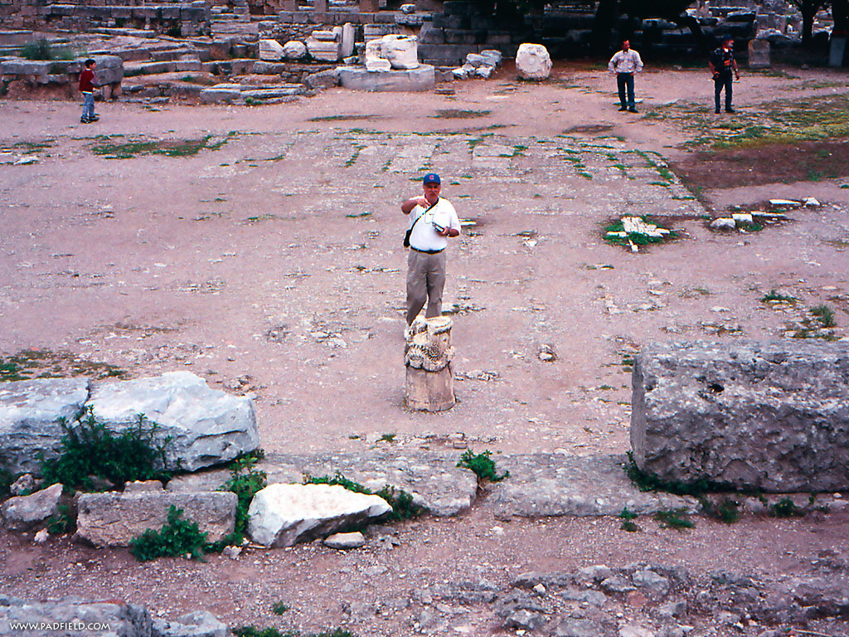
The One Being Judged or Rewarded Stood Below
Notes:
52

Slide 53
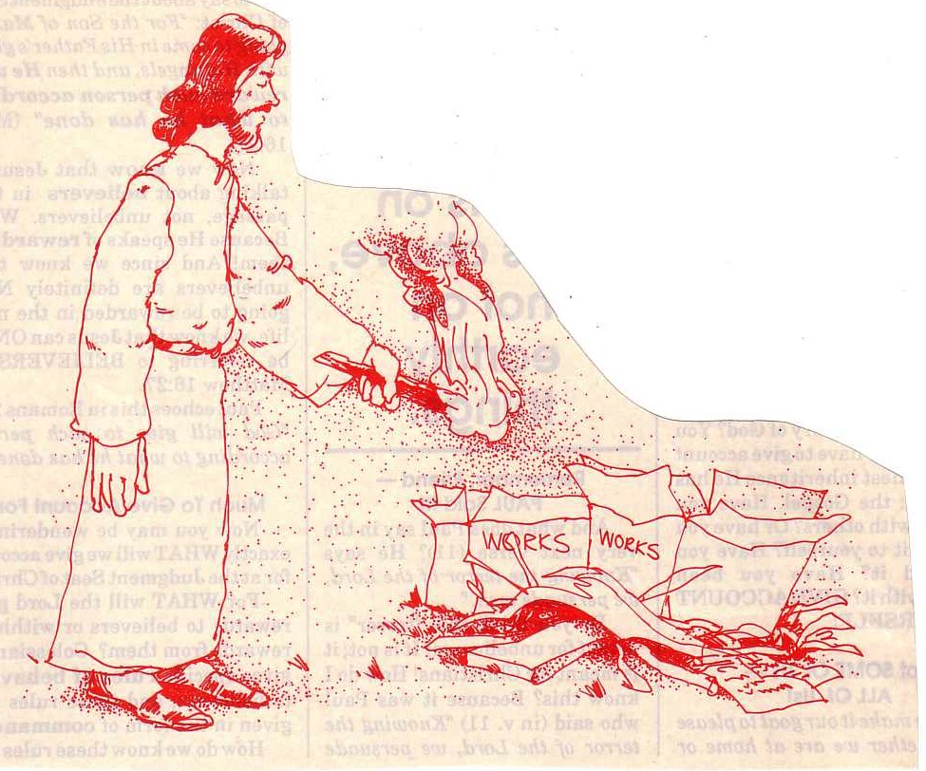
"… the fire will test the quality of each man's work" (1 Cor. 3:13)

Slide 54
Lasting Building Materials (3:12a)
Silver
Gold
Jewels
Foundation: Apostles & Prophets (Eph. 2:20)
Foundation: The Lord Jesus Christ (1 Cor. 3:11)
Adapted from Charles R. Swindoll. "Spiritual Gifts Study Guide" (IFL, 1983), 7

Slide 55
Perishable Building Materials (3:12b)
Hay
Wood
Straw
Foundation: Apostles & Prophets (Eph. 2:20)
Foundation: The Lord Jesus Christ (1 Cor. 3:11)
Adapted from Charles R. Swindoll. "Spiritual Gifts Study Guide" (IFL, 1983), 7

Slide 56
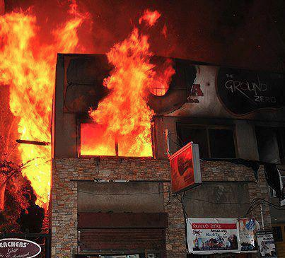
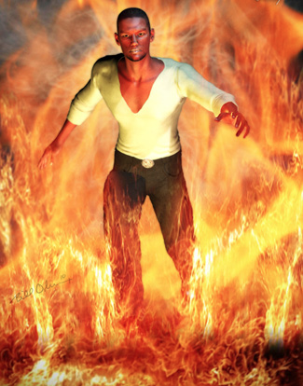
"saved as through fire…" (1 Cor 3:15)

Slide 57
Believers Can Be “Disqualified”
"Don’t you realize that in a race everyone runs, but only one person gets the prize? So run to win! ²⁵All athletes are disciplined in their training. They do it to win a prize that will fade away, but we do it for an eternal prize. ²⁶So I run with purpose in every step. I am not just shadowboxing. ²⁷I discipline my body like an athlete, training it to do what it should. Otherwise, I fear that after preaching to others I myself might be disqualified" (1 Cor. 9:24-27 NLT).

Slide 58
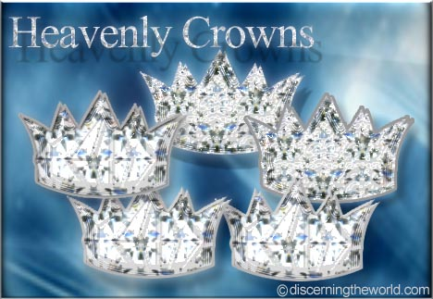
Christ promises rewards for perseverance (Rev. 3:11b).
"I am coming soon. Hold on to what you have, so that no one will take away your crown" (NLT).

Slide 59
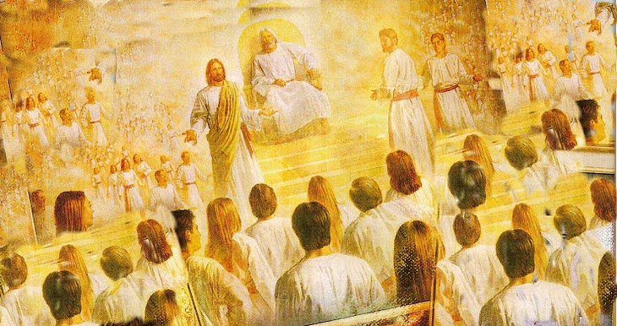
Rewards can be lost!
"Watch out that you do not lose what we have worked so hard to achieve. Be diligent so that you receive your full reward" (2 John 8 NLT)
"I have given you an open door that no one can shut" (3:8)

Slide 60
1 Corinthians 11:27-29 (NIV)
²⁷Therefore, whoever eats the bread or drinks the cup of the Lord in an unworthy manner will be guilty of sinning against the body and blood of the Lord. ²⁸A man ought to examine himself before he eats of the bread and drinks of the cup. ²⁹For anyone who eats and drinks without recognizing the body of the Lord eats and drinks judgment on himself.
Notes:
60

Slide 61
1 Corinthians 11:30-32 (NIV)
³⁰ That is why many among you are weak and sick, and a number of you have fallen asleep. ³¹But if we judged ourselves, we would not come under judgment. ³²When we are judged by the Lord, we are being disciplined so that we will not be condemned with the world.
Notes:
61

Slide 62
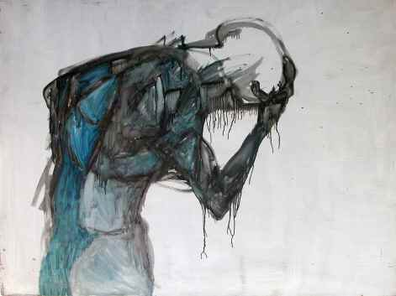
Some sin leads to premature death (1 John 5:16-17 NIV)
“If anyone sees his brother commit a sin that does not lead to death, he should pray and God will give him life. I refer to those whose sin does not lead to death. There is a sin that leads to death. I am not saying that he should pray about that. ¹⁷All wrongdoing is sin, and there is sin that does not lead to death.”

Slide 63
Assurance and Apostasy
Reformed
(Calvinist)
Arminian (Wesleyan)
The Bible distinguishes our two inheritances.
Perseverance of believers
(Apostasy impossible)
Partakers
Apostasy leads to loss of salvation
Only overcomers will reign with Christ.
Security but no assurance
Eternal Security
Apostasy Possible
No security, no assurance
Believers abandoning Jesus lose rewards and rule.
Apostasy leads to loss of rewards
How can we hold both apostasy and assurance?
Assurance
Notes:
63
These are three ways we can balance assurance with apostasy.

Slide 64
Our salvation is secure but defectors lose rewards.
Main Idea
Notes:
The Bible teaches both assurance and apostasy—so believers can lose rewards but not salvation (MI restated).

Slide 65
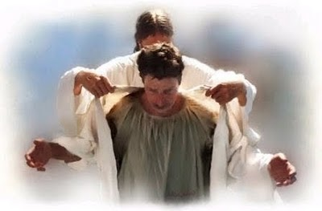
All believers are clothed with Christ’s righteousness.

Slide 66
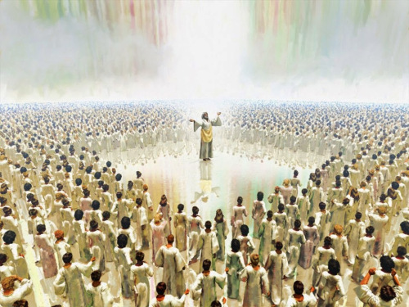
All believers will enjoy heaven.

Slide 67
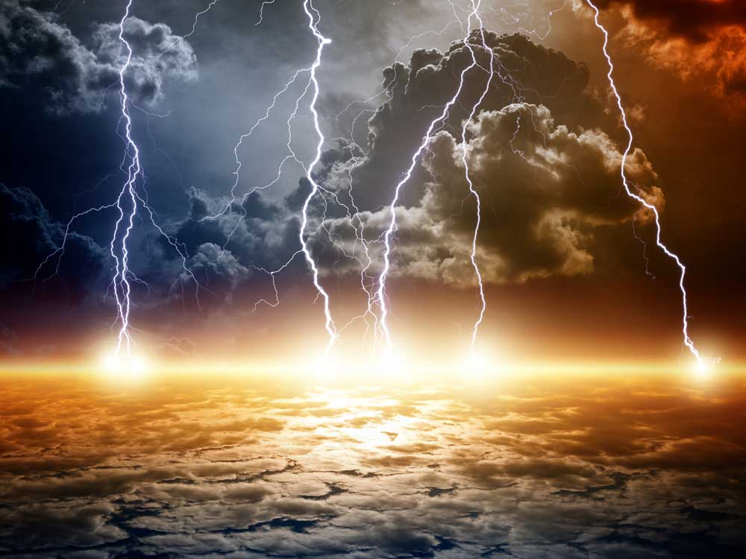
But Jesus will judge the earth.

Slide 68
Jesus will reward the faithful.

Slide 69
Live Towards Your Future!

Slide 70
Turning away from Christ forfeits your future rule.
Notes:
Christians who abandon Jesus will not reign with him after he returns.

Slide 71
Black

Slide 72
Topical Preaching link at BibleStudyDownloads.org
Get this presentation and script for free!
Notes:
TP Topical Preaching

