Slide 1
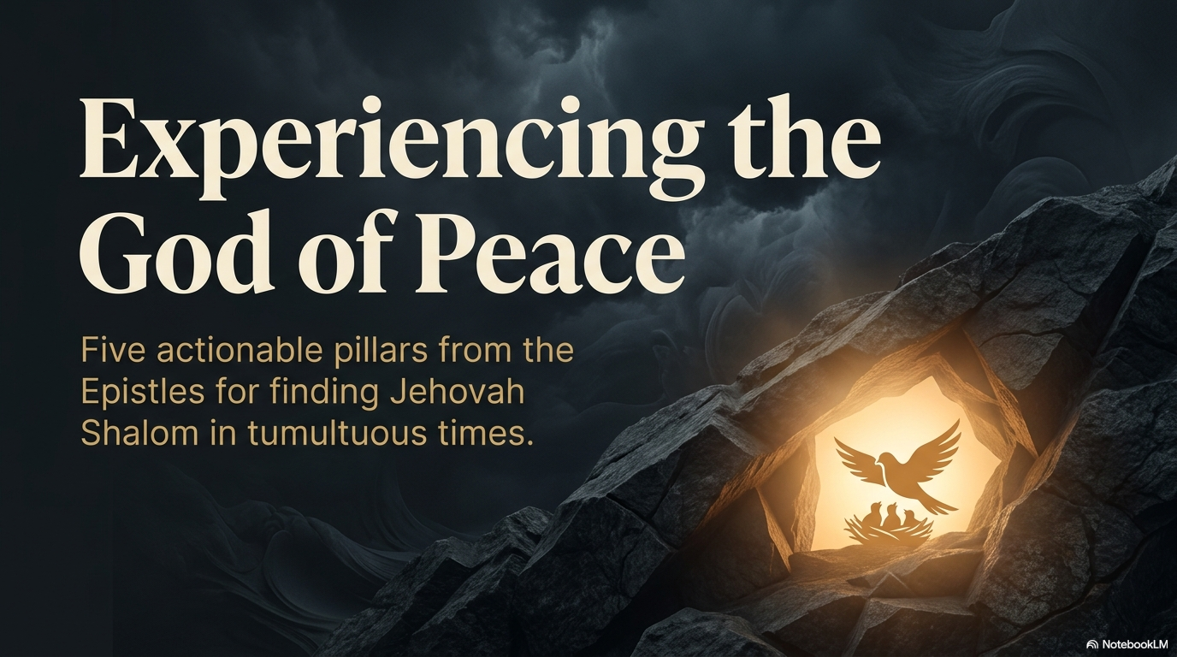
Experiencing the God of Peace
Five Texts on Jehovah Shalom
(The Lord is Peace)
Dr. Rick Griffith • Jordan Evangelical Theological Seminary
BibleStudyDownloads.org

Slide 2

A Painting Contest
Notes:
A painting contest was once conducted to depict peace. If you were in such a competition, what would you paint? Tell the person next to you.

Slide 3

A Painting Contest
Notes:
Maybe your painting would be your dad, since today is Father's Day. Some of our fathers depict peace in a real way.

Slide 4


Peace Painting Contest
Notes:
Many beautiful paintings were submitted, featuring serene landscapes and still waters, with several at sunset under beautiful skies and sunshine.

Slide 5

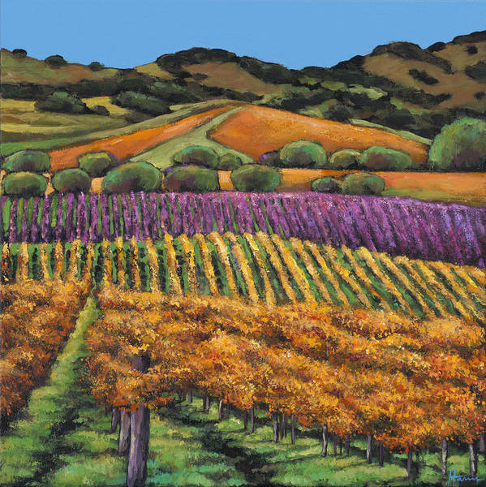
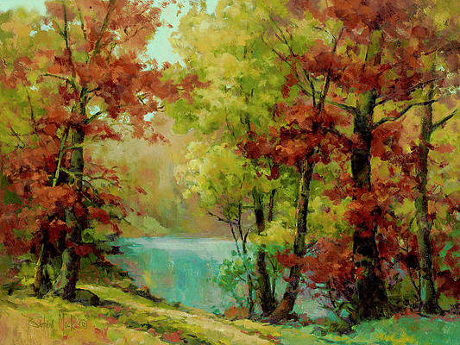
Peace Picture Contest
Notes:
Contestants submitted paintings of peaceful nature scenes of orchards
• or seascapes or forests and lakes.

Slide 6
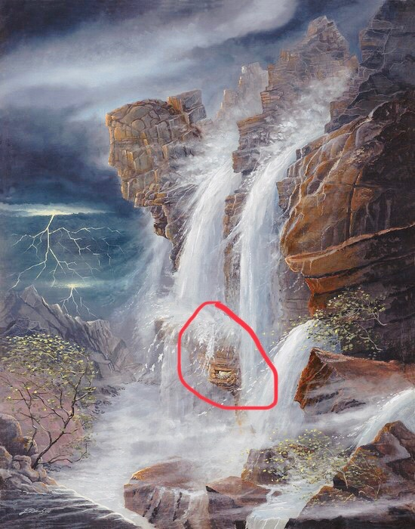
The Winner
Notes:
But one entry was quite the contrast! It showed a raging storm with waves crashing into the rocks of a seashore. The dark sky was menacing over the entire scene—all of it except the center.

Slide 7
The Winner
Notes:
Amidst the chaos, a mother bird sat in the cleft of the rocks, perched on her nest, protecting her tiny chicks, unfazed by the storm above. Not surprisingly, this painting received the prize. It won the contest, reminding us that peace doesn’t come because our surroundings don’t have challenges. It comes from resting in Christ amidst those trials.

Slide 8
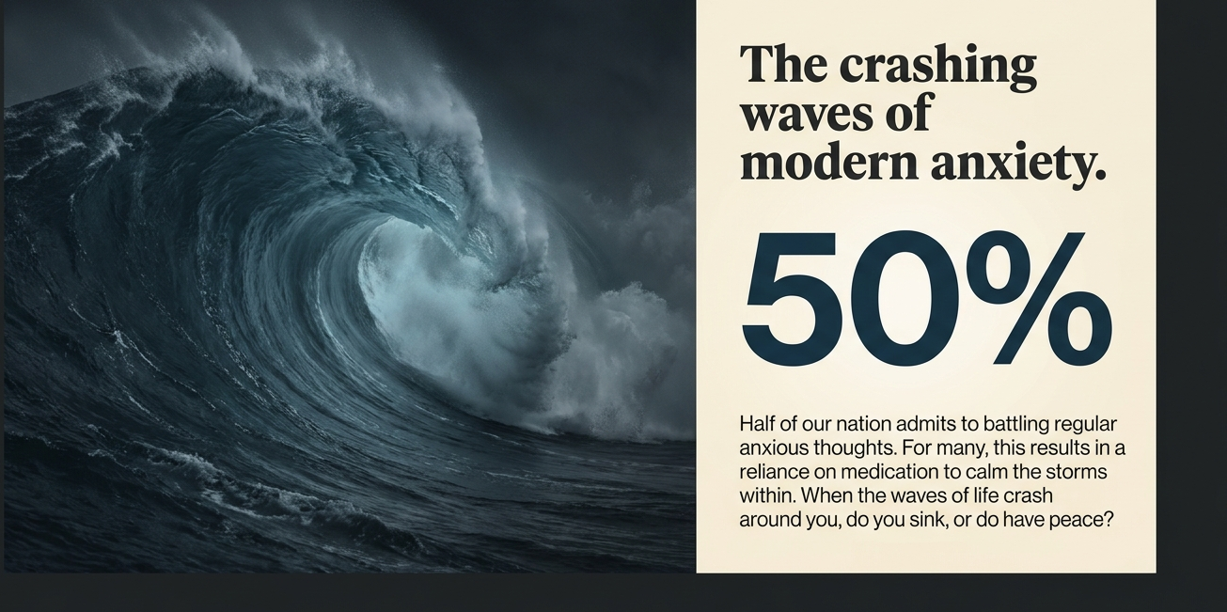
of people experience regular anxious thoughts.
When life's waves crash, do you sink like Peter or stand strong?
Notes:
When the waves of life crash around you, do you have peace?
Or do the waves scare you into sinking like they did Peter walking on the water?
Do you struggle with anxiety? About 50% of our nation admits to regular anxious thoughts, and many take meds to calm them down and hopefully give them peace.
Are your relationships with others harmonious?

Slide 9
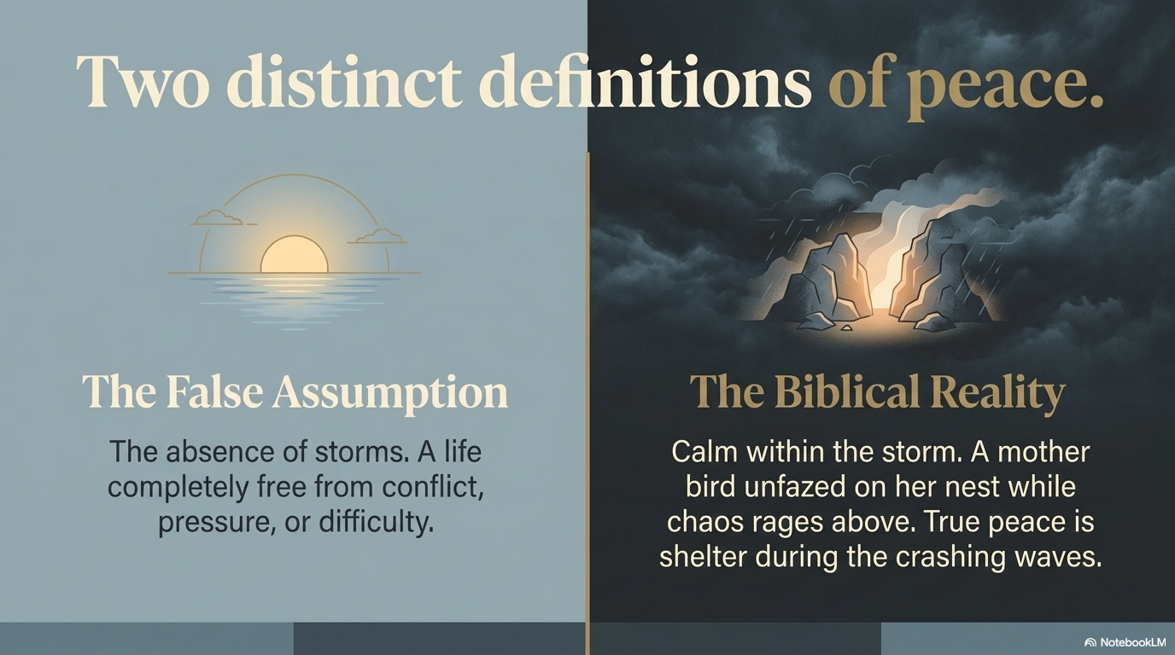
The False Assumption
The absence of storms. A life completely free from conflict, pressure, or difficulty.
Calm within the storm—a mother bird unfazed on her nest while chaos rages around. True peace is shelter amidst crashing waves.
Notes:
What is peace? The painting competition shows us that there are two distinct definitions of peace:
The false assumption is that peace is the absence of storms—a life completely free from conflict, pressure, or difficulty.
But the biblical reality is calm within the storm—a mother bird unfazed on her nest while chaos rages above. True peace is shelter during the crashing waves.

Slide 10
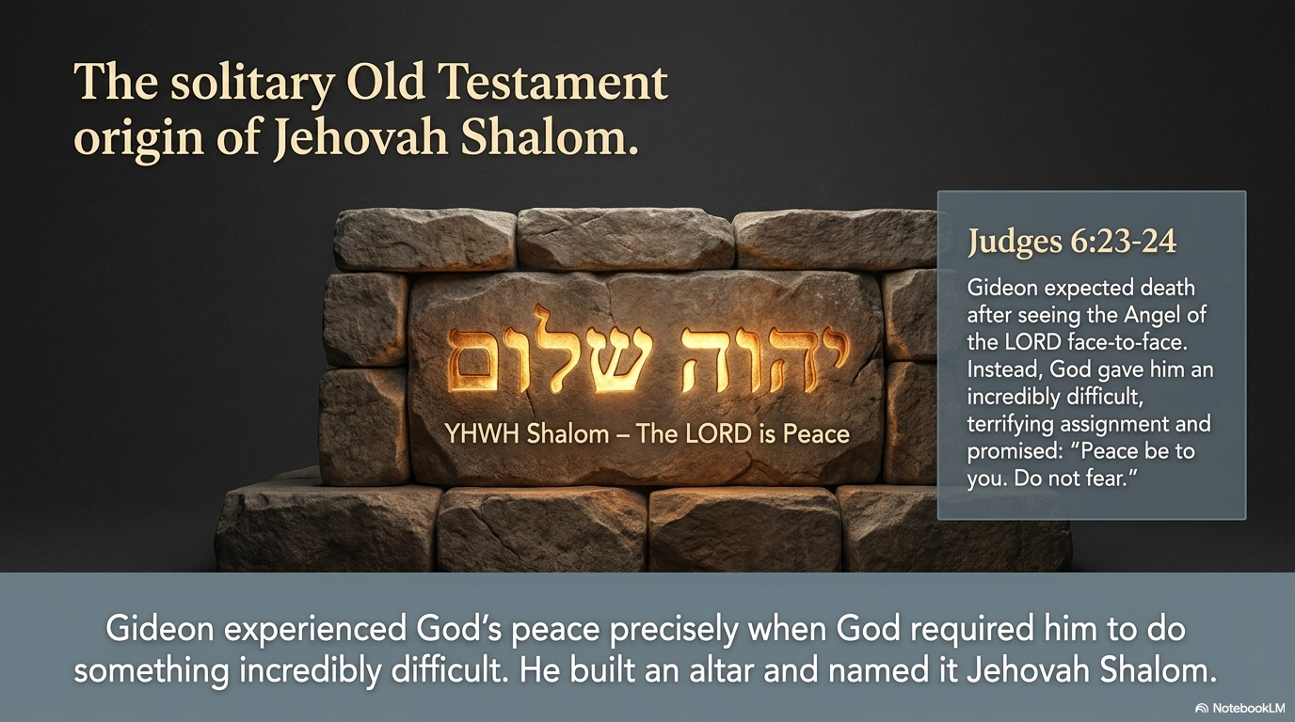
Gideon expected death after seeing the Angel of the LORD face-to-face. Instead, God gave him an incredibly difficult, terrifying assignment and promised, “Peace be to you. Do not fear.”
Gideon experienced God's peace precisely when God required him to do something incredibly difficult. He built an altar and named it Jehovah Shalom.
Notes:
The Hebrew word for peace is shalom. “Jehovah Shalom” (יְהוָה שָׁלוֹם, YHWH Shalom) means “The LORD is Peace” or “The LORD of Peace.”
We typically speak of Jehovah (Yahweh) Shalom, which is obviously an OT title and thus Hebrew. As I began to prepare this message, I thought, “How cool! I get to preach the OT again, and this time about the God of Peace, who is talked about all over the OT!
But the title appears in the Old Testament only once— in the story of Gideon’s fear in the Book of Judges 6:24.
After the Angel of the LORD appeared to Gideon, Gideon feared he would die because he had seen the Angel face-to-face. But the LORD said:
“Peace be to you. Do not fear; you shall not die” (Judg. 6:23).
In response, “Gideon built an altar there to the LORD and called it ‘The LORD is Peace’” (Judg. 6:24).
So, Gideon experienced God’s peace when God required him to do something incredibly difficult. But what about you?

Slide 11
Shalom means:
* wholeness
* well-being
* harmony
* safety
* prosperity
* covenant blessing
* spiritual completeness
Notes:
The Hebrew word shalom means far more than the absence of war. It includes:
* wholeness
* well-being
* harmony
* safety
* prosperity
* covenant blessing
* spiritual completeness

Slide 12

How can you experience the God of peace?
5 ways to God's peace
Notes:
How can you experience the God of peace?
How can Yahweh Shalom give you peace in your life’s circumstances?

Slide 13
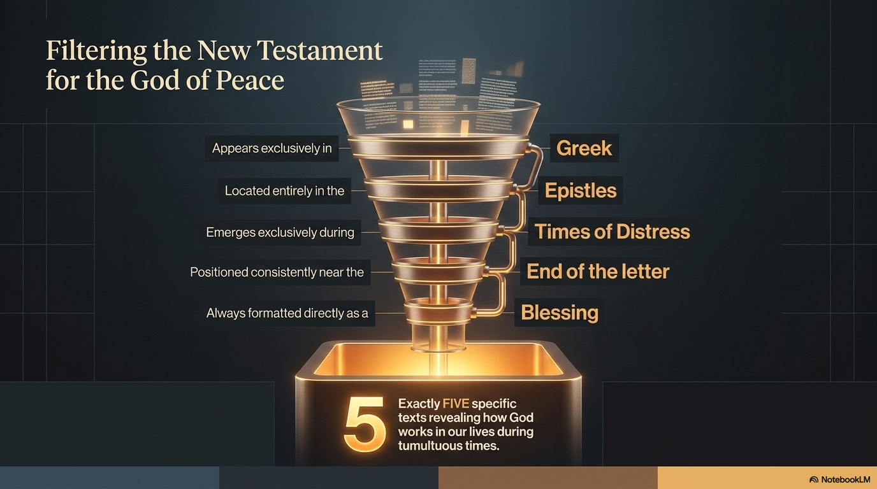
Appears exclusively in
Located entirely in the
Emerges exclusively during
Located near the
Always formatted as a
TEXTS
Notes:
I wanted to speak about all the times Yahweh Shalom appears in the Bible, but when I did a Hebrew search for “Yahweh Shalom,” I found only the Gideon story. And the title never appears in the NT. So, I tried a word search for the title “God of Peace”:
It appears only FIVE times in the Bible—and never in the OT!
Every time it appears, it is in Greek rather than Hebrew.
Every time it appears, it is in the epistles.
Every time it appears in the epistles, it is in a time of distress.
Every time it appears in the epistles, it is near the end of the letter by either Paul or the author of Hebrews.
Every time it appears in the epistles, it is in a blessing.
Every time it appears in a blessing, it tells us how God works.
So, let’s look at these five texts and learn five ways God works in our lives.

Slide 14
How can you experience the God of peace?
5 ways to God's peace
Notes:
How can you experience the God of peace?
How can Yahweh Shalom give you peace in your life’s circumstances?

Slide 15
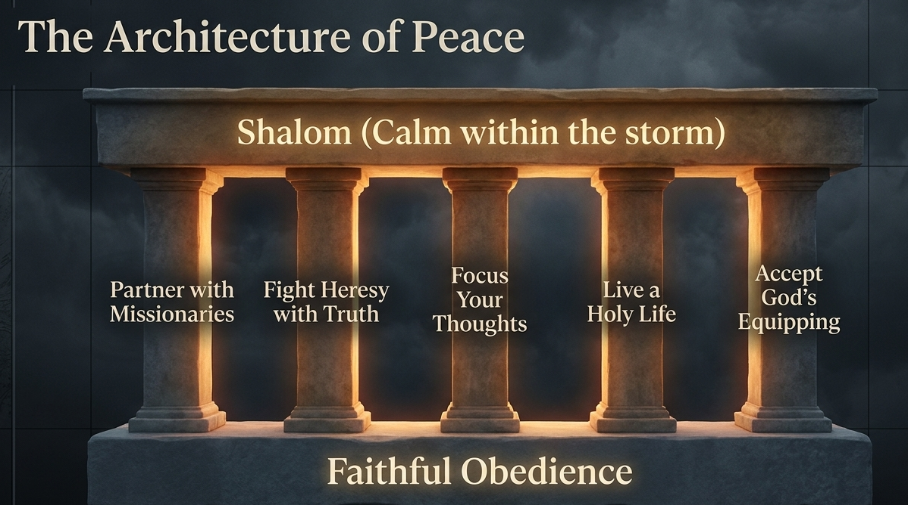
Notes:
God grants peace when we follow his heart for the lost.

Slide 16
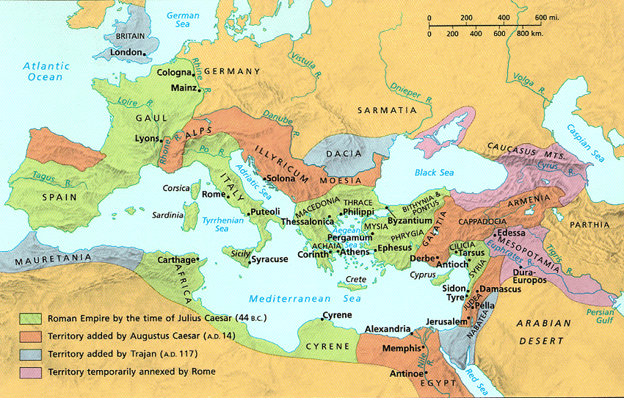
Romans 15:33
The God of peace be with you all.
Amen.
Notes:
Here, Paul concludes chapter 15 of his letter by requesting the church in Rome’s help for his upcoming missionary trip to Spain.
In this context, he wishes that the God of peace be with them all.
Note that, along with this blessing, he asks the Romans to pray for his work to advance the gospel.

Slide 17
Romans 15:23-24
²³ But now I have finished my work in these regions, and after all these long years of waiting, I am eager to visit you.
²⁴ I am planning to go to Spain, and when I do, I will stop off in Rome. And after I have enjoyed your fellowship for a little while, you can provide for my journey.
Notes:
Paul shared his plan to extend his ministry to Spain to get their help (23-24).

Slide 18
Paul's Next Mission Field: Spain (Romans 15:23-29)
154f
Notes:
Why was Paul going to Spain? He had finished pioneering in the eastern Empire. Like in the time of Jonah, Spain (or Tarshish) was the very end of the known world.
Was there really “no more place for me to work in these regions” (NIV, 14:23)? No. He means that church-planting movements in the east would reach these people.
Financial help from the Romans would further his work since he’d be halfway to Spain by the time he got to Rome.
• But he would not go there immediately.

Slide 19
Romans 15:25-27
²⁵ But before I come, I must go to Jerusalem to take a gift to the believers there. ²⁶ For you see, the believers in Macedonia and Achaia have eagerly taken up an offering for the poor among the believers in Jerusalem. ²⁷ They were glad to do this because they feel they owe a real debt to them. Since the Gentiles received the spiritual blessings of the Good News from the believers in Jerusalem, they feel the least they can do in return is to help them financially.
Notes:
But first he had to bring the Gentile offering to Jerusalem to show unity with their Jewish mother church (25-27).
How did this Gentile support for Jerusalem relate to Paul’s calling to Gentiles?
He says here that he intended it to somewhat repay what the Jerusalem church had done for the Gentiles—which is interesting since it was the Antioch church—not the Jerusalem church—that sent him out to reach Gentiles.

Slide 20
Paul's Next Mission Field: Spain (Romans 15:23-29)
154f
Notes:
Paul didn't forget the needy in his passion to expand, so he had to deliver this help in person to Jerusalem.

Slide 21
Romans 15:28-29
²⁸ As soon as I have delivered this money and completed this good deed of theirs,
I will come to see you on my way to Spain.
²⁹ And I am sure that when I come, Christ will richly bless our time together.
Notes:
Paul then also hoped to bless the Roman believers (28-29), and then head to Spain.

Slide 22
Paul's Next Mission Field: Spain (Romans 15:23-29)
154f
Notes:
Paul then planned on stopping off at Rome…

Slide 23
Paul's Next Mission Field: Spain (Romans 15:23-29)
154f
Notes:
…and then proceed from Rome to share the Good News in Spain.

Slide 24
New expansions for us…

Slide 25
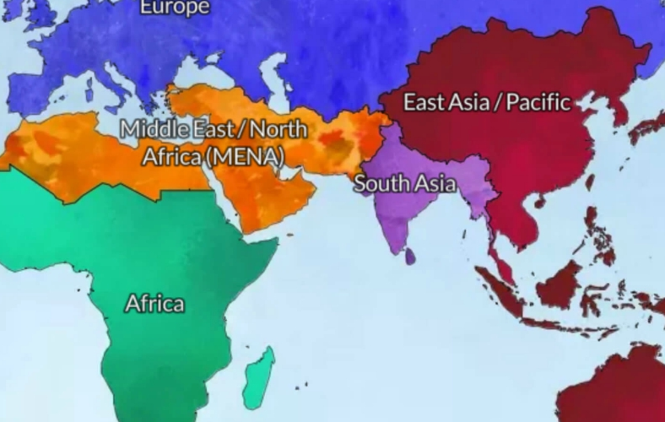
From East to West
Spain
? years
Eastern Empire
30 years
MENA
? years
East Asia
30 years
Notes:
• Paul moved west to Spain
• In like manner, God moved us west to MENA.

Slide 26
God led us from Asia to MENA in 2021
Jordan
Singapore
Notes:
So, in 2021 we shifted from Singapore to Jordan.

Slide 27
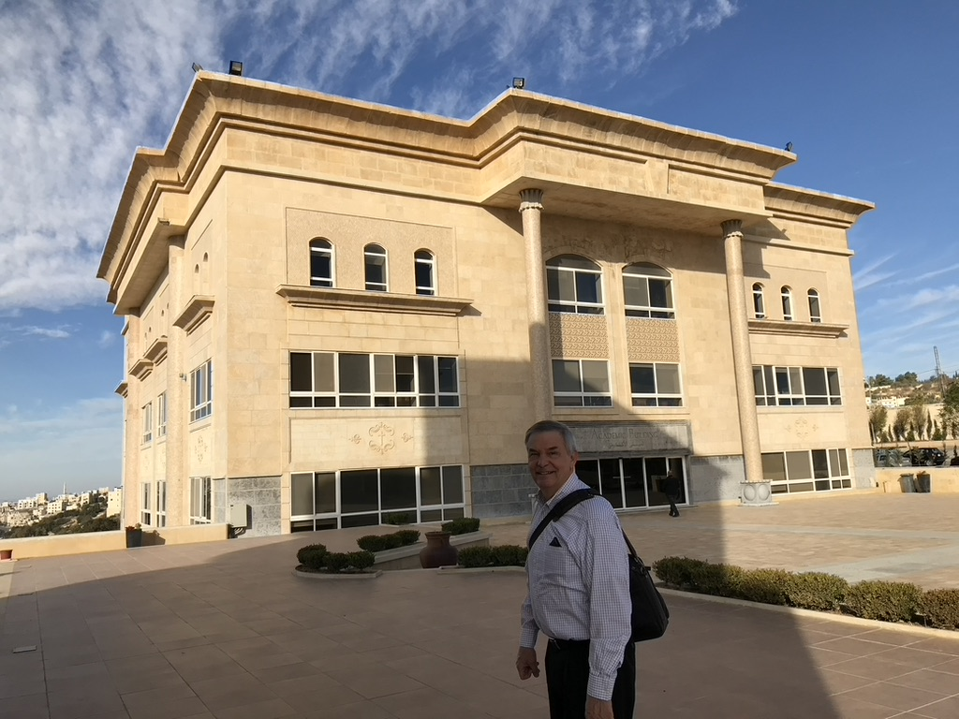
Jordan Evangelical Theological Seminary (JETS)
Notes:
I teach Bible through translation into Arabic.
______
Common-524
NS-05-Acts9-14—slide 143

Slide 28
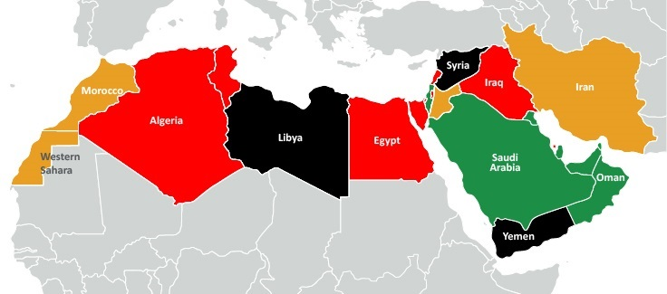
My Students from 11 Nations
Spain
Iraq
Israel
Syria
Morocco
Jordan
Egypt
Dubai
Sudan
Eritrea
Chad
Notes:
My students are now from 11 different nations based at JETS.
____________
Isaiah: Rami (Bible prof in Amman), Jackson (ST prof in Sudan), Jonathan (pastor in Chad), Habil (Hebrew prof? from Sudan in Amman), Amir (Sudanese translator in Amman), Nassef (Egypt), Ayoub (planting church and Bible college as lawyer in Casa Blanca, Morocco), Basem (Egypt), Nassar (Ramallah), Ramzi (Iraq), Dibora (Eritrea)
OT3: Osama (Jordan), Fadi (Syrian trained in Jordan at JETS but translating from Sweden while writing dissertation on Russian theologian for seminary in Belgium), Sara (English teacher in Jordan), Nagat (Egyptian Cru in Spain), Randa (CFO boarding school in Jordan), Jacklin (Jordanian reaching Syrian refugees), Adeeb (Egyptian international church in Dubai), Dani (Arabic apologist in Jordan)
Where serving:
1 Chad—Jonathan
1 Morocco—Ayoub
1 Spain—Nagat
1 Syria—Fadi
1 Dubai—Adeeb
2 Egypt—Nassef, Basem
3 Sudan—Jackson, Habil, Amir
6 Jordan—Rami, Osama, Sara, Randa, Jacklin, Dani
16

Slide 29
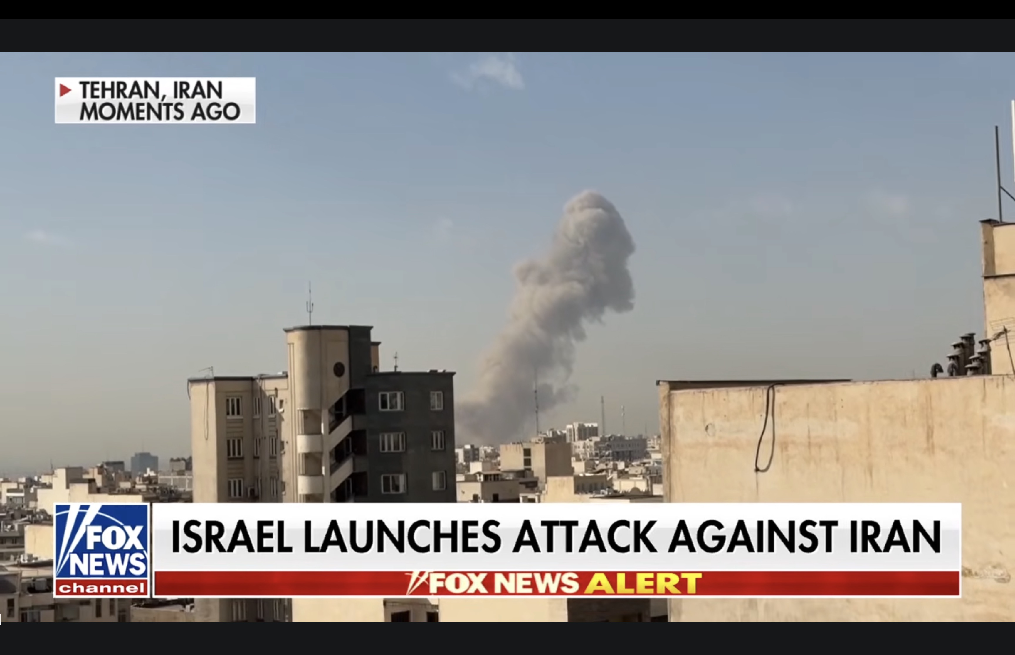
Above Us in Amman, Jordan
Notes:
You likely have heard mostly about attacks against Israel.

Slide 30
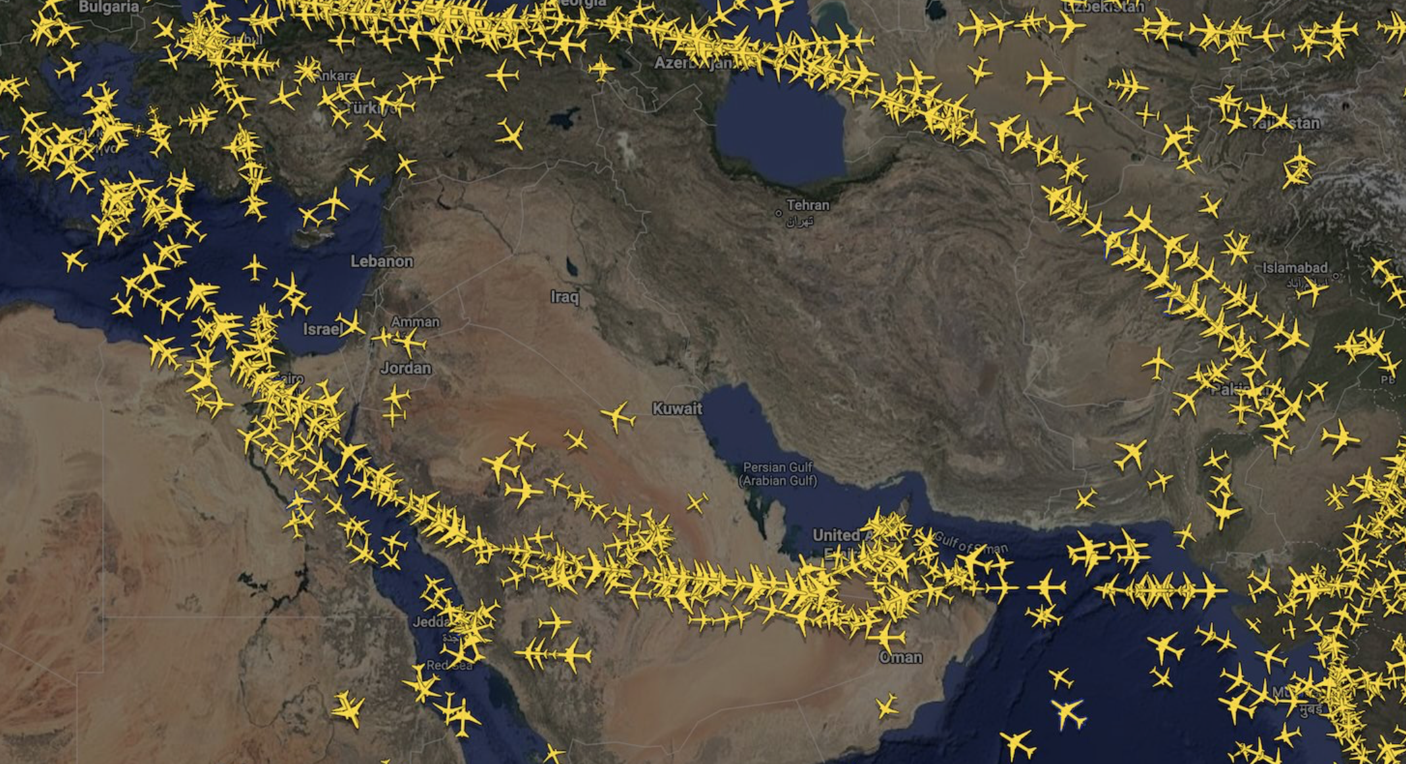
Above Us in Amman, Jordan
Notes:
But there are countries in between Iran and Israel.

Slide 31
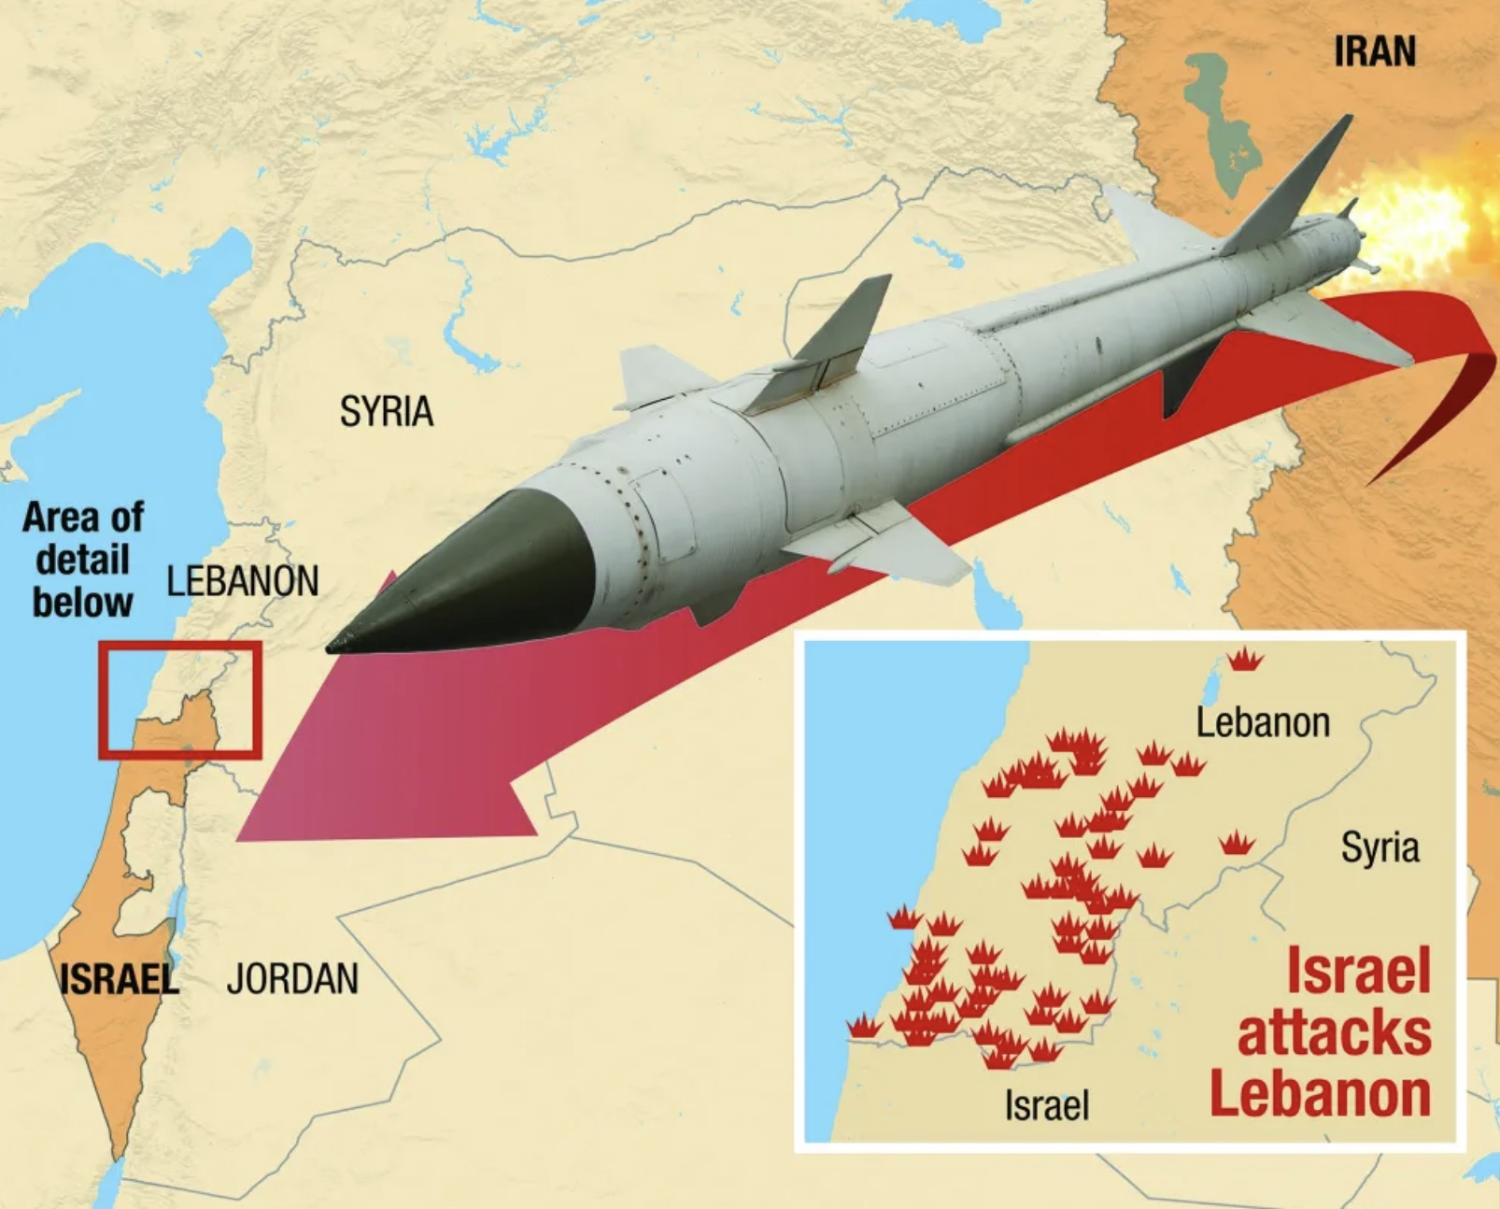
Above Us in Amman, Jordan
Notes:
Such as Jordan, where we live.

Slide 32
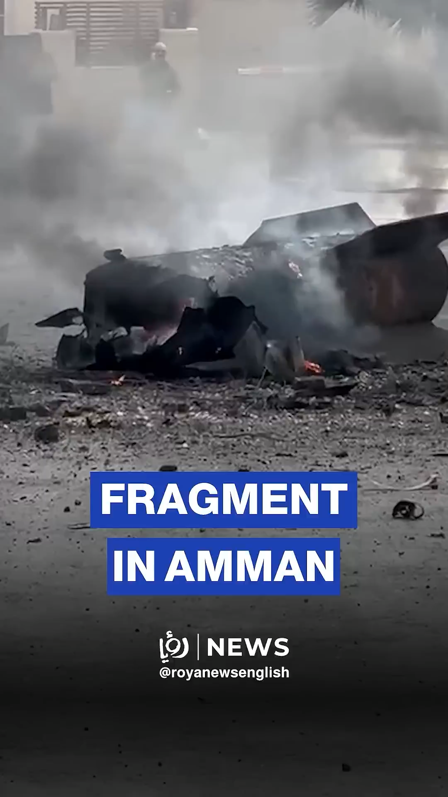
Above Us in Amman, Jordan
Notes:
We have had over 300 missiles shot down in Jordan.
What falls are called fragments, even though they are the size of a car.

Slide 33
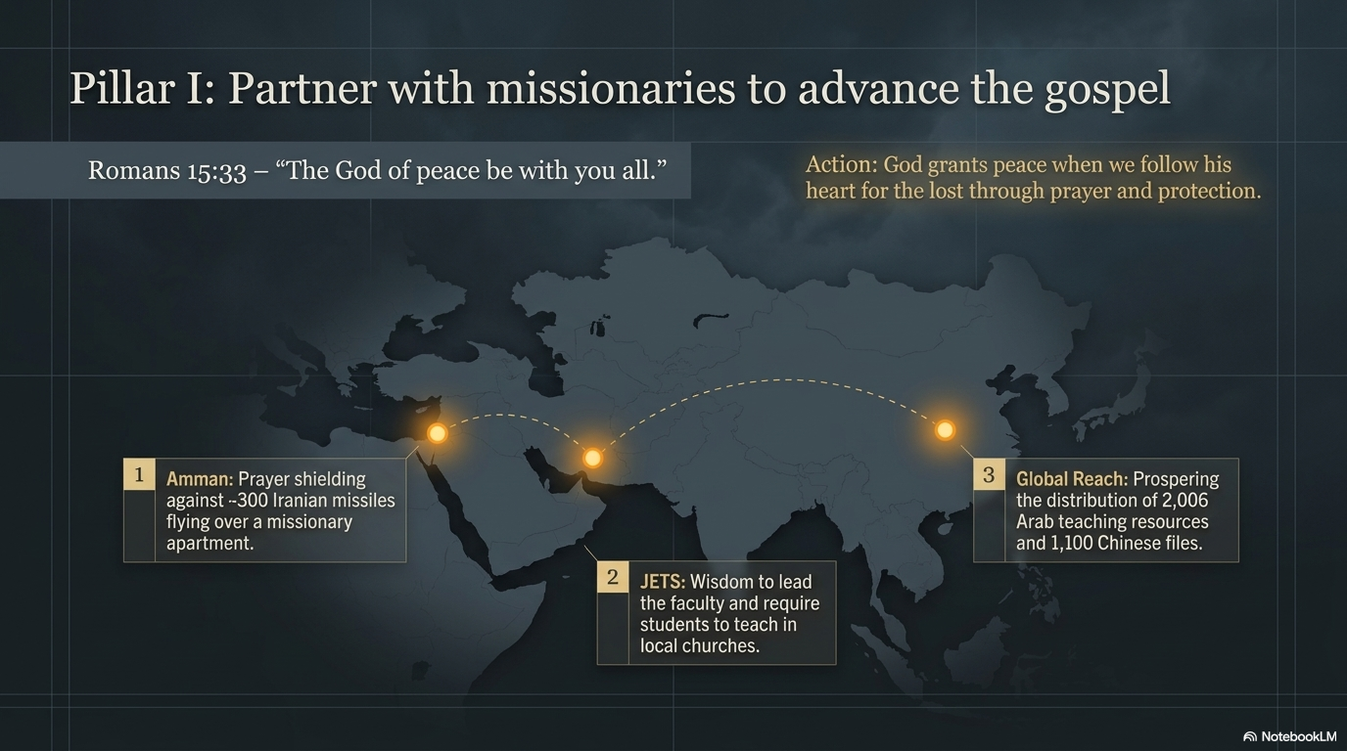
Prayer Requests
Notes:
Pillar I: Partner with missionaries to advance the gospel
Romans 15:33 — “The God of peace be with you all.”
Amman: Prayer shielding against -300 Iranian missiles flying over our missionary apartment.
Action: God grants peace when we follow his heart for the lost through prayer and protection.
JETS: Wisdom to lead the faculty and require students to teach in local churches.
Global Reach: Prospering the distribution of 2006 Arab teaching resources and 1100 Chinese files.

Slide 34
Notes:
God grants peace when we oppose error.

Slide 35

Rom. 16:17 And now I make one more appeal, my dear brothers and sisters. Watch out for people who cause divisions and upset people’s faith by teaching things contrary to what you have been taught. Stay away from them. ¹⁸ Such people are not serving Christ our Lord; they are serving their own personal interests. By smooth talk and glowing words, they deceive innocent people. ¹⁹ But everyone knows that you are obedient to the Lord. This makes me very happy. I want you to be wise in doing right and to stay innocent of any wrong. ²⁰ The God of peace will soon crush Satan under your feet. May the grace of our Lord Jesus be with you.
Romans 16:17-20 (NLT)

Slide 36
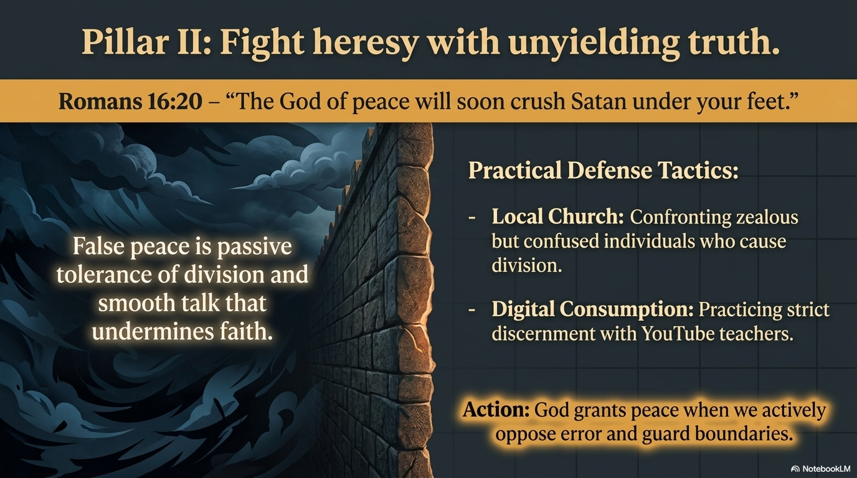
Notes:
Fight false teachers who cause division.
Our church in Amman had a man last year who was filled with zeal—but his zealousness repeatedly caused confusion and division—so the leadership had to ask him to leave.
We also need to be careful of what we watch on YouTube. Amidst the many good things to watch, there are also teachers who can undermine your faith.

Slide 37
Notes:
Focus your thoughts on worthy things.
God grants peace when he gets a hold of your thought life.

Slide 38
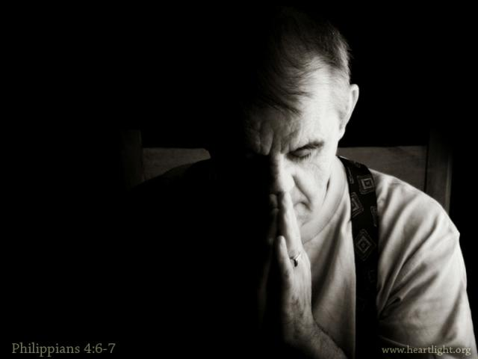
Pray in all circumstances
(Philippians 4:6-7 NLT)
⁶Don't worry about anything; instead, pray about everything. Tell God what you need and thank him for all he has done. ⁷Then you will experience God's peace, which exceeds anything we can understand. His peace will guard your hearts and minds as you live in Christ Jesus.

Slide 39
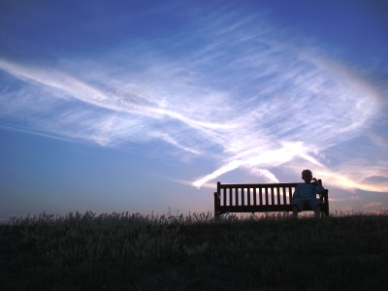
Wholesome Thoughts (Phil 4:8-9 NLT)
⁸And now, dear brothers and sisters, one final thing. Fix your thoughts on what is true, and honorable, and right, and pure, and lovely, and admirable. Think about things that are excellent and worthy of praise.

Slide 40
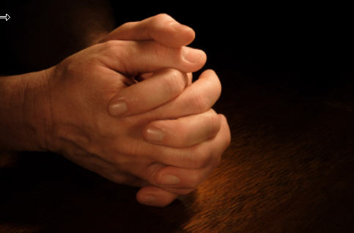
Philippians 4:9 NLT
⁹Keep putting into practice all you learned and received from me—everything you heard from me and saw me doing. Then the God of peace will be with you.

Slide 41


How many TV shows, YouTube channels, and movies fit these criteria?
⁸And now, dear brothers and sisters, one final thing. Fix your thoughts on what is true, and honorable, and right, and pure, and lovely, and admirable. Think about things that are excellent and worthy of praise.
Notes:
Here is a wonderful list of things to think about.
How many TV shows, YouTube channels, and movies fit these criteria?

Slide 42
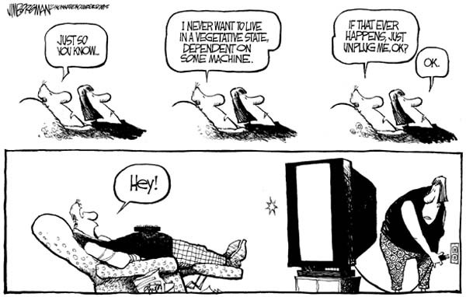
TV
Just so you know…
I never want to live in a vegetative state, dependent on some machine.
If that ever happens, just unplug me, OK?
OK.
HEY!

Slide 43

Wholesome Thoughts
(Psalm 101:2b-3a NLT)
²...I will lead a life of integrity in my own home.
³I will refuse to look at anything vile and vulgar...

Slide 44
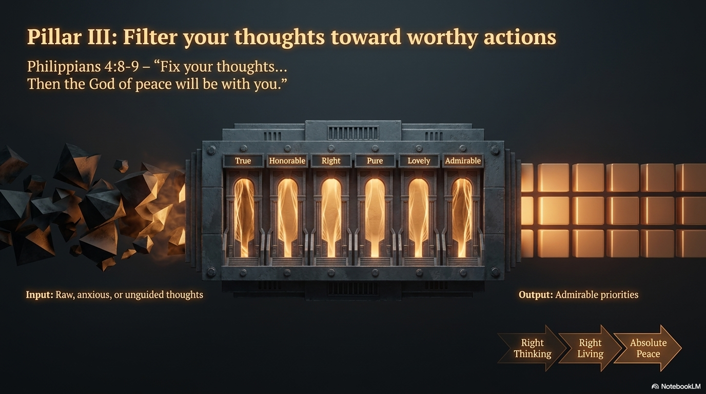
Notes:
Note the seven traits that provide peace.

Slide 45
Notes:
Right thinking leads to right living, which leads to absolute peace.

Slide 46
Notes:
God grants peace when you live the “set apart” life.

Slide 47
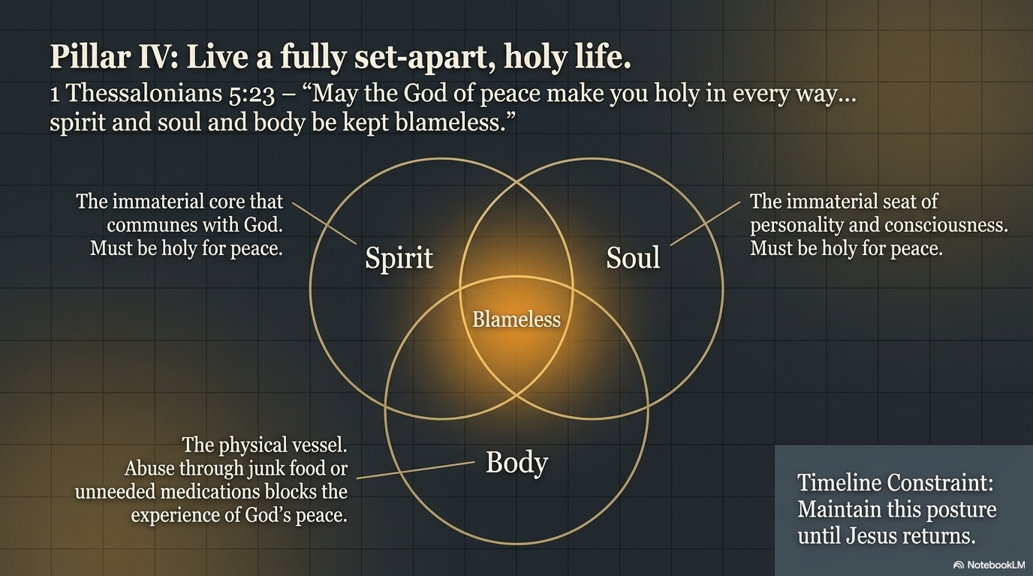
Notes:
1 Thess 5:23 Now may the God of peace make you holy in every way and may your whole spirit and soul and body be kept blameless until our Lord Jesus Christ comes again.
The word “sanctify” (NIV, NAU, ESV) here is to set apart for holy use. The NLT asks that the God of peace “make you holy” in every way.
How long? Until Jesus returns!
In what areas of our lives?
Be blameless in all three parts of you—spirit, soul, and body.
Your spirit is the immaterial core that communes with God. Make it holy for peace.
Your soul is the immaterial seat of personality or conscious self. Make it holy for peace.
Your body must be holy also to experience God’s peace. Too often, we abuse our bodies with junk food or meds we don’t need, and then we wonder why we lack God’s peace!

Slide 48
Notes:
God grants peace when you recognize that you are complete in Christ.

Slide 49

"Now may the God of peace— who brought up from the dead our Lord Jesus, the great Shepherd of the sheep, and ratified an eternal covenant with his blood—
²¹may he equip you with all you need for doing his will.
May he produce in you, through the power of Jesus Christ, every good thing that is pleasing to him.
All glory to him forever and ever! Amen"
(Hebrews 13:20-21 NLT).
Notes:
What is the “eternal covenant” (20)?
This is new covenant that replaced the old covenant given to Moses at Mt. Sinai.
It is eternal because it is rooted in the blood of Jesus, which lasts forever.
The focus here is not what we believe—though that is crucial—but what we do about what we believe.

Slide 50
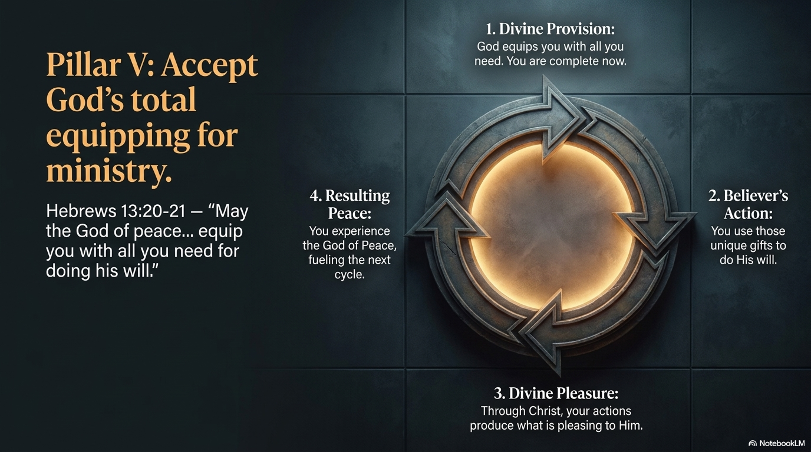
1. Divine Provision
4. Peace as a Result
2. Your Action
3. Divine Pleasure
Notes:
Divine Provision: Do you know how God has uniquely equipped you? He gives you all you need to obey him! Do you ever feel that God hasn’t given you what you need to experience his peace? You have it all now.
Your Action: Use those unique gifts to do His will.
Divine Pleasure: Through Christ, your actions please the Lord.
Peace as a Result: Peace is the effect, not the cause.

Slide 51
How can you experience the God of peace?
5 ways to God's peace
Notes:
How can you experience the God of peace?
How can Yahweh Shalom give you peace in your life’s circumstances?

Slide 52
How can you experience the God of peace?
Live in faithful obedience.
(The Main Idea)
Notes:
How can you experience the God of peace?
How can Yahweh Shalom give you peace in your life’s circumstances?

Slide 53
Notes:
God grants peace when you recognize that you are complete in Christ.

Slide 54
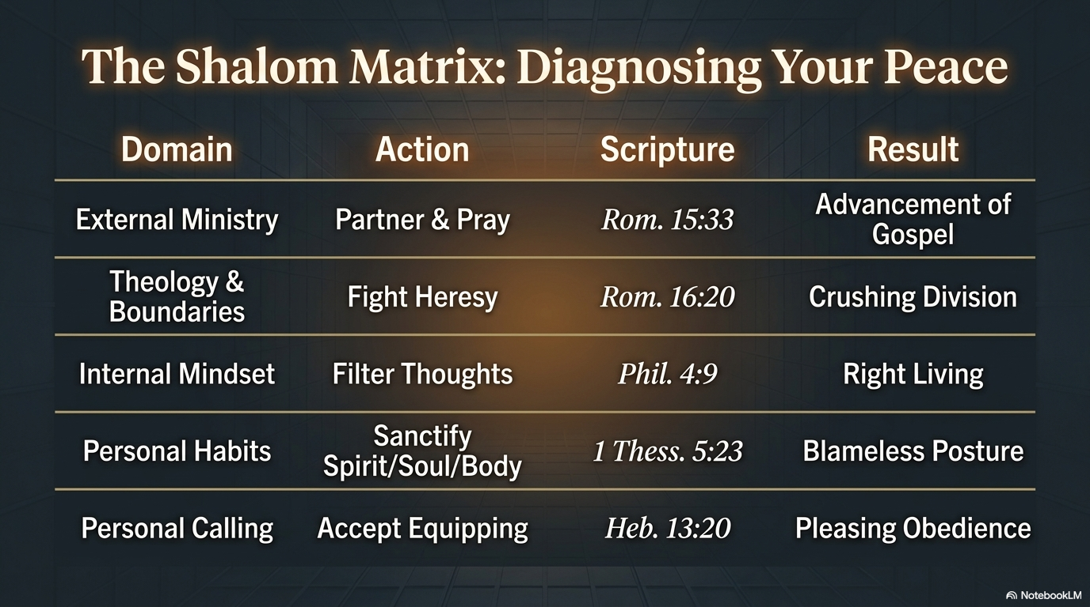
Notes:
Partner with missionaries.
Fight heresy with truth.
Focus your thoughts on doing worthy things.
Live a holy life.
Accept God’s equipping for ministry.
Which of these five ways to peace is lacking in your life?

Slide 55
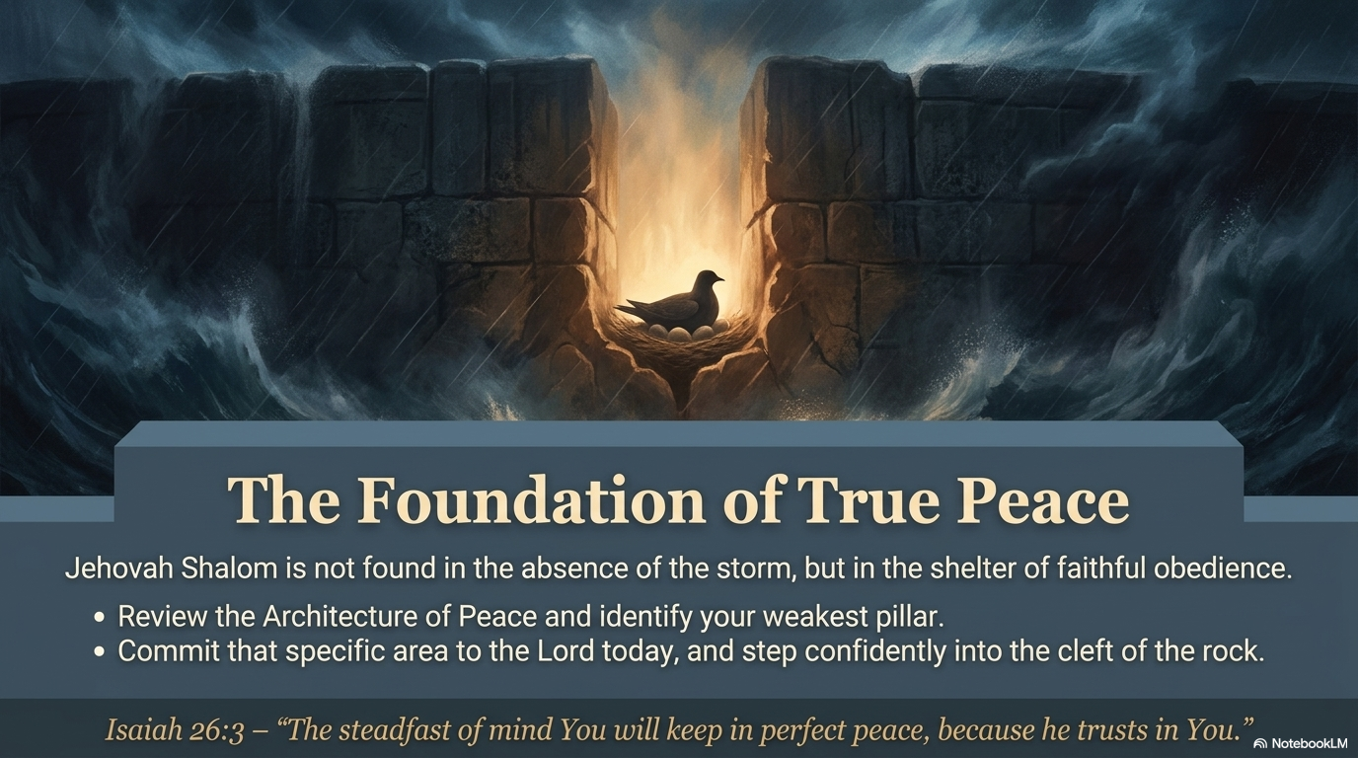
Notes:
Commit that area of weakness to experience the God of peace.

Slide 56
Black

Slide 57


Topical Preaching link at BibleStudyDownloads.org
Get this presentation and script for free!
Notes:
OT Preaching (op)

