Slide 1


Title: Genesis—Key to Evangelism
Dr. Terry Mortenson
Genesis: Key to Evangelism Today
Designed by Dr. Terry Mortenson
Uploaded by Dr. Rick Griffith • Singapore Bible College
All files in many languages for free download at BibleStudyDownloads.org
Notes:
This template is intended for talk titles. Although it can be used for significant section titles, its “cover page” feel makes it best used once at the beginning of a presentation. Subtitle can be as its name suggests or the speaker's name. Presentation Team recommends title text size as 50–72 and subtitle size as 30–48 with optimal sizes already used in this example. This also contains a floating AiG logo that can be repositioned or removed as appropriate for the overhead's content.

Slide 2
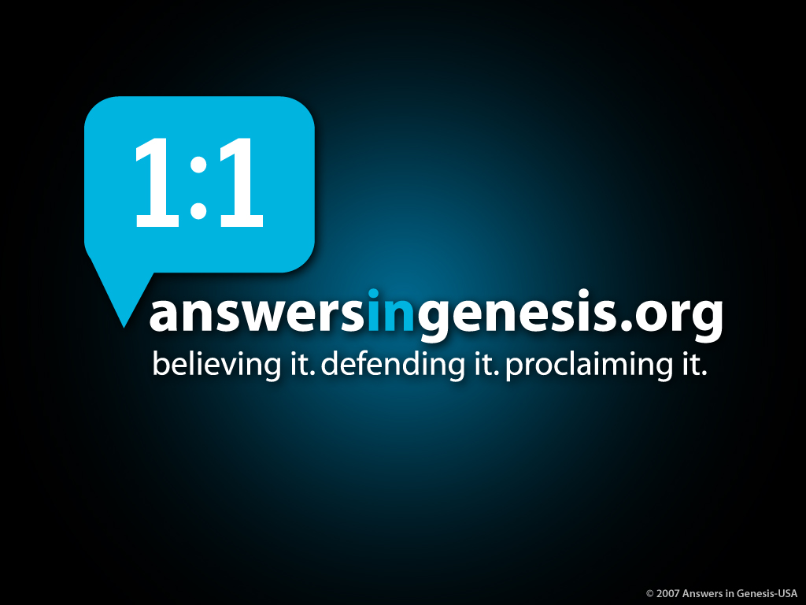
AiG web site #1

Slide 3

Matt. 28:18-20 NAS
Matthew 28:18-20
18. And Jesus came up and spoke to them, saying, “All authority has been given to Me in heaven and on earth.
19. Go therefore and make disciples of all the nations, baptizing them in the name of the Father and the Son and the Holy Spirit,
20. teaching them to observe all that I commanded you; and lo, I am with you always, even to the end of the age.”
Notes:
JP Moreland (Hugh Ross) article that I refute where he relies on Kaiser and Archer
The underlined word is eretz, the same word translated earth in Gen. 1:1 and 2:1 and 2:4. Eretz is used 45 times in the Flood account in Gen. 6:5-9:17. The circled word is adamah, which in modern translations is rendered more accurately as “ground” or “land.” It is used only 9 times in the Flood account. In his rejection of the global Flood, OT scholar Dr. Walter Kaiser said in the Feb. 2006 John Ankerberg debates on creation that eretz is never used in the flood account, but that only adamah is used. He was seriously in error.

Slide 4

Terry for tea #1
TERRY, WE'D
LOVE TO HAVE
YOU OVER
FOR TEA.

Slide 5

Terry for tea #2
TERRY, WE'D
LOVE TO HAVE
YOU OVER
FOR TEA.
GREAT!
WE'D LOVE TO COME OVER
FOR TEA.

Slide 6

Terry for tea #3

Slide 7
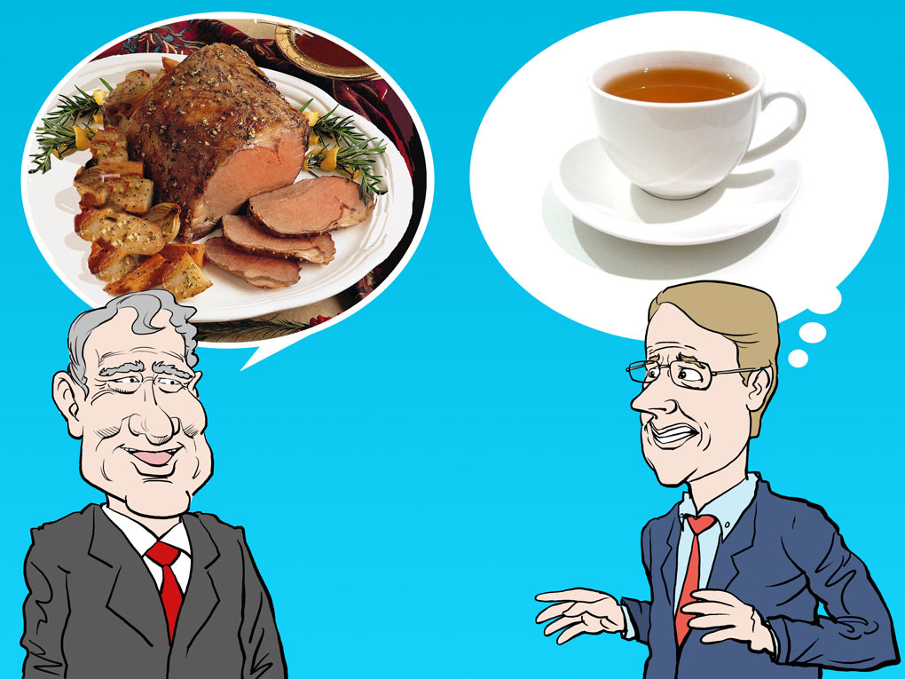
Terry for tea #4

Slide 8
John 3:12 NIV????
1 Chronicles 12:32
…of the sons of Issachar who had understanding of the times, to know what Israel ought to do
Notes:
Athanasius knew the times as he defended the deity and humanity of Christ
Luther knew the times as he defended the authority of the Scriptures and the doctrine of justification by faith

Slide 9


Purple blank
“Today it is perhaps the Darwinian view of nature more than any other that is responsible for the agnostic and skeptical outlook of the twentieth century.”
Michael Denton, Evolution: A Theory in Crisis (London: Burnett Books, 1985), p. 358.
Notes:
Denton is medical doctor and PhD molecular biologist.
At the time of his book, he was an agnostic regarding the existence of God.

Slide 10
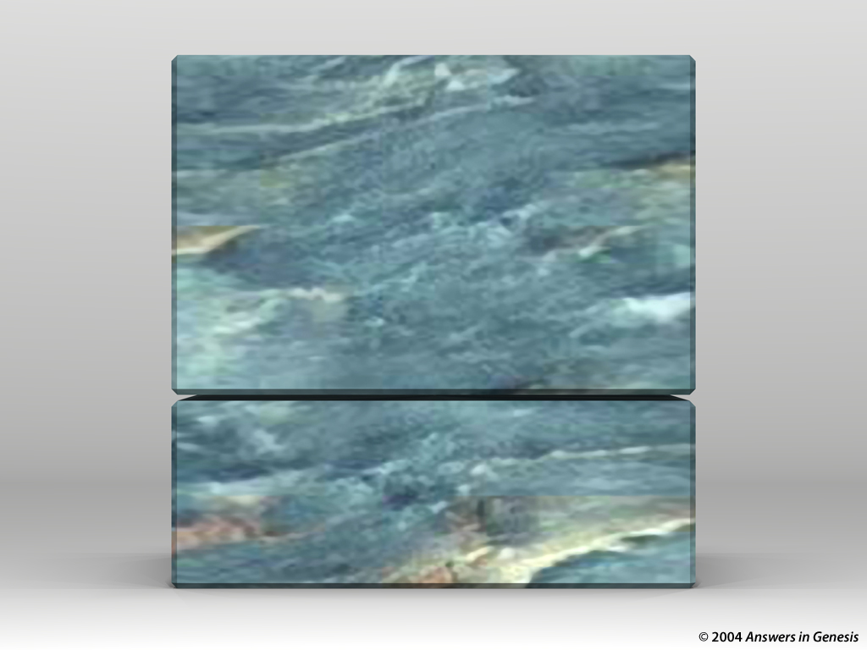
Blocks-Sin + Genesis 00871
GOSPEL
GENESIS

Slide 11
I Cor. 15:3-4 NAS
1 Corinthians 15:3-4
3. For I delivered to you as of first importance what I also received, that Christ died for our sins according to the Scriptures,
4. and that He was buried, and that He was raised on the third day according to the Scriptures.

Slide 12
Gen. 3:15 NAS
Genesis 3:15
And I will put enmity between you and the woman, and between your seed and her seed; he shall bruise you on the head, and you shall bruise him on the heel.

Slide 13
Blocks-Sin + Genesis 00871
SIN
GENESIS

Slide 14
I Jn. 3:4 NAS
1 John 3:4
Everyone who practices sin also practices lawlessness; and sin is lawlessness.

Slide 15
Blocks-Sin + Genesis 00871
DEATH
GENESIS

Slide 16
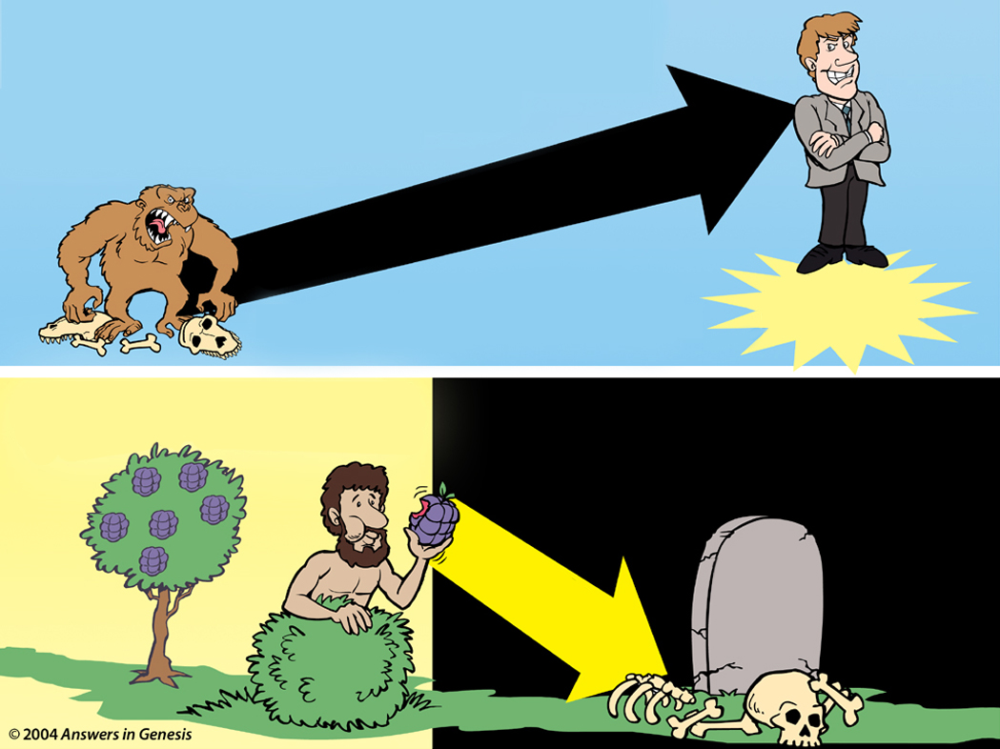
Evolution Creation 00896
EVOLUTION
MILLIONS OF YEARS
DEATH
MAN'S
EXISTENCE
Suffering • Disease • Bloodshed
CREATION
MAN'S
ACTIONS
DEATH
Notes:
16

Slide 17
Rom. 5:12 NAS
Romans 5:12
Therefore, just as through one man sin entered into the world, and death through sin, and so death spread to all men, because all sinned.

Slide 18
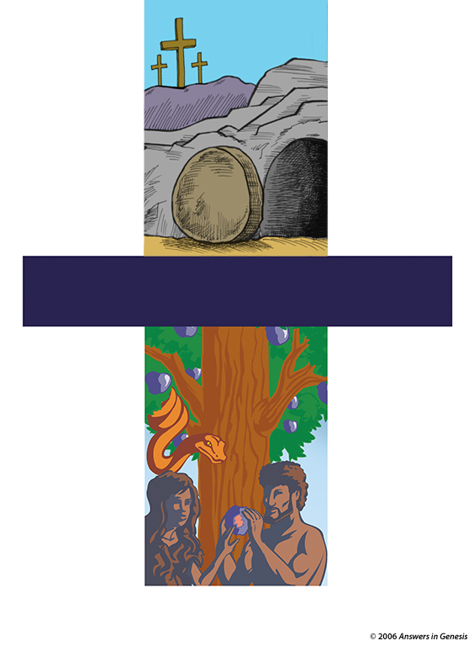
First/last Adam
HE IS RISEN!!
Jesus Christ
"The Last Adam"
1 Cor. 15:45
For as in Adam all die, even so in Christ shall all be made alive
1 Cor. 15:22
"The First Adam"
1 Cor. 15:45

Slide 19
Blks-Gen Jesus
JESUS
GENESIS

Slide 20
Jesus believed the literal truth of the Old Testament history:
Adam and Eve—1st marriage (Mt. 19:4-6)
Abel (1st prophet) murdered (Lk. 11:50-51)
Noah & the Flood (Mt. 24:37-39)
Lot & the fall of Sodom (Mt. 10:15)
Lot's wife turned to salt (Lk. 17:28-32)
Moses & the serpent (Jn. 3:14)
Moses and the manna (Jn. 6:32-33, 49)
Elijah's miracles (Lk. 4:25-27)
Jonah in the fish (Mt. 12:40-41)
Notes:
Another way that Jesus revealed His complete trust in the Scriptures was by treating as historical fact the accounts in the Old Testament which most contemporary people think are unbelievable mythology.

Slide 21
Jesus and the age of universe
“But from the beginning of creation, God made them male and female.” Mark 10:6
4,000 years before Christ
Adam and Eve (Day 6)
The beginning
Christ
Time line for 14,000,000,000 years since 'big bang'
The beginning
"Adam and Eve"
Notes:
If the biblical timeline = 2 metres (7 feet) on the screen, then the evolutionary timeline would stretch 7,500 km (4500 miles).

Slide 22
If Jesus is my Lord …
If Jesus is our Lord, can we have a different view of the age of the earth than He had?

Slide 23
John 5:45-47 NAS
John 5:45-47
Do not think that I will accuse you before the Father; the one who accuses you is Moses, in whom you have set your hope. For if you believed Moses, you would believe Me, for he wrote about Me. But if you do not believe his writings, how will you believe My words?

Slide 24
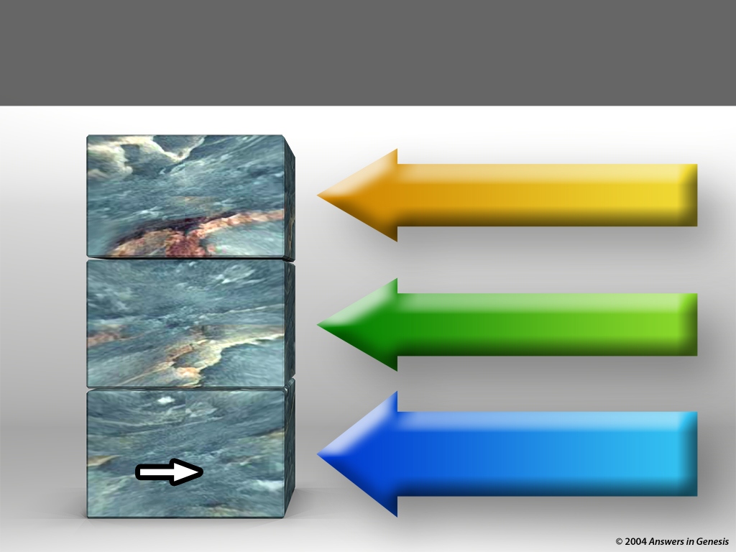
THE GOSPEL
CONSUMMATION OF ALL THINGS
HOPE
JESUS CHRIST CRUCIFIED AND RAISED FROM THE DEAD
POWER
CHRIST & CREATION
FOUNDATIONAL KNOWLEDGE
SIN
DEATH

Slide 25








7 C's Animated—Gen. 1:31 omitted
CREATION
CORRUPTION
CATASTROPHE
THE SEVEN C's OF HISTORY
CONFUSION
CHRIST
CONSUMMATION
CROSS
Notes:
Each element is a TIFF image with alpha channels. This whole page totals 1.1 MB rather than 11+ MB that flat JPEGs would produce.

Slide 26
I Cor. 1:23 NAS
1 Corinthians 1:23
But we preach Christ crucified, to Jews a stumbling block and to Greeks foolishness.
Notes:
Verse 9 echoes the language of Gen. 9:10-16. There is nothing on Day 3, when God made dry land, to link this description with creation week.

Slide 27
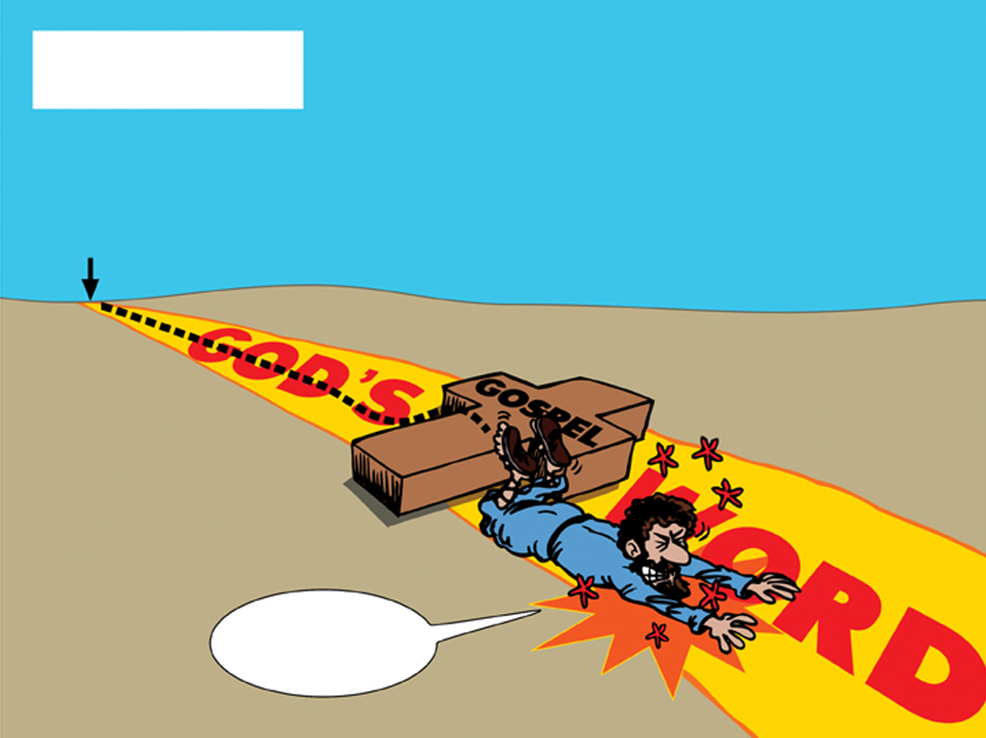
01 Jews fall over Gospel
JEWS
But we preach Christ crucified,
to the Jews a stumbling block,
and to the Greeks foolishness;
1 Corinthians 1:23
GOD'S
GENESIS
GOSPEL
WORD
OUCH!

Slide 28
Acts 2:22-24 NAS
Acts 2:22-24
22. "Men of Israel, listen to these words: Jesus the Nazarene, a man attested to you by God with miracles and wonders and signs which God performed through Him in your midst, just as you yourselves know—
23. this Man, delivered over by the predetermined plan and foreknowledge of God, you nailed to a cross by the hands of godless men and put Him to death.
24. "But God raised Him up again, putting an end to the agony of death, since it was impossible for Him to be held in its power."
Notes:
And Adam gave names to all cattle, and to the fowl of the air, and to every beast of the field; but for Adam there was not found an help meet for him.

Slide 29
Acts 2:37-38 & 40 NAS
Acts 2:37-38 & 40
37. Now when they heard this, they were pierced to the heart, and said to Peter and the rest of the apostles, “Brethren, what shall we do?”
38. Peter said to them, “Repent, and each of you be baptized in the name of Jesus Christ for the forgiveness of your sins; and you will receive the gift of the Holy Spirit. …
40. And with many other words he solemnly testified and kept on exhorting them, saying, “Be saved from this perverse generation!”
Notes:
And Adam gave names to all cattle, and to the fowl of the air, and to every beast of the field; but for Adam there was not found an help meet for him.

Slide 30
Acts 2:41 NAS
Acts 2:41
So then, those who had received his word were baptized; and that day there were added about three thousand souls.

Slide 31
THE GOSPEL
CONSUMMATION OF ALL THINGS
HOPE
JESUS CHRIST CRUCIFIED AND RAISED FROM THE DEAD
POWER
CHRIST & CREATION
FOUNDATIONAL KNOWLEDGE
SIN
DEATH

Slide 32
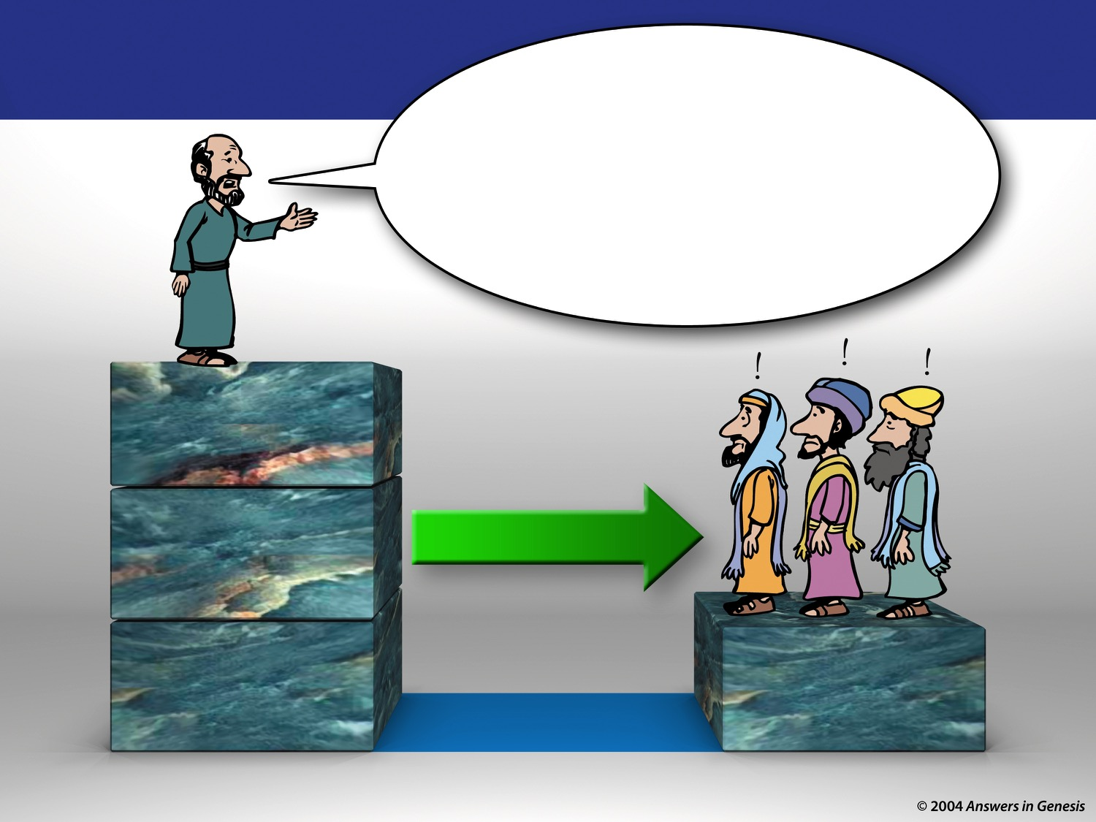
Acts2-Peter + Jews 00903
Acts 2
Therefore let all the house
of Israel know assuredly, that God
has made the same Jesus, whom you have crucified, both Lord and Christ (Acts 2:36).
CONSUMMATION OF ALL THINGS
JESUS CHRIST CRUCIFIED & RAISED FROM THE DEAD
ADD THIS NEXT
Jews
CHRIST & CREATION
SIN DEATH
CHRIST & CREATION
SIN DEATH
FOUNDATION
ALREADY IN PLACE

Slide 33

Blocks – Stumbling Block/Creation Based
STUMBLING BLOCK
JESUS AND RESURRECTION
UNDERSTAND
GOD-SIN-DEATH
CREATION BASED

Slide 34
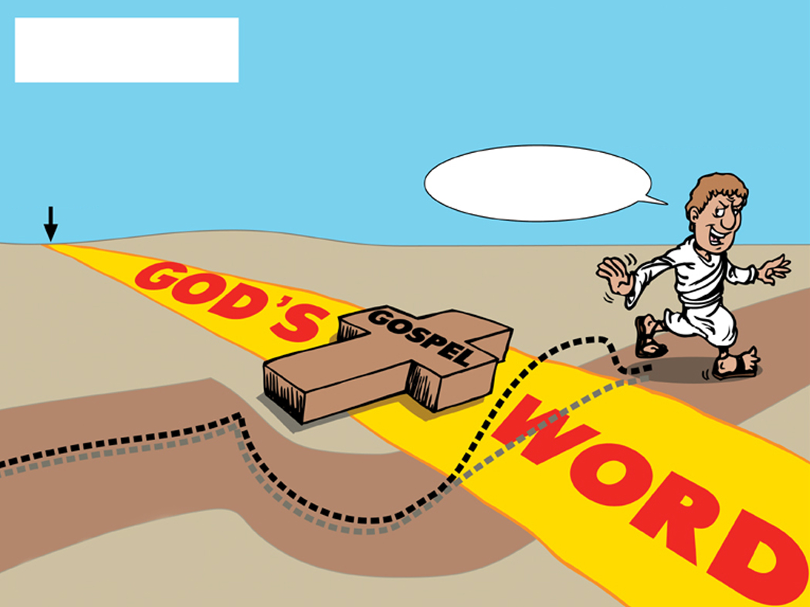
02 Greeks jump road
But we preach Christ crucified,
unto the Jews a stumblingblock,
and unto the Greeks foolishness;
GREEKS
1 Corinthians 1:23
HA! FOOLISHNESS!
GOD'S
GENESIS
GOSPEL
WORD
Greek Road

Slide 35
Acts 17:18 NAS
Acts 17:18
And also some of the Epicurean and Stoic philosophers were conversing with him. Some were saying, “What would this idle babbler wish to say?” Others, “He seems to be a proclaimer of strange deities,”—because he was preaching Jesus and the resurrection.
Notes:
And Adam gave names to all cattle, and to the fowl of the air, and to every beast of the field; but for Adam there was not found an help meet for him.

Slide 36
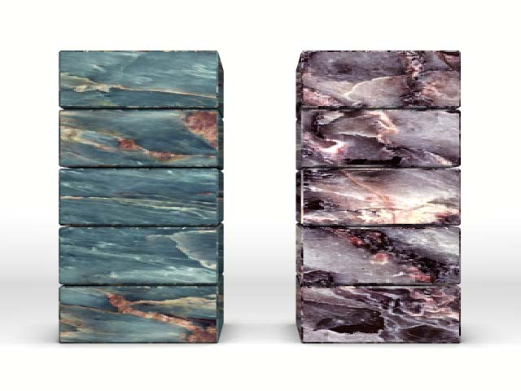
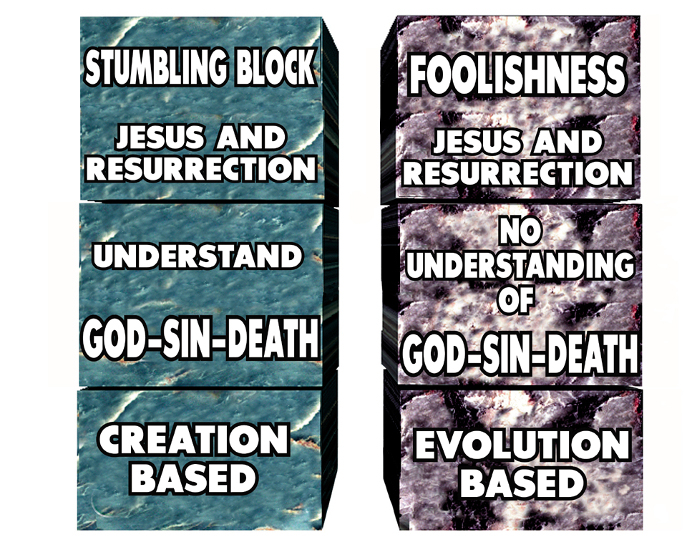
Blocks – Creation/Evol. Based
FOOLISHNESS
STUMBLING BLOCK
JESUS AND RESURRECTION
JESUS AND RESURRECTION
UNDERSTAND
NO UNDERSTANDING OF
GOD-SIN-DEATH
GOD-SIN-DEATH
CREATION BASED
EVOLUTION BASED

Slide 37
Acts 17:23 NAS
Acts 17:23
For while I was passing through and examining the objects of your worship, I also found an altar with this inscription, “TO AN UNKNOWN GOD.” Therefore what you worship in ignorance, this I proclaim to you.
Notes:
And Adam gave names to all cattle, and to the fowl of the air, and to every beast of the field; but for Adam there was not found an help meet for him.

Slide 38
Acts 17:24-25 NAS
Acts 17:24-25
24. The God who made the world and all things in it, since He is Lord of heaven and earth, does not dwell in temples made with hands;
25. nor is He served by human hands, as though He needed anything, since He Himself gives to all people life and breath and all things;

Slide 39
Acts 17:26-27 NAS
Acts 17:26-27
26. and He made from one man every nation of mankind to live on all the face of the earth, having determined their appointed times and the boundaries of their habitation,
27. that they would seek God, if perhaps they might grope for Him and find Him, though He is not far from each one of us;

Slide 40
Acts 17:30-31 NAS
Acts 17:30-31
30. Therefore having overlooked the times of ignorance, God is now declaring to men that all people everywhere should repent,
31. because He has fixed a day in which He will judge the world in righteousness through a Man whom He has appointed, having furnished proof to all men by raising Him from the dead.

Slide 41
Acts 17:32 & 34 NAS
Acts 17:32 & 34
32. Now when they heard of the resurrection of the dead, some began to sneer, but others said, “We shall hear you again concerning this.”
33. So Paul went out of their midst.
34. But some men joined him and believed, among whom also were Dionysius the Areopagite and a woman named Damaris and others with them.
Notes:
32 Now when they heard of the resurrection of the dead, some began to sneer, but others said, “We shall hear you again concerning this.”
33 So Paul went out of their midst.
34 But some men joined him and believed, among whom also were Dionysius the Areopagite and a woman named Damaris and others with them.

Slide 42
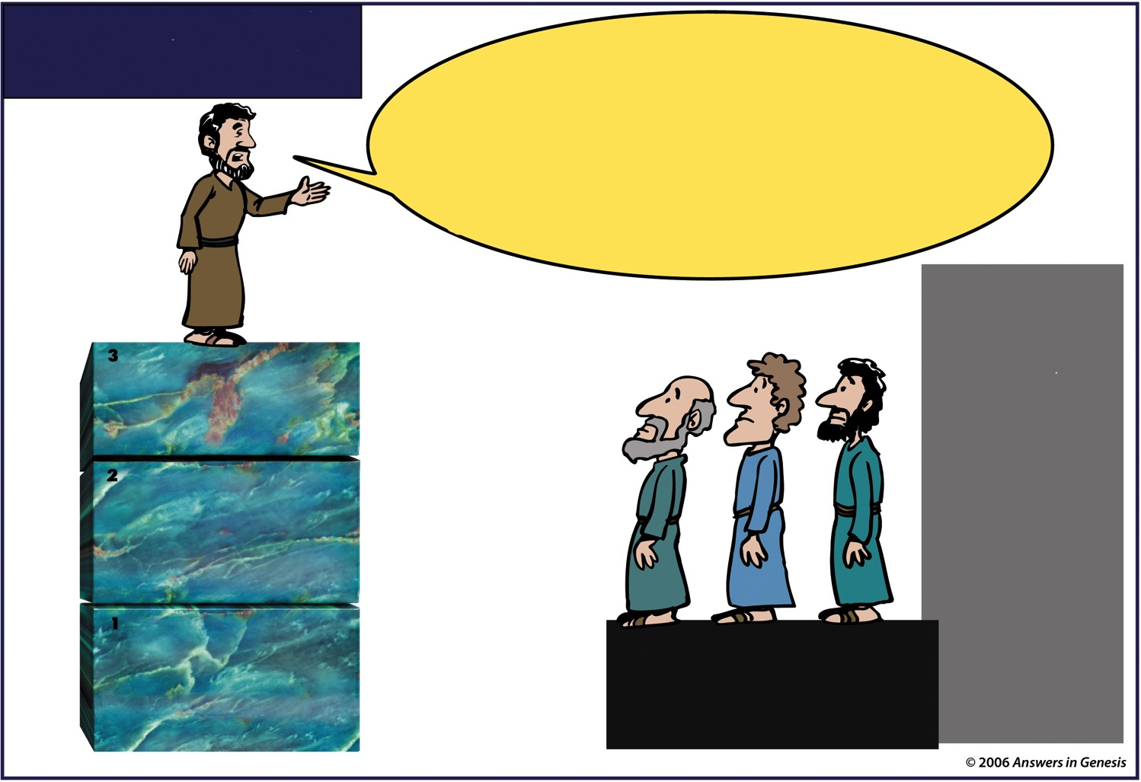
Acts 17 – Paul & Greeks Remove
Acts 17
…I Found an altar with
this inscription, to the unknown god.
Whom therefore ye ignorantly worship,Him declare I unto you. God that made the world
and all things therein, seeing that He is
Lord of heaven and earth…
Acts 17:23-24
ALTAR
TO THE
UNKNOWN
GOD
CONSUMMATION OF ALL THINGS
JESUS CHRIST CRUCIFIED & RAISED FROM THE DEAD
CHRIST & CREATION
SIN DEATH
REMOVE OLD
FOUNDATION FIRST
NO CHRISTIAN BASIS

Slide 43
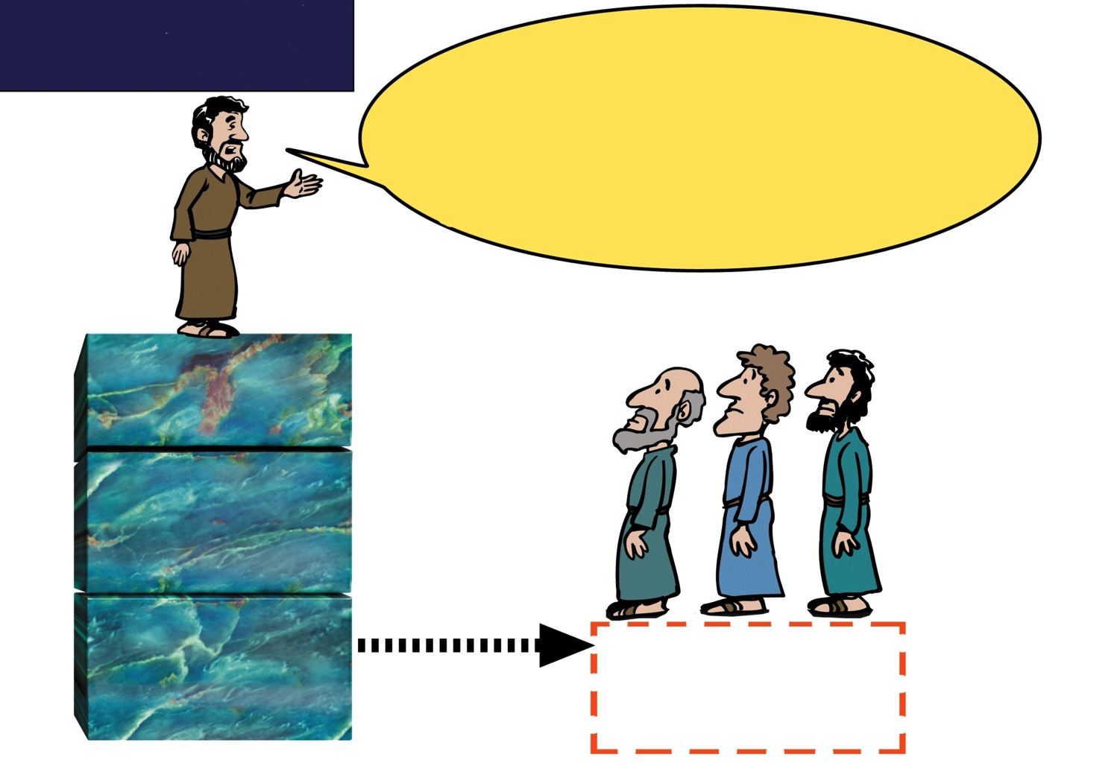
Acts 17 – Paul & Greeks no base
Acts 17
... I found an altar with
This inscription, to the unknown God.
Whom therefore ye ignorantly worship, Him declare I unto you. God that made
the world and all things therein seeing
that he is Lord of Heaven and Earth ...
Acts 17:23-24
Paul
Greeks
CONSUMMATION OF ALL THINGS
JESUS CHRIST CRUCIFIED & RAISED FROM THE DEAD
CHRIST & CREATION
SIN DEATH
REPLACE WITH THE CORRECT FOUNDATION
Notes:
43

Slide 44
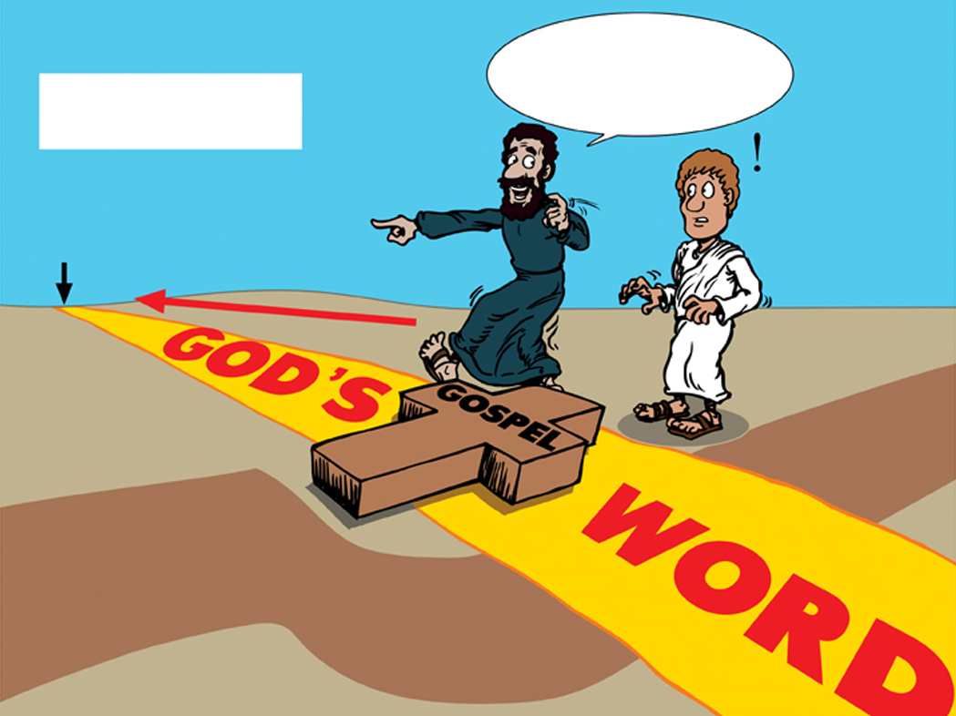
03 reach Greeks – old clothes
REACHING THE
LET'S START FROM
THE BEGINNING!
GREEKS
GOD'S
GENESIS
02 Greeks jump road
GOSPEL
WORD
Greek Road

Slide 45
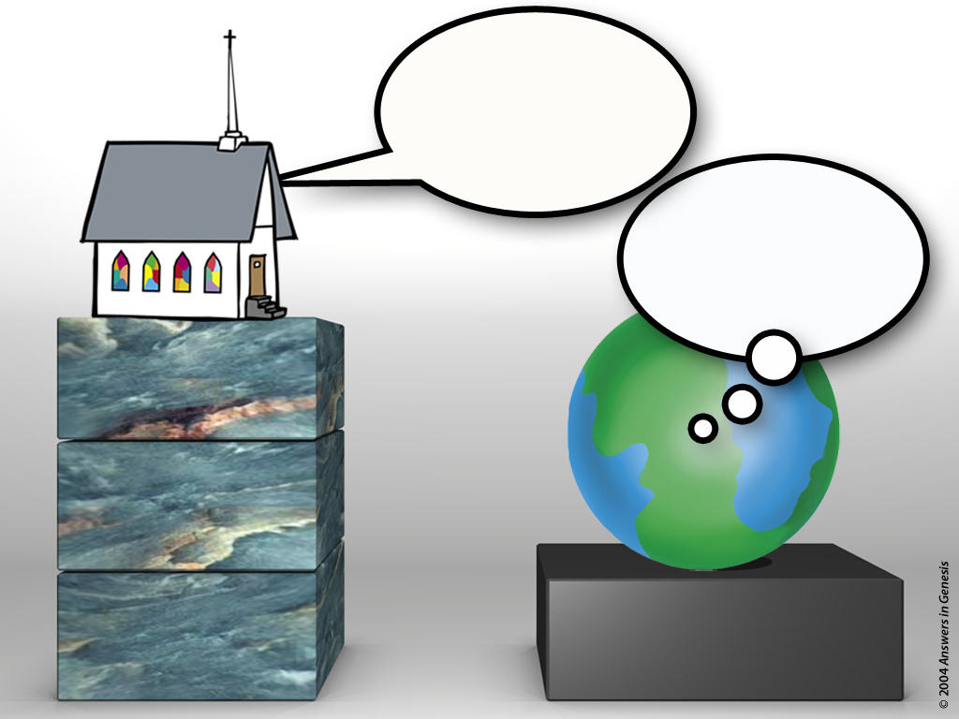
Church Witness to World
REPENT!
JESUS DIED FOR
YOUR SINS!
THE
CHURCH
I understand.
CONSUMMATION OF ALL THINGS
THE
WORLD
JESUS CHRIST CRUCIFIED & RAISED FROM THE DEAD
CHRIST & CREATION
SIN DEATH
"JEWS"
Notes:
45

Slide 46
Church Witness to World
REPENT!
JESUS DIED FOR
YOUR SINS!
THE
CHURCH
FOOLISHNESS
CONSUMMATION OF ALL THINGS
THE
WORLD
JESUS CHRIST CRUCIFIED & RAISED FROM THE DEAD
CHRIST & CREATION
SIN DEATH
"GREEKS"
Notes:
46

Slide 47
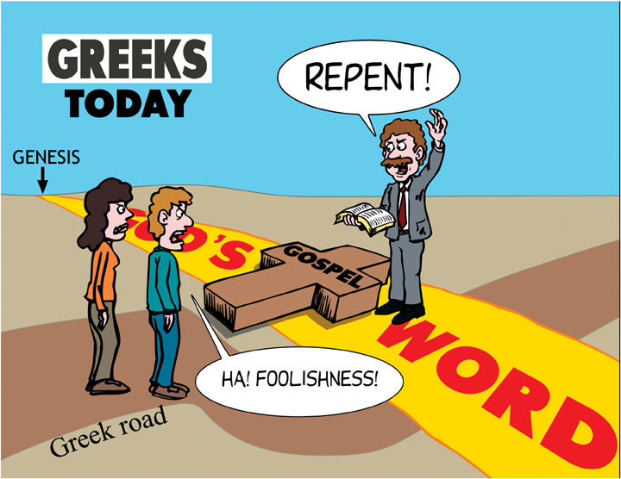
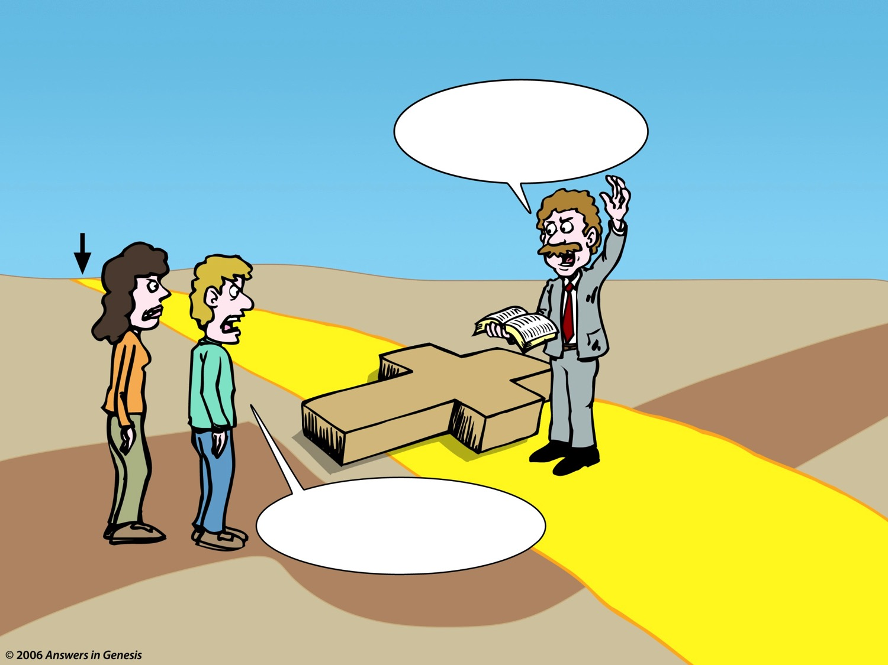
05 Greeks today
TODAY'S
“GREEKS”
REPENT!
GENESIS
GOD'S
GOSPEL
HA! FOOLISHNESS!
WORD
GREEK ROAD
Notes:
47

Slide 48
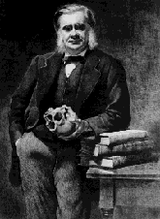
Huxley 1893 #1
“I am fairly at a loss to
comprehend how any one,
for a moment, can doubt
that Christian theology
must stand or fall with the
historical trustworthiness
of the Jewish Scriptures.”
Thomas H. Huxley, Science and Hebrew Tradition (New York: D. Appleton, 1893), p. 207-8.
Notes:
Picture from http://aleph0.clarku.edu/huxley/, accessed 19 Feb. 2004

Slide 49
Huxley 1893 #2
“The very conception of the
Messiah, or Christ, is
inextricably interwoven with
Jewish history; the identifi-
cation of Jesus of Nazareth
with that Messiah rests
upon the interpretation of
the passages of the Hebrew
Scriptures which have no evidential value unless they possess the historical character assigned to them.”
Thomas H. Huxley, Science and Hebrew Tradition (New York: D. Appleton, 1893), p. 207-8.

Slide 50
Huxley 1893 #3
“If the covenant with
Abraham was not made; if
circumcision and sacrifices
were not ordained by
Jahveh; if the 'ten words'
were not written by God's
hand on the stone tables; if
Abraham is more or less a
mythical hero, such as Theseus; the Story of the Deluge a fiction; that of the Fall a legend; and that of the Creation the dream of a seer;”
Thomas H. Huxley, Science and Hebrew Tradition (New York: D. Appleton, 1893), p. 207-8.

Slide 51
Huxley 1893 #4
“if all these definite and
detailed narratives of
apparently real events have
no more value as history
than have the stories of the
regal period of Rome--what
is to be said about the
Messianic doctrine, which
is so much less clearly enunciated?
Thomas H. Huxley, Science and Hebrew Tradition (New York: D. Appleton, 1893), pp. 207-8.

Slide 52
Huxley 1893 #5
“And what about the
authority of the writers of
the books of the New
Testament, who, on this
theory, have not merely
accepted flimsy fictions for
solid truths, but have built
the very foundations of
Christian dogma upon legendary quicksands?”
Thomas H. Huxley, Science and Hebrew Tradition (New York: D. Appleton, 1893), pp. 207-8.

Slide 53
Bozarth 1979 meaning of evolution
It becomes clear now that the whole justification of Jesus' life and death is predicated on the existence of Adam and the forbidden fruit he and Eve ate. Without the original sin, who needs to be redeemed? Without Adam's fall into a life of constant sin terminated by death, what purpose is there to Christianity? None.
G. Richard Bozarth, “The Meaning of Evolution,” American Atheist, 20 Sept. 1979, p. 30

Slide 54
Gospel blocks-new
ANTI-
THE GOSPEL
CONSUMMATION OF ALL THINGS
X
Ridiculous
JESUS CHRIST CRUCIFIED AND RAISED FROM THE DEAD
X
Unbelievable
CHRIST & CREATION
Evolution
& Mill. Yrs.
FOUNDATIONAL KNOWLEDGE
SIN
DEATH

Slide 55
7 C's Animated—Gen. 1:31 omitted
CREATION
CORRUPTION
CATASTROPHE
THE SEVEN C's OF HISTORY
CONFUSION
CHRIST
CONSUMMATION
CROSS
Notes:
Each element is a TIFF image with alpha channels. This whole page totals 1.1 MB rather than 11+ MB that flat JPEGs would produce.

Slide 56
7 C's Animated—Gen. 1:31 omitted
THE SEVEN C's OF HISTORY
Notes:
This is fully animated. The Scripture text frame is editable so you can insert a different version if you so desire.
In case you want to know. Each element is a TIFF image with alpha channels. This whole page totals 1.1 MB rather than 11+ MB that flat JPEGs would produce.

Slide 57
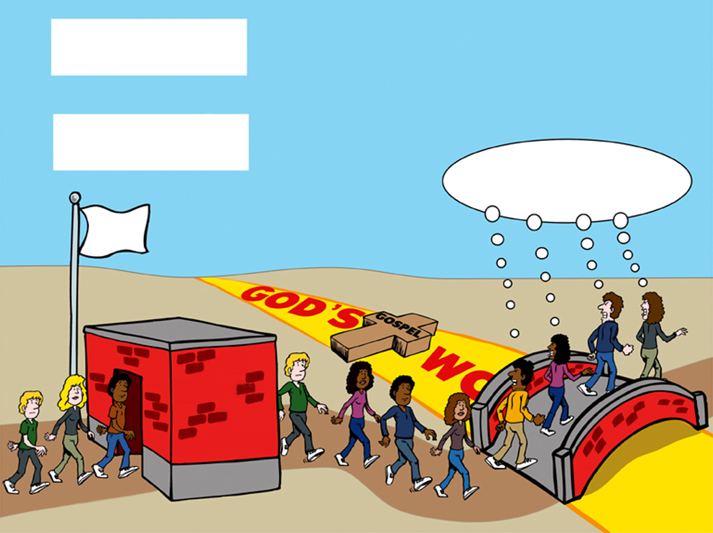
04 Greeks educating Greeks
GREEKS
educating
GREEKS
GOD'S
HA! FOOLISHNESS!
Secular
Education
02 Greeks jump road
GOSPEL
WORD
State
Schools
&
Colleges
Greek Road

Slide 58
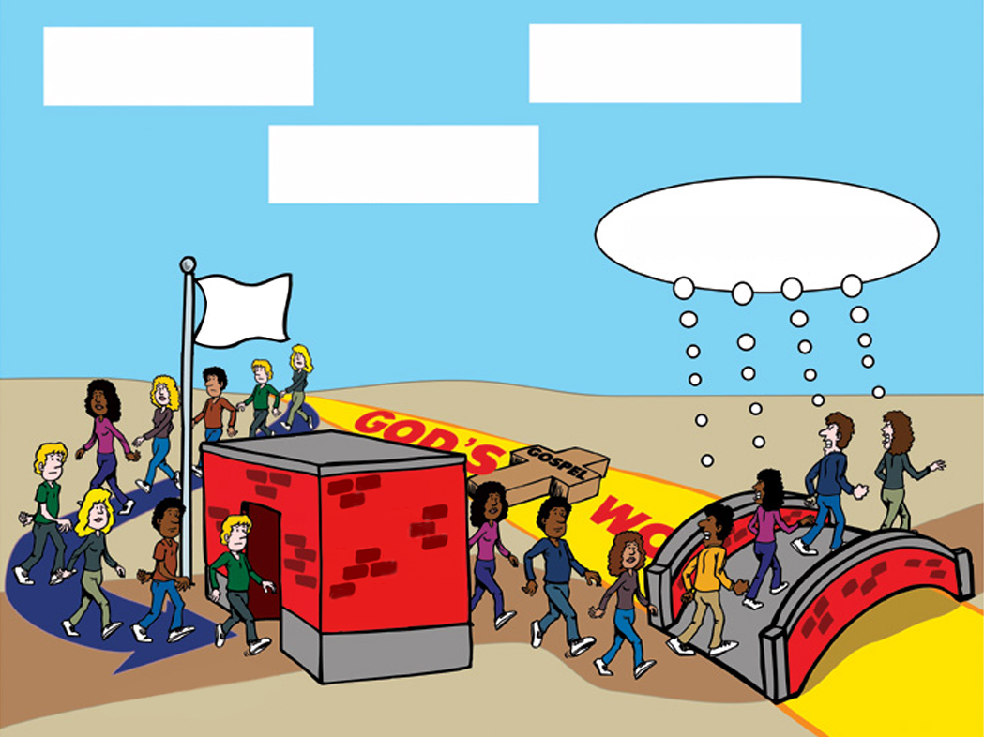
07 Greeks educating Jews
GREEKS
educating
JEWS
to be
GREEKS
GOD'S
HA! FOOLISHNESS!
Secular
Education
GOSPEL
WORD
State
Schools
&
Colleges
Greek Road

Slide 59
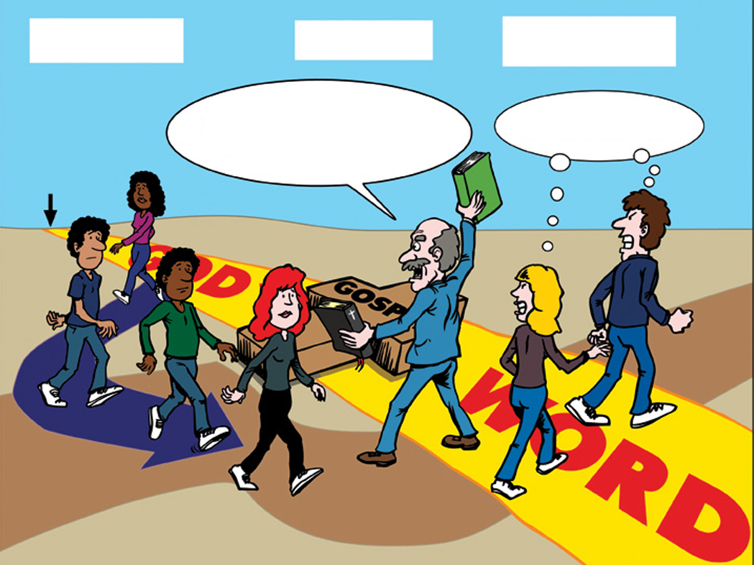
08 Jews educating Jews
JEWS
educating
JEWS
to be
GREEKS
Christians don't have to believe
in six days! We can accept millions
of years and the Big Bang.
Ha! Foolishness!
GOD'S
GENESIS
GOSPEL
WORD
Greek Road

Slide 60
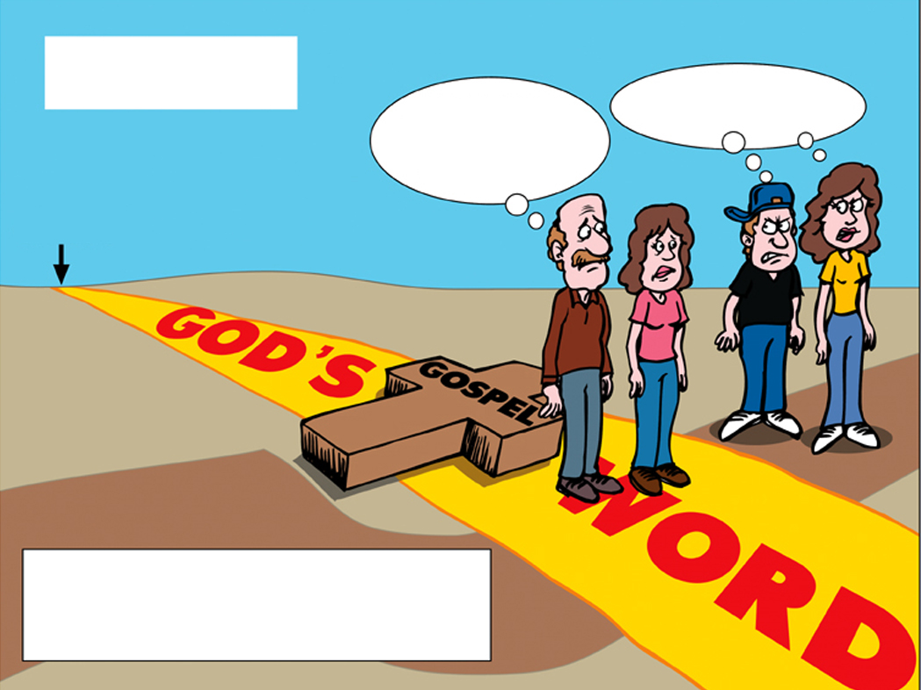
09 Greeks in family
GREEKS
Why don't our
children share
our faith?!
Ha! Foolishness!
IN THE FAMILY
GOD'S
GENESIS
GOSPEL
WORD
Parents are “JEWS”
Children are “GREEKS”

Slide 61
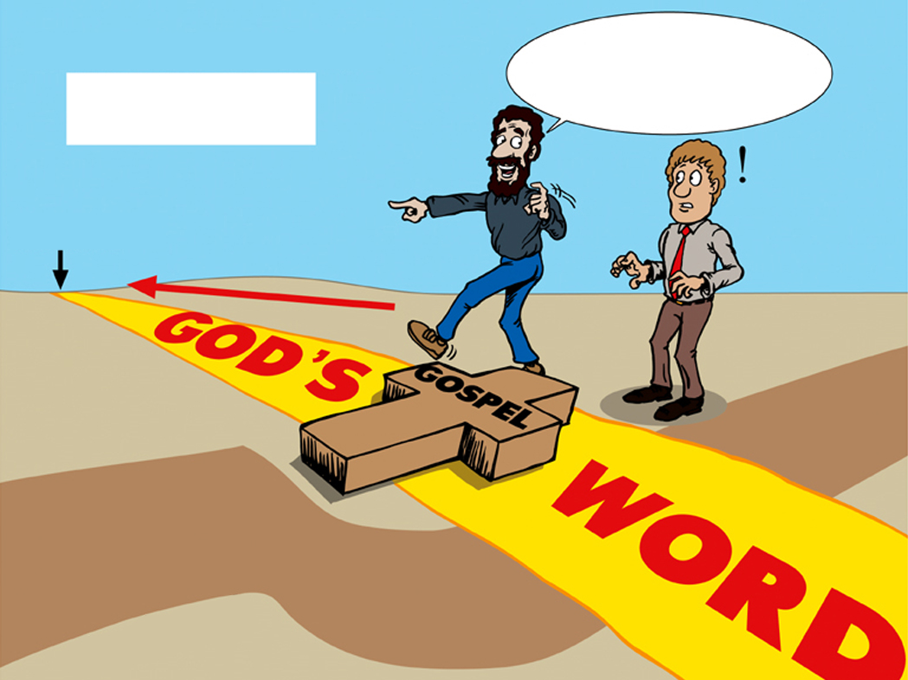
10 Reach today's Greeks
We can believe
the Bible is true history.
Let's start from the
beginning!
REACHING TODAY'S
GREEKS
GOD'S
GENESIS
02 Greeks jump road
GOSPEL
WORD
Greek Road

Slide 62

School violence-Bible story colored
Monday
Tuesday
Wednesday
Thursday
Friday
Saturday
Evolution is true!
The Bible is wrong!
Evolution is true!
The Bible is wrong!
Evolution is true!
The Bible is wrong!
Evolution is true!
The Bible is wrong!
Evolution is true!
The Bible is wrong!
Evolution is true!
The Bible is wrong!
Sunday
Yawn!
Today's Bible story is Jonah and the great fish.
Not another Bible story! This is boring! Church is irrelevant!

Slide 63
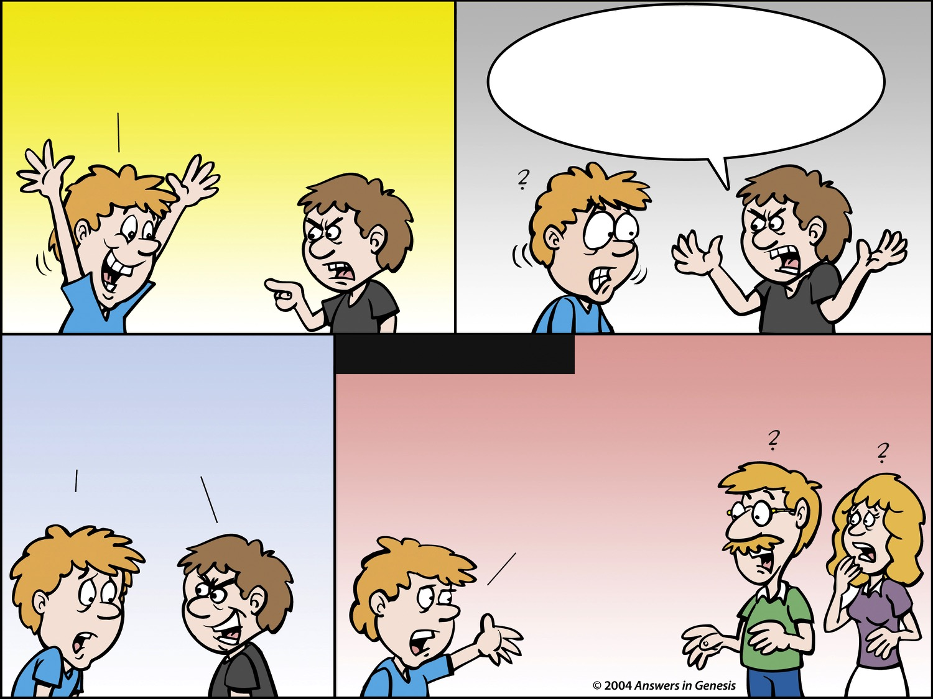
Bible Isn't True 00167
Where did
Cain get his wife? Where do
the dinosaurs fit in the Bible? Where
did all the races come from if
God created Adam and Eve?
Jesus loves you!
The Bible says so.
The Bible
isn't true!
Later at home
Dad and Mom, can you answer
these questions? Where did Cain get his wife? Where do the dinosaurs fit in the Bible? Where did all the races come from if God created Adam and Eve?
We don't
know.
I told you
the Bible's
not true!
I don't
know.

Slide 64
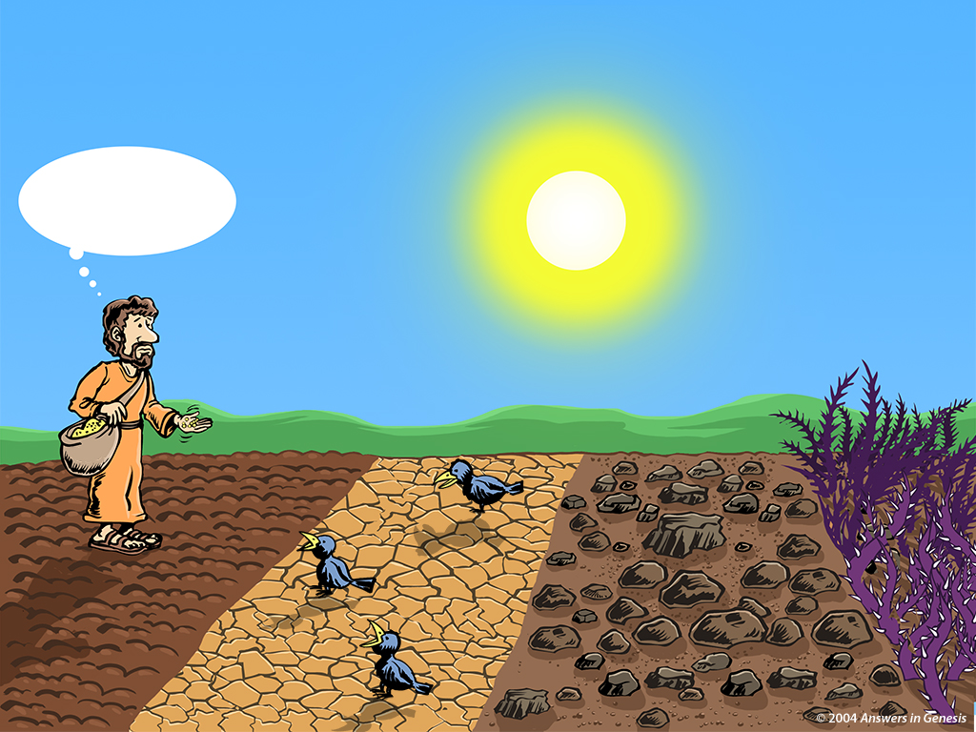
Know Your Soil 00899
Sowers, Know Your Soil!
I know where these seeds won't grow!
Thorny
Soil
Good
Soil
Hard
Soil
Rocky
Soil

Slide 65
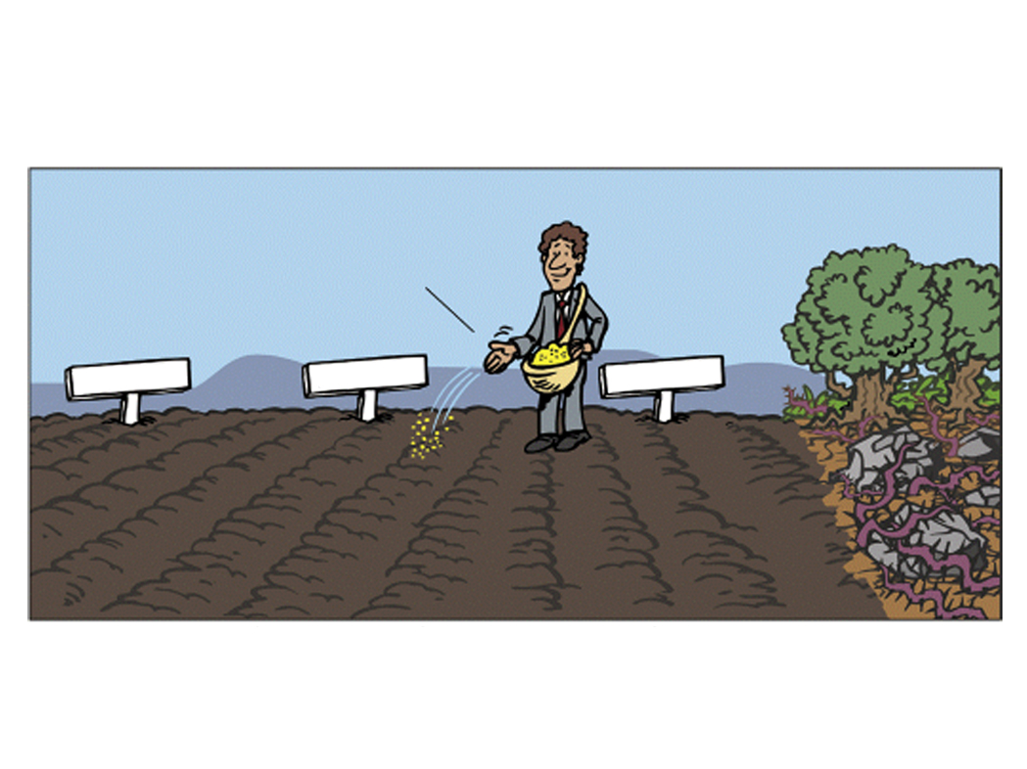
Jews plowed ground
“JEWS”
HOME
SCHOOL
CHURCH
Plowed ground
Unplowed ground

Slide 66
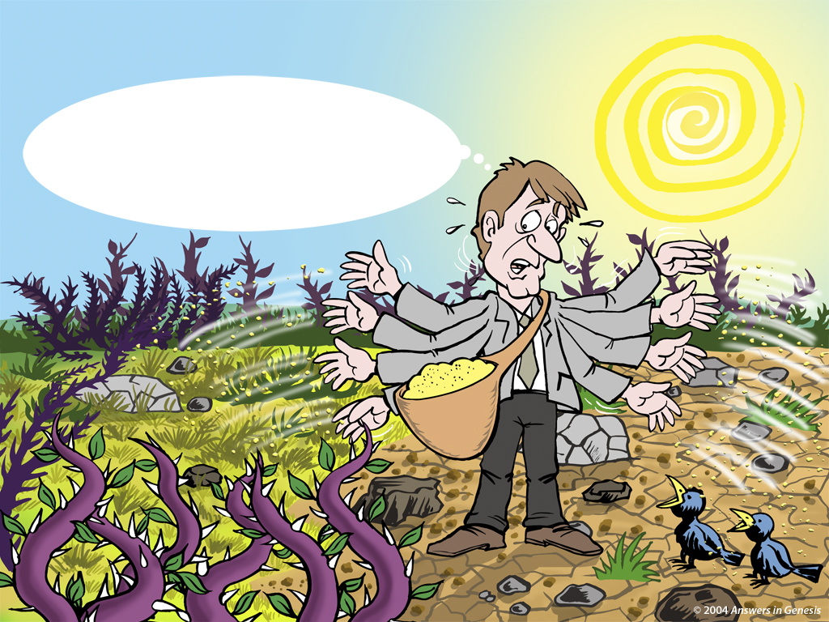
Church Today sowing 00895
THE CHURCH TODAY
THIS IS THE WAY WE'VE ALWAYS SPREAD THE GOSPEL IN THE PAST. WOW! THESE WEEDS ARE GETTING WORSE EVERY DAY! OH WELL!
GOSPEL SEEDS

Slide 67
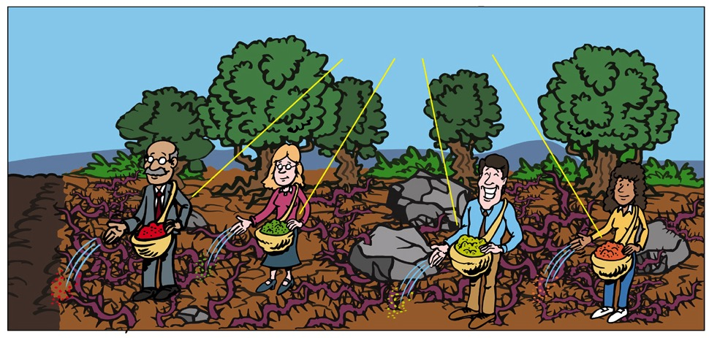
Greeks – Unplowed Ground
“GREEKS”
Churches, schools, media & homes are sowing seeds of destruction.
Contaminated seed
Plowed
ground
Unplowed ground

Slide 68
Blank NAS
Jeremiah 4:3
For thus says the LORD to the men of Judah and to Jerusalem, "Break up your fallow ground, And do not sow among thorns."
Notes:
Verse 9 echoes the language of Gen. 9:10-16. There is nothing on Day 3, when God made dry land, to link this description with creation week.

Slide 69
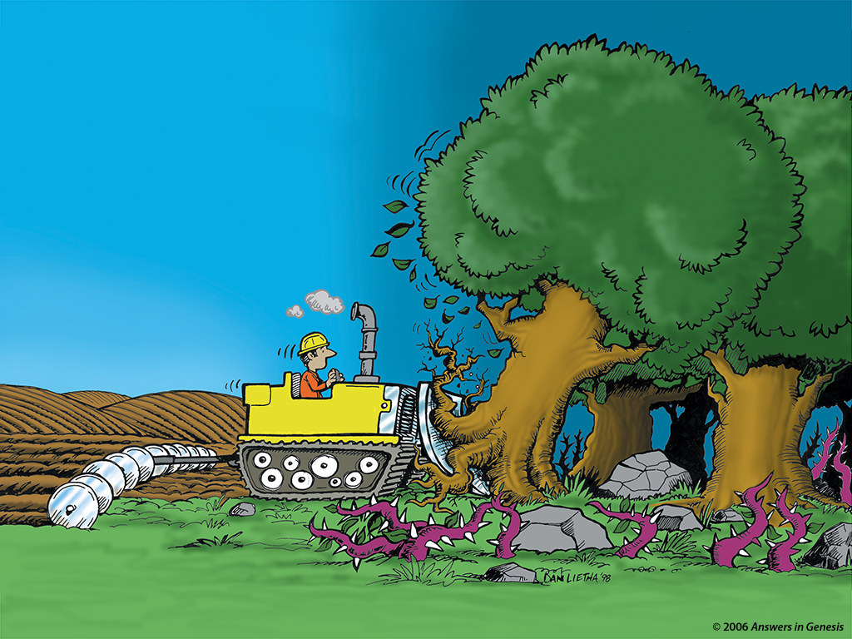
Creation Evangelism Bulldozer 00550
CREATION
EVANGELISM
EVOLUTION
EVOLUTION
GENESIS

Slide 70
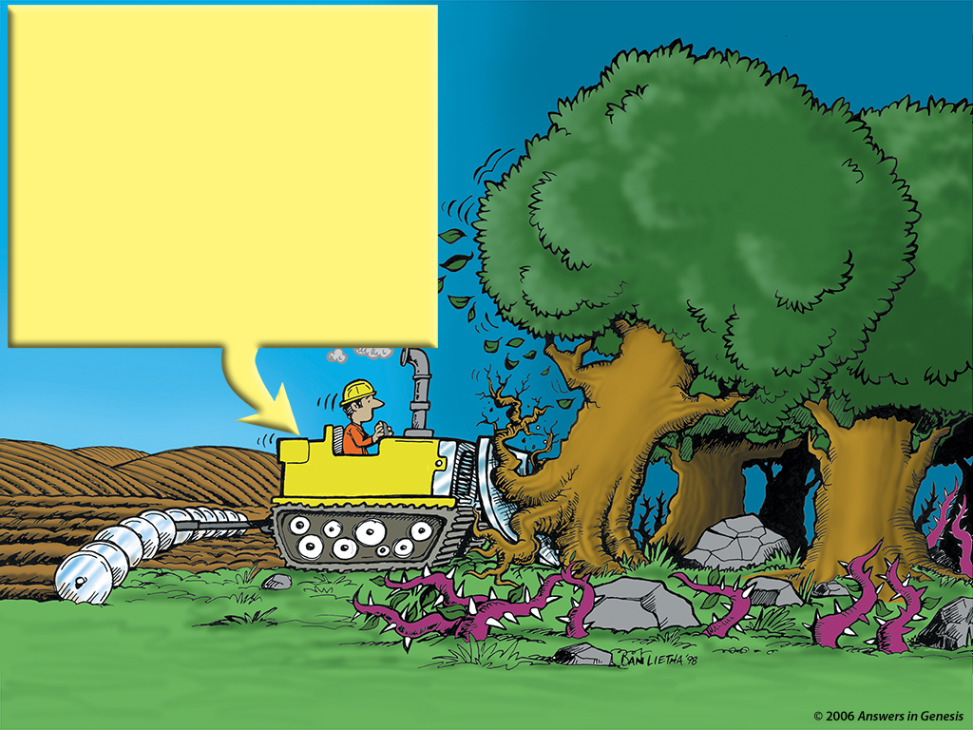
Creation Evangelism Bulldozer 00550
Answers to:
Where God came from?
Cain's wife?
Dinosaurs?
Apemen?
Fossils?
Age of the Earth?
Noah's Ark?
EVOLUTION
EVOLUTION
GENESIS

Slide 71
AiG web site #1

Slide 72
Revelation 14:6-7 NAS
Revelation 14:6-7
6. And I saw another angel flying in mid-heaven, having an eternal gospel to preach to those who live on the earth, and to every nation and tribe and tongue and people;
7. and he said with a loud voice, “Fear God, and give Him glory, because the hour of His judgment has come; worship Him who made the heaven and the earth and sea and springs of waters.”

Slide 73

Nailing Genesis 1-11 to church
GENESIS
1-11
MAN'S OPINIONS
MILLIONS OF YEARS

Slide 74
Black blank------------extras
END

Slide 75
Template Suite 1-Title 01359
Dr. Terry Mortenson
Biblical or Naturalistic Assumptions
Designed by Dr. Terry Mortenson
Uploaded by Dr. Rick Griffith • Singapore Bible College
All files in many languages for free download at BibleStudyDownloads.org

Slide 76
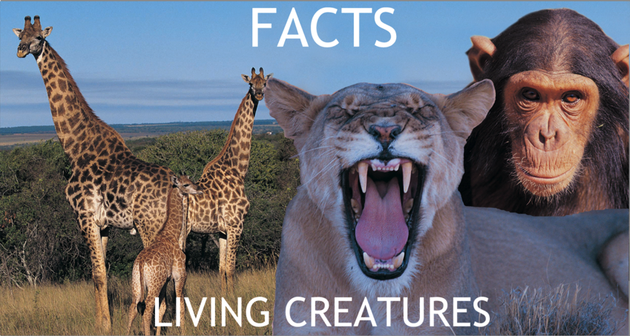
Assumptions Facts-Interpretations astronomy
NATURALISTIC ASSUMPTIONS
BIBLICAL ASSUMPTIONS
FACTS
LIVING CREATURES
EVOLUTION
CREATION

Slide 77
Evolution Millions of Years + Creation 01133
EVOLUTION
Evolution Creation 00896
MILLIONS OF YEARS
DEATH
MAN'S
EXISTENCE
Suffering Disease Bloodshed
CREATION
MAN'S
ACTIONS
DEATH
Notes:
Do these two views agree?
No, of course not. They are diametrically opposed to each other.

Slide 78


2 Guys Books 3-SunMoon Wear Glasses 01871
GOD'S WORD IS TRUTH
MAN DECIDES TRUTH

Slide 79




2 Guys Books 2-Take Glasses 01870
GOD'S WORD IS TRUTH
MAN DECIDES TRUTH

Slide 80
2 Guys Books 3-Earth Wear Glasses 01871
Biblical
Secular
GOD'S WORD IS TRUTH
MAN DECIDES TRUTH

Slide 81


2 Guys Books 4-Share Glasses 01872
MAN DECIDES TRUTH

Slide 82
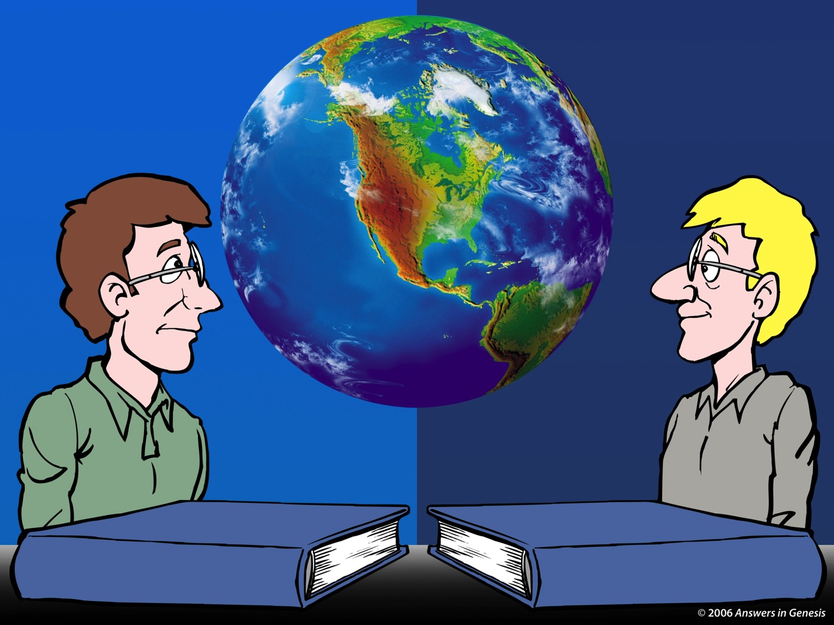
2 Guys Books 5-Same Glasses 01873
MAN DECIDES TRUTH
MAN DECIDES TRUTH

Slide 83
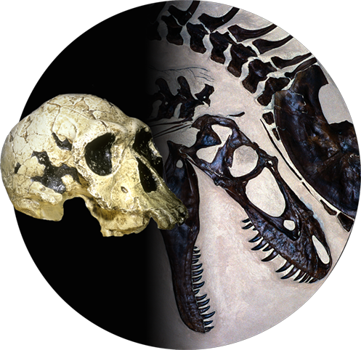
2 Guys Books-Death + Fossils 01876
GOD'S WORD IS TRUTH
MAN DECIDES TRUTH

Slide 84

2 Guys Books-Dog Kind 2 01879
GOD'S WORD IS TRUTH
MAN DECIDES TRUTH
GOD'S WORD IS TRUTH
MAN DECIDES TRUTH

Slide 85
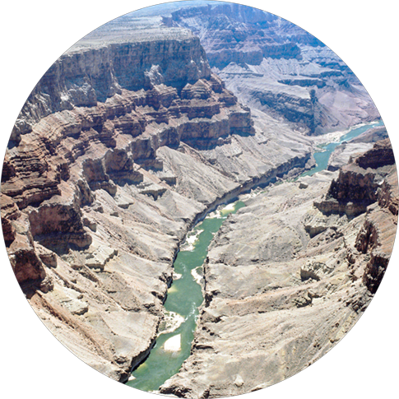
2 Guys Books-Grand Canyon 01880
GOD'S WORD IS TRUTH
MAN DECIDES TRUTH

Slide 86
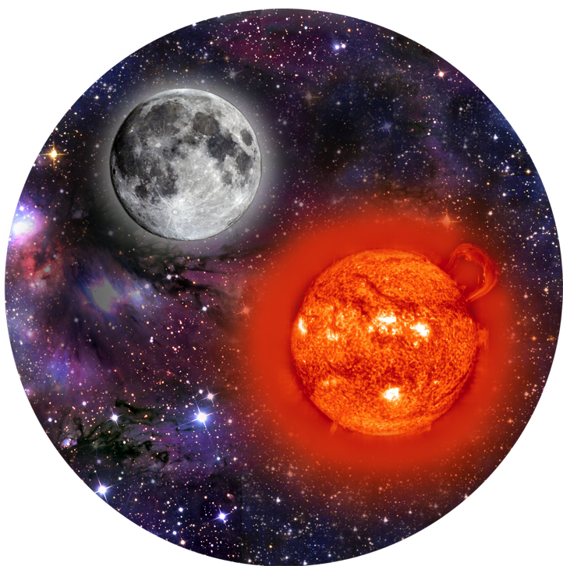
2 Guys Books 3-SunMoon Wear Glasses 01871
GOD'S WORD IS TRUTH
MAN DECIDES TRUTH

Slide 87

2 Guys GW+HR Books-DNA 03149
DNA
GOD'S WORD IS TRUTH
MAN DECIDES TRUTH

Slide 88

2 Guys Books-Races 01884
GOD'S WORD IS TRUTH
MAN DECIDES TRUTH

Slide 89
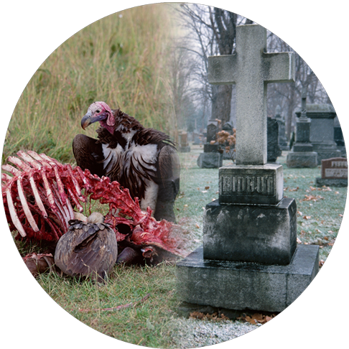
2 Guys Books-Death 2 01875
GOD'S WORD IS TRUTH
MAN DECIDES TRUTH

Slide 90

2 Guys Books-General 01887
GOD'S WORD IS TRUTH
MAN DECIDES TRUTH

Slide 91
Black blank------------extras
END

Slide 92


Creation link at BibleStudyDownloads.org
Get this presentation for free!
Notes:
OT Survey (os)

